Slide 1
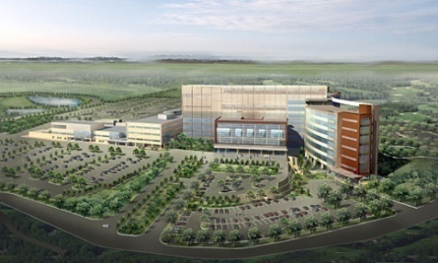
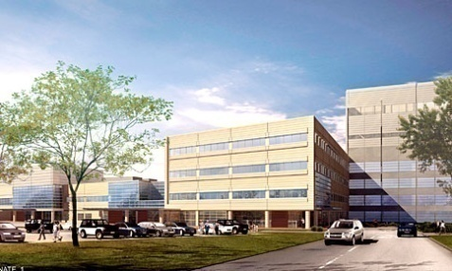
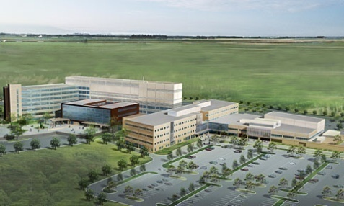
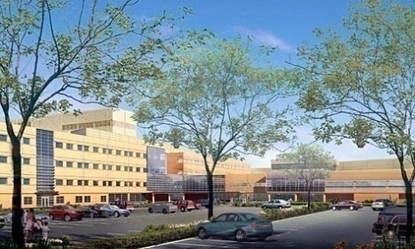
Steven Farrah
Senior Thesis Presentation
Voorhees Replacement Facility
Voorhees, NJ
Steven Farrah
Construction Management
4/12/2010

Slide 2
Presentation Outline
Project Overview
LEED/Sustainability Study
Patient Room LED Lighting
Lighting Breadth
Mechanical Breadth
Bed Tower Schedule Analysis
Conclusions
Acknowledgements
Questions & Answers
Steven Farrah
Construction Management
4/12/2010

Slide 3
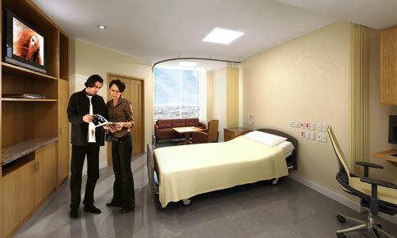
Project Overview
Project Team
Virtua Health
owner
Turner Construction
CM@ Risk
Cives Steel
Structural Steel
Subcontractors
CSRI Safety Services
Owners Safety Rep
HGA
Architect/Engineers
Hammes Company
Program Manager
E.J. Deseta (Bed Tower)
Advantage (Ancillary)
HVAC
Palmieri (Bed Tower)
Scalfo (Ancillary)
Electrical
Presentation Outline
Project Overview
LEED/Sustainability Study
Patient Room LED Lighting
Lighting Breadth
Mechanical Breadth
Bed Tower Schedule Analysis
Conclusions
Acknowledgements
Questions & Answers
Function: Hospital
Size: 675,000 SF
Height: 8 Stories
Delivery Method: CM @ Risk w/GMP Contract
Cost: 323 Million Construction Costs
Construction
Schedule: March 2008 – March 2011
Steven Farrah
Construction Management
4/12/2010

Slide 4
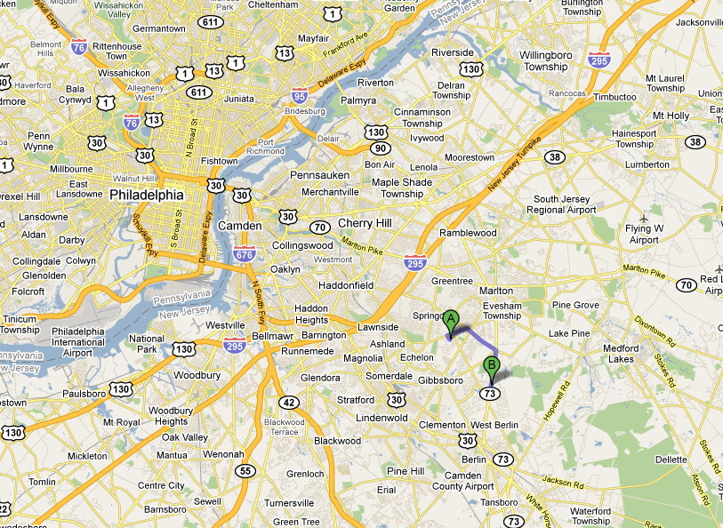
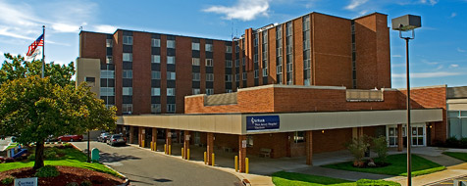
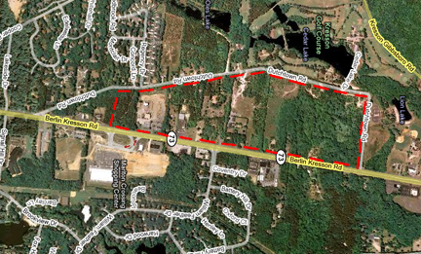
Project Location
Project Location
Presentation Outline
Project Overview
LEED/Sustainability Study
Patient Room LED Lighting
Lighting Breadth
Mechanical Breadth
Bed Tower Schedule Analysis
Conclusions
Acknowledgements
Questions & Answers
Point A
(Current Hospital)
Point B
(Replacement Hospital)
Steven Farrah
Construction Management
4/12/2010

Slide 5
LEED/Sustainability Study
Background/Goals
Presentation Outline
Project Overview
LEED/Sustainability Study
Patient Room LED Lighting
Lighting Breadth
Mechanical Breadth
Bed Tower Schedule Analysis
Conclusions
Acknowledgements
Questions & Answers
LEED/Sustainability Study
Sustainable Sites
Water Efficiency
Energy & Atmosphere
Materials & Resources
Indoor Air Quality
Conclusions
GOALS
Evaluate the Designed Voorhees Replacement
Facility to Determine What LEED Points are Currently Being Achieved.
Conduct a Point-by-Point Cost Analysis of Points Not Being Obtained By the Current Design.
Determine the Cost to Reach Each LEED Certification in the Voorhees Replacement Facility
Voorhees Replacement Facility
Is Not Currently Pursuing a LEED Rating
Steven Farrah
Construction Management
4/12/2010

Slide 6
LEED/Sustainability Study
Sustainable Sites
Presentation Outline
Project Overview
LEED/Sustainability Study
Patient Room LED Lighting
Lighting Breadth
Mechanical Breadth
Bed Tower Schedule Analysis
Conclusions
Acknowledgements
Questions & Answers
LEED/Sustainability Study
Sustainable Sites
Water Efficiency
Energy & Atmosphere
Materials & Resources
Indoor Air Quality
Conclusions
Site Selection
Building Footprint
Parking Footprint
Steven Farrah
Construction Management
4/12/2010
Notes:
-the first section of LEED is sustainable sites and focus’s on the impact the building and supporting spaces have on the site.
-As shown here the table in the middle shows each point in the section, whether or not the point is achieved in the base building and each certification it was used in. The table on the right shows the additional cost of points for each certification in the LEED section. Each following LEED section slide will also follow this format.
- The voorhees facility is currently achieving 9 of the 26 possible points and could achieve other points by incorporating design aspects such as permeable paving and high reflectivity roofing.

Slide 7
LEED/Sustainability Study
Water Efficiency
Presentation Outline
Project Overview
LEED/Sustainability Study
Patient Room LED Lighting
Lighting Breadth
Mechanical Breadth
Bed Tower Schedule Analysis
Conclusions
Acknowledgements
Questions & Answers
LEED/Sustainability Study
Sustainable Sites
Water Efficiency
Energy & Atmosphere
Materials & Resources
Indoor Air Quality
Conclusions
Water Efficient Fixtures
Rainwater/Grey Water Collection Systems
Use Plants Native to Area
Steven Farrah
Construction Management
4/12/2010
Notes:
Voorhees replacement facility does not have any points in the base builidng because if it not using efficient enough fixtures.
To obtain the points shown in the table both water efficient fixtures and plants that are native to the area were used.
To reach the higher levels of water use reduction systems such as rainwater or greywater collection could be used.

Slide 8
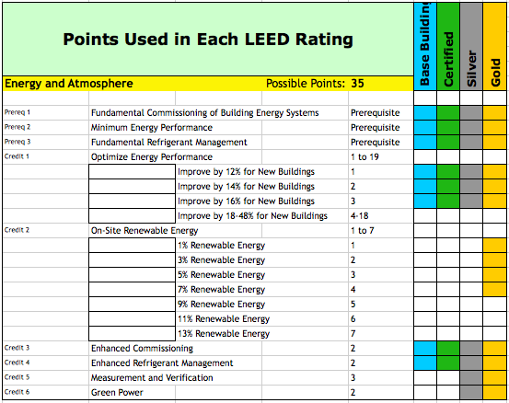
LEED/Sustainability Study
Energy & Atmosphere
Presentation Outline
Project Overview
LEED/Sustainability Study
Patient Room LED Lighting
Lighting Breadth
Mechanical Breadth
Bed Tower Schedule Analysis
Conclusions
Acknowledgements
Questions & Answers
LEED/Sustainability Study
Sustainable Sites
Water Efficiency
Energy & Atmosphere
Materials & Resources
Indoor Air Quality
Conclusions
Energy Modeling
Renewable Energy
Commissioning
Steven Farrah
Construction Management
4/12/2010
Notes:
-There are 35 possible points in the energy and atmosphere section. Up to 19 points can be achieved by reducing the energy consumption of the building. To do this energy modeling is required. The designed building is compared against the building using the minimum ashrae standards. I did a quick analysis using the carrier hourly analysis program and determined that the building has a 17.5% energy savings good enough for 3 points.
- The Voorhees facility also meets the prerequisite and achieves the additional credit for commissioning because the owner has hired a independent commissioning agent to oversee the hospitals systems.

Slide 9
LEED/Sustainability Study
Materials & Resources
Presentation Outline
Project Overview
LEED/Sustainability Study
Patient Room LED Lighting
Lighting Breadth
Mechanical Breadth
Bed Tower Schedule Analysis
Conclusions
Acknowledgements
Questions & Answers
LEED/Sustainability Study
Sustainable Sites
Water Efficiency
Energy & Atmosphere
Materials & Resources
Indoor Air Quality
Conclusions
Construction Waste Management/Recycling
Recycled Content
Regional Materials
Steven Farrah
Construction Management
4/12/2010
Notes:
-The hospital is only achieving 1 credit out of a possible 14 credits in the materials & resources section.
- The credits that are most readily available to achieve for the Voorhees Replacement Facility including construction waste management, recycled content and regional materials.

Slide 10
LEED/Sustainability Study
Indoor Air Quality
Presentation Outline
Project Overview
LEED/Sustainability Study
Patient Room LED Lighting
Lighting Breadth
Mechanical Breadth
Bed Tower Schedule Analysis
Conclusions
Acknowledgements
Questions & Answers
LEED/Sustainability Study
Sustainable Sites
Water Efficiency
Energy & Atmosphere
Materials & Resources
Indoor Air Quality
Conclusions
Outside Air / Ventilation
Indoor Air Quality Plan
Low-Emitting Materials
Controllability of Lighting & Thermal Comfort
Steven Farrah
Construction Management
4/12/2010
Notes:
As you can see here the voorhees replacement facility is current achieving 12 out of 15 possible points in the indoor air quality category.
The hospital achieves these points through utilizing design aspects such as bringing in 60% outside air, providing indoor air quality plans during and after construction, specifying low-emitting materials, and providing building occupants with lighting and thermal controls to fit their needs.

Slide 11
LEED/Sustainability Study
Conclusions
Presentation Outline
Project Overview
LEED/Sustainability Study
Patient Room LED Lighting
Lighting Breadth
Mechanical Breadth
Bed Tower Schedule Analysis
Conclusions
Acknowledgements
Questions & Answers
LEED/Sustainability Study
Sustainable Sites
Water Efficiency
Energy & Atmosphere
Materials & Resources
Indoor Air Quality
Conclusions
Soft Cost Estimates
Cost Decription | % of Construction Cost | Total Construction Cost | Cost to Project
Design Costs | 0.50% | $323,000,000 | $1,615,000
Documentation & Application Fees | 0.50% | $323,000,000 | $1,615,000
Energy Modeling | 0.10% | $323,000,000 | $323,000
 |  | Total | $3,553,000
The current design of the Voorhees Replacement Facility is achieving 30 LEED points
Start Early
A LEED rating can be obtained at little cost to the project if the owner sets the standard early.
TOTALS
LEED Rating | Total Additional Cost | % Construction Cost Increase | Point Range | Point Total
Base Building | $ - | - | - | 30
Certified | $ 3,652,888.00 | 1.118% | 40-49 | 42
Silver | $ 4,370,345.00 | 1.335% | 50-59 | 51
Gold | $ 12,289,182.00 | 3.665% | 60-79 | 60
Platinum | - | - | 80-110 | -
Steven Farrah
Construction Management
4/12/2010
Notes:
So finally we see in the tables to the right that if we add in the soft costs to our construction cost totals the increase in cost to the project is very minimal.

Slide 12
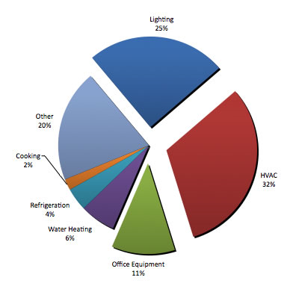
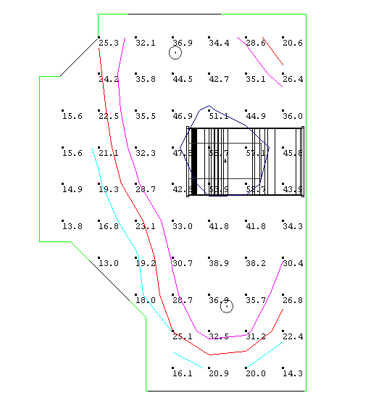
Patient Room LED Lighting
Background/Goals
Presentation Outline
Project Overview
LEED/Sustainability Study
Patient Room LED Lighting
Lighting Breadth
Mechanical Breadth
Bed Tower Schedule Analysis
Conclusions
Acknowledgements
Questions & Answers
Patient Room LED Lighting
Lighting Breadth
Mechanical Breadth
Cost Analysis
Conclusions
GOALS
Redesign a Typical Patient Room to Utilize LED Lighting In Place of Fluorescent Lighting
Determine Effect of Lighting Change on the Mechanical System
Evaluate the Life Cycle of the LED Lit Room
(http://www.ptrenergy.com/images/chart.jpg)
Steven Farrah
Construction Management
4/12/2010
Notes:
Energy costs grow.

Slide 13
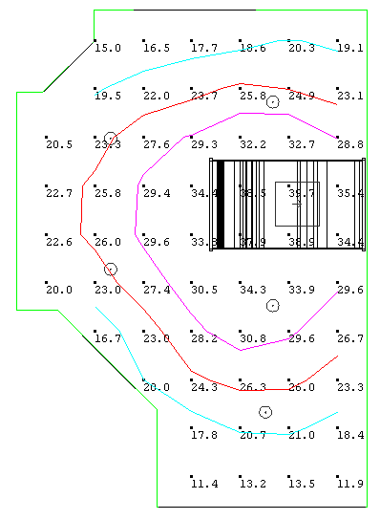
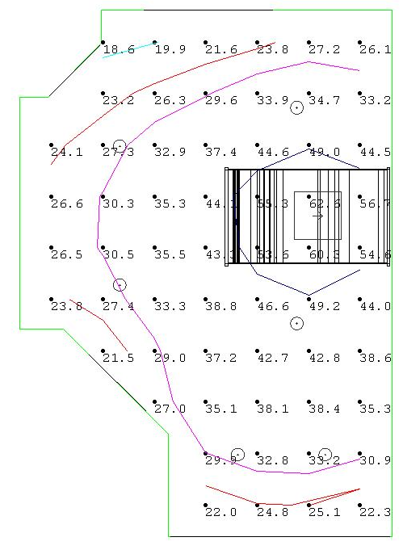
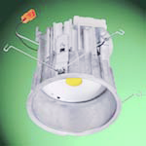
Patient Room LED Lighting
Lighting Breadth
Presentation Outline
Project Overview
LEED/Sustainability Study
Patient Room LED Lighting
Lighting Breadth
Mechanical Breadth
Bed Tower Schedule Analysis
Conclusions
Acknowledgements
Questions & Answers
Patient Room LED Lighting
Lighting Breadth
Mechanical Breadth
Cost Analysis
Conclusions
Required Lighting Levels
Reading – 30 Footcandles
Exam Level – 50 Footcandles
Reading Level Lighting
Exam Level Lighting
Cree LR24
Halo 6” LED Downlight
Steven Farrah
Construction Management
4/12/2010

Slide 14
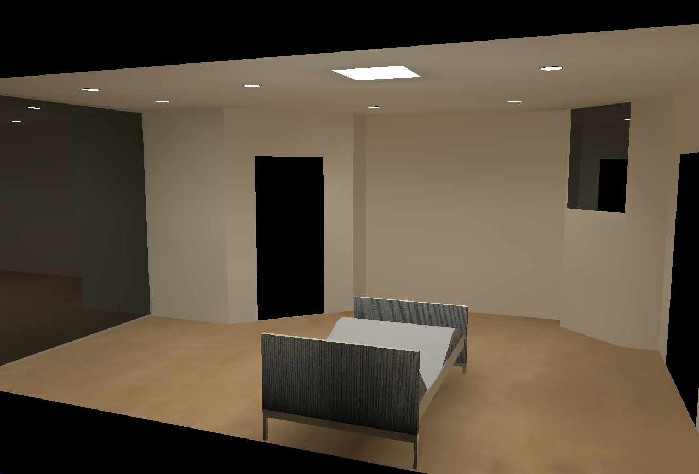
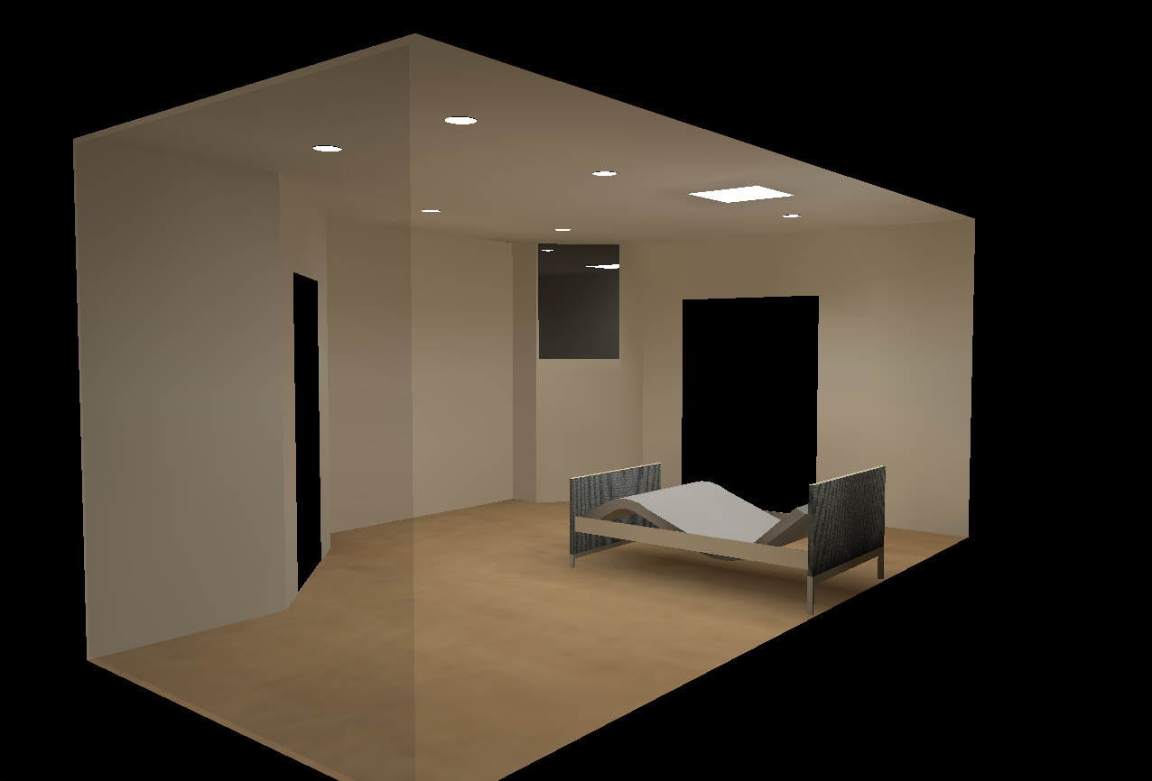
Patient Room LED Lighting
Lighting Breadth
Presentation Outline
Project Overview
LEED/Sustainability Study
Patient Room LED Lighting
Lighting Breadth
Mechanical Breadth
Bed Tower Schedule Analysis
Conclusions
Acknowledgements
Questions & Answers
Patient Room LED Lighting
Lighting Breadth
Mechanical Breadth
Cost Analysis
Conclusions
Steven Farrah
Construction Management
4/12/2010

Slide 15
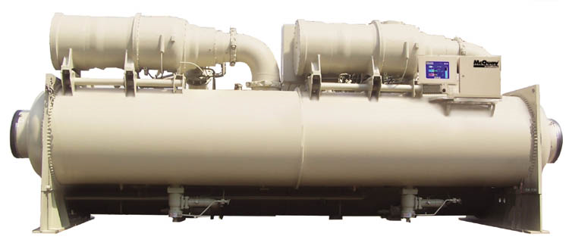
Patient Room LED Lighting
Mechanical Breadth
Presentation Outline
Project Overview
LEED/Sustainability Study
Patient Room LED Lighting
Lighting Breadth
Mechanical Breadth
Bed Tower Schedule Analysis
Conclusions
Acknowledgements
Questions & Answers
Patient Room LED Lighting
Lighting Breadth
Mechanical Breadth
Cost Analysis
Conclusions
Total Fluorescent Room Wattage – 212W
Total LED Room Wattage - 142W
Mechanical Equipment
Total CFM Reduction For All Patient Rooms = 109,200 BTUs/hr / 20° / 1.1 = 4964 CFM
There Is No Mechanical Equipment Cost Savings Due to Equipment Downsizing
Reduction in BTUs/hr Per Room = 364 BTUs/hr
Total Reduction in BTUs/hr = (364 BTUs/hr-room)x(300 patient rooms) = 109,200 BTUs/hr
Electricity Savings
Change in Load on Chillers = (109,200 BTUs/hr) / (12,000BTUs/Ton) = 9.1 Tons
Cost Savings/Year = (0.6kW/Ton)x(9.1Tons)x(2000hrs)x ($0.1307/kWhr) = $1,427.00/Year
Steven Farrah
Construction Management
4/12/2010

Slide 16
Patient Room LED Lighting
Cost Analysis
LED vs Fluorescent Life Cycle Analysis
Voorhees Replacement Facility
Average Number of Hours of Use Per Day |  |  |  | 12
Price of Electricity (Dollars/per kWH) |  |  |  | 0.1307
 | Existing Fluorescent Lighting |  | LED Replacement Lighting
Luminaire Description | DF 11 | MF 13 | HALO | CREE
Presentation Outline
Project Overview
LEED/Sustainability Study
Patient Room LED Lighting
Lighting Breadth
Mechanical Breadth
Bed Tower Schedule Analysis
Conclusions
Acknowledgements
Questions & Answers
Patient Room LED Lighting
Lighting Breadth
Mechanical Breadth
Cost Analysis
Conclusions
Total Luminaire Cost | $ 78,000 | $ 130,500 | $ 302,400 | $ 131,700
Total Controls Cost | N/A | N/A | $ 90,000
Total Initial Cost | $ 208,500 | $ 524,100
Total Annual Energy Costs |  | $ 36,065 |  | $ 18,520
Energy Savings from LED per year |  |  | $ 17,546
Average Annual Lamp Maintenance Cost |  | $ 5,518 |  | $ 35,478
Extra Average Maintenance Cost for LED |  |  | $ (29,959)
Mechanical Savings per year |  |  | $ 1,427
Total savings per year |  |  | $ (10,986)
Steven Farrah
Construction Management
4/12/2010
Notes:
Talk about total initial cost
Energy savings
Maintenance
Mechanical
Cash flow analysis

Slide 17
Patient Room LED Lighting
Conclusions
Presentation Outline
Project Overview
LEED/Sustainability Study
Patient Room LED Lighting
Lighting Breadth
Mechanical Breadth
Bed Tower Schedule Analysis
Conclusions
Acknowledgements
Questions & Answers
Patient Room LED Lighting
Lighting Breadth
Mechanical Breadth
Cost Analysis
Conclusions
Rooms can be designed using LED downlighting
Rooms designed using LED lighting may see a reduction in mechanical energy costs.
LED lighting presents too much of an initial investment and replacement cost to produce a cost savings over time.
Steven Farrah
Construction Management
4/12/2010

Slide 18
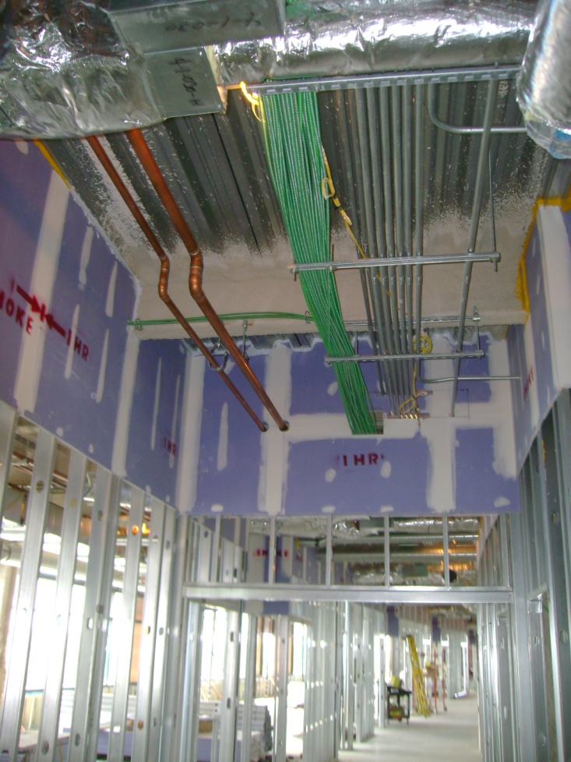
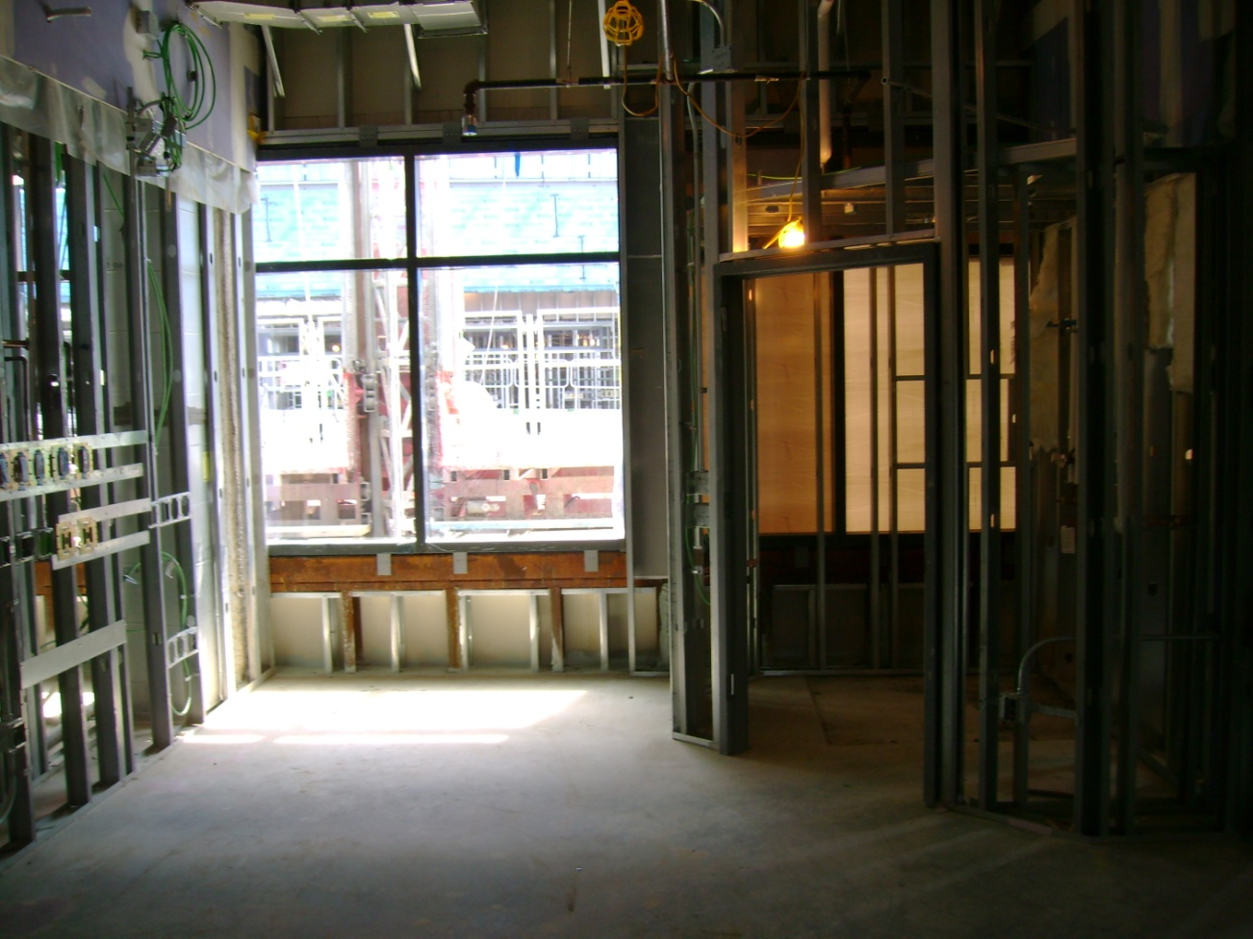
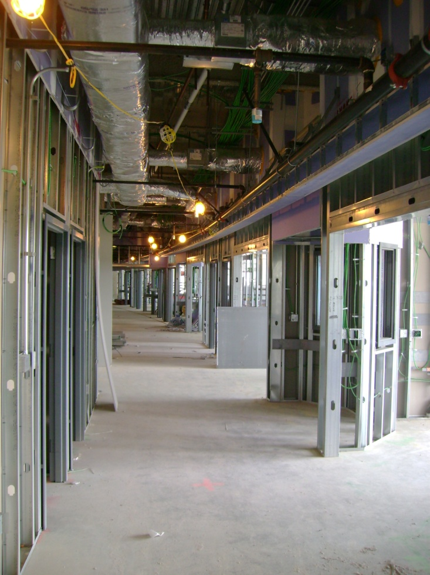
Bed Tower Schedule Analysis
Background/Goals
Presentation Outline
Project Overview
LEED/Sustainability Study
Patient Room LED Lighting
Lighting Breadth
Mechanical Breadth
Bed Tower Schedule Analysis
Conclusions
Acknowledgements
Questions & Answers
Bed Tower Schedule Analysis
Overview
Schedule
Conclusions
GOALS
Create a Short Interval Schedule for the Fit-Out of the Bed Tower to
Accelerate the Project Schedule.
Steven Farrah
Construction Management
4/12/2010

Slide 19
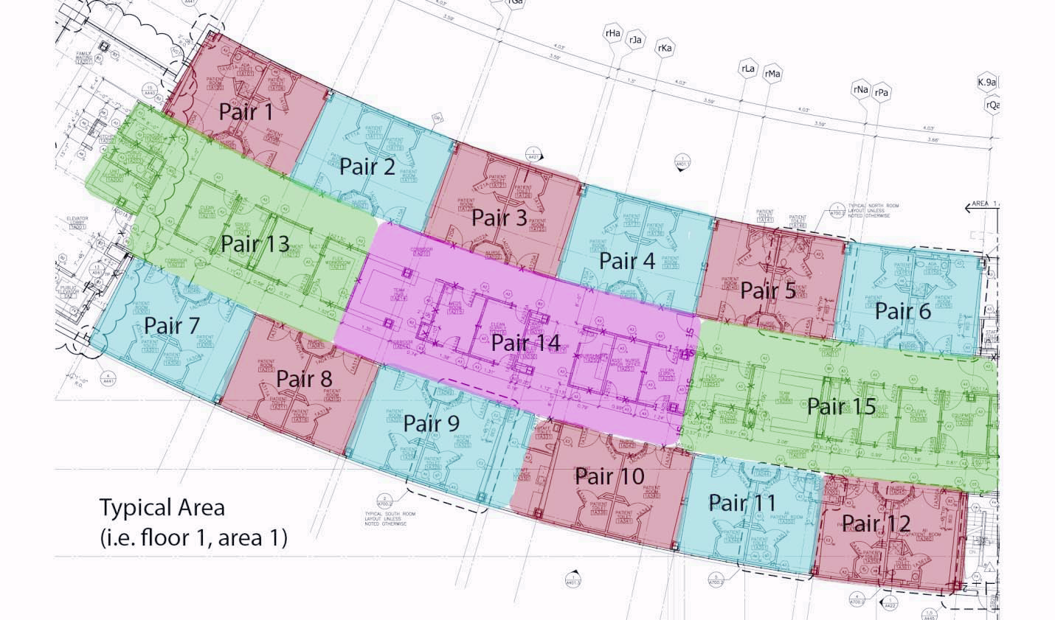
Bed Tower Schedule Analysis
Overview
Patient Room Pairing
Presentation Outline
Project Overview
LEED/Sustainability Study
Patient Room LED Lighting
Lighting Breadth
Mechanical Breadth
Bed Tower Schedule Analysis
Conclusions
Acknowledgements
Questions & Answers
Bed Tower Schedule Analysis
Overview
Schedule
Conclusions
1. Rough-in in wall plumbing
2. Rough-in in wall duct drops
3. Rough-in in wall medical gas
4. Rough-in in wall electrical
5. Rough-in in wall low-voltage wiring
15. Install millwork
16. Install plumbing/bathroom fixtures
17. Install carpet, VCT flooring and base
18. Install grilles and diffusers
19. 2nd and final coat of paint
20. Install doors, hardware and interior
glazing
21. Drop in acoustical ceiling tile into grid
22. Cut in sprinkler heads
(ACT and drywall)
23. Finish and install low voltage devices
24. Finish and install medical gas trim
plates and labels
25. Finish and install electrical devices
and trim plates
6. Insulate, drywall and tape partitions
7. Frame drywall ceilings
8. Electrical work in drywall ceilings
9. Ductwork in drywall ceilings
10. Drywall and tape drywall ceilings
11. Prime and paint 1 coat walls and
drywall ceilings
12. Install acoustical ceiling tile grid
13. Drop in and install light fixtures
14. Install all ceramic tile floors and
partial walls
Steven Farrah
Construction Management
4/12/2010

Slide 20
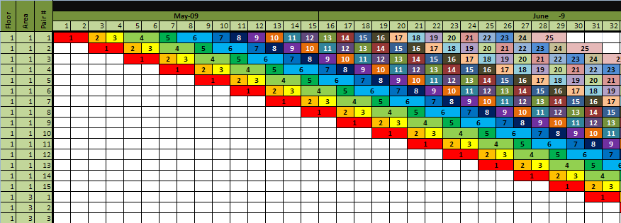
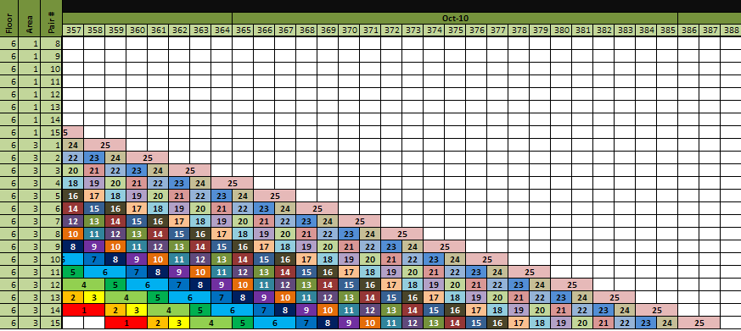
Bed Tower Schedule Analysis
Analysis
Short Interval Schedule Start
Short Interval Schedule Finish
Presentation Outline
Project Overview
LEED/Sustainability Study
Patient Room LED Lighting
Lighting Breadth
Mechanical Breadth
Bed Tower Schedule Analysis
Conclusions
Acknowledgements
Questions & Answers
Bed Tower Schedule Analysis
Overview
Schedule
Conclusions
Steven Farrah
Construction Management
4/12/2010

Slide 21
Bed Tower Schedule Analysis
Conclusions
Presentation Outline
Project Overview
LEED/Sustainability Study
Patient Room LED Lighting
Lighting Breadth
Mechanical Breadth
Bed Tower Schedule Analysis
Conclusions
Acknowledgements
Questions & Answers
Bed Tower Schedule Analysis
Overview
Schedule
Conclusions
Original Bed Tower Fit-Out
Completion Date: December 23rd, 2010
Short Interval Schedule Bed
Tower Fit-Out Completion Date: November 2nd, 2010
Schedule Reduction: 35 Work Days
1.75 Calendar Months
General Conditions/
Requirements Cost/Month: $301,950.00/Month
General Conditions Savings = ($301,950.00/calendar month) x
(1.75 calendar months) = $528,412.00
Steven Farrah
Construction Management
4/12/2010

Slide 22
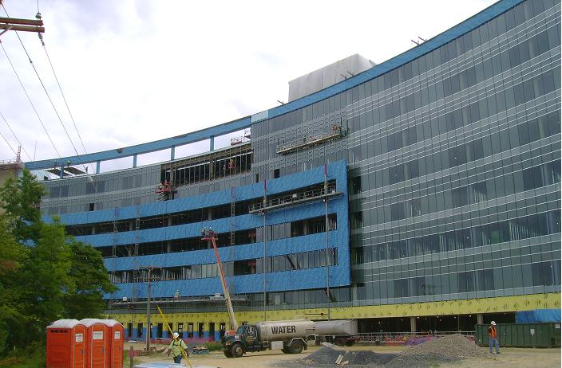
Conclusions
Conclusions
Patient Room LED Lighting
LEED/Sustainability Study
Patient Room LED Lighting
Presentation Outline
Project Overview
LEED/Sustainability Study
Patient Room LED Lighting
Lighting Breadth
Mechanical Breadth
Bed Tower Schedule Analysis
Conclusions
Acknowledgements
Questions & Answers
The current design of the Voorhees Replacement Facility is already achieving 30 LEED points
Start Early
A LEED rating can be obtained at little cost to the project if the owner sets the standard early.
Rooms can be designed using LED downlighting
Rooms designed using LED lighting may see a reduction in mechanical energy costs.
LED lighting presents too much of an initial investment and replacement cost to produce a cost savings over time.
Bed Tower Schedule Analysis
Schedule Reduction: 35 Work Days or
1.75 Calendar Months
General Conditions Savings = ($301,950.00/calendar month)
x(1.75 calendar months) = $528,412.00
Steven Farrah
Construction Management
4/12/2010

Slide 23
Acknowledgements
Acknowledgements
HGA Architects & Engineers
Mike Torine
Wayne Johnson
RD Ruffin
Chad O’Donnell
Paul Gruettner
Pat Hunt
Jim Koehler
Michael Woodson
Presentation Outline
Project Overview
LEED/Sustainability Study
Patient Room LED Lighting
Lighting Breadth
Mechanical Breadth
Bed Tower Schedule Analysis
Conclusions
Acknowledgements
Questions & Answers
Penn State Architectural Engineering Faculty
Chris Magent
Professor Parfitt
Professor Holland
Corey Wilkinson
Turner Construction
Bill Swanson
Joel Miner
Jeremy Klinger
Chris McCrae
HGA Architects & Engineers
Mike Torine
Wayne Johnson
RD Ruffin
Chad O’Donnell
Paul Gruettner
Pat Hunt
Jim Koehler
Michael Woodson
Haines &Kibblehouse
Tom Spenillo
Hamada Inc.
Joe Bruski
Thomas Building Group
Michael Gejer
Hispanic Ventures
Len Spatocco
SwisslogTranslogic
Jeff Mazur
E.J. Deseta Company
Sean Brooks
Majek Fire Protection
George Dougherty
Falasca Mechanical
Wally Copestick
Johnson Controls
Kyle Bonner
Palmieri Electric
Sharon Ashbridge
Steven Farrah
Construction Management
4/12/2010

Slide 24
Questions & Answers
Steven Farrah
Construction Management
4/12/2010

