Slide 1

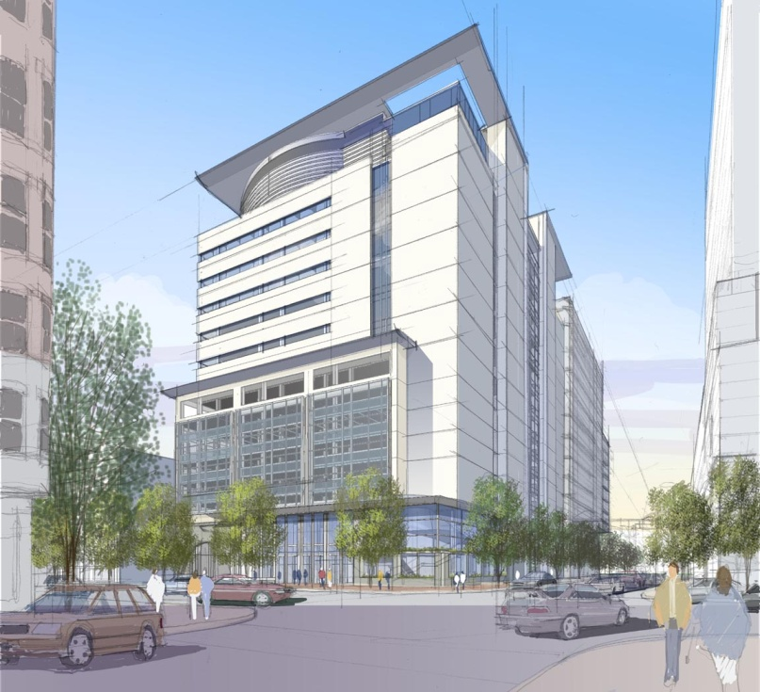
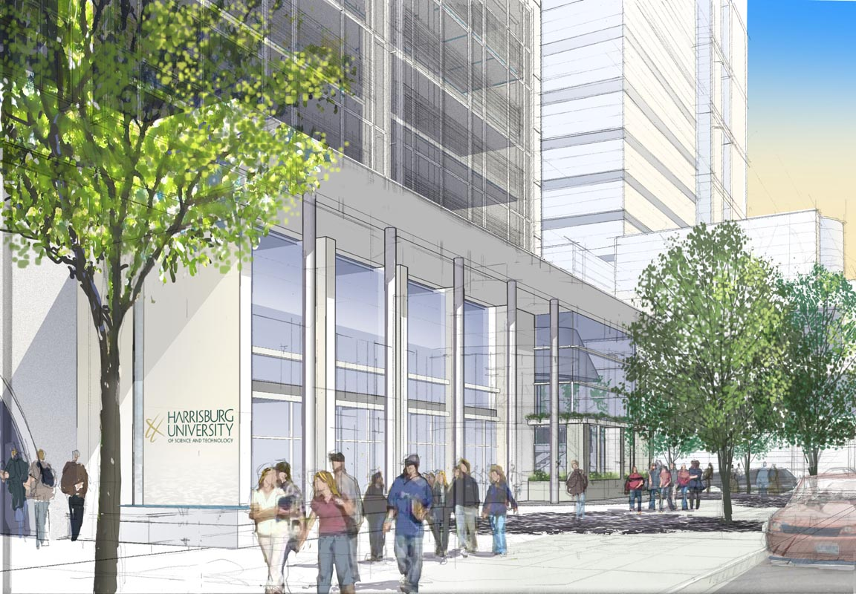
The Pennsylvania State University
Department of Architectural Engineering
Harrisburg University Academic Center
Laurel Heather Warner
Construction Management
August 12, 2008

Slide 2
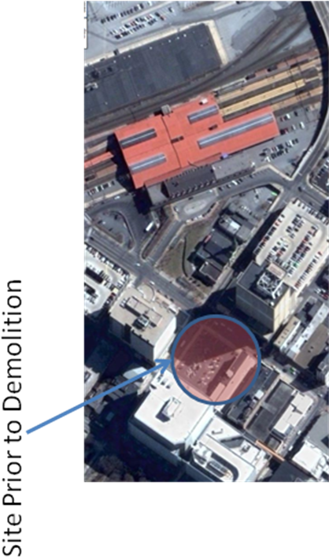
Project Overview
Harrisburg University of Science and Technology
Location: Harrisburg, Pennsylvania
Size: 370,000 SF
Height: 16 Stories
Cost: $73M
Project Overview
Industry Research
Breadth 1
Breadth 2
Results
Site Prior to Demolition
Laurel Warner Penn State AE Senior Thesis Construction Management

Slide 3
Project Overview
Project Overview
Industry Research
Breadth 1
Breadth 2
Results
Project Team
Owner: Harrisburg University of Science and Technology
Construction Manager: Reynolds Construction Management
Architect & M. P. FP Engineer: Burt, Hill
Structural Engineer: Barber & Hoffman
Civil/Electrical Engineer: Benatec Associates
Electrical Engineer (Lighting): Integrated Engineering Solutions, Inc.
Parking Consultant: Timothy Haahs & Associates
Construction Dates: January 2007—December 2008
Laurel Warner Penn State AE Senior Thesis Construction Management

Slide 4
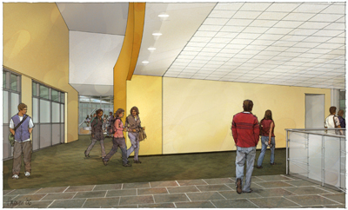
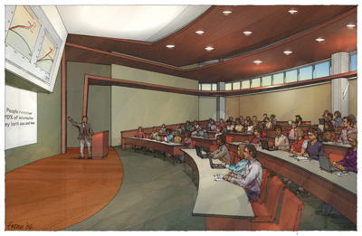
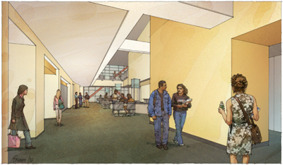
Project Overview
Project Overview
Industry Research
Breadth 1
Breadth 2
Results
Academic Facility with:
Classrooms
Teaching labs
Seminar rooms
Library
Auditorium space
Office space
Parking facility
Laurel Warner Penn State AE Senior Thesis Construction Management

Slide 5
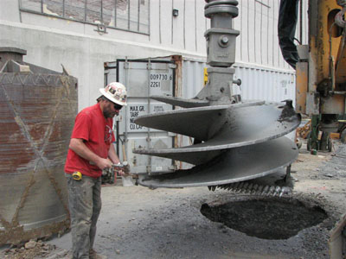
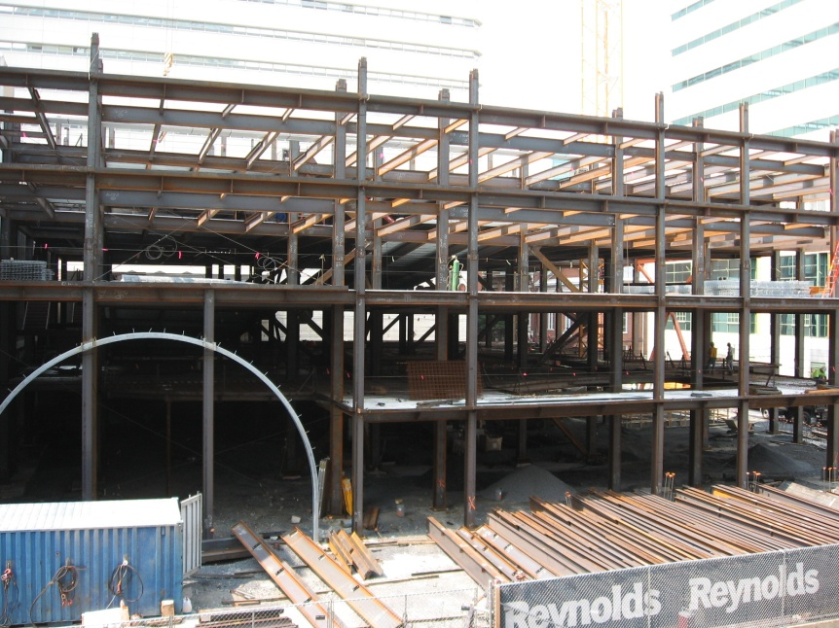

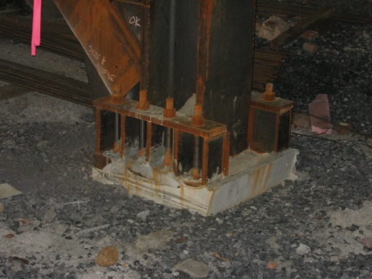
Project Overview
Project Overview
Industry Research
Breadth 1
Breadth 2
Results
Foundation: 70 caissons averaging 5 feet in diameter and 24” grade beam
Core Structure: precast concrete and structural steel wide-flange beams and girders connecting to W18x480 columns
Shell: non load-baring Curtain wall and aluminum window glazing system
Roof: EPDM rubber elastomer
Laurel Warner Penn State AE Senior Thesis Construction Management

Slide 6
Industry Research
Growing Urban Environments
Rising Costs of Energy
Green Urban Design Model
Project Overview
Industry Research
Breadth 1
Breadth 2
Results
Laurel Warner Penn State AE Senior Thesis Construction Management

Slide 7
Industry Research
Project Overview
Industry Research
Breadth 1
Breadth 2
Results
HBGU
LEED Registered Projects
Analyze Criteria
Green Urban Design Model
Laurel Warner Penn State AE Senior Thesis Construction Management

Slide 8
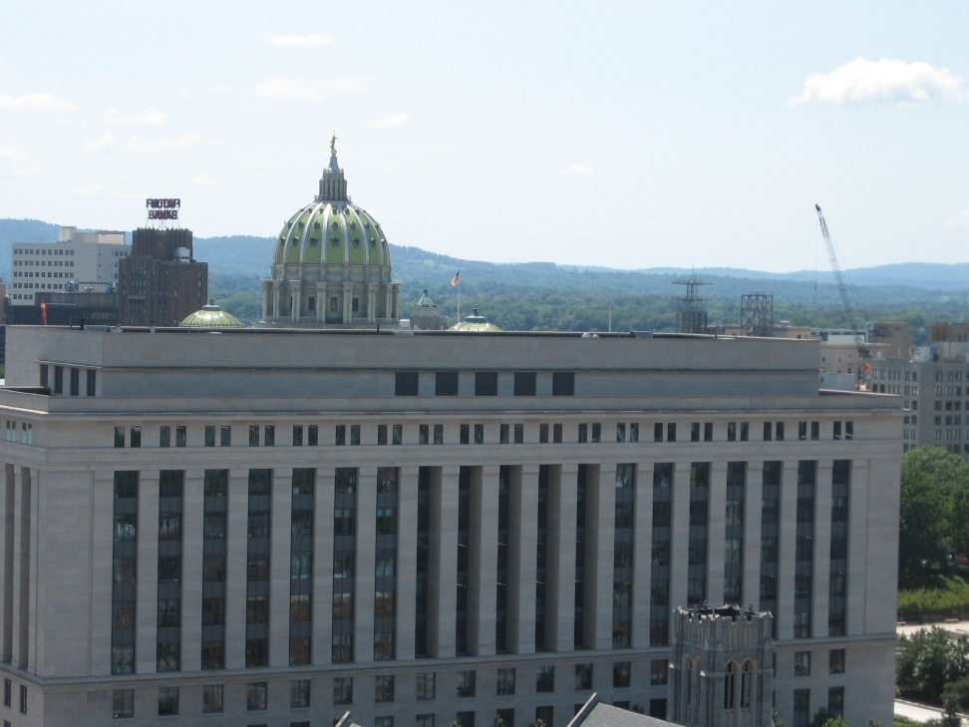

Industry Research
Project Overview
Industry Research
Breadth 1
Breadth 2
Results
Building Project Met the Following Criteria:
Non-classified
LEED Version 2.0 or Later for NC
Within 25% of Gross SF of HBGU
Office or Higher Education
In an Urban Environment
Laurel Warner Penn State AE Senior Thesis Construction Management

Slide 9
Industry Research
Project Overview
Industry Research
Breadth 1
Breadth 2
Results
Laurel Warner Penn State AE Senior Thesis Construction Management

Slide 10
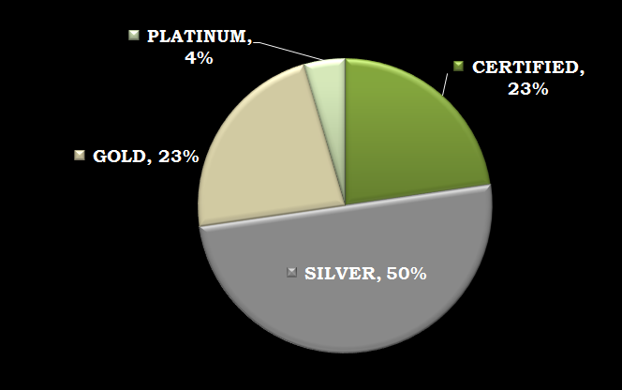
Industry Research
Project Overview
Industry Research
Breadth 1
Breadth 2
Results
Laurel Warner Penn State AE Senior Thesis Construction Management

Slide 11
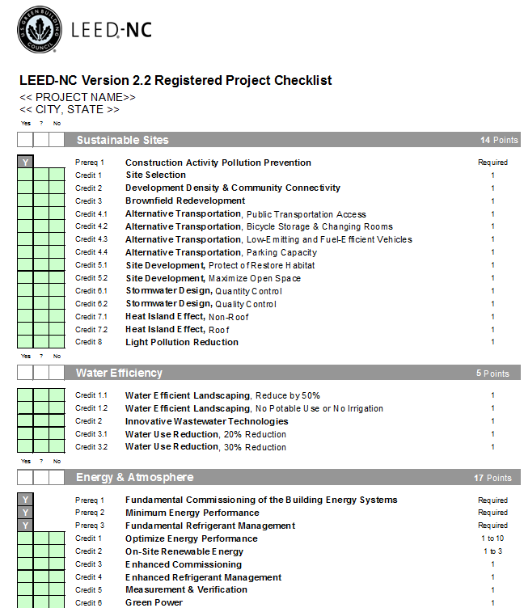
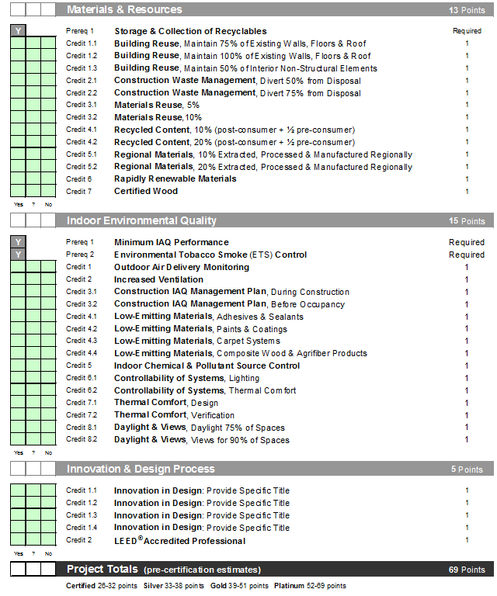
Industry Research
Project Overview
Industry Research
Breadth 1
Breadth 2
Results
Laurel Warner Penn State AE Senior Thesis Construction Management

Slide 12
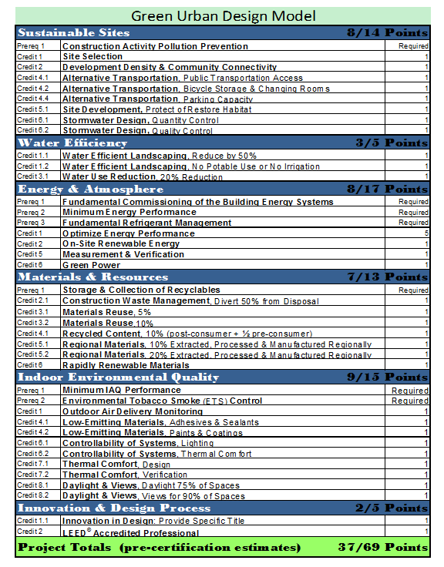
Industry Research
Project Overview
Industry Research
Breadth 1
Breadth 2
Results
Laurel Warner Penn State AE Senior Thesis Construction Management

Slide 13
Industry Research
Awareness of Trends
Industry Leadership
Project Overview
Industry Research
Breadth 1
Breadth 2
Results
Green Urban Design Model
Laurel Warner Penn State AE Senior Thesis Construction Management

Slide 14
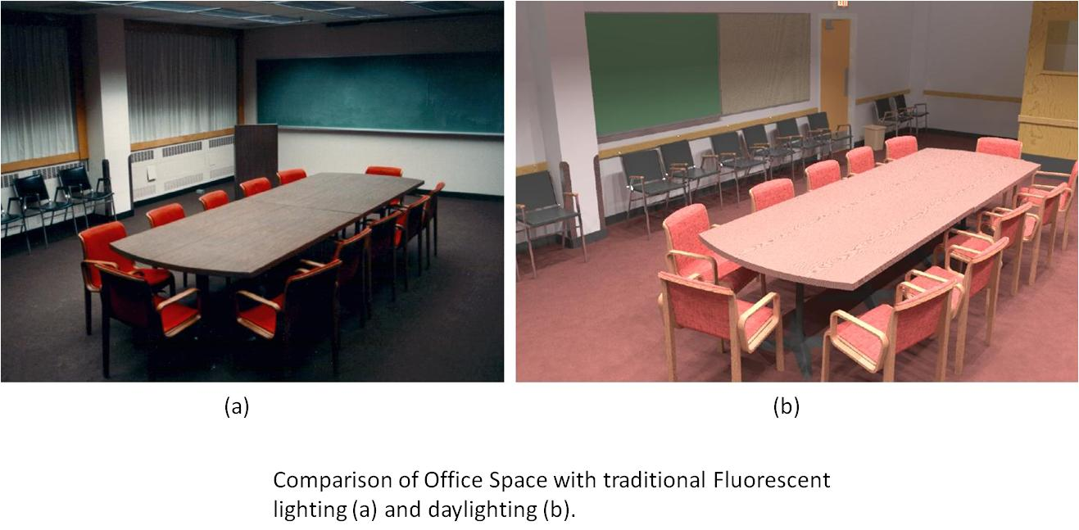
Breadth 1
Daylighting a Typical Interior Space
Project Overview
Industry Research
Breadth 1
Breadth 2
Results
Laurel Warner Penn State AE Senior Thesis Construction Management

Slide 15
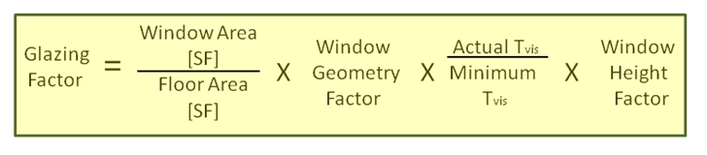
Breadth 1
Project Overview
Industry Research
Breadth 1
Breadth 2
Results
Daylighting Analysis:
LEED EQ 8.1→Solar light for 75% of regularly occupied spaces
Laurel Warner Penn State AE Senior Thesis Construction Management

Slide 16
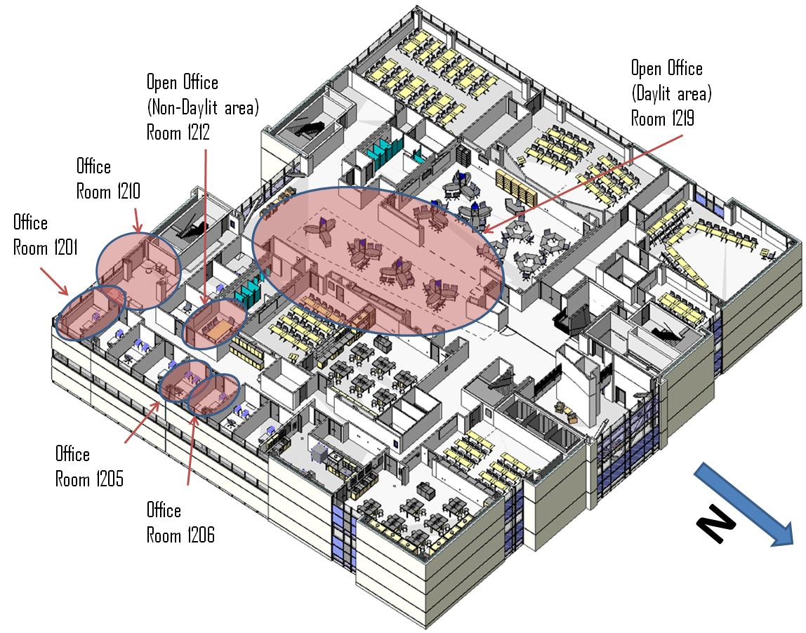
Breadth 1
Project Overview
Industry Research
Breadth 1
Breadth 2
Results
Laurel Warner Penn State AE Senior Thesis Construction Management

Slide 17
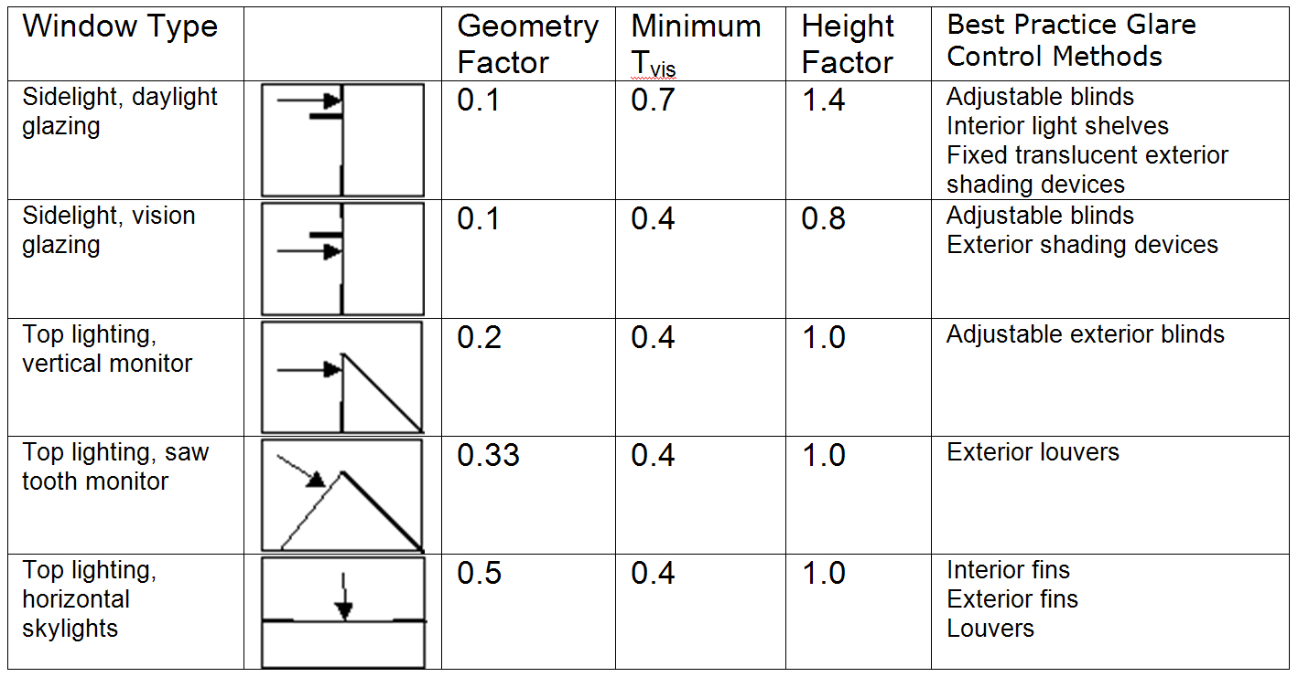
Breadth 1
Project Overview
Industry Research
Breadth 1
Breadth 2
Results
Laurel Warner Penn State AE Senior Thesis Construction Management

Slide 18
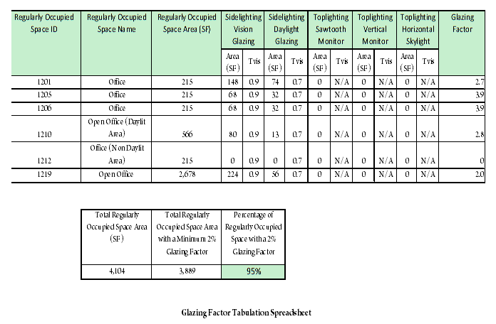
Breadth 1
Project Overview
Industry Research
Breadth 1
Breadth 2
Results
Laurel Warner Penn State AE Senior Thesis Construction Management

Slide 19
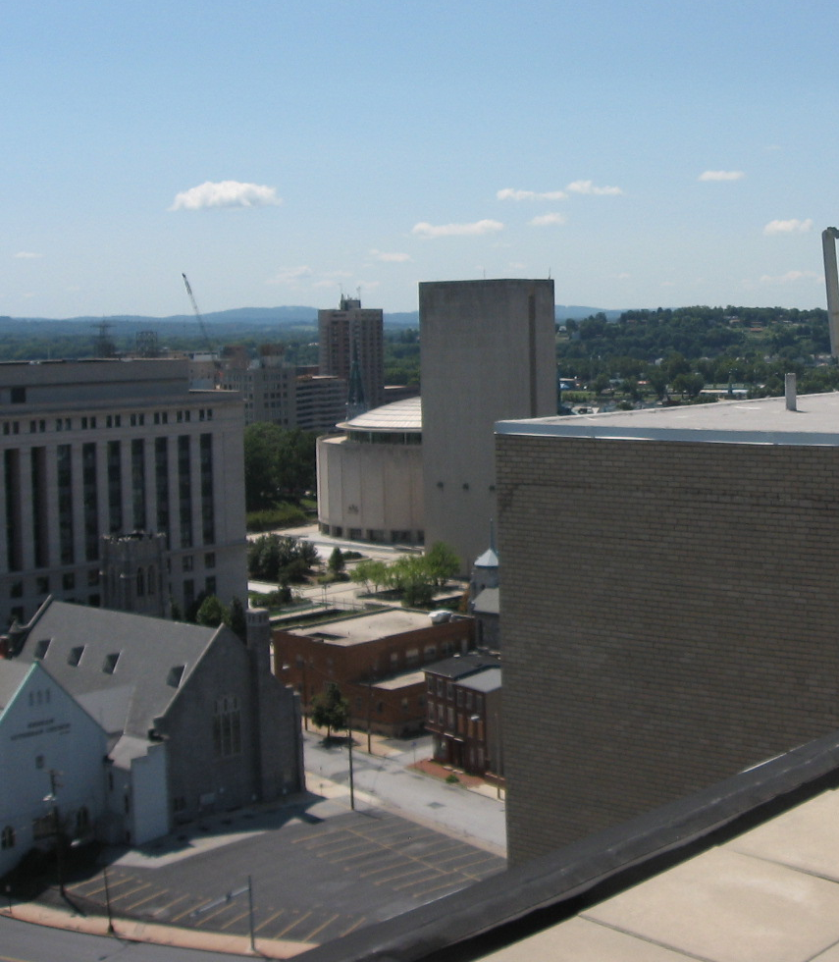
Breadth 1
Project Overview
Industry Research
Breadth 1
Breadth 2
Results
Less Energy Costs
More Productive Occupants
Conserves Natural Resources
Daylighting
Laurel Warner Penn State AE Senior Thesis Construction Management

Slide 20
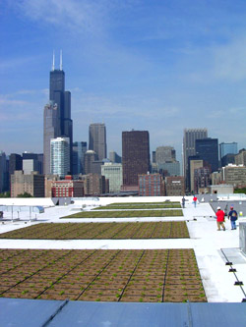
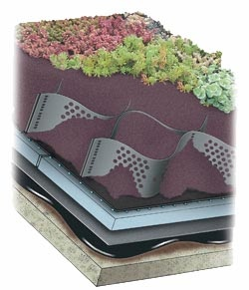
Breadth 2
Green Roof Implementation:
Hydrotech Extensive Assembly
Project Overview
Industry Research
Breadth 1
Breadth 2
Results
Features:
Lightweight
Low maintenance
Reduces storm water runoff
Helps to mitigate the urban heat island
Laurel Warner Penn State AE Senior Thesis Construction Management

Slide 21
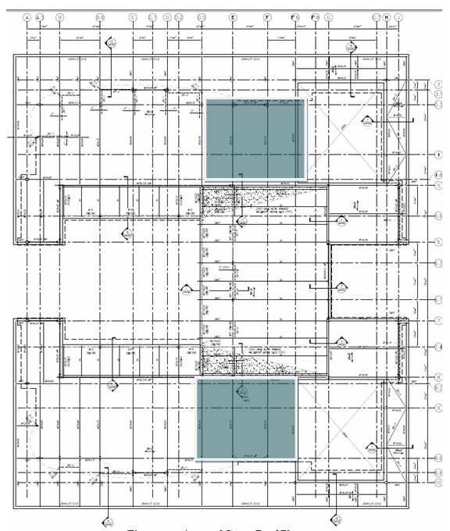
Breadth 2
Project Overview
Industry Research
Breadth 1
Breadth 2
Results
Green Roof Placement
Laurel Warner Penn State AE Senior Thesis Construction Management

Slide 22
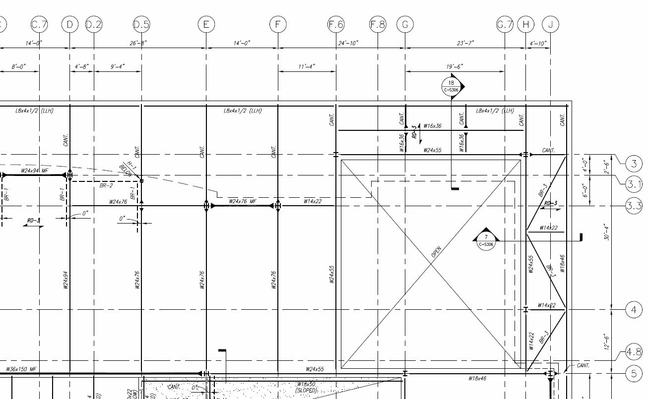
Breadth 2
Project Overview
Industry Research
Breadth 1
Breadth 2
Results
Laurel Warner Penn State AE Senior Thesis Construction Management

Slide 23
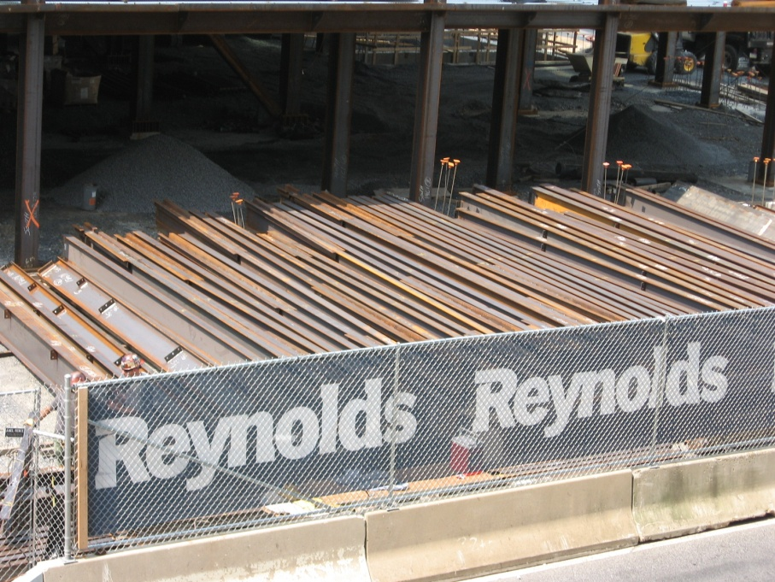
Breadth 2
Project Overview
Industry Research
Breadth 1
Breadth 2
Results
Structural Analysis:
Calculated new loading conditions with added green roof
Simply supported W24x76
Uniformly distributed load
2-span
Tributary width = 13’-4’’
Length of beam = 42’-10’’
Total uniform factored
load = 158psf
Laurel Warner Penn State AE Senior Thesis Construction Management

Slide 24
Breadth 2
Project Overview
Industry Research
Breadth 1
Breadth 2
Results
Laurel Warner Penn State AE Senior Thesis Construction Management

Slide 25
Results
Project Overview
Industry Research
Breadth 1
Breadth 2
Results
Credits for Which the Harrisburg University Qualifies Under the LEED Rating System
SS 2
Development Density and Community Connectivity
SS 4.1
Alternative Transportation, Public Transportation Access
SS 7.2
Heat Island Effect, Roof
EQ 8.1
Daylight & Views, Daylight for 75% of Spaces
ID 2
LEED Accredited Professional
Laurel Warner Penn State AE Senior Thesis Construction Management

Slide 26
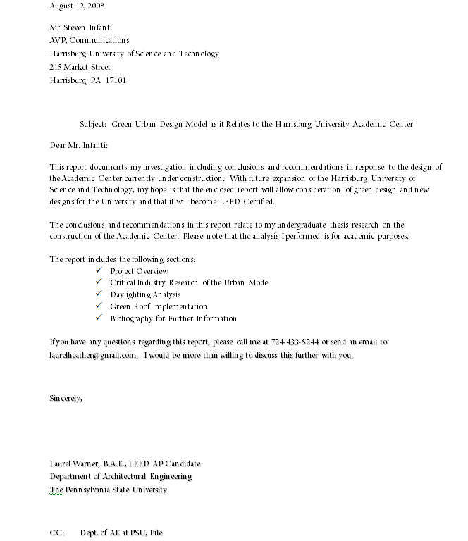
Results
Project Overview
Industry Research
Breadth 1
Breadth 2
Results
Laurel Warner Penn State AE Senior Thesis Construction Management

Slide 27
Acknowledgements
The AE Department
Especially
Robert Holland
Kevin Parfitt
David Riley
Reynolds Construction Management
Patricia Blumenthal
Todd Buzard
James McKamey
John Miller
Ike Sholly
Walter Tack
Harrisburg University of Science and Technology
Steven Infanti
U. S. Green Building Council
John Bernard
Matthew Grenshaw
My Family and Friends
Gina Colalillo
Jay and Marcus Espenlaub
Ghazoll Motlagh
Carolyn Skiba
Tyler Smith
Charlene, Randolph, Heidi, and Darren Warner
Laurel Warner Penn State AE Senior Thesis Construction Management

Slide 28
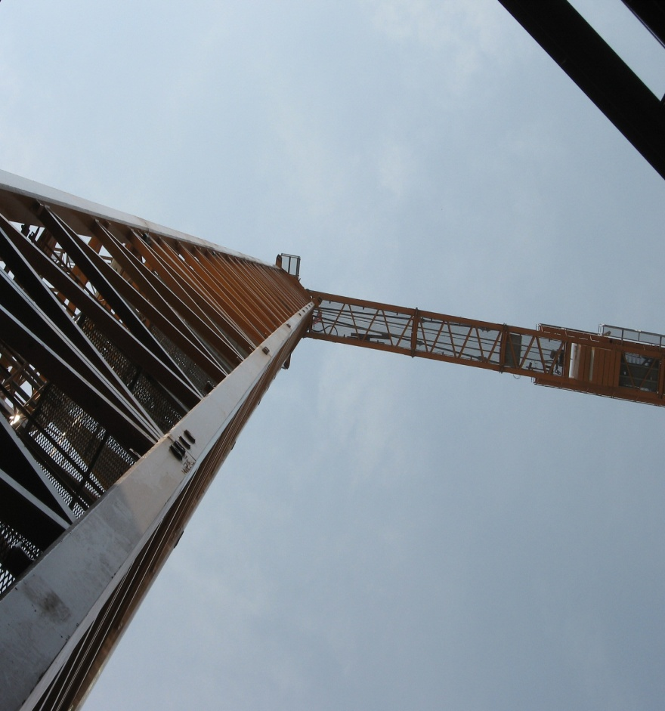
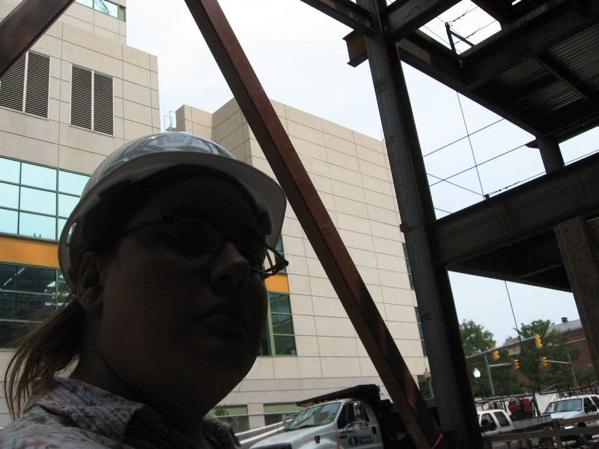
Questions?
Laurel Warner Penn State AE Senior Thesis Construction Management

