Slide 1
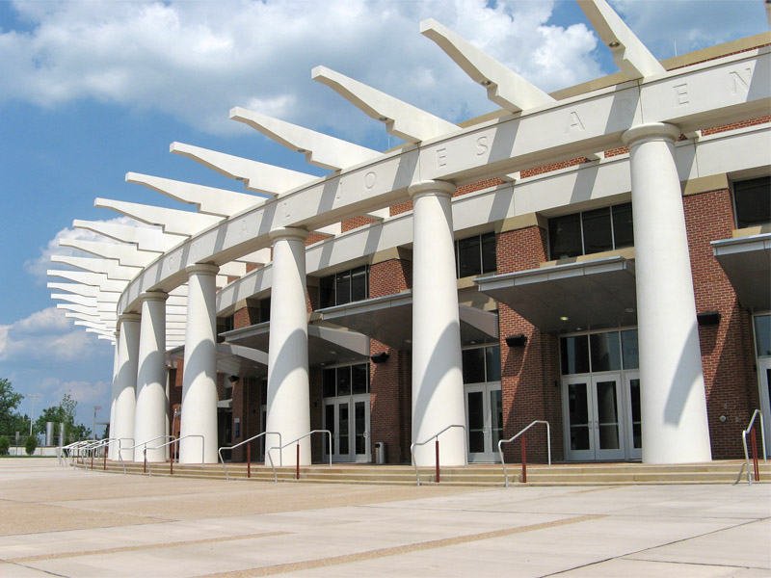
JOHN PAUL JONES ARENA
CHARLOTTESVILLE, VIRGINIA
SCHEMATIC DESIGN PRESENTATION
LOGAN BROWN

Slide 2
JOHN PAUL JONES ARENA
CHARLOTTESVILLE, VIRGINIA
LOCATION:
The University of Virginia
295 Massie Road
Charlottesville, VA 22903
SIZE:
365,000 Square Feet
COST:
$129.8 Million (Overall Cost)
PROJECT TIMETABLE:
May 2003 – August 2006
PRIMARY FUNCTIONS:
16,000 Seat Arena
Team Store
Hall of Fame Museum
Concessions
Team Training Facilities
Educational Spaces
SCHEMATIC DESIGN PRESENTATION: PROJECT OVERVIEW

Slide 3
JOHN PAUL JONES ARENA
CHARLOTTESVILLE, VIRGINIA
ONE. | Exterior Space: WEST ELEVATION
TWO. | Circulation Space: WEST ENTRANCE LOBBY Upper Concourse, Level 3
THREE. | Special Purpose Space: ATHLETIC DINING ROOM Lower Concourse, Level 2
FOUR. | Large Work Space: ACADEMIC CENTER, READING ROOM Event Level, Level 1
SCHEMATIC DESIGN PRESENTATION: DESIGN SCOPE

Slide 4
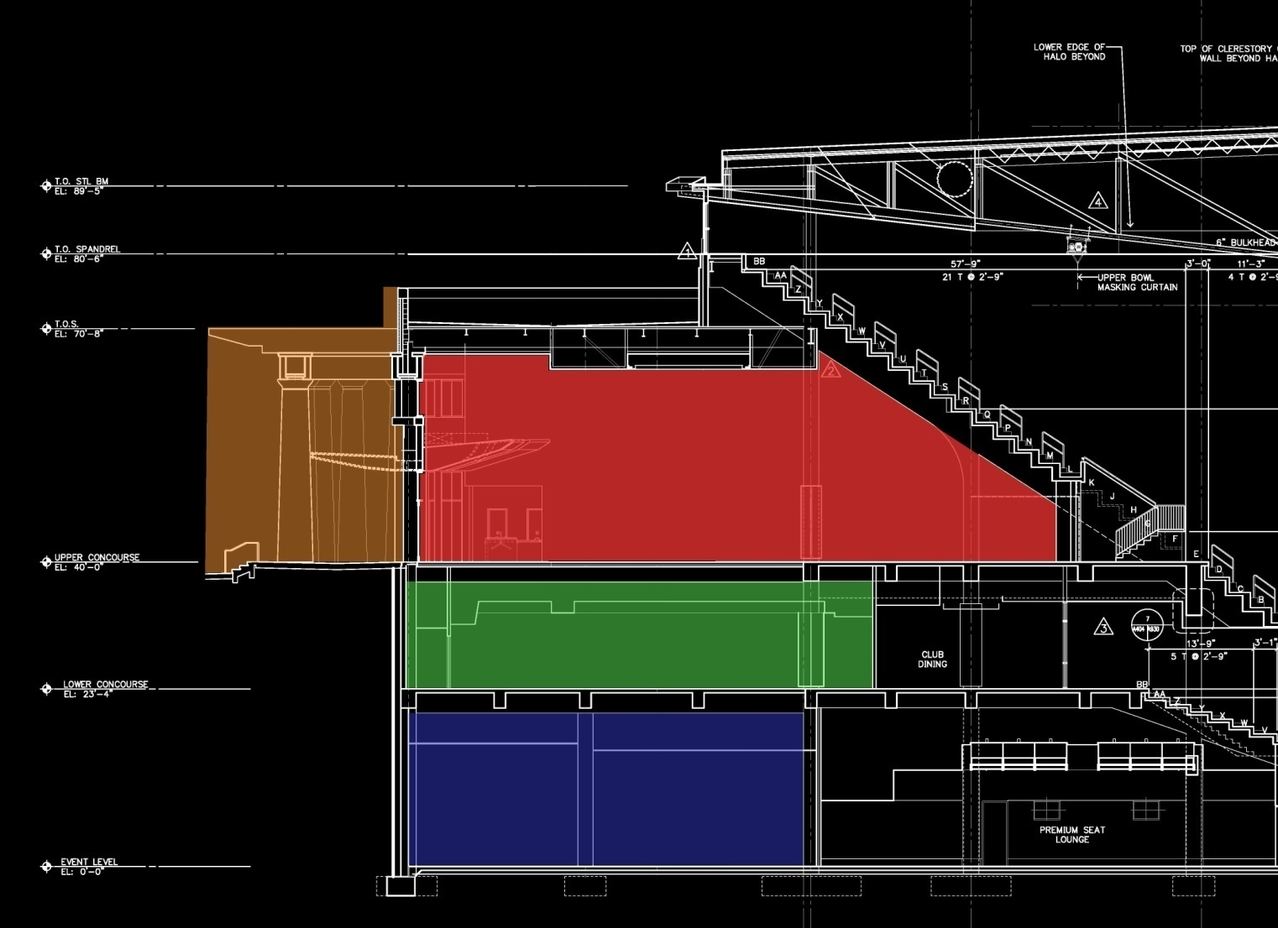
JOHN PAUL JONES ARENA
CHARLOTTESVILLE, VIRGINIA
EXTERIOR FACADE
LOBBY
DINING ROOM
ACADEMIC CENTER
SCHEMATIC DESIGN PRESENTATION: DESIGN SCOPE

Slide 5
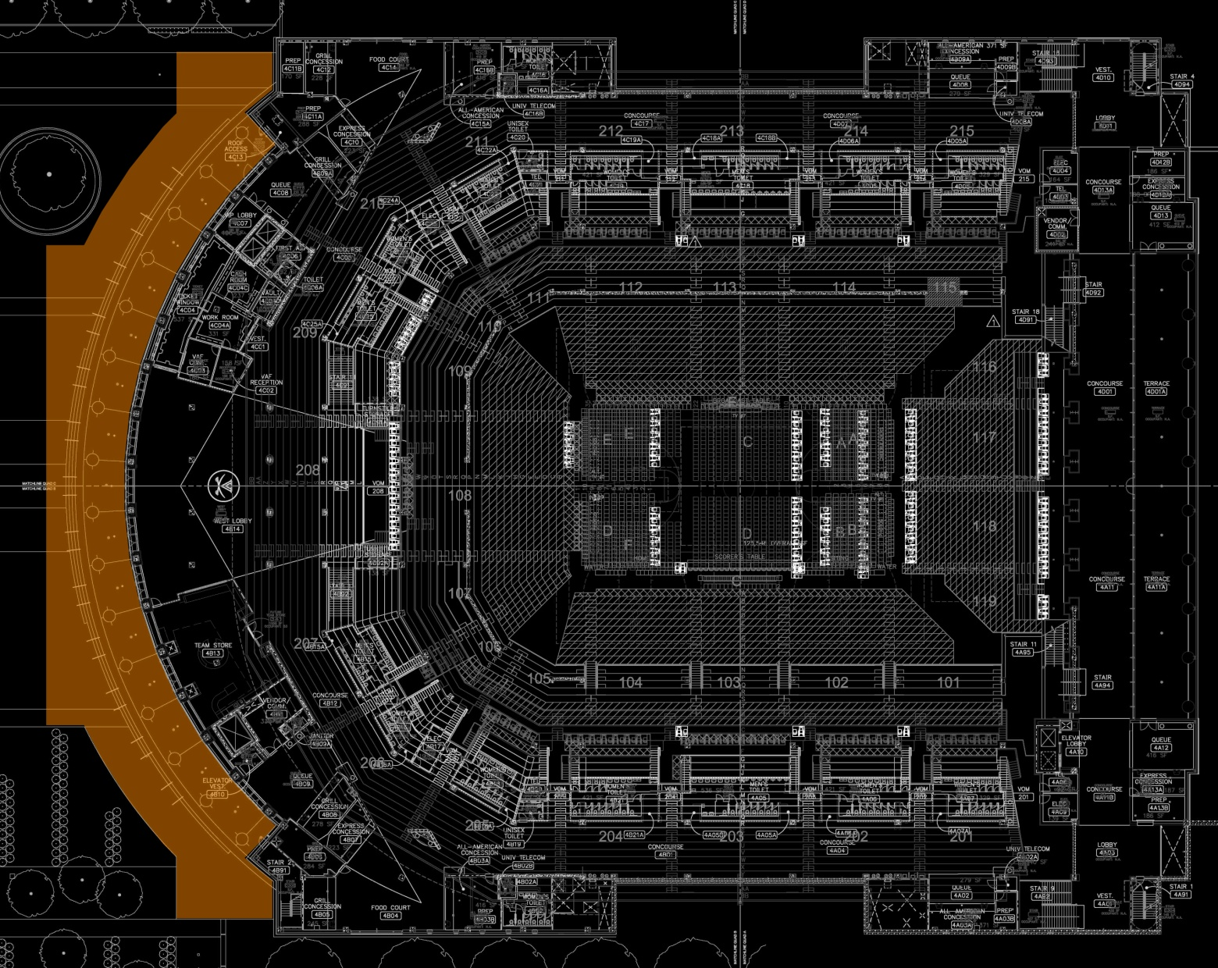
JOHN PAUL JONES ARENA
EXTERIOR FACADE
CHARLOTTESVILLE, VIRGINIA
SCHEMATIC DESIGN PRESENTATION: PLAN VIEW

Slide 6
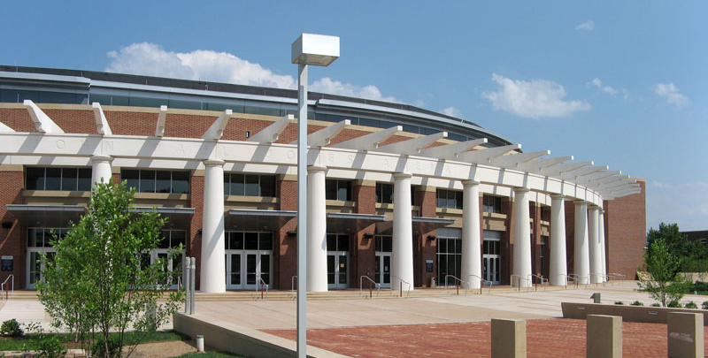
JOHN PAUL JONES ARENA
EXTERIOR FACADE
CHARLOTTESVILLE, VIRGINIA
OVERHEAD TRELLIS
TICKET WINDOW
TEAM STORE EXTERIOR ENTRANCE
(16) WEST FACING DORIC COLUMNS
SCHEMATIC DESIGN PRESENTATION: KEY FEATURES

Slide 7
JOHN PAUL JONES ARENA
EXTERIOR FACADE
CHARLOTTESVILLE, VIRGINIA
ONE. | Match the historic theme of campus
TWO. | Clean, minimal luminaire appearance
THREE. | Accent major features while providing enough illuminance for tasks
FOUR. | Use of lighting to create depth & give visual interest
SCHEMATIC DESIGN PRESENTATION: DESIGN GOALS

Slide 8
JOHN PAUL JONES ARENA
EXTERIOR FACADE
CHARLOTTESVILLE, VIRGINIA
SECTION LOOKING NORTH AT DORIC COLUMN
SCHEMATIC DESIGN PRESENTATION: DESIGN

Slide 9
JOHN PAUL JONES ARENA
EXTERIOR FACADE
CHARLOTTESVILLE, VIRGINIA
SECTION LOOKING NORTH PAST DORIC COLUMN
SCHEMATIC DESIGN PRESENTATION: DESIGN

Slide 10
JOHN PAUL JONES ARENA
EXTERIOR FAÇADE: NORTH HALF
CHARLOTTESVILLE, VIRGINIA
RECESSED DOWNLIGHT & COLUMN ACCENT
FLUSH-MOUNTED DOWNLIGHT
RECESSED LINEAR AWNING DOWNLIGHT
SCHEMATIC DESIGN PRESENTATION: DESIGN

Slide 11
JOHN PAUL JONES ARENA
EXTERIOR FAÇADE: SOUTH HALF
CHARLOTTESVILLE, VIRGINIA
WALLWASH UPLIGHT
RECESSED DOWNLIGHT
DIRECT – INDIRECT WALL SCONCE
SCHEMATIC DESIGN PRESENTATION: DESIGN

Slide 12
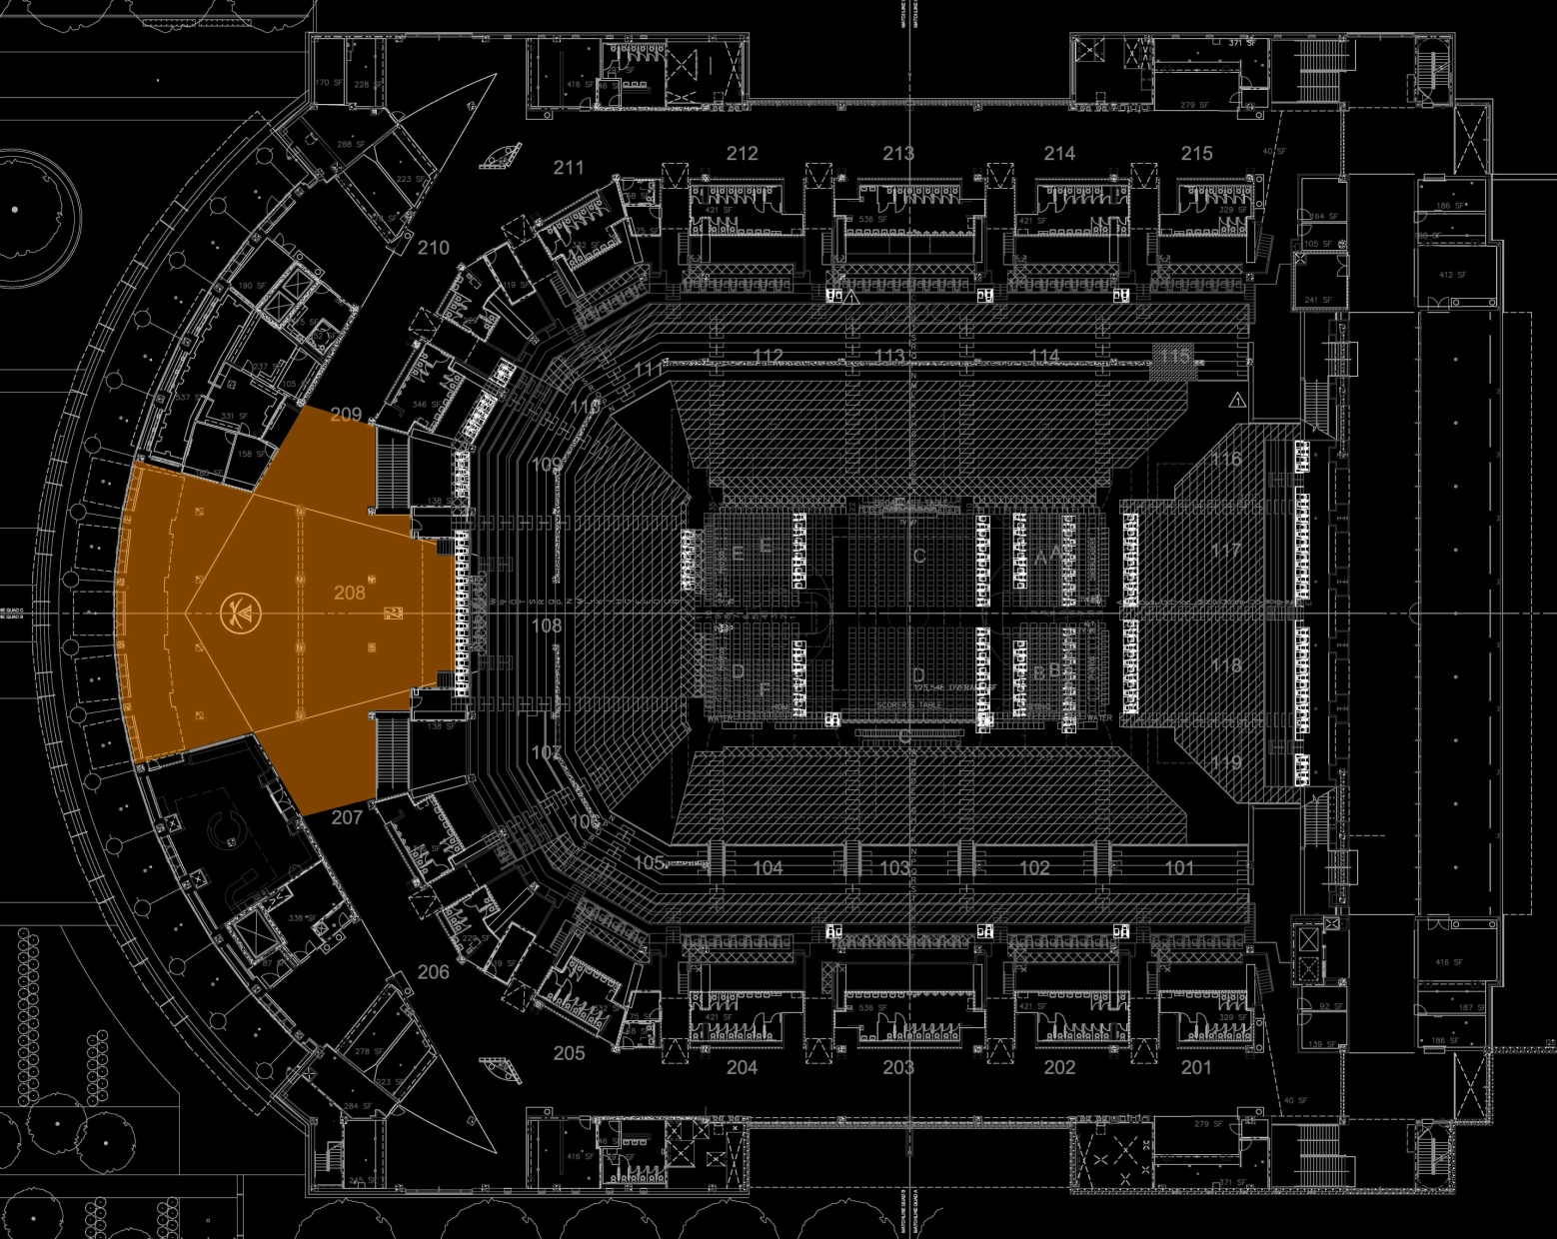
JOHN PAUL JONES ARENA
ENTRANCE LOBBY
CHARLOTTESVILLE, VIRGINIA
SCHEMATIC DESIGN PRESENTATION: PLAN VIEW

Slide 13
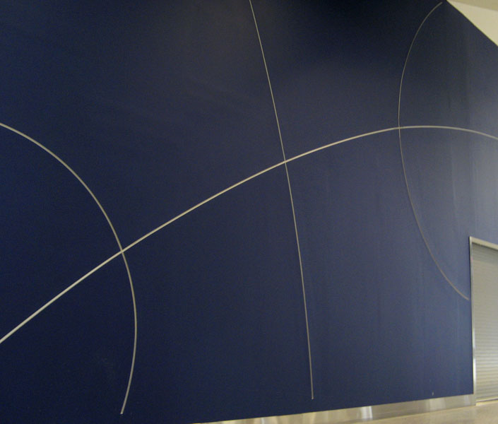
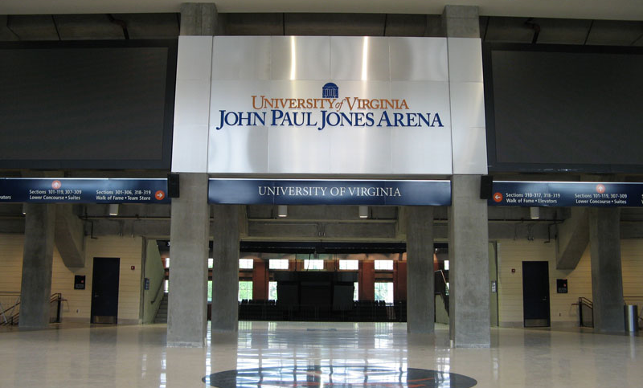
JOHN PAUL JONES ARENA
ENTRANCE LOBBY
CHARLOTTESVILLE, VIRGINIA
UNIVERSITY FLOOR LOGO
ENLARGED BASKETBALL WALL DETAILS
PROJECTION SCREENS
SCHEMATIC DESIGN PRESENTATION: KEY FEATURES

Slide 14
JOHN PAUL JONES ARENA
ENTRANCE LOBBY
CHARLOTTESVILLE, VIRGINIA
ONE. | Clean, uniform appearance & layout of luminaires
TWO. | Emphasis on peripheral areas
THREE. | Creation of a visual hierarchy
FOUR. | Emphasize university logo on floor
SCHEMATIC DESIGN PRESENTATION: DESIGN GOALS

Slide 15
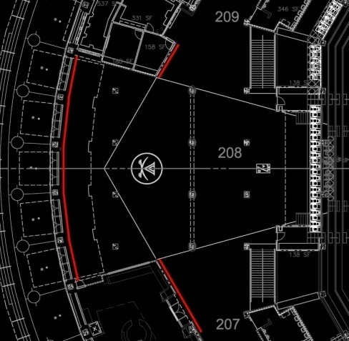
JOHN PAUL JONES ARENA
ENTRANCE LOBBY
CHARLOTTESVILLE, VIRGINIA
LOOKING TOWARD ENTRANCE FROM COURT AREA
SCHEMATIC DESIGN PRESENTATION: DESIGN

Slide 16
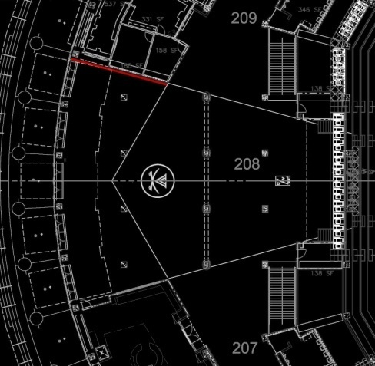
JOHN PAUL JONES ARENA
ENTRANCE LOBBY
CHARLOTTESVILLE, VIRGINIA
LOOKING TOWARD THE NORTH
SCHEMATIC DESIGN PRESENTATION: DESIGN

Slide 17
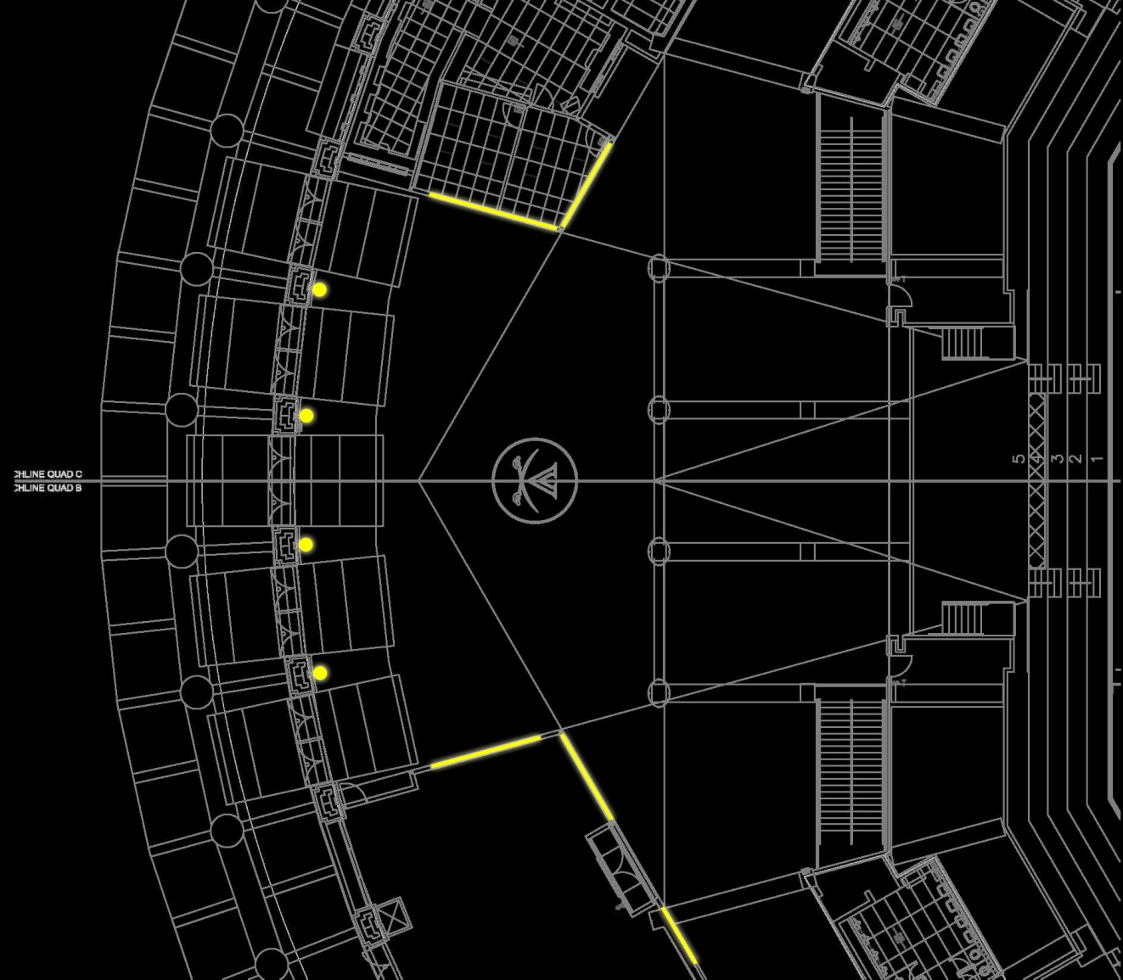
JOHN PAUL JONES ARENA
ENTRANCE LOBBY
CHARLOTTESVILLE, VIRGINIA
WALLWASH UPLIGHT
DIRECT – INDIRECT WALL SCONCE
LUMINATED
WALL DETAIL
SCHEMATIC DESIGN PRESENTATION: DESIGN

Slide 18
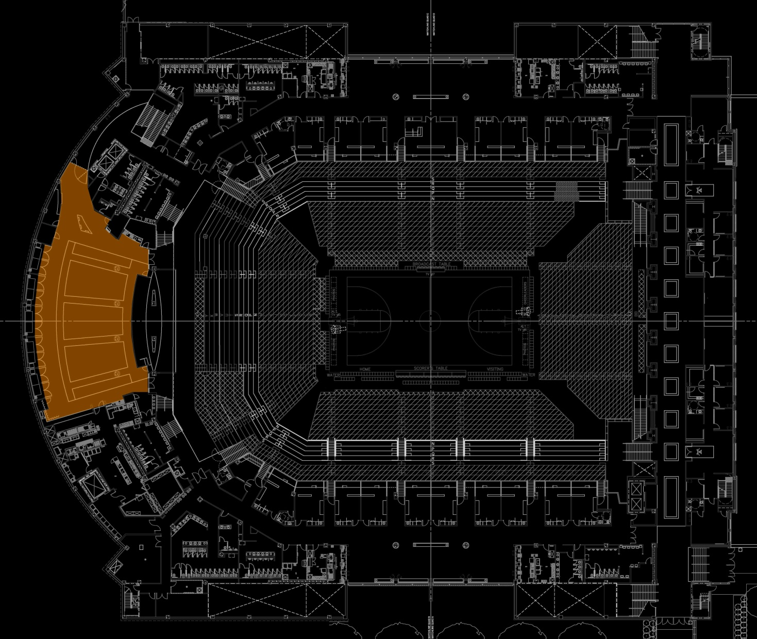
JOHN PAUL JONES ARENA
ATHLETIC DINING ROOM
CHARLOTTESVILLE, VIRGINIA
SCHEMATIC DESIGN PRESENTATION: PLAN VIEW

Slide 19
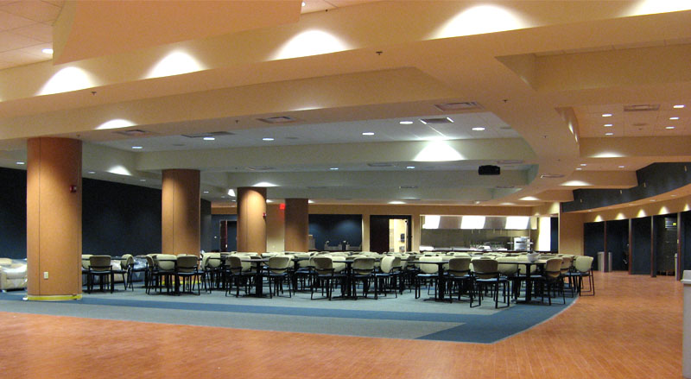
JOHN PAUL JONES ARENA
ATHLETIC DINING ROOM
CHARLOTTESVILLE, VIRGINIA
VARIOUS CEILING & SOFFIT HEIGHTS
ENTRY KIOSK
RETRACTABLE PROJECTION SCREEN
SERVICE KITCHEN & BUFFET
SCHEMATIC DESIGN PRESENTATION: KEY FEATURES

Slide 20
JOHN PAUL JONES ARENA
ATHLETIC DINING ROOM
CHARLOTTESVILLE, VIRGINIA
ONE. | Emphasize varied ceiling heights as architectural features
TWO. | Creation of a spacious & professional environment
THREE. | Controls to allow for video projection setting
FOUR. | A visual hierarchy that starts at the reception desk
SCHEMATIC DESIGN PRESENTATION: DESIGN GOALS

Slide 21
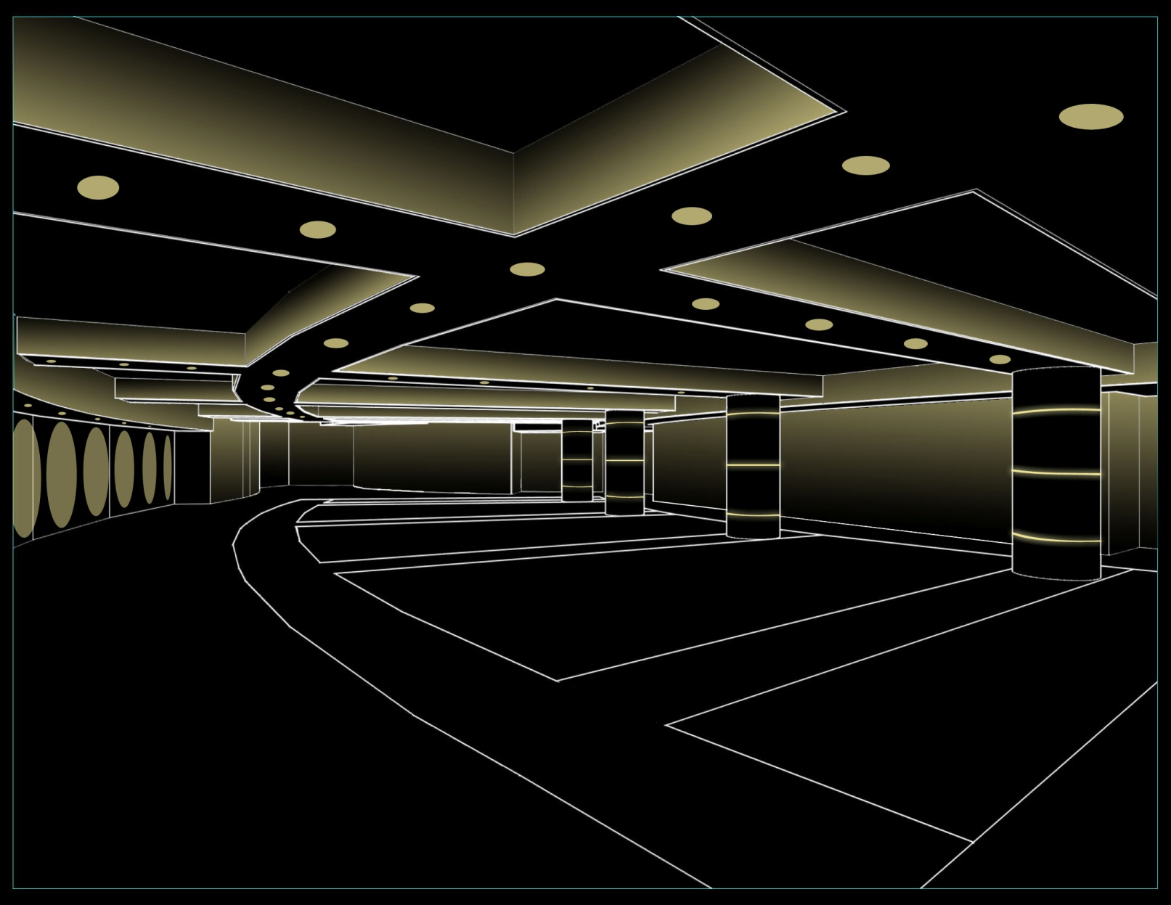
JOHN PAUL JONES ARENA
ATHLETIC DINING ROOM
CHARLOTTESVILLE, VIRGINIA
SCHEMATIC DESIGN PRESENTATION: DESIGN

Slide 22
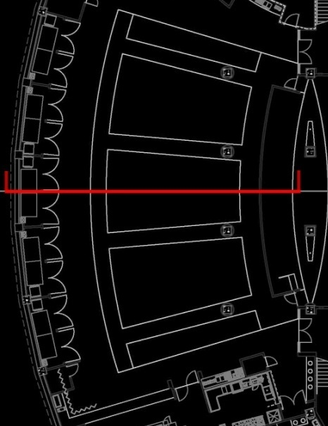
JOHN PAUL JONES ARENA
ATHLETIC DINING ROOM
CHARLOTTESVILLE, VIRGINIA
LOOKING TOWARD THE NORTH
SCHEMATIC DESIGN PRESENTATION: DESIGN

Slide 23
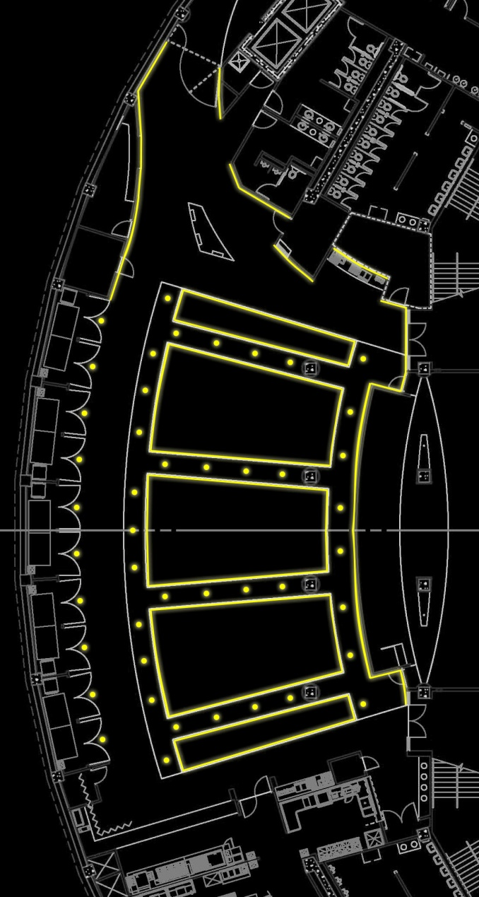
JOHN PAUL JONES ARENA
ATHLETIC DINING ROOM
CHARLOTTESVILLE, VIRGINIA
COVE LIGHTING SYSTEM
UNIFORM WALL WASH
RECESSED DOWNLIGHT
ILLUMINATED COLUMN
SCHEMATIC DESIGN PRESENTATION: DESIGN

Slide 24
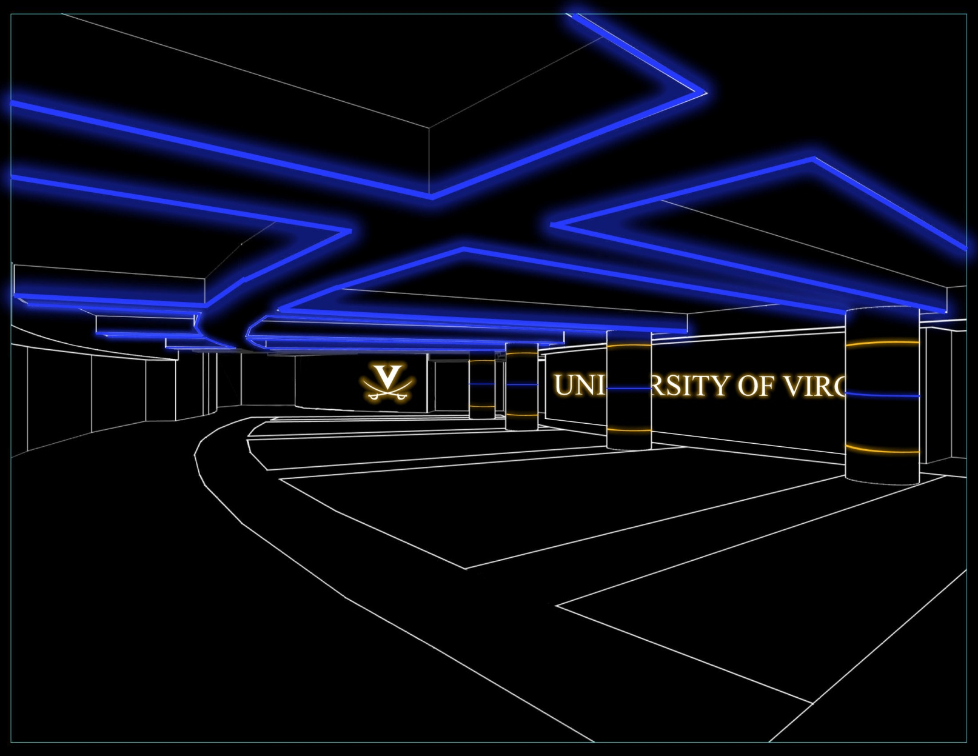
JOHN PAUL JONES ARENA
ATHLETIC DINING ROOM
CHARLOTTESVILLE, VIRGINIA
SCHEMATIC DESIGN PRESENTATION: ALTERNATE DESIGN

Slide 25
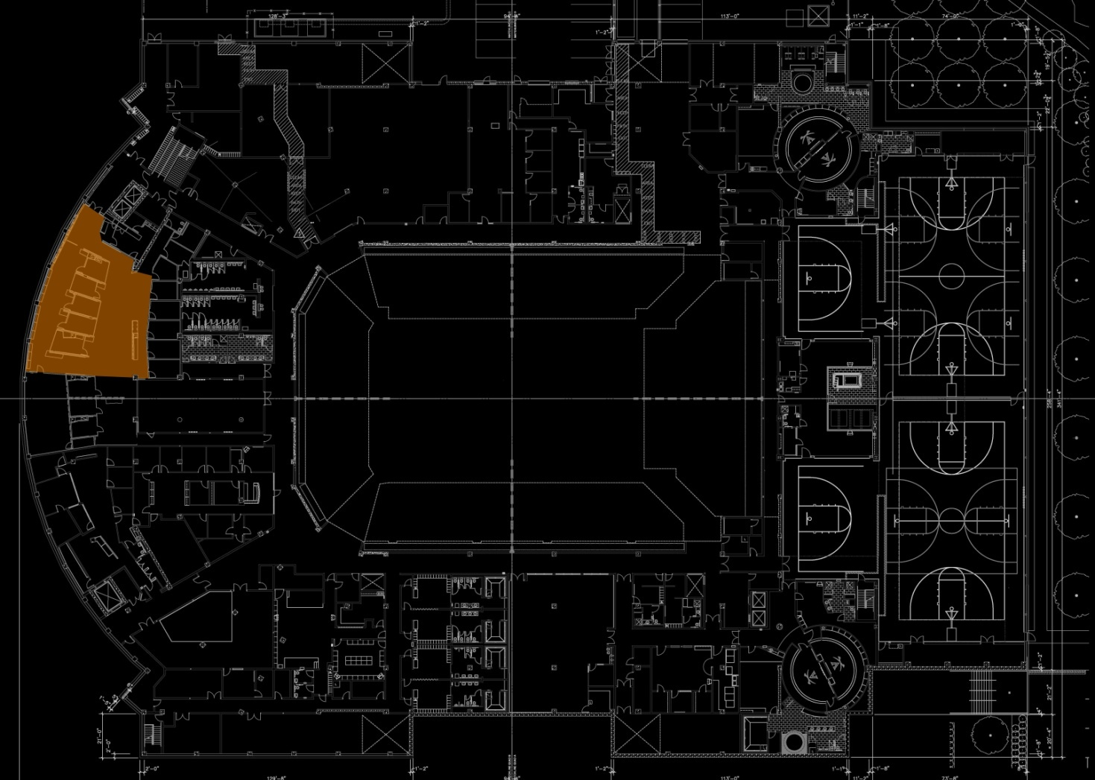
JOHN PAUL JONES ARENA
ACADEMIC CENTER
CHARLOTTESVILLE, VIRGINIA
SCHEMATIC DESIGN PRESENTATION: PLAN VIEW

Slide 26
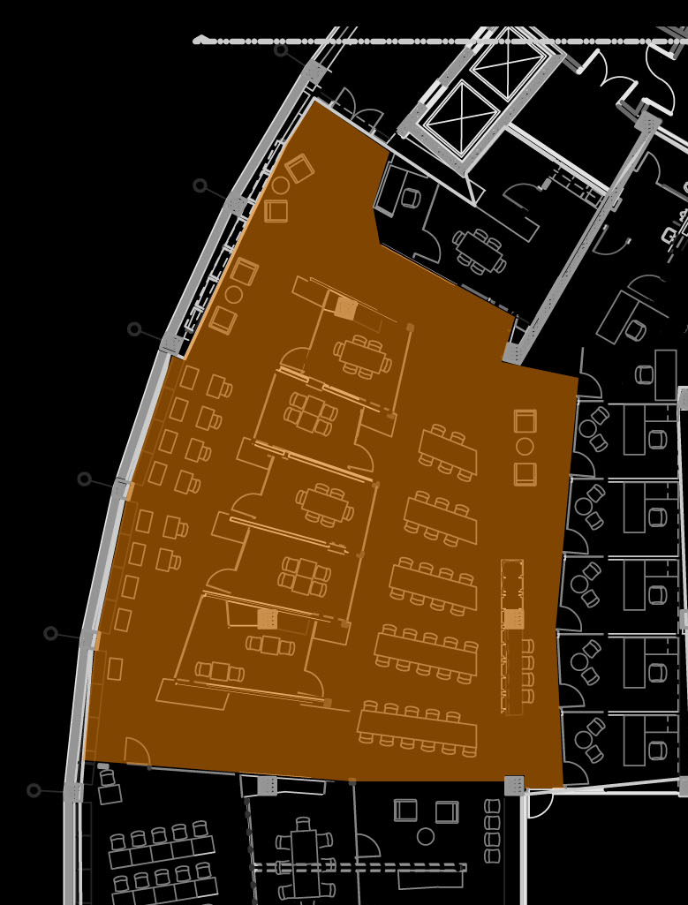
JOHN PAUL JONES ARENA
ACADEMIC CENTER
CHARLOTTESVILLE, VIRGINIA
INDIVIDUAL STUDY AREA
ETCHED GLASS PARTITIONS
GROUP STUDY AREA
TUTOR ROOMS
SCHEMATIC DESIGN PRESENTATION: KEY FEATURES

Slide 27
JOHN PAUL JONES ARENA
ACADEMIC CENTER
CHARLOTTESVILLE, VIRGINIA
ONE. | A relaxed, open environment
TWO. | Uniform and proper light distribution on task plane
THREE. | Creation of room zones to account for occupancy issues
SCHEMATIC DESIGN PRESENTATION: DESIGN GOALS

Slide 28
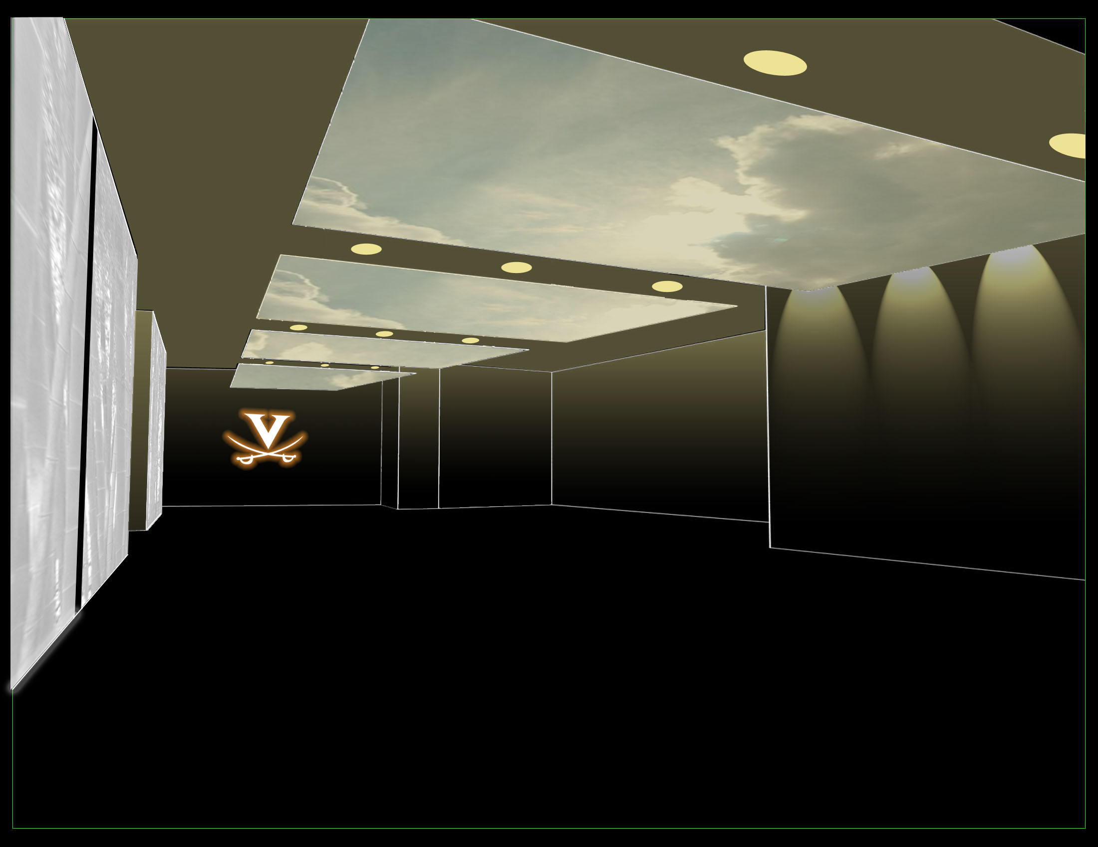
JOHN PAUL JONES ARENA
ACADEMIC CENTER
CHARLOTTESVILLE, VIRGINIA
SCHEMATIC DESIGN PRESENTATION: DESIGN

Slide 29
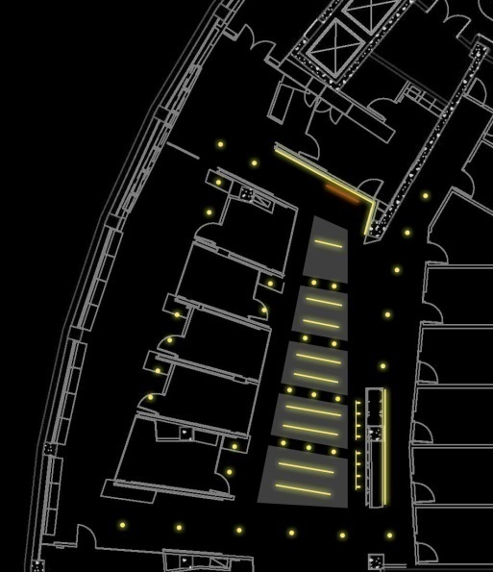
JOHN PAUL JONES ARENA
ACADEMIC CENTER
CHARLOTTESVILLE, VIRGINIA
LOOKING TOWARD THE WEST
SCHEMATIC DESIGN PRESENTATION: DESIGN

Slide 30
JOHN PAUL JONES ARENA
ACADEMIC CENTER
CHARLOTTESVILLE, VIRGINIA
LOOKING TOWARD THE WEST
SCHEMATIC DESIGN PRESENTATION: DESIGN

Slide 31
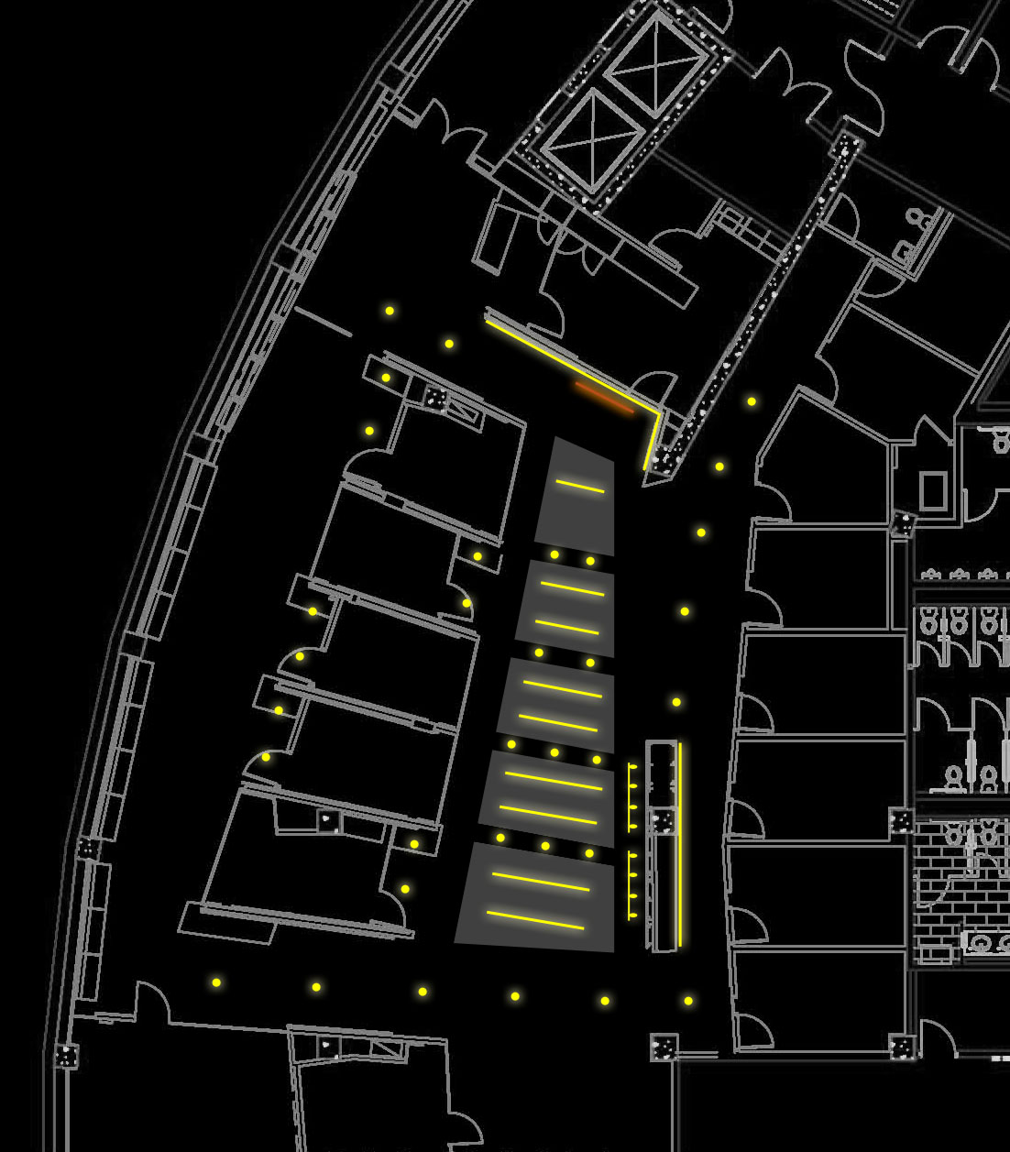
JOHN PAUL JONES ARENA
ACADEMIC CENTER
CHARLOTTESVILLE, VIRGINIA
RECESSED DOWNLIGHT
PENDANT-MOUNTED DOWNLIGHT
LINEAR
DIRECT / INDIRECT
SCHEMATIC DESIGN PRESENTATION: DESIGN

Slide 32
JOHN PAUL JONES ARENA
ACADEMIC CENTER
CHARLOTTESVILLE, VIRGINIA
WALL-MOUNTED ILLUMINATED LOGO
ACCENT TRACK LIGHTING
SCHEMATIC DESIGN PRESENTATION: DESIGN

Slide 33
JOHN PAUL JONES ARENA
CHARLOTTESVILLE, VIRGINIA
THANK YOU.
SCHEMATIC DESIGN PRESENTATION
LOGAN BROWN

