Slide 1
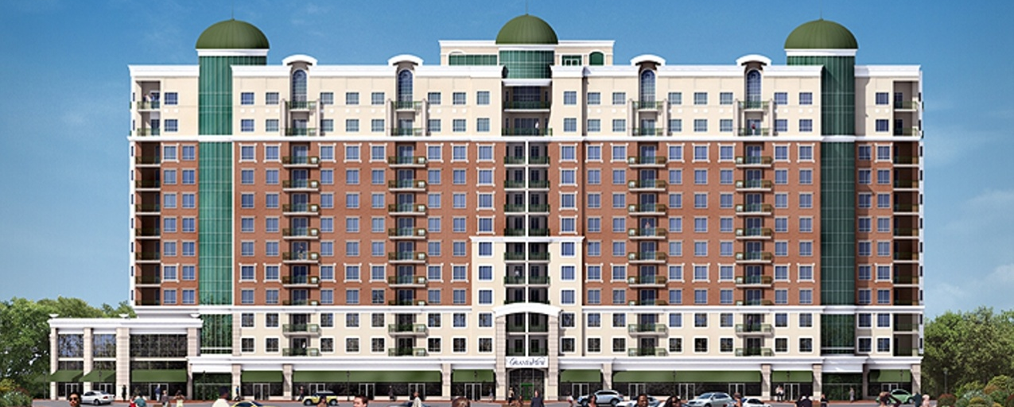
Matt Karle
Construction Management
AE SENIOR THESIS PROJECT

Slide 2
Presentation Outline
Building Overview
Schedule & Cost
Overall Goals
Solar PV Implementation (Electrical Breadth)
Window Glazing
Solar Constructability and Future
Recommendations
Questions

Slide 3
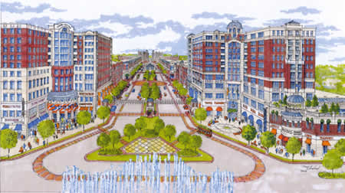

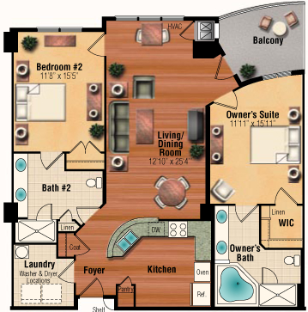
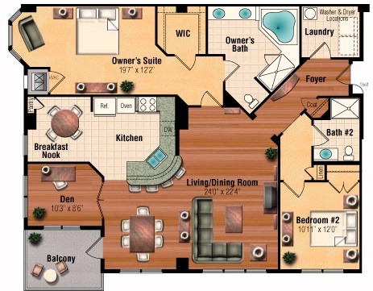
Project Information
Building Overview
Schedule & Cost
Overall Goals
Solar PV Implementation
Glazing
Solar Constructability and Future
Recommendations
Questions
13 Stories
Ground: Retail
2-12: Residential
385,000 ft2
125 Total Units
Top 2 Floors – Penthouse Suites

Slide 4
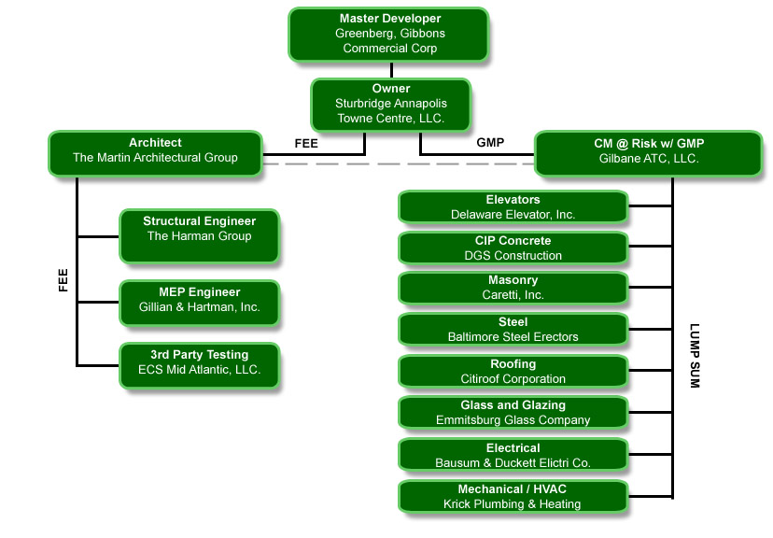



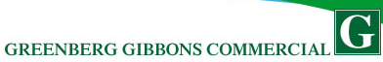
.
Client Information
Building Overview
Schedule & Cost
Overall Goals
Solar PV Implementation
Glazing
Solar Constructability and Future
Recommendations
Questions
Greenberg Gibbons Commercial
Sturbridge Homes
Gilbane
Martin Architectural Group
Large Joint Venture
1 of 2 Condo Projects

Slide 5
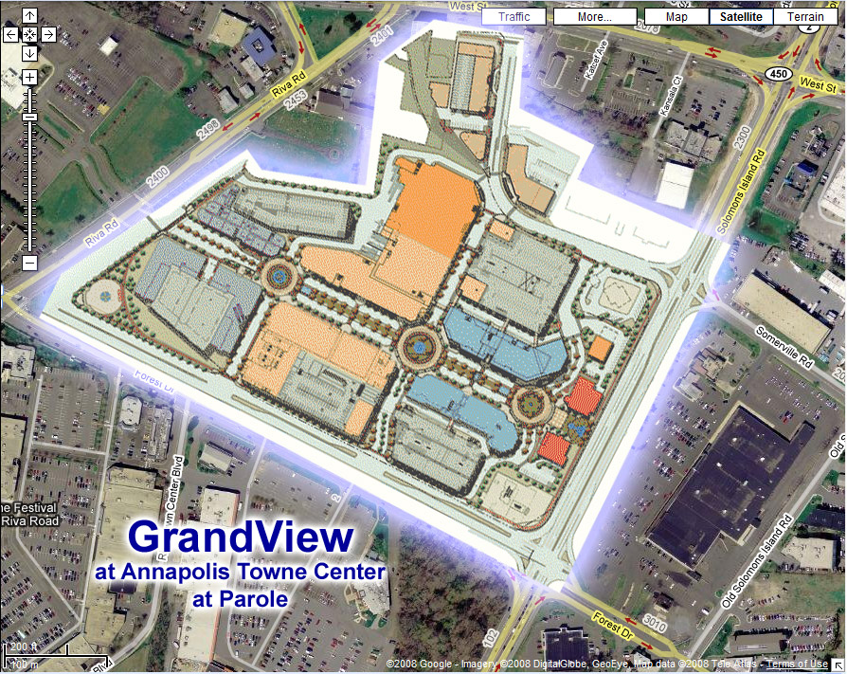
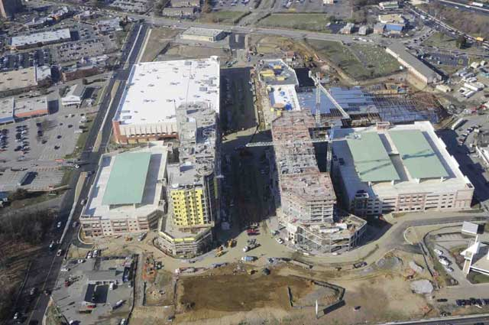
Location & Layout
Building Overview
Schedule & Cost
Overall Goals
Solar PV Implementation
Glazing
Solar Constructability and Future
Recommendations
Questions
Demolished Strip Mall
Grandview at Annapolis Towne Centre
1915 Towne Centre Blvd
Annapolis, MD 21401
Main Office Field Office GrandView Laydown Parking Traffic

Slide 6
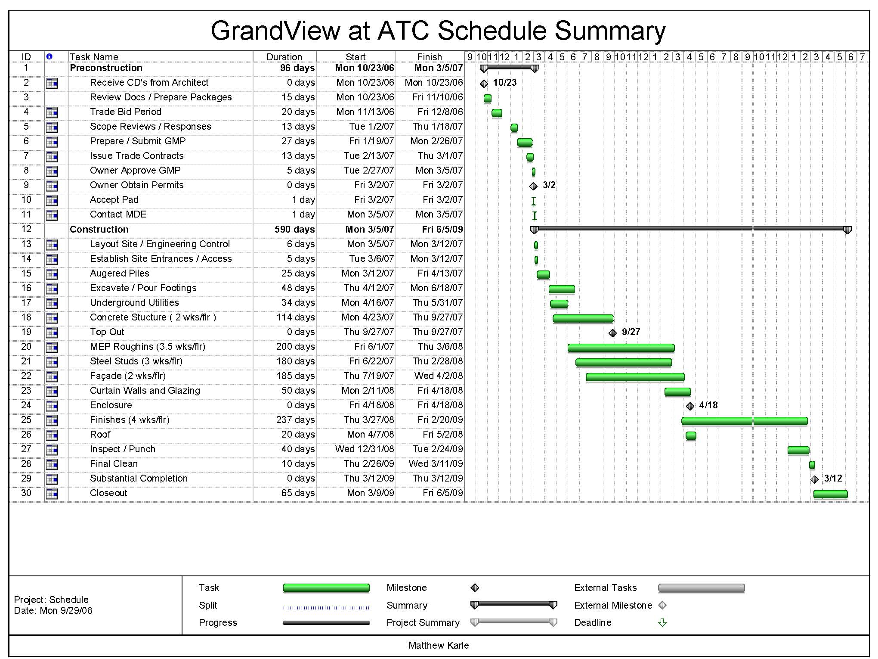
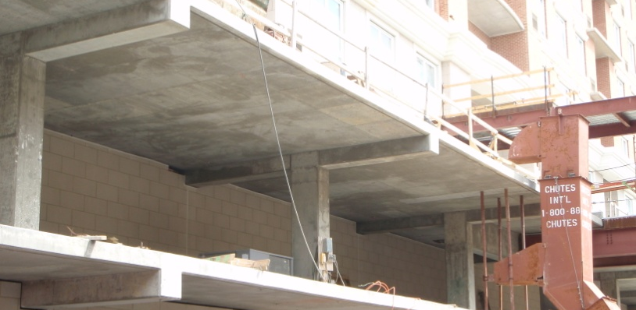
Building Systems
2-Way Flat Slab
Brick Façade
Curved Glass Curtain Walls
Separate Service Utilities for Residential and Retail
Fiscal Projections
Building Overview
Schedule & Cost
Overall Goals
Solar PV Implementation
Glazing
Solar Constructability and Future
Recommendations
Questions
$68.5 Million
Projected : 24 Months Construction
Actual: March 07 – June 09

Slide 7
Overall Project Statement
What effects can the sun have on reducing energy costs and environmental impacts while maintaining constructability and schedule length?

Slide 8
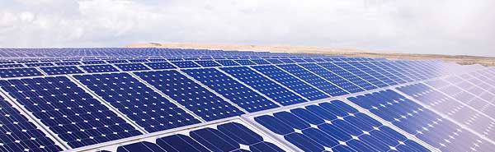
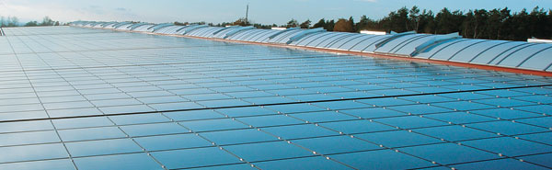
Will the addition have a schedule impact?
Large enough Surface?
Effects of shadows?
Power?
Payback Period?
Total Cost?
Environmental savings?
Building Overview
Schedule & Cost
Overall Goals
Solar PV Implementation
Glazing
Solar Constructability and Future
Recommendations
Questions
Analysis 1
Addition of PV Panels &
Energy Savings Costs

Slide 9
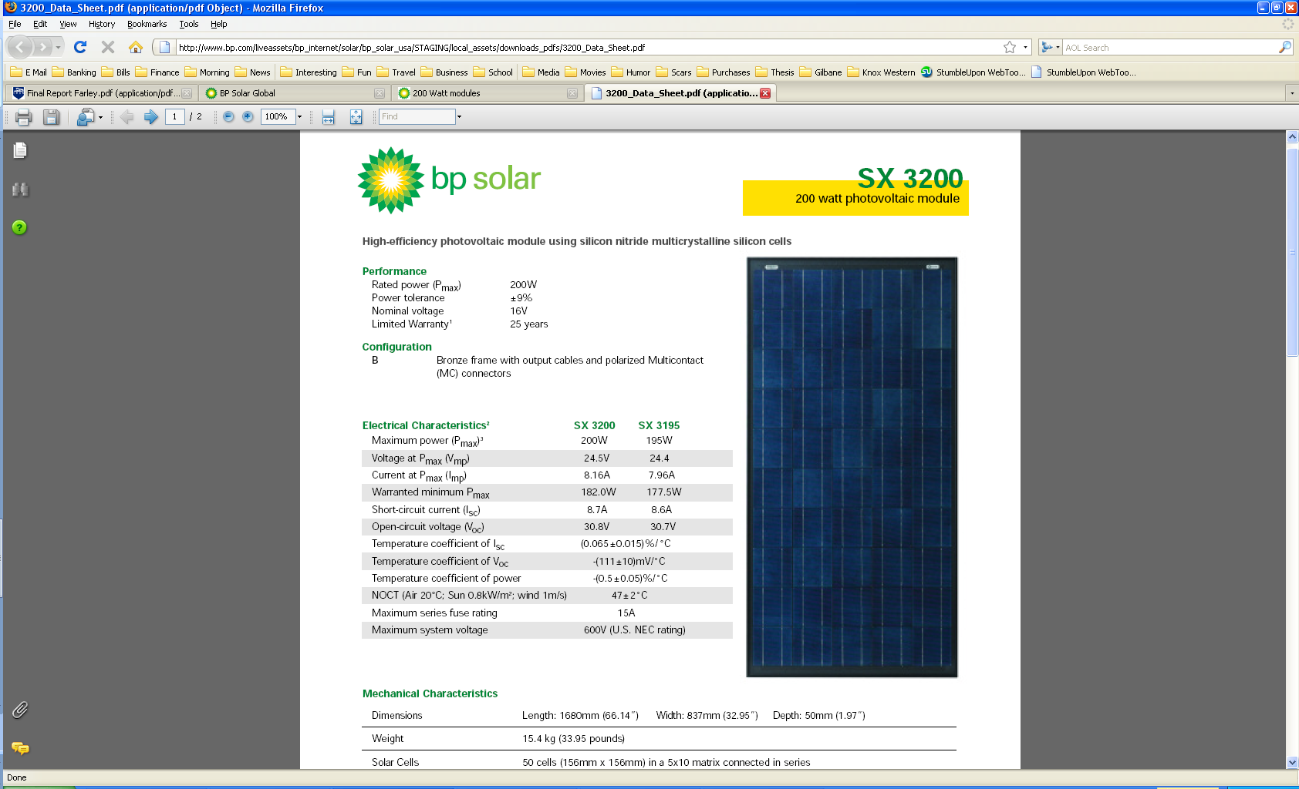
INVERTER SPECIFICATIONS: GT5.0
Power Data
Max AC Power Output | 5000 W : 4500 W
AC OUTPUT (nominal) | 240 V : 208 V
AC FREQUENCY (nominal) | 60 Hz
Max Continuous Output Current | 21-22 A
Max Output over Current Protection | 30
Max Utility Backfeed Current | 12:00 AM
Power Factor | >0.99
Output Characteristics | Current Source
Size
Weight | 58 lbs.
Dimensions | 29" x 16 " x 6"
Design Criteria
Building Overview
Schedule & Cost
Overall Goals
Solar PV Implementation
Glazing
Solar Constructability and Future
Recommendations
Questions
BP Solar sx3200 200 Watt PV Module
34 lbs
66” x 33”
Xantrex GT 5.0 Grid Tie Solar Inverters
5000 Watt / 240 V

Slide 10
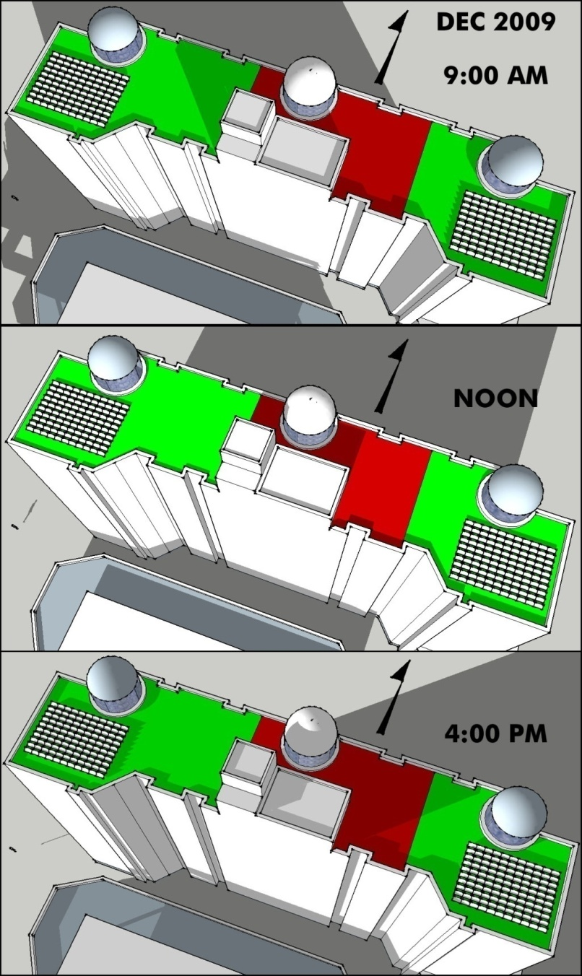
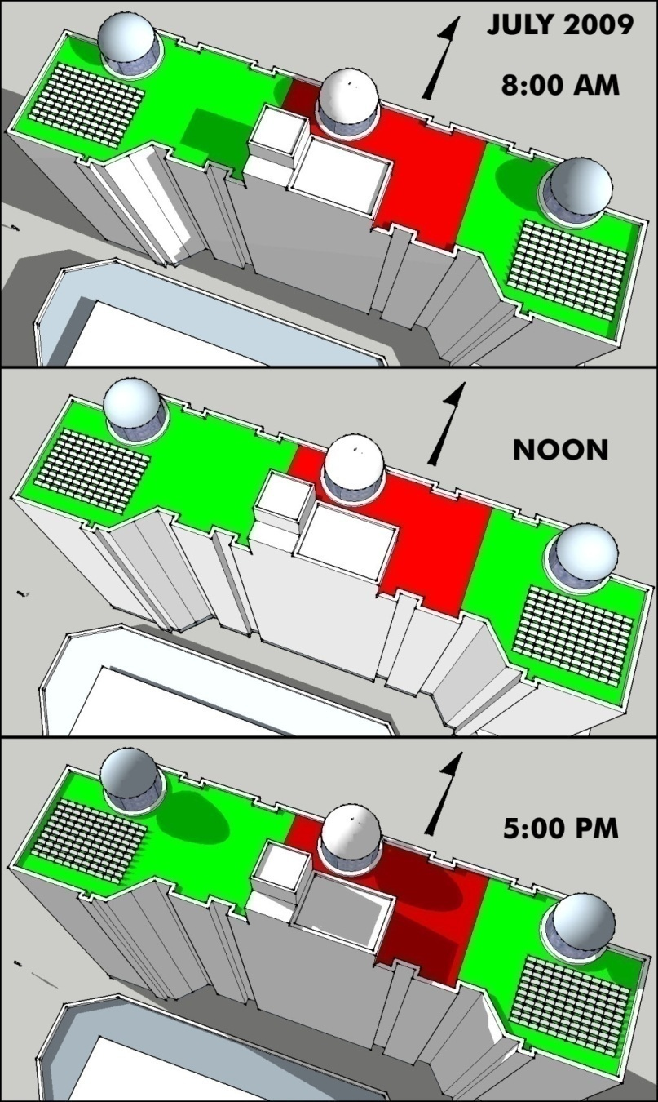
Club Area
Club Area
Available Area
Available Area
Shadow Analysis
Building Overview
Schedule & Cost
Overall Goals
Solar PV Implementation
Glazing
Solar Constructability and Future
Recommendations
Questions
July and December
Uniform Layout
Not Visible From Tenant Area
2 Arrays on East and West End of the Building

Slide 11
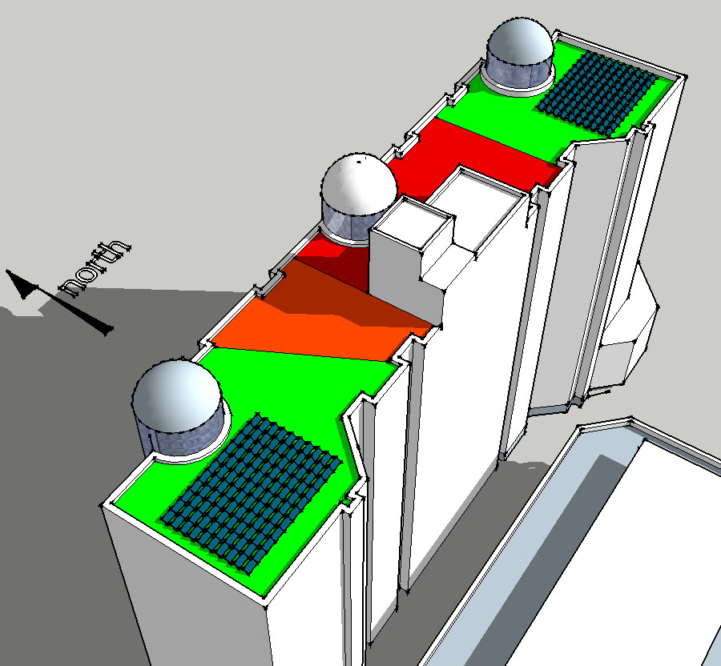
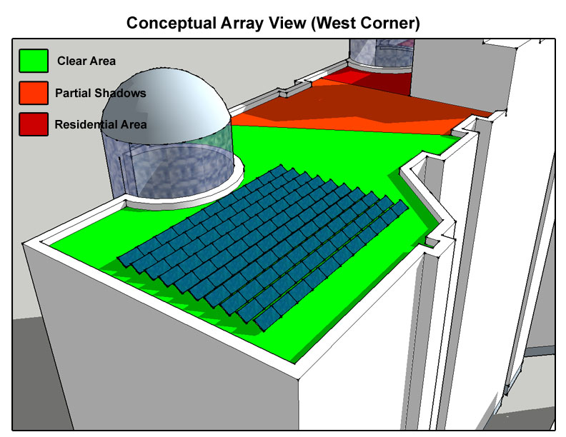
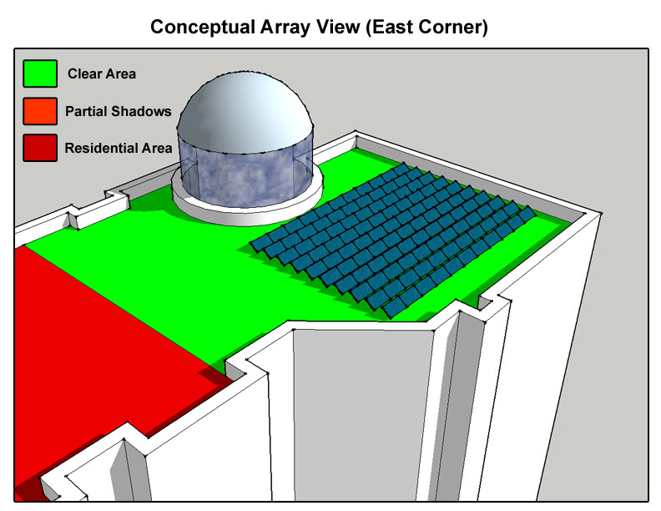
Initial Design
Building Overview
Schedule & Cost
Overall Goals
Solar PV Implementation
Glazing
Solar Constructability and Future
Recommendations
Questions
3025 Square Feet
200 panels (10 X10)
40 kW array
Southern Facing

Slide 12
Electrical Breadth
Panels In Series
20
Inverter Size
4 kW → 5 kW
Number of Inverters
10
Building Overview
Schedule & Cost
Overall Goals
Solar PV Implementation
Glazing
Solar Constructability and Future
Recommendations
Questions

Slide 13
Electrical Breadth
Max Panel Loading
63 kW
Total Inverter Load
40 kW < 49.8 kW available
Load per Inverter
2.0 kW
Building Overview
Schedule & Cost
Overall Goals
Solar PV Implementation
Glazing
Solar Constructability and Future
Recommendations
Questions

Slide 14
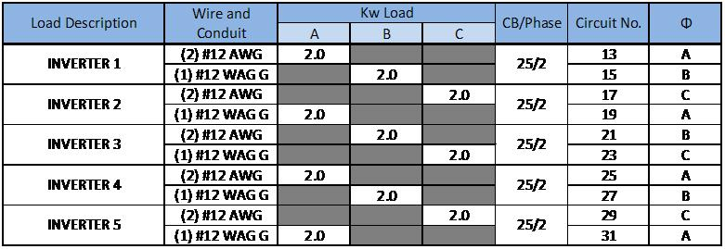
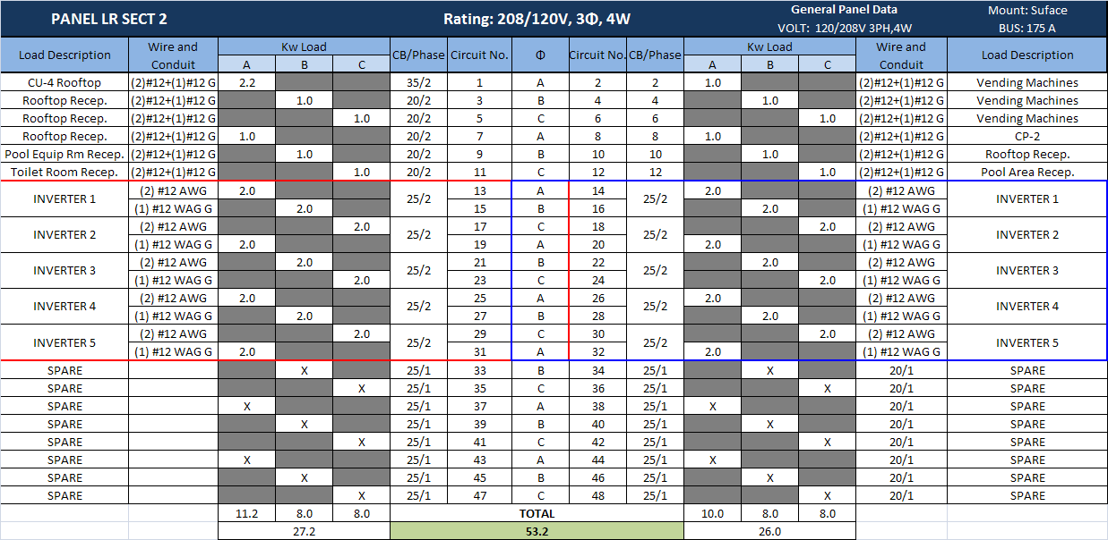
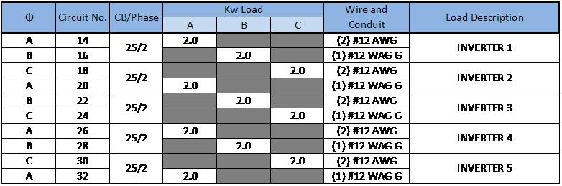
Electrical Breadth
Circuit Breaker Size
25A
Open Panel Board on Roof that can accommodate all Inverters
Building Overview
Schedule & Cost
Overall Goals
Solar PV Implementation
Glazing
Solar Constructability and Future
Recommendations
Questions

Slide 15
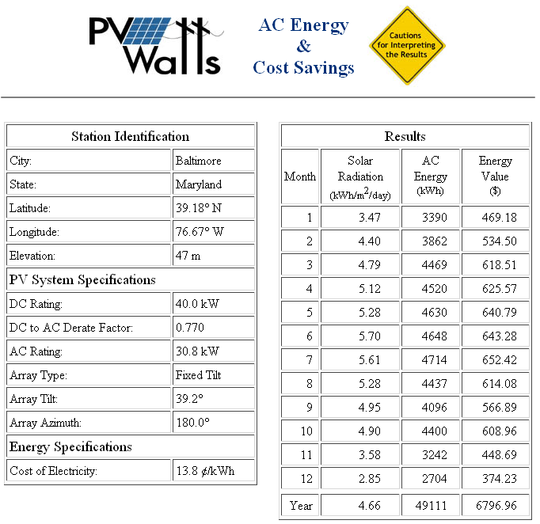
Structural and Schedule Impact
5-Man Crew
Install 10 Panels / Hour = 20 Hours
Tubular Steel Inc
Quoted Support Structure
+$4700.00
Total Panel and Support Load = 3 lb/sf
PV Watts
Building Overview
Schedule & Cost
Overall Goals
Solar PV Implementation
Glazing
Solar Constructability and Future
Recommendations
Questions
40 kW array
Convert to AC Power
49,111 kWh per Year
Power Data (kWh/m2day) Angled Array- Annapolis, MD
 | JAN | FEB | MAR | APR | MAY | JUN | JUL | AUG | SEP | OCT | NOV | DEC
Power | 3.49 | 4.41 | 4.79 | 5.11 | 5.26 | 5.67 | 5.59 | 5.27 | 4.95 | 4.91 | 3.59 | 2.86

Slide 16
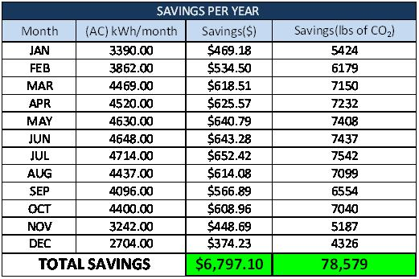
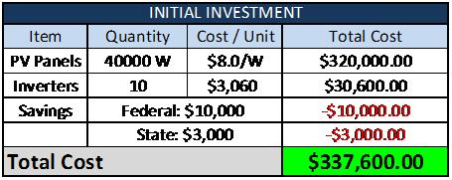
Initial Investment
Building Overview
Schedule & Cost
Overall Goals
Solar PV Implementation
Glazing
Solar Constructability and Future
Recommendations
Questions
Federal Incentive: $10,000
Maryland Incentive: $3,000
Possible: 30% Tax Cut
Carbon Tax

Slide 17
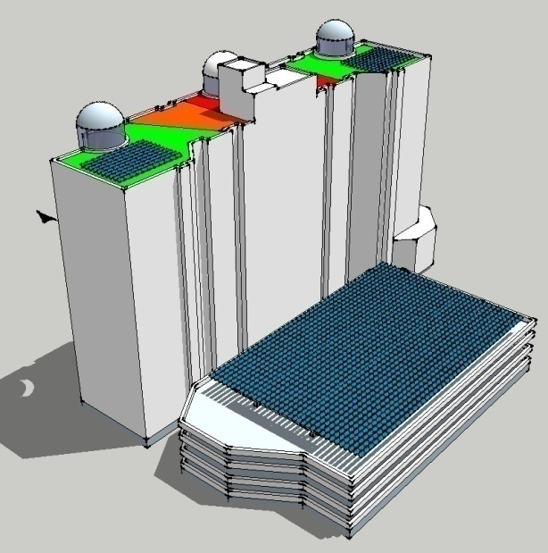
Results
$4.9 Million Initial Investment
630 kW Array
$107,000 Energy Savings
$856.00 / Apartment
Payback Period: 46 Years
Prevents 618 tons of CO2
Shading
No Shadows
Limited Impact on Grandview Schedule
Huge Area
Results
Building Overview
Schedule & Cost
Overall Goals
Solar PV Implementation
Glazing
Solar Constructability and Future
Recommendations
Questions
$337,600 Initial Investment
49,111 kWh annually
$6,797.00 Energy Savings
$49.00 / Apartment
Payback Period: 49 Years
Prevents 39.2 tons of CO2

Slide 18
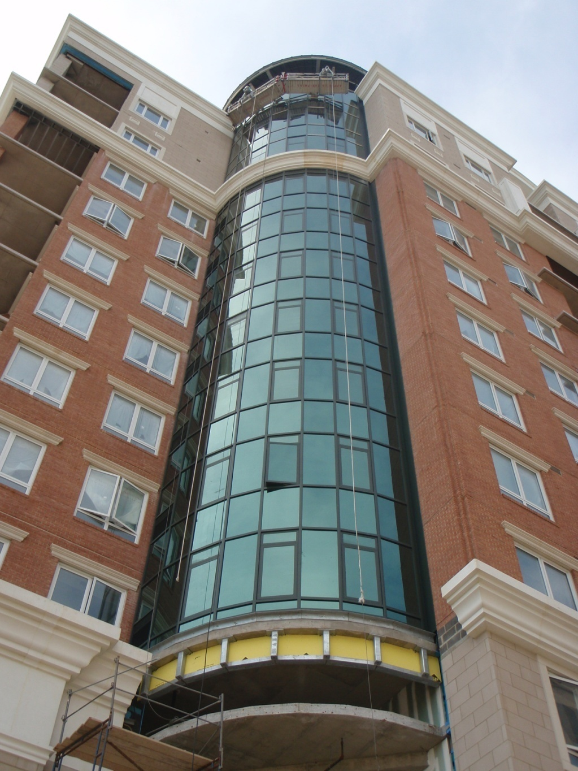
Will the addition have a schedule impact?
Benefits?
Cooling Load Reduction
Payback Period?
Total Cost?
Environmental savings?
Building Overview
Schedule & Cost
Overall Goals
Solar PV Implementation
Glazing
Solar Constructability and Future
Recommendations
Questions
Analysis 2
Thermal Window and Glazing Substitution

Slide 19
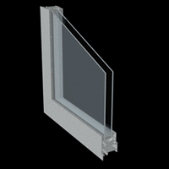
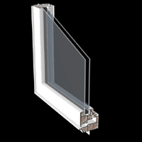
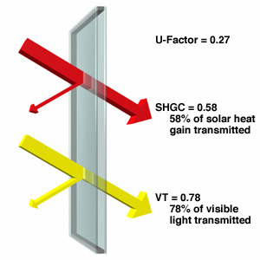
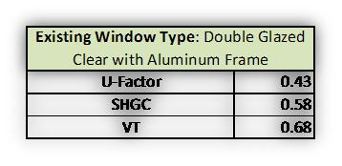
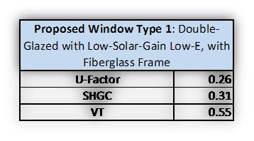
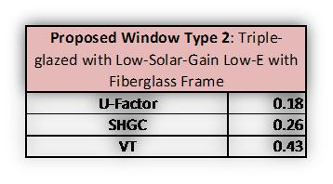
Existing Window Type
Proposed Window Types
Double & Triple Pane
Low Solar Gain Glazing
Fiberglass Frame
Double Glazed
Clear
Aluminum Frame
Design Methodology
Building Overview
Schedule & Cost
Overall Goals
Solar PV Implementation
Glazing
Solar Constructability and Future
Recommendations
Questions
Conduction:
Better Frame
Double & Triple Pane
Solar Gain:
Low Solar Gain Glazing
Low SHGC

Slide 20
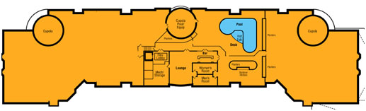
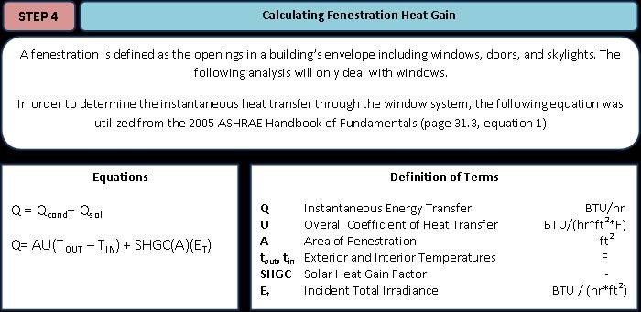
Goals
Building Overview
Schedule & Cost
Overall Goals
Solar PV Implementation
Glazing
Solar Constructability and Future
Recommendations
Questions
Run a Fenestration Heat Analysis
Determine Energy Costs
(Cooling Load Only)
Heating Variables: Humans, Lights, Oven, Computer…

Slide 21
Findings
Building Overview
Schedule & Cost
Overall Goals
Solar PV Implementation
Glazing
Solar Constructability and Future
Recommendations
Questions
Design 1: Saved 56% Cooling Load
Design 2: Saved 70% Cooling Load

Slide 22
Life Cycle and Energy
Annually:
Design 1: Saved $61,783 Electricity
1200 TONS of CO2
Design 2: Saved $76,579 Electricity
1480 TONS of CO2
Building Overview
Schedule & Cost
Overall Goals
Solar PV Implementation
Glazing
Solar Constructability and Future
Recommendations
Questions
FUN FACT:
A 1200 ton CO2 savings is equivalent of a 400 Passenger Boeing 747 making a round trip from DC TO LA. Therefore, over a period of ten years, installing Design 1 would be equivalent of canceling 10 round trip flights of a 747 across the country.

Slide 23
Schedule and Constructability
Only Schedule Impact Lead Time
Constructability:
Double Pane: Same Weight and Design
Triple Pane: Heavier Different Design
**Require Structure Modifications
Building Overview
Schedule & Cost
Overall Goals
Solar PV Implementation
Glazing
Solar Constructability and Future
Recommendations
Questions

Slide 24
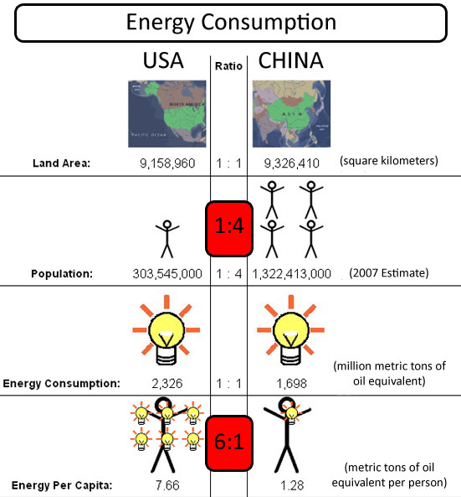
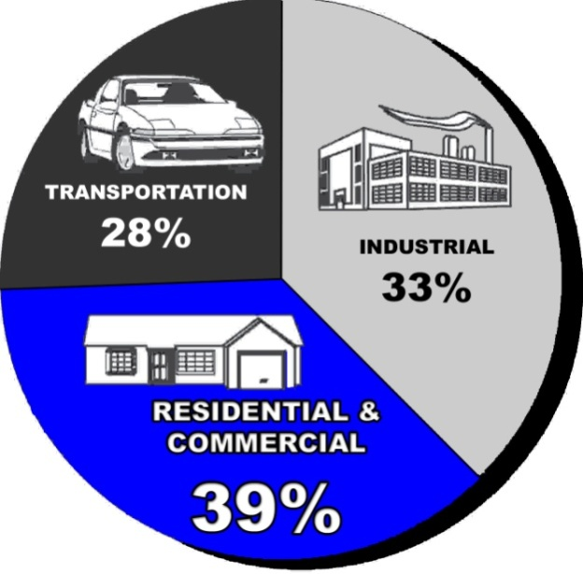
Energy Consumption
Building Overview
Schedule & Cost
Overall Goals
Solar PV Implementation
Glazing
Solar Constructability and Future
Recommendations
Questions
How does America compare?
Residential and Commercial Make Up Bulk of Energy Usage:
Tells us that we need to build smarter!!
China

Slide 25
Would you be inclined to install PV panels on the current project you are working on or your home?
What is the top constructability issue concerning the implementation of a solar array?
Solar Growth and Constructability
Building Overview
Schedule & Cost
Overall Goals
Solar PV Implementation
Glazing
Solar Constructability and Future
Recommendations
Questions
40 Respondents in the Construction Industry, mainly Contractors in the D.C. area, were asked their views on Solar Energy.
A staggering 85% of the 40 respondents polled said that they would not currently install a PV array on their current building or their home. The fact that such a high percentage declined installation alludes to the fact that something is still pushing consumers away from this energy saving technology.
Cost was the number one answer that deterred people from installing a system. This is likely due to a low amount of government incentives available as well as the high cost of the panels and installation. Available area and correct orientation is also a major concern. If a building is not oriented South or if it has limited roof area, it makes solar arrays largely unappealing. The bottom three concerns were aesthetics , connecting the system to the building, and overall installation process.

Slide 26
Would you be inclined to install PV panels on the current project you are working on or your home?
What is the top constructability issue concerning the implementation of a solar array?
What would make you more willing to install a system?
TOP 3:
Lower Initial Cost
Higher Incentives
Better Efficiency
A staggering 85% of the 40 respondents polled said that they would not currently install a PV array on their current building or their home. The fact that such a high percentage declined installation alludes to the fact that something is still pushing consumers away from this energy saving technology.
Cost was the number one answer that deterred people from installing a system. This is likely due to a low amount of government incentives available as well as the high cost of the panels and installation. Available area and correct orientation is also a major concern. If a building is not oriented South or if it has limited roof area, it makes solar arrays largely unappealing. The bottom three concerns were aesthetics , connecting the system to the building, and overall installation process.

Slide 27
SOLAR PANELS AND THE ECONOMY
I recommend that the government provide better funding for renewable energy research as well as provide better federal and state tax cuts and grants for installing energy saving technology.
It is my hope that we one day surpass China.
PV PANELS IMPLEMENTATION
While photovoltaic panels seem to be the way of the future, it is my recommendation that at this point in time GrandView does not add PV’s to the roof.
The low energy gain as compared to each apartment does not seem financially smart when a 49 year payback period exists.
It would be smart to wait 5 years to see what type of new and cheaper PV technology comes out that would allow a much smaller payback period.
Conclusions and Recommendations
THERMAL WINDOW SUBSTITUTION
From an economic, financial, and comfort point of view, I would highly recommend upgrading to a low solar gain glazing on the windows.
However, I would keep the windows double pane as they already are and keep the aluminum frames. These only add to the cost of the units and do not provide substantial enough energy savings in the long run as compared to radiation.

Slide 28
Thank You
I wld b plsd to nswr qustns t ths tm

