Slide 2


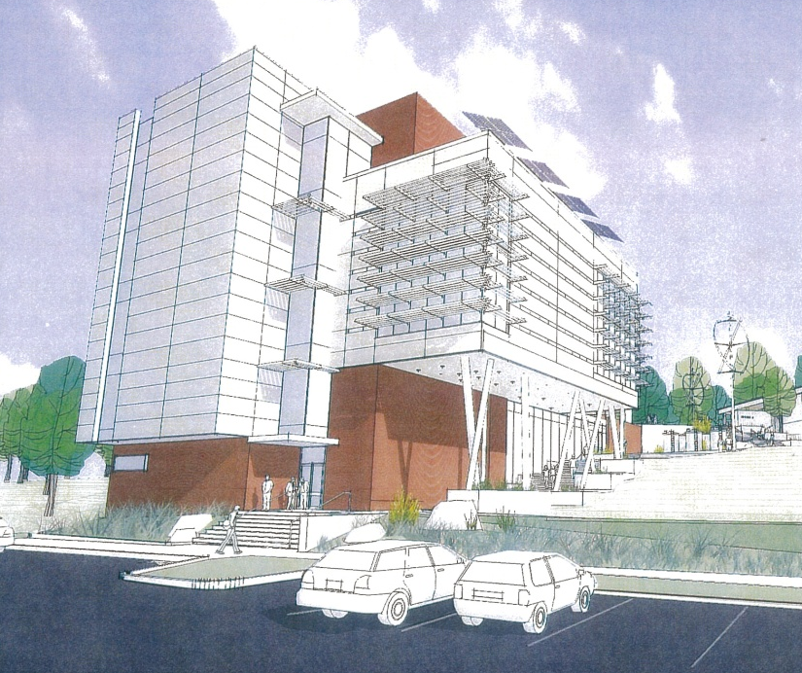
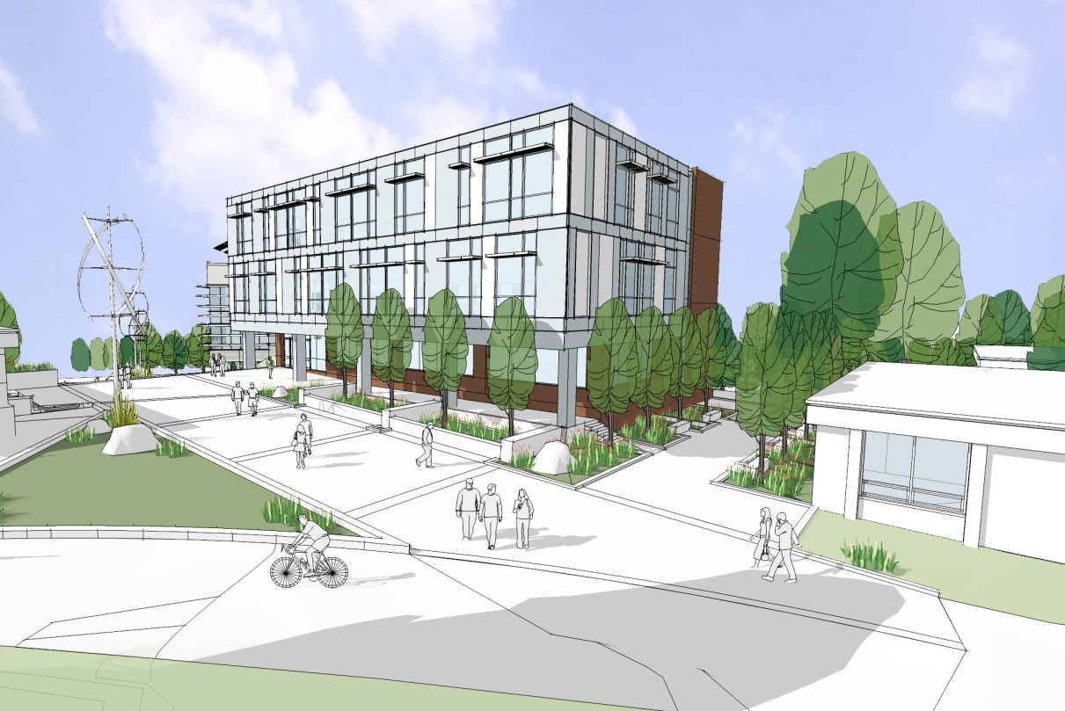
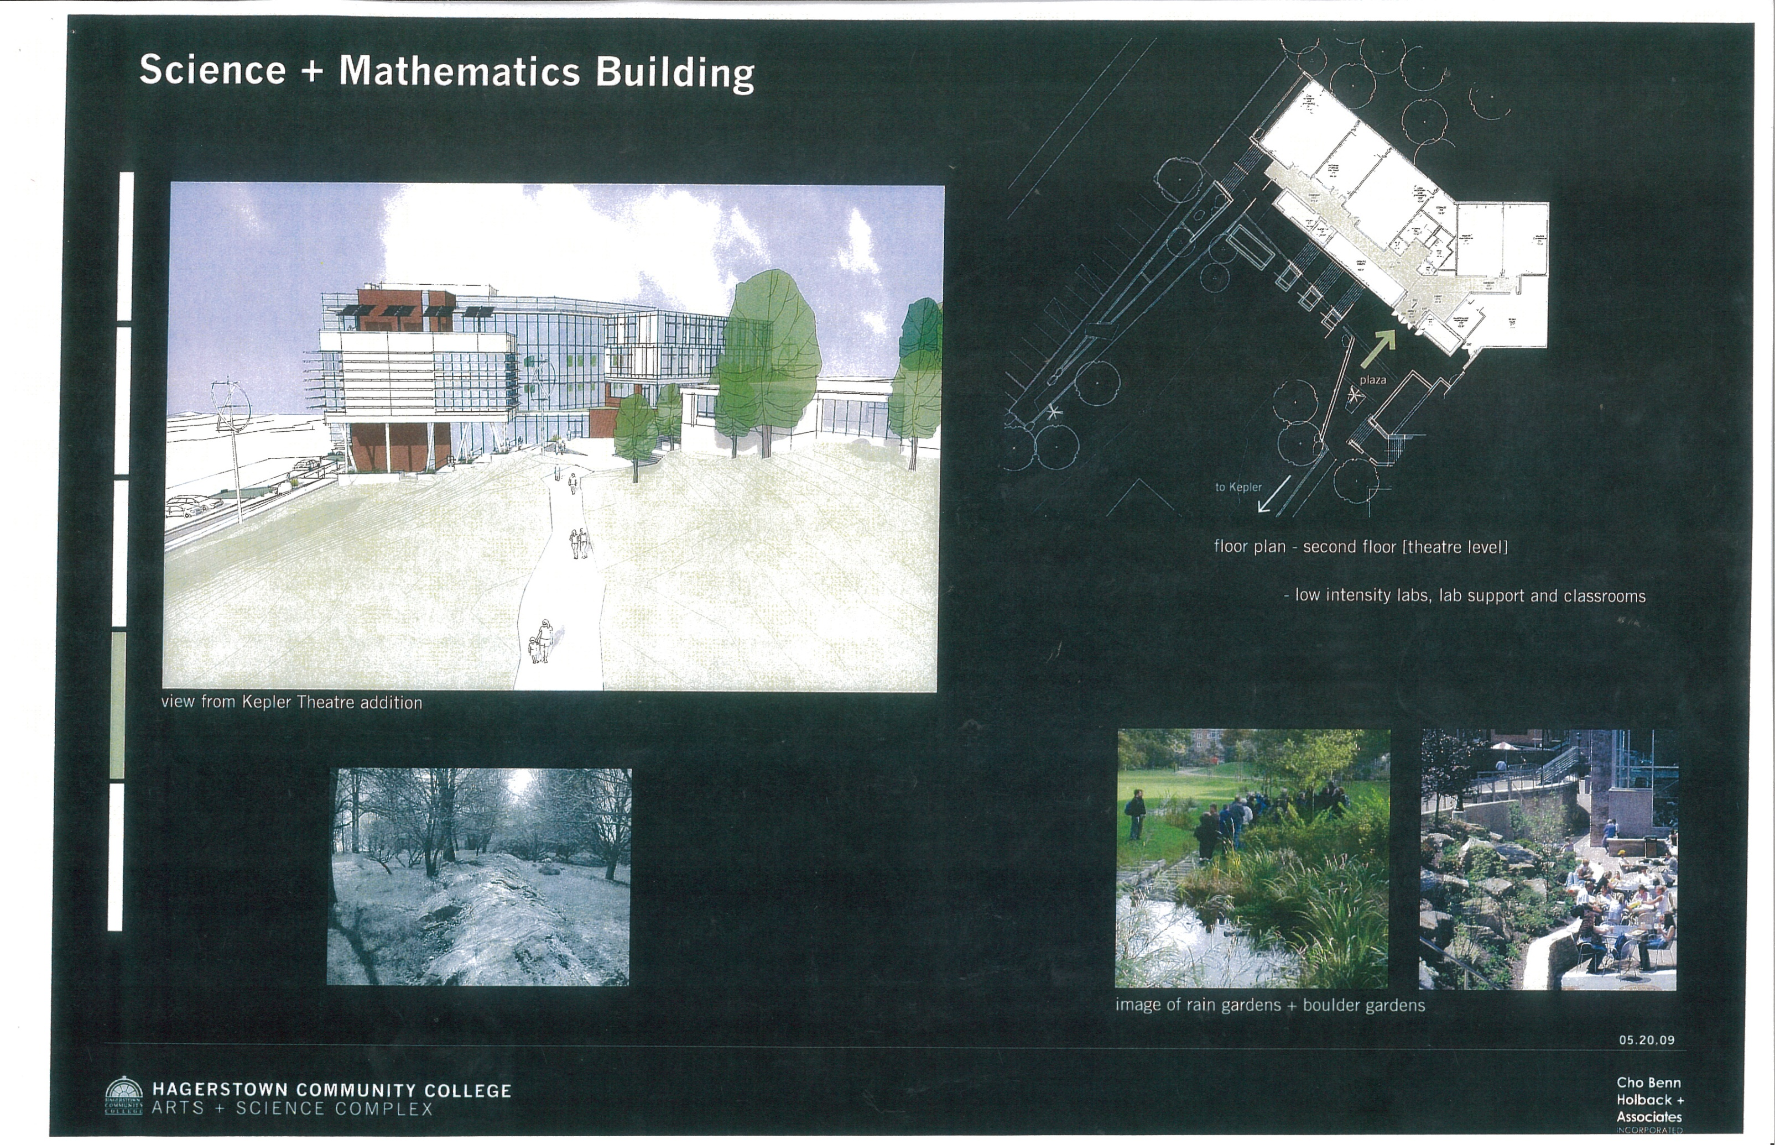
Science Technology Engineering Mathematics Building
STEM Building
Hagerstown Community College
Hagerstown, Maryland 21742
Craig Owsiany
Architectural Engineering – Construction Management
STEM Building
Hagerstown Community College
Hagerstown, Maryland 21742
Outline
Overview
Analysis I: Mat Slab Redesign
Analysis II: Green Roof Redesign
Analysis III: Curtain Wall Redesign
Conclusion/Findings
Acknowledgments
Questions
5 Floors
Size: 62, 840 SF
Cost: $15.6 M
Duration: 18 Months
Southwest View
South View
Southeast View
Notes:
Brick, metals panels and curtain wall envelope

Slide 3
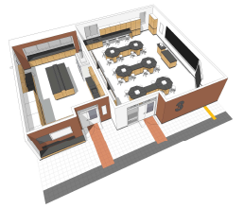
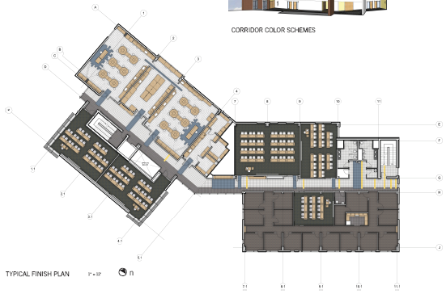
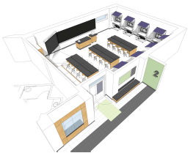
Science Technology Engineering Mathematics Building
STEM Building
Hagerstown Community College
Hagerstown, Maryland 21742
Craig Owsiany
Architectural Engineering – Construction Management
Outline
Overview
Analysis I: Mat Slab Redesign
Analysis II: Green Roof Redesign
Analysis III: Curtain Wall Redesign
Conclusion/Findings
Acknowledgments
Questions
Typical Lab
Typical Floor Plan
Energy Lab
Notes:
Alternate Energy Program, Math, Computer Labs, Physics (High/Low Intensity), Biology, Anatomy, Physiology, Chemistry

Slide 4
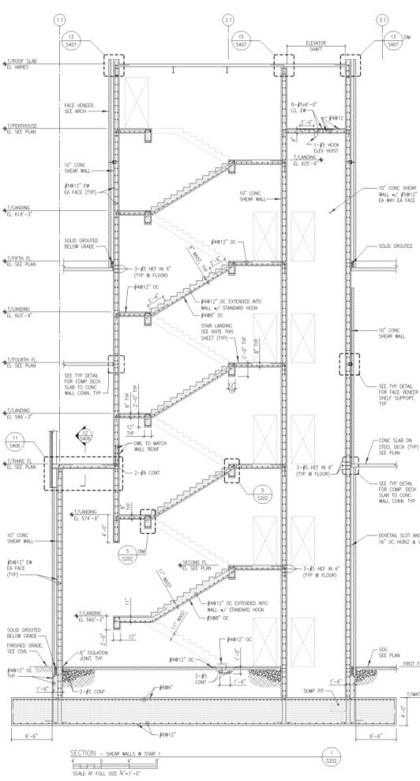
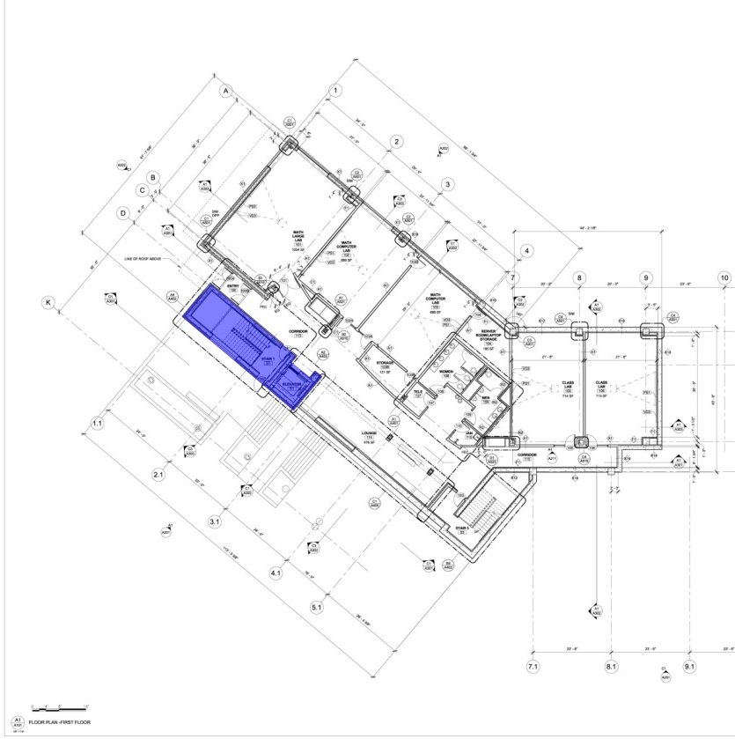
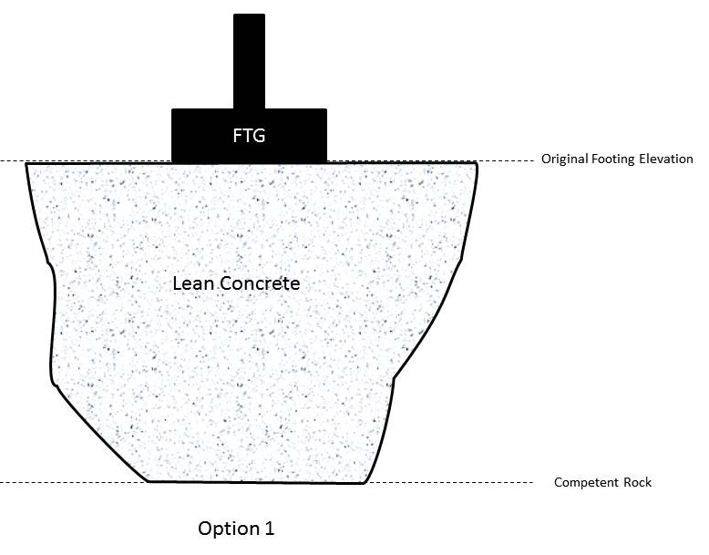
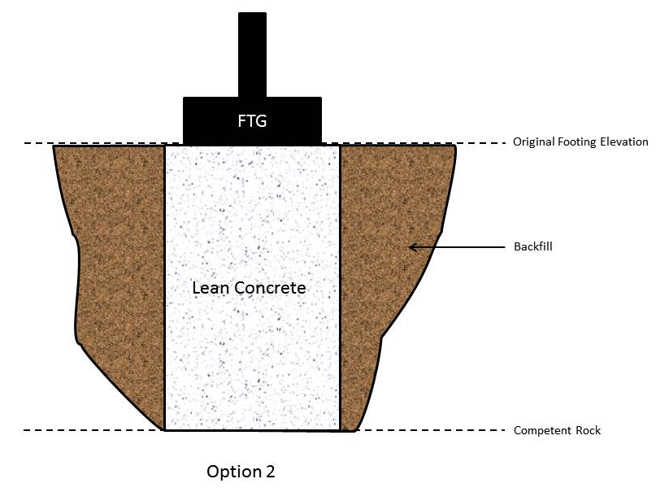
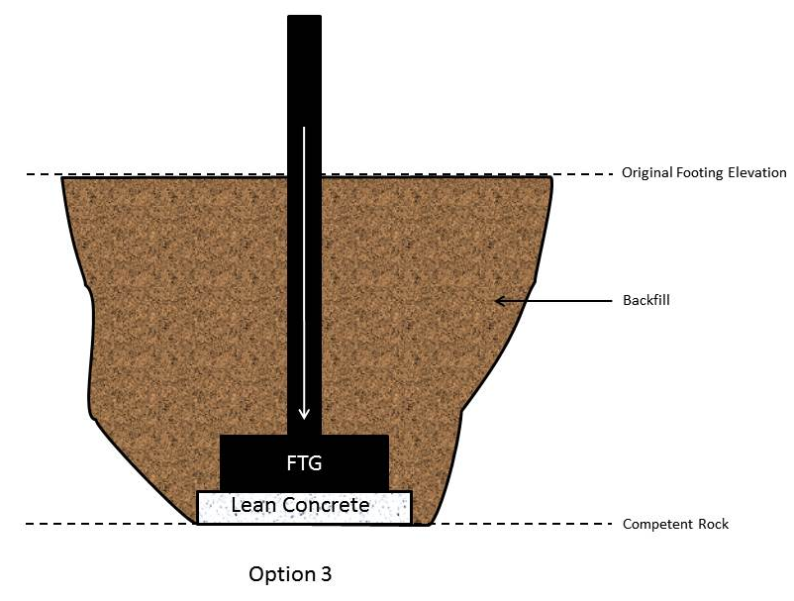
STEM Building
Hagerstown Community College
Hagerstown, Maryland 21742
Craig Owsiany
Architectural Engineering – Construction Management
_{Analysis I: Mat Slab Redesign}
_{Structural Breadth}
Outline
Overview
Analysis I: Mat Slab Redesign
Analysis II: Green Roof Redesign
Analysis III: Curtain Wall Redesign
Conclusion/Findings
Acknowledgments
Questions
Background
Solutions
Goal
Blasting
Non Competent Rock
Reduce Cost Impact
Maintain Schedule
Ensure Structural Integrity
Notes:
Blasting due to limestone, hard to determine depth of competent rock

Slide 5
_{Analysis I: Mat Slab Redesign}
_{Structural Breadth}
STEM Building
Hagerstown Community College
Hagerstown, Maryland 21742
Craig Owsiany
Architectural Engineering – Construction Management
Outline
Overview
Analysis I: Mat Slab Redesign
Analysis II: Green Roof Redesign
Analysis III: Curtain Wall Redesign
Conclusion/Findings
Acknowledgments
Questions
Structural Analysis
Structural Calculations
Findings
Sum Live and Deal Loads
Compare Against Design Load
  10-15% load increase would require further investigation
Mat slab designed for 8000 psf
Actual Load = 38% of Design Load
Design>Actual=No Redesign
Design<Actual=Redesign Required

Slide 6
_{Analysis I: Mat Slab Redesign}
_{Structural Breadth}
STEM Building
Hagerstown Community College
Hagerstown, Maryland 21742
Craig Owsiany
Architectural Engineering – Construction Management
Outline
Overview
Analysis I: Mat Slab Redesign
Analysis II: Green Roof Redesign
Analysis III: Curtain Wall Redesign
Conclusion/Findings
Acknowledgments
Questions
Cost Impact
Savings
Total Savings = $16k

Slide 7
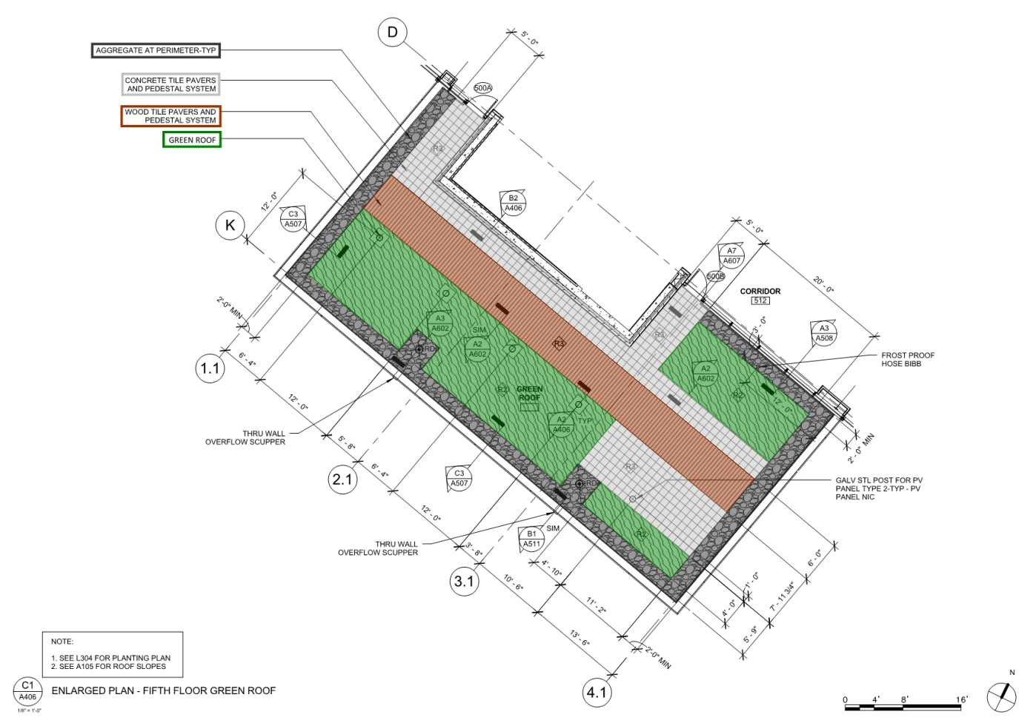
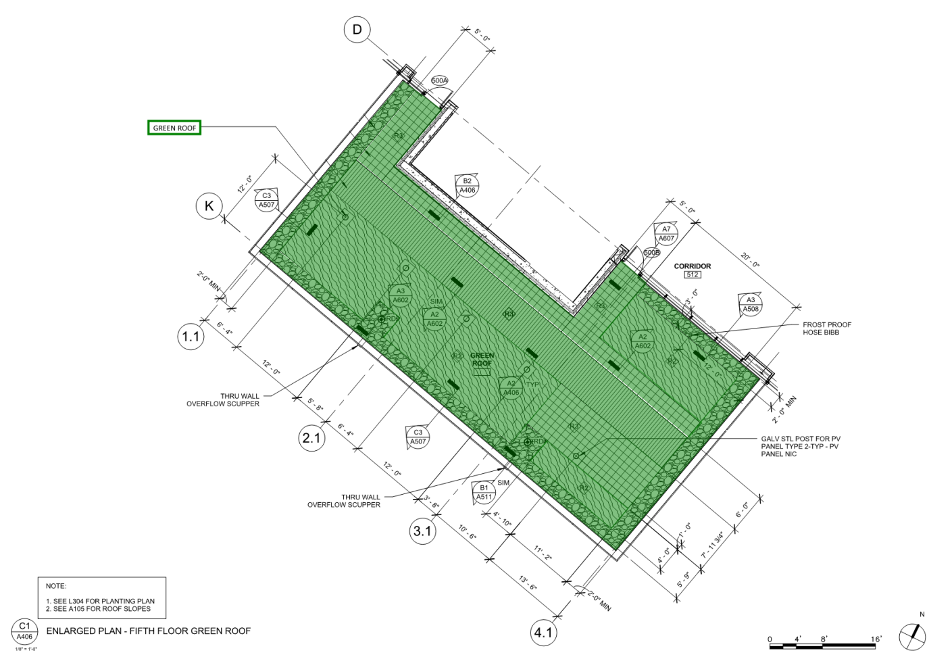
_{Analysis II: Green Roof} _{Redesign}
_{Mechanical Breadth}
STEM Building
Hagerstown Community College
Hagerstown, Maryland 21742
Craig Owsiany
Architectural Engineering – Construction Management
Outline
Overview
Analysis I: Mat Slab Redesign
Analysis II: Green Roof Redesign
Analysis III: Curtain Wall Redesign
Conclusion/Findings
Acknowledgments
Questions
Background
Background
Redesign
Conventional Green Roof
3” Low Profile
Architectural Facets
Negligible Thermal Value
Minimal Educational Value
LiveRoof System
6” High Profile
Added Thermal Value
Higher Educational Value

Slide 8
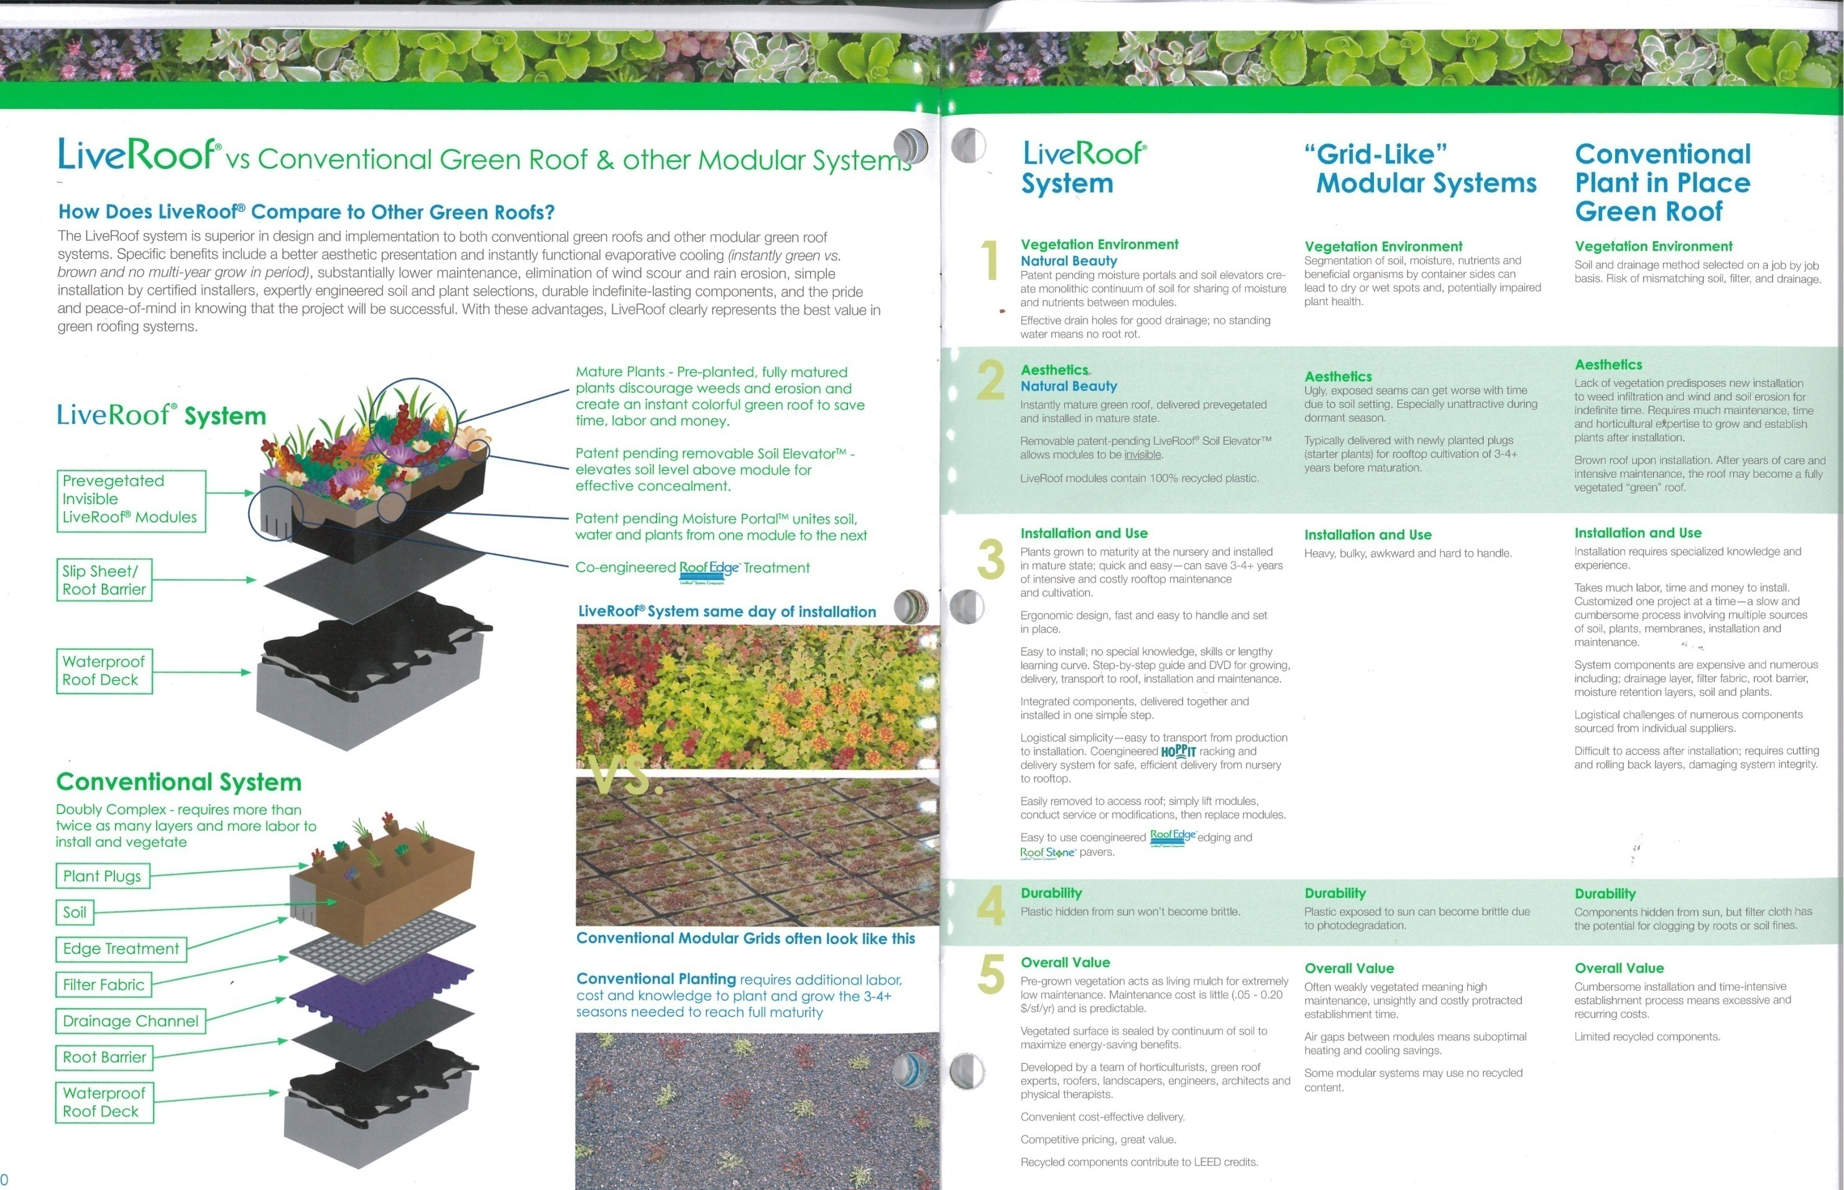
_{Analysis II: Green Roof} _{Redesign}
_{Mechanical Breadth}
STEM Building
Hagerstown Community College
Hagerstown, Maryland 21742
Craig Owsiany
Architectural Engineering – Construction Management
Outline
Overview
Analysis I: Mat Slab Redesign
Analysis II: Green Roof Redesign
Analysis III: Curtain Wall Redesign
Conclusion/Findings
Acknowledgments
Questions
Conventional Green Roof
LiveRoof System
Benefits
Faster Installation
Low Maintenance
Immediate Vegetation

Slide 9
_{Analysis II: Green Roof} _{Redesign}
_{Mechanical Breadth}
STEM Building
Hagerstown Community College
Hagerstown, Maryland 21742
Craig Owsiany
Architectural Engineering – Construction Management
Outline
Overview
Analysis I: Mat Slab Redesign
Analysis II: Green Roof Redesign
Analysis III: Curtain Wall Redesign
Conclusion/Findings
Acknowledgments
Questions
Cost Impact
Payback Period
Payback period is 28.8 years for maintenance cost alone.

Slide 10
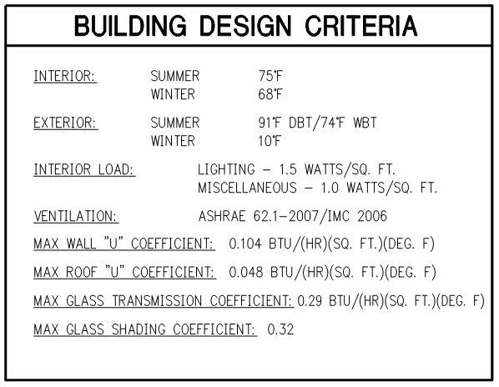


_{Analysis II: Green Roof} _{Redesign}
_{Mechanical Breadth}
STEM Building
Hagerstown Community College
Hagerstown, Maryland 21742
Craig Owsiany
Architectural Engineering – Construction Management
Outline
Overview
Analysis I: Mat Slab Redesign
Analysis II: Green Roof Redesign
Analysis III: Curtain Wall Redesign
Conclusion/Findings
Acknowledgments
Questions
Thermal Calculations
Thermal Calculations

Slide 11
_{Analysis II: Green Roof} _{Redesign}
_{Mechanical Breadth}
STEM Building
Hagerstown Community College
Hagerstown, Maryland 21742
Craig Owsiany
Architectural Engineering – Construction Management
Outline
Overview
Analysis I: Mat Slab Redesign
Analysis II: Green Roof Redesign
Analysis III: Curtain Wall Redesign
Conclusion/Findings
Acknowledgments
Questions
Conventional Green Roof Heat Loss
Current Green Roof Heat Loss
Proposed Green Roof Heat Loss
100% LiveRoof System
High Profile
8.2% reduction from conventional roof
5.0% reduction from current green roof
Low Profile Green Roof
Concrete Pavers
Wood Pavers
Stone Aggregate

Slide 12
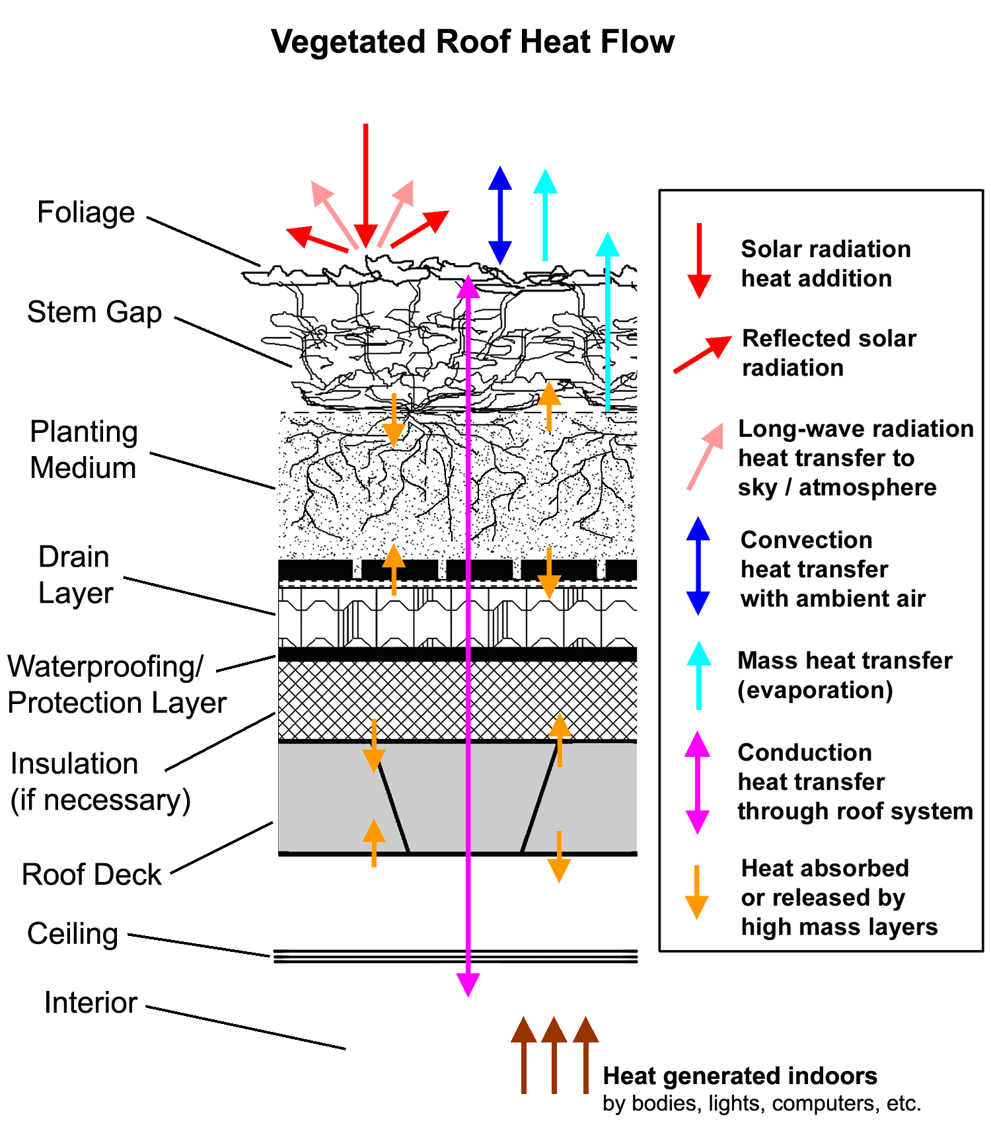
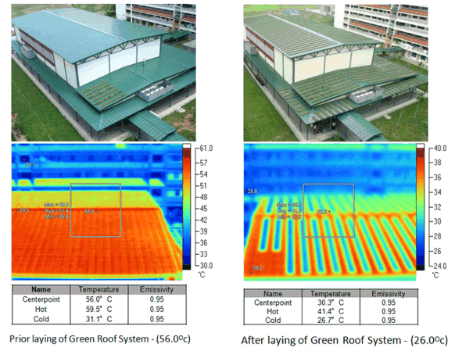
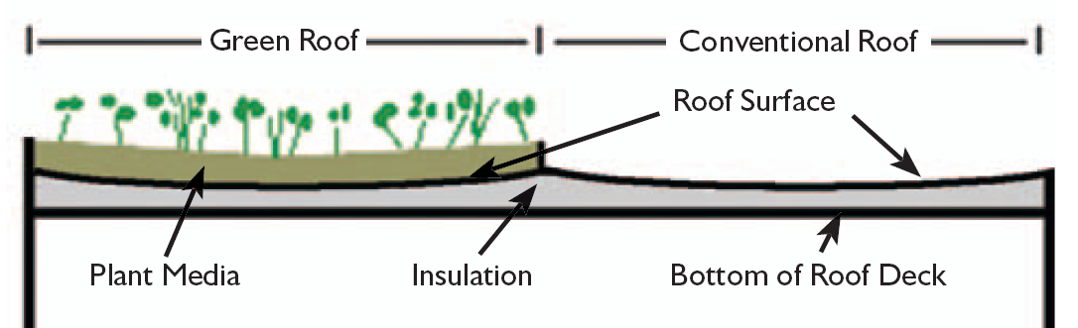
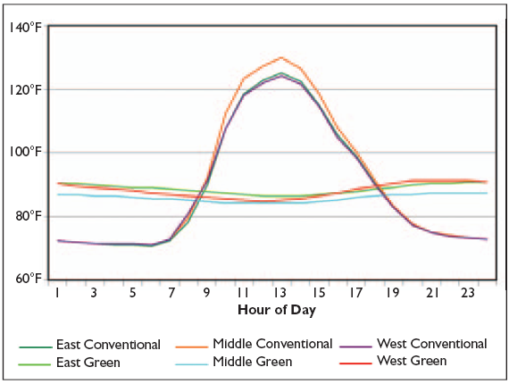
_{Analysis II: Green Roof} _{Redesign}
_{Mechanical Breadth}
STEM Building
Hagerstown Community College
Hagerstown, Maryland 21742
Craig Owsiany
Architectural Engineering – Construction Management
Outline
Overview
Analysis I: Mat Slab Redesign
Analysis II: Green Roof Redesign
Analysis III: Curtain Wall Redesign
Conclusion/Findings
Acknowledgments
Questions
Justification
Educational Factor
Educational Factor
Alternate Energy Program
Mechanical Engineering
Thermal Cameras
Heat Sensors

Slide 13
_{Analysis III: Curtain Wall} _{Redesign}
STEM Building
Hagerstown Community College
Hagerstown, Maryland 21742
Craig Owsiany
Architectural Engineering – Construction Management
Outline
Overview
Analysis I: Mat Slab Redesign
Analysis II: Green Roof Redesign
Analysis III: Curtain Wall Redesign
Conclusion/Findings
Acknowledgments
Questions
Background
Redesign
Goal
Unitized Curtain Wall System
Short Installation Time
Shakeout Not Required
Higher Quality Seals
Long Lead Time
Stick Built Curtain Wall
Approximately 1/3 of Building Envelope
9260 SF
Lengthy Installation Time
Site Congestion
Short Lead Time
Reduce curtain wall installation time
Achieve earlier water tight date
Reduce over all schedule

Slide 14
_{Analysis III: Curtain Wall} _{Redesign}
STEM Building
Hagerstown Community College
Hagerstown, Maryland 21742
Craig Owsiany
Architectural Engineering – Construction Management
Outline
Overview
Analysis I: Mat Slab Redesign
Analysis II: Green Roof Redesign
Analysis III: Curtain Wall Redesign
Conclusion/Findings
Acknowledgments
Questions
Schedule
Schedule Acceleration
Original Duration: 40 Days
New Duration: 20 Days
Stick Built System
Deliver Materials Shakeout Install Sills and Jambs Install Mullions Glaze Caulk
Unitized System
Deliver Modules Set Module Caulk

Slide 15
_{Analysis III: Curtain Wall} _{Redesign}
STEM Building
Hagerstown Community College
Hagerstown, Maryland 21742
Craig Owsiany
Architectural Engineering – Construction Management
Outline
Overview
Analysis I: Mat Slab Redesign
Analysis II: Green Roof Redesign
Analysis III: Curtain Wall Redesign
Conclusion/Findings
Acknowledgments
Questions
Lead Time
Installation Time
Stick Built: 8 Weeks
Unitized: 12 Weeks
Stick Built: 8 Weeks
Unitized: 4 Weeks
Week | Stick Built System | Unitized System
1-6 | Obtain materials | Obtain materials
7 | Fabricate/Deliver | Fabricate/Deliver
8 | Fabricate/Deliver | Fabricate/Deliver
9-12 |  | Fabricate/Deliver
Week | Stick Built System | Unitized System
1 | Deliver/Frame | Deliver/Install/Caulk
2 | Deliver/Frame/Dimension | Deliver/Install/Caulk
3 | Deliver/Frame/Dimension | Deliver/Install/Caulk
4 | Deliver/Frame/Dimension/Glaze/Caulk | Deliver/Install/Caulk
5 | Deliver/Frame/Dimension/Glaze/Caulk
6 | Deliver/Frame/Dimension/Glaze/Caulk
7 | Glaze/Caulk
8 | Glaze/Caulk

Slide 16
_{Analysis III: Curtain Wall} _{Redesign}
STEM Building
Hagerstown Community College
Hagerstown, Maryland 21742
Craig Owsiany
Architectural Engineering – Construction Management
Outline
Overview
Analysis I: Mat Slab Redesign
Analysis II: Green Roof Redesign
Analysis III: Curtain Wall Redesign
Conclusion/Findings
Acknowledgments
Questions
Sequencing – Areas of Concern
Resequencing
Reduced Curtain Wall Installation
Earlier Water Tight Date
Finishes
MEP Rough Ins
Begin MEP rough ins 1 week early.
Stack MEP rough ins and finishes on 3rd, 4th and 5th floors.
Sync water tight date and completion of rough ins.

Slide 17
_{Analysis III: Curtain Wall} _{Redesign}
STEM Building
Hagerstown Community College
Hagerstown, Maryland 21742
Craig Owsiany
Architectural Engineering – Construction Management
Outline
Overview
Analysis I: Mat Slab Redesign
Analysis II: Green Roof Redesign
Analysis III: Curtain Wall Redesign
Conclusion/Findings
Acknowledgments
Questions
Accelerated Schedule
Overall schedule reduced by 44 days

Slide 18
_{Analysis III: Curtain Wall} _{Redesign}
STEM Building
Hagerstown Community College
Hagerstown, Maryland 21742
Craig Owsiany
Architectural Engineering – Construction Management
Outline
Overview
Analysis I: Mat Slab Redesign
Analysis II: Green Roof Redesign
Analysis III: Curtain Wall Redesign
Conclusion/Lessons Learned
Acknowledgments
Questions
Analysis I
Analysis II
Analysis III
Mat Slab Redesign
Current mat slab will support additional load
Redesign not required
Further attention given at a 10-15% load increase
Green Roof Redesign
Cannot place an R-Value on living organisms
Using an R-Value alone will not produce accurate heat transfer results
Offers great value as an education tool
Curtain Wall Redesign
44 days saved
Higher quality product
Resequencing, not accelerating the schedule
“We are sequencing trades in a manner to optimize productivity for all trades involved.”

Slide 19




_{Analysis III: Curtain Wall} _{Redesign}
STEM Building
Hagerstown Community College
Hagerstown, Maryland 21742
Craig Owsiany
Architectural Engineering – Construction Management
Outline
Overview
Analysis I: Mat Slab Redesign
Analysis II: Green Roof Redesign
Analysis III: Curtain Wall Redesign
Conclusion/Findings
Acknowledgments
Questions
Acknowledgements
Acknowledgements
Acknowledgements
General Contractor
Greg Ramirez, Senior Project Manager
Eric Osborne, Senior Superintendent
Brett Robinson, Field Engineer
Owner
Dawn Baker, Facilities Project Coordinator
Robert Spong, Facilities Management and Planning Director
Gerard Rath, Owner Rep.
Architect
Mark Merolla, Architect
Structural Engineer
Chris Johnson, Structural Engineer
Penn State AE Faculty
Bob Holland
Rob Leicht

Slide 20
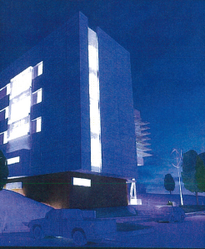
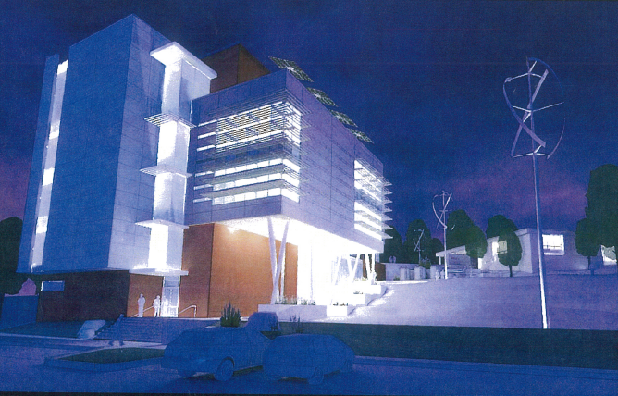
_{Analysis III: Curtain Wall} _{Redesign}
STEM Building
Hagerstown Community College
Hagerstown, Maryland 21742
Craig Owsiany
Architectural Engineering – Construction Management
Outline
Overview
Analysis I: Mat Slab Redesign
Analysis II: Green Roof Redesign
Analysis III: Curtain Wall Redesign
Conclusion/Findings
Acknowledgments
Questions
Questions
Questions?

