Slide 1
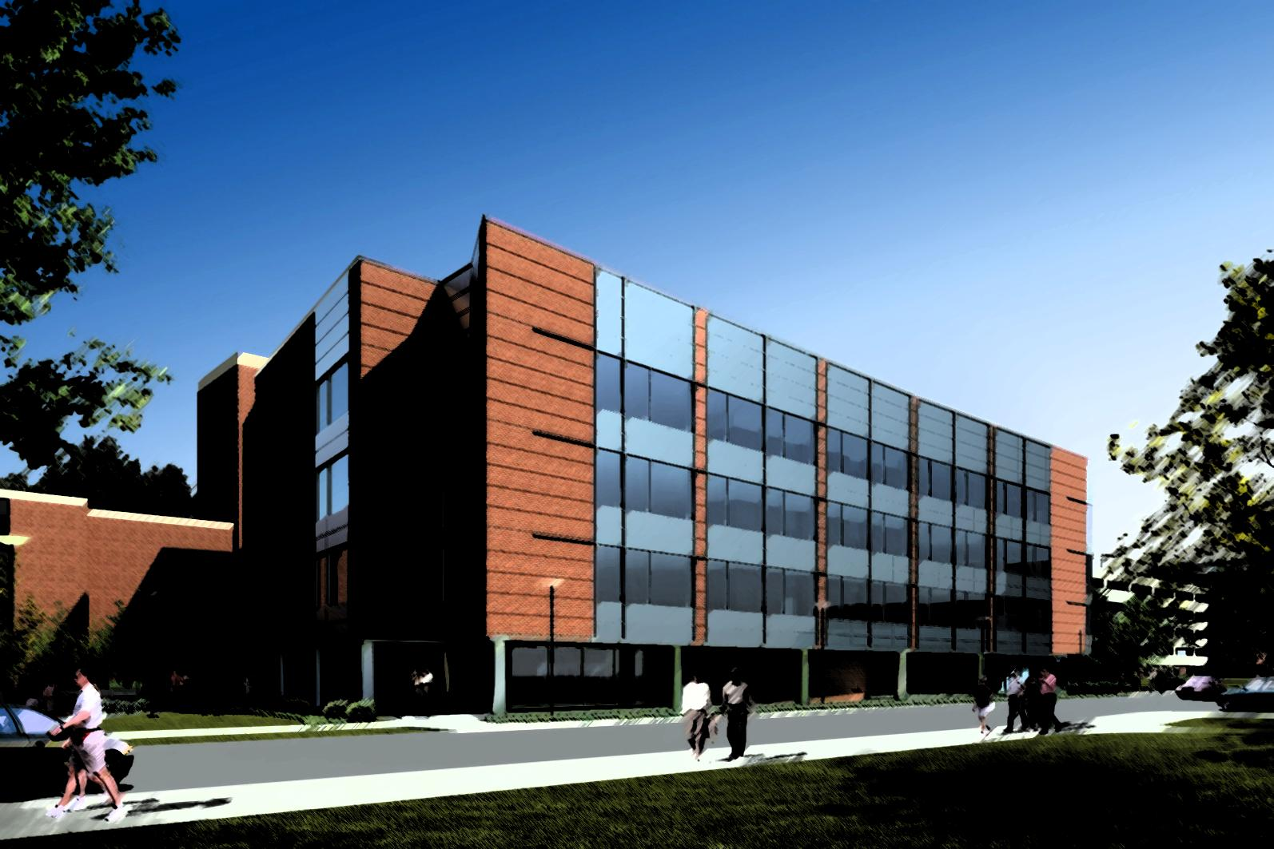
The Moore Building Addition
University Park, PA 16802
Mohammad Alhusaini
Construction Management
Photo Courtesy of OPP
Notes:
Good morning, my name is Mohammad Alhusaini and I will be presenting my thesis, which relates to the Moore Building addition here on campus.

Slide 2
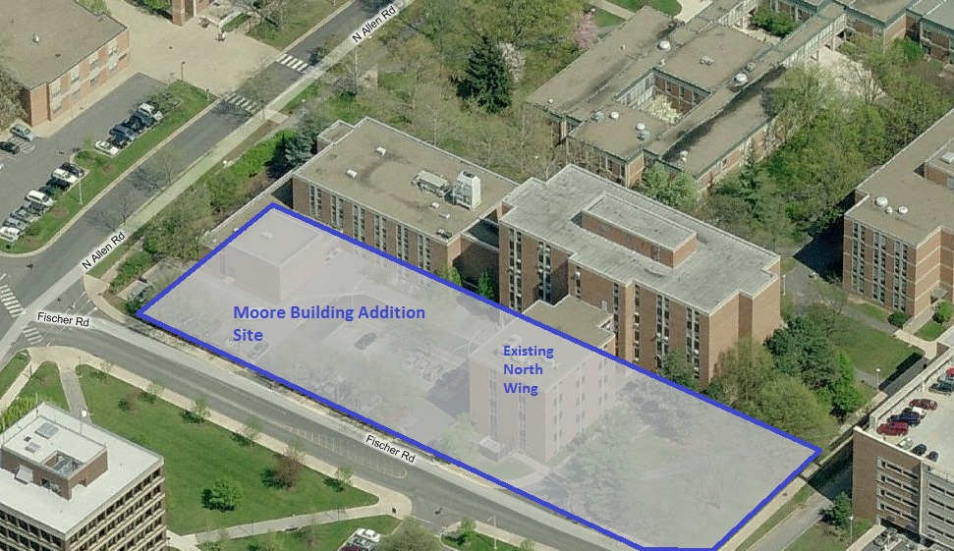
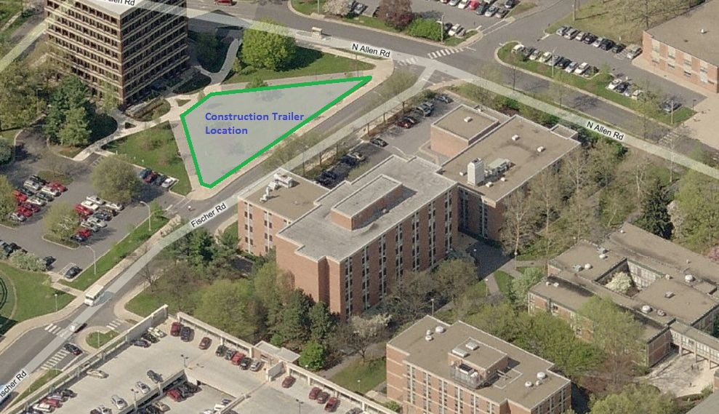
Presentation Outline
Introduction
Project Background
The Theme
Presentation Overview
Analysis I
Analysis II
Mechanical Breadth
Analysis III
Analysis IV
Conclusions
Acknowledgements & Thanks
Project Background
Building Site & Bracing
Building Systems
Steel structure
Laterally braced frames
Basement houses mechanical equipment
Brick veneer façade + aluminum panels & glazing
Ground level glass curtain wall
Underpinning required for existing structure
Building Summary
Department
Budget
Size
Time
Project Delivery Method
Classification
Department of Psychology at PSU
~$26.1 Million State Funds Included
57,000 SF addition + 16,000 SF North Wing
June 2010 to January 2012
Design Bid Build
B (Business)
Photo: Bing Maps
Photo: Bing Maps
Notes:
Center
The building is going to be constructed for use by the department of psychology.
It has a budget of about $26.1 Million and consists of two pieces in this phase of construction (phase 1: addition).
The addition phase will include the stripping of the North wing to its bare structure, and building the addition around it.
The North wing is 16,000 sf and the addition is 57,000 SF, meaning that the addition phase will add 57,000 Gross SF.
In total, there is 73,000 SF worth of construction, and the dep=livery method of choice is design bid build.
Right
*Explain building Site and trailer locations
Left
The building’s structure consists of structural steel, and incorporates laterally braced frames on the outermost part of the structure.
The mechanical equipment will all be housed in the basement level of the building.
The façade consists of brick veneer on cold formed metal framing backing, accompanied by metal panels and lots of glazing to allow for better views for the occupants and to show the new face of the department of psychology.
Ground level has glass curtain wall
Underpinning the old structure is required on this job due to the addition and the future renovation of the 90,000 SF existing building.

Slide 3
Presentation Outline
Introduction
Project Background
The Theme
Presentation Overview
Analysis I
Analysis II
Mechanical Breadth
Analysis III
Analysis IV
Conclusions
Acknowledgements & Thanks
The Theme
Goal: Explore methods that will [theoretically] allow the dept. of psychology to be able to occupy the Moore Building Addition at a date sooner than anticipated.
Department of Psychology
Research intensive – 45% of liberal arts research funds
Focus on new and innovative research and techniques
Currently located in existing Moore Building
“Displaced” researchers
Top Priorities (construction)
Expand & enhance labs
Lab technologies
Soundproofing
Notes:
Center
The department of psychology is research intensive with it claiming over 45% of all funding for research in the college of liberal arts. Their focus is to excel in research and innovation involved with psychology, be it cognitive processes, children’s development, social processes and other relative topics.
The department of psychology is currently located in Moore Building, named after Bruce V. Moore, a distinguished past member of the psychology department.
Currently, there are some “displaced” professors, with one specific example of a researcher who is currently in a basement in Kern building; Obviously, there is a space issue here!
Right
This brings me to the goal of my thesis; to explore methods or possibilities, through architectural engineering practices learned in the AE program, that will allow the dept. of psychology to occupy the addition sooner, and begin the renovation of the existing building sooner, all in order to begin being productive earlier.
The top priorities for this project, based on its program, are to expand and enhance the labs, add new technologies to the labs, and sound attenuation.
Left

Slide 4
Presentation Outline
Introduction
Project Background
The Theme
Presentation Overview
Analysis I
Analysis II
Mechanical Breadth
Analysis III
Analysis IV
Conclusions
Acknowledgements & Thanks
Presentation Overview
Analysis I: Demolition
Analysis II: Façade
Mechanical Breadth presented
Structural Breadth not presented
Analysis III: Structural Steel
Analysis IV: BIM through AE
Notes:
My thesis consisted of four analyses and two breadths.
Analysis 1 explores the differences in selective demolition versus a full demolition and/or a deconstruction effort
Analysis 2 looks at changing the brick portion of the façade of the building from stick-built to precast, with a mechanical breadth exploring the thermal differences of the two systems, along with a structural breadth determining the implications of said change, which will not be presented.
Analysis 3 researches the benefits and drawbacks of incorporating a design-assist contract for the structural steel portion of the project.
These three analyses all aim to improve the schedule of the project, and do so as objectively as possible. Cost is also considered in all three analyses.
Analysis 4, the critical industry issue, researches the possibility of incorporating the AE department with OPP to produce useful BIM models.

Slide 5
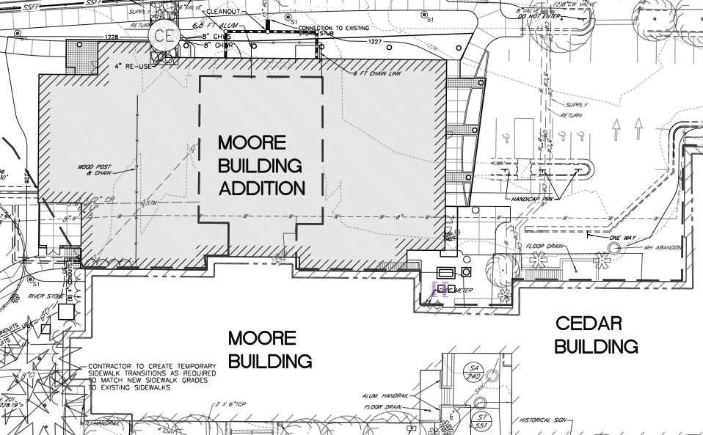
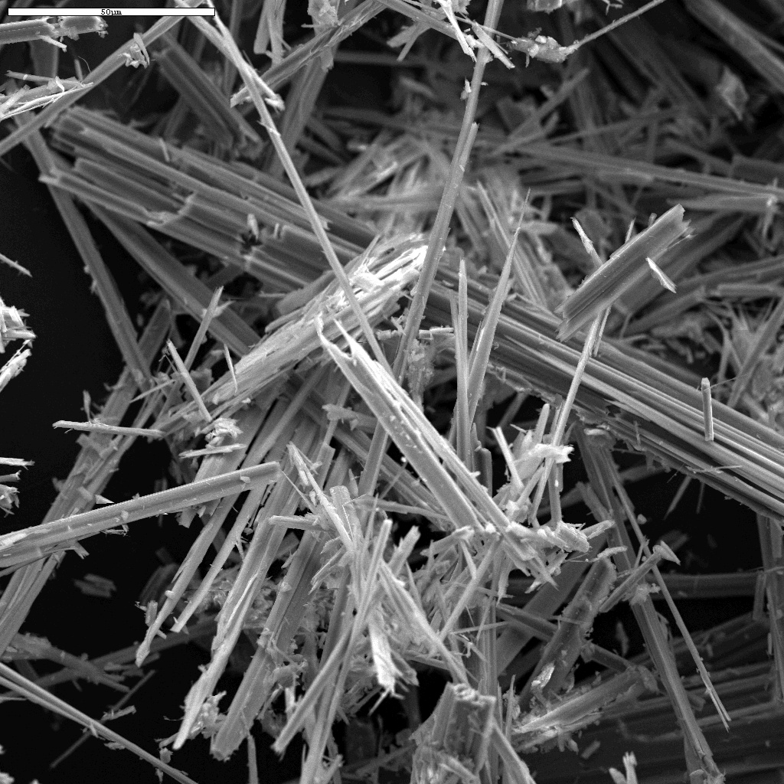
Presentation Outline
Introduction
Project Background
The Theme
Presentation Overview
Analysis I
Analysis II
Mechanical Breadth
Analysis III
Analysis IV
Conclusions
Acknowledgements & Thanks
Analysis I: Demolition
Asbestos
Cost of removing asbestos from North Wing: ~$350K
North Wing
16,000SF
Selective Deconstruction
Structurally independent of addition
Contains asbestos
Selective Demolition
Will occur on North Wing
Cannot begin before Asbestos Abatement
Cost of selective demolition on North Wing: ~$280K
Calendar days required for Asbestos Abatement and Selective Demolition: 103 Days
Notes:
Center
The north wing of the Moore building addition will be stripped down to its bare structure and essentially recycled for use with the rest of the building. It will undergo selective demolition, which will leave it at its structural steel frame. The original plan is to rebuild the addition around this structure, as its space is used as part of the design of the new structure.
The analysis proposes that the north wing be completely torn down, and have the entire building be built as though the north wing never existed. The idea is that this would save time and money.
Left
However, the North Wing contains asbestos, and it is important to understand the implications of this. The most important question is this: “does the asbestos need to be removed in the case that there will be a full demolition?”
Most importantly, one must understand what asbestos is, and how it affects this case.
Asbestos is the name given to the fibrous forms of 6 naturally occurring minerals that are known for their excellent flame retardant, insulation and heat resistant properties, all whilst being stronger than steel. However, they come in forms, depending on their use and installation, called either friable or non-friable.
Friable means that their slightest aggravation allows fibers to dislocate and become airborne, posing great health risks. So, an act such as demolition would greatly aggravate these materials, and send toxic materials into the air, which is not good.
The only way to know what type is in the building is to actually see the asbestos, which requires the same preparation as though it were to be removed. So, any way you put it, it has to be removed if one is to demolish the building.
On the moore building addition, this will cost $350,000.
Right
The selective demolition portion of this process cannot begin, as outlined, until asbestos has been removed.
This will cost $280,000.
Center AGAIN
This process will take 103 calendar days to complete.

Slide 6
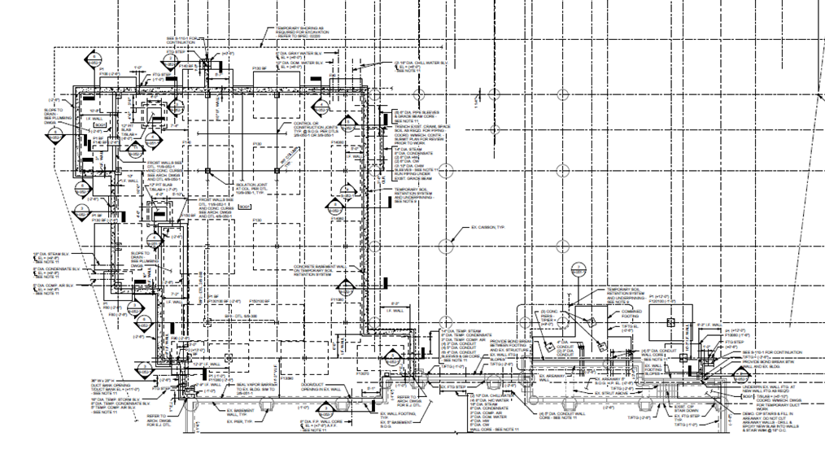
Presentation Outline
Introduction
Project Background
The Theme
Presentation Overview
Analysis I
Analysis II
Mechanical Breadth
Analysis III
Analysis IV
Conclusions
Acknowledgements & Thanks
Analysis I: Demolition
Superstructure Reconstruction
16,000SF
This needs to occur after demolition
Considered as part of entire structure
Cost/SF of steel w/o HSS Bracing
26 workdays to erect superstructure (schedule-derived)
10 workdays to erect superstructure (comparative)
$426K cost of reconstruction
Demolition/Deconstruction
16,000SF
Proposed schedule accelerator
Must occur after asbestos abatement
Deconstruction; less debris, low cost
9 workdays to deconstruct
$81K to deconstruct
Added Benefits
Possible increase in basement size by 5,400SF &
Underpinning will be eliminated for North Wing
Cost would be $24K less than underpinning alone
Notes:
Left
Deconstruction would be performed on the 16,000SF north wing as this method creates less debris than explosives or a wrecking ball, and is more organized, requiring less preparation time. The cost/sf was obtained by a study and can be found in the references under Frisman.
This would be performed after the asbestos is removed and would cost $81K to perform on the North Wing and would take, according to experts’ past experience on several similar projects, 9 workdays. This includes mobilization and removal of waste.
Center
Reconstruction will be assumed to be done as part of the entire structure, as the cost for building two independent structures would be higher.
Based on the estimates created in tech report 2, the cost for constructing an extra 16,000 SF to the new addition would be $426,000.
This is done assuming no HSS steel members are included, as the structure on the outer portion of the building is the only place where these are located.
Based on the current schedule, it would take 26 days to reconstruct the north wing. However, since that is inaccurate, due to it not being constructed as a lone-structure, the expert comparative analysis was used for this result, making the actual time to reconstruct 10 days.
Right
Based on further expert opinion, it was advised to look at underpinning and the possibility of increasing the basement area. This would be possible at a cost $24K less than it would have cost to underpin the structure anyway. So, for a lower cost, they increase the SF of the building by 5,400SF.
*explain by showing the diagram

Slide 7
Presentation Outline
Introduction
Project Background
The Theme
Presentation Overview
Analysis I
Analysis II
Mechanical Breadth
Analysis III
Analysis IV
Conclusions
Acknowledgements & Thanks
Analysis I: Demolition
Risks
If >17,000SF asbestos; losses
Demolition pollution dangerous; 9x increase
Final Comparison (no asbestos)
Demolition/Deconstruction
Cost: $390K
Duration: 19 workdays
Final Comparison (no asbestos)
Selective Demolition
Cost: $237K
Duration: 29 workdays
General Conditions
Savings: $34.4K
Based on $17K/wk
Notes:
Left
If there is more than 17,000Sf of asbestos that must be removed, which is impossible, it would become a loss for the project to demolish and reconstruct. Also, the increase in particulate matter has known to increase up to 9-fold only 50m away from the site. This is not so good.
Center & Right
Considering that the asbestos removal portion of the building is constant, the comparison is done with that in mind, showing only additional costs and schedule changes.
For the selective demolition, you will notice a lower cost, which is because there is selective demolition that only concerns the asbestos, which has been removed.
Although the final comparison shows a savings of 10 days, this is a conservative number.

Slide 8
Presentation Outline
Introduction
Project Background
The Theme
Presentation Overview
Analysis I
Analysis II
Mechanical Breadth
Analysis III
Analysis IV
Conclusions
Acknowledgements & Thanks
Analysis II: Façade
Façade System Composition
Brick veneer
Metal panels
Glazing
Façade System Importance
Face of psychology at PSU
Architectural significance
Notes:
The façade system of the moore building addition is very important to the building. It is the skin, and what the world will see and identify with “the department of psychology.”
It plays an important role in ensuring that the university’s theme and deisgn criteria are consistent and beautified.
It is composed of brick veneer, metal panels and glazing. It symbolizes going forward as an institution whilst being appreciative of roots, in a way. It is important to keep these in mind throughout this analysis.

Slide 9
Presentation Outline
Introduction
Project Background
The Theme
Presentation Overview
Analysis I
Analysis II
Mechanical Breadth
Analysis III
Analysis IV
Conclusions
Acknowledgements & Thanks
Analysis II: Façade
Brick Veneer 13,300SF Brick Façade (+waste)
CFMF Backing
46psf – 307.5 tons
98 days to construct (Framing separate contract)
$300K to construct
Precast Panels (Oldcastle Precast) 12,100SF Brick Façade (+waste)
CFMF Backing
44.5psf – 270.5 tons
7-20 days to construct (after superstructure)
$304-363K to construct
Schedule impact: 67 days reduction
Notes:
Left
the current brick veneer system is priced for 13,300 SF of brick, due to the waste involved. The system is on cold formed metal frame backing, and weighs 46psf.
Based on the schedule and cost data, it would take 98 days to construct and will cost the project roughly $300,000 dollars. The sheathing and framing take place at the same time that the masonry does, but are performed by a different crew.
Center
Oldcastle precast systems were kind enough to provide me with data that is realistic for the timeframe and location of construction, which is at the PSU campus. The panels, based on their information, would cost between $304 - 363,000 dollars installed at the site. This includes transportation and erection costs.
Panels maximum size requirements and weight used to determine total weight and logistics, explained later. I just do not want to overwhelm you with information.
It would take 7 days if the crew was to work slowly, and a buffer time of 13 days is added for worst-case scenario consideration. However, the precast panels cannot begin to be erected until the superstructure is complete.
Materials would take 30 days to become available, and so, it was determined that there would be no delay to the first day of possible construction (when the superstructure is complete), as that is not complete for a few months after the start date of the project.
However, by the time the structure is complete, 30 days are lost to the original time that the brick veneer façade would have started construction.
Right
*explain that the only considered part of the precast system is what is between the arrows.

Slide 10
Presentation Outline
Introduction
Project Background
The Theme
Presentation Overview
Analysis I
Analysis II
Mechanical Breadth
Analysis III
Analysis IV
Conclusions
Acknowledgements & Thanks
Analysis II: Façade
Structural Breadth
Performed hand calculation
Performed STAAD analysis
Realized load implications
Bending moments and deflections in report
Precast panels have no ill effect on structure
Mechanical Breadth
R Values (coloradoENERGY)
Energy Savings
R & U Values for Different Systems
Material | R Value/Inch | Brick Façade | Precast Façade
Concrete | 0.08 | 0.00 (0”) | 0.40 (5”)
Brick | 0.11 | 0.44 (4”) | 0.11 (1”)
Air Film | 1.00 (0.5” – 4”) | 1.00 (2”) | 0.00 (0”)
Rigid Insulation | 4.00 | 8.00 (2”) | 0.00 (0”)
Polyurethane Insulation | 6.25 | 0.00 (0”) | 12.50 (2”)
 | Sum of R Values | 9.44 | 13.01
 | U Value (1/R) | 0.1059 | 0.0769 | BTU/(ft² * ͦF * h)
Energy Through Façade Systems
q = U * A * Δ T
Brick Façade | q = 0.1059 * 12100SF * 25 F | 32,044 | BTU/h | 279,900,000 | BTU/year
Precast Façade | q = 0.0769 * 12100SF * 25 F | 23,251 | BTU/h | 203,100,000 | BTU/year
 |  |  | Difference | 76,800,00 | BTU/year
 |  |  |  | 22,500 | kWh/year
$0.1026/kWh Commercial 2010 Data Cost Saving = 22,500*0.1026 = 2,310 $/year
Notes:
Left
I will not go into detail about the structural breadth, but as an overview, hand calculations were performed to determine the line loads on the beams, as shelf angles are used to hold up the façade, and then a portion of the façade was modeled in STAAD to produce deflections, bending moments and the loads on the bottom of the structure.
It was determined that the precast panels would have no effect on the structure in a negative way. No redesign is necessary.
Right
The mechanical breadth focused its energy on determining the benefits, or losses of incorporating a precast façade system, like the one provided by Oldcastle systems, to the Moore building addition.
The R values are derived from Colorado energy for all values.
The original system is, as shown earlier, made up of 4” of brick, 2” of airspace, and 2” of insulation.
The precast system is 1” thin brick, 6” of concrete with 2” of insulation. According to the company SOEP, polyurethane can be used in precast applications, and is used in this precast system in order to improve its thermal efficiency. This would cost $12,000 more than the normal rigid insulation, used in the current system, but utilizing the polyurethane system would result in a payback time of 5.5 years, making it feasible.
This is because the savings due to the new system are $2,300 a year.
Center
The way this was calculated was by the heat transfer equation Q=UA DeltaT
The 10cents /kWh was from government data, and was used as a rough estimate of the savings. If electricity prices rise, so do the savings.

Slide 11
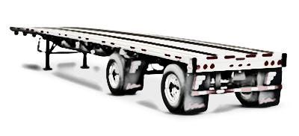
Presentation Outline
Introduction
Project Background
The Theme
Presentation Overview
Analysis I
Analysis II
Mechanical Breadth
Analysis III
Analysis IV
Conclusions
Acknowledgements & Thanks
Analysis II: Façade
 | Trailer
Slot | 1 (x2) | 2 (x2) | 3 (x3) | 4 (x1) | 5 (x2)
1 | 12x30 | 6x24 | 12x19 | 9x24 | 12x24
 | 12x20 | 12x17 | 3x24 | 9x24 | 12x24
2 | 12x30 | 6x24 | 12x19 | 4x24 | 12x24
 | 12x20 | 12x17 | 3x24 | 4x24 | 12x24
3 | 3x24 | 12x17 | 3x24 | 4x24 | 12x24
 | 12x20 | 12x17 | 3x24 | 4x24 | 12x24
 |  | 12x15
4 | 3x24 | 12x17 | 12x19 | 3x24 | 12x24
 | 12x20 | 12x17 | 12x19 | 3x24 | 12x24
 |  | 12x15
5 | 3x24 | 12x15 | 12x19 | 6x24
 | 3x24 | 12x17 | 12x19 | 6x24
 |  | 12x19
6 | 3x24 | 12x15 | 12x19 | 12x16
 | 3x24 | 12x17 | 12x19 | 7x16
 |  | 12x19
7 | 3x24 | 8x24 | 12x19
 | 3x24 | 8x24 | 12x19
Panels
66 panels
Range of sizes: 3’ x 24’ to 12’ x 30’
Logistics
Transport by Semi-trailer
Max load 55,000lbs
8.5’ x 53’ (W x L)
10 trips required
Slot = row on bed of truck
Ample turning room form park avenue to site
Photo: Google
Notes:
Left
The brick façade requires 66 panels, all within the provided limits of the precast panels. The image shows how the panels have been broken down, on the north side. These are not estimates, but quite accurate dimensions of each panel size.
Center and Right
In order to transport these panels, it was determined that a semi-trailer of 53’ length would be appropriate, but a shorter length is just as capable. The maximum load that a typical semi could carry, based on regulation as well as physical characteristics, is about 55,000lbs. This would require 10 trips.
The table shows the sizes of each and how many can be laid on the bed without taking too much space on any side. The spacing is considered with all appropriate spacing to prevent panels from resting on one another.
The maximum height that can be carried is 12 feet.
*point out table and explain how slots work.

Slide 12
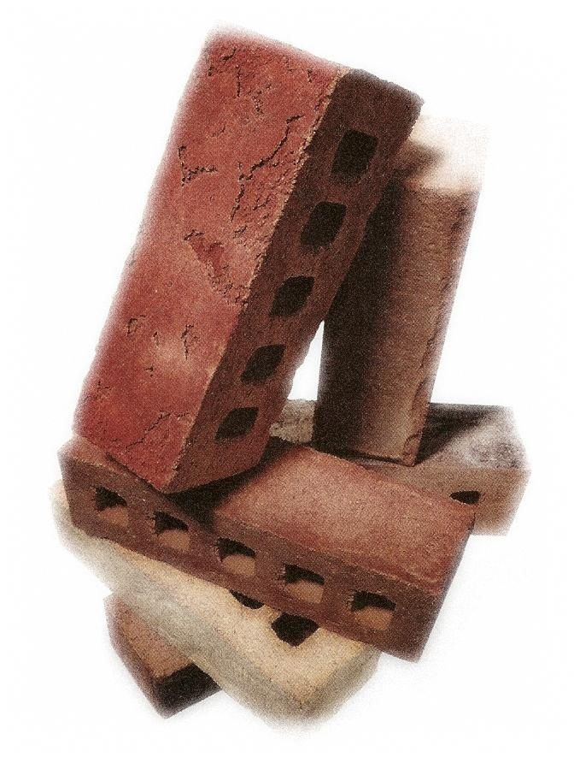
Presentation Outline
Introduction
Project Background
The Theme
Presentation Overview
Analysis I
Analysis II
Mechanical Breadth
Analysis III
Analysis IV
Conclusions
Acknowledgements & Thanks
Analysis II: Façade
Architectural Implications
May not be appropriate
Higher cost to better mimic masonry
Conclusions
Costs more
Saves at least 2 months
Structurally sound
Performs better in energy savings: $2.3K/year
Reduces on-site clutter and waste
May be hard to coordinate
Photo: Google
Notes:
Left
There may or may not be an issue with the look of the precast panels, based on the investment. Although typical panels may not be architecturally satisfying to the university architect, there are ways around this. If saving a substantial amount of time is an important thing for the project, one must only invest a little more in order to produce a final product that fully satisfies.
Center
In conclusion, the precast façade system costs more than the old system, but saves at least 2 months off the schedule. The new system is also structurally sound, and performs better from an energy savings standpoint, saving at least $2,300 a year. As an added benefit, it reduces clutter and waste on site, with a much cleaner installing process. Finally, it may be slightly tougher to coordinate, and may be a “headache” but one that is worth the trouble.

Slide 13
Presentation Outline
Introduction
Project Background
The Theme
Presentation Overview
Analysis I
Analysis II
Mechanical Breadth
Analysis III
Analysis IV
Conclusions
Acknowledgements & Thanks
Analysis III: Structural Steel
Design Assist (DA) Contract
Similar to design-build, but for one subcontract (e.g. steel prime)
Moore Goal: accelerate steel fabrication & erection
Significance of Structural Steel
Most important critical path Item
2 unsuccessful attempts at accelerating
1st attempt: Accelerate foundations
2nd attempt: Accelerate steel fabrication
Shortcomings: No money involved
Design Assist Process
Phase I: Owner must have clearly defined scope, schedule and budget
Phase II: Collaboration between DA professional/contractor and owner to create design goals and specifications
Phase III: Contract adapted for DA introduction, and DA professional formally selected.
Owner (PSU/OPP)
OPP Project Manager
Construction Management Firm
Steel Prime Contractor (DA)
All Subcontracors
Notes:
Center
The structural steel on the moore building addition is the most important critical path item, as it opens the doors for a major amount of trades to begin work on site. Its timely completion is very important, and an early completion may allow the project to occur much faster.
There have been two attempts to try and accelerate this process of getting the steel on site and erecting it. The first attempt was to try and have the foundations completed at a quicker rate, and the second was to get the steel fabricator to fabricate the steel earlier than normal. However, both of these attempts fell short due to the same issue; no money was put into these acceleration methods. This is a problem as there is no incentive for either of the two parties, nor is there any contractual obligation to perform these acceleration methods.
Left
So, for this analysis I explored the possibility of incorporating a design-assist contract for the structural steel package, in order to understand the effects, had it been employed for the moore building addition.
In the easiest terms, design-assist is basically a design-build contract, but instead of it being applied to the entire project, it is applied to one subcontractor. In terms of the moore building addition, this would be the steel contractor, as this is the critical path item we are trying to accelerate.
Right
In order to outline the process, research was done and a publication on DA written by David Hart was utilized. The process is split into three phases;
Phase I: the owner must be very clear of the scope of the project for design-assist purposes, as well as schedule time and a budget set forth.
Phase II: in this phase, there is collaboration between the DA professional or contractor to help the architect research design-goals and together write specifications for the building’s contruction. The owner pays a fee for these specifications and is entitled to their rights. The documentation will be utilized by the design-assist contractor. If this contractor cannot meet the budget determined by the owner in phase one, the owner has the right to hire a different DA contractor
Phase III: finally, the contract is adapted for DA introduction and a DA professional is formally selected. If no DA contractors can meet the schedule, scope and/or budget, then the owner may bid the project and utilize the documentation he purchased in phase II.

Slide 14
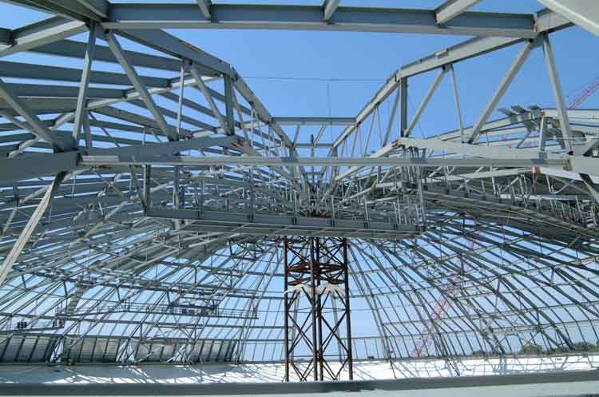
Presentation Outline
Introduction
Project Background
The Theme
Presentation Overview
Analysis I
Analysis II
Mechanical Breadth
Analysis III
Analysis IV
Conclusions
Acknowledgements & Thanks
Analysis III: Structural Steel
Case 1: Dakota Dome
Scope: tear down air supported fabric roof off dome; create structural steel roof
Schedule: 4.5 Months
Successful through DA contract
Case 2: Convention Center
Success story as well!
Case Studies
Based on Don Proffer studies on Haven Steel
Direct DA correlation
Performed in 2000’s
Photo: Proffer
Notes:
Left
The case studies researched had direct correlations to structural steel DA contracts, and showed the benefits. The studies are based on Havens Steel (now bankrupt for reasons unrelated to performance!) and are performed by Don Proffer.
Center
The Dakota dome was a project that required very dedicated “team-work” throughout, as the dome had a slight window in which construction could occur, and a challenging scope. It needed to be done in 4.5 months and the scope was to tear down an air supported fabric roof and replace it with a conventional structural steel roof.
All entities involved with the structural steel construction were brought together in a design-assist contract, where individual opportunity was put aside, and a greater focus was put on achieving the goals in the window provided. For example, the steel fabricator was able to aid the steel designer in maximum member sizes that would not need to be welded on-site. This would save lots of time and money, and allowed the structural steel designer to create a frame that was ample in its support but one that could also easily be transported without causing delay. In this case, the truss size was reduced from 15’ to 11.5’ which allowed them to fit very well on a semi-trailer. These trusses were heavier than the original 15’ ones, but were pre-fabricated, which allowed for ease of installation.
All in all, with the project contracted as a design-assist one to the steel prime contractor, it allowed the success of the job. As it stood, the project was completed within a very close range of the window, and so it was evident that a design-bid-build approach, for example, would not have succeeded.
The second case study is similar, by the same company, with great successes as well, so I will not cover it this morning. But to give you an idea of the application of such a contract type, this case was presented.
Right
Dakota dome photo

Slide 15
Presentation Outline
Introduction
Project Background
The Theme
Presentation Overview
Analysis I
Analysis II
Mechanical Breadth
Analysis III
Analysis IV
Conclusions
Acknowledgements & Thanks
Analysis III: Structural Steel
Survey
Performed to quantify benefits/drawbacks of DA
50+ participants
Majority CM, owners and PMs replied
Most performed >1 DA projects
Survey Results
Survey Results
Results Averaged
Question | Average
3. How much more (or less) effective is a design-assist contract (generally) in terms of schedule reduction than a typical contract? | 15.385%
4. How much more (or less) effective is a design-assist contract for structural steel in terms of schedule reduction than a typical contract? | 15.769%
5. How much more (or less) effective is a design-assist contract (generally) in terms of cost reduction than a typical contract? | 10.388%
6. How much more (or less) effective is a design-assist contract for structural steel in terms of cost reduction than a typical contract? | 8.462%
7. How would you quantify the risk involved with taking on a design-assist contract as opposed to holding a typical contract with a steel subcontractor, as a percentage of the contract value? | 13.88%
Final Analysis
Item | % Average increase/decrease | Original Quantity | Increase/(Savings)
Schedule Impact | 15.769% | 71 Days (from design to delivery of structural steel) | (12 work days)
Cost Impact | 8.462% | $1.28M (structural steel only) | ($108K)
Risk Involved | 13.88% | $26.1M | ($3.62M)
Notes:
Left
A survey was distributed online to at least 50 design professionals, and their responses were collected for purposes of quantifying the benefits and/or drawbacks of using a design-assist contract on a project like the Moore Building Addition.
The majority of responders were construction managers, with the next two highest responders being owners and PMs. Architects, engineers and the like all replied as well.
Center
The results of all the responses were taken and weighted based on how many people selected a certain percentage.
Applicable questions were used only, and the results were as follows.
The most important three were that for a structural steel DA contract, the benefit in schedule was a 15% reduction, and the benefit in cost was a reduction of about 8%. Finally, the risk came in at about 14% of the project value.
Right
This all translated into possible savings of about 12 workdays, or 2 weeks, as well as $108,000 in cost savings at a risk of about $3.62M.

Slide 16
Presentation Outline
Introduction
Project Background
The Theme
Presentation Overview
Analysis I
Analysis II
Mechanical Breadth
Analysis III
Analysis IV
Conclusions
Acknowledgements & Thanks
Analysis III: Structural Steel
Conclusions
Owner buy-in
Action must be taken early
Most cost savings in terms of less changes
Early purchase of steel
Trustworthy contractors
Barrier
The only barrier to this approach is money
Notes:
Center
Many comments by the responders to the survey allowed for a very intricate look into the whole idea. First of all, mention of owner buy-in was made, arguing that if the owner is not convinced, the project may not be as successful as proposed.
Also, the DA process must occur extremely early in order for it to be effective, and while this may be a risk, it is one worth it if the owner is positive about building the design that he has agreed on and building the building itself.
Also, the cost savings that are said to be due to the lack of changes or change orders on the project as a result of a more refined design. Although the actual DA contract would cost more, when the project is over, these are the savings that would be realized.
Another important fact is that buying the steel at a certain price at an early date ensures that the price paid is not higher in the future. This is somewhat like a gamble, because if the price goes down, money is lost and vice versa.
Finally, a trustworthy contractor should be employed, as there is lots of reason to ensure a decent contractor is hired.
Lastly, the only barrier to this approach is the allocation of monies for the project. This is because funding was not available until a time in which a DA contract would be good to pursue. I will not comment on whether or not I think this can be overcome, but it is the only barrier to the success of a project like this one.

Slide 17
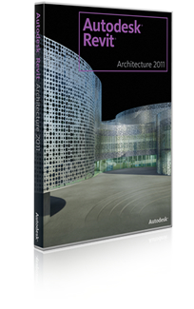
Presentation Outline
Introduction
Project Background
The Theme
Presentation Overview
Analysis I: Demolition
Analysis II: Façade
Mechanical Breadth
Analysis III: Structural Steel
Analysis IV: BIM Through AE
Conclusions
Acknowledgements & Thanks
Analysis IV: BIM Through AE
Outline
Collaboration effort between OPP and AE dept.
Medium: AE222
Main participants: Dr. Ed Gannon, Colleen Kasprzak, Craig Dubler, Paul Bowers, Dr. David Riley
Important to note
Previous trial: good and bad!
AE222 consists of inexperienced students, many have little/no experience with Revit
Lack of definitive standard
OPP considered as client in this analysis
Photo: Google
Notes:
Center
The last analysis was designed to explore the viability of a plan that would allow OPP to purchase student-made models at a modest price, with the money going into the AE department and used as it will be used.
The main idea is that OPP and PSU AE collaborate to incorporate the model-making process into one of the classes and use that to benefit both parties in a way non-intrusive to the students’ education. The main class in which this can all occur is in AE 222, which is appropriately named, the medium! AE 222 is a class whose focus is to introduce students to, among other things, modeling in 3d with Revit. It requires them to model a smaller structure almost entirely.
The key people whose help I pursued were dr. Gannon, Dr. Riley, Colleen Kasprzak, Craig Dubler and Paul Bowers.
Right
It is important to note the following before I begin explaining anything here… first of all, there was a previous trial in which the students created models for OPP and there were a few mixed opinions on what they liked or disliked. Some models were as good as, if not better than industry-produced 3d models, and met all criteria that one could hope for, including geographical accuracy, envelope accuracy etc. Some, however, were not so great and needed some work in order to be useable. This is because many students, myself included at the time, had no experience with Revit. Maybe now, things have changed, but still, it’s a very complicated program. Also, there is no specific standard for what each party wants, and so this analysis attempted to take that into account.
In this sense, since there is a product going to be handed over to the physical plant, we will consider them as Clients.
Left
Revit

Slide 18
Presentation Outline
Introduction
Project Background
The Theme
Presentation Overview
Analysis I: Demolition
Analysis II: Façade
Mechanical Breadth
Analysis III: Structural Steel
Analysis IV: BIM Through AE
Conclusions
Acknowledgements & Thanks
Analysis IV: BIM Through AE
OPP: Why do they want it?
OPP: What do they want?
Useable models
Modeling un-modeled buildings and renovations
425 projects available
M.E.P. modeled accurately
Exterior modeled to close resemblance (differing opinion available!)
Spaces need to be representative
BIM Model
Asset Management
Preventative Maintenance
Enterprise Management System
Complete Item Data
Maximo Integration
Ordering Capabilities
Space & Operational Management
B.A.S. Integration
Photo: Google
Notes:
Center
OPP, as it stands, are not 100% clear on what they want. Let me rephrase; they know what they want, but they cant put their finger on it. First, I’ll tell you what they want, and then why they want it! They want models that need moderate alteration in order to be useable, but not so bad that they sit longer altering it than the students took to create it. Also, they have 400+ projects that need to be modeled, from buildings to just renovations. A lot of these will not be useable for AE222 purposes.
On the exterior of the building, certain parties were not too concerned what was provided so long as the M.E.P. was decent, and another party insisted that the only thing that could be expected is the envelope of the building, with no focus on the interior. For this analysis, though, I will first discuss considering that MEP is the important part.
Finally, the spaces that are modeled must be modeled to be representative of the actual spaces. In other words, a 100SF space should be roughly 100SF!
Right
OPP want to become more efficient, and that is the ultimate goal. This can be realized in a relatively inefficient process of maintenance (not that it’s bad, it’s just not up to its true potential).
Preventative maintenance can be used as a sort of ongoing-commissioning exercise where buildings are constantly monitored and they are ensured to be in running order. This goes with the saying that an ounce of prevention is worth a pound of cure. Facility management, and enterprise management systems is a whole topic in itself, but to be brief, it is as follows:
software provides asset lifecycle and maintenance management for all asset types on a single platform. It is used to help maximize the value of critical business and IT assets over their lifecycles with workflows by enforcing best practices that yield benefits for all types of assets, including transportation, production, delivery, facilities, communications and IT
Some of the added benefits are listed as well.

Slide 19
Presentation Outline
Introduction
Project Background
The Theme
Presentation Overview
Analysis I: Demolition
Analysis II: Façade
Mechanical Breadth
Analysis III: Structural Steel
Analysis IV: BIM Through AE
Conclusions
Acknowledgements & Thanks
Analysis IV: BIM Through AE
Dual-benefit Approach
Fully integrated approach – 2nd to 3rd year
Exterior and interior spaces modeled in 2nd year
3rd year:
Structural class: model structure and use in STAAD
Mechanical class: model mechanical equipment and use if necessary
Electrical Class: model electrical equipment and light fixtures
CM class: perform BIM integration to put models together
Acoustics can also be integrated
4th year: if also integrated, could be used for data
OPP & PSU AE collaborate to select target SF and cost/SF expected as well as SF limits (if OPP budget limited)
Preliminary building lists selected in order to be used for modeling; drawings prepared
PSU AE assigns drawings to students in AE222
Model structure utilized in analyses in AE308
Model MEP enhanced in AE 310 and AE 311
Models produced in “fragments”
Model acoustics analyzed and optimized in AE309
Model completely put together in AE372 as a final piece
Model details and textures enhanced in some areas in AE444
PSU AE
Education is number 1; no intrusions
No tedious modeling; no benefit
Equal learning opportunity
Must be related to classwork
Notes:
Center
On the other hand, we have the AE department who need certain criteria to remain intact. The most important of those is the quality of learning of the student. There should be very little repetitive tasks that do not induce learning, and there shouldn’t tasks that require great skill to produce; not that the students aren’t capable, but all students must be considered and not just the over-achievers.
Right
I am trying to keep this within time limits, so I cannot explain everything I did, which is why I have a report to show you that. However, I will show you what I call the dual-benefit approach as it relates to OPP and PSU AE department.
This approach allows the students in AE222 to simply model the spaces of a building; no details need be placed; simply areas, doors and the like. These students will then see the model in their 3rd year and for each class, instead of using different models, they would build up on their previous model.
Explain the process
Left
I created a process flow diagram to go through the process as I just explained. This is also available in my report in greater detail.

Slide 20
Presentation Outline
Introduction
Project Background
The Theme
Presentation Overview
Analysis I: Demolition
Analysis II: Façade
Mechanical Breadth
Analysis III: Structural Steel
Analysis IV: BIM Through AE
Conclusions
Acknowledgements & Thanks
Analysis IV: BIM Through AE
Challenges
Value 3d model vs. BIM model
Trial and error suffered unusual fate
Very optimistic
Too many constraints
Lost investments
Off-limits buildings
Internship
OPP in full control
Students benefit form pay and experience
No restrictions to program
LACCD currently do this
Photo: Google
Notes:
Left
Some of the challenges that will be faced are very real. First of all, the value of the model is a very hard thing to quantify; it’s hard to say how much a model is worth, or what SF is worth what. I have not had enough time to figure that out as numbers have been thrown around everywhere about this topic.
Also, the previous trial suffered an unusual fate in that it was cut short due to circumstances that must be ironed out; I do not think it is appropriate to mention it because I don’t want to offend anybody in the room who works with these entities.
Another issue is that the model is very optimistic, and with the amount of constraints, so much can go wrong. You have very little control over what the students are producing, and your investment may be short-lived. Yes, it can be a resounding success, but that is considering that even the students have bought-into it, which they may or may not have. There are just too many factors that have to be studied in before taking on this challenge in this form.
Center
However, there has been a solution that came up in the beginning that seems to cover all the bases except one; the students benefit directly as opposed to the AE department.
This approach is called the Internship approach. This approach eliminates almost all constraints and allows all the work that OPP wants to be realized, with a plethora of work available, and a resume-friendly experience. This would be most beneficial to the students themselves for the work that they produce. It might not be appealing to the actual department, but it is a much simpler, more economical approach.
In fact, the LACCD perform the exact same thing. The Los Angeles community college board has several internship opportunities and one of them, called e7studio, is a very similar program to what is to be achieved here; students are hired and work certain hours with their education in mind, and produce models for the campus! It is simple yet very effective.

Slide 21
Presentation Outline
Introduction
Project Background
The Theme
Presentation Overview
Analysis I: Demolition
Analysis II: Façade
Mechanical Breadth
Analysis III: Structural Steel
Analysis IV: BIM Through AE
Conclusions
Acknowledgements & Thanks
Conclusions
Analysis 1: Asbestos must be considered on demo projects
Full demolition will reduce schedule marginally
Analysis 2: Façade change must be incorporated early in project – Design issues
Analysis 3: DA contract must be a planning phase thought
Communication is key
Analysis 4: The answer may be simpler than you think! Internship may be the best method

Slide 22
Presentation Outline
Introduction
Project Background
The Theme
Presentation Overview
Analysis I
Analysis II
Mechanical Breadth
Analysis III
Analysis IV
Conclusions
Acknowledgements & Thanks
ANDY SCHRENK
CHAD SPACKMAN
COLLEEN KASPRZAK
CRAIG DUBLER, (PH.D.)
DAVID RILEY, PH.D.
DEPARTMENT OF PSYCHOLOGY AT PENN STATE
ED GANNON, PH.D.
JAMES FAUST, P.E.
JOHN BECHTEL, P.E.
DR. MOSES LING, P.E., R.A.
OFFICE OF PHYSICAL PLANT
Acknowledgements & Thanks

Slide 23
Presentation Outline
Introduction
Project Background
The Theme
Presentation Overview
Analysis I
Analysis II
Mechanical Breadth
Analysis III
Analysis IV
Conclusions
Acknowledgements & Thanks
?
?
Q & A

Slide 24
Presentation Outline
Introduction
Project Background
The Theme
Presentation Overview
Analysis I
Analysis II
Mechanical Breadth
Analysis III
Analysis IV
Conclusions
Acknowledgements & Thanks
Appendix
Underpinning
Asbestos Abatement Cost Analysis - North Wing
Item |  | Unit | Cost / Unit
1 | Asbestos Abatement & Removal | 16,375 SF | $20/SF | $327,500
2 | Selective Demolition for Asbestos Preparation | 3,986 SF | $10/SF | $39,860
3 | Temporary Equipment for Abatement | 1 EA | $25,000 | $25,000
4 | Selective Demolition for North Wing | 16,375 SF | $12.10/SF | $198,080
5 | Demolition of Concrete, Casework etc. | 16,375 SF | $2.4/SF | $39,303
 |  |  | Total | $629,750
Underpinning Elimination and Basement Expansion Analysis
Condition | Item | Quantity |  | Unitcost | Totalcost
Existing | SOG Basement | 5,788 | SF | 9.26 | $53,596.88
Deduct | Underpin North Wing | 1,620 | SF | 50 | $81,000.00
Add | SOG New Basement | 5,461 | SF | 9.26 | $50,568.86
Add | Concrete Deck Fill New | 5,461 | SF | 6.41 | $35,005.01
Deduct | Strip Footings 18X12 | 136 | LF | 130 | $17,680.00
Add | Strip Footings 24X12 | 500 | LF | 140 | $70,000.00
Total Cost |  |  |  |  | $57,000
Asbestos Abatement Schedule Impact Analysis – North Wing + Selective Demolition
 | W/O Basement Abatement | W/ Basement Abatement | Total Area (SF)
Total Days | 93 days | 207 days | 16,375 SF
Only Workdays | 80 days | 177 days
Schedule Day/CSF | 0.4885 days/CSF | 1.0809 days/CSF
Schedule Hrs./CSF | 11.7252 hrs./CSF | 25.9420 hrs./CSF
Notes:
Left
Assume 103 days for asbestos removal + selective demo; 29 days to reconstruct; hence 74 days left. In 74 days, 17,000 SF removed

Slide 25
Presentation Outline
Introduction
Project Background
The Theme
Presentation Overview
Analysis I
Analysis II
Mechanical Breadth
Analysis III
Analysis IV
Conclusions
Acknowledgements & Thanks
Appendix
Masonry Construction Costs
Item | Quantity |  | Unitcost | Totalcost
Metal Panels | 2,020 | SF | 40 | $80,800
Window Sills | 585 | LF | 35 | $20,475
 |  |  |  | $101,275
Masonry Veneer | 13,360 | SF | 20 | $267,200
Stone Base - Granite | 168 | SF | 100 | $16,800
Caulking & Sealants | 13,360 | SF | 0.75 | $10,020
Rigid Insulation 3" | 13,260 | SF | 2.5 | $33,150
 |  |  |  | $327,170
 |  |  | TOTAL | $428,500

