Slide 1
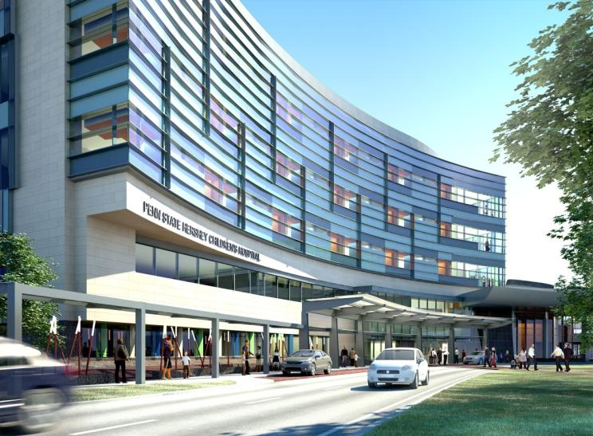
Penn State Hershey Medical Center Children’s Hospital
Hershey, Pennsylvania
Matthew Vandersall
Structural Option
AE Senior Thesis - 2011
Dr. Richard Behr – Thesis Advisor

Slide 2
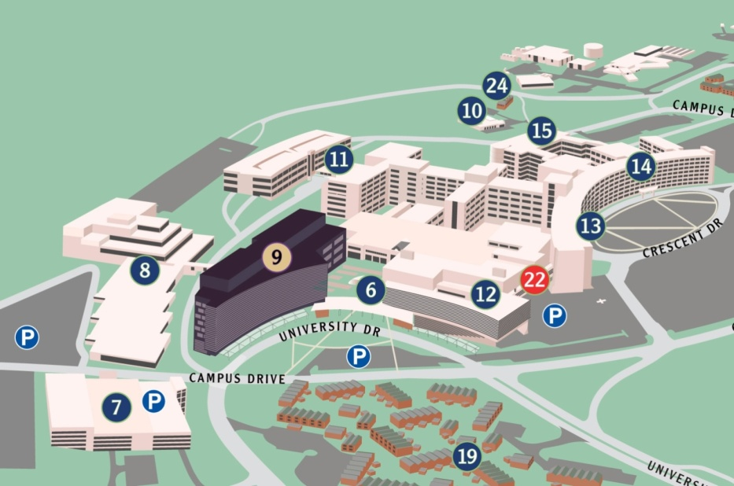
Children’s Hospital – Hershey Medical Center
Introduction
Location: Hershey, PA
Number of Stories: 5 Above Grade / 1 Below Grade
Size: ~263,000 SF
Height: 83.5 ft to top of the roof
Structural Engineer: Gannett Fleming
Construction: 3/17/2010 – 8/20/2012
Contracted Cost: $115,726,613
Delivery Method: Design-Bid-Build
Introduction
Existing Structural System
Thesis Proposal
Structural Depth
Slab Design
Shear Wall Design
Column Design
Construction Management Breadth
Conclusion
(http//www.pennstatehershey.org)

Slide 3
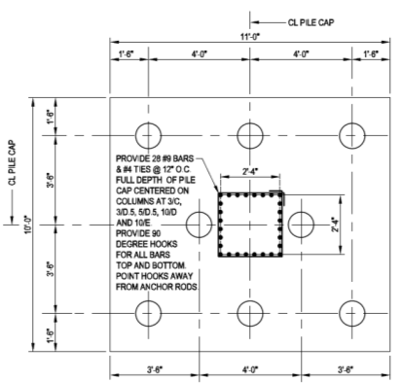
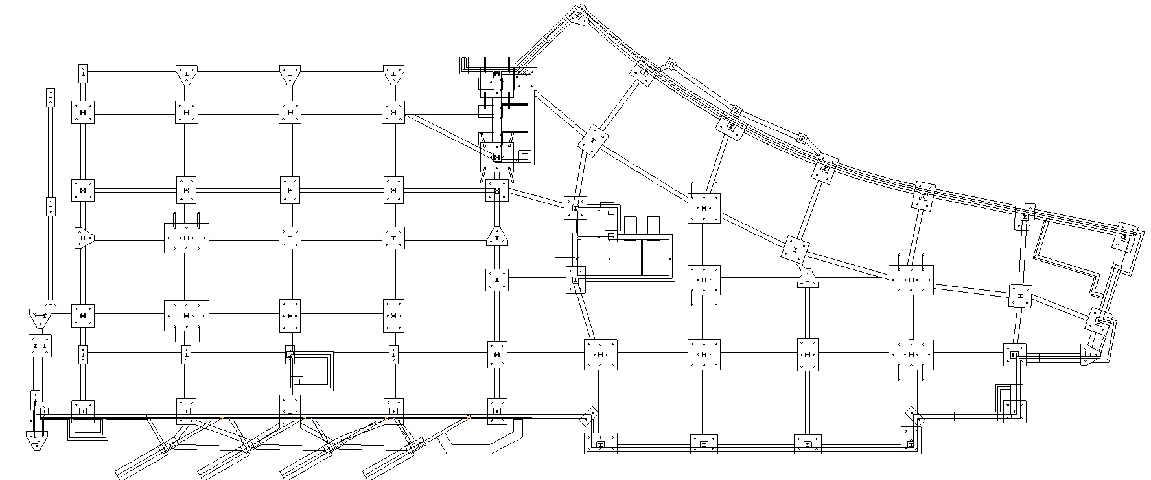
Children’s Hospital – Hershey Medical Center
Existing Structural System
Foundation
  600 micropiles
  3’ x 3’ to 10’ x15’ pile caps
  Strut beams span between pile caps
  f’c = 4000 psi for all concrete elements
Introduction
Existing Structural System
Thesis Proposal
Structural Depth
Slab Design
Shear Wall Design
Column Design
Construction Management Breadth
Conclusion

Slide 4
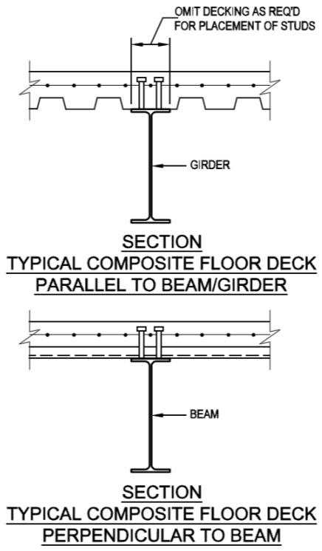
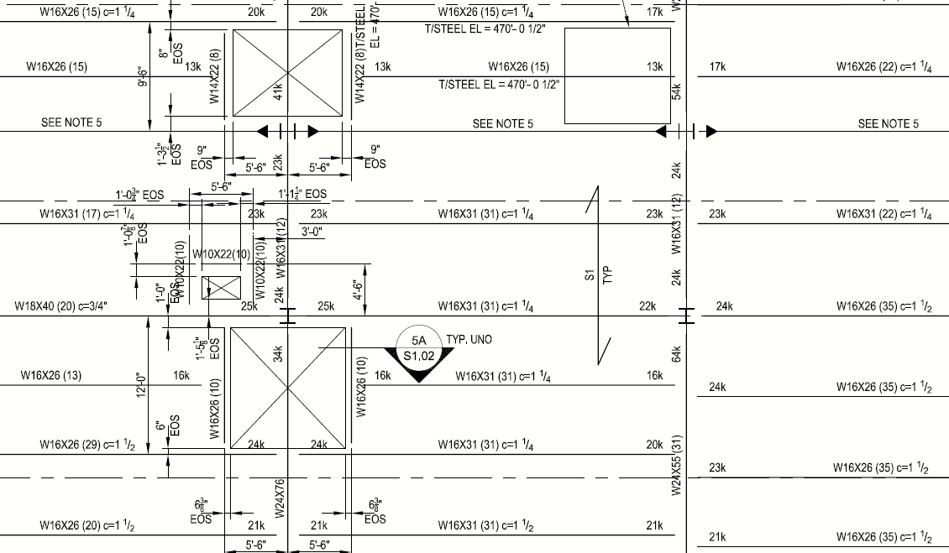
Children’s Hospital – Hershey Medical Center
Existing Structural System
Foundation
  600 micropiles
  3’ x 3’ to 10’ x15’ pile caps
  Strut beams span between pile caps
  f’c = 4000 psi for all concrete elements
Gravity System
  Composite Floor System:
    2” deep, 20-gage composite metal deck with 4 ½ “ topping
    ¾” Shear studs to wide flange beams
  All columns are W 14s
  Beams are typically W16 - W21s
Introduction
Existing Structural System
Thesis Proposal
Structural Depth
Slab Design
Shear Wall Design
Column Design
Construction Management Breadth
Conclusion

Slide 5
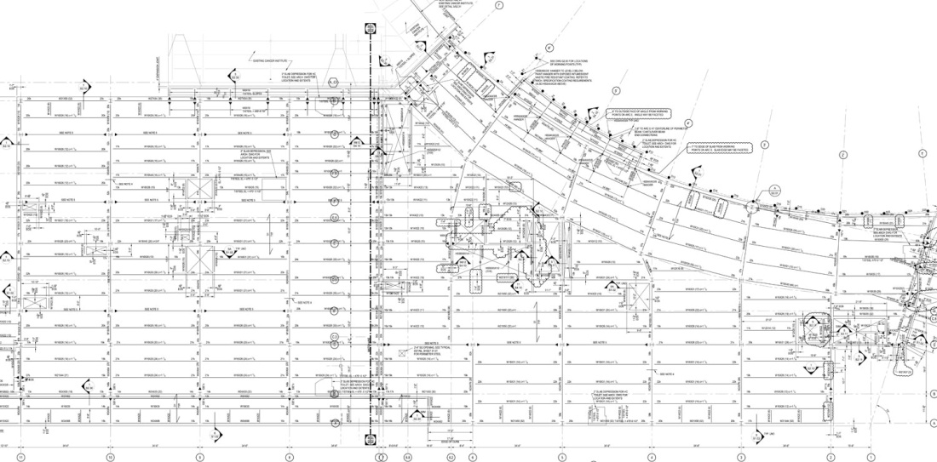
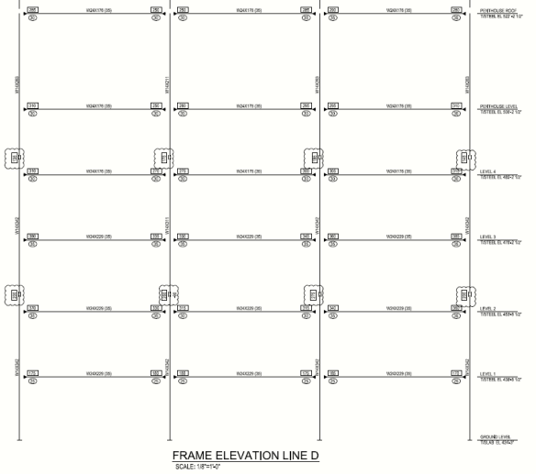
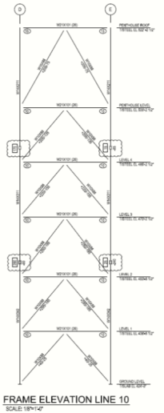
Children’s Hospital – Hershey Medical Center
Existing Structural System
Foundation
  600 micropiles
  3’ x 3’ to 10’ x15’ pile caps
  Strut beams span between pile caps
  f’c = 4000 psi for all concrete elements
Gravity System
  Composite Floor System:
    2” deep, 20-gage composite metal deck with 4 ½ “ topping
    ¾” Shear studs to wide flange beams
  All columns are W 14s
  Beams are typically W16 - W21s
Lateral System
  4 Moment Frames in East-West direction
  4 Braced Frames in North-South direction
Introduction
Existing Structural System
Thesis Proposal
Structural Depth
Slab Design
Shear Wall Design
Column Design
Construction Management Breadth
Conclusion

Slide 6
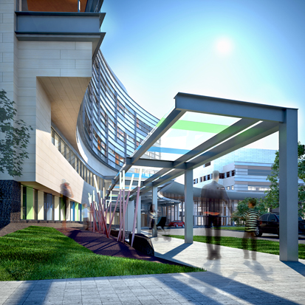
Children’s Hospital – Hershey Medical Center
Thesis Proposal
Structural Depth
  Redesign structure using reinforced concrete
  Preserve architectural layout
  Design with for future expansion
Construction Management Breadth
  Compare cost of existing versus proposed design
  Generate project schedules
Mechanical Breadth
  Analyze heat flow through the insulating glass curtain wall
  Propose an efficient curtain wall system to minimize heat transfer
MAE Coursework
  AE 597A – ETABS model
  AE 542 – heat transfer analysis for curtain wall systems
Introduction
Existing Structural System
Thesis Proposal
Structural Depth
Slab Design
Shear Wall Design
Column Design
Construction Management Breadth
Conclusion
(Payette Associates)

Slide 7
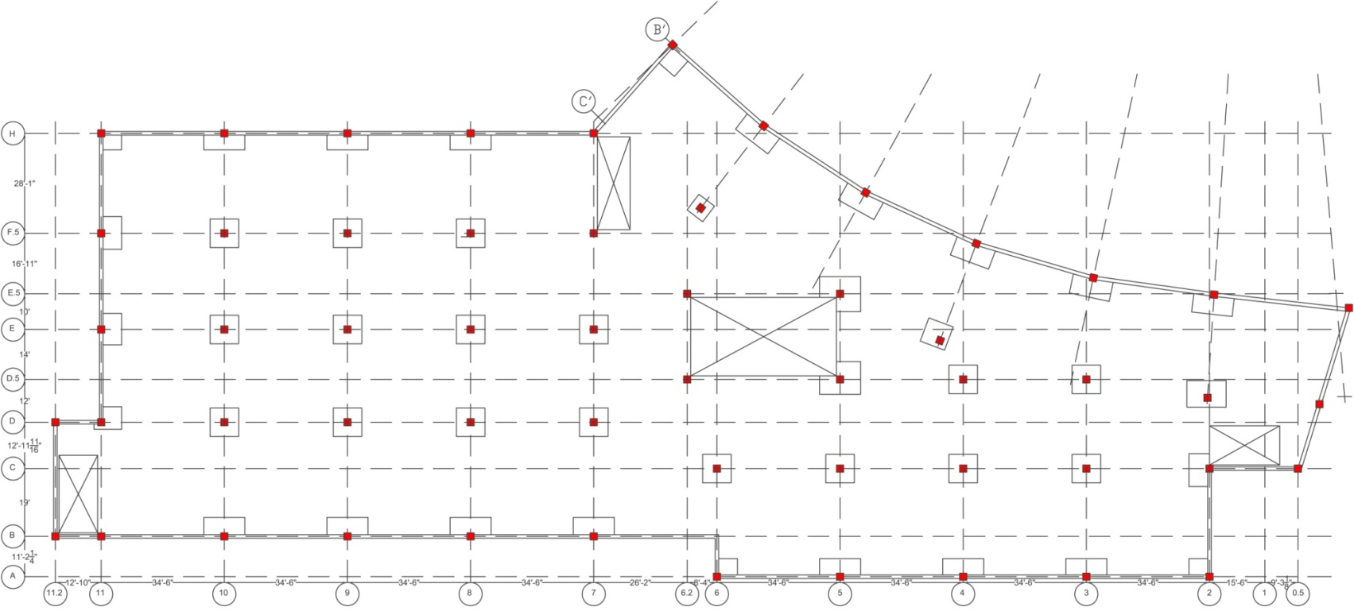
Children’s Hospital – Hershey Medical Center
Structural Depth
Solution
  Gravity System:
    Two-way reinforced flat slab system
    Shear caps if necessary for punching shear
  Lateral System:
    Reinforced concrete shear walls
  Two additional patient floors
    Structural height = 113.5 ft
Proposed Column Layout
  Column line F and G eliminated
  Typical span: 30’ x 34.5’
Introduction
Existing Structural System
Thesis Proposal
Structural Depth
Slab Design
Shear Wall Design
Column Design
Construction Management Breadth
Conclusion
Proposed Layout

Slide 8
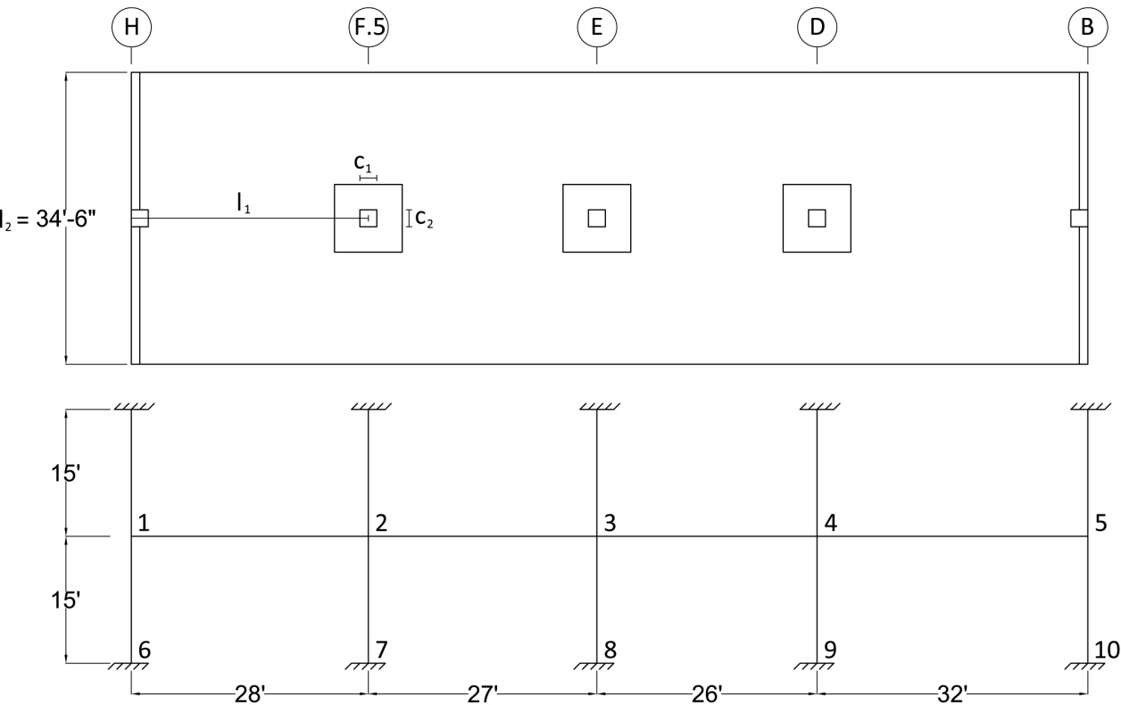
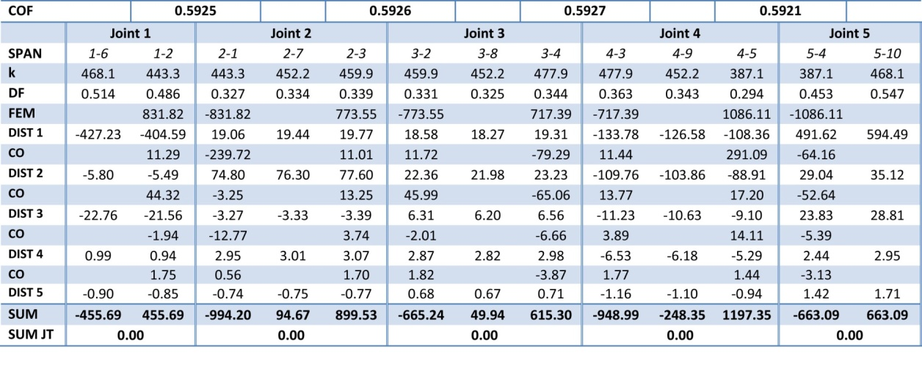
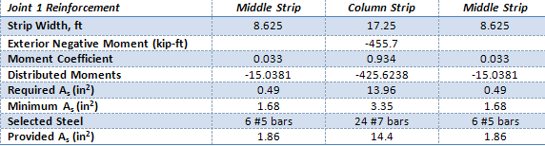
Children’s Hospital – Hershey Medical Center
Structural Depth
Two-Way Flat Slab Design
  Typical span considered for preliminary design
  Element stiffness determined
  Performed moment distribution
  Moments distributed to columns strips and middle strips
  Designed reinforcement
Assumptions:
  f’c = 5000 psi
  Slab thickness of 9”
  Shear cap depth of 4.5”
Final Design
Introduction
Existing Structural System
Thesis Proposal
Structural Depth
Slab Design
Shear Wall Design
Column Design
Construction Management Breadth
Conclusion

Slide 9
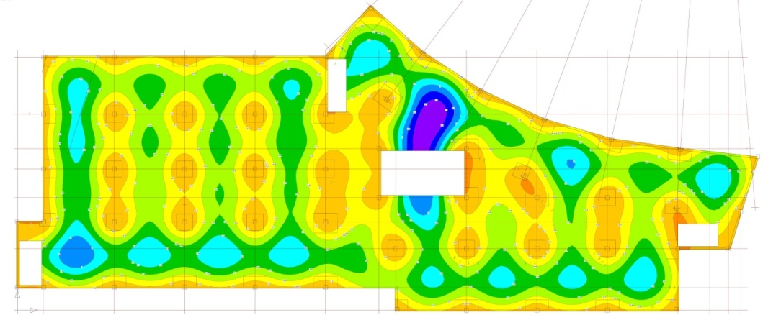
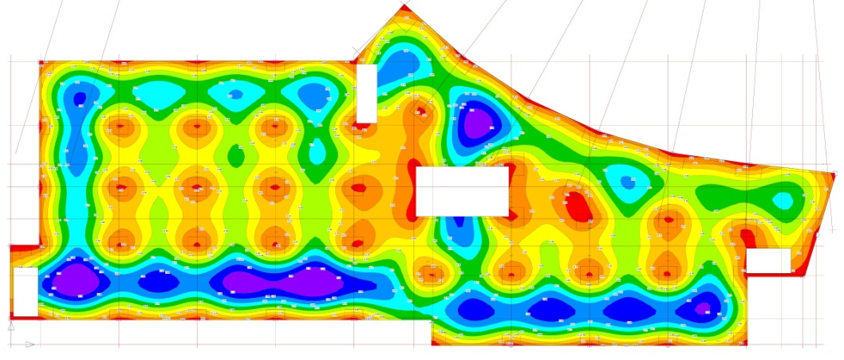
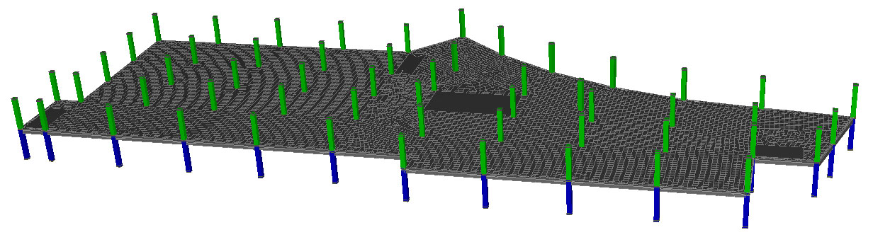

Children’s Hospital – Hershey Medical Center
Structural Depth
Ram Concept Model
  Used to check all floor sections
  Live load patterns were considered
  Punching Shear checks performed
  Allowable deflection, Δ = $\frac{L}{240}$ = 1.73”
  Penthouse live load of 250 psf
  Slab thickness increased for penthouse level
Typical Floor
Max Δ = 1.6”
Introduction
Existing Structural System
Thesis Proposal
Structural Depth
Slab Design
Shear Wall Design
Column Design
Construction Management Breadth
Conclusion
Penthouse Level
Max Δ = 1.4”

Slide 10
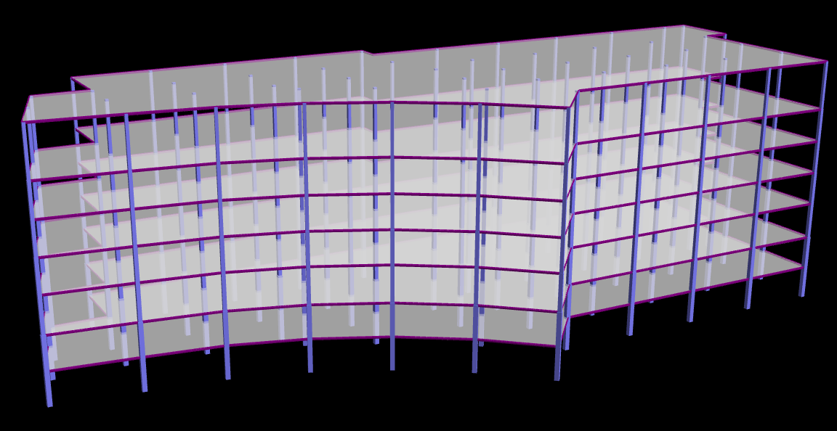
Children’s Hospital – Hershey Medical Center
Structural Depth
Final Slab Design:
  Typical Floor
    9” two-way flat slab for typical floor
    f’c = 5000 psi
    4.5” deep shear caps
  Penthouse Floor
    11” thick slab
    f’c = 6000 psi
    9.5” deep shear caps
  #7 and #8 rebar for column strip
  #5 rebar for middle strip
Introduction
Existing Structural System
Thesis Proposal
Structural Depth
Slab Design
Shear Wall Design
Column Design
Construction Management Breadth
Conclusion

Slide 11
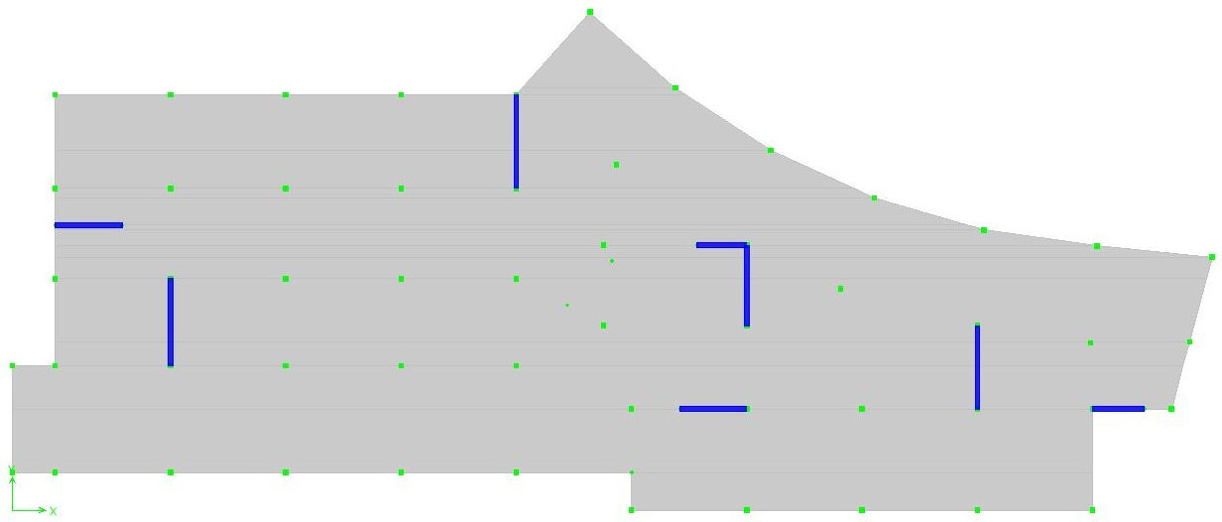
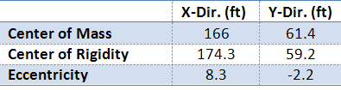
Children’s Hospital – Hershey Medical Center
Structural Depth
Design of Shear Walls
  4 in North-South direction
  4 in East-West direction
Deflection/Story Drift Limitations
  Wind - H/400
  Seismic - 0.02*hsx
Assumptions
  f’c = 5000 psi
  Slab acts as a rigid diaphragm
  Cracked sections
    Columns – 0.7Ig
    Shear Walls – f22 = 0.5
  Shear walls take no out-of-plane bending
  P-Δ effects considered within model
3
D
C
Introduction
Existing Structural System
Thesis Proposal
Structural Depth
Slab Design
Shear Wall Design
Column Design
Construction Management Breadth
Conclusion
Y
2
4
B
1
A
X

Slide 12
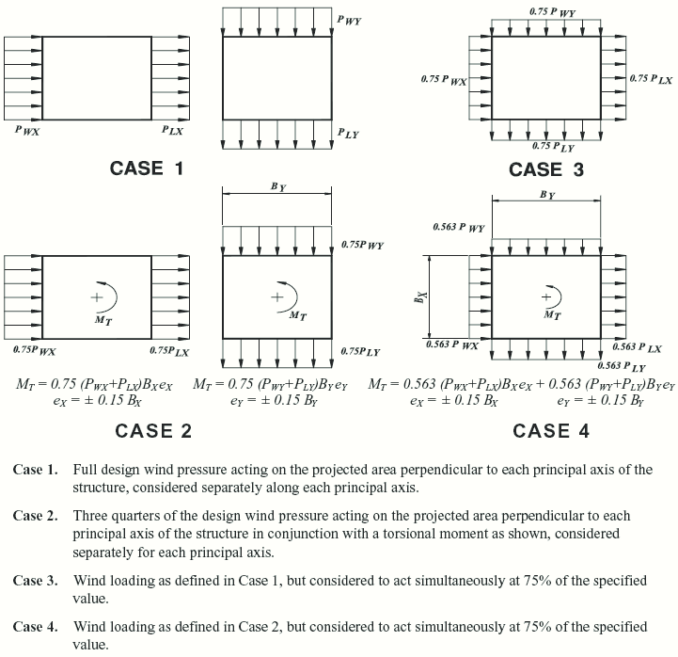
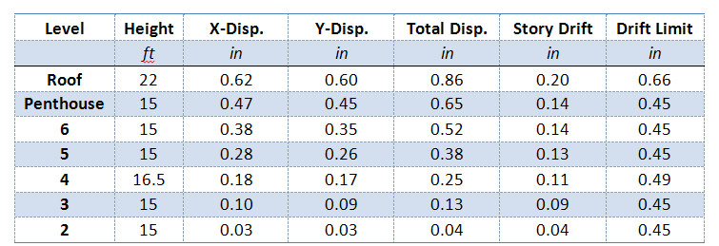
Children’s Hospital – Hershey Medical Center
Structural Depth
Wind Loading
  Recalculation of base shear due to increased story height
  ASCE 7-10 wind load cases applied
  Load Case 1 controlled in both directions
  Serviceability checked for H/400
3
D
C
Introduction
Existing Structural System
Thesis Proposal
Structural Depth
Slab Design
Shear Wall Design
Column Design
Construction Management Breadth
Conclusion
696.3 k
2
4
B
1
A
2109.76 k
Wind Base Shears
ASCE 7-10 Figure 27.4-8
Serviceability Check

Slide 13
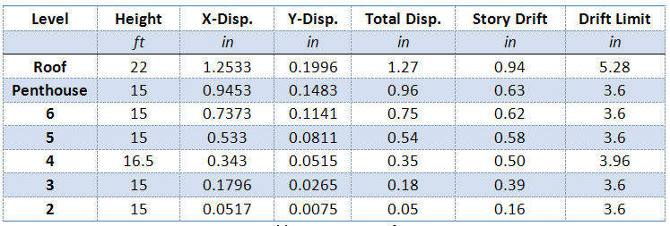
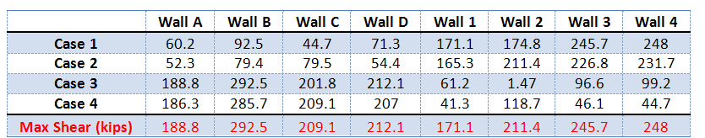
Children’s Hospital – Hershey Medical Center
Structural Depth
Seismic Loading
  Original response modification factor (R) = 3
  Ordinary reinforced concrete shear walls: R = 5, Cd = 4.5
  Base shear calculated for additional weight of the structure
  Accidental torsional effects e = 0.05
  Drift checked against 0.02hsx
Load Cases:
ASCE 7-10 Section 12.5.3 (a) - “the requirement for considering the orthogonal combination is deemed satisfied if members are designed for 100% of the forces for one direction plus 30% of the forces for the perpendicular direction.”
  30%Ex + 100%Ey
  30%Ex – 100%Ey
  100%Ey + 30%Ex
  100%Ey – 30%Ex
3
D
C
Introduction
Existing Structural System
Thesis Proposal
Structural Depth
Slab Design
Shear Wall Design
Column Design
Construction Management Breadth
Conclusion
850 k
2
4
B
1
A
850 k
Seismic Base Shears
Drift Limits

Slide 14
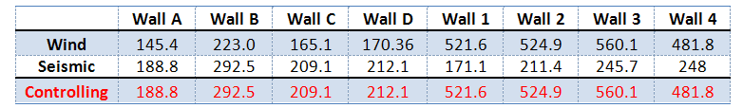
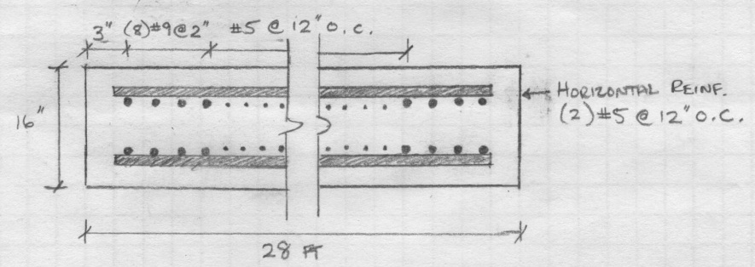
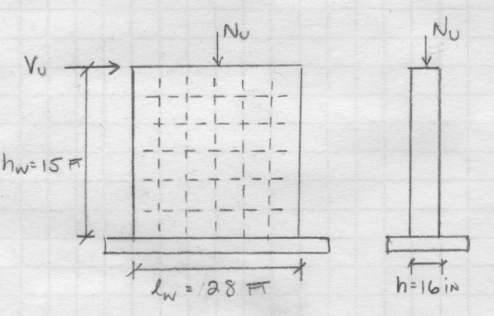
Children’s Hospital – Hershey Medical Center
Structural Depth
Shear Wall Design
  Designed using ACI 318-08 Section 11.9 – “Provision for Walls”
  Design with controlling shear for each wall
  Wall 3 experienced greatest lateral force
  Load combination:
    1.2D + 1.6L + 1.0L
Final Design
3
D
C
4
2
Introduction
Existing Structural System
Thesis Proposal
Structural Depth
Slab Design
Shear Wall Design
Column Design
Construction Management Breadth
Conclusion
B
1
A
Maximum Wall Shear Forces

Slide 15
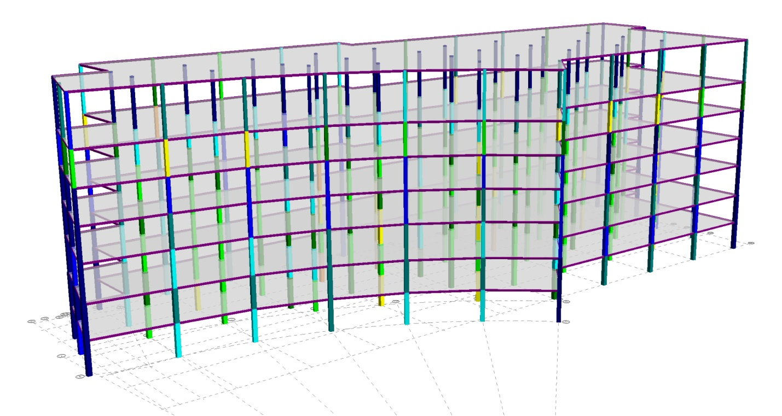
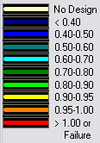
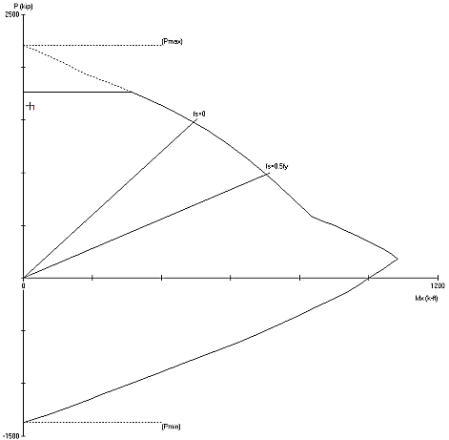
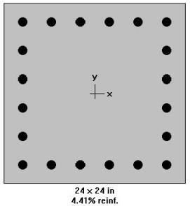
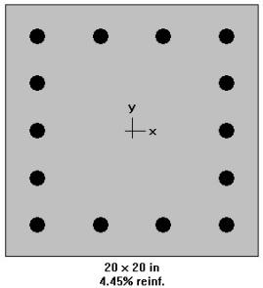
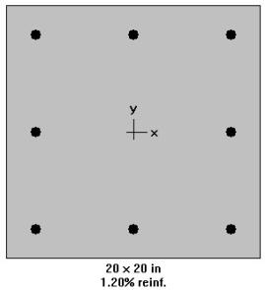
Children’s Hospital – Hershey Medical Center
Structural Depth
Column Design
  Designed in RAM Structural System
  All columns are square geometry
  Three columns sizes
    24” x 24”
    20” x 20”
    18” x 18”
  Reinforcement pattern:
    14 bars, long. #6-#10 (four faces), transverse #3
    16 bars long. #6-#10 (four faces), transverse #3
    20 bars long. #6-#10 (four faces), transverse #3
Introduction
Existing Structural System
Thesis Proposal
Structural Depth
Slab Design
Shear Wall Design
Column Design
Construction Management Breadth
Conclusion
Load Capacity Ratios

Slide 16
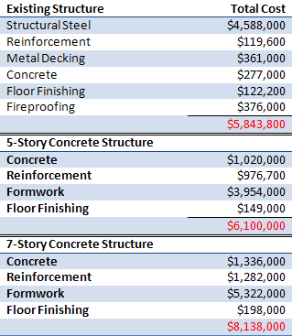
Children’s Hospital – Hershey Medical Center
Construction Management Breadth
Cost Analysis
  Costs determined from RS Means data
  Accounts for material, labor, and equipment costs
  Equivalent structure difference of = $256,000
Introduction
Existing Structural System
Thesis Proposal
Structural Depth
Slab Design
Shear Wall Design
Column Design
Construction Management Breadth
Conclusion

Slide 17
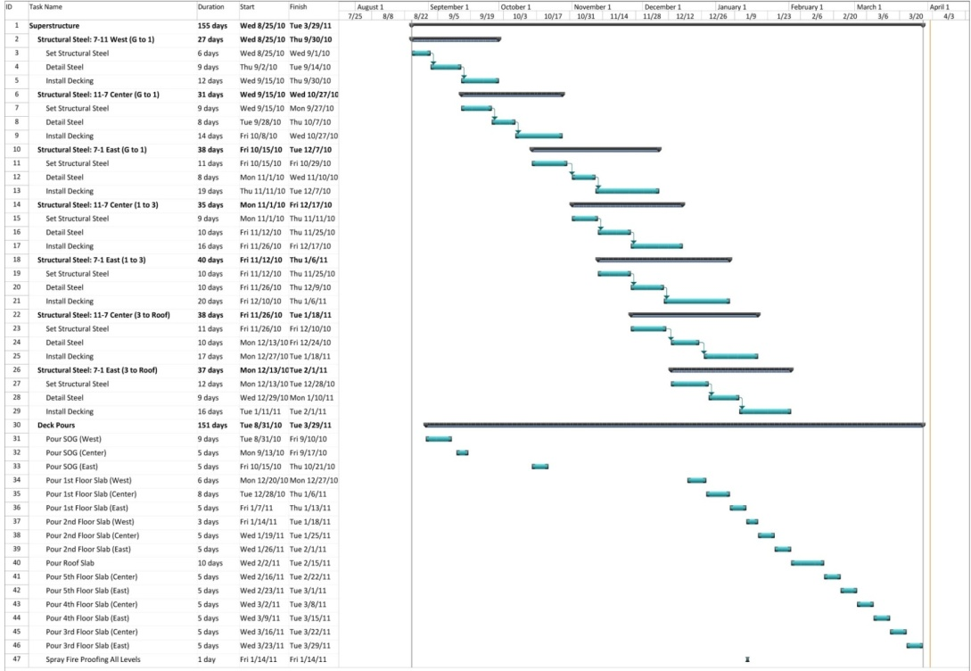
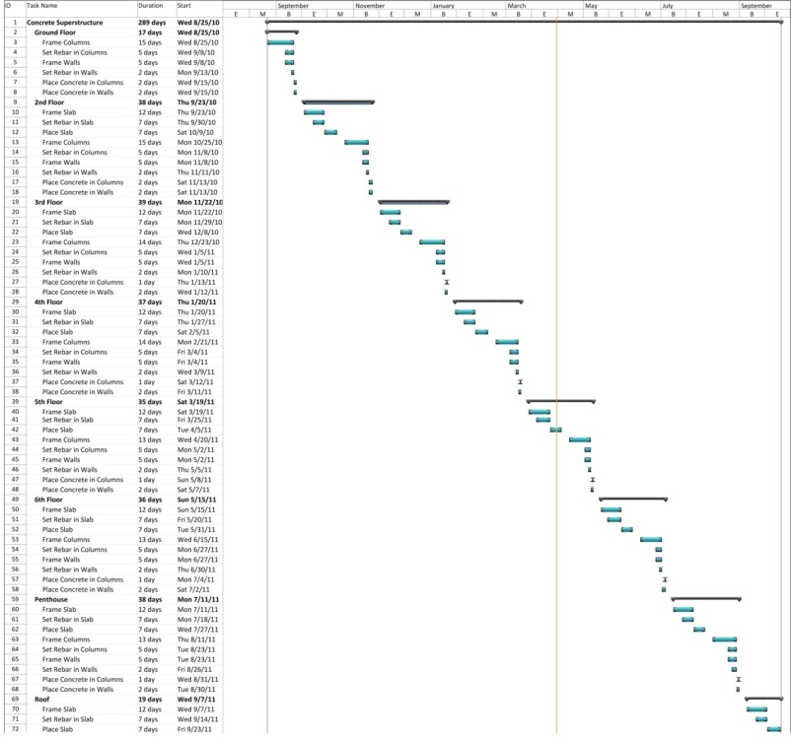
Children’s Hospital – Hershey Medical Center
Construction Management Breadth
Schedule Impact
  Assumptions
    Multiple crews per task
    For an ideal construction process
    Based on RS Means output
  Existing Schedule
    Projected 155 days
  Proposed Schedule
    Completed 7-story design in 289 days
    Equivalent 5 story design in 212 days
Introduction
Existing Structural System
Thesis Proposal
Structural Depth
Slab Design
Shear Wall Design
Column Design
Construction Management Breadth
Conclusion
Existing Schedule
Proposed Schedule

Slide 18
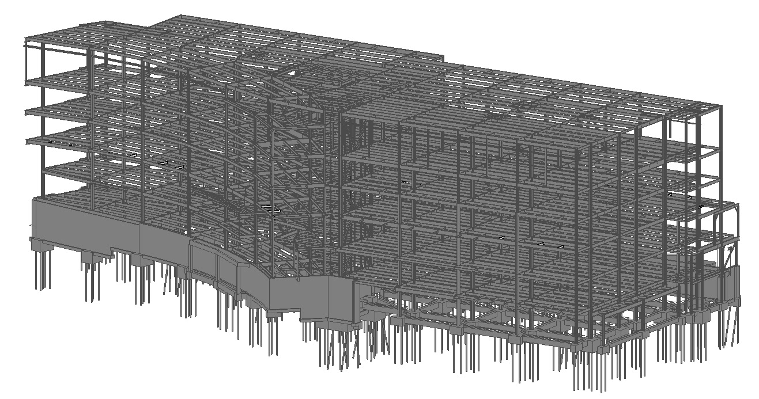
Children’s Hospital – Hershey Medical Center
Conclusion
Goals:
  Structural layout impact minimized
  Floor depth was minimized
  Longer construction time frame
Recommendation:
  Concrete redesign can not be recommended
  Foundation would need to be checked and resized
Introduction
Existing Structural System
Thesis Proposal
Structural Depth
Slab Design
Shear Wall Design
Column Design
Construction Management Breadth
Conclusion

Slide 19
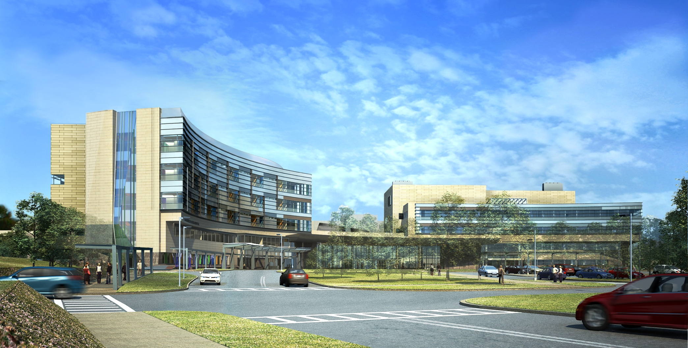
Children’s Hospital – Hershey Medical Center
Questions / Comments
Acknowledgements:
  Earl Roberts (Owner Representative)
  PSU Architectural Engineering Faculty
  Payette Associates Inc.
  L.F. Driscoll Company, LLC
  Gannett Fleming Inc.

