Slide 1



Slide 2
BIM Ex Plan
Research
Integration
Model
Codes
Looking Forward

Slide 3

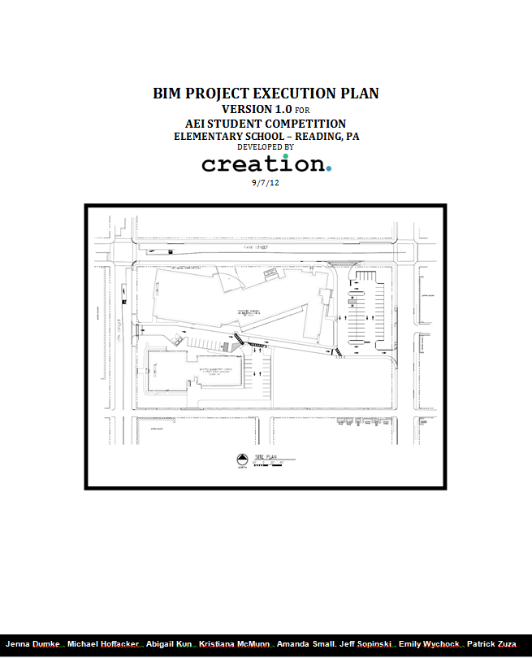
Integration
Bim Ex Plan
Research
Integration
Model
Codes
Looking Forward

Slide 4
Integration
Bim Ex Plan
Research
Integration
Model
BIM Project Execution Plan Overview
Codes
Looking Forward
  Mission Statement
“Creation’s one true aim is to enhance the quality of the communities we work with through innovative ideas and sustainable design.”
  Project Mission Statement
“To create a ‘high performance’ elementary school that functions as a multipurpose space for the community through a collaborative, multi-disciplinary environment.”
-ingenuity -quality -enjoyment -integrity

Slide 5
Integration
Bim Ex Plan
Research
Integration
Model
BIM Project Execution Plan Overview
Codes
Looking Forward
Goals for Bim
    Design a constructable elementary school for the community
    Integrate on the design to enhance the building for a broader user group
    Incorporate energy efficiency while being mindful of cost by focusing on both short term and lifetime cost benefits
    Use BIM as a tool to improve our building design & construction process
    - Achieve LEED Certification for the building
- Understand the effects of discipline specific decisions on the broader project team

Slide 6
Integration
Bim Ex Plan
Research
Integration
Model
BIM Project Execution Project Schedule
Codes
Looking Forward

Slide 7
Integration
Bim Ex Plan
Research
Integration
Model
BIM Project Execution Roles & Organization
Codes
Looking Forward
For each phase of the project, the project team will
Check and ensure completeness and accuracy of model
Check & ensure completeness and accuracy of BIM Project Execution Plan
Coordinate all updates for individual models, specialized discipline models,
  and construction updates
Team Responsibilities
Develop BIM Model
Update & Synchronize changes with Central Files
Proper Maintenance of Model and File Saving
Maintain & Revise BIM Plan
Integrate Discipline Models into Architectural BIM Model

Slide 8
Integration
Bim Ex Plan
Research
Integration
Model
BIM Project Execution Roles & Organization
Codes
Looking Forward
Construction Management:
  Scheduling & Sequencing
  Site Logistics
  Equipment Procurement
  Cost Estimating
  Constructability Analysis
  4D Modeling Needs
  Construction Trends
  Clash Detection & Coordination
  Value Engineering
Lighting/Electrical
  Lighting Plan
  Power Plan
  Load Calculations
  Electrical Equipment Proposal
  Daylighting
  Clash Detection & Coordination
  Value Engineering
Mechanical
  Heating & Cooling Loading
  Mechanical System Design
  Plumbing Design
  Energy Saving Analysis
  Clash Detection & Coordination
  Value Engineering
Structural
  Structural System Design
  Analysis of Structural System Options
  Load Calculations
  Clash Detection & Coordination
  Value Engineering

Slide 9
Integration
Bim Ex Plan
Research
Integration
Model
BIM Project Execution Roles & Organization
Codes
Looking Forward
TASK | ROLE | Staff Size | Hours Planned | Weeks
Model Development | Architect(Collaborative) CM Electrical Lighting Mechanical Structural | 8 2 2 2 2 2 | 2 hrs/wk 8 hrs/wk 8 hrs/wk 8 hrs/wk 8 hrs/wk 8 hrs/wk | 3 8 8 8 8 8
Model Review | CM Electrical Lighting Mechanical Structural | 2 2 2 2 2 | 1 hr/wk 1 hr/wk 1 hr/wk 1 hr/wk 1 hr/wk | 16 16 16 16 16
Structural Analysis & Design | Structural | 2 | 10 hrs/wk | 8
Lighting/Electrical Analysis & Design | Lighting/Electrical | 2 | 10 hrs/wk | 8
Mechanical Analysis & Design | Mechanical | 2 | 10 hrs/wk | 8
LEED Certification Plus+ Reviews | Collaborative | 8 | 4 hrs/wk |  |  | 6
Schedule Development | Construction Manager | 2 | 5 hrs/wk |  |  | 2
Cost Estimating | Construction Manager | 2 | 10 hrs/wk |  | 2
Value Engineering | Collaborative | 8 | 3 hrs/wk |  | Ongoing
3D Coordination | Structural Lighting/Electrical Mechanical Construction Manager | 2 2 2 2 | 4 hrs/wk 4 hrs/wk 4 hrs/wk 7 hrs/wk |  | 3 3 3 3
4D Modeling | Construction Manager | 2 | 5 hrs/wk |  | 3

Slide 10
Integration
Bim Ex Plan
Research
Integration
Model
BIM Project Execution Software
Codes
Looking Forward
SOFTWARE | VERSION | PROJECT STAKE HOLDER | TASK TYPE
Revit | 2013 | ARCH | Design Authoring
3DS Max | 2013 | ARCH,L/E | Design Rendering
Revit MEP | 2013 | ME | Mechanical Authoring
Trane Trace | v700 | ME | Mechanical Calculations
Revit MEP | 2013 | L/E | Lighting/Electrical Authoring
ComCheck | 2013 | L/E | Lighting Requirements
DaySim | 2013 | L/E | Lighting Daylighting
Agi32 | Version 2.2 | L/E | L/E Calculations
ComFen | 2013 | L/E | Glazing Analysis
Revit Structure | 2013 | STRUCT | Structural Authoring
RAM | v14.03 | STRUCT | Structural Analysis
SAP | 2013 | STRUCT | Frame Analysis
Structure Point | 2013 | STRUCT | Structural Analysis
RS Means CostWorks | 2013 | CM | Cost Estimation
Primavera | 2013 | CM | Project Scheduling
Navisworks | 2013 | CM | 4D Modeling
Navisworks | 2013 | CM | Clash Detection
Record Modeling | 2013 | CM | Revit
Revit, Navisworks | 2013 | MEP,CM | Revit, Navisworks

Slide 11
Integration
Bim Ex Plan
Research
Integration
Model
BIM Project Execution File Naming
Codes
Looking Forward
FILE SHOULD BE NAMED ACCORDING TO THE FOLLOWING: AEITEAMNUMBER_DISCIPLINE_PHASE_DATE.XYZ
ARCHITECTURAL MODEL | AEI1_ARCH_SCHEMATIC_DATE.RVT
MECHANICAL/PLUMBING MODEL | AEI1_MECH_SCHEMATIC_DATE.RVT
ELECTRICAL MODEL | AEI1_ELEC_SCHEMATIC_DATE.RVT
LIGHTING MODEL | AEI1_LTG_SCHEMATIC_DATE.RVT
STRUCTURAL MODEL | AEI1_STRUCT_SCHEMATIC_DATE.RVT
CONSTRUCTION MODEL | AEI1_CONST_SCHEMATIC_DATE.RVT
COORDINATION MODEL | AEI1_COORD_SCHEMATIC_DATE.RVT
ENERGY MODEL | AEI1_ENERGY_SCHEMATIC.RVT

Slide 12
Integration
Bim Ex Plan
Research
Integration
Model
BIM Project Execution Quality Control
Codes
Looking Forward
CHECKS | DEFINITION | RESPONSIBLE PARTY | RECOMMENDED PROJECT MILESTONES
Visual | Ensure there are no unintended model components and the design intent has been followed | ALL | Daily
Interference Check | Ensure there are no collisions among disciplines through clash detection methods | CM | Daily
Model Integrity | Ensure that the BIM model has no undefined, incorrectly defined, or duplicated elements; ensure a reporting process and corrective action plans have been developed for noncompliant elements; ensure all disciplines are using same origin and dimension scale | All | Daily

Slide 13

Structural
Bim Ex Plan
Research
Integration
Model
Codes
Looking Forward
Local Materials
Recyclability/ Reusability
Efficient Systems
Informed Decisions

Slide 14
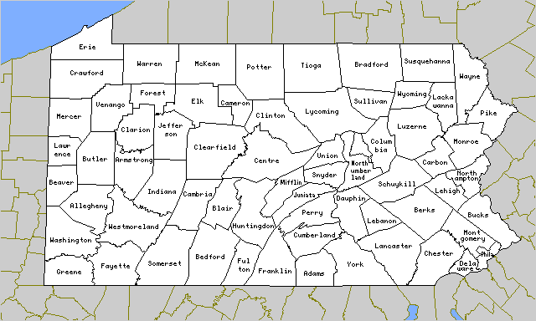

Structural
Bim Ex Plan
Research
Integration
Model
Local Materials
Codes
Looking Forward
Native wood products
Local vendors
All images from google.com

Slide 15
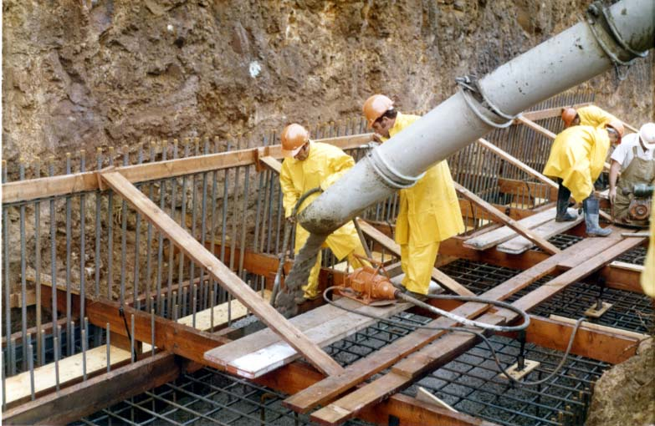
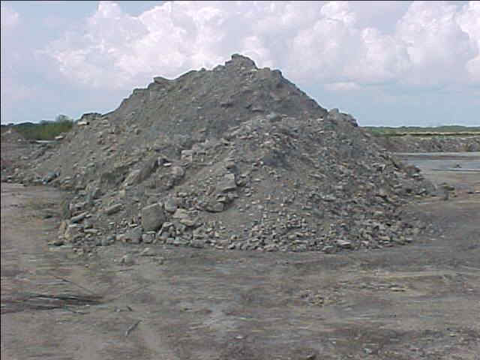
Structural
Bim Ex Plan
Research
Integration
Model
Recyclability/ Reusability
Codes
Looking Forward
Reduce cement CO² emissions
  Fly ash
  Slag
Ground up concrete for parking lot
All images from google.com

Slide 16
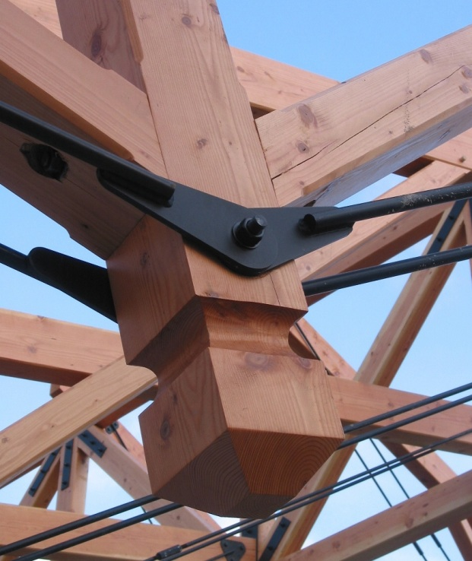
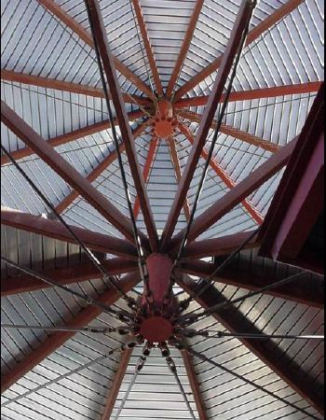
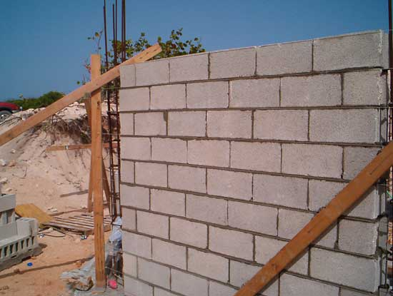
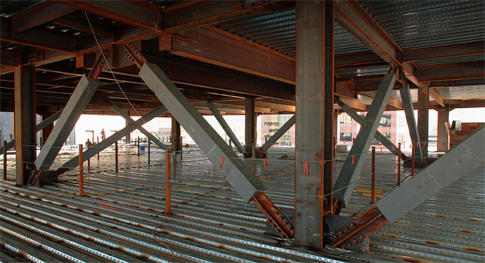
Structural
Bim Ex Plan
Research
Integration
Model
Efficient Systems
Codes
Looking Forward
Combine materials to optimize the performance of each
Braced frame
CMUs
Metal stud walls
All images from google.com

Slide 17

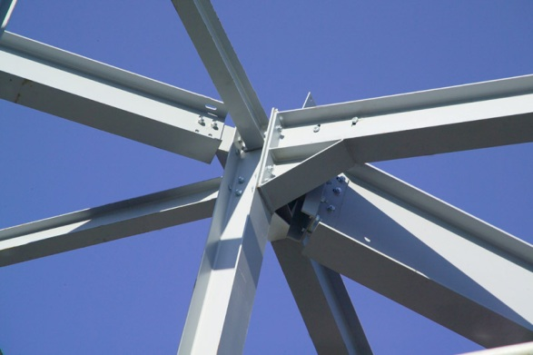
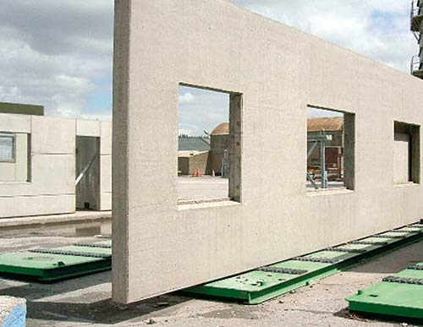
Structural
Bim Ex Plan
Research
Integration
Model
Informed Decisions
Codes
Looking Forward
Recovery time after high wind or seismic event
Bolted connections
Prefabricated materials & precast concrete
All images from google.com

Slide 18

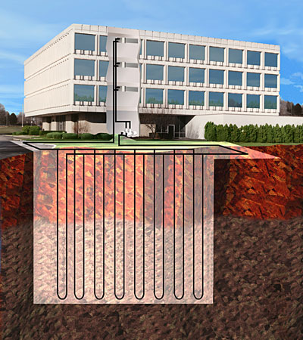
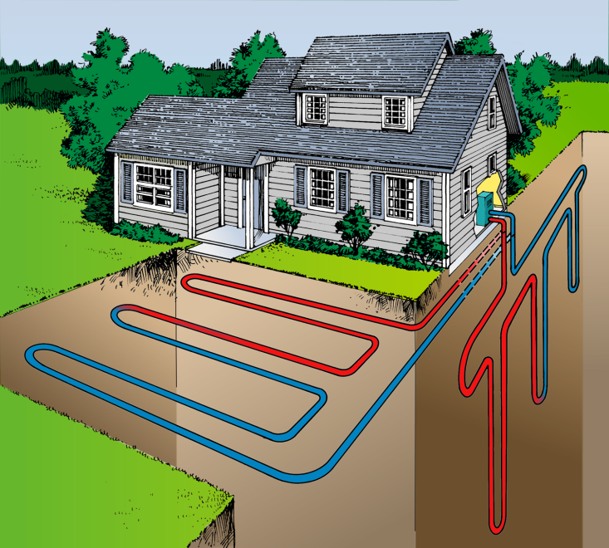
Mechanical
Bim Ex Plan
Research
Integration
Model
Codes
Looking Forward
Mechanical System Options
Geothermal Heat Pump with Ground Loops
Advantages
No boiler necessary
Good controllability
Simultaneous heating and cooling
Good for larger buildings
Disadvantages
Higher first cost
Requires large footprint
Notes:
no boiler necessary, extracts natural heat from Earth
Move energy efficiently- (efficiently cool and heat separate zones simultaneously)- each unit controls only its space
need space- currently have small site footprint so may have to use vertical loops

Slide 19
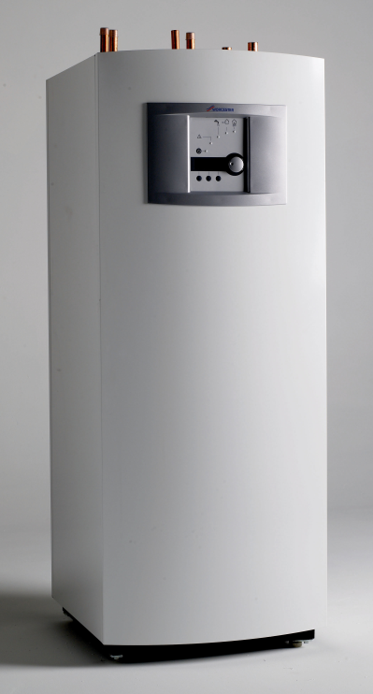
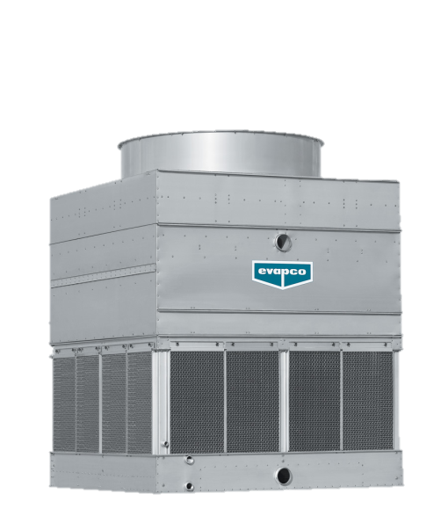
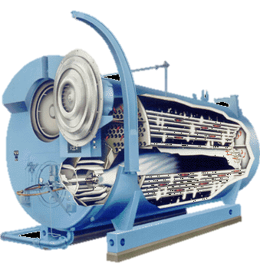
Mechanical
Bim Ex Plan
Research
Integration
Model
Codes
Looking Forward
Mechanical System Options
Water Source Heat Pump
Advantages
Less initial cost
Good controllability
Simultaneous heating and cooling
Good for larger buildings
Disadvantages
Requires boiler & cooling tower
Can leak humidity indoors while unit is off
Does not address latent load effectively
Notes:
Move energy efficiently- (efficiently cool and heat separate zones simultaneously)- each unit controls only its space
Need boiler- must accommodate emissions, noise, maintenance cost
Does not address latent load effectively, this could especially be a problem in highly populated areas in gymnasium or library areas

Slide 20
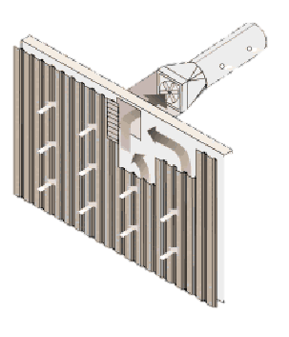
Mechanical
Bim Ex Plan
Research
Integration
Model
Codes
Looking Forward
Mechanical System Options
Solar Wall
Heats air before entering building system
75% efficient
South facing solar- air absorbs wall warmth
Maintenance free
1SF of collection wall produces 4-10CFM warm air
Keys for using
South facing wall
Good for large ventilation loads
For cooling- bypass

Slide 21

Mechanical
Bim Ex Plan
Research
Integration
Model
Codes
Looking Forward
LEED Design Ideas
Water use reduction
Enhanced refrigeration management
Tobacco smoke control
Outdoor air delivery monitoring
Increased ventilation
Thermal comfort
Notes:
Need mention of tobacco smoke?? Smoking isn’t typically allowed on school ground

Slide 22

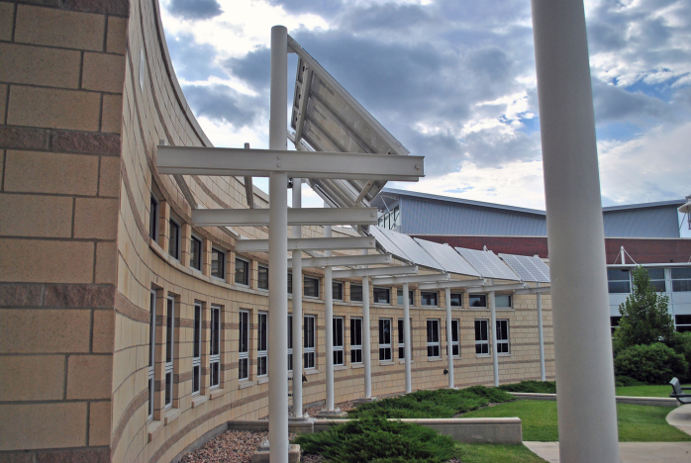

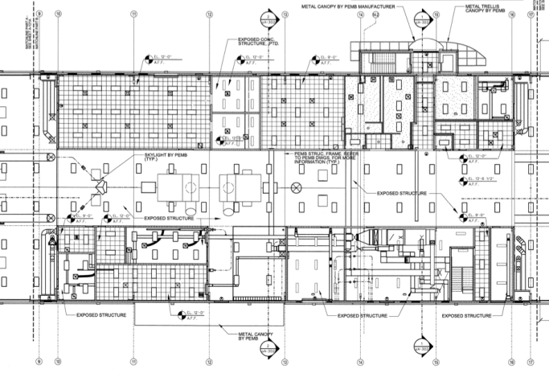

Lighting/Electrical
Bim Ex Plan
Research
Integration
Model
Codes
Looking Forward
Electrical Design
Lighting Layout & Circuiting
Switching/Controls
Receptacle/AV Layout
Fire Alarm/Security Design
Supplemental Energy
Photovoltaics/Solar Arrays
Solar Panel Windows
Solar Roofing Material
Solar Heat Harvesting
All images from google.com

Slide 23
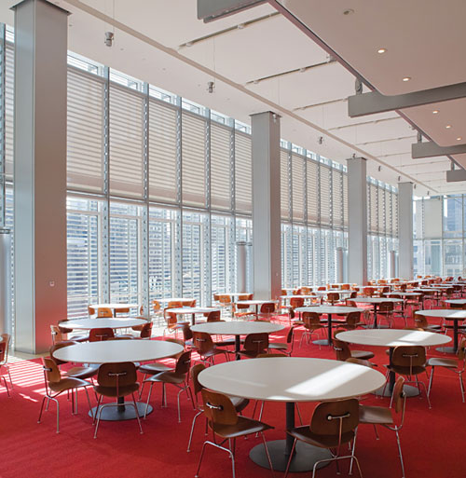
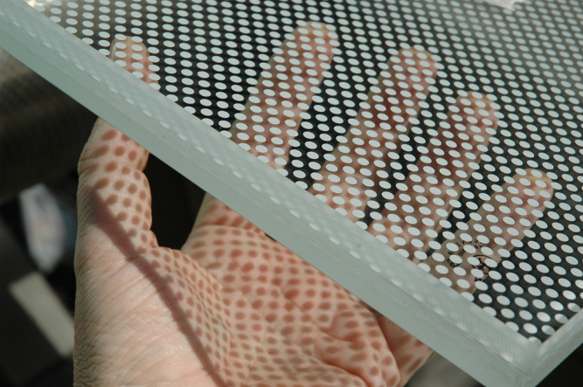
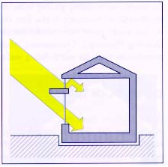
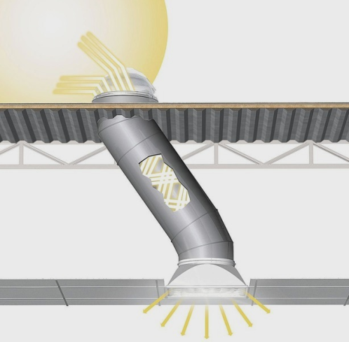
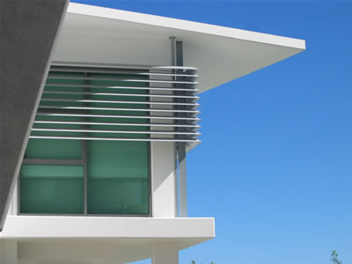
Lighting/Electrical
Bim Ex Plan
Research
Integration
Model
Codes
Looking Forward
Daylighting
Solatubes
Clerestories
Sky lights
Light shelves
Overhangs
Vertical fins
louvers
Shading
Roller Shades
  Automated?
Window Glazing
Frit
All images from google.com

Slide 24

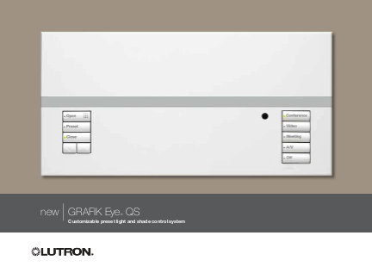

Lighting/Electrical
Bim Ex Plan
Research
Integration
Model
Codes
Looking Forward
Lighting
LEDs
High efficiency lamps and ballasts
Indoor and Outdoor Fixtures
Controls
Grafik Eye
Scene Control
Dimming
Photosensors
Occ./Vacancy Sensors
Override Switches
Switching Panelboards
All images from google.com

Slide 25
Lighting/Electrical
Bim Ex Plan
Research
Integration
Model
Codes
Looking Forward
LEED Design Ideas
Lighting Controls
Daylight Harvesting
Mercury Reduction
On-Site Renewable Energy
Light Trespass Reduction
Innovative Low-Energy Lighting Design
All images from google.com

Slide 26

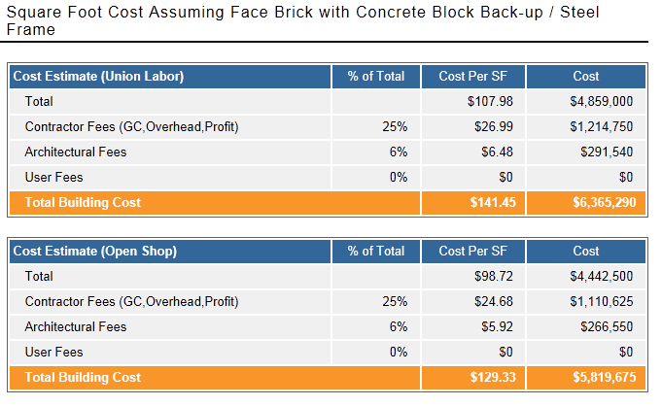
Construction Management
Bim Ex Plan
Research
Integration
Model
Funding & costs
Codes
Looking Forward
Project Delays
State Funding
Costs
Reading, PA
1 Story
45000 SF
Union vs. Open Shop
http://www.reedconstructiondata.com/rsmeans/models/elementary-school/pennsylvania/reading/
All images from google.com

Slide 27
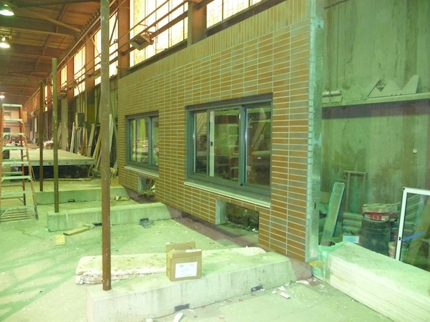
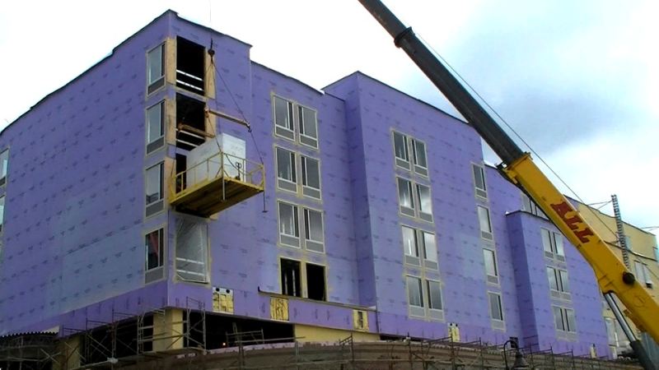
Construction Management
Bim Ex Plan
Research
Integration
Model
Prefabrication & Modularization
Codes
Looking Forward
Benefits of Prefabrication
Quality
Cost
Schedule
Safety
Opportunities
Mechanical Systems
Electrical Systems
Redundant construction
(i.e. Classrooms)
Bathroom Pods
All images from google.com

Slide 28
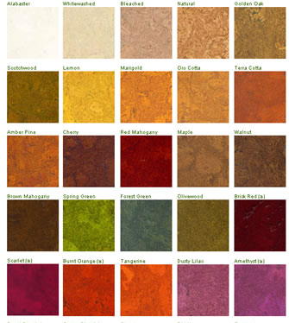
Construction Management
Bim Ex Plan
Research
Integration
Model
Sustainable Materials
Codes
Looking Forward
Sustainability- The Capacity to endure
Possible Materials:
Cork Flooring
Agricultural Waste Products
Green Roof & Cool Roof
Supplementary Cementitious
Materials
All images from google.com

Slide 29
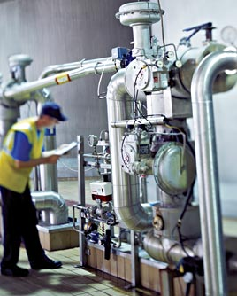
Construction Management
Bim Ex Plan
Research
Integration
Model
Proactive Commissioning Plan
Codes
Looking Forward
Proactive - acting in anticipation of future problems, needs, or changes
Commissioning Goals:
Optimize Energy Use
Minimize Operating Costs
Ensure Proper Building Systems Documentation
All images from google.com

Slide 30
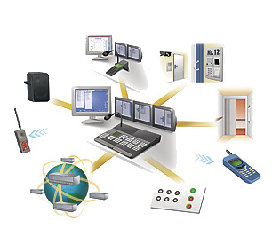
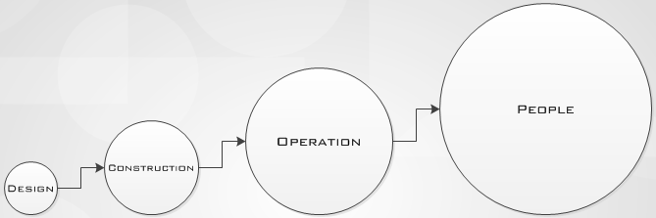
Construction Management
Bim Ex Plan
Research
Integration
Model
Operations & Maintenance
Codes
Looking Forward
Carry design and construction earned benefits through to operations

Slide 31
Integration
Bim Ex Plan
Research
Integration
Model
Codes
Looking Forward

Slide 32
Integration
Bim Ex Plan
Research
Integration
Model
Codes
Looking Forward
A Few Examples of Integration Points
Coordination of plenum space between MEP
Scheduling of building process
Effects of materials on other designs

Slide 33


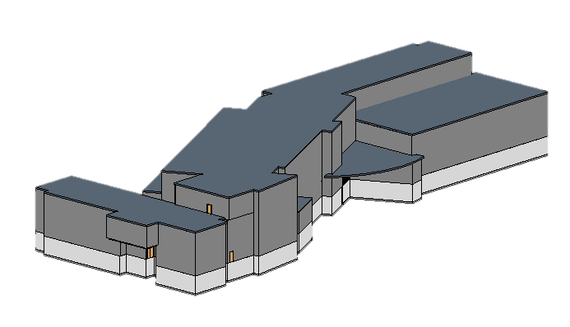
Bim Ex Plan
Research
Integration
Model
Codes
Looking Forward
Northeast Isometric

Slide 34
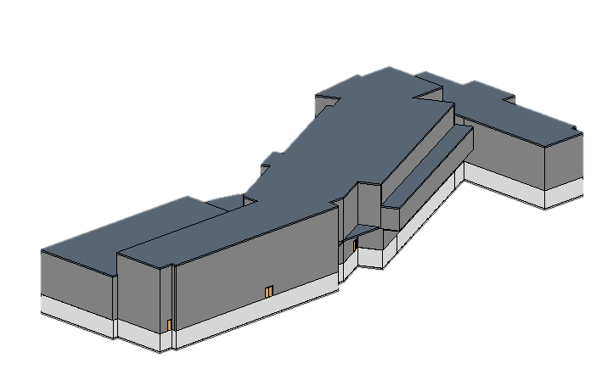
Bim Ex Plan
Research
Integration
Model
Codes
Looking Forward
Southwest Isometric

Slide 35
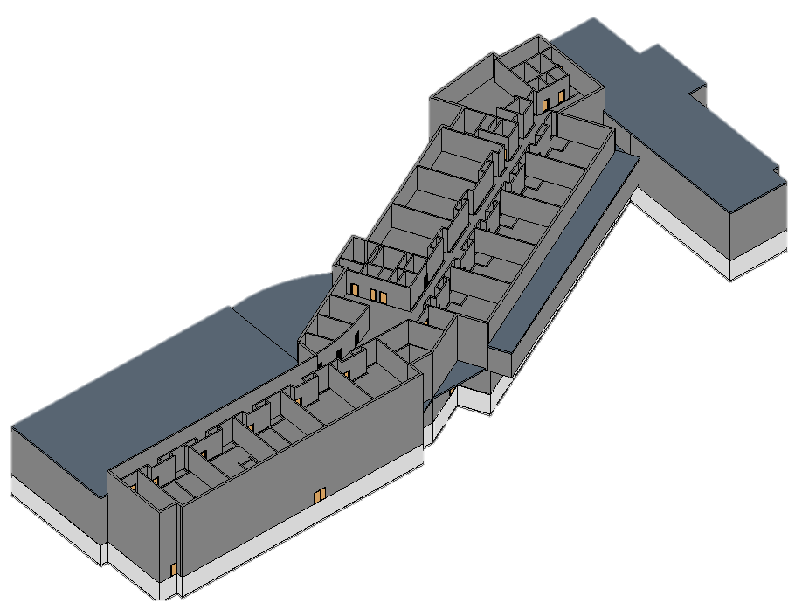
Bim Ex Plan
Research
Integration
Model
Codes
Looking Forward

Slide 36
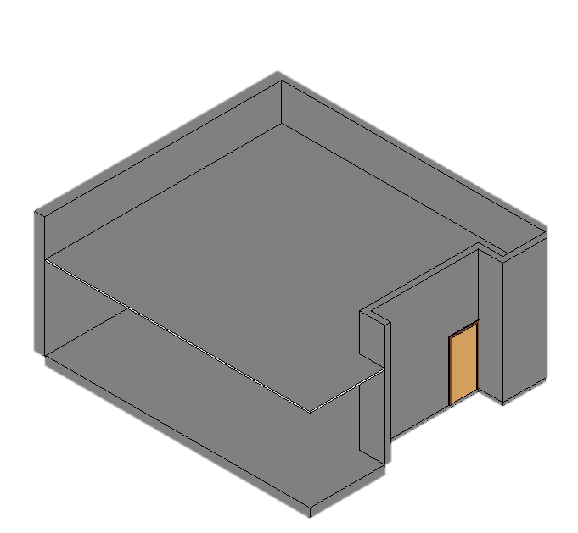
Bim Ex Plan
Research
Integration
Model
Codes
Looking Forward
Individual Ceilings
Plenum Space
14’ Walls
Generic Wall Type
Individual floors

Slide 37
Bim Ex Plan
Research
Integration
Model
Codes
Looking Forward
Construction Codes PA Uniform Construction Code International Building Code OSHA Standards NFPA ADA | Mechanical Codes IMC ASHRAE 62.1 ASHRAE 55 ASHRAE 90.1
Lighting/Electrical Codes ASHRAE Standard 90.1 2009 NEC 2009 Reference – IESNA Lighting Handbook 2011 | Structural Codes PA Uniform Construction Code International Building Code 2009 ASCE7

Slide 38
Bim Ex Plan
Research
Integration
Model
Codes
Looking Forward
Looking forward
  Aware of Community
  Team Effectiveness
  All Encompassing
  Innovative Ideas

Slide 39
Bim Ex Plan
Research
Integration
Model
Codes
Looking Forward
Deliverables
  Development of System Designs
  Create Architectural Appeal
  Develop Model to LOD 200+
  Preliminary Cost & Schedule
      Rom
      Assemblies Estimate

Slide 40





Mechanical
Lighting/electrical
Integration
Construction
management
structural

