Slide 1
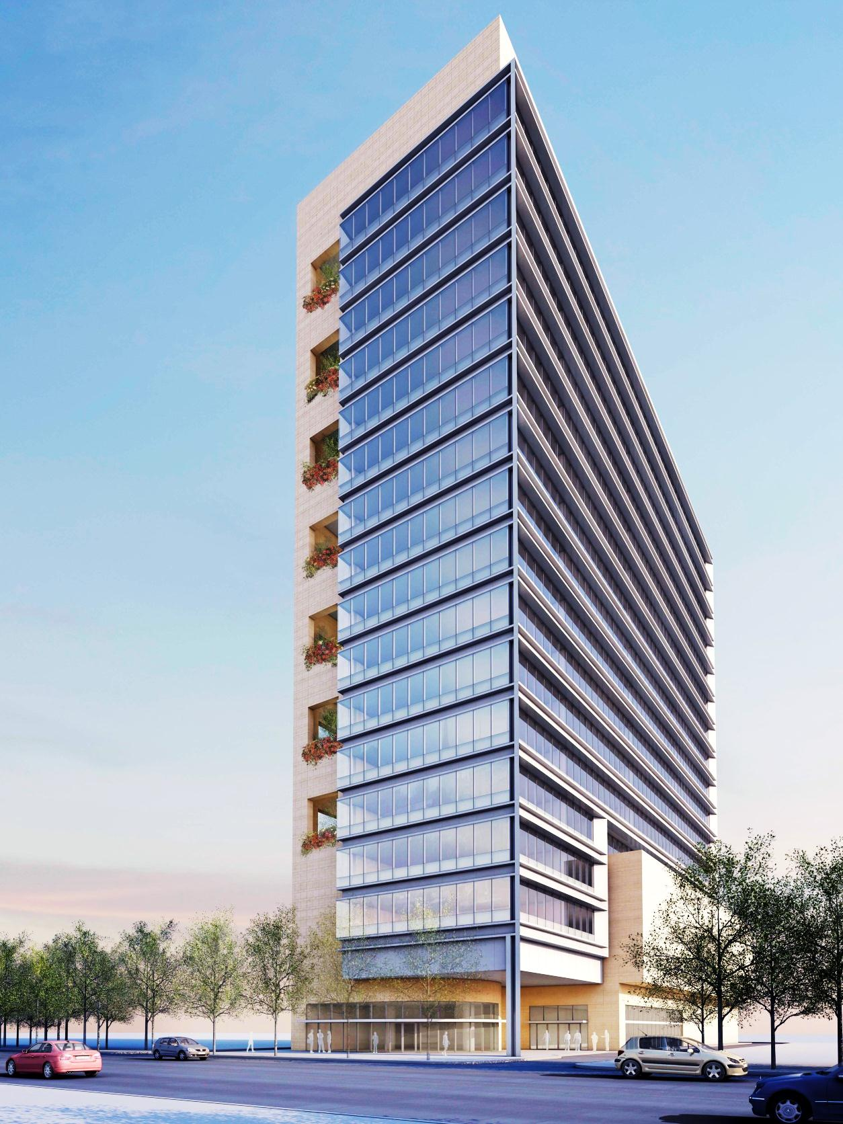
Signature Boutique Offices , India
The Optimus
AE Senior Thesis 2013
Punit G. Das | Structural Option
Faculty Advisor: Dr. Linda Hanagan
Notes:
Personal introduction

Slide 2
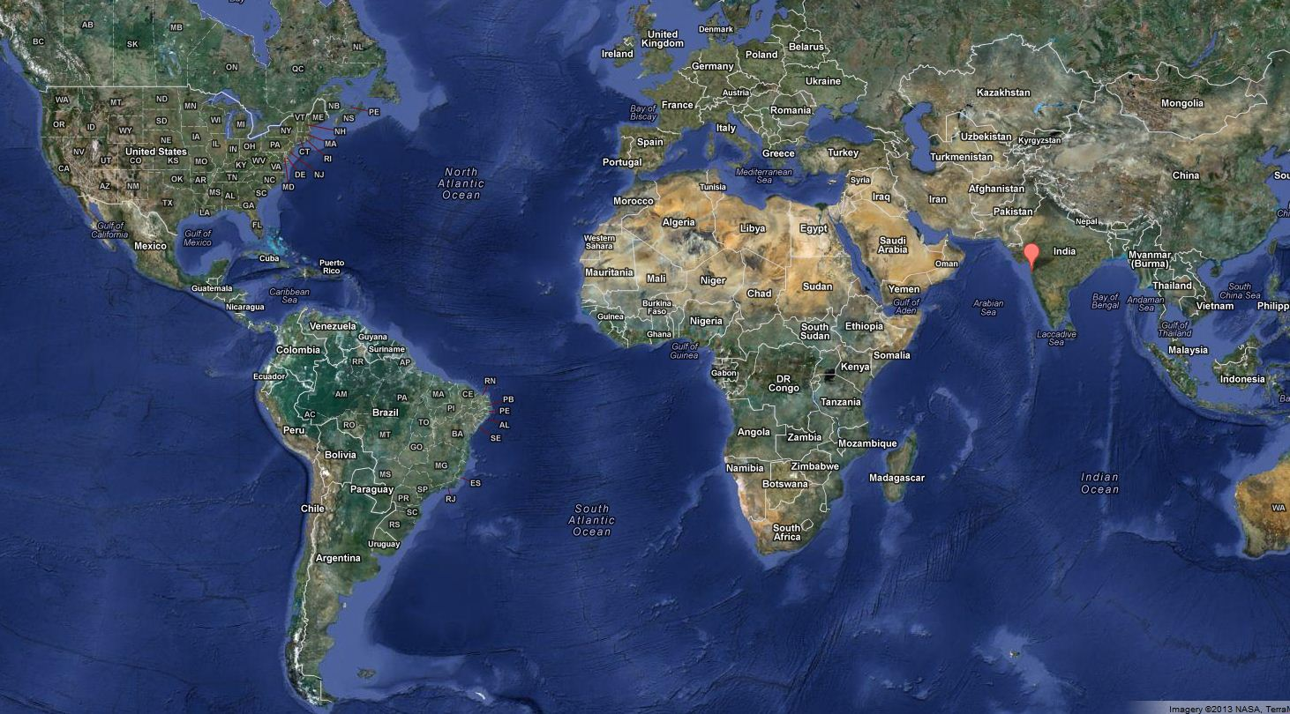
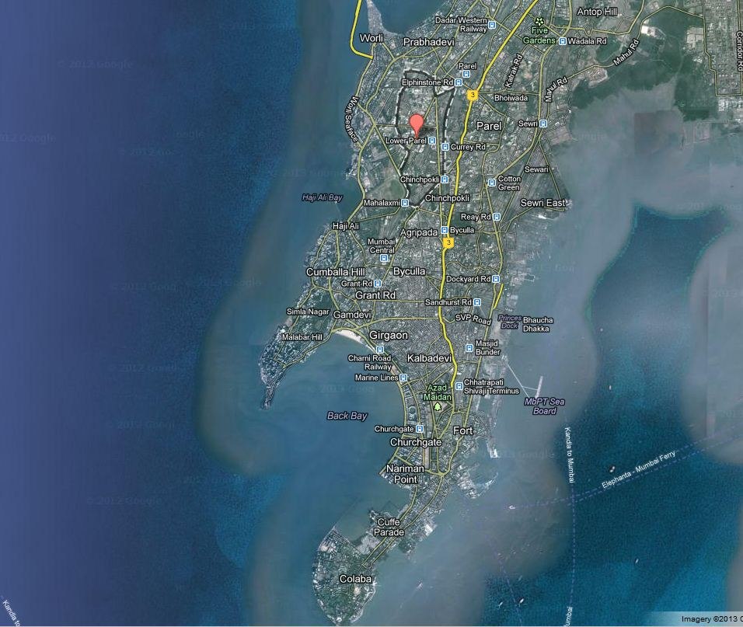
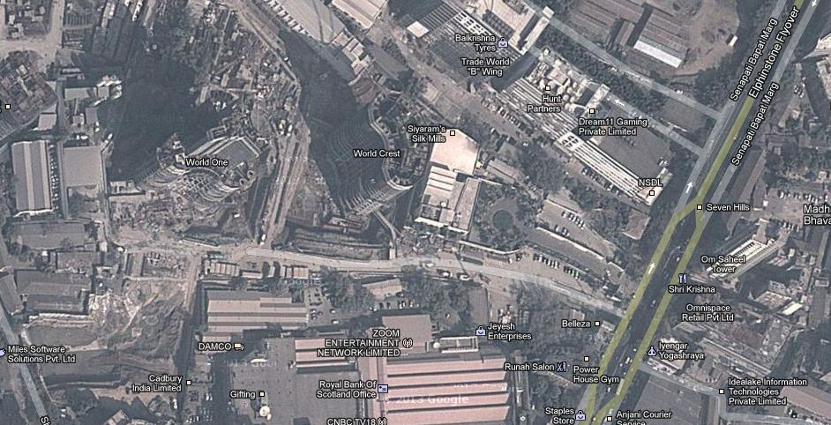
Building Information
Location and Site Map
Building Information
Existing structural system
Thesis Statement
Thesis Solution
Gravity System
Composite Floor system
Lateral System
Moment Connection Design
Effect on foundations
Conclusion
Office + Parking garage + Retail
Ground + 17 floors
430,000 sq. ft.
Max height: 230 ft.
January 2012 – October 2013
The Optimus | India
Main Street

Slide 3


Project Team
Building Information
Existing structural system
Thesis Statement
Thesis Solution
Gravity System
Composite Floor system
Lateral System
Moment Connection Design
Effect on foundations
Conclusion
Owner + Project Manager + General Contractor: Lodha Group
Architect: Pei Cobb Freed & Partners, New York
Local Architect: Edifice Consultants Pvt. Ltd.
Structural Engineer: Leslie E. Robertson Associates
MEP Consultant: Spectral Consultants Pvt. Ltd.
Lighting Designer: George Sexton Associates
The Optimus | India

Slide 4
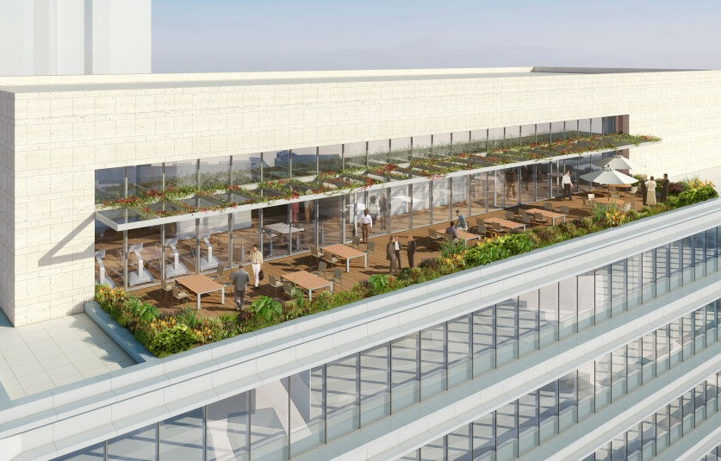
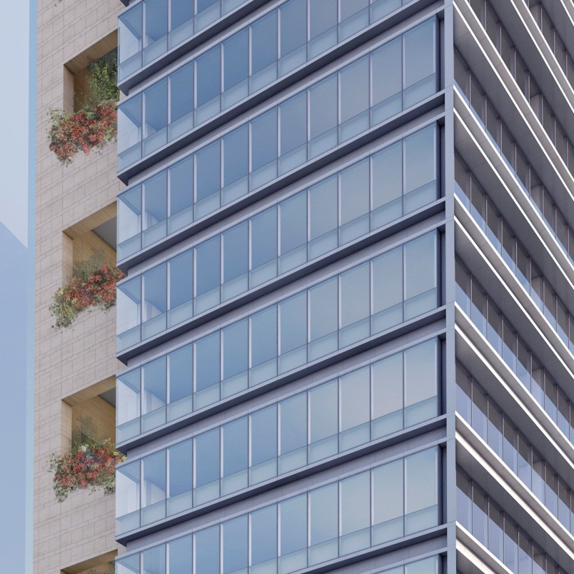
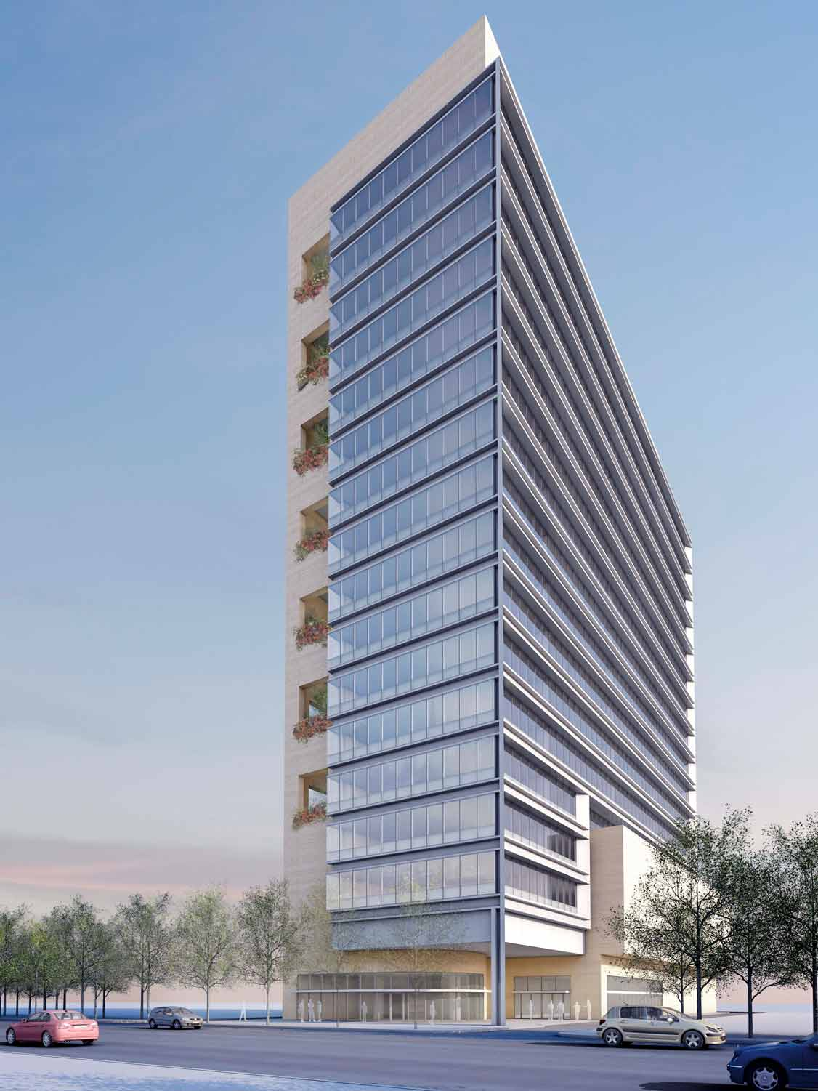
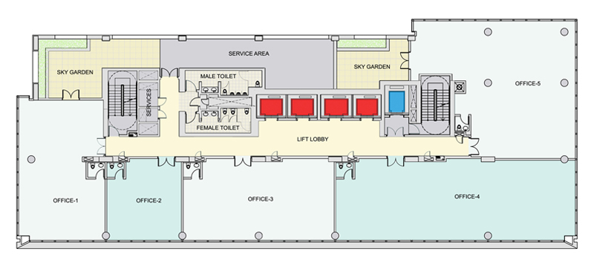
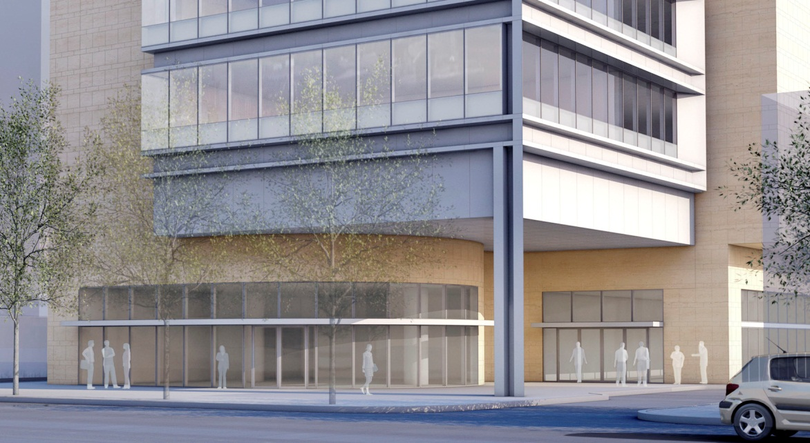
Building Information
Architecture
Open Floor Plan
South facing offices for panoramic views
Balconies on every floor
Façade: Glass + Aluminum + Stone, designed for
Roof garden + Cafeteria + Gymnasium
Building Information
Existing structural system
Thesis Statement
Thesis Solution
Gravity System
Composite Floor system
Lateral System
Moment Connection Design
Effect on foundations
Conclusion
The Optimus | India
Balcony
South facing offices

Slide 5
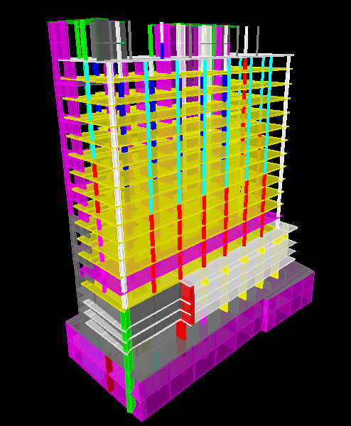
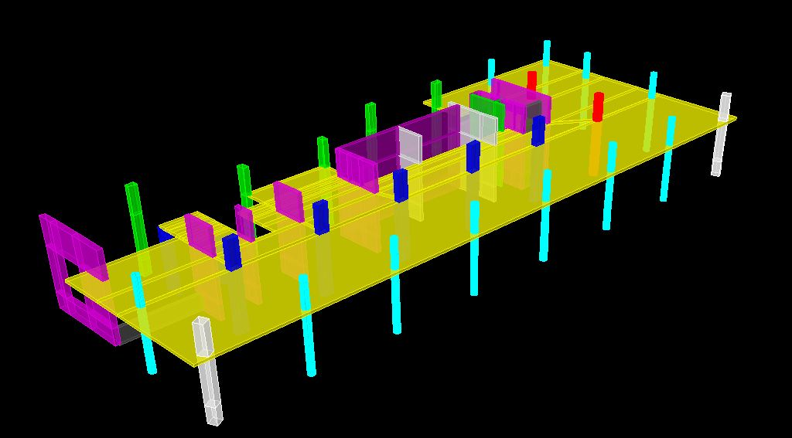
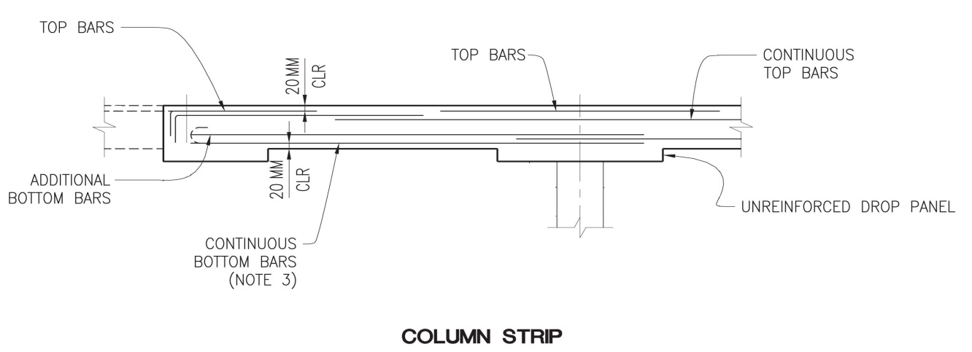
Existing Gravity System
Building Information
Existing structural system
Thesis Statement
Thesis Solution
Gravity System
Composite Floor system
Lateral System
Moment Connection Design
Effect on foundations
Conclusion
Open floor plan: Perimeter columns + 1 row of interior columns
8” flat slabs with additional 8” drop panels
3’x1.5’ to 3’x7’ rectangular columns for parking space
1.5’ to 3’ diameter circular columns in office spaces
Building façade supported at cantilevered slab edges
Concrete strength range from 5000 psi to 7000 psi
The Optimus | India
Architecture

Slide 6
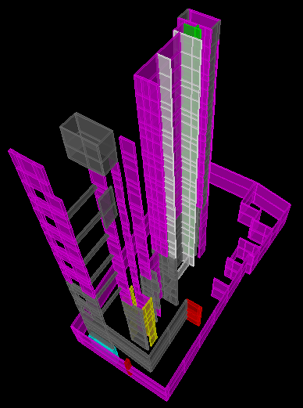
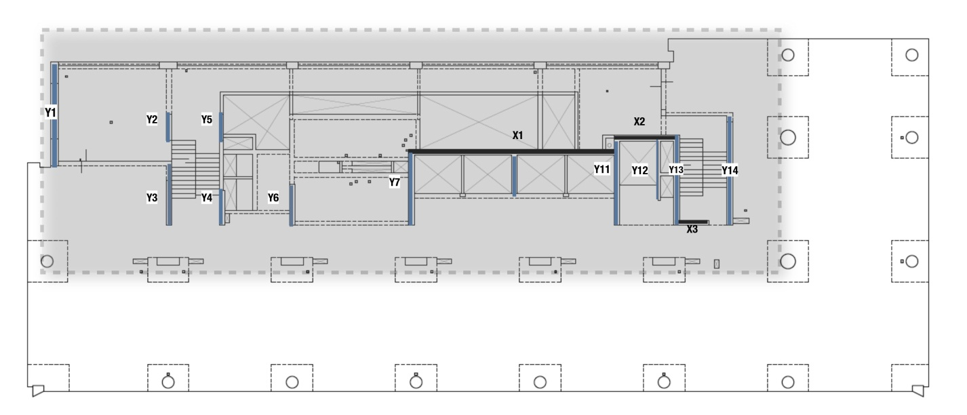
Existing Lateral System
Building Information
Existing structural system
Thesis Statement
Thesis Solution
Gravity System
Composite Floor system
Lateral System
Moment Connection Design
Effect on foundations
Conclusion
Reinforced concrete shear walls ranging from 12” to 20”
8 ft. to 25ft. walls in North-South direction and 47 ft. wall in East-West direction
Shear walls wrap the elevator shaft and stairwells
Due to proximity to the Arabian sea, wind loads control the lateral system
The Optimus | India
Architecture
Facades
Shear wall layout

Slide 7
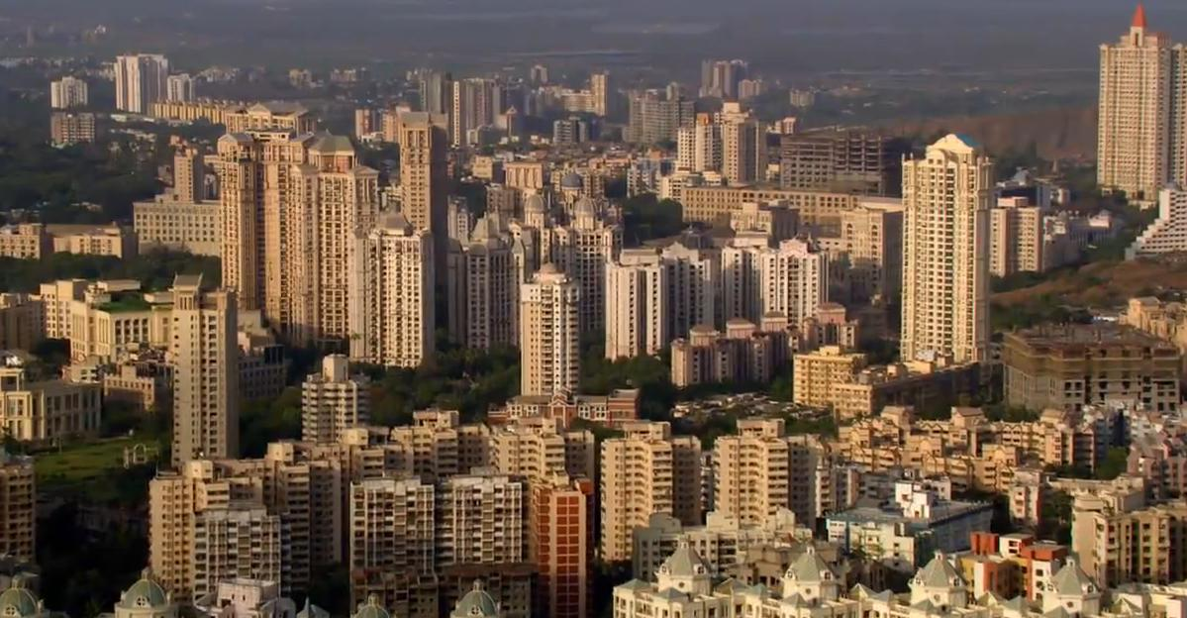
Concrete in India
Mumbai
Concrete is a most prevalent building material
Mumbai is called Concrete Jungle
Client’s perception that concrete is cheap
Cheap labor
Cheap design consultation
Concrete design is comfort zone of most architects and engineers
Lack of steel construction firms
Building Information
Existing structural system
Thesis Statement
Thesis Solution
Gravity System
Composite Floor system
Lateral System
Moment Connection Design
Effect on foundations
Conclusion
The Optimus | India
Architecture
Facades
Image Courtesy of www.skyscrapercity.com

Slide 8
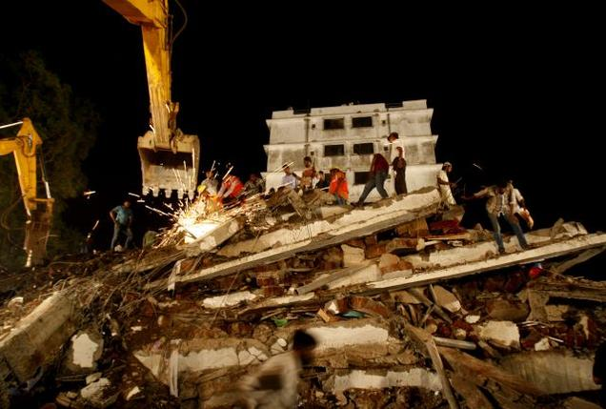
Problems with concrete
Building collapse in Mumbai
Building Information
Existing structural system
Thesis Statement
Thesis Solution
Gravity System
Composite Floor system
Lateral System
Moment Connection Design
Effect on foundations
Conclusion
Environmental impact
Hard to maintain quality control in India
Cheap labor can sometimes be harmful.
Member sizes get huge with taller buildings
Future challenges require alternate materials
The Optimus | India
Architecture
Facades
Image Courtesy of The Hindu Newspaper
Notes:
Problem:
The construction of the building follows the general trend of concrete construction that has been followed in india.
Concrete is said to be a profitable choice as it is a more prevalent material.
Labor is cheap for concrete construction, “The average salary of an on-site worker on a construction projetc is ____ INR which converts to ____USD.
Longer construction time, dust and noise becomes a nuisance in a densely constructed city like mumbai, in tight sight conditions → high rise construction results in large columns and walls sizes.
Does not provide space for future in an ever-growing city like mumbai.
Environmental impacts of using concrete.
SPACE challenge: densest city on planet earth. ¾ size of NYC.

Slide 9
Solution
Thesis Preview
Building Information
Existing structural system
Thesis Statement
Thesis Solution
Gravity System
Composite Floor system
Lateral System
Moment Connection Design
Effect on foundations
Conclusion
Analyze and design of gravity members
Analyze and design lateral system
Typical steel-connection design
Cost-benefit analysis
Integration and optimization with architecture
Integration and optimization of facade
Explore benefits of Steel design
Requires less but skilled labor
Quality control easier
Taller building can have smaller members
Reduced weight of overall structure
The Optimus | India
Architecture
Facades
Notes:
Solution:
Therefore, solution is steel
Environmental benefits, less reliance on scarce resources like water.
Structure uses less space
Faster construction
less disturbance to surrounding building in terms on pollution
Highrise building can be constructed faster → catch up with economic growth of china and other fst growing eastern economies
It has already embraced steel conctruction : mumbai airport, 40 story tallest steel building in india

Slide 10
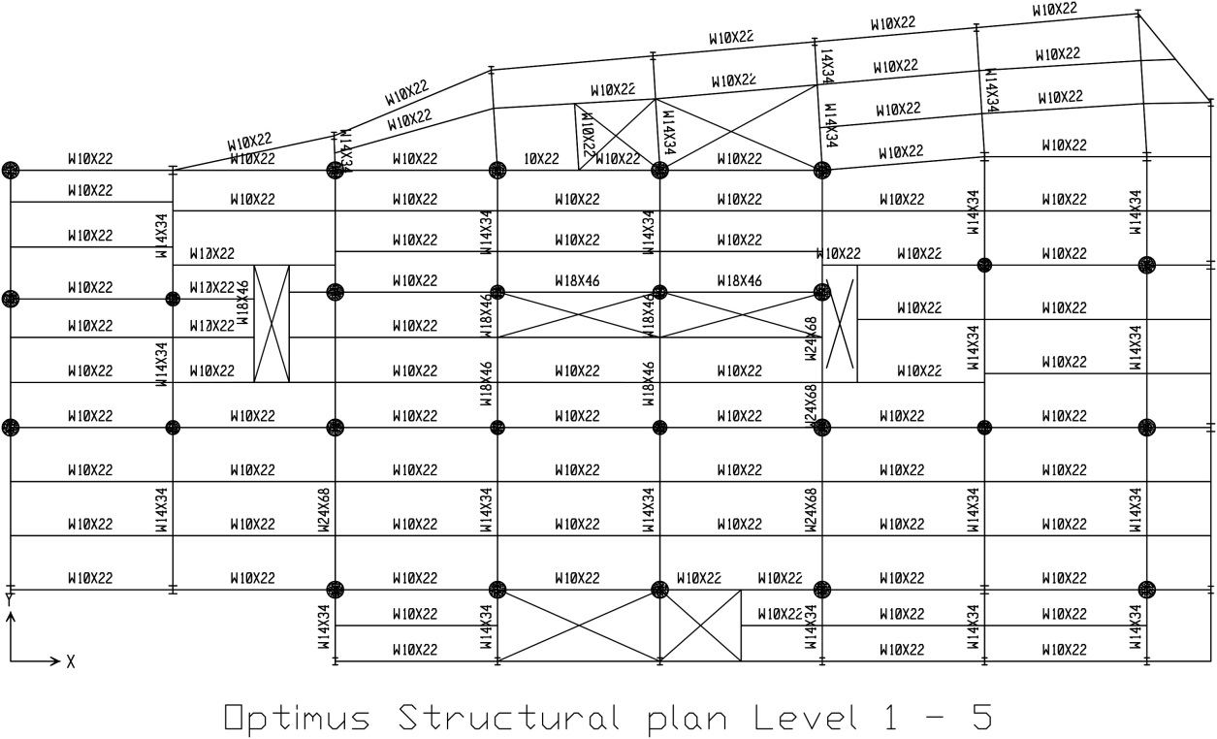
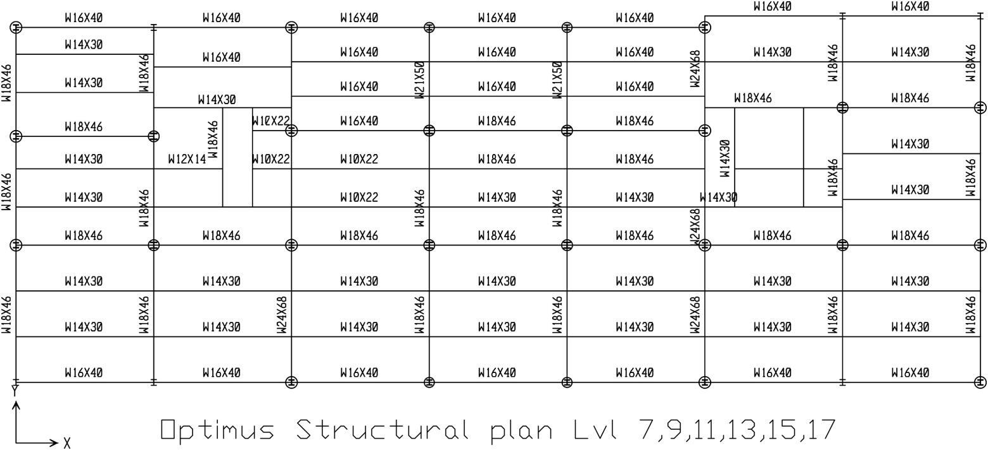
New Gravity system
Structural floor plan
Building Information
Existing structural system
Thesis Statement
Thesis Solution
New Gravity System
Composite Floor system
Lateral System
Moment Connection Design
Effect on foundations
Conclusion
Interior gravity columns - Steel wide-flange columns encased with reinforced concrete
Edge columns – W14 and W12 Steel wide flange
Superimposed dead Loads used from existing system
Critical design load combination - 1.2Dead +1.6Live+0.5Roof Live (ASCE 7-10)
Parking floor plan
The Optimus | India
Architecture
Facades
Office floor plan

Slide 11
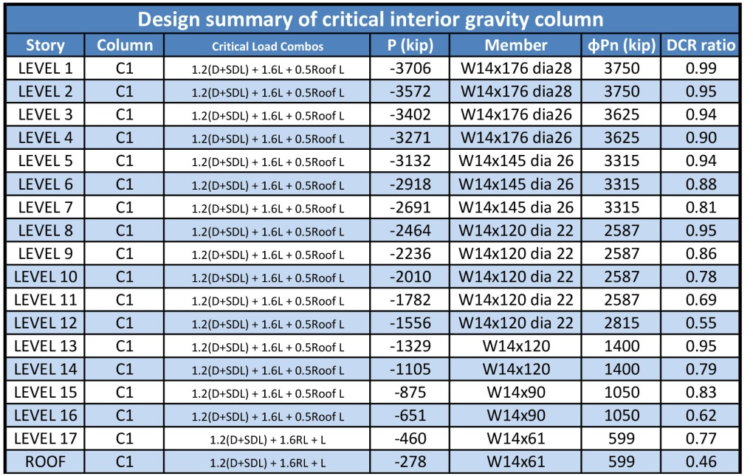
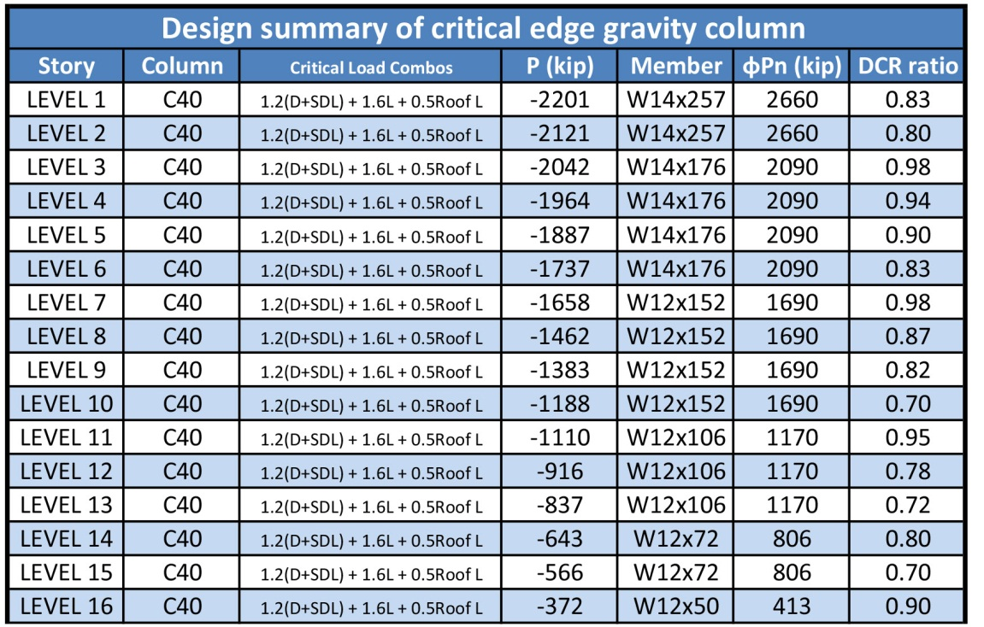
New Gravity system
Building Information
Existing structural system
Thesis Statement
Thesis Solution
New Gravity System
Composite Floor system
Lateral System
Moment Connection Design
Effect on foundations
Conclusion
Following AISC Manual Chapter I
Columns mainly checked for compression, minimum size of steel core and critical elastic bucking
Composite columns caused 40% reduction in column size in parking spaces compared to existing system
The Optimus | India
Architecture
Facades

Slide 12
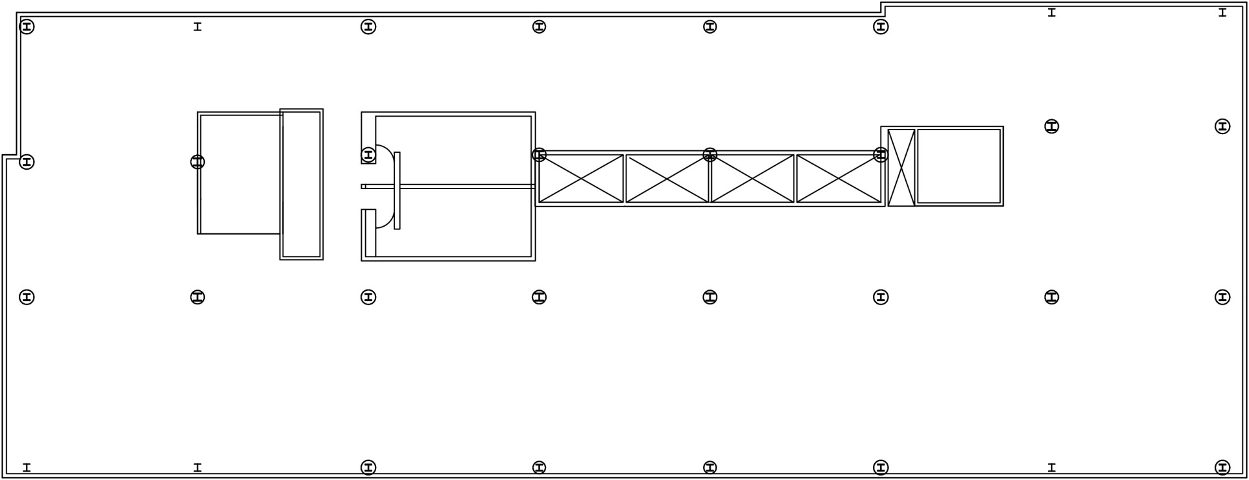
Integration to architecture
Typical office floor plan
Building Information
Existing structural system
Thesis Statement
Thesis Solution
New Gravity System
Composite Floor system
Lateral System
Moment Connection Design
Effect on foundations
Conclusion
Small columns can be integrated easily in the space
Optimized open floor plan
Increased floor space in office and parking
Less obstruction of interior columns to daylight
Concrete encasing has fire-proofing advantage
Utility areas
The Optimus | India
Architecture
Facades
Stairwell
Restrooms
Elevator shafts
Stairwell
Office Space
Typical office floor plan

Slide 13
Composite Floor System
Composite system cross-section
Building Information
Existing structural system
Thesis Statement
Thesis Solution
New Gravity System
Composite Floor system
Lateral System
Moment Connection Design
Effect on foundations
Conclusion
For typical office floor W14x30 beam and W18x46 girder with 1.5VLI20 Vulcraft deck used
Steel deck runs perpendicular to beam and parallel to girder
1.2Dead + 1.6Live load combination used
AISC Manual table 3.21 and 3.20 used to design a partially composite section
The Optimus | India
Architecture
Facades

Slide 14
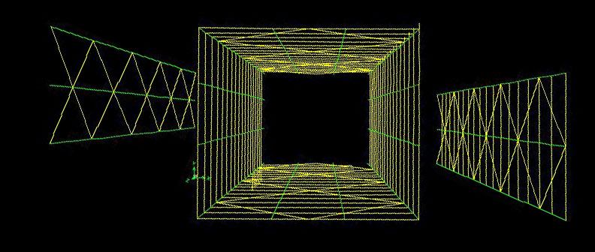
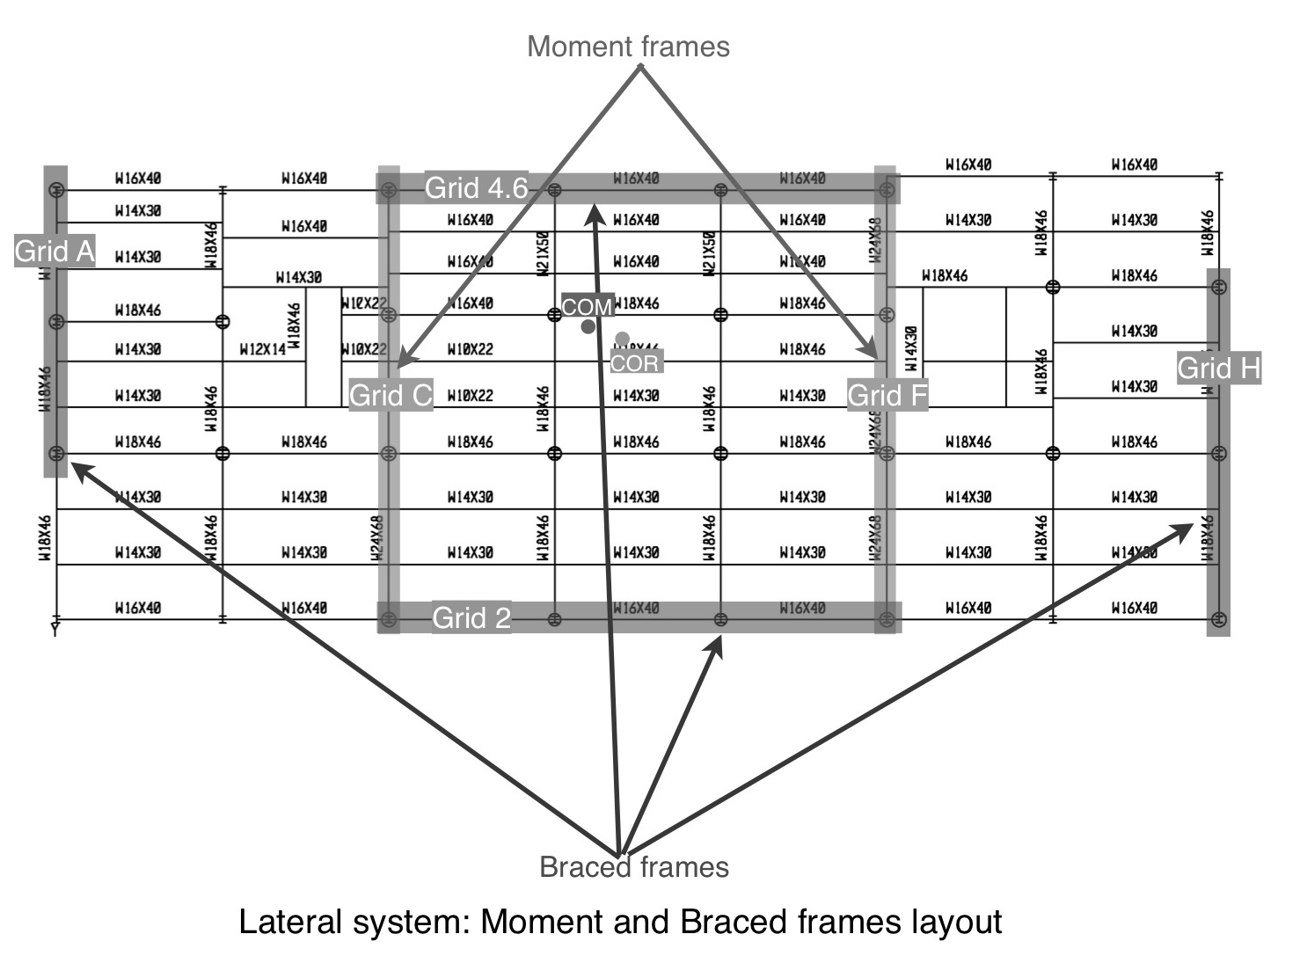
Building Information
Lateral system
Building Information
Existing structural system
Thesis Statement
Thesis Solution
Gravity System
Composite Floor system
Lateral System
Moment Connection Design
Effect on foundations
Conclusion
2 Moment frames in North-south direction
2 Braced frames in North-South direction
2 Braced frames in East-West direction
All columns are steel wide flange W12 encased in reinforced concrete. Size range – 34” to 24”
All columns designed for compression created due to lateral loads
The Optimus | India
Architecture
Facades

Slide 15
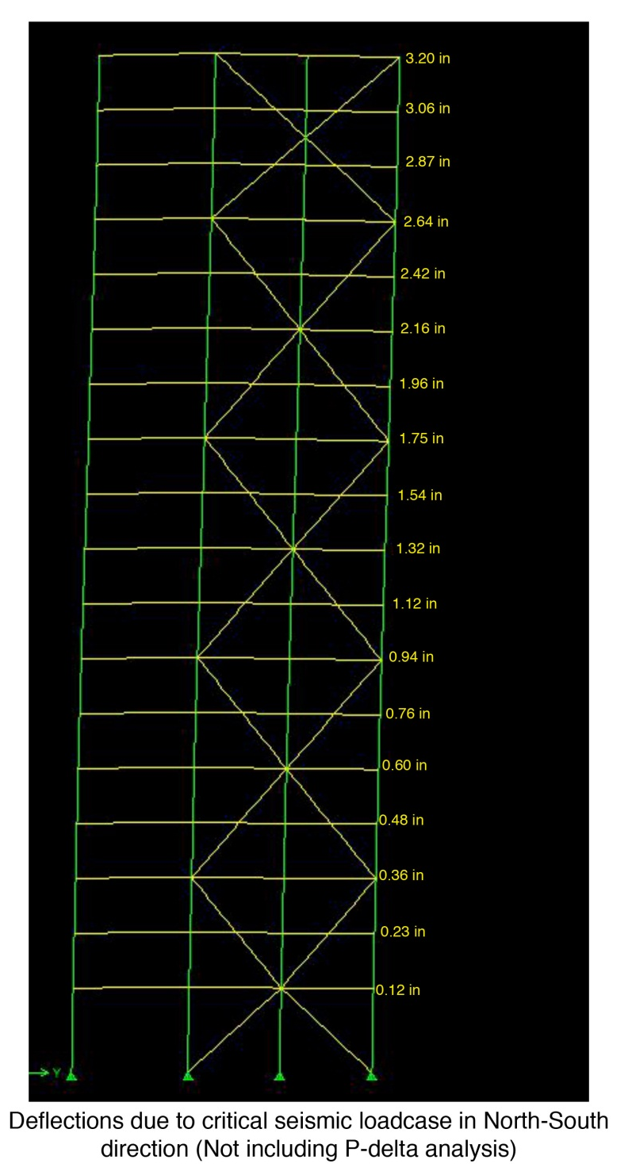
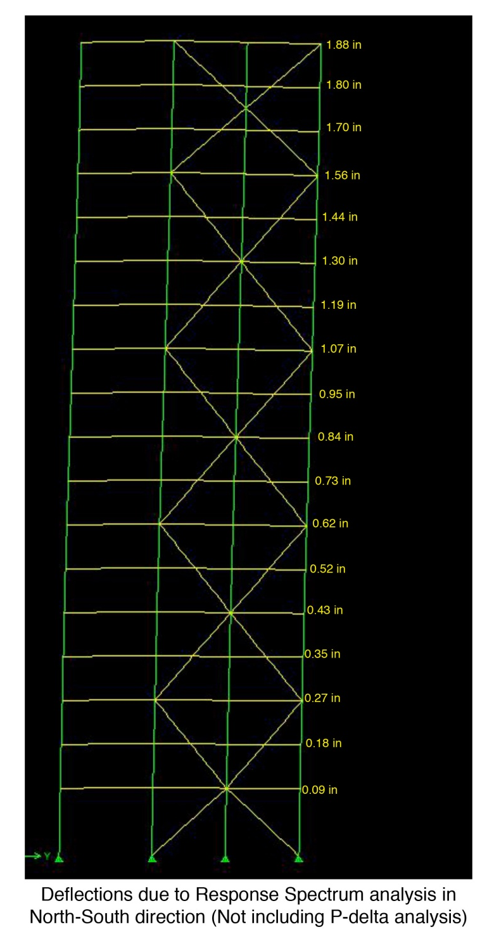
Building Information
Lateral system
Drifts (inches)
Building Information
Existing structural system
Thesis Statement
Thesis Solution
Gravity System
Composite Floor system
Lateral System
Moment Connection Design
Effect on foundations
Conclusion
ASCE 7-10 Directional procedure used to calculate wind loads and drifts
ASCE 7-10 Equivalent Lateral Force Procedure and Modal Response Spectrum Analysis used
The two seismic analysis procedures compared based on drifts and base shears
The Optimus | India
Architecture
Facades

Slide 16
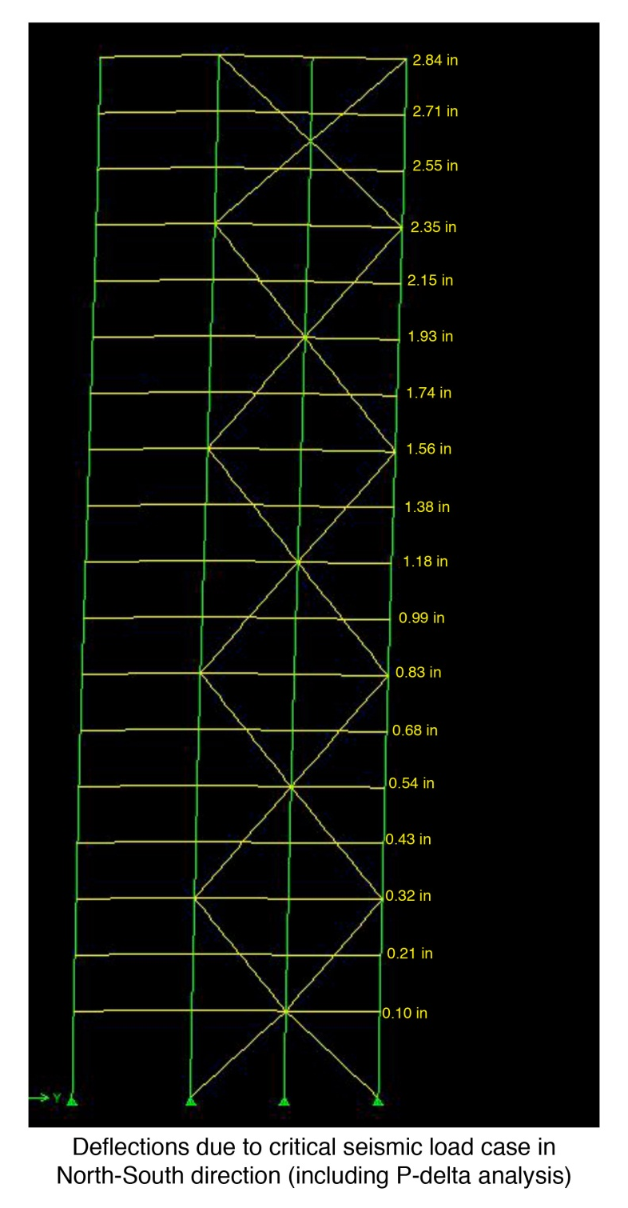
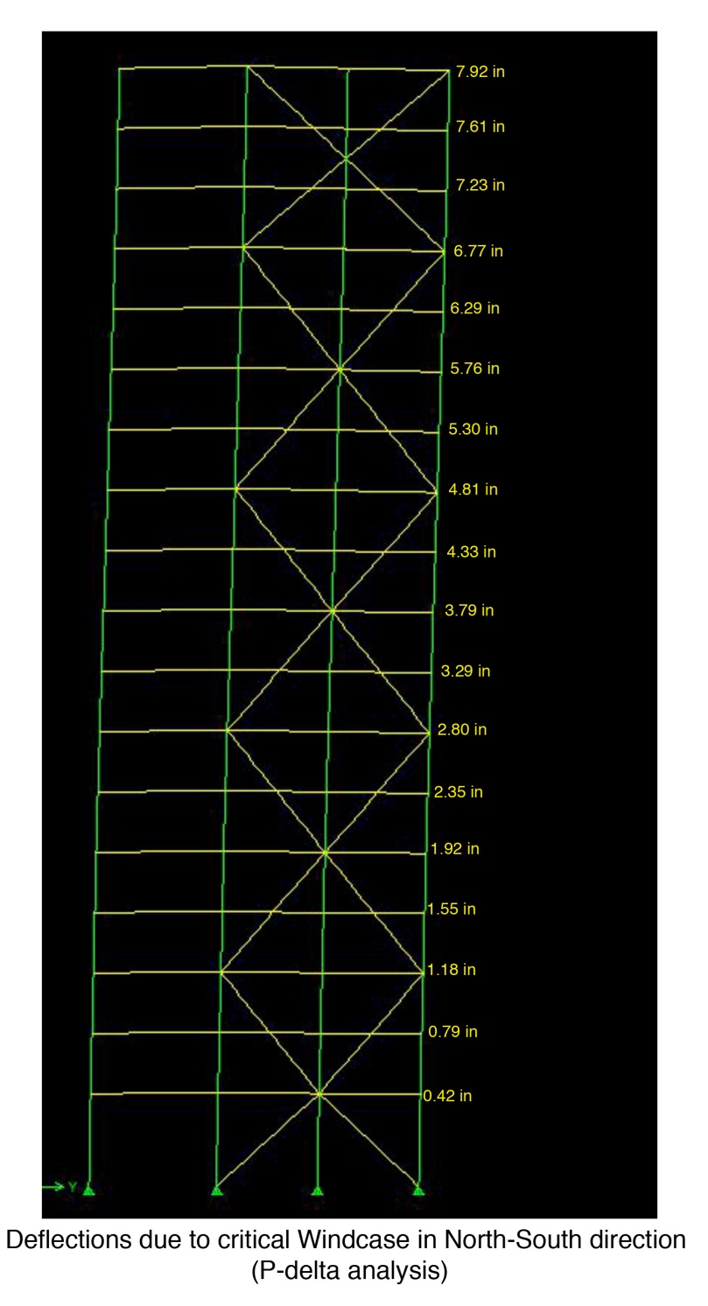
Building Information
Lateral system
Story Drifts (inches)
Building Information
Existing structural system
Thesis Statement
Thesis Solution
Gravity System
Composite Floor system
Lateral System
Moment Connection Design
Effect on foundations
Conclusion
Critical seismic loads compared to critical wind load based on drifts
Design controlled by drifts and base shears due to Wind loads
The Optimus | India
Architecture
Facades

Slide 17
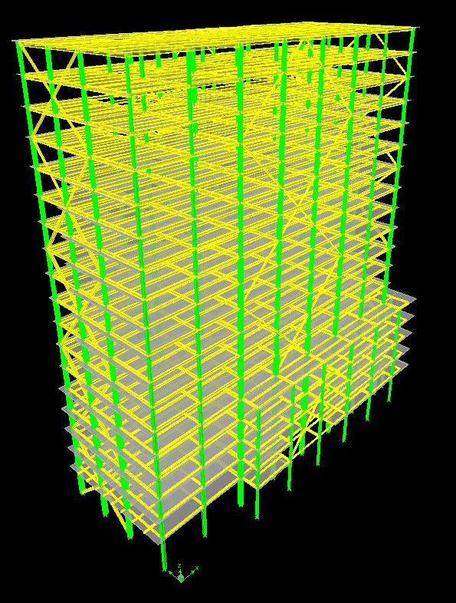
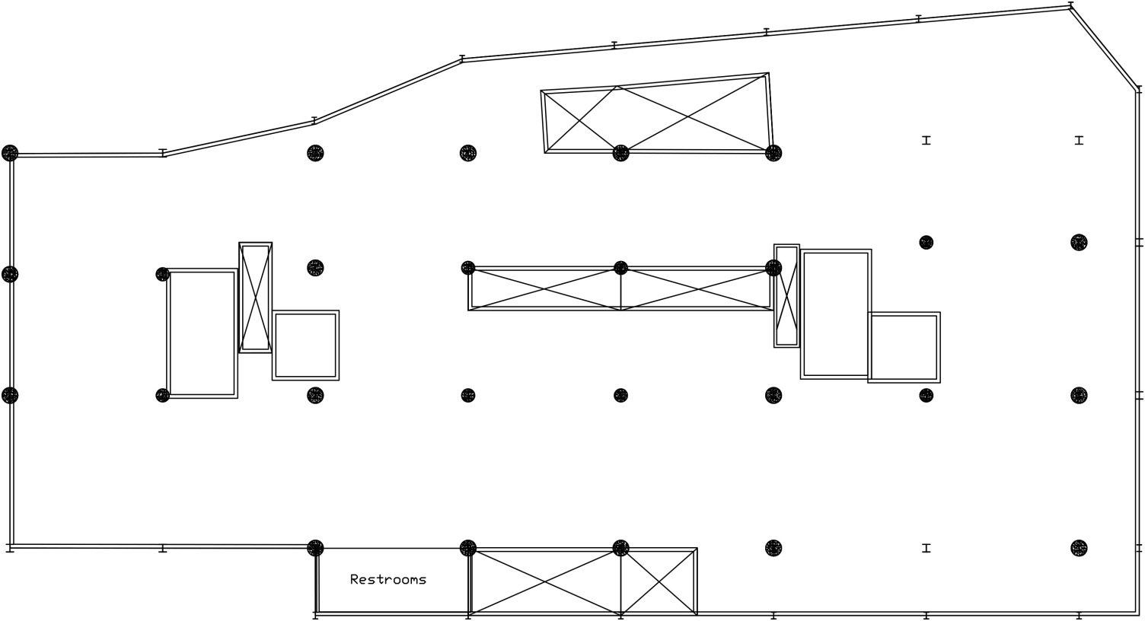
Integration to Architecture
Building Information
Existing structural system
Thesis Statement
Thesis Solution
Gravity System
Composite Floor system
Lateral System
Moment Connection Design
Effect on foundations
Conclusion
Moving braces to exterior creates more open space
Exposing HSS braces as architectural elements
Moving braces help improve parking space
The Optimus | India
Architecture
Facades
Elevator shaft moved
Elevator shaft moved around braces to create more parking space
Parking Floor plan

Slide 18
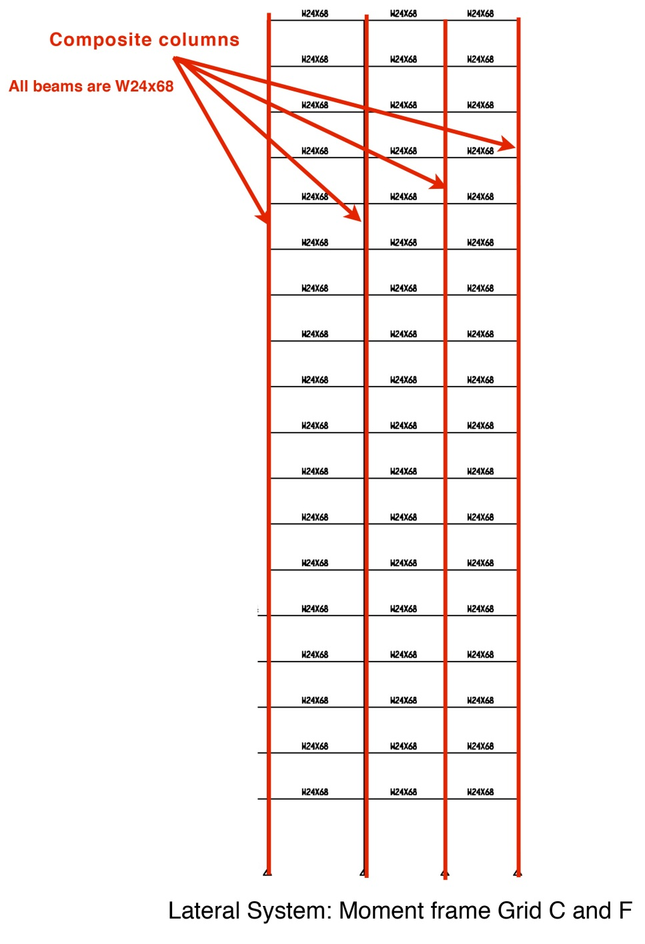
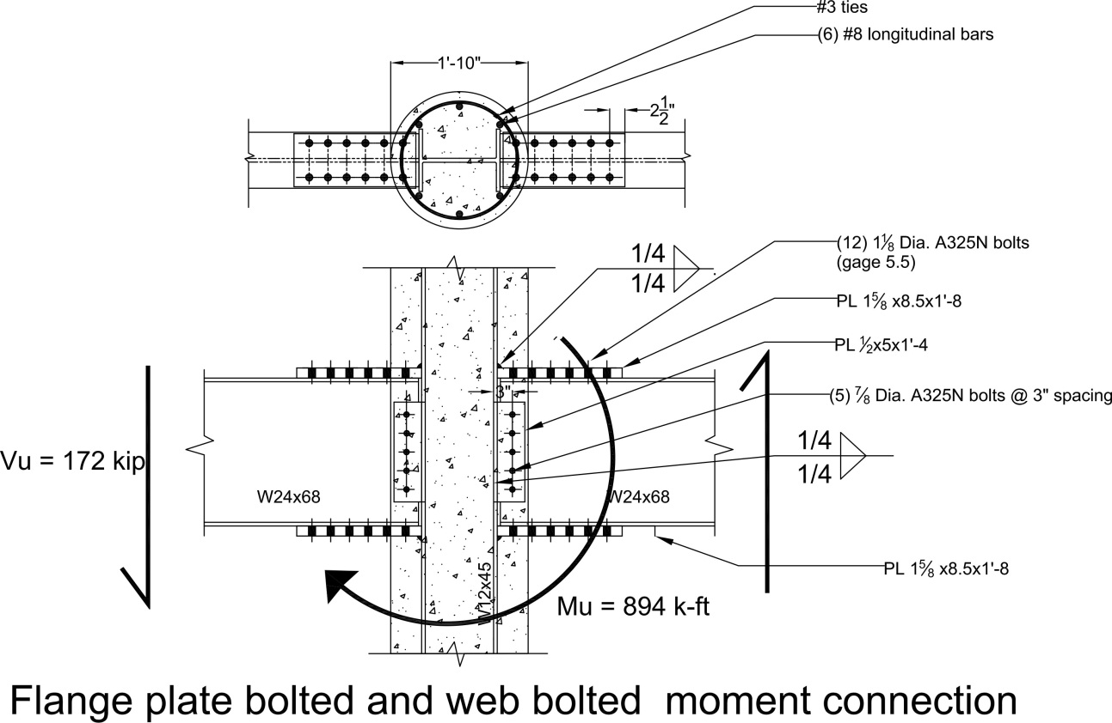
Connection Design
Moment frame
Building Information
Existing structural system
Thesis Statement
Thesis Solution
Gravity System
Composite Floor system
Lateral System
Moment Connection Design
Effect on foundations
Conclusion
The Optimus | India
Architecture
Facades

Slide 19
Effect on foundations
Building Information
Existing structural system
Thesis Statement
Thesis Solution
Gravity System
Composite Floor system
Lateral System
Moment Connection Design
Effect on foundations
Conclusion
Existing building has 50” to 80” thick MAT foundation
Dead load on foundation reduced from 25000 kip to 23000 kip
The Optimus | India
Architecture
Facades

Slide 20
Acknowledgements
Building Information
Existing structural system
Thesis Statement
Thesis Solution
Gravity System
Composite Floor system
Lateral System
Moment Connection Design
Effect on foundations
Conclusion
Family and friends
Engineers at Leslie E. Robertson Associates (New York and Mumbai offices)
Pei Cobb Free & Partners Architects
Lodha Group
The AE faculty
The Optimus | India
Architecture
Facades

Slide 21
Conclusion
Building Information
Existing structural system
Thesis Statement
Thesis Solution
Gravity System
Composite Floor system
Lateral System
Moment Connection Design
Effect on foundations
Conclusion
Every structural change follows architectural integration
Adding steel building to skyline of Mumbai can improve city’s image of concrete jungle
Composite columns can be of great structural and architectural advantage to tall structures
Cost benefit analysis resulted in higher price of steel structure
However, increased floor space area, faster construction and reduced labor can cover up the extra cost of steel structure
The Optimus | India
Architecture
Facades

Slide 22
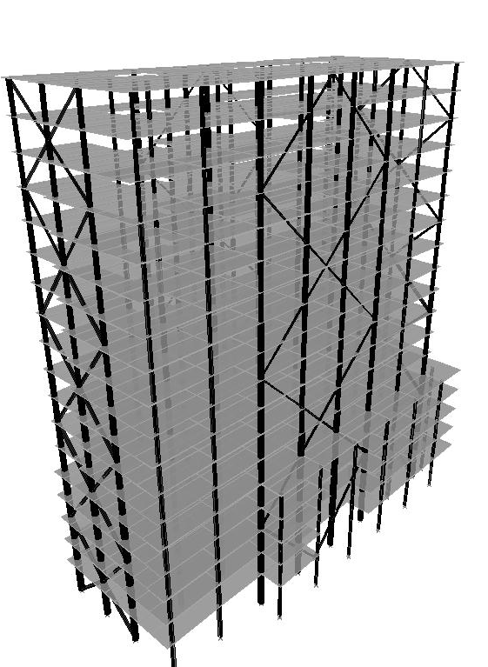
Steel structural system
Concrete structural system
Building Information
Existing structural system
Thesis Statement
Thesis Solution
Gravity System
Composite Floor system
Lateral System
Moment Connection Design
Effect on foundations
Conclusion
The Optimus | India
Architecture
Facades

Slide 23
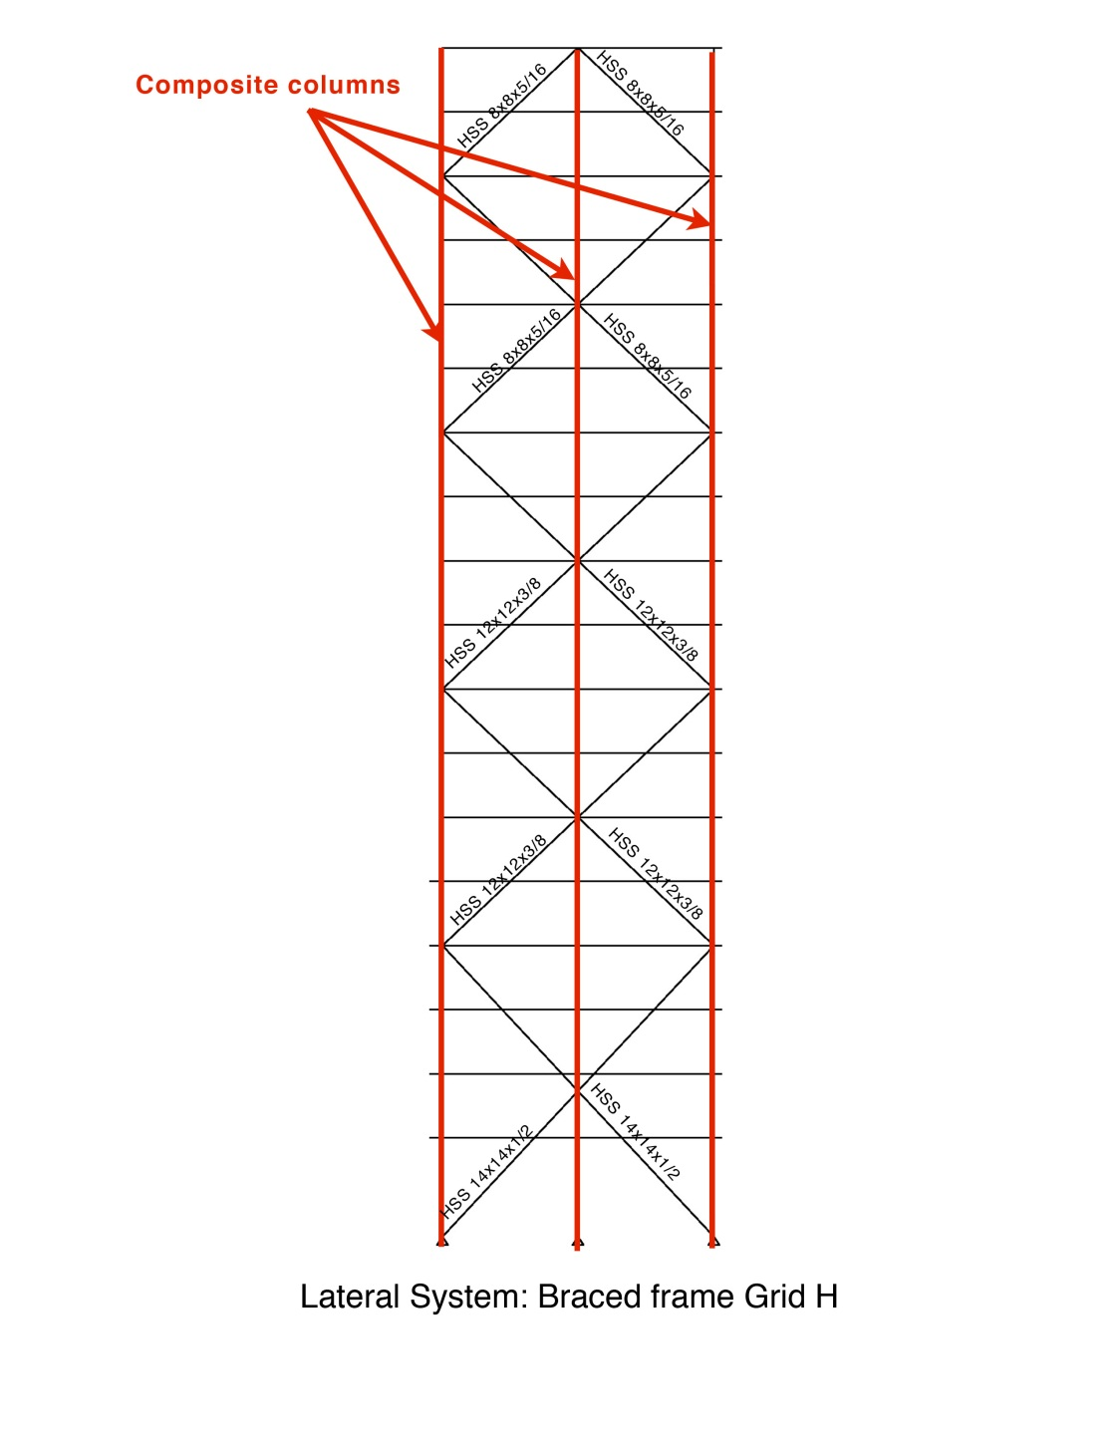
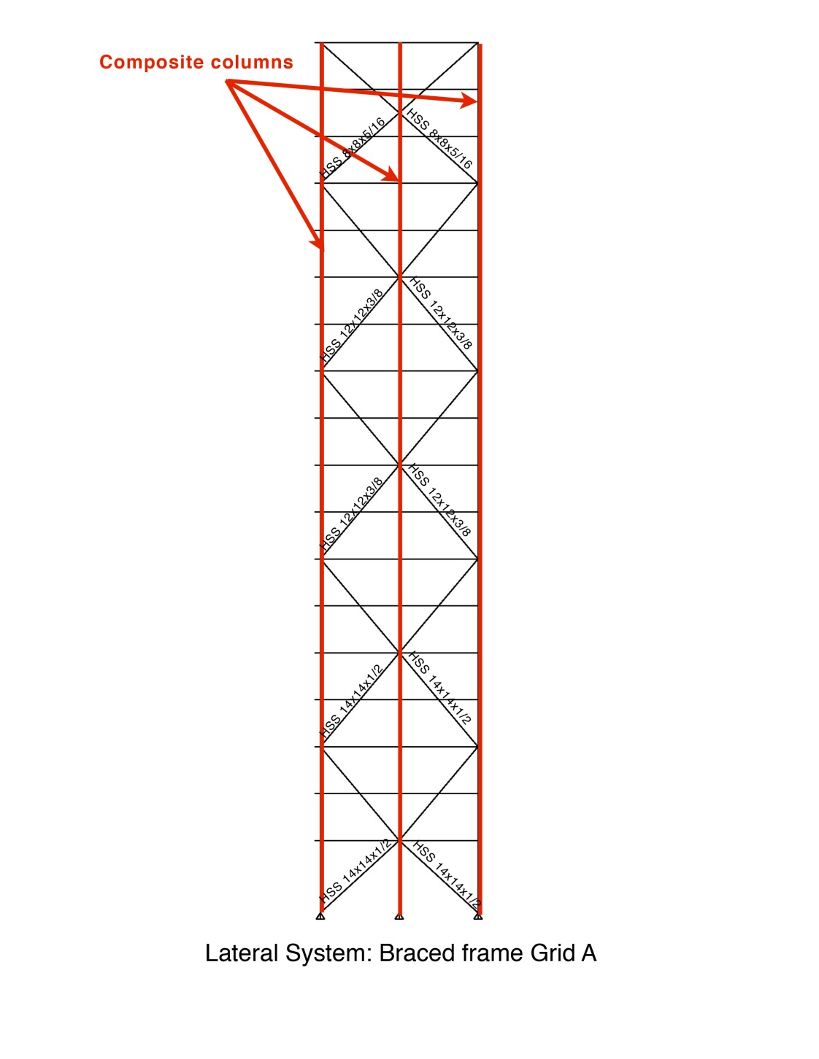

Appendix
Building Information
Existing structural system
Thesis Statement
Thesis Solution
Gravity System
Composite Floor system
Lateral System
Moment Connection Design
Effect on foundations
Conclusion
The Optimus | India
Architecture
Facades

Slide 24
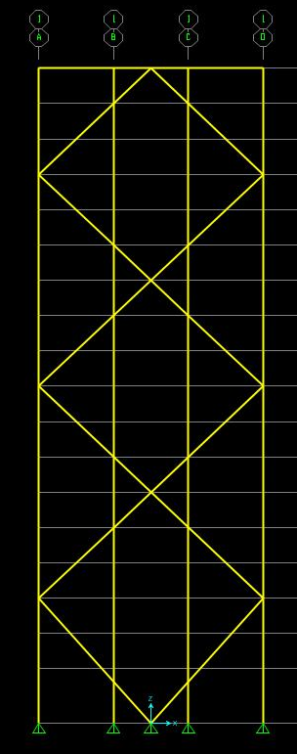
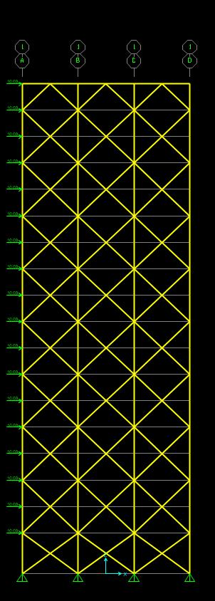
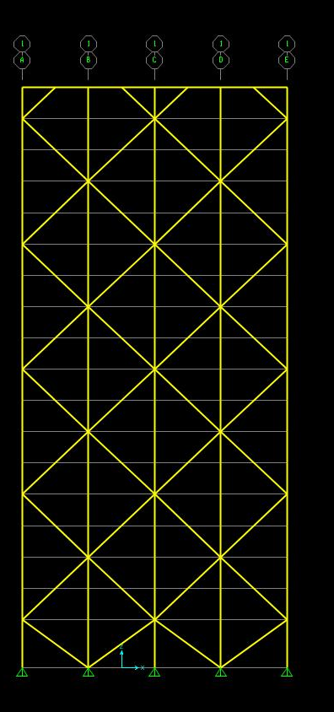
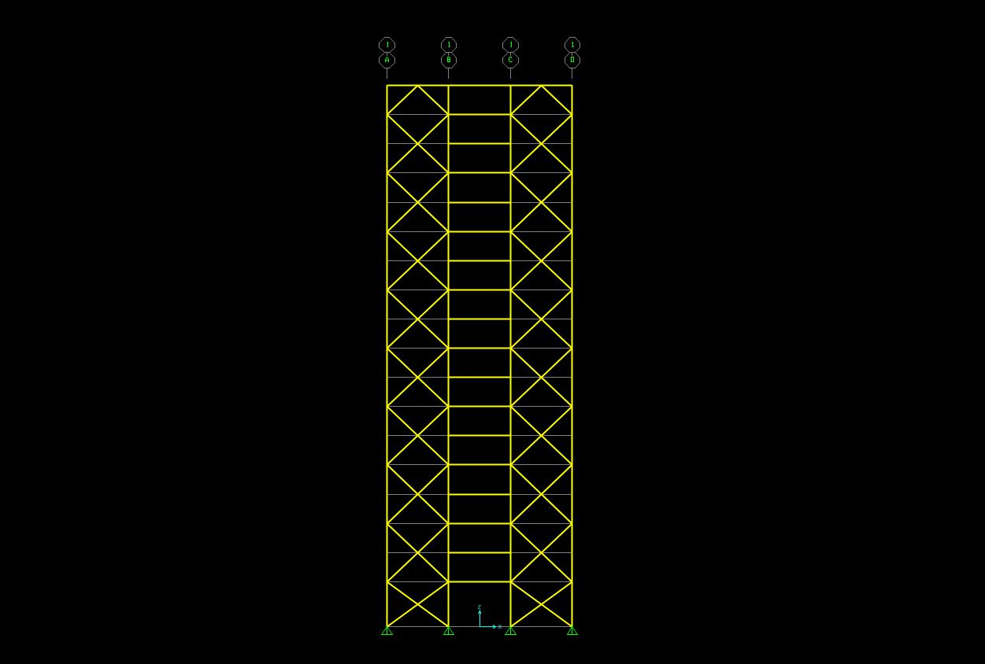
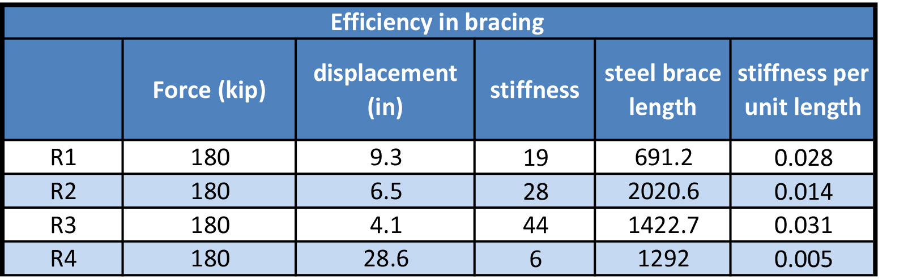
Appendix
Building Information
Existing structural system
Thesis Statement
Thesis Solution
Gravity System
Composite Floor system
Lateral System
Moment Connection Design
Effect on foundations
Conclusion
The Optimus | India
Architecture
Facades
R1
R2
R3
R4

