Slide 1
Apollo
Rebecca Bires | Scott Brown | Scott Eckert | Jordan Huey | Helen Leenhouts | Andrew Levy | Jeffrey Loeb | Patrick Vogel

Slide 2
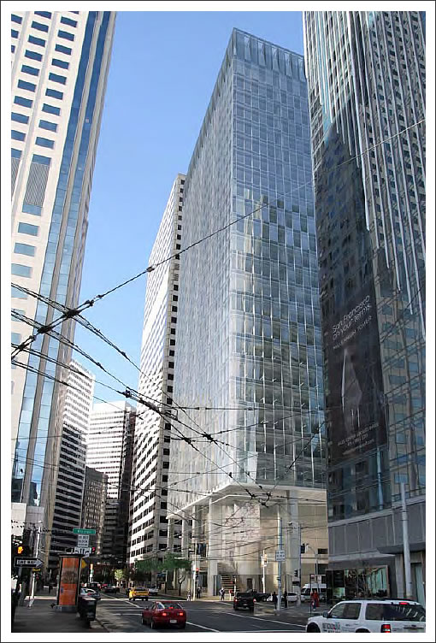
350 Mission
Energy
Structure
Performance

Slide 3
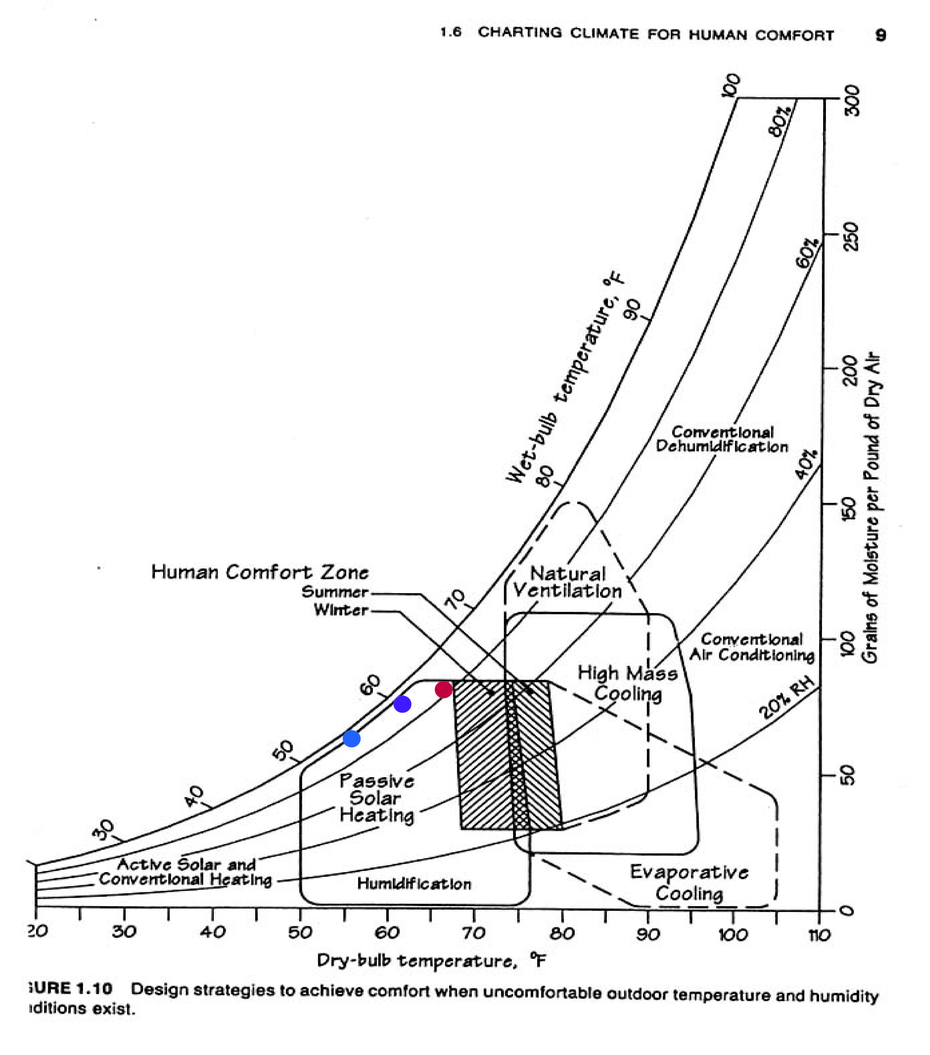
Site Weather Conditions
Weather
Heating DB (99%) - 40.8 ℉
Cooling DB (1%) - 78.3 ℉
HDD – 2708
CDD – 142
Winter Conditions
Summer Conditions
Summer Human Comfort Zone
Winter Human Comfort Zone
Design Challenge
Humidity

Slide 4
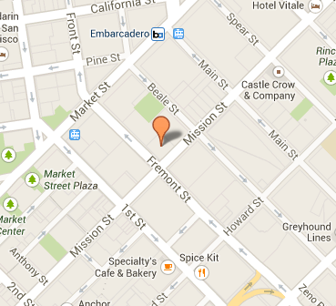
Site
Wind
Prevailing direction: West to East

Slide 5
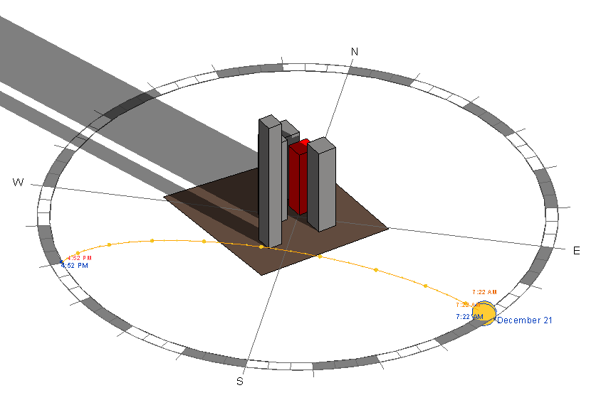
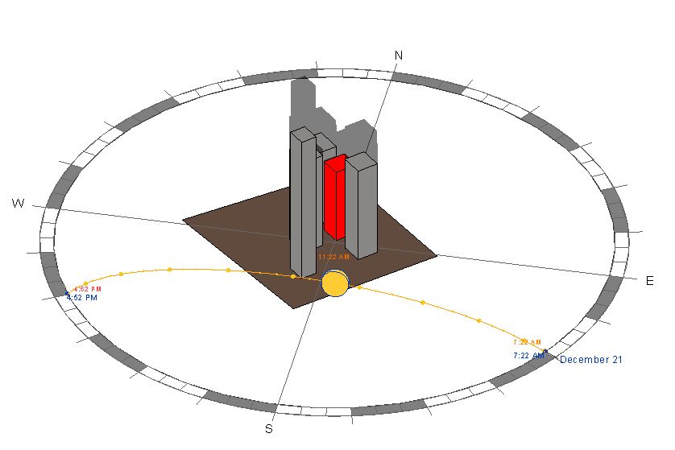
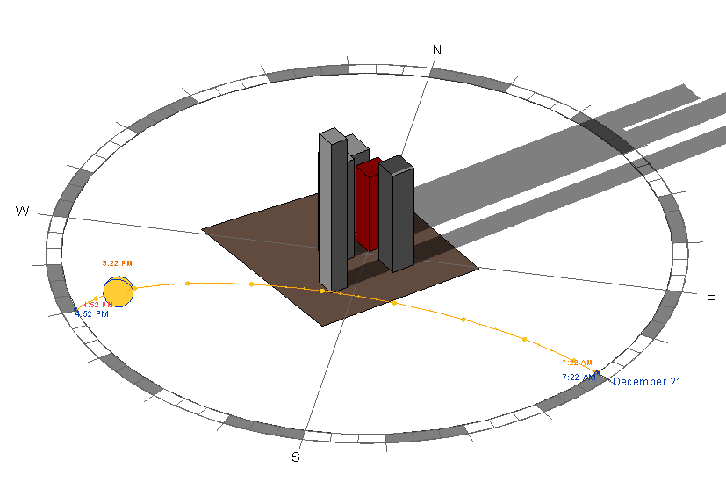
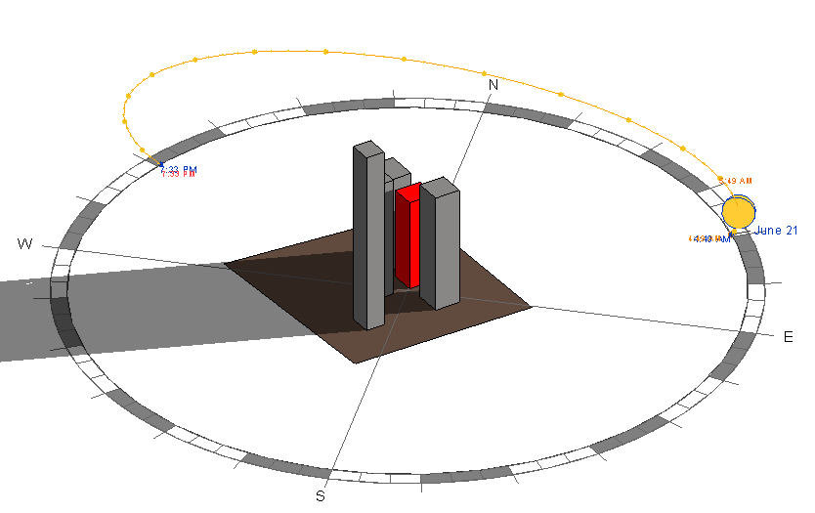
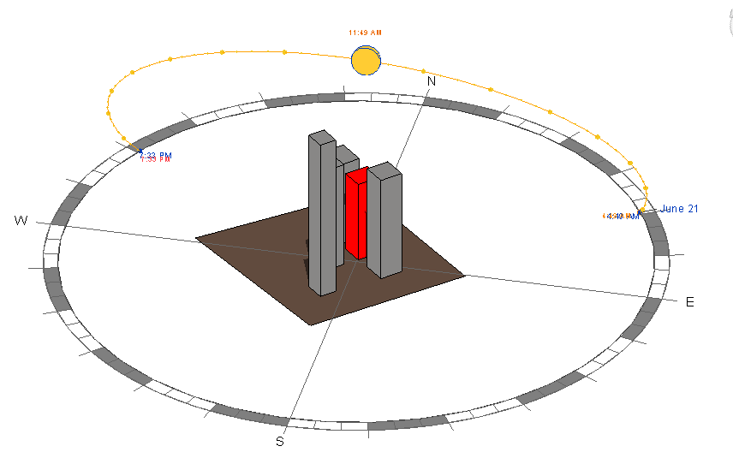
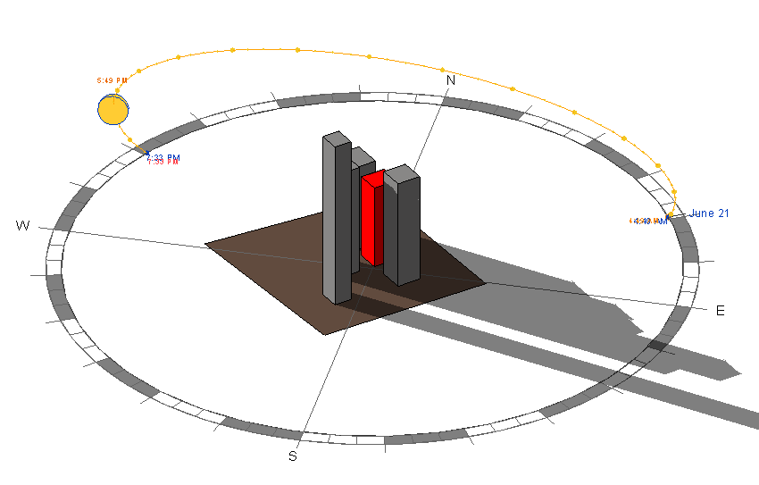
Site Solar Study
Winter Solstice
8:00 AM
12:00 PM
4:00 PM
Summer Solstice
6:00 AM
12:00 PM
6:00 PM

Slide 6
Mechanical
Chapter 4: Ventilation Air Supply
Natural and Mechanical Ventilation
Underground Parking
Exhaust Requirements
Carbon Monoxide Sensing
Chapter 5: Exhaust Systems
General Requirements – Installation & Termination
Chapter 6: Duct Systems
Design & Installation Requirements
Chapter 10: Steam and Hot Water Boilers
Access & Maintenance
Chapter 11: Refrigeration
Design Guidelines
ASHRAE 15
Chapter 12-14: Piping
Piping Design Guidelines
Notes:
Most of the code will lead to a lot of coordination

Slide 7
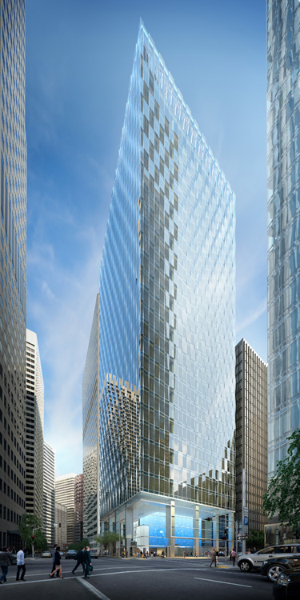
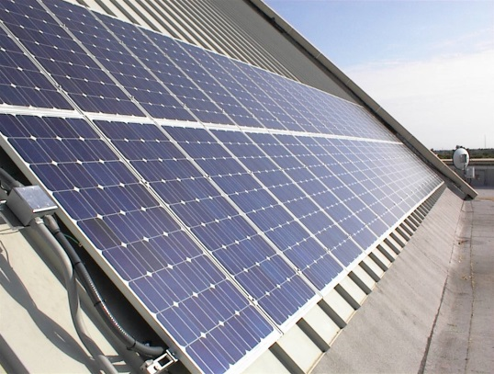
Energy Challenges
Photovoltaic
Arrays:
70-140M kwh
Small footprint;
big building
Open Air Entrance
Notes:
DOE lists only 10 Net Zero Buildings
Largest is 13,600 square feet
350 Mission is 420,000 square feet – 31 times larger
Photovoltaic Arrays
70M – 140M kwh of power
Lower estimate is more realistic, due to lack of direct sun
Energy usage
Typical – 90,000 BTU/yr
Energy Efficient Buildings – 20,000BTU/yr
Still not enough
x

Slide 8
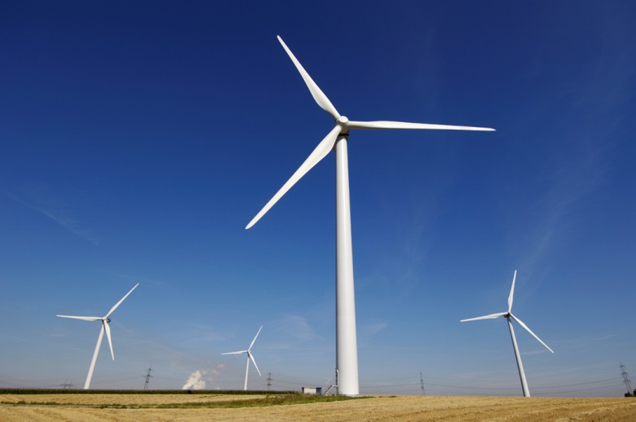
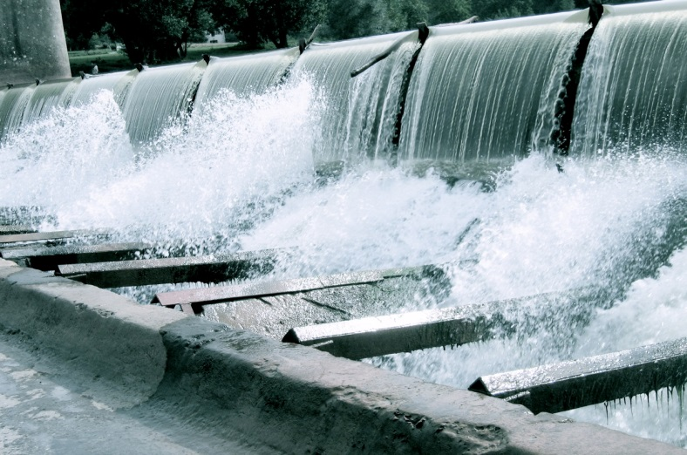
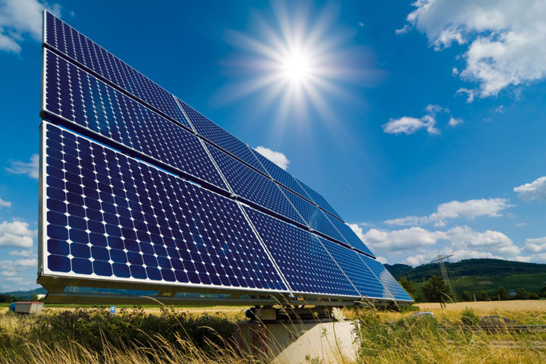
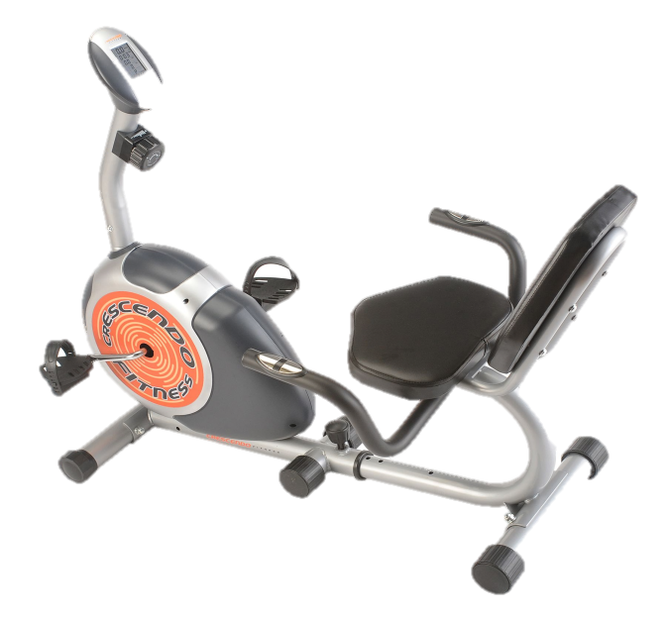
Net- Zero Construction
Notes:
Most of the code will lead to a lot of coordination

Slide 9
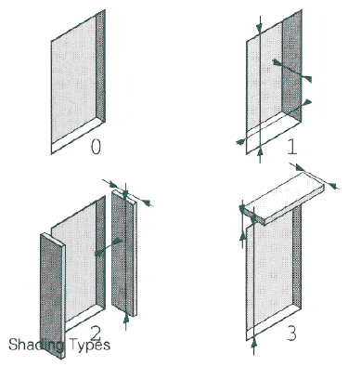
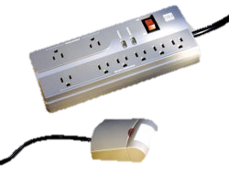
Energy Use Reduction
LPD and Illuminance performance goals
Shading devices
Lighting and Electrical loads on occupancy sensors
Descriptive controls narrative
Notes:
Most of the code will lead to a lot of coordination

Slide 10
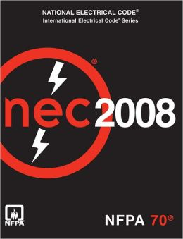
Notes:
Minor Amendments to be used in conjunction with California Building Code
E.g.
Lighting Fixtures attachments (12 gauge)
Emergency lighting required at emergency power distribution areas

Slide 11
Title 24: Energy Code
Section 112: Mandatory Req’s for Space-Conditioning Equipment
Section 116: Mandatory Req’s for Fenestration Products and Exterior Doors
Section 118: Mandatory Req’s for Insulation and Roofing Products
Section 121: Req’s for Ventilation
Section 140: Choice of Performance and Prescriptive Approaches

Slide 12
Structural Provisions
San Francisco governed by 2010 California Building Code
Code provisions for design in LFRD, ASD, empirical design, and conventional construction methods.
Restricts stiffness to limit deflections of lateral drift
Governed by ASCE 7
Deflection of concrete structural members
Governed by ACI 318
Strength design of structural steel members
Governed by AISC steel manual
Seismic load provisions
Governed by ASCE 7
Wind load and story drift provisions
Governed by ASCE 7
Contains various modifications to both ASCE 7 and ASTM standards
Notes:
DOE lists only 10 Net Zero Buildings
Largest is 13,600 square feet
350 Mission is 420,000 square feet – 31 times larger
Photovoltaic Arrays
70M – 140M kwh of power
Lower estimate is more realistic, due to lack of direct sun
Energy usage
Typical – 90,000 BTU/yr
Energy Efficient Buildings – 20,000BTU/yr
Still not enough
x

Slide 13
ASCE 7 Seismic Provisions
Structural System Selection
Limitations for both single and dual systems in both directions
Seismic Load Effects
Horizontal and Vertical seismic load effects
Seismic load combinations and overstrength factor effects
Structural Modeling Criteria
Support conditions for various scenarios
Stiffness and deformation limitations
Drift and Deformation Limitations
Story drift limited by risk category and story height
Foundation Design
Foundation requirements based on seismic design categories
Notes:
DOE lists only 10 Net Zero Buildings
Largest is 13,600 square feet
350 Mission is 420,000 square feet – 31 times larger
Photovoltaic Arrays
70M – 140M kwh of power
Lower estimate is more realistic, due to lack of direct sun
Energy usage
Typical – 90,000 BTU/yr
Energy Efficient Buildings – 20,000BTU/yr
Still not enough
x

Slide 14
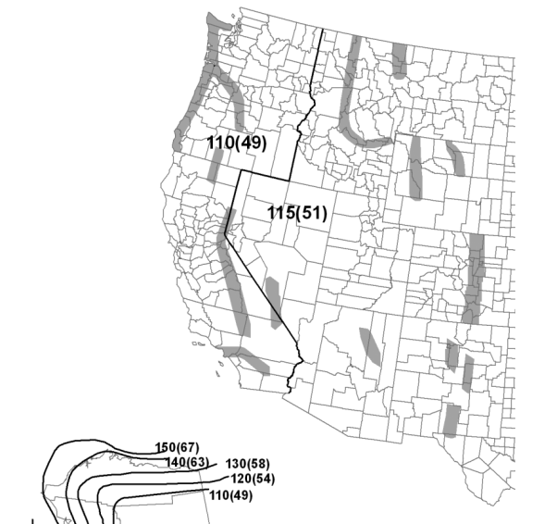
ASCE 7 Wind Provisions
Main Wind-Force Resisting System (MWFRS)
Limited to either Directional Procedure for buildings of all heights or the Wind Tunnel Procedure for all buildings.
Wind Speeds
Procedure uses wind speed based on a three-second gust at 33 ft above ground.
Taken from wind speed maps based on risk category.
Contains provisions for wind gusts and takes into account the approximate natural frequency of the building.
Latitude: 37.7909 Longitude: -122.3967 ASCE 7-10 Wind Speeds (3-sec peak gust MPH*): Risk Category I: 100 Risk Category II: 110 Risk Category III-IV: 115
Notes:
DOE lists only 10 Net Zero Buildings
Largest is 13,600 square feet
350 Mission is 420,000 square feet – 31 times larger
Photovoltaic Arrays
70M – 140M kwh of power
Lower estimate is more realistic, due to lack of direct sun
Energy usage
Typical – 90,000 BTU/yr
Energy Efficient Buildings – 20,000BTU/yr
Still not enough
x

Slide 15
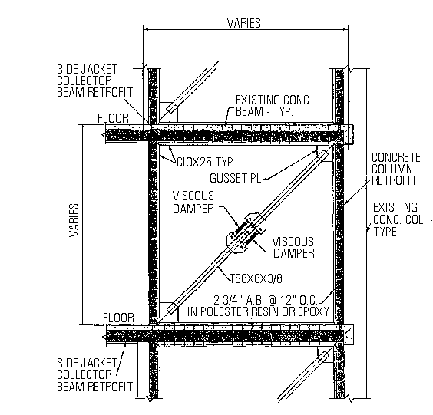
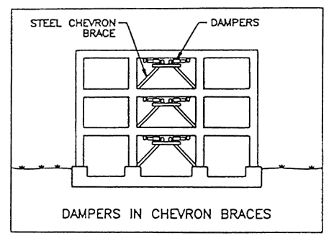
Potential Design components
Fluid Viscous Dampers
Up to 50% decrease in floor acceleration and lateral deformation
Different types of brace configurations
High lifetime cost savings, LEED Points
Can be modeled in ETABS or SAP
Notes:
DOE lists only 10 Net Zero Buildings
Largest is 13,600 square feet
350 Mission is 420,000 square feet – 31 times larger
Photovoltaic Arrays
70M – 140M kwh of power
Lower estimate is more realistic, due to lack of direct sun
Energy usage
Typical – 90,000 BTU/yr
Energy Efficient Buildings – 20,000BTU/yr
Still not enough
x

Slide 16
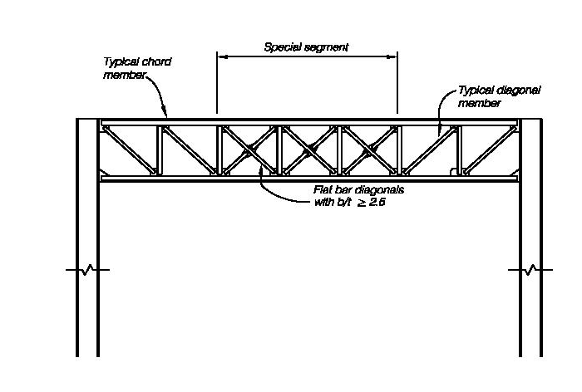
Potential Design components
Base Isolation Techniques
Isolate superstructure and foundation with elastomeric pads
Special Truss Moment Frames
Special part designed to dissipate energy and isolate yielding
Yielded part can be easily replaced without major disruption
Field labor savings, reduced welding
Notes:
DOE lists only 10 Net Zero Buildings
Largest is 13,600 square feet
350 Mission is 420,000 square feet – 31 times larger
Photovoltaic Arrays
70M – 140M kwh of power
Lower estimate is more realistic, due to lack of direct sun
Energy usage
Typical – 90,000 BTU/yr
Energy Efficient Buildings – 20,000BTU/yr
Still not enough
x

Slide 17
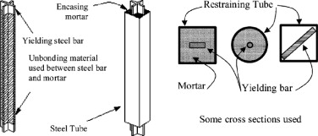
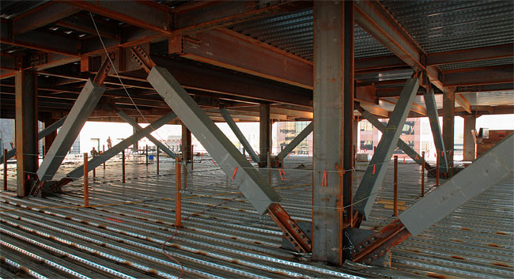
Potential Design components
Buckling-Restrained Braced Frames
Takes both axial tension and compression without buckling
Capacities in tension and compression are similar
Notes:
DOE lists only 10 Net Zero Buildings
Largest is 13,600 square feet
350 Mission is 420,000 square feet – 31 times larger
Photovoltaic Arrays
70M – 140M kwh of power
Lower estimate is more realistic, due to lack of direct sun
Energy usage
Typical – 90,000 BTU/yr
Energy Efficient Buildings – 20,000BTU/yr
Still not enough
x

Slide 18
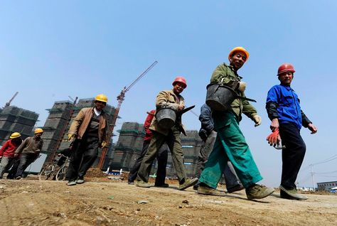
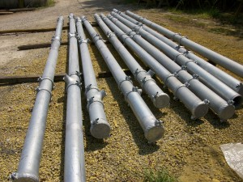
Labor
100% Labor Unions
Well educated work force
7 ½ hour work days
Modularization
Prefabrication is not common
Locally produced
Coordination with traffic hours

Slide 19
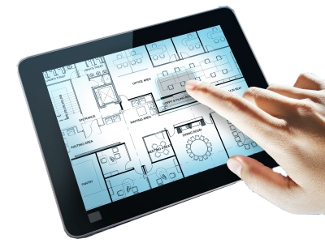
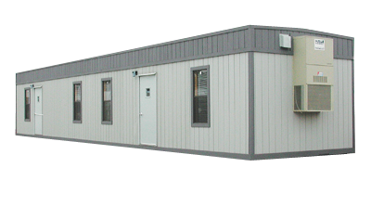
Collaboration
Programs
Technology
Trailers

Slide 20
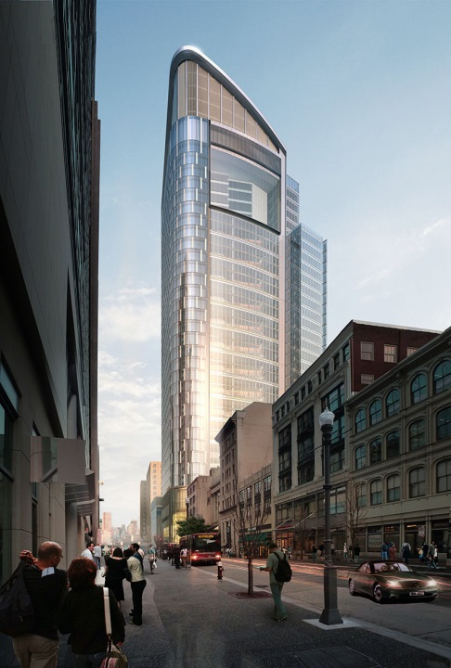
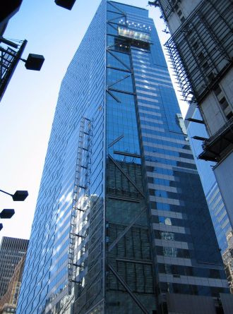
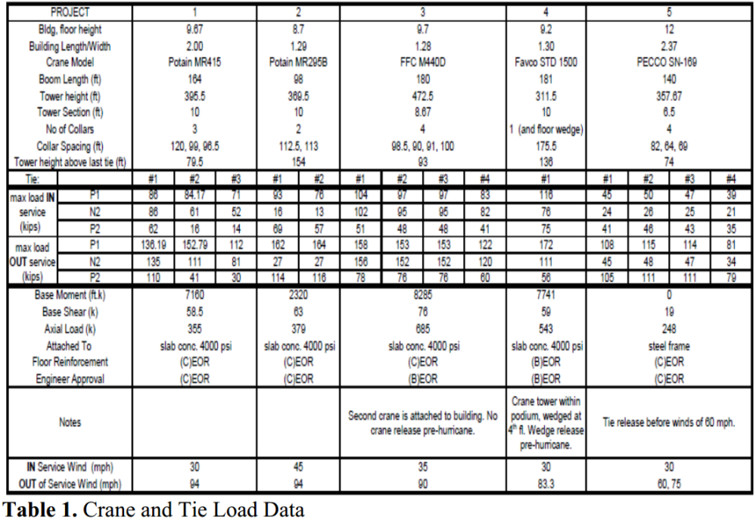
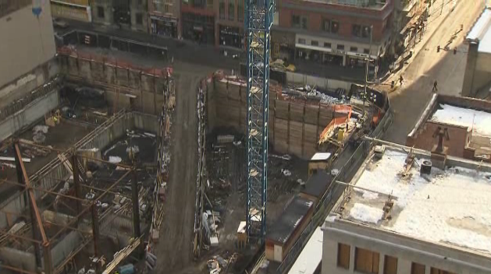
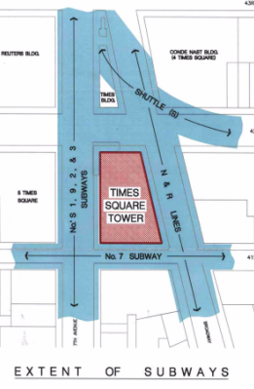
Comparison
The Tower At PNC Plaza
Pittsburgh, PA
Times Square Tower
New York, NY

Slide 21
Questions?

Slide 22
References
The Tower at PNC Plaza: www.toweratpncplaza.com
ITcon Journals: www.itcon.org
ASCE Journals: www.asce.org
Images Found Through Google: www.google.com
https://law.resource.org/pub/us/code/bsc.ca.gov/
http://www.energy.ca.gov
http://apps1.eere.energy.gov/buildings/publications/pdfs/corporate/bt_stateindustry.pdf
http://smud.apogee.net/comsuite/content/ces/?utilid=s&id=963
http://www.ppg.com/corporate/ideascapes/sitecollectiondocuments/high-reflectance_coatings_white_paper.pdf
http://www.denvergov.org/portals/646/documents/chk_lst_elect_hi_rise.pdf
http://www.glumac.com/articles/Net_Zero_Buildings.html
http://www.wbdg.org/resources/microturbines.php
http://www.amlegal.com
http://zeb.buildinggreen.com/
California Building Code: www.bsc.ca.gov
“Buckling restrained braced frames”
Michael D. Engelhardt
https://engineering.purdue.edu/~jliu/courses/CE697R/CE697R_BRB_F12.pdf
“Fluid Viscous Damping as an Alternative to Base Isolation”
Gregg Haskell , David Lee
http://taylordevices.com/fluidviciousdamping.html
The Spectrus group
http://thespectrusgroup.com/index.html

