Slide 1
Apollo
Rebecca Bires | Scott Brown | Scott Eckert | Jordan Huey | Helen Leenhouts | Andrew Levy | Jeffrey Loeb | Patrick Vogel

Slide 2
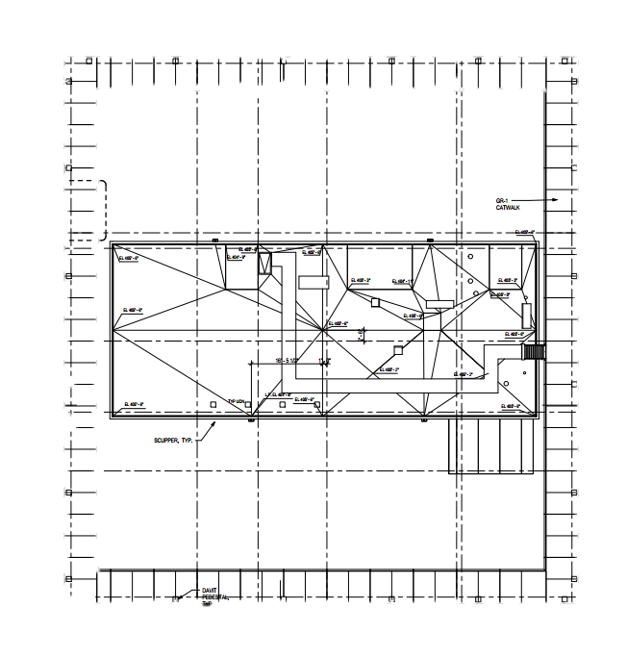
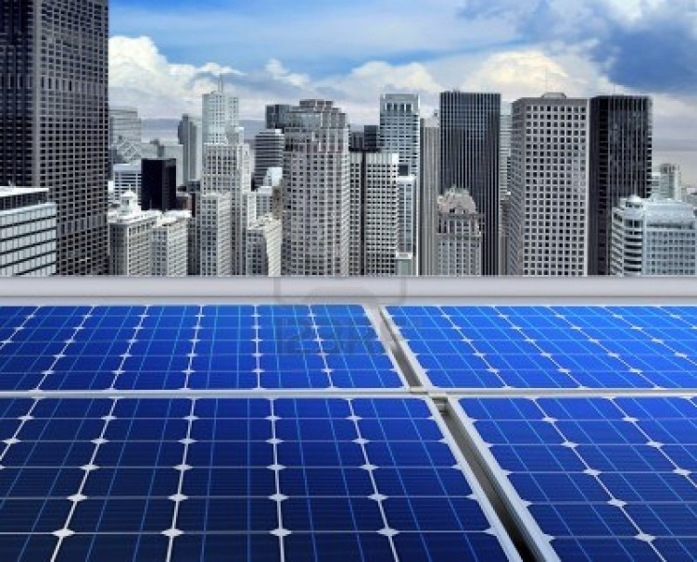
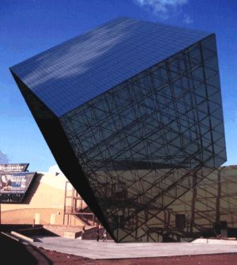
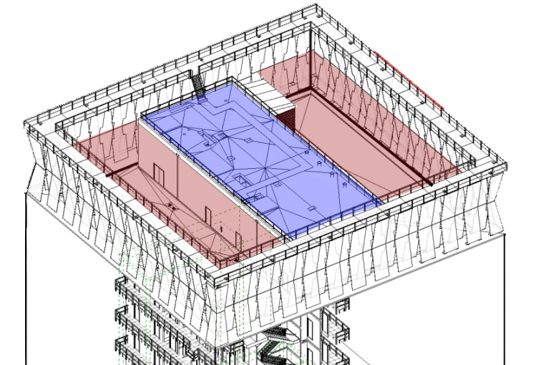
Apollo
Lighting/Electrical
Energy Producing Measures
Solar Panels on the Roof
REC 215 AE-US - 3’x5’
About 650 Panels fit on this roof
Summer: 325-520kW per day*
Winter: 163-390kW per day*
*Depending on cloud cover
100% South Facing at a vertical angle of 10◦-20◦
Photovoltaic Glazing on Upper Floors
Architecturally integrated for seamless design
Amount of energy produced will depend on area of PV Glazing
Lighting/Electrical | Mechanical | Structural | Construction

Slide 3
Apollo
Integration
Effects of Solar System
Structural
Coordinate to ensure roof will be stable/strong enough
Construction
Added schedule time for installation
Limited roof access once installed
Mechanical
Coordinate with cogeneration mechanical rooms on roof
Glazing changes will effect solar heat gain
Lighting/Electrical | Mechanical | Structural | Construction

Slide 4
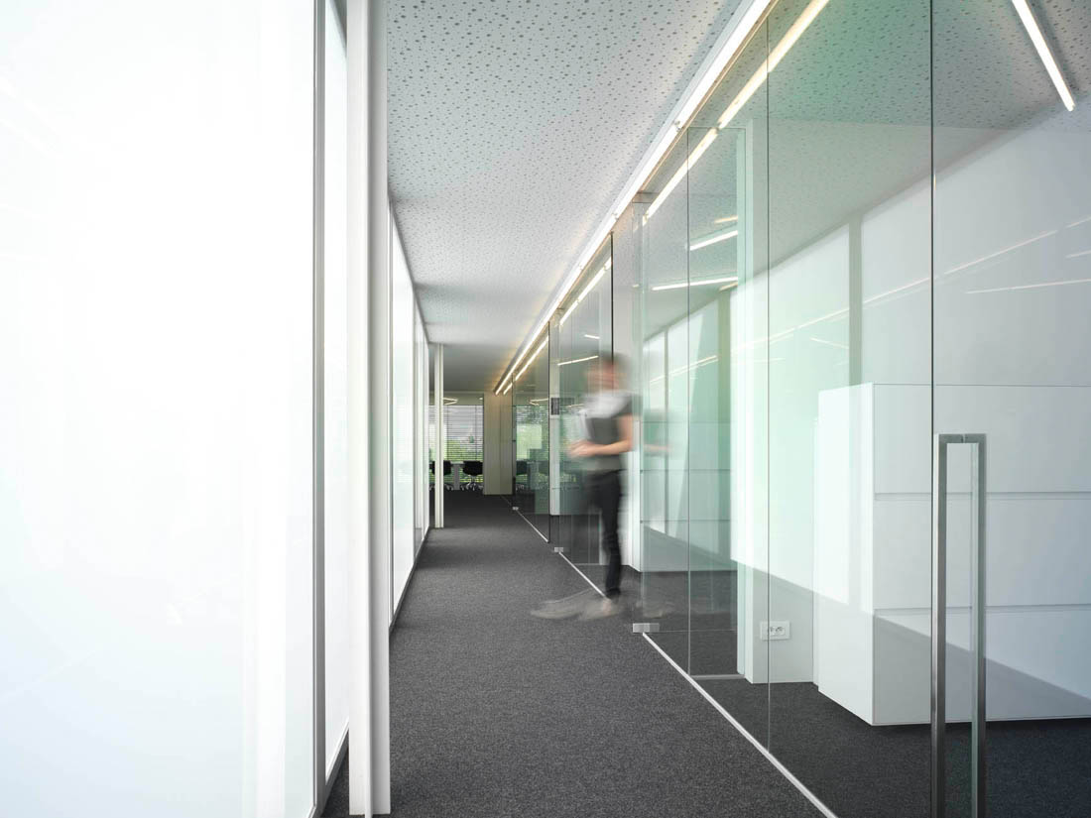
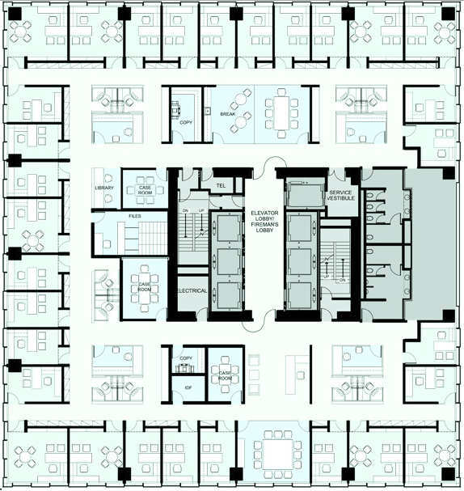
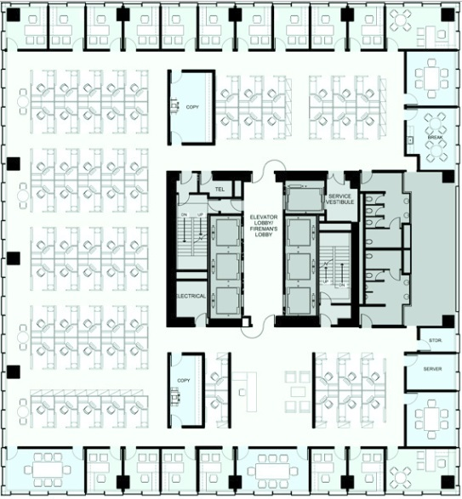
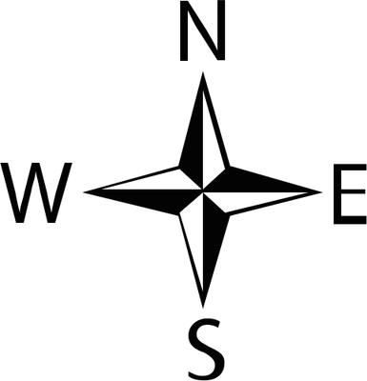
Apollo
Lighting/Electrical
Translucent Partitions
Lighting/Electrical | Mechanical | Structural | Construction

Slide 5
Apollo
Integration
Effects of Glass Partitions
Structural
Weight of glass partitions should be considered
Construction
Schedule decrease, easy installation
Quick drop off time
Mechanical
Coordinate with building energy modeling to accurately measure heat gain/loss between rooms
Lighting/Electrical | Mechanical | Structural | Construction

Slide 6
Apollo
Lighting/Electrical
Energy Saving Measures
113 W
495 kW-hr/year
10 W
44 kW-hr/year
Lighting/Electrical | Mechanical | Structural | Construction

Slide 7
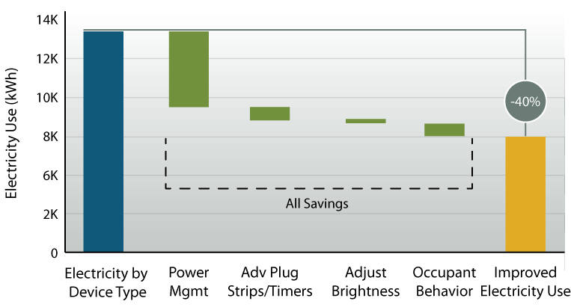
Apollo
Lighting/Electrical
Energy Saving Measures
ecova: Commercial Office Plug Load Savings and Assessment; December 2011
Lighting/Electrical | Mechanical | Structural | Construction

Slide 8
Apollo
Lighting/Electrical
Energy Saving Measures
113 W
495 kW-hr/year
10 W
44 kW-hr/year
26 kW-hr/year
85 Computers per floor
39,865 Kw-hr saved
$ 9,089 saved per floor
$227,230 potential savings
Lighting/Electrical | Mechanical | Structural | Construction

Slide 9
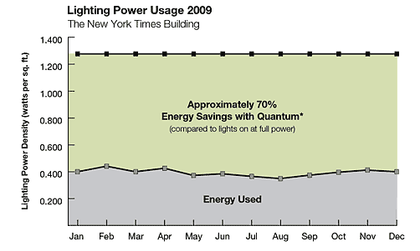
Apollo
Lighting/Electrical
Energy Saving Measures
Design to 75% Code Mandated LPD
~ 0.65 watts/sf
Progressive energy controls system
Lighting/Electrical | Mechanical | Structural | Construction
Notes:
Most of the code will lead to a lot of coordination

Slide 10
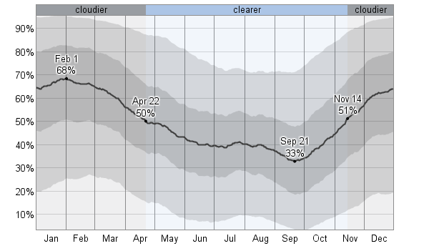
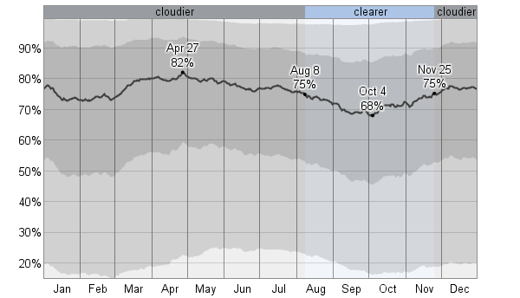
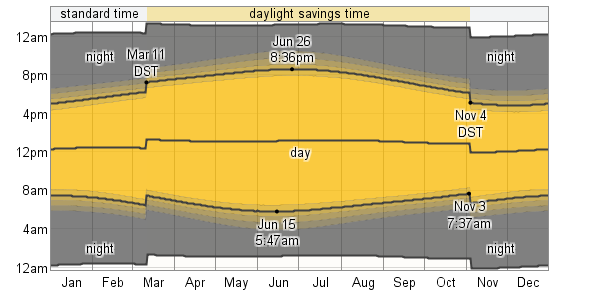
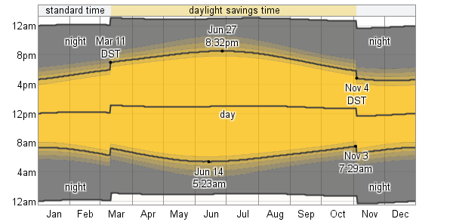
Apollo
Lighting/Electrical
Energy Saving Measures
San Francisco
New York

Slide 11
Apollo
Mechanical
Design Strategy
Lifecycle (Years)
Architecture (Site, Mass, Orientation)
LOW
100-500
Building Envelope (Façade, Roof)
50
MEP (Passive climate control, equipment)
30
Alternative Energy Sources (Fuel Cells, PV, Solar)
HIGH
5
Cost of Maintenance and Operation
Lighting/Electrical | Mechanical | Structural | Construction

Slide 12
Apollo
Mechanical
Façade Analysis
Graph Run | Run # | Description | Cooling (SF/Ton) | Cooling (BTU/hr*SF) | Heating (BTU/hr*SF) | Total (BTU/hr*SF) | U-Factor | Shading Coefficient
1 | 6 | Single Coated 1/8" | 301 | 39.87 | 66.31 | 106.18 | 1 | 0.85
2 | 4 | 6mm Sgl Bronze | 328.6 | 36.52 | 62 | 98.52 | 1 | 0.71
3 | 1 | 3mm Tpl Low-E (e5=1) Clr 6mm air | 348.9 | 34.39 | 51.85 | 86.24 | 0.319 | 0.67
4 | 3 | 3mm Quad Low-E Films Clr 8 mm Krypton | 388.6 | 30.88 | 46.67 | 77.55 | 0.117 | 0.52
5 | 2 | 3 mm Dbl Low-E (e2=.04) Clr 13mm Air | 392 | 30.65 | 46.29 | 76.94 | 0.295 | 0.5
6 | 5 | 6 mm Tpl Low-E Film (66) Tint 13mmAir | 469.3 | 25.57 | 38.74 | 64.31 | 0.218 | 0.29
Lighting/Electrical | Mechanical | Structural | Construction

Slide 13
Apollo
Mechanical
Simulated Environment
Summer: Exhaust cooler air to the air gap
Winter: Exhaust heated air to the air gap
Goal: Create an artificial/simulated environment to retard heat transfer while using conditioned air that would normally be exhausted
Challenges: Humidity and complicated control scheme
Lighting/Electrical | Mechanical | Structural | Construction

Slide 14
Apollo
Mechanical
Simulated Environment
Summer: Exhaust cooler air to the air gap
Winter: Exhaust heated air to the air gap
Goal: Create an artificial/simulated environment to retard heat transfer while using conditioned air that would normally be exhausted
Challenges: Humidity and complicated control scheme
Lighting/Electrical | Mechanical | Structural | Construction
Notes:
Winter heat loss is a lot more drastic because the temperatures are so much further away from the conditioned space temps. In the summer the OA is close to the conditioned air

Slide 15
Apollo
Integration
Effects of Double Facade
Structural
Increase loads
Construction
Schedule increase
Lighting/Electrical
Shading coefficient
Lighting/Electrical | Mechanical | Structural | Construction
Notes:
Structural =
Electrical = wiring moved to under the floor
Construction = scheduling affects, a lot of supervision
Double facade
Structural =

Slide 16
Apollo
Mechanical
Underfloor air distribution
<1% of office market in 1995 to 6% in 2004
PROS
No “short cycling” of air
Ease of renovation
Better air quality
If done right, same price
Floor-to-floor height can be reduced by 6-12 inches
CONS
Designers, owners, tenants unfamiliar
Some designed recently are performing poorly
Too quiet
Need to find experienced installer
Lighting/Electrical | Mechanical | Structural | Construction

Slide 17
Apollo
Integration
Effects of Underfloor System
Structural
Localized movement during earthquake must be examined
Construction
Schedule increase
Find Specialist
More supervision will be needed
Lighting/Electrical
Data/cable moved to under the floor
Lighting/Electrical | Mechanical | Structural | Construction
Notes:
Structural =
Electrical = wiring moved to under the floor
Construction = scheduling affects, a lot of supervision
Double facade
Structural =

Slide 18
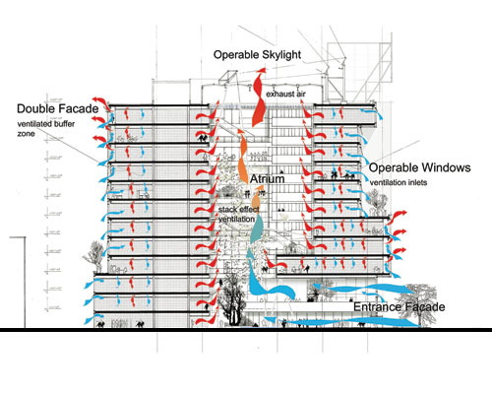
Apollo
Mechanical
Natural Ventilation
Use pressure differences to move air
Pros
Reduce energy consumption
Cons
Best in hot, dry climates
Does not remove humidity from the air
Does not remove outside contaminants
Lighting/Electrical | Mechanical | Structural | Construction

Slide 19
Apollo
Mechanical
Cogeneration
Benefits
Cost savings for host facility/customer
Partially independent from utility grid
Environmental benefits
Incentive programs (Self Generation Incentive Program “SGIP”)
Lighting/Electrical | Mechanical | Structural | Construction

Slide 20
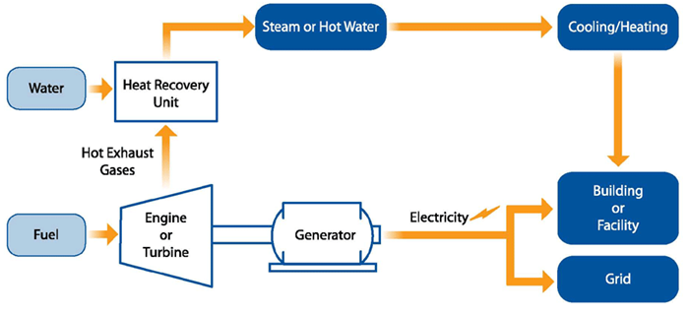
Apollo
Mechanical
Cogeneration Case Study
201 Mission Street 350 Mission Street
Building Type: Office Office
Floor Area: 490,000 SF 480,000 SF
System Size: x2 375 kW -
Annual Electricity Supply 40% -
Annual Steam Demand 90% -
Lighting/Electrical | Mechanical | Structural | Construction

Slide 21
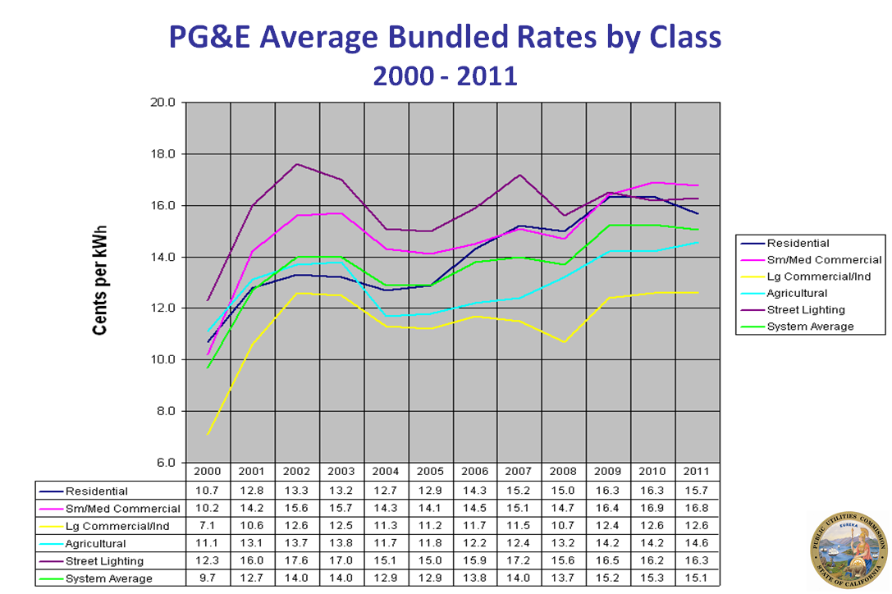
Apollo
Mechanical
CHP Cost Benefit
Typical CHP output: 125kWh per Mcf
Source Unit Price Cost
Electricity: $.126/kWh $15.75
Natural Gas: $7.13/Mcf $7.13
(Note: Doesn’t take into consideration additional benefits such as waste heat recycling)
Lighting/Electrical | Mechanical | Structural | Construction

Slide 22
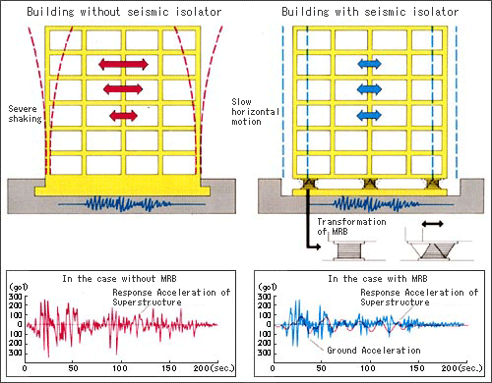
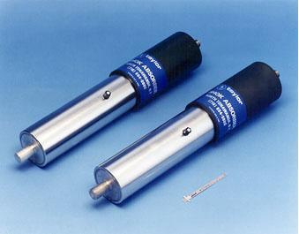
Apollo
Structural
Initial Ideas
Keep Concrete structure and add stiffness where required to control drift
Base Isolation
Fluid Viscous Dampers
Steel Plate Shear Walls
Lighting/Electrical | Mechanical | Structural | Construction

Slide 23
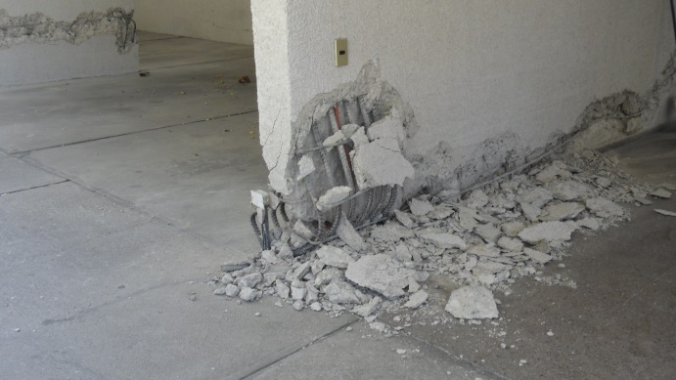
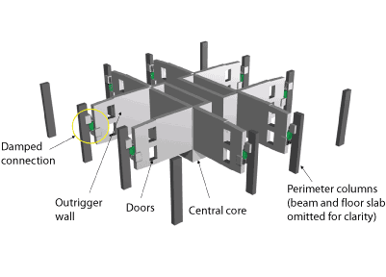
Apollo
Structural
After Meeting
Eliminated Ideas:
Keeping Concrete structure
Base Isolation
Ideas Worth More Consideration:
Steel Plate Shear Walls
Fluid Viscous Dampers
Dampers with Outriggers
Lighting/Electrical | Mechanical | Structural | Construction

Slide 24
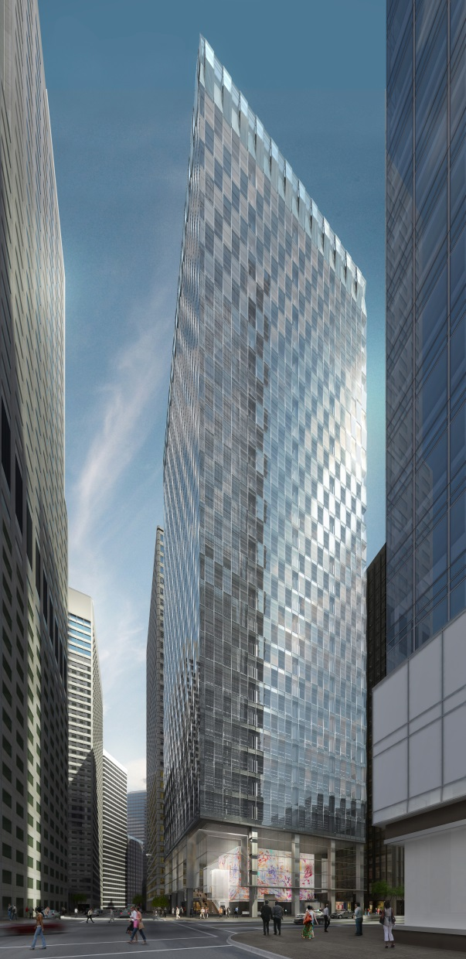
Apollo
Integration
Effects Of Ideas
Mechanical
Heavy integration with systems
Construction
Increased modularization
Schedule decrease
All Options
Building height will increase
Possible floor plan change
Possible façade changes
Lighting/Electrical | Mechanical | Structural | Construction

Slide 25
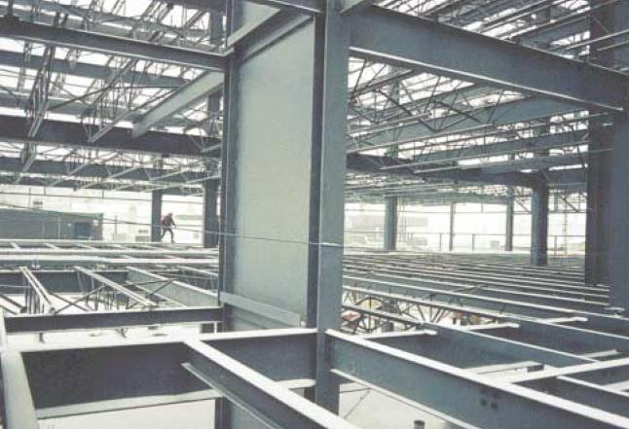
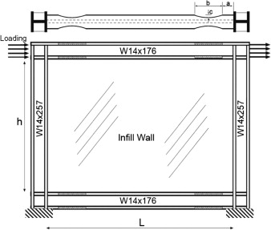
Apollo
Structural
Steel Plate Shear Walls
Large energy dissipation
Very stiff
Ability to assemble off site
Opens up space
Ability to replace
Time and Cost
Lighting/Electrical | Mechanical | Structural | Construction

Slide 26
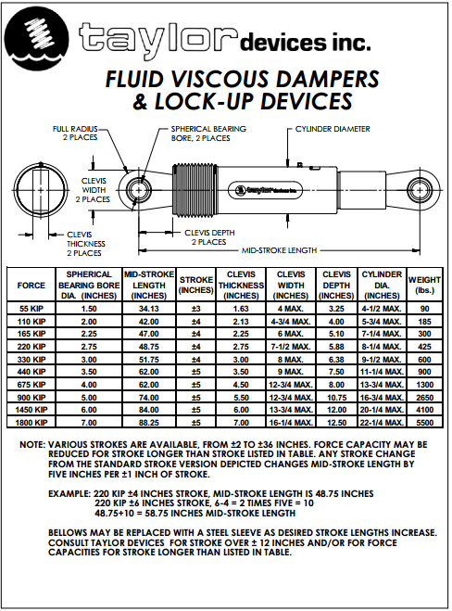
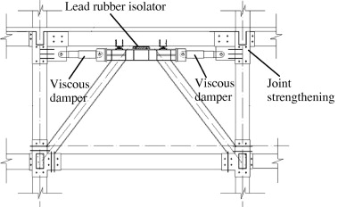
Apollo
Structural
Fluid Viscous Dampers
Adds 20-30 percent damping to structure
Drift Limit
Lifetime Cost
Flexibility of configuration
Range of Sizes
Load Paths
Lighting/Electrical | Mechanical | Structural | Construction
Notes:
Load paths are critical
Lifetime cost – Might be expensive at first but they never need replacing
Size range – use picture

Slide 27
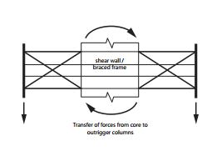
Apollo
Structural
Damped Outriggers
Decrease overturning moment
Reduces column size
Use of outrigger can be concealed
Adds redundancy to our passive system
Our size Building will only need one outrigger
Lighting/Electrical | Mechanical | Structural | Construction
Notes:
Decrease OTM by increasing the use of the building footprint

Slide 28
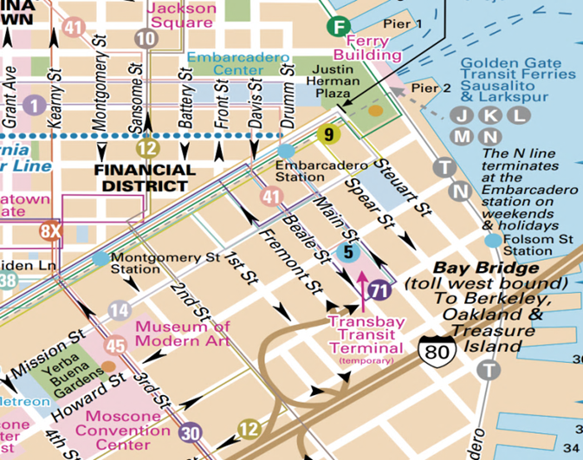
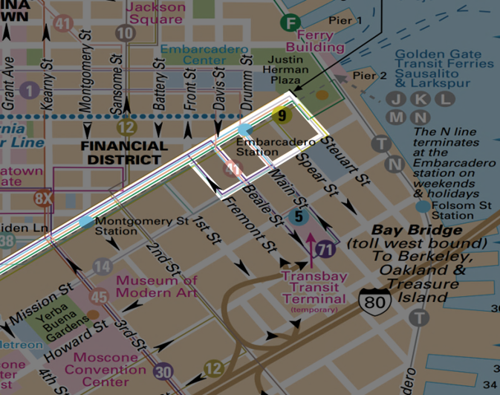
Apollo
Construction
Metro System
Lighting/Electrical | Mechanical | Structural | Construction

Slide 29
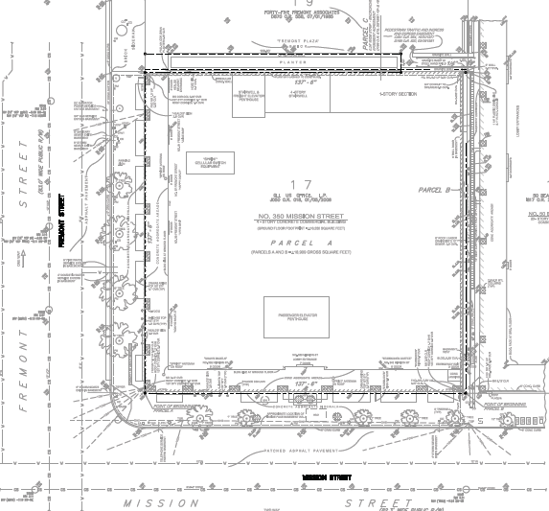
Apollo
Construction
Site Constraints
Lighting/Electrical | Mechanical | Structural | Construction

Slide 30
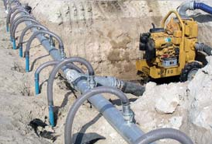
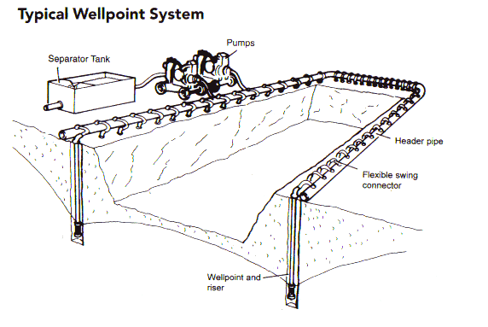
Apollo
Construction
Dewatering System
Design groundwater level at Elevation -3ft
Excavation to extend at Elevation -52ft
Maintain at least 3ft below planned max. excavation
Performance: Number, Depth, Position of wells, & Rate of pump
Cost for disposing water into City’s wastewater system
Lighting/Electrical | Mechanical | Structural | Construction

Slide 31
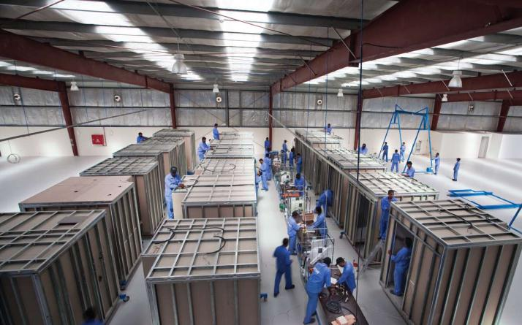
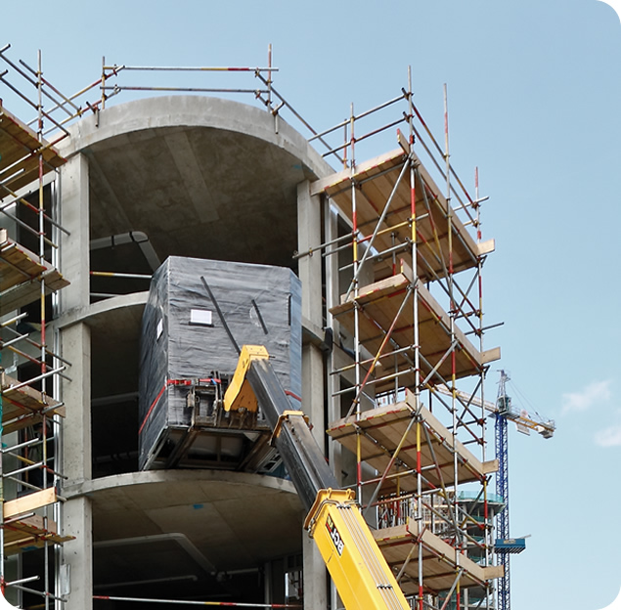
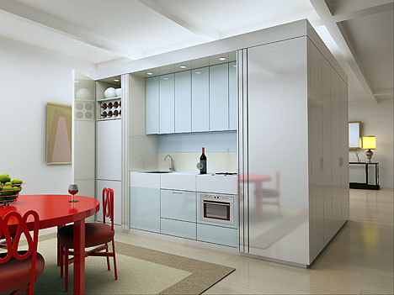
Apollo
Construction
Opportunities to Prefab
Mechanical system
Structural System
Kitchenette/Bathroom Pods
Lighting/Electrical | Mechanical | Structural | Construction

Slide 32
Apollo
Integration
Meeting Schedule
 | Sunday | Monday | Tuesday |  |  | Wednesday | Thursday |  |  | Friday | Saturday
9:00
9:30
10:00
10:30
11:00
11:30
12:00
12:30
1:00
1:30
2:00
2:30
3:00
3:30
4:00
4:30
5:00
5:30
6:00
6:30
7:00
Lighting/Electrical
Mechanical
Structural
Construction
Lighting/Electrical | Mechanical | Structural | Construction

Slide 33
Questions?

Slide 34
References
The Tower at PNC Plaza: www.toweratpncplaza.com
ITcon Journals: www.itcon.org
ASCE Journals: www.asce.org
Images Found Through Google: www.google.com
https://law.resource.org/pub/us/code/bsc.ca.gov/
http://www.energy.ca.gov
http://apps1.eere.energy.gov/buildings/publications/pdfs/corporate/bt_stateindustry.pdf
http://smud.apogee.net/comsuite/content/ces/?utilid=s&id=963
http://www.ppg.com/corporate/ideascapes/sitecollectiondocuments/high-reflectance_coatings_white_paper.pdf
http://www.denvergov.org/portals/646/documents/chk_lst_elect_hi_rise.pdf
http://www.glumac.com/articles/Net_Zero_Buildings.html
http://www.wbdg.org/resources/microturbines.php
http://www.amlegal.com
http://zeb.buildinggreen.com/
California Building Code: www.bsc.ca.gov
“Buckling restrained braced frames”
Michael D. Engelhardt
https://engineering.purdue.edu/~jliu/courses/CE697R/CE697R_BRB_F12.pdf
“Fluid Viscous Damping as an Alternative to Base Isolation”
Gregg Haskell , David Lee
http://taylordevices.com/fluidviciousdamping.html
The Spectrus group
http://thespectrusgroup.com/index.html
http://www.efficientproducts.org/reports/plugload/OfficePlugLoadAssessment_ExecutiveSummary.pdf
http://www.toptenusa.org/Top-Ten-Computers/Top-Ten-Laptop-Computers
http://www.eia.gov/tools/faqs/faq.cfm?id=667&t=6

