Slide 1
Apollo
Rebecca Bires | Scott Brown | Scott Eckert | Jordan Huey | Helen Leenhouts | Andrew Levy | Jeffrey Loeb | Patrick Vogel

Slide 2
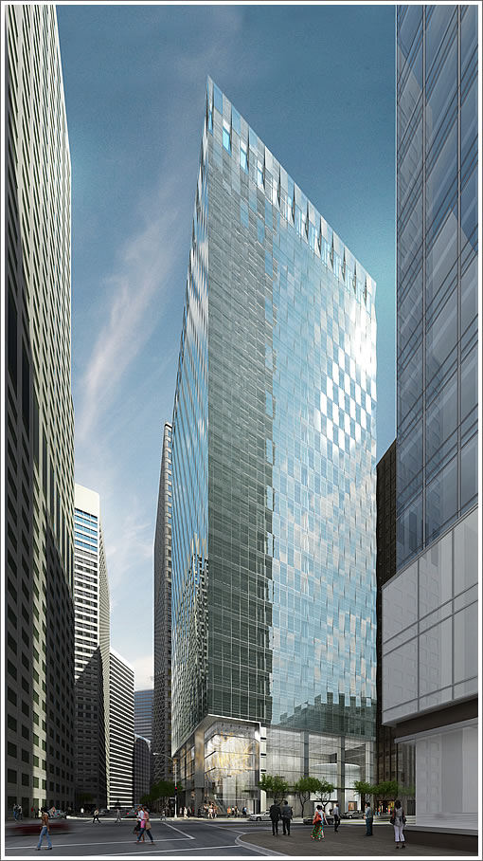
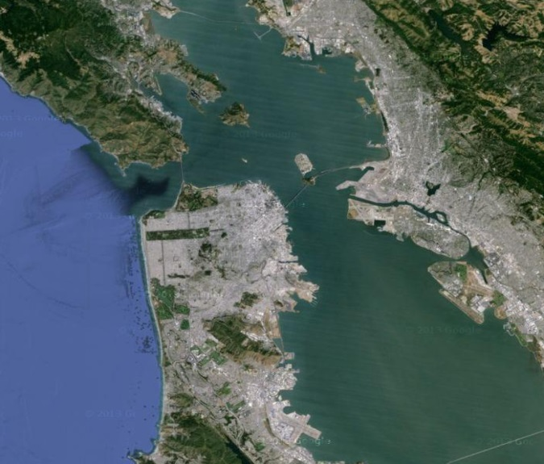
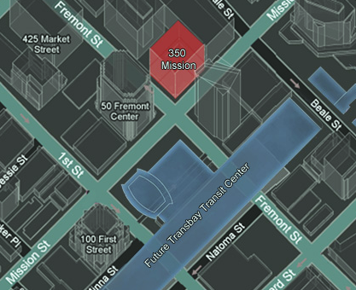
Apollo
350 Mission
30 Story Mixed-Use High-Rise
4 Story Lobby
Restaurant
Retail
25 Office Floors
4 Story Underground Parking Garage
San Francisco , CA
Introduction | Phasing | Daylight | Double Façade | Raised Floor | Gravity | Lateral | Photovoltaic | CHP | Algae | Results

Slide 3
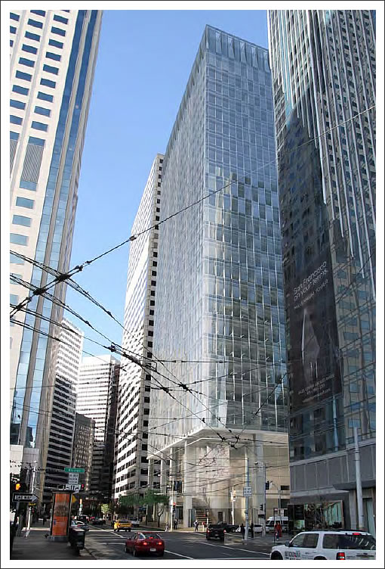
Apollo
Project Goals
Net-Zero Design
Seismic Activity Response
High Quality for Occupants
Producing energy
Reducing energy load
Continuous operation after a design level earthquake
Half of code allowed drift
System performance
Introduction | Phasing | Daylight | Double Façade | Raised Floor | Gravity | Lateral | Photovoltaic | CHP | Algae | Results

Slide 4
Net Zero
Apollo
Net Off-Site Energy Use (ZEB) - 100% of the energy purchased comes from renewable energy sources, even if the energy is generated off the site.
Strategy: buy energy from renewable sources and PV Eco-districts.
Goal: 35%
Net-Zero Source Energy Use (ZNE) - The building generates the same amount of energy that it consumes.
Strategy: use a combined heat-and-power system to generate energy on-site.
Goal: 20%
Net-Zero Energy Emissions (ZEE) – A building with zero net carbon emissions.
Strategy: use algae bioreactors to offset the carbon emissions of the combined
heat-and-power system.
Goal: 50%
Introduction | Phasing | Daylight | Double Façade | Raised Floor | Gravity | Lateral | Photovoltaic | CHP | Algae | Results
Notes:
*Reference Goals based off of PG&E website information and 201 Mission Street case study

Slide 5
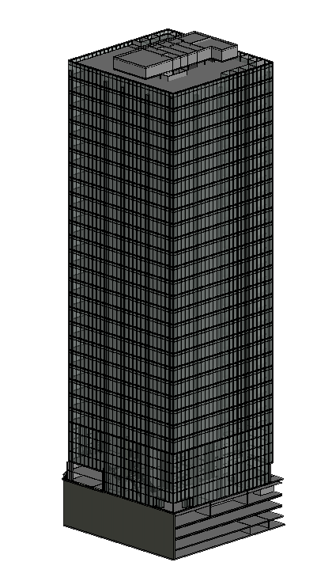
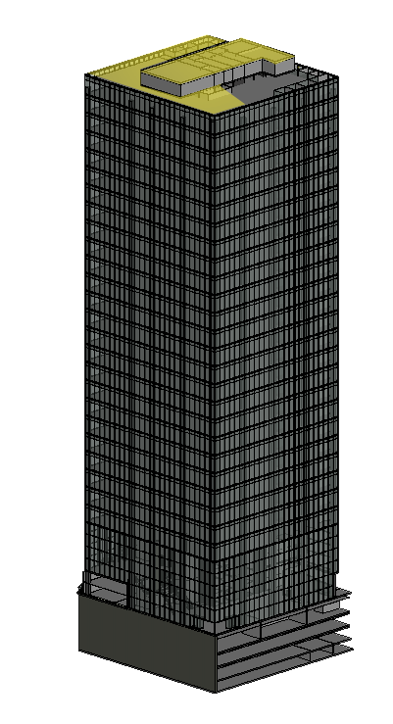
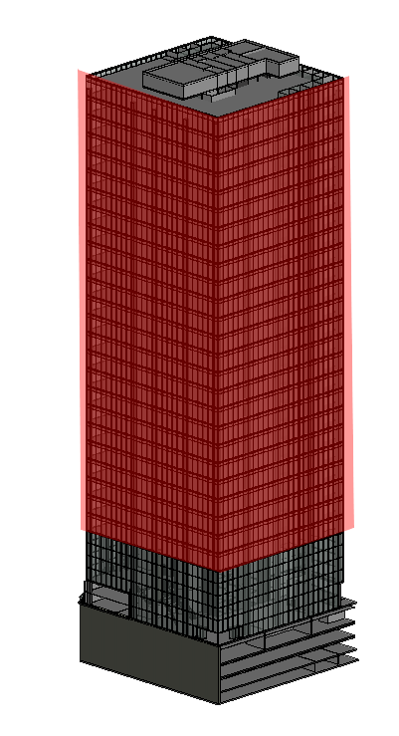
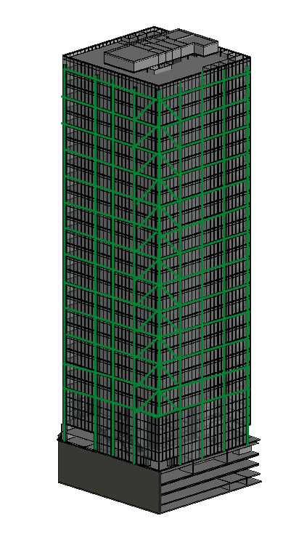
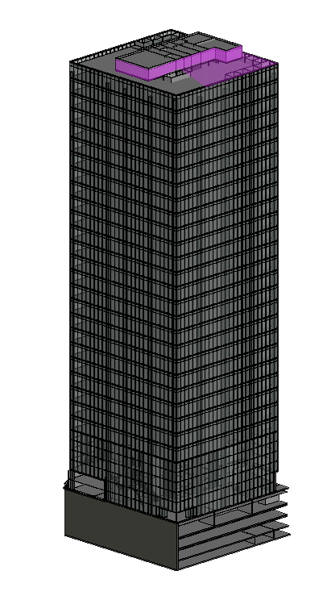
Building Overview
Apollo
Price Estimate: $93 million
Schedule: 2.5 - 3 years
LEED Certification: Platinum
Systems
Double Façade
Raised Access Floor System
Structural Steel System
Photovoltaic Grid
Combined Heat and Power
4 Story Parking Garage
Introduction | Phasing | Daylight | Double Façade | Raised Floor | Gravity | Lateral | Photovoltaic | CHP | Algae | Results

Slide 6
Apollo
Lobby Layout
Street Level
Lower Lobby
Retail
Back of House
Elevator Lobby
Fremont Street
Staircase
Second Level
Upper Lobby
Restaurant
Elevator Lobby
Mission Street
Introduction | Phasing | Daylight | Double Façade | Raised Floor | Gravity | Lateral | Photovoltaic | CHP | Algae | Results

Slide 7
Apollo
Typical Office Layout
Elevator Lobby
Reception
Executive Offices
Partner Offices
Open Offices
Conference Rooms
Ancillary Spaces
Introduction | Phasing | Daylight | Double Façade | Raised Floor | Gravity | Lateral | Photovoltaic | CHP | Algae | Results

Slide 8
Project Phasing
Apollo
Introduction | Phasing | Daylight | Double Façade | Raised Floor | Gravity | Lateral | Photovoltaic | CHP | Algae | Results

Slide 9
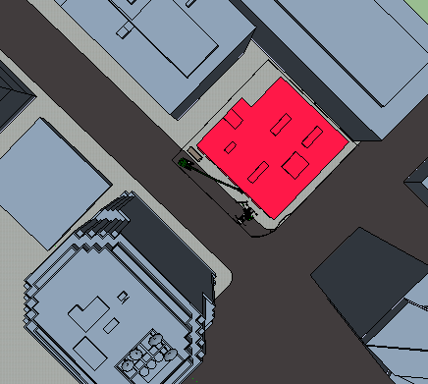
Demolition Phase
Apollo
Electric Bus Lines
Asbestos Abatement
Demolition Mat
Sort & Recycle off-site
Concrete Reuse
Off Site Trailer
Introduction | Phasing | Daylight | Double Façade | Raised Floor | Gravity | Lateral | Photovoltaic | CHP | Algae | Results

Slide 10
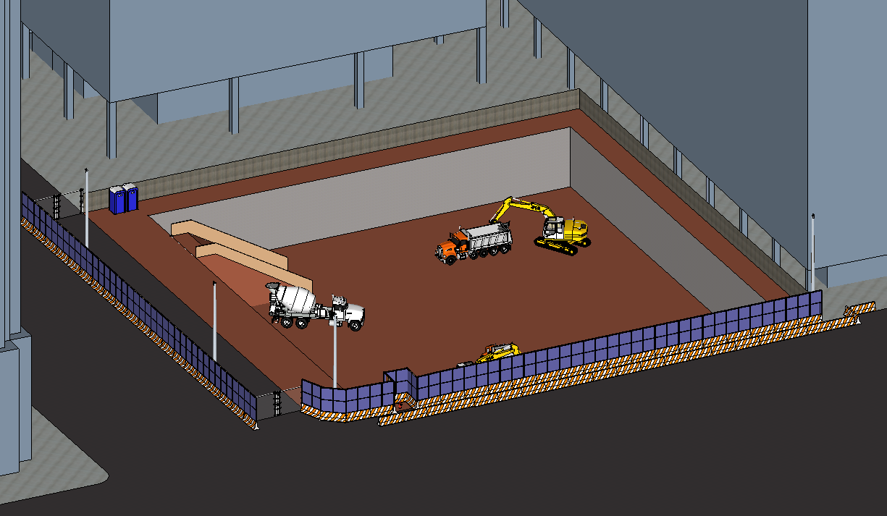
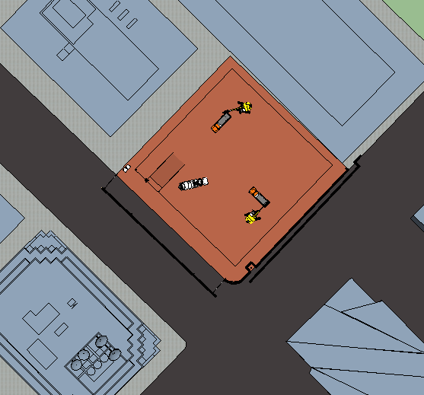
Excavation Phase
Apollo
Construction Fence
Soil Conditions
Retaining Wall
Foundation Mat
$5 million
Introduction | Phasing | Daylight | Double Façade | Raised Floor | Gravity | Lateral | Photovoltaic | CHP | Algae | Results

Slide 11
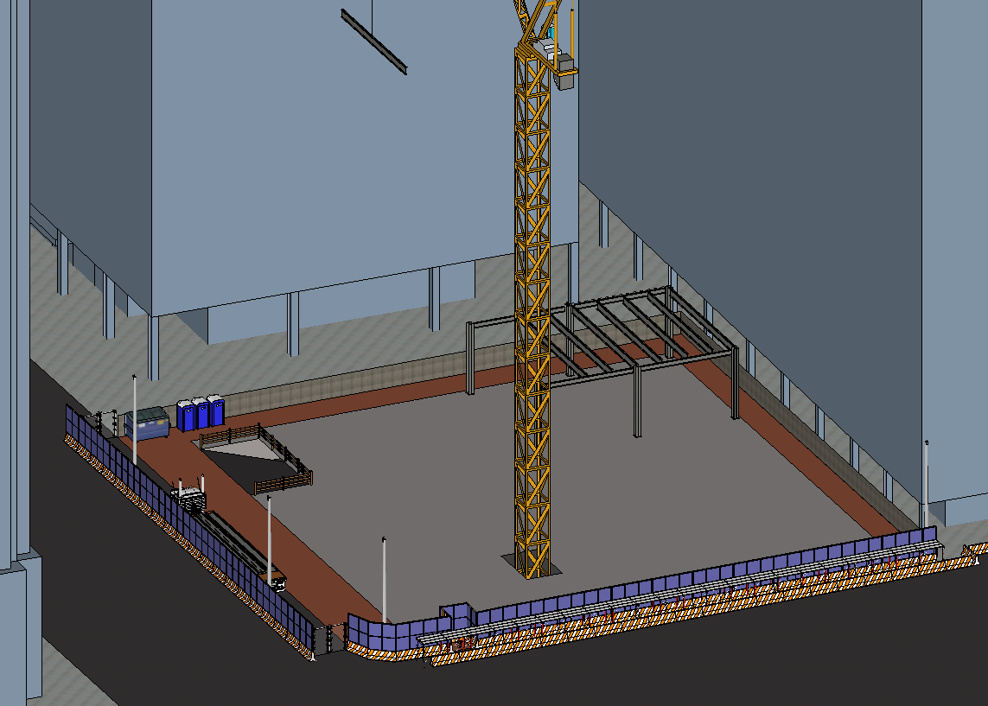
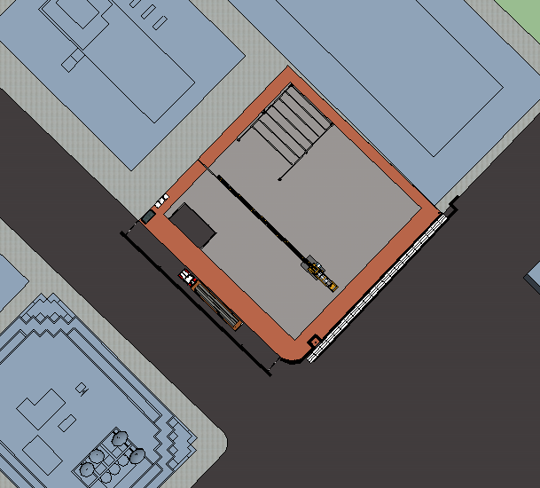
Erection Phase
Apollo
Office Location
Crane Location
Safety
Electric Bus Lines
Introduction | Phasing | Daylight | Double Façade | Raised Floor | Gravity | Lateral | Photovoltaic | CHP | Algae | Results

Slide 12
Systems
Apollo
Introduction | Phasing | Daylight | Double Façade | Raised Floor | Gravity | Lateral | Photovoltaic | CHP | Algae | Results

Slide 13
Daylight
Apollo
Introduction | Phasing | Daylight | Double Façade | Raised Floor | Gravity | Lateral | Photovoltaic | CHP | Algae | Results

Slide 14
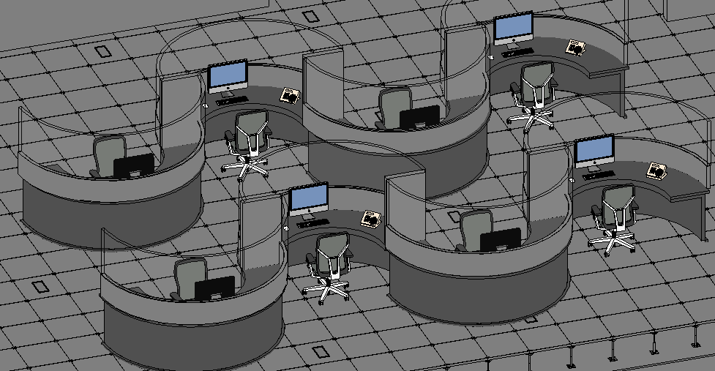
Apollo
Typical Office Layout
Frosted Glass Walls
Clear Glass Walls
Half Height Walls
Introduction | Phasing | Daylight | Double Façade | Raised Floor | Gravity | Lateral | Photovoltaic | CHP | Algae | Results

Slide 15
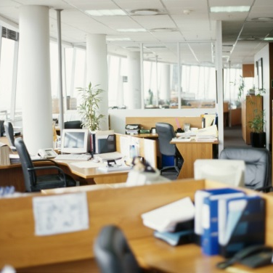
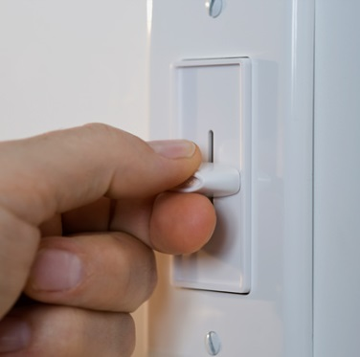
Apollo
Energy Use Reduction
Daylight Harvesting
Vacancy Sensing
Non-Dimmed
Light Level Tuning
Non-Dimmed
Introduction | Phasing | Daylight | Double Façade | Raised Floor | Gravity | Lateral | Photovoltaic | CHP | Algae | Results

Slide 16
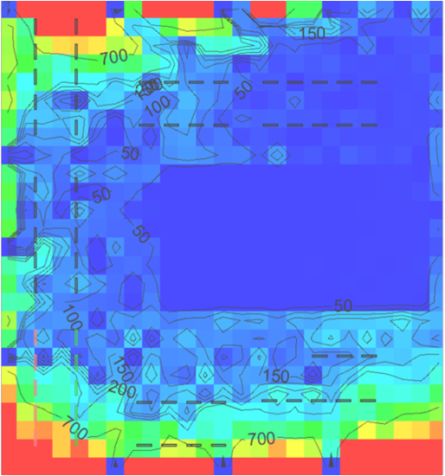
Apollo
Energy Savings
LPD Reduction
0.67 W/ft² out of 0.9 allowable, 36% reduction
191,360 kWhr
Daylight Harvesting
dimming 38 fixtures to an average level of 24%
98,300 kWhr
Light Level Tuning
continually reducing lighting output, until it is too low
24,700 kWhr
Vacancy Sensing
turning off lights in unoccupied spaces
29,000 kWhr
Total
383,814 kWhr
Introduction | Phasing | Daylight | Double Façade | Raised Floor | Gravity | Lateral | Photovoltaic | CHP | Algae | Results

Slide 17
Double Façade ~$13 M
Apollo
Introduction | Phasing | Daylight | Double Façade | Raised Floor | Gravity | Lateral | Photovoltaic | CHP | Algae | Results

Slide 18
Double Façade
Apollo
Summer Conditions (>74ºF)
Window Layer | Action
Outer | Open
Plenum | Opens when plenum >85ºF
Inner | Closed
Introduction | Phasing | Daylight | Double Façade | Raised Floor | Gravity | Lateral | Photovoltaic | CHP | Algae | Results

Slide 19
Double Façade
Apollo
Winter Conditions (0-45 ºF)
Window Layer | Action
Outer | Closed
Plenum | Opens when plenum >85ºF
Inner | Opens when plenum > 70
Introduction | Phasing | Daylight | Double Façade | Raised Floor | Gravity | Lateral | Photovoltaic | CHP | Algae | Results

Slide 20
Double Façade
Apollo
Natural Ventilation Conditions (55-74ºF)
Window Layer | Action
Outer | Open
Plenum | Opens when plenum >85ºF
Inner | Open
Introduction | Phasing | Daylight | Double Façade | Raised Floor | Gravity | Lateral | Photovoltaic | CHP | Algae | Results

Slide 21
Raised Floor ~ $6 M
Apollo
Introduction | Phasing | Daylight | Double Façade | Raised Floor | Gravity | Lateral | Photovoltaic | CHP | Algae | Results

Slide 22
Raised Floor
Apollo
Raised Floor System
Walls that penetrate the raised floor
Pods
Introduction | Phasing | Daylight | Double Façade | Raised Floor | Gravity | Lateral | Photovoltaic | CHP | Algae | Results
Notes:
Benefits
IAQ
Less conditioning
No short circuit
Flexibility
Why chose over radiant – immediate occupancy
Seismic Bracing
Pods – CM (location of underfloor) and Structural (weight)

Slide 23
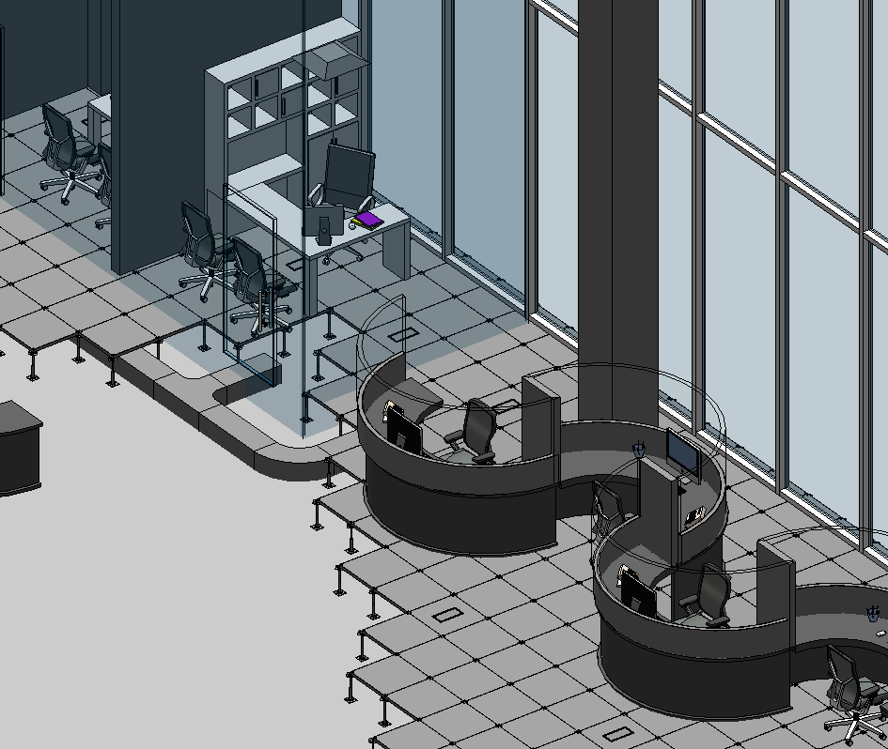
Raised Floor
Apollo
Introduction | Phasing | Daylight | Double Façade | Raised Floor | Gravity | Lateral | Photovoltaic | CHP | Algae | Results
Notes:
Benefits
Seismic Bracing

Slide 24
Gravity Elements ~ $5.5 M
Apollo
Introduction | Phasing | Daylight | Double Façade | Raised Floor | Gravity | Lateral | Photovoltaic | CHP | Algae | Results

Slide 25
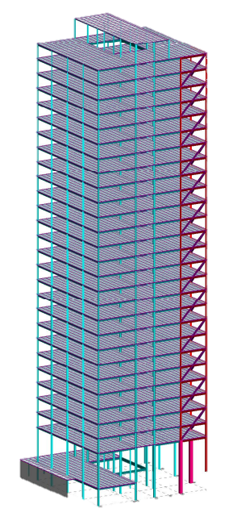
Gravity Elements
Apollo
Steel Super-Structure
Design Considerations:
Long span conditions for steel beams
Limit excessive beam depths
Limit Floor to Floor height increase
Loads:
Live Load: 100 psf
Dead load: self weight + 10 psf
Partition Load: 20 psf
Raised Floor: 10 psf
Introduction | Phasing | Daylight | Double Façade | Raised Floor | Gravity | Lateral | Photovoltaic | CHP | Algae | Results

Slide 26
Gravity Elements
Apollo
Strategy
RAM SS was used to design all gravity elements
Initial RAM model was built for a typical floor with non-composite beams and unreducible loads to determine a worst case beam depth
Team check-in to discuss beam depths
RAM model rebuilt to a typical floor with composite beams and reducible loads
Structural Elements
Beams range from W14 shapes to W36 shapes
All columns in upper floors are W14 shapes
Built up columns were designed where W14 had inadequate capacity
2VLI20 deck from the Vulcraft Manufacturer’s catalog was used with a 4 ½ inch topping thickness of normal weight concrete (2 hour fire rating)
Introduction | Phasing | Daylight | Double Façade | Raised Floor | Gravity | Lateral | Photovoltaic | CHP | Algae | Results

Slide 27
Gravity Elements
Apollo
Typical Floor Beam Layout
Introduction | Phasing | Daylight | Double Façade | Raised Floor | Gravity | Lateral | Photovoltaic | CHP | Algae | Results

Slide 28
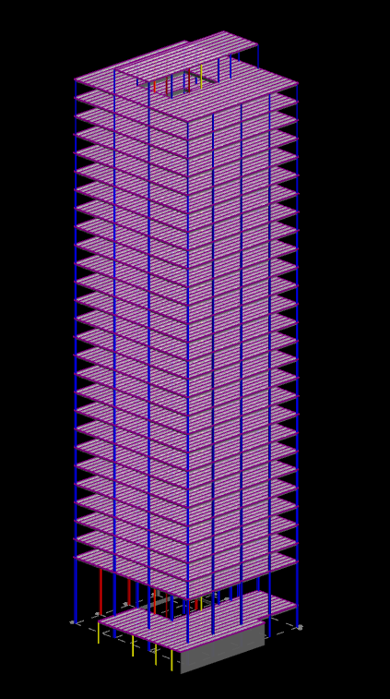
Gravity Elements
Apollo
Columns
Spliced every 2 levels
W14 shape
Built-up columns designed in lower levels
Introduction | Phasing | Daylight | Double Façade | Raised Floor | Gravity | Lateral | Photovoltaic | CHP | Algae | Results

Slide 29
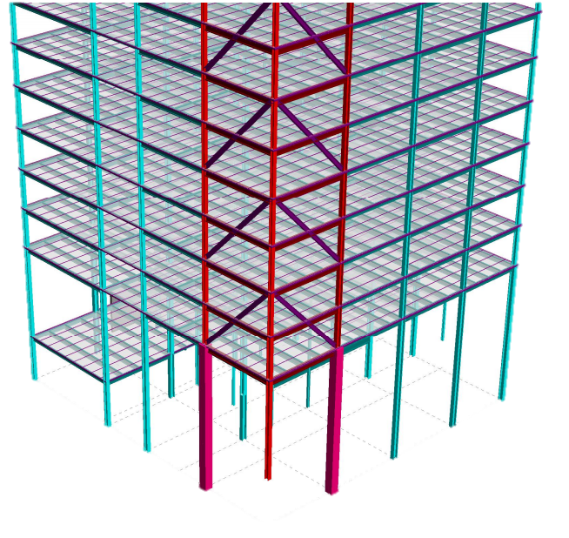
Gravity Elements
Apollo
Solution
Interior columns added, new spaces created
Corner column introduced above lobby level, cantilever now only exists at lobby level
Transfer braces added to cantilevered corner to transfer load away from corner
Problems
Beam depths still excessive
Cantilever
Introduction | Phasing | Daylight | Double Façade | Raised Floor | Gravity | Lateral | Photovoltaic | CHP | Algae | Results

Slide 30
Lateral Elements ~ $15 M
Apollo
Introduction | Phasing | Daylight | Double Façade | Raised Floor | Gravity | Lateral | Photovoltaic | CHP | Algae | Results

Slide 31
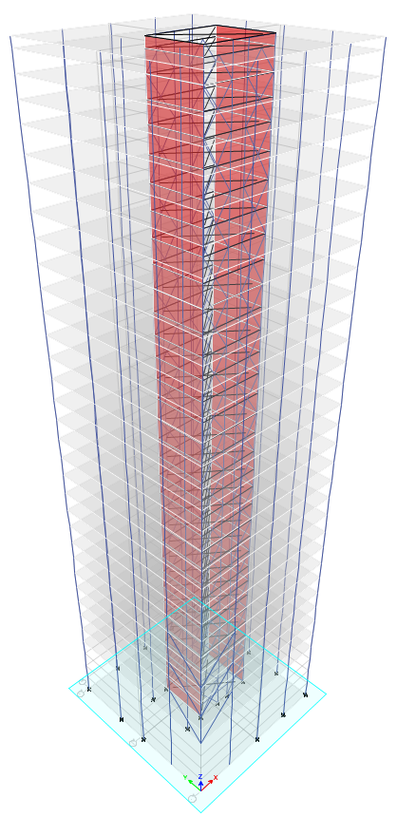
Lateral Elements
Apollo
Design considerations:
Building is to be able to withstand a design level earthquake with near immediate occupancy required after the event.
The structure is to comply with one half the code allowed drift limit.
While economy is not explicitly mentioned in the competition guidelines, the design team did consider the cost of different systems.
Introduction | Phasing | Daylight | Double Façade | Raised Floor | Gravity | Lateral | Photovoltaic | CHP | Algae | Results

Slide 32
Lateral Elements
Apollo
Initial Strategy:
Remove concrete structure as the primary LFRS and replace with steel
Determine the new drift limit for the high rise
Investigate potential damping systems
Propose a new LFRS based on investigation and check progress for drift and ease of repair after a seismic event
Introduction | Phasing | Daylight | Double Façade | Raised Floor | Gravity | Lateral | Photovoltaic | CHP | Algae | Results
Notes:
Concrete will require more effort to repair after a design level earthquake and will be harder to attain the drift limit described in the competition guidelines.
The team proposed an estimated height for the building after a redesign in steel in order to obtain the story drift allowed by the competition
With a strict drift limit such as that imposed by the competition the design team wanted to explore all options for reducing story drift.

Slide 33
Initial Lateral Calculations
Apollo
Equivalent Lateral Force
Performed for the estimated design weight in order to determine the approximate forces that the design team would be dealing with
Revised drift limit
Upon accounting for extra height imposed by the new steel construction and mechanical systems the drift limit was determined to be 41.5 inches at the full height of the building
Level | F_{x} (kips) | M (kip-ft)
Roof | 221.60 | 85130.23
26 | 207.66 | 76835.23
25 | 195.04 | 69598.54
24 | 182.76 | 62809.38
23 | 170.82 | 56455.63
22 | 159.21 | 50525.63
21 | 147.96 | 45005.28
20 | 137.05 | 39883.79
19 | 126.50 | 35147.91
18 | 116.31 | 30784.84
17 | 106.49 | 26781.59
16 | 97.03 | 23125.00
15 | 87.94 | 19801.73
14 | 79.24 | 16798.22
13 | 70.92 | 14100.72
12 | 62.99 | 11695.24
11 | 55.46 | 9567.51
10 | 48.34 | 7703.02
9 | 31.64 | 6086.94
8 | 35.37 | 4707.10
7 | 29.53 | 3538.98
6 | 24.15 | 2575.59
5 | 19.22 | 1797.51
4 | 14.78 | 1187.73
3 | 10.85 | 728.58
2 | 7.44 | 401.59
Lobby | 0.00 | 0.00
 | 2456.30 | 702769.9
Introduction | Phasing | Daylight | Double Façade | Raised Floor | Gravity | Lateral | Photovoltaic | CHP | Algae | Results

Slide 34
Lateral System Investigation
Apollo
After performing the initial calculations and discovering the significant forces on the building, lateral systems and damping were investigated. This investigation included:
Base Isolation
Outrigger systems
Damping systems (primarily viscous fluid damping)
Steel plate shear walls
Special braced and moment frames
Introduction | Phasing | Daylight | Double Façade | Raised Floor | Gravity | Lateral | Photovoltaic | CHP | Algae | Results
Notes:
Base isolation was not appropriate for a building of this size
Used primarily for buildings with a period around 1s, while 350 mission will be on the range of 2-3s
Outrigger systems utilize the entire building footprint, but for a project of this scale the technique is excessive
Viscous fluid damping
Only assists with energy dissipation and reduction of drift
This means that strength is actually lost due to replacing cross members with dampers
An expensive solution to the problem
Steel plate shear walls
Potentially expensive, but adds considerable lateral strength and stiffness
Braced and moment frames
Common practice for a building this size, provides an accessible space, and adds strength and stiffness to the lateral system.

Slide 35
New Lateral Calculations
Apollo
Level | F_{x} (kips) | M (kip-ft)
Roof | 258.12 | 114603.37
30 | 194.45 | 83419.72
29 | 182.84 | 75695.71
28 | 171.53 | 68441.00
27 | 160.53 | 61643.12
26 | 153.02 | 56465.09
25 | 142.42 | 50417.00
24 | 132.14 | 44796.41
23 | 122.19 | 39590.04
22 | 115.81 | 35785.56
21 | 106.26 | 31239.88
20 | 97.05 | 27078.25
19 | 88.21 | 23286.27
18 | 80.14 | 19955.64
17 | 71.98 | 16842.28
16 | 64.18 | 14055.75
15 | 56.77 | 11580.62
14 | 51.01 | 9640.52
13 | 44.21 | 7692.35
12 | 37.82 | 6014.15
11 | 31.87 | 4588.70
10 | 26.59 | 3429.76
9 | 21.47 | 2447.39
8 | 16.82 | 1665.09
7 | 12.66 | 1063.25
6 | 9.45 | 652.03
5 | 6.18 | 333.92
Restaurant | 0.58 | 10.52
Lobby | 0.00 | 0
 | 2456.3 | 812433.396
Equivalent Lateral Force
Performed for the proposed steel structure with estimated lateral members
Increased loads and moments at each floor
Introduction | Phasing | Daylight | Double Façade | Raised Floor | Gravity | Lateral | Photovoltaic | CHP | Algae | Results

Slide 36
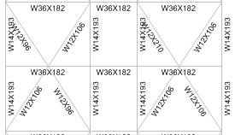
Final Lateral Design
Apollo
Composed of special concentrically braced frames in the core
Includes moment frames on the perimeter as required by code although the core alone meets requirements
Originally composed of SPSW and braced frames
SPSW actually proved to be not only stiffer than was needed, but also significantly more expensive than the final design.
Introduction | Phasing | Daylight | Double Façade | Raised Floor | Gravity | Lateral | Photovoltaic | CHP | Algae | Results

Slide 37
Final Lateral Design
Apollo
Drift achieved: 39 inches
Compare to 41.5 inch requirement
Neither over nor under-designed
Results in an economic design meeting requirements
Withstands normal low magnitude seismic events
Minimal drift during design level events and presents an easily repairable structure.
Introduction | Phasing | Daylight | Double Façade | Raised Floor | Gravity | Lateral | Photovoltaic | CHP | Algae | Results

Slide 38
Photovoltaic ~$510,000
Apollo
Introduction | Phasing | Daylight | Double Façade | Raised Floor | Gravity | Lateral | Photovoltaic | CHP | Algae | Results

Slide 39
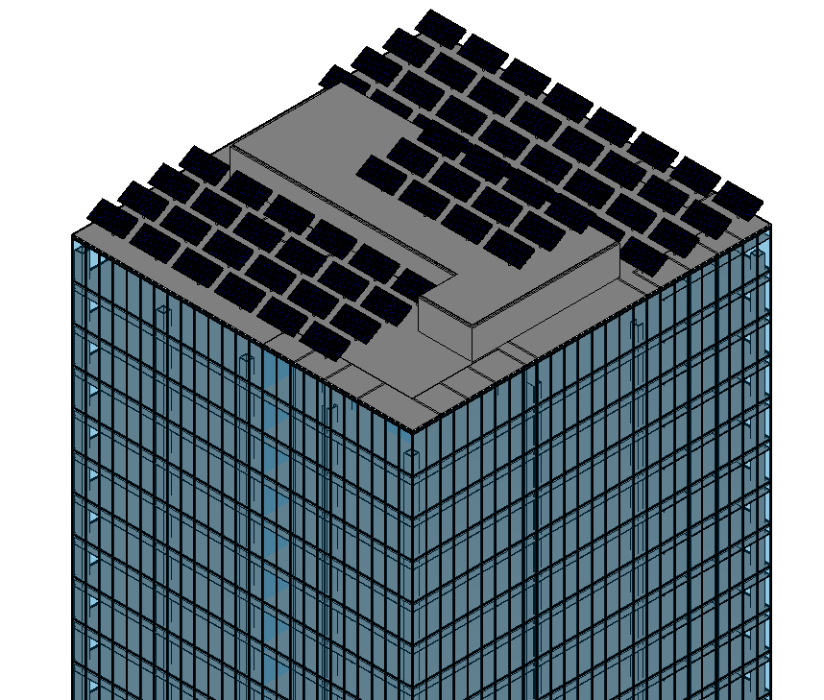
Photovoltaic System
Apollo
Size
816 Photovoltaic panels mounted on 68 telescoping poles
Distribution
Transformed and fed into a distribution panel in rooftop electrical room
Output
313,250 kBTU per year
Over 3% of total energy use
Introduction | Phasing | Daylight | Double Façade | Raised Floor | Gravity | Lateral | Photovoltaic | CHP | Algae | Results

Slide 40
Combined Heat and Power ~$815,000
Apollo
Introduction | Phasing | Daylight | Double Façade | Raised Floor | Gravity | Lateral | Photovoltaic | CHP | Algae | Results

Slide 41
Combined Heat and Power
Apollo
Feasibility
High Electric Rates: $0.18/kWh
Desirable Spark Spread: $0.10/kWh
Future Energy Cost Concerns: Yes
Reducing Environmental Impact: Yes
Simple Payback Period (SPP)
Initial System Cost $815,000 California CHP/Cogeneration Incentives Rebates $312,000
Capital Cost Post Rebate $503,000
Annual Operational Savings $101,400
SPP = $\frac{Capital Cost}{Annual Savings}$ = $\frac{503,000}{101,400}$ = 5 years
Introduction | Phasing | Daylight | Double Façade | Raised Floor | Gravity | Lateral | Photovoltaic | CHP | Algae | Results

Slide 42
Combined Heat and Power
Apollo
Electrical Output
Generation Capacity: 650 kW
Generated Power: 1,014,000 kWh/yr
Electrical Capacity Met: 27%
Thermal Output
Heat Recovery: 1,850 MBtu/hr
Heat Recovery Efficiency: 45%
Heat Capacity Met: 88%
Introduction | Phasing | Daylight | Double Façade | Raised Floor | Gravity | Lateral | Photovoltaic | CHP | Algae | Results

Slide 43
Combined Heat and Power
Apollo
CHP Fuel Savings and Carbon Emission Reduction
Fuel Savings: 625 MCF (5%)
Carbon Reduction: 355,663 lbs. CO₂ (20%)
350 Mission
33%
74%
Power Plant
Electricity
Electricity
CHP
Heat
Heat
Boiler
System Efficiency Model
Introduction | Phasing | Daylight | Double Façade | Raised Floor | Gravity | Lateral | Photovoltaic | CHP | Algae | Results

Slide 44
Algae Bioreactors
Apollo
Introduction | Phasing | Daylight | Double Façade | Raised Floor | Gravity | Lateral | Photovoltaic | CHP | Algae | Results

Slide 45
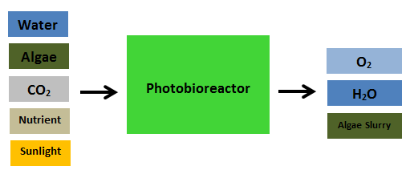
Algae Bioreactors
Apollo
Carbon Reduction
Yearly Emissions: 1,369,638 lbs. CO₂
Algae Sequestration: 837,503 lbs. CO₂
Percent Reduction: 60%
Photosynthesis Chemical Reaction:
6CO2 + 12H2O + Light → C6H12O6 + 6O2 + 6H2O
Algae Bioreactor Cylinders
CO₂ Intake (Connected to CHP flue gas exhaust)
Degassing Column
Introduction | Phasing | Daylight | Double Façade | Raised Floor | Gravity | Lateral | Photovoltaic | CHP | Algae | Results

Slide 46
Results
Apollo
Introduction | Phasing | Daylight | Double Façade | Raised Floor | Gravity | Lateral | Photovoltaic | CHP | Algae | Results

Slide 47
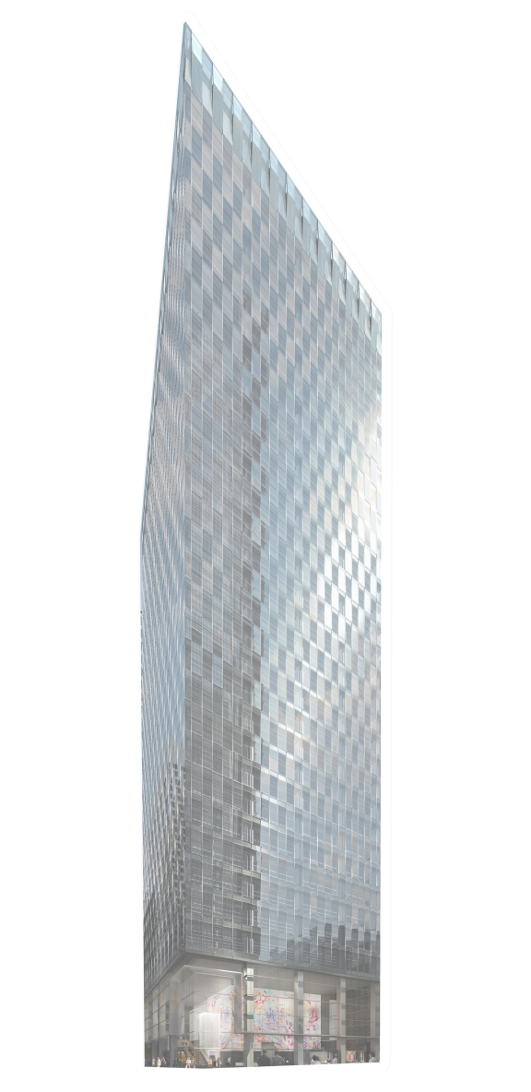
Energy Savings
Apollo
Lighting
1,456,000 kBtu
Lighting
4,567,000 kBtu
Heating
1,870,000 kBtu
Heating
4,625,000 kBtu
Cooling
517,000 kBtu
Cooling
1,550,000 kBtu
Pumps
38,000 kBtu
Pumps
155,000 kBtu
Heat Rejection
419,000 kBtu
Heat Rejection
481,000 kBtu
46%
Fans
1,240,000 kBtu
Fans
6,578,000 kBtu
Plug Load
4,900,000 kBtu
Plug Load
4,900,000 kBtu
Total
10,440,000 kBtu
Total
22,856,000 kBtu
Proposed
Baseline
Introduction | Phasing | Daylight | Double Façade | Raised Floor | Gravity | Lateral | Photovoltaic | CHP | Algae | Results
Notes:
Special duct braces for vibrations (and piping)

Slide 48
Achievements
Apollo
Goal Achieved
Building Energy Use Reduction: 30% 54%
Net-Zero Energy Emissions: 50% 68%
Net-Zero Source Energy Use: 20% 30%
Net Off-Site Energy Use: 35% 19%
Drift Limit: 41.5 in 39 in
Lifecycle 5 yrs -
Schedule Time 2.5 yrs -
Introduction | Phasing | Daylight | Double Façade | Raised Floor | Gravity | Lateral | Photovoltaic | CHP | Algae | Results

Slide 49
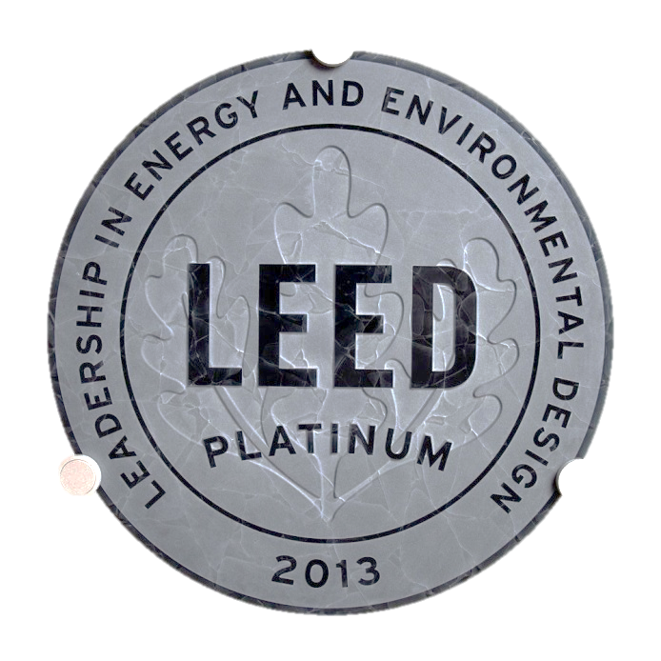
LEED
Apollo
Project Checklist | Possible Points
Sustainable Sites | 21
Water Efficiency | 6
Energy and Atmosphere | 26
Materials and Resources | 8
Indoor Environmental Quality | 12
Innovation and Design Process | 3
Regional Priority Credits | 4
Total | 80
Introduction | Phasing | Daylight | Double Façade | Raised Floor | Gravity | Lateral | Photovoltaic | CHP | Algae | Results

Slide 50
Apollo
350 Mission
An iconic building that sets a precedent for sustainable architecture in San Francisco
Introduction | Phasing | Daylight | Double Façade | Raised Floor | Gravity | Lateral | Photovoltaic | CHP | Algae | Results

