Slide 1
Apollo
Scott Brown | Andrew Levy

Slide 2
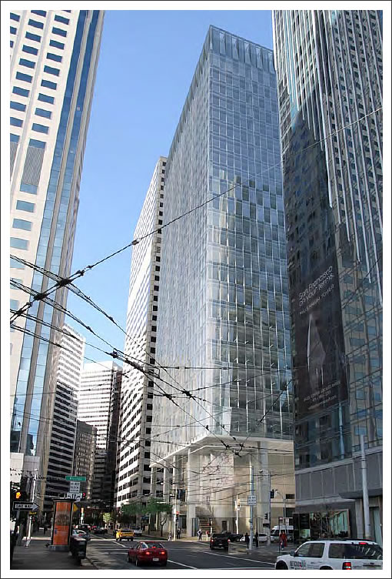
Apollo
350 Mission
Introduction | Lighting Design | Lighting Controls | Energy Savings | Conclusions

Slide 3
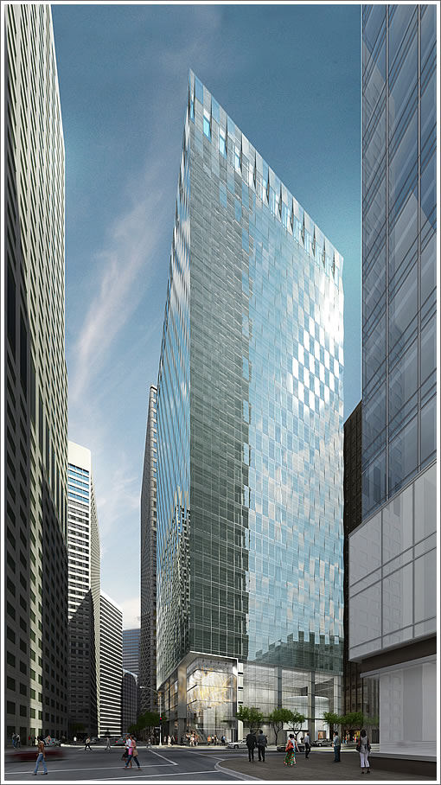
Apollo
Function
30 story mixed-use high-rise
4 story lobby
restaurant
retail
25 office floors
Introduction | Lighting Design | Lighting Controls | Energy Savings | Conclusions

Slide 4
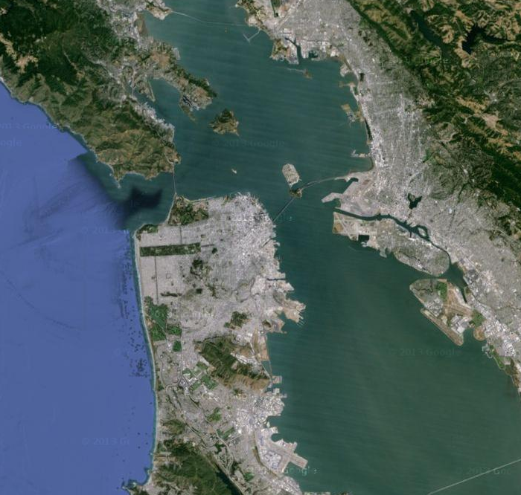
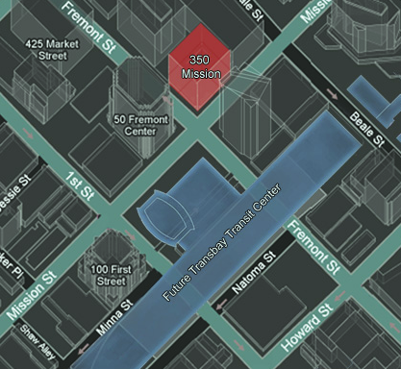
Apollo
Location
San Francisco Business District
Introduction | Lighting Design | Lighting Controls | Energy Savings | Conclusions

Slide 5
Apollo
Design Goal
Create an iconic building that sets a precedent for
sustainable architecture in San Francisco
Net Zero Design
Structural Integrity
High Quality for Occupants
Producing Energy
Reducing Energy use
Continuous operation after a design level earthquake
Half of code allowed drift
Lighting Design
Lighting Controls
Introduction | Lighting Design | Lighting Controls | Energy Savings | Conclusions

Slide 6
Apollo
Design Goal
Create an iconic building that sets a precedent for
sustainable architecture in San Francisco
Net Zero Design
Producing Energy
Reducing Energy use
Structural Integrity
Continuous operation after a design level earthquake
Half of code allowed drift
High Quality for Occupants
Lighting Design
Lighting Controls
Introduction | Lighting Design | Lighting Controls | Energy Savings | Conclusions

Slide 7
Apollo
Defining Net Zero
Net Off-Site Energy Use (Buy From Renewable Sources)
100% of the energy purchased comes from renewable energy sources, even if the energy is generated off the site
Zero Net Site Energy Use (Onsite Renewable)
Amount of energy provided by on-site renewable energy sources is equal to the amount of energy used by the building
Zero Net Source Energy Use (Co-generation)
The building generates the same amount of energy that it uses
Introduction | Lighting Design | Lighting Controls | Energy Savings | Conclusions

Slide 8
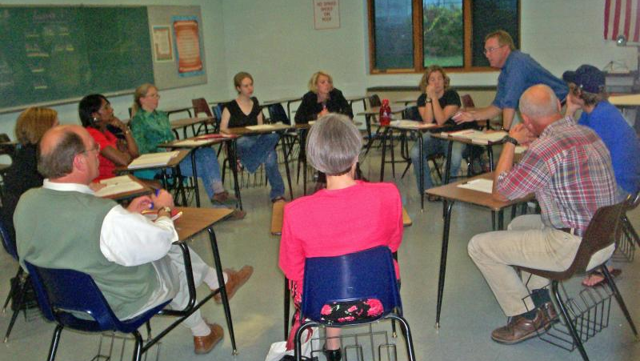
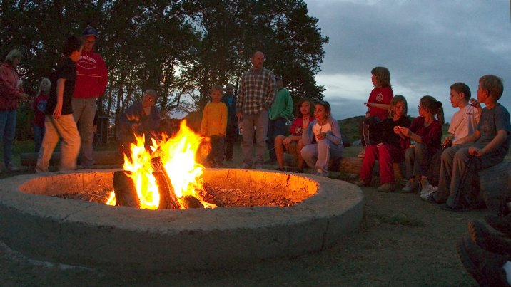
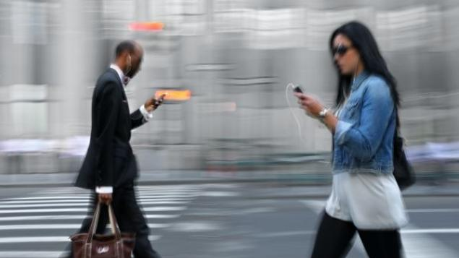
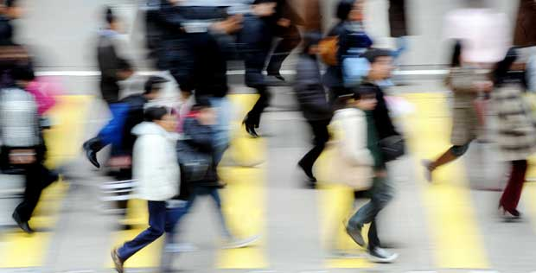
Apollo
Lighting Design
Concept: Use geometry to lead people through areas of transition and to create places of congregation
Introduction | Lighting Design | Lighting Controls | Energy Savings | Conclusions

Slide 9
Apollo
Lobby
Street Level
Lower Lobby
Retail
Back of House
Elevator Lobby
Freemont Street
Staircase
Second Level
Upper Lobby
Restaurant
Elevator Lobby
Mission Street
Introduction | Lighting Design | Lighting Controls | Energy Savings | Conclusions

Slide 10
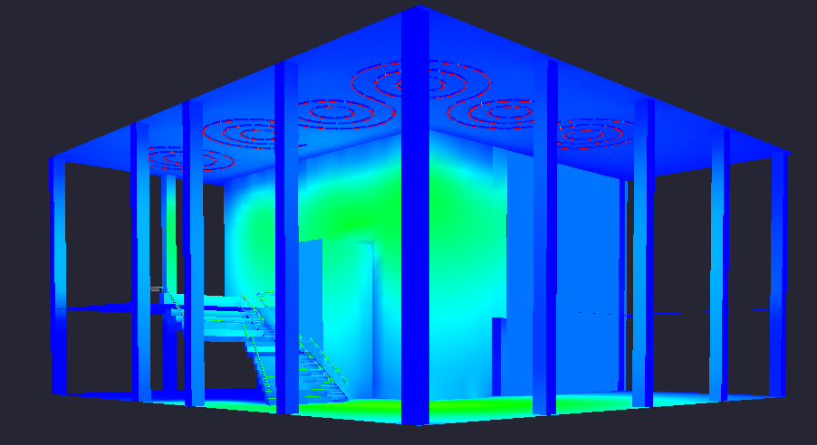
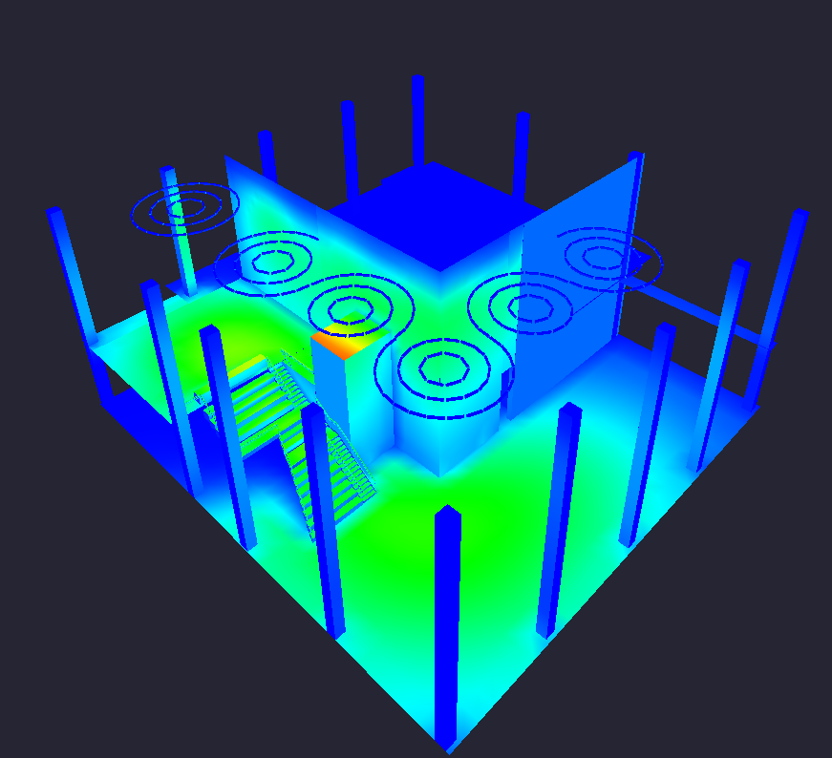
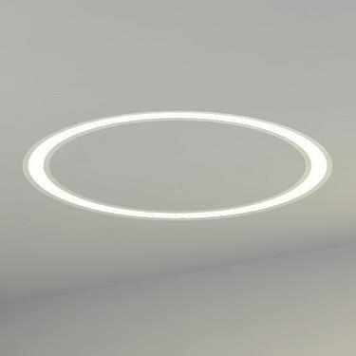
Apollo
Lobby
 | Horizontal Illuminance | Avg:Min Ratio | LPD
Target | 10FC | 2.5 | .8W/sf
Design | 8FC | 2.25 | 0.64W/sf
Staircase Target | 15FC | 2.5 | -
Staircase Design | 11FC | 2.29 | -
LED Video Display Walls
Winona Linear Recessed
Ø8‘, 12‘, 16‘, 24‘
3000K 21W T5
Introduction | Lighting Design | Lighting Controls | Energy Savings | Conclusions

Slide 11
Apollo
Typical Office
Elevator Lobby
Reception
Executive Offices
Partner Offices
Open Offices
Conference Rooms
Ancillary Spaces
Introduction | Lighting Design | Lighting Controls | Energy Savings | Conclusions

Slide 12
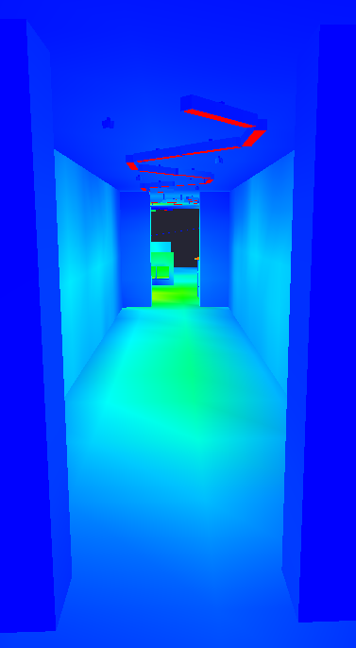
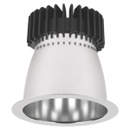
Apollo
Typical Office
Elevator Lobby
 | Horizontal Illuminance | LPD
Target | 15FC | 0.67W/sf
Design | 20FC | 0.72W/sf
Winona Linear Recessed
Ø8
3000K 21W T5
Lightolier Round
3000K 8.7W LED
Introduction | Lighting Design | Lighting Controls | Energy Savings | Conclusions

Slide 13
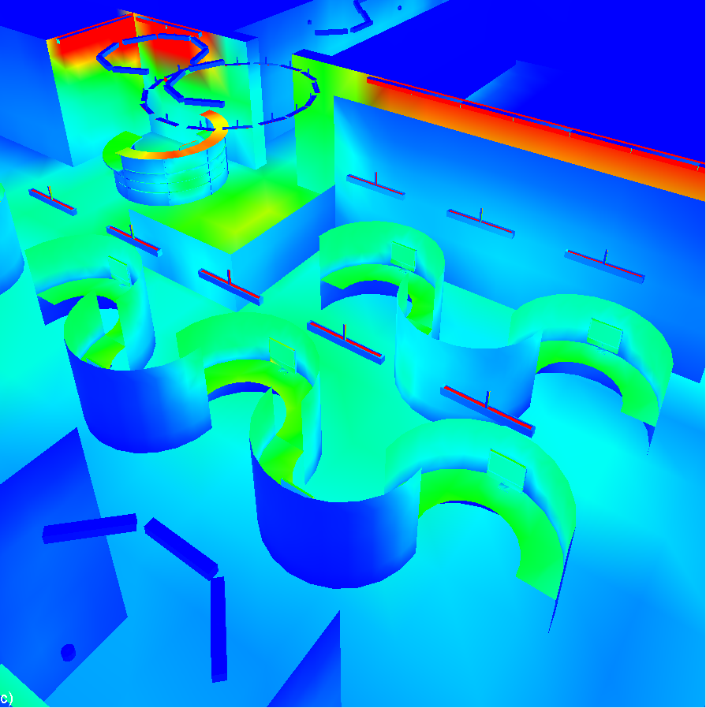
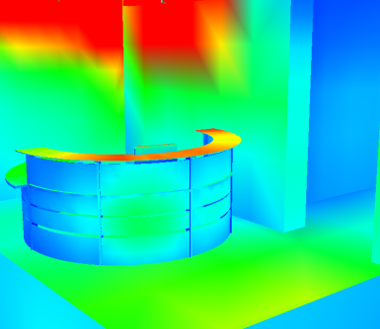
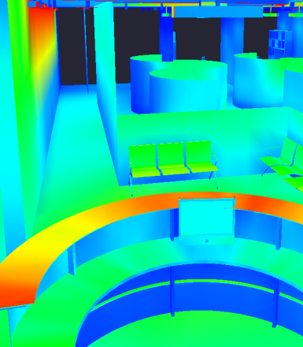
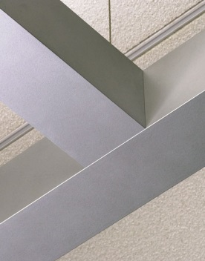
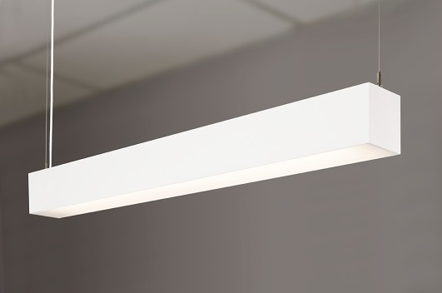
Apollo
Typical Office
Reception and Open Office
 | Horizontal Illuminance | LPD
Target | 10-20FC | 0.67W/sf
Design | 17FC | 0.51W/sf
Reception Desk Target | 30-50FC | -
Reception Desk Design | 45-55FC | -
Office Desk Target | 30-50FC | -
Office Desk Design* | 30FC | -
Gammalux G-Beam Suspended Direct/Indirect
*Additional Task Lighting at each desk for desired light levels
4’
3000K 68W LED
Introduction | Lighting Design | Lighting Controls | Energy Savings | Conclusions

Slide 14
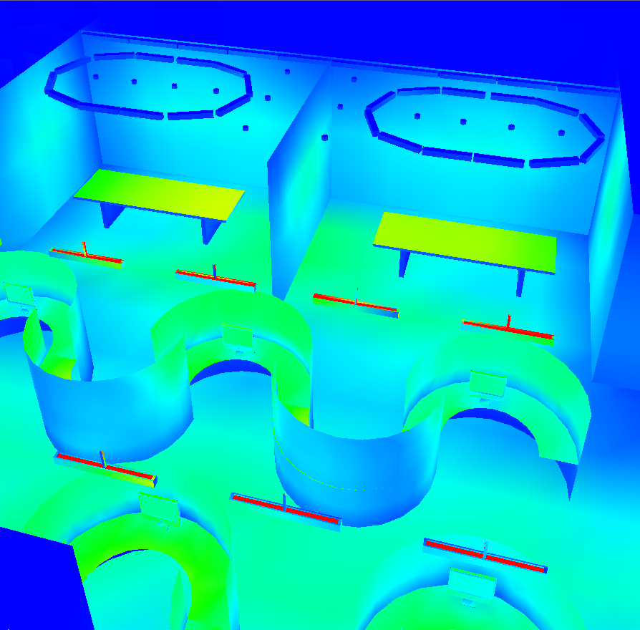
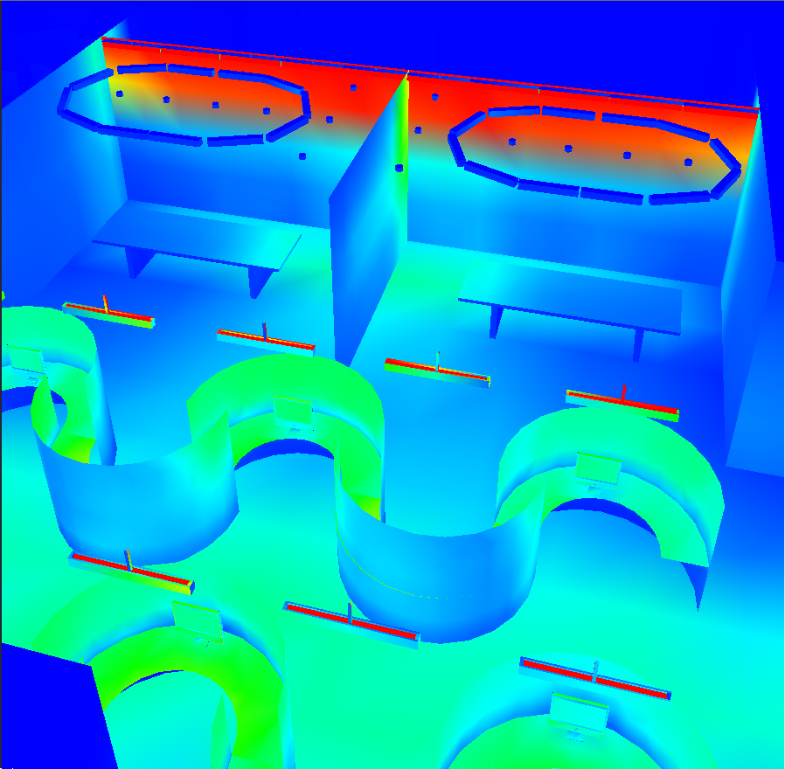
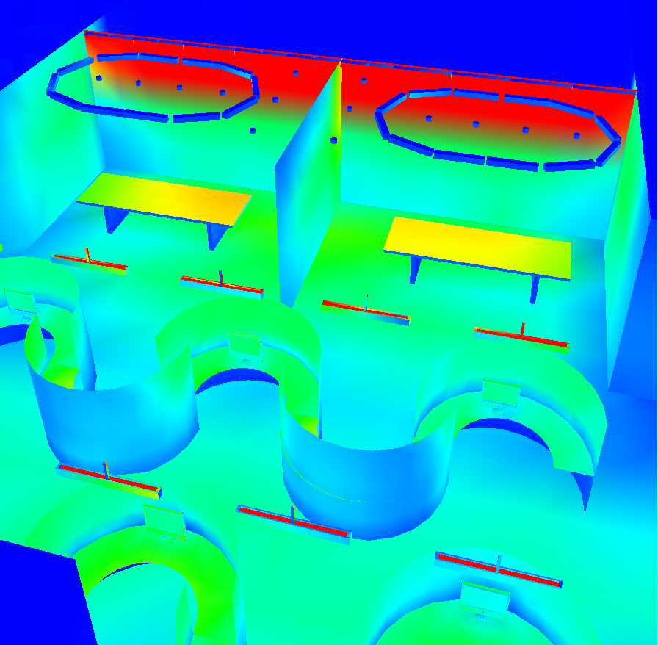
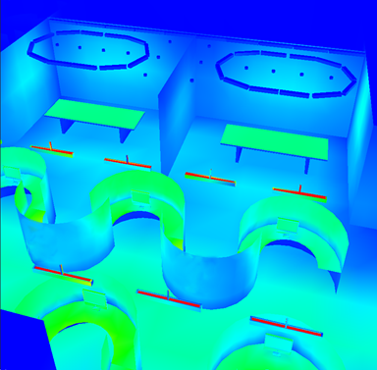
Apollo
Typical Office
Conference Rooms and Open Office
 | Horizontal Illuminance on Table | LPD
Target | 10FC, 30-50FC* | 0.9W/sf
Design | 5FC, 23-45FC | 1.1W/sf
*Depending on the activity
Introduction | Lighting Design | Lighting Controls | Energy Savings | Conclusions

Slide 15
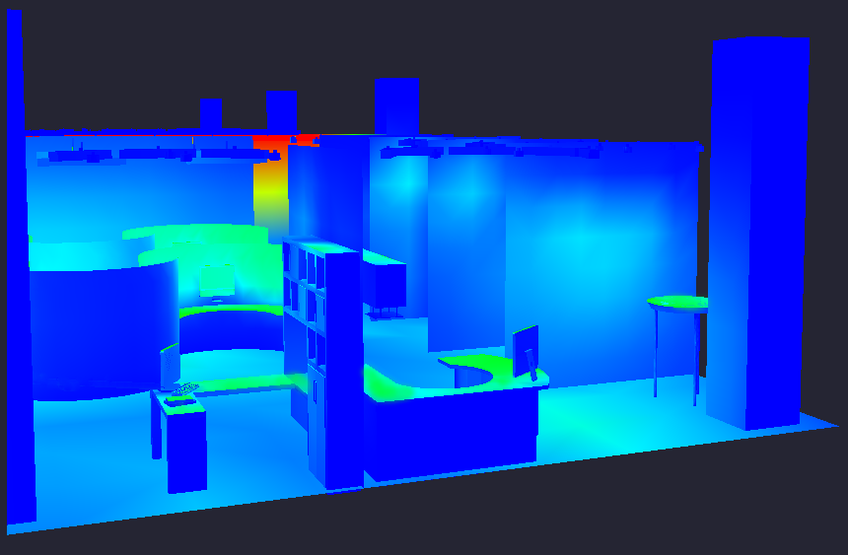
Apollo
Typical Office
Typical Executive Office and Partner Office
 | Horizontal Illuminance | LPD
Target | 10-20FC | .83W/SF
Design | 12FC | .81W/SF
Desk Target | 30-50FC | -
Desk Design | 34FC | -
Winona Linear Recessed
Ø8
3000K 21W T5
Lightolier Round
3000K 8.7W LED
Introduction | Lighting Design | Lighting Controls | Energy Savings | Conclusions

Slide 16
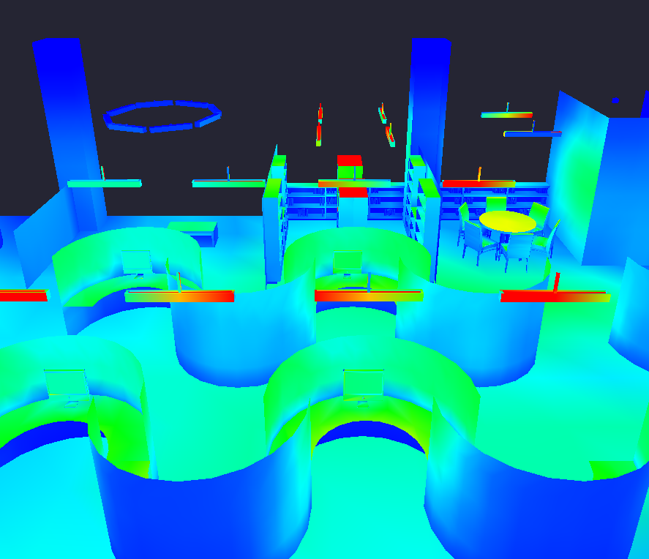
Apollo
Typical Office
Break Room and Library
 | Horizontal Illuminance | Vertical Illuminance | LPD
Target | 10-20 | - | .9W/sf
Design | 14FC | - | 1.01W/sf
Desk Target | 30-50FC | - | -
Desk Design | 44FC | - | -
Bookshelf Target | - | 30FC | -
Bookshelf Design | - | 21FC | -
Introduction | Lighting Design | Lighting Controls | Energy Savings | Conclusions

Slide 17
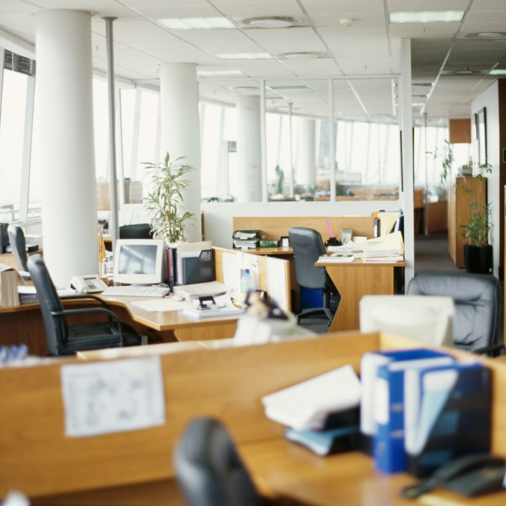
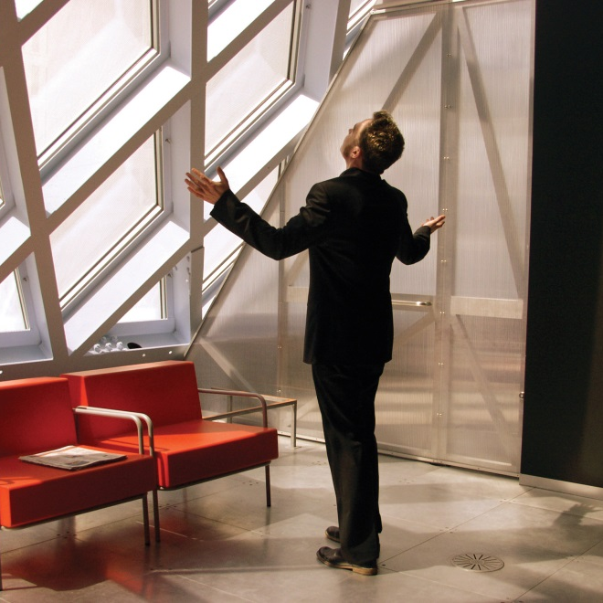
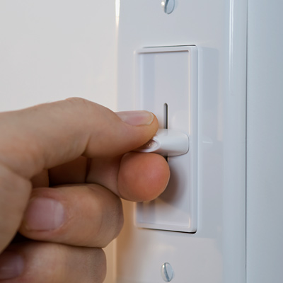
Apollo
Automated Controls
Occupancy Sensing
Daylight Harvesting
Light Level Tuning
Introduction | Lighting Design | Lighting Controls | Energy Savings | Conclusions

Slide 18
Apollo
Automated Controls
Occupancy Sensing
Occupancy Sensing
Daylight Harvesting
Light Level Tuning
Light Level Tuning
Introduction | Lighting Design | Lighting Controls | Energy Savings | Conclusions

Slide 19
Apollo
Typical Office
Non-Dimmed
Non-Dimmed
Introduction | Lighting Design | Lighting Controls | Energy Savings | Conclusions

Slide 20
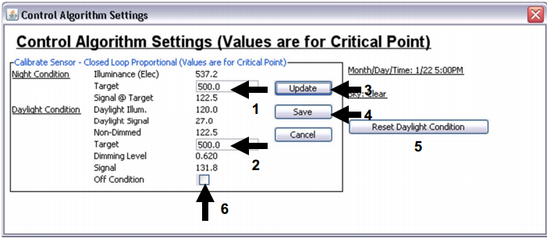
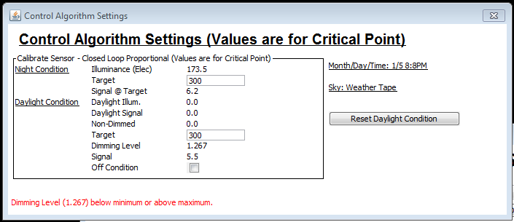
Apollo
DAYSIM
Lost Input Buttons
Have you seen me?
Reward!!!
Introduction | Lighting Design | Lighting Controls | Energy Savings | Conclusions

Slide 21
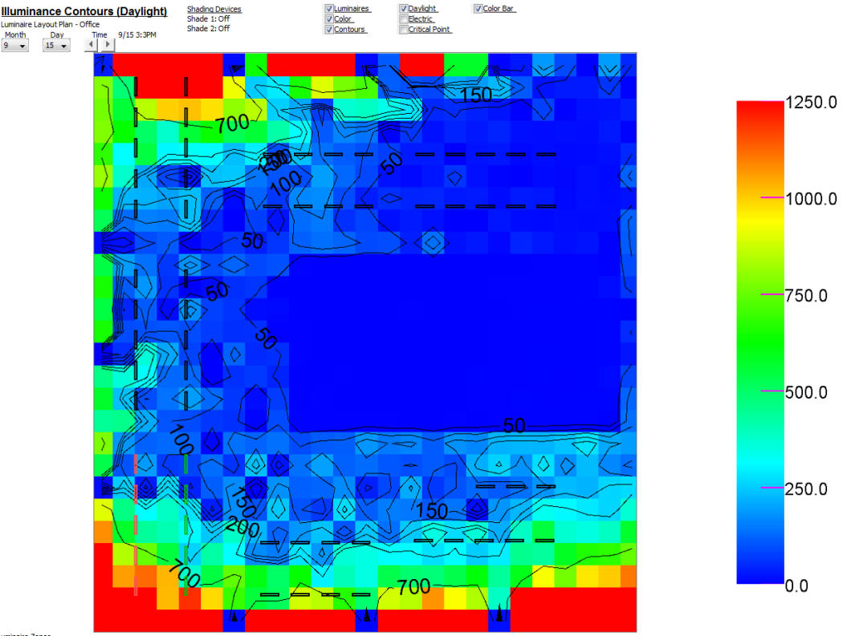
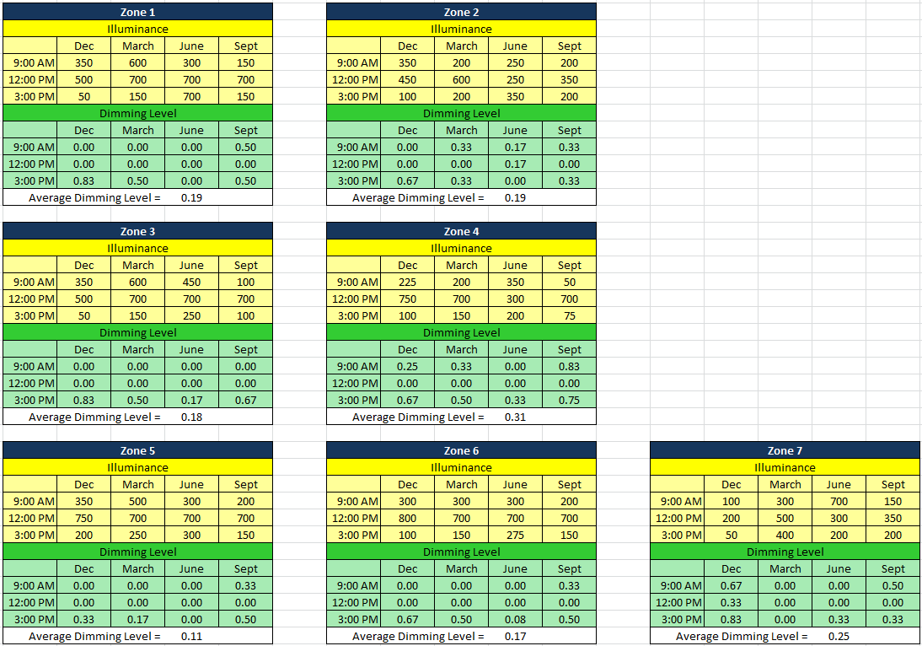
Apollo
Calibration
Introduction | Lighting Design | Lighting Controls | Energy Savings | Conclusions

Slide 22
Apollo
Results
Zone 1: 19%
Zone 2: 19%
Zone 3: 18%
Zone 4: 31%
Zone 5: 11%
Zone 6: 17%
Zone 7: 25%
Average:
24%
Non-Dimmed
Non-Dimmed
Introduction | Lighting Design | Lighting Controls | Energy Savings | Conclusions

Slide 23
Apollo
Results
Based on this model, we predict to save roughly
- 98,000 kWhr every year
- $25,500 every year
with daylight harvesting alone.
Introduction | Lighting Design | Lighting Controls | Energy Savings | Conclusions

Slide 24
Apollo
Energy Saving
LPDs (calculated)
– 0.67 W/ft2
– less than 75% of baseline
– 97,200 kWhr/yr energy savings
Daylight Harvesting (DAYSIM estimated)
– 98,300 kW/yr energy savings
Light Level Tuning (estimated)
– 24,700 kW/yr energy savings
Occupancy Sensing (estimated)
– 29,00 kW/yr energy savings
Introduction | Lighting Design | Lighting Controls | Energy Savings | Conclusions

Slide 25
Apollo
249,069
kWhr
139,732 kWhr
Introduction | Lighting Design | Lighting Controls | Energy Savings | Conclusions

Slide 26
Apollo
350 Mission
An iconic building that sets a precedent for sustainable architecture in San Francisco
Introduction | Lighting Design | Lighting Controls | Energy Savings | Conclusions

Slide 27
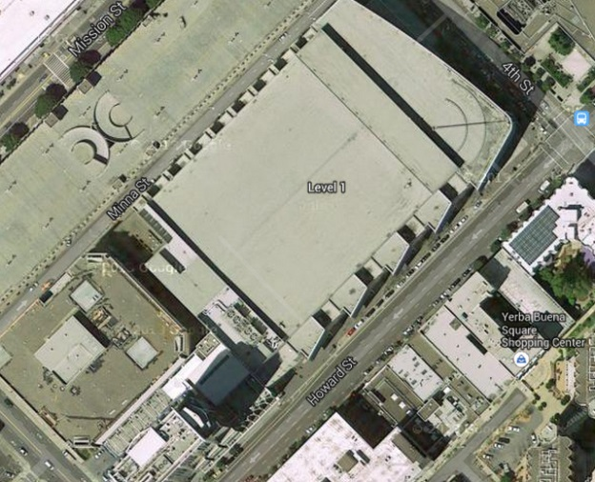
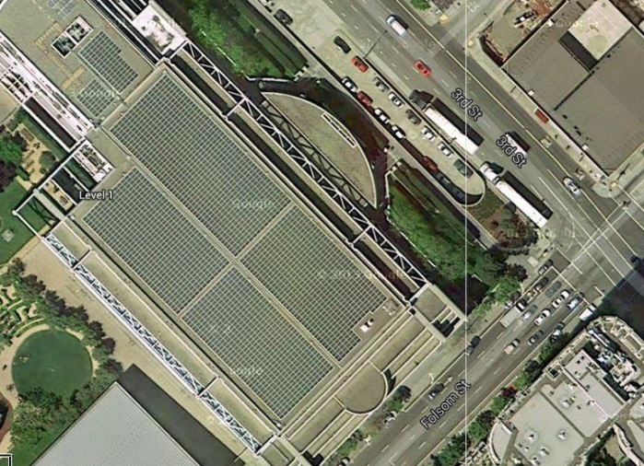
Apollo
Solar energy
Photovoltaic (PV) and Ecodistricts
Onsite PV
PV roof area: 8,000 SF (half of roof)
PV Efficiency: 21%
Energy Produced: 210,704 KWh
EUI Reduction: 1 kBTU/SF
Ecodistrict PV
Estimated area: 75,000 SF (w/o incentive)

Slide 28
Apollo
Reducing Energy Use
Lighting Power Density
Whole Building Method: 0.9 W/SF
Space By Space Method: 0.89 W/SF
Energy Used for 1 year……………… 786 kW-h
Designed to 75% of code…………590 kW-h
Dimming and Solar Harvesting…442 kW-h
Reduction of 344 kW-h, or 44% of load

Slide 29
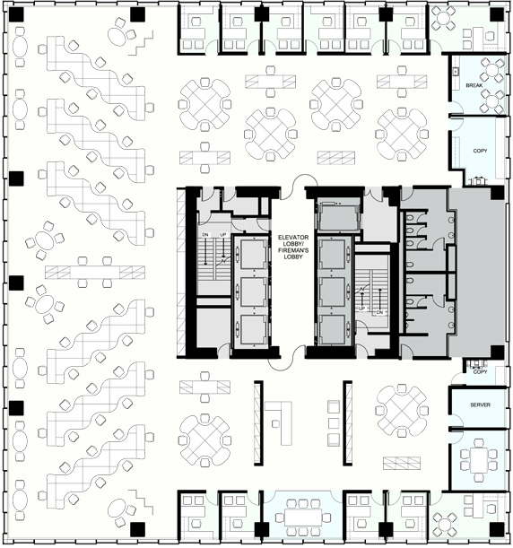
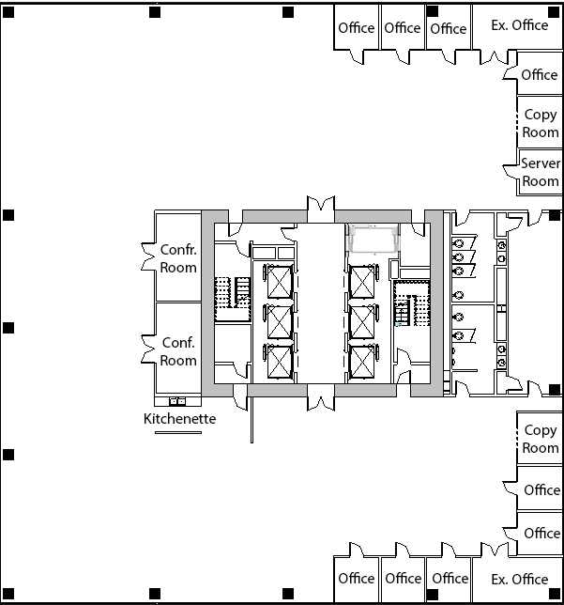
Apollo
Floor Layout
350 Mission Plan
Our Floor Plan

Slide 30
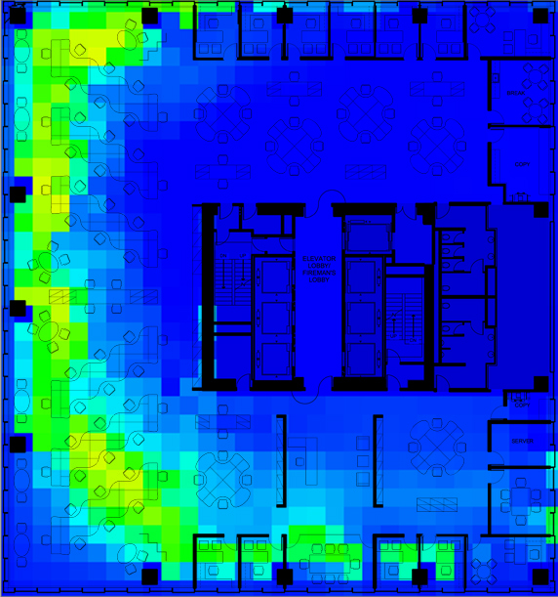
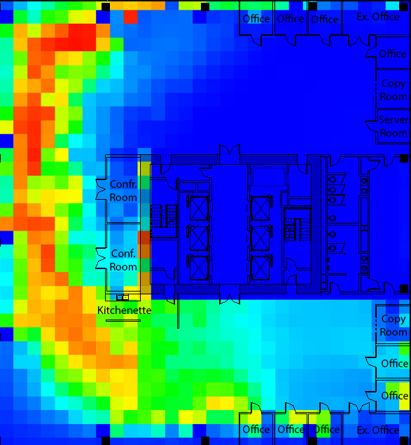
Apollo
Daylighting Study
350 Mission Plan
Our Floor Plan
.75
.6
.45
.3
.15
0

Slide 31
Questions?
Introduction | Net Zero | Floor System | Façade System | Core

Slide 32
References
The Tower at PNC Plaza: www.toweratpncplaza.com
ITcon Journals: www.itcon.org
ASCE Journals: www.asce.org
Images Found Through Google: www.google.com
https://law.resource.org/pub/us/code/bsc.ca.gov/
http://www.energy.ca.gov
http://apps1.eere.energy.gov/buildings/publications/pdfs/corporate/bt_stateindustry.pdf
http://smud.apogee.net/comsuite/content/ces/?utilid=s&id=963
http://www.ppg.com/corporate/ideascapes/sitecollectiondocuments/high-reflectance_coatings_white_paper.pdf
http://www.denvergov.org/portals/646/documents/chk_lst_elect_hi_rise.pdf
http://www.glumac.com/articles/Net_Zero_Buildings.html
http://www.wbdg.org/resources/microturbines.php
http://www.amlegal.com
http://zeb.buildinggreen.com/
California Building Code: www.bsc.ca.gov
“Buckling restrained braced frames”
Michael D. Engelhardt
https://engineering.purdue.edu/~jliu/courses/CE697R/CE697R_BRB_F12.pdf
“Fluid Viscous Damping as an Alternative to Base Isolation”
Gregg Haskell , David Lee
http://taylordevices.com/fluidviciousdamping.html
The Spectrus group
http://thespectrusgroup.com/index.html
http://www.efficientproducts.org/reports/plugload/OfficePlugLoadAssessment_ExecutiveSummary.pdf
http://www.toptenusa.org/Top-Ten-Computers/Top-Ten-Laptop-Computers
http://www.asmproducts.com/seismiczones.htm
http://www.eia.gov/tools/faqs/faq.cfm?id=667&t=6

