Slide 1
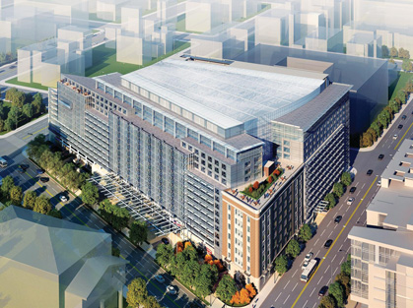
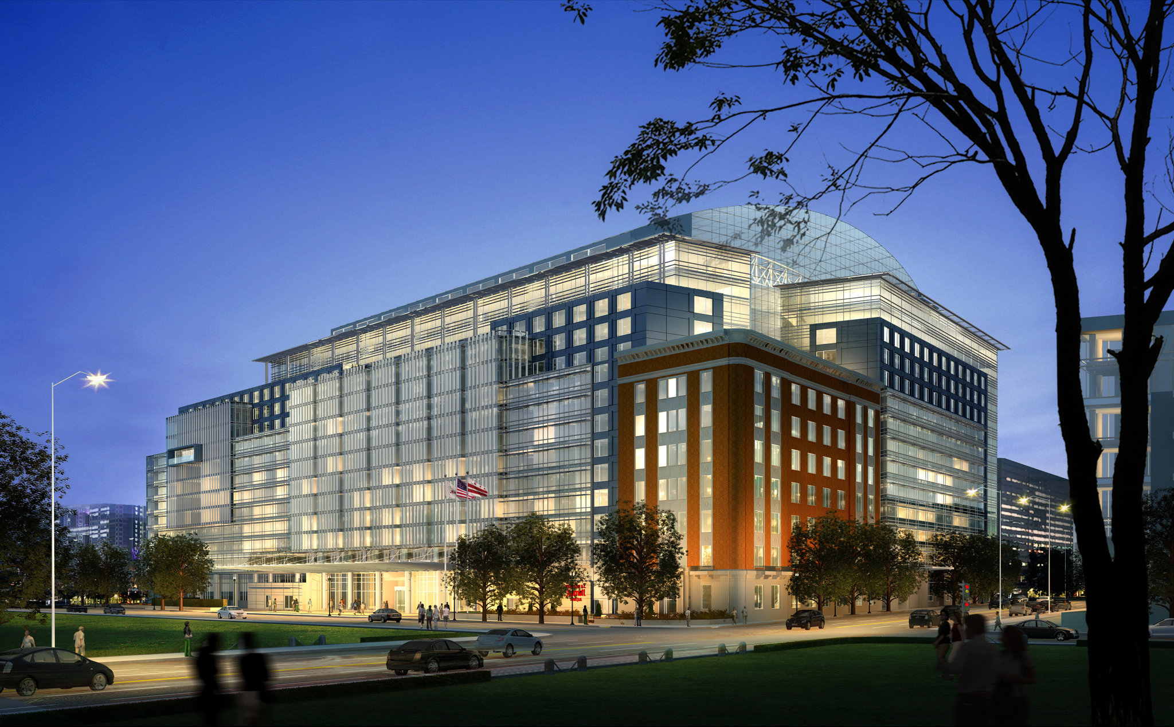
Final Thesis – Nathan Braskey Construction Option Craig Dubler
Sunnyvale plaza
Notes:
Hello, I am Nathan Braskey and welcome to my final presentation

Slide 2
Project Overview
Project Overview Analysis Overview Analysis 1 Analysis 2 Analysis 3 Analysis 4 Conclusions & Recommendations
Size: 752,000 Gross Sq. Ft.
Stories: 15 Above Grade, 7 Below Grade
Location: Mid-Atlantic
Prime Cost: $500 million
Contract: Guaranteed Maximum Price
Delivery Method: Design-Build
Completion: May 2014
Architect: Cooper Carry, TVS
Gen. Contractor: Hensel Phelps
Structural: GEI Consultants, Inc.
MEP: GHT Limited
Electrical: Truland Systems
Notes:
Sunnyvale Plaza is a 752,000 sq. ft. high rise hotel located within the mid-Atlantic region
It is a 22 story structure, 15 of which are above grade
The hotel consists of 1,175 guestrooms, 5 restaurants, 3 ballrooms, and a parking garage
It is also connected to the neighboring convention center via an underground concourse

Slide 3
Analysis Overview
Project Overview Analysis Overview Analysis 1 Analysis 2 Analysis 3 Analysis 4 Conclusions & Recommendations
Analysis #1: Implementation of A Stormwater Harvesting System
Analysis #2: Analysis of Excavation Method
Analysis #3: Façade Retention Method
Analysis #4: Profitability of Early Scheduled Opening
Notes:
The four analyses that I conducted consisted of the implementation of a stormwater harvesting system, an in-depth analysis of the excavation, the use of façade retention for the existing building, and the profitability of opening the hotel early

Slide 4
Analysis #1: Implementation of A Stormwater Harvesting System Breadth 1: Plumbing
Project Overview Analysis Overview Analysis 1 Analysis 2 Analysis 3 Analysis 4 Conclusions & Recommendations
Notes:
Analysis 1 consisted of the implementation of a stormwater harvesting system and included a plumbing breadth

Slide 5
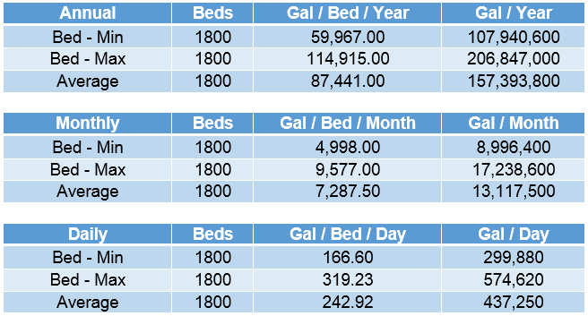
Average Water Usage
Project Overview Analysis Overview Analysis 1 Analysis 2 Analysis 3 Analysis 4 Conclusions & Recommendations
Notes:
The first step included analyzing the average water usage for a hotel room lavatory
Only toilet fixtures within the guestrooms were considered due to the high quantity of guestrooms
The total water usage for toilet fixtures alone added up to about 157 million gallons/yr

Slide 6
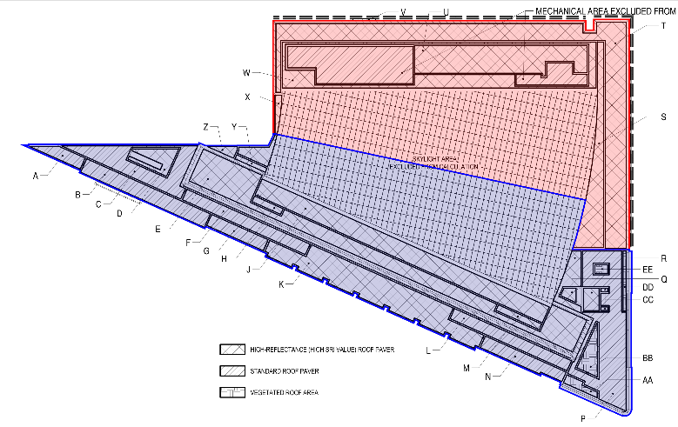
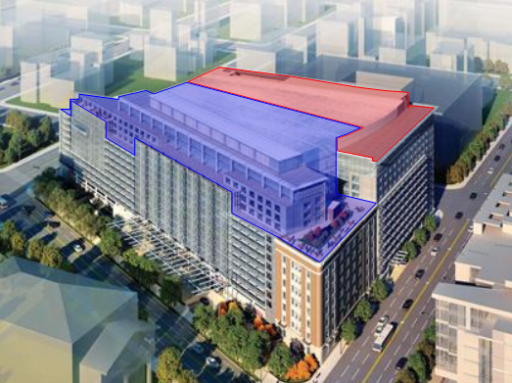
Roof Area Consideration
Project Overview Analysis Overview Analysis 1 Analysis 2 Analysis 3 Analysis 4 Conclusions & Recommendations
Notes:
I then considered the roof area available for rainwater collection
This roof area was separated into two areas directly split by the peak of the atrium skylight due to the high amount of rainwater that may be collected during a given storm

Slide 7
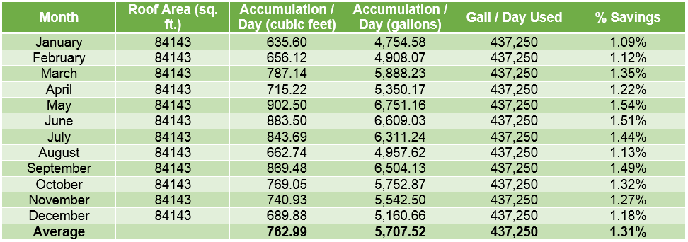
Roof Area Consideration
Project Overview Analysis Overview Analysis 1 Analysis 2 Analysis 3 Analysis 4 Conclusions & Recommendations
Notes:
Utilizing a weather database, the rainfall for each month was collected to calculate the accumulation over the total roof area
The % savings of water from rainfall collection was then calculated and averaged about 1.3%

Slide 8
Water Utility Fee Analysis
Project Overview Analysis Overview Analysis 1 Analysis 2 Analysis 3 Analysis 4 Conclusions & Recommendations
Notes:
I then calculated the total water and stormwater utility cost for the hotel guestrooms utilizing local utility rates and the average water usage from the beginning of the analysis

Slide 9
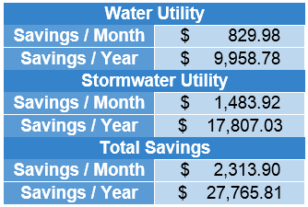
Water Utility Fee Analysis
Project Overview Analysis Overview Analysis 1 Analysis 2 Analysis 3 Analysis 4 Conclusions & Recommendations
Notes:
This allowed me to generate an estimated savings of approximately $27,800 per year from the collected rainwater

Slide 10
Results
Project Overview Analysis Overview Analysis 1 Analysis 2 Analysis 3 Analysis 4 Conclusions & Recommendations
Notes:
Utilizing RSMeans Data I conducted a takeoff for the system
Through analysis of the weather database information I concluded that an average of 17,000 gallons of rainwater may be collected during a given storm
To be safe, I chose a 25,000 gallon storage tank with an overflow release to the stormwater utility
The total estimate came out to about $60,800

Slide 11
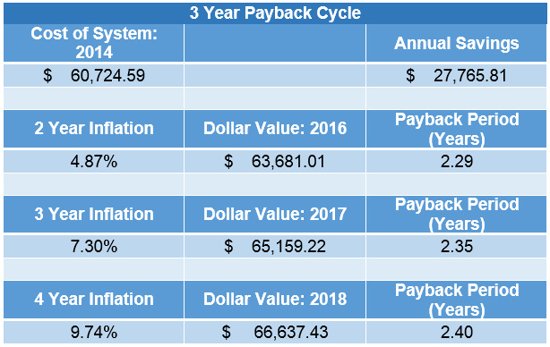
Results
Project Overview Analysis Overview Analysis 1 Analysis 2 Analysis 3 Analysis 4 Conclusions & Recommendations
Notes:
Therefore, the savings create a payback period of approximately 2.4 years
After that period, the hotel will benefit from an annual savings of $27,800
Utilizing a stormwater harvesting system can also generate more LEED points towards the LEED certification that the project team is pursuing

Slide 12
Project Overview Analysis Overview Analysis 1 Analysis 2 Analysis 3 Analysis 4 Conclusions & Recommendations
Analysis #2: Analysis of Excavation Method
Notes:
My second analysis consisted of in-depth research of the currently employed excavation method utilized by the project team

Slide 13
Background Information / Research
Project Overview Analysis Overview Analysis 1 Analysis 2 Analysis 3 Analysis 4 Conclusions & Recommendations
Notes:
The hotel consists of 7 below grade levels which include a grand ballroom, two junior ballrooms, 87 meeting rooms, and a parking garage

Slide 14
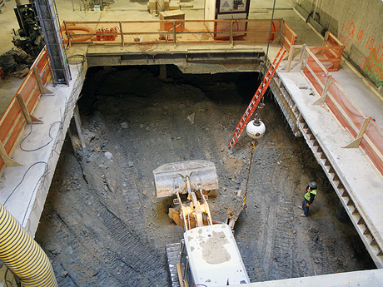
Background Information / Research
Project Overview Analysis Overview Analysis 1 Analysis 2 Analysis 3 Analysis 4 Conclusions & Recommendations
Notes:
The excavation method utilized by the project team consisted of a top-down construction in which the slab-on-grade was poured with several holes left out
A crane was then utilized to dig the soil out of the holes, in which larger equipment was lowered into to continue digging
After most of the below-grade level was excavated, a new slab-on-grade was poured for that level
This continued for each level below grade
Utilizing top-down excavation was very difficult due to the amount of large equipment that was utilized within each below-grade level

Slide 15
Background Information / Research
Project Overview Analysis Overview Analysis 1 Analysis 2 Analysis 3 Analysis 4 Conclusions & Recommendations
Notes:
This excavation method was chosen due to the highly constrained project site
The project was located within a dense city on a lot that included to existing structures
There was also extensive excavation below the east street to allow for an underground concourse construction
These constraints made it unfavorable to utilize typical excavation and shoring methods
There were also extensive safety concerns involved in this excavation method
The slurry wall was extremely deep and consisted of a thin concrete mixture to prevent blockage or honeycombing
This created a risk of a worker sinking if they were to fall into the mixture
High-pressure lines were also utilized to pump the concrete
The excavation also created confined space underground
A tunneling expert was hired full-time to ensure appropriate measures were taken for oxygen circulation and equipment usage
A confined space rescue team also participated in regular drills to stay current with the changing environment

Slide 16
Project Overview Analysis Overview Analysis 1 Analysis 2 Analysis 3 Analysis 4 Conclusions & Recommendations
Analysis #3: Façade Retention Method
Breadth 2: Structural
Notes:
My third analysis consisted of utilizing façade retention to preserve the existing building in place of renovation

Slide 17
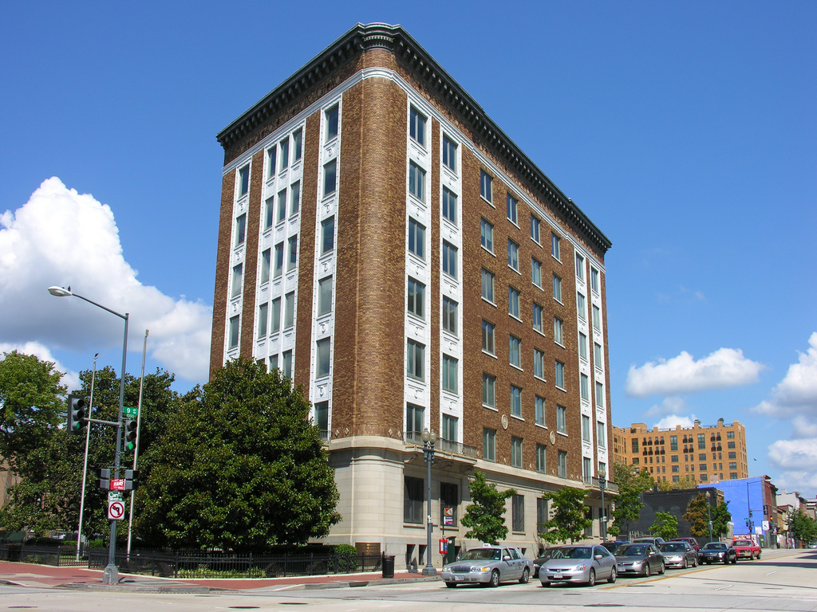
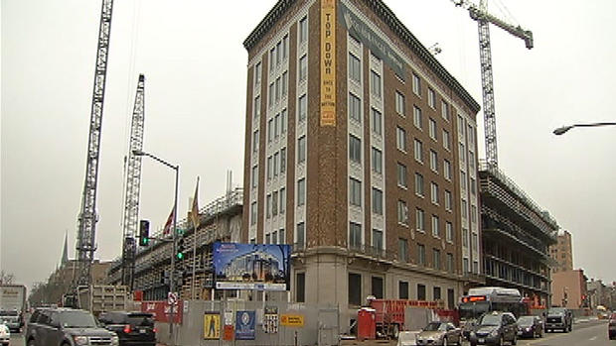
Background Information
Project Overview Analysis Overview Analysis 1 Analysis 2 Analysis 3 Analysis 4 Conclusions & Recommendations
Notes:
The existing building, known as the Plumber’s Union Building, was required to be maintained due to the historical elements, it is a brick and concrete structure located in the southeast corner of the site

Slide 18
Retaining Structure Analysis
Project Overview Analysis Overview Analysis 1 Analysis 2 Analysis 3 Analysis 4 Conclusions & Recommendations
Notes:
A structural analysis was conducted for the wind load on the brick facade

Slide 19
Retaining Structure Analysis
Project Overview Analysis Overview Analysis 1 Analysis 2 Analysis 3 Analysis 4 Conclusions & Recommendations
Notes:
Through research and interviews concerning structural support and façade retention structures, it was determined that a truss system would be the most efficient way to retain the façade

Slide 20
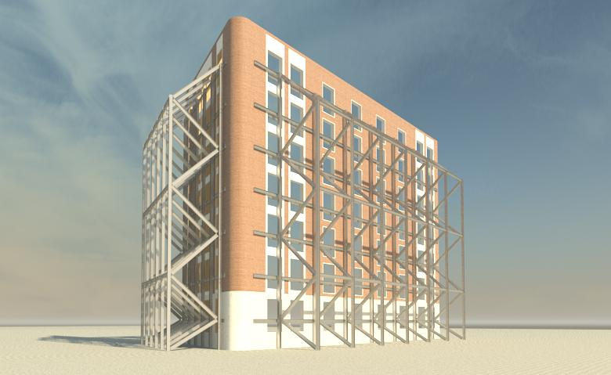
Retaining Structure Analysis
Project Overview Analysis Overview Analysis 1 Analysis 2 Analysis 3 Analysis 4 Conclusions & Recommendations
Notes:
Horizontal beams were secured on both sides of the wall with a through-bolt connection and attached to the vertical truss system
Once the façade is retained, the structure can be demolished and rebuilt with the rest of the new construction
The new structural system will create a higher value for the hotel compared to renovating an existing structure

Slide 21
Cost Analysis
Project Overview Analysis Overview Analysis 1 Analysis 2 Analysis 3 Analysis 4 Conclusions & Recommendations
Notes:
A cost estimate was completed using RSMeans Data for the façade retention method including the retention structure, demolition of the existing building, and the new structure
The total estimate came out to about $2,575,000

Slide 22
Cost Analysis
Project Overview Analysis Overview Analysis 1 Analysis 2 Analysis 3 Analysis 4 Conclusions & Recommendations
Notes:
A square foot estimate for the renovation method was completed
This estimate came out to about $3,408,000

Slide 23
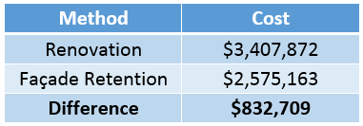
Cost Analysis
Project Overview Analysis Overview Analysis 1 Analysis 2 Analysis 3 Analysis 4 Conclusions & Recommendations
Notes:
Thus, there is an estimated cost difference of approximately $833,000 between the two methods
Utilizing façade retention is estimated to be more cost efficient for the PUB construction

Slide 24
Schedule Analysis
Project Overview Analysis Overview Analysis 1 Analysis 2 Analysis 3 Analysis 4 Conclusions & Recommendations
Notes:
I then completed a duration analysis for each of the methods
The project schedule reflected a total duration of 236 days for the renovation process

Slide 25
Schedule Analysis
Project Overview Analysis Overview Analysis 1 Analysis 2 Analysis 3 Analysis 4 Conclusions & Recommendations
Notes:
The façade retention duration consisted of a total of 37 days
This creates a difference in duration of approximately 6.5 months
Although this is significantly different, it is important to review how it may actually effect the schedule

Slide 26
Schedule Analysis
Project Overview Analysis Overview Analysis 1 Analysis 2 Analysis 3 Analysis 4 Conclusions & Recommendations
Notes:
In re-sequencing the schedule, I found that the fit-out start dates for the PUB began on average 30 days after the new construction area
Therefore, completing the PUB structure with the rest of the building will allow for a 30 day decrease in the overall schedule from lead time

Slide 27
Project Overview Analysis Overview Analysis 1 Analysis 2 Analysis 3 Analysis 4 Conclusions & Recommendations
Analysis #4: Profitability of Early Scheduled Opening
Notes:
The final analysis consisted of analyzing the profitability of opening the hotel earlier than the originally scheduled opening

Slide 28
Background Information
Project Overview Analysis Overview Analysis 1 Analysis 2 Analysis 3 Analysis 4 Conclusions & Recommendations
March 20 – April 13: Cherry Blossom Festival
2-21-2014
Public Space Finishes Completed
3-28-2014
Cx & Testing Complete
Substantial Completion
4-25-2014
Hotel Open
Notes:
The hotel is set to open on April 25, 2014, just 12 days after the National Cherry Blossom Festival has ended
Utilizing the façade retention method from Analysis 3 creates the possibility of opening on a targeted date just before the festival
Opening for the festival also allows for a low-risk, high revenue opening for the business

Slide 29
Financial Analysis
Project Overview Analysis Overview Analysis 1 Analysis 2 Analysis 3 Analysis 4 Conclusions & Recommendations
Notes:
Guestroom data was collected throughout the winter at two week intervals
This data was collected from three hotels of similar owner, quality, and location
An average room rate was determined to approximate the revenue that can be earned each month

Slide 30
Financial Analysis
Project Overview Analysis Overview Analysis 1 Analysis 2 Analysis 3 Analysis 4 Conclusions & Recommendations
Notes:
The profit margin was then determined through cost data for the hotel chain from the past four years
This generated an average profit margin of 12.45%

Slide 31
Financial Analysis
Project Overview Analysis Overview Analysis 1 Analysis 2 Analysis 3 Analysis 4 Conclusions & Recommendations
Notes:
Occupancy rates were also determined through business analysis reports
A high occupancy rate was also utilized for the festival duration
I then factored the profit margin and occupancy rates into the revenue data to determine the approximate profit for each month
As you can see, opening 30 days earlier will generate a profit of about $1.6 million

Slide 32
General Conditions
Project Overview Analysis Overview Analysis 1 Analysis 2 Analysis 3 Analysis 4 Conclusions & Recommendations
Notes:
The general conditions savings for those 30 days were also calculated
It was determined that approximately $551,000 can be saved by decreasing the schedule

Slide 33
Results
Project Overview Analysis Overview Analysis 1 Analysis 2 Analysis 3 Analysis 4 Conclusions & Recommendations
Notes:
Therefore, the total profit through the schedule decrease is about $1.85 million

Slide 34
Conclusion
Project Overview Analysis Overview Analysis 1 Analysis 2 Analysis 3 Analysis 4 Conclusions & Recommendations
Schedule Decrease
Profitability
Annual Savings
Analysis 1:
Annual savings of $27,800
Payback period of 2.5 years
Summary:
Decrease schedule by 30 days
Total Profit of $3 million
Annual Savings of $27,800
Analysis 3:
Decrease schedule by 30 days
Cost savings of $832,700
Analysis 4:
Added revenue of $14,500,000
Profitability of $2,140,000
Notes:
In conclusion, utilizing the façade retention will create a direct construction cost saving while decreasing the schedule
Through this schedule decrease, the hotel can open before the festival and generate a total profit of $2.7 million
This profit can be used to fund the addition of the stormwater harvesting system which will in turn generate annual savings for the hotel

Slide 35
Acknowledgements
Project Overview Analysis Overview Analysis 1 Analysis 2 Analysis 3 Analysis 4 Conclusions & Recommendations
Academic:
Dr. Craig Dubler - Construction Advisor
Penn State AE Faculty
Special Thanks:
Chris Mihalick
Keith Bush
David Webb
Jeff Overmiller
PACE Industry Members
Family and Friends

Slide 36
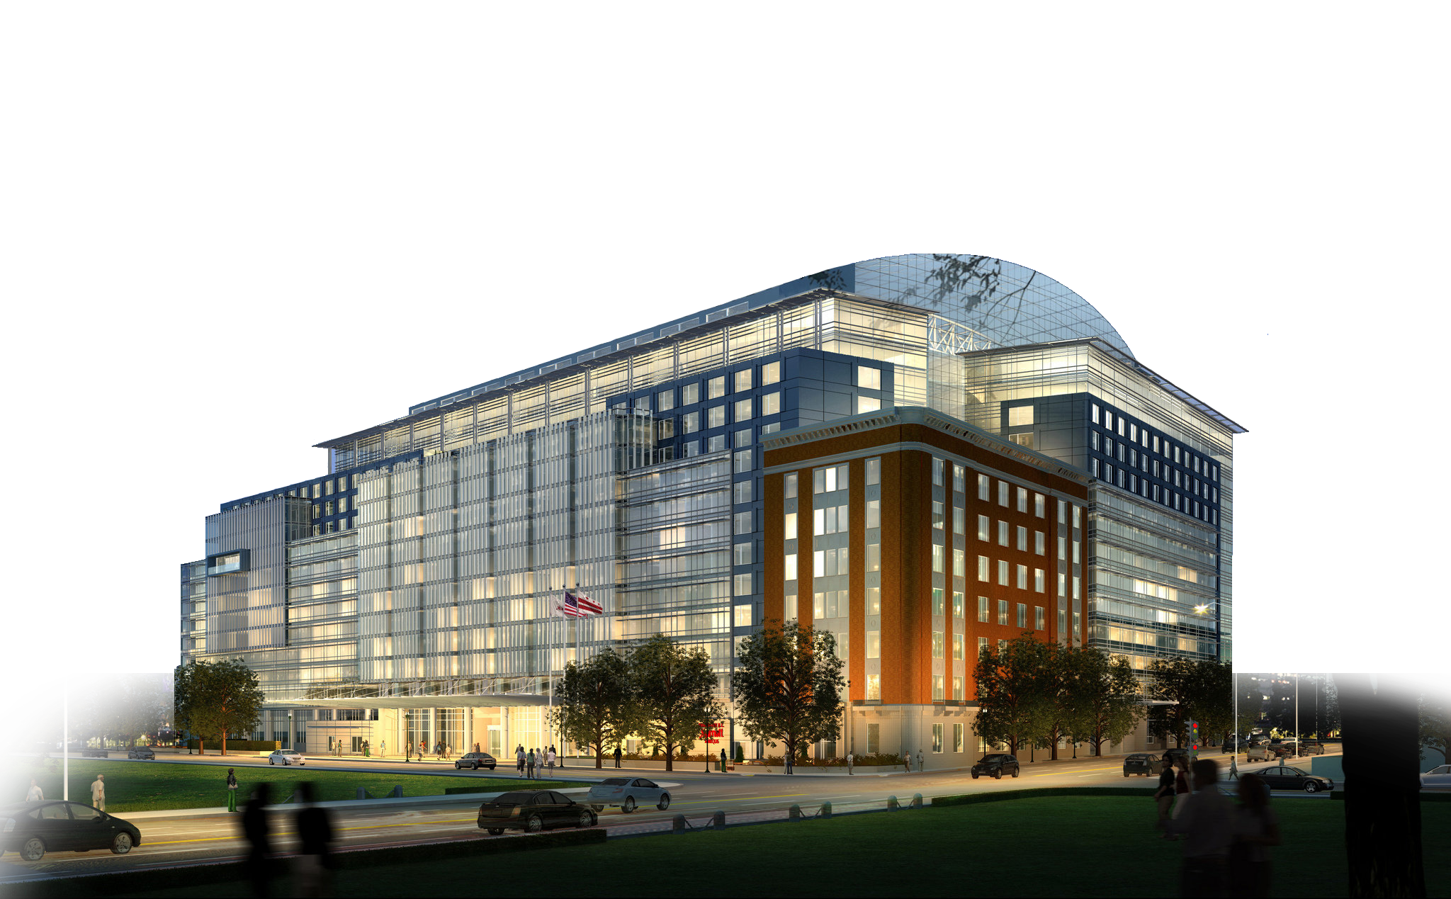
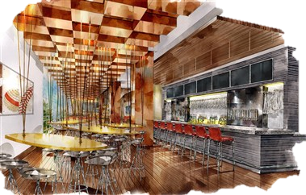
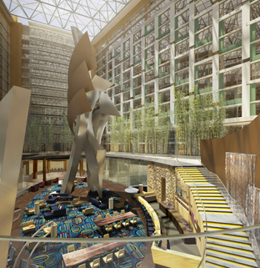
Sunnyvale Plaza
Project Overview Analysis Overview Analysis 1 Analysis 2 Analysis 3 Analysis 4 Conclusions & Recommendations

Slide 37
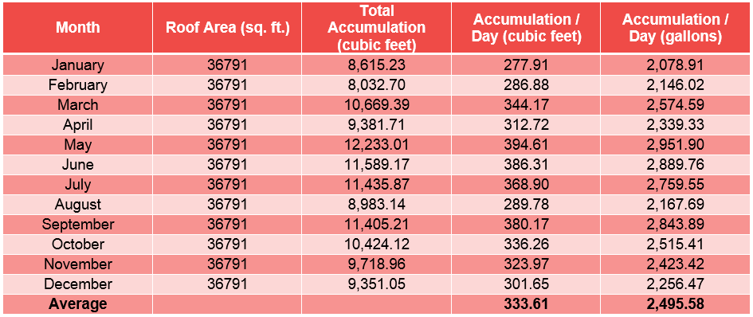
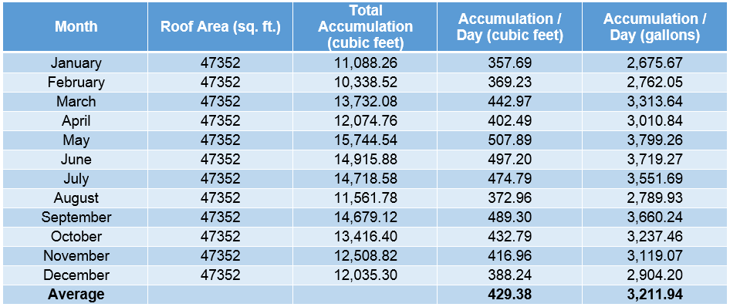
Analysis #1: Zone Rainwater Collection

Slide 38
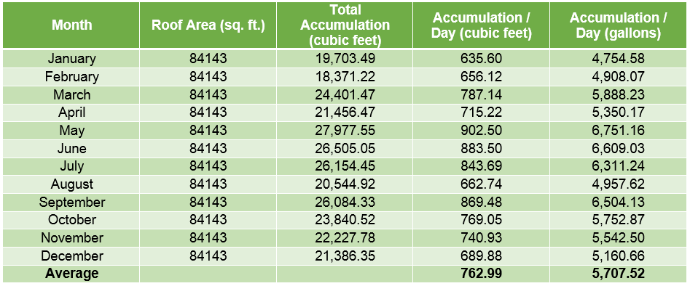
Analysis #1: Total Rainwater Collection

Slide 39
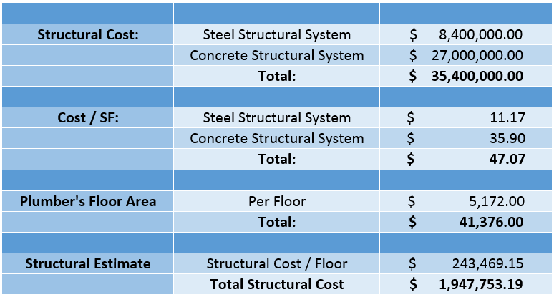
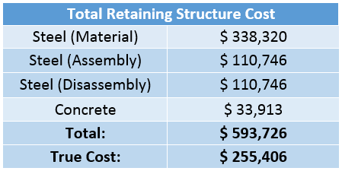
Analysis #3: New Construction Costs

Slide 40
Analysis #3: Renovation Costs

Slide 41
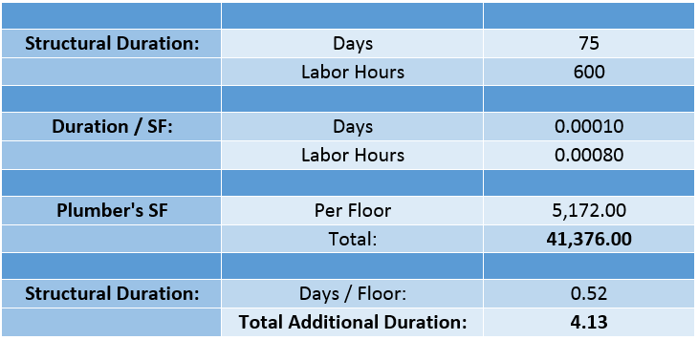
Analysis #3: New Construction Durations

Slide 42
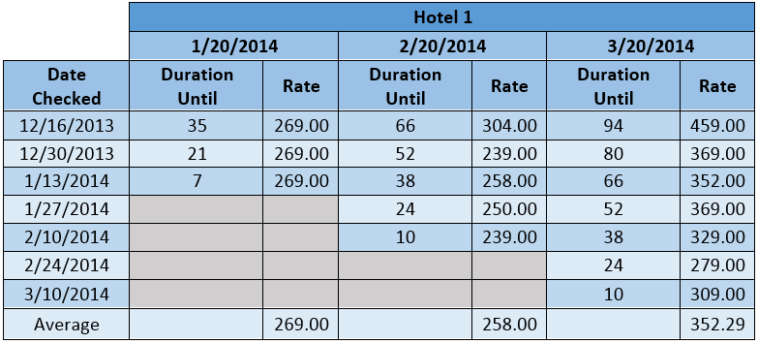
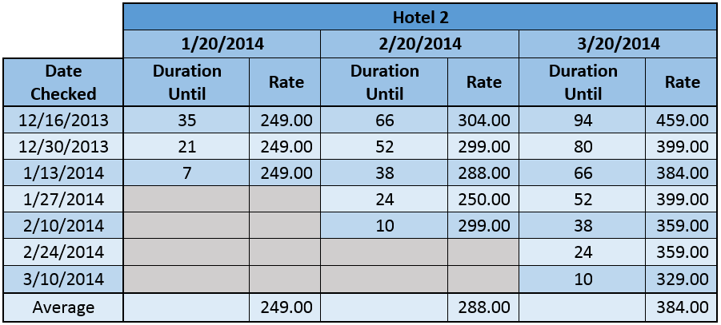
Analysis #4: Hotel Rate Data

