Slide 1
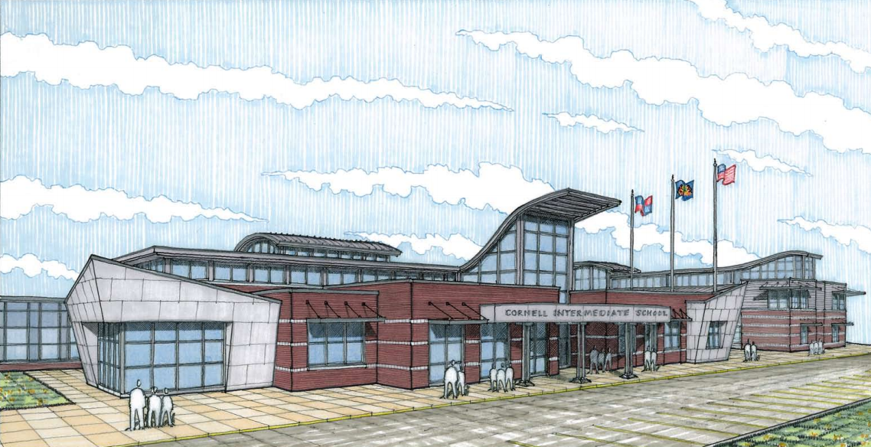
Introduction
Mechanical Systems Overview
Mechanical Depth
Structural Breadth
Acoustical Breadth
Conclusions
Recommendations
Questions
Twin Rivers Elementary/Intermediate of McKeesport Area School District
Tessa Bauman
Mechanical Option
Technical Consultant: Laura Miller
1600 Cornell St., McKeesport, Pa

Slide 2
Introduction
Mechanical Systems Overview
Mechanical Depth
Structural Breadth
Acoustical Breadth
Conclusions
Recommendations
Questions
Building Statistics
Project Team
Occupancy: Education
Size: 127,000 ft²
Number of Stories: 2
Completion Date: February 2014
Project Cost: $29 million
Owner: McKeesport Area School District
Architect: J C Pierce
Construction Manager: PJ Dick
General Contractor: Gurtner Construction
Civil Engineers: Phillips & Associates, Inc.
Structural & MEP Engineers: Loftus Engineers
Environmental Engineers: American Geosciences, Inc.

Slide 3
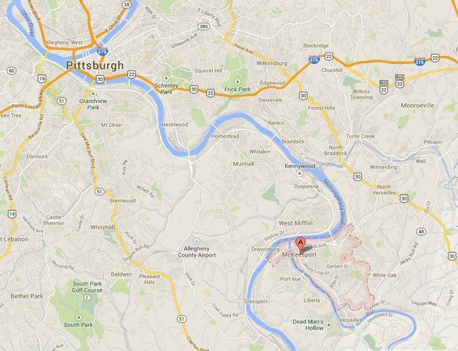
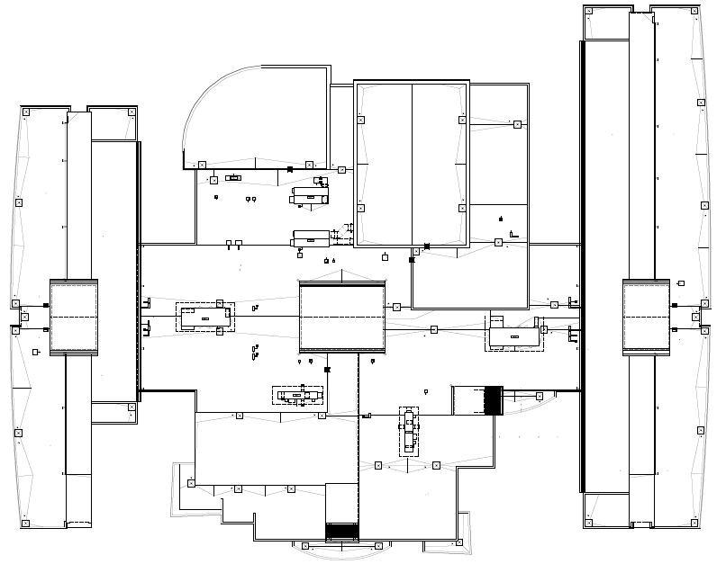
Introduction
Mechanical Systems Overview
Mechanical Depth
Structural Breadth
Acoustical Breadth
Conclusions
Recommendations
Questions
Location
Building
Pittsburgh
20 miles SE of
Pittsburgh, Pa
5 miles east of
Allegheny County
Airport
Café Roof
North
Wing
Gym
Roof
South
Wing
ACA
McKeesport

Slide 4
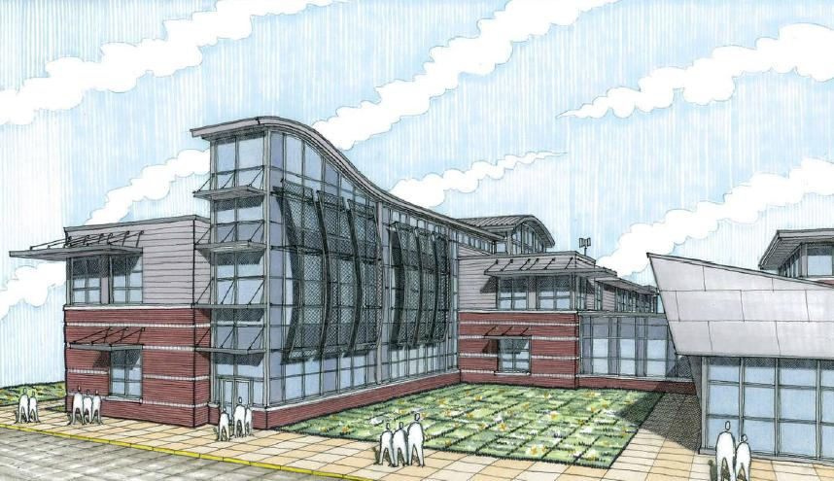
Introduction
Mechanical Systems Overview
Mechanical Depth
Structural Breadth
Acoustical Breadth
Conclusions
Recommendations
Questions
Design Goals
Tracking LEED Gold Accreditation
Mechanical designed with
ASHRAE Advanced Energy Design Guide
for K-12 School Buildings
Education Aspects of Sustainable Design
LCD screens describing systems
Curtain wall system around Mechanical
and Electrical Room

Slide 5
Introduction
Mechanical Systems Overview
Mechanical Depth
Structural Breadth
Acoustical Breadth
Conclusions
Recommendations
Questions
Ventilation
Roof Layout
2 DOAS
Heat Recovery Wheel
Desiccant Wheel
4 AHUs
Single Zone VAV
Multi Zone VAV with reheat
Partial Occupancy
Café Roof
Gym Roof
North
Wing
South
Wing

Slide 6
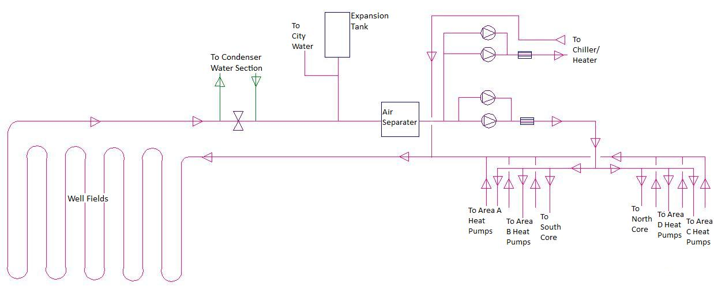
Introduction
Mechanical Systems Overview
Mechanical Depth
Structural Breadth
Acoustical Breadth
Conclusions
Recommendations
Questions
Heating and Cooling
Schematic
Geothermal Heat Pumps
Closed looped earth coupled vertical water loop
60°F water
Chiller supply
Water to Air HPs located in classroom cabinets
Auxiliary heating and cooling
VAV Reheat to Library and Offices

Slide 7
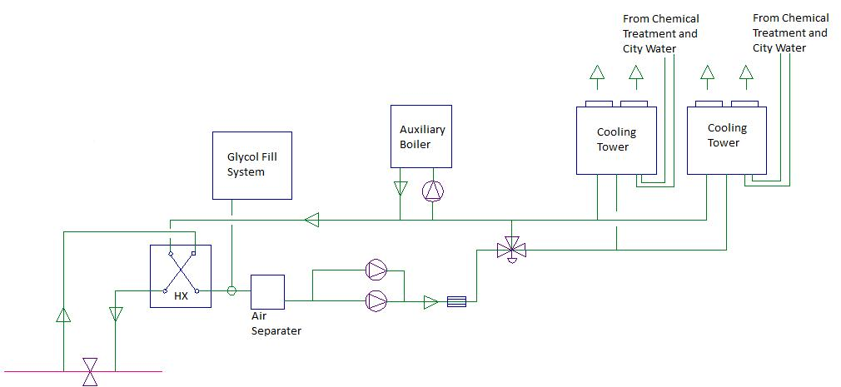
Introduction
Mechanical Systems Overview
Mechanical Depth
Structural Breadth
Acoustical Breadth
Conclusions
Recommendations
Questions
Condenser Water Loop
Schematic
30% polyethylene glycol solution
Heat Exchanger
Cooling Towers
Auxiliary Boiler
Domestic Hot Water
Two 125 Gallon Water Heaters
Supply at 140°F
Heat Pump Water Supply

Slide 8
Introduction
Mechanical Systems Overview
Mechanical Depth
Structural Breadth
Acoustical Breadth
Conclusions
Recommendations
Questions
Solar Thermal Auxiliary
Shading Analysis
Goals:
Reduce dependency on natural gas
Increase sustainability
“If cost is no issue” possibility
Boiler and Water Heater Reduced Loads
Solar Thermal Array

Slide 9
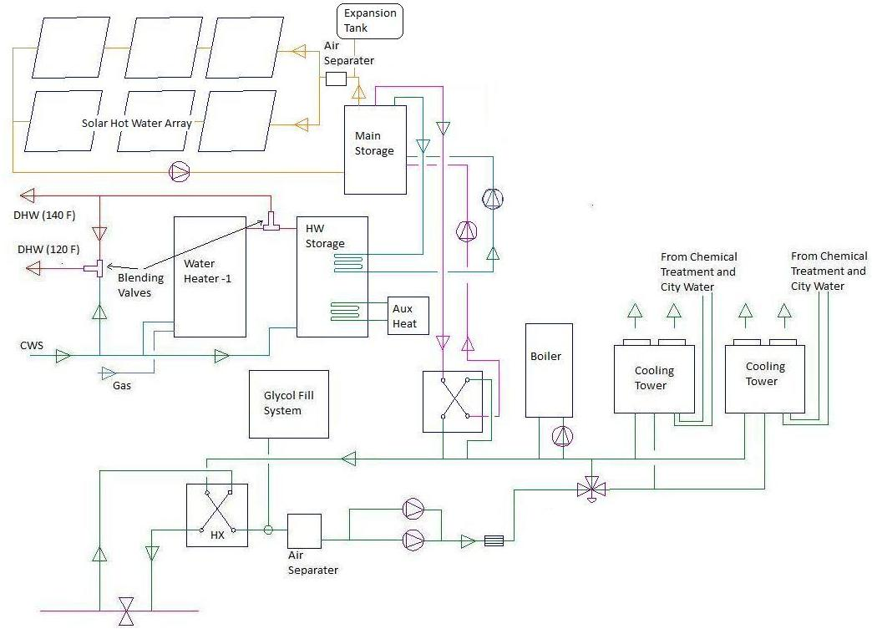
Introduction
Mechanical Systems Overview
Mechanical Depth
Structural Breadth
Acoustical Breadth
Conclusions
Recommendations
Questions
Solar Thermal Auxiliary
Main Components
FPC Array
Main Storage Tank
Solar Hot Water Tank
GA Heat Exchanger
Heat Pump Water Supply

Slide 10
Introduction
Mechanical Systems Overview
Mechanical Depth
Structural Breadth
Acoustical Breadth
Conclusions
Recommendations
Questions
Hourly Solar Calculations
Array Calculations

Slide 11
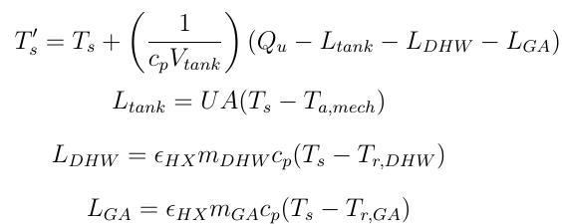
Introduction
Mechanical Systems Overview
Mechanical Depth
Structural Breadth
Acoustical Breadth
Conclusions
Recommendations
Questions
System Calculations

Slide 12
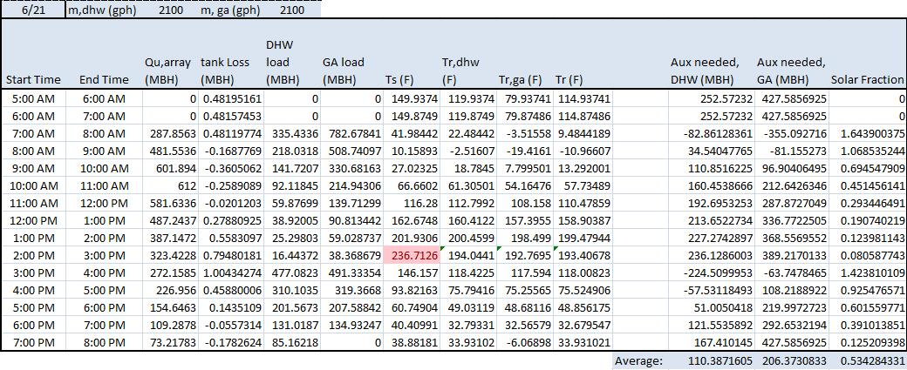
Introduction
Mechanical Systems Overview
Mechanical Depth
Structural Breadth
Acoustical Breadth
Conclusions
Recommendations
Questions
System Calculations

Slide 13
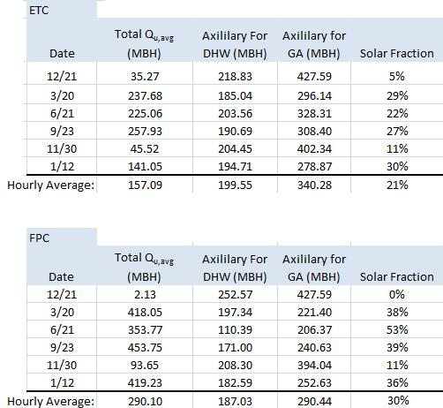
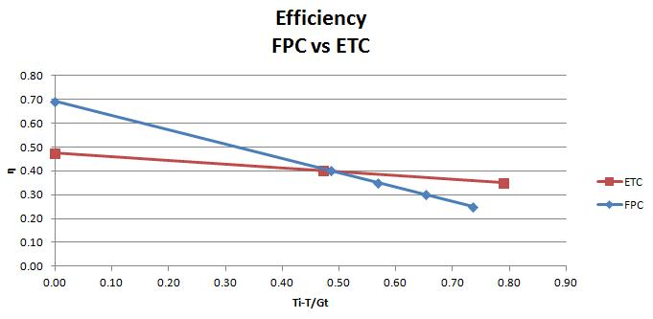
Introduction
Mechanical Systems Overview
Mechanical Depth
Structural Breadth
Acoustical Breadth
Conclusions
Recommendations
Questions
ETC VS FPC

Slide 14
Introduction
Mechanical Systems Overview
Mechanical Depth
Structural Breadth
Acoustical Breadth
Conclusions
Recommendations
Questions
Cost Analysis
Cost of System: $371,450
Fuel Savings at Solar Fraction of 0.3: $3,386
Life Cycle Cost Analysis

Slide 15
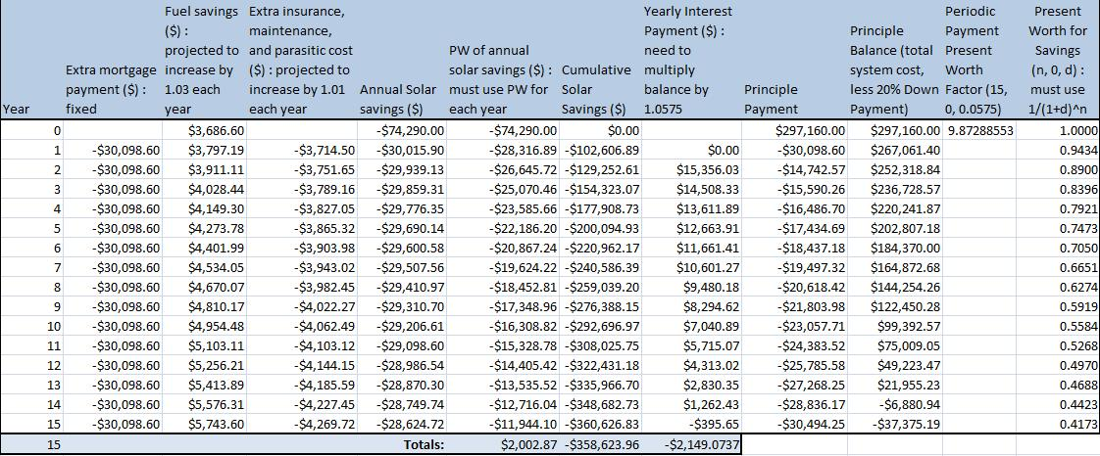
Introduction
Mechanical Systems Overview
Mechanical Depth
Structural Breadth
Acoustical Breadth
Conclusions
Recommendations
Questions
Cost Analysis

Slide 16
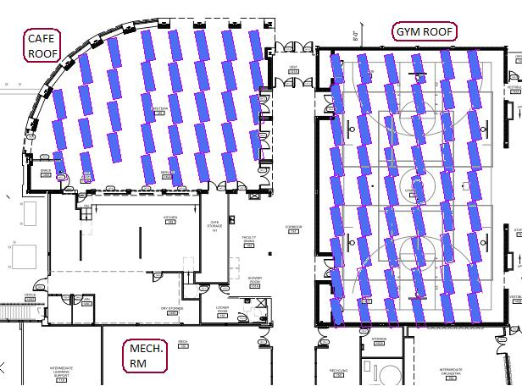
Introduction
Mechanical Systems Overview
Mechanical Depth
Structural Breadth
Acoustical Breadth
Conclusions
Recommendations
Questions
Array Effect on Structural Roof

Slide 17
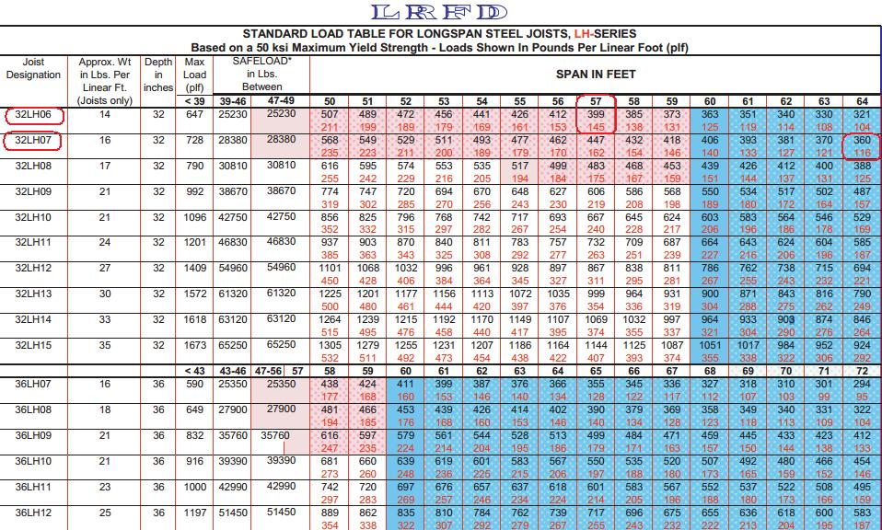
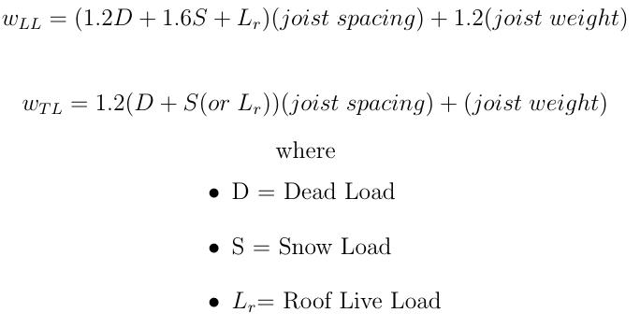
Introduction
Mechanical Systems Overview
Mechanical Depth
Structural Breadth
Acoustical Breadth
Conclusions
Recommendations
Questions
Array Effect on Structural Roof

Slide 18
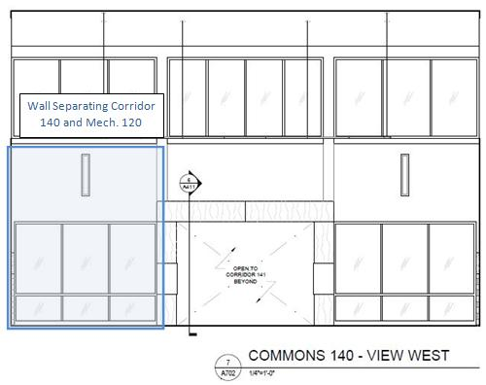
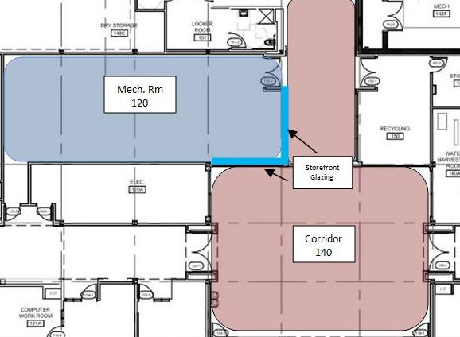
Introduction
Mechanical Systems Overview
Mechanical Depth
Structural Breadth
Acoustical Breadth
Conclusions
Recommendations
Questions
Redesign of Mechanical Room Walls

Slide 19
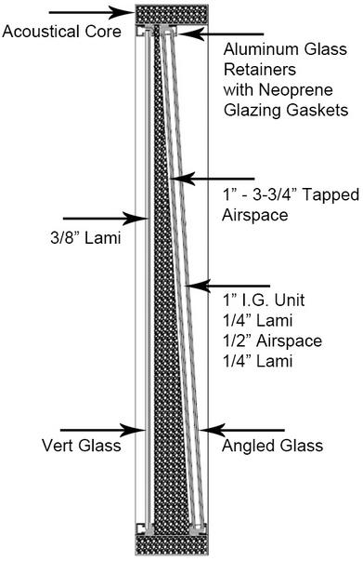
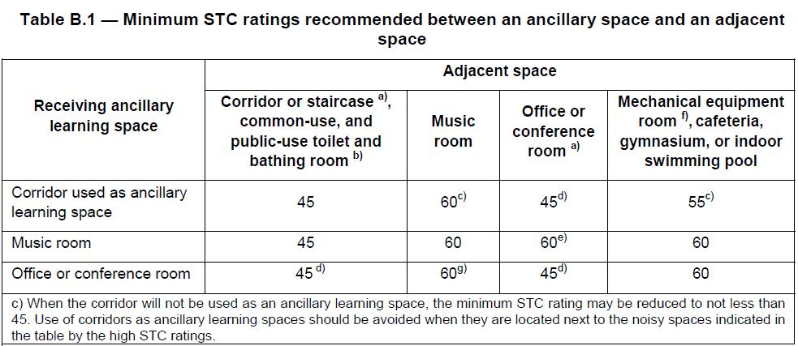
Introduction
Mechanical Systems Overview
Mechanical Depth
Structural Breadth
Acoustical Breadth
Conclusions
Recommendations
Questions
Redesign of Mechanical Room Walls
Proposed Redesign
Current STC of Glass Window: STC-30

Slide 20
Introduction
Mechanical Systems Overview
Mechanical Depth
Structural Breadth
Acoustical Breadth
Conclusions
Recommendations
Questions
Conclusions
As Solar hot Water System is possible and economical
Costly ramifications for structure
Acoustical Treatment is necessary for the mechanical display windows

Slide 21
Introduction
Mechanical Systems Overview
Mechanical Depth
Structural Breadth
Acoustical Breadth
Conclusions
Recommendations
Questions
Recommendations
Generate More Accurate Model
Do not proceed with solar hot water system

Slide 22
Introduction
Mechanical Systems Overview
Mechanical Depth
Structural Breadth
Acoustical Breadth
Conclusions
Recommendations
Questions
Special Thanks To:
David Nitchkey
Harry Bauman
David Winklebleck
Questions?

