Slide 1
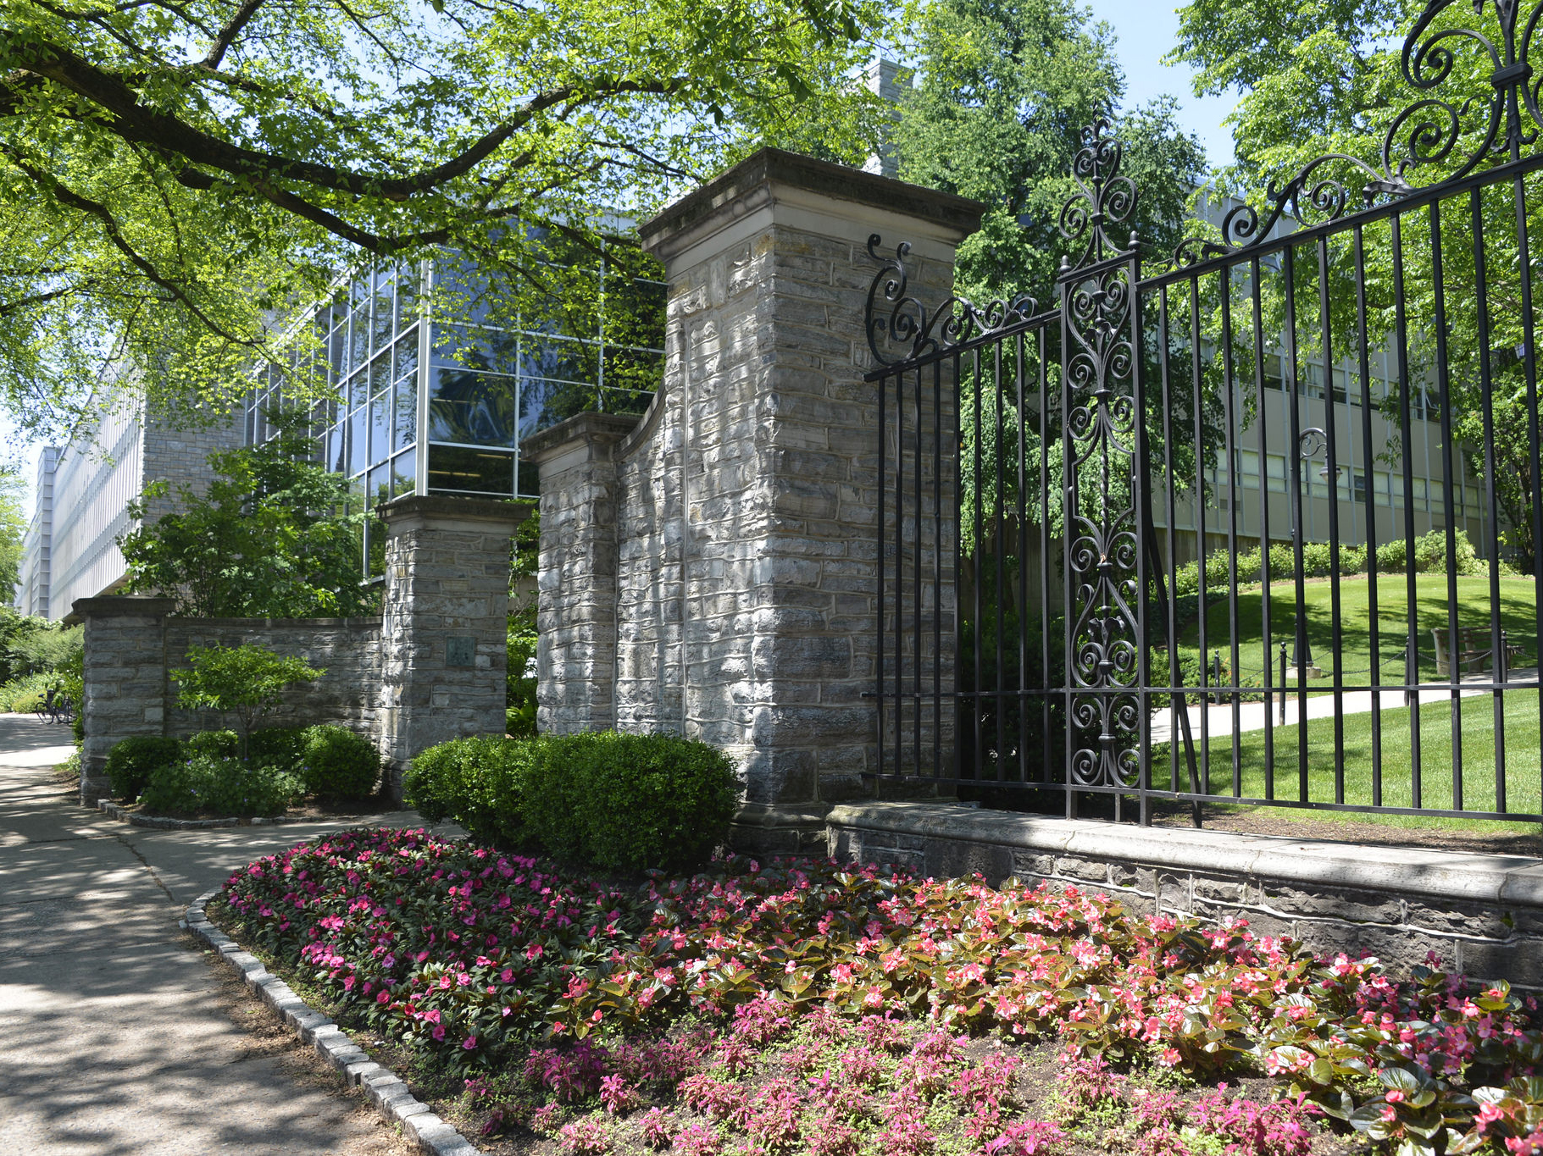

2014 Overview of the College
Amr Elnashai

Slide 2
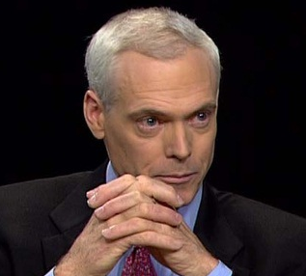
Good-to-Great
“Every institution has its unique set of irrational and difficult constraints, yet some make a leap while others
facing the same environmental challenges do not.”
– Jim Collins in ‘Good-to-Great and the Social Sector’

Slide 3
State of the College

Slide 4
Undergraduate Enrollment

Slide 5
Graduate Enrollment

Slide 6
Baccalaureate Degrees Conferred

Slide 7
Graduate Degrees Conferred

Slide 8
Enrollment - University Park Colleges

Slide 9
UP Colleges – Research Expenditure
Percentage of UP Total

Slide 10
Development – Annual Gifts

Slide 11
Endowment Comparisons
Annual Average of 5 Years

Slide 12
Comparison of Academic Units
Dollars per Donor
Average of 5 Years

Slide 13
Campaign Goal $200 Million
Endowments Received-to-Goal
$12,952,368.72
Received
$187,047,631.28

Slide 14
Departmental Ranking

Slide 15
College Metrics
College of Engineering | UG Ranking | Grad Ranking | T/TT Faculty | UG Students | MS | UG/Fac. | MS/Fac. | PhD | PhD/fac. | Research $ | $/faculty
MIT | 1 | 1 | 371 | 2706 | 1071 | 7 | 2.9 | 1740 | 4.7 | $332,463,000 | $896,127
Stanford | 2 | 2 | 217 | 2914 | 1479 | 13 | 6.8 | 1770 | 8.2 | $197,409,000 | $909,719
Berkeley | 3 | 3 | 225 | 3469 | 330 | 15 | 1.5 | 1466 | 6.5 | $192,495,000 | $855,533
CalTech | 3 | 4 | 92 | 489 | 22 | 5 | 0.2 | 565 | 6.1 | $88,955,000 | $966,902
GT | 5 | 5 | 462 | 8597 | 1142 | 19 | 2.5 | 1958 | 4.2 | $195,419,000 | $422,985
UIUC | 5 | 5 | 403 | 7558 | 1114 | 19 | 2.8 | 1696 | 4.2 | $236,410,660 | $586,627
UMich | 7 | 9 | 366 | 5665 | 1360 | 15 | 3.7 | 1561 | 4.3 | $196,024,000 | $535,585
CMU | 8 | 5 | 153 | 1722 | 1001 | 11 | 6.5 | 780 | 5.1 | $204,380,028 | $1,335,817
Cornell | 8 | 13 | 242 | 3192 | 768 | 13 | 3.2 | 922 | 3.8 | $132,414,000 | $547,165
UT Austin | 10 | 11 | 274 | 5276 | 519 | 19 | 1.9 | 1295 | 4.7 | $163,883,000 | $598,113
Purdue | 10 | 8 | 297 | 7497 | 790 | 25 | 2.7 | 1499 | 5.0 | $222,250,000 | $748,316
Averages |  |  | 282 | 4462 | 872 | 16 | 3.1 | 1387 | 5.2 | $196,554,790 | $763,899
Penn State | 16 | 25 | 335 | 8523 | 521 | 25 | 1.6 | 1091 | 3.3 | $152,322,978 | $454,695
Percent Comparison |  |  |  |  | 60% | 161% | 49% | 79% | 63% | 77% | 60%
Target Change |  |  |  |  | 40% | -61% | 51% | 21% | 37% | 23% | 40%
Note that to compare similar numbers, PSU Engineering includes engineering degrees in other colleges and Commonwealth campuses - 2012

Slide 16
Observations and Implications
Undergraduate Program Size
Faculty Size
Graduate Program
Research Expenditure
Technical Fields
Intellectual Footprint
Quo vadimus?

Slide 17
Academic Management
Through Strategic Planning
and Implementation

Slide 18

Research Universities
“We must strive to be sure that research universities fulfill their promise as a learning environment that is remarkably well suited to the coming era – one in which undergraduates, graduate students, and faculty alike share in the discipline, joy and continual renewal of original research and scholarship.”
– Chuck Vest, late president of the National Academy of Engineering,
past president of MIT, from ‘Pursuing the Endless Frontier’

Slide 19
Academic Management
THE USUAL
Most of academe have no multiyear budget planning
Strategy documents are not turned into plans
Funds are historically and reactively allocated
No relationship between goals and expenditure
BENEFIT OF OPERATIONAL MODEL
Support academic strategy through investment
Increase transparency and accountability
Plan for investment
and contingencies
Metrics
Budget Model
Academic Plan
COE

Slide 20
Penn State Engineering Operational Model
Community Strategy
Surveys, Retreats
Functional Budget
Effort, Target
Academic Plan
Budget
Model
Strategic Goals
IPACs, Retreats
Portfolio Budgets
Requests, Audit
Implementation
Timeline, Resources, Metrics
Five-Year Budget
Assumptions

Slide 21
Coupled Academe and Finance

Slide 22
Metrics
INPUTS
The resources (human, space, infrastructure, finance) and management (policies, oversight) required to operate the academic unit
e.g., students, professors, staff, funds, guidelines
OUTCOMES
The results that fulfill the mission and objectives, and contribute to stakeholders and society
e.g., graduates, scholarship (i.e., publications, inventions), ranking, recognitions
IMPACTS
Positive change over time (10+ years) resulting from the outcomes above
e.g., healthier population, abundant water, safer optimized societal system
of systems

Slide 23
Current Strategy Development Process
Community
Strategy
Goals
Implementation
Existing 11 strategy documents
Strategy Snapshots
High Level College Strategy
Priority Goals – College, Departments
Implementation Plan
  Goals
  Responsibilities
  Resources
  Time lines and Metrics
Implementation-steered budget
Finalize, share, implement, continuously review, and refine

Slide 24
Short-term Stimuli
and Enablers

Slide 25
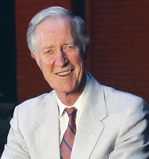
Core Mission of Universities
“The core business of the university is learning, and the most fundamental aspect of that learning is the education of undergraduates.”
– Frank Rhodes, President Emeritus, Cornell University,
in ‘The Creation of the Future’

Slide 26
Enrichment and Invigoration
Projects
Opportunities for efficiencies
Enabling mechanisms
for initiatives
Accountable business culture
Streamlined, efficient organization capable of implementing academic initiatives

Slide 27
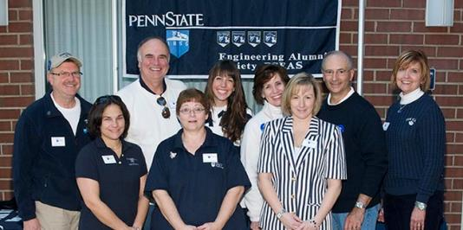
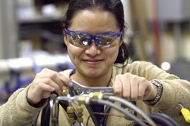
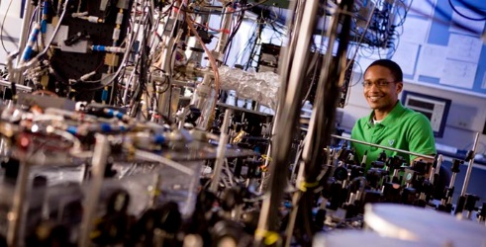
Enrichment and Invigoration
Initiatives
Strengthening the Undergraduate Program
Expanding the
Graduate Program
Broader UG experience;
Larger and higher-quality
Grad program

Slide 28
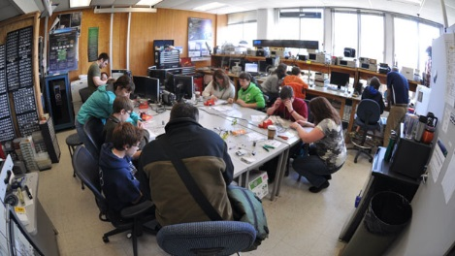
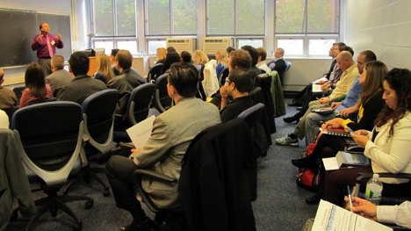
Enrichment and Invigoration
INITIATIVES
Distinguished Teaching Fellowships
Ten fellowships for
senior Ph.D. students
Teach one regular course under professional supervision
Engage with
award-winning educators
Better prepared, more competitive Ph.D. graduates

Slide 29
Enrichment and Invigoration
INITIATIVES
Frontier Faculty Lines
Six interdisciplinary hires on frontier topics
At the intersection of societal challenges, faculty interests,
and existing/short term research infrastructure
To create further synergies between departments, centers, institutes, Penn State colleges, and other universities
Uniquely branded UG and Grad programs; Better S/F Ratio

Slide 30
Enrichment and Invigoration
INITIATIVES
Innovation Grants
Twenty one-year research grants
Interdisciplinary topics meshing
with Penn State priorities
Research gems nearing completion
Increased competitiveness of
Penn State engineering faculty

Slide 31
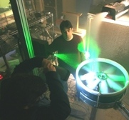
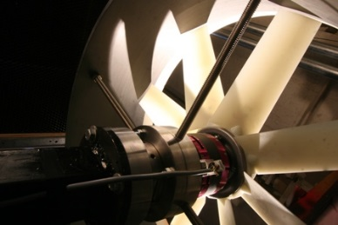
Enrichment and Invigoration
INITIATIVES
Excellence Graduate Fellowships
Twenty-five full 3-year offers
Targeted at top incoming graduate NSF fellowship-caliber
Accompanying specific academic
and social programs
Enhanced Ph.D. program quality

Slide 32
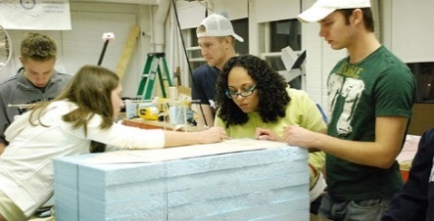
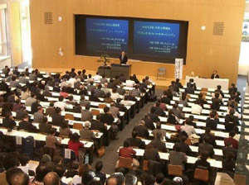
Enrichment and Invigoration
INITIATIVES
One-year Course-based Masters
Ten grants for complete proposals
Non-thesis residential M.S. degrees
August-to-August format
Enlarged M.S. program; Feeder into Ph.D. program; Revenue generation

Slide 33
Enrichment and Invigoration
INITIATIVES
Research Experience for Undergraduates
Fifty+ eight-week embedded opportunities
Attendance in research methods seminars
Participation in professional conferences
Broader UG experience; Feeder to Grad program

Slide 34
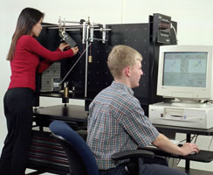
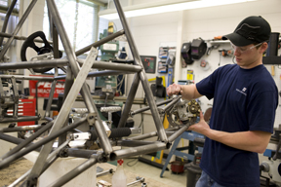
Enrichment and Invigoration
INITIATIVES
Instructional and Research Equipment Grants
Fifteen grants for instruction and research
Innovative content on both education and investigation
State-of-the-art instruction;
Top research infrastructure

Slide 35
Human Resources
Job Description Updates
Review and complete Job Review Worksheets
Track JRW completion and updates
Work with Department Heads to assess job needs
Create final inventory for compensation review
Communicate final outcome to staff
Compensation Analysis
Develop timeline with Compensation Analyst
Compile data to conduct salary analysis of all positions
Develop plan for communication to staff upon completion

Slide 36
Human Resources
Staff Career Development
Collect input from Department Heads
Communicate support for training to supervisors
Make training part of review process
Communicate available resources
Develop annual tracking mechanism
Staff Awards
Review current programs
Conduct staff survey to determine what is of value
Develop new programs based on feedback

Slide 37
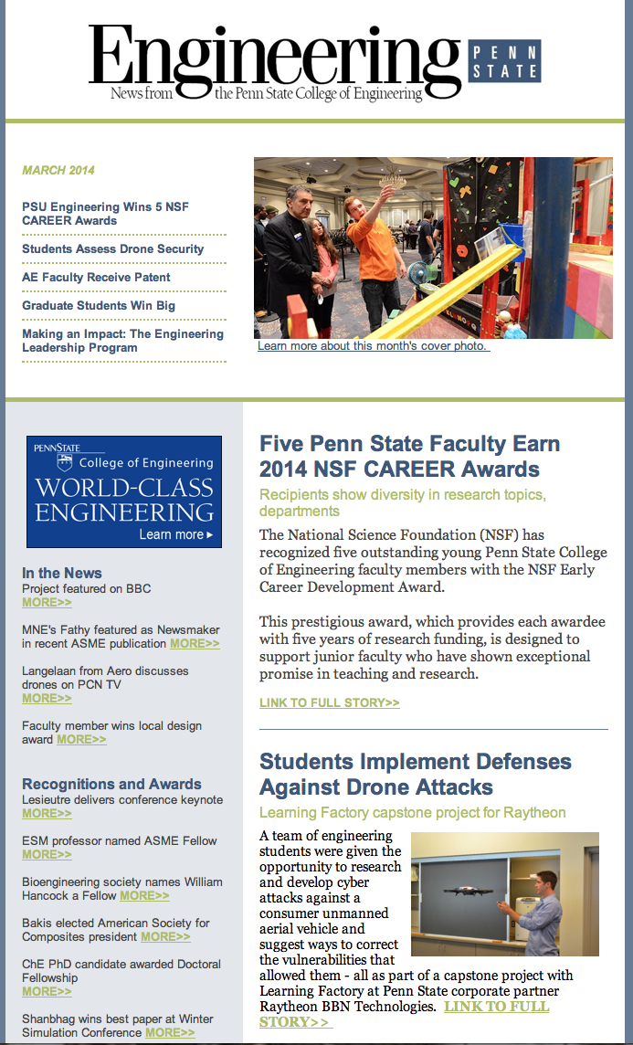
CoE e-Newsletter - Overview
First E-Newsletter sent March 13-14, 2014
Branding on World-Class Engineering
Sent monthly
Five highlighted accomplishments
Monthly features
Mailing List (55,000) Includes
Alumni
Deans and department heads of ABET-accredited engineering programs
Corporate contacts
Industry CEOs
PSU senior administration
College of Engineering faculty and staff

Slide 38
CoE e-Newsletter - Design
Familiar magazine Engineering Penn State header for brand recognition
Clean format using white space, engaging photos, and attractive colors in order to maximize readability and engagement
Powerful College of Engineering branding and references – through color, graphics, and content
Clear calls to action

Slide 39
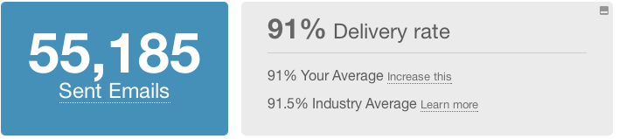
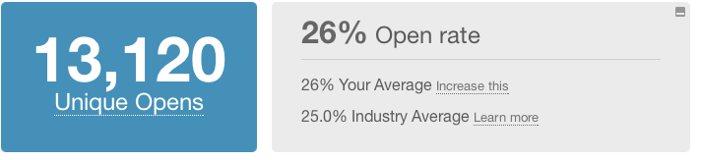
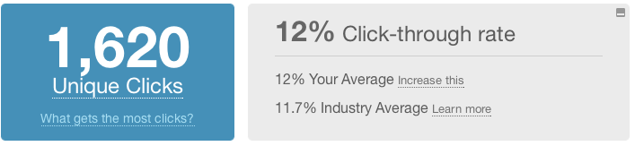
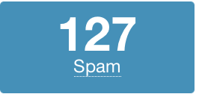
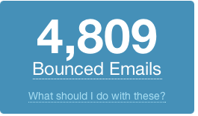
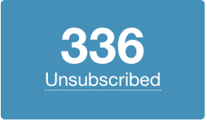
CoE e-Newsletter - Statistics
Open rates by audience segment
Faculty 67%
Staff 67%
Penn State administration 64%
Deans 36%
Department Heads 35%
Alumni 23%
CEOs 22%
Corporate contacts 14%
Top five links
NSF CAREER Awards 1,093 clicks
Drone Attacks 229 clicks
Graduate Students Win $10,000 177 clicks
A Grand Experiment 116 clicks
Patent Issued 107 clicks

Slide 40
NSF CAREER Award Announcement
First widely distributed announcement of College-wide award winners
Sending to over 1,000 deans of ABET-accredited engineering programs
Most clicked-on story in March e-newsletter
Repetition will reinforce this important and news-worthy message
Beginning of a series of messages that will call attention to the excellent faculty, programs and research across the College

Slide 41
Ongoing Communications Projects
Expand College mementos
and souvenirs
Redesign all College websites
Redesign Penn State Engineering magazine
Expand persistent
social media presence
Create e-newsletters for departments
Expand and reconfigure Communications team
Commission
promotional videos

Slide 42
Closure

Slide 43
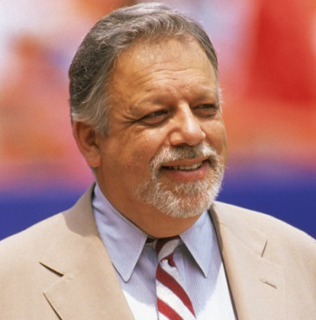
Academic Administration
“Being a university president is no way for an adult to make a living.”
– Bartlett Giamatti, late president of Yale,
from ‘The University and the Public Interest’

Slide 44
Objectives
Expansion of Faculty Size
Enlargement of Graduate Programs
Renovation of Laboratories
Enhancement of Faculty, Students, Staff Diversity
Approaching, Breaching Academic Frontiers
EXCELLENCE IN EVERYTHING!

Slide 45
Recap
Exceptional College of Engineering with tremendous strength across the board
Opportunities for further excellence and a steep
upward trajectory
Development of a
business model for the
College is underway
Short term enrichments
and invigoration measures showing early promise
Short term enrichments and invigoration measures showing
early promise. The present is very good, the future is GREAT.

