Slide 1
Amr Elnashai

Slide 2
CONTENTS
- Initiatives
- Administration
- Communications
- Strategic Goals
- Implementation Plan
- Development Thrusts
- Diversity
- Five-year Plan
- MS/MEng Programs
- Highlights

Slide 3
Initiatives
INNOVATION GRANTS
Twenty one-year research grants
Interdisciplinary topics meshing with PSU priorities
Research gems nearing completion
FRONTIER FACULTY LINES
Six interdisciplinary hires on frontier topics
At the intersection of societal challenges, faculty interests, and existing/short term research infrastructure
To create further synergies between departments, centers, institutes, Penn State colleges, and other universities
DISTINGUISHED TEACHING FELLOWSHIPS
Ten fellowships for senior PhD students
Teach one regular course under professorial supervision
Engage with award-winning educators

Slide 4
Initiatives
EXCELLENCE GRADUATE FELLOWSHIPS
Twenty five full 3-year offers
Targeted at top incoming graduate NSF fellowship-caliber
Accompanying specific academic and social program
INSTRUCTIONAL AND RESEARCH EQUIPMENT GRANTS
Fifteen grants for instruction and research
Innovative content on both education and investigation
RESEARCH EXPERIENCES FOR UNDERGRADUATES
More than 50 eight-week embedded opportunities
Attendance in research methods seminars
Participation in professional conferences

Slide 5
Initiatives
ONE-YEAR COURSE-BASED MASTERS
Ten grants for complete proposals
Non-thesis residential MS degrees
August-to-August format
GLOBAL PROGRAM DEVELOPMENT
Ten grants for complete proposals
Non-thesis residential MS degrees
August-to-August format
COMMERCIALIZATION GRANTS
Four funded and second round under review
Research outcomes that are amenable to commercialization
Linked to industry requirements

Slide 6
Current/New Initiatives
Innovation Grants
Instructional and Research Equipment Grants
12/$1M
10/$1.5M
Excellence Graduate Fellowships
Global Program Development
25/$1.45M
5/$100k
One-year Course-based Masters
ENGIN Grants
12/$600k
4/$300k
Distinguished Teaching Fellowships
PSU-wide Research Experience for Undergraduate
10/$195k
200/$1.2M
Research Experiences For Undergraduates
Business Experience for Undergraduates and Grads
75/$500k
15/$100k
Frontier Faculty Lines
Laboratory Renovation
6/$6M
5/$500k

Slide 7
Strategy
Implementation
Day-to-day
Management Model
Research
Global Programs
Diversity
Communications
Governance
Entrepreneurship/Innovation
Finance
Development/Advancement
Education/Academics
Service

Slide 8
Administration
Development
Objectives derived from College priorities
Expansion of Major Gift Officers
Strengthening of corporate gift effort
HR
Annual review process
Job responsibilities worksheet
Pre- and Post-Award Management
IT
Strengthening of the team
Creation of symmetric structure
Major proposals coordinator
Streamlining two groups into one
Expanding the definition of Engineering IT
Coordination of College and Departments IT
Communications
Finance
Expanded from one to ten
New templates for slides
Brochures
Major advertising campaign
Total redesign of all web sites
New and consistent branding
Functional budget
Five-year budget projection
Cash flow analysis
Carry-forward management
Activity budget allocations

Slide 9
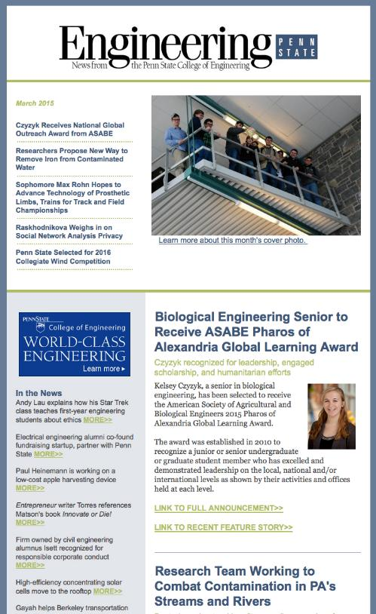
Communications Firsts
e-newsletter
Ad Campaign
Communications Team

Slide 10
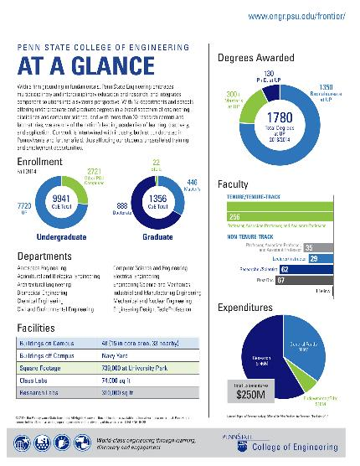
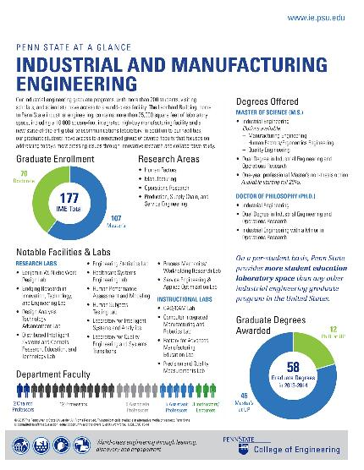
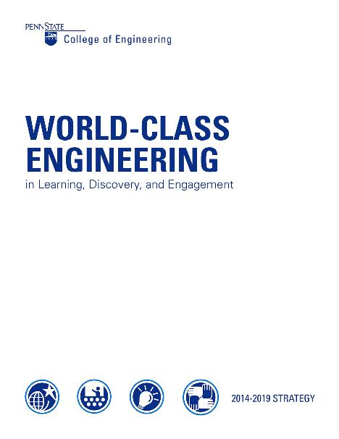
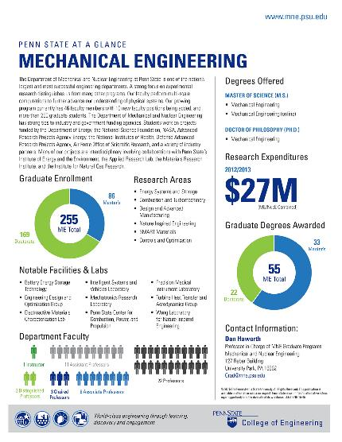
Communications Firsts
Marketing Campaign
College/Departments Strategy

Slide 11
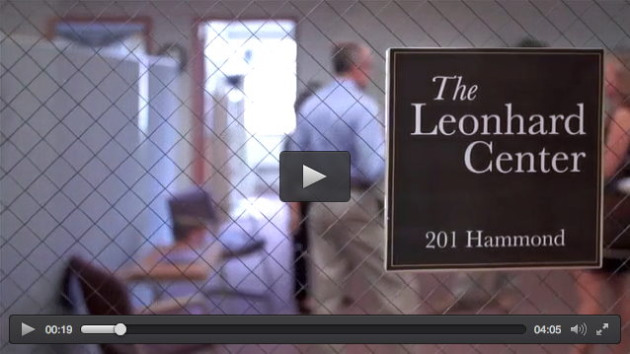
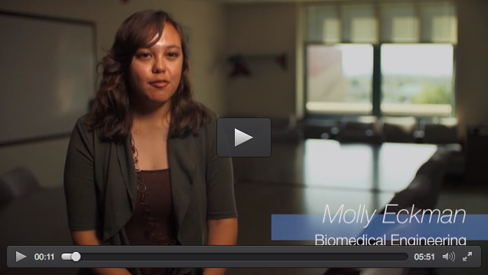
Communications Firsts
Professional videos

Slide 12
GOALS
Strategic Goals
Enhanced educational experience
Interdisciplinary majors and minors
Non-thesis Master
Strengthened Ph.D. programs
Improve student environments
Increased funded projects
Research collaboration
Research partnerships
Improved labs
Faculty contributions to policy
Engaged service
Enhanced business operations
Alignment of College priorities
Financial system improvements
Strengthened institutional effectiveness

Slide 14
Development Thrusts
Innovation in
Undergrad Education
The Global Engineer
Pioneers of
Economic Development
Professor of the Future
Inclusive Penn State
Frontiers of Discovery

Slide 15
STRATEGY: Diversity
Develop a shared and inclusive understanding of diversity
Create a welcoming campus climate
Recruit and retain a diverse student body
Recruit and retain a diverse workforce
Develop a curriculum that fosters cultural competencies
Inclusive University leadership and management

Slide 16
Investment in Inclusive Penn State 2015-2019:
$900,000

Slide 17
Five-year Plan for Global Preeminence
12
STAFF
5-year plan
FACULTY
5-year plan
SPACE
5-year plan
FINANCE
5-year plan

Slide 18
MS/MEng Programs
Aerospace Engineering
Chemical Engineering
Civil Engineering
Computer Science and Engineering
APPROVED
Electrical Engineering
Engineering Design
Engineering Mechanics
Environmental Engineering
Industrial Engineering
Coming Soon: Acoustics, Leadership and Intrapreneurship, Engineering at the Nano-scale, Facilities Engineering and Management, Biomedical Engineering, Structural Integrity

Slide 19
Masters Comparison
Big Ten+ Engineering College
MS One Year
MS No Research
MEng
YES
YES
YES
#9 / 3.7
YES
#2 / 6.8
YES
YES
#62 / 1.1
YES
#20 / 3.0
YES
YES
YES
#25 / 1.5

Slide 20
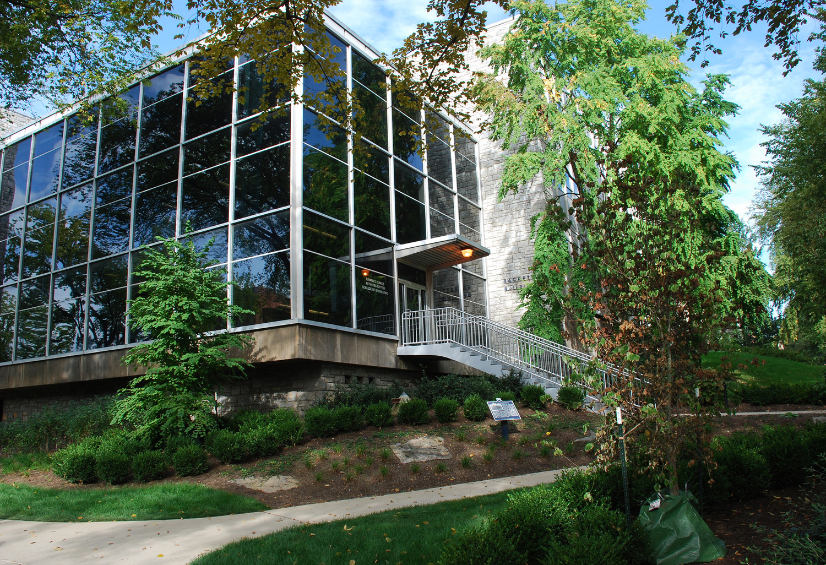
The Highlights
ChemE/Bio building
School of EECS
20% expansion of the faculty

Slide 21
8
Successful initiatives

Slide 22
14
MS/MEng courses

Slide 23
18
ABET accredited programs

Slide 24
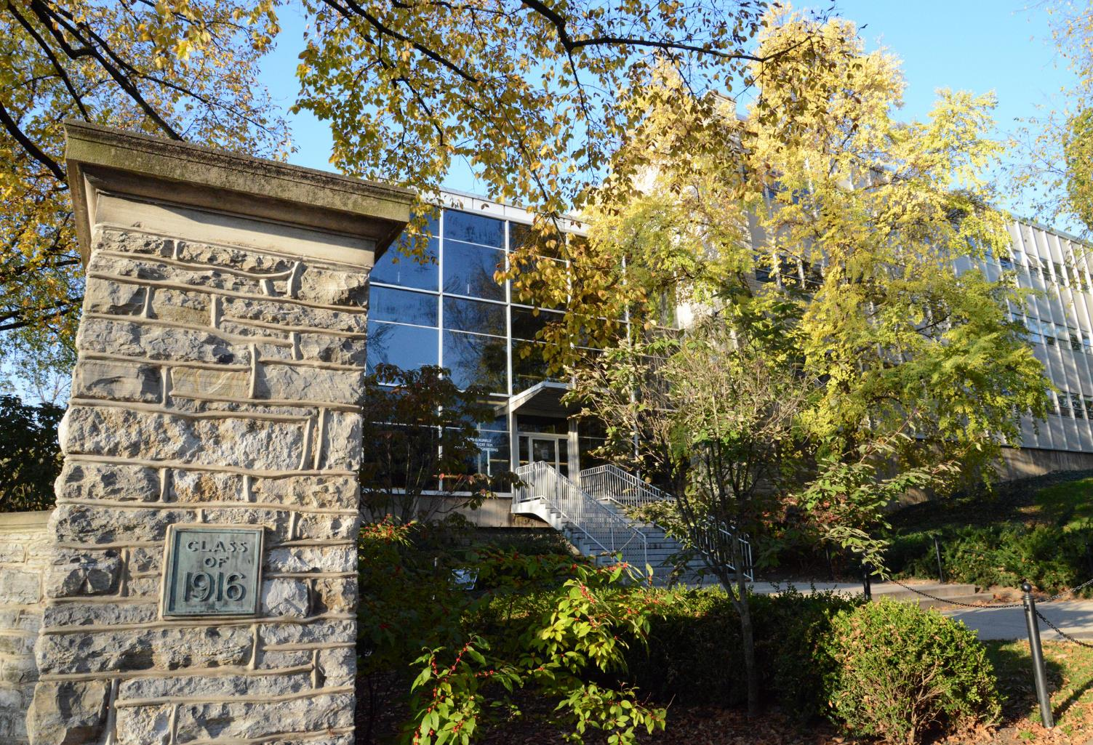
Planned Strengthening of Acoustics
Addition of Associate Dean for Research and Innovation
Reorganization of Finance
Expansion of Communications

Slide 25
10
Faculty lines in MNE

Slide 26
2
Faculty lines in SEDTAPP

Slide 27
6
Frontier lines

Slide 28
12
Faculty lines in BME

Slide 29
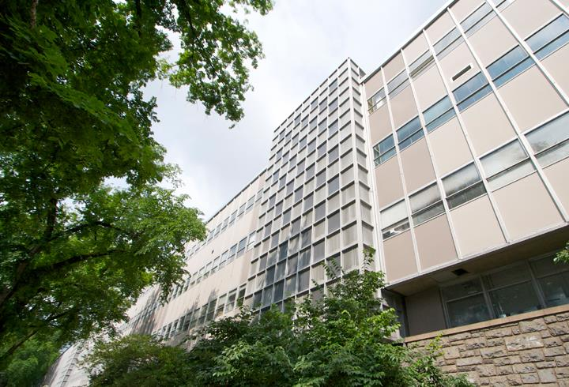
HR Reorganization
Planned IT Reorganization
Strategy and Implementation
Strategy-steered Development

Slide 30
Over the Horizon
IN EDUCATION
Interdisciplinary problem- based majors/minors
Intercollegiate MS/MEng degrees
Service learning
Quantitative student satisfaction/feedback

Slide 31
Over the Horizon
IN RESEARCH
Launching research thrusts
Industry-CoE research partnerships
Increase in funded centers
Intellectual Property support
Fund large equipment purchases

Slide 32
Over the Horizon
IN SERVICE
Membership in policy-forming committees
Reward system for distinguished technical service
Transnational committees

Slide 33
Over the Horizon
IN GOVERNANCE
Management and Admin Manual
Financial tracking and projections
NTT career progression systems
Alignment of personal and institutional aspirations
Departmental and college external reviews

