Slide 1
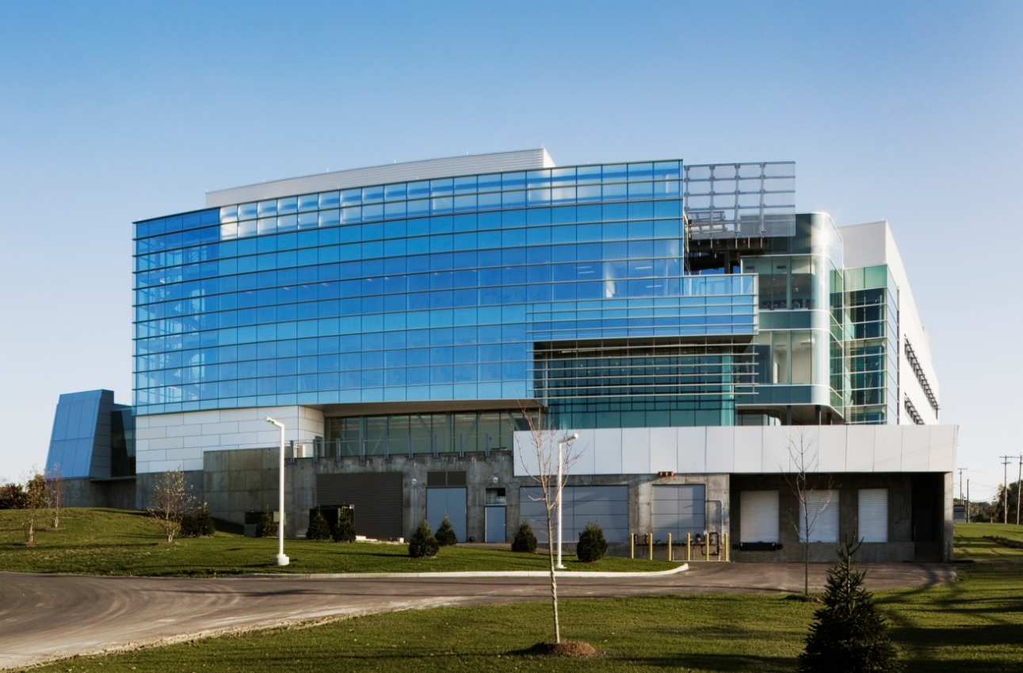
Gen*NY*Sis Center for Excellence in Cancer Genomics
Rensselaer, NY
Meral Kanik Structural Option Advisor: A.M. Memari April 14, 2008

Slide 2
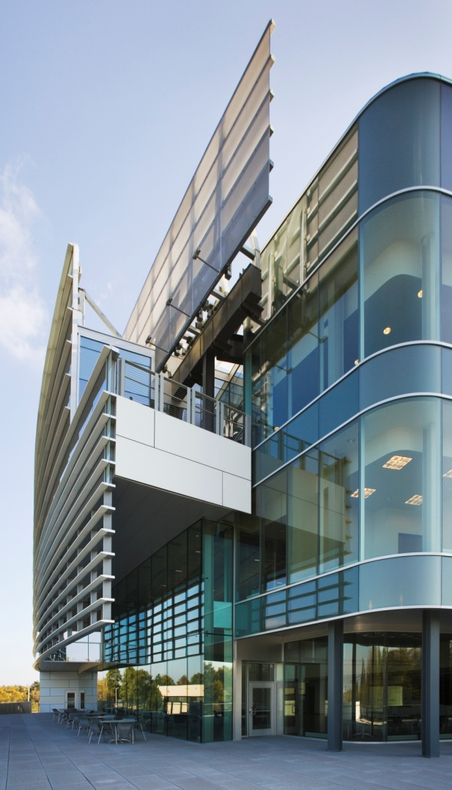
Gen*NY*Sis Center for Genomics
Introduction
Building Statistics
Existing Structure
Proposal
Structural Redesign
Lateral Redesign
Vibration Analysis
Sustainability Concerns
Cost Analysis
Schedule Change
Conclusions
Meral Kanik Structural Option April 14, 2008

Slide 3
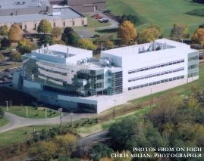
Building Statistics
Introduction
Building Statistics
Existing Structure
Proposal
Structural Redesign
Lateral Redesign
Vibration Analysis
Sustainability Concerns
Cost Analysis
Schedule Change
Conclusions
Owner: University at Albany
Architect/Engineer: Einhorn Yaffee Prescott Architecture & Engineering P.C.
Location: Rensselaer, NY
Function: Cancer Research Laboratories
Size: 117,400 square feet
Height: 87 feet
Number of Stories: 4 above grade, 1 below grade
Cost: $45 million (base building cost)
Project Delivery Method: Fast Track Delivery
Meral Kanik Structural Option April 14, 2008

Slide 4
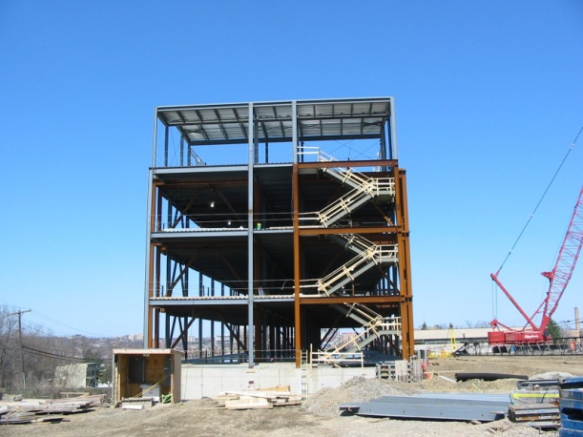
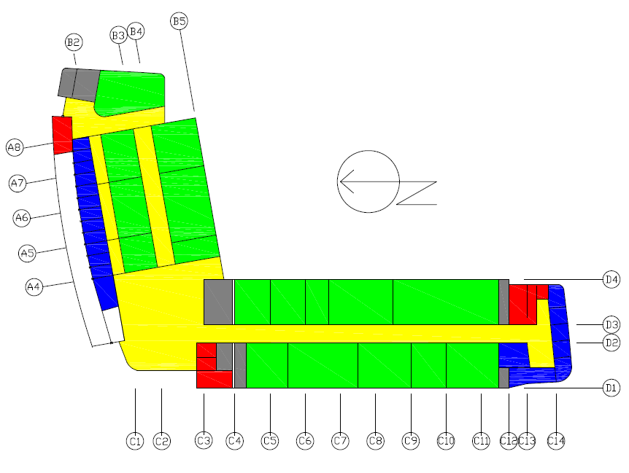

Typical Floor Layout
Labs/classrooms
Offices
Vertical Egress
Corridor/gathering
Introduction
Building Statistics
Existing Structure
Proposal
Structural Redesign
Lateral Redesign
Vibration Analysis
Sustainability Concerns
Cost Analysis
Schedule Change
Conclusions
Meral Kanik Structural Option April 14, 2008

Slide 5
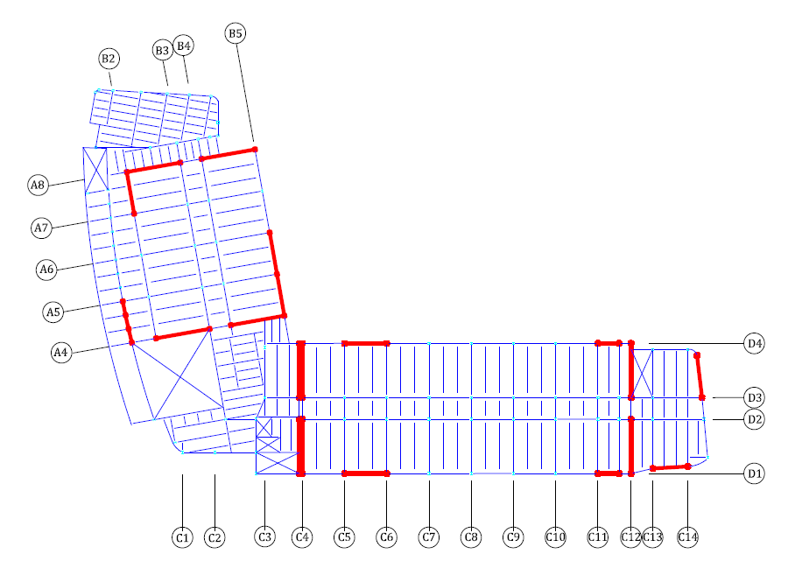
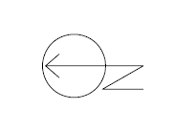
Existing Structure
Introduction
Building Statistics
Existing Structure
Proposal
Structural Redesign
Lateral Redesign
Vibration Analysis
Sustainability Concerns
Cost Analysis
Schedule Change
Conclusions
Meral Kanik Structural Option April 14, 2008

Slide 6
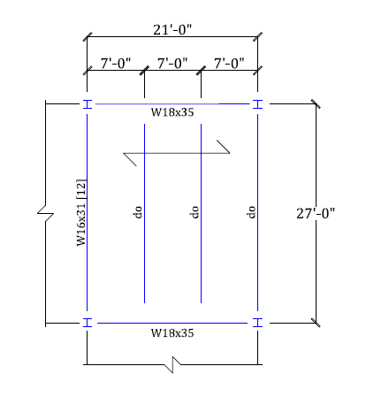
Typical Bay
Introduction
Building Statistics
Existing Structure
Proposal
Structural Redesign
Lateral Redesign
Vibration Analysis
Sustainability Concerns
Cost Analysis
Schedule Change
Conclusions
4 ½” normal weight concrete
2” composite metal deck
f’c = 3.5 ksi
Fy = 50 ksi
Meral Kanik Structural Option April 14, 2008

Slide 7
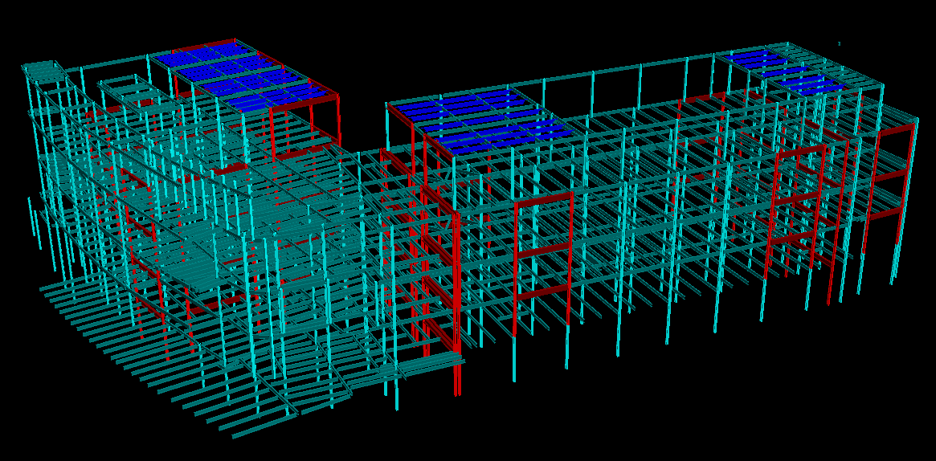
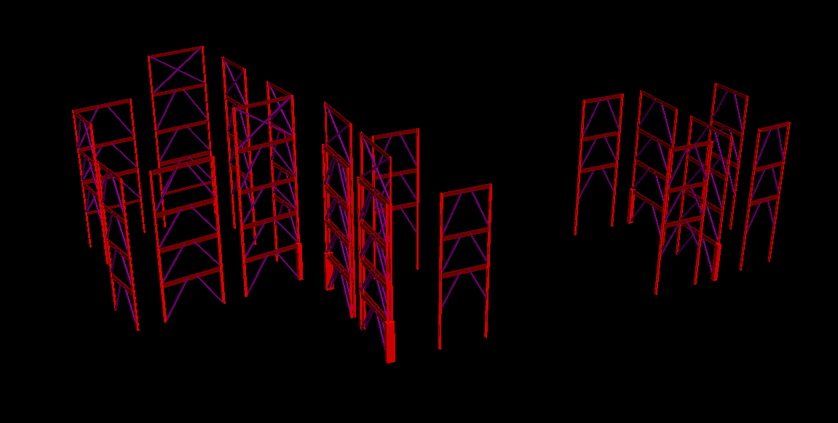
Lateral System
Non moment-resisting eccentrically braced frames
Bracing diagonal of HSS8x8x5/16 steel
Wind controlled
Introduction
Building Statistics
Existing Structure
Proposal
Structural Redesign
Lateral Redesign
Vibration Analysis
Sustainability Concerns
Cost Analysis
Schedule Change
Conclusions
Meral Kanik Structural Option April 14, 2008

Slide 8
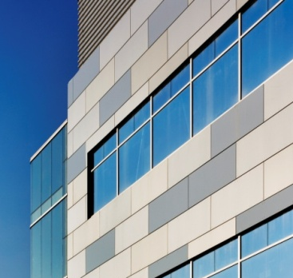
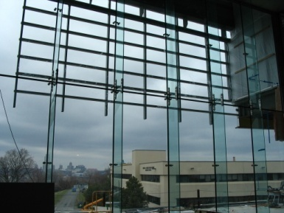
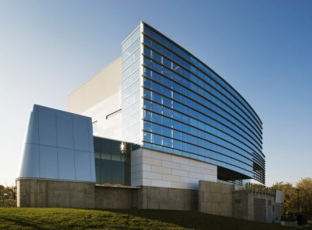
Proposal
Introduction
Building Statistics
Existing Structure
Proposal
Structural Redesign
Lateral Redesign
Vibration Analysis
Sustainability Concerns
Cost Analysis
Schedule Change
Conclusions
Replace steel gravity system
  Employ hollow core planks
Remove steel braced frames
  Utilize concrete shear walls
Evaluate vibration effects
Implement PSU sustainable designs
Reduce erection time
Evaluate price differences
Meral Kanik Structural Option April 14, 2008

Slide 9

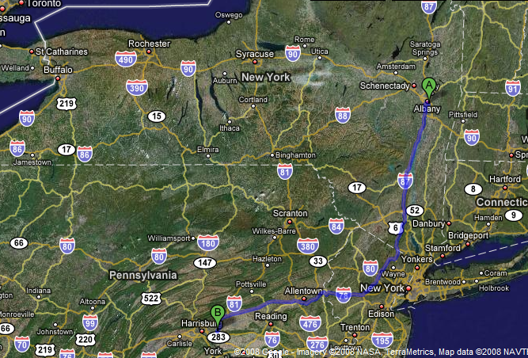
Proposal
Introduction
Building Statistics
Existing Structure
Proposal
Structural Redesign
Lateral Redesign
Vibration Analysis
Sustainability Concerns
Cost Analysis
Schedule Change
Conclusions
Transfer the design from SUNY University at Albany to Penn State’s Hershey Medical Center
Meral Kanik Structural Option April 14, 2008

Slide 10
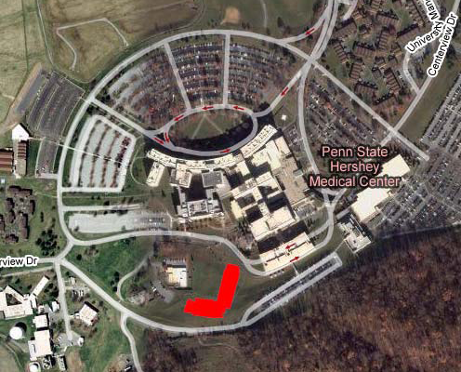
New Design Criteria
Introduction
Building Statistics
Existing Structure
Proposal
Structural Redesign
Lateral Redesign
Vibration Analysis
Sustainability Concerns
Cost Analysis
Schedule Change
Conclusions
N
Meral Kanik Structural Option April 14, 2008

Slide 11
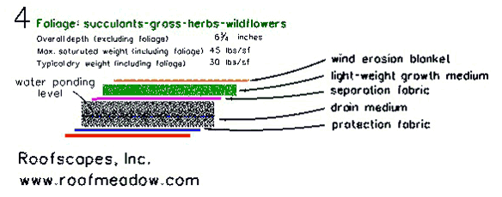
Gravity Loading
Introduction
Building Statistics
Existing Structure
Proposal
Structural Redesign
Lateral Redesign
Vibration Analysis
Sustainability Concerns
Cost Analysis
Schedule Change
Conclusions
Must account for new roof loading
Previous machine weight of 160 kips
Add live load roof garden assembly
Area of roof garden = 14600 ft²
166 psf
Meral Kanik Structural Option April 14, 2008

Slide 12
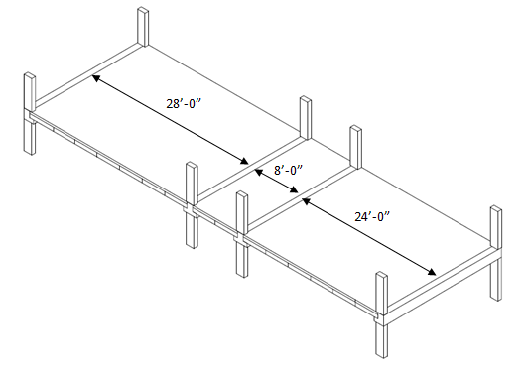
Hollow Core Planks
Introduction
Building Statistics
Existing Structure
Proposal
Structural Redesign
Lateral Redesign
Vibration Analysis
Sustainability Concerns
Cost Analysis
Schedule Change
Conclusions
4HC8 + 2” topping
20” square columns
20LB24
28IT20
Meral Kanik Structural Option April 14, 2008

Slide 13
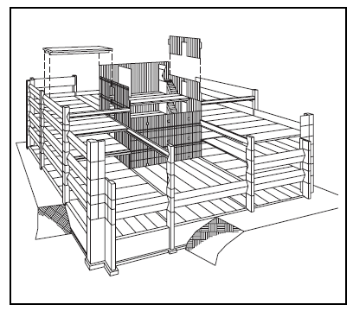
New Lateral Loads
Introduction
Building Statistics
Existing Structure
Proposal
Structural Redesign
Lateral Redesign
Vibration Analysis
Sustainability Concerns
Cost Analysis
Schedule Change
Conclusions
Cast In Place Concrete Shear Walls
Precast Concrete Shear Wall Panels
Meral Kanik Structural Option April 14, 2008

Slide 14
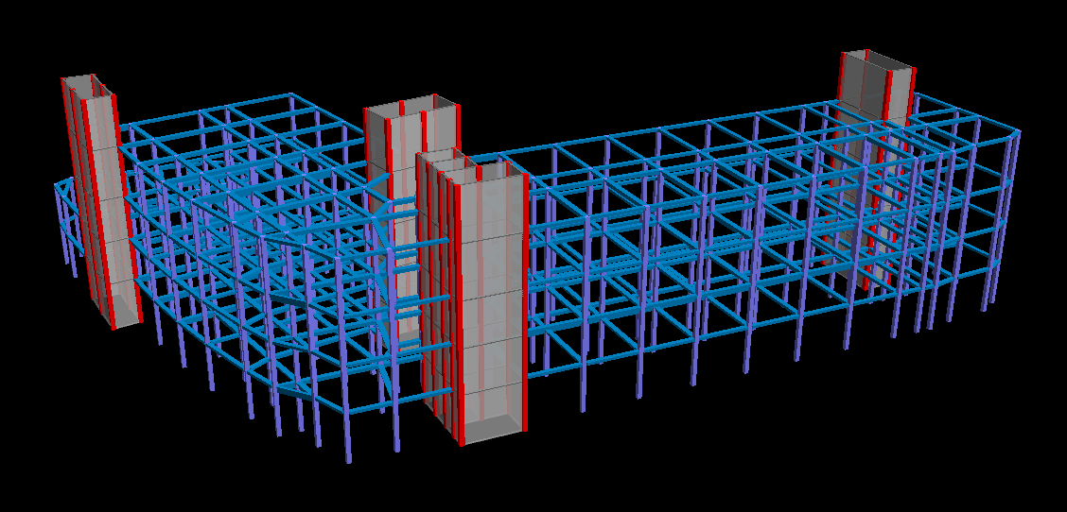
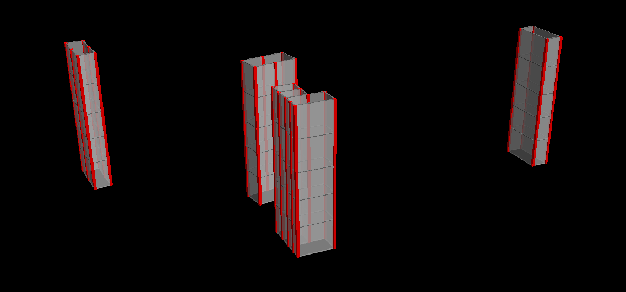
New Lateral System
Use vertical egress as shear walls
Introduction
Building Statistics
Existing Structure
Proposal
Structural Redesign
Lateral Redesign
Vibration Analysis
Sustainability Concerns
Cost Analysis
Schedule Change
Conclusions
Add new stair case
Meral Kanik Structural Option April 14, 2008

Slide 15
Effects of Drift
Introduction
Building Statistics
Existing Structure
Proposal
Structural Redesign
Lateral Redesign
Vibration Analysis
Sustainability Concerns
Cost Analysis
Schedule Change
Conclusions
According to IBC,
Δ_{WIND}= H/400
Meral Kanik Structural Option April 14, 2008

Slide 16
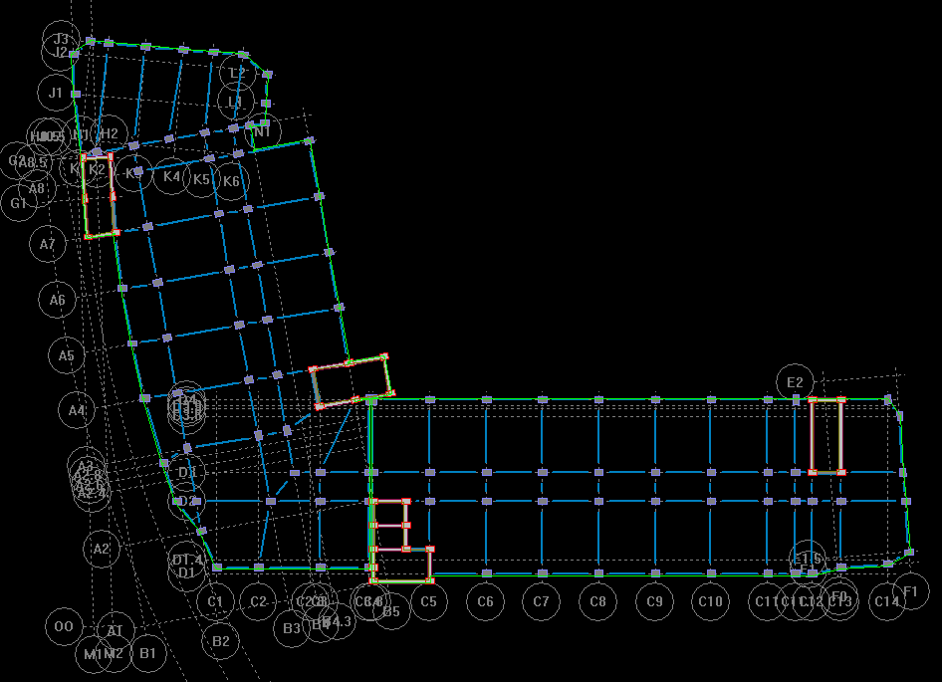
Concrete Shear Walls
Only Continuous Walls Used
Introduction
Building Statistics
Existing Structure
Proposal
Structural Redesign
Lateral Redesign
Vibration Analysis
Sustainability Concerns
Cost Analysis
Schedule Change
Conclusions
Meral Kanik Structural Option April 14, 2008

Slide 17
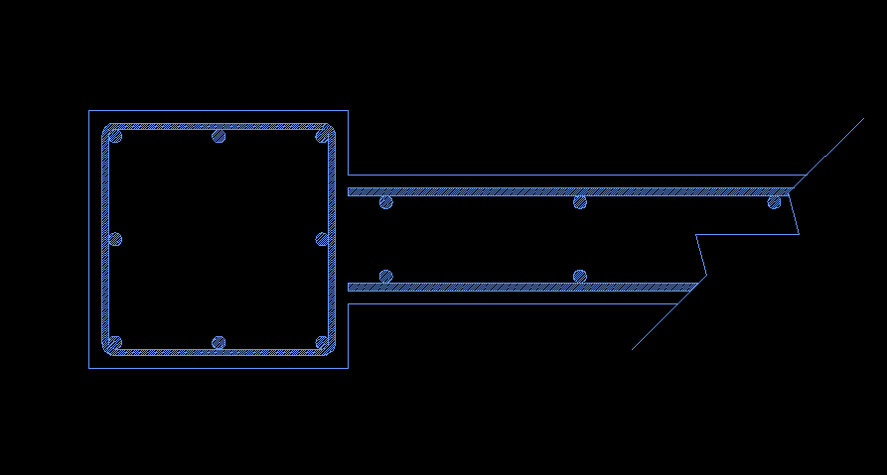
Shear Wall Boundary Element
(8)#9
#3 Ties
#5 Vertical 15” o.c.
#5 Horizontal 15” o.c.
Introduction
Building Statistics
Existing Structure
Proposal
Structural Redesign
Lateral Redesign
Vibration Analysis
Sustainability Concerns
Cost Analysis
Schedule Change
Conclusions
20”
10”
20”
Meral Kanik Structural Option April 14, 2008

Slide 18
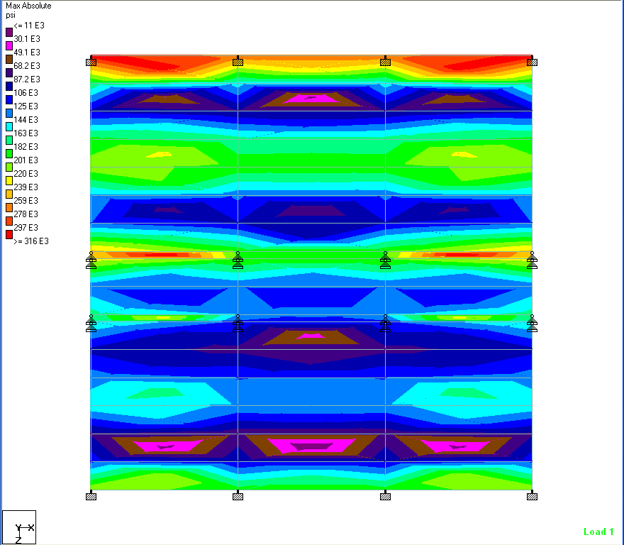
Laboratory Facilities
Introduction
Building Statistics
Existing Structure
Proposal
Structural Redesign
Lateral Redesign
Vibration Analysis
Sustainability Concerns
Cost Analysis
Schedule Change
Conclusions
Equipment Used For:
DNA sequencing
Gene cloning
Microarray
Mice Testing
Mass Spectrometry
Meral Kanik Structural Option April 14, 2008

Slide 19
Laboratory Facilities
Introduction
Building Statistics
Existing Structure
Proposal
Structural Redesign
Lateral Redesign
Vibration Analysis
Sustainability Concerns
Cost Analysis
Schedule Change
Conclusions
Microscopes up to 100x
Microscopes up to 400x
Microscopes over 400x
Microscopes up to 30,000x
Meral Kanik Structural Option April 14, 2008

Slide 20
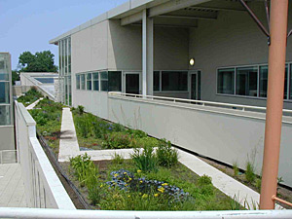
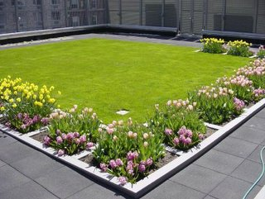
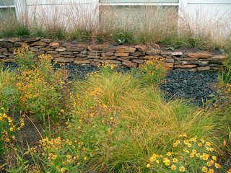
Green Roof
Provide:
Wind Erosion Stabilization
Passive irrigation
Habitat creation
Moderate maintenance
Introduction
Building Statistics
Existing Structure
Proposal
Structural Redesign
Lateral Redesign
Vibration Analysis
Sustainability Concerns
Cost Analysis
Schedule Change
Conclusions
“Meadow” Roof Garden Examples set up by RoofScapes inc.
Meral Kanik Structural Option April 14, 2008

Slide 21
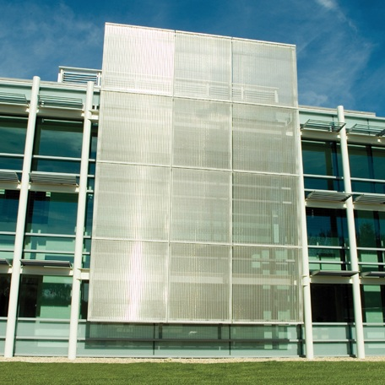
Metal Mesh Shading
Introduction
Building Statistics
Existing Structure
Proposal
Structural Redesign
Lateral Redesign
Vibration Analysis
Sustainability Concerns
Cost Analysis
Schedule Change
Conclusions
Provide:
Shade from harsh summer day
Gain heat to save energy costs
Still utilize curtain wall view
Metal Screen from Cambridge Architectural
Meral Kanik Structural Option April 14, 2008

Slide 22
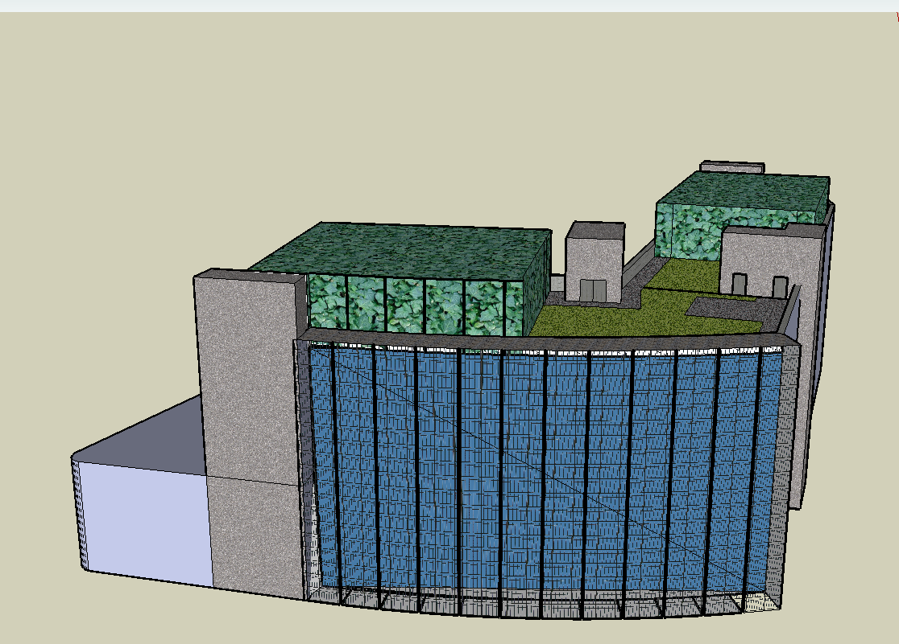
New Green Look
Introduction
Building Statistics
Existing Structure
Proposal
Structural Redesign
Lateral Redesign
Vibration Analysis
Sustainability Concerns
Cost Analysis
Schedule Change
Conclusions
Meral Kanik Structural Option April 14, 2008

Slide 23
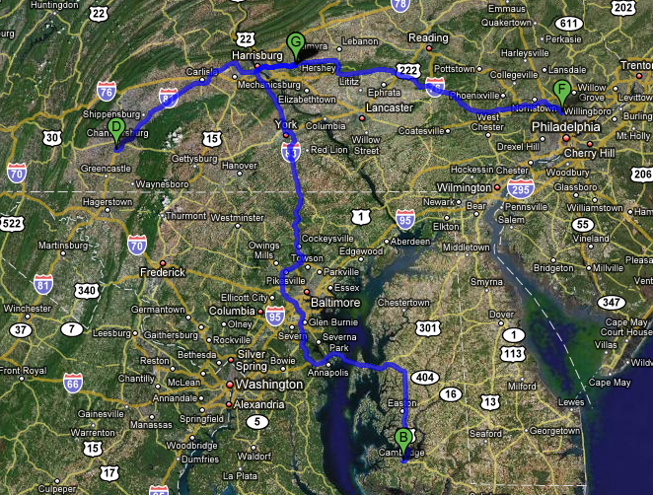

Local Materials
Hershey Medical Center
Introduction
Building Statistics
Existing Structure
Proposal
Structural Redesign
Lateral Redesign
Vibration Analysis
Sustainability Concerns
Cost Analysis
Schedule Change
Conclusions
Nitterhouse
RoofScapes, inc.
Cambridge Architectural
Meral Kanik Structural Option April 14, 2008

Slide 24
Structural System Costs
Introduction
Building Statistics
Existing Structure
Proposal
Structural Redesign
Lateral Redesign
Vibration Analysis
Sustainability Concerns
Cost Analysis
Schedule Change
Conclusions
Low $$ Lateral System
OR
Low $$ Gravity System
Meral Kanik Structural Option April 14, 2008

Slide 25
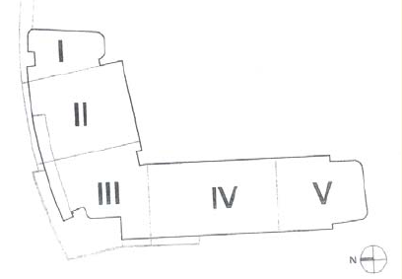
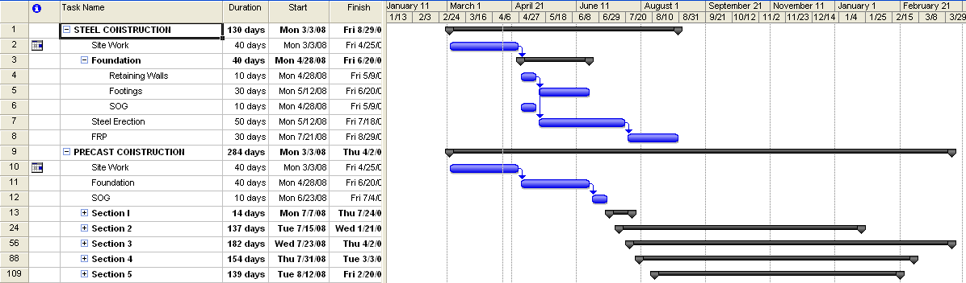
Structural System Schedule
Phases of Construction
Introduction
Building Statistics
Existing Structure
Proposal
Structural Redesign
Lateral Redesign
Vibration Analysis
Sustainability Concerns
Cost Analysis
Schedule Change
Conclusions
Meral Kanik Structural Option April 14, 2008

Slide 26
In Retrospect…
Structural
Precast Planks
Drift
Shear Walls
Vibration
Sustainability
Green Roof
PSU LEED
Construction
Erection Time
Cost
Introduction
Building Statistics
Existing Structure
Proposal
Structural Redesign
Lateral Redesign
Vibration Analysis
Sustainability Concerns
Cost Analysis
Schedule Change
Conclusions
Meral Kanik Structural Option April 14, 2008

Slide 27
Special Thanks To…
E.Y.P.A.E.
  Franklin Lancaster
  David Clemenzi
PSU AE Faculty and Staff
  Dr. Ali Memari
  Professor Kevin Parfitt
  Professor Bob Holland
Fellow AE students
All of my family
(Ben Sizin Seviyorum)
Penn State Rugby
(Lessss GO State!)
Meral Kanik Structural Option April 14, 2008

Slide 28
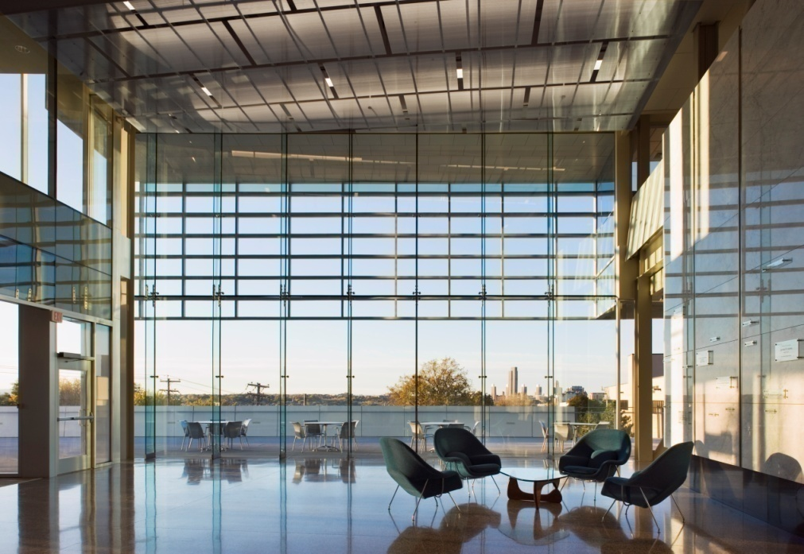
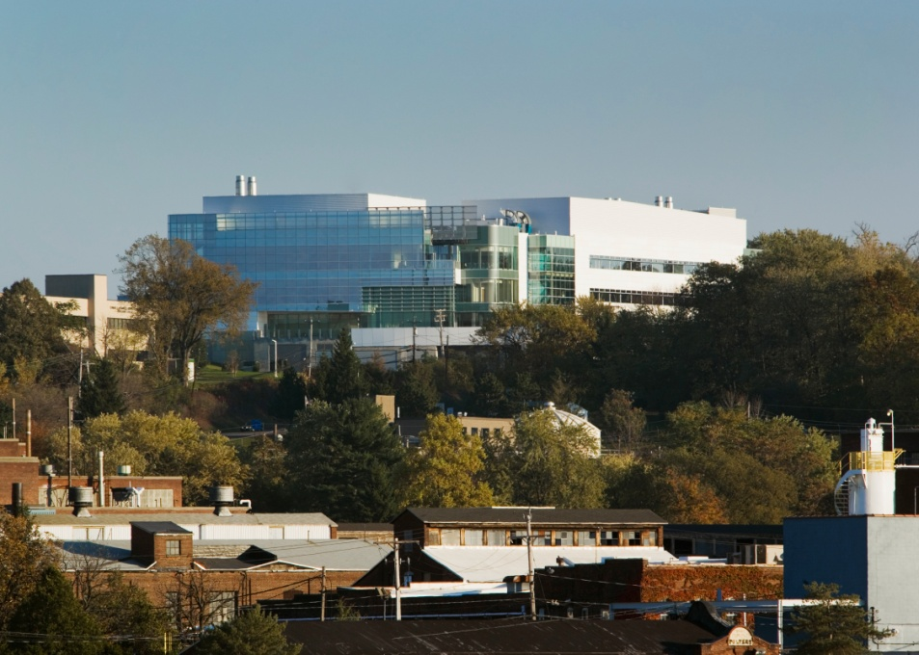
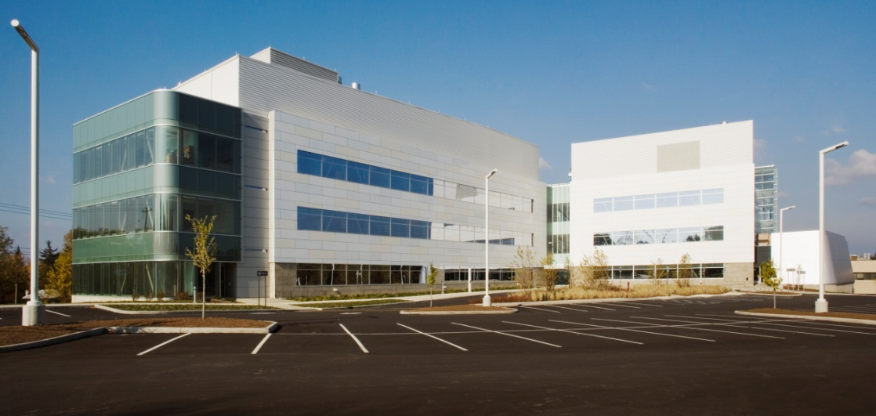

Questions?
Meral Kanik Structural Option April 14, 2008

