Slide 1
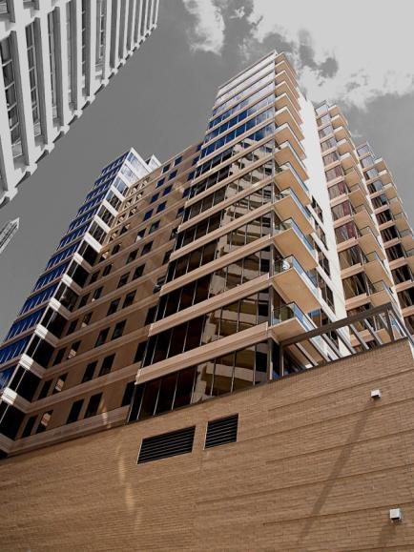
151 First Side Pittsburgh, PA
William J. Buchko
Structural Option
Senior Thesis
April 14th, 2008
Advisor: Kevin Parfitt
introduction

Slide 2
Presentation Outline
Overview
Proposal
Structural Depth
Acoustics Breadth
Construction Management Breadth
Conclusions
Acknowledgements
Questions
introduction

Slide 3
Overview
Location:
Pittsburgh, PA
Significance:
First condominium built downtown since 1968
Architecture:
18 stories
82 units
Open floor plan
233,000 SF
overview

Slide 4
Overview
Mechanical:
36.7 Ton roof top unit by AAON
Individual heat pumps
Electrical:
120/208 3 phase system
1800a main switch
Lighting:
Incandescent downlights in units
Fluorescent downlights and wall washers in corridors and public areas
overview

Slide 5
Overview
Construction:
$24M construction cost
Owned by Zambrano Corp., Ralph A. Falbo, Inc., and EQA Landmark Communities
Design-build construction
Structural:
Hambro composite joist floor system
Braced frame and moment connection lateral system
overview

Slide 6
Proposal
Structural Depth
Decrease cost and increase performance by using typical structural systems
Acoustics Breadth
Analyze proposed systems and check existing systems for acoustical quality
Construction Management Breadth
Analyze and compare proposed systems to current systems
proposal

Slide 7
Structural Depth
Floor System
Current Hambro MD2000 composite joist system compared to a typical composite beam system
Lateral System
Current combination braced frame and moment connection system compared to concrete core, braced frame, and moment connection systems
structural depth

Slide 8
Structural Depth
Current Hambro floor system
3¼” concrete on metal decking
Supported by joist with composite top chord
structural depth

Slide 9
Structural Depth
Proposed composite steel system
4” light weight concrete on B-LOK decking with 1 stud/ft
Beams placed at third points of bays
structural depth

Slide 10
Structural Depth
structural depth
Typical floor beam layout and design

Slide 11
Structural Depth
structural depth
Column redesign

Slide 12
Structural Depth
Current lateral system
Combination of braced frames and moment connections
structural depth

Slide 13
Structural Depth
structural depth
Frames long grids 2, 3, and 4 in north-south direction

Slide 14
Structural Depth
structural depth
Frames long grids E and F in east-west direction

Slide 15
Structural Depth
Concrete core lateral system
Utilizes concrete core to handle all lateral loading
Unacceptable due to interaction of trades
structural depth

Slide 16
Structural Depth
Braced frame lateral system
Utilizes braced frames for all lateral loading
Quicker installation
Low torsion due to design
Unacceptable due to diagonal braces within floor plan
structural depth

Slide 17
Structural Depth
E
structural depth
F
G
2
4
Proposed braced frame layout

Slide 18
Structural Depth
Moment connection lateral system
Utilizes moment connections for all lateral loading
Fully restrained connections recommended for greater than 10 stories
Unacceptable due to cost and scheduling of fully restrained connections
structural depth

Slide 19
Acoustics Breadth
Floor system
Compare current Hambro system to proposed composite beam system
Mechanical system
Analyze current issues and provide alternative solutions
acoustics breadth

Slide 20
Acoustics Breadth
Current Hambro floor system
STC of 57
IIC of 30
Susceptible to structure born sound
Susceptible to “wave” phenomenon
acoustics breadth

Slide 21
Acoustics Breadth
Proposed beam floor system
STC of 55
IIC of 35
Potential for better low end absorption
Not susceptible to “wave” phenomenon
acoustics breadth

Slide 22
Acoustics Breadth
Mechanical system
Roof top unit in direct line of sight with penthouse terraces
Most common complaint from workers and potential tenants
acoustics breadth

Slide 23
Acoustics Breadth
Existing sound levels
AAON representative unable or unwilling to provide acoustical data
Data obtained through IVIE IE-33 Pocket PC and similar unit
Values were confirmed by 3rd party acoustician
acoustics breadth

Slide 24
Acoustics Breadth
acoustics breadth
IVIE IE-33 Graph

Slide 25
Acoustics Breadth
Proposed solutions
Acoustical barrier would only provide 6dB reduction
System can be relocated to minimize sound levels on terraces
acoustics breadth

Slide 26
Acoustics Breadth
acoustics breadth
Proposed roof top unit relocation

Slide 27
Acoustics Breadth
Relocation effects
30ft gives 15dB reduction
Nosier supply intake now faces away from all occupied spaces
Two walls separate unit from terraces, adding approximately 20dB of reduction
acoustics breadth

Slide 28
Construction Management Breadth
Schedule
Compare scheduling impacts of proposed systems both on and off of the critical path
Cost
Compare cost of proposed systems to current systems
cm breadth

Slide 29
Construction Management Breadth
Schedule
Steel placement takes 177 days and is unaffected by floor system change
Pouring of proposed floor system would save a minimum of 1 day per floor, though not on the critical path
A potential 10 days could be saved through fire protection
The braced frame lateral system could save 5 days along critical path, but was found to be unacceptable
cm breadth

Slide 30
Construction Management Breadth
Cost
Larger slab and more expensive concrete offset with cheaper steel, resulting in a similar cost between floor systems
Redesign of columns and beams save 131 Tons of steel, which saves approximately $228,000
Labor savings estimated at approximately $30,000
Total system savings over 1% of total building cost
cm breadth

Slide 31
Conclusions
Structural Depth
A composite beam floor system would be both feasible and economical to use
No better lateral system was found
Acoustics Breadth
A composite beam floor system could provide equal acoustical qualities
Mechanical system can be moved to provide a better sound level on outdoor terraces
Construction Management Breadth
All proposed systems could be implemented without a change in the critical path
All proposed systems would be similar in cost or less expensive
conclusions

Slide 32
Acknowledgements
I would like to thank the following companies and individuals:
Zambrano Corp.
The Kachele Group
Indovina Associates Architects
Hambro Systems
Cenkner Engineering Associates, Inc.
Professor Kevin Parfitt
Professor Moses Ling
The Thesis Mentors
Family and friends for their support and understanding
conclusions

Slide 33
Dedication
This Thesis presentation and year long project is dedicated to the memory of:
Nicholas Buchko
9/15/15 – 12/6/06
“Never give up.”
conclusions

Slide 34
Questions?
conclusions

