Slide 1
Mountain State Blue Cross Blue Shield Headquarters
Parkersburg, WV
Department of Architectural Engineering
The Pennsylvania State University

Slide 2
PRESENTATION OUTLINE
  THESIS GOALS
  BUILDING INTRODUCTION
  STRUCTURAL DEPTH
      ADDITIONAL FLOOR
      RELOCATION TO UTAH
      ARCHITECTURAL BREADTH
          COLUMN GRID ADJUSTMENT
          CHANGES TO FLOOR PLAN
          CONSTRUCTION MANAGEMENT BREADTH
              SCHEDULE IMPACT
              COST ANALYSIS
              SUMMARY RECOMMENDATIONS
              THANKS
              QUESTIONS

Slide 3
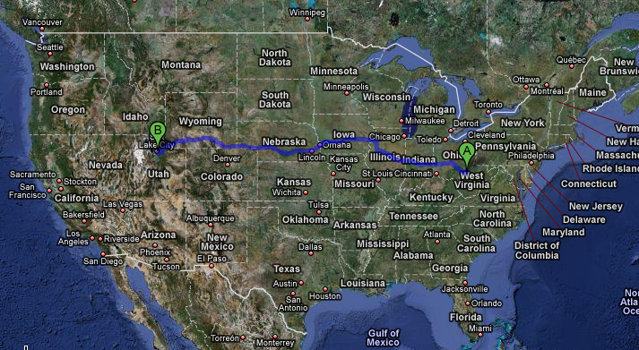
PRESENTATION OUTLINE
  THESIS GOALS
  BUILDING INTRODUCTION
  STRUCTURAL DEPTH
      ADDITIONAL FLOOR
      RELOCATION TO UTAH
      ARCHITECTURAL BREADTH
          COLUMN GRID ADJUSTMENT
          CHANGES TO FLOOR PLAN
          CONSTRUCTION MANAGEMENT BREADTH
              SCHEDULE IMPACT
              COST ANALYSIS
              SUMMARY RECOMMENDATIONS
              THANKS
              QUESTIONS
THESIS GOALS
    ADD FLOOR FOR MORE OFFICE SPACE
    RELOCATE THE BUILDING TO SALT LAKE CITY, UTAH
    REDESIGN LATERAL SYSTEM
    INVESTIGATE FOUNDATIONS
    SCHEDULE IMPACT
    COST ANALYSIS

Slide 4
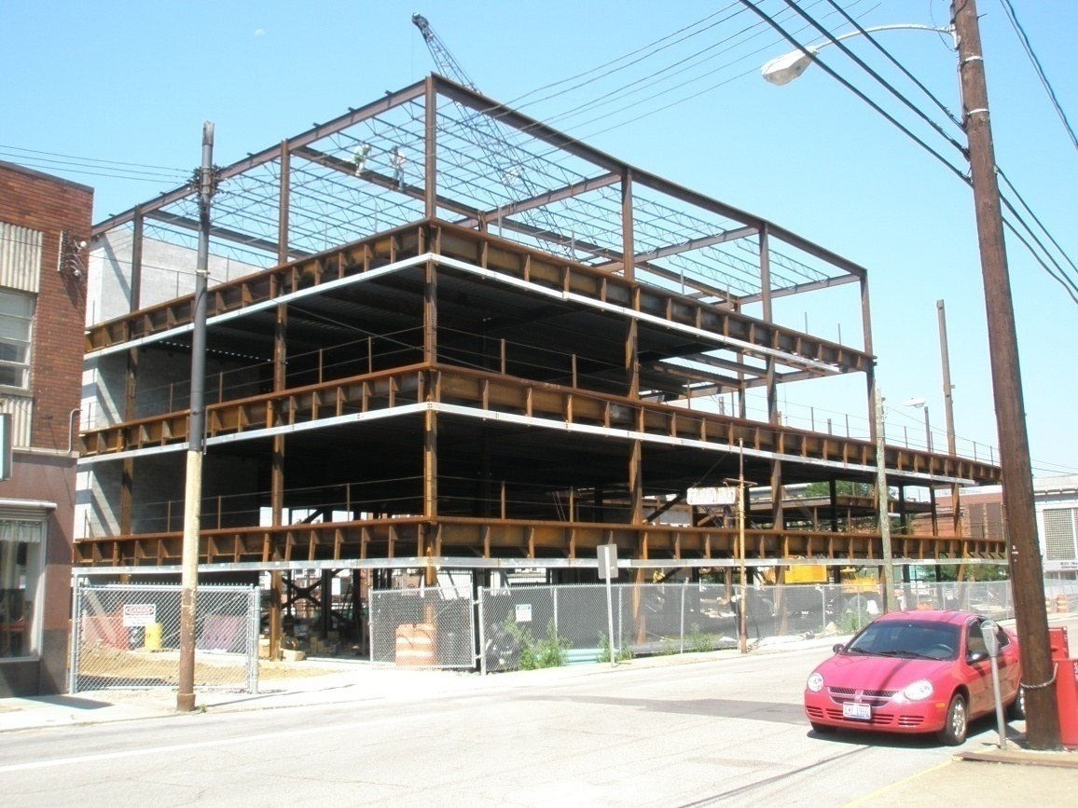
PRESENTATION OUTLINE
  THESIS GOALS
  BUILDING INTRODUCTION
  STRUCTURAL DEPTH
      ADDITIONAL FLOOR
      RELOCATION TO UTAH
      ARCHITECTURAL BREADTH
          COLUMN GRID ADJUSTMENT
          CHANGES TO FLOOR PLAN
          CONSTRUCTION MANAGEMENT BREADTH
              SCHEDULE IMPACT
              COST ANALYSIS
              SUMMARY RECOMMENDATIONS
              THANKS
              QUESTIONS
  BUILDING STATISTICS
  OFFICE BUILDING
  4 FLOORS – 128,496 SQ. FT.
  TOTAL COST - 18 MILLION – DESIGN BID BUILD
  (ADDING FLOOR FOR THESIS REQUIREMENT)
  STRUCTURAL SYSTEM
  COMPOSITE STEEL FRAMING
  4 CONCENTRICALLY BRACED FRAMES
  (2 IN EACH DIRECTION)
  TYPICAL BAY SIZE – 30’ X 30’
  PROJECT TEAM
  OWNER: WOOD COUNTY DEVELOPMENT AUTHORITY
  ARCHITECT: BURT HILL
  STRUCTURAL: ATLANTIC ENGINEERING SERVICES
  CONTRACTOR: G.A. BROWN
PHOTO COURTESY OF ATLANTIC ENGINEERING SERVICES

Slide 5
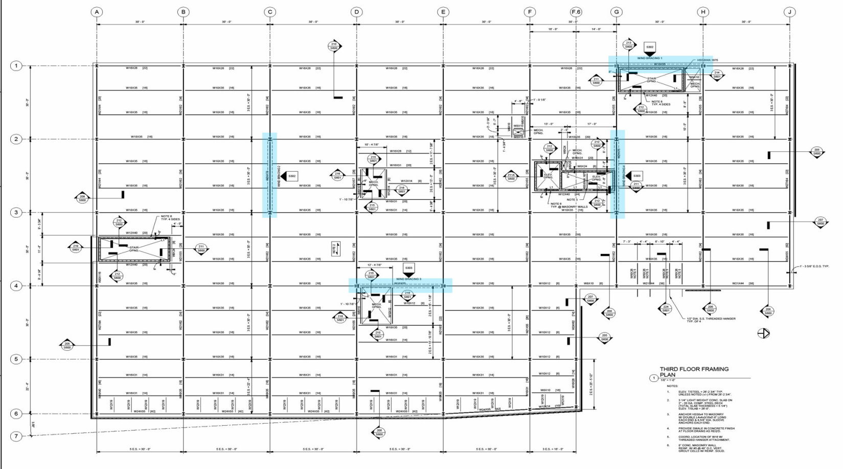
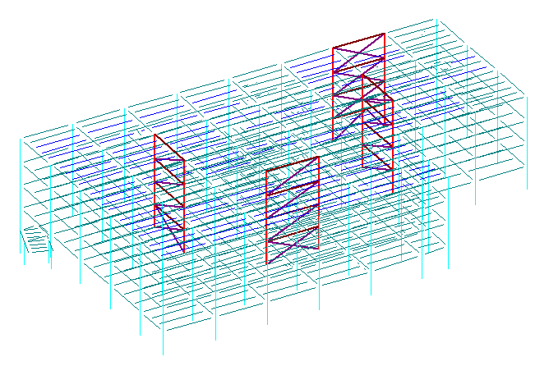
ORIGINAL WEST VIRGINIA (4 STORIES) FLOOR PLAN
ORIGINAL WEST VIRGINIA (4 STORIES) 3D STRUCTURE
PRESENTATION OUTLINE
  THESIS GOALS
  BUILDING INTRODUCTION
  STRUCTURAL DEPTH
      ADDITIONAL FLOOR
      RELOCATION TO UTAH
      ARCHITECTURAL BREADTH
          COLUMN GRID ADJUSTMENT
          CHANGES TO FLOOR PLAN
          CONSTRUCTION MANAGEMENT BREADTH
              SCHEDULE IMPACT
              COST ANALYSIS
              SUMMARY RECOMMENDATIONS
              THANKS
              QUESTIONS
RAM STRUCTURAL SYSTEM

Slide 6
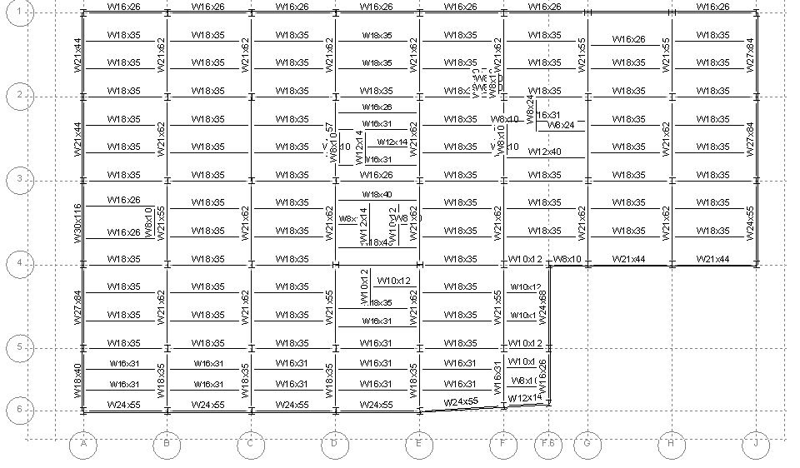
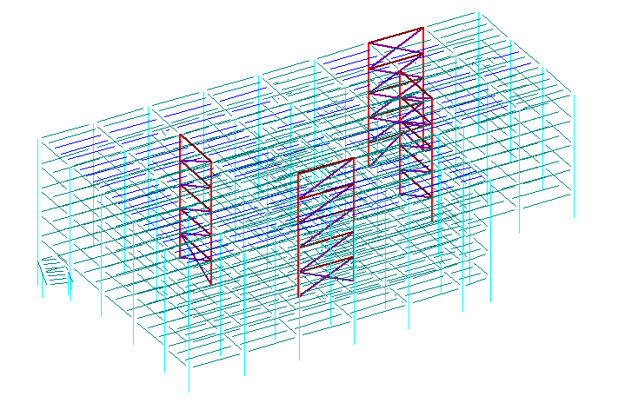
ADDITIONAL FLOOR FOR WEST VIRGINIA
WEST VIRGINIA (5 STORIES) 3D STRUCTURE
PRESENTATION OUTLINE
  THESIS GOALS
  BUILDING INTRODUCTION
  STRUCTURAL DEPTH
      ADDITIONAL FLOOR
      RELOCATION TO UTAH
      ARCHITECTURAL BREADTH
          COLUMN GRID ADJUSTMENT
          CHANGES TO FLOOR PLAN
          CONSTRUCTION MANAGEMENT BREADTH
              SCHEDULE IMPACT
              COST ANALYSIS
              SUMMARY RECOMMENDATIONS
              THANKS
              QUESTIONS
RAM STRUCTURAL SYSTEM

Slide 7
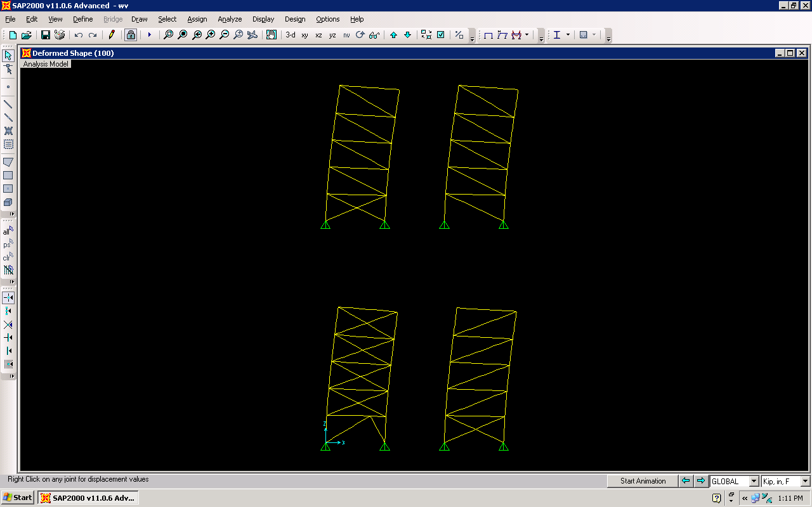
RELATIVE STIFFNESS FOR X DIRECTION
2D MODEL FROM SAP 2000
PRESENTATION OUTLINE
  THESIS GOALS
  BUILDING INTRODUCTION
  STRUCTURAL DEPTH
      ADDITIONAL FLOOR
      RELOCATION TO UTAH
      ARCHITECTURAL BREADTH
          COLUMN GRID ADJUSTMENT
          CHANGES TO FLOOR PLAN
          CONSTRUCTION MANAGEMENT BREADTH
              SCHEDULE IMPACT
              COST ANALYSIS
              SUMMARY RECOMMENDATIONS
              THANKS
              QUESTIONS
FRAME 1 FRAME 3
(30’ SPAN FOR EACH BRACED FRAME)

Slide 8
RELATIVE STIFFNESS FOR Y DIRECTION
2D MODEL FROM SAP 2000
PRESENTATION OUTLINE
  THESIS GOALS
  BUILDING INTRODUCTION
  STRUCTURAL DEPTH
      ADDITIONAL FLOOR
      RELOCATION TO UTAH
      ARCHITECTURAL BREADTH
          COLUMN GRID ADJUSTMENT
          CHANGES TO FLOOR PLAN
          CONSTRUCTION MANAGEMENT BREADTH
              SCHEDULE IMPACT
              COST ANALYSIS
              SUMMARY RECOMMENDATIONS
              THANKS
              QUESTIONS
FRAME 4 FRAME 2
(30’ SPAN FOR EACH BRACED FRAME)

Slide 9
DIRECT AND TORSIONAL SHEAR ANALYSIS
5 STORY WEST VIRGINIA BUILDING DRIFTS
PRESENTATION OUTLINE
  THESIS GOALS
  BUILDING INTRODUCTION
  STRUCTURAL DEPTH
      ADDITIONAL FLOOR
      RELOCATION TO UTAH
      ARCHITECTURAL BREADTH
          COLUMN GRID ADJUSTMENT
          CHANGES TO FLOOR PLAN
          CONSTRUCTION MANAGEMENT BREADTH
              SCHEDULE IMPACT
              COST ANALYSIS
              SUMMARY RECOMMENDATIONS
              THANKS
              QUESTIONS
X DIRECTION
X DIRECTION
Y DIRECTION
Y DIRECTION

Slide 10
DRILLED CAISSON CAPACITY AND LOADS
CHANGES MADE TO FOUNDATIONS (5 STORY WV BLDG.)
PRESENTATION OUTLINE
  THESIS GOALS
  BUILDING INTRODUCTION
  STRUCTURAL DEPTH
      ADDITIONAL FLOOR
      RELOCATION TO UTAH
      ARCHITECTURAL BREADTH
          COLUMN GRID ADJUSTMENT
          CHANGES TO FLOOR PLAN
          CONSTRUCTION MANAGEMENT BREADTH
              SCHEDULE IMPACT
              COST ANALYSIS
              SUMMARY RECOMMENDATIONS
              THANKS
              QUESTIONS
4% INCREASE

Slide 11
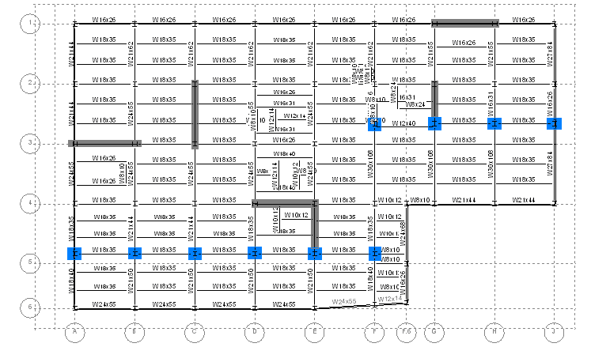
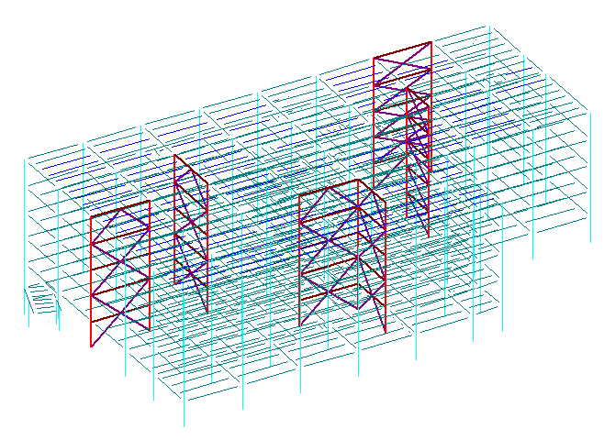
NEW GRAVITY FLOOR DESIGN FOR UTAH
UTAH 3D STRUCTURE
PRESENTATION OUTLINE
  THESIS GOALS
  BUILDING INTRODUCTION
  STRUCTURAL DEPTH
      ADDITIONAL FLOOR
      RELOCATION TO UTAH
      ARCHITECTURAL BREADTH
          COLUMN GRID ADJUSTMENT
          CHANGES TO FLOOR PLAN
          CONSTRUCTION MANAGEMENT BREADTH
              SCHEDULE IMPACT
              COST ANALYSIS
              SUMMARY RECOMMENDATIONS
              THANKS
              QUESTIONS

Slide 12
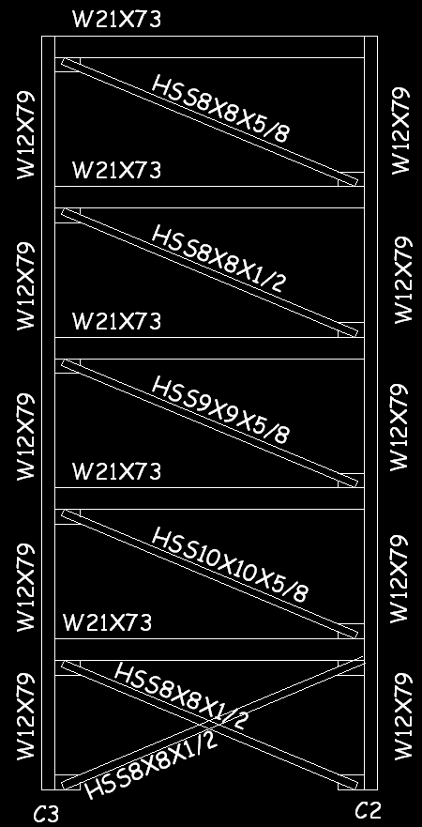
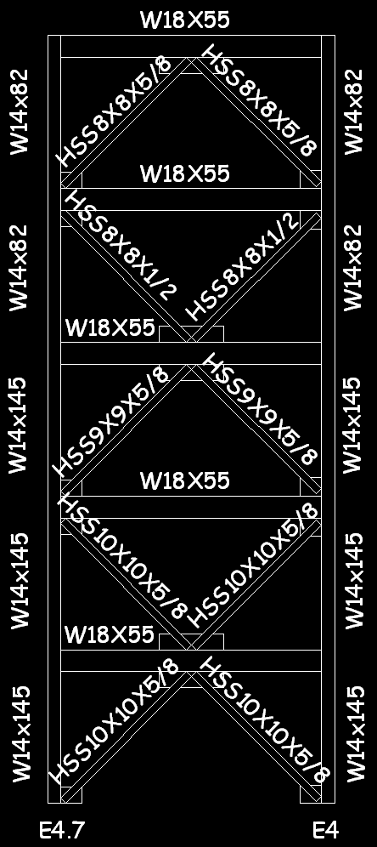
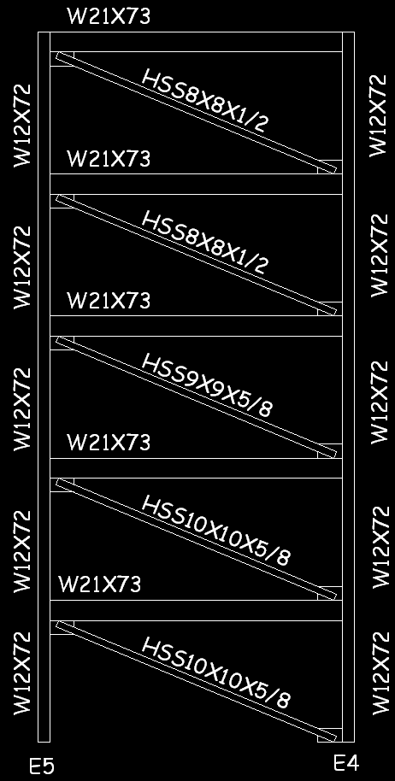
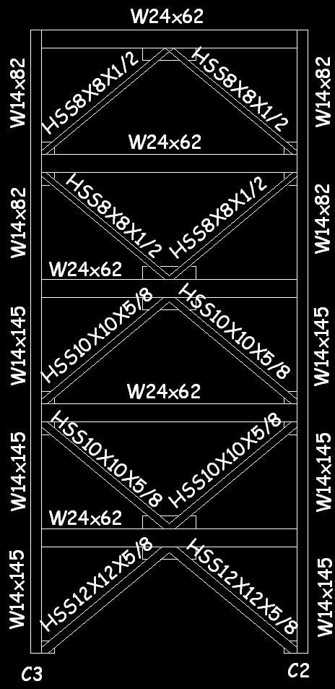
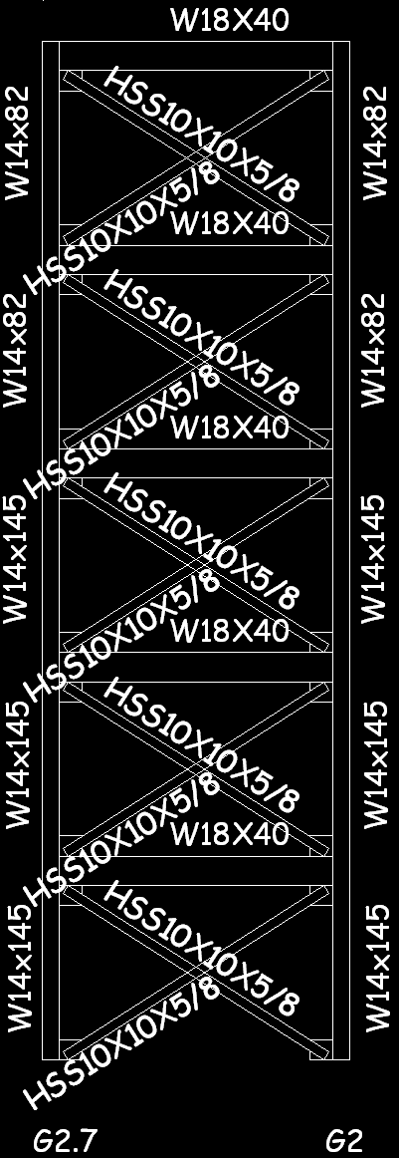
BRACED FRAME 1 –Y DIRECTION
Y DIRECTION-BRACED FRAME 2 BRACED FRAME 3
PRESENTATION OUTLINE
  THESIS GOALS
  BUILDING INTRODUCTION
  STRUCTURAL DEPTH
      ADDITIONAL FLOOR
      RELOCATION TO UTAH
      ARCHITECTURAL BREADTH
          COLUMN GRID ADJUSTMENT
          CHANGES TO FLOOR PLAN
          CONSTRUCTION MANAGEMENT BREADTH
              SCHEDULE IMPACT
              COST ANALYSIS
              SUMMARY RECOMMENDATIONS
              THANKS
              QUESTIONS
NEW DESIGN WV DESIGN
NEW DESIGN WV DESIGN NEW DESIGN

Slide 13
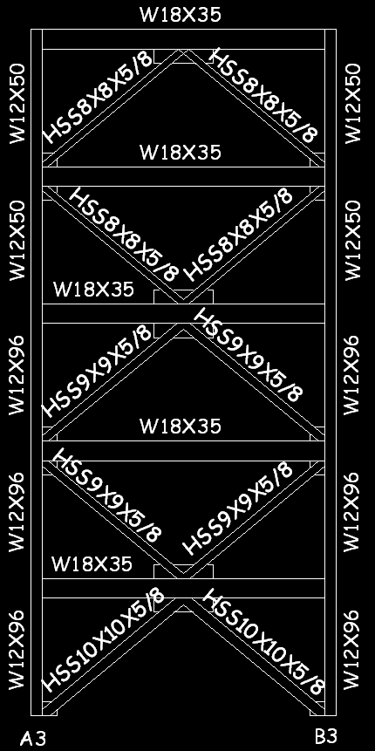
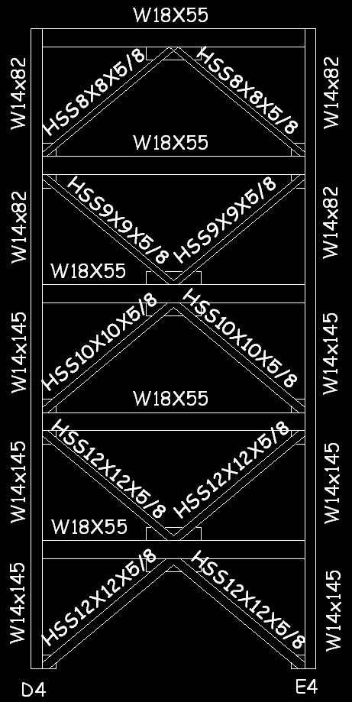
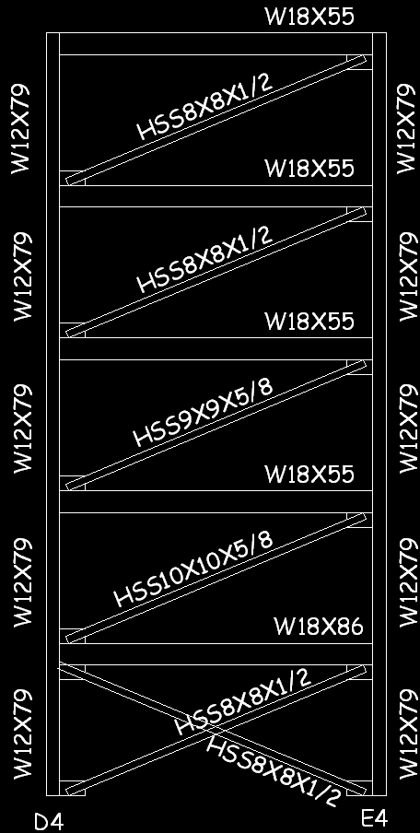
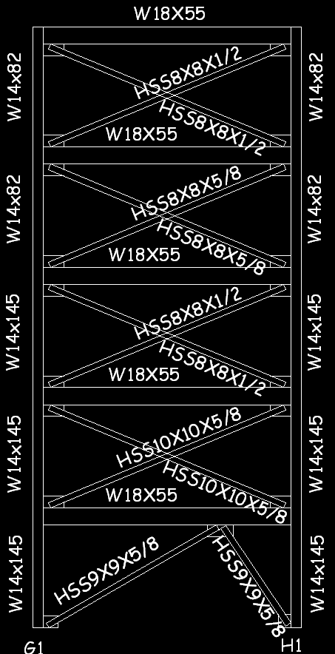
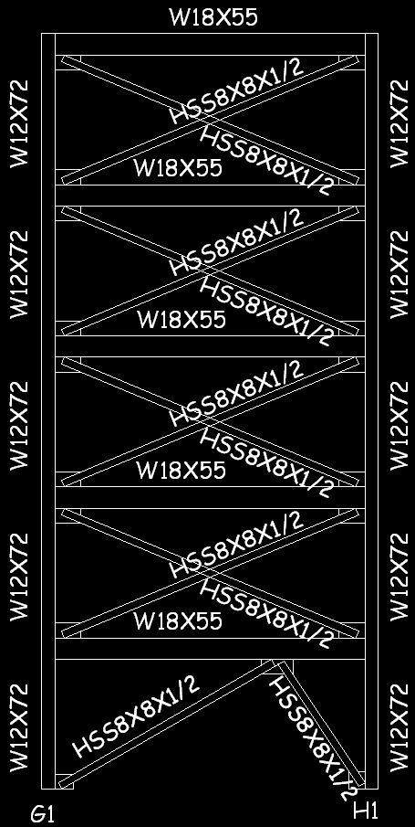
BRACED FRAME 4 (X DIRECTION) BRACED FRAME 5
BRACED FRAME 6 –(X DIRECTION)
PRESENTATION OUTLINE
  THESIS GOALS
  BUILDING INTRODUCTION
  STRUCTURAL DEPTH
      ADDITIONAL FLOOR
      RELOCATION TO UTAH
      ARCHITECTURAL BREADTH
          COLUMN GRID ADJUSTMENT
          CHANGES TO FLOOR PLAN
          CONSTRUCTION MANAGEMENT BREADTH
              SCHEDULE IMPACT
              COST ANALYSIS
              SUMMARY RECOMMENDATIONS
              THANKS
              QUESTIONS
NEW DESIGN NEW DESIGN WV DESIGN
NEW DESIGN WV DESIGN

Slide 14
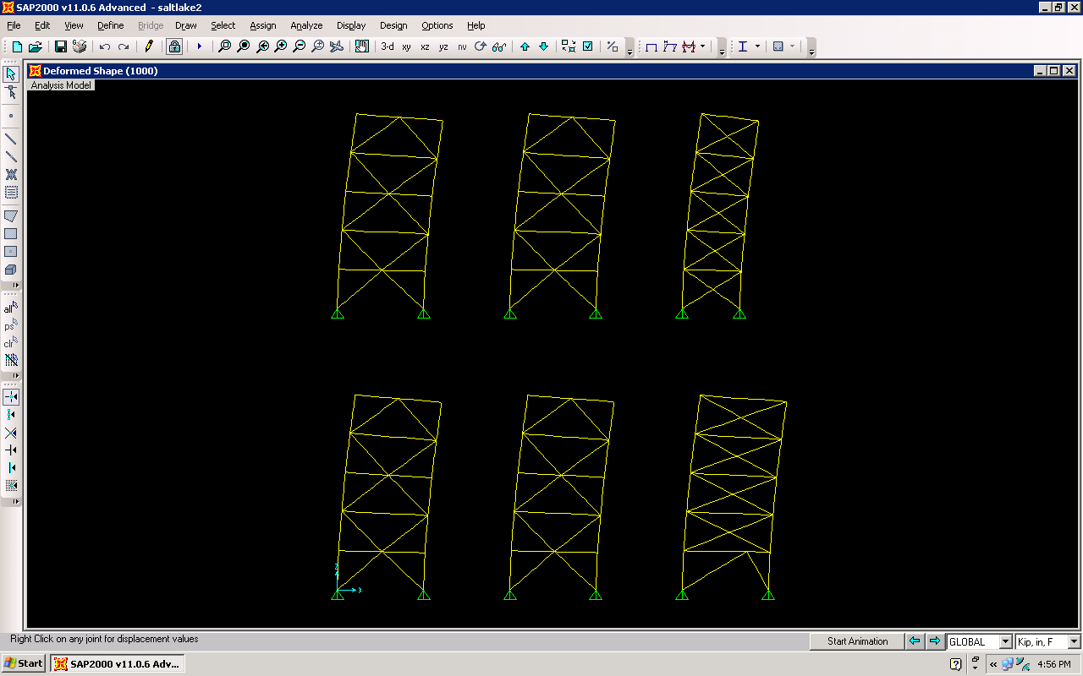
RELATIVE STIFFNESS FOR Y DIRECTION
2D MODEL FROM SAP 2000
PRESENTATION OUTLINE
  THESIS GOALS
  BUILDING INTRODUCTION
  STRUCTURAL DEPTH
      ADDITIONAL FLOOR
      RELOCATION TO UTAH
      ARCHITECTURAL BREADTH
          COLUMN GRID ADJUSTMENT
          CHANGES TO FLOOR PLAN
          CONSTRUCTION MANAGEMENT BREADTH
              SCHEDULE IMPACT
              COST ANALYSIS
              SUMMARY RECOMMENDATIONS
              THANKS
              QUESTIONS
FRAME 1 FRAME 2 FRAME 3

Slide 15
RELATIVE STIFFNESS FOR X DIRECTION
2D MODEL FROM SAP 2000
PRESENTATION OUTLINE
  THESIS GOALS
  BUILDING INTRODUCTION
  STRUCTURAL DEPTH
      ADDITIONAL FLOOR
      RELOCATION TO UTAH
      ARCHITECTURAL BREADTH
          COLUMN GRID ADJUSTMENT
          CHANGES TO FLOOR PLAN
          CONSTRUCTION MANAGEMENT BREADTH
              SCHEDULE IMPACT
              COST ANALYSIS
              SUMMARY RECOMMENDATIONS
              THANKS
              QUESTIONS
FRAME 4 FRAME 5 FRAME 6

Slide 16
DIRECT AND TORSIONAL SHEAR ANALYSIS
5 STORY UTAH BUILDING DRIFTS
PRESENTATION OUTLINE
  THESIS GOALS
  BUILDING INTRODUCTION
  STRUCTURAL DEPTH
      ADDITIONAL FLOOR
      RELOCATION TO UTAH
      ARCHITECTURAL BREADTH
          COLUMN GRID ADJUSTMENT
          CHANGES TO FLOOR PLAN
          CONSTRUCTION MANAGEMENT BREADTH
              SCHEDULE IMPACT
              COST ANALYSIS
              SUMMARY RECOMMENDATIONS
              THANKS
              QUESTIONS
X DIRECTION
X DIRECTION
Y DIRECTION
Y DIRECTION

Slide 17
DRILLED CAISSON WV CAPACITY AND UT LOADS
CHANGES MADE TO FOUNDATIONS (5 STORY UT BLDG.)
PRESENTATION OUTLINE
  THESIS GOALS
  BUILDING INTRODUCTION
  STRUCTURAL DEPTH
      ADDITIONAL FLOOR
      RELOCATION TO UTAH
      ARCHITECTURAL BREADTH
          COLUMN GRID ADJUSTMENT
          CHANGES TO FLOOR PLAN
          CONSTRUCTION MANAGEMENT BREADTH
              SCHEDULE IMPACT
              COST ANALYSIS
              SUMMARY RECOMMENDATIONS
              THANKS
              QUESTIONS
29% INCREASE

Slide 18
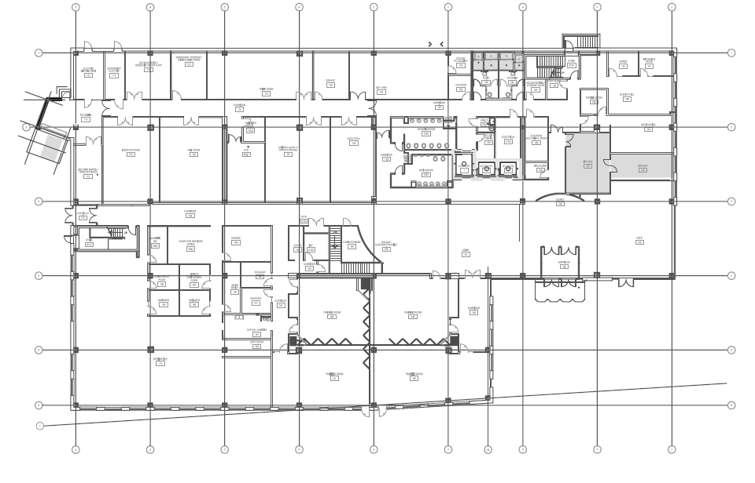
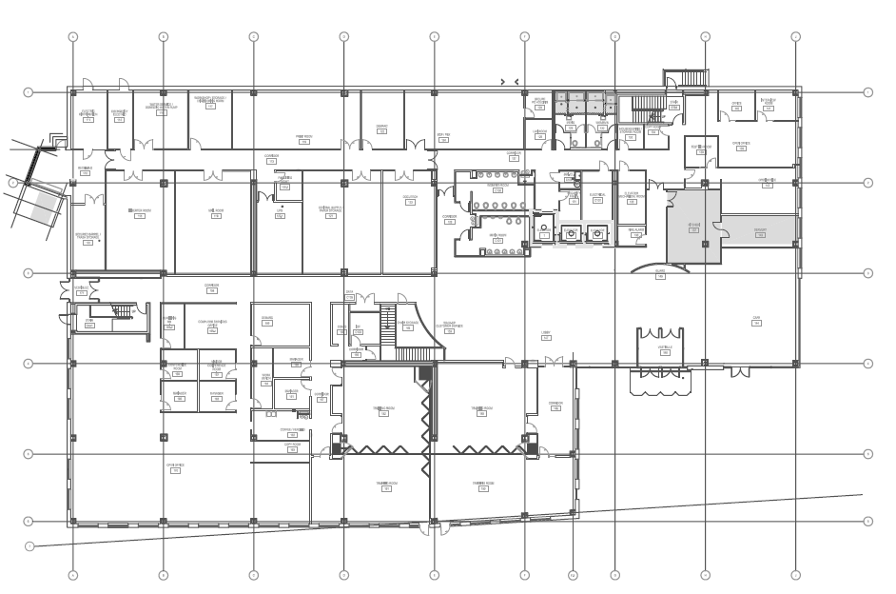
ORIGINAL FIRST FLOOR PLAN
NEW FIRST FLOOR PLAN
PRESENTATION OUTLINE
  THESIS GOALS
  BUILDING INTRODUCTION
  STRUCTURAL DEPTH
      ADDITIONAL FLOOR
      RELOCATION TO UTAH
      ARCHITECTURAL BREADTH
          COLUMN GRID ADJUSTMENT
          CHANGES TO FLOOR PLAN
          CONSTRUCTION MANAGEMENT BREADTH
              SCHEDULE IMPACT
              COST ANALYSIS
              SUMMARY RECOMMENDATIONS
              THANKS
              QUESTIONS

Slide 19
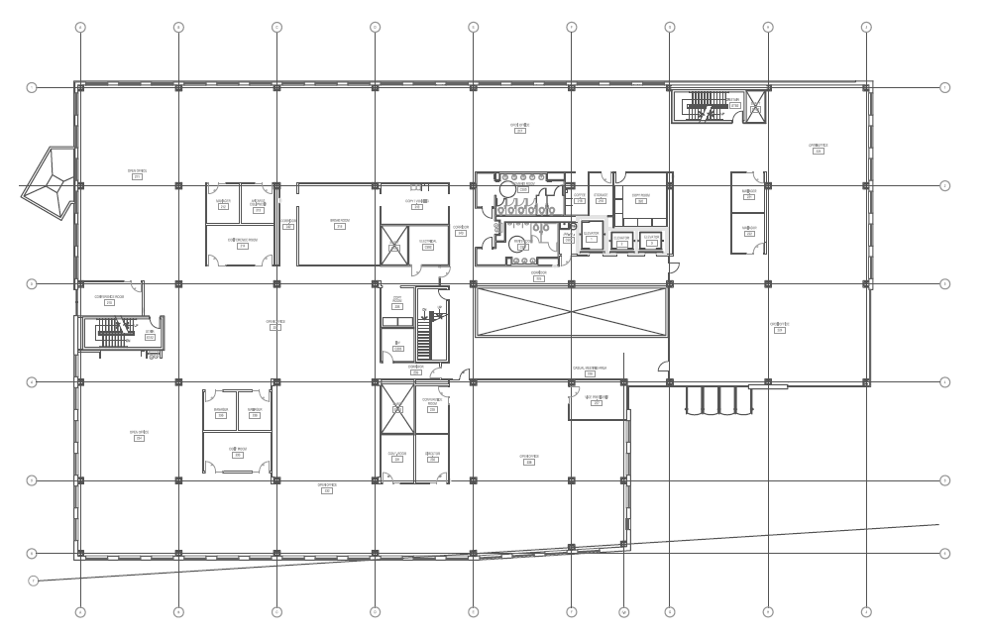
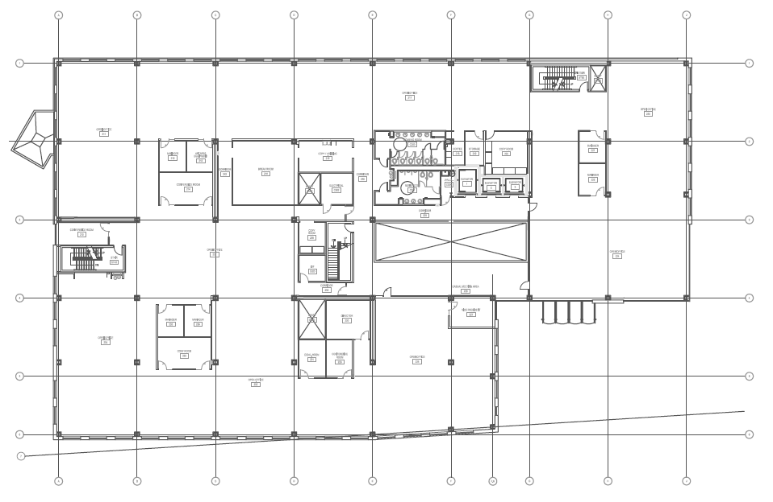
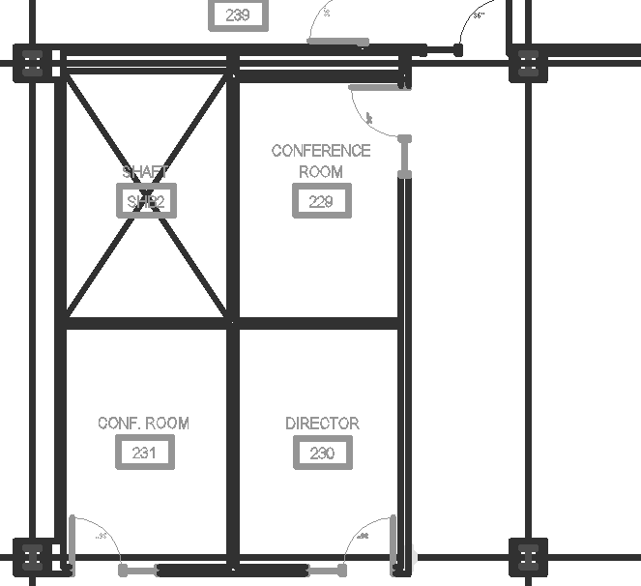
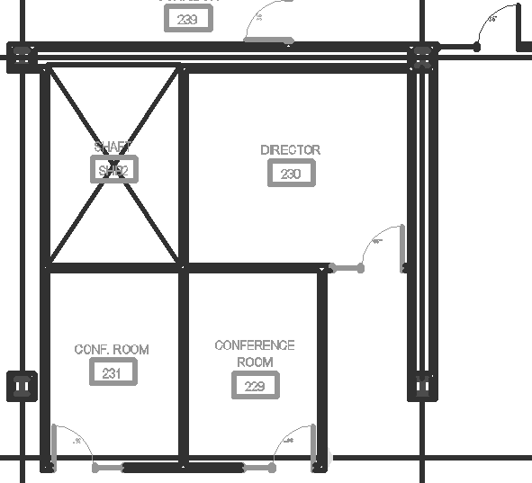
ORIGINAL SECOND FLOOR PLAN
NEW SECOND FLOOR PLAN
PRESENTATION OUTLINE
  THESIS GOALS
  BUILDING INTRODUCTION
  STRUCTURAL DEPTH
      ADDITIONAL FLOOR
      RELOCATION TO UTAH
      ARCHITECTURAL BREADTH
          COLUMN GRID ADJUSTMENT
          CHANGES TO FLOOR PLAN
          CONSTRUCTION MANAGEMENT BREADTH
              SCHEDULE IMPACT
              COST ANALYSIS
              SUMMARY RECOMMENDATIONS
              THANKS
              QUESTIONS

Slide 20
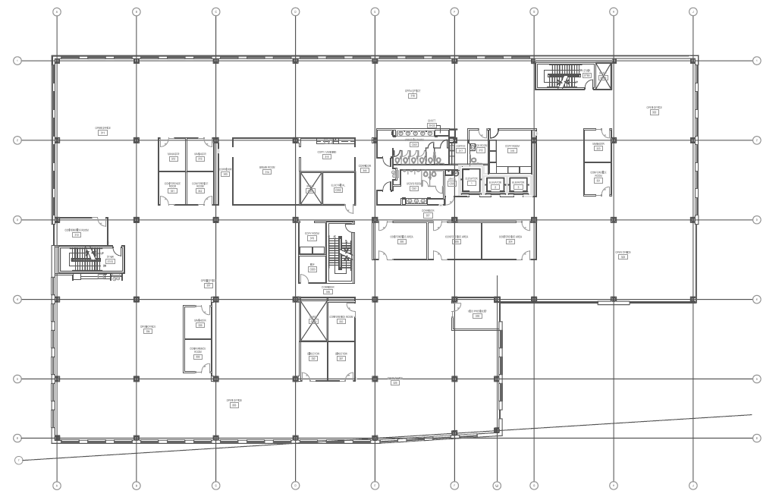
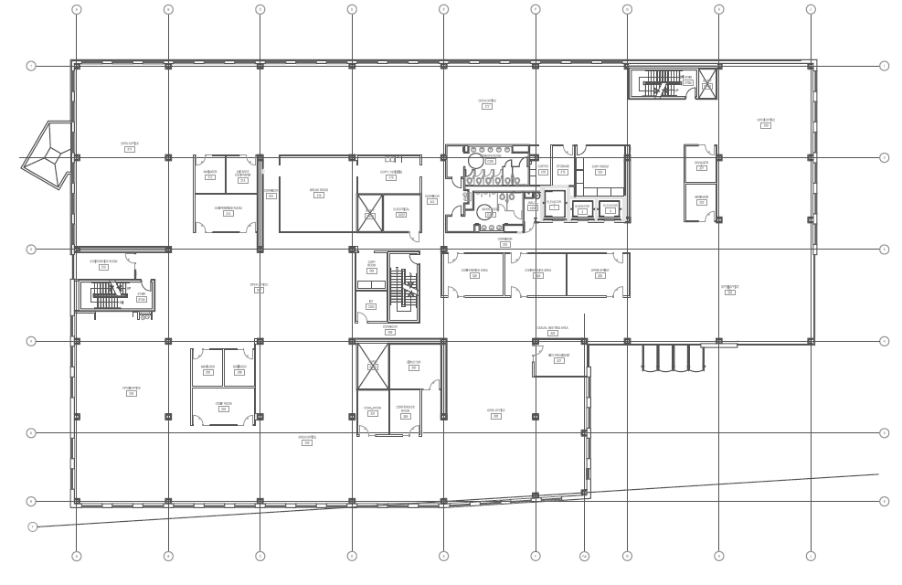
ORIGINAL REMAINING 3 FLOOR PLANS
NEW REMAINING 3 FLOOR PLANS
PRESENTATION OUTLINE
  THESIS GOALS
  BUILDING INTRODUCTION
  STRUCTURAL DEPTH
      ADDITIONAL FLOOR
      RELOCATION TO UTAH
      ARCHITECTURAL BREADTH
          COLUMN GRID ADJUSTMENT
          CHANGES TO FLOOR PLAN
          CONSTRUCTION MANAGEMENT BREADTH
              SCHEDULE IMPACT
              COST ANALYSIS
              SUMMARY RECOMMENDATIONS
              THANKS
              QUESTIONS

Slide 21
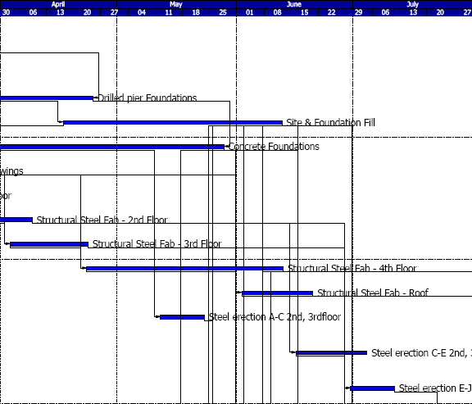
CRITICAL SCHEDULE IMPACT OF ADDITIONAL FLOOR
SCHEDULE FOR ORIGINAL BUILDING
PRESENTATION OUTLINE
  THESIS GOALS
  BUILDING INTRODUCTION
  STRUCTURAL DEPTH
      ADDITIONAL FLOOR
      RELOCATION TO UTAH
      ARCHITECTURAL BREADTH
          COLUMN GRID ADJUSTMENT
          CHANGES TO FLOOR PLAN
          CONSTRUCTION MANAGEMENT BREADTH
              SCHEDULE IMPACT
              COST ANALYSIS
              SUMMARY RECOMMENDATIONS
              THANKS
              QUESTIONS
TOTAL DURATION
RESULTS
40 ADDITIONAL DAYS

Slide 22
BUILDING COMPARISON
COST ANALYSIS
PRESENTATION OUTLINE
  THESIS GOALS
  BUILDING INTRODUCTION
  STRUCTURAL DEPTH
      ADDITIONAL FLOOR
      RELOCATION TO UTAH
      ARCHITECTURAL BREADTH
          COLUMN GRID ADJUSTMENT
          CHANGES TO FLOOR PLAN
          CONSTRUCTION MANAGEMENT BREADTH
              SCHEDULE IMPACT
              COST ANALYSIS
              SUMMARY RECOMMENDATIONS
              THANKS
              QUESTIONS

Slide 23
PRESENTATION OUTLINE
  THESIS GOALS
  BUILDING INTRODUCTION
  STRUCTURAL DEPTH
      ADDITIONAL FLOOR
      RELOCATION TO UTAH
      ARCHITECTURAL BREADTH
          COLUMN GRID ADJUSTMENT
          CHANGES TO FLOOR PLAN
          CONSTRUCTION MANAGEMENT BREADTH
              SCHEDULE IMPACT
              COST ANALYSIS
              SUMMARY RECOMMENDATIONS
              THANKS
              QUESTIONS
STRUCTURAL
DESIGN ADDITIONAL GRAVITY FLOOR
REDESIGN LATERAL SYSTEM FOR UTAH
INVESTIGATE FOUNDATIONS
    YES
    YES
    YES
ARCHITECTURAL
REDESIGN COLUMN GRID LAYOUT
MINIMIZE CHANGES TO FLOOR PLAN
    YES
    YES
CONSTRUCTION MANAGEMENT
DETERMINE SCHEDULE IMPACT
COST ANALYSIS
RECOMMEND IF SITUATION
WAS PRESENTED
    YES
    YES
    YES

Slide 24
PRESENTATION OUTLINE
  THESIS GOALS
  BUILDING INTRODUCTION
  STRUCTURAL DEPTH
      ADDITIONAL FLOOR
      RELOCATION TO UTAH
      ARCHITECTURAL BREADTH
          COLUMN GRID ADJUSTMENT
          CHANGES TO FLOOR PLAN
          CONSTRUCTION MANAGEMENT BREADTH
              SCHEDULE IMPACT
              COST ANALYSIS
              SUMMARY RECOMMENDATIONS
              THANKS
              QUESTIONS
I WOULD LIKE TO EXTEND A SPECIAL THANKS AND ACKNOWLEDGEMENTS TO THE FOLLOWING FOR INPUT CONCERNING THIS THESIS:
ATLANTIC ENGINEERING SERVICES:
ROBERT BERTOCCHI
TIMOTHY JONES
ANDY VERRENGIA
BURT HILL ARCHITECTS
THE PENNSYLVANIA STATE UNIVERSITY:
DR. ANDRES LEPAGE
PROF. PARFITT
PROF. HOLLAND
ENTIRE AE FACULTY AND STAFF
A SPECIAL THANKS TO MY FRIENDS, AND FELLOW STUDENTS.
AN EXTRA SPECIAL THANKS TO MY MOTHER AND FATHER, FOR ALL THE OPPORTUNITIES THEY HAVE PROVIDED ME WITH AND ALWAYS MOTIVATING ME TO BE MY BEST.
I WOULD ALSO LIKE TO STATE THAT BODYBUILDING REALLY HELPED ME STAY FOCUSED AND TAUGHT ME A LOT OF DISCIPLINE. STRICT WORKOUT SCHEDULES AND DIETING FOR 16 WEEKS IS A COMMITMENT IN ITSELF. I BELIEVE IT HELPED ME A GREAT DEAL TO STAY FOCUSED THROUGHOUT THIS THESIS AND ON TASK.

Slide 25
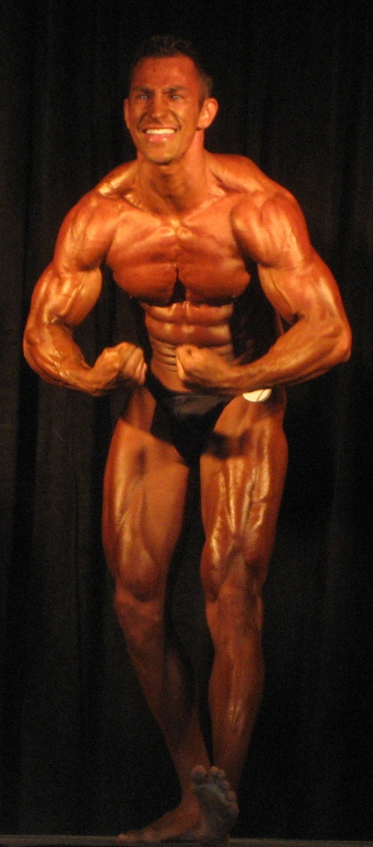
PRESENTATION OUTLINE
  THESIS GOALS
  BUILDING INTRODUCTION
  STRUCTURAL DEPTH
      ADDITIONAL FLOOR
      RELOCATION TO UTAH
      ARCHITECTURAL BREADTH
          COLUMN GRID ADJUSTMENT
          CHANGES TO FLOOR PLAN
          CONSTRUCTION MANAGEMENT BREADTH
              SCHEDULE IMPACT
              COST ANALYSIS
              SUMMARY RECOMMENDATIONS
              THANKS
              QUESTIONS
QUESTIONS ?

