Slide 1
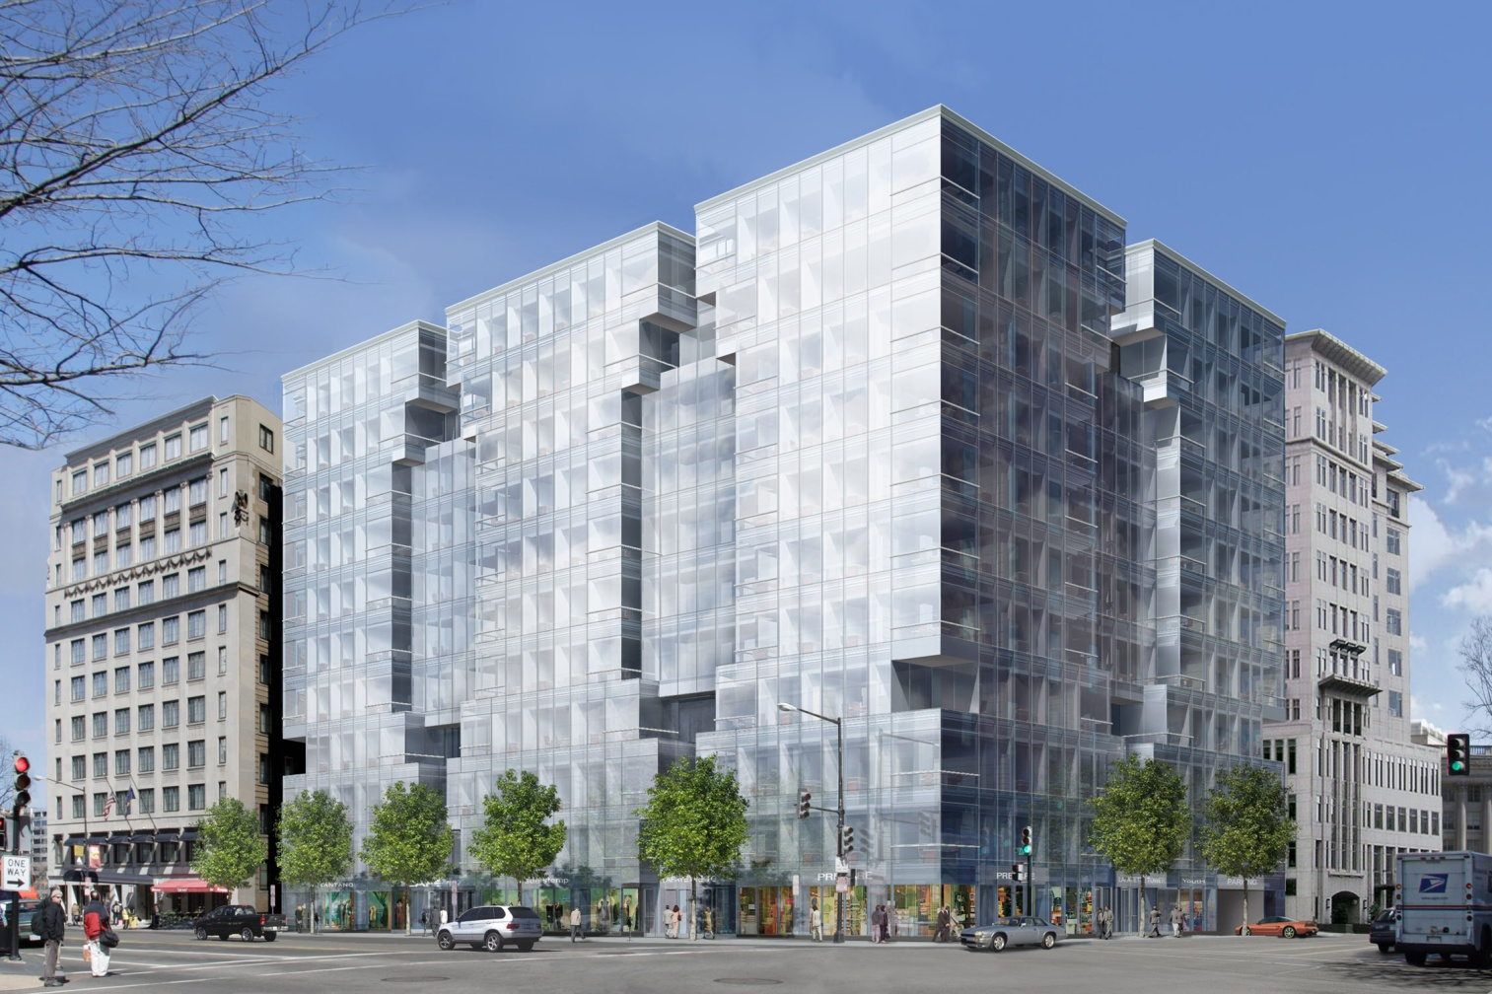
Lafayette Tower
801 17th St. NW, Washington D.C.
Justin Wingenfield
Construction Management
Dr. David Riley
Senior Thesis Presentation 2009
The Pennsylvania State University

Slide 2

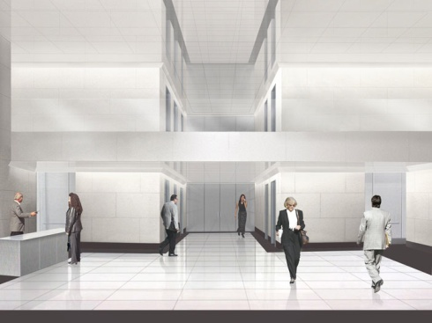
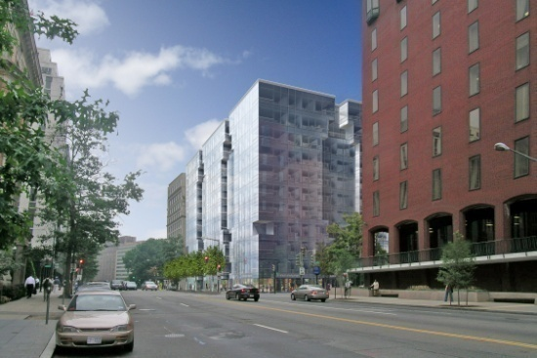
Lafayette Tower
801 17th St. NW, Washington D.C.
Presentation Outline
Project Overview
Column-Free Perimeter
Structural Redesign
Solar Implementation
Conclusions
Questions
Justin Wingenfield
Construction Management
Dr. David Riley
Senior Thesis Presentation 2009
The Pennsylvania State University

Slide 3
Lafayette Tower
801 17th St. NW, Washington D.C.
General Building Data
Building name: Lafayette Tower
Location and Site: 801 17th St. NW, Washington D.C.
Building Occupant Name: Louis Dreyfus Properties
Occupancy or Function Types (type of building): Office / Corporate
Size (total square feet): 328,00 SF
Number of stories above grade: 11
Primary project team:
Construction Manager: Clark Construction Group, LLC
Owner: Louis Dreyfus Property Group
Architect: Kevin Roche John Dinkeloo & Associates, LCC
Structural Engineer: Tadjer-Cohen-Edelson & Associates, Inc.
MEP Engineer: Tolk, Inc.
Civil Engineer: Edwards & Kelcey
Dates of construction: August 2006– December 2009
Building Cost: $47 million
Project delivery method: GMP (Guaranteed Max. Price)
Presentation Outline
Project Overview
Column-Free Perimeter
Structural Redesign
Solar Implementation
Conclusions
Questions
Justin Wingenfield
Construction Management
Dr. David Riley
Senior Thesis Presentation 2009
The Pennsylvania State University

Slide 4
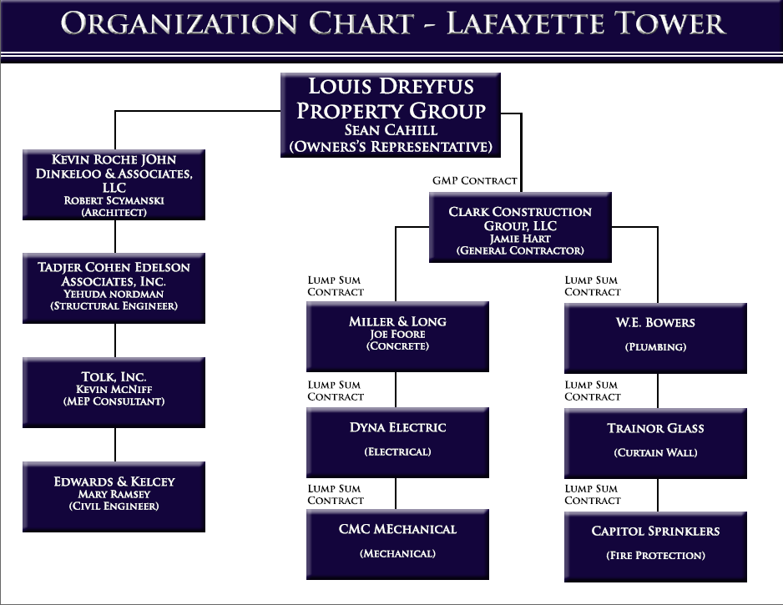
Project Delivery Method
General Building Data
Building name: Lafayette Tower
Location and Site: 801 17th St. NW, Washington D.C.
Building Occupant Name: Louis Dreyfus Properties
Occupancy or Function Types (type of building): Office / Corporate
Size (total square feet): 328,00 SF
Number of stories above grade: 11
Primary project team:
Construction Manager: Clark Construction Group, LLC
Owner: Louis Dreyfus Property Group
Architect: Kevin Roche John Dinkeloo & Associates, LCC
Structural Engineer: Tadjer-Cohen-Edelson & Associates, Inc.
MEP Engineer: Tolk, Inc.
Civil Engineer: Edwards & Kelcey
Dates of construction: August 2006– December 2009
Building Cost: $47 million
Project delivery method: GMP
Presentation Outline
Project Overview
Column-Free Perimeter
Structural Redesign
Solar Implementation
Conclusions
Questions

Slide 5
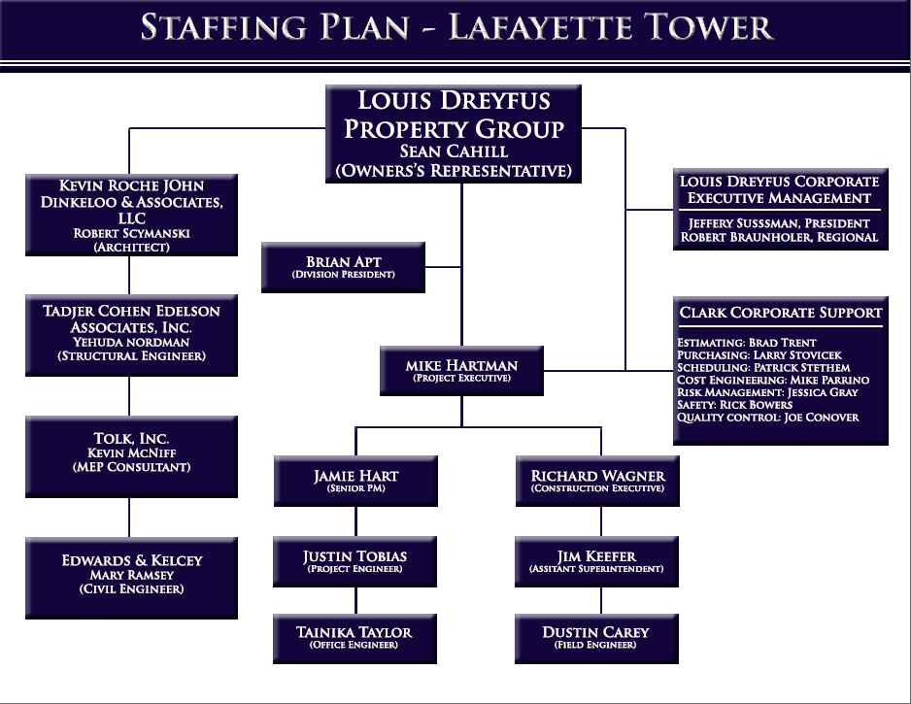
Project Delivery Method
Project Staffing
Presentation Outline
Project Overview
Column-Free Perimeter
Structural Redesign
Solar Implementation
Conclusions
Questions

Slide 6
Owner / GC Relations
Had prior relationship that run dry
This project was a good opportunity for the two companies to reestablish that relationship
Reestablishing the relationship would lead to:
  Continued work between LD and Clark
  Both parties making $$
This added additional pressure on both companies staffs to make this project successful
Project Staffing
Presentation Outline
Project Overview
Column-Free Perimeter
Structural Redesign
Solar Implementation
Conclusions
Questions

Slide 7

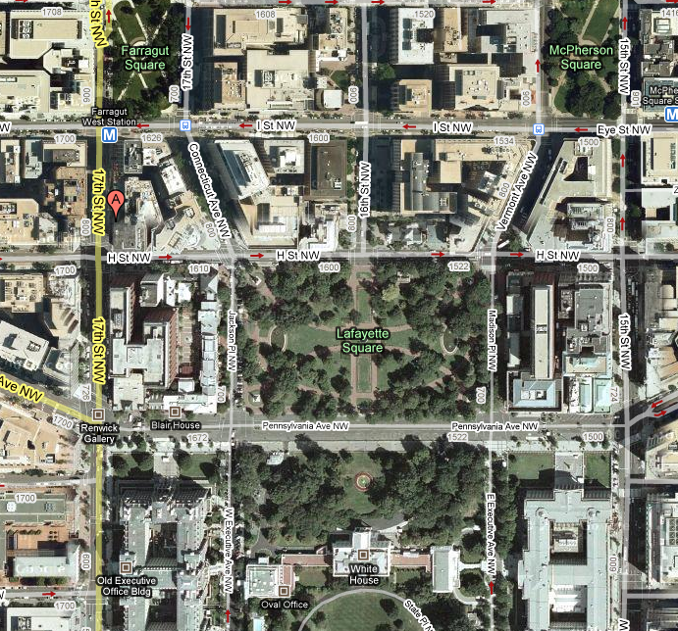
Owner / GC Relations
Had prior relationship that run dry
This project was a good opportunity for the two companies to reestablish that relationship
Reestablishing the relationship would lead to:
  Continued work between LD and Clark
  Both parties making $$
This added additional pressure on both companies staffs to make this project successful
Site Location
Presentation Outline
Project Overview
Column-Free Perimeter
Structural Redesign
Solar Implementation
Conclusions
Questions

Slide 8
Site Logistics
Site Location
Presentation Outline
Project Overview
Column-Free Perimeter
Structural Redesign
Solar Implementation
Conclusions
Questions

Slide 9
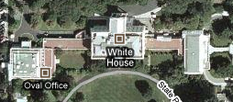
Site Logistics
Site Location
Presentation Outline
Project Overview
Column-Free Perimeter
Structural Redesign
Solar Implementation
Conclusions
Questions

Slide 10
Site Logistics
Site Location
Presentation Outline
Project Overview
Column-Free Perimeter
Structural Redesign
Solar Implementation
Conclusions
Questions
Presidential Motorcade Route

Slide 11
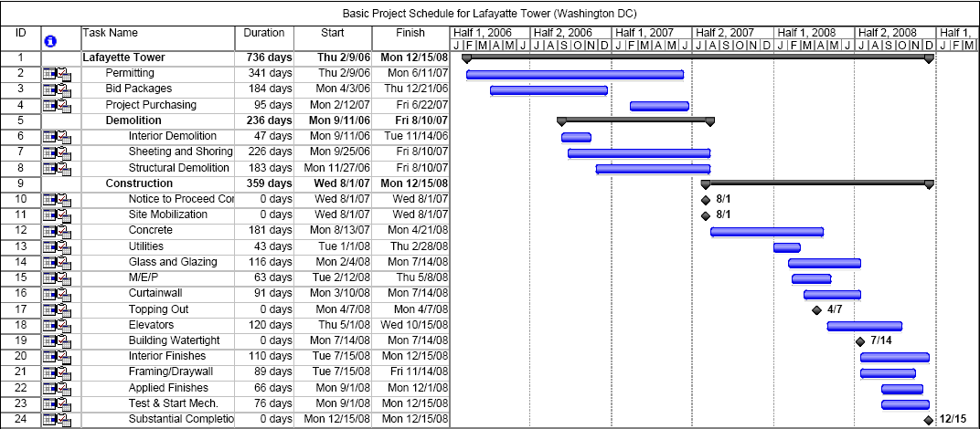
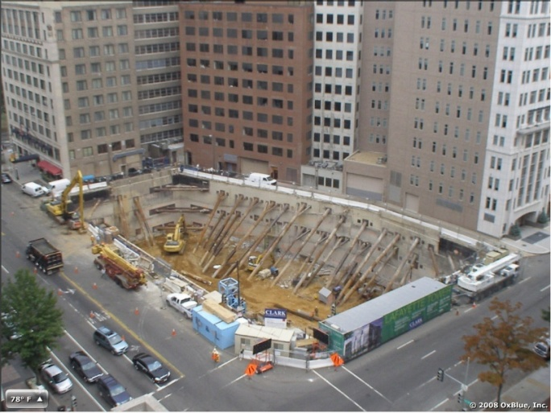
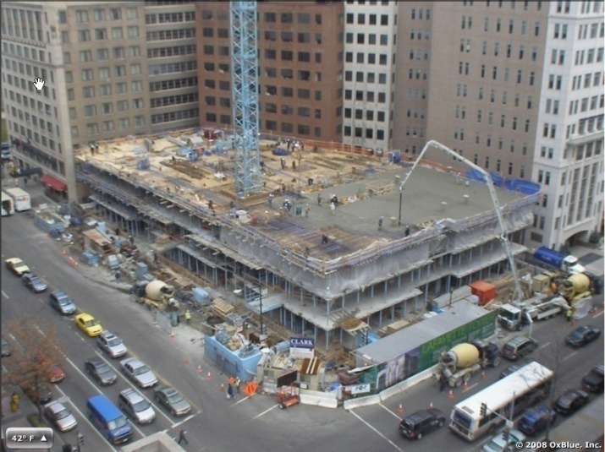
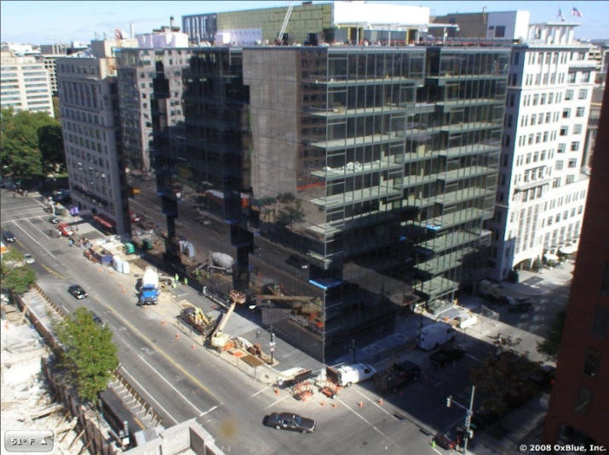
Schedule
Presentation Outline
Project Overview
Column-Free Perimeter
Structural Redesign
Solar Implementation
Conclusions
Questions
Demolition (9.11.06 – 8.10.07)
Superstructure (8.13.07 – 4.7.08)
Finishes (4.8.08 – 12.15.08)

Slide 12
Column-Free Perimeter Depth
Problem:
The column-free perimeters are an exciting feature for potential tenants because of the increased square footage of window space they provide on the North, West, and South faces of the building but they greatly increase the difficulty of construction due to the incorporation of detailed fall protection plans and cantilevered slabs.
Presentation Outline
Project Overview
Column-Free Perimeter
Structural Redesign
Solar Implementation
Conclusions
Questions

Slide 13
Column-Free Perimeter Depth
Problem:
The column-free perimeters are an exciting feature for potential tenants because of the increased square footage of window space they provide on the North, West, and South faces of the building but they greatly increase the difficulty of construction due to the incorporation of detailed fall protection plans and cantilevered slabs.
Solution:
I agree that the views to the South side of the building are worthwhile due to the fact that they overlook The White House. However, I don’t feel the views to the West and North are worthy of the extra time, money and energy needed to incorporate this feature. Therefore, I propose to remove this feature on these sides of the building.
Presentation Outline
Project Overview
Column-Free Perimeter
Structural Redesign
Solar Implementation
Conclusions
Questions

Slide 14
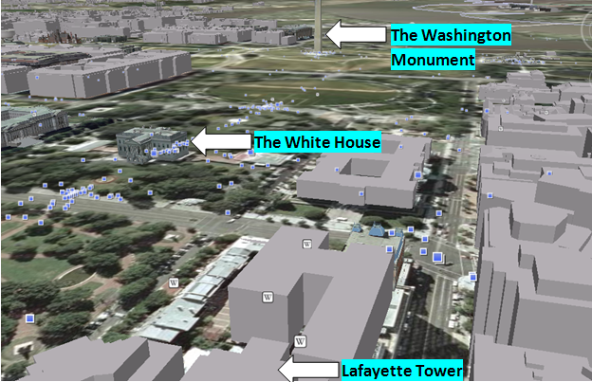
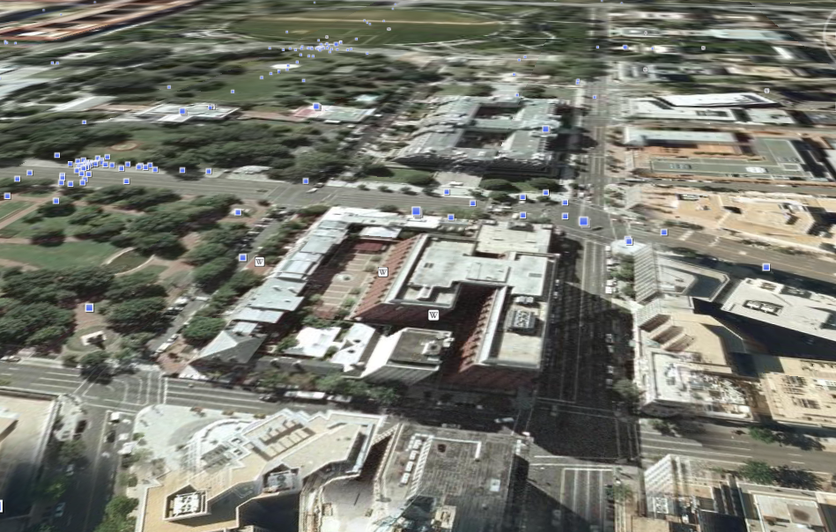
Column-Free Perimeter Depth
South Facing Views:
Presentation Outline
Project Overview
Column-Free Perimeter
Structural Redesign
Solar Implementation
Conclusions
Questions
GOOD! ☺

Slide 15
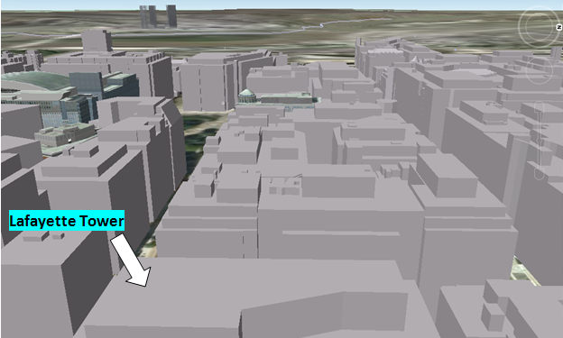
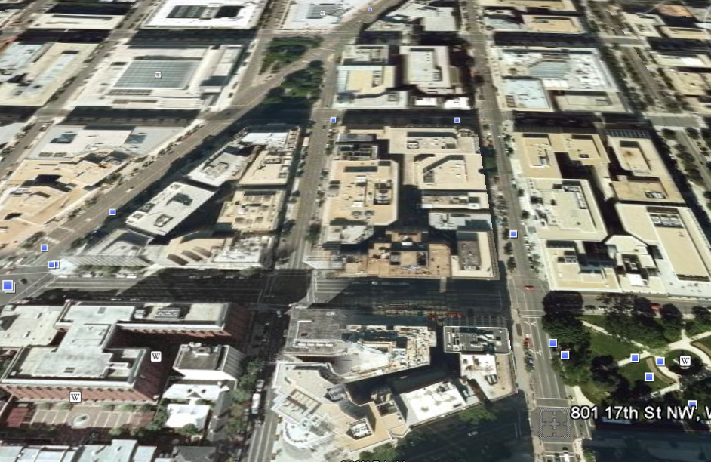
Column-Free Perimeter Depth
South Facing Views:
West Facing Views:
Presentation Outline
Project Overview
Column-Free Perimeter
Structural Redesign
Solar Implementation
Conclusions
Questions
GOOD! ☺
OKAY 😐

Slide 16
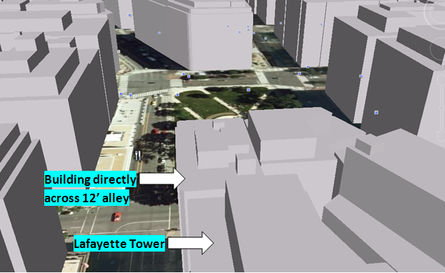
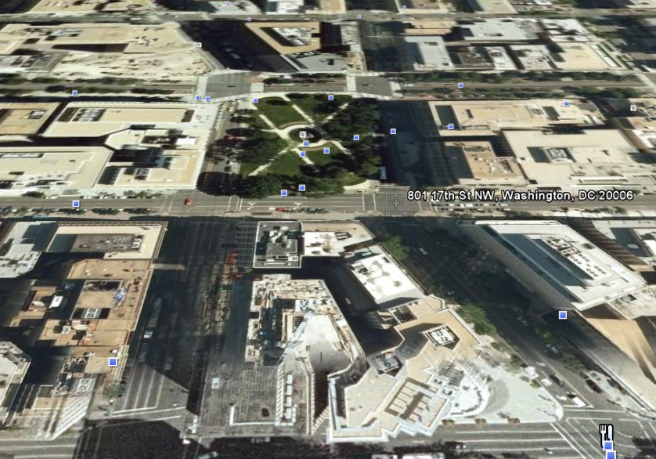
Column-Free Perimeter Depth
North Facing Views:
West Facing Views:
Presentation Outline
Project Overview
Column-Free Perimeter
Structural Redesign
Solar Implementation
Conclusions
Questions
POOR ☹
OKAY 😐

Slide 17
Column-Free Perimeter Depth
Items to Consider:
  Cost Implications
  Schedule Impacts
  Constructability Variances
Presentation Outline
Project Overview
Column-Free Perimeter
Structural Redesign
Solar Implementation
Conclusions
Questions

Slide 18
Column-Free Perimeter Depth
Items to Consider:
  Cost Implications
  Schedule Impacts
  Constructability Variances
Main Sources of Information:
  Owners Representative
  Clark Construction Rep.
  Information From Structural Redesign
  (obtained in structural breadth)
Presentation Outline
Project Overview
Column-Free Perimeter
Structural Redesign
Solar Implementation
Conclusions
Questions

Slide 19
Column-Free Perimeter Depth
Important Info From Owner’s Rep.:
The cantilever cost him $1.00/gsf. With the building sitting at around 328,000 SF, the addition of the cantilever cost approximately $328,000
The column-free perimeter increases the value of the rental space somewhere between $0.25 and $0.50 per square foot.
The typical lease period is 15 years
Main Sources of Information:
  Owners Representative
  Clark Construction Rep.
  Information From Structural Redesign
  (obtained in structural breadth)
Presentation Outline
Project Overview
Column-Free Perimeter
Structural Redesign
Solar Implementation
Conclusions
Questions

Slide 20
Column-Free Perimeter Depth
Important Info From Owner’s Rep.:
The cantilever cost him $1.00/gsf. With the building sitting at around 328,000 SF, the addition of the cantilever cost approximately $328,000
The column-free perimeter increases the value of the rental space somewhere between $0.25 and $0.50 per square foot.
The typical lease period is 15 years
Presentation Outline
Project Overview
Column-Free Perimeter
Structural Redesign
Solar Implementation
Conclusions
Questions
Cantilever Value Calculator
Floor | Floor Area (SF) | Low $/SF | High $/SF | Value Range |  | Typical Lease |  | Value Range
2nd | 17,482 | $0.25 | $0.50 | $4,370.50 | $8,741.00 | 15 | years | $65,557.50 | $131,115.00
3rd | 21,156 | $0.25 | $0.50 | $5,289.00 | $10,578.00 | 15 | years | $79,335.00 | $158,670.00
4th | 20,556 | $0.25 | $0.50 | $5,139.00 | $10,278.00 | 15 | years | $77,085.00 | $154,170.00
5th | 21,006 | $0.25 | $0.50 | $5,251.50 | $10,503.00 | 15 | years | $78,772.50 | $157,545.00
6th | 21,006 | $0.25 | $0.50 | $5,251.50 | $10,503.00 | 15 | years | $78,772.50 | $157,545.00
7th | 21,006 | $0.25 | $0.50 | $5,251.50 | $10,503.00 | 15 | years | $78,772.50 | $157,545.00
8th | 21,006 | $0.25 | $0.50 | $5,251.50 | $10,503.00 | 15 | years | $78,772.50 | $157,545.00
9th | 21,006 | $0.25 | $0.50 | $5,251.50 | $10,503.00 | 15 | years | $78,772.50 | $157,545.00
10th | 20,856 | $0.25 | $0.50 | $5,214.00 | $10,428.00 | 15 | years | $78,210.00 | $156,420.00
11th | 21,156 | $0.25 | $0.50 | $5,289.00 | $10,578.00 | 15 | years | $79,335.00 | $158,670.00
Total |  |  |  |  |  |  |  | $773,385.00 | $1,546,770.00

Slide 21
Column-Free Perimeter Depth
Presentation Outline
Project Overview
Column-Free Perimeter
Structural Redesign
Solar Implementation
Conclusions
Questions
Cantilever Value / Floors Leased
Floors Leased | Value Range/ Floor |  | Low Total | Ave. Total | High Total
1 | $77,338.50 | $154,677.00 | $77,338.50 | $116,007.75 | $154,677.00
2 | $77,338.50 | $154,677.00 | $154,677.00 | $232,015.50 | $309,354.00
3 | $77,338.50 | $154,677.00 | $232,015.50 | $348,023.25 | $464,031.00
4 | $77,338.50 | $154,677.00 | $309,354.00 | $464,031.00 | $618,708.00
5 | $77,338.50 | $154,677.00 | $386,692.50 | $580,038.75 | $773,385.00
6 | $77,338.50 | $154,677.00 | $464,031.00 | $696,046.50 | $928,062.00
7 | $77,338.50 | $154,677.00 | $541,369.50 | $812,054.25 | $1,082,739.00
8 | $77,338.50 | $154,677.00 | $618,708.00 | $928,062.00 | $1,237,416.00
9 | $77,338.50 | $154,677.00 | $696,046.50 | $1,044,069.75 | $1,392,093.00
10 | $77,338.50 | $154,677.00 | $773,385.00 | $1,160,077.50 | $1,546,770.00
Cantilever Value Calculator
Floor | Floor Area (SF) | Low $/SF | High $/SF | Value Range |  | Typical Lease |  | Value Range
2nd | 17,482 | $0.25 | $0.50 | $4,370.50 | $8,741.00 | 15 | years | $65,557.50 | $131,115.00
3rd | 21,156 | $0.25 | $0.50 | $5,289.00 | $10,578.00 | 15 | years | $79,335.00 | $158,670.00
4th | 20,556 | $0.25 | $0.50 | $5,139.00 | $10,278.00 | 15 | years | $77,085.00 | $154,170.00
5th | 21,006 | $0.25 | $0.50 | $5,251.50 | $10,503.00 | 15 | years | $78,772.50 | $157,545.00
6th | 21,006 | $0.25 | $0.50 | $5,251.50 | $10,503.00 | 15 | years | $78,772.50 | $157,545.00
7th | 21,006 | $0.25 | $0.50 | $5,251.50 | $10,503.00 | 15 | years | $78,772.50 | $157,545.00
8th | 21,006 | $0.25 | $0.50 | $5,251.50 | $10,503.00 | 15 | years | $78,772.50 | $157,545.00
9th | 21,006 | $0.25 | $0.50 | $5,251.50 | $10,503.00 | 15 | years | $78,772.50 | $157,545.00
10th | 20,856 | $0.25 | $0.50 | $5,214.00 | $10,428.00 | 15 | years | $78,210.00 | $156,420.00
11th | 21,156 | $0.25 | $0.50 | $5,289.00 | $10,578.00 | 15 | years | $79,335.00 | $158,670.00
Total |  |  |  |  |  |  |  | $773,385.00 | $1,546,770.00

Slide 22
Column-Free Perimeter Depth
Important Info From Clark Rep.:
Installation is very similar between a cantilevered slab vs. a traditional PT slab
As far as installation costs, schedule and constructability, both slabs are very similar therefore no analysis is necessary
The real differences are apparent when considering safety for the cantilevered slabs
  Quality Control needs to be monitored much more stringently
  The associated fall protection plan makes tasks more difficult/time intensive
Presentation Outline
Project Overview
Column-Free Perimeter
Structural Redesign
Solar Implementation
Conclusions
Questions

Slide 23
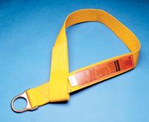
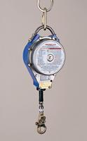

Column-Free Perimeter Depth
Important Info From Clark Rep.:
Installation is very similar between a cantilevered slab vs. a traditional PT slab
As far as installation costs, schedule and constructability, both slabs are very similar therefore no analysis is necessary
The real differences are apparent when considering safety for the cantilevered slabs
  Quality Control needs to be monitored much more stringently
  The associated fall protection plan makes tasks more difficult/time intensive
Materials Needed for Addition Safety:
Presentation Outline
Project Overview
Column-Free Perimeter
Structural Redesign
Solar Implementation
Conclusions
Questions
In Column Anchor Strap
(2) Per column
Retractable Lifeline Cable
Full Body Harness

Slide 24
Extra Man Hours Safety Plan Causes:
“The major drawback of this plan is the additional time caused for people who are affected by it. Something that would take an hour would take approximately an hour and a half if it had to be done outside of the cables.”
Materials Needed for Addition Safety:
Presentation Outline
Project Overview
Column-Free Perimeter
Structural Redesign
Solar Implementation
Conclusions
Questions
Fall Protection Labor Cost
Employee Classification | Hours/Day | Multiplier | Duration (days) | Wage ($/hr) | Cost ($)
Engineer | 6 | 0.33 | 56 | 32 | $3,548.16
Helper | 6 | 0.33 | 56 | 23 | $2,550.24
Engineer | 4 | 0.33 | 75 | 32 | $3,168.00
Helper | 4 | 0.33 | 75 | 23 | $2,277.00
Sub-Total |  |  |  |  | $11,543.40
25% increase |  |  |  |  | $2,885.85
Total |  |  |  |  | $14,429.25
In Column Anchor Strap
(2) Per column
Retractable Lifeline Cable
Full Body Harness

Slide 25
Extra Man Hours Safety Plan Causes:
“The major drawback of this plan is the additional time caused for people who are affected by it. Something that would take an hour would take approximately an hour and a half if it had to be done outside of the cables.”
Effect on Curtain Wall Sub-Contractor:
Presentation Outline
Project Overview
Column-Free Perimeter
Structural Redesign
Solar Implementation
Conclusions
Questions
Curtain Wall Total Cost = approx. $4 million
Total Labor Cost (%15) = approx. $600,000
Production Rate Reduction = approx. 20%
Increase in Labor Cost = approx. $120,000
Fall Protection Labor Cost
Employee Classification | Hours/Day | Multiplier | Duration (days) | Wage ($/hr) | Cost ($)
Engineer | 6 | 0.33 | 56 | 32 | $3,548.16
Helper | 6 | 0.33 | 56 | 23 | $2,550.24
Engineer | 4 | 0.33 | 75 | 32 | $3,168.00
Helper | 4 | 0.33 | 75 | 23 | $2,277.00
Sub-Total |  |  |  |  | $11,543.40
25% increase |  |  |  |  | $2,885.85
Total |  |  |  |  | $14,429.25

Slide 26
Information From Structural Redesign:
This study involved redesigning the column layout in order to create an optimal plan that kept the column-free design on the South face of the building but incorporated a more typical layout for the columns on the West and North faces while keeping it as close to the original design as possible.
Presentation Outline
Project Overview
Column-Free Perimeter
Structural Redesign
Solar Implementation
Conclusions
Questions

Slide 27
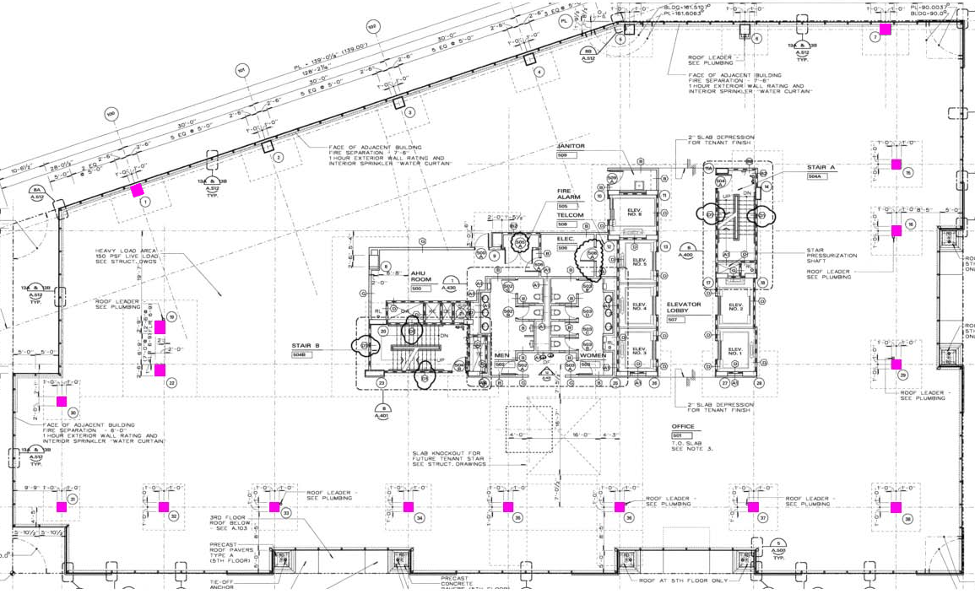
Information From Structural Redesign:
This study involved redesigning the column layout in order to create an optimal plan that kept the column-free design on the South face of the building but incorporated a more typical layout for the columns on the West and North faces while keeping it as close to the original design as possible.
Original Column Layout
Presentation Outline
Project Overview
Column-Free Perimeter
Structural Redesign
Solar Implementation
Conclusions
Questions

Slide 28
New Column Layout:
Original Column Layout:
Presentation Outline
Project Overview
Column-Free Perimeter
Structural Redesign
Solar Implementation
Conclusions
Questions

Slide 29
New Column Layout:
Results:
New design is structural stable with little changes to original slab and reinforcing designs
70% removal of the cantilevered slabs
Original cost of cantilever, $328,000, is reduces it by $229,600 to $98,400
The new design will retain between approx. 50-66% of the original increased rental value
Presentation Outline
Project Overview
Column-Free Perimeter
Structural Redesign
Solar Implementation
Conclusions
Questions

Slide 30
Pros vs. Cons
Means of Tabulation:
Original Design:
The total value of the scenario can be found by taking the average value the column-free exterior brings to the building per floor and subtract the cost of the cantilever
There will be a different values depending on the number of floors being leased
New Design:
All of the benefits (money saved from fall protection materials and extra labor for both the GC and curtain wall company) will be compiled
The average value per floor that the column-free exterior brings to each floor will be adjusted by the percentage determined by the cantilever’s partial removal analysis.
The cantilever cost will be adjusted to correspond with the percentage of cantilevered slab remaining in the new design
All of the inputs for each scenario will be summed and the highest value for each number of floors being leased will be indicated.
Presentation Outline
Project Overview
Column-Free Perimeter
Structural Redesign
Solar Implementation
Conclusions
Questions

Slide 31
Pros vs. Cons
Means of Tabulation:
Original Design:
The total value of the scenario can be found by taking the average value the column-free exterior brings to the building per floor and subtract the cost of the cantilever
There will be a different values depending on the number of floors being leased
New Design:
All of the benefits (money saved from fall protection materials and extra labor for both the GC and curtain wall company) will be compiled
The average value per floor that the column-free exterior brings to each floor will be adjusted by the percentage determined by the cantilever’s partial removal analysis.
The cantilever cost will be adjusted to correspond with the percentage of cantilevered slab remaining in the new design
All of the inputs for each scenario will be summed and the highest value for each number of floors being leased will be indicated.
Column-Free Exterior Value Calculator for Original Design
Presentation Outline
Project Overview
Column-Free Perimeter
Structural Redesign
Solar Implementation
Conclusions
Questions
Cantilever Value / Floors Leased
 | Original Design
Floors Leased | Value/ Floor | Ave. Total | Cantilever Cost | Total Value
1 | $116,007.80 | $116,007.80 | $328,000 | -$211,992.20
2 | $116,007.80 | $232,015.60 | $328,000 | -$95,984.40
3 | $116,007.80 | $348,023.40 | $328,000 | $20,023.40
4 | $116,007.80 | $464,031.20 | $328,000 | $136,031.20
5 | $116,007.80 | $580,039.00 | $328,000 | $252,039.00
6 | $116,007.80 | $696,046.80 | $328,000 | $368,046.80
7 | $116,007.80 | $812,054.60 | $328,000 | $484,054.60
8 | $116,007.80 | $928,062.40 | $328,000 | $600,062.40
9 | $116,007.80 | $1,044,070.20 | $328,000 | $716,070.20
10 | $116,007.80 | $1,160,078.00 | $328,000 | $832,078.00

Slide 32
New Design Benefits:
Presentation Outline
Project Overview
Column-Free Perimeter
Structural Redesign
Solar Implementation
Conclusions
Questions
 | Material | Labor | Total $$
Safety Plan | $11,830 | $14,430 | $26,260
 | Original Value | Multiplier | New Cost
Cantilever | $328,000 | 30% | $98,400
Curtain Wall Labor Savings | $600,000 | 20% | $120,000
New Value / Floor | $116,008 | 58% | $67,285

Slide 33
New Design Benefits:
Column-Free Exterior Value Calculator for New Design
Presentation Outline
Project Overview
Column-Free Perimeter
Structural Redesign
Solar Implementation
Conclusions
Questions
 | Material | Labor | Total $$
Safety Plan | $11,830 | $14,430 | $26,260
Cantilever Value / Floors Leased
 | New Design
Floors Leased | Value/ Floor | Ave. Total | Benefits | Cantilever Cost | Total Value
1 | $67,284.52 | $67,284.52 | $146,260 | $98,400 | $115,144.52
2 | $67,284.52 | $134,569.05 | $146,260 | $98,400 | $182,429.05
3 | $67,284.52 | $201,853.57 | $146,260 | $98,400 | $249,713.57
4 | $67,284.52 | $269,138.10 | $146,260 | $98,400 | $316,998.10
5 | $67,284.52 | $336,422.62 | $146,260 | $98,400 | $384,282.62
6 | $67,284.52 | $403,707.14 | $146,260 | $98,400 | $451,567.14
7 | $67,284.52 | $470,991.67 | $146,260 | $98,400 | $518,851.67
8 | $67,284.52 | $538,276.19 | $146,260 | $98,400 | $586,136.19
9 | $67,284.52 | $605,560.72 | $146,260 | $98,400 | $653,420.72
10 | $67,284.52 | $672,845.24 | $146,260 | $98,400 | $720,705.24
 | Original Value | Multiplier | New Cost
Cantilever | $328,000 | 30% | $98,400
Curtain Wall Labor Savings | $600,000 | 20% | $120,000
New Value / Floor | $116,008 | 58% | $67,285

Slide 34
Design Value Comparison
Column-Free Exterior Value Calculator for New Design
Presentation Outline
Project Overview
Column-Free Perimeter
Structural Redesign
Solar Implementation
Conclusions
Questions
FLOORS LEASED | OLD DESIGN | NEW DESIGN
1 | -$211,992.20 | $115,144.52
2 | -$95,984.40 | $182,429.05
3 | $20,023.40 | $249,713.57
4 | $136,031.20 | $316,998.10
5 | $252,039.00 | $384,282.62
6 | $368,046.80 | $451,567.14
7 | $484,054.60 | $518,851.67
8 | $600,062.40 | $586,136.19
9 | $716,070.20 | $653,420.72
10 | $832,078.00 | $720,705.24
Cantilever Value / Floors Leased
 | New Design
Floors Leased | Value/ Floor | Ave. Total | Benefits | Cantilever Cost | Total Value
1 | $67,284.52 | $67,284.52 | $146,260 | $98,400 | $115,144.52
2 | $67,284.52 | $134,569.05 | $146,260 | $98,400 | $182,429.05
3 | $67,284.52 | $201,853.57 | $146,260 | $98,400 | $249,713.57
4 | $67,284.52 | $269,138.10 | $146,260 | $98,400 | $316,998.10
5 | $67,284.52 | $336,422.62 | $146,260 | $98,400 | $384,282.62
6 | $67,284.52 | $403,707.14 | $146,260 | $98,400 | $451,567.14
7 | $67,284.52 | $470,991.67 | $146,260 | $98,400 | $518,851.67
8 | $67,284.52 | $538,276.19 | $146,260 | $98,400 | $586,136.19
9 | $67,284.52 | $605,560.72 | $146,260 | $98,400 | $653,420.72
10 | $67,284.52 | $672,845.24 | $146,260 | $98,400 | $720,705.24

Slide 35
Design Value Comparison
Recommendations
The first thing that needs to be said about this analysis is that a good portion of the items that values were found for are subjective and almost, if not, impossible to obtain a 100% value for. That being said, I feel that a fair representation for each scenario has been selected and used to help determine a solution which is:
Construct the building with the partial removal of the column-free exterior
If less than 8 floors are being leased, then the new design is more valuable the original design over the first 15 years of operation
Today’s economy will make leasing 8 or more floors an extremely difficult, if not impossible, task
Presentation Outline
Project Overview
Column-Free Perimeter
Structural Redesign
Solar Implementation
Conclusions
Questions
FLOORS LEASED | OLD DESIGN | NEW DESIGN
1 | -$211,992.20 | $115,144.52
2 | -$95,984.40 | $182,429.05
3 | $20,023.40 | $249,713.57
4 | $136,031.20 | $316,998.10
5 | $252,039.00 | $384,282.62
6 | $368,046.80 | $451,567.14
7 | $484,054.60 | $518,851.67
8 | $600,062.40 | $586,136.19
9 | $716,070.20 | $653,420.72
10 | $832,078.00 | $720,705.24

Slide 36
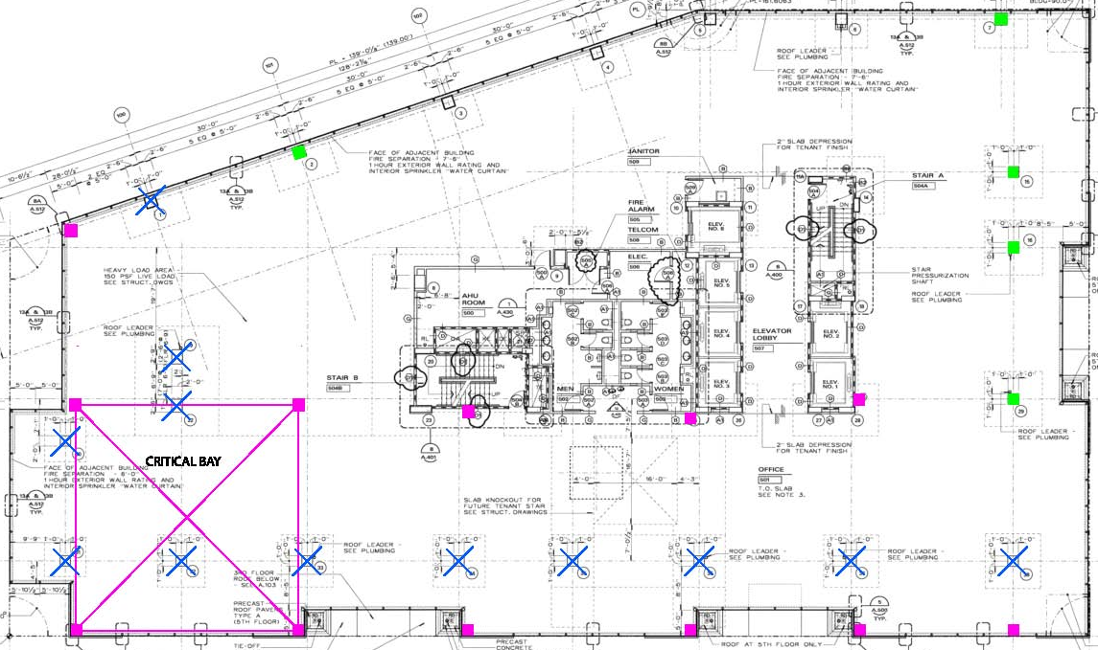
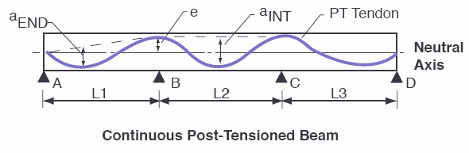
Structural Redesign (Structural Breadth)
Final Design
Presentation Outline
Project Overview
Column-Free Perimeter
Structural Redesign
Solar Implementation
Conclusions
Questions
Final Design
(70) 1/2" 7-Wire Strand Post-Tension Unbounded Tendons
12" Slab depth
42 #7 Reinforcement Bars @ Interior Span spaced ≤12" OC
42 #7 Reinforcement Bars @ Exterior Span spaced ≤12" OC
30 # 7 Reinforcement Bars @ Interior Supports spaced ≤18“ OC
30 # 7 Reinforcement Bars @ Exterior Supports spaced ≤18" OC
Tendon Ordinate | Tendon (CG) Location*
Exterior Support - Anchor | 5”
Interior Support -Top | 9”
Interior Span - Bottom | 1”
End Span Bottom | 1.75”

Slide 37
Solar Implementation
(Electrical Breadth / Critical Industry Issue)
Problem:
  With today’s economy in a recession and the growing global awareness of green technologies, saving money and the environment is on everyone’s mind. As a soon to be construction manager, both topics are of the utmost importance to me and lead me to the question: what can I do about it?
Presentation Outline
Project Overview
Column-Free Perimeter
Structural Redesign
Solar Implementation
Conclusions
Questions

Slide 38
Solar Implementation
(Electrical Breadth / Critical Industry Issue)
Problem:
  With today’s economy in a recession and the growing global awareness of green technologies, saving money and the environment is on everyone’s mind. As a soon to be construction manager, both topics are of the utmost importance to me and lead me to the question: what can I do about it?
Solution:
  One answer to this question is to do everything in my power to try to incorporate as much sustainable design into my projects as possible. A great way to add sustainable design into Lafayette Tower would be the introduction of photovoltaic panels into the current building systems in order to utilize one of nature’s greatest energy sources, the sun.
Presentation Outline
Project Overview
Column-Free Perimeter
Structural Redesign
Solar Implementation
Conclusions
Questions

Slide 39
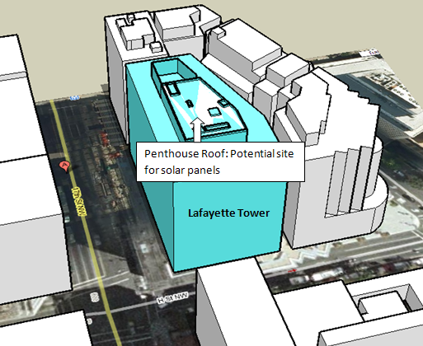
PV Panel Placement
Presentation Outline
Project Overview
Column-Free Perimeter
Structural Redesign
Solar Implementation
Conclusions
Questions

Slide 40
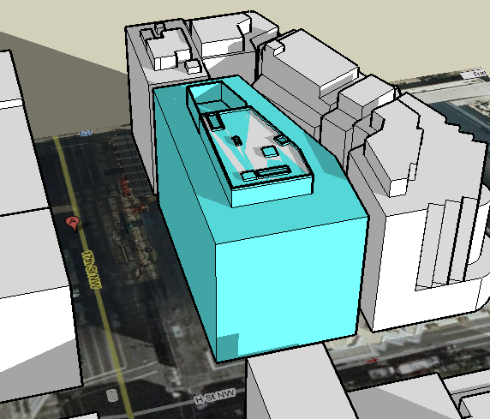
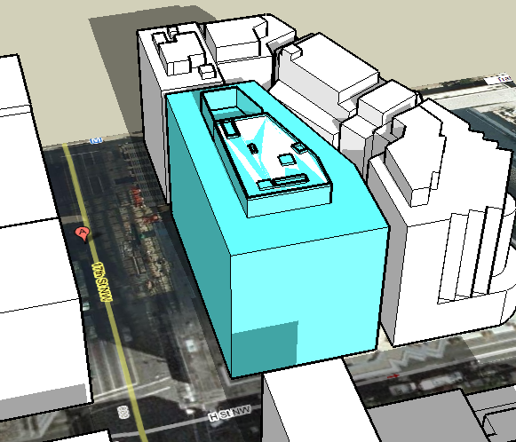
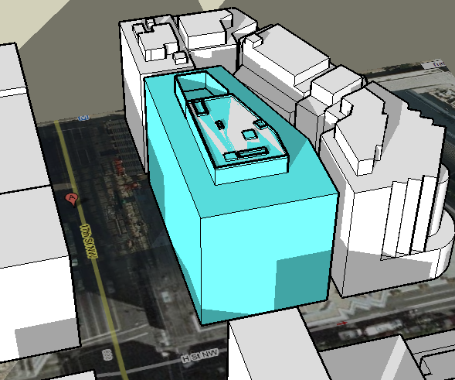
PV Panel Placement
Shadow Analysis (Winter Solstice - December 21, 2009)
Presentation Outline
Project Overview
Column-Free Perimeter
Structural Redesign
Solar Implementation
Conclusions
Questions
12:00PM
3:00PM
9:00AM

Slide 41
PV Panel Selection
Selection Criteria:
Is the company well-known and reputable? Are they on the forefront of technology?
Is the panel made for large commercial usage?
Is the panel made for grid tied systems?
Is there a vender nearby?
Presentation Outline
Project Overview
Column-Free Perimeter
Structural Redesign
Solar Implementation
Conclusion & Lessons Learned
Questions

Slide 42

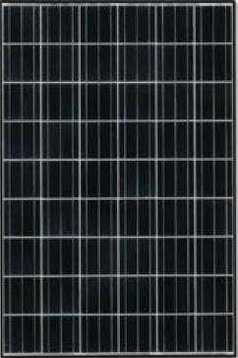
PV Panel Selection
Selection Criteria:
Is the company well-known and reputable? Are they on the forefront of technology?
Is the panel made for large commercial usage?
Is the panel made for grid tied systems?
Is there a vender nearby?
KD210GX-LP
Presentation Outline
Project Overview
Column-Free Perimeter
Structural Redesign
Solar Implementation
Conclusions
Questions
Product Details
Weight | 40.8 lbs
Type (thin-film, poly-crystal, CIGS, CeTe, etc.) | Highly efficient multi-crystal
Connectors | Plug-in
Operating temperature | -40ºC to +90ºC
Temperature Coefficient (Pmp) | (-)0.40%/ºC
Temperature Coefficient (Voc) | (-)0.12%/ºC
Temperature Coefficient (Vmp) | (-)0.34%/ºC
Temperature Coefficient (Isc) | 0.52%/ºC
Temperature Coefficient (Imp) | 0.19%/ºC
Max power current (Imp) | 7.90 A
Short-circuit current (Isc) | 8.58 A
Rated power at PTC (Pptc) | 184.6 W
Durability features | All weather construction
Module Construction/Materials | These cells are encapsulated between a tempered glass cover and a pottant with back sheet to provide efficient protection from the severest environmental conditions. The entire laminate is installed in an anodized aluminum frame to provide structural strength and ease of installation.

Slide 43
Inverter Selection
Selection Criteria:
Is the company well-known and reputable? Are they on the forefront of technology?
Is the panel made for large commercial usage?
Is the panel made for grid tied systems?
Is there a vender nearby?
Is the inverter compatible with the chosen PV panel?
Presentation Outline
Project Overview
Column-Free Perimeter
Structural Redesign
Solar Implementation
Conclusions
Questions

Slide 44

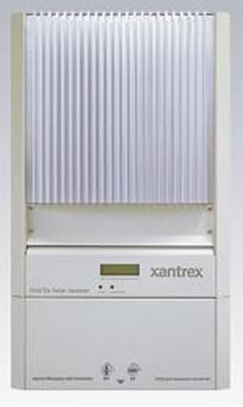

Inverter Selection
Selection Criteria:
Is the company well-known and reputable? Are they on the forefront of technology?
Is the panel made for large commercial usage?
Is the panel made for grid tied systems?
Is there a vender nearby?
Is the inverter compatible with the chosen PV panel?
Xantrex GT5.0 Inverter
Presentation Outline
Project Overview
Column-Free Perimeter
Structural Redesign
Solar Implementation
Conclusions
Questions

Slide 45
Sizing an Array
Determined from EDSGN 498A Exercise
Charts located in Final Report
Presentation Outline
Project Overview
Column-Free Perimeter
Structural Redesign
Solar Implementation
Conclusions
Questions
String Configurations for the Chosen Inverter
# of Modules in Series | 1 String |  |  | 2 Strings
 | # | Pac out (W) | % of max | # | Pac out (W) | % of max
1 | 1 | 168 | 3 | 2 | 336 | 7
2 | 2 | 336 | 7 | 4 | 673 | 13
3 | 3 | 505 | 10 | 6 | 1009 | 20
4 | 4 | 673 | 13 | 8 | 1345 | 27
5 | 5 | 841 | 17 | 10 | 1682 | 34
6 | 6 | 1009 | 20 | 12 | 2018 | 40
7 | 7 | 1177 | 24 | 14 | 2355 | 47
8 | 8 | 1345 | 27 | 16 | 2691 | 54
9 | 9 | 1514 | 30 | 18 | 3027 | 61
10 | 10 | 1682 | 34 | 20 | 3364 | 67
11 | 11 | 1850 | 37 | 22 | 3700 | 74
12 | 12 | 2018 | 40 | 24 | 4036 | 81
13 | 13 | 2186 | 44 | 26 | 4373 | 87
14 | 14 | 2355 | 47 | 28 | 4709 | 94
15 | 15 | 2523 | 50 | 30 | 5045 | 101
16 | 16 | 2691 | 54 | 32 | 5382 | 108
17 | 17 | 2859 | 57 | 34 | 5718 | 114
18 | 18 | 3027 | 61 | 36 | 6054 | 121
Criteria | Value
Max. Modules in Series | 15
Min. Modules in Series | 10
Max. Strings in Parallel | 2
Max. Array Capacity | 28
w/ Derate Factor | 29

Slide 46
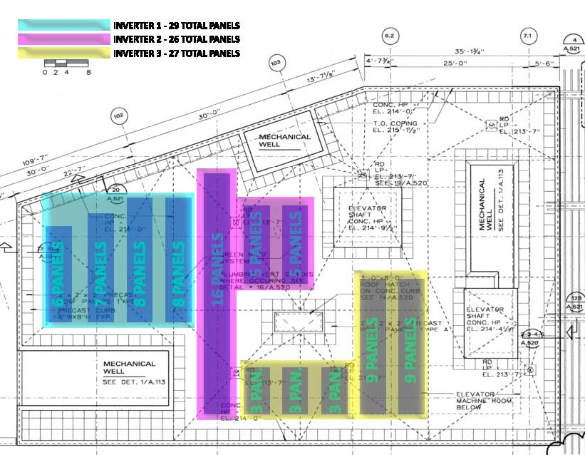
PV Panel Layout
Presentation Outline
Project Overview
Column-Free Perimeter
Structural Redesign
Solar Implementation
Conclusions
Questions
Total Components
3 Inverters
82 Panels

Slide 47
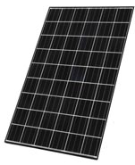
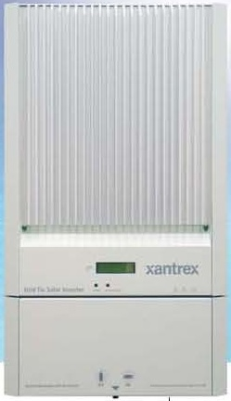
PV Panel Layout
Cost Analysis
Presentation Outline
Project Overview
Column-Free Perimeter
Structural Redesign
Solar Implementation
Conclusions
Questions
Total Components
3 Inverters
82 Panels
PV Panel
Inverter
Mounting Rack
Solar Equipment Estimate
Material | Cost | # of | Total Cost
Solar Panels | $874 | 82 | $71,668
Inverters | $3,004 | 3 | $9,012
Mounting Kits | $46 | 82 | $3,731
Labor | $5,000 | 1 | $5,000
Total |  |  | $89,411

Slide 48
Electrical Gains
Determined using PV Watts
Cost Analysis
Presentation Outline
Project Overview
Column-Free Perimeter
Structural Redesign
Solar Implementation
Conclusions
Questions
Station Identification
City: | Sterling
State: | Virginia
Latitude: | 38.95° N
Longitude: | 77.45° W
Elevation: | 82 m
PV System Specifications
DC Rating: | 17.2 kW
DC to AC Derate Factor: | 0.95
AC Rating: | 16.4 kW
Array Type: | Fixed Tilt
Array Tilt: | 39.0°
Array Azimuth: | 180.0°
Energy Specifications
Cost of Electricity: | 8.0 ¢/kWh
Results
Month | Solar Radiation | AC Energy | Energy Value
 | (kWh/m²/day) | (kWh) | ($)
1 | 3.59 | 1888 | 151.04
2 | 4.28 | 1982 | 158.56
3 | 4.80 | 2391 | 191.28
4 | 5.34 | 2477 | 198.16
5 | 5.32 | 2426 | 194.08
6 | 5.66 | 2500 | 200.00
7 | 5.46 | 2434 | 194.72
8 | 5.38 | 2439 | 195.12
9 | 5.07 | 2271 | 181.68
10 | 4.72 | 2253 | 180.24
11 | 3.56 | 1715 | 137.20
12 | 3.03 | 1525 | 122.00
Year | 4.68 | 26301 | 2104.08
PV Panel
Inverter
Mounting Rack
Solar Equipment Estimate
Material | Cost | # of | Total Cost
Solar Panels | $874 | 82 | $71,668
Inverters | $3,004 | 3 | $9,012
Mounting Kits | $46 | 82 | $3,731
Labor | $5,000 | 1 | $5,000
Total |  |  | $89,411

Slide 49
Electrical Gains
Determined using PV Watts
Incentives
On February 24th, 2009 the District Department of the Environment (DDOE) announced that DC residents, businesses, nonprofits and private schools may now apply for up to $33,000 in assistance to install renewable energy systems on their buildings. Up to $2 million for each of the next 4 years will be available which begins immediately for solar photovoltaic and wind turbine systems. PV incentives are based off of the systems kilowatt rating. It is broken off into 3 tiers.
$3 for each of the first 3,000 installed watts of capacity
$2 for each of the next 7,000 installed watts of capacity
$1 for each of the next 10,000 installed watts of capacity
Lafayette Tower’s solar PV system totaled 17.2kW which means it would be eligible for $30,200 in assistance.
Presentation Outline
Project Overview
Column-Free Perimeter
Structural Redesign
Solar Implementation
Conclusions
Questions
Station Identification
City: | Sterling
State: | Virginia
Latitude: | 38.95° N
Longitude: | 77.45° W
Elevation: | 82 m
PV System Specifications
DC Rating: | 17.2 kW
DC to AC Derate Factor: | 0.95
AC Rating: | 16.4 kW
Array Type: | Fixed Tilt
Array Tilt: | 39.0°
Array Azimuth: | 180.0°
Energy Specifications
Cost of Electricity: | 8.0 ¢/kWh
Results
Month | Solar Radiation | AC Energy | Energy Value
 | (kWh/m²/day) | (kWh) | ($)
1 | 3.59 | 1888 | 151.04
2 | 4.28 | 1982 | 158.56
3 | 4.80 | 2391 | 191.28
4 | 5.34 | 2477 | 198.16
5 | 5.32 | 2426 | 194.08
6 | 5.66 | 2500 | 200.00
7 | 5.46 | 2434 | 194.72
8 | 5.38 | 2439 | 195.12
9 | 5.07 | 2271 | 181.68
10 | 4.72 | 2253 | 180.24
11 | 3.56 | 1715 | 137.20
12 | 3.03 | 1525 | 122.00
Year | 4.68 | 26301 | 2104.08

Slide 50
Payback Period
Initial Cost = $89,411.00
Expected Incentives = $30,200.00
Savings / Year = $2104.08
Total Payback Period = 28 Years
Incentives
On February 24th, 2009 the District Department of the Environment (DDOE) announced that DC residents, businesses, nonprofits and private schools may now apply for up to $33,000 in assistance to install renewable energy systems on their buildings. Up to $2 million for each of the next 4 years will be available which begins immediately for solar photovoltaic and wind turbine systems. PV incentives are based off of the systems kilowatt rating. It is broken off into 3 tiers.
$3 for each of the first 3,000 installed watts of capacity
$2 for each of the next 7,000 installed watts of capacity
$1 for each of the next 10,000 installed watts of capacity
Lafayette Tower’s solar PV system totaled 17.2kW which means it would be eligible for $30,200 in assistance.
Presentation Outline
Project Overview
Column-Free Perimeter
Structural Redesign
Solar Implementation
Conclusions
Questions

Slide 51
Payback Period
Initial Cost = $89,411.00
Expected Incentives = $30,200.00
Savings / Year = $2104.08
Total Payback Period = 28 Years
Recommendations
Although a 28 year payback period isn’t the best decision financially, I still believe this system should be incorporated. There are many benefits to a solar PV system other than $$ saved.
  Electric systems generate no emissions of greenhouse gases or other pollutants, thereby reducing our impact on the global climate
  Solar panels provide a visible demonstration of concern for the environment, community education and proactive forward thinking
Not only are these are things a responsible person should do, but they could attract potential tenants who are
likeminded.
Presentation Outline
Project Overview
Column-Free Perimeter
Structural Redesign
Solar Implementation
Conclusions
Questions

Slide 52
Conclusions
Column-Free Exterior ☺
  Analysis included fairly subjective material but remained unbiased
  Partial removal of the column-free exterior proved to be financially beneficial in most cases
Structural Redesign ☺
  Proved the proposed layout could be constructed with minimal changes to existing design conditions
Solar Implementation ☺
  Not the best decision financially but still the correct decision as a responsible member of the construction industry
Presentation Outline
Project Overview
Column-Free Perimeter
Structural Redesign
Solar Implementation
Conclusions
Questions

Slide 53

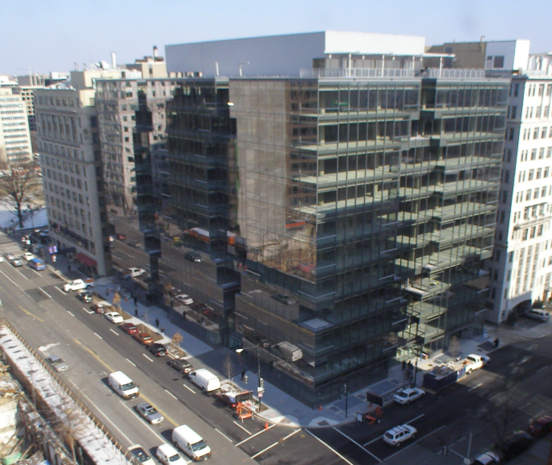



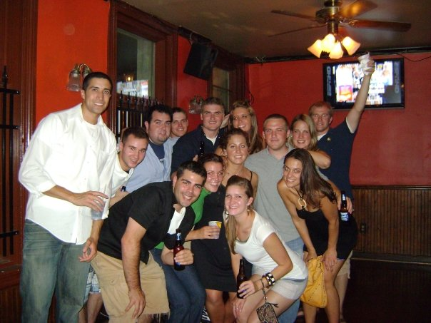
Questions?
Acknowledgements
Presentation Outline
Project Overview
Column-Free Perimeter
Structural Redesign
Solar Implementation
Conclusions
Questions
 | Penn State Faculty Dr. David Riley Dr. Robert Holland Dr. Moses Ling
 | Clark Construction Team Jamie Hart Justin Tobias Dustin Carey Richard Wagner
 | Louis Dreyfus Group Sean Cahill
 | My Family Father - John Mother - Linda Sister - Emily Dogs - Lilly & Sophie
 | My Friends & Fellow AEs

