Slide 1
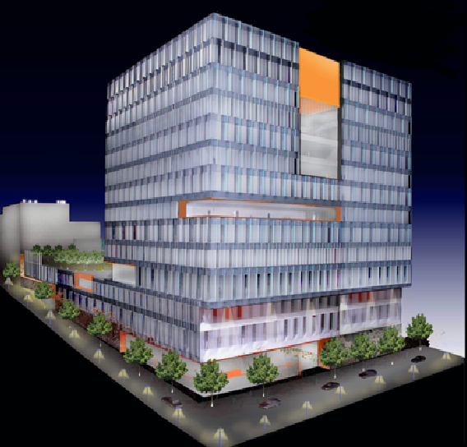
The John Jay College Expansion Project
New York, NY
Michael Hopper – Structural Option
AE Senior Thesis 2009
John Jay College Expansion Project
New York, NY

Slide 2
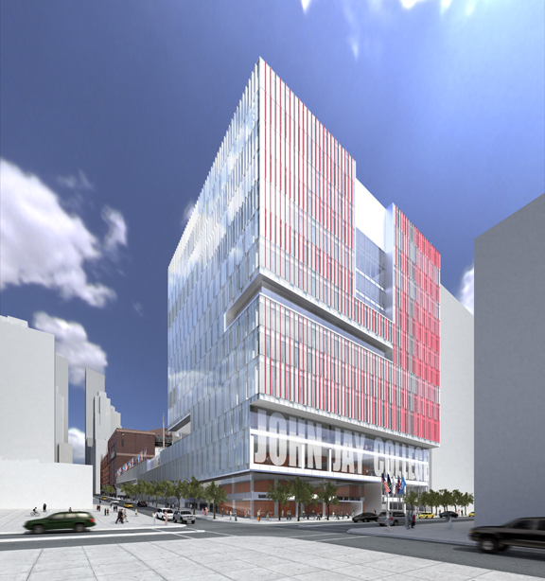
Presentation Outline
Project Information
Existing Structural Systems
Problem Statement and Solution
Structural Design
Architectural Studies
Construction Studies
Conclusions
Michael Hopper – Structural Option
AE Senior Thesis 2009
John Jay College Expansion Project
New York, NY

Slide 3
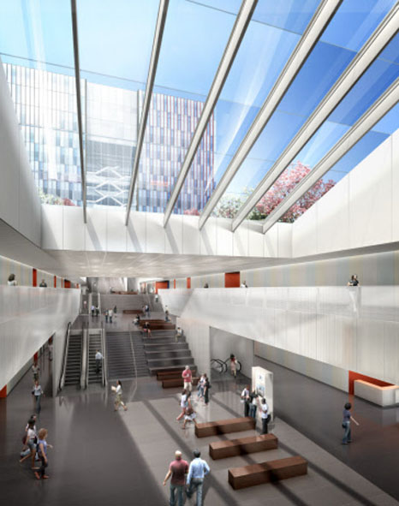
Project Information
General Information
Transform JJC of Criminal Justice into a 1-block urban campus
Expansion to Existing Harren Hall
620,000 Square Feet
$ 457 Million
14 Story Tower
5 story Podium connecting tower to
Harren Hall
Design calls for:
  Grand Cascade
  Landscaped Podium Roof
  Prefabricated Curtain Wall System
Michael Hopper – Structural Option
AE Senior Thesis 2009
John Jay College Expansion Project
New York, NY

Slide 4
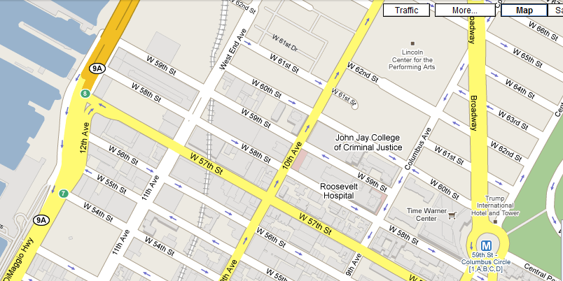
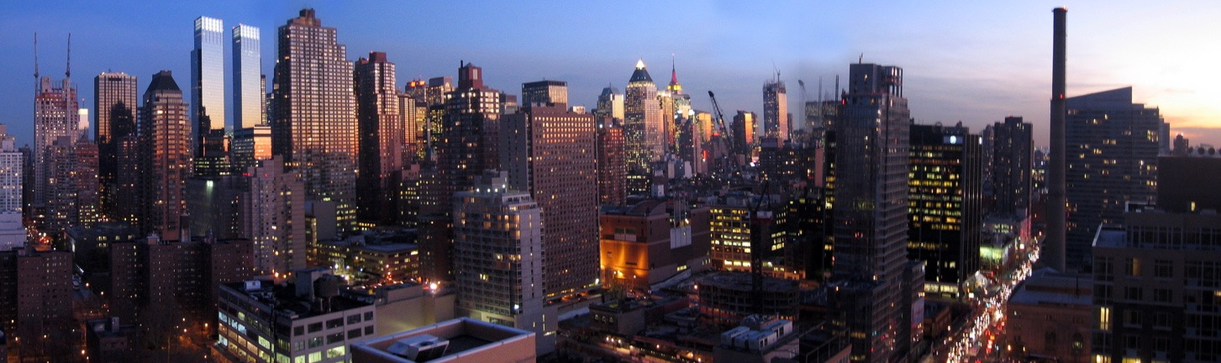
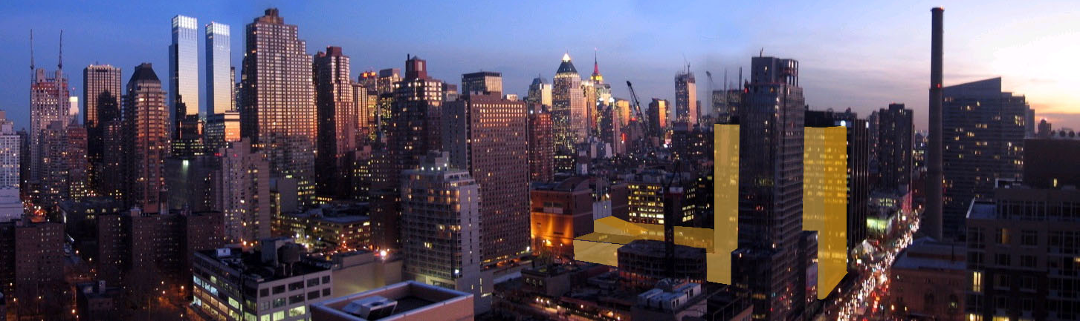
Project Information
Project Location
11th Avenue between 58th and
59th Street
Michael Hopper – Structural Option
AE Senior Thesis 2009
John Jay College Expansion Project
New York, NY

Slide 5
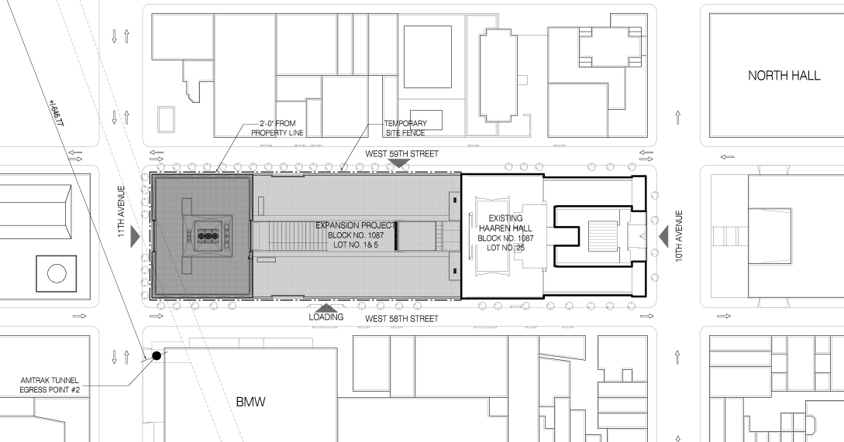

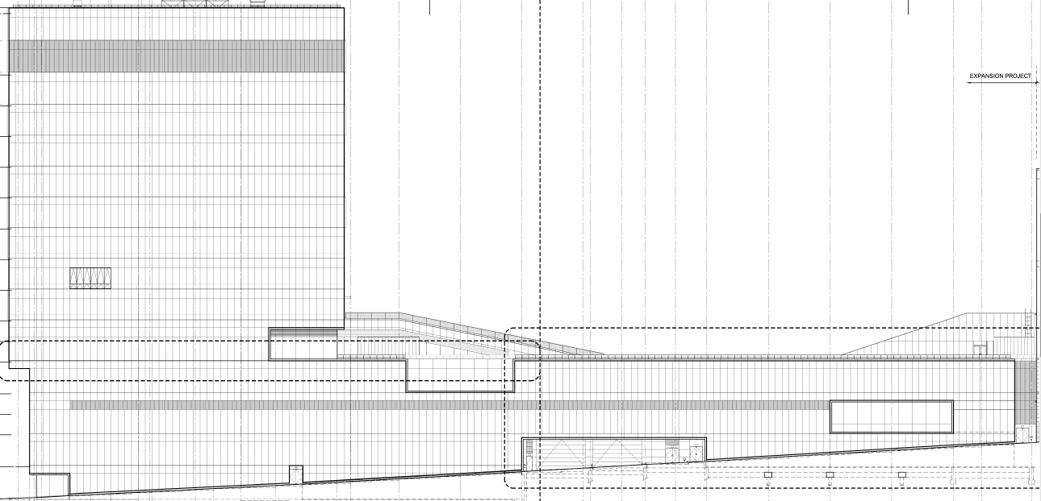
Project Information
Site Restriction
N
Site Plan
Amtrak tracks pass beneath the tower!
South Elevation
Michael Hopper – Structural Option
AE Senior Thesis 2009
John Jay College Expansion Project
New York, NY

Slide 6
Presentation Outline
Project Information
Existing Structural Systems
Problem Statement and Solution
Structural Design
Architectural Studies
Construction Studies
Conclusions
Michael Hopper – Structural Option
AE Senior Thesis 2009
John Jay College Expansion Project
New York, NY

Slide 7
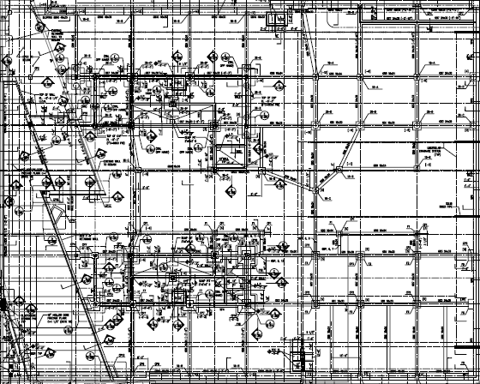
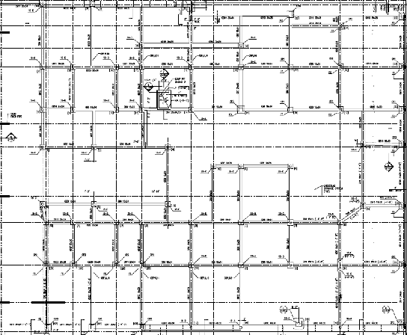
Existing Structural Systems
Foundation
Reinforced Concrete Caissons
  18” to 36” diameter embedded up to 14’ in bedrock
  Encased w/ ½” thick steel tubing
Reinforced Concrete Piers
  20”x20” to 72”x42”
  Typically extend 10’ to individual column footings that bear on bedrock
Caissons
Concrete Piers
Michael Hopper – Structural Option
AE Senior Thesis 2009
John Jay College Expansion Project
New York, NY

Slide 8
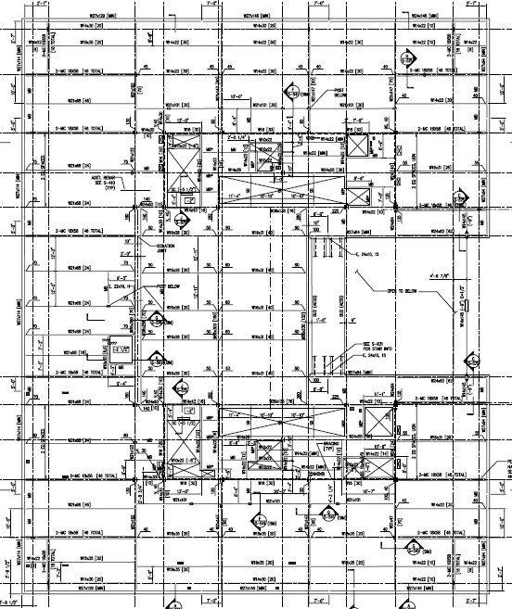
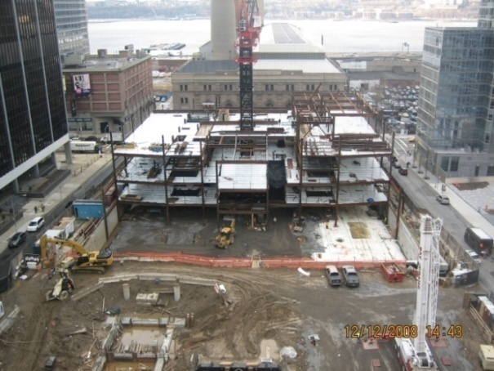
Existing Structural Systems
Gravity System
Composite Steel System
  3” metal decking spans 12’
  3 ¼” L.W. Concrete
Typical Floor-to-Floor Height is 15’
Typical Bay Spacing
38’
26’
68’
26’
38’
30’
Michael Hopper – Structural Option
AE Senior Thesis 2009
John Jay College Expansion Project
New York, NY

Slide 9
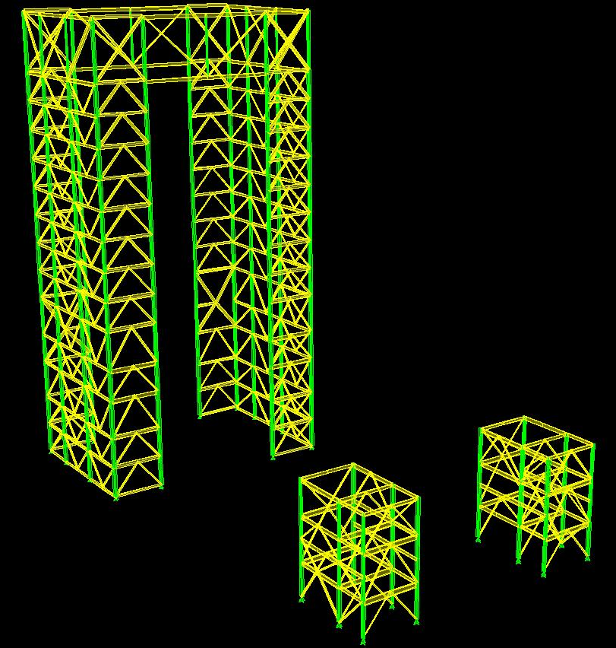
Existing Structural Systems
Lateral Force Resisting System
Concentrically Braced Frame Core
  Braces range from HSS 6x6x3/8” to HSS 16x8x1/2”
Michael Hopper – Structural Option
AE Senior Thesis 2009
John Jay College Expansion Project
New York, NY

Slide 10

Existing Structural Systems
Transfer System Solution
Typical Steel Framing
Braced Frame Core
Plate Hangers
Penthouse Trusses
Built-Up Steel Girders
Amtrak
Tunnel
Michael Hopper – Structural Option
AE Senior Thesis 2009
John Jay College Expansion Project
New York, NY

Slide 11
Presentation Outline
Project Information
Existing Structural Systems
Problem Statement and Solution
Structural Design
Architectural Studies
Construction Studies
Conclusions
Michael Hopper – Structural Option
AE Senior Thesis 2009
John Jay College Expansion Project
New York, NY

Slide 12
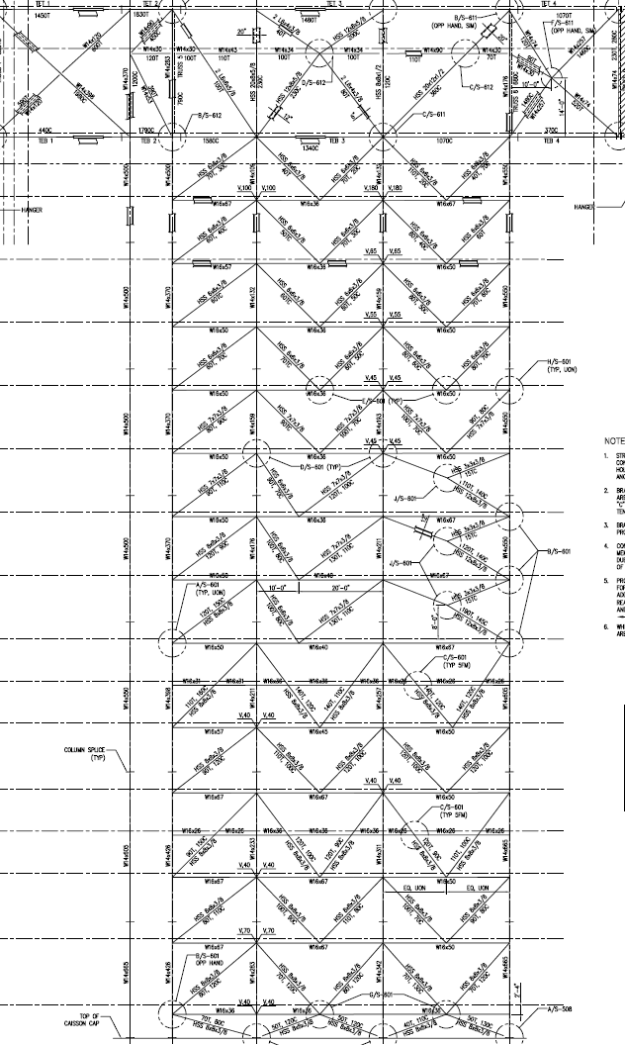
Problem Statement
Inefficient Braced Frames
Difficult Construction Methods
Use of temporary columns
Use of stiffened plate hangers to prevent buckling
Built-up girders above Amtrak tracks must support construction loads of all levels until penthouse trusses are complete
  Cannot place concrete deck until trusses are complete
Expensive premiums charged
W14x500
W14x550
Michael Hopper – Structural Option
AE Senior Thesis 2009
John Jay College Expansion Project
New York, NY

Slide 13
Problem Solution
Design a New Transfer System
Optimize the Braced Frame Core
Allow Traditional Construction Methods
Gravity Loads are transferred more efficiently
  All loads transferred down
Typical Steel Framing
Braced Frame Core
Transfer Trusses
Built-Up Steel Girders
Amtrak
Tunnel
Michael Hopper – Structural Option
AE Senior Thesis 2009
John Jay College Expansion Project
New York, NY

Slide 14
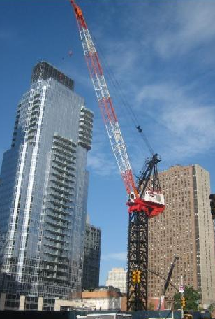
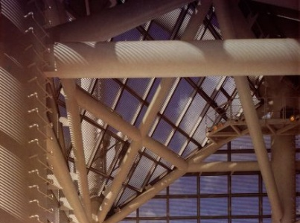
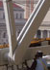
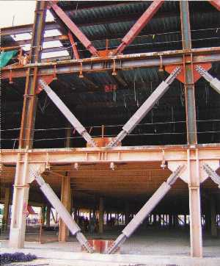
Project Goals
Create a more constructible transfer solution than the existing design
Design a series of transfer trusses which are architecturally exposed to building occupants
Design custom built-up steel shapes for exposed truss members
Perform an in-depth lateral analysis to develop an efficient design for the braced frame core
Michael Hopper – Structural Option
AE Senior Thesis 2009
John Jay College Expansion Project
New York, NY

Slide 15
Presentation Outline
Project Information
Existing Structural Systems
Problem Statement and Solution
Structural Design
Architectural Studies
Construction Studies
Conclusions
Michael Hopper – Structural Option
AE Senior Thesis 2009
John Jay College Expansion Project
New York, NY

Slide 16
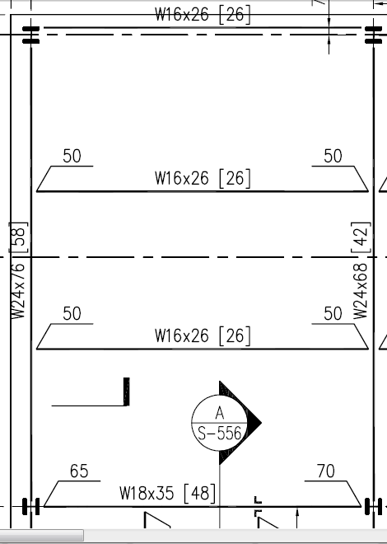
Structural Depth Studies
Corner Column Relocation and Floor Framing Design
W18x40 [26]
W18x40 [26]
W24x68 [28]
W24x68 [28]
W18x40 [26]
Existing Plate Hanger Location
New Column Location
W18x40 [26]
2 Plate Hangers
1 Corner Column
Michael Hopper – Structural Option
AE Senior Thesis 2009
John Jay College Expansion Project
New York, NY

Slide 17
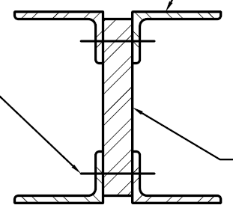
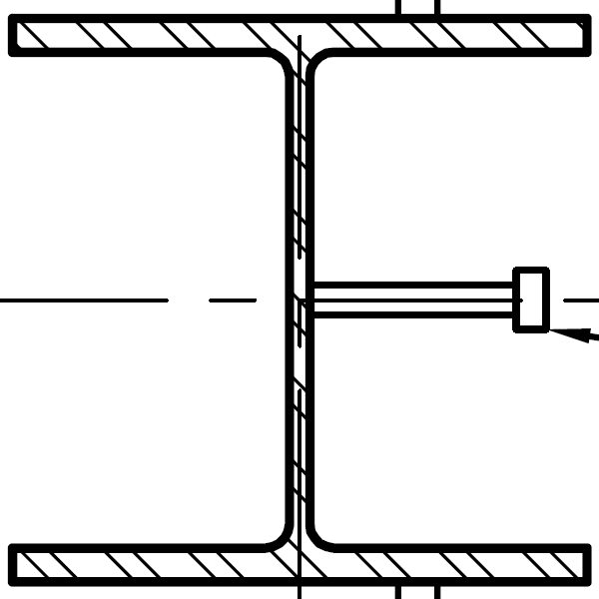
Structural Depth Studies
Corner Column Relocation and Design
Existing Plate Hangers
New Columns
Easier to Construct
Total Weight: 107 kips
Need to reinforce plates during construction to avoid buckling
Total Weight: 112 kips
Typical steel framing can be used
Michael Hopper – Structural Option
AE Senior Thesis 2009
John Jay College Expansion Project
New York, NY

Slide 18
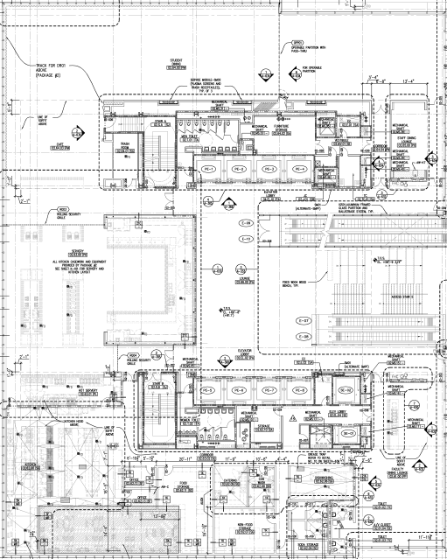
Structural Depth Studies
Transfer Truss Layout
Michael Hopper – Structural Option
AE Senior Thesis 2009
John Jay College Expansion Project
New York, NY

Slide 19
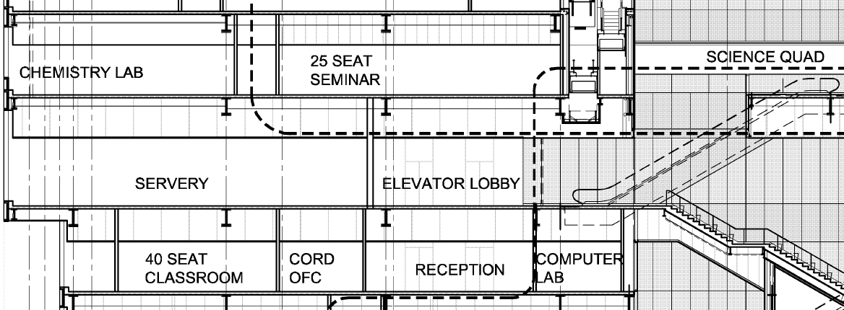
Structural Depth Studies
Transfer Truss Layout
Level 7
15’
Level 6
5th Floor Mechanical Mezzanine
10’
Level 5m
10’
Level 5
15’
Level 4
20’ Floor-to-Floor Height
Michael Hopper – Structural Option
AE Senior Thesis 2009
John Jay College Expansion Project
New York, NY

Slide 20
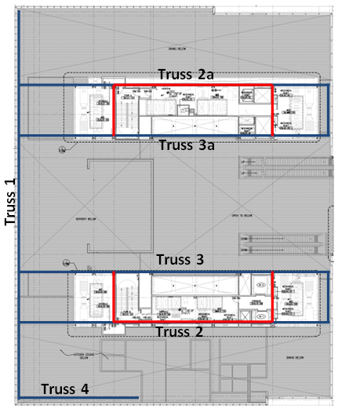
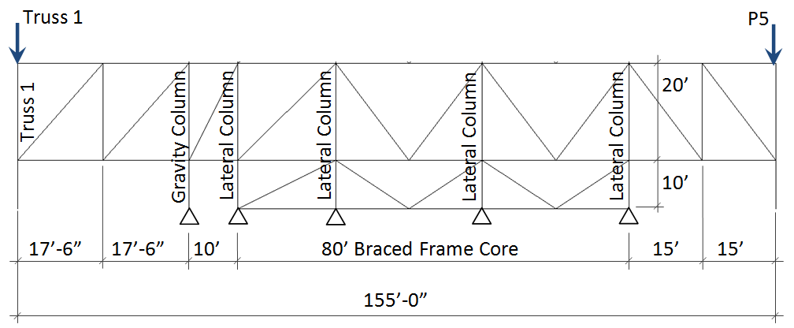
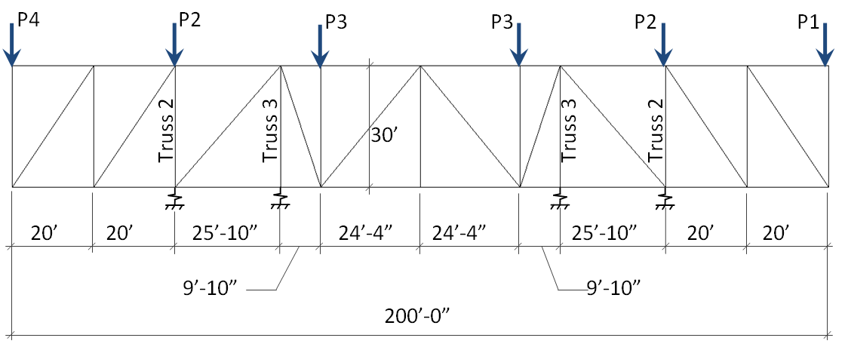
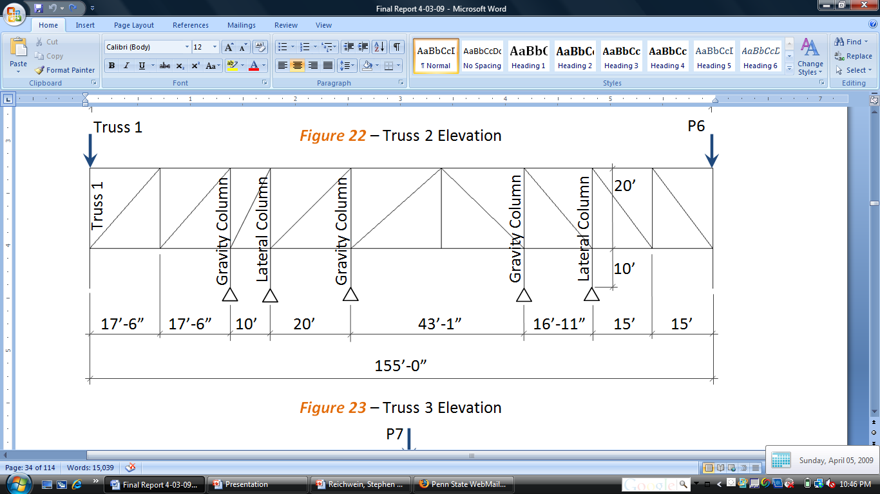
Structural Depth Studies
Transfer Truss Analysis
Truss 1
Truss 2
Truss 3
Loads | P1 | P2 | P3 | P4 | P5 | P6 | P7
Pu (kips) | 804 | 1450 | 1668 | 876 | 1162 | 1753 | 1296
Michael Hopper – Structural Option
AE Senior Thesis 2009
John Jay College Expansion Project
New York, NY

Slide 21
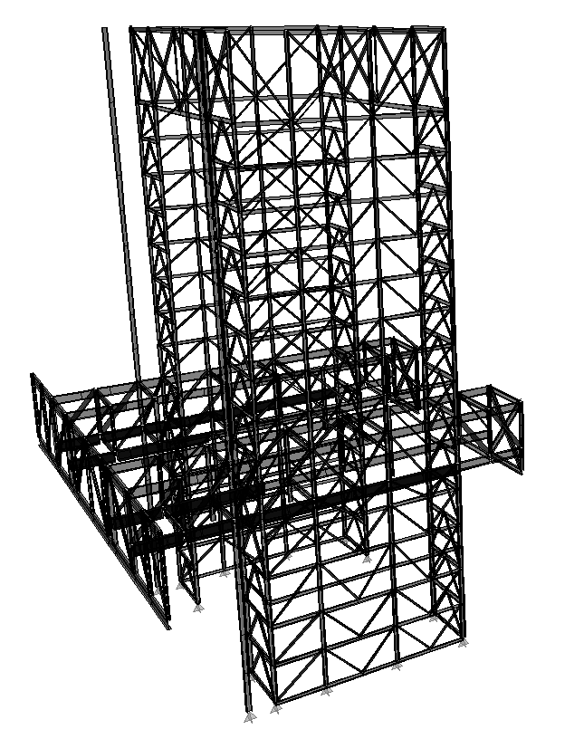
Structural Depth Studies
Truss Analysis – ETABS Gravity Model
Diagonal web members are pinned at each end
Top and bottom chords are continuous
Floor diaphragms were not modeled
  Top and bottom chords resist axial and bending forces
  Chord unbraced lengths were taken as the distance between vertical web members
Gravity Model was also used for deflection calculations
Michael Hopper – Structural Option
AE Senior Thesis 2009
John Jay College Expansion Project
New York, NY

Slide 22
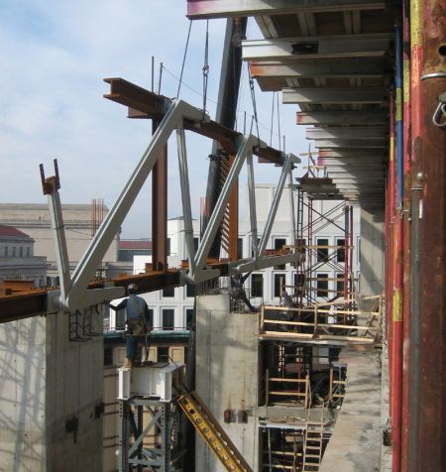
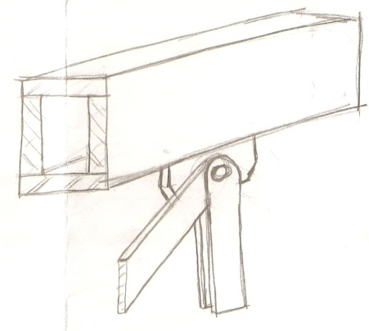
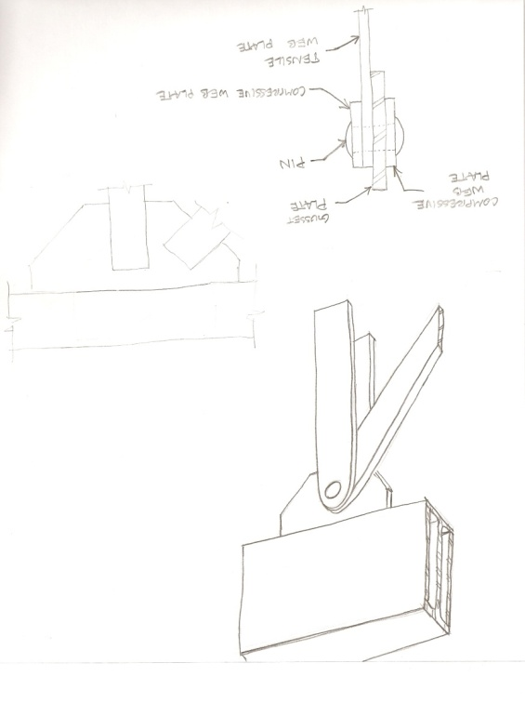
Structural Depth Studies
Truss Member Design
Desired Truss Details
Design of all custom and built-up steel sections comply with the Specification of the 13th Edition AISC Steel Construction Manual
The Newseum “Megatruss”
Michael Hopper – Structural Option
AE Senior Thesis 2009
John Jay College Expansion Project
New York, NY

Slide 23
Structural Depth Studies
Truss 1 Final Design
Member | Section | Design Forces
Top and Bottom Chords | W40x362 | 2700 kips (T) 1960 ft-kips
Web Tension Member | 18 x 4 ¼” Plate | 2430 kips
Web Compression Member | (2) 16 x 3” Plates stitched at 2’ | 1960 kips
Common Truss Members | W36x441 | 3410 kips (C) 680 ft-kips
Michael Hopper – Structural Option
AE Senior Thesis 2009
John Jay College Expansion Project
New York, NY

Slide 24
Structural Depth Studies
Truss 2 Final Design
Member | Section | Design Forces
Top Chord | W36x800 | 5800 kips (T) 4500 ft-kips
Bottom Chord | Built-Up Box | 6000 kips (C) 9500 ft-kips
Web Tension Member | 28 x 5” Plate | 4850 kips
Web Compression Member | (2) 16 x 3” Plates stitched at 1’ | 3370 kips
Common Truss Members | W36x441 | 3410 kips (C) 680 ft-kips
4” thick flanges
1 ½” thick web
50” deep x 24” wide
Weighs 1082 PLF
Michael Hopper – Structural Option
AE Senior Thesis 2009
John Jay College Expansion Project
New York, NY

Slide 25
Structural Depth Studies
Transfer Truss Comparison
Criteria | Thesis Transfer System | Existing Transfer System
Number of Transfer Trusses | 6 | 10
Perimeter Columns Transferred | 11/20 (55%) | 24/24 (100%)
Total Web Members | 102 | 206
Avg. Truss Weight (kips) | 230 | 152
Interior Truss Height | 20’-0” | 30’-0”
Number of Levels Being Transferred w/ Trusses | 11 | 10
Michael Hopper – Structural Option
AE Senior Thesis 2009
John Jay College Expansion Project
New York, NY

Slide 26
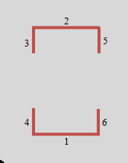
Structural Depth Studies
Lateral Analysis and Design
Tower Braced Frame Core Re-design
ETABS Lateral Model
  Floors modeled as rigid diaphragms
  Lateral loads distributed based on relative stiffness of each braced frame
Lateral loads determined using ASCE 7-05
  Wind: Method 2 of Chapter 6
  Seismic: ELFP of Chapter 11 (SDC: B)
  Wind governed for strength and serviceability
Michael Hopper – Structural Option
AE Senior Thesis 2009
John Jay College Expansion Project
New York, NY

Slide 27
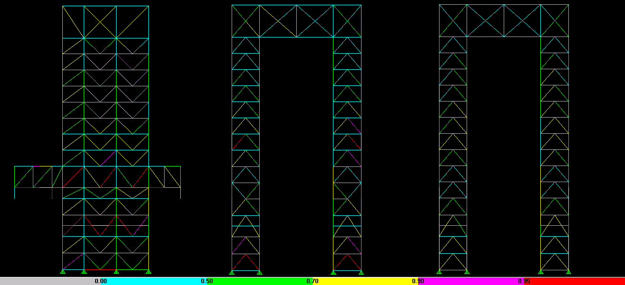
Structural Depth Studies
Lateral Analysis and Design
  Braced Frame Configurations and Demand-to-Capacity Ratios
Coupling Trusses
  1 & 2 3 4 5 6
Michael Hopper – Structural Option
AE Senior Thesis 2009
John Jay College Expansion Project
New York, NY

Slide 28
Structural Depth Studies
Lateral Analysis and Design – Braced Frame 1 & 2
Existing Typical Members
Re-designed Typical Members
Level | Column | Brace | Girder
1 - 3 | W14x665 | HSS 8x8x3/8 | W16x67
4-7 | W14x605 | HSS 8x8x3/8 | W16x45
7-10 | W14x550 | HSS 7x7x3/8 | W16x36
11-14 | W14x550 | HSS 6x6x3/8 | W16x36
Level | Column | Brace | Girder
1 - 3 | W14x455 | HSS 8x8x3/8 | W16x67
4-7 | W14x455 | HSS 8x8x5/8 | W16x45
7-10 | W14x176 | HSS 8x8x3/8 | W16x36
11-14 | W14x99 | HSS 6x6x3/8 | W16x36
Largest Brace is an HSS 8x8x3/8
Largest Brace is an HSS 20x12x5/8
New braced frame design resulted in saving
71 tons of steel in columns
Michael Hopper – Structural Option
AE Senior Thesis 2009
John Jay College Expansion Project
New York, NY

Slide 29
Structural Depth Studies
Lateral Drift – ASCE 7-05
Calculated Lateral Drifts
  Wind:
  LC: 0.7W (App. C)
  Seismic:
    δ_{xe} C_{d} / I
Lateral Drift Limitations
  Wind:
    H/400
  Seismic:
    0.015h_{sx}
Lateral Drifts due to wind governed
  Maximum drift is in N-S direction
Michael Hopper – Structural Option
AE Senior Thesis 2009
John Jay College Expansion Project
New York, NY

Slide 30
Structural Depth Studies
Lateral Drift – New York City Building Code
Necessary to compare re-design to the original design criteria
Michael Hopper – Structural Option
AE Senior Thesis 2009
John Jay College Expansion Project
New York, NY

Slide 31
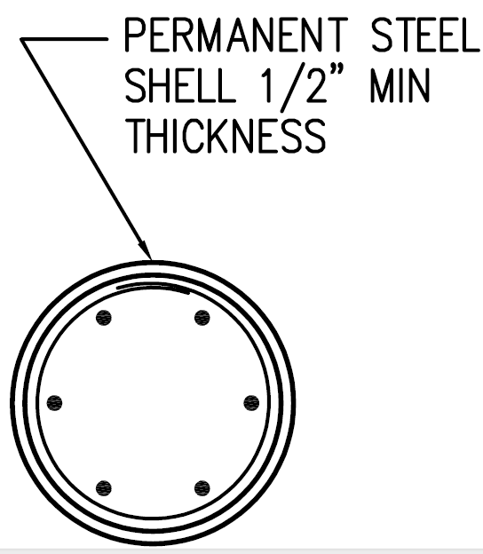
Structural Depth Studies
Foundation Impacts
Perimeter columns not transferred using 5th level trusses now extend to the foundation
Existing concrete caissons support 5 levels of gravity load, where the new design calls for 14 levels of gravity loads
 | Existing | Thesis
Diameter | 18” | 36”
Reinforcement | (7) #14 Bars | (11) #14 Bars
Impacts are minimal as only 7 caissons need changed
Michael Hopper – Structural Option
AE Senior Thesis 2009
John Jay College Expansion Project
New York, NY

Slide 32
Presentation Outline
Project Information
Existing Structural Systems
Problem Statement and Solution
Structural Design
Architectural Studies
Construction Studies
Conclusions
Michael Hopper – Structural Option
AE Senior Thesis 2009
John Jay College Expansion Project
New York, NY

Slide 33
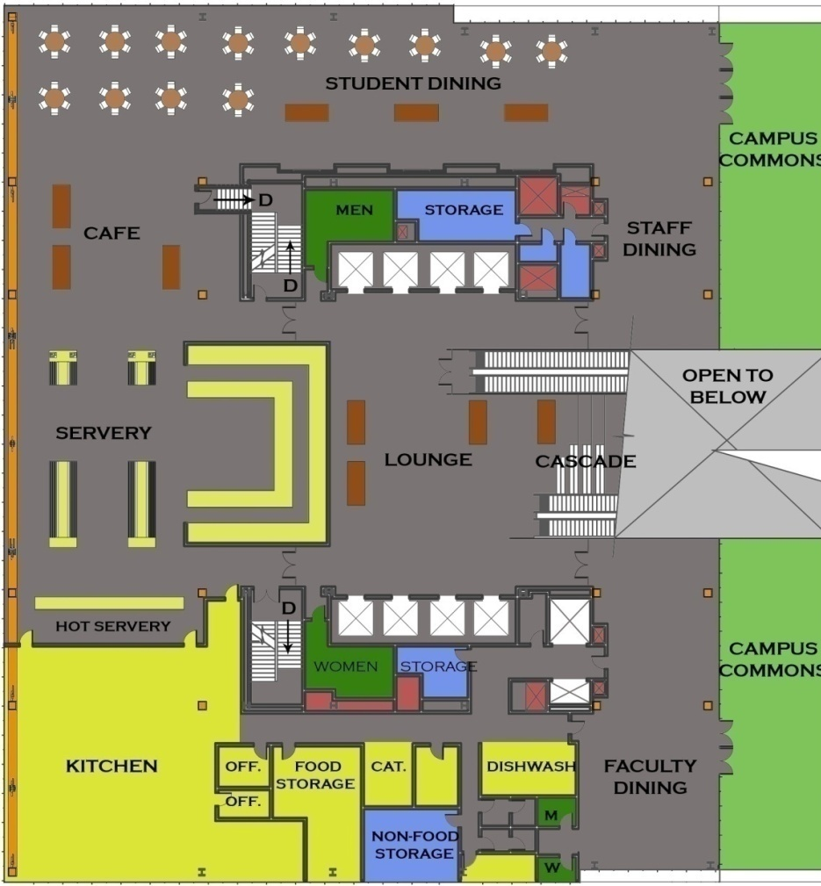
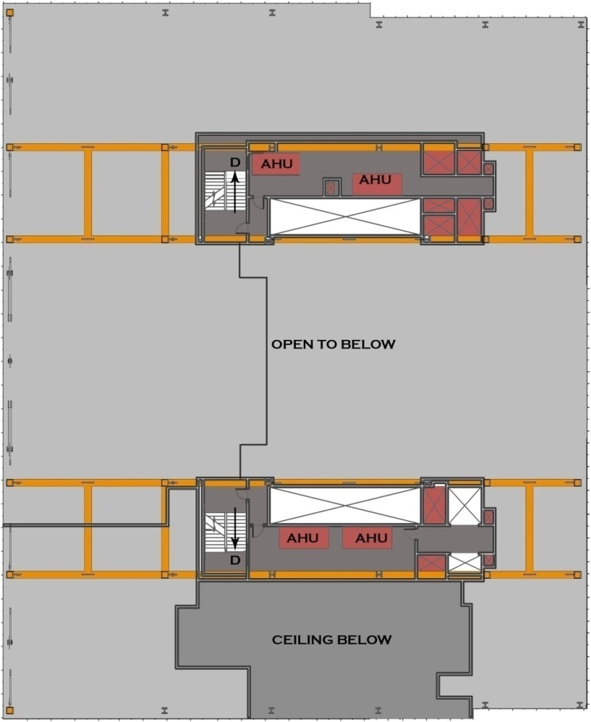
Architectural Breadth Studies
5th Level Floor Plan
5th Level Mezzanine Floor Plan
2
2
1
1
Michael Hopper – Structural Option
AE Senior Thesis 2009
John Jay College Expansion Project
New York, NY

Slide 34
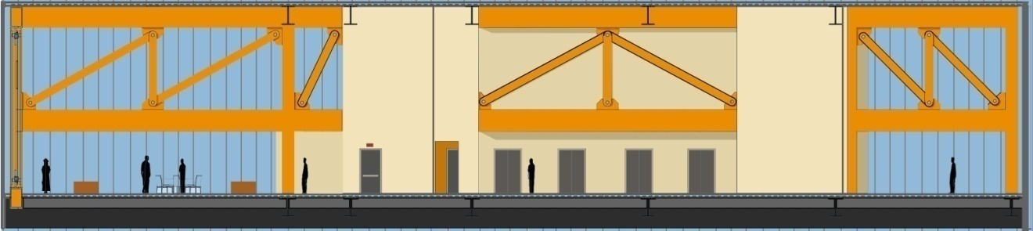
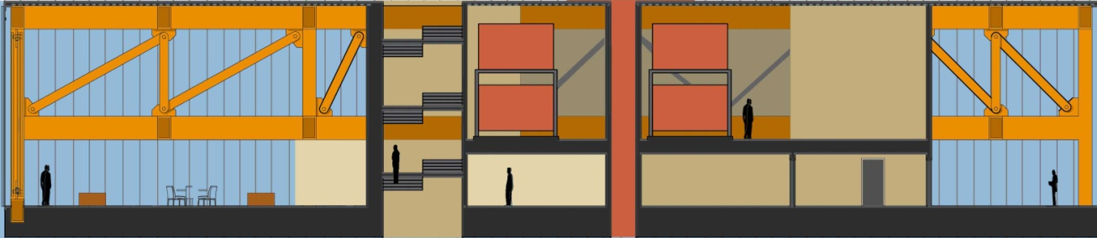
Architectural Breadth Studies
Section 1
Section 2
AHU AHU
AHU AHU
Michael Hopper – Structural Option
AE Senior Thesis 2009
John Jay College Expansion Project
New York, NY

Slide 35
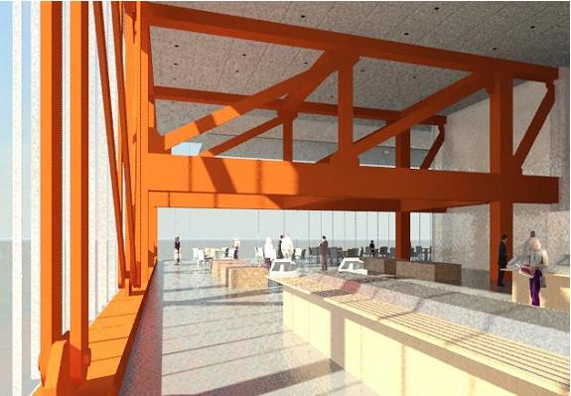
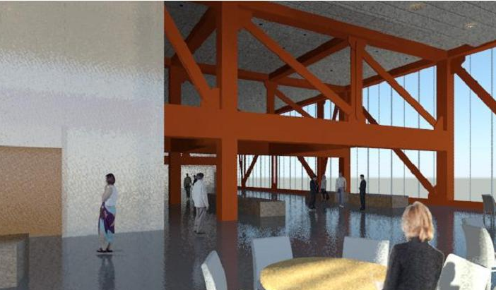
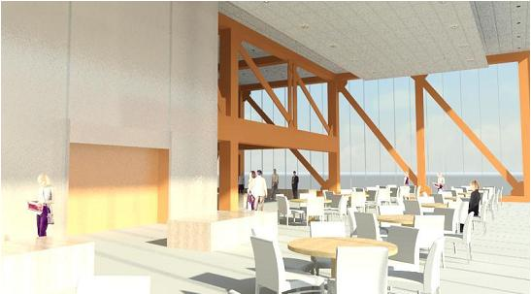
Architectural Breadth Studies
Interior Renderings
Michael Hopper – Structural Option
AE Senior Thesis 2009
John Jay College Expansion Project
New York, NY

Slide 36
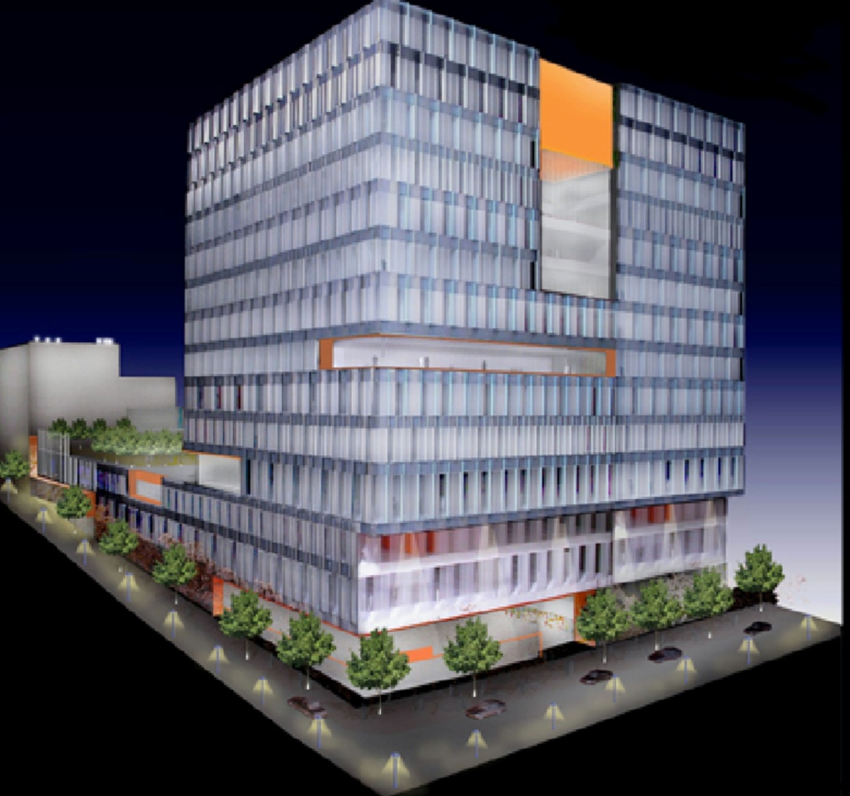
Architectural Breadth Studies
Existing Exterior
Renderings
Michael Hopper – Structural Option
AE Senior Thesis 2009
John Jay College Expansion Project
New York, NY

Slide 37
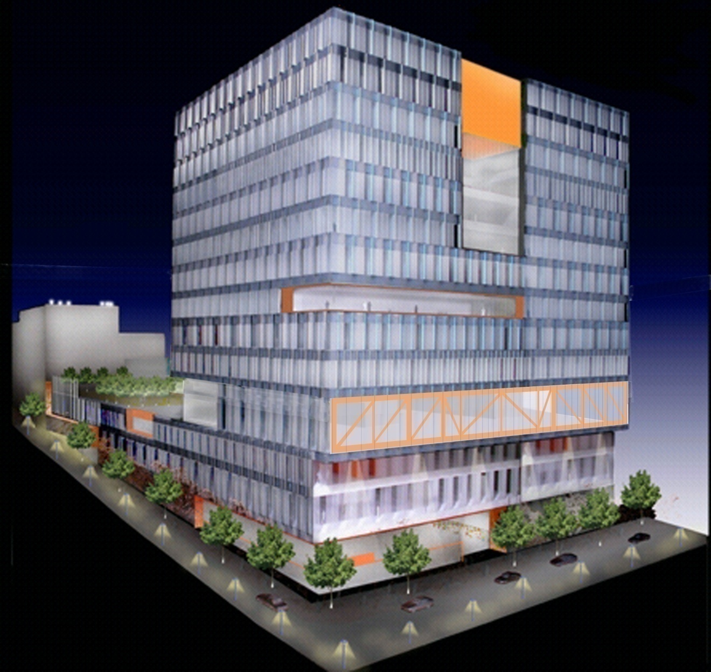
Architectural Breadth Studies
New Exterior
Renderings
Michael Hopper – Structural Option
AE Senior Thesis 2009
John Jay College Expansion Project
New York, NY

Slide 38
Presentation Outline
Project Information
Existing Structural Systems
Problem Statement and Solution
Structural Design
Architectural Studies
Construction Studies
Conclusions
Michael Hopper – Structural Option
AE Senior Thesis 2009
John Jay College Expansion Project
New York, NY

Slide 39
Construction Management Breadth Studies
Cost Comparison
 | Thesis (kips) | Existing (kips)
Cost of Steel | $ 5.91 Million | $ 6.15 Million
Increased Curtain Wall Cost | $ .820 Million | --
Total | $ 6.74 Million | $ 6.15 Million*
* Does not include premiums charged for difficult hanging construction
Both systems cost about the same
Michael Hopper – Structural Option
AE Senior Thesis 2009
John Jay College Expansion Project
New York, NY

Slide 40
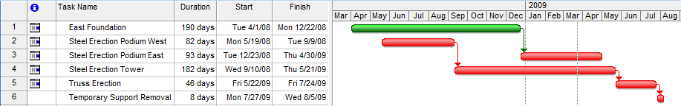
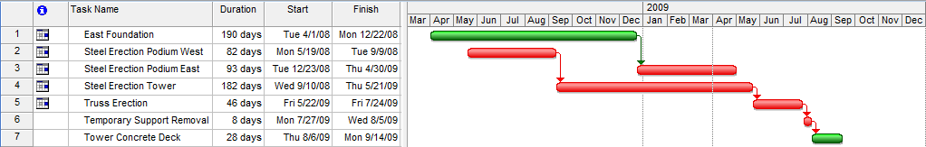
Construction Management Breadth Studies
Schedule Comparison – Existing Sequence
Steel Erection Time: 63 Weeks
Total Superstructure Time: 70 Weeks
Amtrak
Tunnel
Michael Hopper – Structural Option
AE Senior Thesis 2009
John Jay College Expansion Project
New York, NY

Slide 41
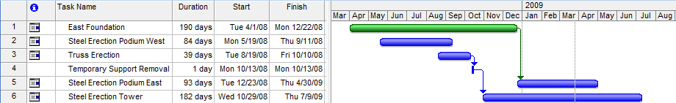
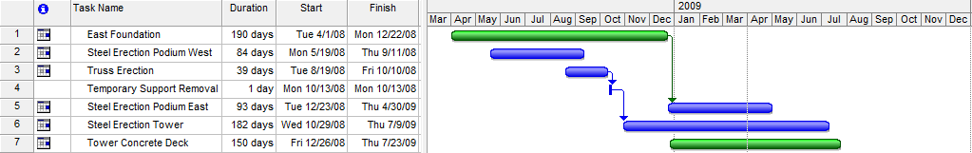
Construction Management Breadth Studies
Schedule Comparison – New Sequence
Steel Erection Time: 60 Weeks
Total Superstructure Time: 64 Weeks
Amtrak
Tunnel
Michael Hopper – Structural Option
AE Senior Thesis 2009
John Jay College Expansion Project
New York, NY

Slide 42
Construction Management Breadth Studies
Construction Conclusions
 | Thesis Transfer System | Existing Transfer System
Structural System Cost | $ 5.91 Million | $ 6.15 Million
Total Cost | $ 6.74 Million | $ 6.15 Million*
Steel Erection Schedule (Weeks) | 60 | 63
Entire Superstructure Schedule (Weeks) | 64 | 70
Steel erection tops out 3 weeks earlier using the new transfer system
Total superstructure schedule is 6 weeks less using the new transfer system
Less trusses and truss members
Eliminating the use of temporary supports in tower construction
Using typical steel framing
Michael Hopper – Structural Option
AE Senior Thesis 2009
John Jay College Expansion Project
New York, NY

Slide 43
Presentation Outline
Project Information
Existing Structural Systems
Problem Statement and Solution
Structural Design
Architectural Studies
Construction Studies
Conclusions
Michael Hopper – Structural Option
AE Senior Thesis 2009
John Jay College Expansion Project
New York, NY

Slide 44

Conclusions and Recommendation
Braced Frame Core was optimized by relocating the transfer trusses to the 5th level
Exposed steel transfer trusses with custom steel members compliment the 5th level dining commons
A more constructible structure was achieved
Recommendation:
Use the new transfer solution
Michael Hopper – Structural Option
AE Senior Thesis 2009
John Jay College Expansion Project
New York, NY

Slide 45
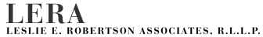
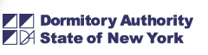
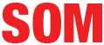
Acknowledgements
A special thanks to:
Jason Stone, PE
Patrick Hopple
Ramesh Rastogi
I also would like to thank my friends and family for their support over the past year, this project would not have been possible without you.
Michael Hopper – Structural Option
AE Senior Thesis 2009
John Jay College Expansion Project
New York, NY

Slide 46
Questions?
Michael Hopper – Structural Option
AE Senior Thesis 2009
John Jay College Expansion Project
New York, NY

Slide 47

Building Height Limitations
C6-2 Special Purpose Zone – No Maximum Building Height
However, NYC has building setback requirements
Sky Exposure Plane
  For a C6-2 Zone, vertical to horizontal ratio is 7.6 : 1
  Existing design requires a setback of 20’ at the roof and only 15’ is provided
  Assumed that a variance was obtained or the zone was changed
Michael Hopper – Structural Option
AE Senior Thesis 2009
John Jay College Expansion Project
New York, NY

Slide 48



Braced Frames
1 & 2 3 4 5 6
Michael Hopper – Structural Option
AE Senior Thesis 2009
John Jay College Expansion Project
New York, NY

Slide 49
Load Combinations
ASCE 7 – 05 Load Combinations
1. 1.4D
2. 1.2D + 1.6L + 0.5L_{r}
3. 1.2D + 1.6L_{r} + (L or 0.8W)
4. 1.2D + 1.6W + L + 0.5L_{r}
5. (1.2 + 0.2S_{DS})D + E + L
6. 0.9D + 1.6W
7. (0.9 – 0.2S_{DS})D + E
Transfer System Members
Braced Frame Members
Michael Hopper – Structural Option
AE Senior Thesis 2009
John Jay College Expansion Project
New York, NY

Slide 50
Scheduling Assumptions
Activity | Thesis (Duration in Days/Level) | Existing (Duration in Days/Level)
Erect Columns | 1 | 1
Erect Braced Frames | 1 | 1
Erect Typical Floor Framing | 7 | 7
Decking and Detailing | 10 | 10
Erect Temporary Columns | 1 | 1
Erect Reinforced Plate Hangers | N/A | 1
Erect Truss Bottom Chords | 3 | 4
Erect Truss Top Chords | 2 | 4
Erect Truss Web Members | 3 | 6
Detail and Plum Trusses | 5 | 10
Remove Temporary Columns/Reinforced Plates | 1¹ | 5¹
Placing Concrete Decking | 10² | 2³
¹ - Unit is Total Days
² – Includes duration of embeds, box outs, rebar, and placing concrete
³ – Includes placing concrete
Michael Hopper – Structural Option
AE Senior Thesis 2009
John Jay College Expansion Project
New York, NY

Slide 51
Truss Cambers and Deflections
2.2” 1.1” .5”
2.6” 1.5” .5” .83”
Truss 1
Maximum Live Load Deflections
Truss | L | 0.5Δ_{L} | (L/250)
 | (ft) | (in) | (in)
1 | 40 | 1.41 | 1.92
2 | 35 | 0.73 | 1.68
2a | 35 | 0.35 | 1.68
3 | 35 | 0.53 | 1.68
3a | 35 | 0.36 | 1.68
1.96” 1.08” .66” 1.2”
Truss 2
Truss 3
Michael Hopper – Structural Option
AE Senior Thesis 2009
John Jay College Expansion Project
New York, NY

Slide 52



Existing Structural Systems
Transfer System Solution
Floors 1 – 5 transferred using
built-up girders
Floors 6 – Roof are hanging and
are transferred at the penthouse
level using trusses
Michael Hopper – Structural Option
AE Senior Thesis 2009
John Jay College Expansion Project
New York, NY

Slide 53

Existing Structural Systems
Transfer System Solution
Floors 6 – Penthouse use
perimeter plate hangers instead
of columns
Perimeter Plate Hangers
Michael Hopper – Structural Option
AE Senior Thesis 2009
John Jay College Expansion Project
New York, NY

Slide 54

Structural Depth Studies
Transfer Truss Analysis
Truss 1
Truss 2
Truss 3
Truss 4
Loads | P1 | P2 | P3 | P4 | P5 | P6 | P7
Pu (kips) | 804 | 1450 | 1668 | 876 | 1162 | 1753 | 1296
Michael Hopper – Structural Option
AE Senior Thesis 2009
John Jay College Expansion Project
New York, NY

Slide 55
Structural Depth Studies
Lateral Analysis and Design
Existing Braced Frame 3 & 4
Re-designed Braced Frame 3 & 4
Level | Column | Brace | Girder
1 - 3 | W14x426 | HSS 8x8x3/8 | W24x84
4-7 | W14x398 | HSS 20x8x1/2 | W16x67
7-10 | W14x370 | HSS 8x8x3/8 | W16x36
11-14 | W14x500 | HSS 16x8x1/2 | W16x36
Level | Column | Brace | Girder
1 - 3 | W14x426 | HSS 12x8x5/8 | W24x84
4-7 | W14x550 | HSS 20x8x5/8 | W16x67
7-10 | W14x132 | HSS 8x8x1/2 | W16x36
11-14 | W14x132 | HSS 12x8x3/8 | W16x36
Michael Hopper – Structural Option
AE Senior Thesis 2009
John Jay College Expansion Project
New York, NY

Slide 56
Structural Depth Studies
Lateral Analysis and Design
Existing Braced Frame 5 & 6
Re-designed Braced Frame 5 & 6
Level | Column | Brace | Girder
1 - 3 | W14x665 | HSS 8x8x3/8 | W24x84
4-7 | W14x605 | HSS 10x8x3/8 | W24x94
7-10 | W14x455 | HSS 10x8x3/8 | W24x94
11-14 | W14x342 | HSS 16x8x1/2 | W24x94
Level | Column | Brace | Girder
1 - 3 | W14x500 | HSS 8x8x3/8 | W24x84
4-7 | W14x730 | HSS 8x8x3/8 | W24x94
7-10 | W14x370 | HSS 8x8x3/8 | W24x94
11-14 | W14x159 | HSS 12x8x3/8 | W24x94
New braced frame design resulted in saving
71 tons of steel in columns!
Michael Hopper – Structural Option
AE Senior Thesis 2009
John Jay College Expansion Project
New York, NY

Slide 57
Structural Depth Studies
Lateral Drift – New York City Building Code
Necessary to compare re-design to the original design criteria
NYC Building Code Wind Pressures
Height | Pressure (PSF)
0 – 100’ | 20
100’ – 300’ | 25
Limit: H/500
Design Drift Limitation Comparison
Design | Base Shear | Limit
 | (N-S)
ASCE 7-05 | 1476 | H/400
NYC BC | 1379 | H/500
Michael Hopper – Structural Option
AE Senior Thesis 2009
John Jay College Expansion Project
New York, NY

Slide 58

Existing Structural Systems
Lateral Force Resisting System
Concentrically Braced Frame Core
  Braces range from HSS 6x6x3/8” to HSS 16x8x1/2”
Michael Hopper – Structural Option
AE Senior Thesis 2009
John Jay College Expansion Project
New York, NY

Slide 59
Construction Management Breadth Studies
Weight Comparison
System | Thesis (kips) | Existing (kips)
Trusses | 1380 | 1521
Perimeter Columns/Plate hangers | 112 | 107
Braced Frame Core | 1324 | 1304
Built-Up Girders | 235 | 294
Total | 3051 | 3226
New transfer system weighs 87 tons less than the existing design
Michael Hopper – Structural Option
AE Senior Thesis 2009
John Jay College Expansion Project
New York, NY

