Slide 1
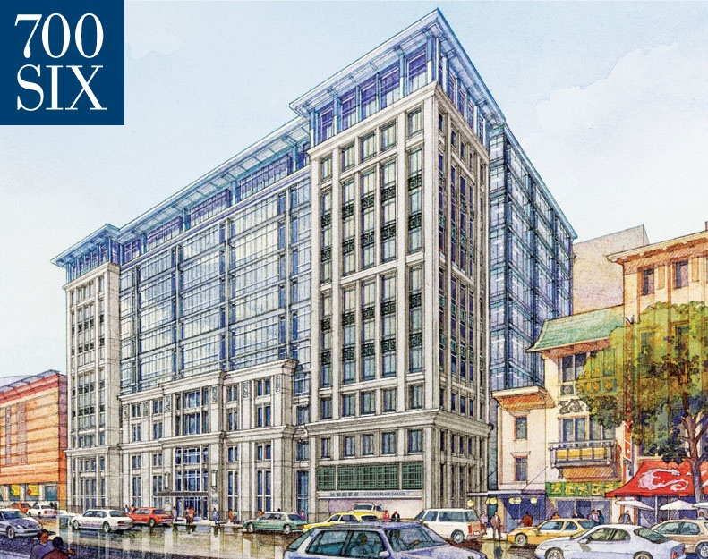
AE Senior Thesis 2010
April 12th 2010
700 Sixth Street

Slide 2
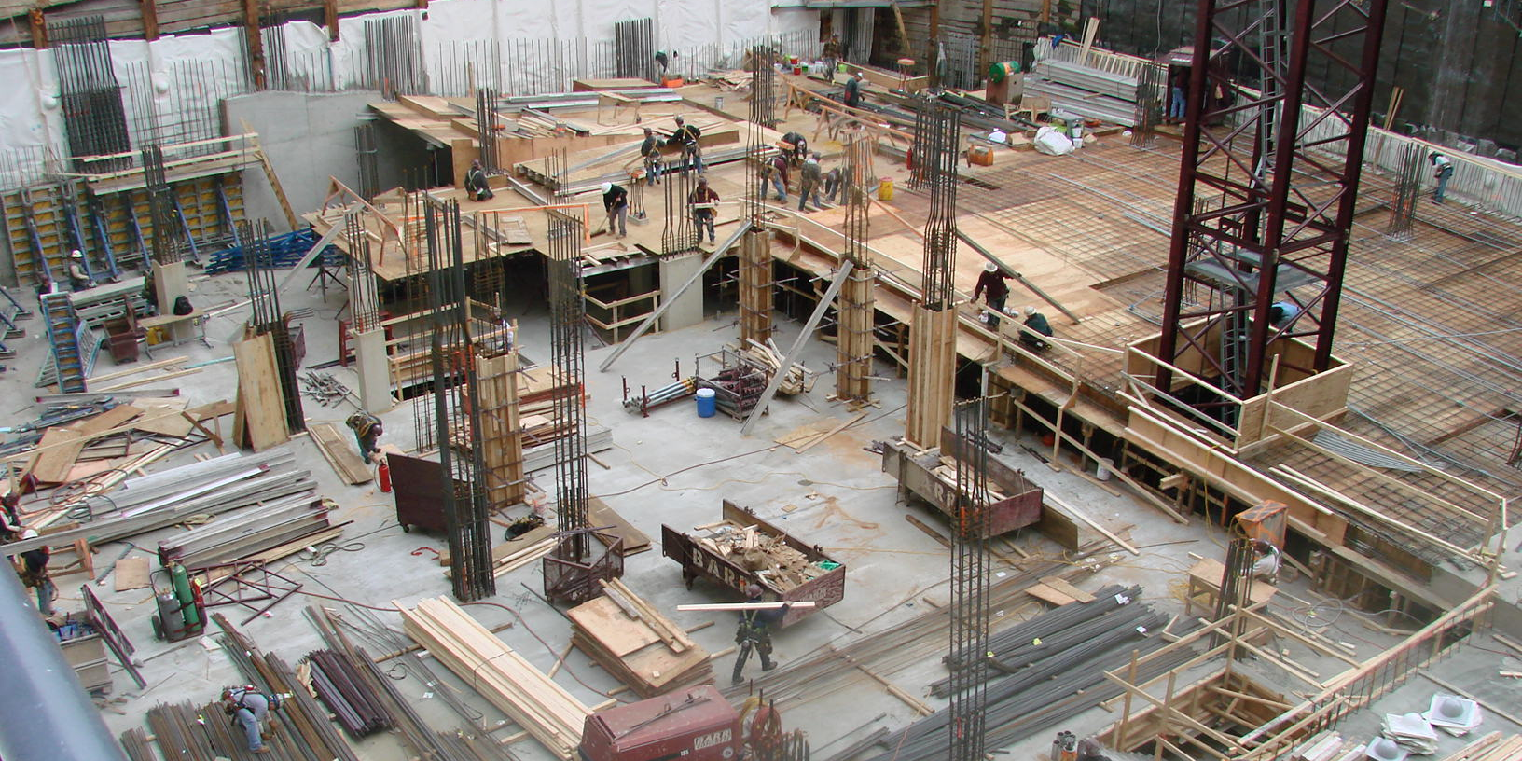
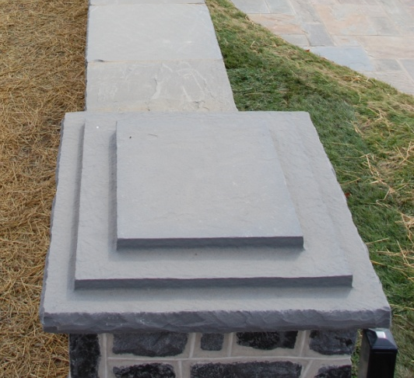
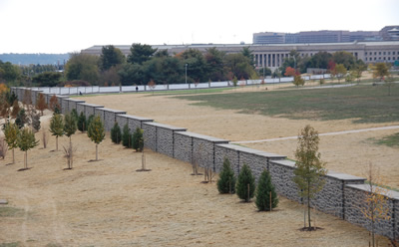
Shane Flynn
Hometown
Lakewood, PA
Have a family stone business
Flynnstone
Arlington National Cemetery
Visit website for more info
www.flynnstonerocks.com
Arlington National Cemetery Niche Wall
About Myself
700 Sixth Street

Slide 3
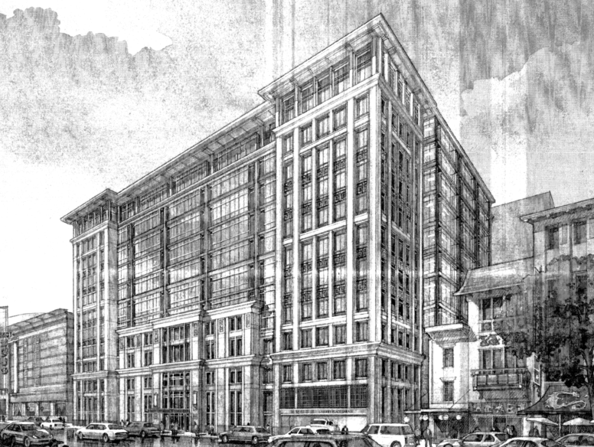
General Data
Size:
300,000 S.F. 12 Story Office Space w/ 3 1/2 Level Underground Parking Garage
Location:
Downtown DC (Next to Verizon Center)
Contract Value:
$46.5 million
Project Schedule:
May 2007 thru May 2009
Building Features:
Innovative Green Roof Design
Glass Bridge Located in the Lobby
Curtain Wall/Pre-Cast/Stone Façade
Contracted at LEED ‘Silver’ (Rated LEED ‘Platinum’)
700 6th Street Rendering
Project Overview
700 Sixth Street

Slide 4
Size:
300,000 S.F. 12 Story Office Space w/ 3 1/2 Level Underground Parking Garage
Location:
Downtown DC (Next to Verizon Center)
Contract Value:
$51.3 million
Project Schedule:
May 2007 thru March 2009
Building Features:
Innovative Green Roof Design
Glass Bridge Located in the Lobby
Curtain Wall/Pre-Cast/Stone Façade
Contracted at LEED ‘Silver’ (Rated LEED ‘Platinum’)
Green Roof
Project Overview
700 Sixth Street

Slide 5
Size:
294,000+ S.F. 12 Story Office Space w/ 3 1/2 Level Underground Parking Garage
Location:
Downtown DC (Next to Verizon Center)
Contract Value:
$51.3 million
Project Schedule:
May 2007 thru March 2009
Building Features:
Innovative Green Roof Design
Glass Bridge located in the Lobby
Curtain Wall/Pre-Cast/Stone Façade
Contracted at LEED ‘Silver’ (Rated LEED ‘Platinum’)
Glass Bridge
Project Overview
700 Sixth Street

Slide 6
Size:
300,000 S.F. 12 Story Office Space w/ 3 1/2 Level Underground Parking Garage
Location:
Downtown DC (Next to Verizon Center)
Contract Value:
$46.5 million
Project Schedule:
May 2007 thru May 2009
Building Features:
Innovative Green Roof Design
Lobby Glass Bridge
Curtain Wall/Pre-Cast/Stone Façade
Contracted at LEED ‘Silver’ (Rated LEED ‘Platinum’)
Building Façade
Project Overview
700 Sixth Street

Slide 7
Mechanical:
VAV System
Main components located on the Penthouse floor
3 cooling towers
Emergency generator
Each individual floor has a mechanical room
25 air handling units located throughout the building
Project Overview
700 Sixth Street

Slide 8
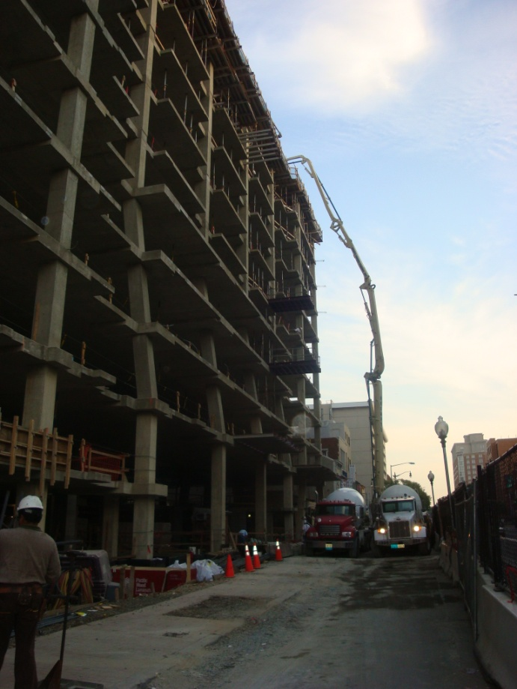
Structural System:
Cast In Place Concrete
Footings
Foundation Walls
Grade Beams
Slab on Grade
Suspended Slabs
Columns
Column Spacing 30’ x 30’
Columns typically 24” x 24”
Finished Ceiling Height 8’-6”
Typical Slab Thickness is 9”
Cast in Place
Project Overview
700 Sixth Street

Slide 9
Major Players in Construction:
Owner: Akridge Real Estate Services
General Contractor/Construction Manager: Balfour Beatty Construction
Architect: HOK
Engineer: Cagley & Associates
MEP Engineer: Girard Engineering
LEED Consultant: Sustainable Design Consulting
Commissioning Consultant: Advanced Building Performance
Project Overview
700 Sixth Street

Slide 10
Topics to be Presented:
Construction Industry Issue
It’s Never to Late to Go Green
Alternative Stone For Lobby
Precast vs. Handset Stone (Architectural Breadth)
Not Presenting:
Glass Bridge Improvements (Structural Breadth)
Topics to be presented
700 Sixth Street

Slide 11
Nov. 08 75% of Construction Completed (Owner decides to go for ‘Platinum’)
December 09-Notified of ‘Platinum’
It’s never to late to go green
700 Sixth Street

Slide 12
Final LEED Scorecard (Added 12 points from original design)
It’s never to late to go green
700 Sixth Street

Slide 13
Relevant Overview of LEED Items:
Item #1: Improve Energy Design Performance (Most Important)
Item #2: Increase Recycled Content to 20%
Item #3: Increase Construction Waste Management to 75%
Item #4: 20% of Materials needed to be Within a 500 Mile Radius
Item #5: Low Emitting Materials
Item #6: 40% Water Use Reduction
It’s never to late to go green
700 Sixth Street

Slide 14
Item #1: Energy Design Performance
“Baseline” Projections
$2.41/SF annual energy cost
Initial Design Performance
16.3% savings over baseline = 2 points
$2.02/SF annual energy cost
It’s never to late to go green
700 Sixth Street

Slide 15
Item #1: Energy Design Performance
Energy Design Strategies (Need to get energy performance over 21%)
Upgrading core lighting (Changed restroom lighting to LED)
Reducing garage lighting power density (Lowered Foot Candle Levels and redesigned layout)
Adding garage lighting occupancy sensors (Provides 15 minutes of illumination when tripped)
Adding tenant day lighting controls (lease requires use of dimmable perimeter zone fixtures)
It’s never to late to go green
700 Sixth Street

Slide 16
Item #1: Energy Design Performance
Platinum Strategy Energy Savings
Cumulative Savings = 21.4% compared to baseline projections; 4 points achieved total
$151,770/yr utility cost savings
$0.52/SF annual utility cost savings
It’s never to late to go green
700 Sixth Street

Slide 17
Item #2: Increase Recycled Content to 20%
Originally contracted for 10%
All steel and aluminum used on project was recycled
Toilet partitions
CMU
Construction team achieved 20.5% (barely enough)
Achieved another LEED point
It’s never to late to go green
700 Sixth Street

Slide 18
Item #3: Increased Construction Waste Management
Divert debris from disposal in landfills.
LEED provides 1 point for 50% diversion which is what they were contracted to do
LEED provides 1 additional point if 75% diversion is obtained
How did Balfour Beatty achieve this?
Developed construction waste management plans with subcontractors
Subcontractor reported the percentages of waste diverted from land fills
Reported recycling percentages monthly
During excavation a demo’d structure was found (some schedule implications but helped with this LEED point)
Concrete and rebar from existing was used
2 Points Awarded
It’s never to late to go green
700 Sixth Street

Slide 19
Item #4: 20% of Materials needed to be Within a 500 Mile Radius
What:
10% of building material cost must be manufactured/harvested/extracted within 500 miles of project to achieve first point
If 20% is achieved, a second LEED Point is granted
Materials:
Limestone
Precast
Concrete
All the furniture in the building is within the radius as well.
Achieved second LEED point for the category
It’s never to late to go green
700 Sixth Street

Slide 20
Item #4: 20% of Materials Needed to be Within a 500 Mile Radius
700 Sixth Street 500 Mile Radius
It’s never to late to go green
700 Sixth Street

Slide 21
Item #5: Low Emitting Materials
Had to redesign elevator cabs to reduce VOC content
Locker room benches, telephone room backer boards, walnut window sills, rest room purse shelves, all got changed
New materials contained no formaldehyde resins
Construction team verified that the proper VOC compliant material that was specified was used on the project
Item #6: 40% Water Reduce Reduction
Waterless Urinals
Aerated Faucets and Shower Heads
Dual Flush Valve Toilets (full or half flush option for the user)
It’s never to late to go green
700 Sixth Street

Slide 22
Conclusion:
Construction Team achieved LEED ‘Platinum’ 75% of the way through construction
Achieved this with a holistic approach
Was able to add 12 points
Changes did not affect schedule
Besides elevator cab construction
It’s never to late to go green
700 Sixth Street

Slide 23
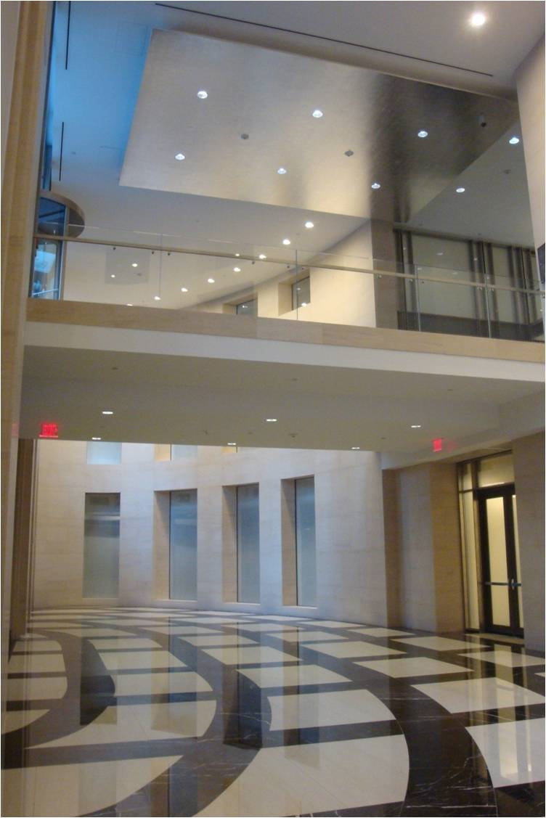
Main Lobby
Alternative stone for lobby
700 Sixth Street

Slide 24
Marble vs. Granite:
Italian Marble
Porous Material
Needs to be resealed every 9 months
Expensive
Long lead time
Vermont Limestone
More durable and harder
Needs to be resealed less
Within 500 mile radius for LEED
Readily available
Alternative stone for lobby
700 Sixth Street

Slide 25
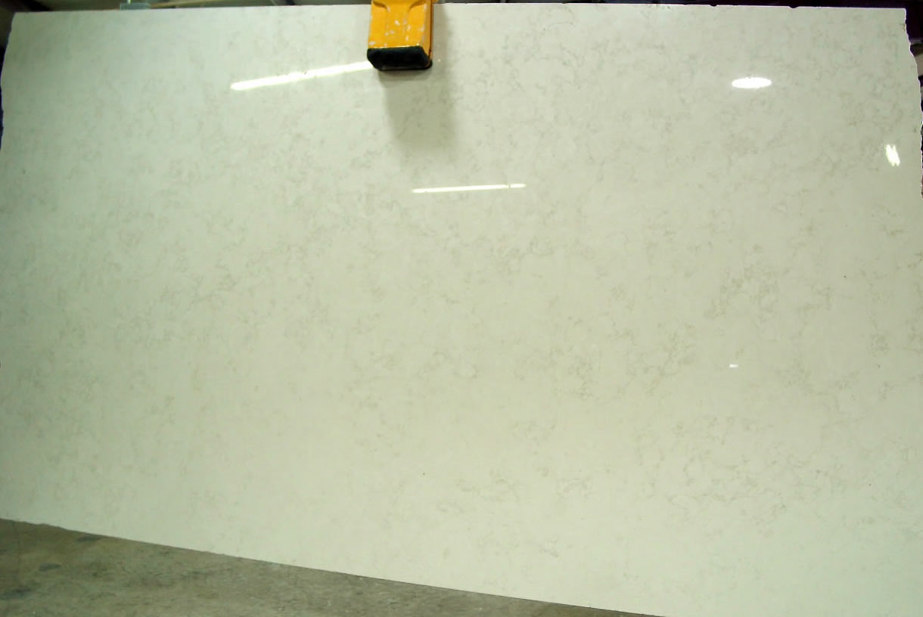
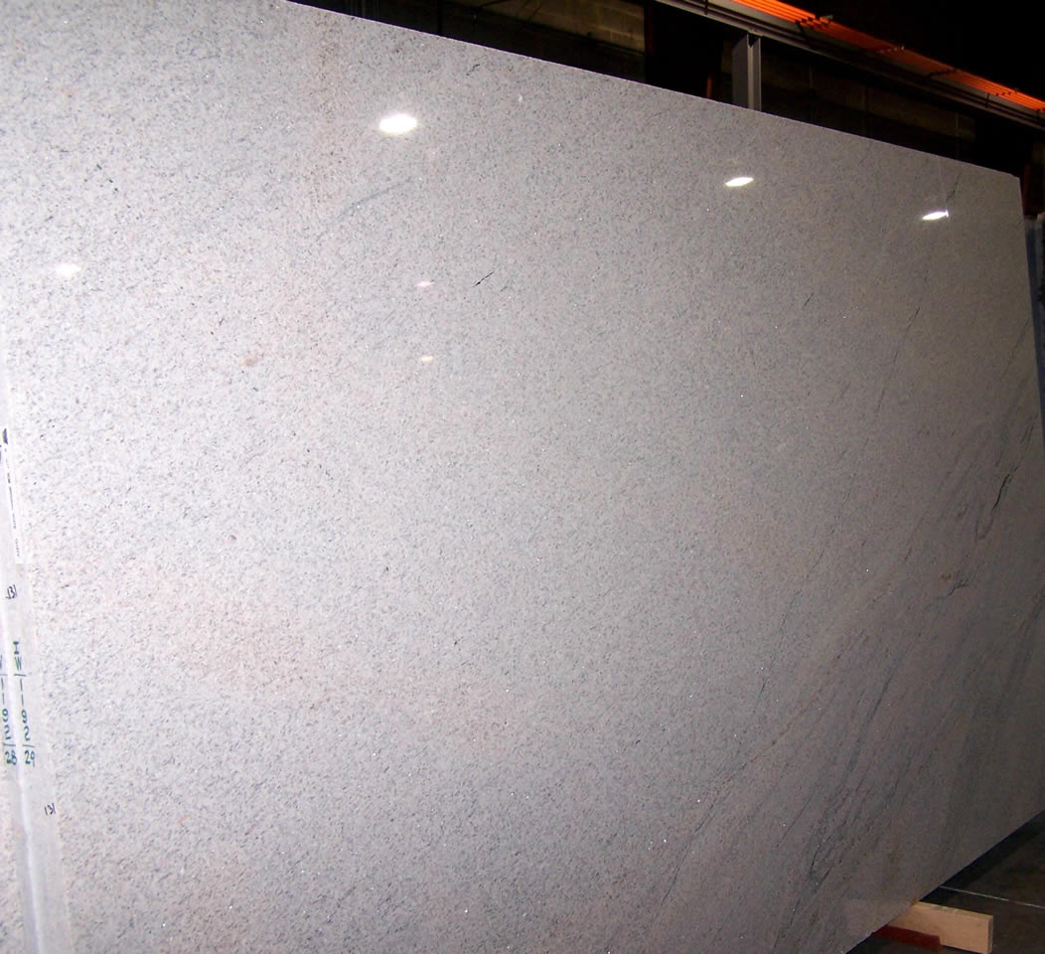
Marble vs. Granite Architectural Comparison:
Italian Marble Vermont Limestone
Alternative stone for lobby
700 Sixth Street

Slide 26
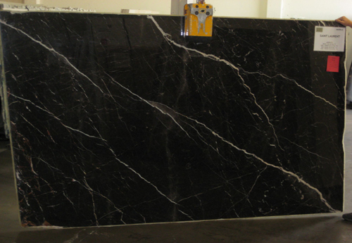
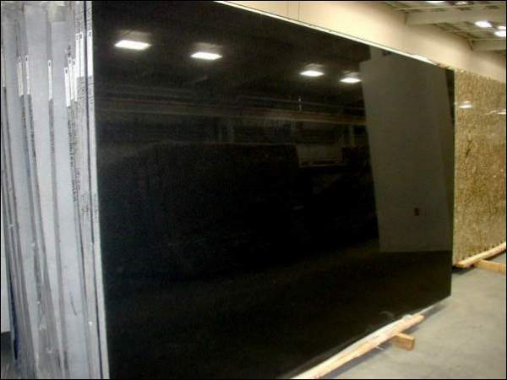
Marble vs. Granite Aesthetic Comparison:
Italian Marble Vermont Limestone
Alternative stone for lobby
700 Sixth Street

Slide 27
Marble vs. Granite Cost Comparison:
Italian Marble
$70 per SF to install and furnish
Total cost: $243,740
Vermont Limestone
$50 per SF to install and furnish
Total Cost: $174,100
Total Savings: Approx. $70,000
Alternative stone for lobby
700 Sixth Street

Slide 28
Recommendation:
Granite!
More durable
Cheaper
American Made
Looks Similar
Would also recommend PA Blue Stone Supplied by Flynnstone for half the Price
Alternative stone for lobby
700 Sixth Street

Slide 29
Arch. Breadth analysis
Verizon Center
Gallery Place
West
700 6th Street
South
North
East
6th Street
Precast vs. handset stone
700 Sixth Street

Slide 30
Arch. Breadth analysis
Existing Facade
South, East, and North Elevations all have handset on floors 1-3 and precast with Limestone floors 4-12
East Elevation
Precast w/ Limestone Casted Into Place Floors 4-12
Handset Floors 1-3
Precast vs. handset stone
700 Sixth Street

Slide 31
Arch. Breadth analysis
Existing Facade
West Elevation
Precast w/out Limestone
Precast vs. handset stone
700 Sixth Street

Slide 32
Arch. Breadth analysis
Precast vs. Handset Stone
Handset more expensive
Longer installation time than precast
Handset is very labor intensive
Handset stone causes site congestion on an already congested site
Precast is craned off of the truck and into position
One con of precast is some of the precast pieces were very large and were hard to install
Precast vs. handset stone
700 Sixth Street

Slide 33
Arch. Breadth analysis
Proposed Systems
1st Proposed System eliminate all of handset stone with precast w/ Limestone
2nd Proposed System eliminate all limestone and replace with just precast
Precast vs. handset stone
700 Sixth Street

Slide 34
Arch. Breadth analysis
Schedule Analysis
Precast for floors 3-12 took 60 days
Handset for floors 1-3 took 60 days
Precast is 3 times faster than handset
25 days of construction could have been saved
Precast vs. handset stone
700 Sixth Street

Slide 35
Arch. Breadth analysis
Cost Analysis
Cost of Existing System
$2,027,970
Precast w/ Limestone $85/SF to Install and Furnish
Total Cost $1,056,720
Handset Limestone $105/SF to Install and Furnish
Total Cost $971,250
Precast vs. handset stone
700 Sixth Street

Slide 36
Arch. Breadth analysis
Cost Analysis
Cost of Proposed System 1 (Eliminate Handset Stone)
$1,842,970
Total Savings of $185,000
25 days saved on schedule
$77,000 of general conditions is saved
Total Savings $262,000
Precast vs. handset stone
700 Sixth Street

Slide 37
Arch. Breadth analysis
Cost Analysis
Cost of Proposed System 2 (Eliminate All Limestone)
$1,311,761
Total Savings of $716,209
25 days saved on schedule
$77,000 of general conditions is saved
Total Savings $793,209
Precast vs. handset stone
700 Sixth Street

Slide 38
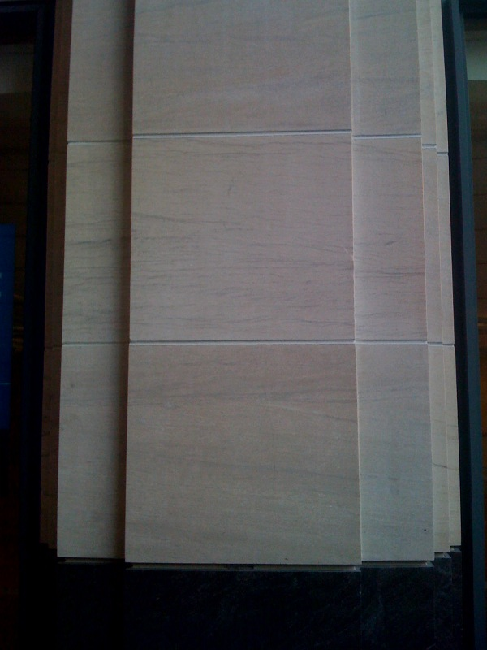
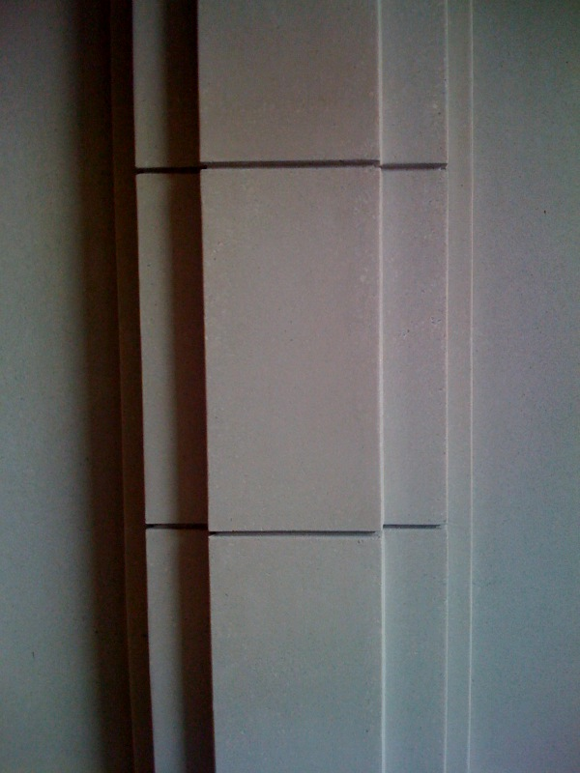
Arch. Breadth analysis
Architectural Analysis
Handset Limestone Precast w/out Limestone
Precast vs. handset stone
700 Sixth Street

Slide 39
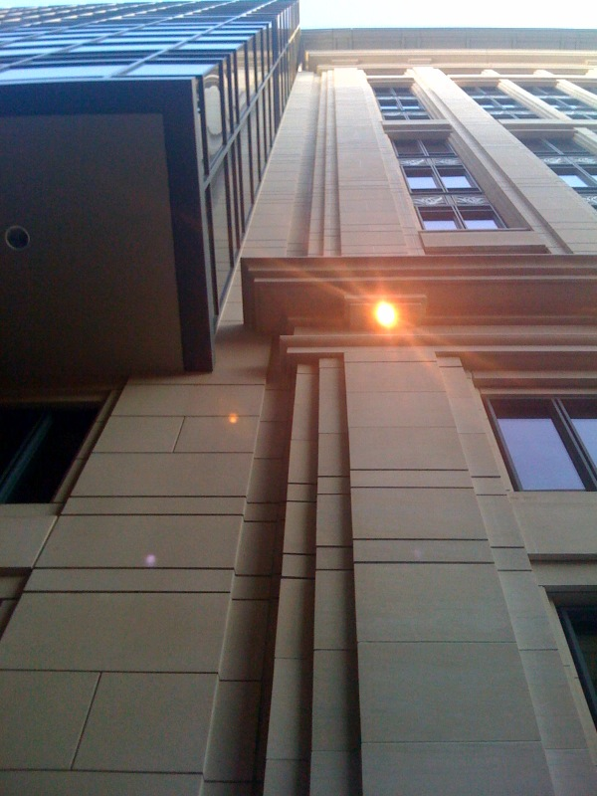
Arch. Breadth analysis
Architectural Analysis
Precast (left) and Limestone (right) Side by Side
Precast vs. handset stone
700 Sixth Street

Slide 40
Arch. Breadth analysis
Recommendation/Summary
Precast is cheaper
Quicker to install
Looks Similar to Limestone
Proposed System 2 (removal of all limestone) is my recommendation
Biggest Cost Savings
Precast vs. handset stone
700 Sixth Street

Slide 41
In Conclusion
It Is Never to Late to Go Green
700 6th Street did it with minimal schedulee impact
Recommend
Alternative Stone for Lobby
Granite is the obvious choice because of cost and durability
Recommend
Precast is cheaper and looks similar to Limestone
Recommend
Results
700 Sixth Street

Slide 42
Acknowledgements
The AE Department
Balfour Beatty Construction
Sean Flynn
My Family and Friends
Lorton Stone
Manuel Seara
700 6th Street
John E. Akridge
Matthew J. Klein
acknowledgements
700 Sixth Street

Slide 43
Questions or Comments?
questions
700 Sixth Street

