Slide 1
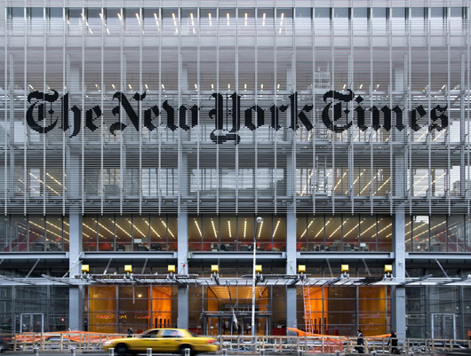
Proposed Schematic Design
Casey Leman
December 5, 2009

Slide 2
Building Overview
Class A Office Space and Ground Floor Retail
Location
New York City, New York
Size
52 Stories
1.6 Million sq.ft.
Budget
Approximately $1 Billion
Design Team
Owner: The New York Times Company
Forest City Ratner Companies
Architect: Renzo Piano Building Workshop FXFowle Arcitechts of New York
Lighting Designers: Office of Visual Interaction (OVI)
Susan Brady Lighting Design
1

Slide 3
BIM and IPD
Building Information Modeling and Integrated Project Delivery Senior Thesis Pilot Program
3 Teams
Construction Management
Lighting/Electrical
Mechanical
Structural
Lighting/Electrical Team
Craig Casey
Daniel Cox
Casey Leman
2

Slide 4
Design Concepts and Goals
The architect’s plan was to reinforce the values of the New York Times Company
3

Slide 5
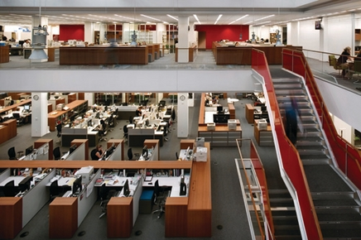
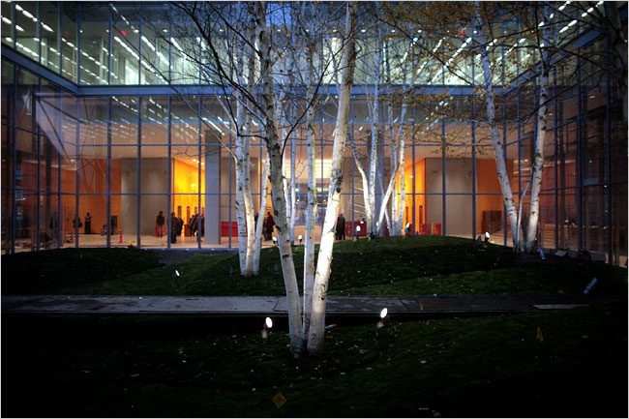
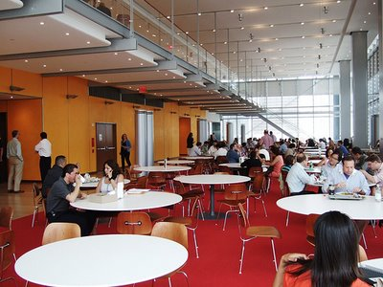
Design Concepts and Goals
The architect’s plan was to reinforce the values of the New York Times Company
newyorktimesbuilding.com
newyorktimesbuilding.com
newyorktimesbuilding.com
Open Plan and Ease of Communication
Transparency, Lightness, and Collaboration
3

Slide 6
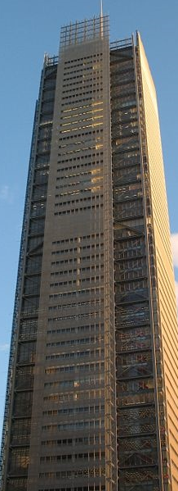
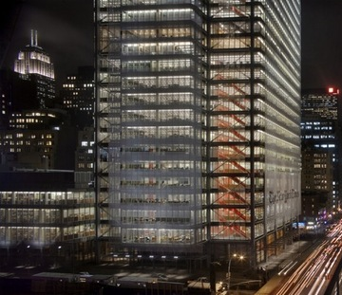
Design Concepts and Goals
The architect’s plan was to reinforce the values of the New York Times Company
newyorktimesbuilding.com
newyorktimesbuilding.com
Create an Architectural Icon
Commitment to Innovation
newyorktimesbuilding.com
3

Slide 7
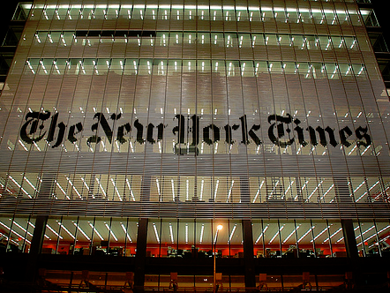
Spaces Under Consideration
newyorktimesbuilding.com
Façade
4

Slide 8
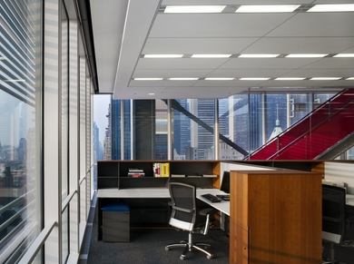
Spaces Under Consideration
newyorktimesbuilding.com
Office
4

Slide 9
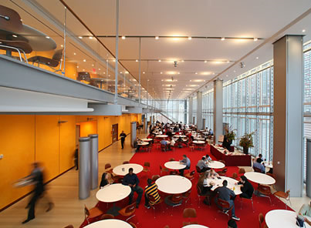
Spaces Under Consideration
newyorktimesbuilding.com
Cafe
4

Slide 10
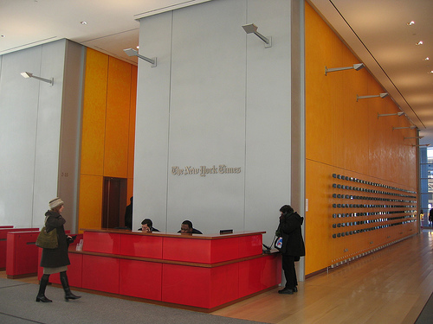
Spaces Under Consideration
newyorktimesbuilding.com
Lobby
4

Slide 11
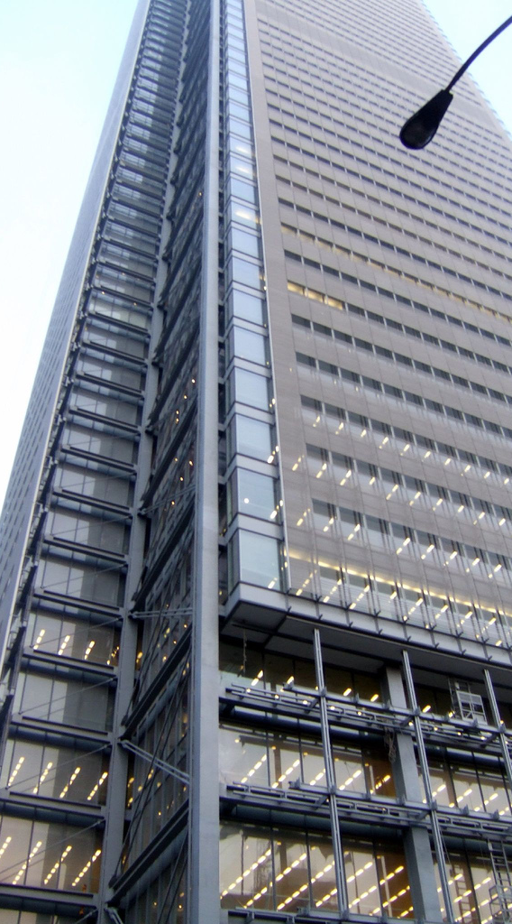
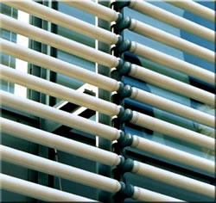
Current Façade Conditions
newyorktimesbuilding.com
5

Slide 12
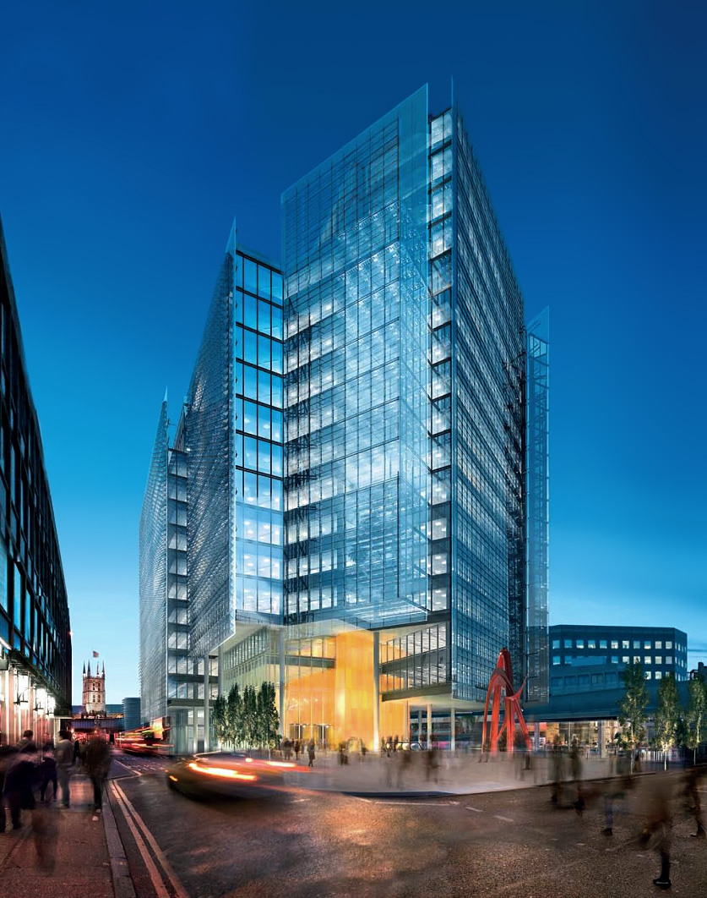
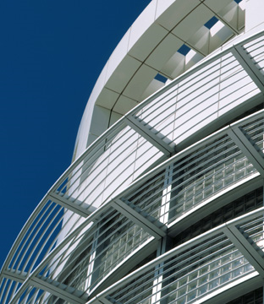
Façade Schematic Design
Unicelarchitectural.com
shardlondonbridge.com
6

Slide 13
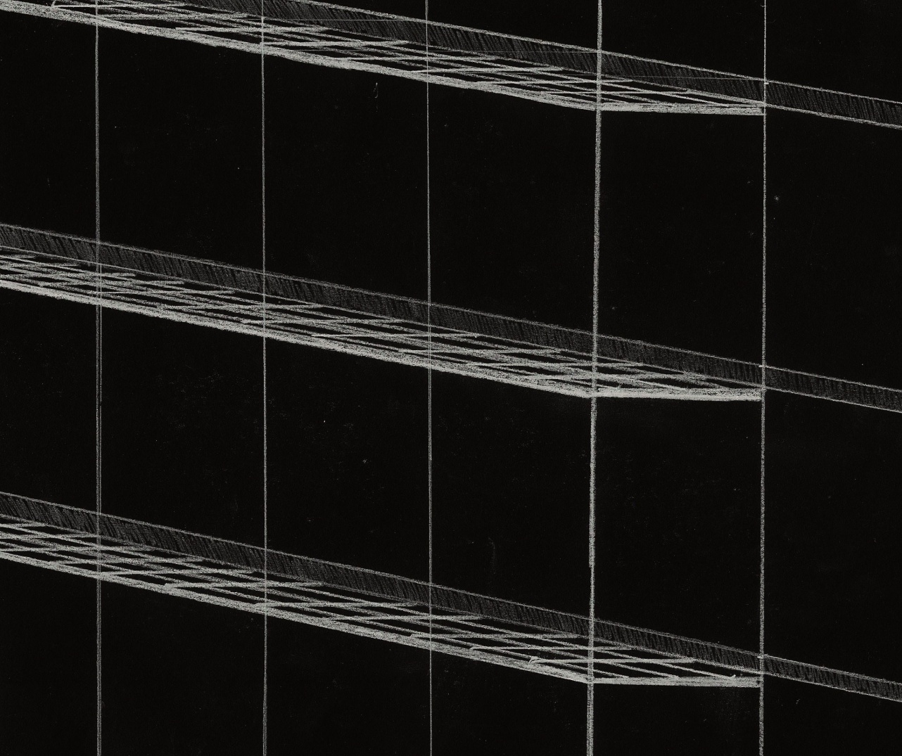
Façade Schematic Design
7

Slide 14
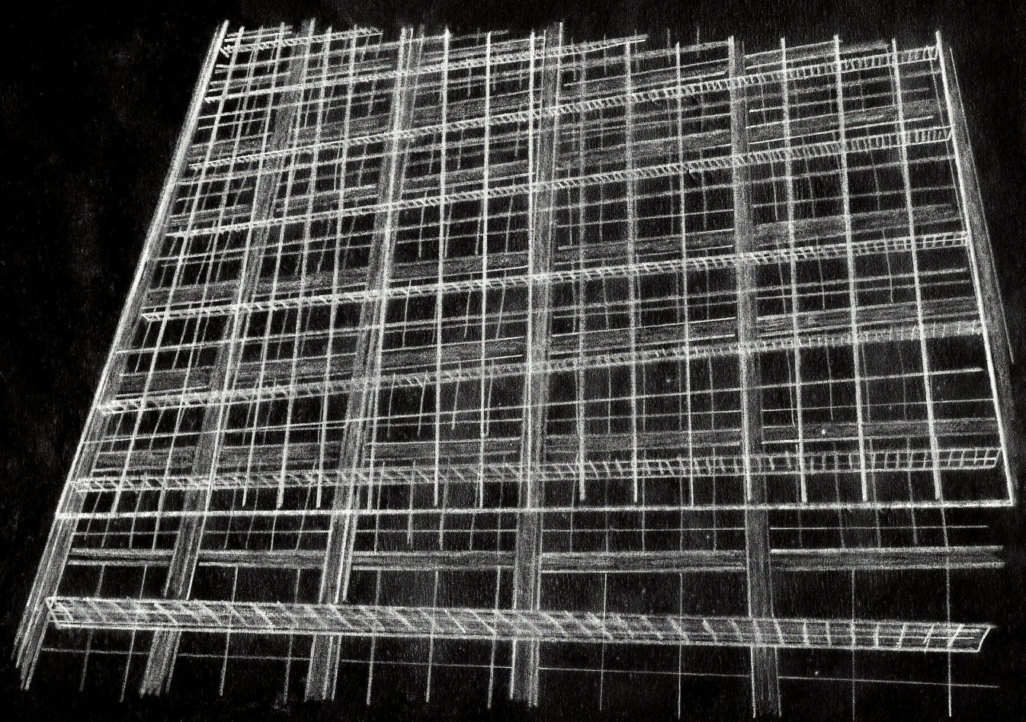
Façade Schematic Design
8

Slide 15
9

Slide 16
Schematic Office Designs
Schematic Design 1
Daylighting Conditions for Proposed Façade
Schematic Design 2
Late Afternoon or Afterhours Scenario
Schematic Design 3
Everyday Working Conditions
10

Slide 17
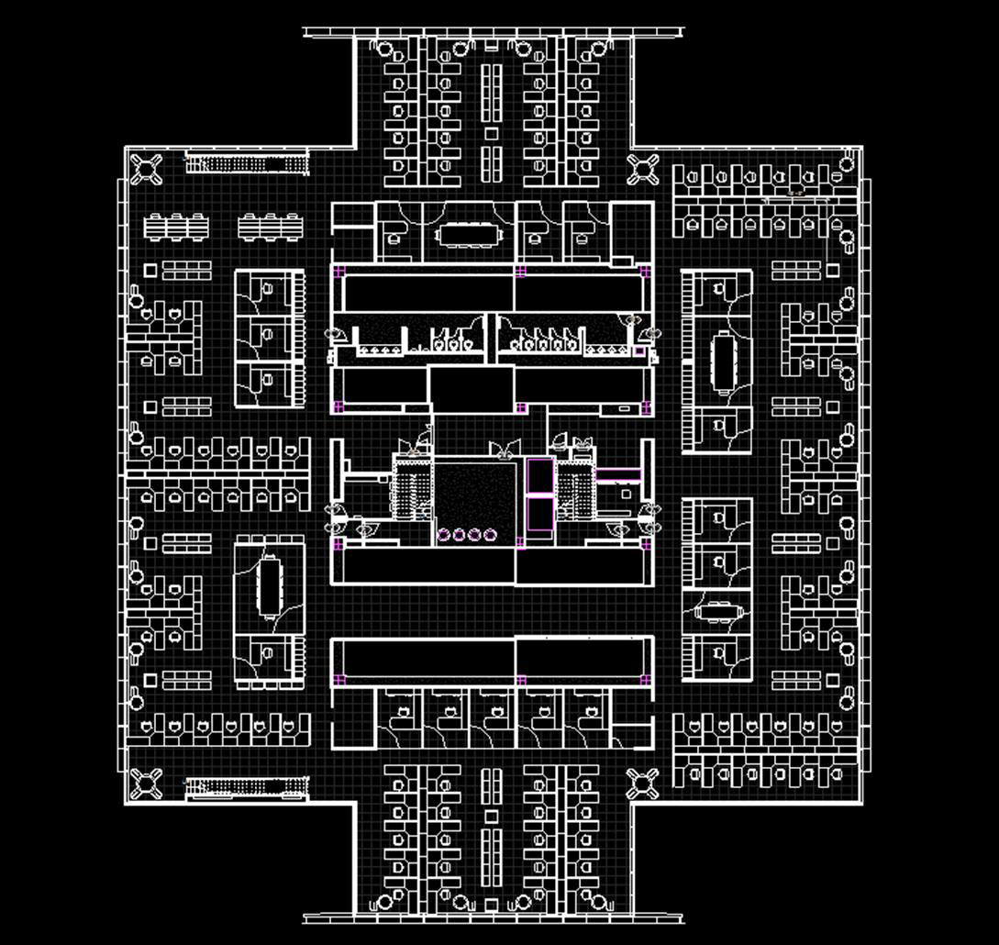
Solar Study
North
West
East
28⁰
South
11

Slide 18
Solar Study
Daylighting Conditions for 12:00 pm
Summer Solstice
Equinox
Winter Solstice
72 ͦ
50 ͦ
26 ͦ
12

Slide 19
Solar Study
13

Slide 20
Current Daylighting Conditions
Summer Solstice
14

Slide 21
Current Daylighting Conditions
Equinox
15

Slide 22
Current Daylighting Conditions
Winter Solstice
16

Slide 23
Office Schematic Design 1
Summer Solstice
17

Slide 24
Office Schematic Design 1
Equinox
18

Slide 25
Office Schematic Design 1
Winter Solstice
19

Slide 26
Office Schematic Design 2
20

Slide 27
Office Schematic Design 2
21

Slide 28
Office Schematic Design 2
22

Slide 29
Office Schematic Design 2
23

Slide 30
Office Schematic Design 3
24

Slide 31
Office Schematic Design 3
25

Slide 32
Office Schematic Design 3
26

Slide 33
Office Schematic Design 3
27

Slide 34
Cafeteria Flynn Impressions
Private
Public
28

Slide 35
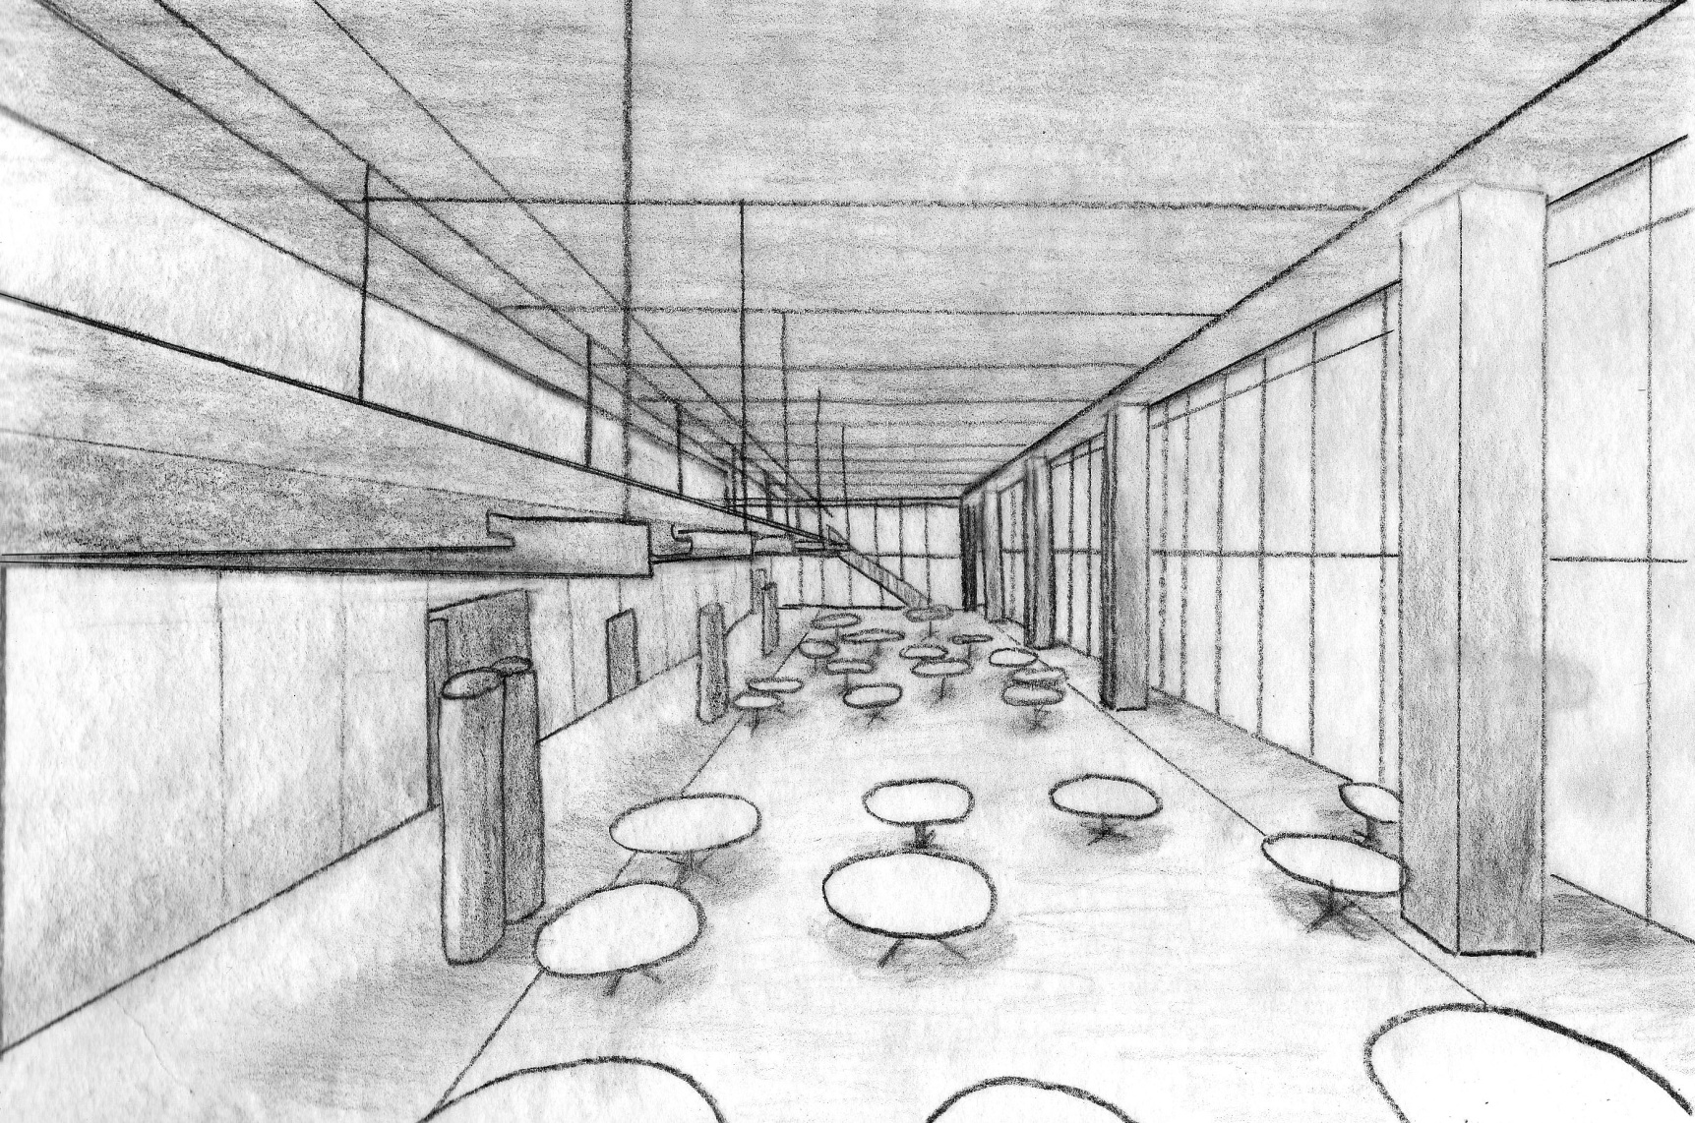
Cafeteria Flynn Impression 1
Private
29

Slide 36
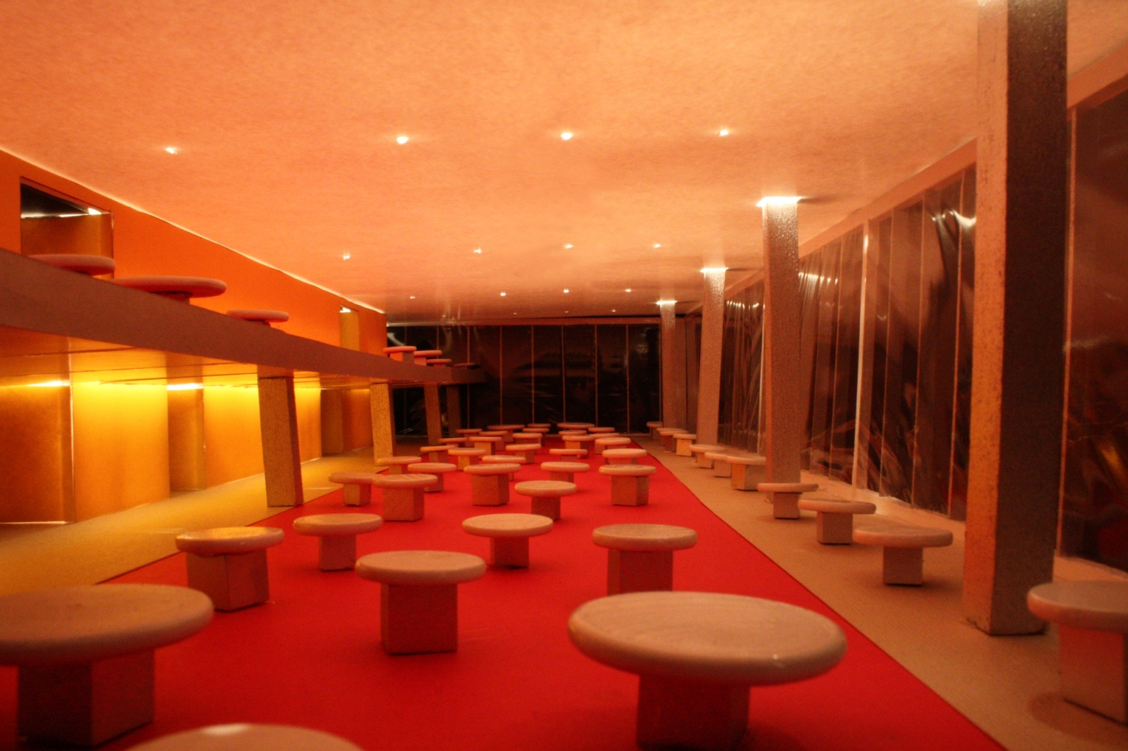
Cafeteria Flynn Impression 1
Private
30

Slide 37
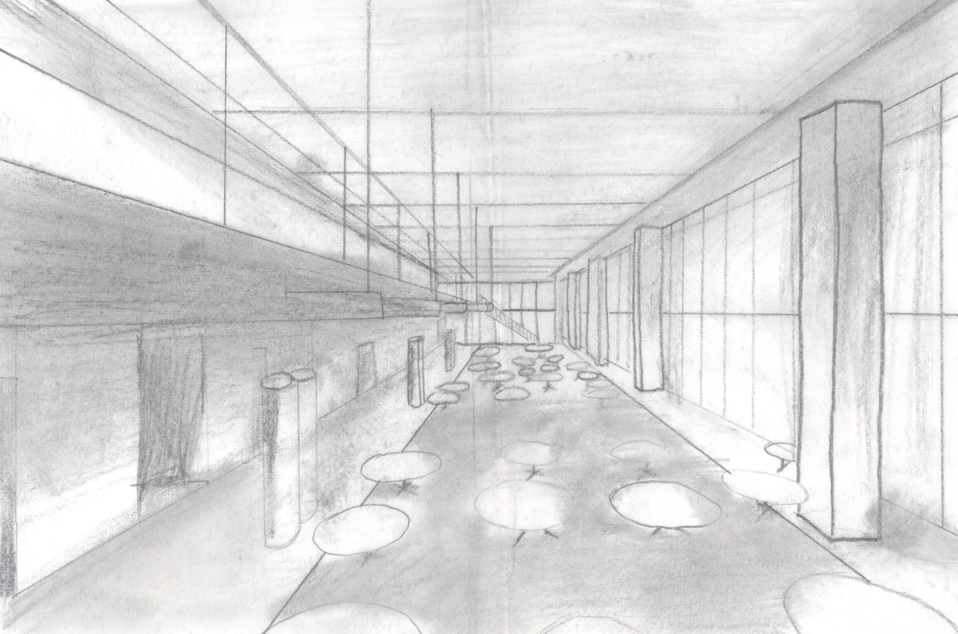
Cafeteria Flynn Impression 2
Public
31

Slide 38
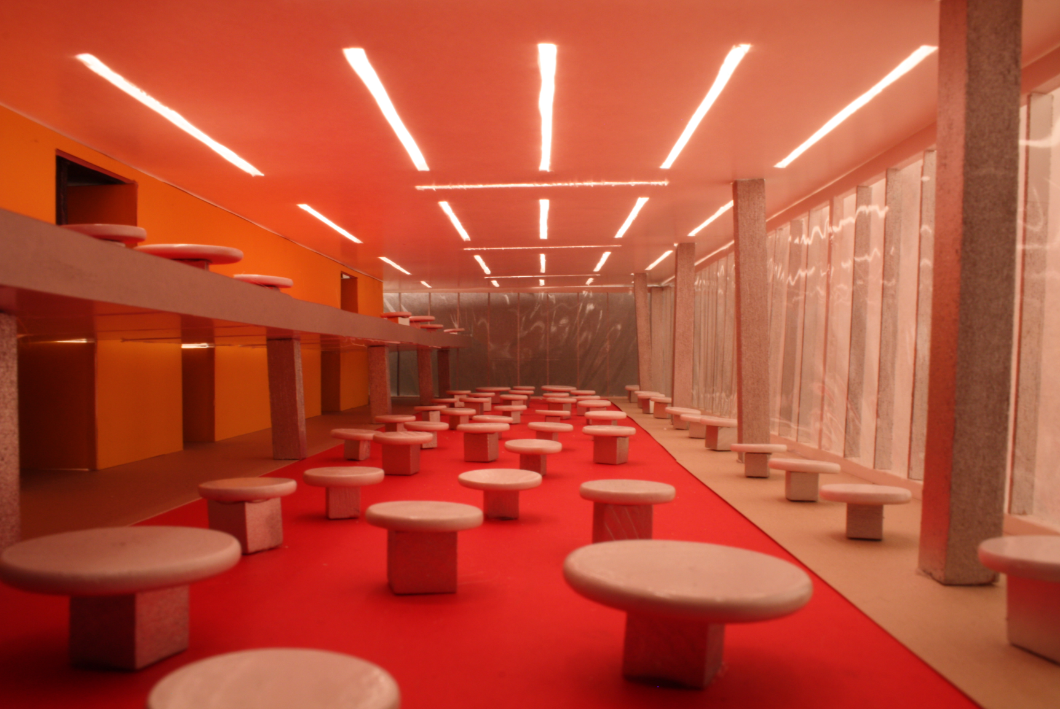
Cafeteria Flynn Impression 2
Public
32

Slide 39
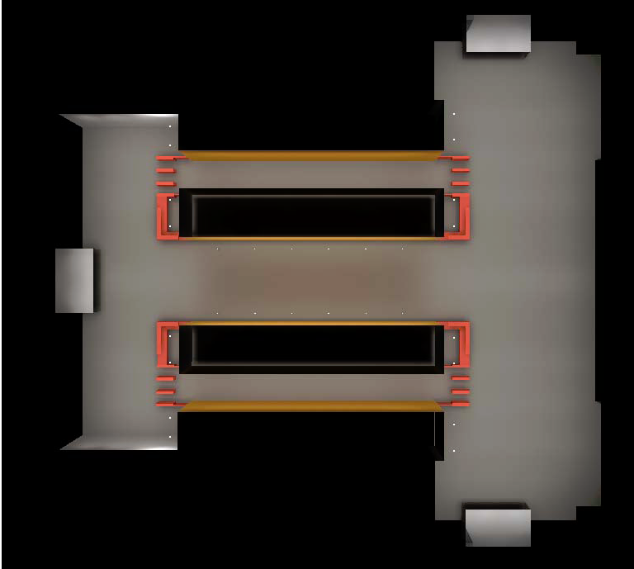
Lobby Schematic Design
W 41st St
8th Ave
W 40th St
33

Slide 40
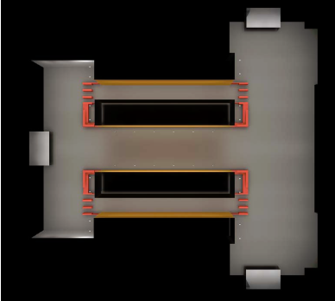
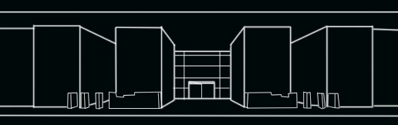
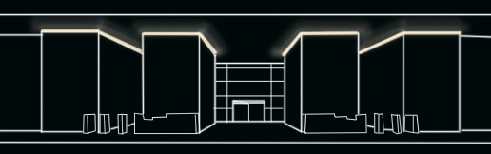
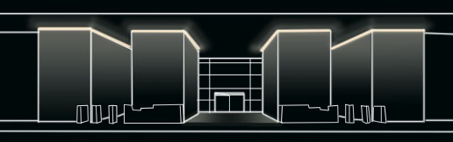
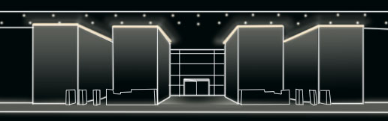
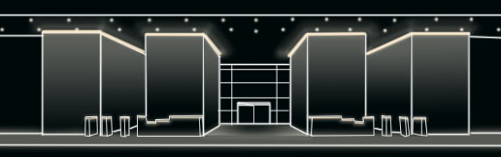
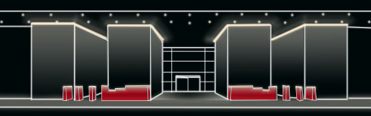
Lobby Schematic Design
34

Slide 41
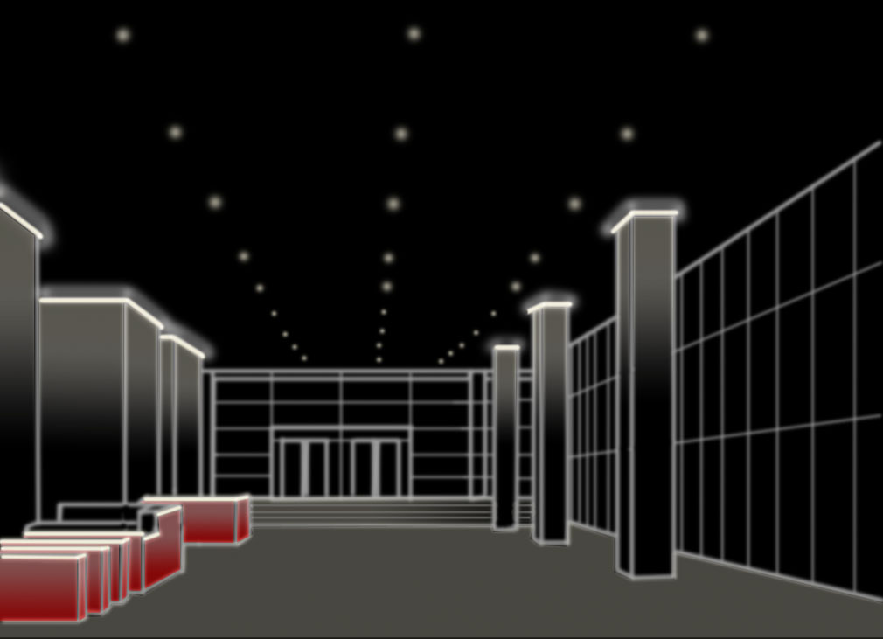
Lobby Schematic Design
35

