Slide 1
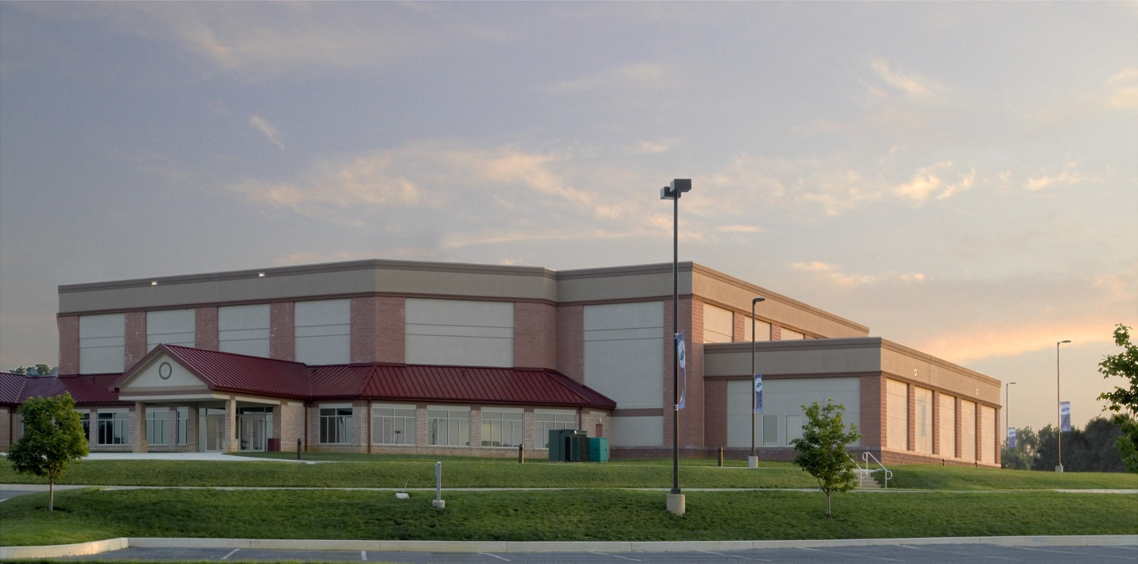
Lancaster County Bible Church

Slide 2
Outline
Overview of Existing
Proposal
Structural Depth Study
Architectural Breadth Study
Construction Management Breadth Study
Summary/Conclusions
Acknowledgements
Questions

Slide 3
Overview of Existing
Location
- 2392 Mount Joy Road
Manheim, PA 11754

Slide 4
Overview of Existing
Location
- 2392 Mount Joy Road
Manheim, PA 11754

Slide 5
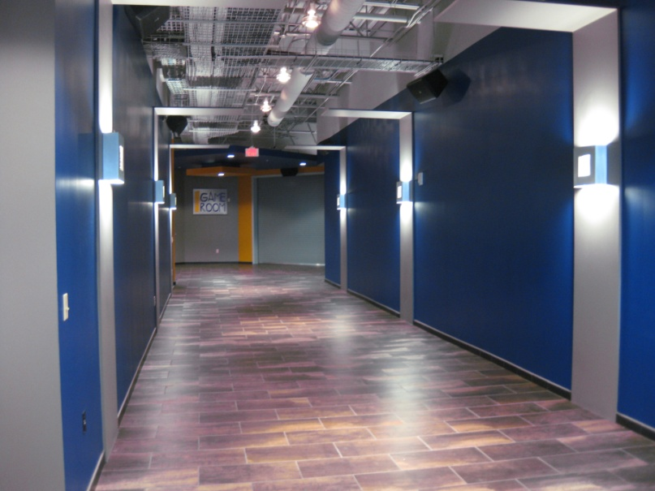
Overview of Existing
Location
Use
Business (B)
Assembly (A-3)
Educational (E)

Slide 6
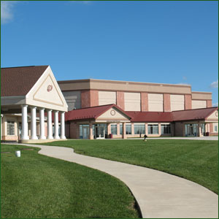
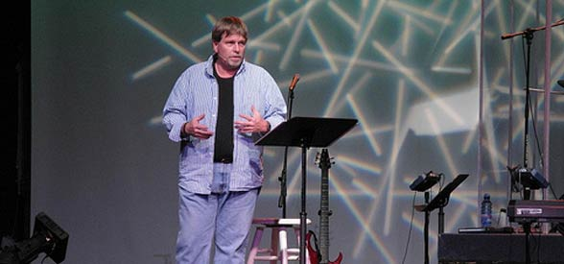
Overview of Existing
Location
Use
Owners
Lancaster County Bible Church
Pastor David Ashcraft

Slide 7
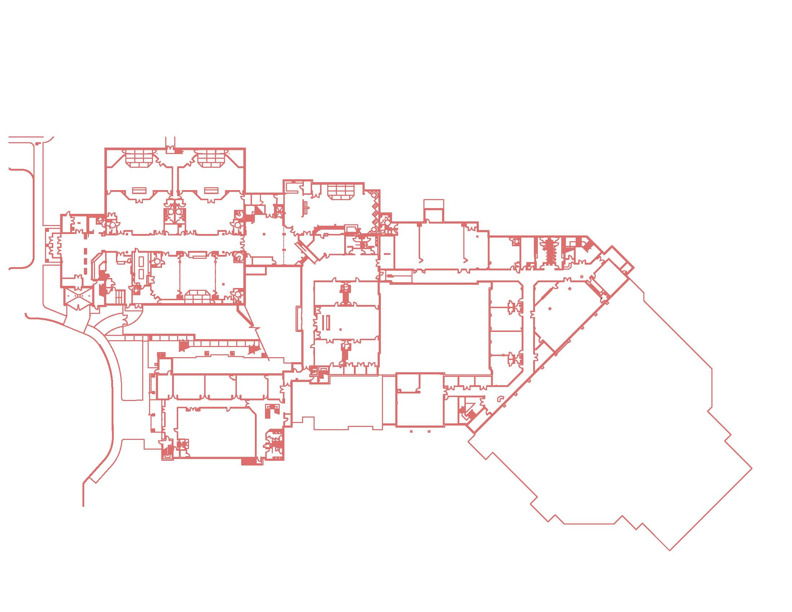
Overview of Existing
Location
Use
Owners
Size
3-Story Low-Rise Building (45 ft.)
200,000 s.f. (Total)
78,000 s.f. (Addition)

Slide 8
Overview of Existing
Location
Use
Owners
Size
Cost
Approximately $15 Million

Slide 9
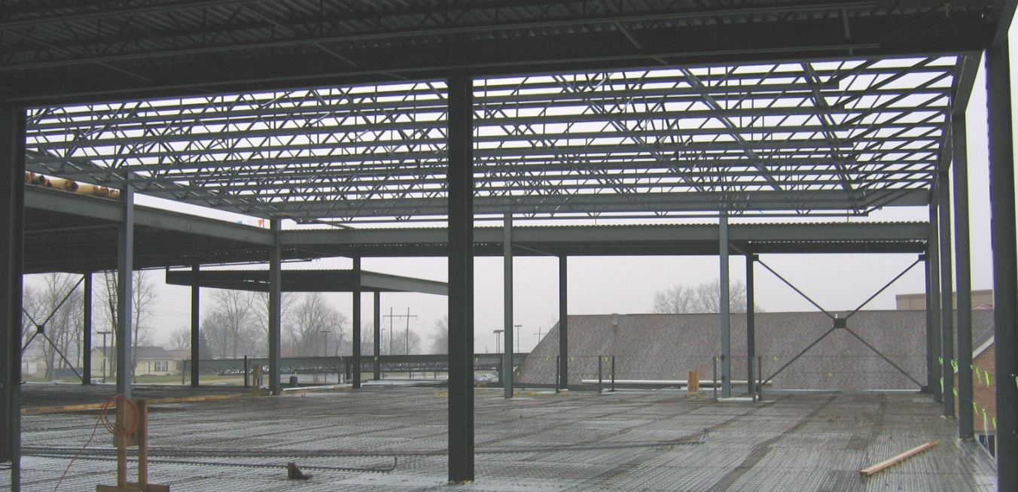
Overview of Existing
Structure
W-Shaped Columns, Beams, Girders
Open Web Steel Joist Flooring
Tubular Steel Cross Bracing

Slide 10
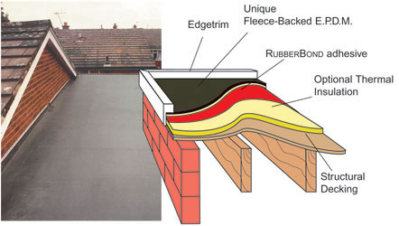
Overview of Existing
Structure
Exterior Finishes
Façade: E.I.F.S. and Brick Veneer
Roofing: Flat E.P.D.M.

Slide 11
Outline
Overview of Existing
Proposal
Structural Depth Study
Architectural Breadth Study
Construction Management Breadth Study
Summary/Conclusions
Acknowledgements
Questions

Slide 12
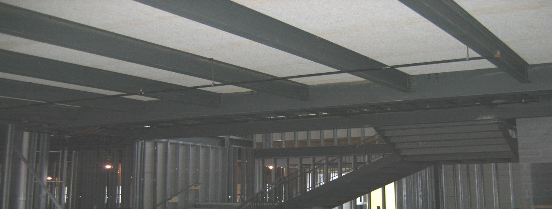
Proposal
Structural Depth Study
Structural Re-design Using L.R.F.D.
Structural Re-design using Composite Steel Framing

Slide 13
Proposal
Structural Depth Study
Construction Management Breadth Study
Relative Cost Comparison of Different Framing Systems
Architectural Breadth Study
Impact to Ceiling Layout due to Composite Steel Re-design

Slide 14
Outline
Overview of Existing
Proposal
Structural Depth Study
Architectural Breadth Study
Construction Management Breadth Study
Summary/Conclusions
Acknowledgements
Questions

Slide 15
Structural Depth Study
Existing Design Method
Allowable Stress Design (ASD)
Proposed Design Method
Load and Resistance Factor Design

Slide 16
Structural Depth Study
Open Web Steel Joists
No Reduction
Beams
No Reduction
Girders
% 6.02 Reduction Achieved

Slide 17
Structural Depth Study
Existing Flooring System
Open Web Steel Joist
Proposed Composite Floor System
3” USD Metal Deck w/ 4 ½” N.W.C.

Slide 18
Structural Depth Study
In-fill Beams
W 21x55 (76)
W 16x26 (22)
Girders
W 24x76 (60,102)

Slide 19
Structural Depth Study
Structural Steel
23.3 % Weight Reduction
Metal Decking
Increased 2.14 (#/s.f.)
Total 115,000 (pounds)
Shear Studs
11,420 (5”, ¾” ∅)

Slide 20
Outline
Overview of Existing
Proposal
Structural Depth Study
Architectural Breadth Study
Construction Management Breadth Study
Summary/Conclusions
Acknowledgements
Questions

Slide 21
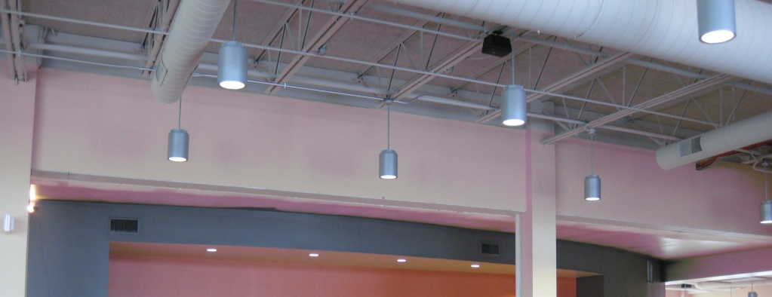
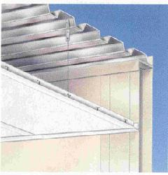
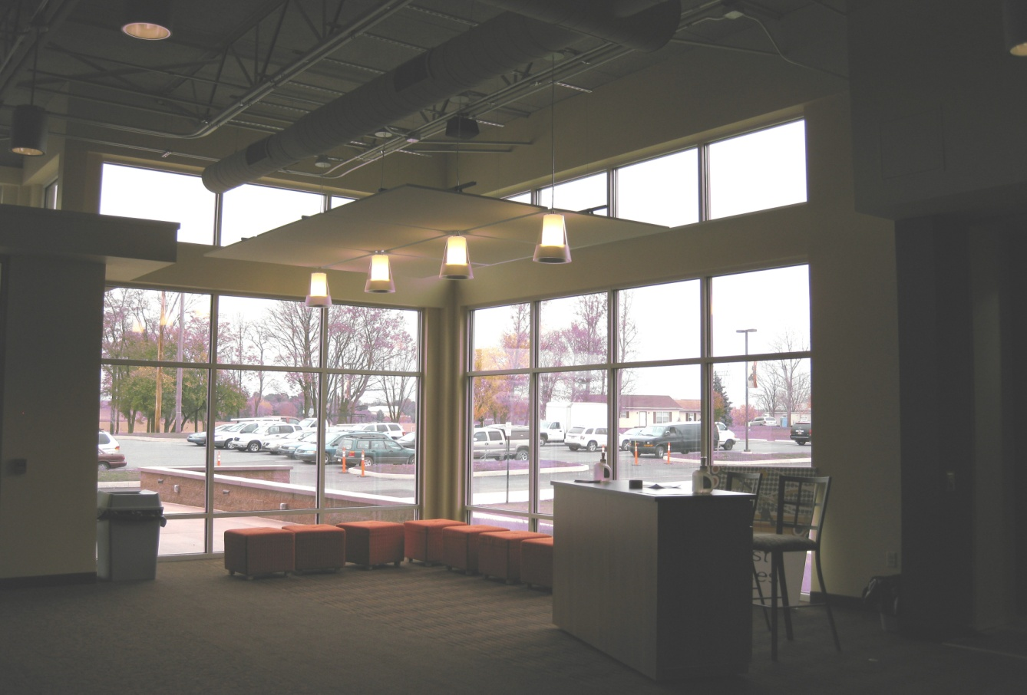
Architectural Breadth Study
Existing Ceiling
Exposed
Proposed Ceiling
Drop Acoustical Panel

Slide 22
Outline
Overview of Existing
Proposal
Structural Depth Study
Architectural Breadth Study
Construction Management Breadth Study
Summary/Conclusions
Acknowledgements
Questions

Slide 23
Construction Management Breadth Study
Cost
$1.54 Million (Existing System)
$2.08 Million (Composite Redesign)
Schedule
Longer Construction Time
Fewer Members
Original Schedule Difficult to Maintain

Slide 24
Outline
Overview of Existing
Proposal
Structural Depth Study
Architectural Breadth Study
Construction Management Breadth Study
Summary/Conclusions
Acknowledgements
Questions

Slide 25
Summary/Conclusions
Structural
LRFD more Efficient ASD
Composite Design not most Efficient System
Architectural
Ceiling Impact Minimal
Maintained Overall Architectural Program
Construction Management
Higher Cost
Original Schedule Difficult to Maintain

Slide 26
Outline
Overview of Existing
Proposal
Structural Depth Study
Architectural Breadth Study
Construction Management Breadth Study
Summary/Conclusions
Acknowledgements
Questions

Slide 27
Acknowledgements
Warren Mann and Michael Hughes of
Mann-Hughes Architecture
Pastor David Ashcraft
AE Faculty and Staff
My Family

Slide 28
Thank You!

Slide 29
Questions ???

