Slide 1

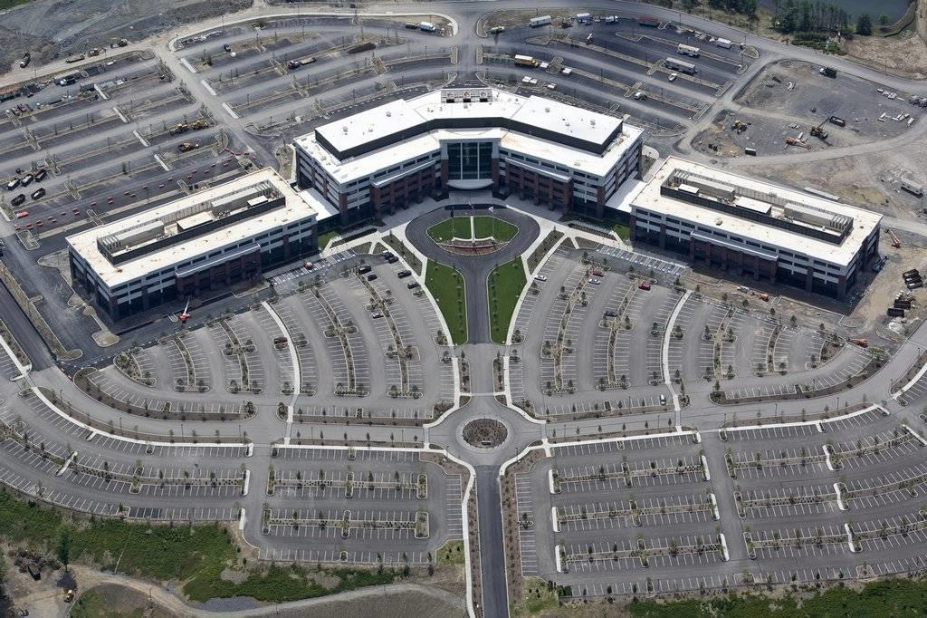
Westinghouse Electric Company Nuclear Power Engineering Headquarters Campus
1000 Cranberry Woods Drive, Cranberry Township, PA
Mark Speicher
Senior Thesis 2010
Construction Management
April 12, 2010

Slide 2
Westinghouse Electric Company Nuclear Power Engineering Headquarters Campus
  Presentation Outline
  Project Overview
  Analysis 1: Energy and Environment
  Analysis 2: Concrete Slabs
  Analysis 3: BIM Implementation
  Conclusions/Recommendations
  Acknowledgements
Mark Speicher / Construction Management / Senior Thesis 2010

Slide 3
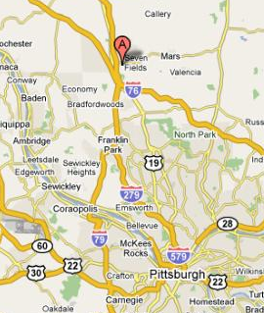
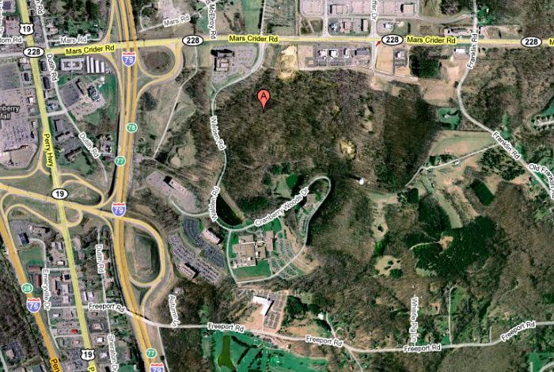
Westinghouse Electric Company Nuclear Power Engineering Headquarters Campus
PROJECT OVERVIEW
  Presentation Outline
  Project Overview
  Analysis 1: Energy and Environment
  Analysis 2: Concrete Slabs
  Analysis 3: BIM Implementation
  Conclusions/Recommendations
  Acknowledgements
  Location: Cranberry Township, PA
  Occupant: Westinghouse Electric Company
  Building Type: Office
  Size: 844,595 square feet
  Construction Dates: February 2008 – May 2010
  Overall Project Cost: $240,000,000
  Delivery Method: Design-Bid-Build
  Mark Speicher / Construction Management / Senior Thesis 2010

Slide 4





Westinghouse Electric Company Nuclear Power Engineering Headquarters Campus
PROJECT OVERVIEW
  Presentation Outline
  Project Overview
  Analysis 1: Energy and Environment
  Analysis 2: Concrete Slabs
  Analysis 3: BIM Implementation
  Conclusions/Recommendations
  Acknowledgements
  Project Team:
  Owner: Wells Reit II
  Tenant: Westinghouse Electric Company
  GC/CM: Turner Construction Company
  Architect: IKM Incorporated
  Engineer: LLI Engineering
  Mark Speicher / Construction Management / Senior Thesis 2010

Slide 5
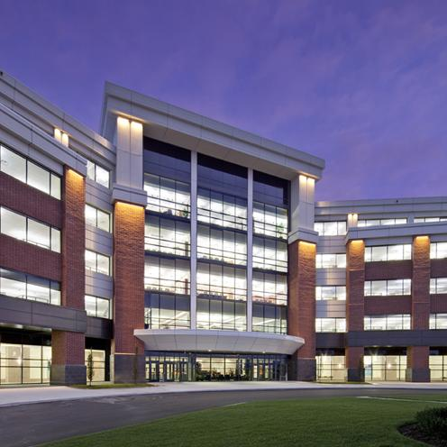
Westinghouse Electric Company Nuclear Power Engineering Headquarters Campus
PROJECT OVERVIEW
  Architecture
  Consists of 3 Buildings
  Primarily office space for over 4,000 engineers
  Structural
  Steel framed with concrete slab-on-deck floors
  Building Enclosure
  Aluminum curtain wall
  Insulated wall panels
  Brick
  Polished concrete
  Presentation Outline
  Project Overview
  Analysis 1: Energy and Environment
  Analysis 2: Concrete Slabs
  Analysis 3: BIM Implementation
  Conclusions/Recommendations
  Acknowledgements
  Mark Speicher / Construction Management / Senior Thesis 2010

Slide 6
Westinghouse Electric Company Nuclear Power Engineering Headquarters Campus
ANALYSIS 1: Energy and Environment
  Background
  As energy company Westinghouse has opportunity to raise the standard
  Leased property → Wells Reit would benefit from reduced lifecycle cost
  Objective
  Identify finishes which could be replaced with “greener” products
  Reduce the energy usage of the Westinghouse campus
  Presentation Outline
  Project Overview
  Analysis 1: Energy and Environment
  Analysis 2: Concrete Slabs
  Analysis 3: BIM Implementation
  Conclusions/Recommendations
  Acknowledgements
  Mark Speicher / Construction Management / Senior Thesis 2010

Slide 7
Westinghouse Electric Company Nuclear Power Engineering Headquarters Campus
ANALYSIS 1: Energy and Environment
  Current Windows
  1” insulated tempered glass
  Large percentage of building envelope
  Potential for energy savings by implementing higher efficiency windows
  Presentation Outline
  Project Overview
  Analysis 1: Energy and Environment
  Analysis 2: Concrete Slabs
  Analysis 3: BIM Implementation
  Conclusions/Recommendations
  Acknowledgements
  Mark Speicher / Construction Management / Senior Thesis 2010

Slide 8
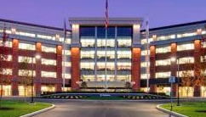
Westinghouse Electric Company Nuclear Power Engineering Headquarters Campus
ANALYSIS 1: Energy and Environment
  PPG Solarban 80 Windows
  Excellent thermal properties
  Manufactured locally: United Plate Glass, Butler, PA
  Presentation Outline
  Project Overview
  Analysis 1: Energy and Environment
  Analysis 2: Concrete Slabs
  Analysis 3: BIM Implementation
  Conclusions/Recommendations
  Acknowledgements
  Mark Speicher / Construction Management / Senior Thesis 2010

Slide 9
Westinghouse Electric Company Nuclear Power Engineering Headquarters Campus
ANALYSIS 1: Energy and Environment
  Assumptions:
    City = Philadelphia, PA
    Window Sq. Footage = 50,976 sq ft
    Floor area = 270,000 sq ft
  Energy Analysis
  U.S. Department of Energy (DOE) 2.2 Building Energy Analysis Simulation Tool
    Calculates hour-by-hour energy consumption using hourly climate data
  Presentation Outline
  Project Overview
  Analysis 1: Energy and Environment
  Analysis 2: Concrete Slabs
  Analysis 3: BIM Implementation
  Conclusions/Recommendations
  Acknowledgements
  Mark Speicher / Construction Management / Senior Thesis 2010

Slide 10
Westinghouse Electric Company Nuclear Power Engineering Headquarters Campus
ANALYSIS 1: Energy and Environment
  Results:
  Presentation Outline
  Project Overview
  Analysis 1: Energy and Environment
  Analysis 2: Concrete Slabs
  Analysis 3: BIM Implementation
  Conclusions/Recommendations
  Acknowledgements
    Total operating cost reduced by 9%
    Total cooling HVAC cost reduced by 12.5%
  Mark Speicher / Construction Management / Senior Thesis 2010

Slide 11
Westinghouse Electric Company Nuclear Power Engineering Headquarters Campus
ANALYSIS 2: Prefabricated Concrete Slabs
  Background
  Campus constructed on a compressed schedule
    22 month → 15 month
  Slabs on critical path of schedule
  Cost of overtime had large impact on overall cost
  Objective
  Explore the feasibility of precast concrete
    Cost
    Schedule
    Structural Ramifications
  Presentation Outline
  Project Overview
  Analysis 1: Energy and Environment
  Analysis 2: Concrete Slabs
  Analysis 3: BIM Implementation
  Conclusions/Recommendations
  Acknowledgements
  Mark Speicher / Construction Management / Senior Thesis 2010

Slide 12
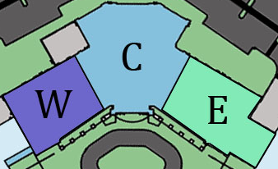
Westinghouse Electric Company Nuclear Power Engineering Headquarters Campus
ANALYSIS 2: Prefabricated Concrete Slabs
  Current Slab on Deck System
  2 ½” lightweight concrete on 22 gauge metal deck
  Schedule:
  Poured in the typical workflow pattern
    Bottom to Top: Center → East → West
  Presentation Outline
  Project Overview
  Analysis 1: Energy and Environment
  Analysis 2: Concrete Slabs
  Analysis 3: BIM Implementation
  Conclusions/Recommendations
  Acknowledgements
  Mark Speicher / Construction Management / Senior Thesis 2010

Slide 13
Westinghouse Electric Company Nuclear Power Engineering Headquarters Campus
ANALYSIS 2: Prefabricated Concrete Slabs
  Current Slab on Deck System
  Cost:
  No actual cost data provided
  Estimate calculated using RS Means
  Approximate cost = $3,400,000
  Presentation Outline
  Project Overview
  Analysis 1: Energy and Environment
  Analysis 2: Concrete Slabs
  Analysis 3: BIM Implementation
  Conclusions/Recommendations
  Acknowledgements
  Mark Speicher / Construction Management / Senior Thesis 2010

Slide 14
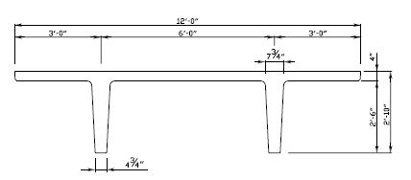
Westinghouse Electric Company Nuclear Power Engineering Headquarters Campus
ANALYSIS 2: Prefabricated Concrete Slabs
  Prefabricated Concrete Slabs
  Double Tees
    Larger widths
    Reduce number by 2/3 over Hollowcore planks
    Reduce steel
  Placement
    Typical bay sizes were maintained (24’)
    12’ wide double tees selected
  Presentation Outline
  Project Overview
  Analysis 1: Energy and Environment
  Analysis 2: Concrete Slabs
  Analysis 3: BIM Implementation
  Conclusions/Recommendations
  Acknowledgements
  Mark Speicher / Construction Management / Senior Thesis 2010

Slide 15
Westinghouse Electric Company Nuclear Power Engineering Headquarters Campus
ANALYSIS 2: Prefabricated Concrete Slabs
  Prefabricated Concrete Slabs
  Schedule Analysis:
  20-30 minute erection time → 20
  Maintained initial start date → July 16, 2008
  Duration → 32 days
  Estimated completion date → August 28, 2008
  58 days ahead of current schedule (November 18, 2008)
  Presentation Outline
  Project Overview
  Analysis 1: Energy and Environment
  Analysis 2: Concrete Slabs
  Analysis 3: BIM Implementation
  Conclusions/Recommendations
  Acknowledgements
  Mark Speicher / Construction Management / Senior Thesis 2010

Slide 16
Westinghouse Electric Company Nuclear Power Engineering Headquarters Campus
ANALYSIS 2: Prefabricated Concrete Slabs
  Prefabricated Concrete Slabs
  Cost Analysis:
  Material and shipping costs from Nitterhouse
  Erection costs from RS Means
  Removal of steel cost data taken from previous estimate
  Cost after steel savings → $1,723,017
  Savings of $1,654,5895 off current system ($3,377,612)
  Presentation Outline
  Project Overview
  Analysis 1: Energy and Environment
  Analysis 2: Concrete Slabs
  Analysis 3: BIM Implementation
  Conclusions/Recommendations
  Acknowledgements
Precast Cost Summary
Steel Cost Summary
  Mark Speicher / Construction Management / Senior Thesis 2010

Slide 17
Westinghouse Electric Company Nuclear Power Engineering Headquarters Campus
ANALYSIS 2: Prefabricated Concrete Slabs
  Structural Ramifications (Structural Breadth Analysis)
  Bay size and layout would remain the same
  Ceiling height would be reduced
  Calculations
  Redesign of steel members according to Table 3-10 of the AISC Steel Manual
  Increase steel joist size to W21x101 (from W24x80)
  Presentation Outline
  Project Overview
  Analysis 1: Energy and Environment
  Analysis 2: Concrete Slabs
  Analysis 3: BIM Implementation
  Conclusions/Recommendations
  Acknowledgements
  Calculations:
  Tributary Area: At= 864 sq ft
  Live Load Reduction: L=61 psf
  Dead Load: D=108 psf
  Factored Load: Wu= 227 psf = 8.2 klf
  Maximum Shear: Vu= 98 kips ≈ 100 kips
  Maximum Moment: Mu=590 kip – ft ≈ 600 kip – ft
  Unbraced length= 24’
  Mark Speicher / Construction Management / Senior Thesis 2010

Slide 18
Westinghouse Electric Company Nuclear Power Engineering Headquarters Campus
ANALYSIS 3: BIM Implementation
  Background
  Large push from industry towards Building Information Modeling (BIM)
  Can provide value by:
    Identifying potential clashes
    Enhancing coordination
    Better communicate ideas
  Objective
  Determine where BIM could have been effective
  Explore views of Turner staff
  Analyze potential of clash detection
  Presentation Outline
  Project Overview
  Analysis 1: Energy and Environment
  Analysis 2: Concrete Slabs
  Analysis 3: BIM Implementation
  Conclusions/Recommendations
  Acknowledgements
  Mark Speicher / Construction Management / Senior Thesis 2010

Slide 19
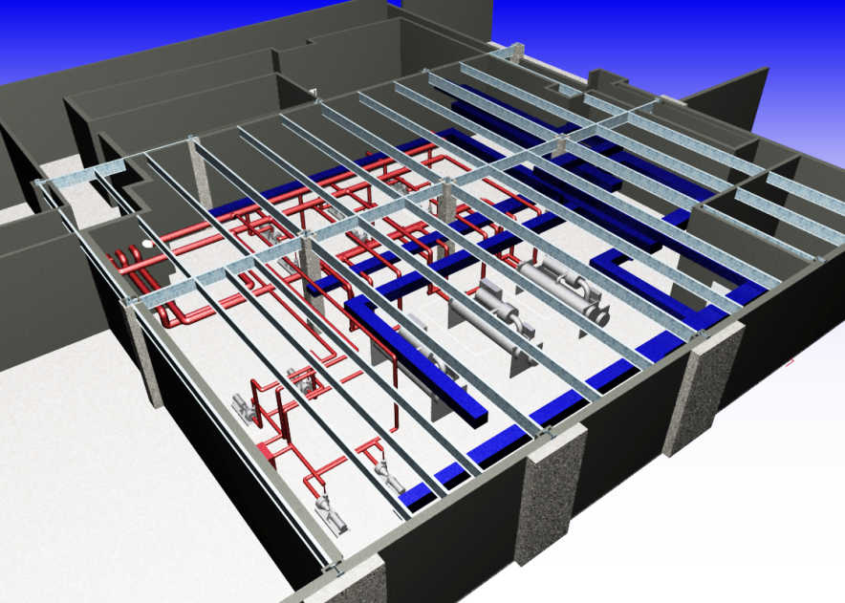
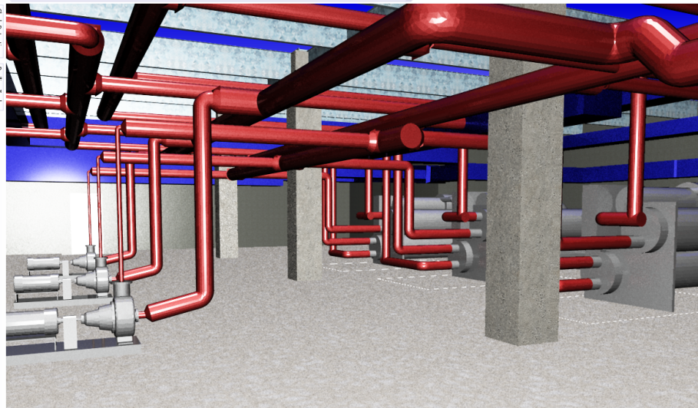
Westinghouse Electric Company Nuclear Power Engineering Headquarters Campus
ANALYSIS 3: BIM Implementation
  3D and 4D Modeling
  Autodesk Revit 2010
  Autodesk Navisworks 2010
  Chose to explore the benefits of clash detection
  Basement mechanical space was modeled
    Ductwork
    Piping
    Steel
    Equipment
  Presentation Outline
  Project Overview
  Analysis 1: Energy and Environment
  Analysis 2: Concrete Slabs
  Analysis 3: BIM Implementation
  Conclusions/Recommendations
  Acknowledgements
  Mark Speicher / Construction Management / Senior Thesis 2010

Slide 20
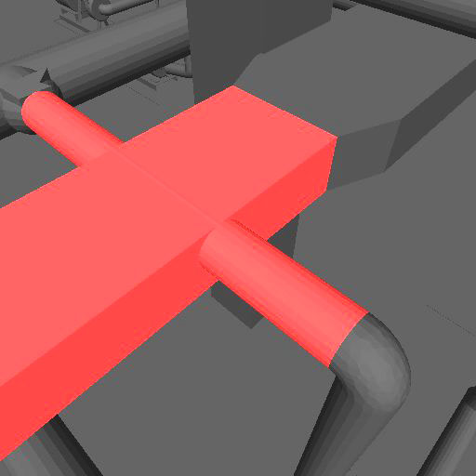
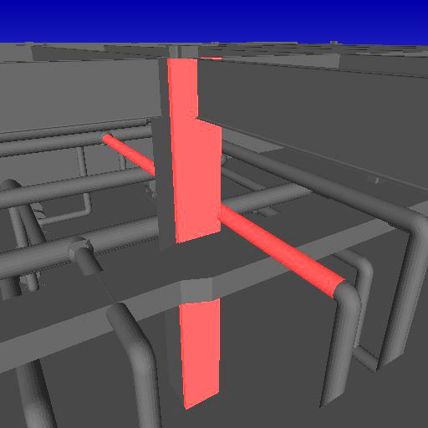
Westinghouse Electric Company Nuclear Power Engineering Headquarters Campus
ANALYSIS 3: BIM Implementation
  Clash Detection
  Tests were run against:
    Plumbing vs Mechanical → 10 clashes
    Plumbing vs Structural → 2 clashes
    Structural vs Mechanical → 0 clashes
  If found in the field result in RFIs, change orders, and/or delays
  Presentation Outline
  Project Overview
  Analysis 1: Energy and Environment
  Analysis 2: Concrete Slabs
  Analysis 3: BIM Implementation
  Conclusions/Recommendations
  Acknowledgements
  Mark Speicher / Construction Management / Senior Thesis 2010

Slide 21
Westinghouse Electric Company Nuclear Power Engineering Headquarters Campus
ANALYSIS 3: BIM Implementation
  Cost and Schedule Analysis
  Difficult to quantify
    Problems never actually faced
  Slightly higher upfront cost
    Even this is reducing with BIM becoming a standard
  Presentation Outline
  Project Overview
  Analysis 1: Energy and Environment
  Analysis 2: Concrete Slabs
  Analysis 3: BIM Implementation
  Conclusions/Recommendations
  Acknowledgements
  Minor conflict found between piping and ceiling heights
    No money to cover coordination issues in budget
    Bulkheads installed to cover piping
  Mark Speicher / Construction Management / Senior Thesis 2010

Slide 22
Westinghouse Electric Company Nuclear Power Engineering Headquarters Campus
CONCLUSIONS/RECOMMENDATIONS
  Analysis 1: Energy and the Environment
  Current finishes within building meet LEED requirements
    Low levels of VOC and regionally manufactured
  Opportunity to save money by implementing high efficiency windows
    Total operating costs could be reduced up to 9%
  Load on mechanical equipment would be reduced
  Presentation Outline
  Project Overview
  Analysis 1: Energy and Environment
  Analysis 2: Concrete Slabs
  Analysis 3: BIM Implementation
  Conclusions/Recommendations
  Acknowledgements
  Mark Speicher / Construction Management / Senior Thesis 2010

Slide 23
Westinghouse Electric Company Nuclear Power Engineering Headquarters Campus
CONCLUSIONS/RECOMMENDATIONS
  Analysis 2: Prefabricated Concrete Slabs
  Prefabricated Concrete slabs could have saved time and money
    58 days ahead of schedule
    $1.7 million less
  Negative impacts on structural system
    Heavier steel
    Reduced ceiling height
  Difficult to determine the lead time necessary to complete the project
  Presentation Outline
  Project Overview
  Analysis 1: Energy and Environment
  Analysis 2: Concrete Slabs
  Analysis 3: BIM Implementation
  Conclusions/Recommendations
  Acknowledgements
  Mark Speicher / Construction Management / Senior Thesis 2010

Slide 24
Westinghouse Electric Company Nuclear Power Engineering Headquarters Campus
CONCLUSIONS/RECOMMENDATIONS
  Analysis 3: BIM Implementation
  Staff did not feel BIM could have been successfully employed due to incomplete drawings
    Would not have been an issue if designed with BIM
  Clashes found in mechanical room
    Value of these findings is unknown
  Clashes found in field which carried an additional cost
  Presentation Outline
  Project Overview
  Analysis 1: Energy and Environment
  Analysis 2: Concrete Slabs
  Analysis 3: BIM Implementation
  Conclusions/Recommendations
  Acknowledgements
  Mark Speicher / Construction Management / Senior Thesis 2010

Slide 25
Westinghouse Electric Company Nuclear Power Engineering Headquarters Campus
ACKNOWLEDGEMENTS
  Acknowledgements
  Turner Construction Company
  Kathleen McCartney
  Bob Hennessey
  Nitterhouse Concrete Products
  Mark Taylor
  Acknowledgements
  Penn State AE Department
  Dr. Chris Magent
  Dr. David Riley
  Friends and Family
  Presentation Outline
  Project Overview
  Analysis 1: Energy and Environment
  Analysis 2: Concrete Slabs
  Analysis 3: BIM Implementation
  Conclusions/Recommendations
  Acknowledgements
  Mark Speicher / Construction Management / Senior Thesis 2010

Slide 26
Westinghouse Electric Company Nuclear Power Engineering Headquarters Campus
  Questions?
Mark Speicher / Construction Management / Senior Thesis 2010

