Slide 2
building statistics
size
stories
cost
construction
function
occupants
location
architect
248,000 sq.ft.
5/6
$180 million
summer 2010 – spring 2013
educational
Neuroscience Institute and Psychology Dept.
South of Icahn Lab, Lot 20
Rafael Moneo Valles
Davis Brody Bond, LLP

Slide 3
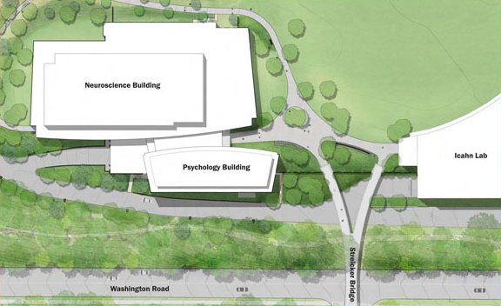

Slide 4
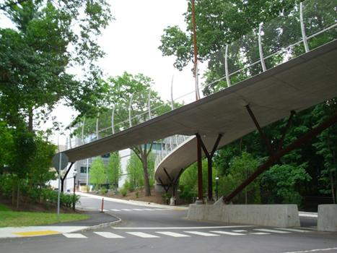

Slide 5
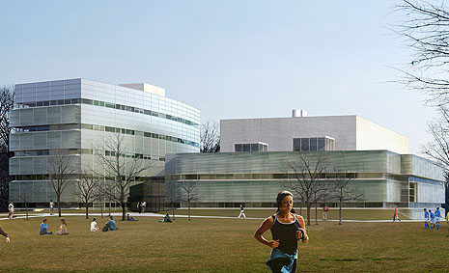

Slide 6
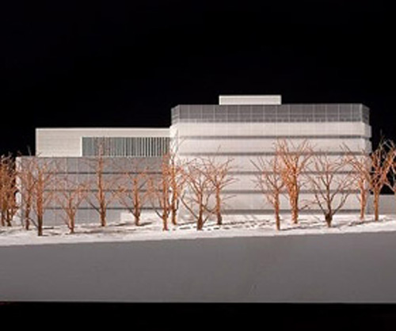

Slide 7
lighting concepts

Slide 8
connection

Slide 9
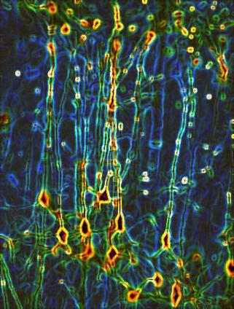

Slide 10
lighting concepts

Slide 11
mirroring opposites

Slide 12
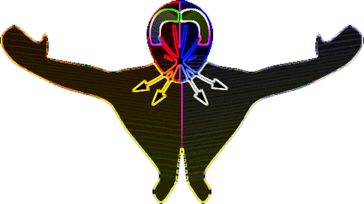

Slide 13
lighting concepts

Slide 14
static motion

Slide 15
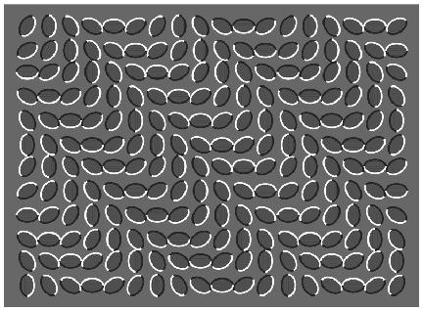

Slide 16
lighting concepts

Slide 17
building as brain activity

Slide 18
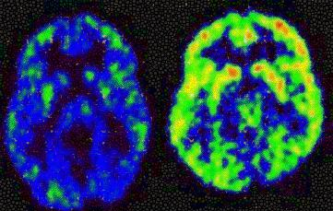

Slide 19
spaces
1.
2.
3.
4.
5.
north entrance
lobby
lecture hall
cafeteria
large patio

Slide 20
north entrance

Slide 21
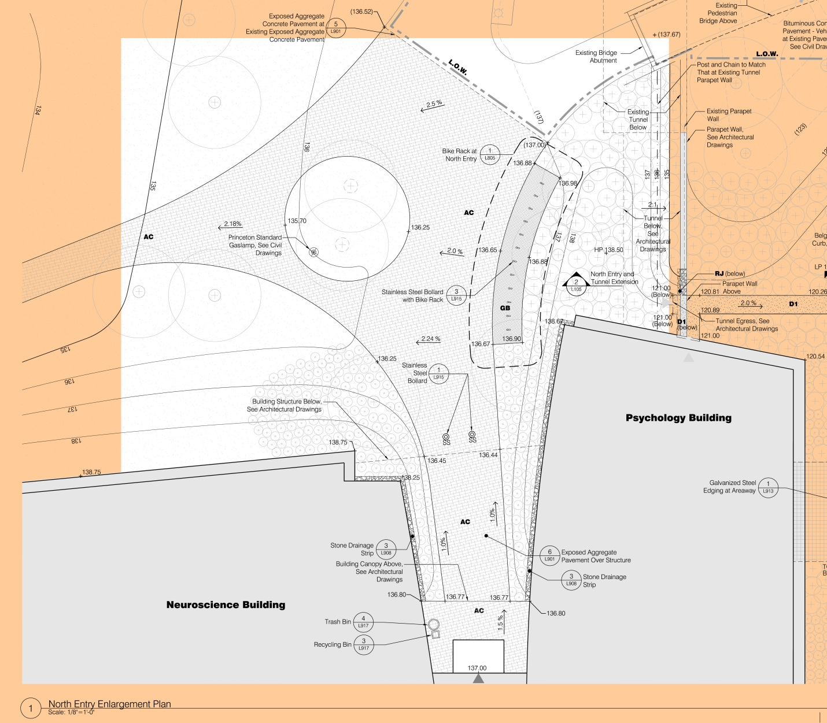

Slide 22
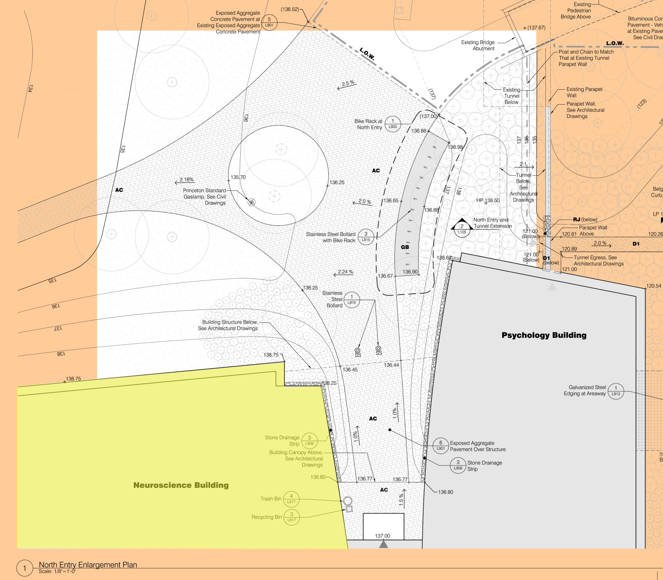

Slide 23
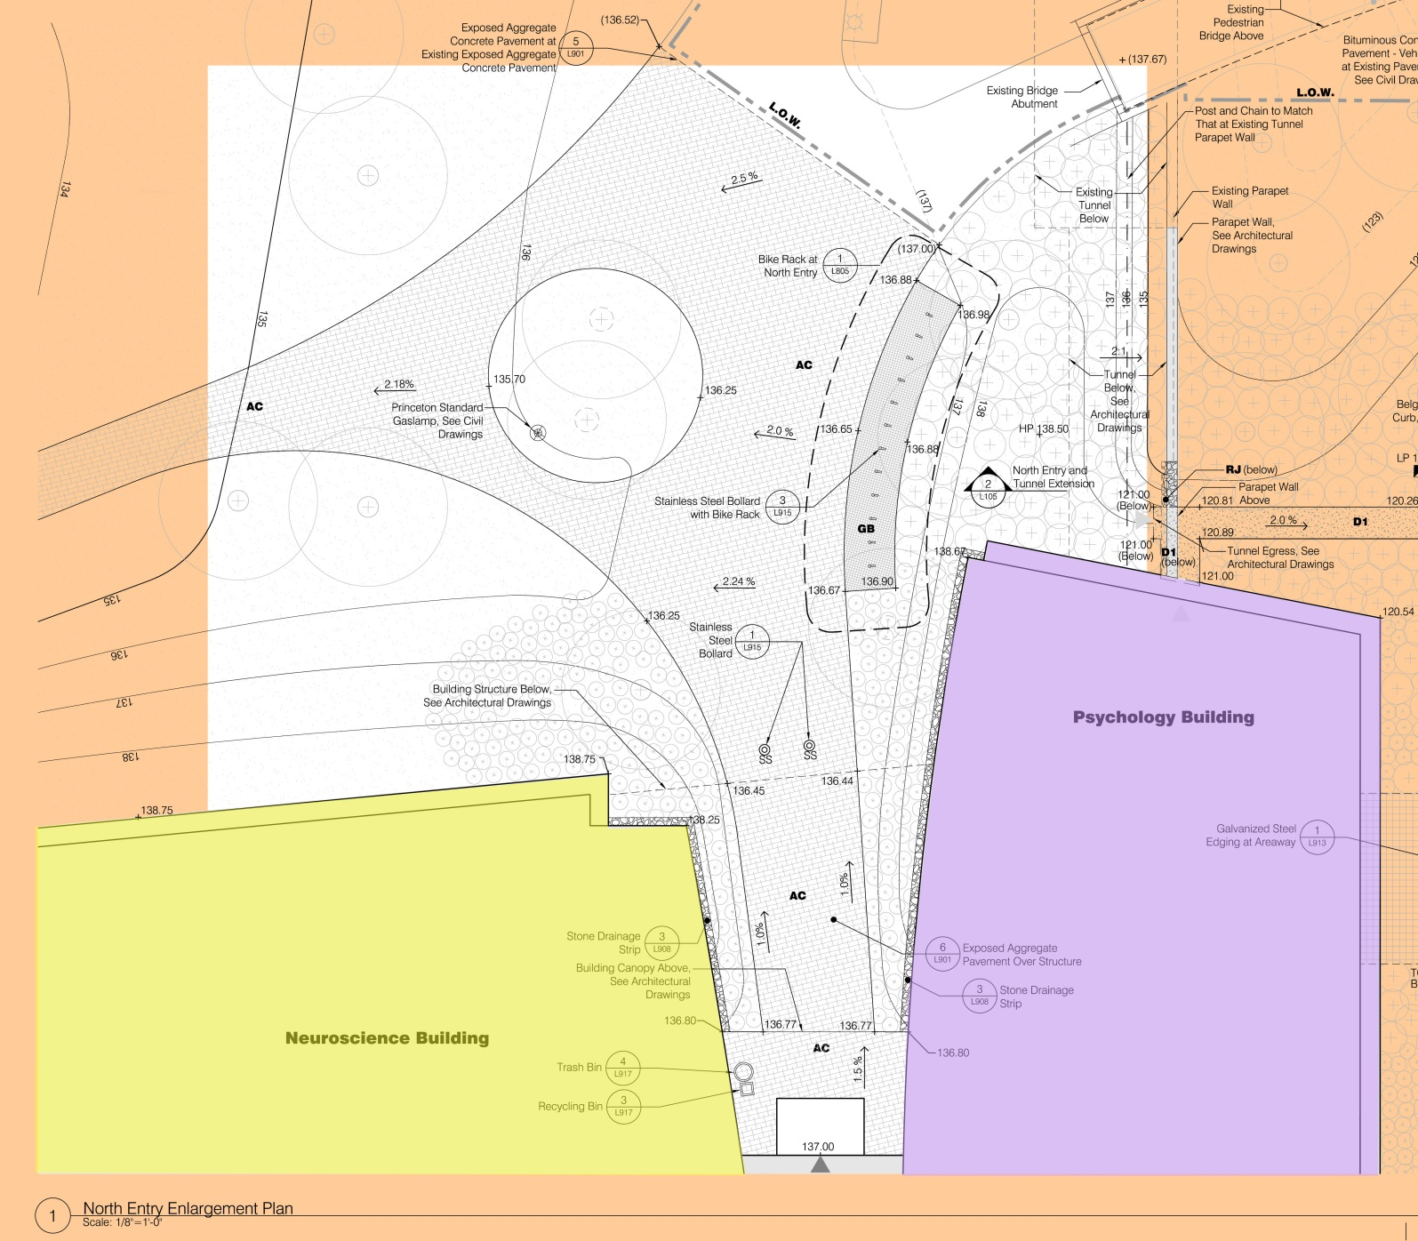

Slide 25
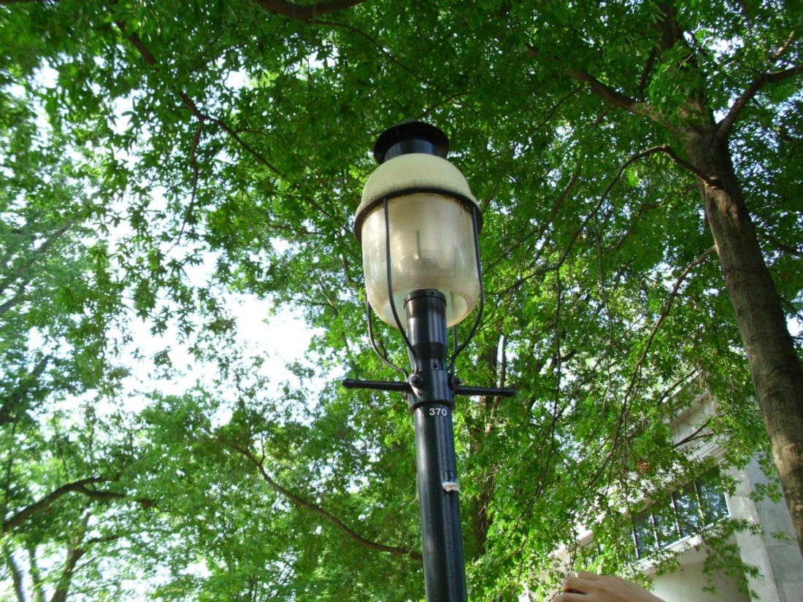
Notes:
Princeton standard gas lamp, glow-top
QL induction lamp
85 W
Penn-glow

Slide 26
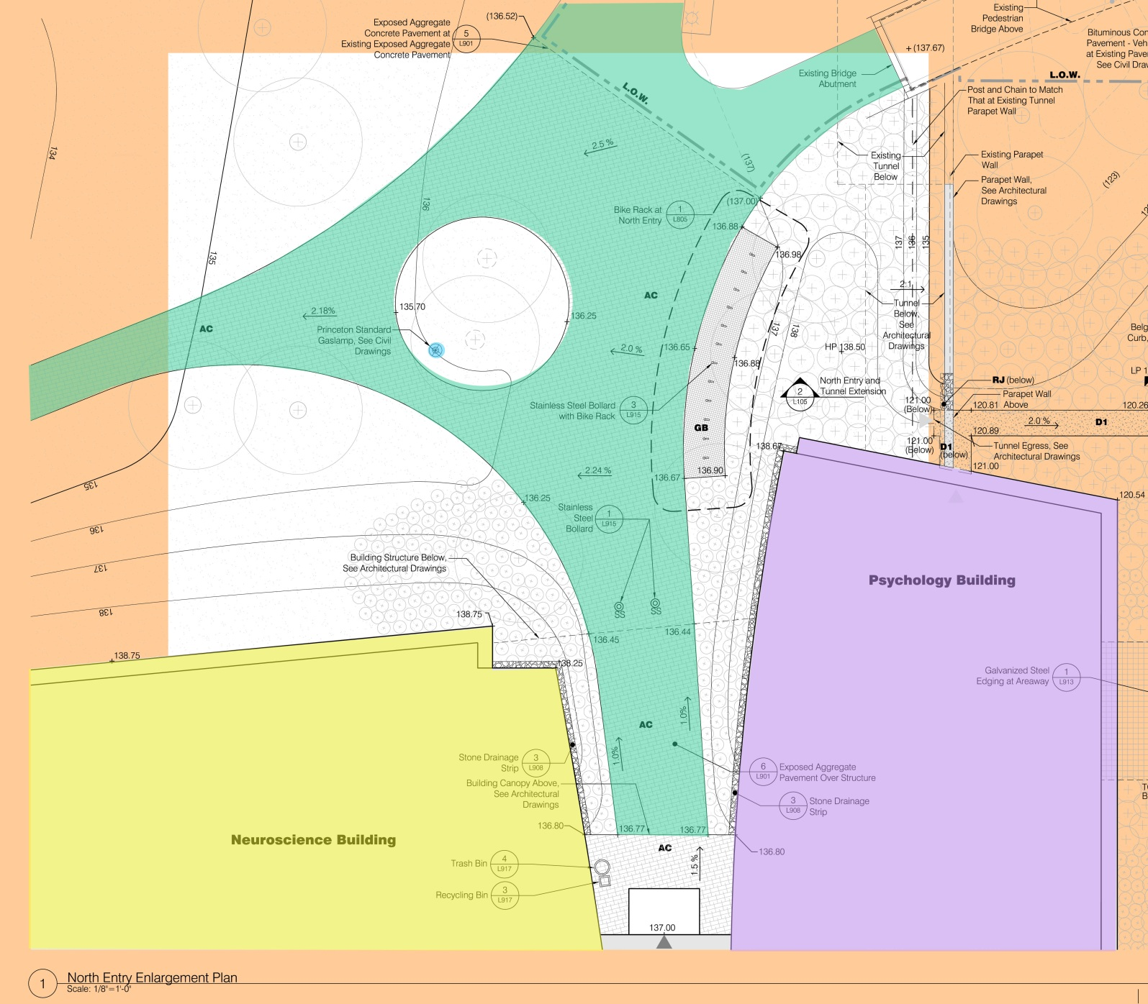
Notes:
Princeton standard gas lamp, glow-top
QL induction lamp
85
Penn-glow

Slide 27
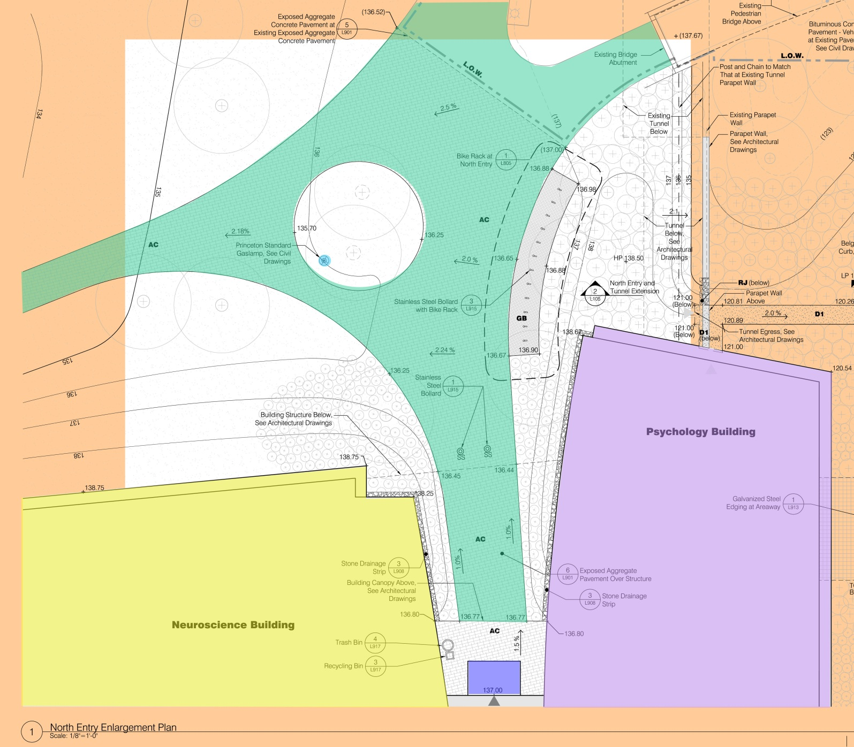

Slide 28
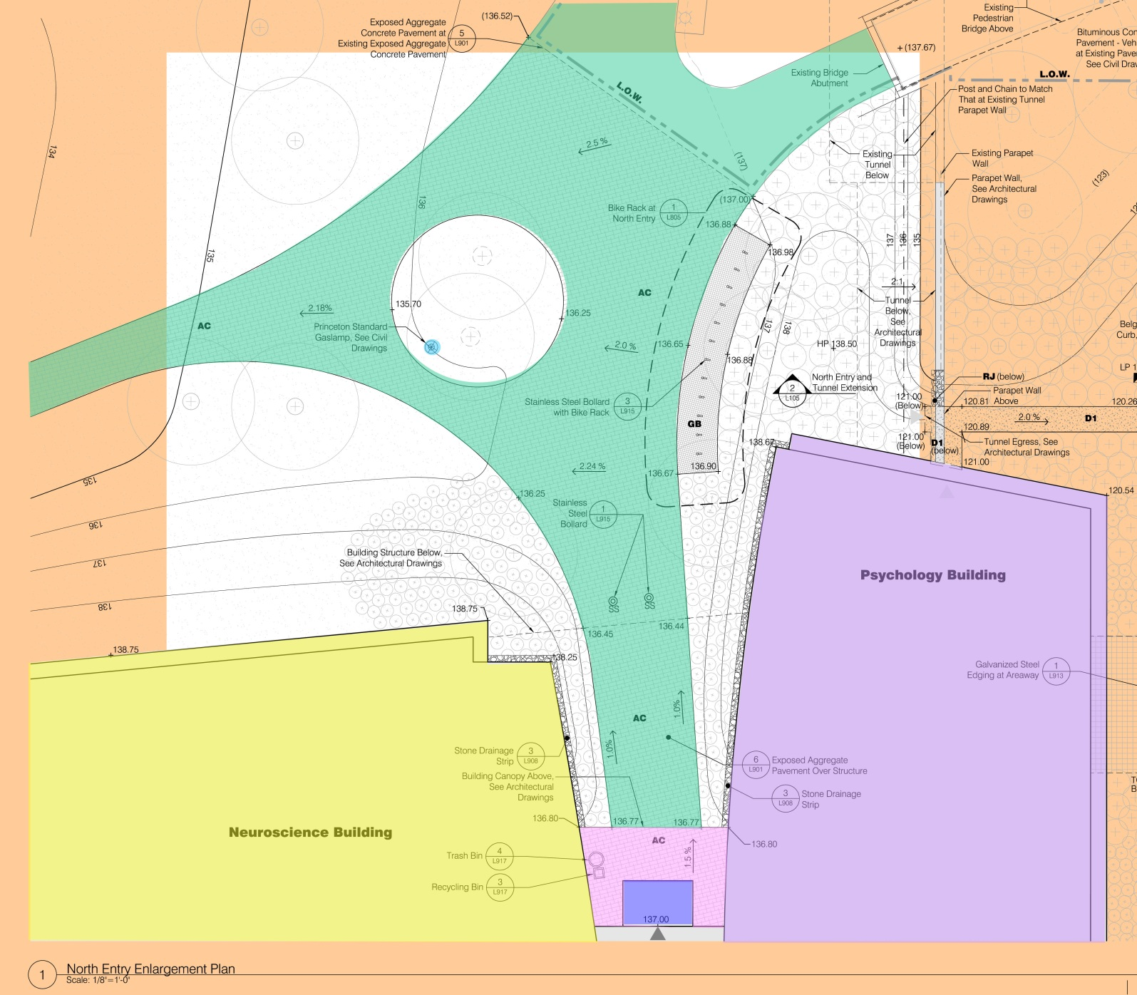

Slide 29
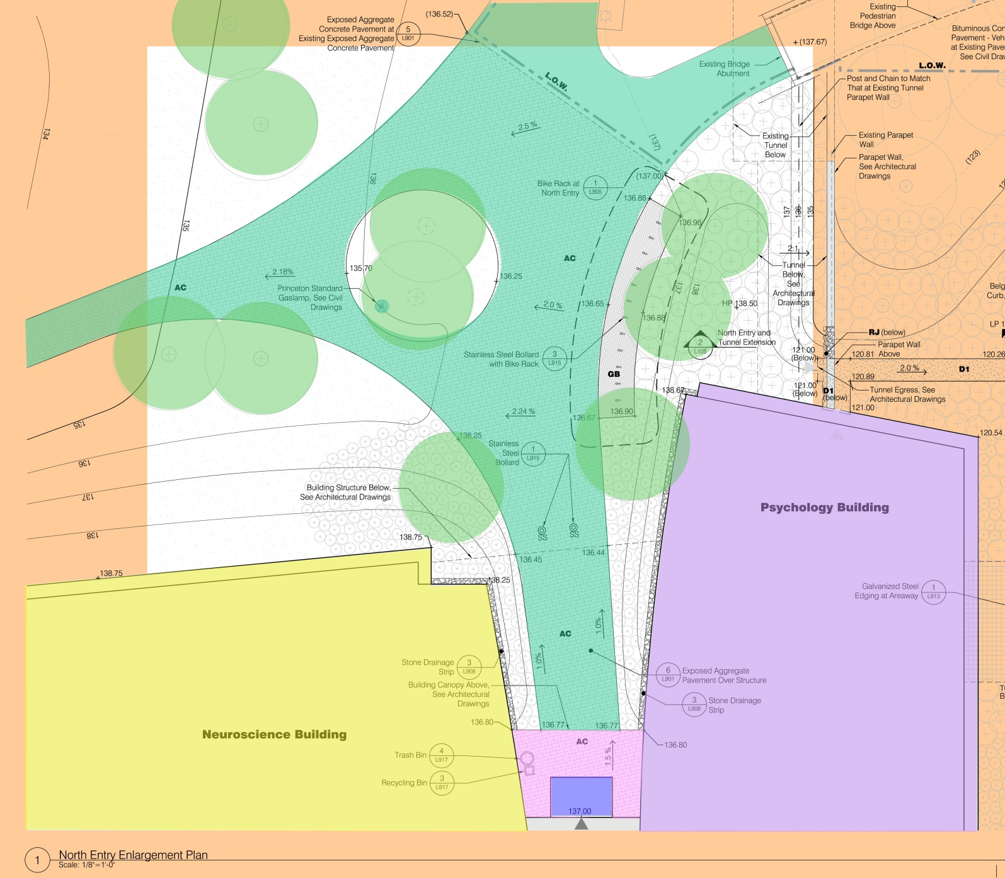

Slide 30
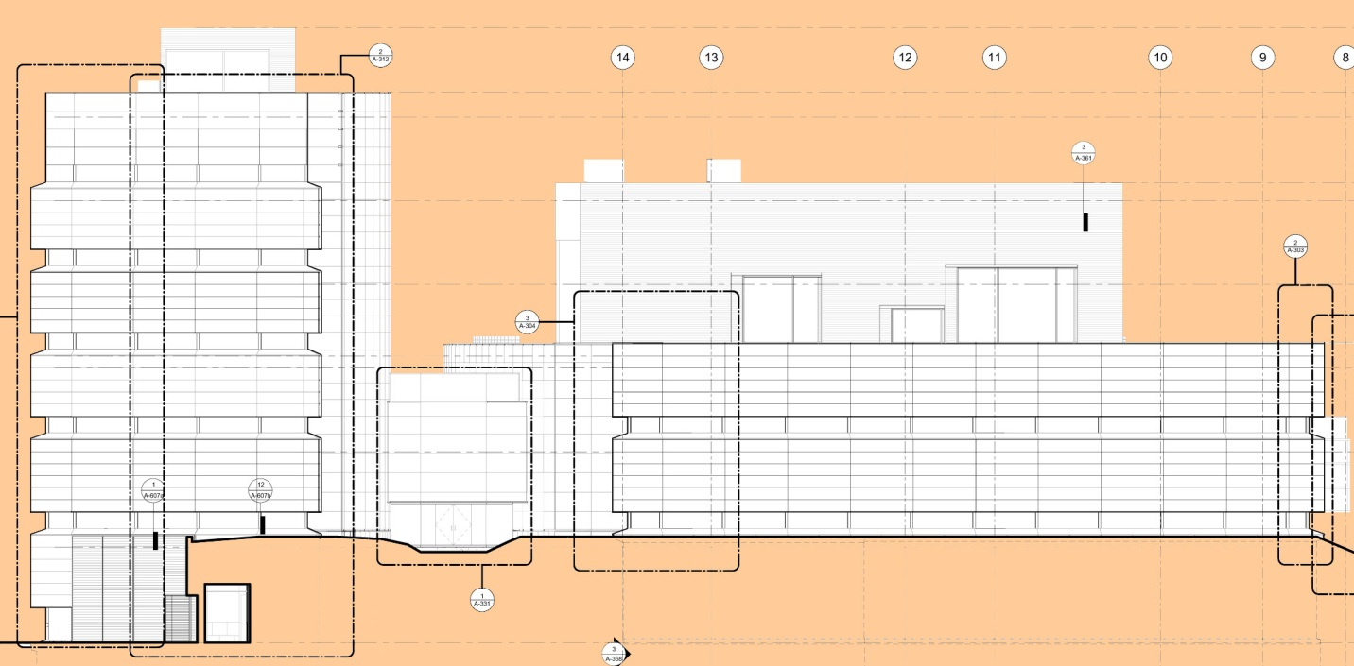

Slide 31
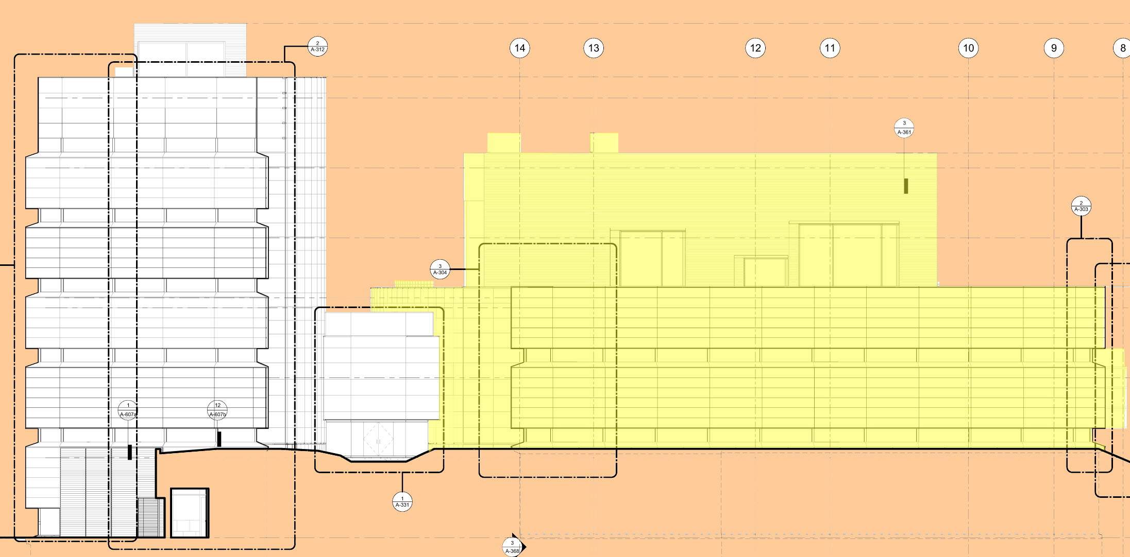

Slide 32
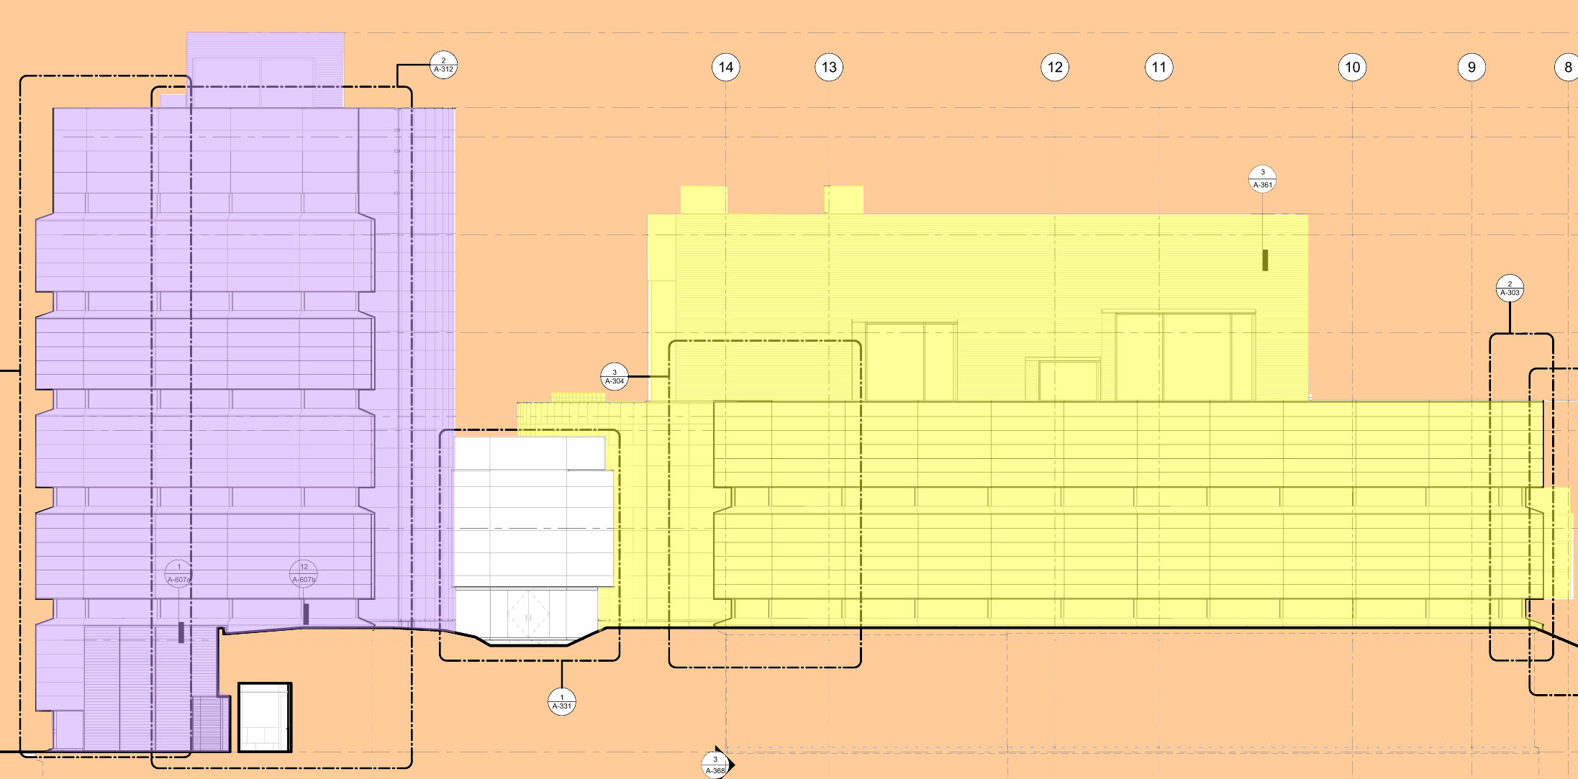

Slide 33
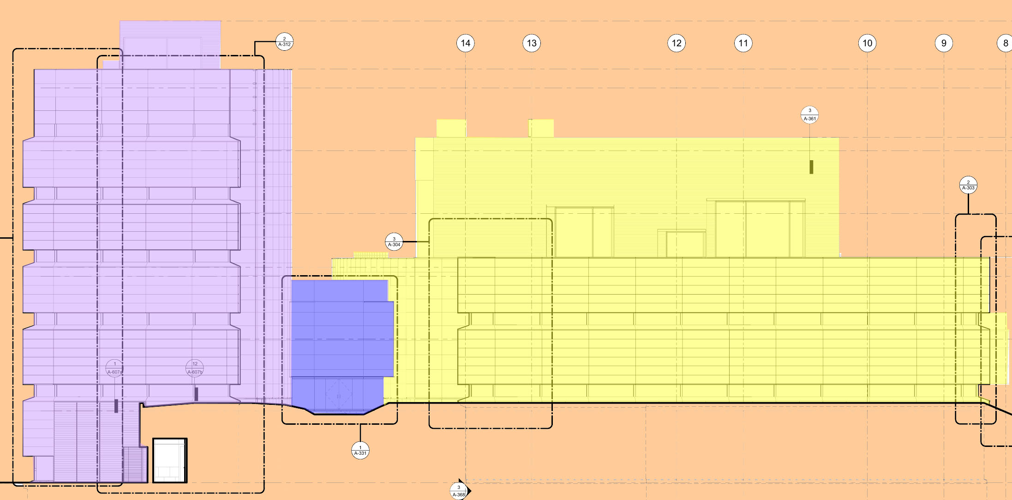

Slide 34
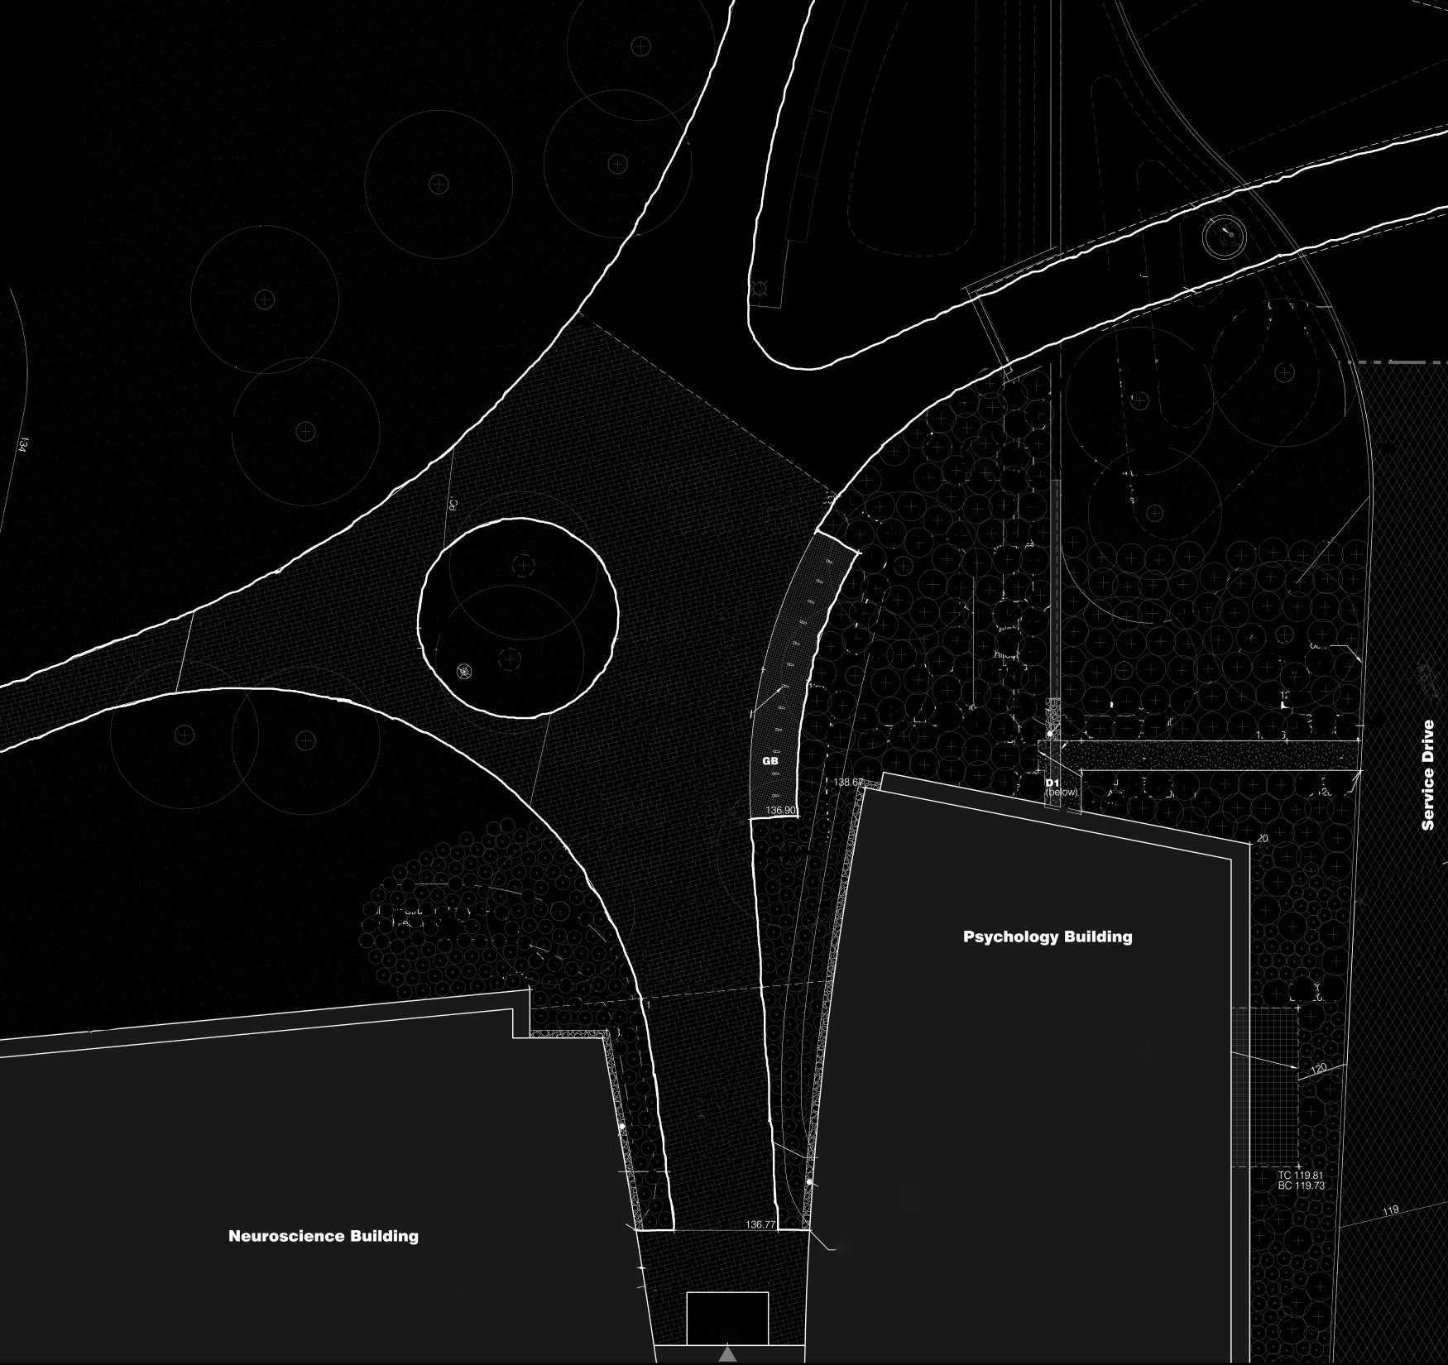
static motion

Slide 35
connection

Slide 36
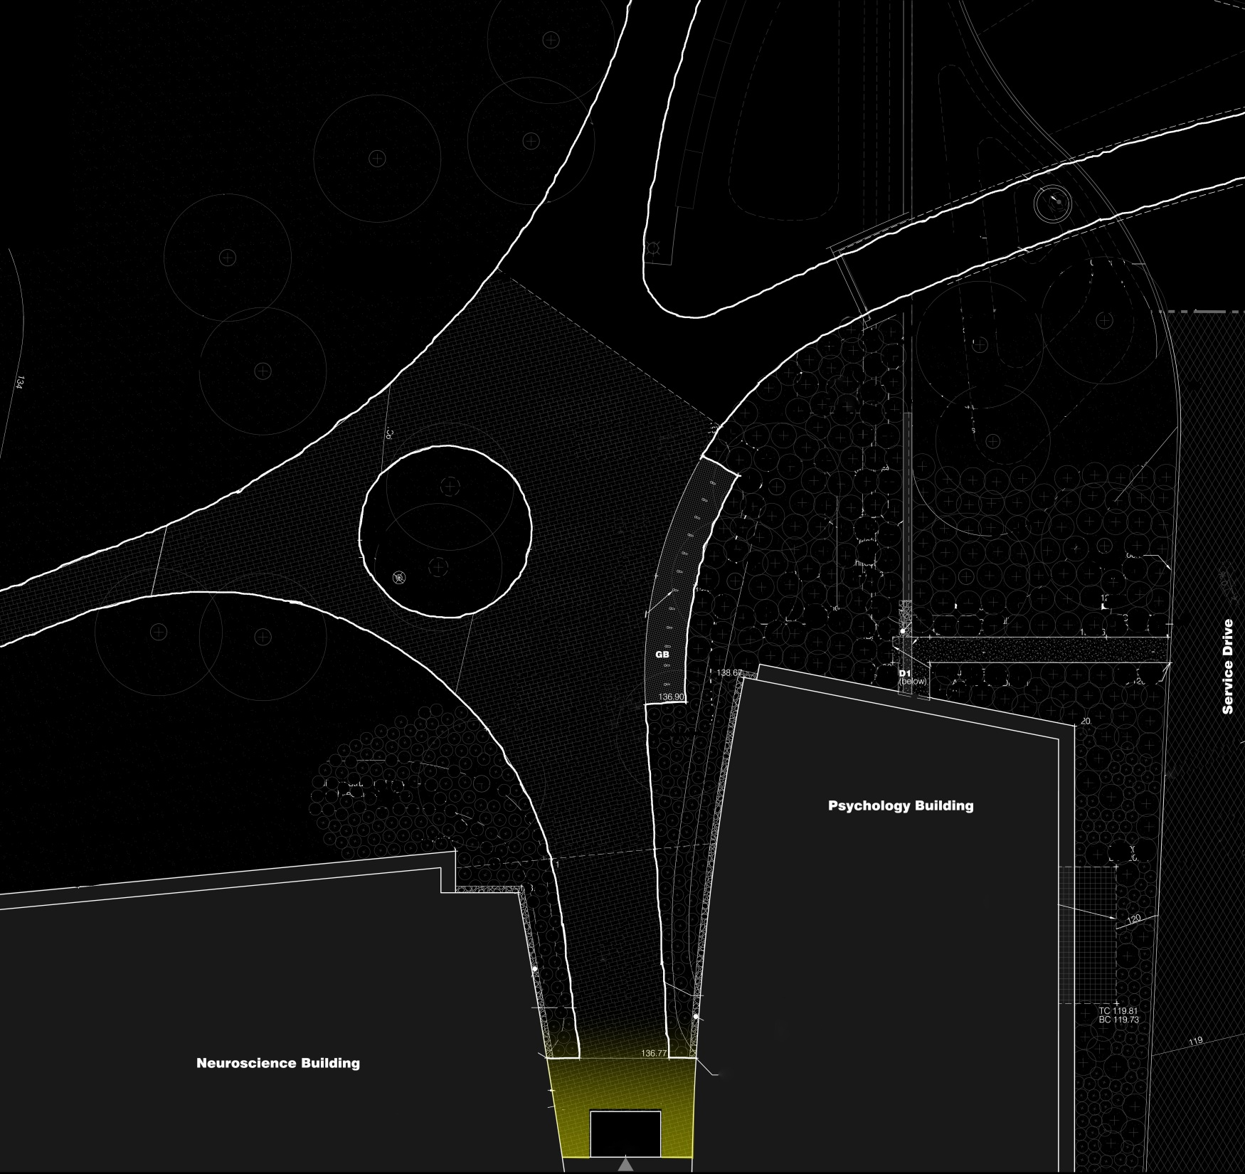

Slide 37
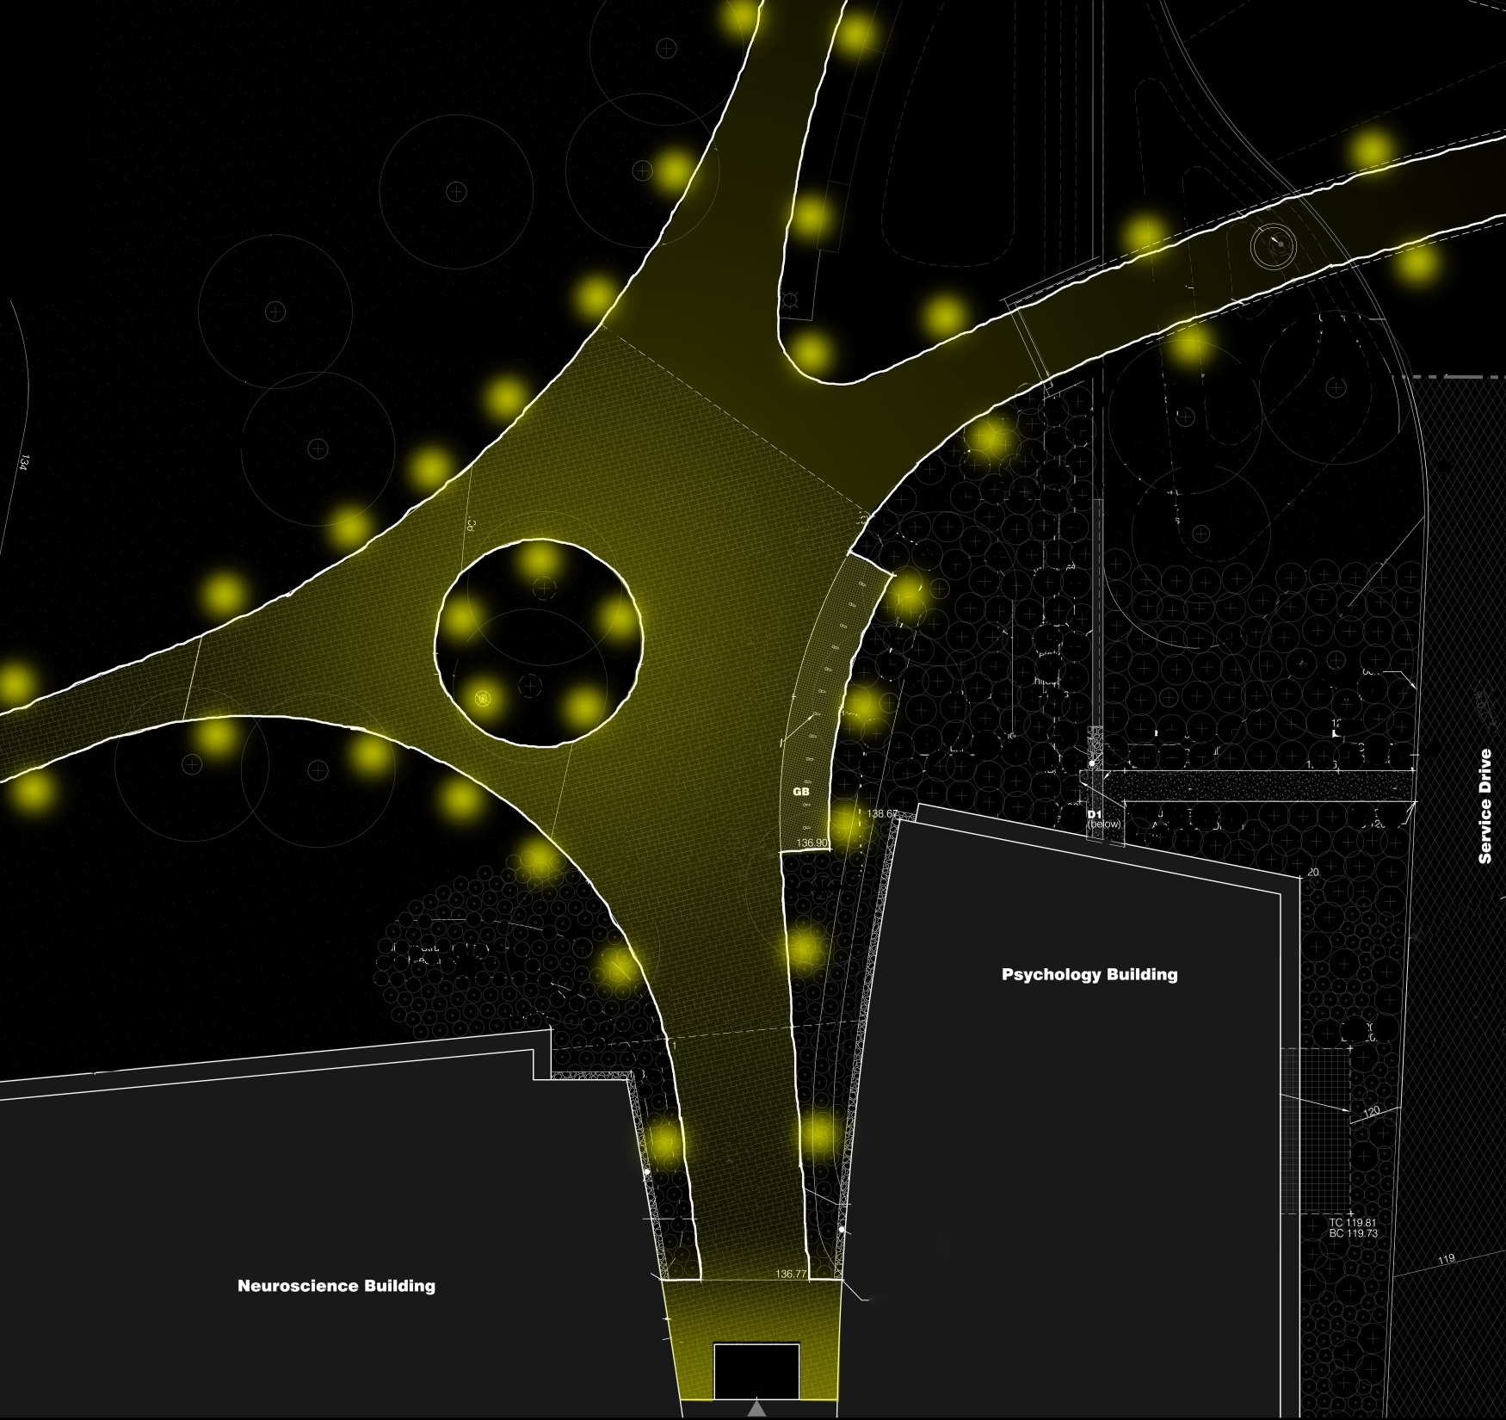

Slide 38
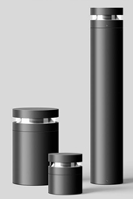
Notes:
Bega us

Slide 39
Notes:
Santa y cole causas externas

Slide 40
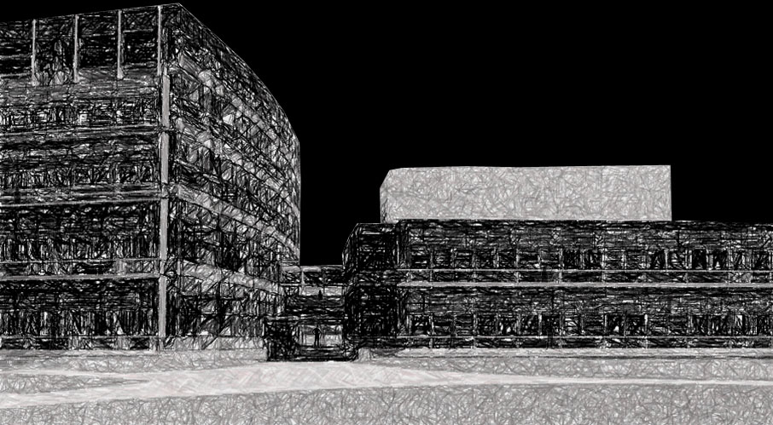
building as brain activity

Slide 41
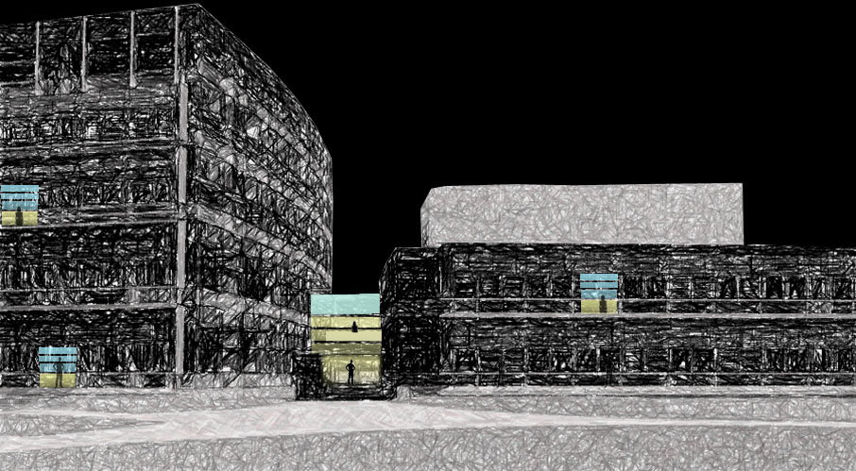

Slide 42
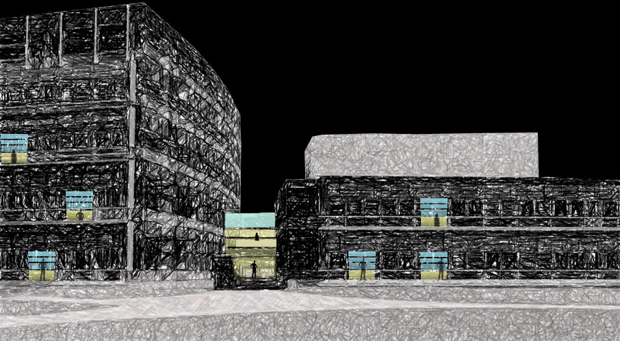

Slide 43
spaces
1.
2.
3.
4.
5.
north entrance
lobby
lecture hall
cafeteria
large patio

Slide 44
lobby

Slide 45
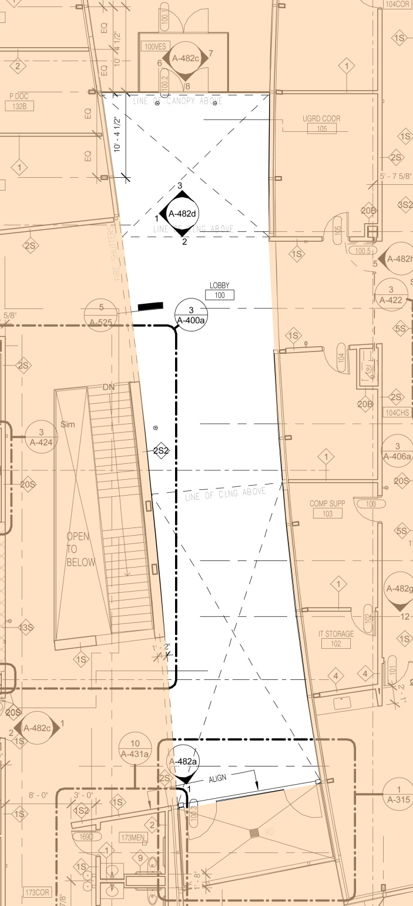
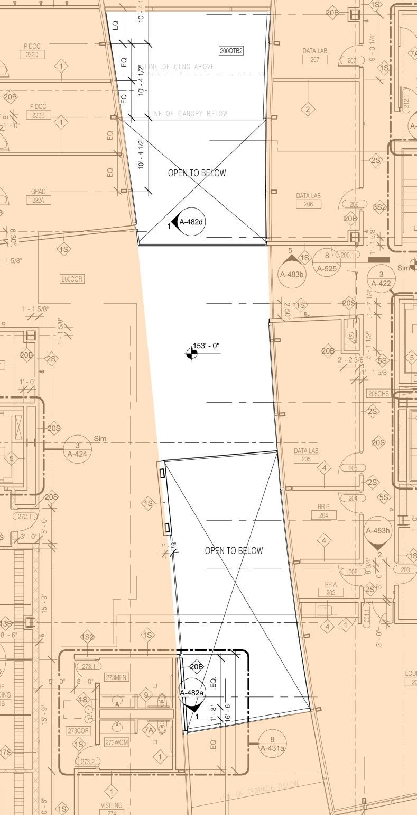

Slide 46
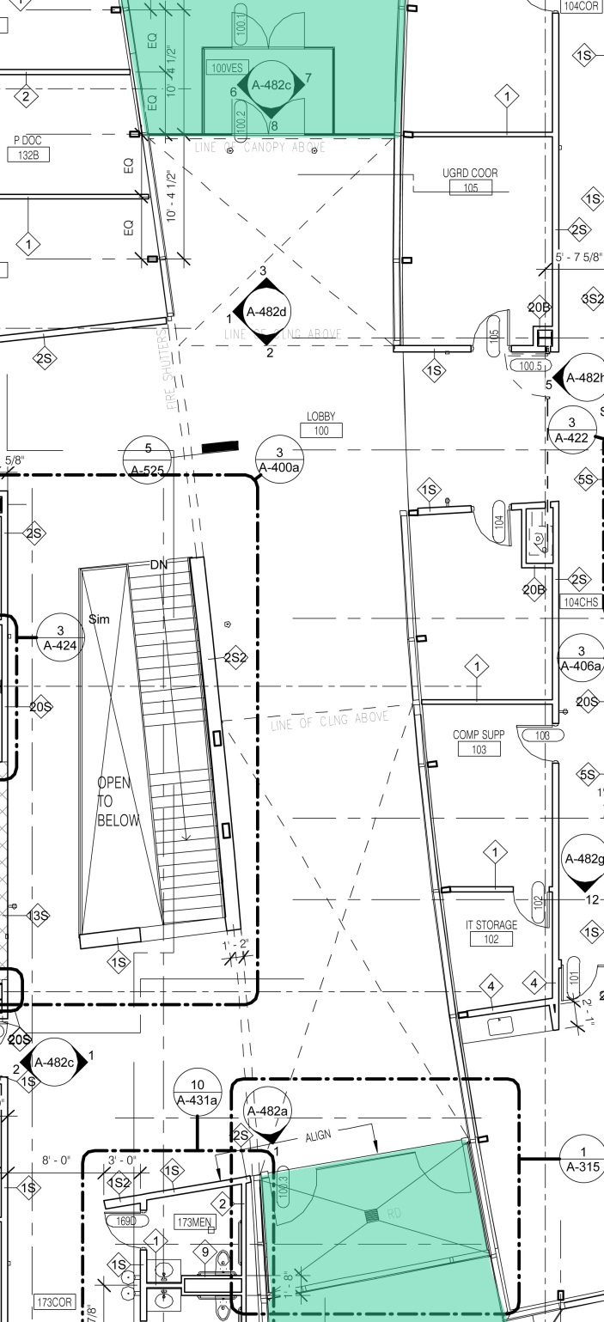
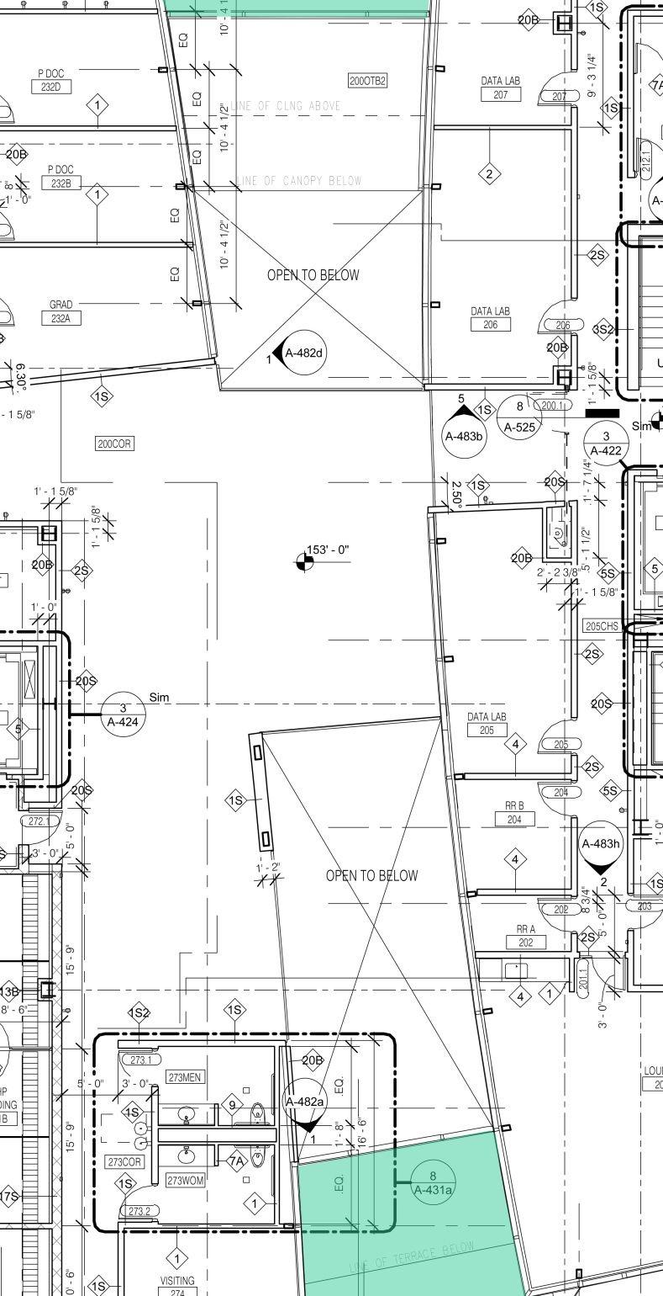

Slide 47
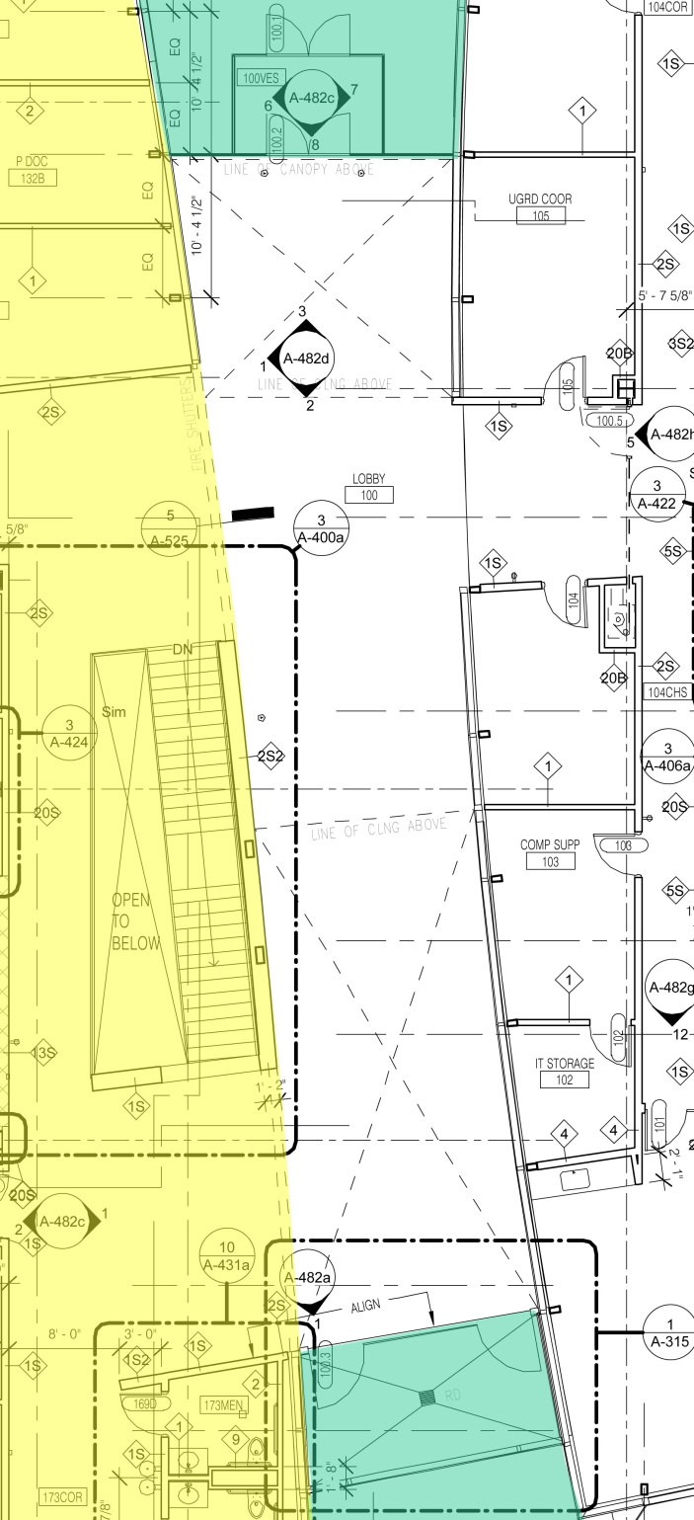
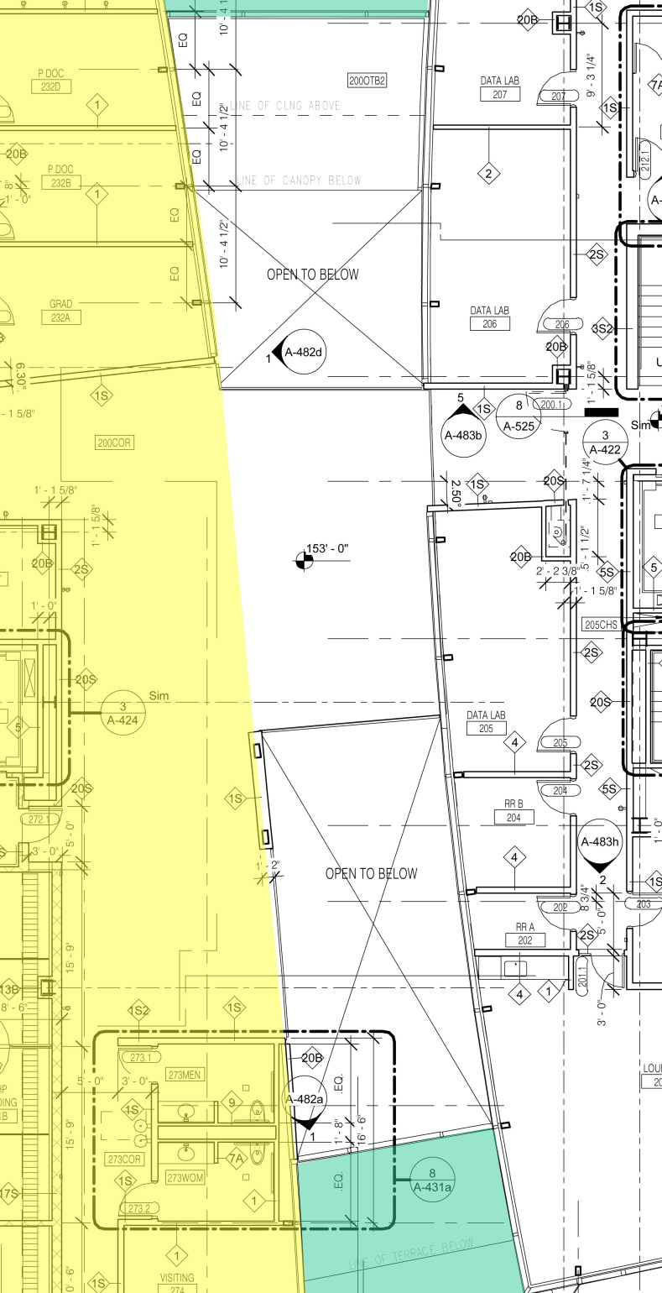

Slide 48
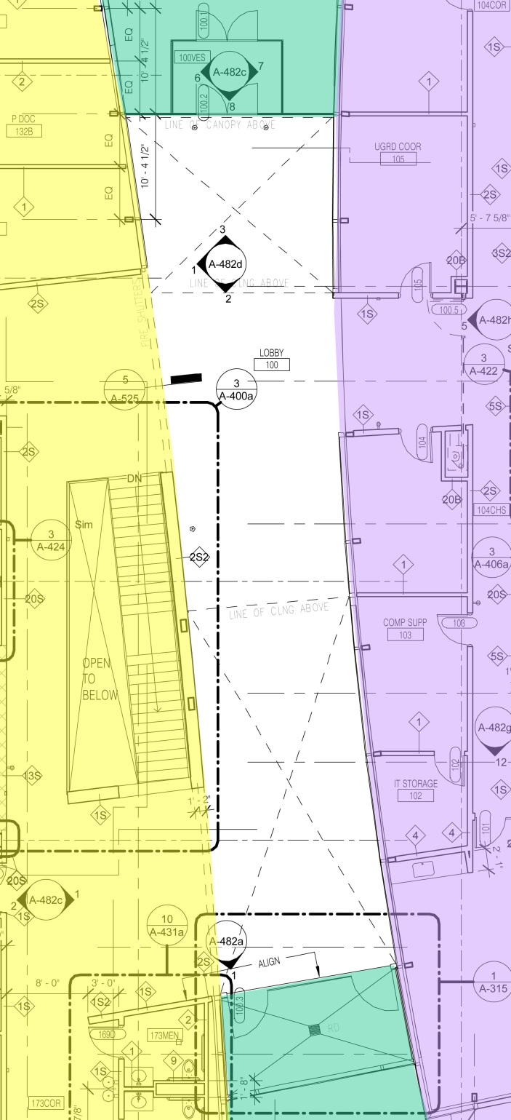
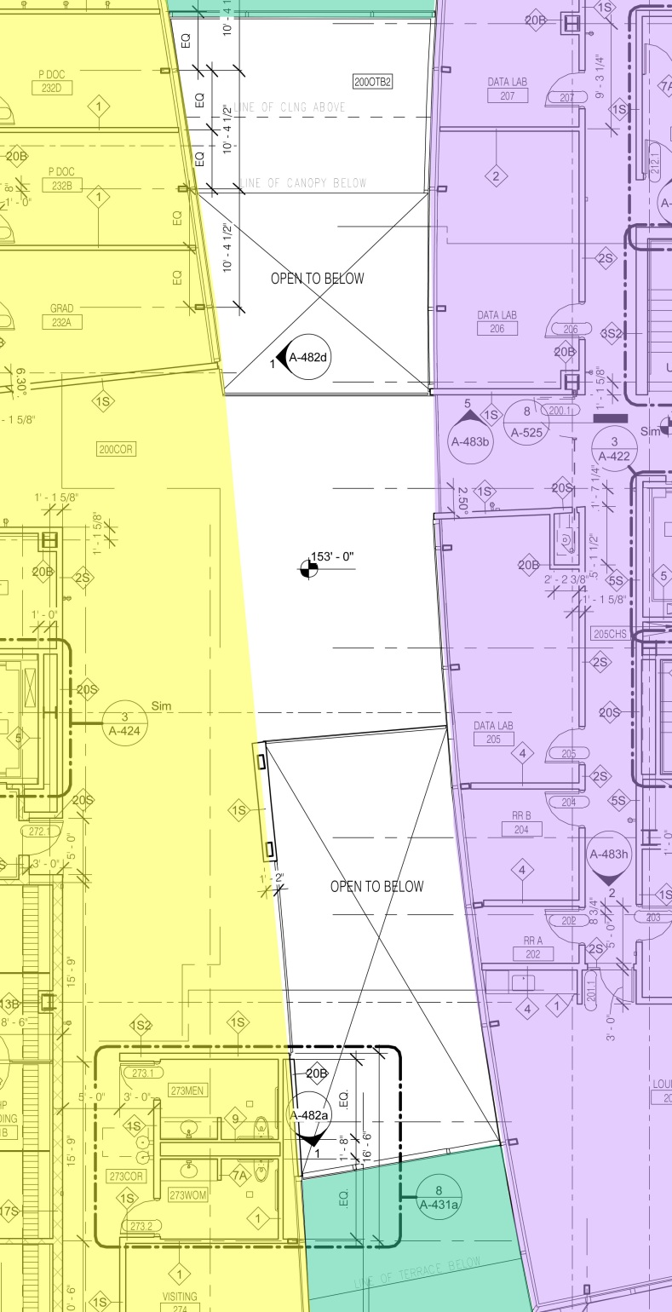

Slide 49
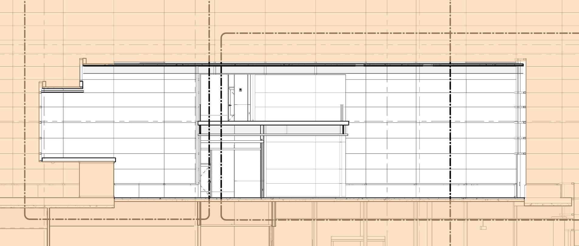

Slide 50
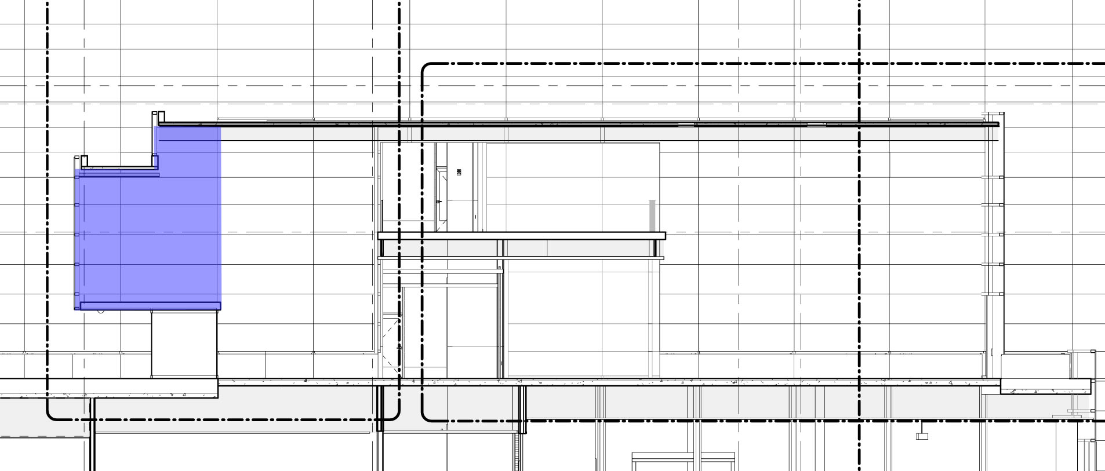

Slide 51
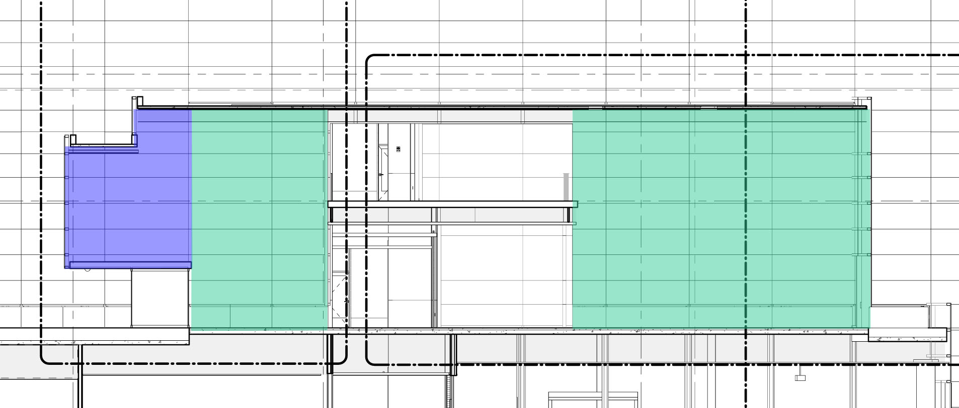

Slide 52
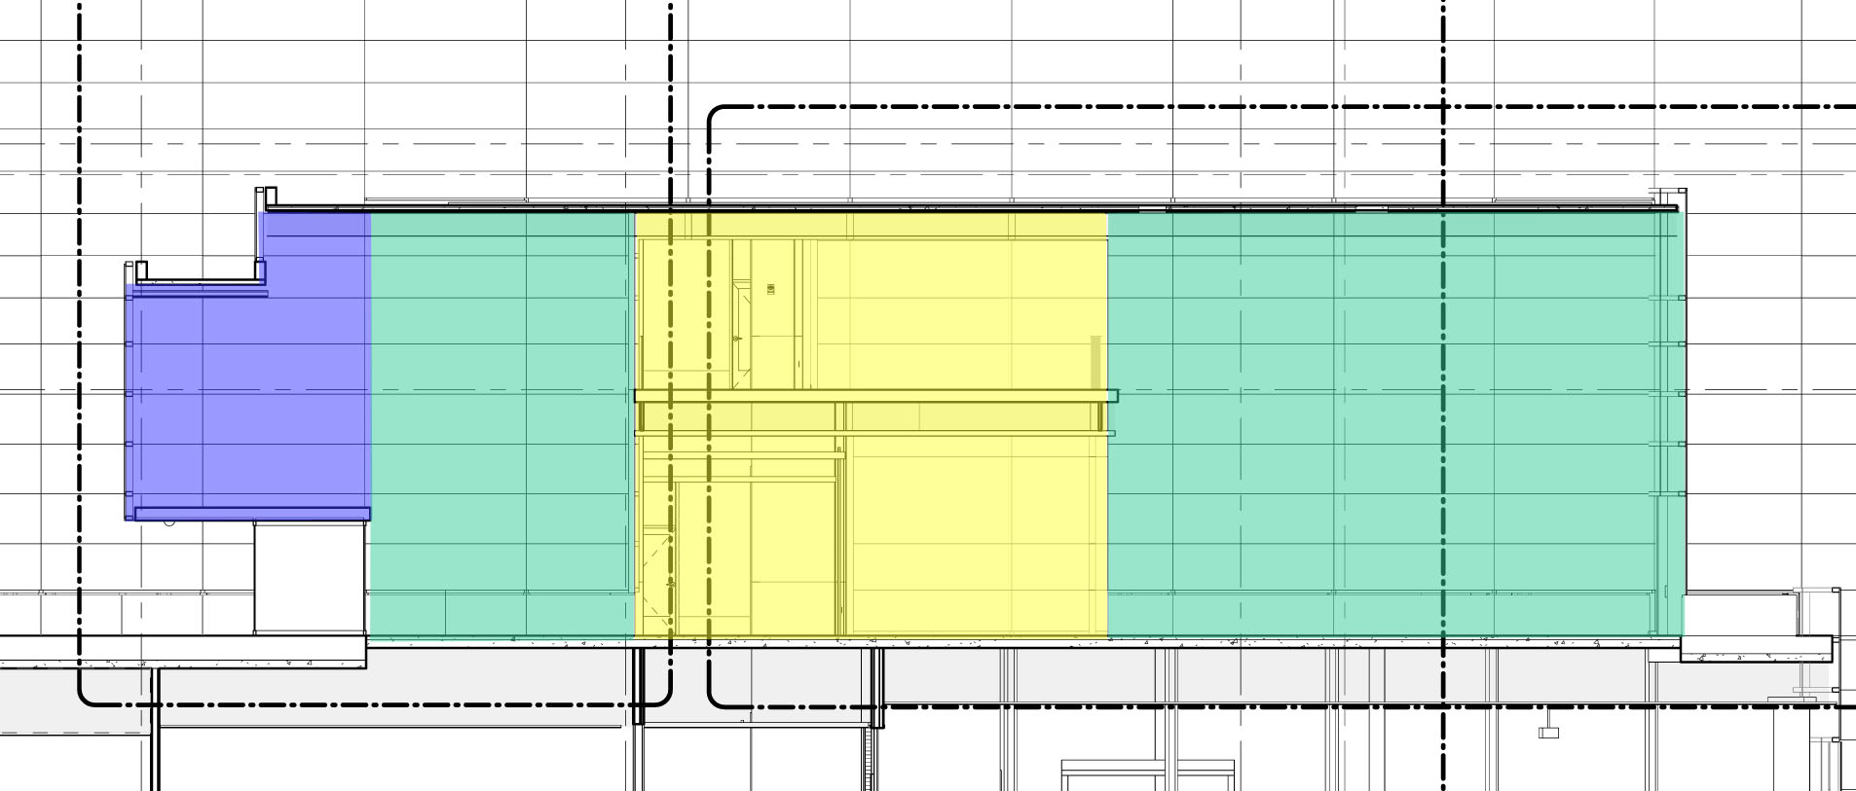

Slide 53
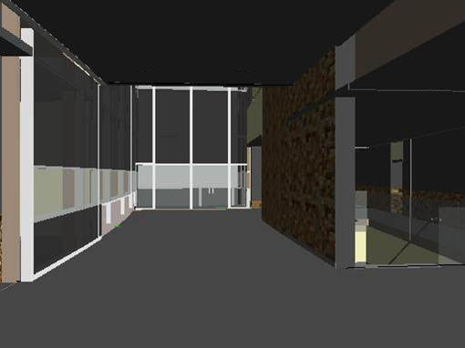

Slide 54
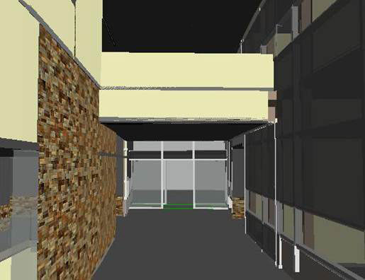

Slide 55
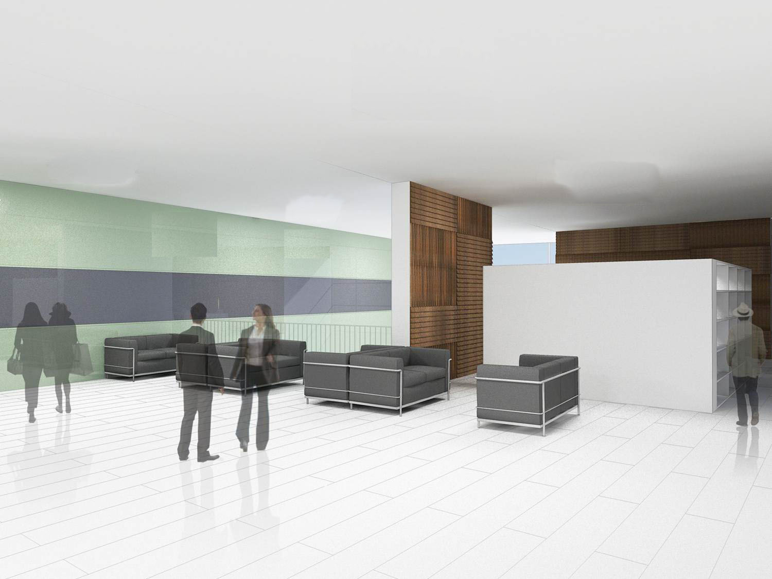

Slide 56
lobby – 3 schematic designs

Slide 57
lobby – architecture

Slide 58
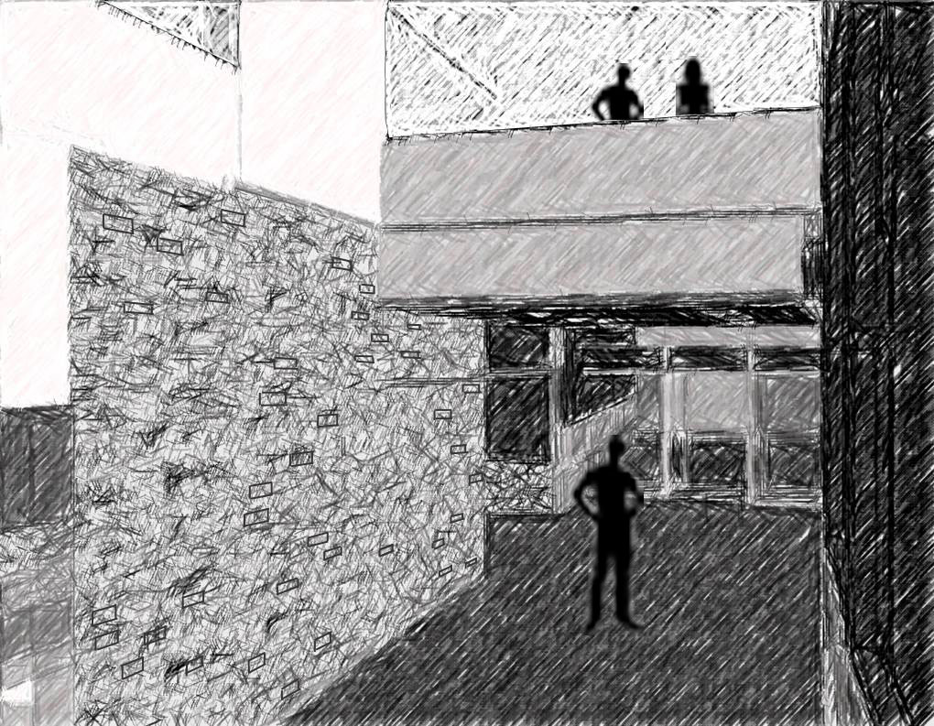
building as brain activity

Slide 59
mirroring opposites

Slide 60
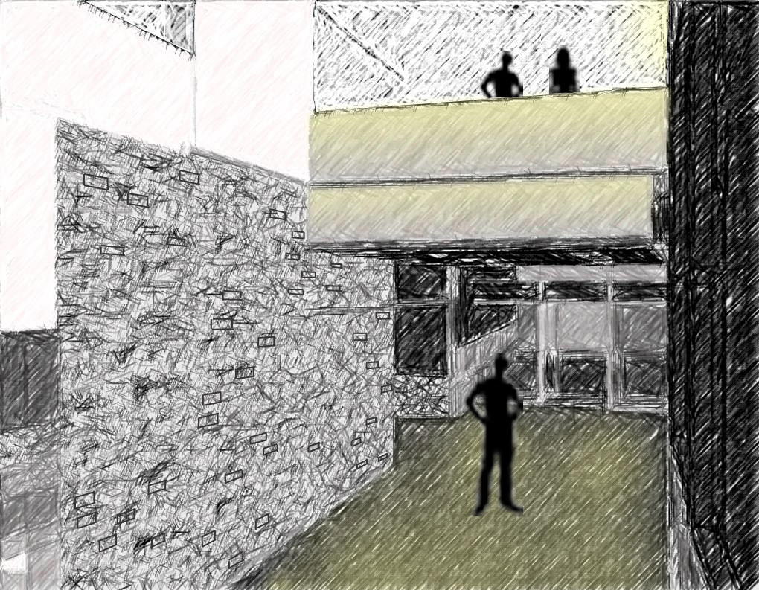
Notes:
Erco quintessence for metal halide

Slide 62
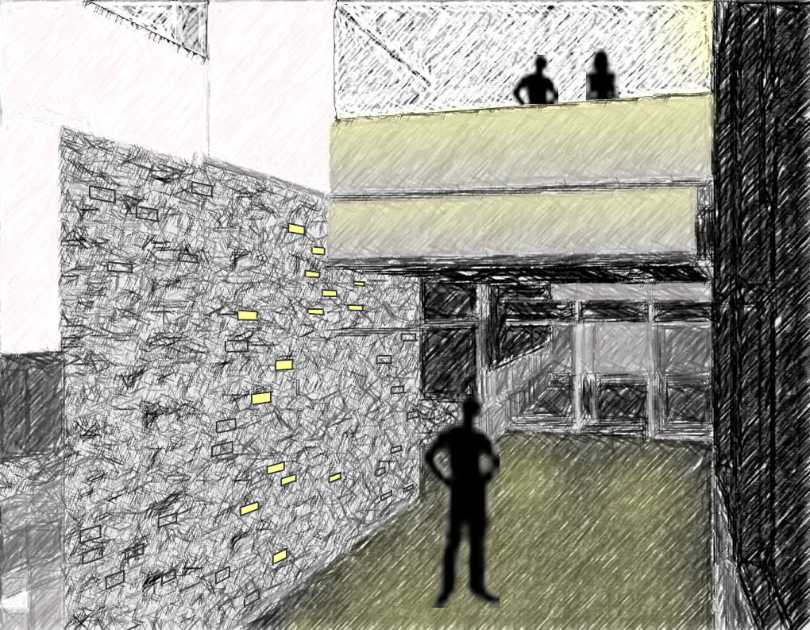

Slide 63
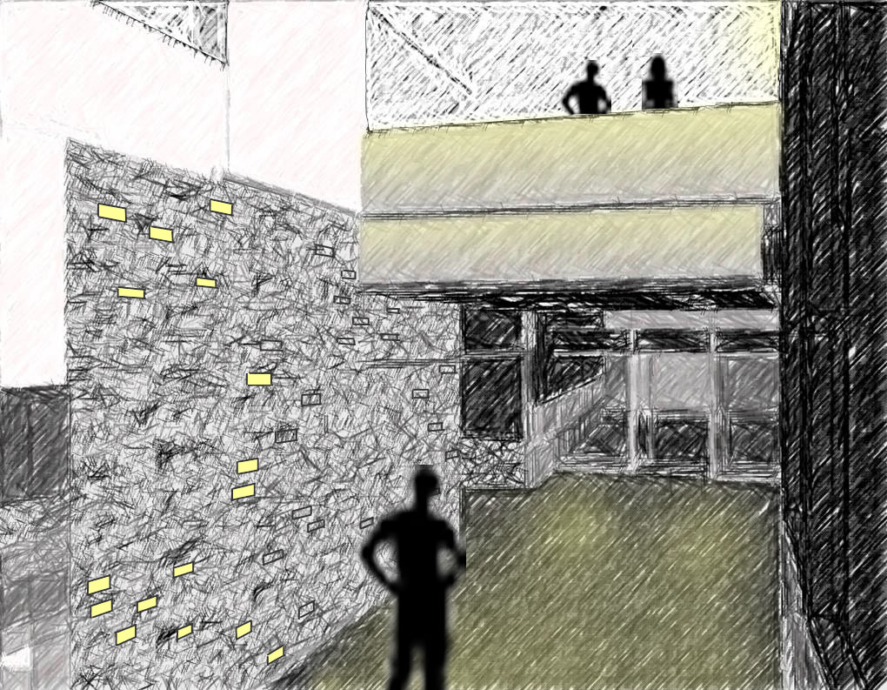

Slide 64
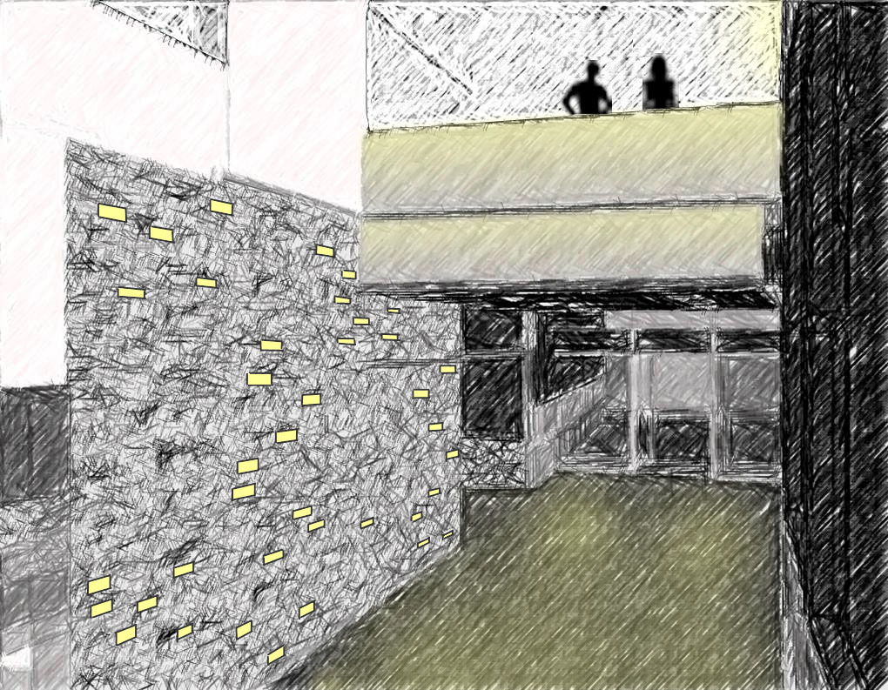
Notes:
Erco quintessence for metal halide , martini light porfido

Slide 65
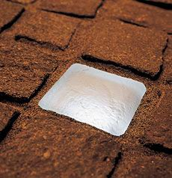
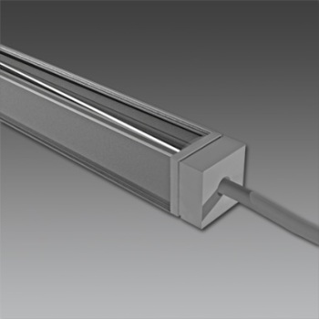
Notes:
Erco quintessence for metal halide , martini light porfido , cooper io

Slide 66
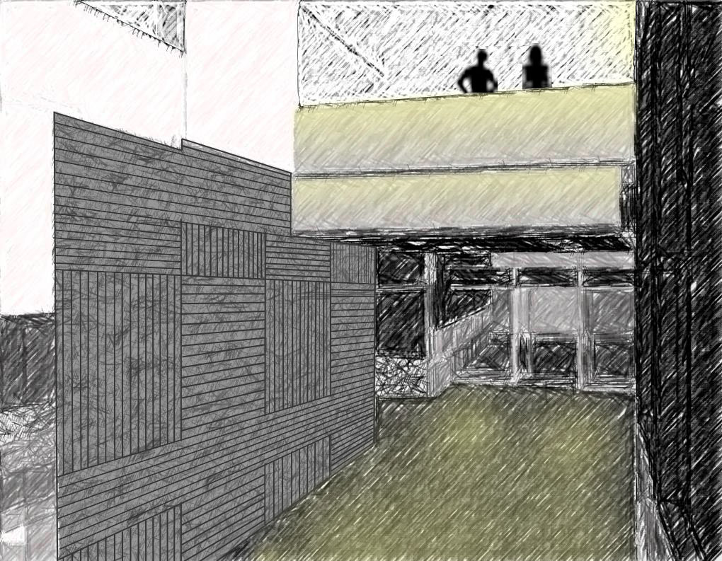

Slide 71
Notes:
cooper lighting io line .75

Slide 74
lobby – neuroscience

Slide 75
connection

Slide 82
Notes:
Color kinetics eW Flex, bartco linear t6 , image from kreon (neon)

Slide 83
lobby – psychology

Slide 84
static motion

Slide 89
Notes:
Io cooper lighting line .75, Nippo seamless, erco quientessense

Slide 90
spaces
1.
2.
3.
4.
5.
north entrance
lobby
lecture hall
cafeteria
large patio

Slide 91
lecture hall

Slide 101
static motion

Slide 102
mirroring opposites

Slide 103
connection

Slide 104
Notes:
Nippo seamless t6 flourescent system

Slide 108
Notes:
Se lux m100 super recessed, Nippo seamless t6 flourescent system

Slide 111
Notes:
nippo

Slide 112
spaces
1.
2.
3.
4.
5.
north entrance
lobby
lecture hall
cafeteria
large patio

Slide 113
cafeteria – flynn mode

Slide 123
building as brain activity

Slide 125
Notes:
Bartco t2, cooper lighting io line .75

Slide 131
Notes:
Louis poulsen satellite, tokistarTokilum, Bartco t2, cooper lighting io line .75
nippo

Slide 132
Notes:
Louis poulsen satellite, tokistarTokilum, Bartco t2, cooper lighting io line .75
nippo

Slide 133
spaces
1.
2.
3.
4.
5.
north entrance
lobby
lecture hall
cafeteria
large patio

Slide 134
large patio

Slide 141
connection

Slide 146
concept review
building as brain activity
mirroring opposites
static motion
connection

Slide 147
questions/comments

