Slide 1
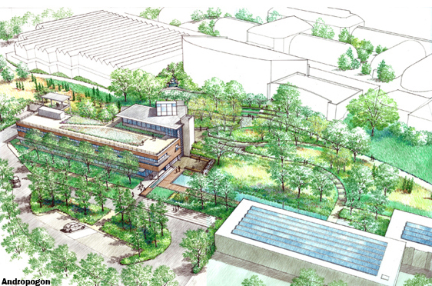
Center for Sustainable Landscapes
Pittsburgh, PA
Daniel Zartman | Construction
Advisor : Dr. Robert Leicht
Daniel Zartman | Construction
Advisor : Dr. Robert Leicht
PLACE HOLDER FOR IMAGE
Images courtesy of the Design Alliance Architects

Slide 2
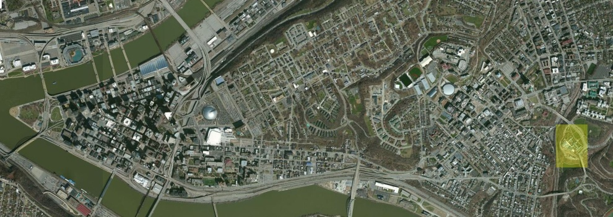
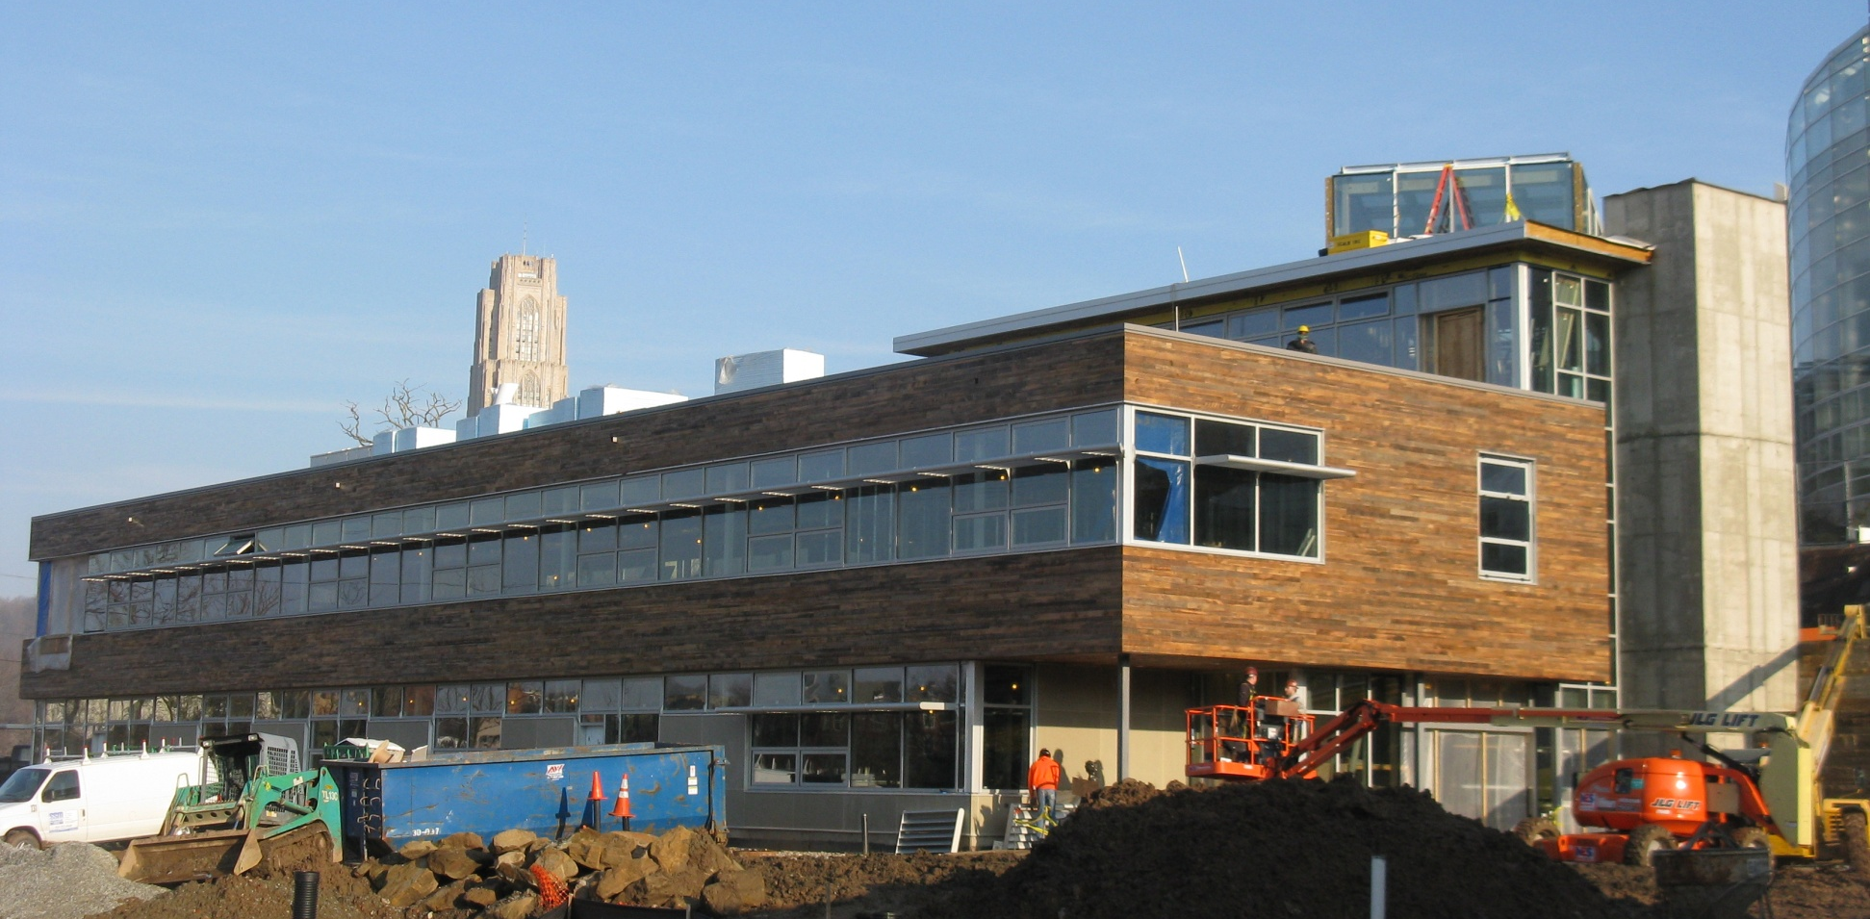
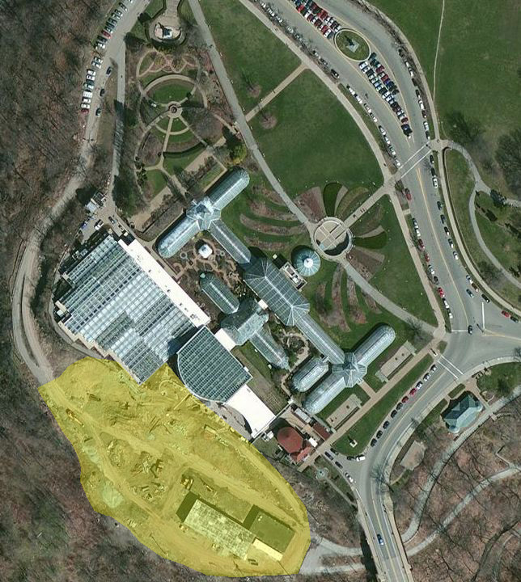
Center for Sustainable Landscapes
Pittsburgh, PA
Daniel Zartman | Construction
Project Background
Center for Sustainable Landscapes
Pittsburgh, PA
Daniel Zartman | Construction
Presentation Outline:
Project Background
General Information
Building Information
Analysis 1: Critical Industry Issue
Analysis 2: Constructability
Analysis 3: Value Engineering
Analysis 4: Schedule Acceleration
Final Recommendations
Acknowledgements
General Project Information:
Owner: Phipps Conservatory
Contractor: Turner Construction
Location: Schenley Park, Pittsburgh, PA
Function: Mixed Use (Office/Education)
Building Size :
Area: 24,350 GSF
Height: 40’- 4” (3 Stories)
Project Size:
Contract Value: $10 Million ($410 per SF)
Project Type: New Construction
Project Duration: 11 Months
Images Courtesy of Turner Construction
Images Courtesy of Microsoft Corporation

Slide 3
Center for Sustainable Landscapes
Pittsburgh, PA
Daniel Zartman | Construction
Project Background
Center for Sustainable Landscapes
Pittsburgh, PA
Daniel Zartman | Construction
Presentation Outline:
Project Background
General Information
Building Information
Analysis 1: Critical Industry Issue
Analysis 2: Constructability
Analysis 3: Value Engineering
Analysis 4: Schedule Acceleration
Final Recommendations
Acknowledgements
Structural System:
Substructure: Concrete Strip/Spread Footing
Superstructure: Braced Steel Frame
Building Envelope:
Exterior Walls: 8” Metal Stud w/ Reclaimed Barn Wood Facade
7,600 SF Green Roof
Sustainable Achievements:
LEED Platinum
Living Building Challenge
SITES Certification for Landscapes
Net-Zero Annual Energy Consumption
Net-Zero Annual Water Consumption
Images Courtesy of Turner Construction

Slide 4
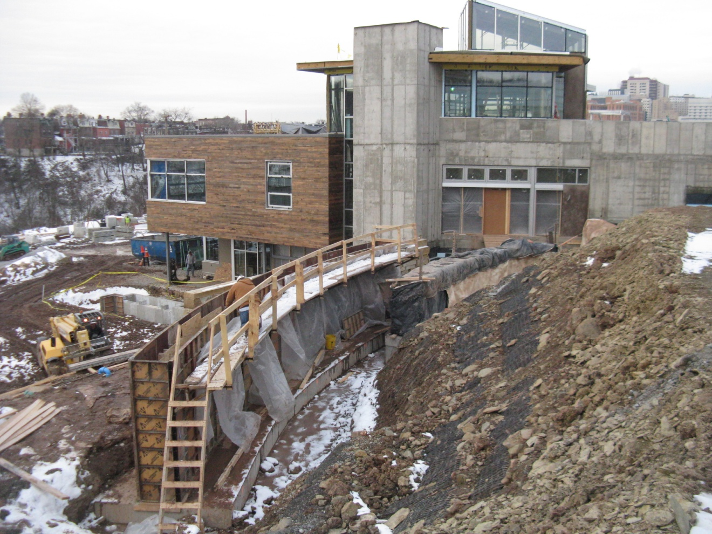
Center for Sustainable Landscapes
Pittsburgh, PA
Daniel Zartman | Construction
Analysis 1: Critical Industry Issue - Avoiding Traditional Delivery Methods on Publicly Funded Projects
Center for Sustainable Landscapes
Pittsburgh, PA
Daniel Zartman | Construction
Presentation Outline:
Project Background
Analysis 1: Critical Industry Issue
Overview
Research
Results/Conclusion
Analysis 2: Constructability
Analysis 3: Value Engineering
Analysis 4: Schedule Acceleration
Final Recommendations
Acknowledgements
Critical Industry Issue: Legislation in Pennsylvania prevents public projects from utilizing progressive delivery systems.
State requirements for publicly funded projects:
Traditional Design – Bid – Build
Hard-bid
Multiple Prime Contracts
Problems:
Does not adequately address the needs of complex projects
Does not incentivize the contractor to minimize schedule and cost growth
Images courtesy of the Design Alliance Architects

Slide 5
Center for Sustainable Landscapes
Pittsburgh, PA
Daniel Zartman | Construction
Analysis 1: Critical Industry Issue - Avoiding Traditional Delivery Methods on Publicly Funded Projects
Center for Sustainable Landscapes
Pittsburgh, PA
Daniel Zartman | Construction
Presentation Outline:
Project Background
Analysis 1: Critical Industry Issue
Overview
Research
Results/Conclusion
Analysis 2: Constructability
Analysis 3: Value Engineering
Analysis 4: Schedule Acceleration
Final Recommendations
Acknowledgements
Critical Industry Issue: Legislation in Pennsylvania prevents public projects from utilizing progressive delivery systems.
Research Goal: To create a decision tree that illustrates the progressive alternatives available to Penn State’s OPP.
Funding Types:
Private
Public
Combination
Images courtesy of the Design Alliance Architects

Slide 6
Center for Sustainable Landscapes
Pittsburgh, PA
Daniel Zartman | Construction
Analysis 1: Critical Industry Issue - Avoiding Traditional Delivery Methods on Publicly Funded Projects
Center for Sustainable Landscapes
Pittsburgh, PA
Daniel Zartman | Construction
Presentation Outline:
Project Background
Analysis 1: Critical Industry Issue
Overview
Research
Results/Conclusion
Analysis 2: Constructability
Analysis 3: Value Engineering
Analysis 4: Schedule Acceleration
Final Recommendations
Acknowledgements
Critical Industry Issue: Legislation in Pennsylvania prevents public projects from utilizing progressive delivery systems.
Research Goal: To create a decision tree that illustrates the progressive alternatives available to Penn State’s OPP.
Research Method: Analyze projects completed in PA by public and private owners using public funding.
Project Features Analyzed:
Funding Type
Delivery System
Contract Type
Procurement Method
Industry Members Interviewed:
John Bechtel – Asst. Director of Design and Construction at Penn State‘s OPP
James Hostetler – Director of Construction and Design at Bucknell University
Kristine Retetagos – VP Preconstruction Turner Construction Pittsburgh
Tim Gilotti – Radner Property Group
Jeff Sandeen - Hensel Phelps Construction Co
Mike Arnold – Foreman Group
Elizabeth O’Reilly - Deputy Secretary of Pennsylvania’s Public Works
Images courtesy of the Design Alliance Architects

Slide 7
Center for Sustainable Landscapes
Pittsburgh, PA
Daniel Zartman | Construction
Analysis 1: Critical Industry Issue - Avoiding Traditional Delivery Methods on Publicly Funded Projects
Center for Sustainable Landscapes
Pittsburgh, PA
Daniel Zartman | Construction
Presentation Outline:
Project Background
Analysis 1: Critical Industry Issue
Overview
Research
Results/Conclusion
Analysis 2: Constructability
Analysis 3: Value Engineering
Analysis 4: Schedule Acceleration
Final Recommendations
Acknowledgements
Penn State’s Office of Physical Plant:
Operates as an extension of DGS
Public funding types most commonly received:
Delegated (most common) – OPP is given money with specific use
Non-Delegated (uncommon) – DGS stays heavily involved

Slide 8
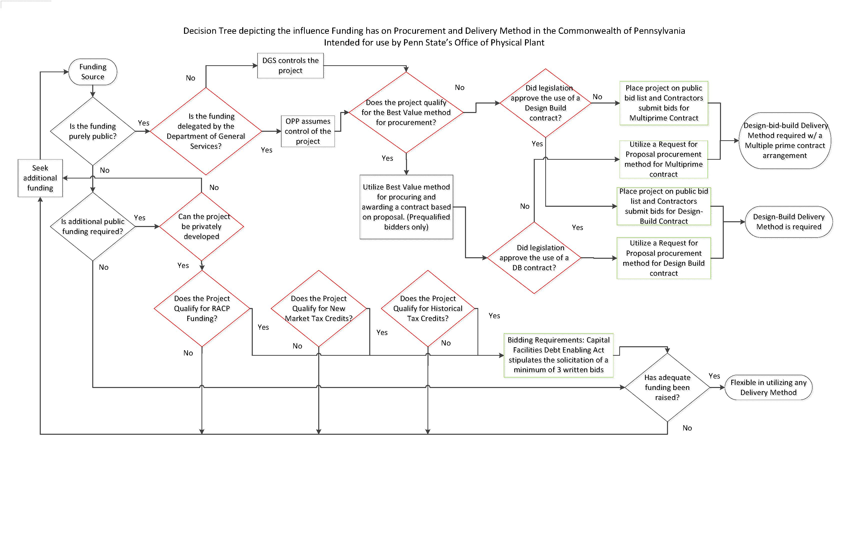
Center for Sustainable Landscapes
Pittsburgh, PA
Daniel Zartman | Construction
Analysis 1: Critical Industry Issue - Avoiding Traditional Delivery Methods on Publicly Funded Projects
Center for Sustainable Landscapes
Pittsburgh, PA
Daniel Zartman | Construction
Presentation Outline:
Project Background
Analysis 1: Critical Industry Issue
Overview
Research
Results/Conclusion
Analysis 2: Constructability
Analysis 3: Value Engineering
Analysis 4: Schedule Acceleration
Final Recommendations
Acknowledgements
Penn State’s Office of Physical Plant:
Operates as an extension of DGS
Public funding types most commonly received:
Delegated (most common) – OPP is given money with specific use
Non-Delegated (uncommon) – DGS stays heavily involved
Projects Researched:
SCI Benner: Design-Build, GMP
Bucknell University Bookstore: Design-Bid-Build, CM At-Risk, GMP
Center for Sustainable Landscapes: Design-Bid-Build, CM At-Risk, GMP
The Decision Tree: Illustrates the influence funding has on procurement, delivery and contract methods
Black Diamonds: Represent questions that can be answered by OPP project staff
Red Diamonds: Represent decisions that are made by the Government
Green Boxes: Display the conditional procurement methods

Slide 9
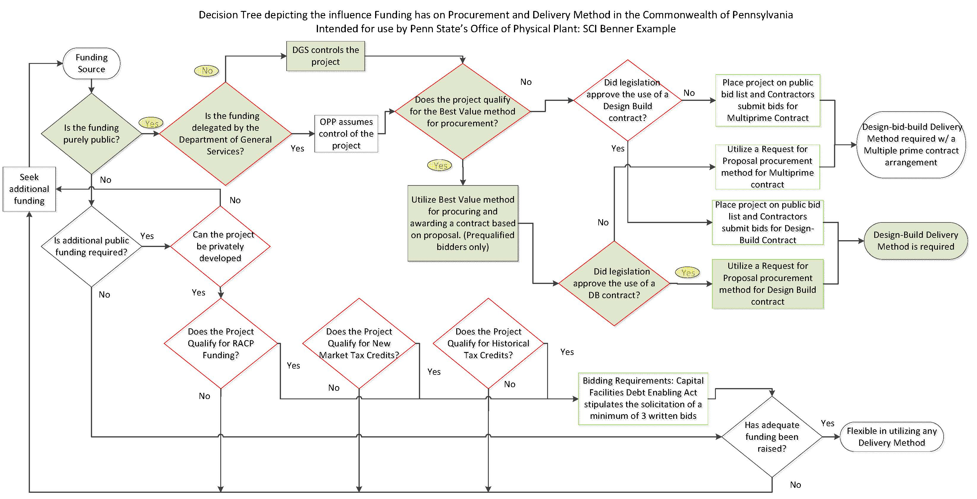
Center for Sustainable Landscapes
Pittsburgh, PA
Daniel Zartman | Construction
Analysis 1: Critical Industry Issue - Avoiding Traditional Delivery Methods on Publicly Funded Projects
Center for Sustainable Landscapes
Pittsburgh, PA
Daniel Zartman | Construction
Presentation Outline:
Project Background
Analysis 1: Critical Industry Issue
Overview
Research
Results/Conclusion
Analysis 2: Constructability
Analysis 3: Value Engineering
Analysis 4: Schedule Acceleration
Final Recommendations
Acknowledgements
Project: SCI Benner
Project Synopsis: $174 million new construction of a 2,000 bed medium security prison
Location: Bellefonte, PA
Owner: Department of General Services
Delivery Method: Design-Build
Contract Type: GMP
Procurement Method: Best Value

Slide 10
Center for Sustainable Landscapes
Pittsburgh, PA
Daniel Zartman | Construction
Analysis 1: Critical Industry Issue - Avoiding Traditional Delivery Methods on Publicly Funded Projects
Center for Sustainable Landscapes
Pittsburgh, PA
Daniel Zartman | Construction
Presentation Outline:
Project Background
Analysis 1: Critical Industry Issue
Overview
Research
Results/Conclusion
Analysis 2: Constructability
Analysis 3: Value Engineering
Analysis 4: Schedule Acceleration
Final Recommendations
Acknowledgements
Project: SCI Benner
Project Synopsis: $174 million new construction of a 2,000 bed medium security prison
Location: Bellefonte, PA
Owner: Department of General Services
Delivery Method: Design-Build
Contract Type: GMP
Procurement Method: Best Value
Conclusions: Project Exemption is Plausible
Provided exemption is approved by DGS
Provided exemption is authorized by Legislation
Recommendations
2 out of 3 owners analyzed utilized a traditional delivery system despite exemption
Pursue the use of contemporary delivery methods when necessary

Slide 11
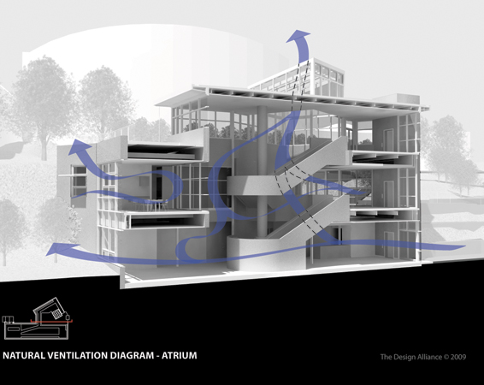
Center for Sustainable Landscapes
Pittsburgh, PA
Daniel Zartman | Construction
Analysis 2: Constructability – Alternative Design of Atrium
Center for Sustainable Landscapes
Pittsburgh, PA
Daniel Zartman | Construction
Presentation Outline:
Project Background
Analysis 1: Critical Industry Issue
Analysis 2: Constructability
Overview
Alternative Design
Results/Conclusion
Analysis 3: Value Engineering
Analysis 4: Schedule Acceleration
Final Recommendations
Acknowledgements
Problem Identification: 2-Story radiused cast-in-place concrete atrium stair
Labor intensive
Produces a large amount of onsite waste
Images courtesy of the Design Alliance Architects

Slide 12
Center for Sustainable Landscapes
Pittsburgh, PA
Daniel Zartman | Construction
Analysis 2: Constructability – Alternative Design of Atrium
Center for Sustainable Landscapes
Pittsburgh, PA
Daniel Zartman | Construction
Presentation Outline:
Project Background
Analysis 1: Critical Industry Issue
Analysis 2: Constructability
Overview
Alternative Design
Results/Conclusion
Analysis 3: Value Engineering
Analysis 4: Schedule Acceleration
Final Recommendations
Acknowledgements
Problem Identification: 2-Story radiused cast-in-place concrete atrium stair
Labor intensive
Produces a large amount of onsite waste
Research Goal: Develop an alternative atrium design that:
Improves Constructability at a minimal cost
Maintains the spaces passive performance
Aesthetically pleasing
Images courtesy of the Design Alliance Architects

Slide 13
Center for Sustainable Landscapes
Pittsburgh, PA
Daniel Zartman | Construction
Analysis 2: Constructability – Alternative Design of Atrium
Center for Sustainable Landscapes
Pittsburgh, PA
Daniel Zartman | Construction
Presentation Outline:
Project Background
Analysis 1: Critical Industry Issue
Analysis 2: Constructability
Overview
Alternative Design
Results/Conclusion
Analysis 3: Value Engineering
Analysis 4: Schedule Acceleration
Final Recommendations
Acknowledgements
Problem Identification: 2-Story radiused cast-in-place concrete atrium stair
Labor intensive
Produces a large amount of onsite waste
Research Goal: Develop an alternative atrium design that:
Improves Constructability at a minimal cost
Maintains the spaces passive performance
Aesthetically pleasing
Proposed Solution:
Structural steel stair
Transfer thermal mass to atrium walls
Images courtesy of the Design Alliance Architects

Slide 14
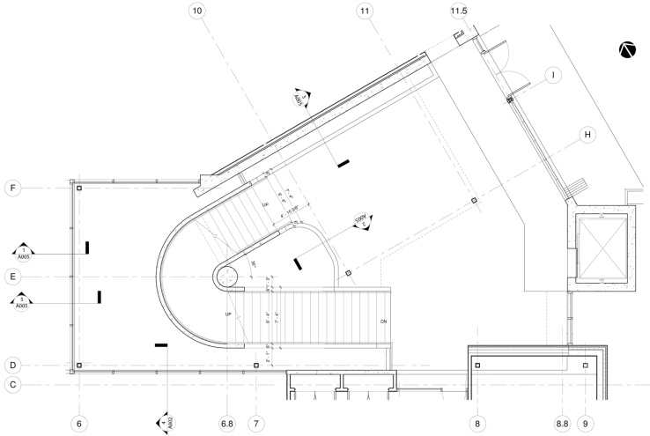
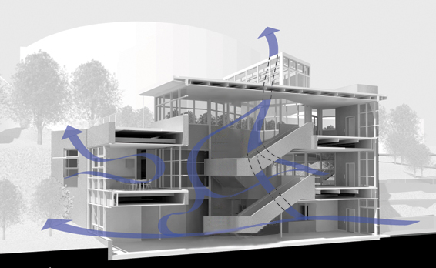
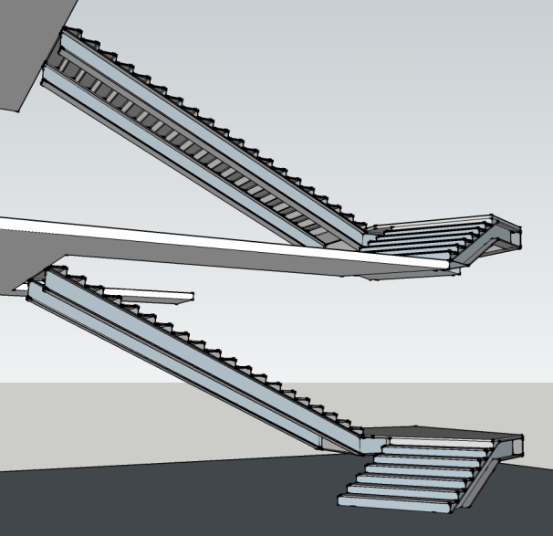
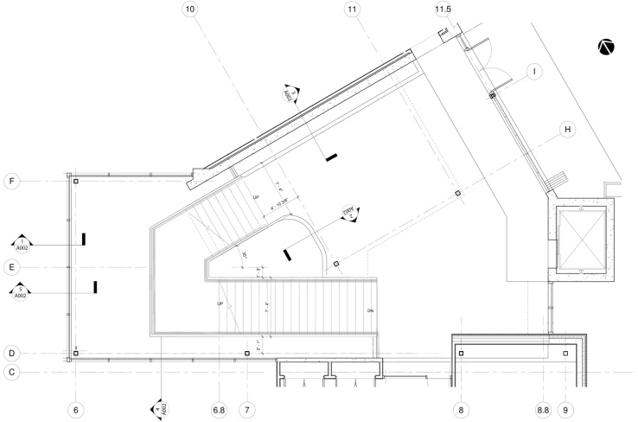
Center for Sustainable Landscapes
Pittsburgh, PA
Daniel Zartman | Construction
Analysis 2: Constructability – Alternative Design of Atrium
Center for Sustainable Landscapes
Pittsburgh, PA
Daniel Zartman | Construction
Original Design (Below)
Presentation Outline:
Project Background
Analysis 1: Critical Industry Issue
Analysis 2: Constructability
Overview
Alternative Design
Results/Conclusion
Analysis 3: Value Engineering
Analysis 4: Schedule Acceleration
Final Recommendations
Acknowledgements
Changes to Original Design in Alternative Design
Alternative Stair
Structural Steel
Rectilinear
Self-supporting
Alternative Design (Below)
Imagery based off of one provided by The Design Alliance Architects

Slide 15
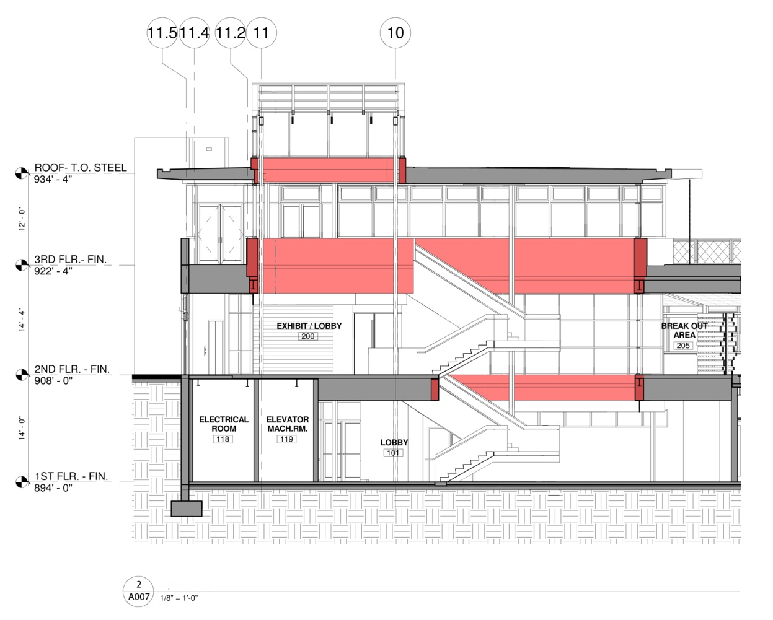
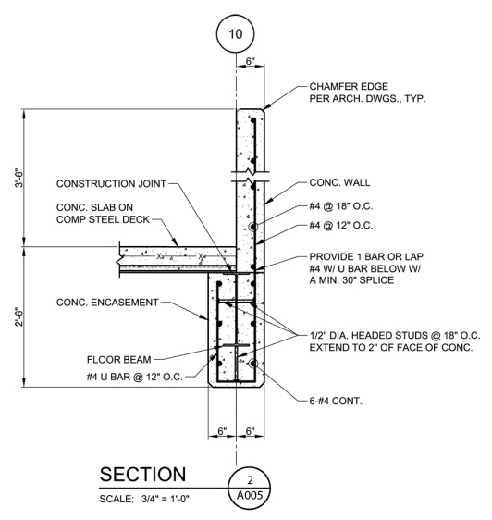
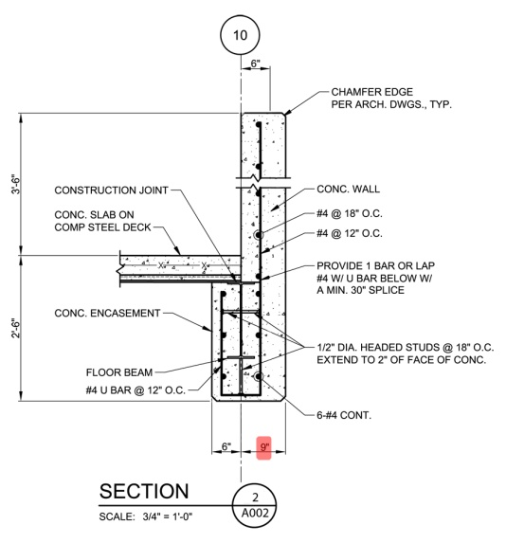
Center for Sustainable Landscapes
Pittsburgh, PA
Daniel Zartman | Construction
Analysis 2: Constructability – Alternative Design of Atrium
Center for Sustainable Landscapes
Pittsburgh, PA
Daniel Zartman | Construction
Original Design (Below)
Presentation Outline:
Project Background
Analysis 1: Critical Industry Issue
Analysis 2: Constructability
Overview
Alternative Design
Results/Conclusion
Analysis 3: Value Engineering
Analysis 4: Schedule Acceleration
Final Recommendations
Acknowledgements
Changes to Original Design in Alternative Design:
Alternative Stair
Structural Steel
Rectilinear
Self-supporting
Alternative Wall Design
Inc. thickness of concrete by 3 inches
Net decrease in concrete: 3 cubic yards
Alternative Design (Below)

Slide 16
Center for Sustainable Landscapes
Pittsburgh, PA
Daniel Zartman | Construction
Analysis 2: Constructability – Alternative Design of Atrium
Center for Sustainable Landscapes
Pittsburgh, PA
Daniel Zartman | Construction
Presentation Outline:
Project Background
Analysis 1: Critical Industry Issue
Analysis 2: Constructability
Overview
Alternative Design
Results/Conclusion
Analysis 3: Value Engineering
Analysis 4: Schedule Acceleration
Final Recommendations
Acknowledgements
Schedule Impacts:
Original Design: 20 days
Alternative Design: 10 days (phased with steel erection)
Not located on critical path

Slide 17
Center for Sustainable Landscapes
Pittsburgh, PA
Daniel Zartman | Construction
Analysis 2: Constructability – Alternative Design of Atrium
Center for Sustainable Landscapes
Pittsburgh, PA
Daniel Zartman | Construction
Presentation Outline:
Project Background
Analysis 1: Critical Industry Issue
Analysis 2: Constructability
Overview
Alternative Design
Results/Conclusion
Analysis 3: Value Engineering
Analysis 4: Schedule Acceleration
Final Recommendations
Acknowledgements
Schedule Impacts:
Original Design: 20 days
Alternative Design: 10 days (phased with steel erection)
Not located on critical path
Cost Summary:
Net Increase: $70,000
Resulting from:
No central support added approximately $25,000
Increased connections costs
Increased structural steel costs
Terrazzo finishes added approximately $15,000
Cost Comparison
Original Design - Cost of Concrete Stair | $ 49,950.00
Alternative Design - Total Cost | $ 119,707.63
Alternative Design - Cost of Steel Stair | $ 105,603.65
Alternative Design - Increase in Wall Thicknesses | $ 14,103.98
Net Increase in Alternative Design over Original Design | $ 69,757.63

Slide 18
Center for Sustainable Landscapes
Pittsburgh, PA
Daniel Zartman | Construction
Analysis 2: Constructability – Alternative Design of Atrium
Center for Sustainable Landscapes
Pittsburgh, PA
Daniel Zartman | Construction
Presentation Outline:
Project Background
Analysis 1: Critical Industry Issue
Analysis 2: Constructability
Overview
Alternative Design
Results/Conclusion
Analysis 3: Value Engineering
Analysis 4: Schedule Acceleration
Final Recommendations
Acknowledgements
Schedule Impacts:
Original Design: 20 days
Alternative Design: 10 days (phased with steel erection)
Not located on critical path
Cost Summary:
Net Increase: $70,000
Resulting from:
No central support added approximately $25,000
Increased connections costs
Increased structural steel costs
Terrazzo finishes added approximately $15,000
Alternative Design Conclusions: Not Recommended
Pros
Comparably Sustainable
Minimizes Construction Waste
Improves Aesthetics
Reduces Schedule by 10 days
Cons
Significantly increased material cost
Recommendations
Make adjustments to reduce cost:
Replace terrazzo
Add column
Cost Comparison
Original Design - Cost of Concrete Stair | $ 49,950.00
Alternative Design - Total Cost | $ 119,707.63
Alternative Design - Cost of Steel Stair | $ 105,603.65
Alternative Design - Increase in Wall Thicknesses | $ 14,103.98
Net Increase in Alternative Design over Original Design | $ 69,757.63

Slide 19
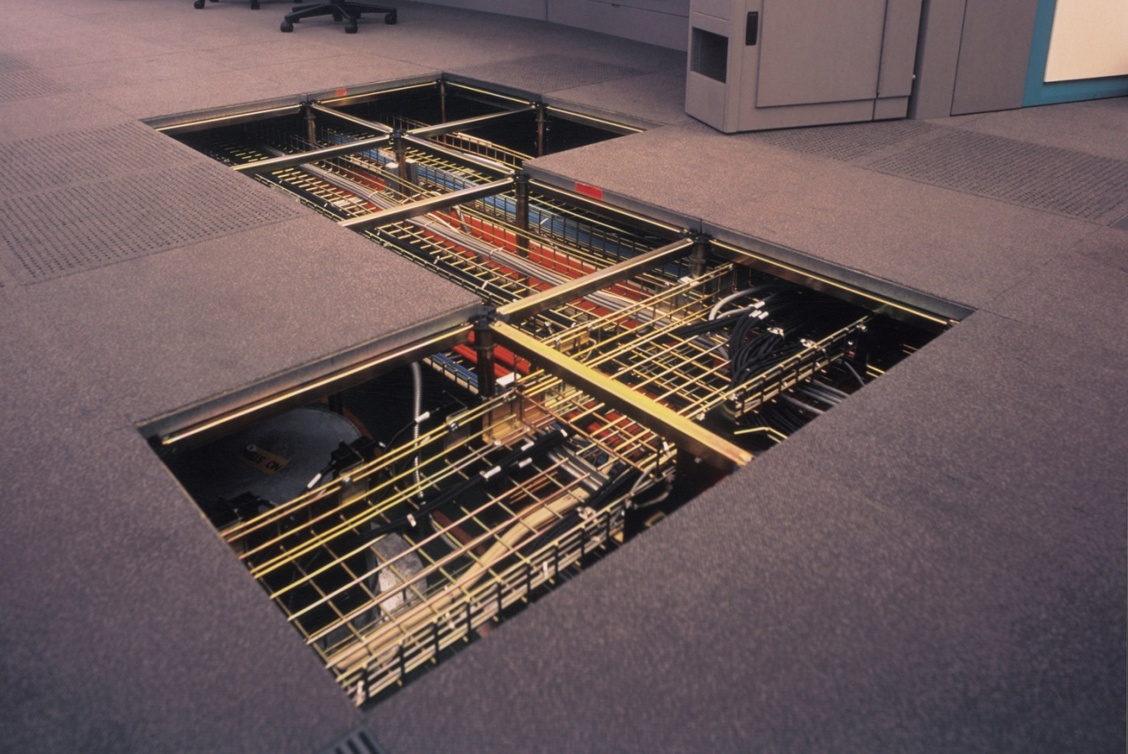
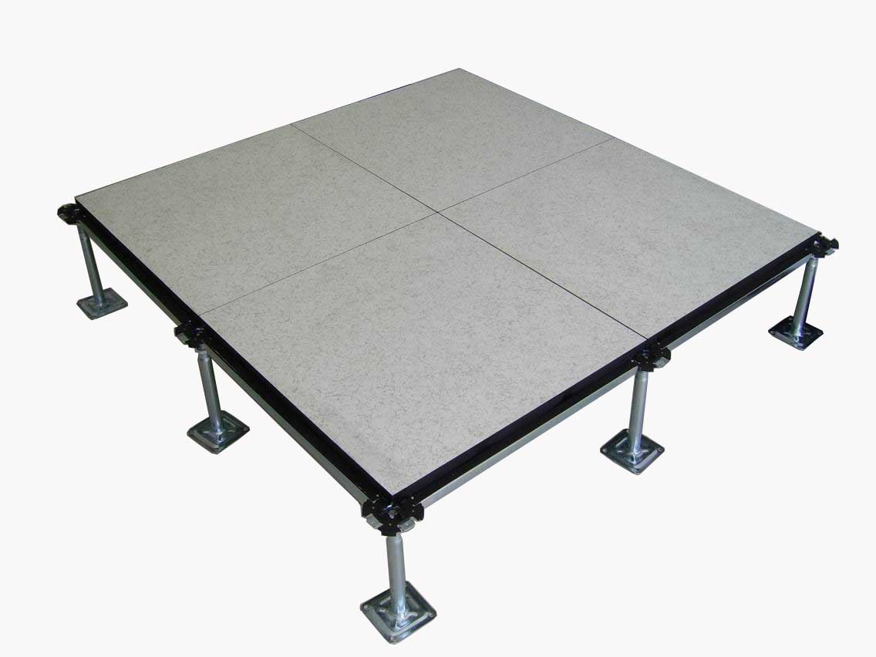
Center for Sustainable Landscapes
Pittsburgh, PA
Daniel Zartman | Construction
Analysis 3: Value Engineering – Redesign of Raised Floor Distribution System
Center for Sustainable Landscapes
Pittsburgh, PA
Daniel Zartman | Construction
Presentation Outline:
Project Background
Analysis 1: Critical Industry Issue
Analysis 2: Constructability
Analysis 3: Value Engineering
Overview
Alternative Design
Results/Conclusion
Analysis 4: Schedule Acceleration
Final Recommendations
Acknowledgements
Problem Identification: Raised Floor Distribution Plenum
Higher system costs
Increased building height from redundant plenum spaces
Images courtesy of accessfloorsystems.com
Images courtesy of kingspan.com/raised_flooring/full.jpg

Slide 20
Center for Sustainable Landscapes
Pittsburgh, PA
Daniel Zartman | Construction
Analysis 3: Value Engineering – Redesign of Raised Floor Distribution System
Center for Sustainable Landscapes
Pittsburgh, PA
Daniel Zartman | Construction
Presentation Outline:
Project Background
Analysis 1: Critical Industry Issue
Analysis 2: Constructability
Analysis 3: Value Engineering
Overview
Alternative Design
Results/Conclusion
Analysis 4: Schedule Acceleration
Final Recommendations
Acknowledgements
Problem Identification: Raised Floor Distribution Plenum
Higher system costs
Increased building height from redundant plenum spaces
Research Goal:
Reduce system cost without compromising performance
Improve constructability
Images courtesy of accessfloorsystems.com
Images courtesy of kingspan.com/raised_flooring/full.jpg

Slide 21
Center for Sustainable Landscapes
Pittsburgh, PA
Daniel Zartman | Construction
Analysis 3: Value Engineering – Redesign of Raised Floor Distribution System
Center for Sustainable Landscapes
Pittsburgh, PA
Daniel Zartman | Construction
Presentation Outline:
Project Background
Analysis 1: Critical Industry Issue
Analysis 2: Constructability
Analysis 3: Value Engineering
Overview
Alternative Design
Results/Conclusion
Analysis 4: Schedule Acceleration
Final Recommendations
Acknowledgements
Problem Identification: Raised Floor Distribution Plenum
Higher system costs
Increased building height from redundant plenum spaces
Research Goal:
Reduce system cost without compromising performance
Improve constructability
Proposed Solution: Relocated HVAC distribution to above the ceiling
Images courtesy of accessfloorsystems.com
Images courtesy of kingspan.com/raised_flooring/full.jpg

Slide 22
Center for Sustainable Landscapes
Pittsburgh, PA
Daniel Zartman | Construction
Analysis 3: Value Engineering – Redesign of Raised Floor Distribution System
Center for Sustainable Landscapes
Pittsburgh, PA
Daniel Zartman | Construction
Presentation Outline:
Project Background
Analysis 1: Critical Industry Issue
Analysis 2: Constructability
Analysis 3: Value Engineering
Overview
Alternative Design
Results/Conclusion
Analysis 4: Schedule Acceleration
Final Recommendations
Acknowledgements
Alternative Design: Second Floor
Original Design: Raised Floor Distribution
Alternative Design: Above Ceiling Distribution
Original Design
14” Raised Access Floor System
In-floor electrical distribution
Alternative Design
Lowered the ceiling 6”
Reduced building height by 8”
Maintained High Volume/Low Velocity flow rate
Alternative Design: First Floor

Slide 23
Center for Sustainable Landscapes
Pittsburgh, PA
Daniel Zartman | Construction
Analysis 3: Value Engineering – Redesign of Raised Floor Distribution System
Center for Sustainable Landscapes
Pittsburgh, PA
Daniel Zartman | Construction
Presentation Outline:
Project Background
Analysis 1: Critical Industry Issue
Analysis 2: Constructability
Analysis 3: Value Engineering
Overview
Alternative Design
Results/Conclusion
Analysis 4: Schedule Acceleration
Final Recommendations
Acknowledgements
Schedule Impacts:
Original Design: 16 days
Alternative Design: 24 days
Neither designs were located on the Critical Path
Schedule Durations for Raised Floor Analysis
System | Schedule Duration (Days) | Total Man Hours | Crew Size
Raised Floor Dist. | 16 | 480 | 6
Ceiling Dist. | 24 | 581 | 3

Slide 24
Center for Sustainable Landscapes
Pittsburgh, PA
Daniel Zartman | Construction
Analysis 3: Value Engineering – Redesign of Raised Floor Distribution System
Center for Sustainable Landscapes
Pittsburgh, PA
Daniel Zartman | Construction
Presentation Outline:
Project Background
Analysis 1: Critical Industry Issue
Analysis 2: Constructability
Analysis 3: Value Engineering
Overview
Alternative Design
Results/Conclusion
Analysis 4: Schedule Acceleration
Final Recommendations
Acknowledgements
Schedule Impacts:
Original Design: 16 days
Alternative Design: 24 days
Neither designs were located on the Critical Path
Cost Impacts
46% Decrease in cost
Indirect Costs
Reduction in building height (credit)
Flooring Cost
Electrical Distribution Contingency
Sales Tax Credit
Schedule Durations for Raised Floor Analysis
System | Schedule Duration (Days) | Total Man Hours | Crew Size
Raised Floor Dist. | 16 | 480 | 6
Ceiling Dist. | 24 | 581 | 3
Total System Comparisons
Raised Floor Distribution System - Total Cost | $ 110,000.00
Raised Floor - Material Cost | $ 76,000.00
Raised Floor - Labor Cost | $ 34,000.00
Ceiling Distribution System | $ 50,838.00
Ceiling - Material Cost | $ 7,696.00
Ceiling - Labor Cost | $ 19,620.00
Indirect Costs | $ 23,521.00
Net Decrease in System Cost: | $ 59,162.00
Total Man Hours: | 581 | hrs

Slide 25
Center for Sustainable Landscapes
Pittsburgh, PA
Daniel Zartman | Construction
Analysis 3: Value Engineering – Redesign of Raised Floor Distribution System
Center for Sustainable Landscapes
Pittsburgh, PA
Daniel Zartman | Construction
Presentation Outline:
Project Background
Analysis 1: Critical Industry Issue
Analysis 2: Constructability
Analysis 3: Value Engineering
Overview
Alternative Design
Results/Conclusion
Analysis 4: Schedule Acceleration
Final Recommendations
Acknowledgements
Schedule Impacts:
Original Design: 16 days
Alternative Design: 24 days
Neither designs were located on the Critical Path
Cost Impacts
46% Decrease in cost
Indirect Costs
Reduction in building height (credit)
Flooring Cost
Electrical Distribution Contingency
Sales Tax Credit
Alternative Design Conclusions:
Added 100 hours of work
Reduced cost by approximately $59,000
Recommendations:
Met analysis goal to increase project’s value
Pursue alternative design based on significant decrease in system cost
Marginal compromises in value
Schedule Durations for Raised Floor Analysis
System | Schedule Duration (Days) | Total Man Hours | Crew Size
Raised Floor Dist. | 16 | 480 | 6
Ceiling Dist. | 24 | 581 | 3
Total System Comparisons
Raised Floor Distribution System - Total Cost | $ 110,000.00
Raised Floor - Material Cost | $ 76,000.00
Raised Floor - Labor Cost | $ 34,000.00
Ceiling Distribution System | $ 50,838.00
Ceiling - Material Cost | $ 7,696.00
Ceiling - Labor Cost | $ 19,620.00
Indirect Costs | $ 23,521.00
Net Decrease in System Cost: | $ 59,162.00
Total Man Hours: | 581 | hrs

Slide 26
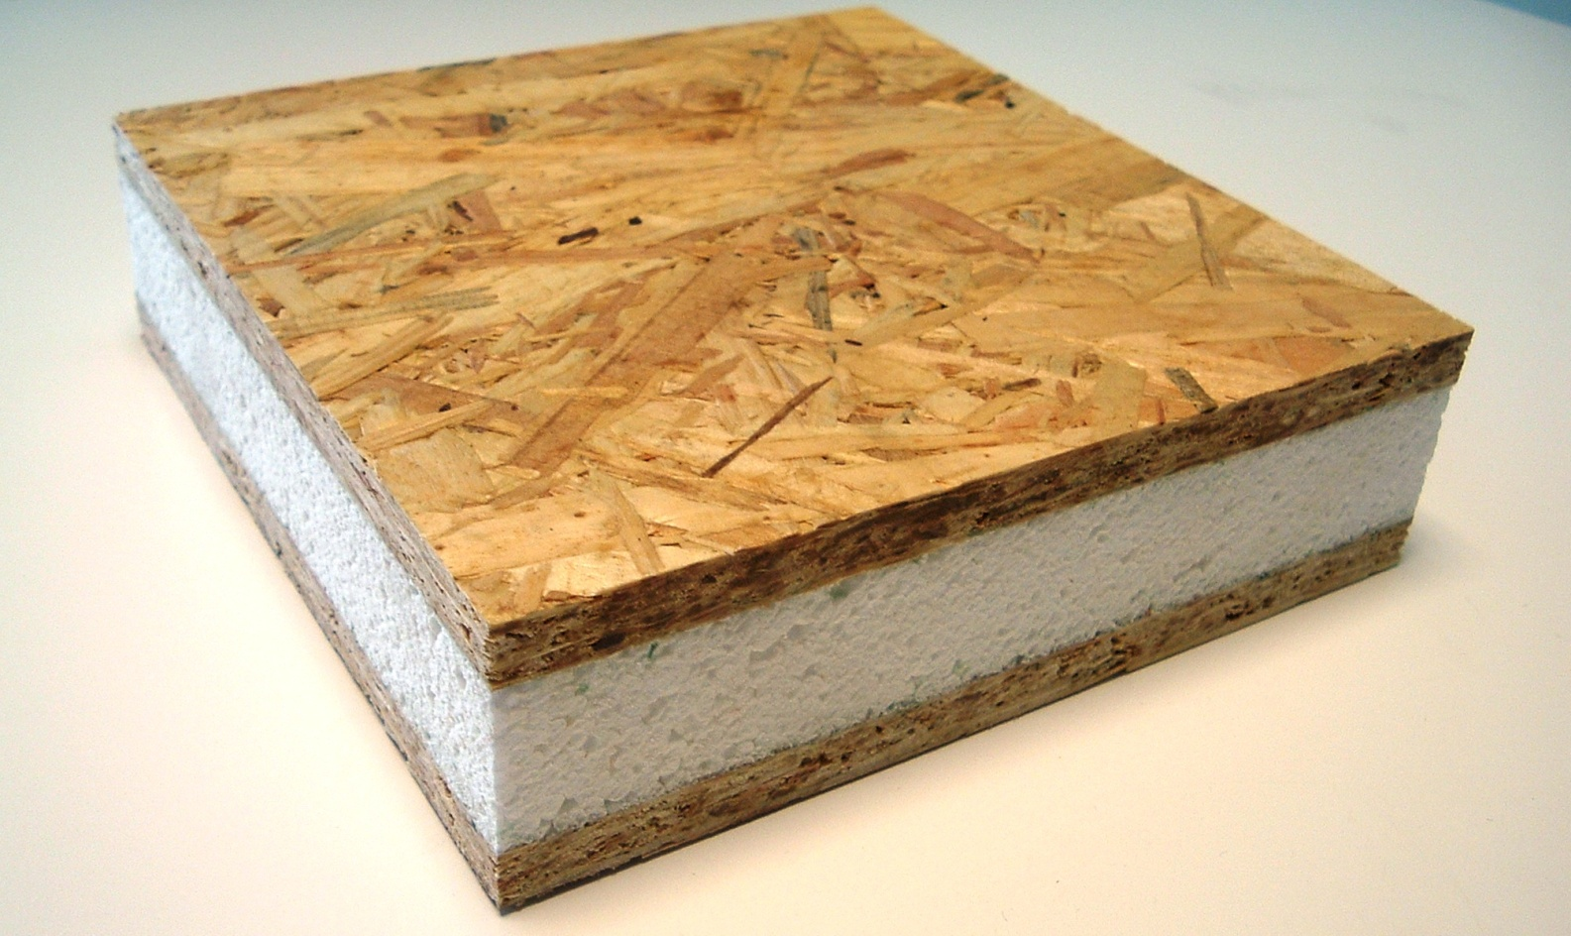
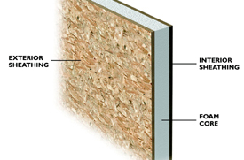
Center for Sustainable Landscapes
Pittsburgh, PA
Daniel Zartman | Construction
Analysis 4: Schedule Acceleration –Alternative Wall System
Center for Sustainable Landscapes
Pittsburgh, PA
Daniel Zartman | Construction
Presentation Outline:
Project Background
Analysis 1: Critical Industry Issue
Analysis 2: Constructability
Analysis 3: Value Engineering
Analysis 4: Schedule Acceleration
Overview
Alternative Design
Structural Breadth
Results/Conclusion
Final Recommendations
Acknowledgements
Problem Identification: 8” Metal Stud Exterior wall
Time and Labor intensive
Located on the Critical Path
Produces a large amount of waste onsite
Images courtesy of sips.org
Images courtesy of sips.org

Slide 27
Center for Sustainable Landscapes
Pittsburgh, PA
Daniel Zartman | Construction
Analysis 4: Schedule Acceleration –Alternative Wall System
Center for Sustainable Landscapes
Pittsburgh, PA
Daniel Zartman | Construction
Presentation Outline:
Project Background
Analysis 1: Critical Industry Issue
Analysis 2: Constructability
Analysis 3: Value Engineering
Analysis 4: Schedule Acceleration
Overview
Alternative Design
Structural Breadth
Results/Conclusion
Final Recommendations
Acknowledgements
Problem Identification: 8” Metal Stud Exterior wall
Time and Labor intensive
Located on the Critical Path
Produces a large amount of waste onsite
Research Goal: Develop alternative design
Decreases the project schedule
Images courtesy of sips.org
Images courtesy of sips.org

Slide 28
Center for Sustainable Landscapes
Pittsburgh, PA
Daniel Zartman | Construction
Analysis 4: Schedule Acceleration –Alternative Wall System
Center for Sustainable Landscapes
Pittsburgh, PA
Daniel Zartman | Construction
Presentation Outline:
Project Background
Analysis 1: Critical Industry Issue
Analysis 2: Constructability
Analysis 3: Value Engineering
Analysis 4: Schedule Acceleration
Overview
Alternative Design
Structural Breadth
Results/Conclusion
Final Recommendations
Acknowledgements
Problem Identification: 8” Metal Stud Exterior wall
Time and Labor intensive
Located on the Critical Path
Produces a large amount of waste onsite
Research Goal: Develop alternative design
Decreases the project schedule
Proposed Solution: Structural Insulated Panel System (SIPS)
High performance wall type composed of:
OSB Sheathing
EPS (Expanded Polystyrene) Foam Core
Increase superstructure to accommodate additional load
Images courtesy of sips.org
Images courtesy of sips.org

Slide 29
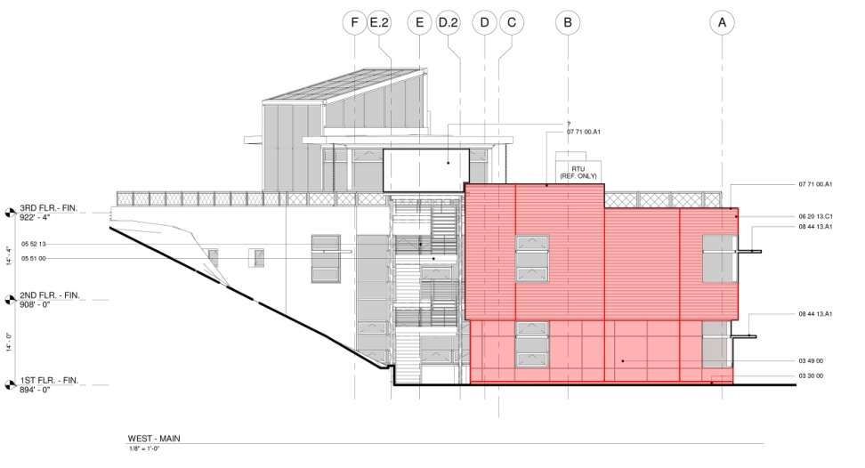
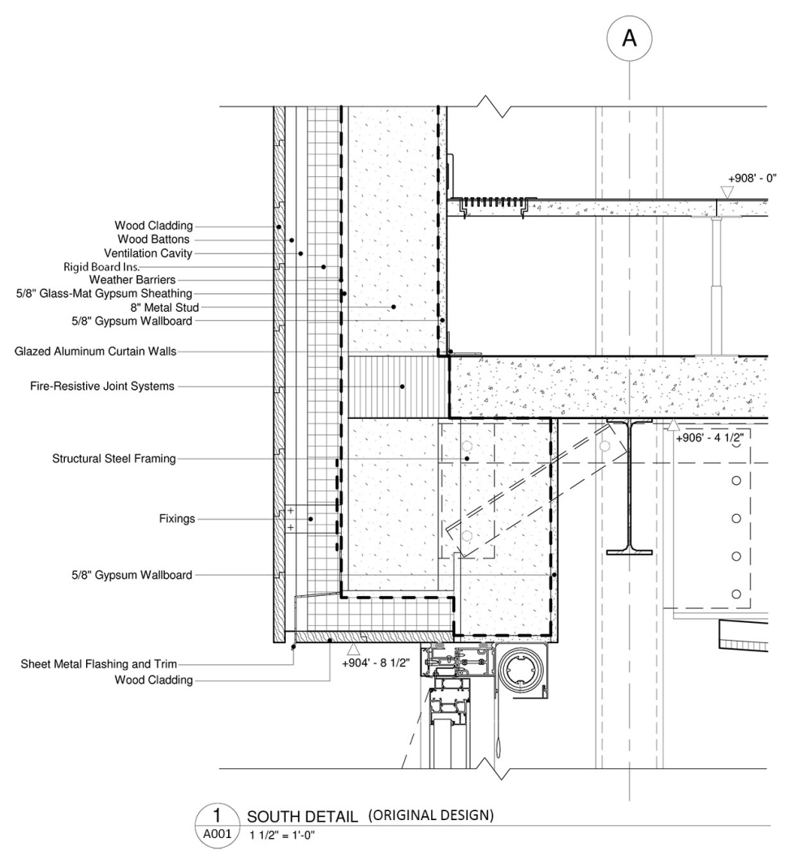
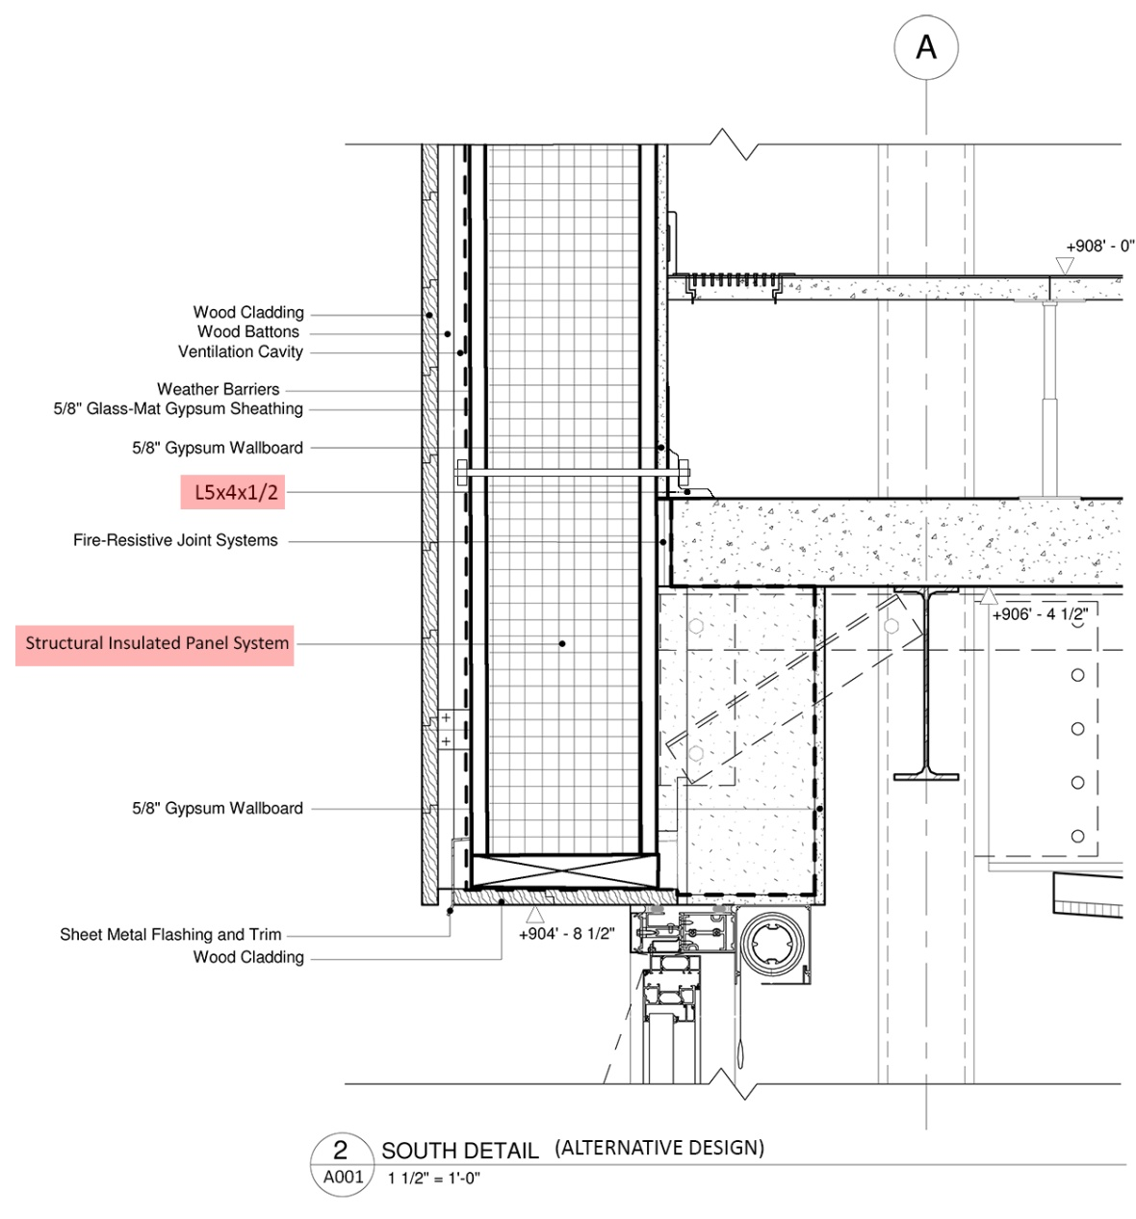
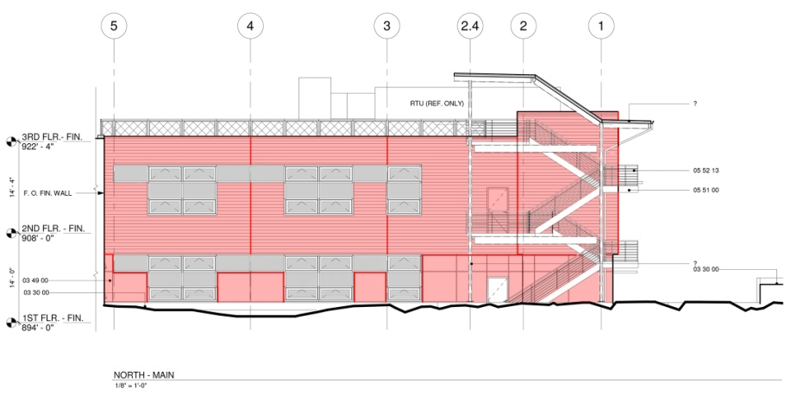
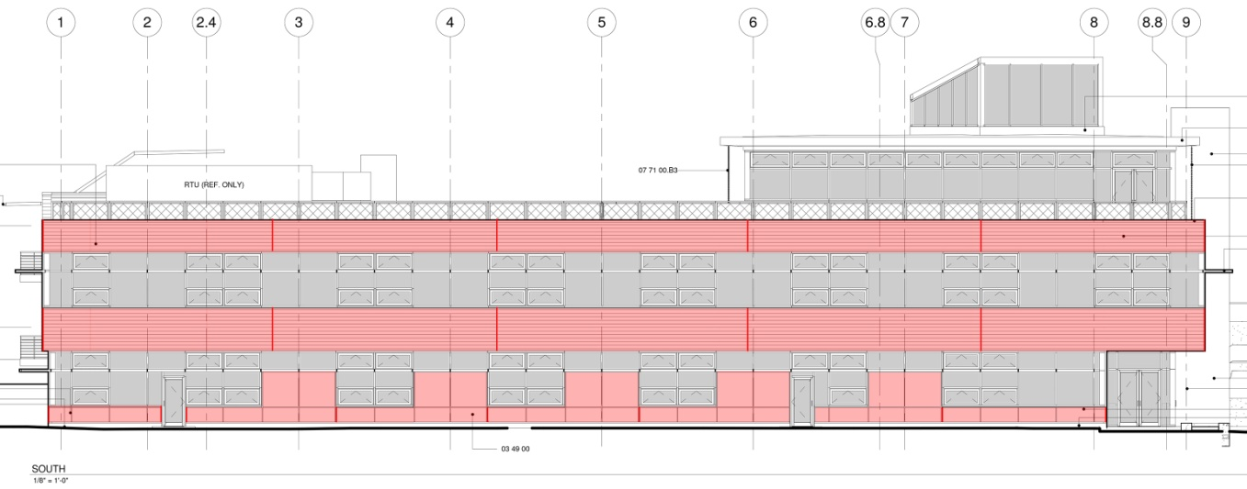
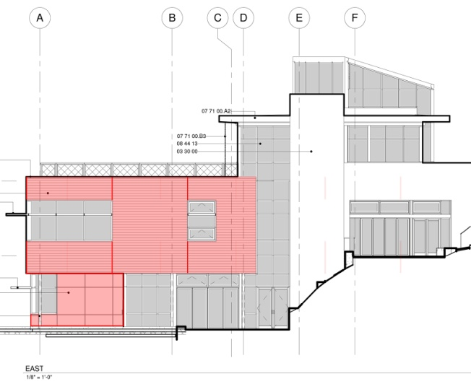
Center for Sustainable Landscapes
Pittsburgh, PA
Daniel Zartman | Construction
Analysis 4: Schedule Acceleration –Alternative Wall System
Center for Sustainable Landscapes
Pittsburgh, PA
Daniel Zartman | Construction
Presentation Outline:
Project Background
Analysis 1: Critical Industry Issue
Analysis 2: Constructability
Analysis 3: Value Engineering
Analysis 4: Schedule Acceleration
Overview
Alternative Design
Structural Breadth
Results/Conclusion
Final Recommendations
Acknowledgements
Original Design
8” Metal Stud Framing
2” Rigid Board Insulation
5/8” Fiberglass-matt gypsum board
Alternative Design
10 ¼” SIP Panel

Slide 30
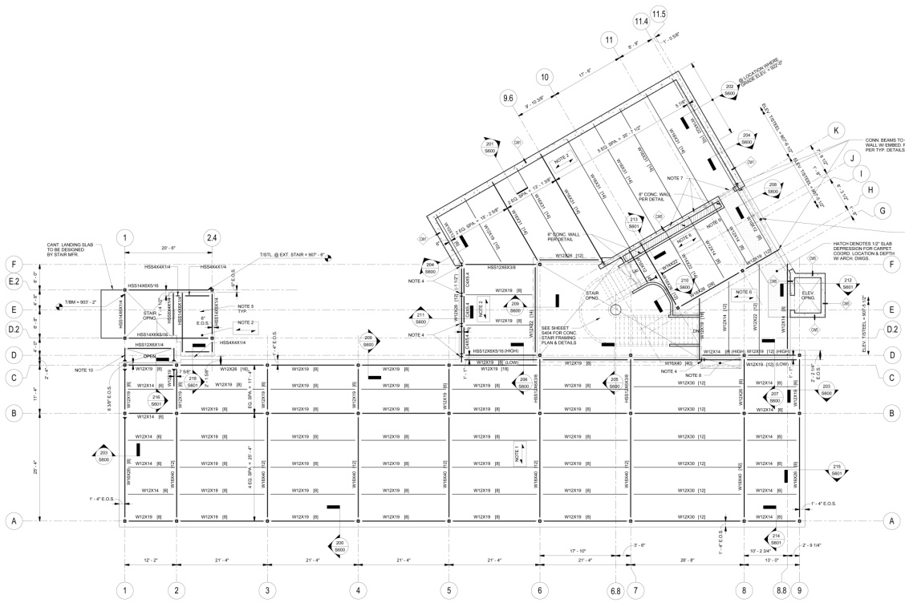
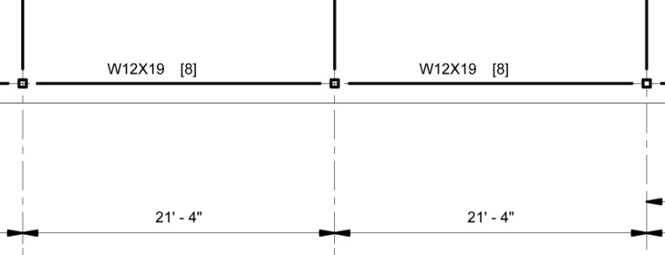
Center for Sustainable Landscapes
Pittsburgh, PA
Daniel Zartman | Construction
Analysis 4: Schedule Acceleration –Alternative Wall System
Center for Sustainable Landscapes
Pittsburgh, PA
Daniel Zartman | Construction
Presentation Outline:
Project Background
Analysis 1: Critical Industry Issue
Analysis 2: Constructability
Analysis 3: Value Engineering
Analysis 4: Schedule Acceleration
Overview
Alternative Design
Structural Breadth
Results/Conclusion
Final Recommendations
Acknowledgements
Structural Impacts: Structural Breadth
Original Stud Wall: 45 PLF
Alternative SIP Wall: 75 PLF
Results:
W12x19 Spandrel Beams were found to be inadequate
Max. Allowable Def. = 1.07”
Deflection = 1.3”
Max. Allowable Bending Moment = 55.9 ft-kips
Bending Moment = 82.2 ft-kips
W12x26 Spandrel Beams were found to be adequate
HSS 6x6x5/8 Columns were found to be adequate

Slide 31
Center for Sustainable Landscapes
Pittsburgh, PA
Daniel Zartman | Construction
Analysis 4: Schedule Acceleration –Alternative Wall System
Center for Sustainable Landscapes
Pittsburgh, PA
Daniel Zartman | Construction
Presentation Outline:
Project Background
Analysis 1: Critical Industry Issue
Analysis 2: Constructability
Analysis 3: Value Engineering
Analysis 4: Schedule Acceleration
Overview
Alternative Design
Structural Breadth
Results/Conclusion
Final Recommendations
Acknowledgements
Sustainability
Provides superior conductive and convective performance
No additional LEED points gained
Structural Impacts: Structural Breadth
Original Stud Wall: 45 PLF
Alternative SIP Wall: 75 PLF
Results:
W12x19 Spandrel Beams were found to be inadequate
Max. Allowable Def. = 1.07”
Deflection = 1.3”
Max. Allowable Bending Moment = 55.9 ft-kips
Bending Moment = 82.2 ft-kips
W12x26 Spandrel Beams were found to be adequate
HSS 6x6x5/8 Columns were found to be adequate
Relative R-Value Comparison
R-Value Original Design | 25.3
2" Rigid Board Insulation | 8
5/8” Fiberglass-mat | 8
8" Wall Cavity | 9.3
R-Value Alternative Design | 35
(2) 7/16" OSB Sheathing | 1
10 1/4" SIP w/ EPS Core | 34

Slide 32
Center for Sustainable Landscapes
Pittsburgh, PA
Daniel Zartman | Construction
Analysis 4: Schedule Acceleration –Alternative Wall System
Center for Sustainable Landscapes
Pittsburgh, PA
Daniel Zartman | Construction
Presentation Outline:
Project Background
Analysis 1: Critical Industry Issue
Analysis 2: Constructability
Analysis 3: Value Engineering
Analysis 4: Schedule Acceleration
Overview
Alternative Design
Structural Breadth
Results/Conclusion
Final Recommendations
Acknowledgements
Schedule Impacts:
Reduced the project schedule by a total of 8 days
Allowed Glazing to begin 8 days earlier than the original schedule
Schedule Durations for Façade Analysis
System | Schedule Duration (Days) | Total Man Hours | Crew Size
8” Metal Stud Framing | 16 | 770 | 6
SIP Wall Panel | 8 | 320 | 5

Slide 33
Center for Sustainable Landscapes
Pittsburgh, PA
Daniel Zartman | Construction
Analysis 4: Schedule Acceleration –Alternative Wall System
Center for Sustainable Landscapes
Pittsburgh, PA
Daniel Zartman | Construction
Presentation Outline:
Project Background
Analysis 1: Critical Industry Issue
Analysis 2: Constructability
Analysis 3: Value Engineering
Analysis 4: Schedule Acceleration
Overview
Alternative Design
Structural Breadth
Results/Conclusion
Final Recommendations
Acknowledgements
Schedule Impacts:
Reduced the project schedule by a total of 8 days
Allowed Glazing to begin 8 days earlier than the original schedule
Cost Impacts:
SIP System Cost w/ General Conditions Savings: $74,920
Includes increased cost of superstructure of $2,578
Schedule Durations for Façade Analysis
System | Schedule Duration (Days) | Total Man Hours | Crew Size
8” Metal Stud Framing | 16 | 770 | 6
SIP Wall Panel | 8 | 320 | 5
Façade Estimate Summary
Total Original Metal Stud Wall System | $ 71,216
Original Design Labor Cost | $ 42,508
Original Design Material Cost | $ 25,708
Adjusted Total Alternative Wall System Cost | $ 74,920
Total Alternative SIP Wall System | $ 88,382
Alt. Design Labor Costs | $ 37,594
Alt. Design Material Costs | $ 50,789
Estimated General Conditions Savings | $ (13,462.00)
Net Increase in Cost | $ 3,704

Slide 34
Center for Sustainable Landscapes
Pittsburgh, PA
Daniel Zartman | Construction
Analysis 4: Schedule Acceleration –Alternative Wall System
Center for Sustainable Landscapes
Pittsburgh, PA
Daniel Zartman | Construction
Presentation Outline:
Project Background
Analysis 1: Critical Industry Issue
Analysis 2: Constructability
Analysis 3: Value Engineering
Analysis 4: Schedule Acceleration
Overview
Alternative Design
Structural Breadth
Results/Conclusion
Final Recommendations
Acknowledgements
Schedule Impacts:
Reduced the project schedule by a total of 8 days
Allowed Glazing to begin 8 days earlier than the original schedule
Cost Impacts:
SIP System Cost w/ General Conditions Savings: $74,920
Includes increased cost of superstructure of $2,578
Alternative Wall Construction Design Conclusions:
Reduces project schedule by 8 days
Increases Superstructure
Improves the performance of the building envelope
Marginal increase in cost
Recommendations:
Met analysis goal to reduce project schedule
Pursue alternative design as specified due to significant schedule savings
Schedule Durations for Façade Analysis
System | Schedule Duration (Days) | Total Man Hours | Crew Size
8” Metal Stud Framing | 16 | 770 | 6
SIP Wall Panel | 8 | 320 | 5
Façade Estimate Summary
Total Original Metal Stud Wall System | $ 71,216
Original Design Labor Cost | $ 42,508
Original Design Material Cost | $ 25,708
Adjusted Total Alternative Wall System Cost | $ 74,920
Total Alternative SIP Wall System | $ 88,382
Alt. Design Labor Costs | $ 37,594
Alt. Design Material Costs | $ 50,789
Estimated General Conditions Savings | $ (13,462.00)
Net Increase in Cost | $ 3,704

Slide 35
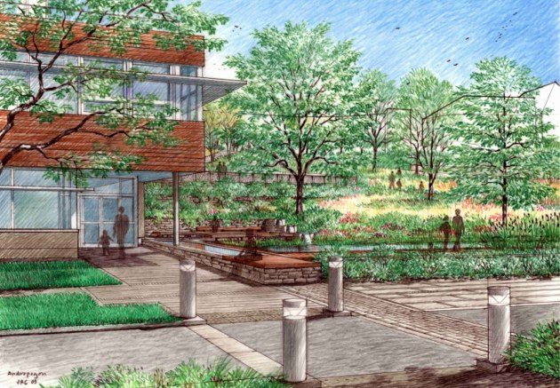
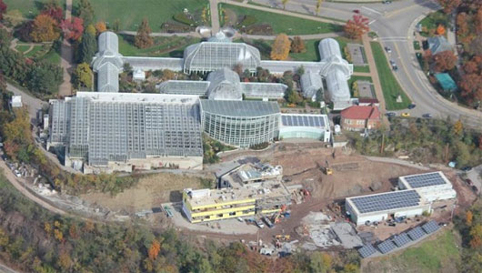
Center for Sustainable Landscapes
Pittsburgh, PA
Daniel Zartman | Construction
Recommendation/Conclusion
Center for Sustainable Landscapes
Pittsburgh, PA
Daniel Zartman | Construction
Presentation Outline:
Project Background
Analysis 1: Critical Industry Issue
Analysis 2: Constructability
Analysis 3: Value Engineering
Analysis 4: Schedule Acceleration
Final Recommendations
Acknowledgements
Analysis 1: Critical Industry Issue - Avoiding Traditional Delivery Methods on Publicly Funded Projects
Project exemption can be gained by OPP
Analysis 2: Constructability – Alternative Design of Atrium
Rejected alternative design due to substantial increases in cost
Analysis 3: Value Engineering – Redesign of Raised Floor Distribution System
Accepted above ceiling distribution system as a result of the significant cost savings
Analysis 4: Schedule Acceleration –Alternative Wall System
Accepted Structural Insulated Panel System as a result of reduced schedule and marginal increase in cost
Images courtesy of the Design Alliance Architects
Images courtesy of the Design Alliance Architects

Slide 36
Center for Sustainable Landscapes
Pittsburgh, PA
Daniel Zartman | Construction
Questions
Center for Sustainable Landscapes
Pittsburgh, PA
Daniel Zartman | Construction
Presentation Outline:
Project Background
Analysis 1: Critical Industry Issue
Analysis 2: Constructability
Analysis 3: Value Engineering
Analysis 4: Schedule Acceleration
Final Recommendations
Acknowledgements
Special Acknowledgements:
Dr. Robert Leicht – CM Faculty Advisor
Megan Corrie, Kristine Retetagos of Turner Construction contacts and project sponsors
Owner Phipps Conservatory
David Zartman and staff of Zartman Construction
James Hostetler Director of Construction and Design Bucknell University
John Bechtel Assistant Director of Design and Construction of Penn State OPP
Tim Gilotti of Radner Property Group
Jeff Sandeen of Hensel Phelps Construction Co.
Images courtesy of the Design Alliance Architects
Images courtesy of the Design Alliance Architects

