Slide 1
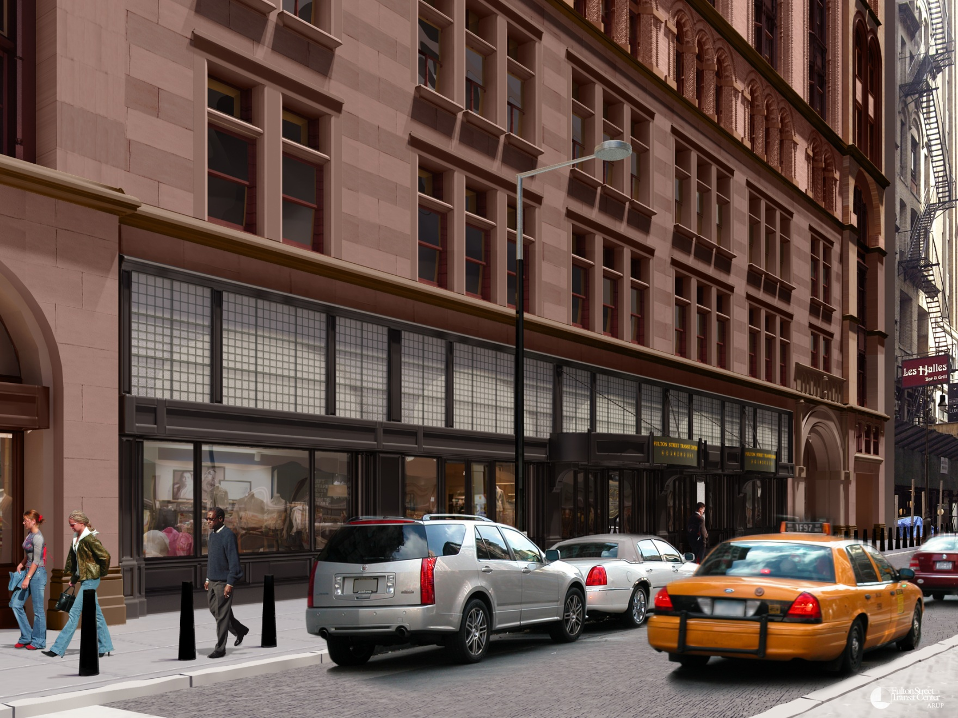
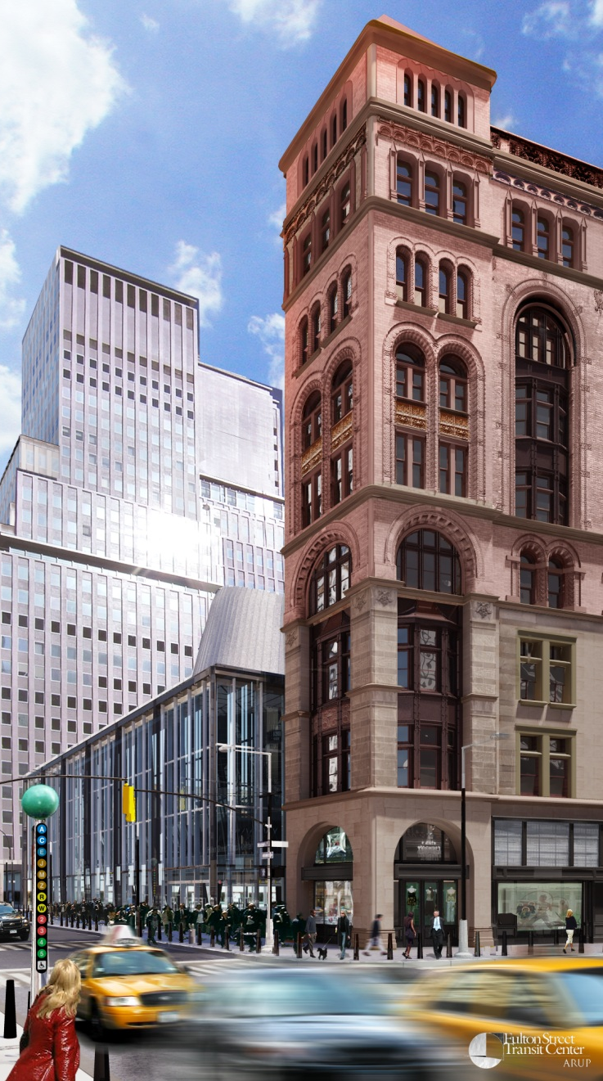
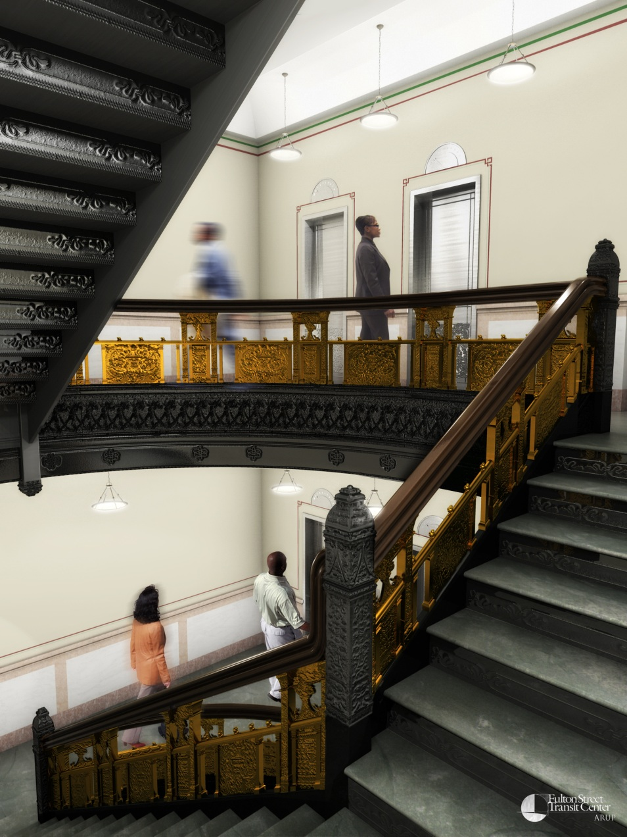
Corbin Building
192 Broadway
New York, NY
Final Thesis Presentation
4/11/2012
Matthew Trethaway | Lighting/ Electrical | Advisor: Dr. Houser | Advisor: Ted Dannerth

Slide 2
Presentation Outline
Corbin Building
Introduction
Electrical Depth
Wire vs. Bus Duct
Lighting Depth
Façade | FSTC Lobby
Breadth Topics
Architectural | Mechanical
Lighting Depth
Retail
MAE
Daylighting
Conclusion

Slide 3
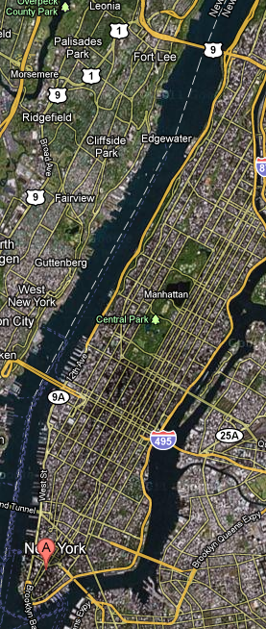
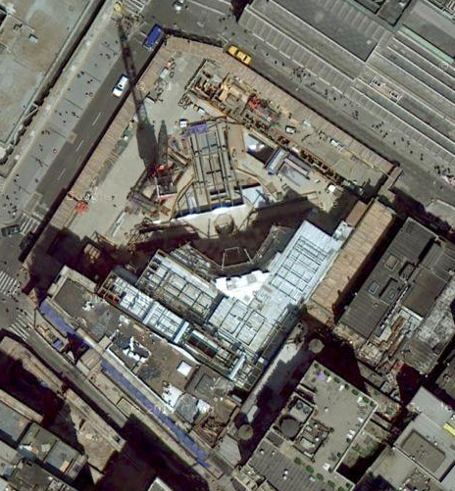
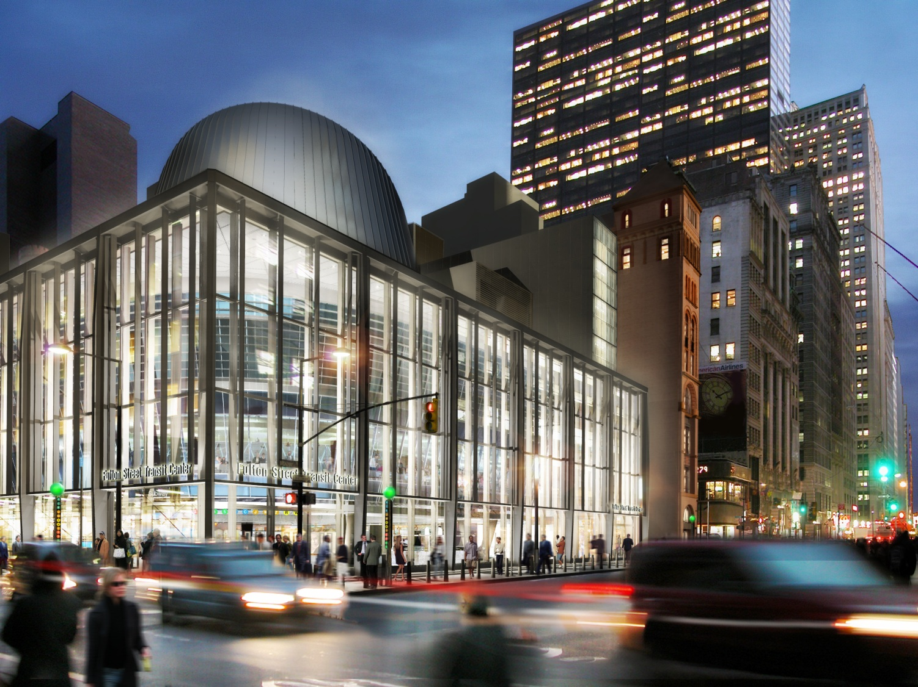
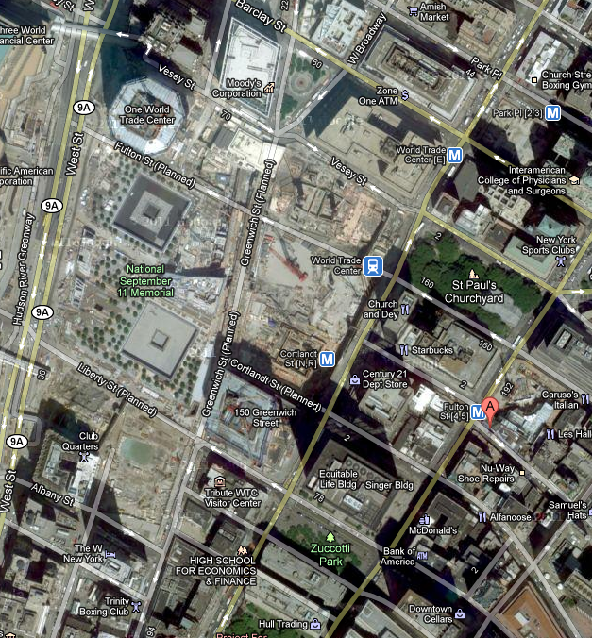
Introduction
Wire vs. Bus Duct
Façade | FSTC Lobby
Architectural | Mechanical
Retail
Daylighting
Corbin Building Location
Site Layout
Fulton Street Transit Center
World Trade Center
Fulton Street Transit Center
Corbin Building
Corbin Building
N
Corbin Building | Electrical Depth | Lighting Depth | Breadth Topics | Lighting Depth | MAE | Conclusion

Slide 4
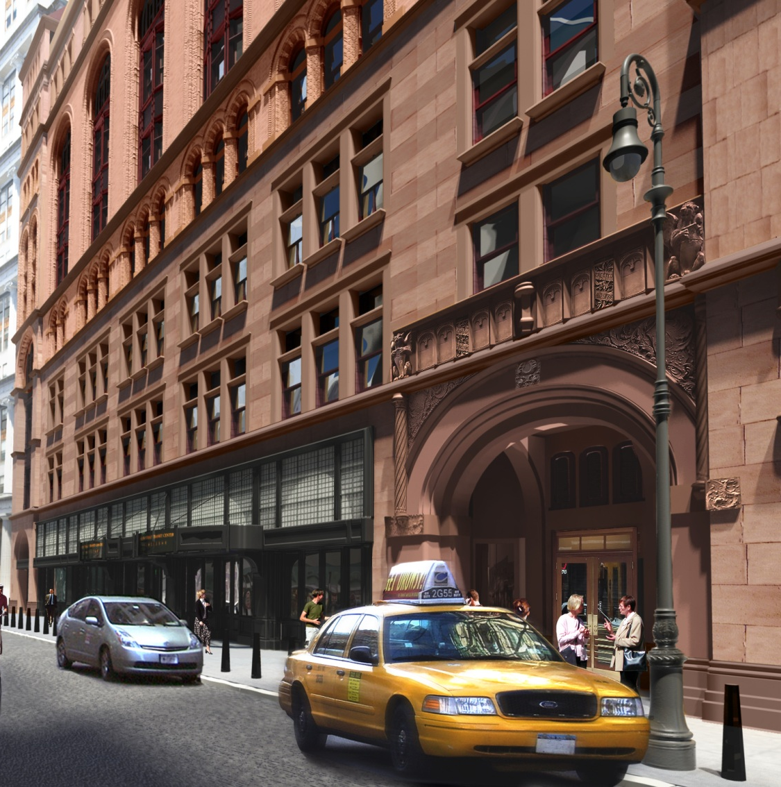
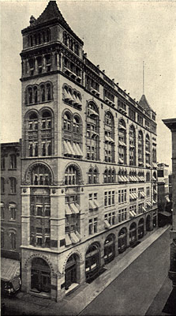
Introduction
Wire vs. Bus Duct
Façade | FSTC Lobby
Architectural | Mechanical
Retail
Daylighting
Theme
Corbin Building History
Corbin Building Statistics
Renovation of Retail / Office Space
Size
53,000 Square Feet
Cost
$59.5 Million
Owner
Metropolitan Transit Authority (MTA)
Architect
Page Ayres Cowley Architects
SMEP
Arup
Contractor
Judlau Contracting
“Renovation and integration into the design of the Transit Center while preserving its historic character.”
Built in 1888 by Francis Kimball
Named for Austin Corbin
President of Long Island Rail Road (LIRR)
Wrought-Iron Frame
First to be dubbed “skyscraper”
First to use gearless-traction Otis Elevator
Corbin Building | Electrical Depth | Lighting Depth | Breadth Topics | Lighting Depth | MAE | Conclusion

Slide 5
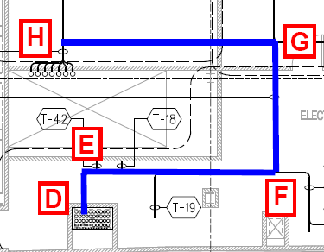
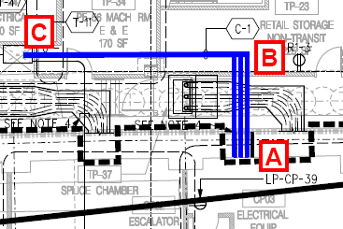
Introduction
Façade | FSTC Lobby
Architectural | Mechanical
Retail
Daylighting
Wire vs. Bus Duct
Feeder Pathway
Results
800 Amp Main Feeder
From: 5th Floor Electric Room in FSTC
To: Basement Electric Room in Corbin Building
Copper Wire- 3 Sets of
Phase & Neutral: 500 MCM
Ground: 250 MCM
Conduit- Rigid Galvanized Steel
4 Inch
Bus Duct- 800Amp Copper
N
Cost Savings: $13,370
N
Corbin Building | Electrical Depth | Lighting Depth | Breadth Topics | Lighting Depth | MAE | Conclusion

Slide 6
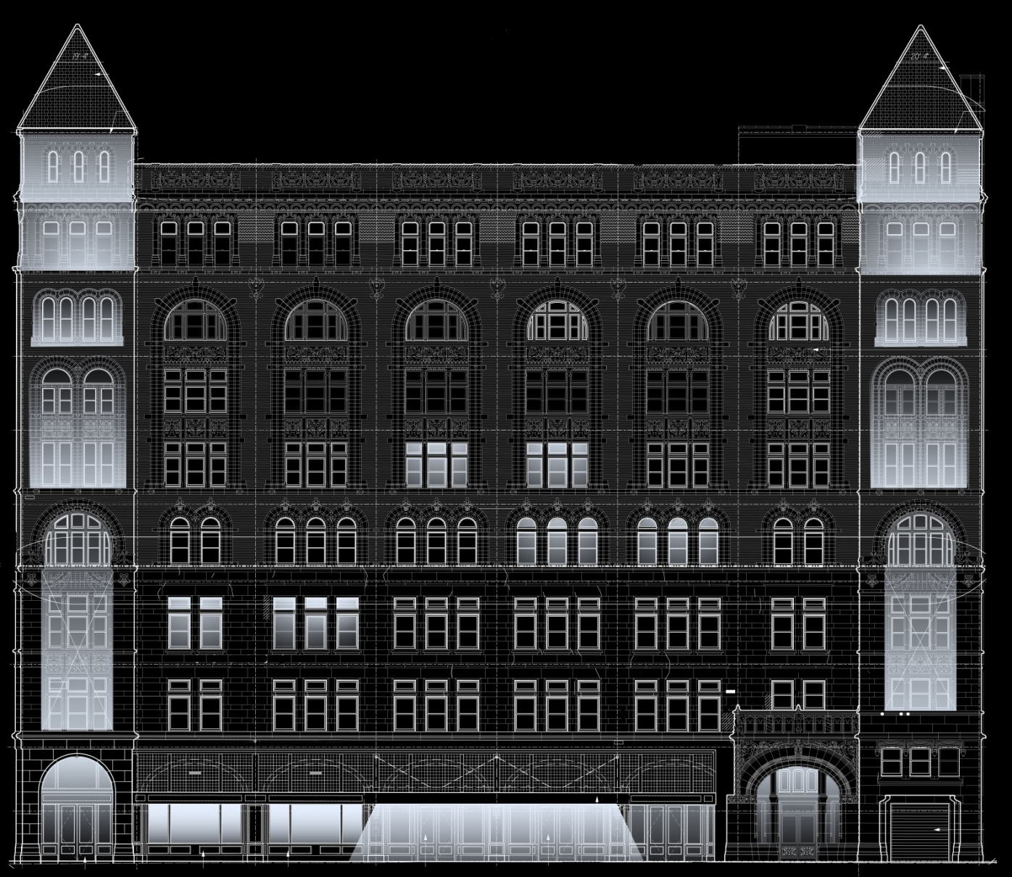
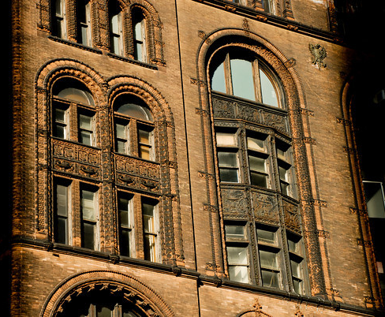
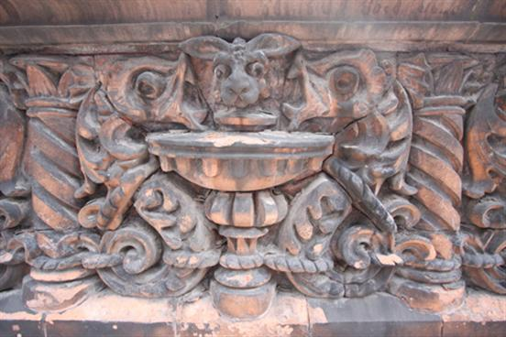
Introduction
Façade | FSTC Lobby
Architectural | Mechanical
Retail
Daylighting
Façade
Schematic Design
Façade Layout
Design Criteria
Appearance- historical landmark
Hierarchy- guidance
Connection- historic & modern
Corbin Building | Electrical Depth | Lighting Depth | Breadth Topics | Lighting Depth | MAE | Conclusion

Slide 7
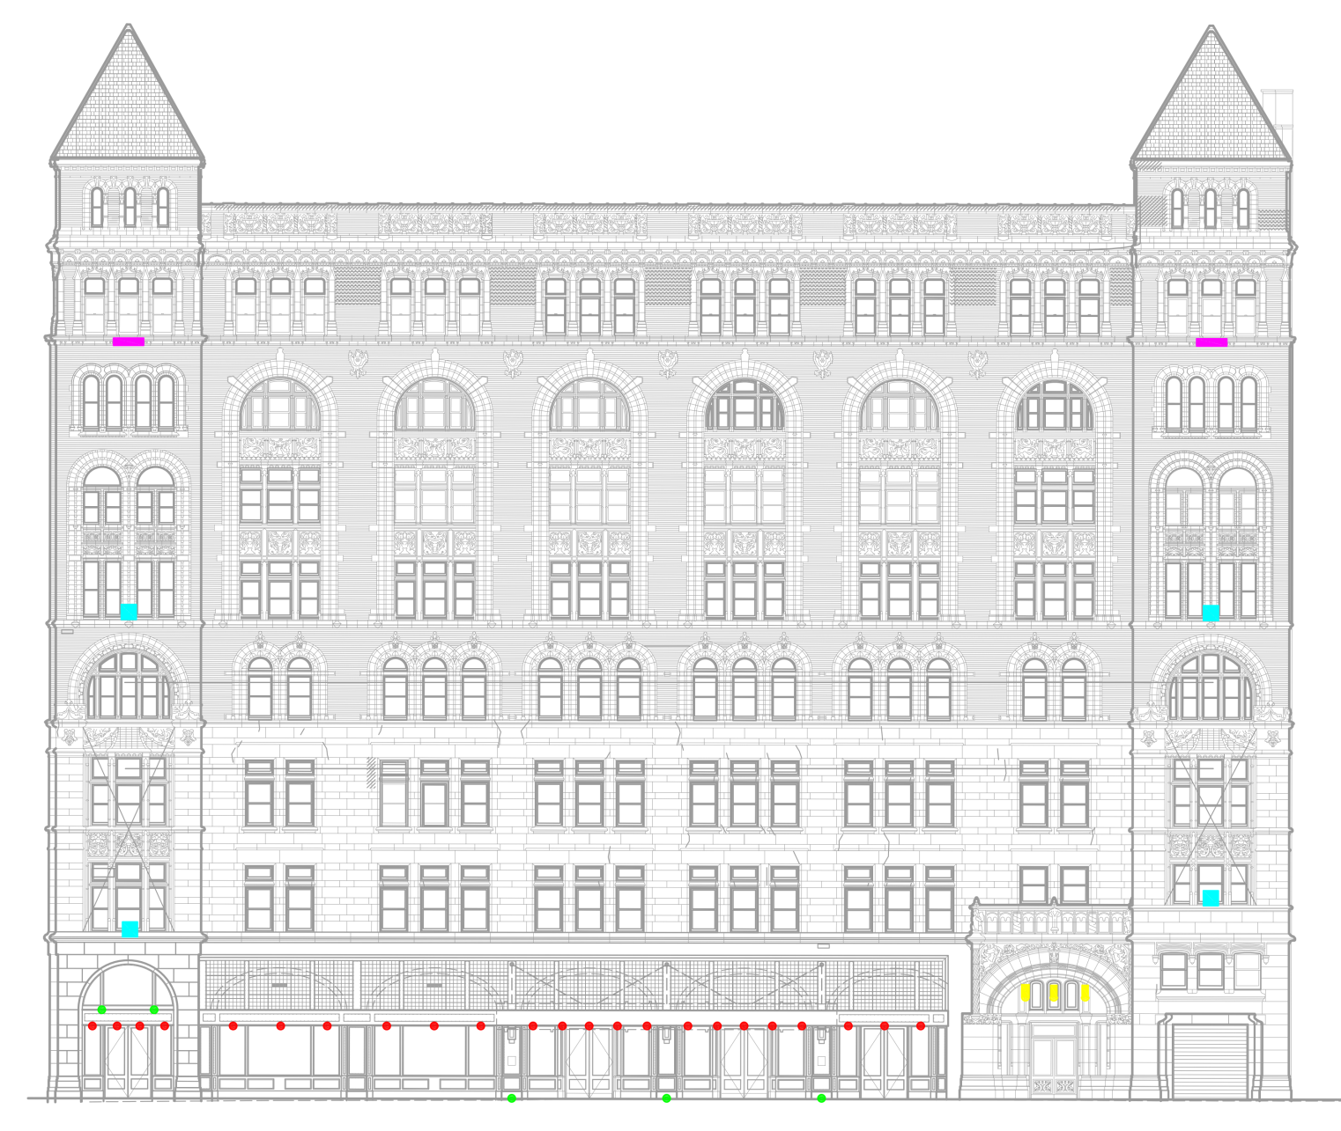
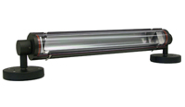
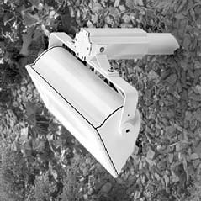
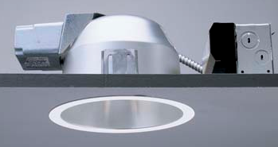
Introduction
Façade | FSTC Lobby
Architectural | Mechanical
Retail
Daylighting
Façade
Schematic Design
Final Lighting Plan
Design Criteria
Appearance- historical landmark
Hierarchy- guidance
Connection- historic & modern
Corbin Building | Electrical Depth | Lighting Depth | Breadth Topics | Lighting Depth | MAE | Conclusion

Slide 8
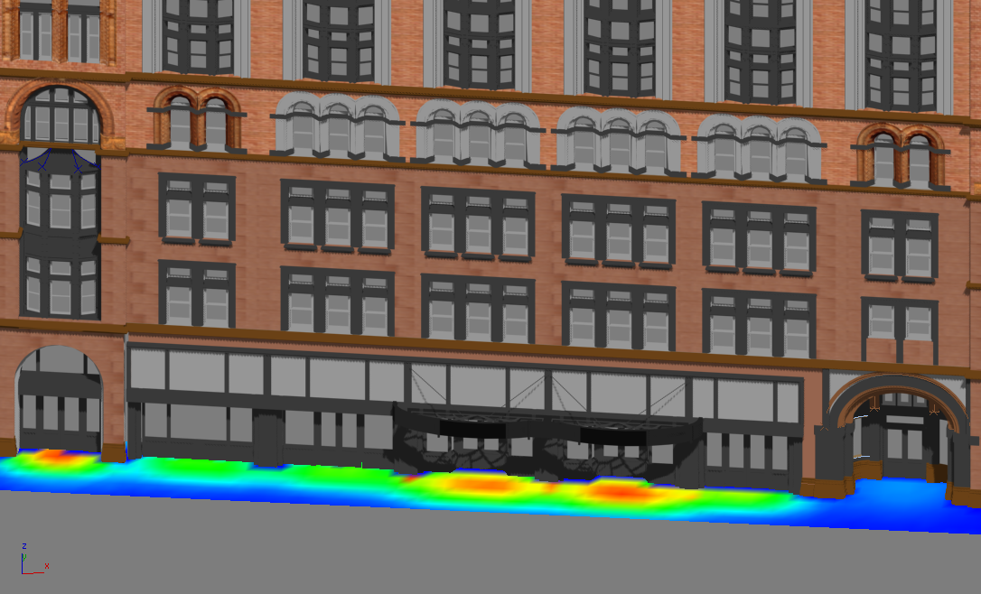
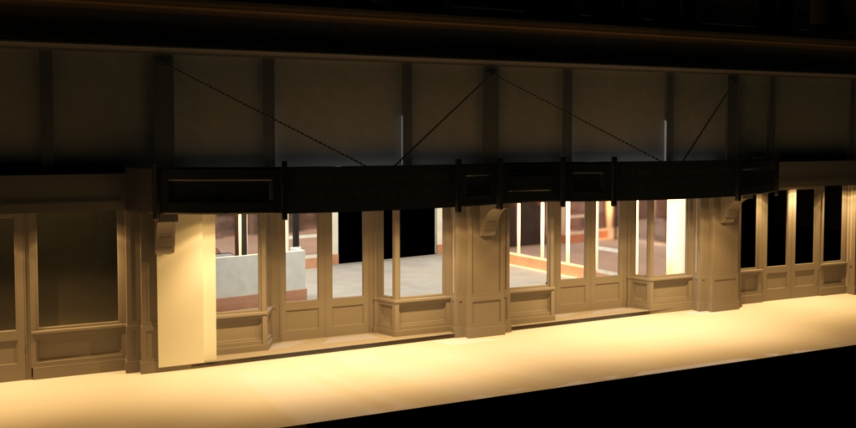
Introduction
Façade | FSTC Lobby
Architectural | Mechanical
Retail
Daylighting
Sidewalk Illuminance
Façade Pseudo Rendering
Rendering Lobby Entrance
30 fc
45 fc
22
10
15
5
7
2
0 fc
0 fc
Corbin Building | Electrical Depth | Lighting Depth | Breadth Topics | Lighting Depth | MAE | Conclusion

Slide 9
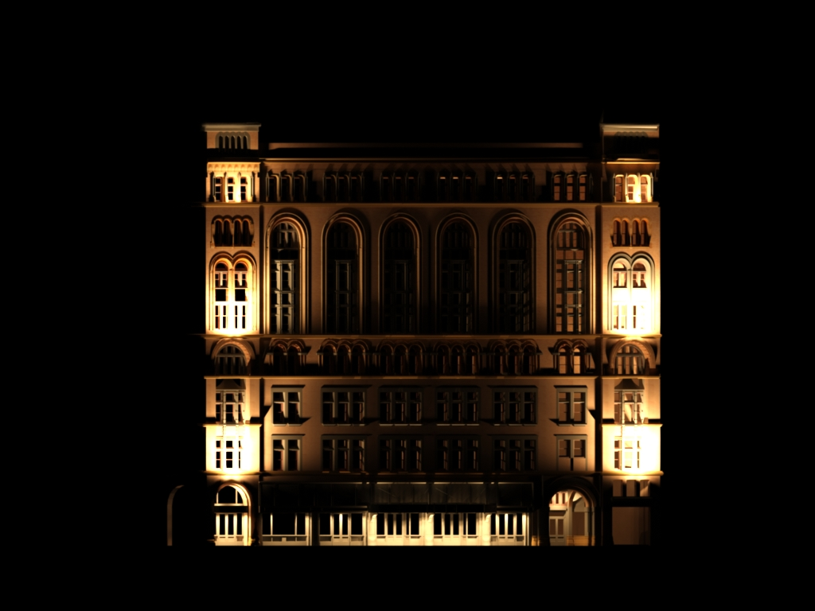
Introduction
Façade | FSTC Lobby
Architectural | Mechanical
Retail
Daylighting
Final Rendering
Façade Pseudo Rendering
Façade Statistics
Façade Lighting Power Density
 |  | ASHRAE | Watts Allowed | Watts Used
Tradable
Retail 1 Door |  | 20 W/LF | 388 | 244
FSTC Lobby |  | 30 W/LF | 1224 | 726
Retail 2 Door |  | 20 W/LF | 408 | 108
Corbin Lobby |  | 30 W/LF | 612 | 108
Total Tradable |  |  | 2632 | 1186
Non-Tradable
Façade |  | .2W/SF | 3240 | 1832
Total Non-Tradable |  |  | 3240 | 1832
45 fc
10
5
2
0 fc
Corbin Building | Electrical Depth | Lighting Depth | Breadth Topics | Lighting Depth | MAE | Conclusion

Slide 10
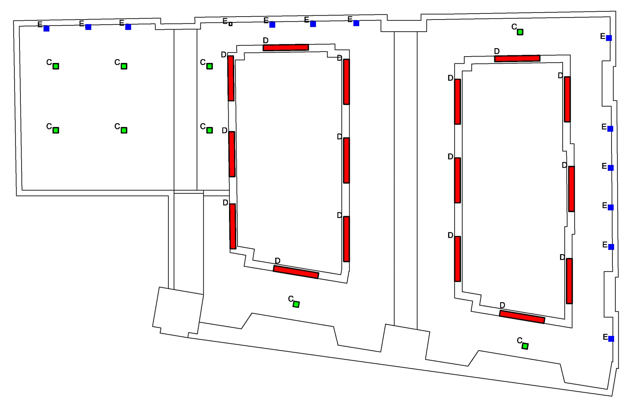
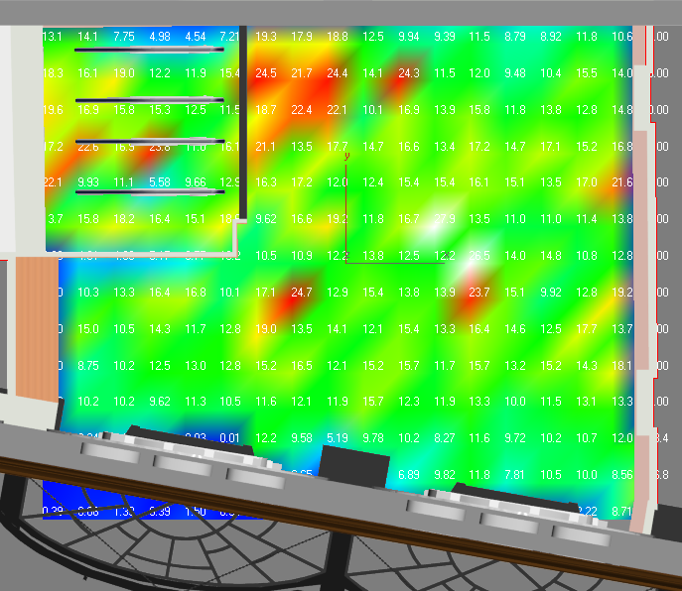
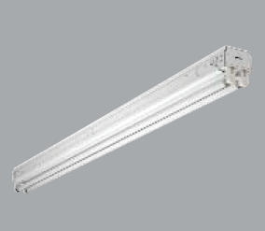
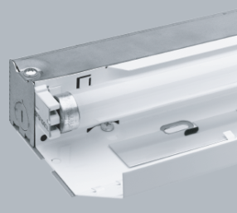
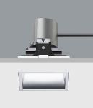
Introduction
Façade | FSTC Lobby
Architectural | Mechanical
Retail
Daylighting
Lobby
Lighting Layout
Illuminance
Design Criteria
Welcoming- Inviting interior to draw one in
Connection- Linking Corbin Building & Fulton Street Transit Center
Guiding- Lead to a destination
Safety- Illuminated area
Illuminance
Horizontal- 10 fc
Vertical- 3 fc at 5’ AFF
25 fc
19
13
6
0 fc
Avg. Illuminance= 13.4 fc
Corbin Building | Electrical Depth | Lighting Depth | Breadth Topics | Lighting Depth | MAE | Conclusion

Slide 11
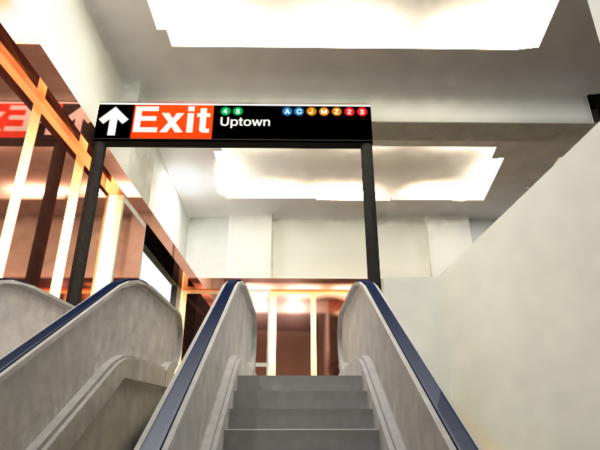
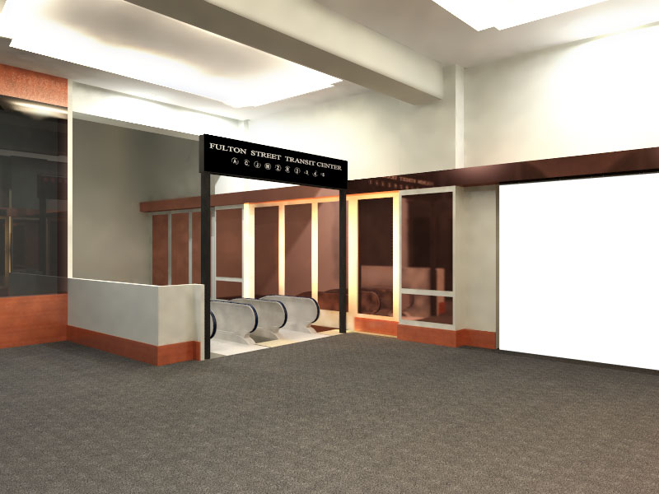
Introduction
Façade | FSTC Lobby
Architectural | Mechanical
Retail
Daylighting
Final Rendering
Final Rendering
Lobby Statistics
Lobby Lighting Power Density
Type | Quantity | Input Watts | Total Watts
C | 9 | 45 | 405
D | 16 | 30 | 480
E | 13 | 31 | 403
 |  | Total Watts | 1288
 |  | Total SF | 1460
ASHREA 90.1 (W/SF) |  |  | 1.3
LPD (W/SF) |  |  | 0.88
Corbin Building | Electrical Depth | Lighting Depth | Breadth Topics | Lighting Depth | MAE | Conclusion

Slide 12
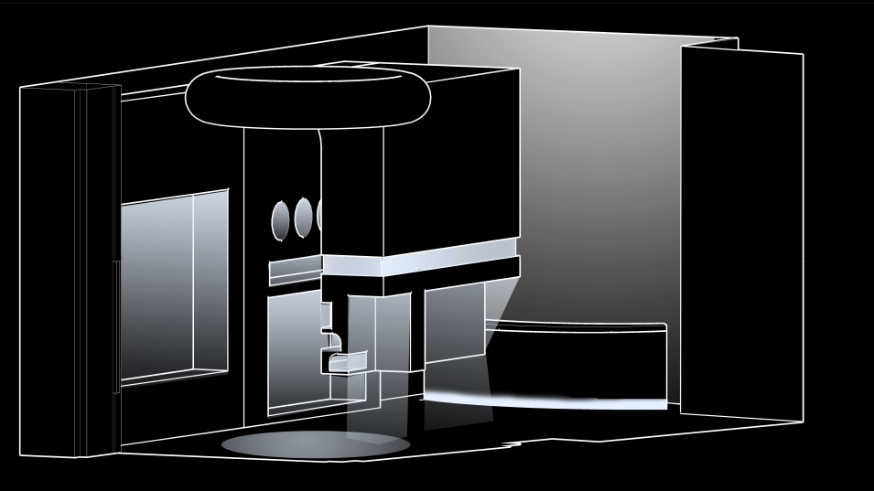
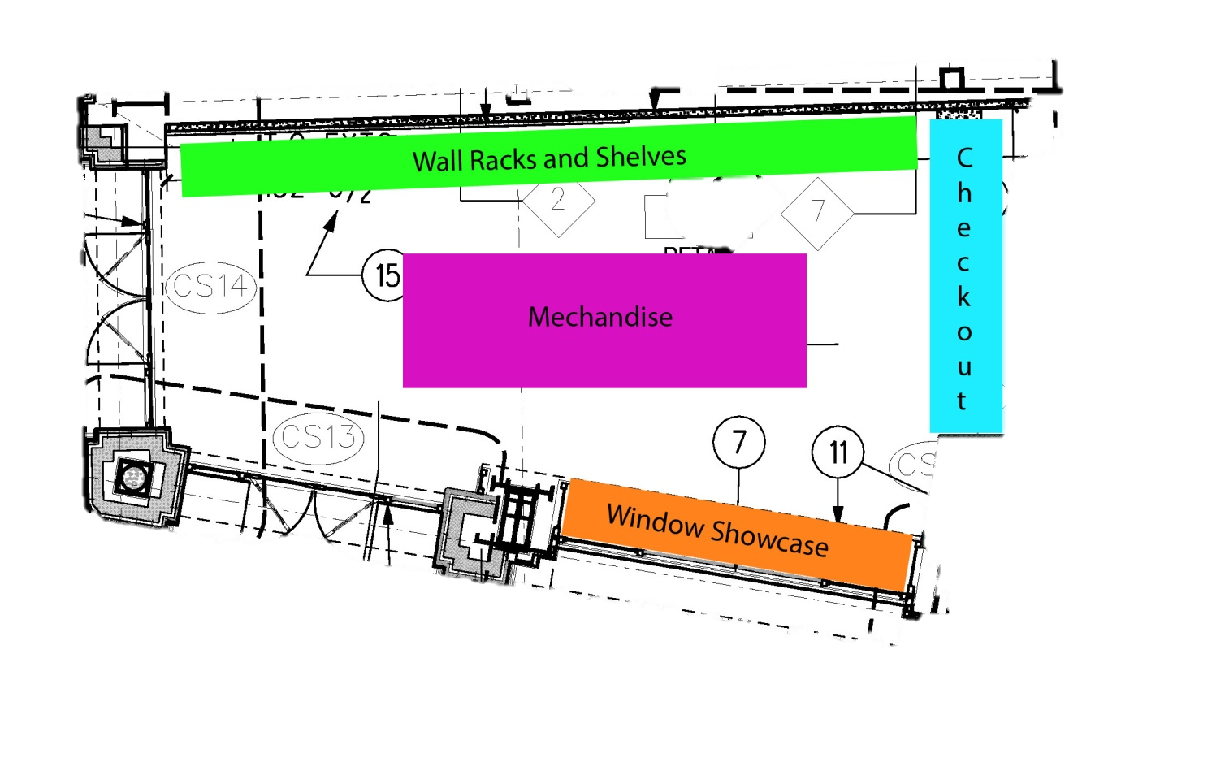
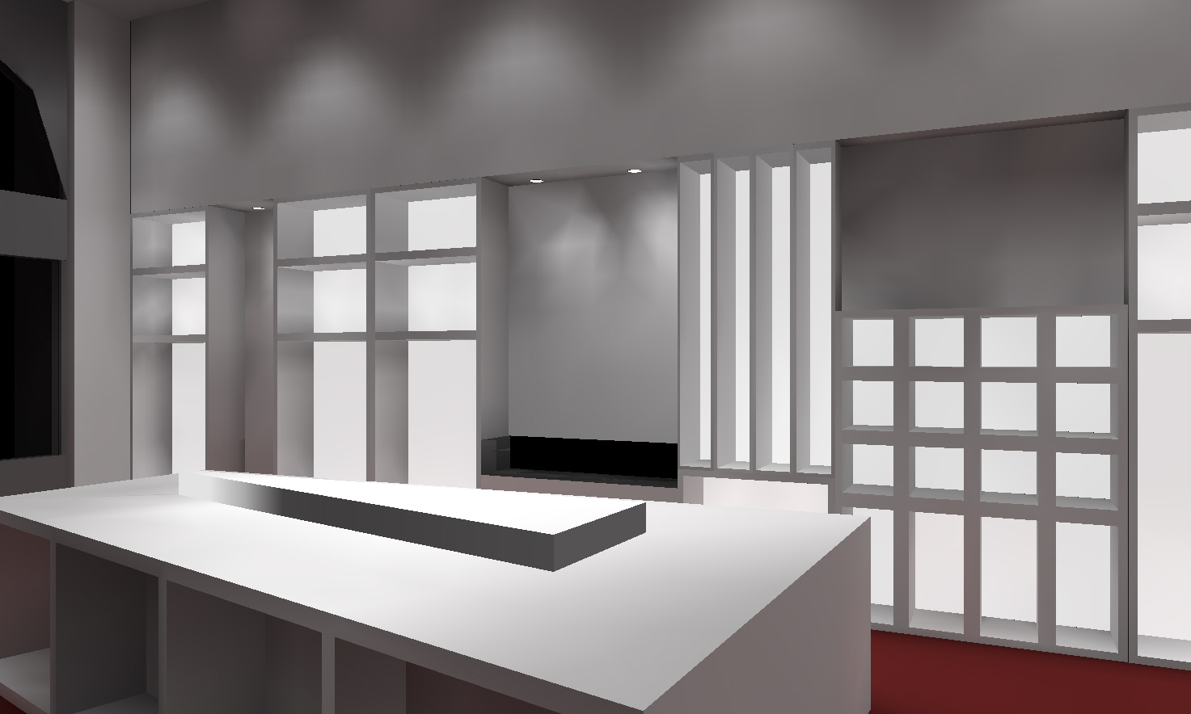
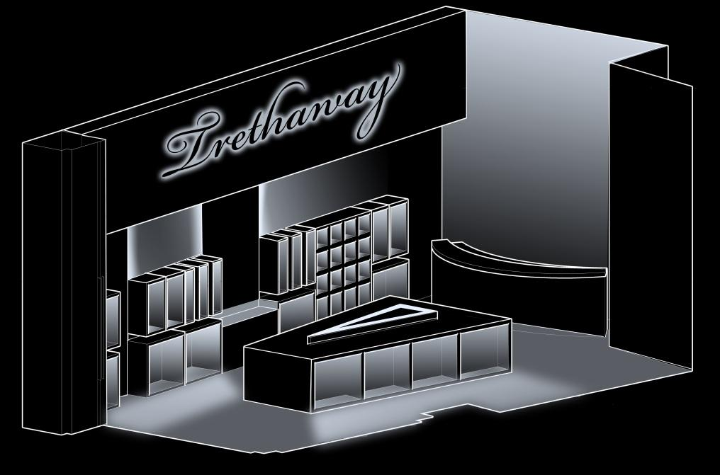
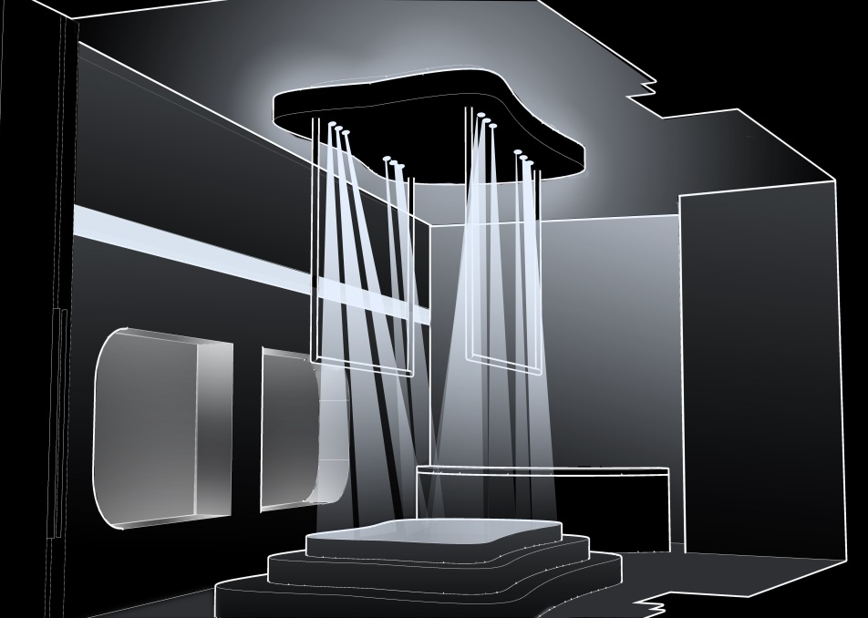
Introduction
Façade | FSTC Lobby
Architectural | Mechanical
Retail
Daylighting
Architectural- Retail Space
Schematic Design
Final Design
Design 1
Retail Statistics
Fit out by Tenant
Size: 840 Square Feet
Boutique Clothing
Upscale
Design 3
Design 2
Corbin Building | Electrical Depth | Lighting Depth | Breadth Topics | Lighting Depth | MAE | Conclusion

Slide 13
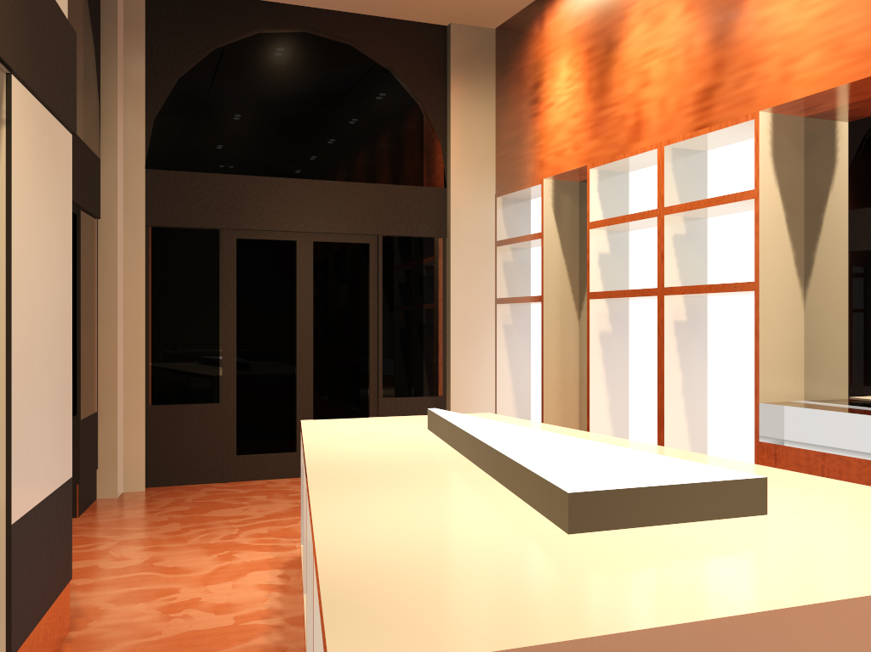
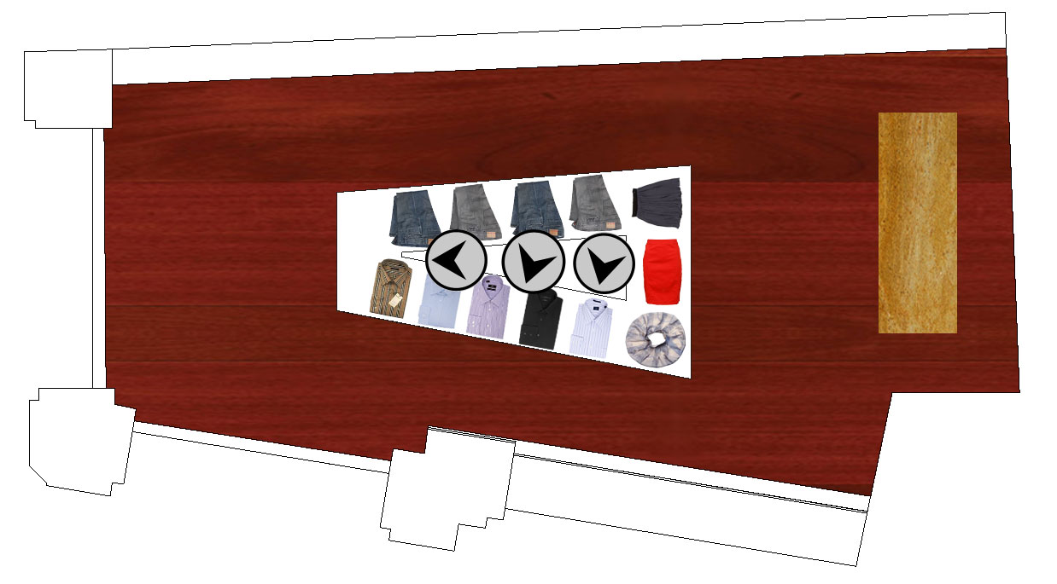
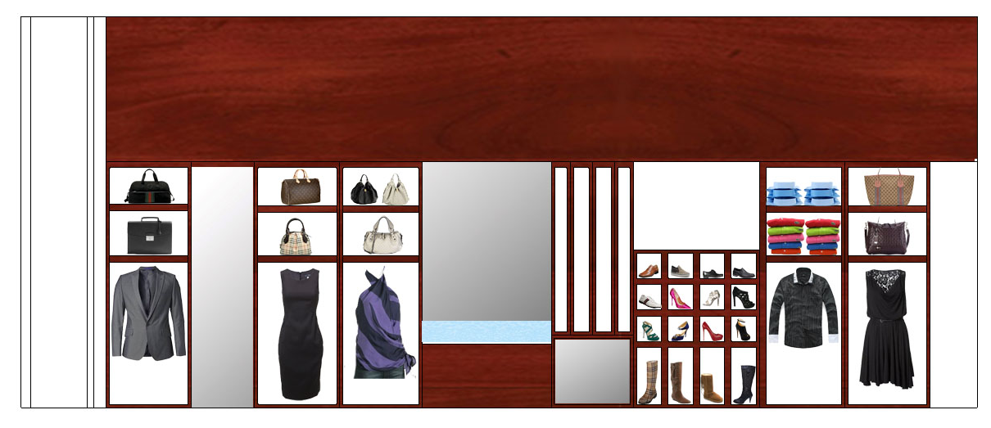
Introduction
Façade | FSTC Lobby
Architectural | Mechanical
Retail
Daylighting
Rendering
Plan View
North Elevation
Corbin Building | Electrical Depth | Lighting Depth | Breadth Topics | Lighting Depth | MAE | Conclusion

Slide 14
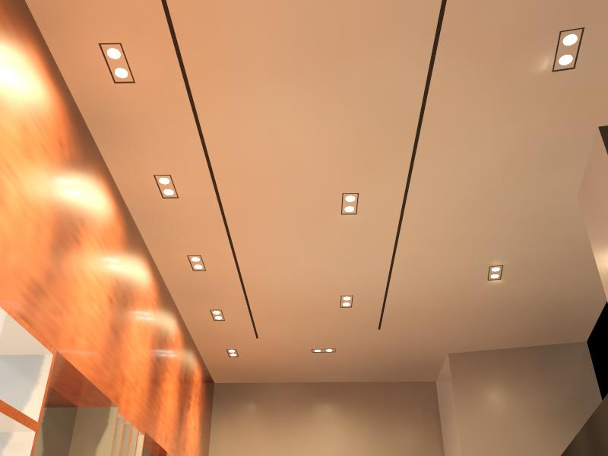
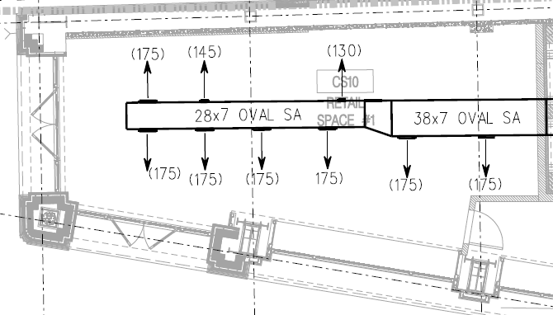
Introduction
Façade | FSTC Lobby
Architectural | Mechanical
Retail
Daylighting
Mechanical- Retail Space
Rendering
Existing Duct Layout
Redesign Duct Layout
Corbin Building | Electrical Depth | Lighting Depth | Breadth Topics | Lighting Depth | MAE | Conclusion

Slide 15
Introduction
Façade | FSTC Lobby
Architectural | Mechanical
Retail
Daylighting
Retail Space
Store Layout
Store Layout
Design Goals
Welcoming- inviting interior to draw one in
Guiding- lead to a destination
Comfort- minimal glare & view of fixtures
Dynamic- ability to adjust
General Retail Illuminance- 30 fc at 2’-6” AFF
Feature Displays- x10 fc greater than illuminance of adjacent spaces
Corbin Building | Electrical Depth | Lighting Depth | Breadth Topics | Lighting Depth | MAE | Conclusion

Slide 16
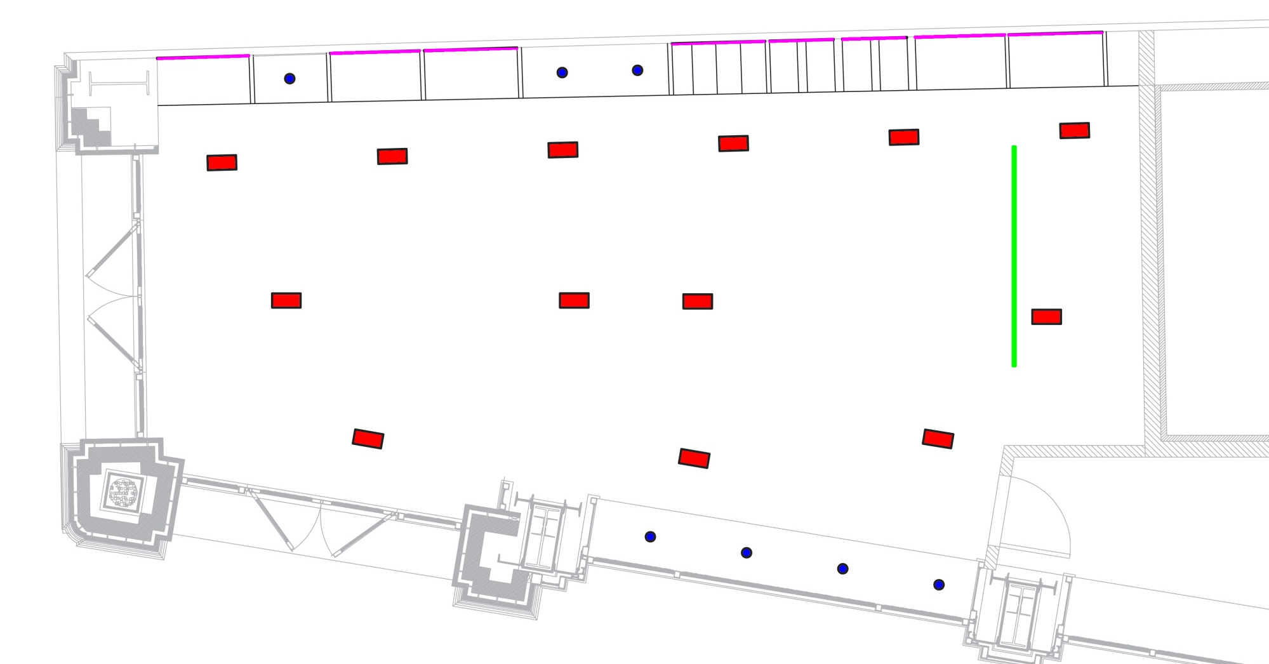
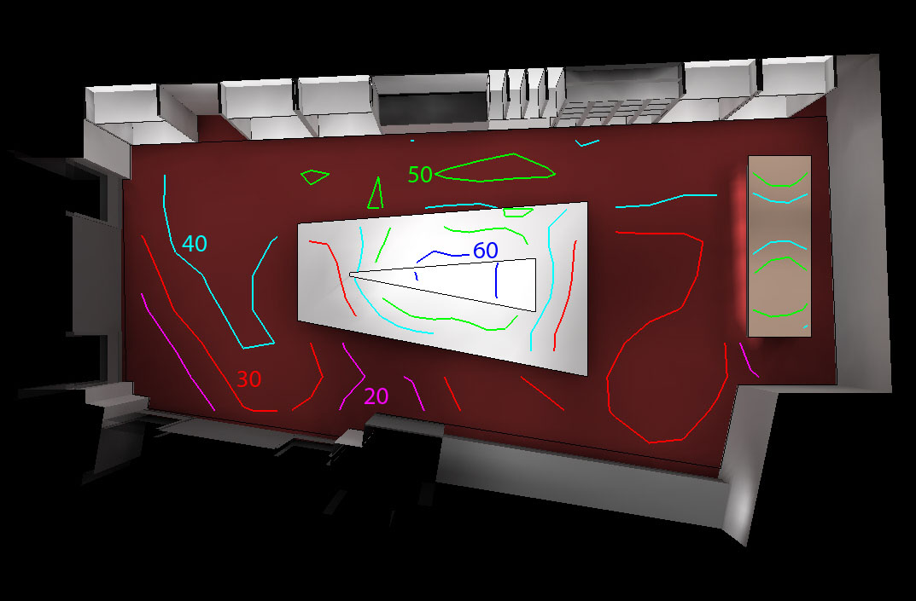
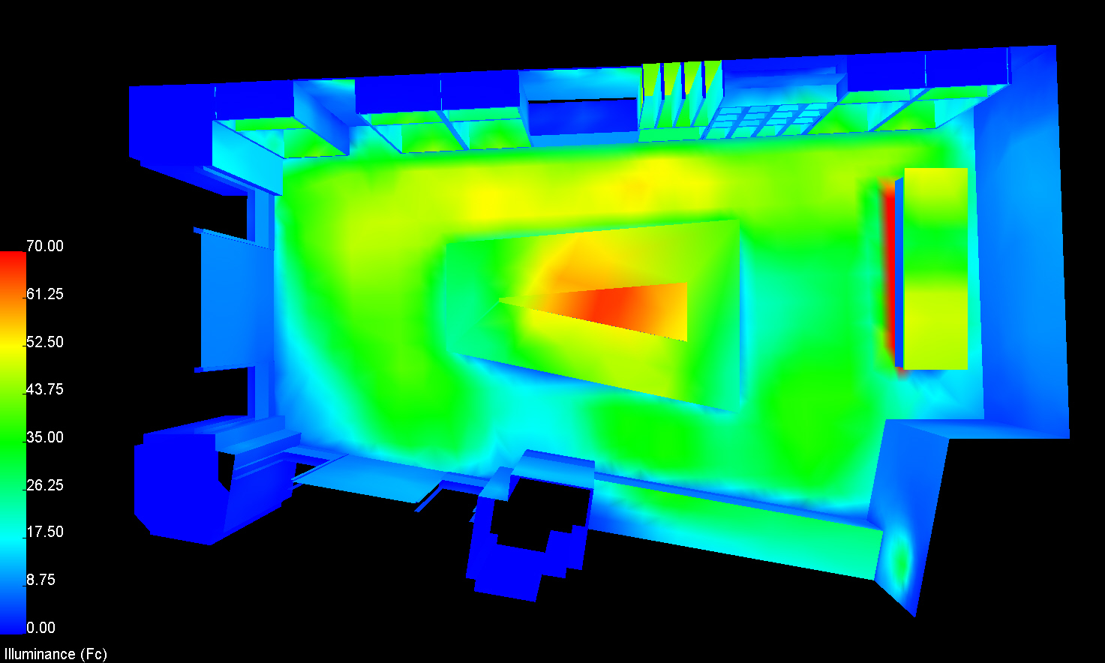
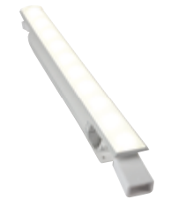
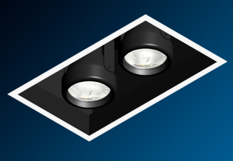
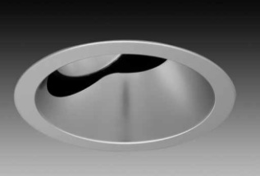
Introduction
Façade | FSTC Lobby
Architectural | Mechanical
Retail
Daylighting
Lighting Plan
Illuminance
Pseudo Illuminance
Corbin Building | Electrical Depth | Lighting Depth | Breadth Topics | Lighting Depth | MAE | Conclusion

Slide 17
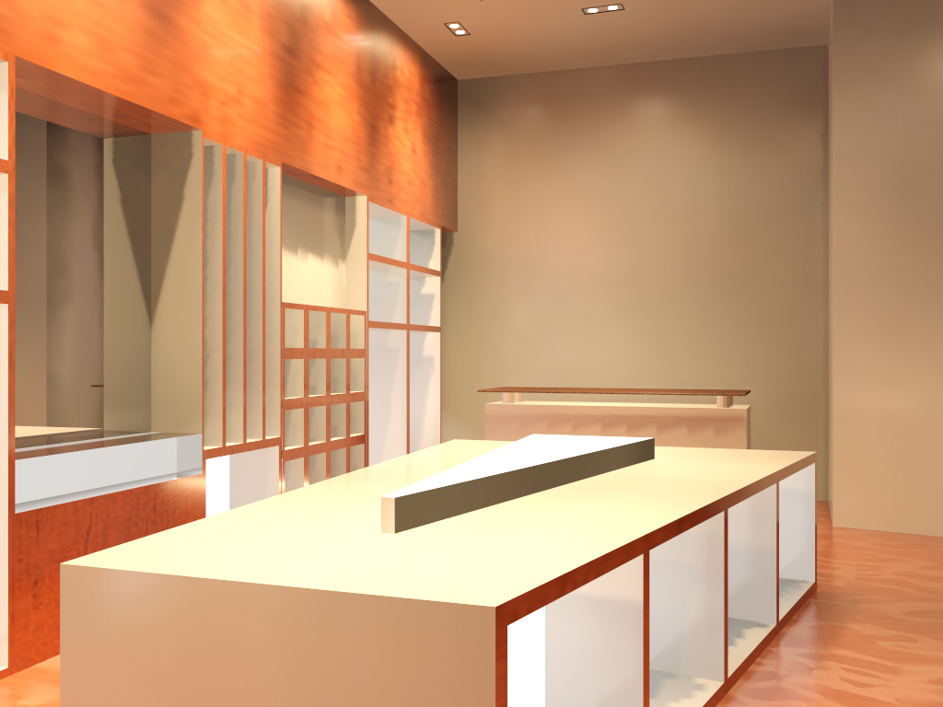
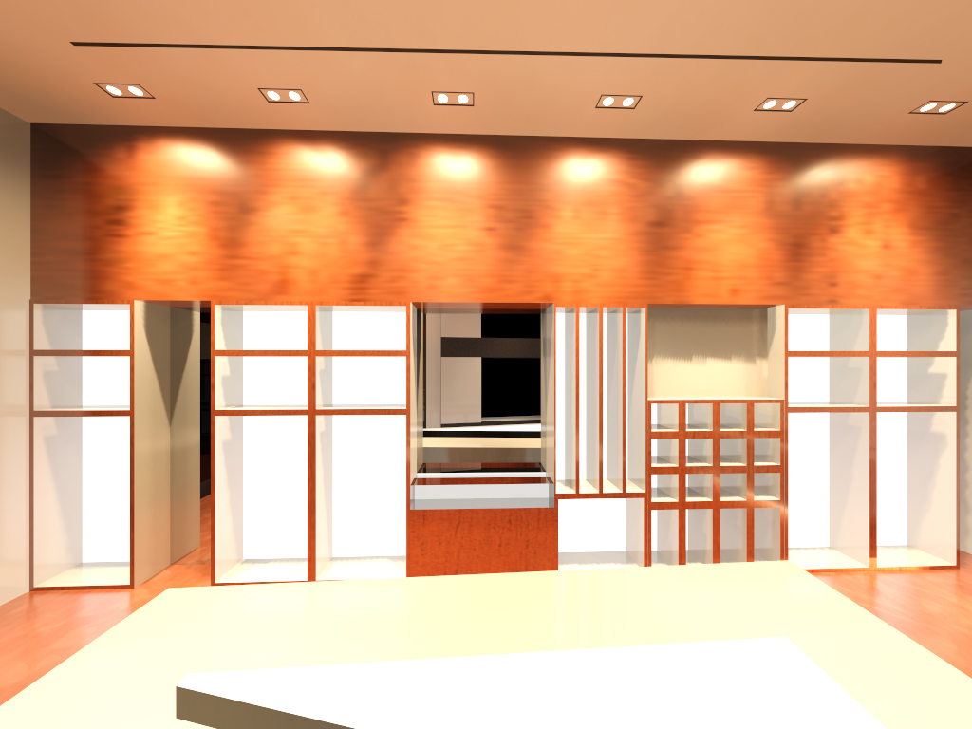
Introduction
Façade | FSTC Lobby
Architectural | Mechanical
Retail
Daylighting
East Interior View
West Interior View
North Interior View
Corbin Building | Electrical Depth | Lighting Depth | Breadth Topics | Lighting Depth | MAE | Conclusion

Slide 18
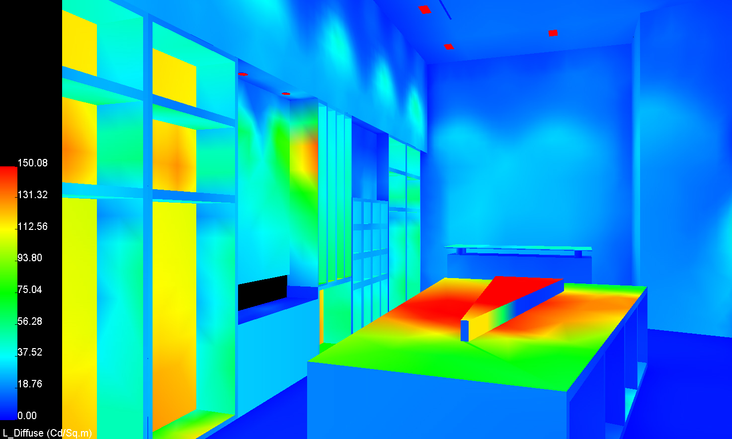
Introduction
Façade | FSTC Lobby
Architectural | Mechanical
Retail
Daylighting
East Interior View
East Pseudo Color View
Retail Statistics
Retail Lighting Power Density
Type | Quantity | Input Watts | Total Watts
K | 13 | 89 | 1157
L | 9 | 12.5 | 112.5
M | 9 | 170 | 1530
N | 7 | 14 | 98
 |  | Total Watts | 2897.5
 |  | Total SF | 840
ASHREA 90.1 (W/SF) |  |  | 1.4
Additional Power Allowance (W) |  |  | 2176
Decorative Lighting (1.0 W/SF) |  |  | 840
Total Watts Allowed (W) |  |  | 3016
Total Watts Used (W) |  |  | 2897.5
 |  | LPD (W/SF) | 3.45
Corbin Building | Electrical Depth | Lighting Depth | Breadth Topics | Lighting Depth | MAE | Conclusion

Slide 19
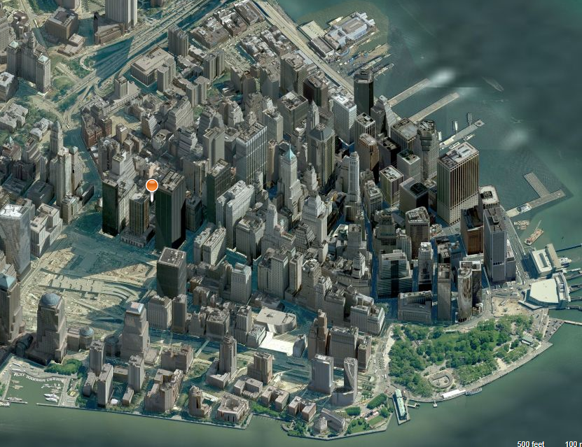
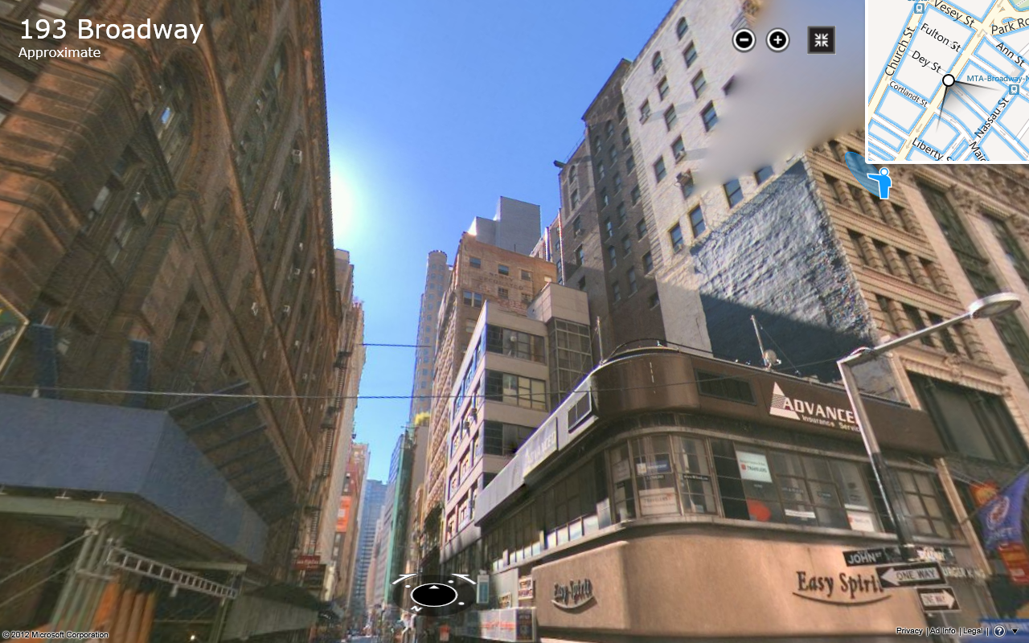
Introduction
Façade | FSTC Lobby
Architectural | Mechanical
Retail
Daylighting
MAE Focus- Daylighting
Site Location
Street View
Daylight penetration on 3rd floor office
Lower
Manhattan
New York, NY
Congested area of tall buildings
Corbin Building | Electrical Depth | Lighting Depth | Breadth Topics | Lighting Depth | MAE | Conclusion

Slide 20
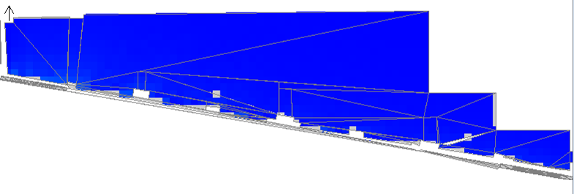
Introduction
Façade | FSTC Lobby
Architectural | Mechanical
Retail
Daylighting
December 21st
March 20th
June 21st
8:00 AM
8:00 AM
8:00 AM
12:00 PM
12:00 PM
12:00 PM
Corbin Building | Electrical Depth | Lighting Depth | Breadth Topics | Lighting Depth | MAE | Conclusion

Slide 21
Introduction
Façade | FSTC Lobby
Architectural | Mechanical
Retail
Daylighting
December 21st
March 20th
June 21st
3:00 PM
3:00 PM
3:00 PM
6:00 PM
6:00 PM
6:00 PM
Corbin Building | Electrical Depth | Lighting Depth | Breadth Topics | Lighting Depth | MAE | Conclusion

Slide 22
Introduction
Façade | FSTC Lobby
Architectural | Mechanical
Retail
Daylighting
8:00 AM- 1:00 PM
2:00 PM- 6:00 PM
Conclusions
Most sunlight penetration on west side
Shades would best be optimized on the west
Shading on east from exterior buildings
Corbin Building | Electrical Depth | Lighting Depth | Breadth Topics | Lighting Depth | MAE | Conclusion

Slide 23
Introduction
Façade | FSTC Lobby
Architectural | Mechanical
Retail
Daylighting
Conclusions
Lighting Design
Highlight architectural details
Clean modern design
Promote safety and integration
Daylighting
Sufficient daylight penetration
Architectural & Mechanical
Redesign provides a modern and upscale design
Corbin Building | Electrical Depth | Lighting Depth | Breadth Topics | Lighting Depth | MAE | Conclusion

Slide 24
Introduction
Façade | FSTC Lobby
Architectural | Mechanical
Retail
Daylighting
Acknowledgements
Penn State AE Faculty
Dr. Mistrick
Dr. Houser
Mr. Dannerth
Arup
Family and Friends
Corbin Building | Electrical Depth | Lighting Depth | Breadth Topics | Lighting Depth | MAE | Conclusion

Slide 25
Introduction
Façade | FSTC Lobby
Architectural | Mechanical
Retail
Daylighting
Comments and Questions
Matthew Trethaway | Lighting/ Electrical | Advisor: Dr. Houser | Advisor: Ted Dannerth

