Slide 1
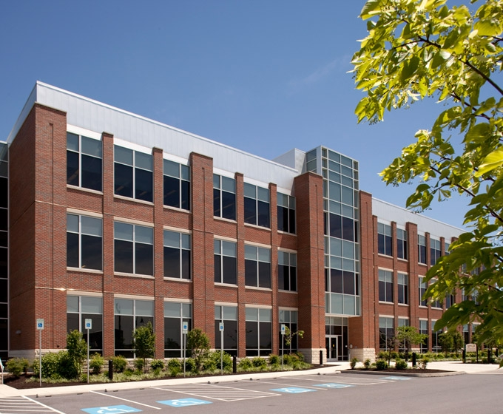
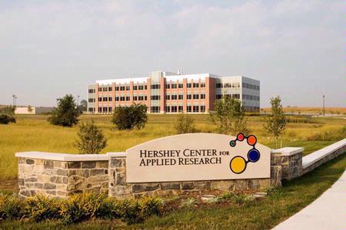
Hershey Research Park Building One
Jonathan Krepps
Structural Option
Senior Thesis 2013
Faculty Advisor: Dr. Hanagan

Slide 2
Presentation Outline
Building Introduction
Existing Conditions
Structural Depth – Structural Redesign
Breadth One – Sustainability
Breadth Two – Mechanical
Conclusion
Comments

Slide 3
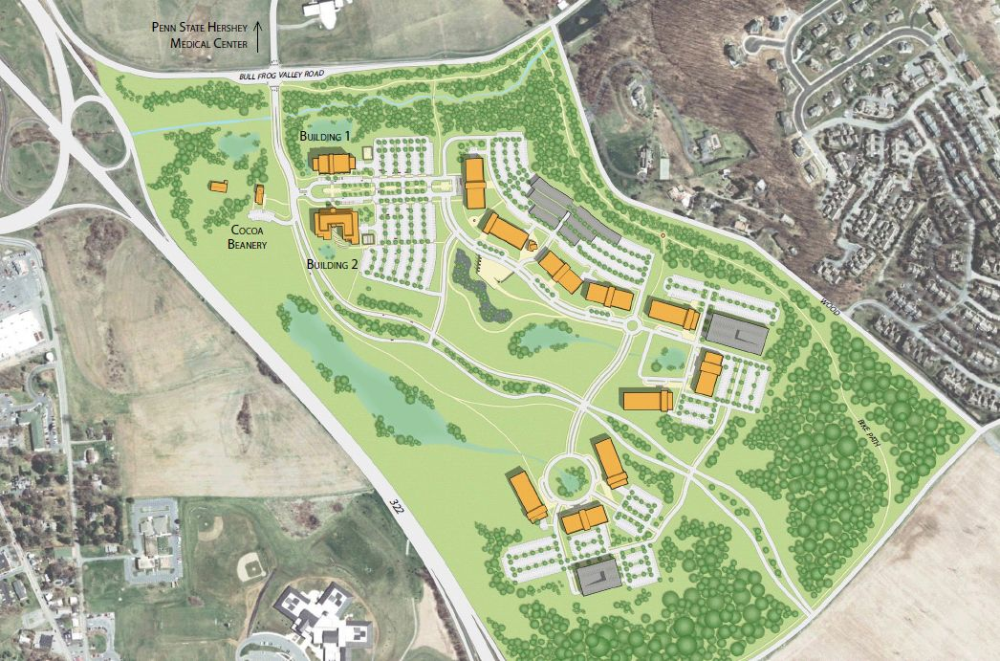
Building Introduction
Project Team
Hershey, PA
Research Facility
80,000 square feet
Three Stories, 50 feet tall
Construction started in April 2006
Opened in May 2007
$10.7 Million
Owner: Wexford Technology, LLC
Architect: Ayers/Saint/Gross Inc.
Engineers: Brinjac Engineering
Construction Mangers: Whiting – Turner Construction
Site Master Plan

Slide 4
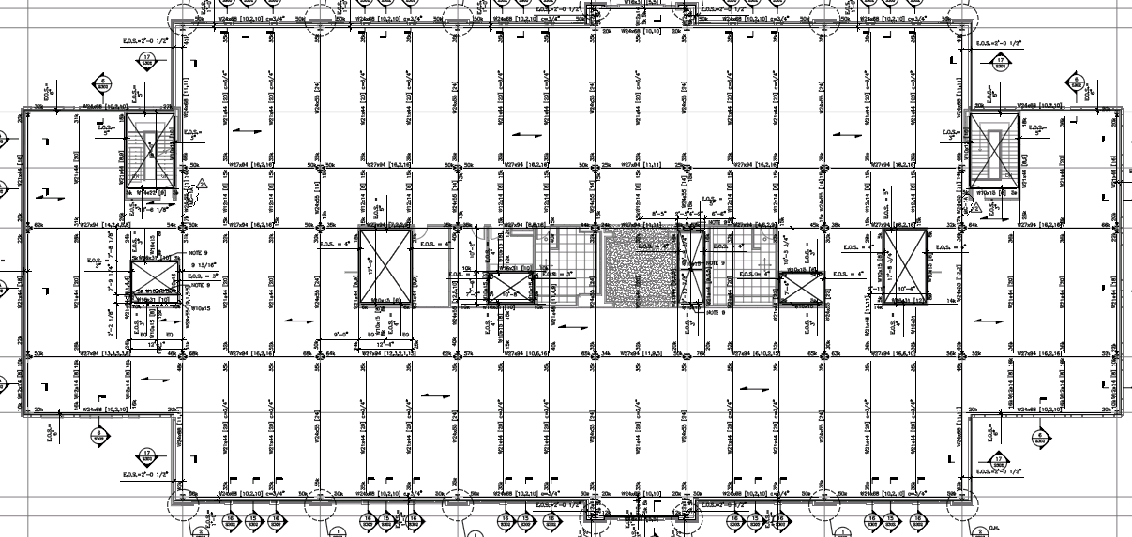
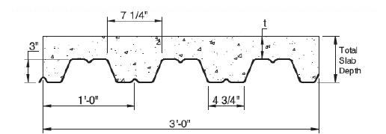
Existing Structural System
Steel Moment Frame
Composite Metal Deck
  Vulcraft 3VLI18
Piers with Concrete Caps
Deck Cross Section
Typical Floor Frame

Slide 5
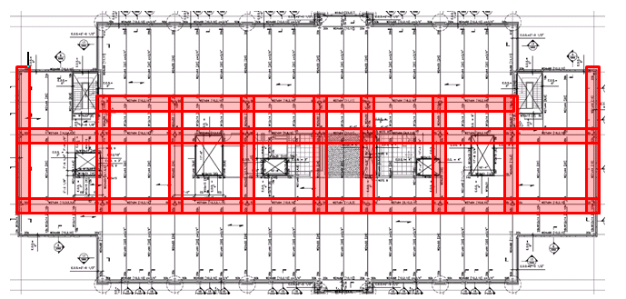
Existing Structural System
Steel Moment Frame
Composite Metal Deck
  Vulcraft 3VLI18
Piers with Concrete Caps
Deck Cross Section
Lateral Frame

Slide 6
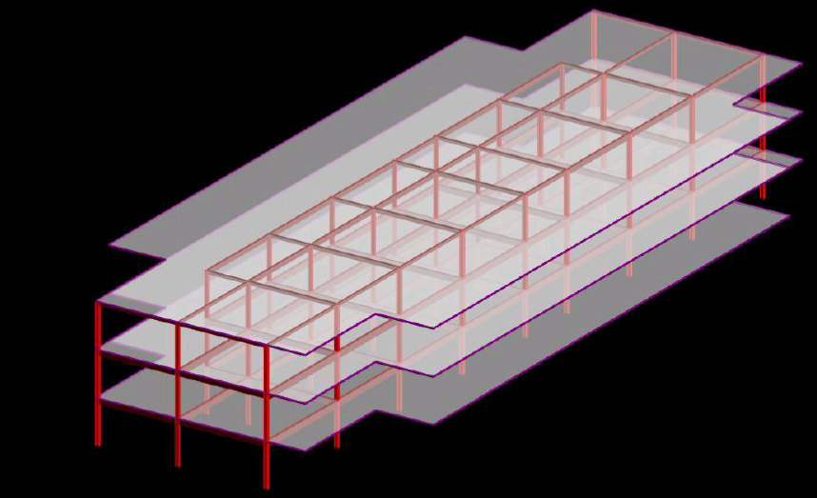
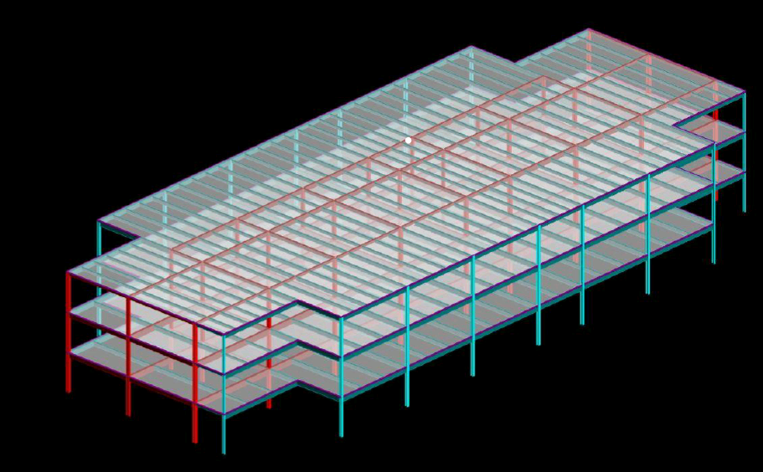
RAM Model - Lateral Frame
RAM Model – Existing Structure
Lateral Frame

Slide 7
Structural Depth
Thesis Breadths
System Redesign
  Steel to Concrete
  One Way Slab with Beams
Lateral Design
  Concrete Moment Frame
Goals
  Design an adequate system
  Cost effective and easy to construct
Breadth One – Sustainability
Breadth Two – Mechanical
Goals
  LEED Certification through the addition of green roof
  More energy efficient

Slide 8
32’
Redesign Details
Slab Design
Controlling Load Combination
  1.2D + 1.6L
Live Load = 100 psf
Superimposed Dead Load = 25 psf
Total Load = 190 psf
Table 9.5(a) of ACI used to help determine beam depths
As = Mu / 4d
Span Length
  10.67 ft
Slab Thickness
  5.5 in
Slab Weight
  68.75 psf
Reinforcement
  Flexural - # 4 bars @ 12 in OC
  Transverse - # 4 bars @ 18 in OC
32.5’
B2
B1
G1
Typical Bay

Slide 9
32’
Redesign Details
Beam B1 Design
Controlling Load Combination
  1.2D + 1.6L
Live Load = 100 psf
Superimposed Dead Load = 25 psf
Total Load = 190 psf
Table 9.5(a) of ACI used to help determine beam depths
As = Mu / 4d
Span Length
  32.5 ft
Beam Section
  16” x 28”
Mu = 237 k-ft < ΦMn = 264 k-ft
Vu = 39 k < ΦVn = 78 k
Reinforcement
  Exterior Spans – (3) # 7 bars
  Interior Spans – (4) # 7 bars
  # 4 Stirrups
32.5’
B2
B1
G1
Typical Bay

Slide 10
32’
Beam B2 Design
Beam B1 Design
Span Length
  32.5 ft
Beam Section
  20” x 28”
Mu = 247 k-ft < ΦMn = 267 k-ft
Vu = 41 k < ΦVn = 88 k
Reinforcement
  Exterior Spans – (3) # 7 bars
  Interior Spans – (4) # 7 bars
  # 4 Stirrups
Span Length
  32.5 ft
Beam Section
  16” x 28”
Mu = 237 k-ft < ΦMn = 264 k-ft
Vu = 39 k < ΦVn = 78 k
Reinforcement
  Exterior Spans – (3) # 7 bars
  Interior Spans – (4) # 7 bars
  # 4 Stirrups
32.5’
B2
B1
G1
Typical Bay

Slide 11
32’
Beam B2 Design
Girder Design
Span Length
  32.5 ft
Beam Section
  20” x 28”
Mu = 247 k-ft < ΦMn = 267 k-ft
Vu = 41 k < ΦVn = 88 k
Reinforcement
  Exterior Spans – (3) # 7 bars
  Interior Spans – (4) # 7 bars
  # 4 Stirrups
Span Length
  32 ft
Beam Section
  20” x 28”
Mu = 302 k-ft < ΦMn = 333 k-ft
Vu = 47 k < ΦVn = 117 k
Reinforcement
  Exterior Spans – (3) # 7 bars
  Interior Spans – (5) # 7 bars
  # 4 Stirrups
32.5’
B2
B1
G1
Typical Bay

Slide 12
32’
Column Design
Girder Design
Column Layout Unchanged
Simplified Design for Columns
  Alsamsam and Kamara
Design Aids based of ACI
Column Section
  20” x 20”
Reinforcement
  (12) # 10 bars
Max Load
  Pu = 564 kips < ΦPn = 1050 kips
Span Length
  32 ft
Beam Section
  20” x 28”
Mu = 302 k-ft < ΦMn = 333 k-ft
Vu = 47 k < ΦVn = 117 k
Reinforcement
  Exterior Spans – (3) # 7 bars
  Interior Spans – (5) # 7 bars
  # 4 Stirrups
32.5’
B2
B1
G1
Typical Bay

Slide 13
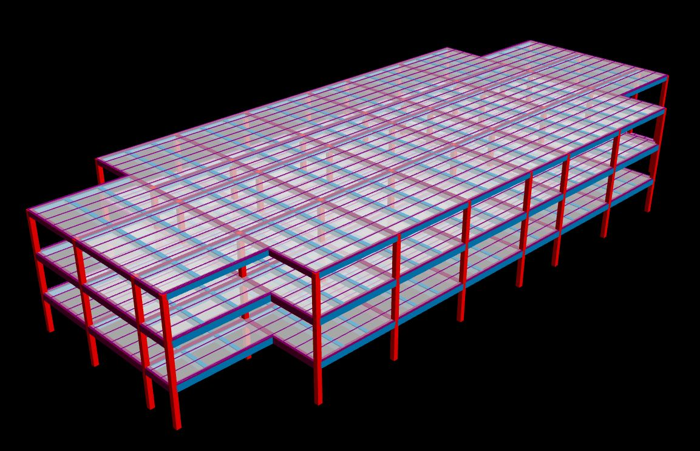
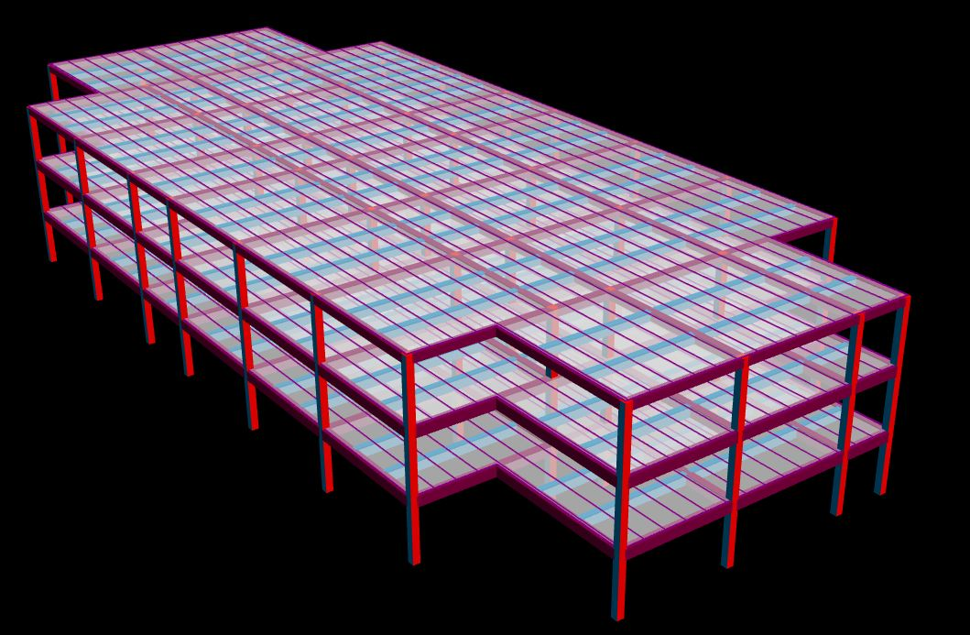
Lateral Redesign
Concrete Moment Frame
No addition lateral resisting needed
Analysis done using RAM Structural System
Controlling Load Cases
  Wind – 1.2 D + 1.0 L + 1.0 W
  Seismic – 1.2 D + 1.0 L + 1.0 E
RAM Structural Model
RAM Structural Model

Slide 14
Serviceability
Wind Loads
Controlling Wind Load Case 1.2D+1.0L+1.0W
Floor | X Deflection (in) | Y Deflection (in) | X Drift (in) | Y Drift (in) | Allowable Drift (in)
Roof | 0.059 | 0.02152 | 0.0124 | 0.01 | 0.44
3rd | 0.04666 | -0.01148 | 0.0231 | 0.0066 | 0.44
2nd | 0.0236 | -0.00485 | 0.0236 | 0.0049 | 0.44
Total |  |  | 0.0591 | 0.0215
ASCE 7 – 10
Load Combination
  1.2 D + 1.0 L + 1.0 W
  Wind Case One
Max Story Drift
  H/400
RAM Structural Model

Slide 15
Serviceability
Seismic Loads
Controlling Seismic Load Case 1.2D+1.0L+1.0E
Floor | X Deflection (in) | Y Deflection (in) | X Drift (in) | Y Drift (in) | Allowable Drift (in)
Roof | 0.51621 | -0.019 | 0.1492 | 0.0008 | 2.64
3rd | 0.36698 | -0.00981 | 0.2005 | 0.0059 | 2.64
2nd | 0.16647 | -0.00424 | 0.1664 | 0.0045 | 2.64
Total |  |  | 0.5161 | 0.0112
ASCE 7 – 10
Load Combination
  1.2 D + 1.0 L + 1.0 E
Max Story Drift
  0.015 x H
Design Variables
  Seismic Design Category = “D”
  R = 3.0
  I = 1.25
RAM Structural Model

Slide 16



Sustainability Breadth
Main goal is to achieve LEED certification through the addition of a green roof
Owners Future Plans – LEED Certification for all buildings
Two different green roofs were compared
  LiveRoof
  TectaGreen
Roof Structure
  Extra 35 psf on Roof

Slide 17
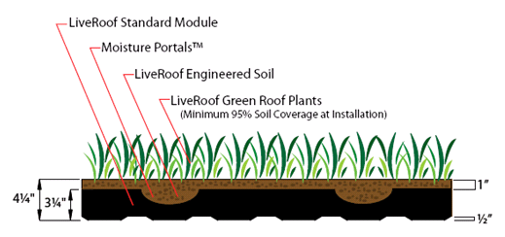
Sustainability Breadth
LiveRoof System
LEED Category | Credit Abbreviation | Credits Possible
Protect or Restore Habitat and Maximum Open Space | SS 5.1/5.2 | 1 each (2 total)
Storm Water Design | SS 6.1/6.2 | 1 each (2 total)
Heat Island Effect | SS 7.1/7.2 | 1 each (2 total)
Water Efficient Landscape | WE 1.1/1.2 | 2/4 (6 total)
Optimized Energy Performance | EA 1.1-1.19 | 1 each (19 total)
Construction Waste Management | MR 2 | 1 to 2
Recycled Content | MR 4.1/4.2 | 1 to 2
Regional Materials | MR 5.1/5.2 | 1 to 2
Rapidly Renewable Materials | MR 6 | 1
Both designs have similar advantages and disadvantages
The LiveRoof system was chosen as the better choice
Standard Module
Possible of obtaining over 20 LEED credits
Optimized Energy Performance – Mechanical Breadth
LiveRoof Green Roof Design Detail

Slide 18
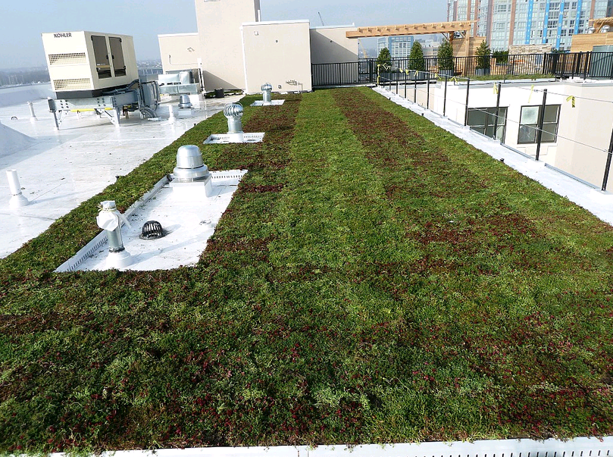
Sustainability Breadth
Both designs have similar advantages and disadvantages
The LiveRoof system was chosen as the better choice
Standard Module
Possible of obtaining over 20 LEED credits
Optimized Energy Performance – Mechanical Breadth
LiveRoof Green Roof Design Detail
LiveRoof Green Roof

Slide 19
Roof Slab Design Details
Slab Thickness | 5.5”
Flexural Reinforcement (Top and Bottom) | # 4 Bars @ 12”
Transverse Reinforcement | # 4 Bars @ 18”
System Weight | 68.75 psf
Structural Effects
Roof Loads
  Roof Live Load – 30 psf
  Superimposed Dead Load – 25 psf
  Green Roof – 35 psf
  Snow Load – 30 psf
Controlling Load Case
  1.2 D + 1.6 Lr
Total Load – 120 psf
Roof Beam Design Details
Beam Section | 12”x22”
Flexural Reinforcement (Exterior Spans) | (3) #7 Bars
Flexural Reinforcement (Interior Spans) | (2) #10 Bars
Beam Weight | 206 plf
Roof Girder Design Details
Beam Section | 18”x22”
Flexural Reinforcement (Midspan) | (3) #7 Bars
Flexural Reinforcement (Supports) | (5) #7 Bars
Beam Weight | 310 plf
LiveRoof Green Roof

Slide 20
Breadth Conclusion
The addition of a green roof would be helpful
LEED credits can help for LEED certification
  Certified: 40 – 49 points
  Silver: 50 – 59 points
  Gold: 60 – 79 points
  Platinum: 80 or more
LiveRoof Green Roof

Slide 21
Conclusions
The existing steel frame is the more feasible structural system for the building
  Higher floor thickness
  Longer construction time
The addition of a green roof would be helpful
  Possible addition of over 20 LEED Credits
  LEED Certification
  Lower energy cost

Slide 22
Acknowledgements
Comments
Or
Questions?
Wexford Science and Technology, LLC
Brinjac Engineering
Ayers/Saint/Gross Inc.
AE Staff
Advisor: Dr. Linda Hanagan

Slide 23
Mechanical Breadth
Main goal was to find the energy saving ability of the green roof
The more energy the green saves, the better
More LEED Credits
  Optimized Energy Performance – Mechanical Breadth
  Up to 19 Credits Possible

Slide 24
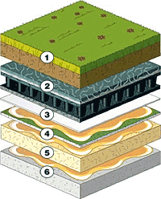
Mechanical Breadth
Roof Assembly R - Values
Material | R – Value
Concrete Slab (5.5”) | .4125
Insulation | 22
Roof Board | 1.09
Water Proofing Membrane | .12
LiveRoof Standard Green Roof System | 2
Main goal was to find the energy saving ability of the green roof
The more energy the green saves, the better
More LEED Credits
  Optimized Energy Performance – Mechanical Breadth
  Up to 19 Credits Possible
Green Roof Assembly

Slide 25
Mechanical Breadth
Roof Assembly R - Values
Material | R – Value
Concrete Slab (5.5”) | .4125
Insulation | 22
Roof Board | 1.09
Water Proofing Membrane | .12
LiveRoof Standard Green Roof System | 2
Energy Saving of 77,375,928 BTU per year
Additional financial benefits from tax credits
  Federal – 30% of total cost
LEED points
  One Credit from energy reduction
Green Roof Assembly

