Slide 1
Water Bottling Facility | Mid-Atlantic United States
Mechanical Option | Spring 2013 Advised by Dr. William Bahnfleth | Justyne Neborak

Slide 2
Introduction
Water Bottling Facility
Production
Warehouse
Office
Mid Atlantic Region
30 ft Ceiling Warehouse
23 ft 6 in Draft Curtain Production
8 – 30 ft Ceiling Office
Introduction

Slide 3
Introduction
Outdoor Design Conditions
Indoor Design Conditions
Introduction
 | Conditioned Process | Offices, QC Lab, & Parts Office | Warehouse & Packaging | Storage, Maintenance & Mechanical
Cooling Set Point | 85°F | 72°F | 95°F | 95°F
Heating Set Point | 65°F | 72°F | 48°F | 60°F
Relative Humidity | - | 45% | - | -
 | Summer Design Cooling (0.4%) | Winter Design Heating (99.6%)
OA Dry Bulb (°F) | 88°F | 5°F
OA Wet Bulb (°F) | 72°F | -

Slide 4
Existing Mechanical Systems
Heating Water System
Only used for Manufacturing Purposes
Chilled Water System
3 Ammonia Chillers
4 Cooling Towers
Air Side
5 Air Handing Units
17 VAV Terminal Units
8 Makeup Units
Space | Max Cooling Dry Bulb | Cooling Dew Point/Max | Relative Humidity | Min Heating Temperature
Warehouse | 80°± 2°F | 48°F/50°F | - | 60°F
Shipping Office | 74°F | - | 45% | 68°F
Main Office | 74°F | - | 45% | 68°F
Production | 80°± 2°F | 48°F/50°F | - | 60°F
Maintenance | 104°± 2°F | - | 45% | 60°F
QC Lab | 75°F | 59°F/64°F | - | 68°F
H-3 Essence | 80°± 2°F | 48°F/50°F | - | 50°F
Mechanical | 80°± 2°F | 48°F/50°F | - | 60°F
Existing Mechanical System

Slide 5
Existing Mechanical Systems
Existing Mechanical System
 | Warehouse |  | Shipping office |  | Main Office
 | Production Area |  | Maintenance |  | Quality Control Lab
 | H-3 Essence |  | Mechanical Rooms

Slide 6
Existing Mechanical System
Existing Mechanical System

Slide 7
Existing Mechanical System
Existing Mechanical System
Function | Energy (kW) | Total Energy (%)
HVAC | 27,354,233 | 28.1
Lighting | 12,686,111 | 12.1
Electrical Equipment | 64,583,837 | 61.7

Slide 8
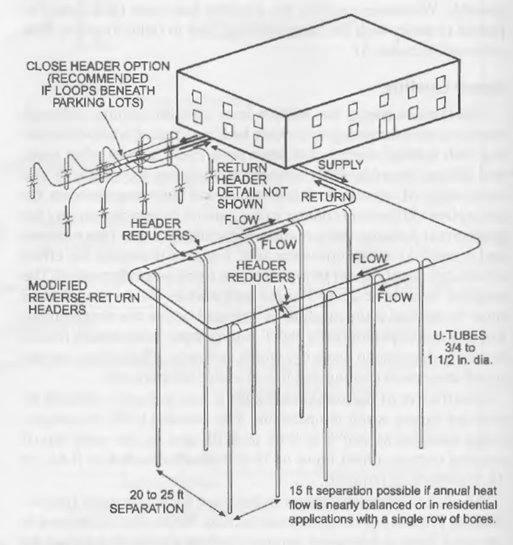
Ground Coupled Heat Pump
Vertical Layout
Pros
Less Space
Maintains Thermal Properties of Ground
Less Pipe
Less Pump Energy
Cons
Expensive
Specialized equipment
Pipe Sizing
6” Diameter Bores
1” Diameter U-Tube
Bore Fill
15% Bentonite, 85% SiO₂
Ground Coupled Heat Pump

Slide 9
Ground Coupled Heat Pump
$$F_{sc}$$ | Short-Circuit Heat Loss Factor
$${PLF}_{m}$$ | Part-Load Factor during Design Month
$$q_{a}$$ | Net Annual Average Heat Transfer to Ground
$$q_{l}$$ | Building Design Block Load
$R_{ga}$, $R_{gd}, R_{gm}$ | Effective Thermal Resistance of Ground
$$R_{b}$$ | Thermal Resistance of Bore
$$t_{g}$$ | Undisturbed Ground Temperature
$$t_{p}$$ | Temperature Penalty for Interference of Adjacent Bores
$t_{wi}$, $t_{wo}$ | Liquid Temperature at Heat Pump
$$W$$ | System Power Input at Design Load
$$L_{c}=\frac{q_{a}R_{ga}+\left(q_{lc}−3.41W_{c}\right)\left(R_{b}+{PLF}_{m}R_{gm}+R_{gd}F_{sc}\right)}{t_{g}−\frac{t_{wi}+t_{wo}}{2}−t_{p}} (1)$$
Ground Coupled Heat Pump
$$L_{h}=\frac{q_{a}R_{ga}+\left(q_{lh}−3.41W_{h}\right)\left(R_{b}+{PLF}_{m}R_{gm}+R_{gd}F_{sc}\right)}{t_{g}−\frac{t_{wi}+t_{wo}}{2}−t_{p}} (2)$$

Slide 10
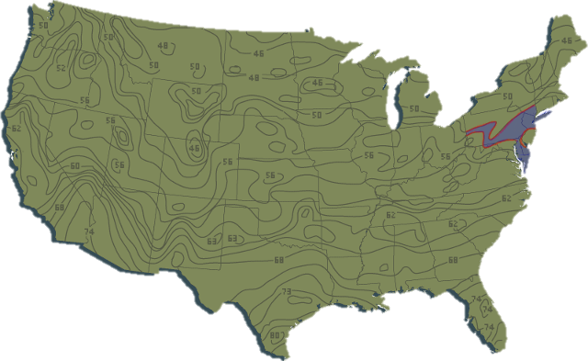
Ground Coupled Heat Pump
Short-Circuit Heat Loss Factor, $F_{sc}$
1 bore/loop + 3 gpm/loop = 1.04 short-circuit heat loss factor
Part-Load Factor during Design Month, ${PLF}_{m}$
Unknown therefore use maximum of 1.0
Building Design Block Load, $q_{lc}$(Cooling), $q_{lh}$(Heating)
Found using block load analysis, 6,125,519 Btu/hr & 0 Btu/hr
Net Annual Average Heat Transfer to Ground, $q_{a}$
Difference between heating and cooling, 6,125,519 Btu/hr
Undisturbed Ground Temperature, $t_{g}$
Ground Coupled Heat Pump
Average Ground Temperature
53°

Slide 11
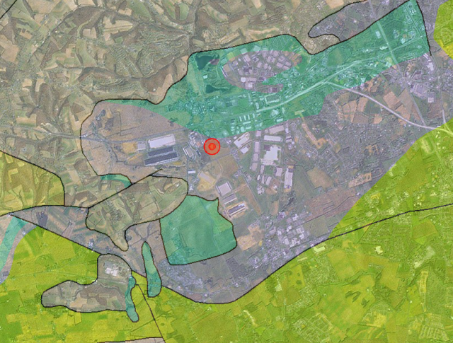
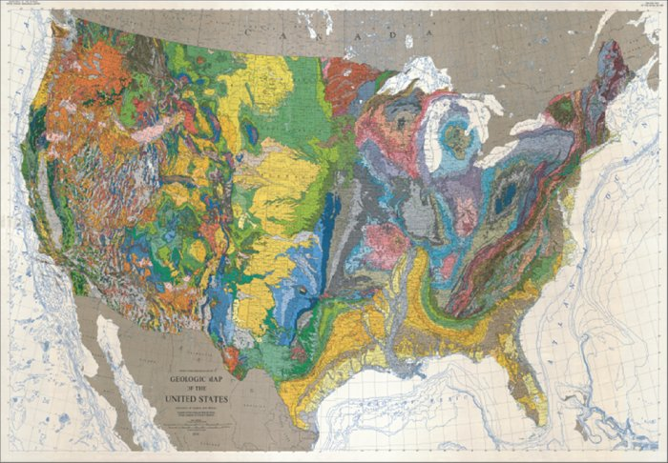
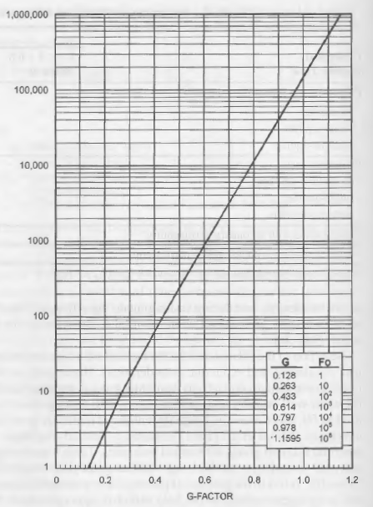
Ground Coupled Heat Pump
Effective Thermal Resistance of Ground, $R_{ga}$ (Annual), $R_{gd}$ (Daily), $R_{gm}$ (Monthly)
Calculate Fourier number
Use table to find G-Factor
Calculate Thermal Resistance
Ground Coupled Heat Pump
Time Pulse | Fourier Number | G-Factor | Thermal Resistance (ft·h·°F/Btu)
Annual | 67,716.6 | 0.94 | 0.211
Monthly | 556.6 | 0.56 | 0.183
Daily Peak | 4.6 | 0.22 | 0.122
Rock Type | Dry Density (lb/ft³) | Conductivity (Btu/h·ft·°F) | Diffusivity (ft²/day)
Limestone | 150 to 175 | 1.4 to 2.2 | 0.9 to 1.4
Average Value | 162.5 | 1.8 | 1.15

Slide 12
Ground Coupled Heat Pump
Thermal Resistance of Bore, $R_{b}$
15% Bentonite 85% SiO₂, 0.10 Btu/h·ft·°F
Temperature Penalty for Interference of Adjacent Bores, $t_{p}$
20 ft spacing results in a penalty of 1.8°F
System Power Input at Design Load, $W_{c}$ (Cooling), $W_{h}$ (Heating)
Based on pump selection, 112,000 W
Liquid Temperature at Heat Pump, $t_{wi}$ (Inlet), $t_{wo}$ (Outlet)
Inlet 20 to 30°F higher for heating, 10 to 20°F lower for cooling
68°F Cooling
38°F Heating
Outlet 10°F increase from inlet
78°FCooling
48°F Heating
Ground Coupled Heat Pump

Slide 13
Ground Coupled Heat Pump
Variable | Cooling Value | Heating Value | Units
$$F_{sc}$$ | 1.04 |  | -
$${PLF}_{m}$$ | 1.0 |  | -
$$q_{a}$$ | 6,125,519 |  | Btu/h
$$q_{l}$$ | 6,125,519 | 0 | Btu/h
$$R_{ga}$$ | 0.211 |  | ft·h·°F/Btu
$$R_{gd}$$ | 0.183 |  | ft·h·°F/Btu
$$R_{gm}$$ | 0.122 |  | ft·h·°F/Btu
$$R_{b}$$ | 0.10 |  | ft·h·°F/Btu
$$t_{g}$$ | 53 |  | °F
$$t_{p}$$ | 1.8 |  | °F
$$t_{wi}$$ | 78 | 38 | °F
$$t_{wo}$$ | 88 | 48 | °F
$$W$$ | 112,000 | 112,000 | W
$$L$$ | 125,020 | 0 | ft
Ground Coupled Heat Pump

Slide 14
Ground Coupled Heat Pump
Head Loss Calculations
 | Length (ft) | Flow Rate (gpm) | Fittings | Equivalent Length (ft) | Head Loss (ft/100ft) | Total Head Loss (ft)
Header | 2800 | 1531 | 6 90° elbows | 66 | 3.5 | 100.31
1 | 100 | 1505 | 2 Tees | 14 | 3.5 | 3.99
2 | 100 | 1480 | 2 Tees | 14 | 3.5 | 3.99
3 | 100 | 1455 | 2 Tees | 14 | 3.5 | 3.99
4 | 100 | 1430 | 2 Tees | 14 | 3.5 | 3.99
5 | 100 | 1405 | 2 Tees | 14 | 3 | 3.42
6 | 100 | 1380 | 2 Tees | 14 | 2.5 | 2.85
⁞ | ⁞ | ⁞ | ⁞ | ⁞ | ⁞ | ⁞
60 | 100 | 25 | 2 Tees | 14 | 0.7 | 0.798
Total |  |  |  |  |  | 203.252
 | Length (ft) | Multiplicity | Total Length (ft) | Head Loss (ft/100 ft) | Total Head Loss (ft)
Bore | 400 | 2 | 800 | 2.5 | 20
Longest Branch | 20 | 60 | 1200 | 2.5 | 30
Tee-Fittings | 7 | 2 | 14 | 2.5 | 0.35
Elbows | 3.5 | 4 | 14 | 2.5 | 0.35
Total |  |  |  |  | 50.7
Ground Coupled Heat Pump

Slide 15
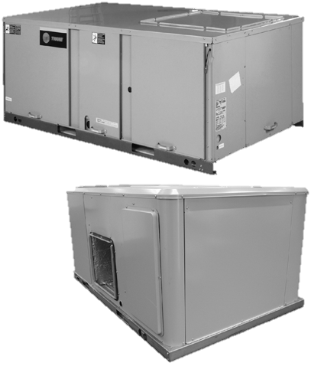
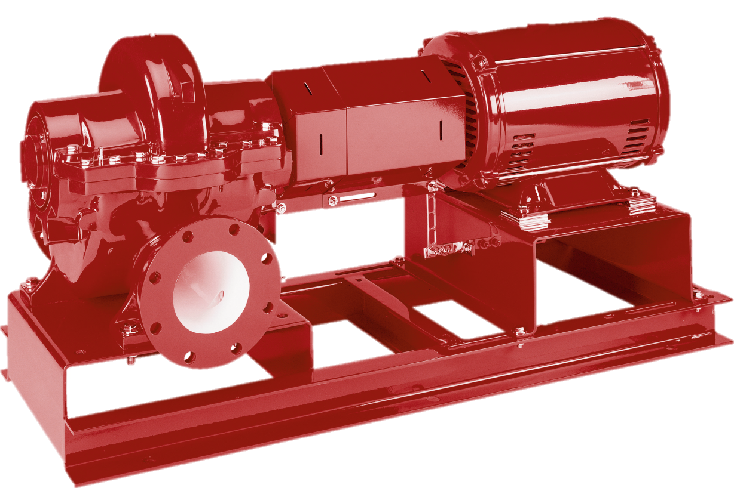
Ground Coupled Heat Pump
Pump
Heat Pump
21 Rooftop Units
Twenty 25 ton
One 10 ton
Manufacturer | Bell & Gossett
Model | 4x6x10M HSC³
Flow Rate (gpm) | 1531
Head (ft) | 254
Impeller Diameter (in) | 8.3
RPM | 3565
HP | 150
Ground Coupled Heat Pump

Slide 16
Cost Analysis
Month | Original Energy (kWh) | GCHP Energy (kWh) | Difference (kWh)
January | 2,275,032 | 1,713,184 | 561,848
February | 2,056,716 | 1,547,770 | 508,946
March | 2,285,022 | 1,707,854 | 577,168
April | 2,228,204 | 1,654,628 | 573,576
May | 2,344,024 | 1,729,509 | 614,515
June | 2,291,104 | 1,690,252 | 600,852
July | 2,390,752 | 1,765,344 | 625,408
August | 2,389,709 | 1,764,376 | 625,333
September | 2,273,169 | 1,677,335 | 595,834
October | 2,319,265 | 1,715,919 | 603,346
November | 2,223,874 | 1,655,288 | 568,586
December | 2,277,362 | 1,712,482 | 564,880
Largest Difference |  |  | 116,462
Average Value |  |  | 585,024
Cost Analysis

Slide 17
Cost Analysis
Design | Energy Usage (kWh) | Electric Cost
Original | 27,354,230 | $ 2,065,428
Ground Source Heat Pump | 19,201,080 | $ 1,449,730
Difference | 8,153,150 | $ 615,698
Cost Analysis

Slide 18
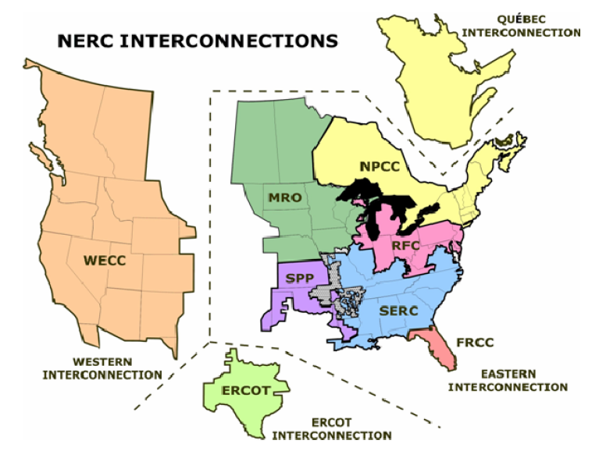
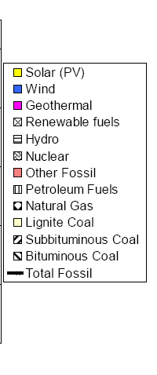
Emissions Analysis
Pollutant | Regional Grid Emission Factors 2007 (lb/kWh) | Calculated Emissions (lb/year) |  | Reduction in Emissions
 |  | Original | GCHP
CO2_{e} | 1.74E+00 | 3.96E+06 | 2.98E+06 | 25%
CO₂ | 1.64E+00 | 3.37E+06 | 2.54E+06 | 25%
CH₄ | 3.59E-03 | 8.20E+03 | 6.13E+03 | 25%
N₂O | 3.87E-05 | 8.62E+01 | 6.40E+01 | 26%
NO_{X} | 3.00E-03 | 7.03E+03 | 5.19E+03 | 26%
SO_{X} | 8.57E-03 | 1.96E+04 | 1.45E+04 | 26%
CO | 8.54E-04 | 2.04E+03 | 1.51E+03 | 26%
TNMOC | 7.26E-05 | 1.73E+02 | 1.28E+02 | 26%
Lead | 1.39E-07 | 3.16E-01 | 2.33E-01 | 26%
Mercury | 3.36E-08 | 7.79E-02 | 5.77E-02 | 26%
PM10 | 9.26E-05 | 2.06E+02 | 1.53E+02 | 26%
Solid Waste | 2.05E-01 | 4.67E+05 | 3.51E+05 | 25%
Emissions Analysis

Slide 19
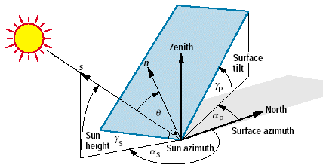
Photovoltaic Design
33°
25°
Photovoltaic Design

Slide 20
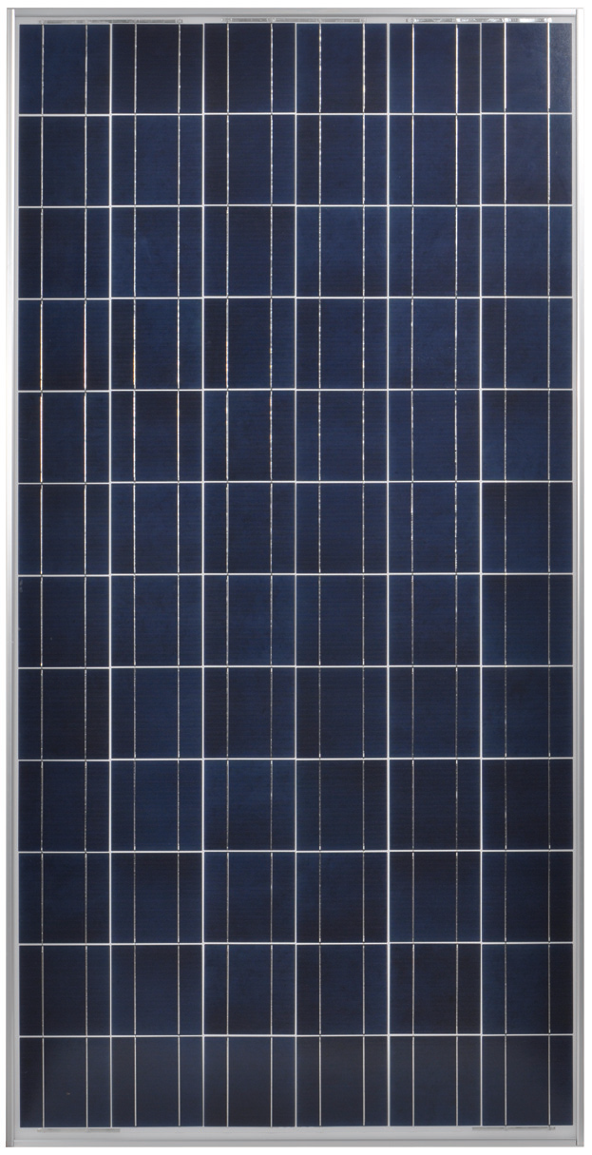
Photovoltaic Design
Sharp ND-F4Q300 Electrical Characteristics
Maximum Power (P_{max}) | 300 W
Open Circuit Voltage (V_{oc}) | 45.1 V
Maximum Power Voltage (V_{pm}) | 35.2 V
Short Circuit Current (I_{sc}) | 8.94 A
Maximum Power Current (I_{pm}) | 8.52 A
Module Efficiency (%) | 15.3%
Maximum System (DC) Voltage | 1000 V
Temperature Coefficient (P_{max}) | -0.439%/°C
Temperature Coefficient (V_{oc}) | -0.321%/°C
Temperature Coefficient (I_{sc}) | 0.050%/°C
Panel Length | Panel Width | Array Tilt Angle | Height From Ground | Horizontal Length | Distance Between Panels | Row Spacing
39.1 in | 77.6 in | 33° | 21.3 in | 32.8 in | 63.9 in | 96.7 in
Photovoltaic Design
h
h

Slide 21
Photovoltaic Design
Month | Beam Incident Radiation (kWh/m2) | Total Incident Radiation (kWh/m2) | Net DC Output (kWh) | Net AC Output (kWh)
January | 55.95 | 90.61 | 50,402 | 41,602
February | 50.55 | 97.46 | 84,698 | 75,567
March | 76.06 | 134.88 | 154,112 | 142,010
April | 79.07 | 146.97 | 226,988 | 212,703
May | 77.37 | 153.18 | 274,686 | 258,784
June | 69.07 | 151.30 | 275,015 | 259,367
July | 83.74 | 163.15 | 295,087 | 278,953
August | 80.86 | 152.08 | 237,668 | 223,063
September | 74.28 | 134.93 | 165,337 | 153,409
October | 76.37 | 124.04 | 93,685 | 83,602
November | 43.55 | 80.11 | 55,004 | 46,542
December | 50.17 | 79.11 | 42,569 | 34,245
Photovoltaic Design

Slide 22
Photovoltaic Design
 | # of units | kW/unit | kW | $/W | Total
Module | 7695 | 0.3 | 2307.76 | 2.05 | $ 4,730,910.62
Inverter | 5 | 500 | 2500 | 0.37 | $ 925,000.00
Balancing | - | - | - | 0.43 | $ 992,337.3
Installation Labor | - | - | - | 0.48 | $ 1,107,725.41
Margin And Overhead | - | - | - | 0.81 | $ 1,869,286.64
Permitting | - | - | - | 0.23 | $ 530,785.09
Grid Interconnection | - | - | - | 0.01 | $ 23,077.61
Total |  |  |  | $ 4.62 | $ 10,660,385.73
Payback Period
Infinite
Photovoltaic Design

Slide 23
Acoustical Design
Duration Per Day (h) | Sound Level (dBA)
8 | 90
6 | 92
4 | 95
3 | 97
2 | 100
1 ½ | 102
1 | 105
½ | 110
¼ or less | 115
Acoustical Design

Slide 24
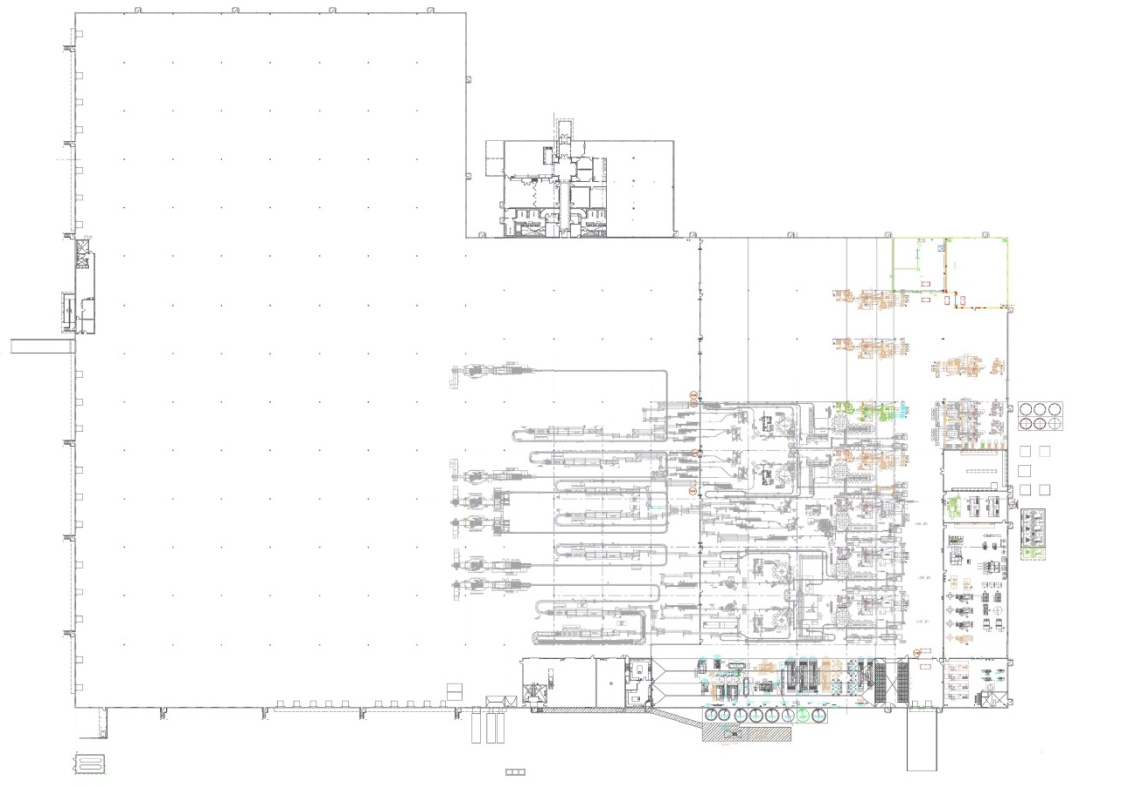
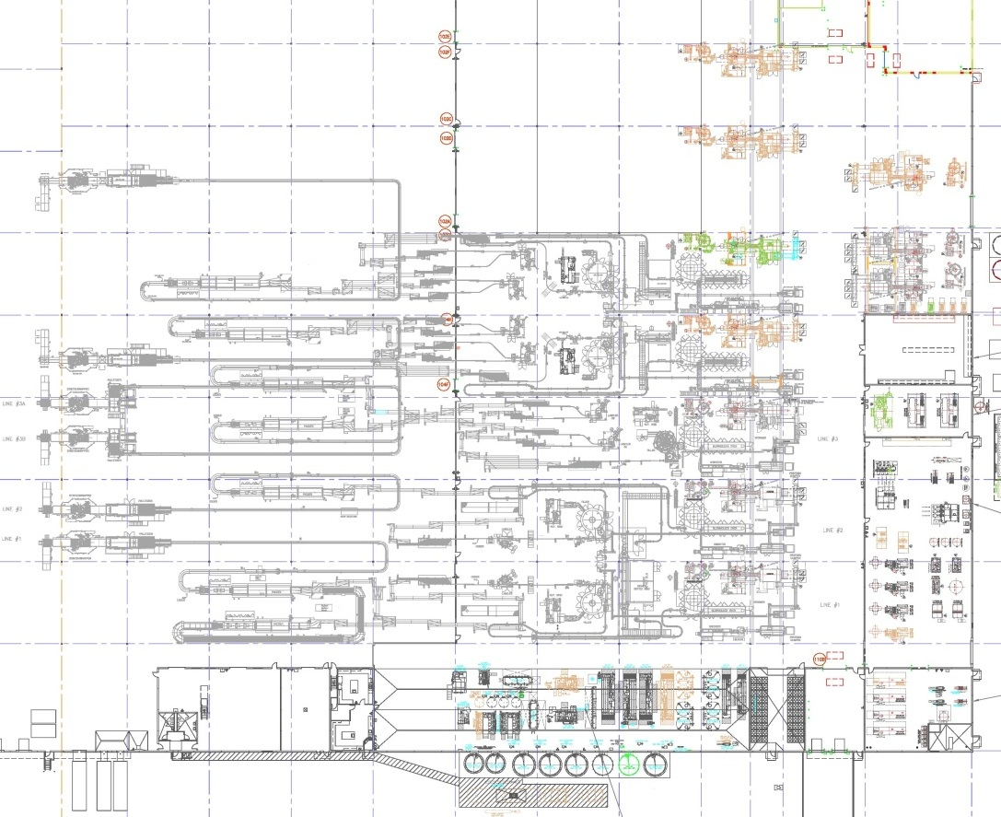
Acoustical Design
73
76
80
77
84
86
86
87
82
81
81
84
88
87
88
88
87
 | SL < 87 dBA
 | 87dBA ≤ SL <90 dBA
 | SL ≥ 90 dBA
81
85
87
93
83
88
89
91
89
87
86
72
81
89
89
89
90
91
101
80
87
87
87
91
90
89
91
86
80
90
90
90
91
86
91
Acoustical Design
79
88
89
92
96
85
87
89
89
88
86
85
70
80

Slide 25
Acoustical Design
Step 1: Determine Surface Area
Step 2: Determine Overall Acoustical Character
Surface | Dimensions (ft) | Number of Surfaces | Area (ft²)
Walls | 23.5 x 315 23.5 x 439 | 2 2 | 14,805 20,633
Floor | 315 x 439 | 1 | 138,285
Ceiling | 315 x 439 | 1 | 138,285
Total |  |  | 312,008
Surface | Acoustical Characteristic
Walls: | Hard x 5 (Concrete) Medium x 1 (Stacked Pallets)
Floor: | Hard (Concrete)
Ceiling: | Hard (Steel)
Combined Characteristic: | Medium Hard
Acoustical Design

Slide 26
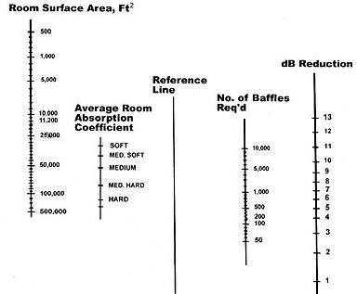
Acoustical Design
Steps 3-5: Plot Information from Previous Steps on Nomogram
Quality | Results
Room Surface Area (ft²) | 312,008
Average Room Absorption Coefficient | Medium Hard
dB Reduction (dBA) | 10
Number of Baffles Required | 6,000
Acoustical Design

Slide 27
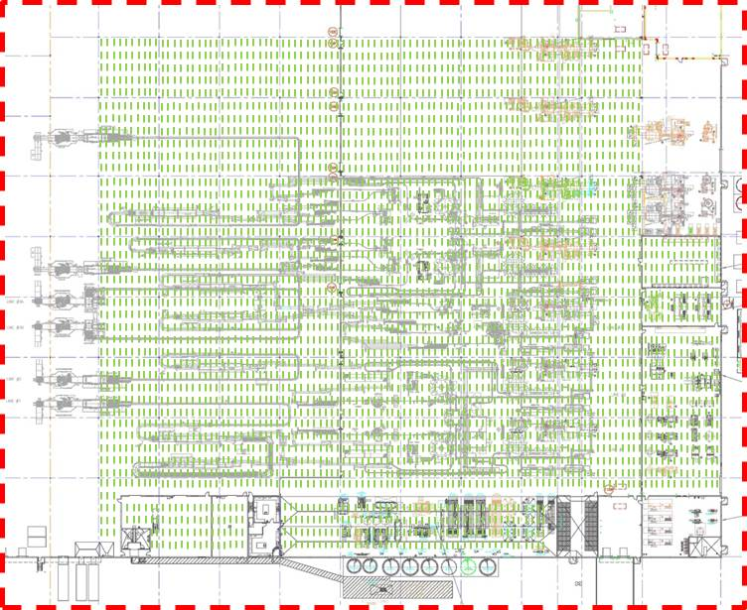
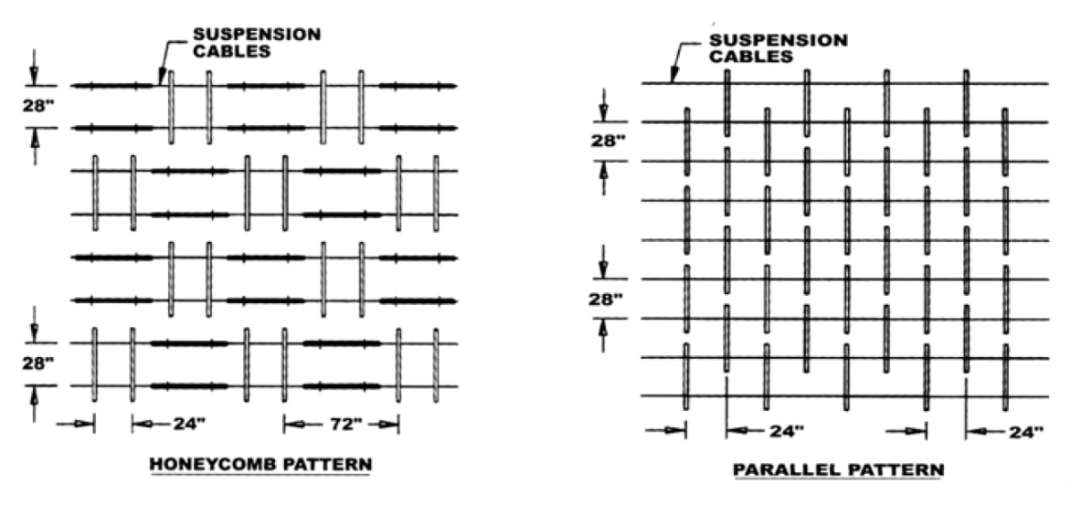
Acoustical Design
Acoustical Design

Slide 28
Conclusion
Ground Coupled Heat Pump
Save Money
Reduce Emissions
Photovoltaics
Not Feasible
Acoustics
Able to reduce the Sound Level by 10 dBA
Conclusion

Slide 29
Acknowledgements
Thank You!
AE Professors, Advisors, & Staff
The Water Bottling Facility
Jack, Ron, & Chris
My Parents & Family
My Friends & Classmates
Conclusion

Slide 30
References
"Copper Roof Vents and Steel Roof Caps for Exhaust by Luxury Metals." Copper Roof Vents and Steel Roof Caps for Exhaust by Luxury Metals. 03 Mar. 2013 <http://www.luxurymetals.com/roofcaps.html>.
Deru, M. and P Torcellini, Source Energy and Emission Factors for Energy Use in Buildings. Technical Report NREL/TP-550-38617
"Energy.gov." Geothermal Heat Pumps. N.p., 24 June 2012. Web. 17 Dec. 2012.
"Geothermal Heating Contractor for Massachusetts and surrounding area." Geothermal Heating Contractor for Massachusetts and surrounding area. 03 Mar. 2013 <http://www.geosundesign.com/Deep_Earth_Temperature_Map.html>.
"Index of /images/Geologic." Index of /images/Geologic. 03 Mar. 2013 <http://mapagents.com/images/Geologic/>.
McDowall, Robert, and Ross Montgomery. Fundamentals of HVAC control systems. Atlanta, GA: American Society of Heating, Refrigerating and Air-Conditioning Engineers, 2011.
"Occupational Noise Exposure - 1910.95." OSHA.gov. OSHA, n.d. Web. 17 Dec. 2012.
"PA DCNR Map Viewer." PA DCNR Map Viewer. 03 Mar. 2013 <http://www.gis.dcnr.state.pa.us/maps/index.html?geology=true>.
"Pump manufacturer representatives, commercial pumps, residential pumps, submersible pumps, circulators, heating pumps, chiller pumps, condenser pumps." 04 Mar. 2013 <http://bell-gossett.com/pumpsbg.htm>.
"Rooftop WSHP." DX Unitary HVAC System. 04 Mar. 2013 <http://www.trane.com/COMMERCIAL/Dna/View.aspx?i=1122>.
"Solar PV Tilt Angle Graph." PV System Tilt Angle Graph. 09 Apr. 2013 <http://www.mrsolar.com/content/pv_tilt_angle.php>.
Haskel Architects and Engineers Engineering Reports
Water Bottling Facility Specifications and Images
Conclusion

Slide 31
Questions?
Conclusion

