Slide 1
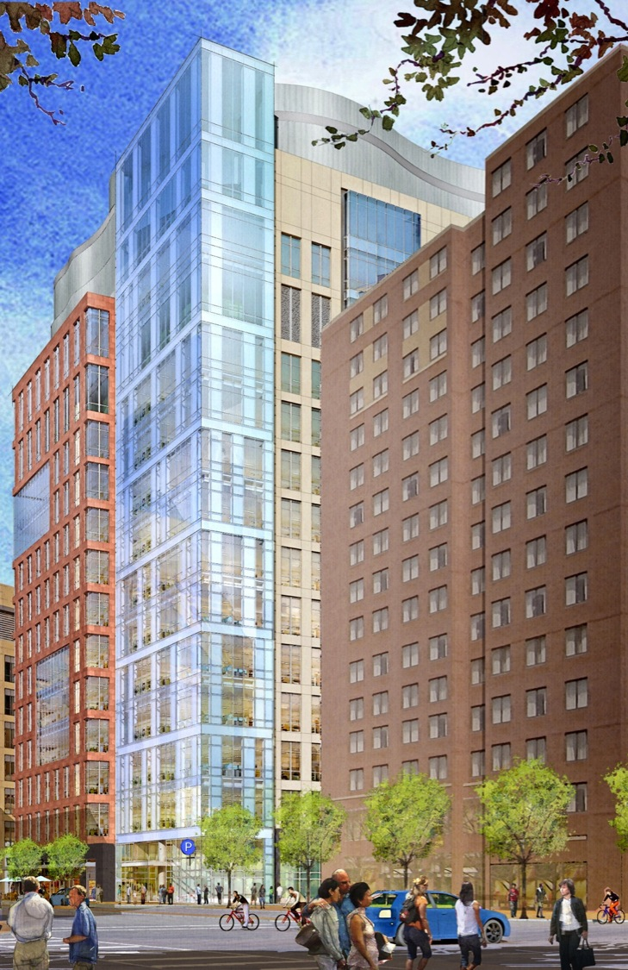
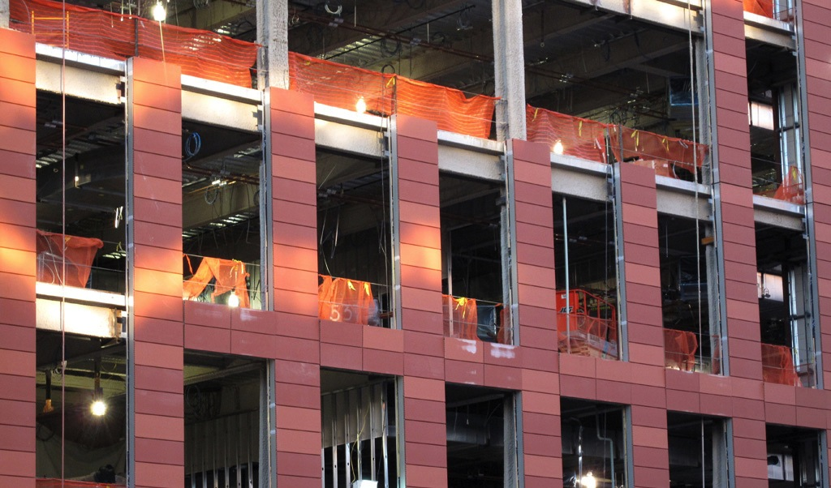

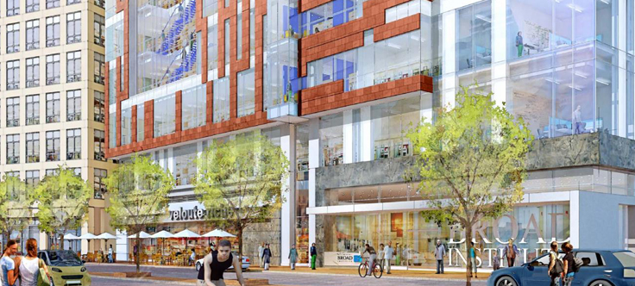


75 Ames Street:
Cambridge, Massachusetts
INTRODUCTION
DEPTH I
DEPTH II
DEPTH III
BREADTH I
CONCLUSION
ACKNOWLEDGEMENTS
QUESTIONS
Nate Mooney | Mechanical Option
Advisor: William P. Bahnfleth, PH.D., PE
The Pennsylvania State University
Architectural Engineering
Spring 2013

Slide 2
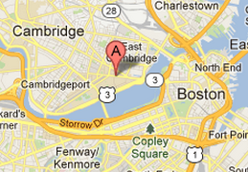
75 Ames Street:
Nathaniel Mooney
BUILDING OVERVIEW
[COST] $188,000,000 Building Cost
[CONSTRUCTION] January 2012 → Early 2014
INTRODUCTION
Building Overview
Existing Mechanical
DEPTH I
DEPTH II
DEPTH III
BREADTH I
CONCLUSION
ACKNOWLEDGEMENTS
QUESTIONS
[SIZE] 250,000 SF
[LEVELS] 15 STORYS
GROUND FLOOR – RETAIL
L-11 – MIXED OFFICES & LABS
L-12 – VIVARIUM
3 MECHANICAL LEVELS M1,M2 & M3
[OCCUPANCY] Mixed Assembly
Restaurant | A-2
Large Conference & Meeting Rooms | A-3
Small Conference & Offices | B
Retail Tenant | M
Laboratory | H-2, H-3, H-4 High Hazard
[LOCATION] 75 Ames Street, Cambridge Massachusetts
The Broad Institute Expansion

Slide 3
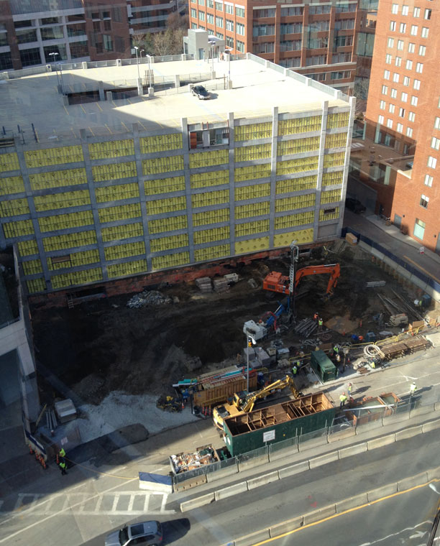
75 Ames Street:
Nathaniel Mooney
BUILDING OVERVIEW
[COST] $188,000,000 Building Cost
[CONSTRUCTION] January 2012 → Early 2014
INTRODUCTION
Building Overview
Existing Mechanical
DEPTH I
DEPTH II
DEPTH III
BREADTH I
CONCLUSION
ACKNOWLEDGEMENTS
QUESTIONS
[SIZE] 250,000 SF
[LEVELS] 15 STORYS
GROUND FLOOR – RETAIL
L-11 – MIXED OFFICES & LABS
L-12 – VIVARIUM
3 MECHANICAL LEVELS M1,M2 & M3
[OCCUPANCY] Mixed Assembly
Restaurant | A-2
Large Conference & Meeting Rooms | A-3
Small Conference & Offices | B
Retail Tenant | M
Laboratory | H-2, H-3, H-4 High Hazard
[LOCATION] 75 Ames Street, Cambridge Massachusetts
The Broad Institute Expansion

Slide 4
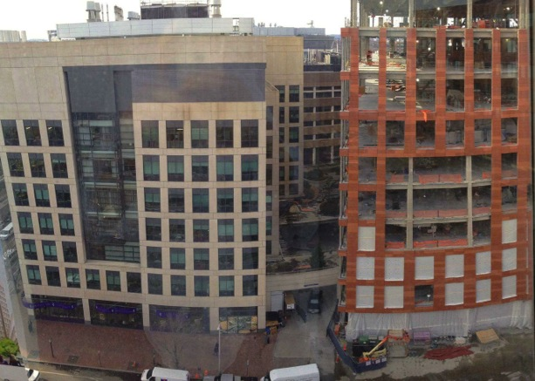
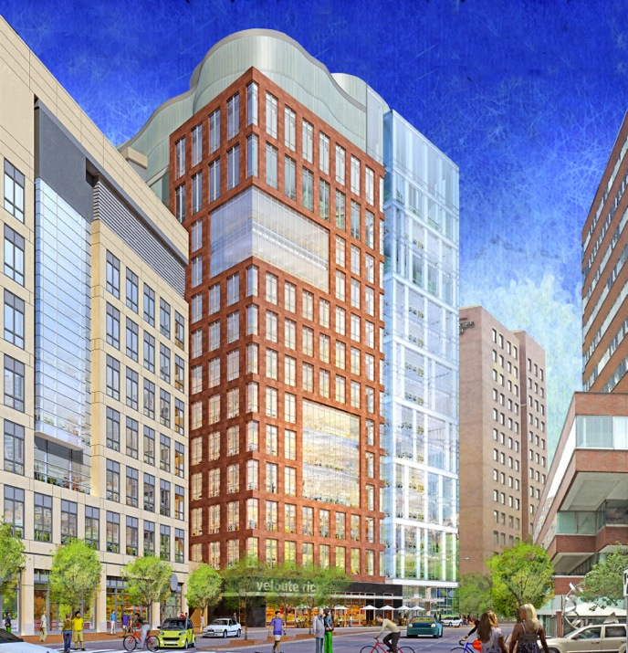
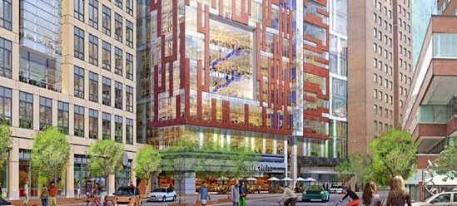
75 Ames Street:
Nathaniel Mooney
BUILDING OVERVIEW
[COST] $188,000,000 Building Cost
[CONSTRUCTION] January 2012 → Early 2014
INTRODUCTION
Building Overview
Existing Mechanical
DEPTH I
DEPTH II
DEPTH III
BREADTH I
CONCLUSION
ACKNOWLEDGEMENTS
QUESTIONS
[SIZE] 250,000 SF
[LEVELS] 15 STORYS
GROUND FLOOR – RETAIL
L-11 – MIXED OFFICES & LABS
L-12 – VIVARIUM
3 MECHANICAL LEVELS M1,M2 & M3
[OCCUPANCY] Mixed Assembly
Restaurant | A-2
Large Conference & Meeting Rooms | A-3
Small Conference & Offices | B
Retail Tenant | M
Laboratory | H-2, H-3, H-4 High Hazard
[LOCATION] 75 Ames Street, Cambridge Massachusetts
The Broad Institute Expansion

Slide 5
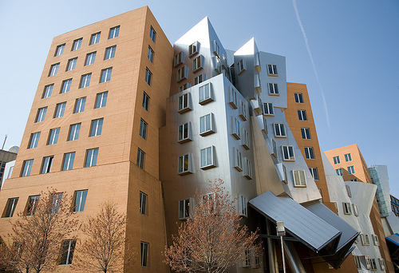
75 Ames Street:
Nathaniel Mooney
BUILDING OVERVIEW
[COST] $188,000,000 Building Cost
[CONSTRUCTION] January 2012 → Early 2014
INTRODUCTION
Building Overview
Existing Mechanical
DEPTH I
DEPTH II
DEPTH III
BREADTH I
CONCLUSION
ACKNOWLEDGEMENTS
QUESTIONS
[SIZE] 250,000 SF
[LEVELS] 15 STORYS
GROUND FLOOR – RETAIL
L-11 – MIXED OFFICES & LABS
L-12 – VIVARIUM
3 MECHANICAL LEVELS M1,M2 & M3
[OCCUPANCY] Mixed Assembly
Restaurant | A-2
Large Conference & Meeting Rooms | A-3
Small Conference & Offices | B
Retail Tenant | M
Laboratory | H-2, H-3, H-4 High Hazard
[LOCATION] 75 Ames Street, Cambridge Massachusetts
The Broad Institute Expansion
Frank Gehry – Ray & Maria Center at MIT

Slide 6
75 Ames Street:
Nathaniel Mooney
Existing Mechanical System
INTRODUCTION
Building Overview
Existing Mechanical
DEPTH I
DEPTH II
DEPTH III
BREADTH I
CONCLUSION
ACKNOWLEDGEMENTS
QUESTIONS
[AIR SIDE]
    100% Outside Air
      4 – Ganged 115,000 CFM AHU’s
          Basement → L-11
      1 – 60,000 CFM AHU
          Vivarium L-12
      2 – 230,000 CFM EAHU
      VAV Box with terminal reheat
The Broad Institute Expansion
Exhaust Air Handling Units
Air Handling Units

Slide 7
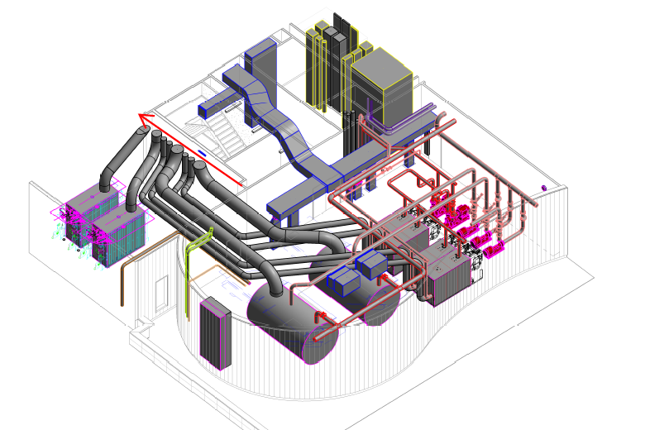
75 Ames Street:
Nathaniel Mooney
Existing Mechanical System
INTRODUCTION
Building Overview
Existing Mechanical
DEPTH I
DEPTH II
DEPTH III
BREADTH I
CONCLUSION
ACKNOWLEDGEMENTS
QUESTIONS
[WATER SIDE]
Heating Plant
        2 - 500 BHP Preheat fire-tube Boilers
          AHU 1,2,3,4,5 preheat
          HVU’s
        4 – 120 BHP Reheat Condensing Boilers
          Building terminal reheat
        2 – 215 BHP MPS Boilers
          60 PSIG
          Humidification
          Process steam loads
The Broad Institute Expansion

Slide 8
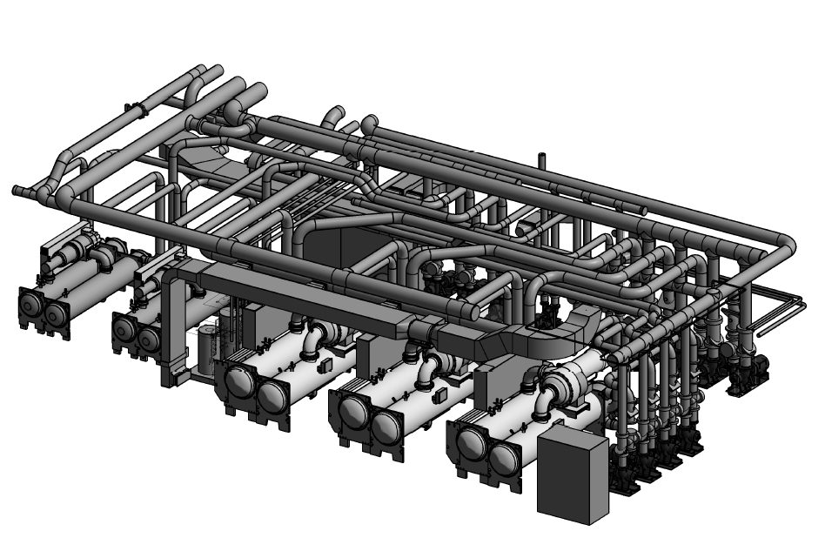
75 Ames Street:
Nathaniel Mooney
Existing Mechanical System
INTRODUCTION
Building Overview
Existing Mechanical
DEPTH I
DEPTH II
DEPTH III
BREADTH I
CONCLUSION
ACKNOWLEDGEMENTS
QUESTIONS
[WATER SIDE]
Chiller Plant
      42 °F water
        3 – 1000 ton centrifugal chillers
          3 – 1000 ton cooling towers on VFD
          AHU 1,2,3 & 4 cooling
        2 – 450 ton centrifugal chillers
          2 – 450 ton cooling towers on VFD
          AHU 5
          Process chilled water loads
The Broad Institute Expansion

Slide 9
Demand Controlled Ventilation with Aircuity’s Optinet System
75 Ames Street:
Nathaniel Mooney
INTRODUCTION
DEPTH I
GOAL
OPERATION
RESULTS
COST & SAVINGS
EMISSIONS
DEPTH II
DEPTH III
BREADTH I
CONCLUSION
ACKNOWLEDGEMENTS
QUESTIONS
[GOAL]
Turn down ventilation air in order to save energy while maintaining appropriate room conditions.
The Broad Institute Expansion

Slide 10
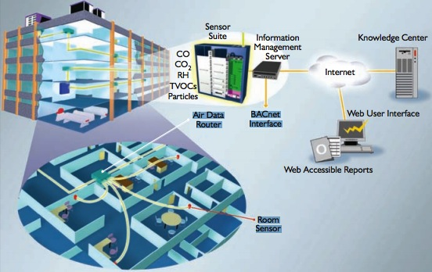
Demand Controlled Ventilation with Aircuity’s Optinet System
75 Ames Street:
Nathaniel Mooney
INTRODUCTION
DEPTH I
GOAL
OPERATION
RESULTS
COST & SAVINGS
EMISSIONS
DEPTH II
DEPTH III
BREADTH I
CONCLUSION
ACKNOWLEDGEMENTS
QUESTIONS
[HOW IT WORKS]
Typical lab rooms are supplied with 6/12ACH
Aircuity allows air change rates of 2/4ACH
    15-20 rooms every 15 minutes
        Photoionization ~ Ammonia
        Metal Oxide detector
        Lasers
        CO₂ Sensors
        Dew point
    Dilution ventilation up to 15 ACH
        Labs clean of contaminants 99% of time
The Broad Institute Expansion

Slide 11
Demand Controlled Ventilation with Aircuity’s Optinet System
75 Ames Street:
Nathaniel Mooney
INTRODUCTION
DEPTH I
GOAL
OPERATION
RESULTS
COST & SAVINGS
EMISSIONS
DEPTH II
DEPTH III
BREADTH I
CONCLUSION
ACKNOWLEDGEMENTS
QUESTIONS
Energy Usage |  | Original System VAV Reheat |  | Alternate DCV
 |  | Electric KWH | Gas Therms | Electric KWH | Gas Therms
 | Jan | 721,666 | 17,302 | 630,014 | 18,918
 | Feb | 654,882 | 16,453 | 571,874 | 18,323
 | Mar | 791,432 | 10,610 | 694,572 | 10,289
 | Apr | 746,783 | 6,680 | 659,139 | 4,954
 | May | 894,909 | 6,230 | 811,156 | 4,473
 | June | 978,922 | 4,318 | 923,273 | 3,839
 | July | 962,894 | 1,243 | 947,253 | 3,007
 | Aug | 1,040,655 | 3,556 | 987,417 | 3,922
 | Sept | 847,768 | 6,004 | 766,895 | 4,229
 | Oct | 895,855 | 7,054 | 800,672 | 4,943
 | Nov | 771,446 | 8,173 | 664,497 | 6,118
 | Dec | 678,311 | 19,423 | 602,751 | 22,206
 | Total | 9,985,524 | 107,047 | 9,059,513 | 105,222
 |  |  | Difference
 |  |  | Electrical KWH | Gas Therms
 |  |  | -926,011 | -1,825
[RESULTS]
Using Trane TRACE 700 and the new ventilation rates of 2/4 ACH for a group of 32 select lab rooms
 | Electricity (KWH) | Natural Gas (Therms) | Electricity Cost Per Year | Natural Gas Cost Per Year | Total Cost Per Year
Original System | 9985524.00 | 107047.00 | $ 2,007090.32 | $ 170,954.06 | $ 2,178,044.38
DCV | 9,059,513.00 | 105,222.00 | $ 1,820,962.11 | $ 168,039.53 | $ 1,989,001.65
Difference | 926,011.00 | 1,825.00 | $ 186,128.21 | $ 2,914.53 | $ 189,042.74
 |  |  |  | % Change | -9%
The Broad Institute Expansion

Slide 12
Demand Controlled Ventilation with Aircuity’s Optinet System
75 Ames Street:
Nathaniel Mooney
INTRODUCTION
DEPTH I
GOAL
OPERATION
RESULTS
COST & SAVINGS
EMISSIONS
DEPTH II
DEPTH III
BREADTH I
CONCLUSION
ACKNOWLEDGEMENTS
QUESTIONS
[RESULTS]
Using Trane TRACE 700 and the new ventilation rates of 2/4 ACH for a group of 32 select lab rooms
 | Electricity (KWH) | Natural Gas (Therms) | Electricity Cost Per Year | Natural Gas Cost Per Year | Total Cost Per Year
Original System | 9985524.00 | 107047.00 | $ 2,007090.32 | $ 170,954.06 | $ 2,178,044.38
DCV | 9,059,513.00 | 105,222.00 | $ 1,820,962.11 | $ 168,039.53 | $ 1,989,001.65
Difference | 926,011.00 | 1,825.00 | $ 186,128.21 | $ 2,914.53 | $ 189,042.74
 |  |  |  | % Change | -9%
The Broad Institute Expansion

Slide 13
Demand Controlled Ventilation with Aircuity’s Optinet System
75 Ames Street:
Nathaniel Mooney
INTRODUCTION
DEPTH I
GOAL
OPERATION
RESULTS
COST & SAVINGS
EMISSIONS
DEPTH II
DEPTH III
BREADTH I
CONCLUSION
ACKNOWLEDGEMENTS
QUESTIONS
[RESULTS]
Using Trane TRACE 700 and the new ventilation rates of 2/4 ACH for a group of 32 select lab rooms
 | Electricity (KWH) | Natural Gas (Therms) | Electricity Cost Per Year | Natural Gas Cost Per Year | Total Cost Per Year
Original System | 9985524.00 | 107047.00 | $ 2,007090.32 | $ 170,954.06 | $ 2,178,044.38
DCV | 9,059,513.00 | 105,222.00 | $ 1,820,962.11 | $ 168,039.53 | $ 1,989,001.65
Difference | 926,011.00 | 1,825.00 | $ 186,128.21 | $ 2,914.53 | $ 189,042.74
 |  |  |  | % Change | -9%
The Broad Institute Expansion

Slide 14
Demand Controlled Ventilation with Aircuity’s Optinet System
75 Ames Street:
Nathaniel Mooney
INTRODUCTION
DEPTH I
GOAL
OPERATION
RESULTS
COST & SAVINGS
EMISSIONS
DEPTH II
DEPTH III
BREADTH I
CONCLUSION
ACKNOWLEDGEMENTS
QUESTIONS
[COSTS & SAVINGS]
First Cost Estimate:
      Typically budgeted at $5,000 per space
      32 spaces
      $160,000
      Optional:
        $20,963 / Year Maintenance
        1st year waived
Payback
      Annual savings = 189,042.74
      0.85 Year payback
2.5% Inflation
10 Year Life Cycle Cost Analysis
YEAR | Original System VAV Reheat | DCV - Aircuity Alternate | Savings | With Maintanance First Year Free | Savings
0 | $- | $160,000.00 | $(160,000.00) | $160,000.00 | $(160,000.00)
1 | $2,123,593.27 | $2,095,276.61 | $28,316.67 | $2,095,276.61 | $28,316.67
2 | $4,141,006.88 | $3,933,689.38 | $207,317.50 | $3,953,617.33 | $187,389.55
3 | $6,056,222.57 | $5,678,871.97 | $377,350.60 | $5,717,731.48 | $338,491.09
4 | $7,873,089.34 | $7,334,336.87 | $538,752.46 | $7,391,168.90 | $481,920.44
5 | $9,595,327.63 | $8,903,479.24 | $691,848.39 | $8,977,360.87 | $617,966.76
6 | $11,226,533.33 | $10,389,580.52 | $836,952.80 | $10,479,623.77 | $746,909.56
7 | $12,770,181.66 | $11,795,812.07 | $974,369.59 | $11,901,162.66 | $869,018.99
8 | $14,229,630.99 | $13,125,238.55 | $1,104,392.44 | $13,245,074.85 | $984,556.14
9 | $15,608,126.49 | $14,380,821.32 | $1,227,305.17 | $14,514,353.20 | $1,093,773.29
10 | $16,908,803.70 | $15,565,421.68 | $1,343,382.02 | $15,711,889.46 | $1,196,914.24
The Broad Institute Expansion

Slide 15
Demand Controlled Ventilation with Aircuity’s Optinet System
75 Ames Street:
Nathaniel Mooney
INTRODUCTION
DEPTH I
GOAL
OPERATION
RESULTS
COST & SAVINGS
EMISSIONS
DEPTH II
DEPTH III
BREADTH I
CONCLUSION
ACKNOWLEDGEMENTS
QUESTIONS
[EMISSIONS]
ENVIRONMENTAL IMPACT
 | Unit | Original System VAV Reheat | DCV - Aircuity Alternate | % Change | Difference
CO2 | lbm/yr | 876,396,480 | 795,123,520 | -9.27% | 81,272,960
SO2 | gm/yr | 2,742,078 | 2,487,791 | -9.27% | 254,287
NOX | gm/yr | 742,165 | 673,340 | -9.27% | 68,825
The Broad Institute Expansion

Slide 16
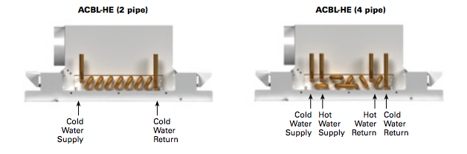
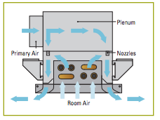
75 Ames Street:
Nathaniel Mooney
Chilled Beams Alternate
INTRODUCTION
DEPTH I
DEPTH II
GOAL
OPERATION
RESULTS
COST & SAVINGS
EMISSIONS
DEPTH III
BREADTH I
CONCLUSION
ACKNOWLEDGEMENTS
QUESTIONS
[GOAL]
To reduce energy consumption and carbon footprint compared to the original system by lowing supply air rates and need for reheat.
The Broad Institute Expansion

Slide 17
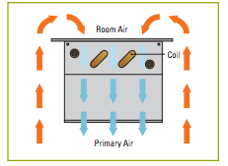
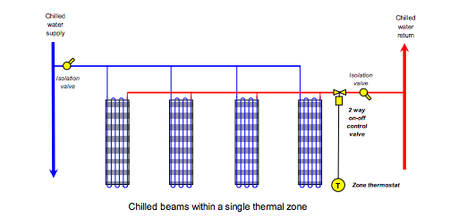
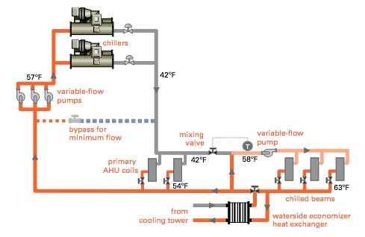
75 Ames Street:
Nathaniel Mooney
Chilled Beams Alternate
INTRODUCTION
DEPTH I
DEPTH II
GOAL
OPERATION
RESULTS
COST & SAVINGS
EMISSIONS
DEPTH III
BREADTH I
CONCLUSION
ACKNOWLEDGEMENTS
QUESTIONS
[OPERATION]
  Determine Sensible and Latent Loads for Space
      TRANE TRACE 700
  Air Flow Rate For Space
      V_{bz}= Rp * Pz + Ra * Az
      Office 5 cfm / person & .06 cfm/ft²
      Lab 10 cfm / person & 18 cfm/ft²
  Cooling Capacity of Air
      Humidity Ratio w_{supply}= 0.007997 lb_{w}/lb_{DA}
  w_{room} = 0.009233 lb_{w}/lb_{DA}
      Q_{latent} = 4840 V_{bz} (w_{room} – w_{supply})
  4) Required Supply Air To Remove Latent
      Q_{latent} = 4840 V_{bz_new} (w_{room}- w_{supply})
      This gives a new sensible capacity of
Q_{sensible}= 1.08 V_{bz_new} (T_{room}- T_{supply})
  5) Sensible Load for Chilled Beams
      Sensible load from Trace minus Q_{sens} above
  6) Size & Quantity
      From PRICE-HVAC catalogue
The Broad Institute Expansion

Slide 18
75 Ames Street:
Nathaniel Mooney
Chilled Beams Alternate
INTRODUCTION
DEPTH I
DEPTH II
GOAL
OPERATION
RESULTS
COST & SAVINGS
EMISSIONS
DEPTH III
BREADTH I
CONCLUSION
ACKNOWLEDGEMENTS
QUESTIONS
[RESULTS]
Unit | Type | Quantity | CFM | Min SP | HP | RPM
EXISTING
AHU1 | plenum | 4 | 28750 | 7.5 | 75 | 1750
AHU2 | plenum | 4 | 28750 | 7.5 | 75 | 1750
AHU3 | plenum | 4 | 28750 | 7.5 | 75 | 1750
AHU4 | plenum | 4 | 28750 | 7.5 | 75 | 1750
AHU5 | plenum | 4 | 15000 | 7.5 | 50 | 1750
EAHU1 | Cent. | 5 | 57,500 | 5.3 | 100 | 770
EAHU2 | Cent. | 5 | 57,500 | 5.3 | 100 | 770
EAHU3 | Cent. | 3 | 30000 | 4.5 | 50 | 1132
REDESIGN
AHU1 | plenum | 4 | 30516 | 7.5 | 89.76 | 1858
AHU2 | plenum | 4 | 30516 | 7.5 | 89.76 | 1858
AHU3 | plenum | 4 | 30516 | 7.5 | 89.76 | 1858
AHU5 | plenum | 4 | 15000 | 7.5 | 50 | 1750
EAHU1 | Cent. | 5 | 45,774 | 5.3 | 50.46 | 613
EAHU2 | Cent. | 5 | 45,774 | 5.3 | 50.46 | 613
EAHU3 | Cent. | 3 | 30000 | 4.5 | 50 | 1132
EXISTING
AHU-1-2 | VAV | 77,274 | 26,333
AHU-3-4 | VAV | 223,882 | 121,876
REDESIGN
AHU-1-2 | VAV | 77,274 | 26,333
% CHANGE |  | 0% | 0%
AHU-3-4 | ACTIVE CHILLED BEAMS | 82,552 | 82,552
% CHANGE |  | -63% | -32%
The Broad Institute Expansion
Unit | Fan Type | # Fans | Original | Redesign
AHU1 | plenum | 4 | 28750 | 30516
AHU2 | plenum | 4 | 28750 | 30516
AHU3 | plenum | 4 | 28750 | 30516
AHU4 | plenum | 4 | 28750 | ELIMINATED
AHU5 | plenum | 4 | 15000 | 15000
EAHU1 | Cent. | 5 | 57,500 | 45,774
EAHU2 | Cent. | 5 | 57,500 | 45,774
EAHU3 | Cent. | 3 | 30000 | 30000

Slide 19
Fan Sizing
Unit | Type | Quantity | CFM | Min SP | HP | RPM
EXISTING
AHU1 | plenum | 4 | 28750 | 7.5 | 75 | 1750
AHU2 | plenum | 4 | 28750 | 7.5 | 75 | 1750
AHU3 | plenum | 4 | 28750 | 7.5 | 75 | 1750
AHU4 | plenum | 4 | 28750 | 7.5 | 75 | 1750
AHU5 | plenum | 4 | 15000 | 7.5 | 50 | 1750
EAHU1 | Cent. | 5 | 57,500 | 5.3 | 100 | 770
EAHU2 | Cent. | 5 | 57,500 | 5.3 | 100 | 770
EAHU3 | Cent. | 3 | 30000 | 4.5 | 50 | 1132
REDESIGN
Unit | Type | Quantity | CFM | Min SP | HP | RPM
AHU1 | plenum | 4 | 30516 | 7.5 | 89.76 | 1858
AHU2 | plenum | 4 | 30516 | 7.5 | 89.76 | 1858
AHU3 | plenum | 4 | 30516 | 7.5 | 89.76 | 1858
AHU5 | plenum | 4 | 15000 | 7.5 | 50 | 1750
EAHU1 | Cent. | 5 | 45,774 | 5.3 | 50.46 | 613
EAHU2 | Cent. | 5 | 45,774 | 5.3 | 50.46 | 613
EAHU3 | Cent. | 3 | 30000 | 4.5 | 50 | 1132
AHU Redesign
Unit | Fan Type | # Fans | Original | Redesign
AHU1 | plenum | 4 | 28750 | 30516
AHU2 | plenum | 4 | 28750 | 30516
AHU3 | plenum | 4 | 28750 | 30516
AHU4 | plenum | 4 | 28750 | ELIMINATED
AHU5 | plenum | 4 | 15000 | 15000
EAHU1 | Cent. | 5 | 57,500 | 45,774
EAHU2 | Cent. | 5 | 57,500 | 45,774
EAHU3 | Cent. | 3 | 30000 | 30000
EXISTING
AHU-1-2 | VAV | 77,274 | 26,333
AHU-3-4 | VAV | 223,882 | 121,876
REDESIGN
AHU-1-2 | VAV | 77,274 | 26,333
% CHANGE |  | 0% | 0%
AHU-3-4 | ACTIVE CHILLED BEAMS | 82,552 | 82,552
% CHANGE |  | -63% | -32%
75 Ames Street:
Nathaniel Mooney
Chilled Beams Alternate
INTRODUCTION
DEPTH I
DEPTH II
GOAL
OPERATION
RESULTS
COST & SAVINGS
EMISSIONS
DEPTH III
BREADTH I
CONCLUSION
ACKNOWLEDGEMENTS
QUESTIONS
[RESULTS]
Utility | Unit | Cost
Electricity | $/KWH | 0.201
Natural Gas | $/Therm | 1.597
 | Electricity (kWh) | Natural Gas (Therms) | Electricity Cost Per year | Natural Gas Cost per year | Total Cost Per Year
Original System | 9,985,524.00 | 107,047.00 | $2,007,090.32 | $170,954.06 | $2,178,044.38
Chilled Beams | 7,817,379.00 | 46,671.00 | $1,571,293.18 | $74,533.59 | $1,645,826.77
Difference | 2,168,145.00 | 60,376.00 | $435,797.15 | $96,420.47 | $532,217.62
 |  |  |  | % change | -24%
The Broad Institute Expansion
Energy Usage | System | Original System VAV Reheat |  | Alternate Chilled Beams
 | Units | Electric KWH | Gas Therms | Electric KWH | Gas Therms
 | Jan | 721,666 | 17,302 | 577,161 | 9,233
 | Feb | 654,882 | 16,453 | 522,319 | 8,833
 | Mar | 791,432 | 10,610 | 630,116 | 4,829
 | Apr | 746,783 | 6,680 | 582,533 | 2,293
 | May | 894,909 | 6,230 | 696,508 | 1,635
 | June | 978,922 | 4,318 | 753,254 | 1,097
 | July | 962,894 | 1,243 | 749,789 | 374
 | Aug | 1,040,655 | 3,556 | 799,291 | 949
 | Sept | 847,768 | 6,004 | 661,653 | 1,606
 | Oct | 895,855 | 7,054 | 692,335 | 1,936
 | Nov | 771,446 | 8,173 | 601,660 | 3,106
 | Dec | 678,311 | 19,423 | 550,762 | 10,781
 | Total | 9,985,524 | 107,047 | 7,817,379 | 46,671
 |  |  |  | Difference
 |  |  |  | Electrical KWH |  | Gas Therms
 |  |  |  | -2,168,145 |  | -60,376

Slide 20
Fan Sizing
Unit | Type | Quantity | CFM | Min SP | HP | RPM
EXISTING
AHU1 | plenum | 4 | 28750 | 7.5 | 75 | 1750
AHU2 | plenum | 4 | 28750 | 7.5 | 75 | 1750
AHU3 | plenum | 4 | 28750 | 7.5 | 75 | 1750
AHU4 | plenum | 4 | 28750 | 7.5 | 75 | 1750
AHU5 | plenum | 4 | 15000 | 7.5 | 50 | 1750
EAHU1 | Cent. | 5 | 57,500 | 5.3 | 100 | 770
EAHU2 | Cent. | 5 | 57,500 | 5.3 | 100 | 770
EAHU3 | Cent. | 3 | 30000 | 4.5 | 50 | 1132
REDESIGN
Unit | Type | Quantity | CFM | Min SP | HP | RPM
AHU1 | plenum | 4 | 30516 | 7.5 | 89.76 | 1858
AHU2 | plenum | 4 | 30516 | 7.5 | 89.76 | 1858
AHU3 | plenum | 4 | 30516 | 7.5 | 89.76 | 1858
AHU5 | plenum | 4 | 15000 | 7.5 | 50 | 1750
EAHU1 | Cent. | 5 | 45,774 | 5.3 | 50.46 | 613
EAHU2 | Cent. | 5 | 45,774 | 5.3 | 50.46 | 613
EAHU3 | Cent. | 3 | 30000 | 4.5 | 50 | 1132
AHU Redesign
Unit | Fan Type | # Fans | Original | Redesign
AHU1 | plenum | 4 | 28750 | 30516
AHU2 | plenum | 4 | 28750 | 30516
AHU3 | plenum | 4 | 28750 | 30516
AHU4 | plenum | 4 | 28750 | ELIMINATED
AHU5 | plenum | 4 | 15000 | 15000
EAHU1 | Cent. | 5 | 57,500 | 45,774
EAHU2 | Cent. | 5 | 57,500 | 45,774
EAHU3 | Cent. | 3 | 30000 | 30000
EXISTING
AHU-1-2 | VAV | 77,274 | 26,333
AHU-3-4 | VAV | 223,882 | 121,876
REDESIGN
AHU-1-2 | VAV | 77,274 | 26,333
% CHANGE |  | 0% | 0%
AHU-3-4 | ACTIVE CHILLED BEAMS | 82,552 | 82,552
% CHANGE |  | -63% | -32%
75 Ames Street:
Nathaniel Mooney
Chilled Beams Alternate
INTRODUCTION
DEPTH I
DEPTH II
GOAL
OPERATION
RESULTS
COST & SAVINGS
EMISSIONS
DEPTH III
BREADTH I
CONCLUSION
ACKNOWLEDGEMENTS
QUESTIONS
[RESULTS]
Utility | Unit | Cost
Electricity | $/KWH | 0.201
Natural Gas | $/Therm | 1.597
 | Electricity (kWh) | Natural Gas (Therms) | Electricity Cost Per year | Natural Gas Cost per year | Total Cost Per Year
Original System | 9,985,524.00 | 107,047.00 | $2,007,090.32 | $170,954.06 | $2,178,044.38
Chilled Beams | 7,817,379.00 | 46,671.00 | $1,571,293.18 | $74,533.59 | $1,645,826.77
Difference | 2,168,145.00 | 60,376.00 | $435,797.15 | $96,420.47 | $532,217.62
 |  |  |  | % change | -24%
The Broad Institute Expansion

Slide 21
75 Ames Street:
Nathaniel Mooney
Chilled Beams Alternate
INTRODUCTION
DEPTH I
DEPTH II
GOAL
OPERATION
RESULTS
COST & SAVINGS
EMISSIONS
DEPTH III
BREADTH I
CONCLUSION
ACKNOWLEDGEMENTS
QUESTIONS
[COST & SAVINGS]
  Chilled Beams $130/LF
  VAV box’s priced on CFM
  Pipe priced at $50 LF
  CHWP From RS Means
  1.4 years payback
W/ 2.5% inflation
10 Year Life Cycle Cost Analysis
YEAR | Original System VAV Reheat | Chilled Beams Alternate | Savings
0 | $- | $743,167.79 | $(743,167.79)
1 | $2,123,593.27 | $2,329,269.69 | $(205,676.42)
2 | $4,141,006.89 | $3,835,602.02 | $305,404.87
3 | $6,056,222.57 | $5,265,161.94 | $791,060.63
4 | $7,873,089.33 | $6,620,846.61 | $1,252,242.73
5 | $9,595,327.63 | $7,905,456.32 | $1,689,871.31
6 | $11,226,533.33 | $9,121,697.51 | $2,104,835.81
7 | $12,770,181.66 | $10,272,185.74 | $2,497,995.92
8 | $14,229,630.99 | $11,359,448.49 | $2,870,182.49
9 | $15,608,126.50 | $12,385,927.99 | $3,222,198.50
10 | $16,908,803.70 | $13,353,983.86 | $3,554,819.84
Unit | Cost
Chilled Beams & Resized VAV Box's Total | $962,824.69
VAV BOX & Diffusers | ($417,784.28)
Piping | $822,942.38
AHU Removal | ($640,815.00)
CHW PUMP | $16,000.00
Total Cost | $743,167.79
The Broad Institute Expansion

Slide 22
75 Ames Street:
Nathaniel Mooney
Chilled Beams Alternate
INTRODUCTION
DEPTH I
DEPTH II
GOAL
OPERATION
RESULTS
COST & SAVINGS
EMISSIONS
DEPTH III
BREADTH I
CONCLUSION
ACKNOWLEDGEMENTS
QUESTIONS
[EMISSIONS]
ENVIRONMENTAL IMPACT
 | Unit | Original System VAV Reheat | Chilled Beams Alternate | % Change | Difference
CO2 | lbm/yr | 876,396,480 | 685,284,352 | -21.81% | 191,112,128
SO2 | gm/yr | 2,742,078 | 2,144,125 | -21.81% | 597,953
NOX | gm/yr | 742,165 | 580,324 | -21.81% | 161,841
The Broad Institute Expansion

Slide 23
75 Ames Street:
Nathaniel Mooney
Chilled Beams + DC Alternate
INTRODUCTION
DEPTH I
DEPTH II
DEPTH III
GOAL
OPERATION
RESULTS
COST & SAVINGS
EMISSIONS
BREADTH I
CONCLUSION
ACKNOWLEDGEMENTS
QUESTIONS
[GOAL]
To reduce energy consumption and carbon footprint compared to the original system.
The Broad Institute Expansion

Slide 24
75 Ames Street:
Nathaniel Mooney
Chilled Beams + DC Alternate
INTRODUCTION
DEPTH I
DEPTH II
DEPTH III
GOAL
OPERATION
RESULTS
COST & SAVINGS
EMISSIONS
BREADTH I
CONCLUSION
ACKNOWLEDGEMENTS
QUESTIONS
[OPERATION]
Combine The Aircuity-Optinet system in labs with a chilled beam system using the design criteria from depth I & II already mentioned
The Broad Institute Expansion

Slide 25
75 Ames Street:
Nathaniel Mooney
Chilled Beams + DC Alternate
INTRODUCTION
DEPTH I
DEPTH II
DEPTH III
GOAL
OPERATION
RESULTS
COST & SAVINGS
EMISSIONS
BREADTH I
CONCLUSION
ACKNOWLEDGEMENTS
QUESTIONS
[RESULTS]
 | Electricity (kWh) | Natural Gas (Therms) | Electricity Cost Per year | Natural Gas Cost per year | Total Cost Per Year
Original System | 9,985,524.00 | 107,047.00 | $2,007,090.32 | $170,954.06 | $2,178,044.38
Chilled Beams + DCV | 7,493,006.00 | 42,136.00 | $1,506,094.21 | $67,291.19 | $1,573,385.40
Difference | 2,492,518.00 | 64,911.00 | $500,996.12 | $103,662.87 | $604,658.99
 |  |  |  | % change | -28%
The Broad Institute Expansion

Slide 26
75 Ames Street:
Nathaniel Mooney
Chilled Beams + DC Alternate
INTRODUCTION
DEPTH I
DEPTH II
DEPTH III
GOAL
OPERATION
RESULTS
COST & SAVINGS
EMISSIONS
BREADTH I
CONCLUSION
ACKNOWLEDGEMENTS
QUESTIONS
[RESULTS]
 | Electricity (kWh) | Natural Gas (Therms) | Electricity Cost Per year | Natural Gas Cost per year | Total Cost Per Year
Original System | 9,985,524.00 | 107,047.00 | $2,007,090.32 | $170,954.06 | $2,178,044.38
Chilled Beams + DCV | 7,493,006.00 | 42,136.00 | $1,506,094.21 | $67,291.19 | $1,573,385.40
Difference | 2,492,518.00 | 64,911.00 | $500,996.12 | $103,662.87 | $604,658.99
 |  |  |  | % change | -28%
The Broad Institute Expansion

Slide 27
75 Ames Street:
Nathaniel Mooney
Chilled Beams + DC Alternate
INTRODUCTION
DEPTH I
DEPTH II
DEPTH III
GOAL
OPERATION
RESULTS
COST & SAVINGS
EMISSIONS
BREADTH I
CONCLUSION
ACKNOWLEDGEMENTS
QUESTIONS
[RESULTS]
 | Electricity (kWh) | Natural Gas (Therms) | Electricity Cost Per year | Natural Gas Cost per year | Total Cost Per Year
Original System | 9,985,524.00 | 107,047.00 | $2,007,090.32 | $170,954.06 | $2,178,044.38
Chilled Beams + DCV | 7,493,006.00 | 42,136.00 | $1,506,094.21 | $67,291.19 | $1,573,385.40
Difference | 2,492,518.00 | 64,911.00 | $500,996.12 | $103,662.87 | $604,658.99
 |  |  |  | % change | -28%
The Broad Institute Expansion

Slide 28
75 Ames Street:
Nathaniel Mooney
Chilled Beams + DC Alternate
INTRODUCTION
DEPTH I
DEPTH II
DEPTH III
GOAL
OPERATION
RESULTS
COST & SAVINGS
EMISSIONS
BREADTH I
CONCLUSION
ACKNOWLEDGEMENTS
QUESTIONS
[COST & SAVINGS]
First Cost
Chilled Beams + Aircuity = $903,167.79
Annual Savings
$604,658.99
Pay back
1.5 years
With 2.5% inflation
10 Year Life Cycle Cost Analysis
YEAR | Original System VAV Reheat | DCV + Chilled Beams Alternate | Savings | With Maintenance First Year Free | Savings
0 | $- | $903,167.79 | $(903,167.79) | $903,167.79 | $(903,167.79)
1 | $2,123,593.27 | $2,414,639.36 | $(291,046.08) | $2,414,639.36 | $(291,046.08)
2 | $4,141,006.88 | $3,849,972.87 | $291,034.01 | $3,869,900.82 | $271,106.06
3 | $6,056,222.57 | $5,212,030.55 | $844,192.01 | $5,250,890.06 | $805,332.51
4 | $7,873,089.34 | $6,503,579.12 | $1,369,510.22 | $6,560,411.15 | $1,312,678.19
5 | $9,595,327.63 | $7,727,292.74 | $1,868,034.89 | $7,801,174.38 | $1,794,153.25
6 | $11,226,533.33 | $8,885,755.94 | $2,340,777.38 | $8,975,799.19 | $2,250,734.14
7 | $12,770,181.66 | $9,981,466.43 | $2,788,715.23 | $10,086,817.02 | $2,683,364.64
8 | $14,229,630.99 | $11,016,837.79 | $3,212,793.20 | $11,136,674.09 | $3,092,956.90
9 | $15,608,126.49 | $11,994,202.17 | $3,613,924.33 | $12,127,734.05 | $3,480,392.45
10 | $16,908,803.70 | $12,915,812.80 | $3,992,990.90 | $13,062,280.58 | $3,846,523.12
The Broad Institute Expansion

Slide 29
75 Ames Street:
Nathaniel Mooney
Chilled Beams + DC Alternate
INTRODUCTION
DEPTH I
DEPTH II
DEPTH III
GOAL
OPERATION
RESULTS
COST & SAVINGS
EMISSIONS
BREADTH I
CONCLUSION
ACKNOWLEDGEMENTS
QUESTIONS
[EMISSIONS]
ENVIRONMENTAL IMPACT
Pollutant | Unit | Original System VAV Reheat | DCV & Chilled Beams Alternate | % Change | Difference
CO2 | lbm/yr | 876,396,480 | 657,636,416 | -24.96% | 218,760,064
SO2 | gm/yr | 2,742,078 | 2,057,619 | -24.96% | 684,459
NOX | gm/yr | 742,165 | 556,911 | -24.96% | 185,254
The Broad Institute Expansion

Slide 30
75 Ames Street:
Nathaniel Mooney
Electrical Breadth
INTRODUCTION
DEPTH I
DEPTH II
DEPTH III
BREADTH I
GOAL
  METHOD
RESULT
CONCLUSION
ACKNOWLEDGEMENTS
QUESTIONS
[GOAL]
To size the new electrical equipment (wires, conduit, breakers, starters) serving the new fans and chilled water pump for the chilled beam system
The Broad Institute Expansion

Slide 31
75 Ames Street:
Nathaniel Mooney
Electrical Breadth
INTRODUCTION
DEPTH I
DEPTH II
DEPTH III
BREADTH I
GOAL
  METHOD
RESULT
CONCLUSION
ACKNOWLEDGEMENTS
QUESTIONS
[Method]
Fan HP found using fan affinity laws
FLC
      Table 430.250 Full load Current Three-Phase Alternating Current from NEC 2011
Find KVA
      FLA=KVA / (Voltage√(3))→ KVA = (Voltage)(√(3))(FLA)
Wire Size
      1.25 for continuous loads
      Table 310.15(B)(16) from NEC 2-11
      THWN Type wire Copper
      Rated 75C
Circuit Breaker
    2.5 multiplier
    Table 430.52 NEC 2011
    Next lowest breaker chosen
Ground Wire
    Based on breaker size
    Table 250.122 NEC 2011
Conduit
    Table C.1 NEC 2011
    EMT
The Broad Institute Expansion

Slide 32
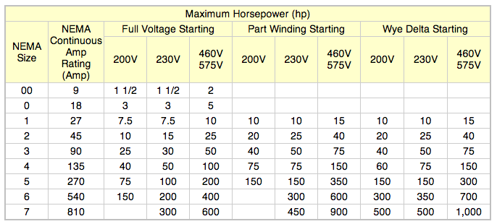
75 Ames Street:
Nathaniel Mooney
Electrical Breadth
INTRODUCTION
DEPTH I
DEPTH II
DEPTH III
BREADTH I
GOAL
  METHOD
RESULT
CONCLUSION
ACKNOWLEDGEMENTS
QUESTIONS
[Method]
Starter
Disconnect
Disconnect
    Standard Sizes 30, 60, 100, and 200 amps
    Next higher disconnect is chosen based on the FLC.
The Broad Institute Expansion
Redesign
UNIT | UNIT # | Volt | Phase | Fan HP | FLA | kVA
AHU1 | SF1 | 480 | 3 | 52.82 | 65 | 54
 | SF2 | 480 | 3 | 52.82 | 65 | 54
 | SF3 | 480 | 3 | 52.82 | 65 | 54
 | SF4 | 480 | 3 | 52.82 | 65 | 54
EAHU1 | EF1 | 480 | 3 | 29.75 | 34 | 28
 | EF2 | 480 | 3 | 29.75 | 34 | 28
 | EF3 | 480 | 3 | 29.75 | 34 | 28
 | EF4 | 480 | 3 | 29.75 | 34 | 28
 | EF5 | 480 | 3 | 29.75 | 34 | 28
CHWP | CHILLED BEAMS | 480 | 3 | 35 | 40 | 33

Slide 33
75 Ames Street:
Nathaniel Mooney
Electrical Breadth
INTRODUCTION
DEPTH I
DEPTH II
DEPTH III
BREADTH I
GOAL
  METHOD
RESULT
CONCLUSION
ACKNOWLEDGEMENTS
QUESTIONS
[RESULT]
The Broad Institute Expansion

Slide 34
75 Ames Street:
Nathaniel Mooney
Chilled Beams Alternate
INTRODUCTION
DEPTH I
DEPTH II
DEPTH III
BREADTH I
CONCLUSION
ACKNOWLEDGEMENTS
QUESTIONS
[CONCLUSION]
    Chilled Beams coupled with Aircutiy demand controlled ventilation offers the best energy savings ($604,658.99) and environmental savings.
    Reduction of Air Handlers off sets most of the costs
    $20,963 maintenance important for keeping system working properly
    reasonable Payback 1.5 years
The Broad Institute Expansion

Slide 35
`
75 Ames Street:
Nathaniel Mooney
THANK YOU TO…
INTRODUCTION
DEPTH I
DEPTH II
DEPTH III
BREADTH I
CONCLUSION
ACKNOWLEDGEMENTS
QUESTIONS
BR+A
The Broad Institute
ElLKUS|MANFRDI Architects
Entire Project Design and Construction Team
Bryan Donovan
Tom Kolsun
Dr. William Bahnfleth
M. Kevin Parfitt, P.E.
Bob Holland
Corey Wilkinson
Friends and Family
AE Class 2013
The Broad Institute Expansion

Slide 36
75 Ames Street:
Nathaniel Mooney
INTRODUCTION
DEPTH I
DEPTH II
DEPTH III
BREADTH I
CONCLUSION
ACKNOWLEDGEMENTS
QUESTIONS
And Thank You For Your Time…
The Broad Institute Expansion

Slide 37
75 Ames Street:
Nathaniel Mooney
INTRODUCTION
DEPTH I
DEPTH II
DEPTH III
BREADTH I
CONCLUSION
ACKNOWLEDGEMENTS
QUESTIONS
Aircuity Rooms:
Chosen Based On:
  Size
  ACH
    Labs 6/12
    Tissue Culture 6/15
The Broad Institute Expansion

Slide 38
75 Ames Street:
Nathaniel Mooney
Questions…
INTRODUCTION
DEPTH I
DEPTH II
DEPTH III
BREADTH I
CONCLUSION
ACKNOWLEDGEMENTS
QUESTIONS
Typical Building Loads
The Broad Institute Expansion

Slide 39
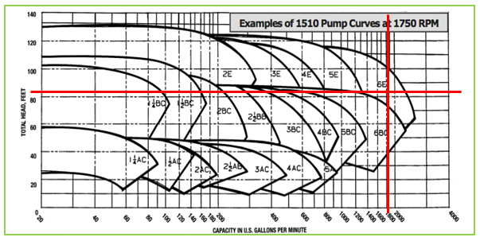
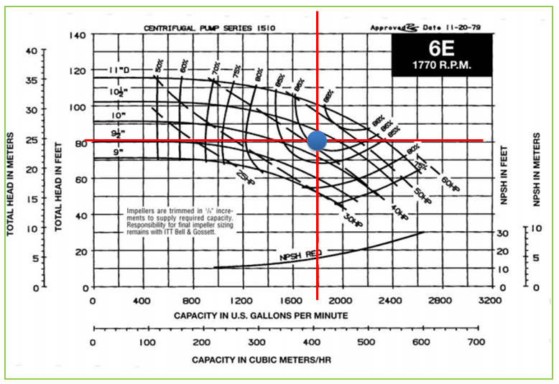
75 Ames Street:
Nathaniel Mooney
INTRODUCTION
DEPTH I
DEPTH II
DEPTH III
BREADTH I
CONCLUSION
ACKNOWLEDGEMENTS
QUESTIONS
Pump Size
Q=500 x GPM x DT
DT=5
Q= 4582210 BTU/HR
GPM=1832.884
The Broad Institute Expansion

Slide 40
75 Ames Street:
Nathaniel Mooney
INTRODUCTION
DEPTH I
DEPTH II
DEPTH III
BREADTH I
CONCLUSION
ACKNOWLEDGEMENTS
QUESTIONS
Chilled Beam Control
  On VAV
  Vary water flow rate through beam using zone level thermostats
    7-8 degree change can change cooling rates of beams by 60%
  Dew point sensors can be used in spaces where concern of condensation is high
    Resets water temperature higher to prevent condensation
  Beam supply varied by 2 way on-off control valve controlled by zone thermostat.
The Broad Institute Expansion

