Slide 1
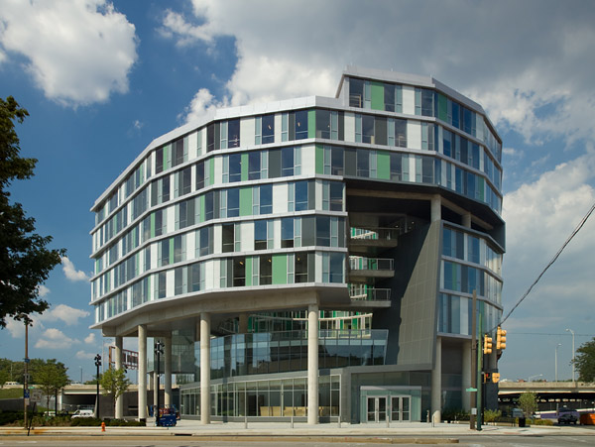
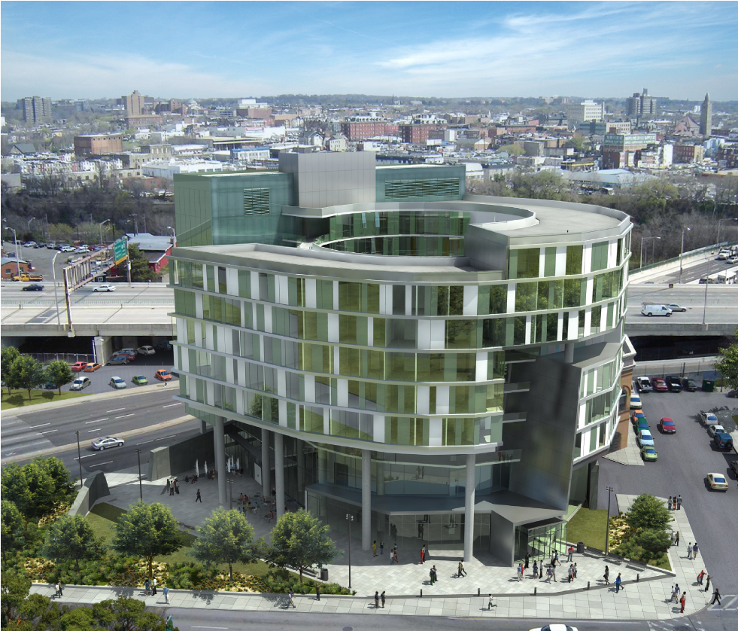
MICA GATEWAY RESIDENCE
BALTIMORE, MARYLAND
SCOTT MOLONGOSKI
SENIOR THESIS
STRUCTURAL OPTION
ADVISOR:
PROFESSOR SUSTERSIC

Slide 2
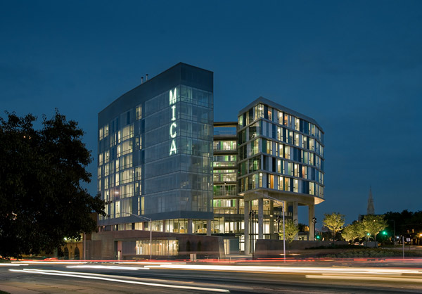
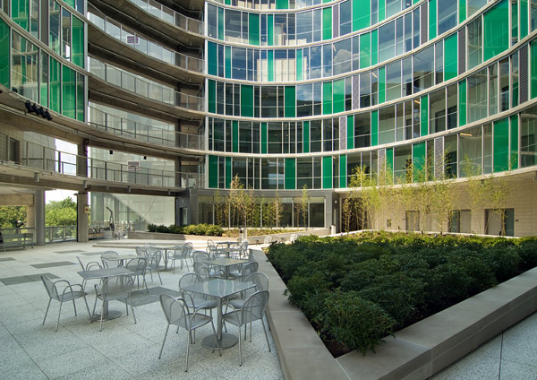
PRESENTATION OUTLINE
BUILDING INTRODUCTION
EXISTING STRUCTURE
THESIS CHALLENGE
PROPOSED SOLUTION
GRAVITY SYSTEM DESIGN
LATERAL SYSTEM DESIGN
ARCHITECTURAL BREADTH
CONCLUSION

Slide 3
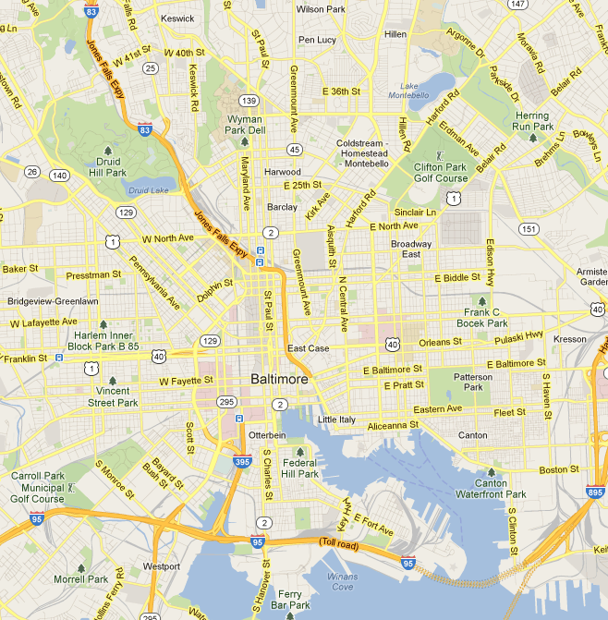
PRESENTATION
OUTLINE
BUILDING INTRODUCTION
OWNER: MARYLAND INSTITUTE COLLEGE OF ARTS
ARCHITECT AND ENGINEER: RTKL ASSOCIATES
CIVIL ENGINEER: KCW ENGINEERING TECHNOLOGIES
GENERAL CONTRACTOR: WHITING TURNER
LANDSCAPE ARCHITECT: HIGGINS LAZARUS
122’ TALL
9 STORIES PLUS MECHANICAL PENTHOUSE
108,000 SQFT
64 APARTMENTS
MULTIPURPOSE “BLACK BOX” THEATER
COURTYARD
CAFÉ
STUDIOS
BUILDING INTRODUCTION
EXISTING STRUCTURE
THESIS CHALLENGE
PROPOSED SOLUTION
GRAVITY SYSTEM DESIGN
LATERAL SYSTEM DESIGN
ARCHITECTURAL BREADTH
CONCLUSION

Slide 4
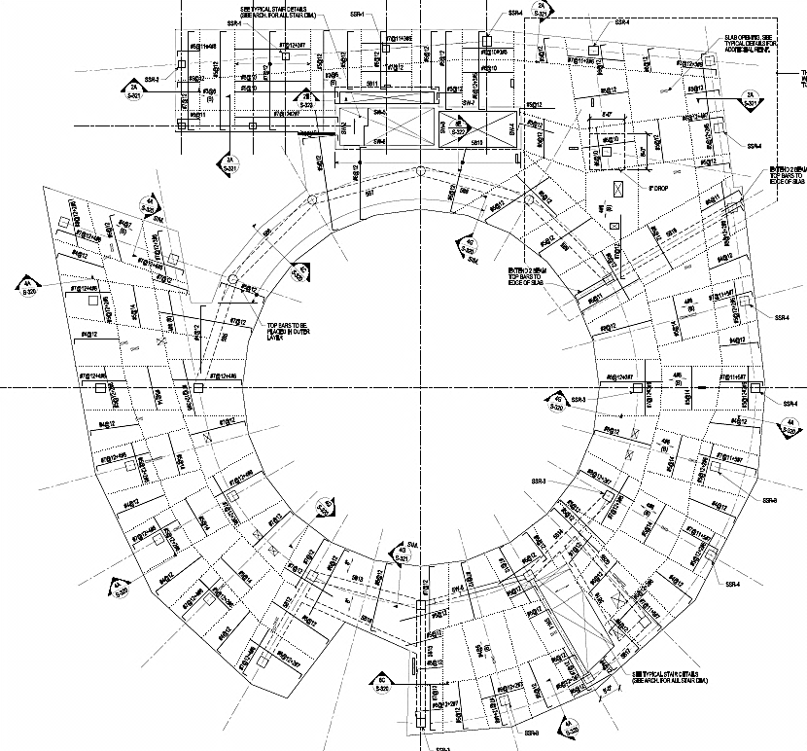
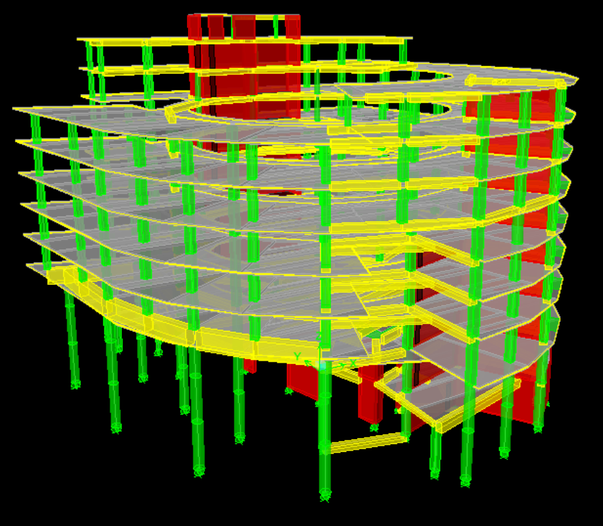
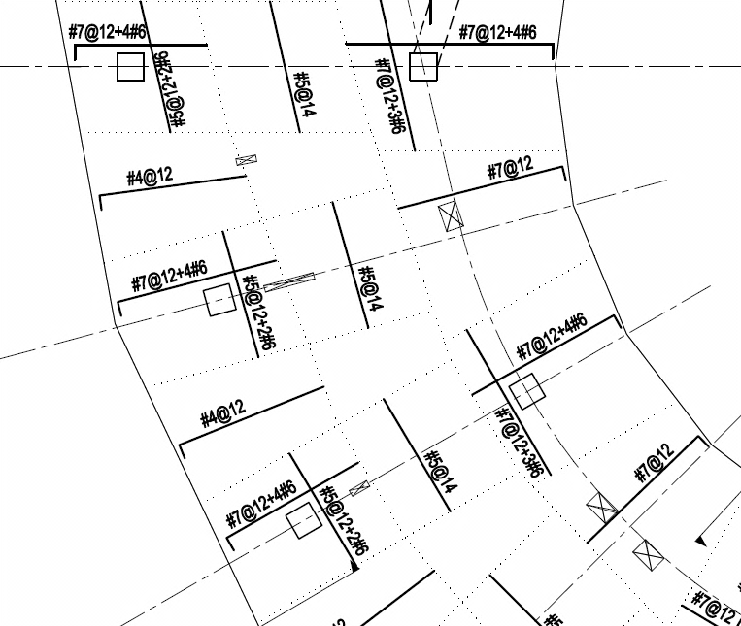
PRESENTATION
OUTLINE
EXISTING STRUCTURE
SLABS:
TWO WAY FLAT PLATE
8” THICK
COLUMNS:
TWO CONCENTRIC RINGS
12”x12” – 24”x24”
CIRCULAR EXTERIOR
36” DIAMETER
UNIQUE CONDITIONS:
BLACK BOX ROOF
41’ SLENDER COLUMNS
BUILDING INTRODUCTION
EXISTING STRUCTURE
THESIS CHALLENGE
PROPOSED SOLUTION
GRAVITY SYSTEM DESIGN
LATERAL SYSTEM DESIGN
ARCHITECTURAL BREADTH
CONCLUSION

Slide 5
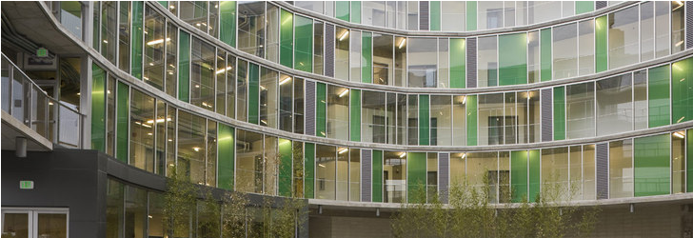
PRESENTATION
OUTLINE
EXISTING STRUCTURE
CONCRETE SHEAR WALLS
DRILLED CAISSONS
360º CURTAIN WALL FAÇADE
BUILDING INTRODUCTION
EXISTING STRUCTURE
THESIS CHALLENGE
PROPOSED SOLUTION
GRAVITY SYSTEM DESIGN
LATERAL SYSTEM DESIGN
ARCHITECTURAL BREADTH
CONCLUSION

Slide 6
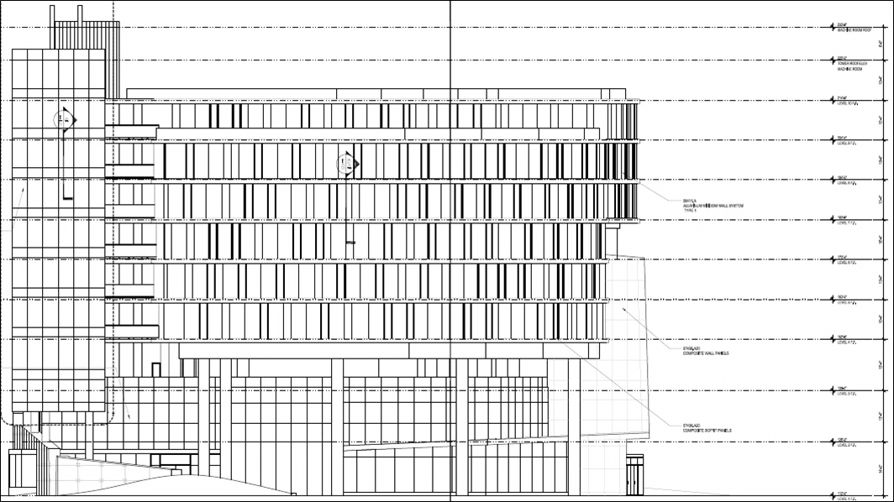
PRESENTATION
OUTLINE
THESIS CHALLENGE
CHANGE USE TO MUSUEM
BENEFITS:
CIRCULAR FLOOR PLAN
ARCHITECTURAL SIGNIFICANCE
OTHER APPROPRIATE SPACES
DETRACTIONS:
LOW DESIGN LIVE LOADS
LOW FLOOR TO FLOOR HEIGHT
POOR SUNLIGHT CONTROL
BUILDING INTRODUCTION
EXISTING STRUCTURE
THESIS CHALLENGE
PROPOSED SOLUTION
GRAVITY SYSTEM DESIGN
LATERAL SYSTEM DESIGN
ARCHITECTURAL BREADTH
CONCLUSION

Slide 7
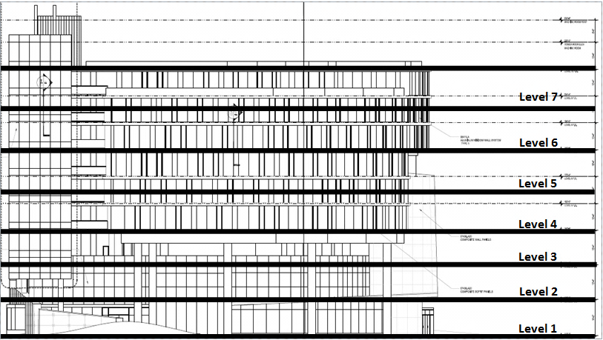
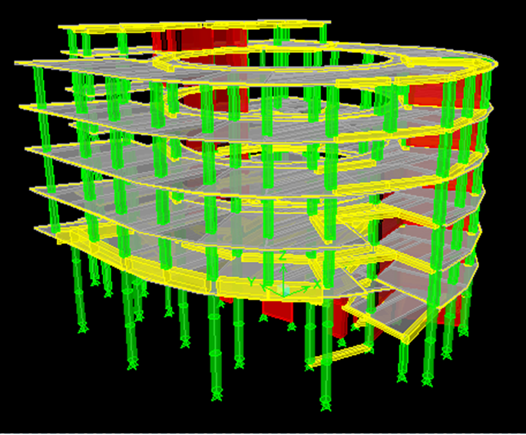
PRESENTATION
OUTLINE
PROPOSED SOLUTION
INCREASE LIVE LOAD:
40 PSF – 100 PSF
INCREASE FLOOR TO FLOOR HEIGHT:
10 FEET – 15 FEET
LEVEL 4 – LEVEL 7
ELMINATE LEVELS 8, 9
DECREASE SUNLIGHT EMITTED INTO BUILDING:
USE SOLID PANELS
USE REFLECTIVE/ABSORBANT GLASS
ARCHITECTURAL CHANGES:
FLOOR PLAN
CIRCULATION
BUILDING INTRODUCTION
EXISTING STRUCTURE
THESIS CHALLENGE
PROPOSED SOLUTION
GRAVITY SYSTEM DESIGN
LATERAL SYSTEM DESIGN
ARCHITECTURAL BREADTH
CONCLUSION

Slide 8
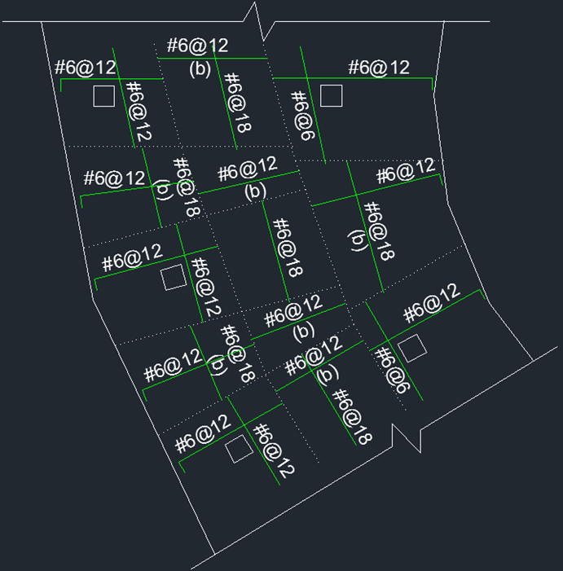
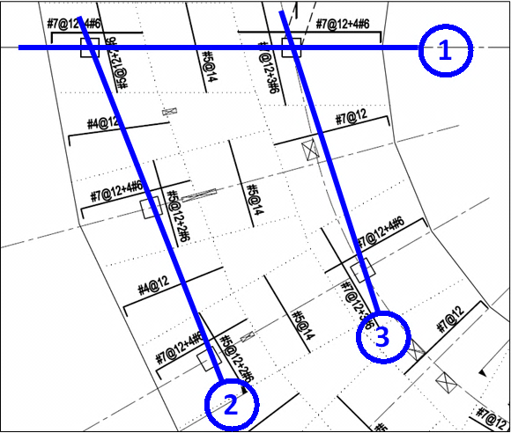
PRESENTATION
OUTLINE
GRAVITY SYSTEM DESIGN
SLAB ANALYSIS:
EQUIVALENT FRAME METHOD
FLEXURE
PUNCHING SHEAR
DEFLECTIONS
SLAB DESIGN:
12” THICK
#6 USED FOR FLEXURE
#5 @ 12” BOTTOM MAT
#4 @ 3” FOR SHEAR
BUILDING INTRODUCTION
EXISTING STRUCTURE
THESIS CHALLENGE
PROPOSED SOLUTION
GRAVITY SYSTEM DESIGN
LATERAL SYSTEM DESIGN
ARCHITECTURAL BREADTH
CONCLUSION

Slide 9
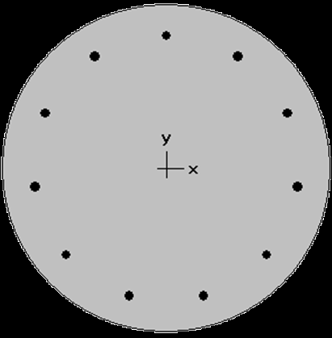
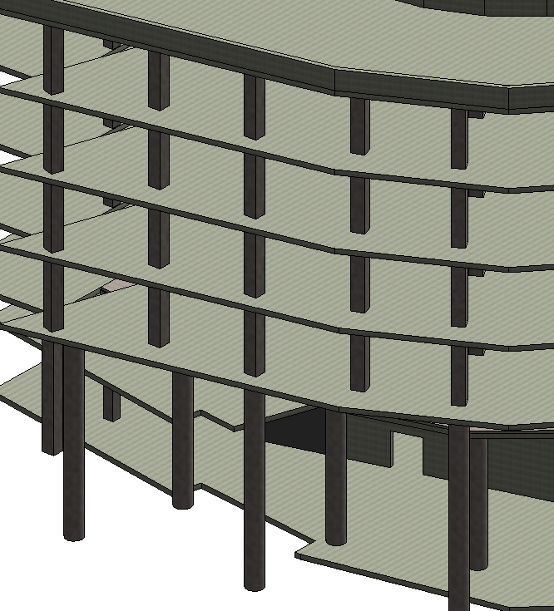
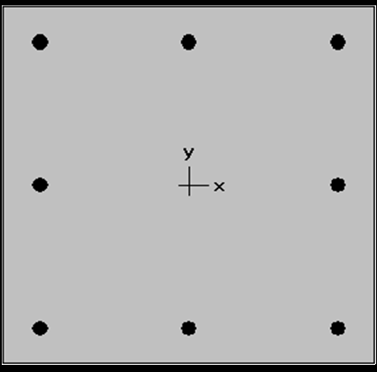
PRESENTATION
OUTLINE
GRAVITY SYSTEM DESIGN
COLUMN ANALYSIS:
41’ TALL SECTION
STANDARD 15’ TALL SECTION
spCOLUMN
SLENDERNESS CHECK
COLUMN DESIGN:
36” – 42” DIAMETER EXTERIOR
11 #10’s
SLENDERNESS CHECK OKAY
24”x24” – 30”x30” INTERIOR
8 #10’s
CONTINUOUS SIZE LEVEL 4 - ROOF
BUILDING INTRODUCTION
EXISTING STRUCTURE
THESIS CHALLENGE
PROPOSED SOLUTION
GRAVITY SYSTEM DESIGN
LATERAL SYSTEM DESIGN
ARCHITECTURAL BREADTH
CONCLUSION

Slide 10
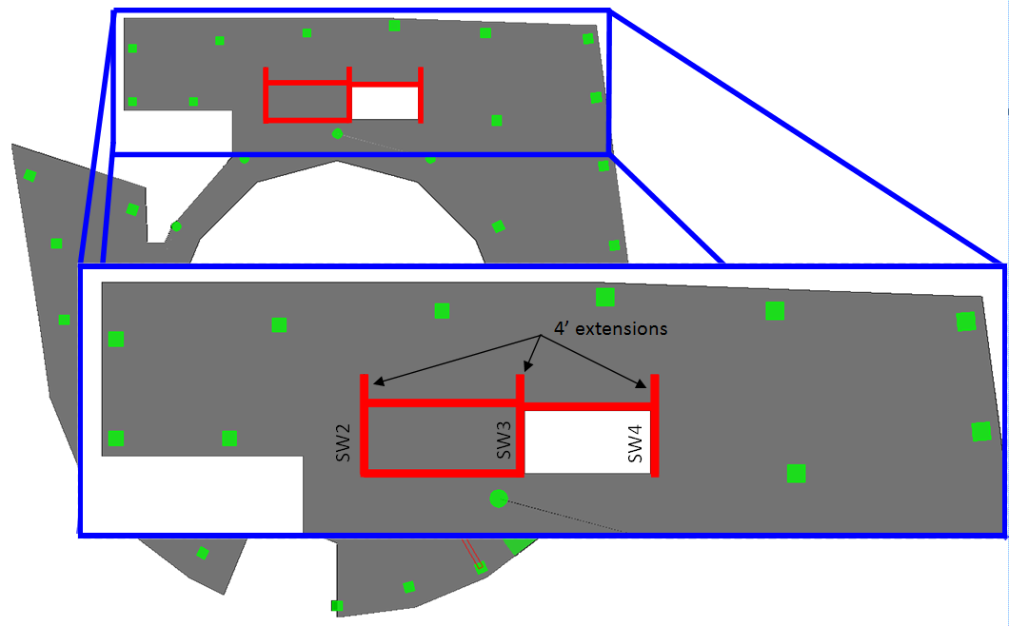
PRESENTATION
OUTLINE
LATERAL SYSTEM DESIGN
ETABS MODEL:
UPDATED SLABS AND COLUMNS
UPDATED FLOOR TO FLOOR HEIGHT
SHEAR WALLS - MESHED SHELLS
LATERAL AND GRAVITY
1ST ANALYSIS:
SEISMIC IN Y DIRECTION CONTROLLED
SHEAR WALLS INADEQUATE IN FLEXURE
INCREASED LENGTH 4’
BUILDING INTRODUCTION
EXISTING STRUCTURE
THESIS CHALLENGE
PROPOSED SOLUTION
GRAVITY SYSTEM DESIGN
LATERAL SYSTEM DESIGN
ARCHITECTURAL BREADTH
CONCLUSION

Slide 11
PRESENTATION
OUTLINE
LATERAL SYSTEM DESIGN
2ND ANALYSIS:
ACCEPTABLE DEFLECTIONS AND STORY DRIFT
CHECKED OVERTURNING MOMENT
SHEAR WALL DESIGN:
36” BOUNDARY ELEMENT
12 #11’s WITH #3 TIES @ 12”
#4@18” VERTICAL SHEAR
#5@18” HORIZONTAL SHEAR
FOUNDATION DESIGN:
SHEAR WALL CAISSONS
CRSI 2008 HANDBOOK
ADEQUATE SHAFT AND BELL SIZES
BUILDING INTRODUCTION
EXISTING STRUCTURE
THESIS CHALLENGE
PROPOSED SOLUTION
GRAVITY SYSTEM DESIGN
LATERAL SYSTEM DESIGN
ARCHITECTURAL BREADTH
CONCLUSION

Slide 12
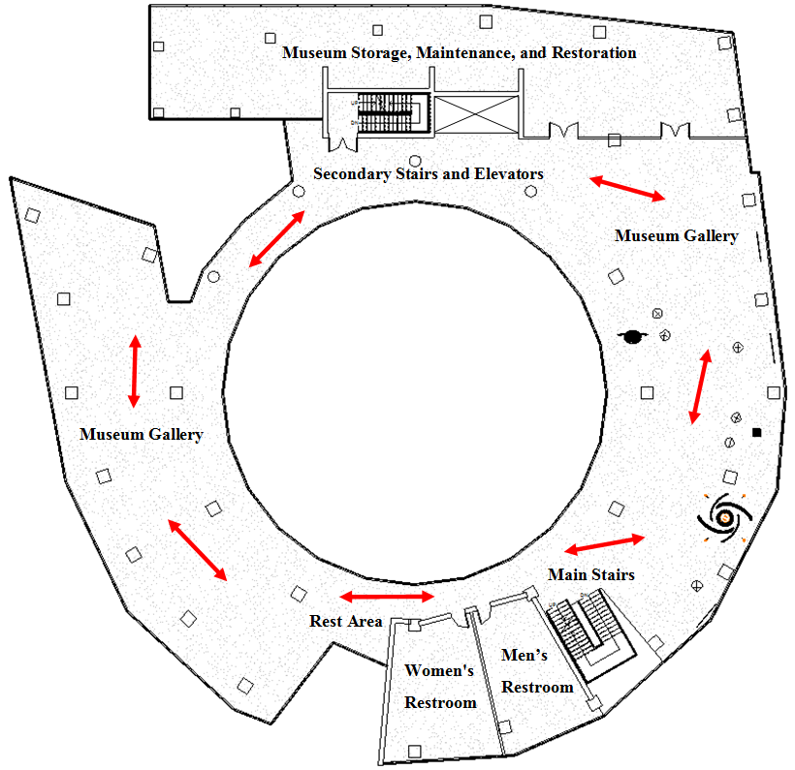
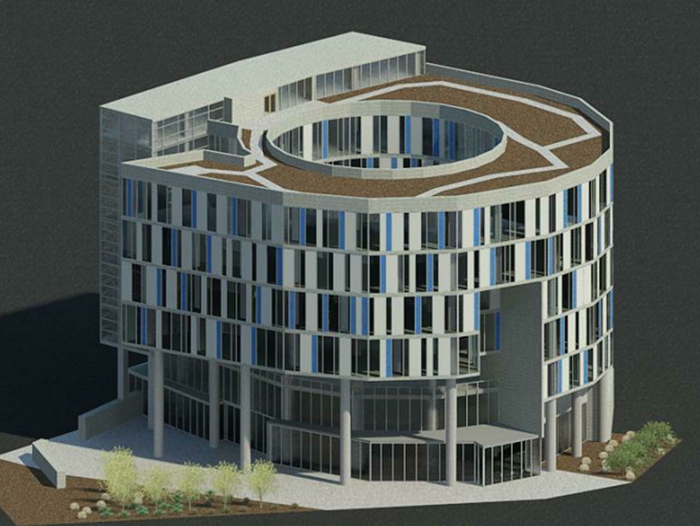
PRESENTATION
OUTLINE
ARCHITECTURAL BREADTH
DESIGN ASPECTS:
LARGE VIEWING SPACES
OPEN GALLERIES
CIRCULATION
SUNLIGHT CONTROL
REST AREAS
DESIGN CHANGES:
APARTMENT REMOVAL
MUSEUM STORAGE AND MAINTENANCE
RESTROOMS
ART ALCOVES
BUILDING INTRODUCTION
EXISTING STRUCTURE
THESIS CHALLENGE
PROPOSED SOLUTION
GRAVITY SYSTEM DESIGN
LATERAL SYSTEM DESIGN
ARCHITECTURAL BREADTH
CONCLUSION

Slide 13
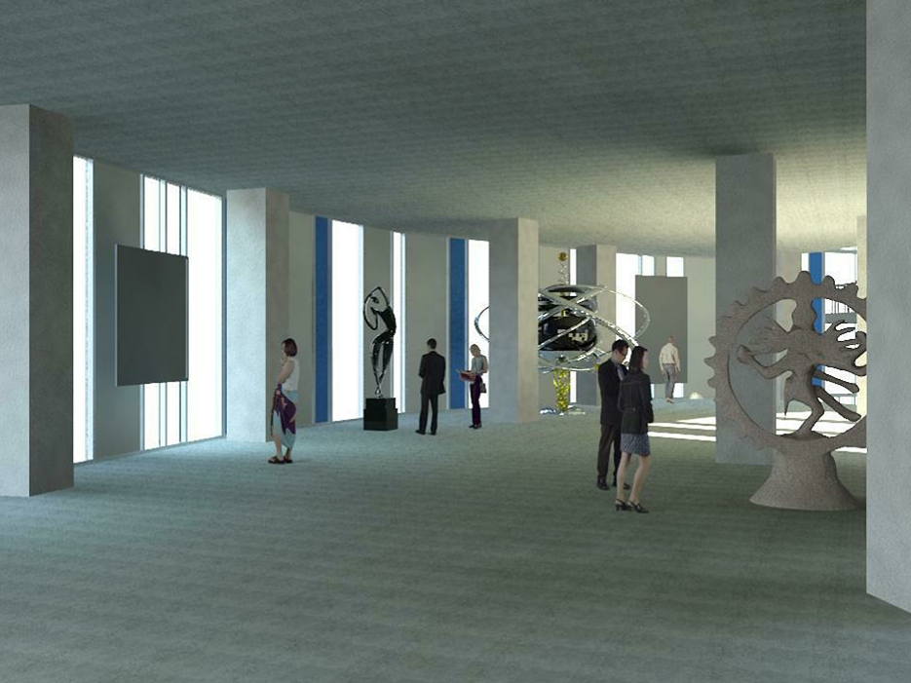
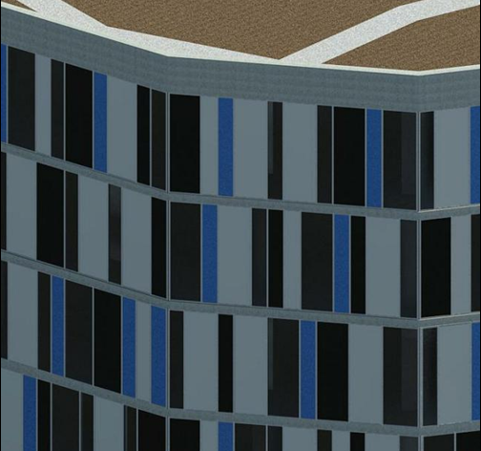
PRESENTATION
OUTLINE
ARCHITECTURAL BREADTH
FAÇADE CHANGES:
CONTROL SOUTH SIDE
INCREASED USE OF SOLID PANELS
REFLECTIVE AND ABSORBENT GLASS
BUILDING INTRODUCTION
EXISTING STRUCTURE
THESIS CHALLENGE
PROPOSED SOLUTION
GRAVITY SYSTEM DESIGN
LATERAL SYSTEM DESIGN
ARCHITECTURAL BREADTH
CONCLUSION

Slide 14
PRESENTATION
OUTLINE
CONCLUSION
COULD HAVE BEEN DESIGNED AS MUSEUM
SYSTEM TYPES FEASIBLE
SIGNIFICANT STRUCTURAL STRENGTHENING
SIGNIFICANT ARCHITECTURAL CHANGES
INCREASED MATERIAL AMOUNTS = HIGHER COST
BUILDING INTRODUCTION
EXISTING STRUCTURE
THESIS CHALLENGE
PROPOSED SOLUTION
GRAVITY SYSTEM DESIGN
LATERAL SYSTEM DESIGN
ARCHITECTURAL BREADTH
CONCLUSION

Slide 15
PRESENTATION
OUTLINE
ACKNOWLEDGEMENTS
MARYLAND INSTITUTE COLLEGE OF ARTS
RTKL ASSOCIATES
BOB KNIGHT
PETE MALMQUIST
DAVID DYMOND
ADAM REED
PENN STATE ARCHITECTURAL ENGINEERING:
PROFESSOR HEATHER SUSTERSIC
PROFESSOR KEVIN PARFITT
PROFESSOR BOB HOLLAND
FRIENDS AND FAMILY
QUESTIONS
AND
COMMENTS
BUILDING INTRODUCTION
EXISTING STRUCTURE
THESIS CHALLENGE
PROPOSED SOLUTION
GRAVITY SYSTEM DESIGN
LATERAL SYSTEM DESIGN
ARCHITECTURAL BREADTH
CONCLUSION

Slide 16
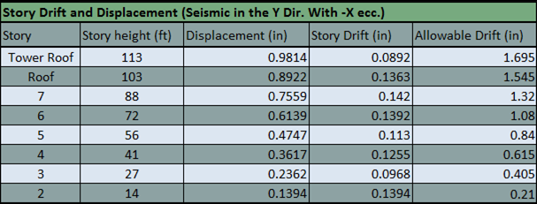
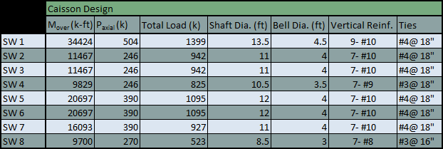
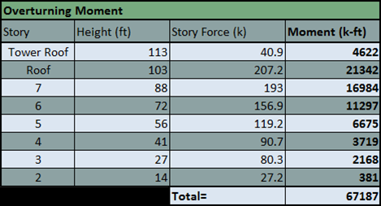
PRESENTATION
OUTLINE
APPENDIX
MATERIAL INCREASE:
SLAB CONCRETE: 27%
COL. CONCRETE: 26%
COL. STEEL: 21%
DEVELOPMENT LENGTH:
6’ BEYOND IN FRAME 1
5’ BEYOND IN FRAME 2
7’ BEYOND IN FRAME 3
BOT. BARS CONT.
HOOKS:
90º
6” BOT. BARS
9.8” TOP BARS
BUILDING INTRODUCTION
EXISTING STRUCTURE
THESIS CHALLENGE
PROPOSED SOLUTION
GRAVITY SYSTEM DESIGN
LATERAL SYSTEM DESIGN
ARCHITECTURAL BREADTH
CONCLUSION

