Slide 1
engineering center oakland university
lighting schematic
initial design development presentation
JOHNCONLEY

Slide 2
| building
name
location
owner
size
cost
architect
construction
engineering center
rochester, mi
oakland university school of engineering and computer sciences
136,653 sf
$57 million
smithgroupjjr
walbridge aldinger company
building | concept | exterior walkway | lobby + atrium | auditorium | project labs | questions

Slide 3
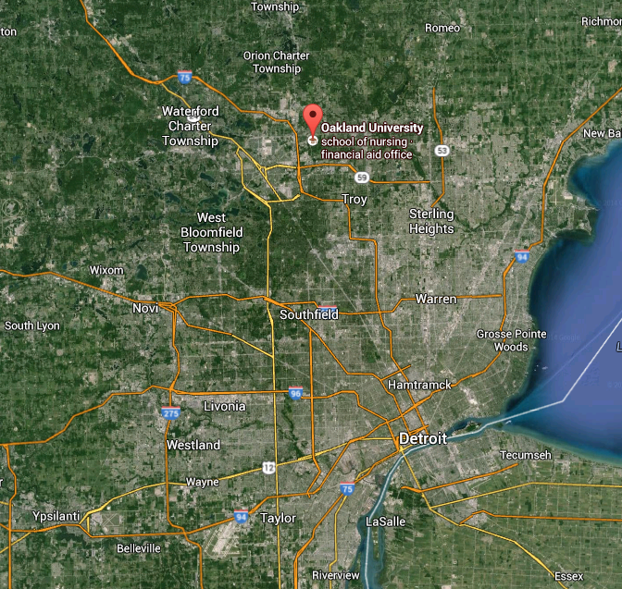
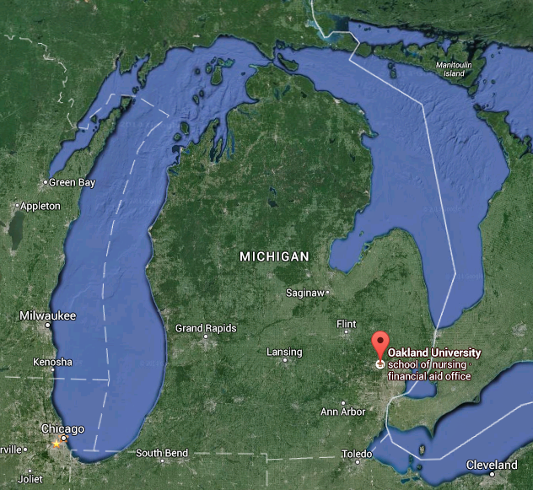
| location
building | concept | exterior walkway | lobby + atrium | auditorium | project labs | questions

Slide 4
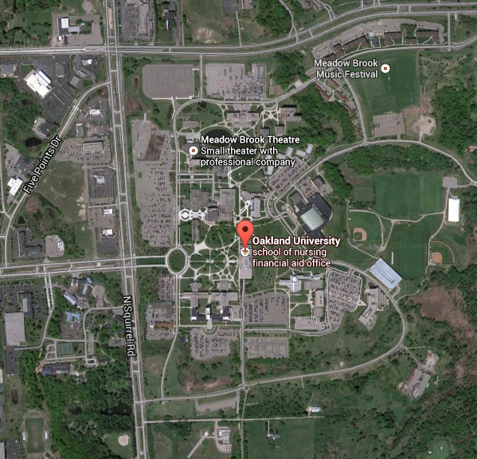
| location
building | concept | exterior walkway | lobby + atrium | auditorium | project labs | questions

Slide 5
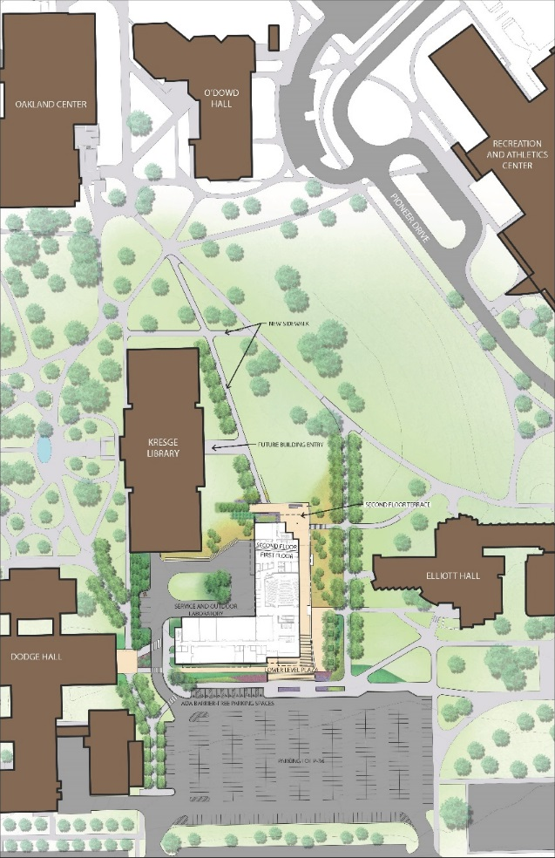
| location
building | concept | exterior walkway | lobby + atrium | auditorium | project labs | questions

Slide 6
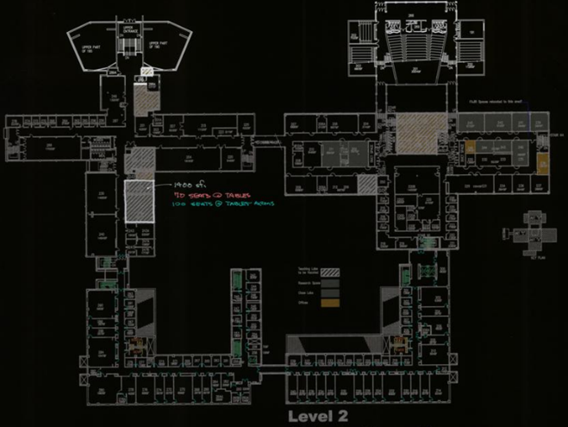
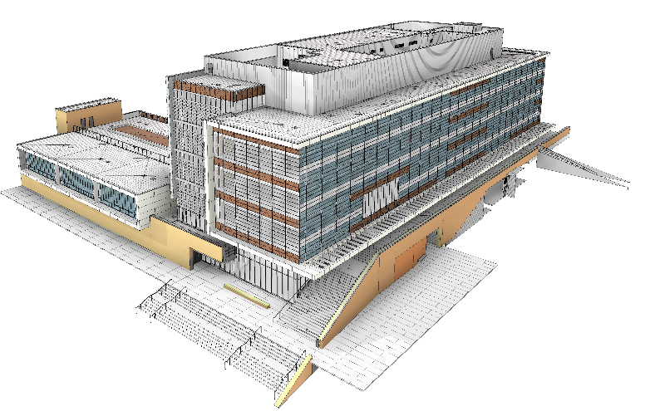
| program of the building
building | concept | exterior walkway | lobby + atrium | auditorium | project labs | questions

Slide 7
| concept
SECS Mission
In carrying out its mission the school will address the needs of the automotive and related industries in southeast Michigan for the:
Education of engineers and computer scientists,
Development of research programs and
Fulfillment of the demands for professional service.
building | concept | exterior walkway | lobby + atrium | auditorium | project labs | questions
Notes:
1999? At a computer expo (COMDEX), Bill Gates reportedly compared the computer industry with the auto industry and stated: "If GM had kept up with the technology like the computer industry has, we would all be driving $25.00 cars that got 1,000 miles to the gallon." Read more at http://www.snopes.com/humor/jokes/autos.asp#7f05jBkwHDKImPKX.99

Slide 8
| concept
If GM had kept up with technology like the computer industry has, we would all be driving $25 cars that got 1,000 MPG.
Bill Gates
Read more at http://www.brainyquote.com/quotes/quotes/b/billgates389269.html#baOwi0zo3fVrzdpZ.99
building | concept | exterior walkway | lobby + atrium | auditorium | project labs | questions
Notes:
1999? At a computer expo (COMDEX), Bill Gates reportedly compared the computer industry with the auto industry and stated: "If GM had kept up with the technology like the computer industry has, we would all be driving $25.00 cars that got 1,000 miles to the gallon." Read more at http://www.snopes.com/humor/jokes/autos.asp#7f05jBkwHDKImPKX.99

Slide 9
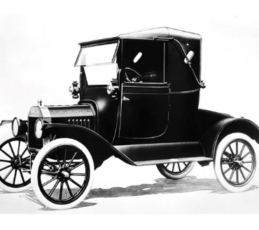
| concept
Paving the Road to Progress
building | concept | exterior walkway | lobby + atrium | auditorium | project labs | questions

Slide 10
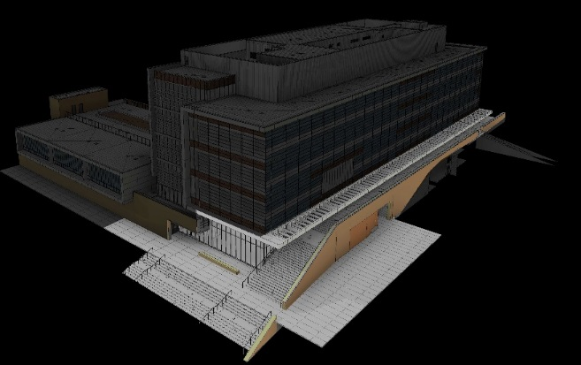
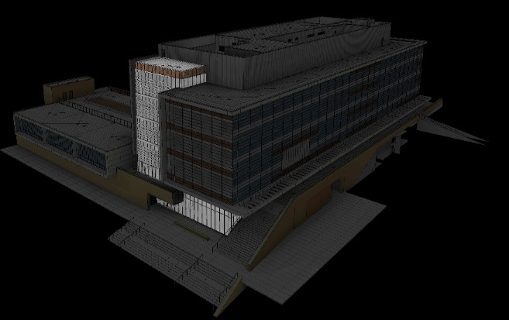
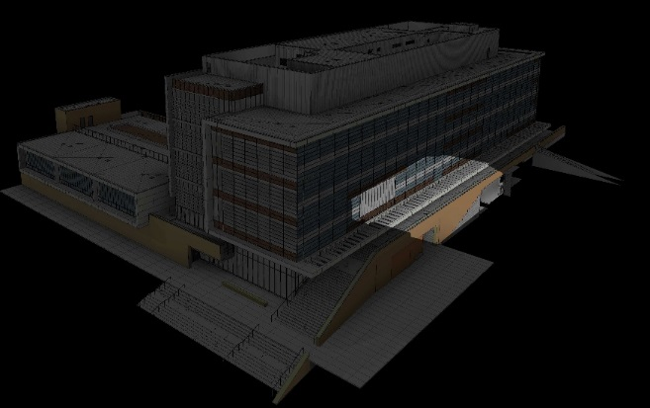
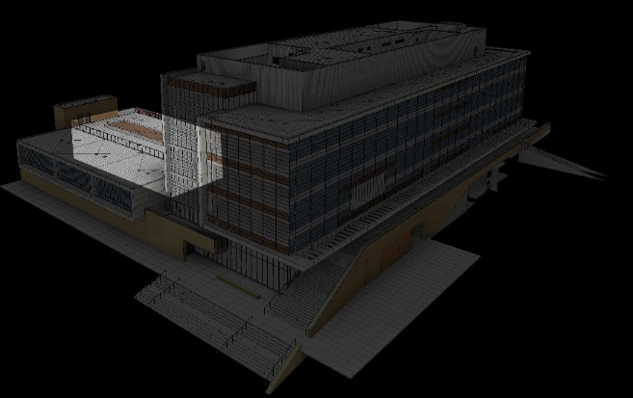
| location
exterior walkway
lobby + atrium
auditorium
project labs
building | concept | exterior walkway | lobby + atrium | auditorium | project labs | questions

Slide 11
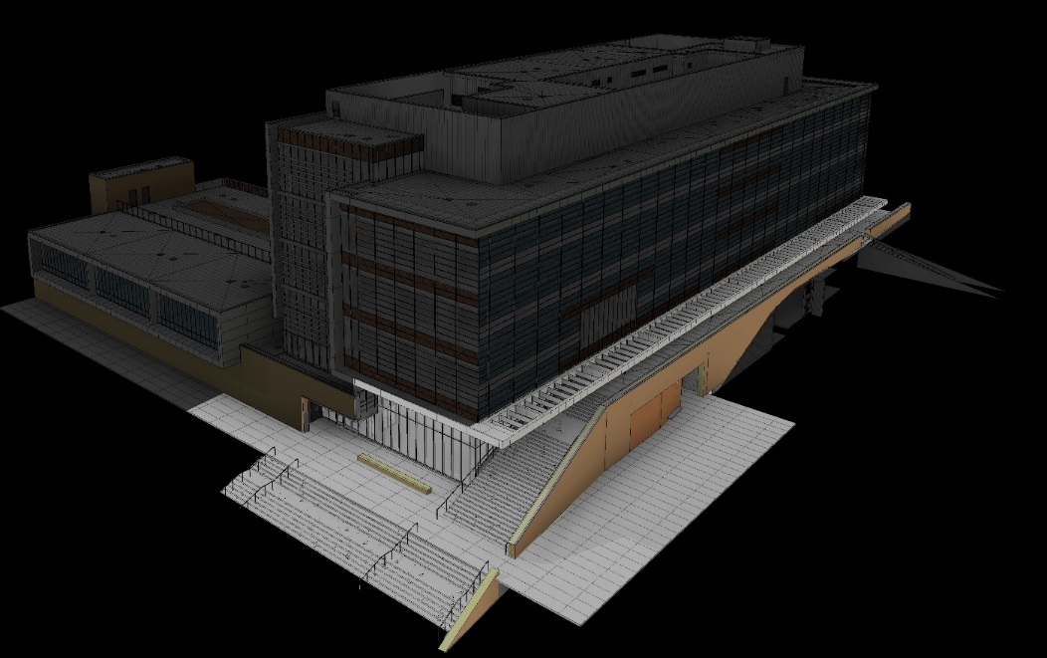
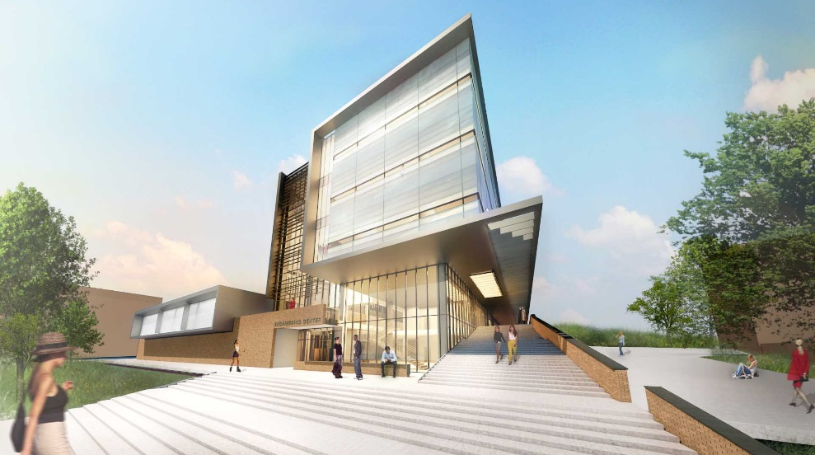
| exterior walkway
building | concept | exterior walkway | lobby + atrium | auditorium | project labs | questions

Slide 12
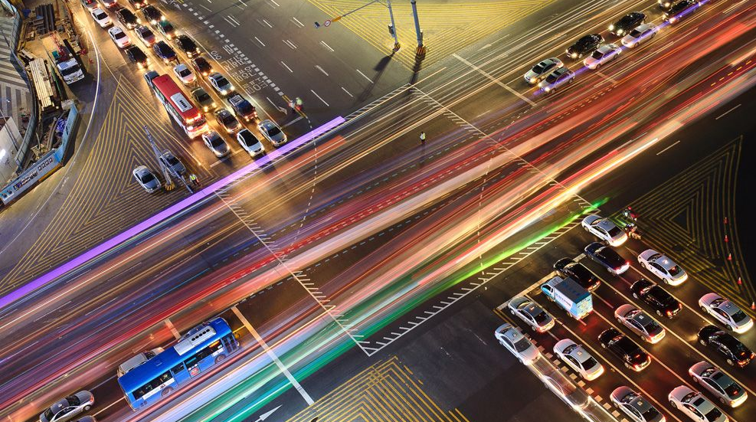
| exterior walkway
design criteria
paths clearly laid out
building as stop not just billboard
campus safety
minimize light to surroundings
LPD = 0.16 W/ft²
LZ2 moderate ambient light
trespass criteria
E_{h} = 3 lux pre-curfew
= 1 lux post-curfew
E_{v} = N/A
building | concept | exterior walkway | lobby + atrium | auditorium | project labs | questions
Notes:
Zone 3 Ashrae building grounds walkways 10ft or wider and plaza areas = 0.16 W/sf

Slide 13
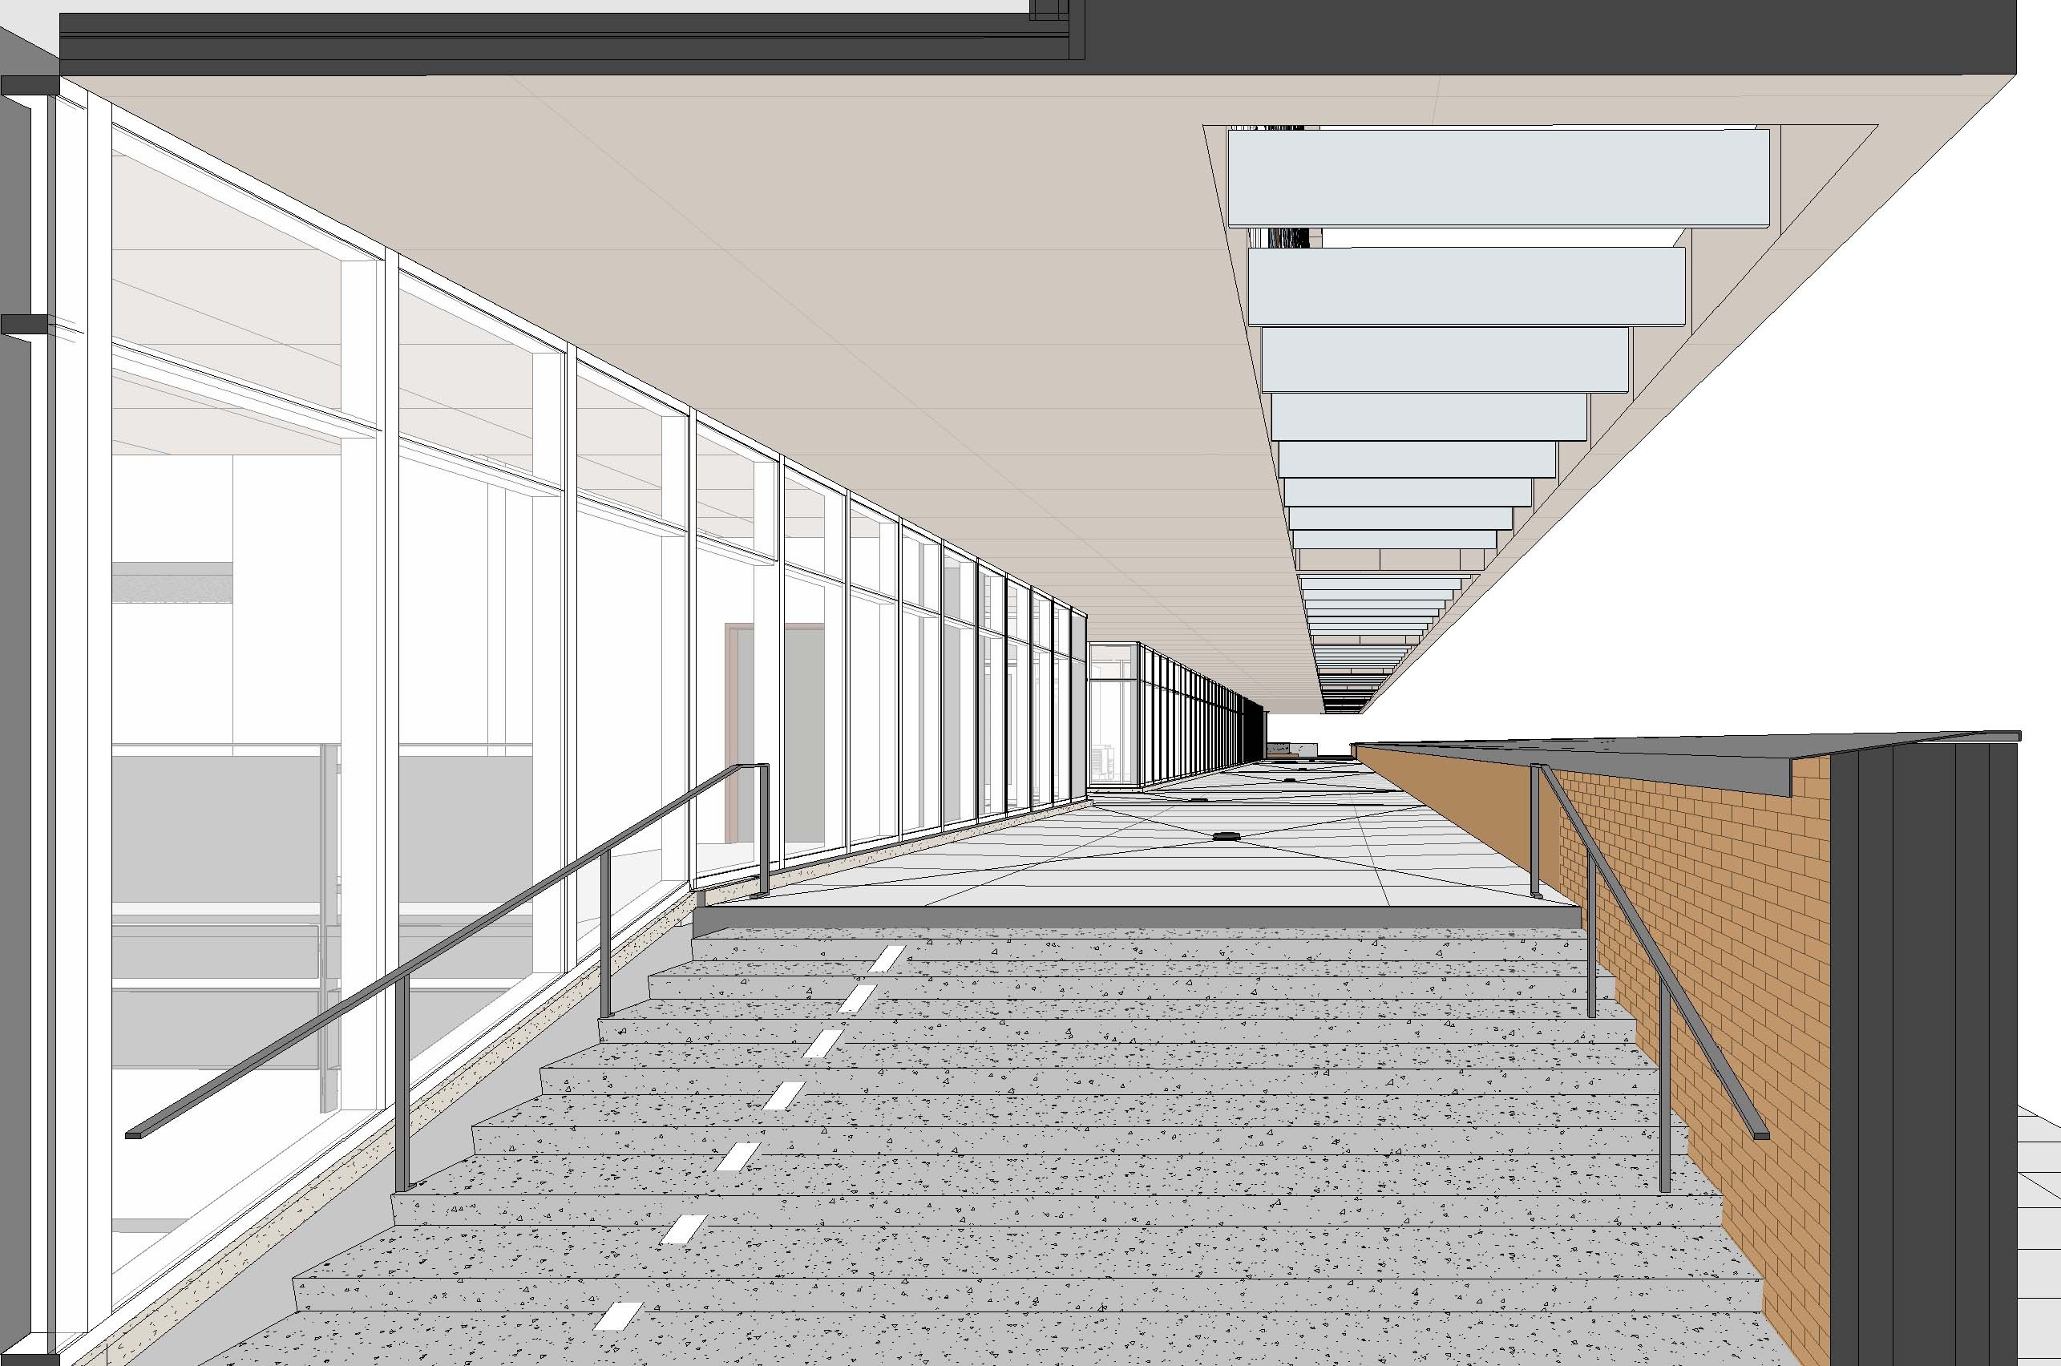
| exterior walkway
building | concept | exterior walkway | lobby + atrium | auditorium | project labs | questions

Slide 14
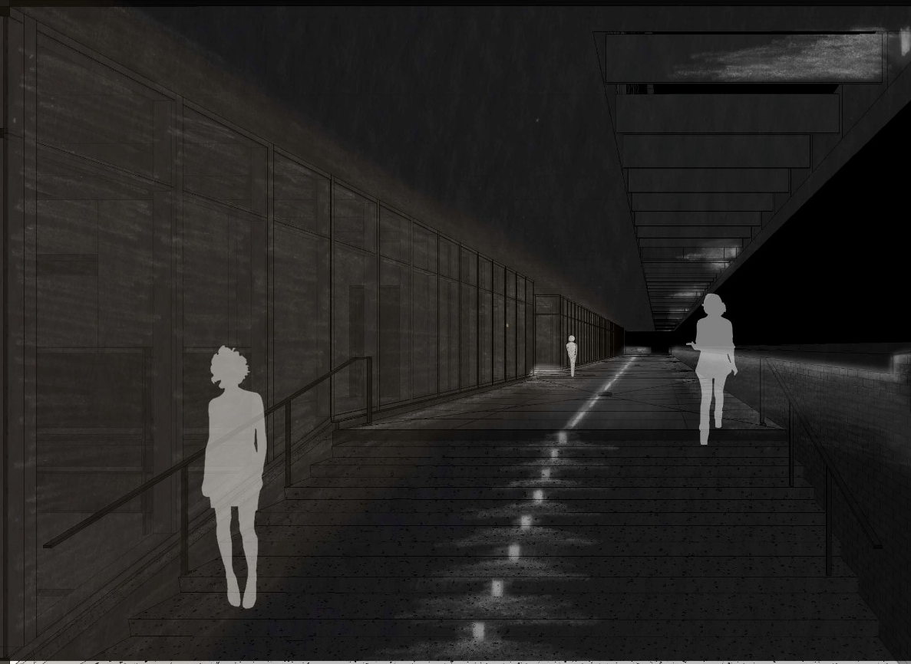
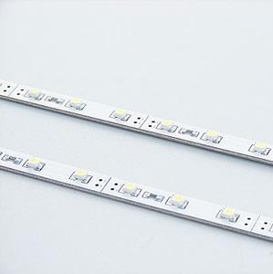
| exterior walkway
building | concept | exterior walkway | lobby + atrium | auditorium | project labs | questions

Slide 15
| exterior walkway
building | concept | exterior walkway | lobby + atrium | auditorium | project labs | questions

Slide 16
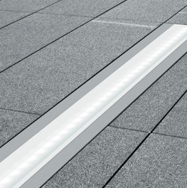
| exterior walkway
building | concept | exterior walkway | lobby + atrium | auditorium | project labs | questions

Slide 17
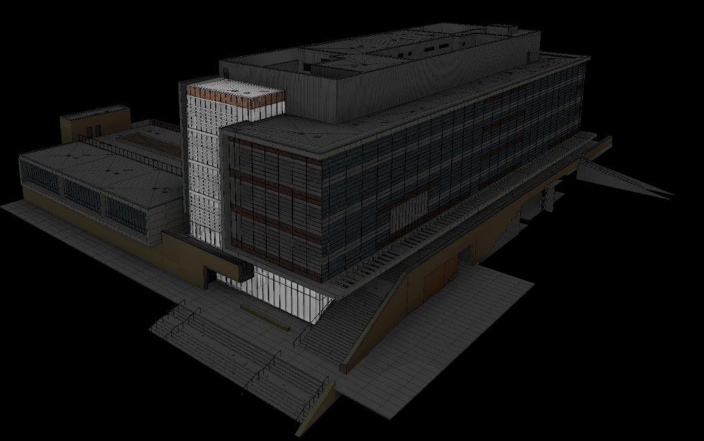
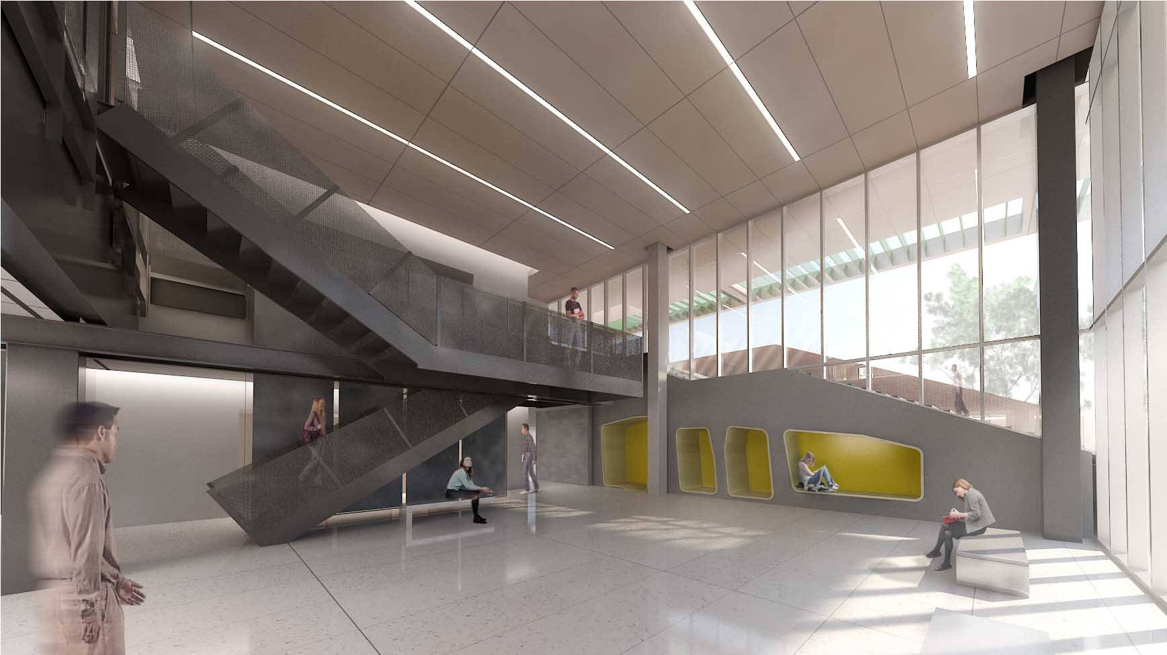
| lobby + atrium
building | concept | exterior walkway | lobby + atrium | auditorium | project labs | questions

Slide 18
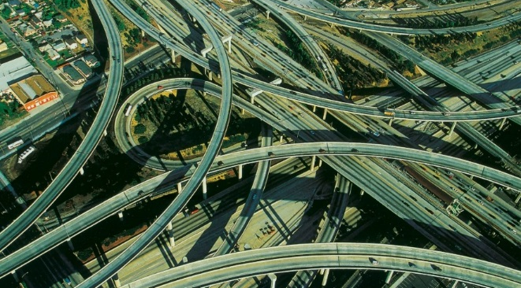
| lobby + atrium
design criteria
paths clearly laid out
architecture accented in clean lines
points of higher traffic brighter
points of respite with perimeter light
LPD = 1.23 W/ft²
Day
E_{h} = 100 lux
E_{v} = 50 lux
Night
E_{h} = 50 lux
E_{v} = 20 lux
building | concept | exterior walkway | lobby + atrium | auditorium | project labs | questions

Slide 19
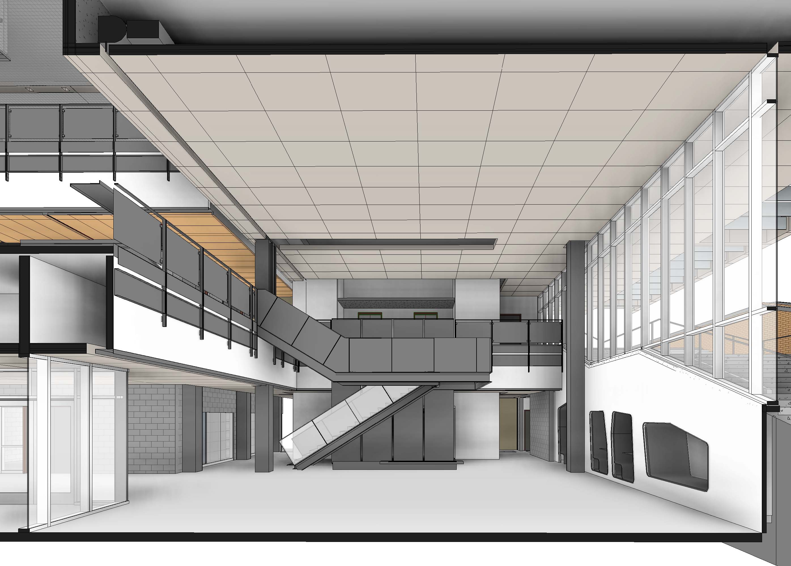
| lobby + atrium
building | concept | exterior walkway | lobby + atrium | auditorium | project labs | questions

Slide 20
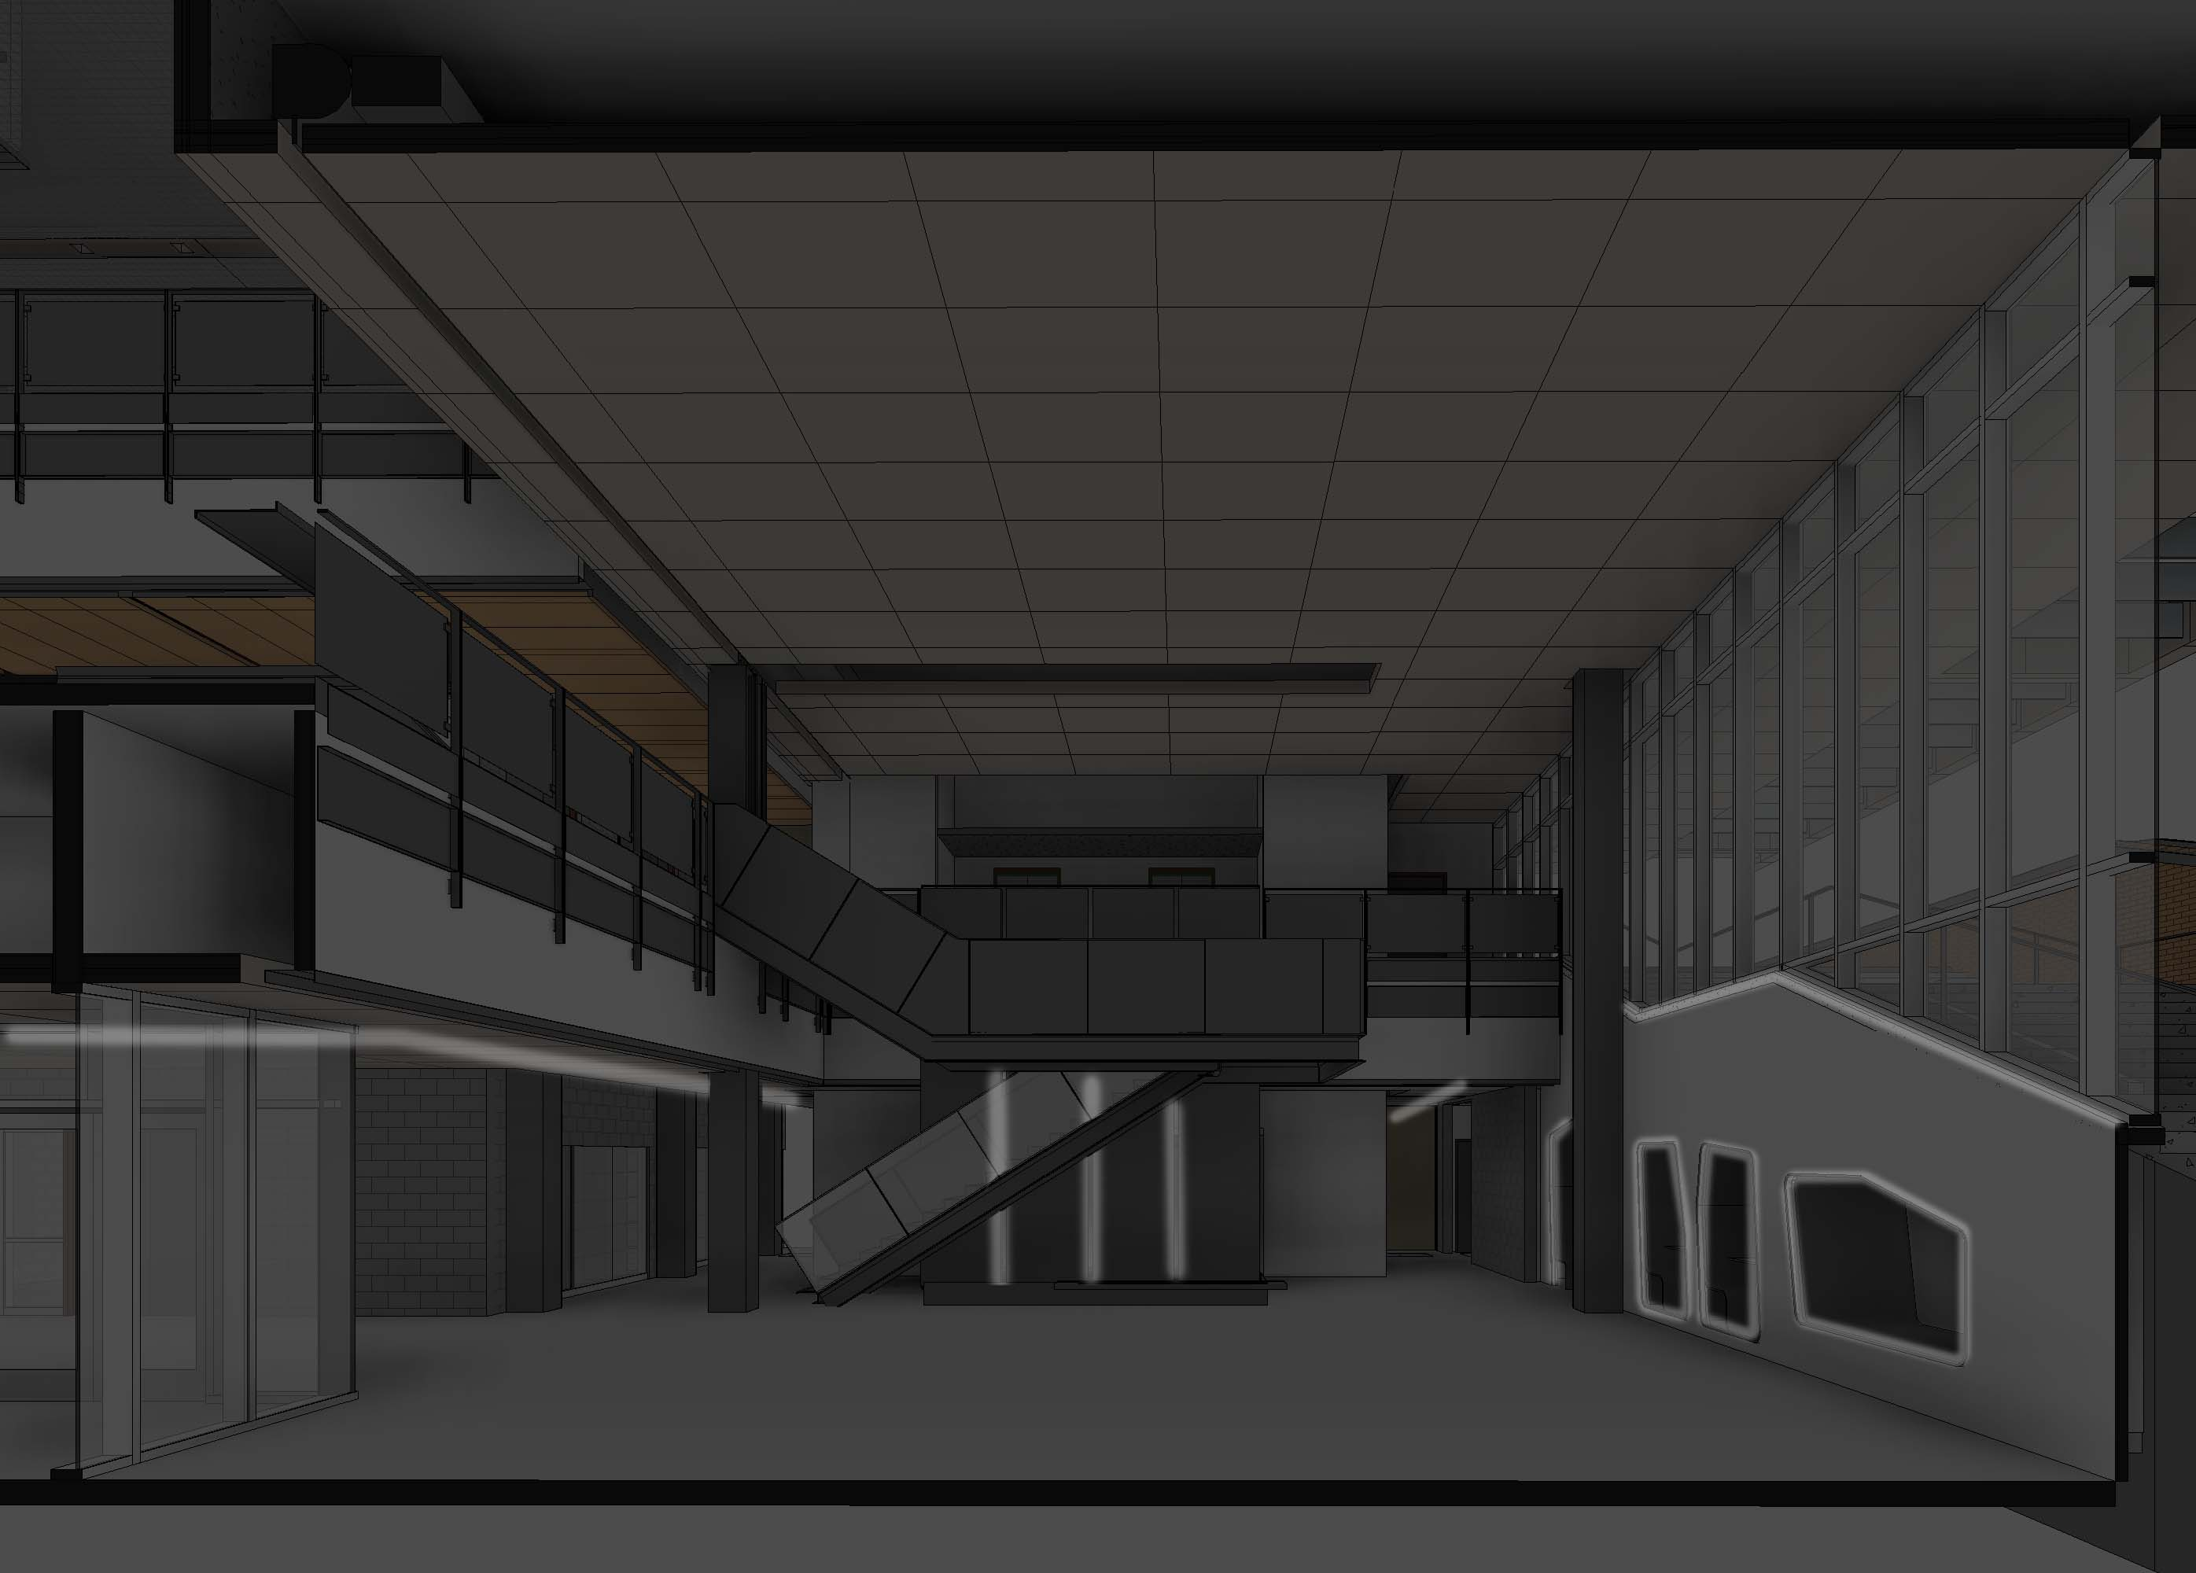
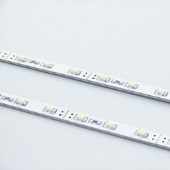
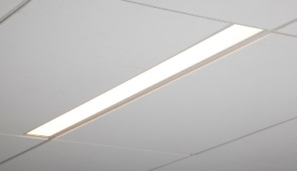
| lobby + atrium
building | concept | exterior walkway | lobby + atrium | auditorium | project labs | questions

Slide 21
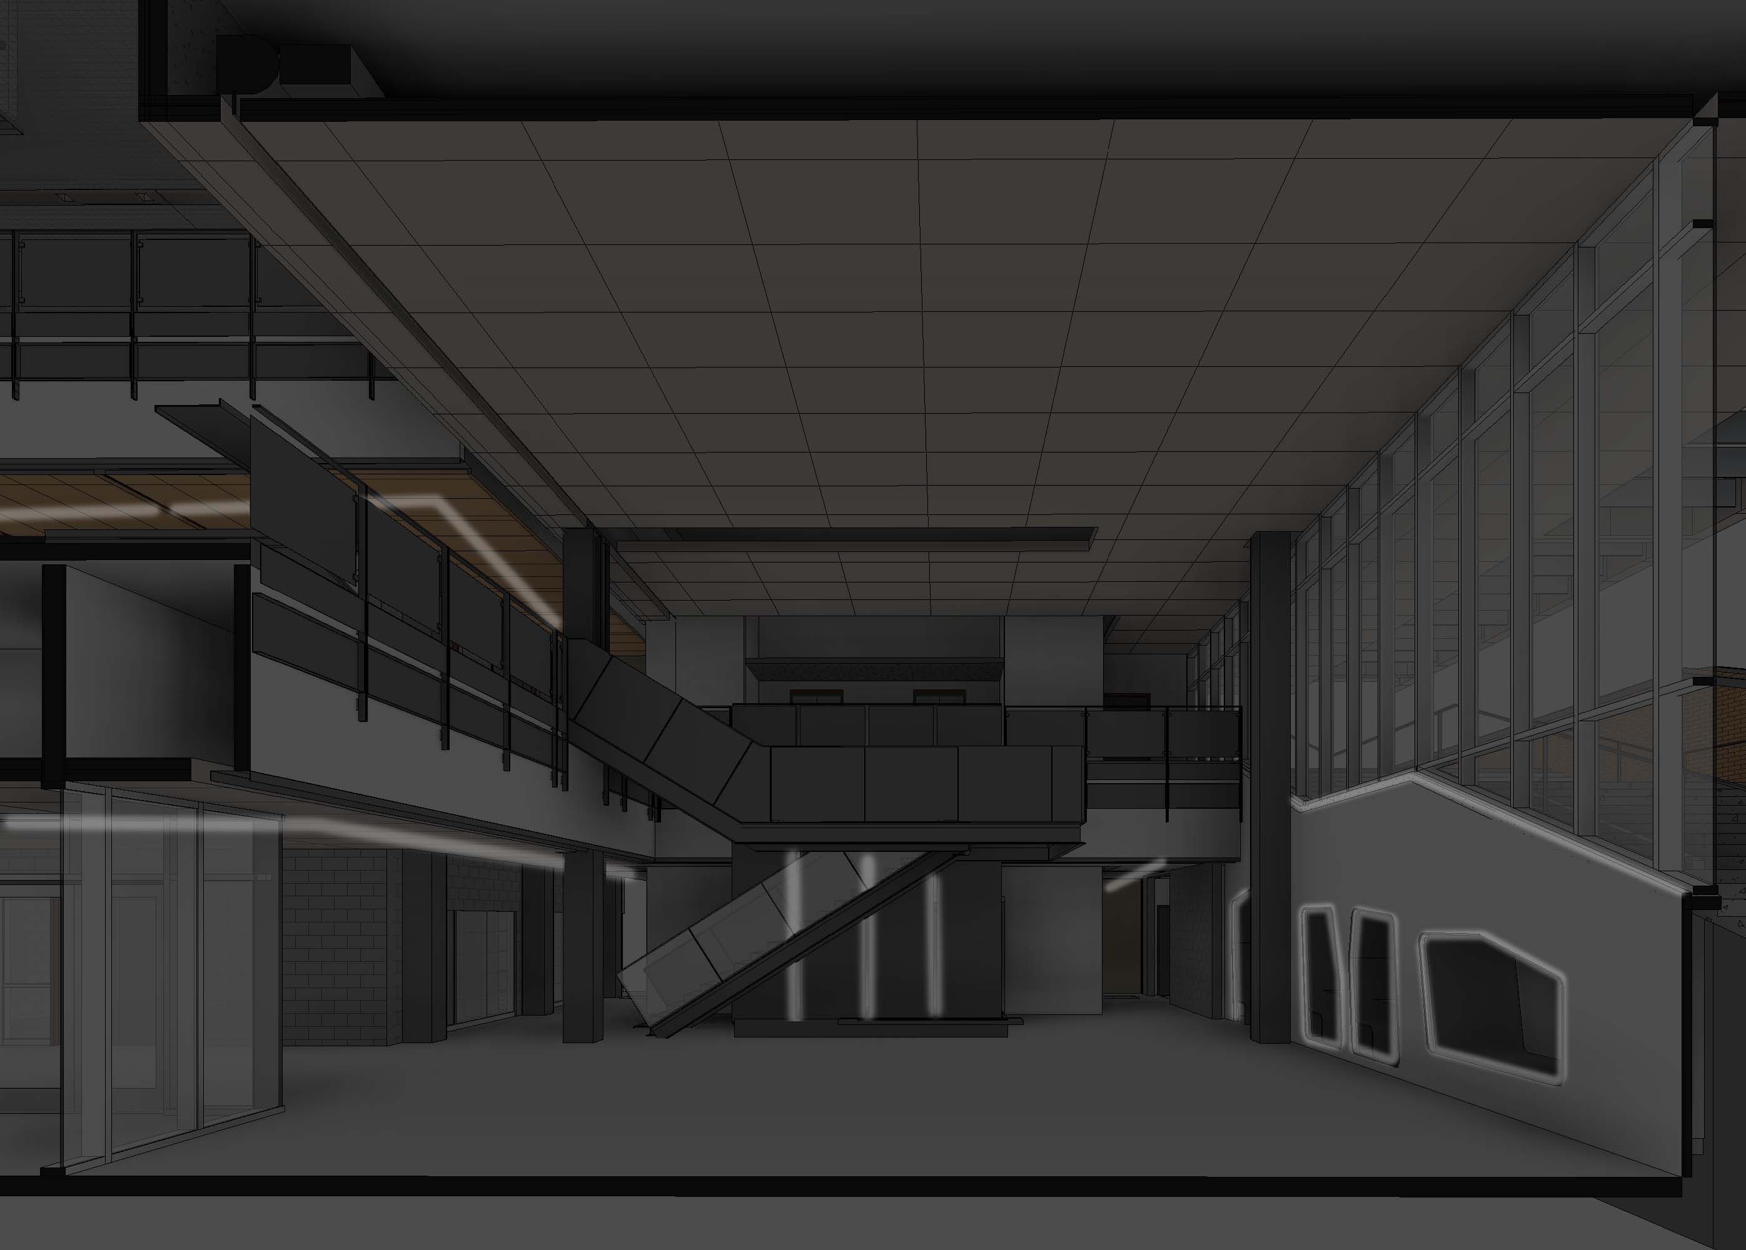
| lobby + atrium
building | concept | exterior walkway | lobby + atrium | auditorium | project labs | questions

Slide 22
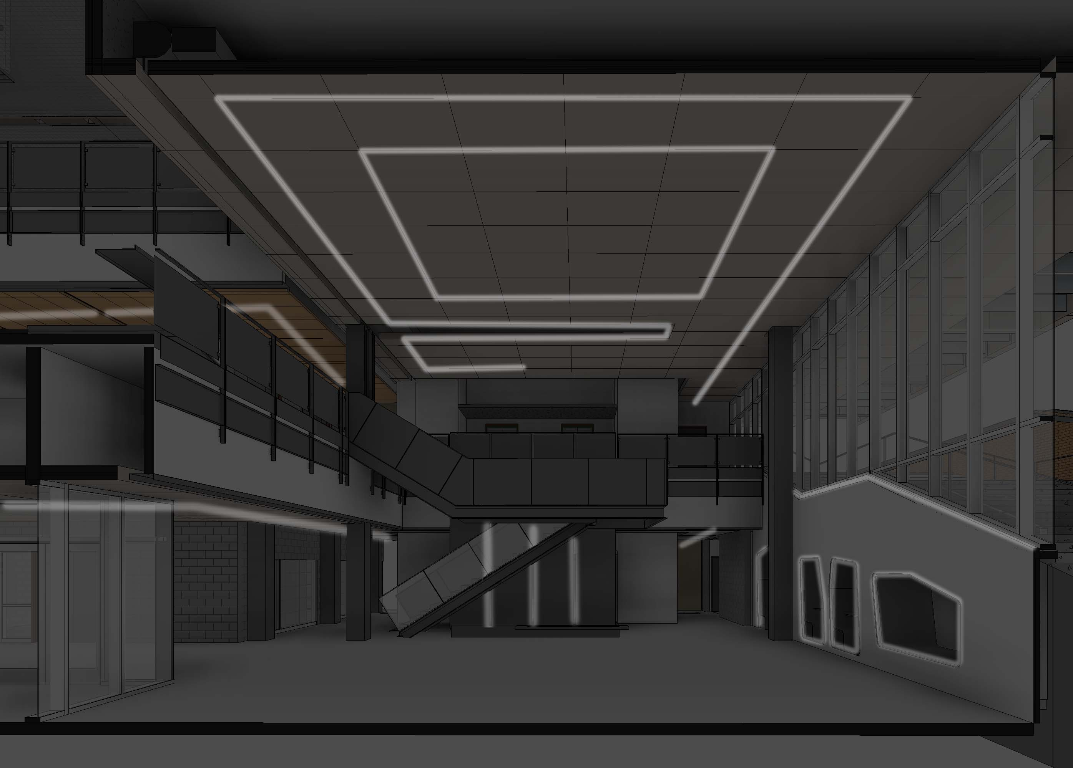
| lobby + atrium
building | concept | exterior walkway | lobby + atrium | auditorium | project labs | questions

Slide 23
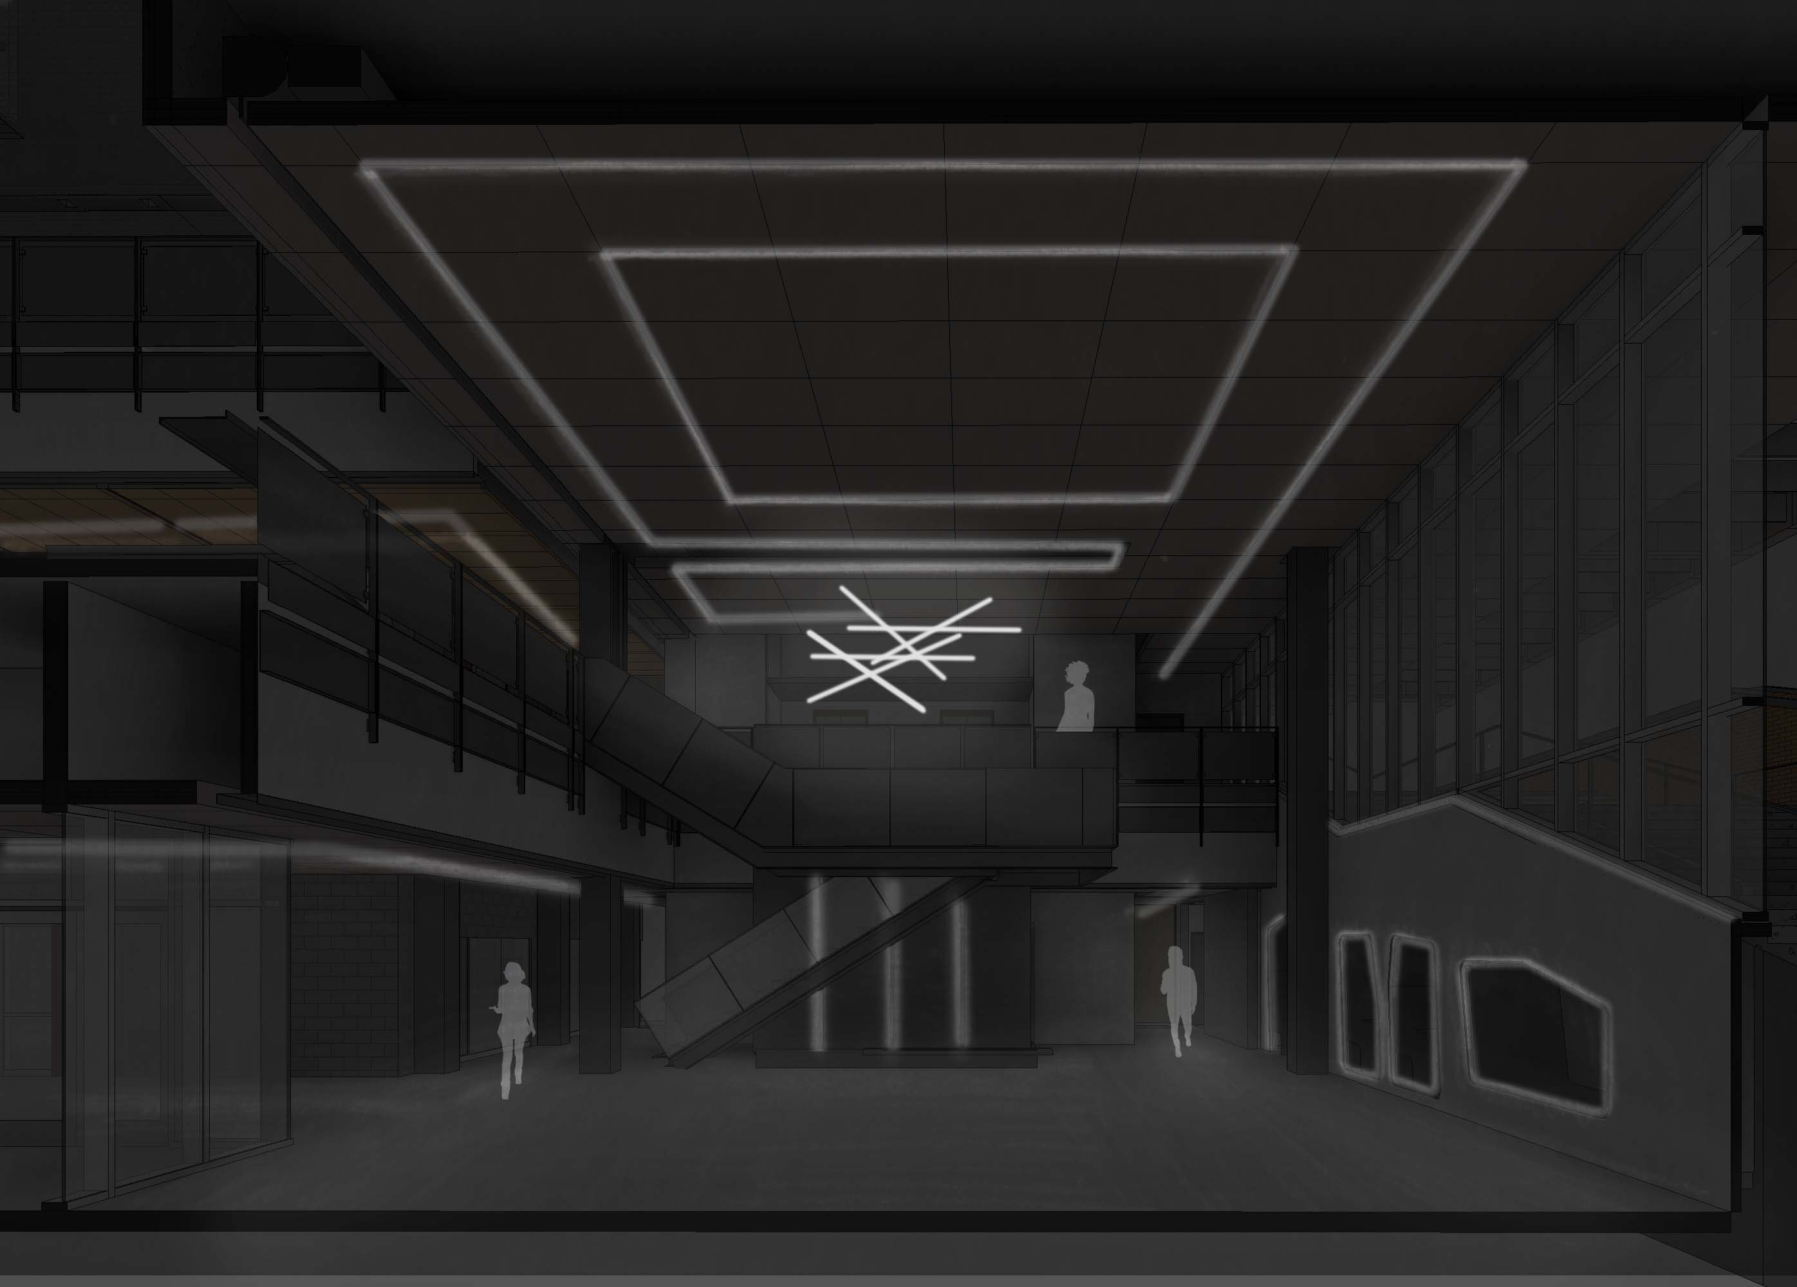
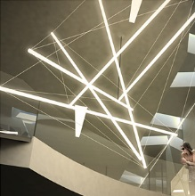
| lobby + atrium
building | concept | exterior walkway | lobby + atrium | auditorium | project labs | questions

Slide 24
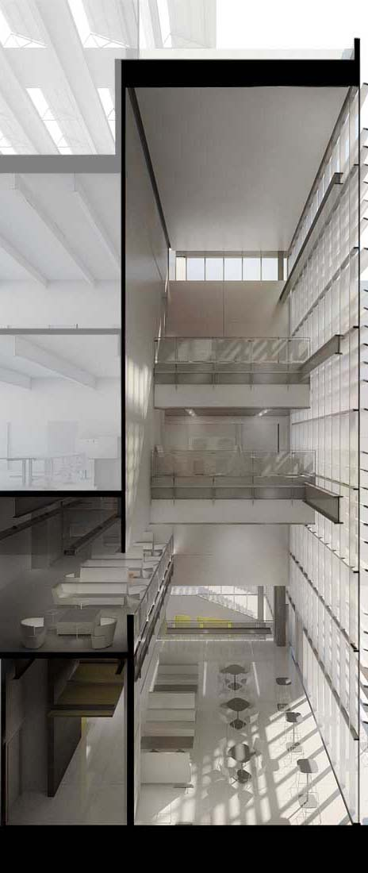
| lobby + atrium
building | concept | exterior walkway | lobby + atrium | auditorium | project labs | questions

Slide 25
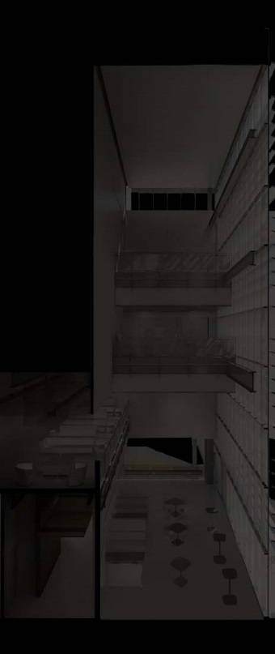
| lobby + atrium
building | concept | exterior walkway | lobby + atrium | auditorium | project labs | questions

Slide 26
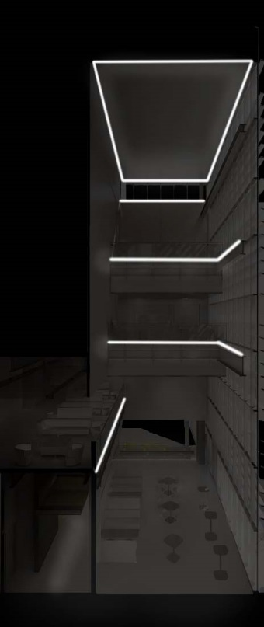
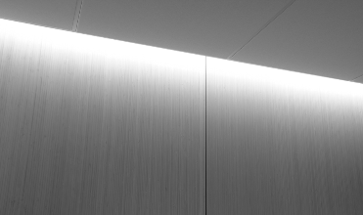
| lobby + atrium
building | concept | exterior walkway | lobby + atrium | auditorium | project labs | questions

Slide 27
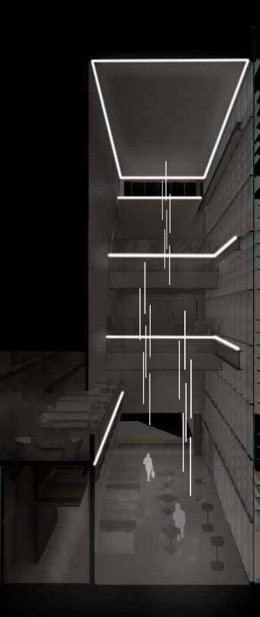
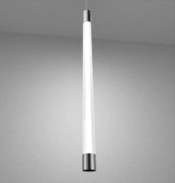
| lobby + atrium
building | concept | exterior walkway | lobby + atrium | auditorium | project labs | questions

Slide 28
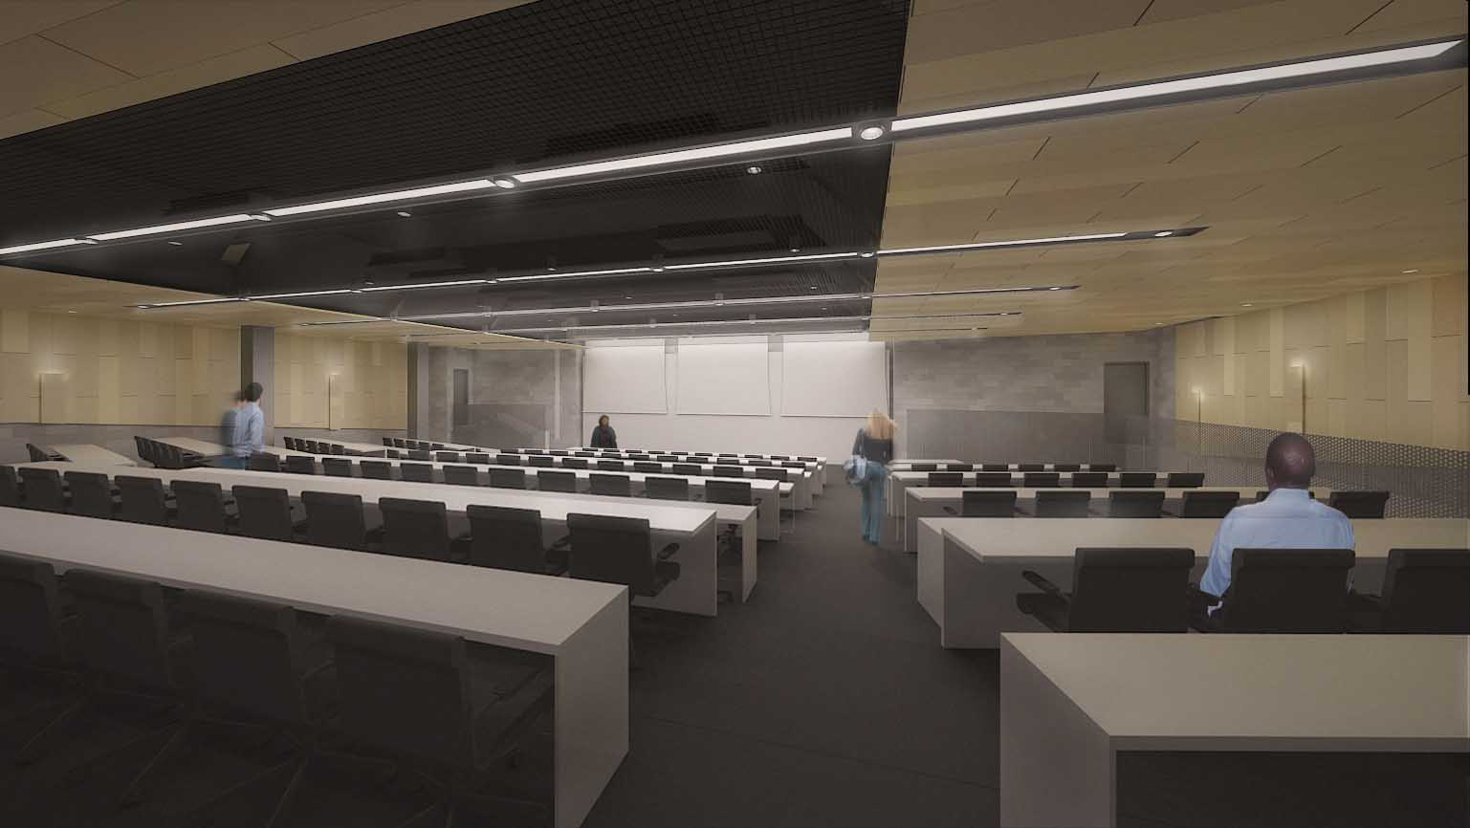
| auditorium
building | concept | exterior walkway | lobby + atrium | auditorium | project labs | questions

Slide 29
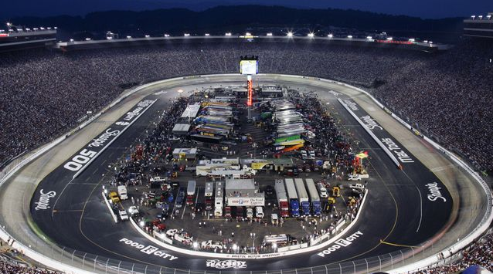
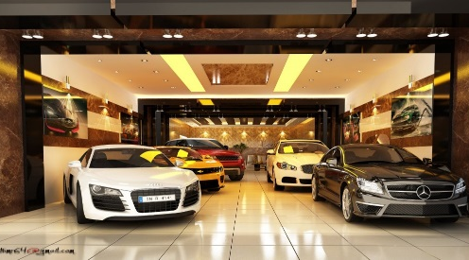
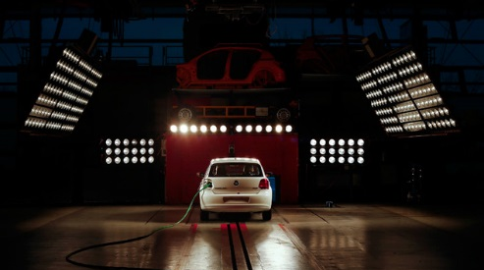
| auditorium
race track
learn from the achievements of others
show room
let the world see your own achievements
crash testing
test your ideas against others
building | concept | exterior walkway | lobby + atrium | auditorium | project labs | questions

Slide 30
| auditorium
design criteria
focus on the center or speaker
perimeter highlighted
rythm and symmetry
race track
LPD = 1.24 W/ft²
E_{h} = 300 lux
E_{v} = 75 lux
building | concept | exterior walkway | lobby + atrium | auditorium | project labs | questions

Slide 31
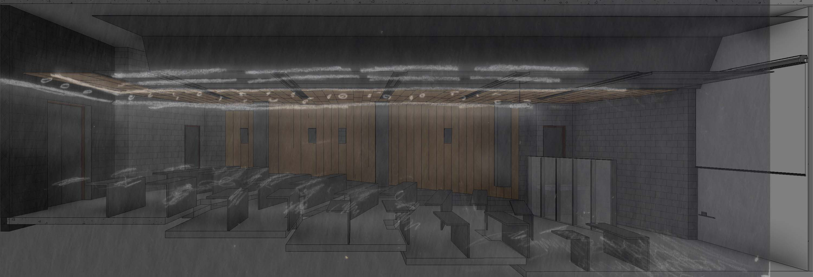
| auditorium
building | concept | exterior walkway | lobby + atrium | auditorium | project labs | questions

Slide 32
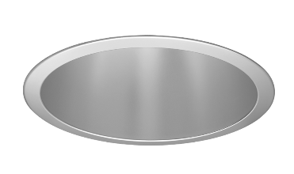
| auditorium
building | concept | exterior walkway | lobby + atrium | auditorium | project labs | questions

Slide 33
| auditorium
design criteria
high-end feeling space
versatile
focused
LPD = 1.24 W/ft²
E_{h} = 300 lux
E_{v} = 75 lux
building | concept | exterior walkway | lobby + atrium | auditorium | project labs | questions

Slide 34
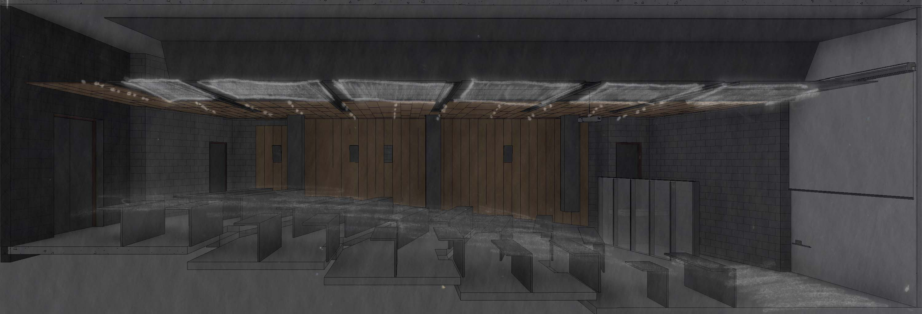
| auditorium
building | concept | exterior walkway | lobby + atrium | auditorium | project labs | questions

Slide 35
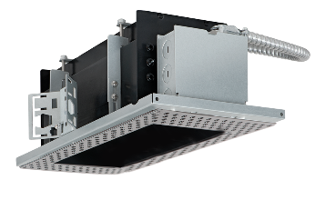
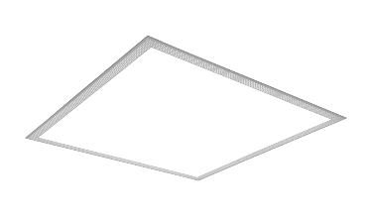
| auditorium
building | concept | exterior walkway | lobby + atrium | auditorium | project labs | questions

Slide 36
| auditorium
design criteria
point source lighting
multiple directions
focus on task and clarity
LPD = 1.24 W/ft²
E_{h} = 300 lux
E_{v} = 75 lux
building | concept | exterior walkway | lobby + atrium | auditorium | project labs | questions

Slide 37
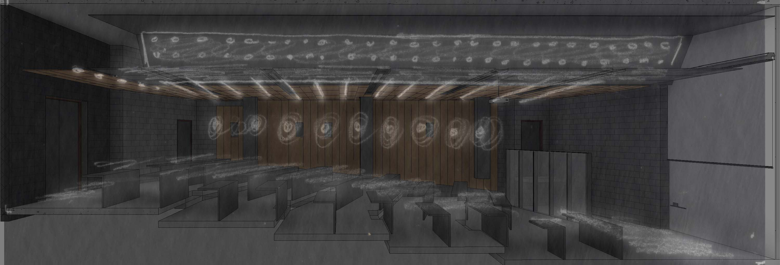
| auditorium
building | concept | exterior walkway | lobby + atrium | auditorium | project labs | questions

Slide 38
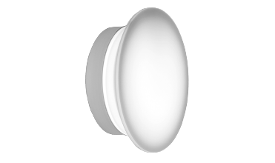
| auditorium
building | concept | exterior walkway | lobby + atrium | auditorium | project labs | questions

Slide 39
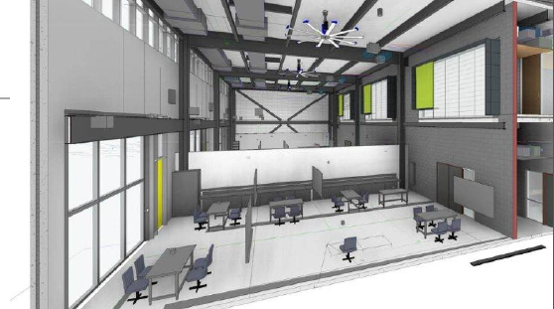
| project rooms
building | concept | exterior walkway | lobby + atrium | auditorium | project labs | questions

Slide 40
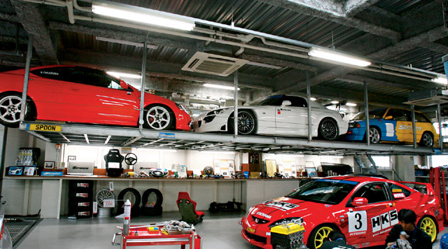
| project rooms
design criteria
starting gate of ideas
very intensive task oriented
shop + show room mix
stylized industrial feel
LPD = 1.4 W/ft²
E_{h} = 1000 lux
E_{v} = 500 lux
building | concept | exterior walkway | lobby + atrium | auditorium | project labs | questions

Slide 41
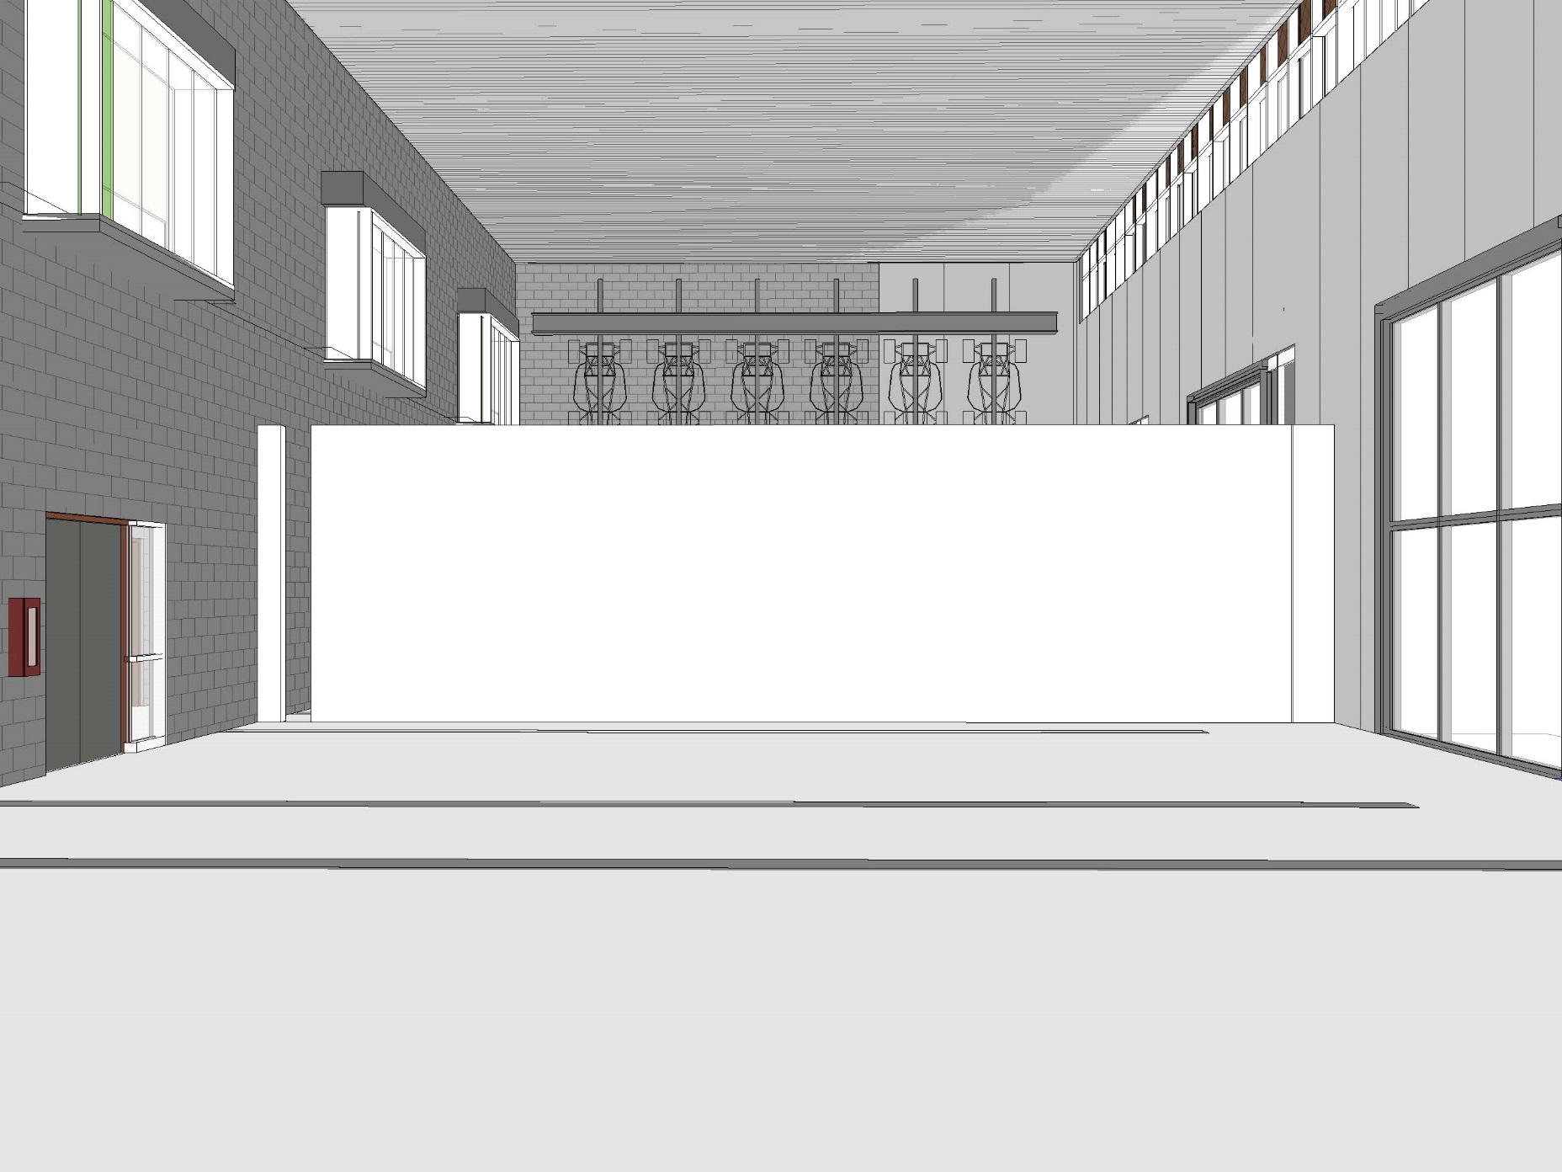
| project rooms
building | concept | exterior walkway | lobby + atrium | auditorium | project labs | questions

Slide 42
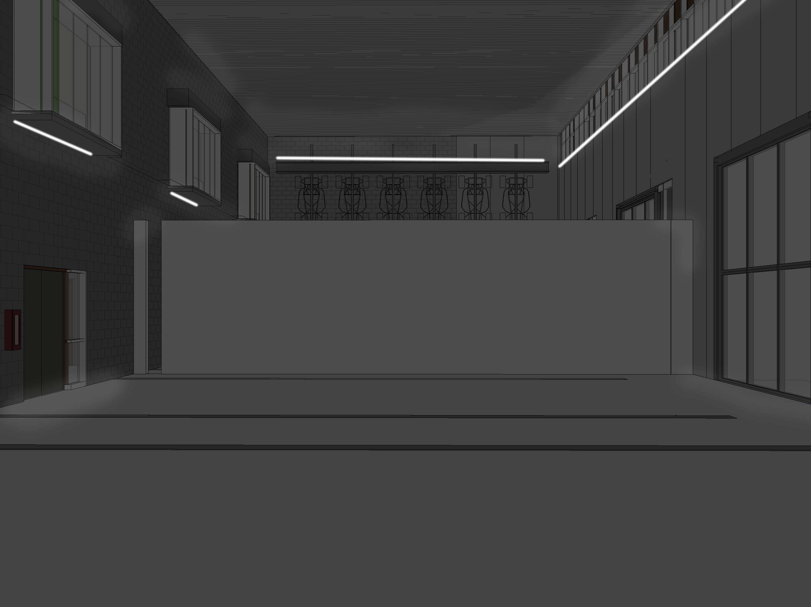
| project rooms
building | concept | exterior walkway | lobby + atrium | auditorium | project labs | questions

Slide 43
| project rooms
building | concept | exterior walkway | lobby + atrium | auditorium | project labs | questions

Slide 44
| project rooms
building | concept | exterior walkway | lobby + atrium | auditorium | project labs | questions

Slide 45
| questions
special thanks to
SmithGroupJJR for all models and images used
shawn good
richard mistrick
building | concept | exterior walkway | lobby + atrium | auditorium | project labs | questions

