Slide 1

DENVER POLICE DPT. CRIME LAB
jackie eury
senior thesis presentation
lighting | electrical
15 april 2015
Notes:
Hey everyone, my name is Jackie eury, I’m a 5th year lighting/electrical student and this is my thesis presentation on the Denver Police Department Crime lab.

Slide 2

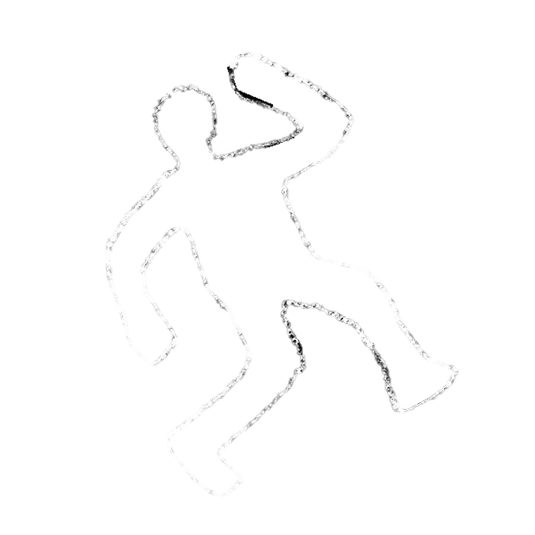
denver crime lab
introduction
lighting depth
lobby
south plaza
electrical depth
photovoltaic array
construction breadth
structural breadth
conclusion
Notes:
First, I wanted to run through today’s agenda. I will be touching on two of my spaces (lobby and south plaza) in the lighting depth, go over a pv array design in my electrical depth, and look for financial and structural support for the installation in my two breadths. Let’s jump right into the basics (click)

Slide 3
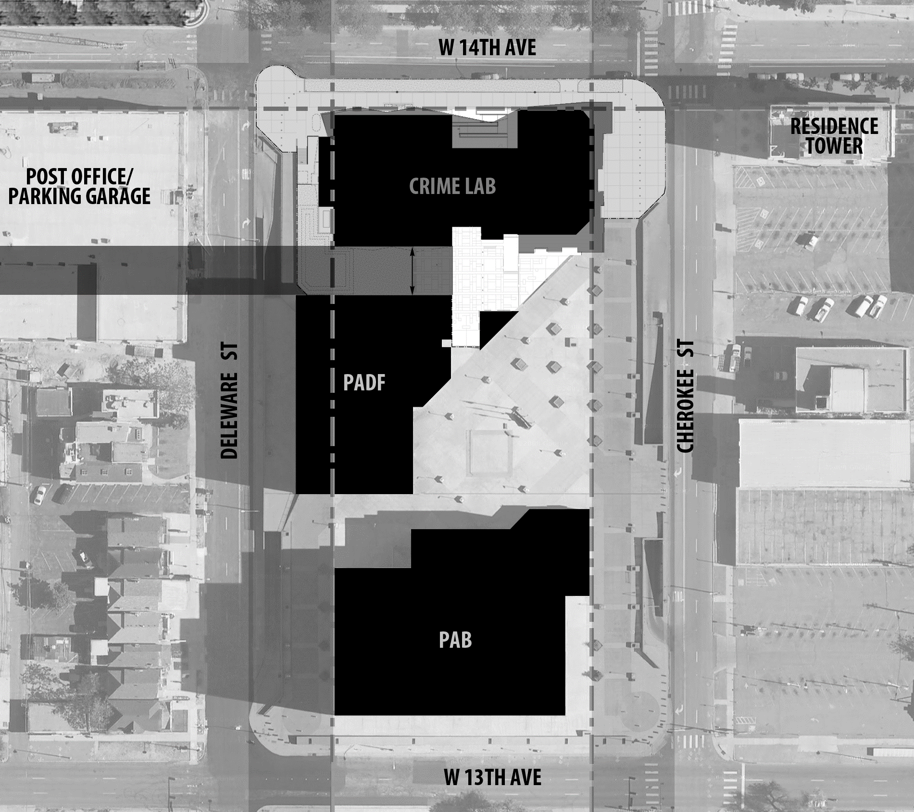
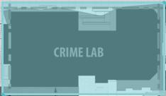
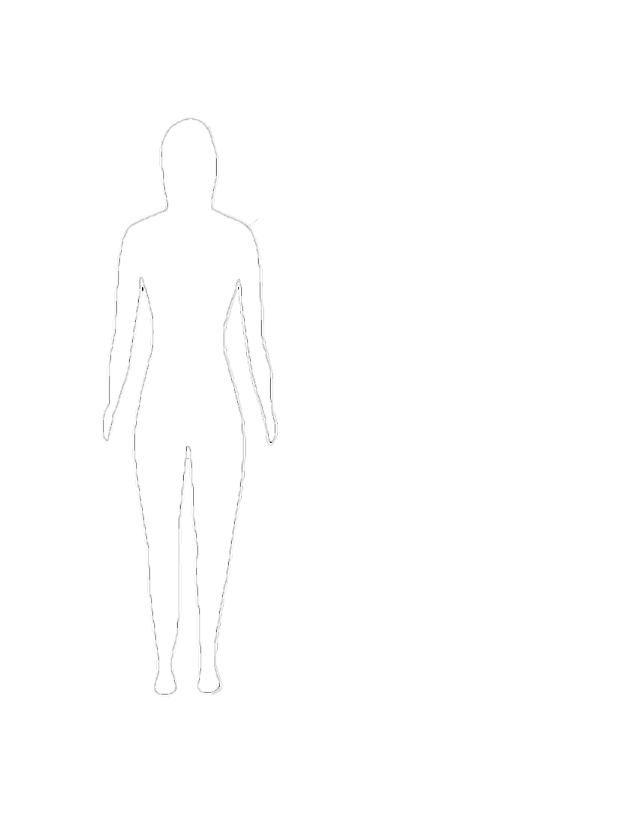
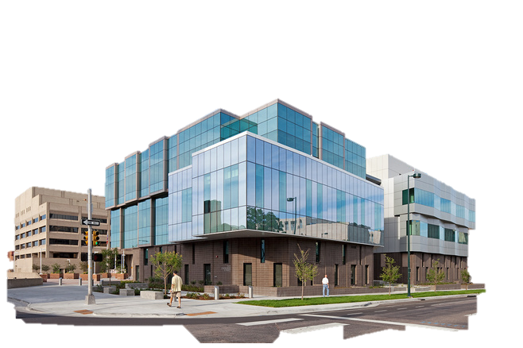
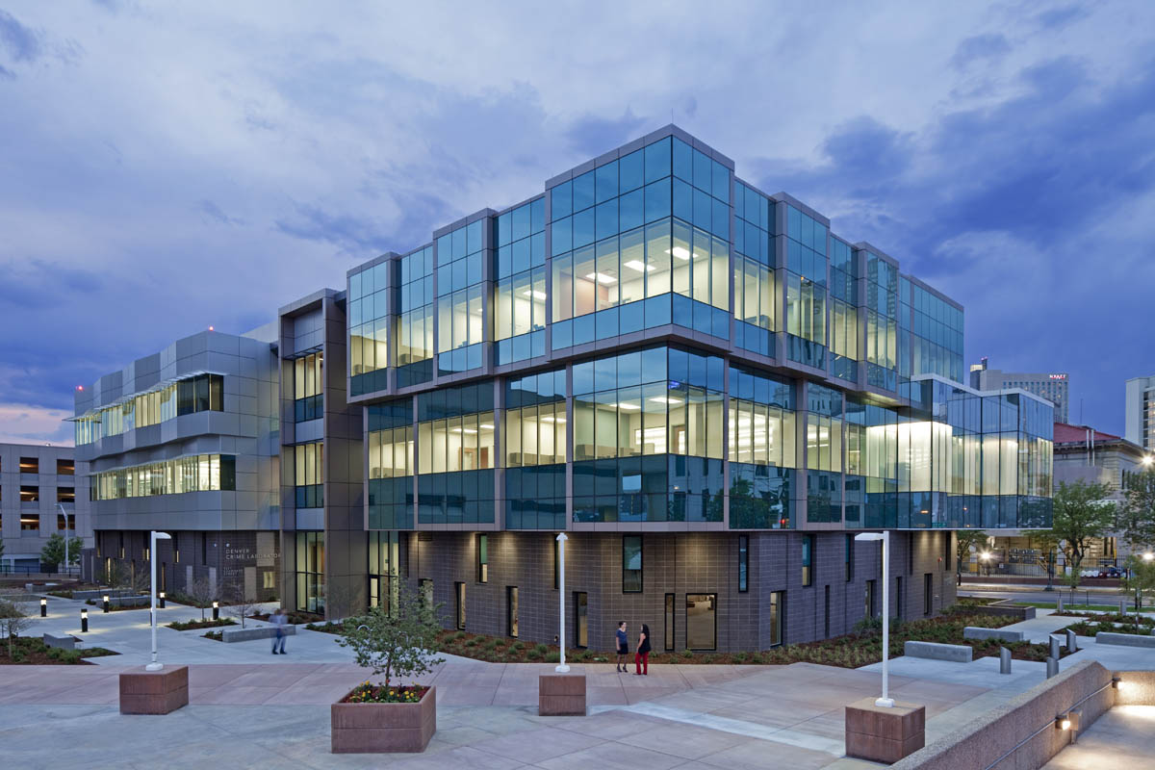


denver crime lab
introduction
lighting depth
lobby
south plaza
electrical depth
photovoltaic array
construction breadth
structural breadth
conclusion
building statistics
building location
location | denver, colorado
occupant | denver police department
type | laboratory
size | 60,000 gsf
constructed | march 2011 – july 2012
actual cost | $28 million
Notes:
The Denver crime lab is located in the center of Denver in a zoned as the golden triangle district. Occupied by crime lab, and usually operates until 3 am Monday through Friday. It is a laboratory that houses 3 stories and around 60,000 sf. (click) The crime lab stands just north of the Denver police department and a large parking deck. With logistics out of the way, it’s time to get into the (click) lighting depth

Slide 4
denver crime lab
introduction
lighting depth
lobby
south plaza
electrical depth
photovoltaic array
construction breadth
structural breadth
conclusion
l i g h t i n g d e p t h

Slide 5
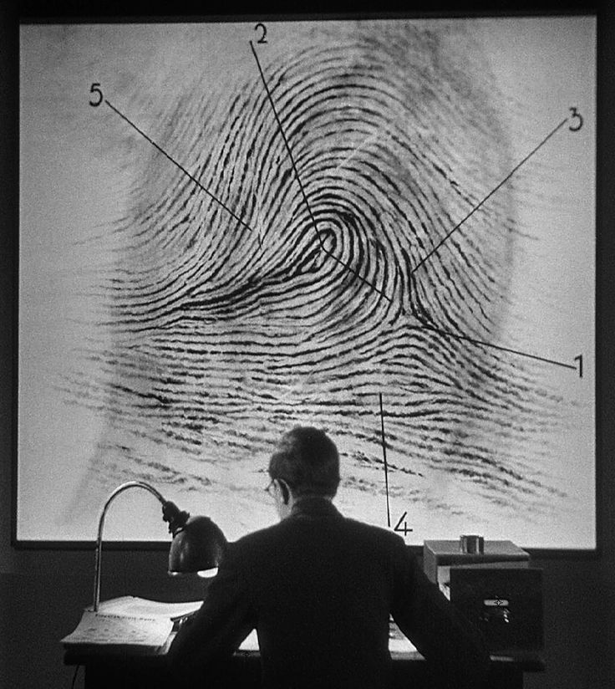
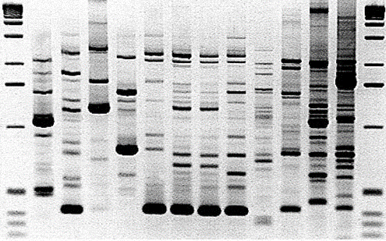
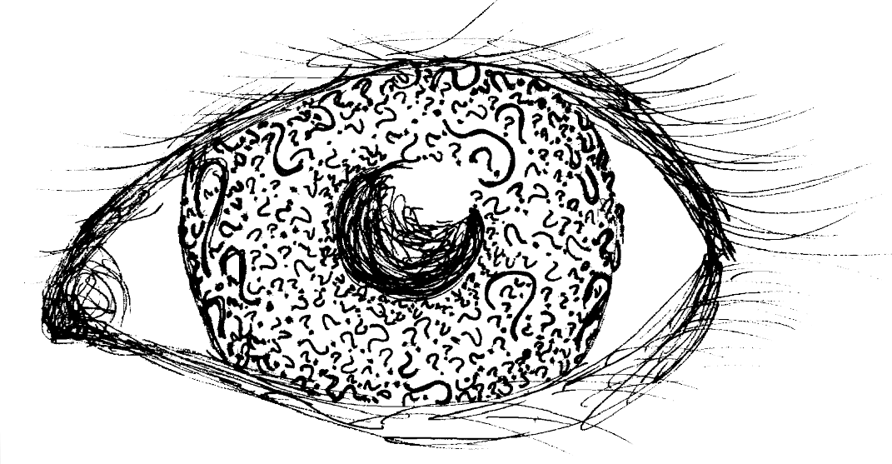
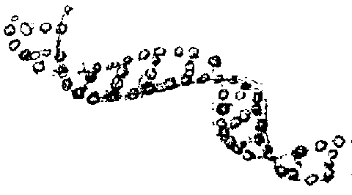
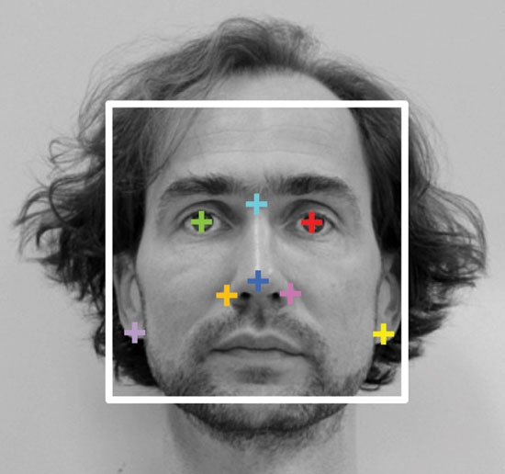
denver crime lab
introduction
lighting depth
lobby
south plaza
electrical depth
photovoltaic array
construction breadth
structural breadth
conclusion
concept
investigation
research
justice
mystery
i d e n t i t y
analysis
discovery
trials
chemistry
teamwork
Notes:
When searching for a concept, I thought of the people that occupy the crime lab. People that are constantly researching, studying, and analyzing evidence. Their work leads to the solution of a case, the conviction of a criminal, and the peaceful mind of a victim. What they are ultimately doing is discovering someone’s I D E N T I T Y. It could be a drop of blood left at a crime scene, a physical feature observed by a witness, or a fingerprint on a murder weapon. All of these components are ways to discover a person’s identity. This concept, along with the architecture and function of each space influence the lighting design. With that in mind, let me introduce you to the lobby.

Slide 6
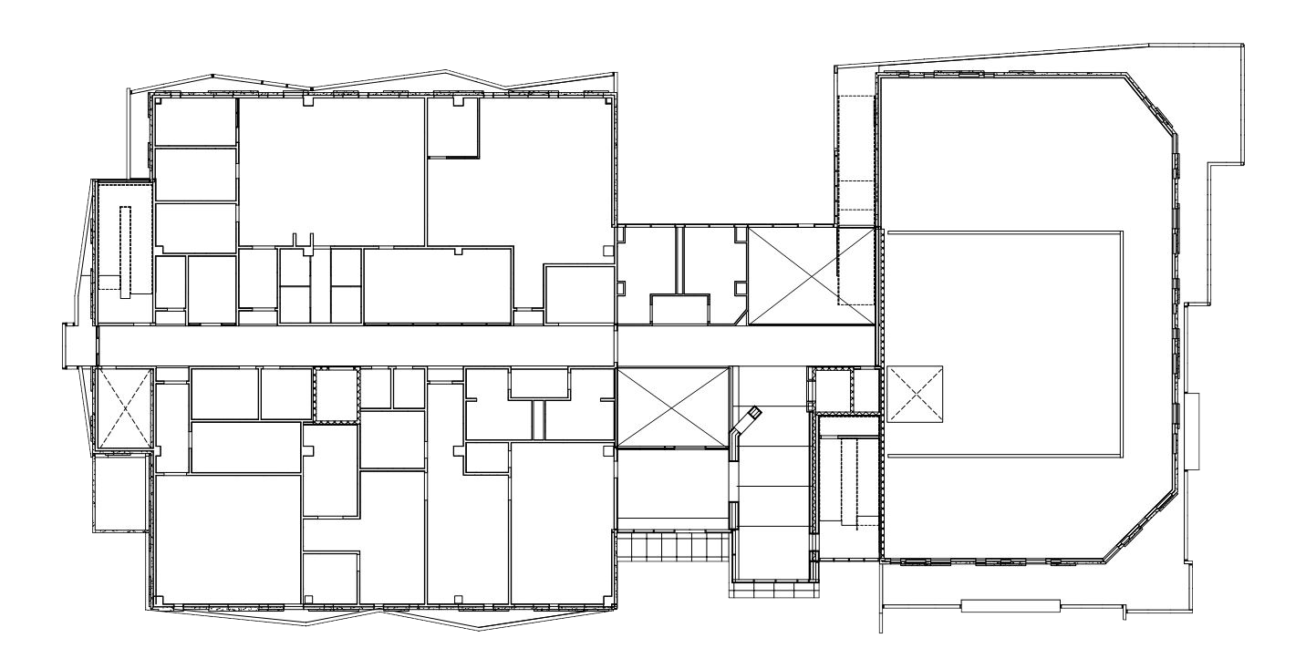
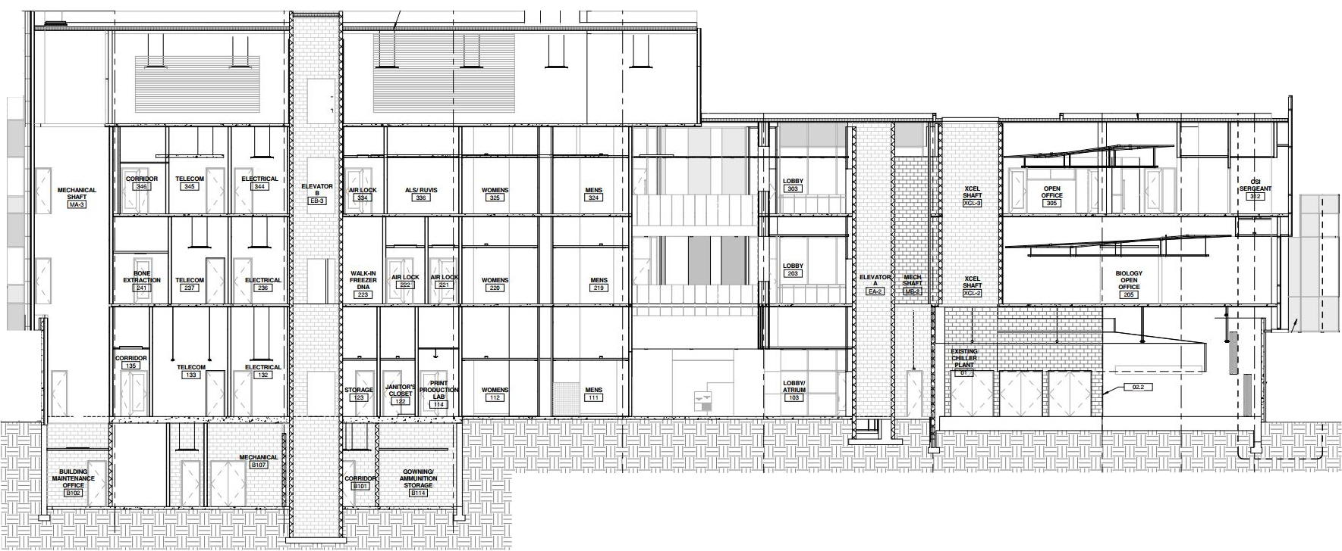
denver crime lab
introduction
lighting depth
lobby
south plaza
electrical depth
photovoltaic array
construction breadth
structural breadth
conclusion
orientation
plan
l o b b y
section
Notes:
The lobby is located in the center of the building with occupants entering through the south atrium. The north atrium also reaches 3 floors and instead of reception, has a lounge space and staircase. Connecting the two is a 12’ high corridor. Within the lobby are two atriums that carry through the three stories of the building and accommodate corridors. An elevator and large staircase help transition employees throughout the building.
Area | 1903 ft²
Ceiling Height | 12’-0,” 46’-0”
Room Length | 71’-0”
Room Width | 51’-0”
Ceiling | Perforated Metal Panels
Walls | Gypsum, Composite Panels, Wood Panels
Floor | Terrazzo, Carpet

Slide 7
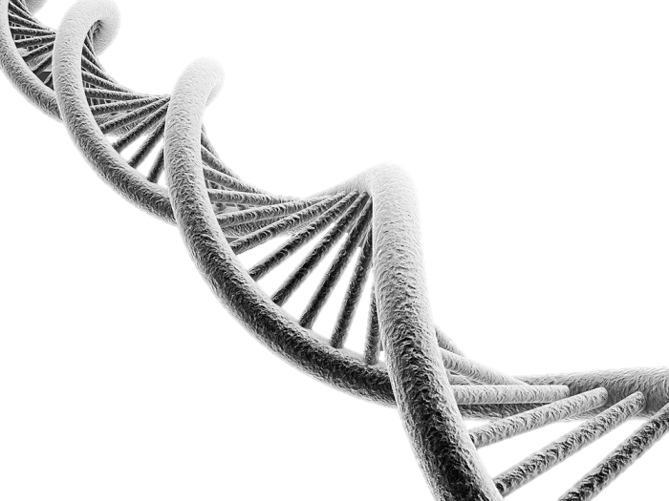
denver crime lab
introduction
lighting depth
lobby
south plaza
electrical depth
photovoltaic array
construction breadth
structural breadth
conclusion
concept
core
beginning
d n a
Notes:
Just as a strand of DNA becomes the genetic material of a person’s beginning, the Lobby represents the start of the building and is truly its core. There are traditional (double helix) and new ways (dna fingerprint) to analyze DNA.

Slide 8
denver crime lab
introduction
lighting depth
lobby
south plaza
electrical depth
photovoltaic array
construction breadth
structural breadth
conclusion
qualitative criteria
quantitative criteria
illuminance levels
aesthetics
Task | E_{h} (lux) | Avg:Min
Transition | - | -
Day Night | 100 50 | 4:1 4:1
Reception | 150 | 4:1
Lounge | 150 | 2:1
transition
welcoming
lighting power density
Space | Allowance (W/ft²)
Lobby | 1.10
bright
Notes:
As the main entrance space, and first visually impactful room in the crime lab, the lobby should be aesthetically pleasing.
Power density.

Slide 9
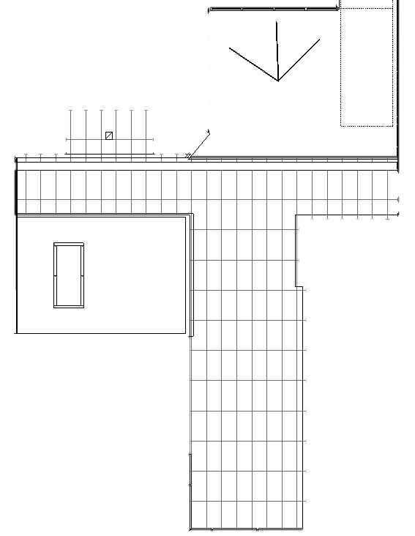
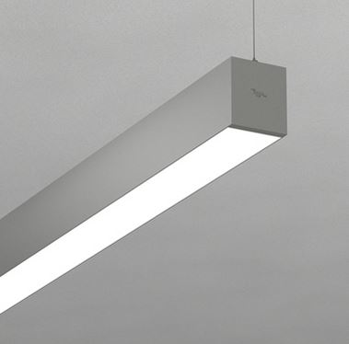
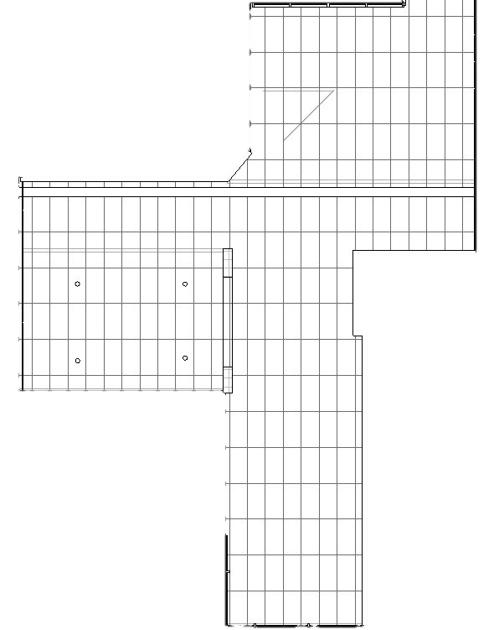
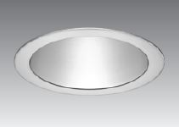
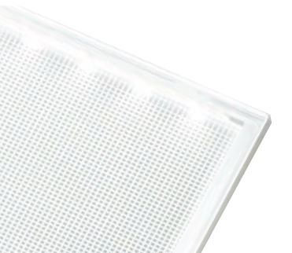
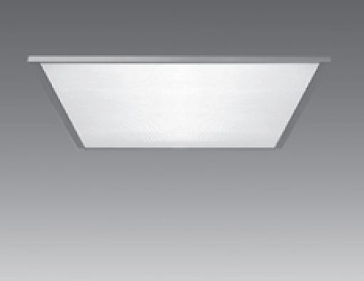
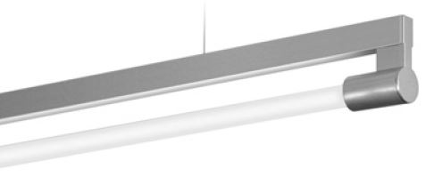

denver crime lab
introduction
lighting depth
lobby
south plaza
electrical depth
photovoltaic array
construction breadth
structural breadth
conclusion
reflected ceiling plans
first floor
third floor
Notes:
spacing between rl2a, rl2b
dimming

Slide 10
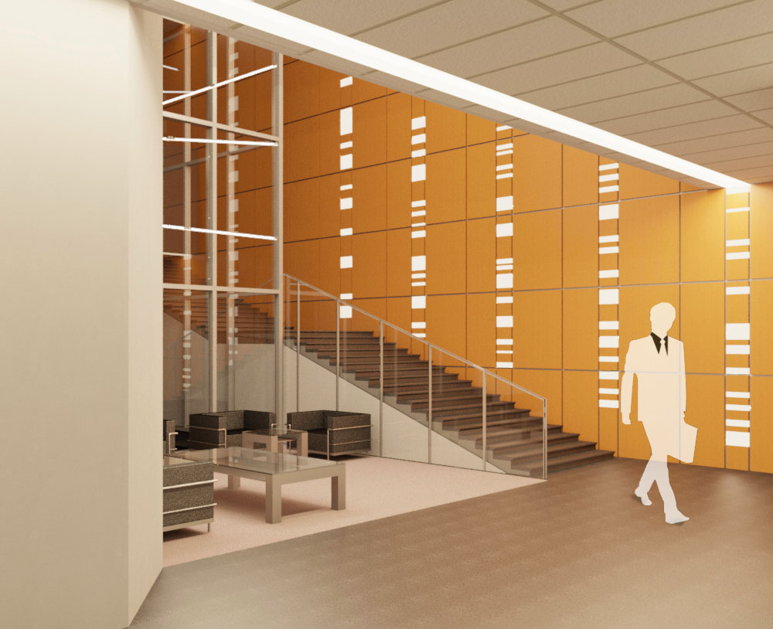
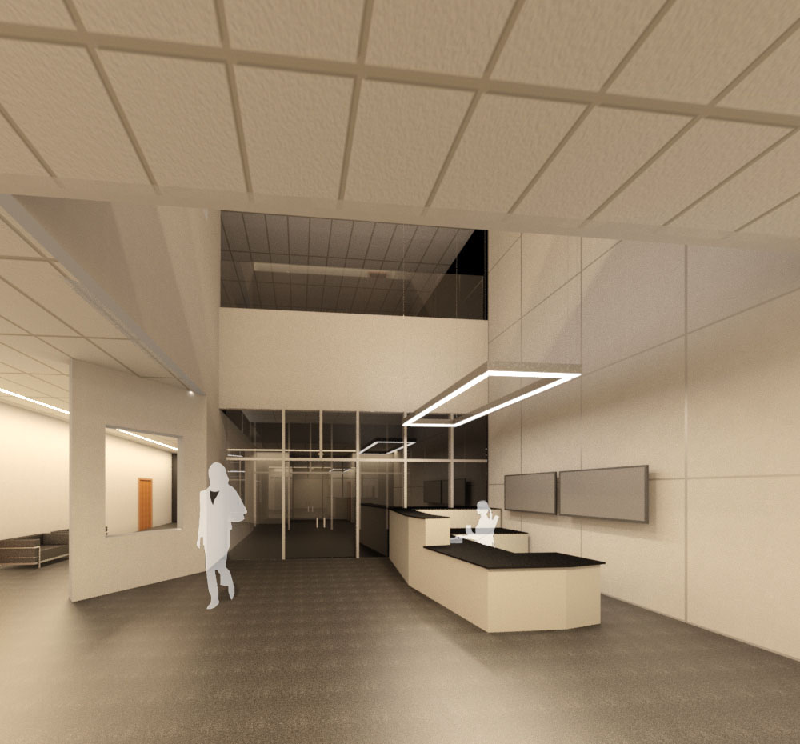
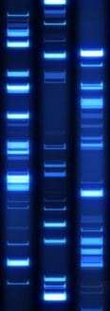
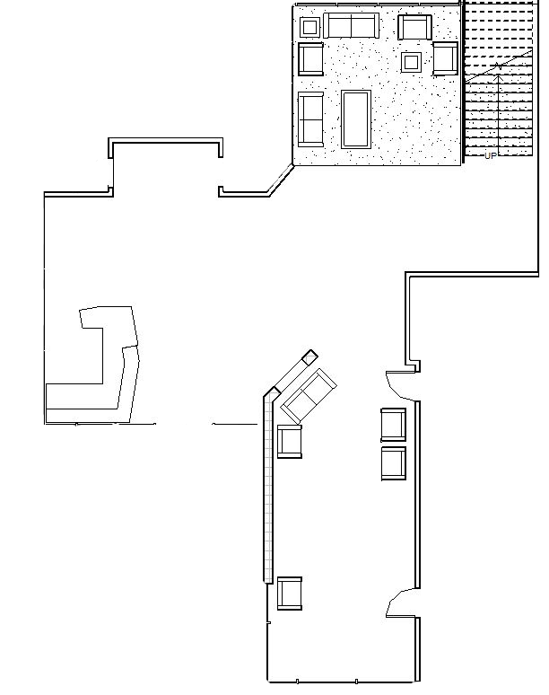
denver crime lab
introduction
lighting depth
lobby
south plaza
electrical depth
photovoltaic array
construction breadth
structural breadth
conclusion
renderings
plan view
first floor
Notes:
Entrance. Brightly lit. Upon turning away from the desk a visitor’s eyes would be drawn to the wood wall, which showcases a dna fingerprint design using 3 different sizes of led panels.
When walking into the Denver Crime Lab, a visitor is immediately drawn to the reception desk, which is brightly illuminated. From there, one can be guided to the elevator or corridors through recessed linear LED panels that create a line of transition. However, one may be drawn to the exposed staircase via the DNA fingerprint design incorporated in the wood-paneled wall. This LED design is intended to be eye-catching, and can be seen upon turning away from the reception desk. In contrast to the wall, there is a DNA helix inspired pendant that hangs in the North Atrium above the lounge. The helix, which is composed of bare fluorescent lamps represents the older idea of DNA whereas the LED DNA wall represents the leaps technology has made in crime investigation and lamp type together.

Slide 11
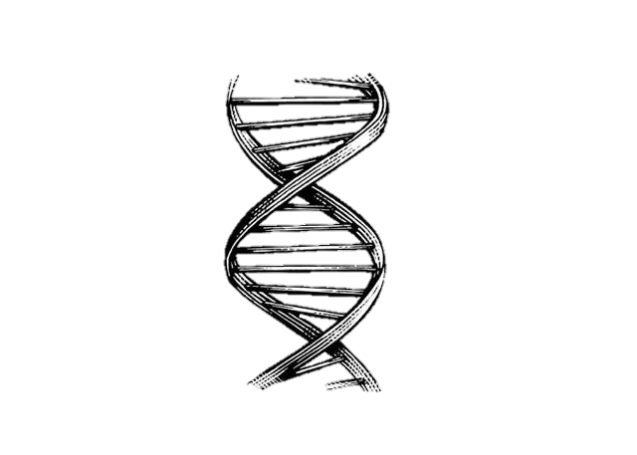
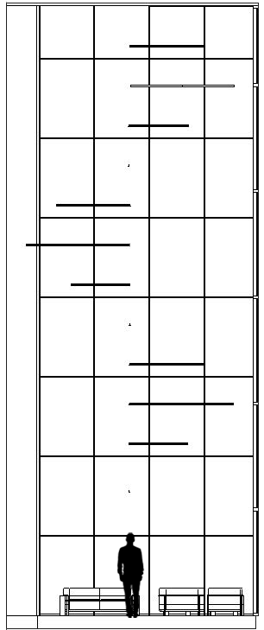
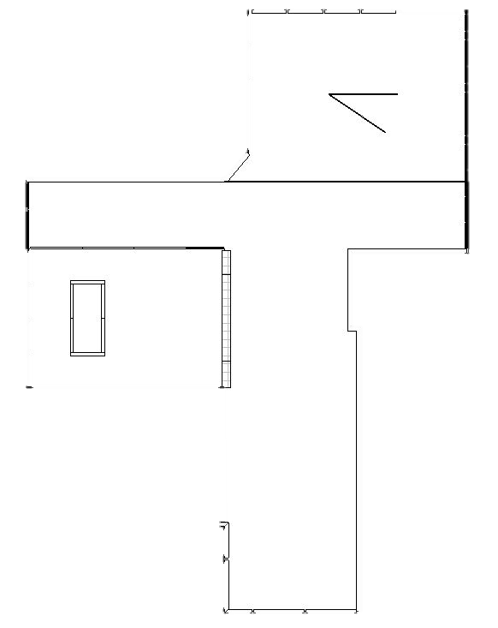
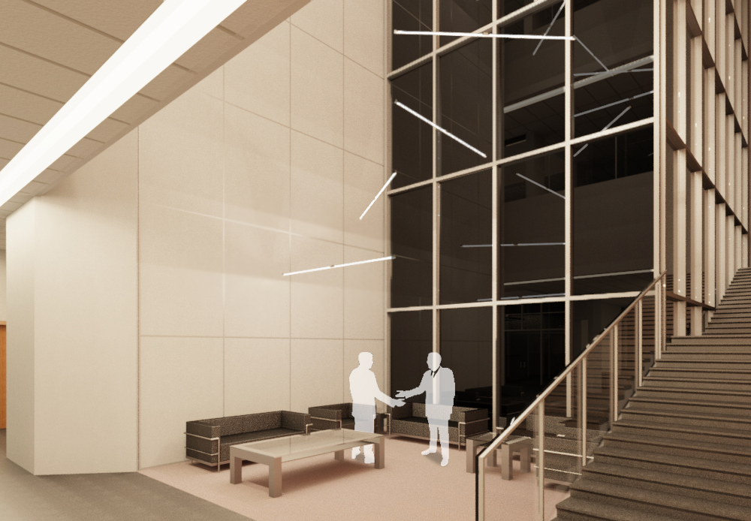
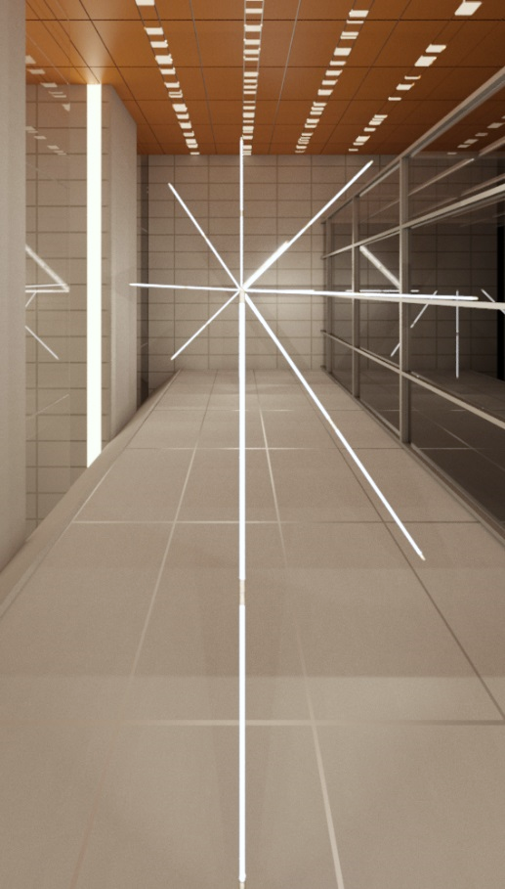
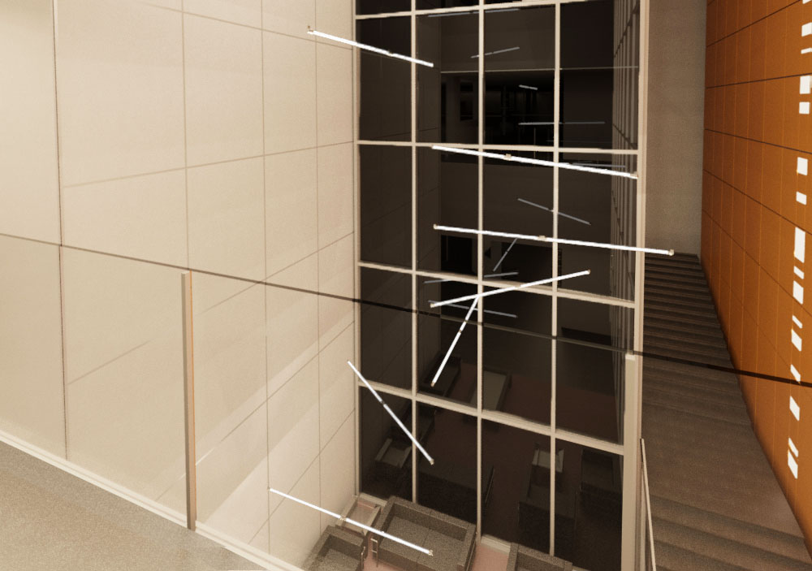
denver crime lab
introduction
lighting depth
lobby
south plaza
electrical depth
photovoltaic array
construction breadth
structural breadth
conclusion
renderings
plan view
second floor
first floor
Notes:
Upon entering the lounge you are greeted with the next focal point, a double-helix inspired pendants. The 12 pendants twist around in a spiral to the 3rd floor of the crime lab atrium. Giving viewers who decide to rest in the lounge sufficient light and

Slide 12
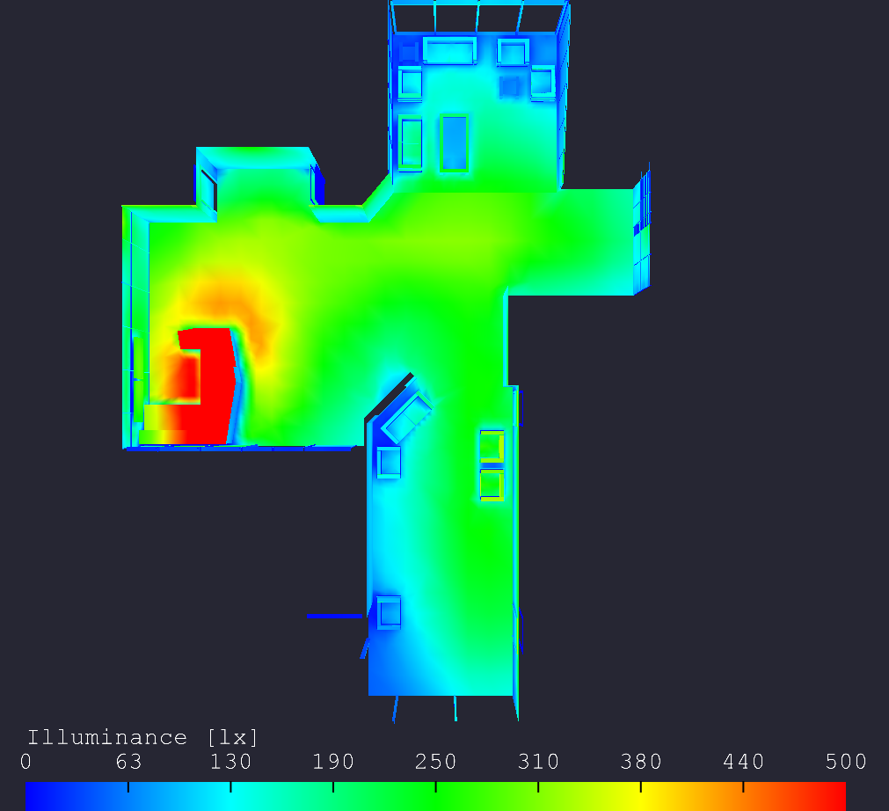
denver crime lab
introduction
lighting depth
lobby
south plaza
electrical depth
photovoltaic array
construction breadth
structural breadth
conclusion
quantitative data
elumtools calculation
Illuminance average | 206 lux
average/minimum | 3.7:1
lighting power density | 1.0 w/sf
Notes:
An Elumtools calculation can be shown on the right.

Slide 13
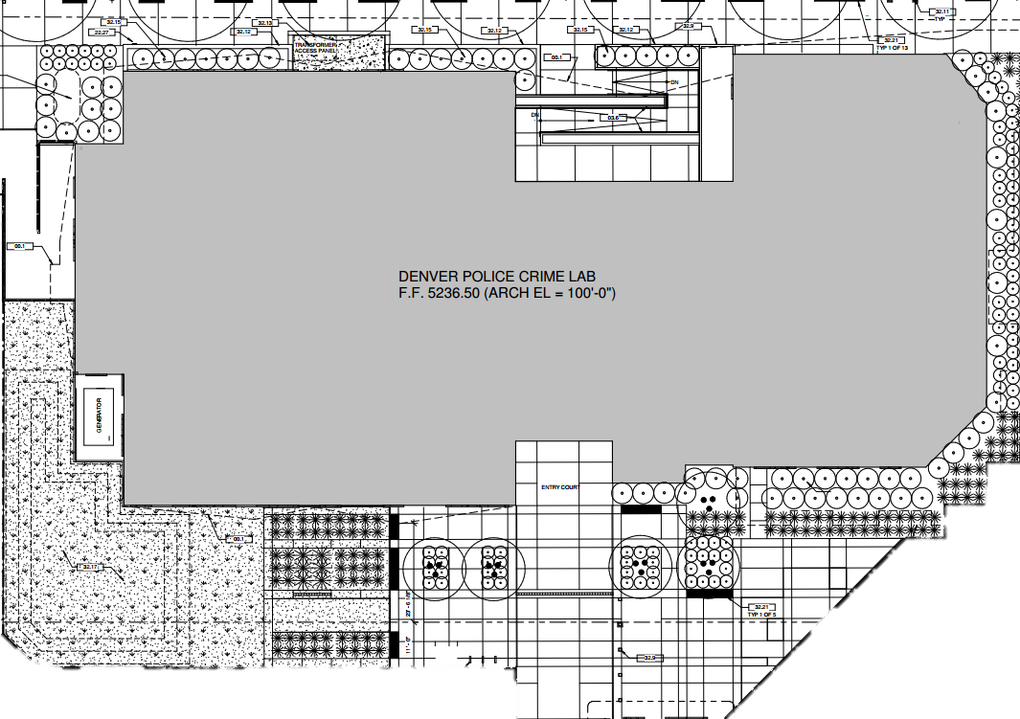
denver crime lab
introduction
lighting depth
lobby
south plaza
electrical depth
photovoltaic array
construction breadth
structural breadth
conclusion
orientation
s o u t h p l a z a
plan
Notes:
5500 sf

Slide 14
denver crime lab
introduction
lighting depth
lobby
south plaza
electrical depth
photovoltaic array
construction breadth
structural breadth
conclusion
concept
individuality
f i n g e r p r i n t
one of a kind
uniqueness
Notes:
The identity for the south plaza was inspired by individuality, one of a kind uniqueness.

Slide 15
denver crime lab
introduction
lighting depth
lobby
south plaza
electrical depth
photovoltaic array
construction breadth
structural breadth
conclusion
qualitative criteria
quantitative criteria
illuminance levels
relaxation
Task | E_{h} (lux) | E_{v} (lux) | Avg:Min
Transition – Plaza | 6 | 2 | 5:1
safety
lighting power density
Space | Base Allowance (W) | Allowance (W/sf) | Square Footage | Total Allowance (W)
South Plaza | 1300 | 0.2 | 5500 | 2400
model lighting ordinance
Space | Lighting Zone | Allowance (LM/sf)
South Plaza | LZ4 | 7.5
Notes:
performance method, Flynn modes

Slide 16
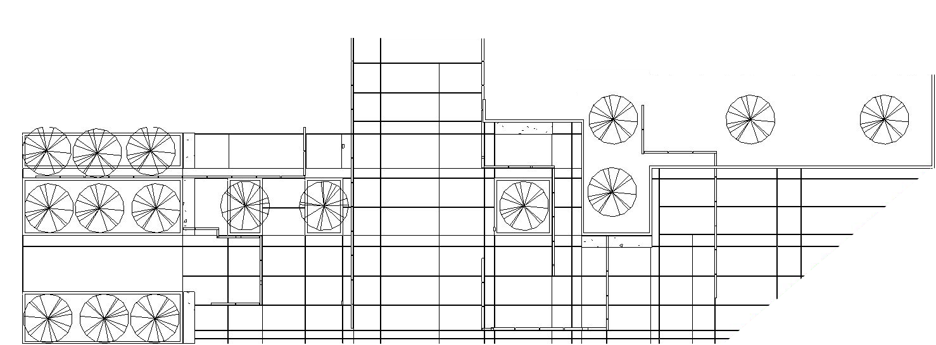
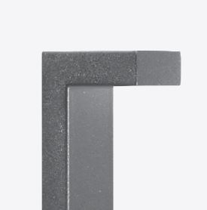
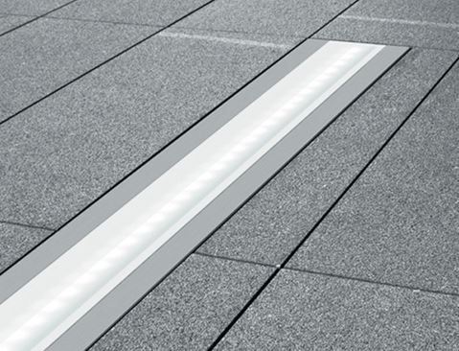
denver crime lab
introduction
lighting depth
lobby
south plaza
electrical depth
photovoltaic array
construction breadth
structural breadth
conclusion
site plan
Notes:
linear form in front of the entrance

Slide 17
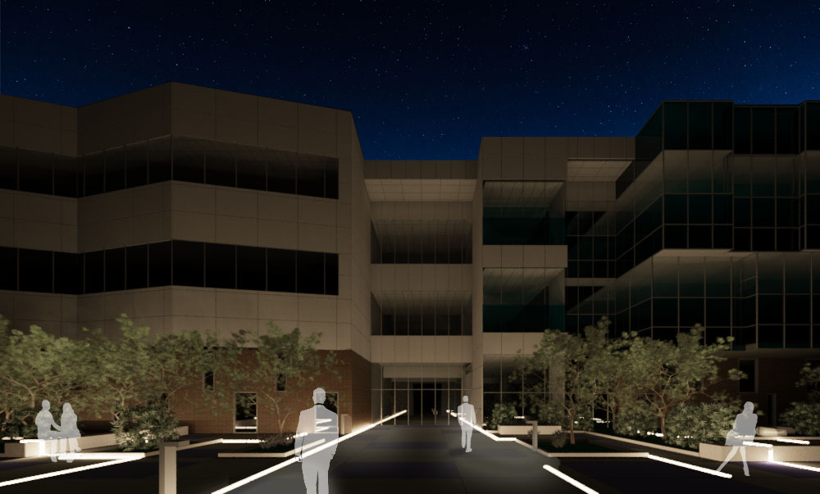
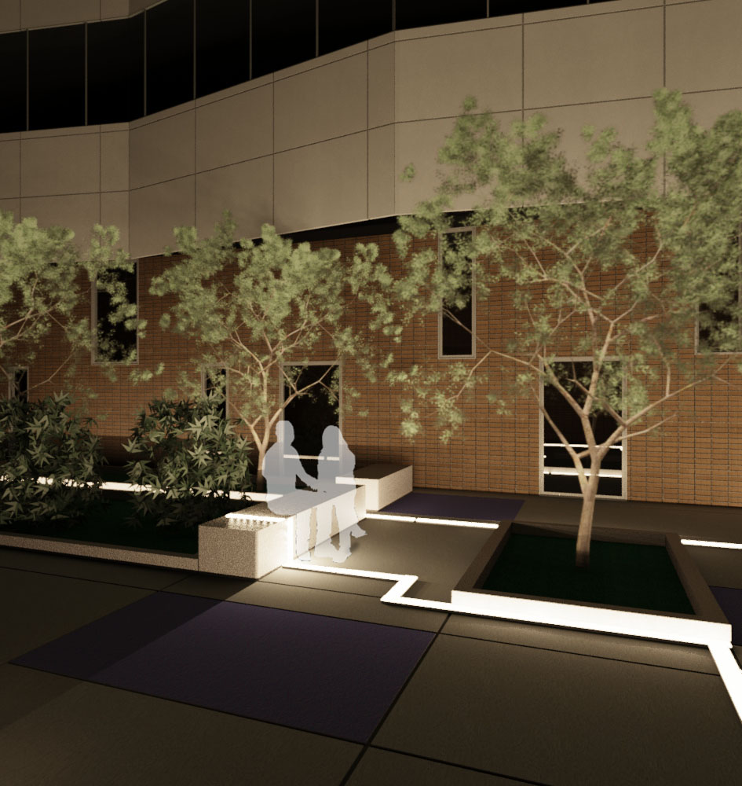
denver crime lab
introduction
lighting depth
lobby
south plaza
electrical depth
photovoltaic array
construction breadth
structural breadth
conclusion
renderings
plan view
site
Notes:
Intimate setting is created with nonuniform light levels

Slide 18
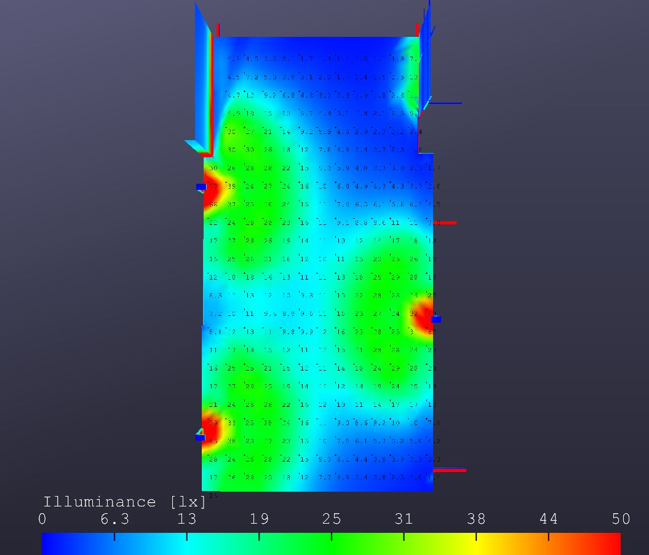
denver crime lab
introduction
lighting depth
lobby
south plaza
electrical depth
photovoltaic array
construction breadth
structural breadth
conclusion
quantitative data
elumtools calculation
Illuminance average | 15 lux
average/minimum | 21:1
total watts | 1848 W
total site lumens | 18,552
lumens/sf | 3.37

Slide 19
denver crime lab
introduction
lighting depth
lobby
south plaza
electrical depth
photovoltaic array
construction breadth
structural breadth
conclusion
e l e c t r i c a l d e p t h
Notes:
National renewable energy laboratory

Slide 20
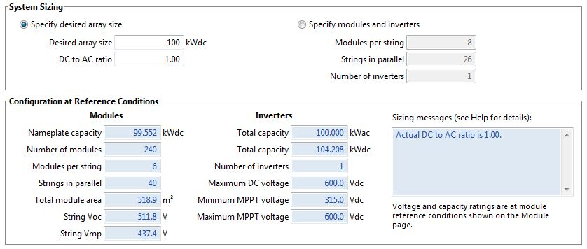
denver crime lab
introduction
lighting depth
lobby
south plaza
electrical depth
photovoltaic array
construction breadth
structural breadth
conclusion
system advisor model (sam)
modules
Manufacturer | SunPower
Nominal Efficiency | 19.19%
Maximum Power | 414.8 Wdc
Number of Cells | 128
Length | 7'-0"
Width | 3'-3"
Number of Panels | 240
inverter
Manufacturer | Satcon Technology Corp.
CEC Weighted Efficiency | 96.24%
Maximum Power (DC) | 104 kWdc
Maximum Power (AC) | 100 kWac
Nominal AC voltage | 480 V
Number of Inverters | 1
Notes:
Desired array size of 100kwdc to help power lighting panel for south plaza
Dc/AC ratio of 1
240 modules were used
Modules
Monocrystalline > poly or thin film
19.2% efficiency
7’x3’ panel

Slide 21
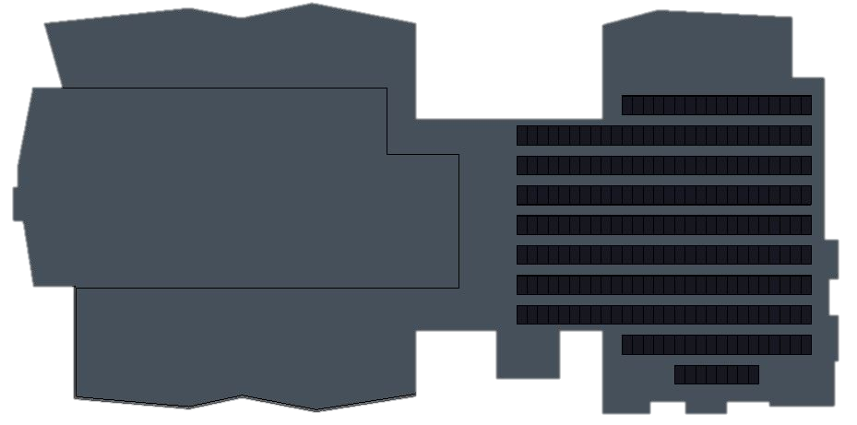
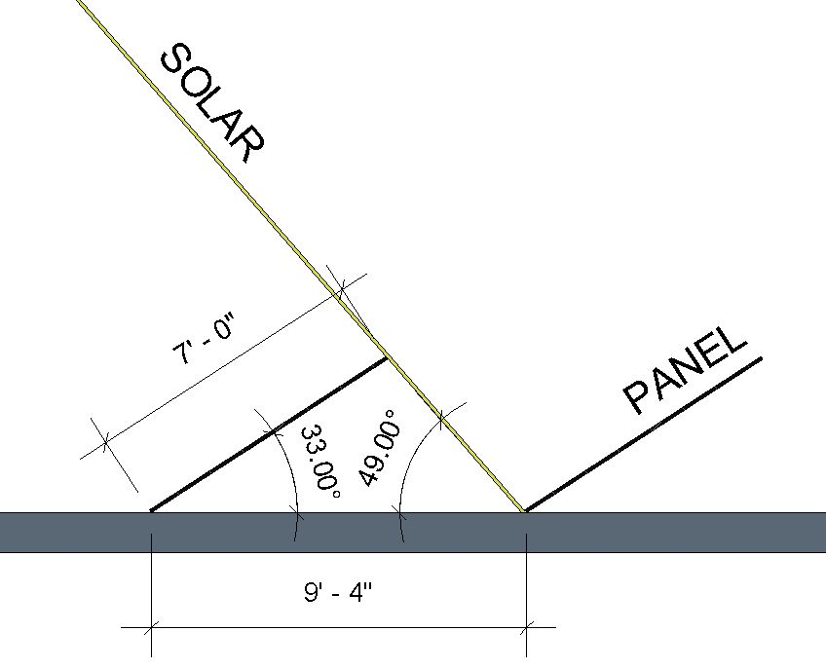
denver crime lab
introduction
lighting depth
lobby
south plaza
electrical depth
photovoltaic array
construction breadth
structural breadth
conclusion
module layout
analysis summary
solar angles
Annual Energy Production | 160,128 kWh
Performance ratio | 0.86
Electricity Cost without system | $92,605
Electricity Cost with system | $77,440
Initial Cost | $646,431
Payback Period | 50 + Years
Number of Panels | 240
penthouse
total savings | $15,165
Notes:
The modules were laid out on the east side of the roof since the west side houses the penthouse (CLICK). The angle and spacing of the panels was determined by where the sun’s altitude was at noon on the Fall Equinox. The sun’s altitude should fall between the low angles of winter and the high angles of summer in Denver so there will be a better chance of maintaining an average amount of sunlight for the year. In summary, the total savings that the crime lab would receive from the photovoltaic array would be $15,000, but the payback of more than 50 years and initial cost of 646,000 would deem the installation unfeasible.

Slide 22
denver crime lab
introduction
lighting depth
lobby
south plaza
electrical depth
photovoltaic array
construction breadth
structural breadth
conclusion
c o n s t r u c t i o n b r e a d t h
Notes:
In my construction breadth I will be discussing a cost, schedule, and energy saving analysis.

Slide 23
denver crime lab
introduction
lighting depth
lobby
south plaza
electrical depth
photovoltaic array
construction breadth
structural breadth
conclusion
cost analysis
schedule
RS MEANS 2015 COST DATA
ITEM | CREW | QUANTITY | 2015 BARE COSTS
 |  |  | MATERIAL | LABOR | TOTAL | INCLUDING OVERHEAD & PROFIT
ALT. ENERGY SOURCE, SUNPOWER PHOTOVOLTAIC MODULE, 415 WATT, 73 VOLTS | 2 | 240 | 1,785.00 | 109.00 | 454,560.00 | 522,744.00
SATCON CORP. DC TO AC INVERTER, 480 V, 100 KW | 1 | 1 | 41,688.00 | 219.00 | 41,907.00 | 48,193.05
PV COMPONENTS, COMBINER BOX, NEMA 3R ENCLOSURE | 1 | 1 | 191.00 | 109.00 | 300.00 | 345.00
FUSE, 15 A FOR COMBINER BOX | 1 | 40 | 18.75 | 10.95 | 1,188.00 | 1,366.20
PV RACK SYSTEM, ROOF, NON-PENETRATING BALLAST, 1 PANEL | 1 | 240 | 895.00 | 23.50 | 220,440.00 | 253,506.00
ITEM | CREW | DAILY OUTPUT | LABOR HOURS | QTY. | HOURS | DAYS
ALT. ENERGY SOURCE, SUNPOWER PHOTOVOLTAIC MODULE, 415 WATT, 73 VOLTS | 2 | 8 | 1 | 240 | 120 | 15.00
SATCON CORP. DC TO AC INVERTER, 480 V, 100 KW | 1 | 2 | 4 | 1 | 4 | 0.50
PV COMPONENTS, COMBINER BOX, NEMA 3R ENCLOSURE | 1 | 4 | 2 | 1 | 2 | 0.25
FUSE, 15 A FOR COMBINER BOX | 1 | 40 | 0.2 | 40 | 8 | 1.00
PV RACK SYSTEM, ROOF, NON-PENETRATING BALLAST, 1 PANEL | 1 | 30.5 | 0.525 | 240 | 126 | 15.75
total cost | $826,154.25
schedule duration | 1 month
Notes:
RS means green building 2015 were used except for the values of the module and inverter. Using 2 crews for the installation of the modules and 1 for the rest of the project, the photovoltaic array would cost 826,000 and take a month to complete. This value is 180,000 different from SAM’s estimate, but I attributed this to RS MEANS more accurate method of estimating labor.

Slide 24
denver crime lab
introduction
lighting depth
lobby
south plaza
electrical depth
photovoltaic array
construction breadth
structural breadth
conclusion
s t r u c t u r a l b r e a d t h
Notes:
My structural breadth focuses on the pv array installation on the roof.

Slide 25
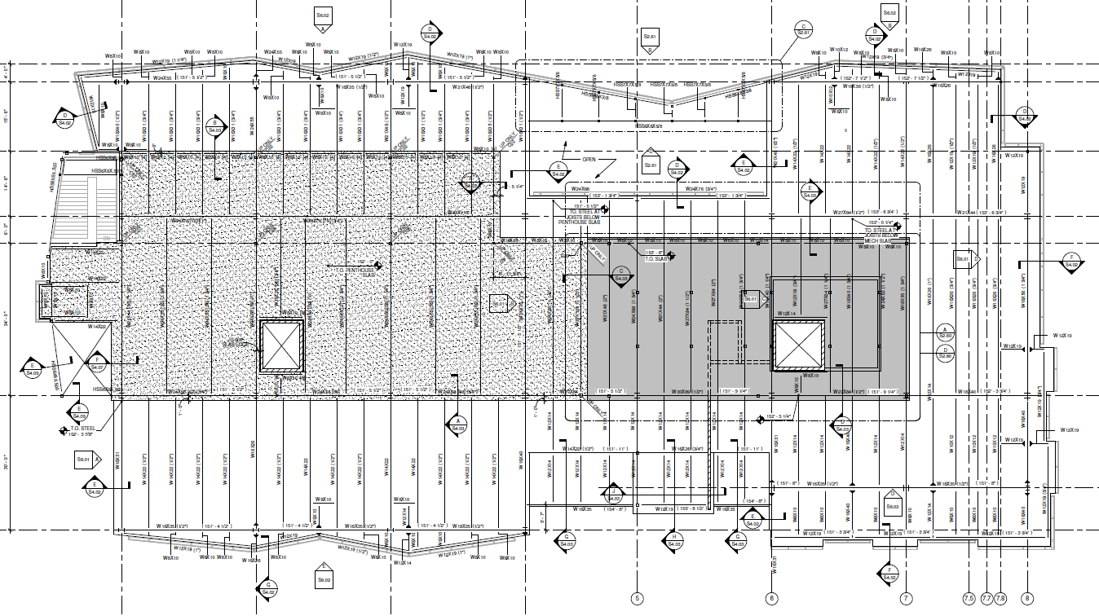
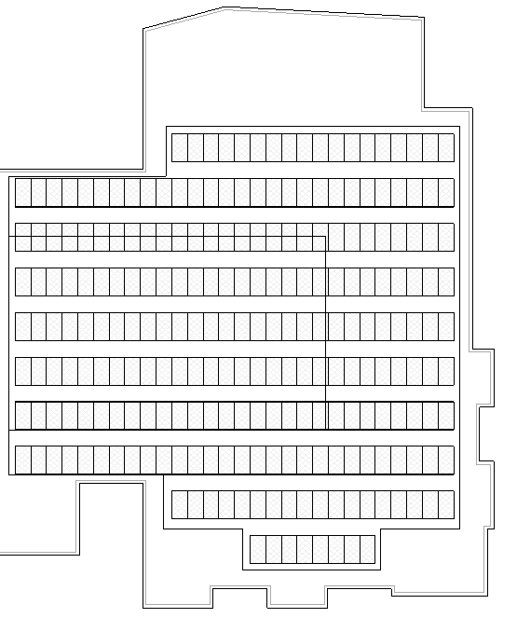
denver crime lab
introduction
lighting depth
lobby
south plaza
electrical depth
photovoltaic array
construction breadth
structural breadth
conclusion
roof analysis
deck type
composite | 2VLI20
roof | 1.5B20
module layout
Notes:
The crime lab’s roof is made of composite deck and roof deck. There are more than 3 spans, with the largest span being 6’0.” (CLICK). The module layout sits on both types of deck. The composite deck portion of the roof is highlighted in blue and is composed of Vulcraft’s 2” 20 Gage deck. The roof deck is 1.5” 20 Gage deck. The composite deck supports 100 modules while the roof deck supports 140.

Slide 26


denver crime lab
introduction
lighting depth
lobby
south plaza
electrical depth
photovoltaic array
construction breadth
structural breadth
conclusion
loads
calculations
composite deck
live
minimum live load | 30 psf
dead
rigid insulation | 2 psf
superimposed dead load | 10 psf
composite deck self-weight | 1.97 psf
roof deck self-weight | 2.14 psf
module weight | 56 lbs
$$\text{W}\text{TL} =30 psf+2 psf+10 psf+1.97 psf+ \frac{56 lbs. × 100 panels}{2693 SF}$$
snow load | 20 psf
W_{TL} = $46 psf$ < 400 psf √
roof deck
$$\text{W}\text{TL}=30 psf+2 psf+10 psf+2.14 psf+ \frac{56 lbs. × 140 panels}{4600 SF}$$
W_{TL} = $45 psf$ < 111 psf √
Notes:
minimum live load controls. was larger than snow load. The weights of the deck were found in the Vulcraft manual and the per square foot of the modules was found by taking the weight of the module and multiplying by the panels and dividing by the square feet it rests on. The composite deck more than adequately supported the 46 psf total load and the roof deck was a little under half the requirement via Vulcraft. In conclusion, the roof could support the photovoltaic array with no problems.

Slide 27

denver crime lab
introduction
lighting depth
lobby
south plaza
electrical depth
photovoltaic array
construction breadth
structural breadth
conclusion
c o n c l u s i o n
lighting
electrical
construction
structural
Notes:
Speaking of conclusions, we have just arrived at the end of my presentation. Lighting was explored through DNA and fingerprints, both important parts of a person’s identity. My electrical depth analyzed a pv array that would be able to supply 100 kw, but may not be financially feasible. The construction breadth confirmed this initial electrical analysis, but should it proceed the installation should last a month. And lastly, my structural breadth supported the PV array installation, even if it wasn’t supported financially. …The Denver Crime Lab is a building that seeks justice through careful forensic investigating (and specially placed lighting) while maintaining its own (click) identity. (click) thank you.

Slide 28
denver crime lab
introduction
lighting depth
lobby
south plaza
electrical depth
photovoltaic array
construction breadth
structural breadth
conclusion
a special thanks:
Mom & Dad
SmithgroupJJR
Denver Police Department
Shawn Good
AE Faculty & Staff
Friends and Colleagues
Nicolas Cage
t h a n k y o u

Slide 29



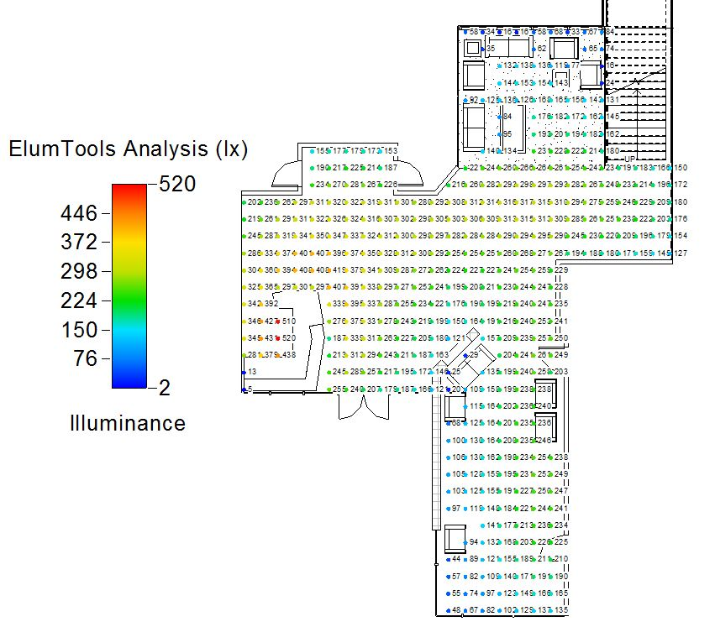
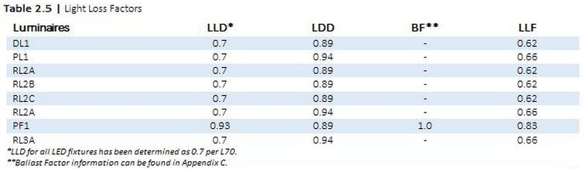
support | lobby

Slide 30
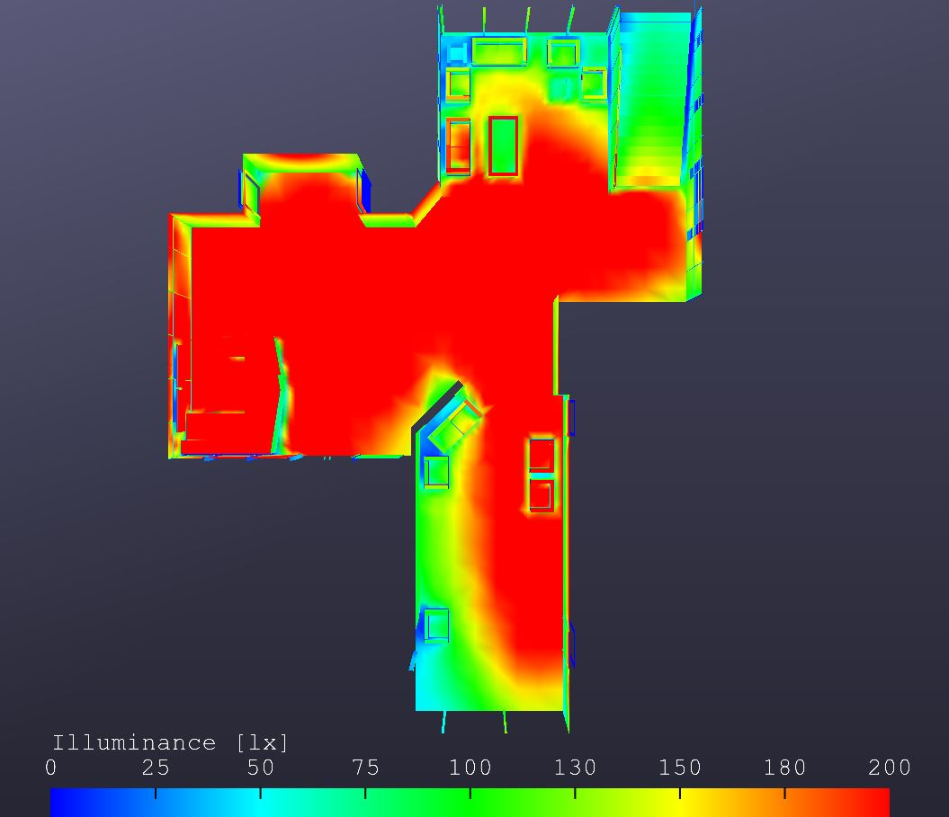

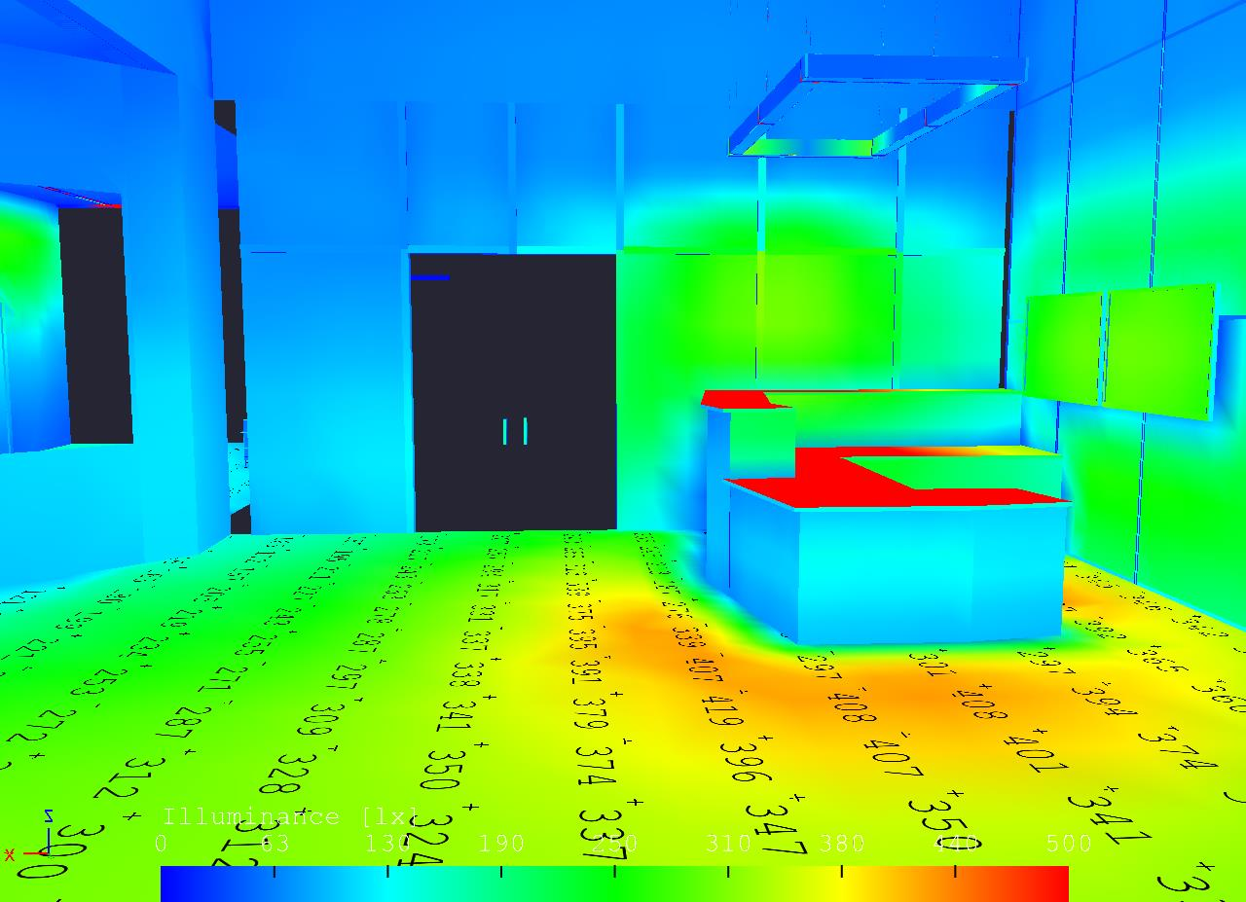
support | lobby

Slide 31

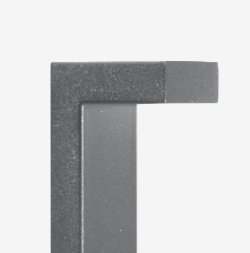
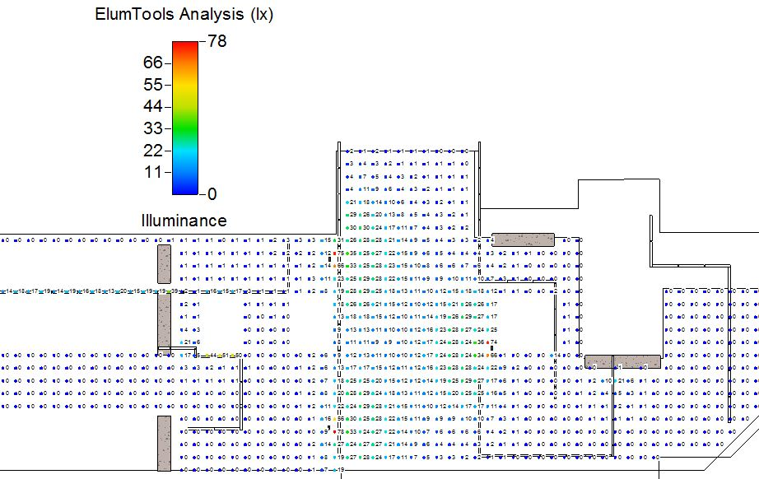


support | plaza

Slide 32



support | plaza

Slide 33




support | structural

Slide 34


denver crime lab
shading loss
support | electrical
 | 5am | 6am | 7am | 8am | 9am | 10am | 11am | 12pm | 1pm | 2pm | 3pm | 4pm | 5pm | 6pm
Jan | 100 | 100 | 66.6262 | 41.4284 | 30.9819 | 26.1548 | 24.3441 | 24.0069 | 25.4262 | 31.477 | 43.3256 | 66.0323 | 100 | 100
Feb | 100 | 100 | 38.6662 | 23.2976 | 17.1339 | 14.3545 | 13.1805 | 12.6909 | 13.6214 | 17.108 | 25.4686 | 43.101 | 73.5851 | 100
Mar | 100 | 9.15711 | 4.28353 | 2.24689 | 1.49688 | 1.17057 | 0.832361 | 0.978999 | 0.923388 | 2.54405 | 7.19344 | 17.0431 | 57.1892 | 100
Apr | 100 | 0 | 0 | 0 | 0 | 0 | 0 | 0 | 0 | 0.597934 | 4.19657 | 11.1939 | 29.4424 | 100
May | 100 | 0 | 0 | 0 | 0 | 0 | 0 | 0 | 0 | 0.195979 | 3.21961 | 8.33564 | 21.2989 | 100
Jun | 100 | 0 | 0 | 0 | 0 | 0 | 0 | 0 | 0 | 0.018403 | 2.41565 | 6.35199 | 15.5866 | 100
Jul | 100 | 0 | 0 | 0 | 0 | 0 | 0 | 0 | 0 | 0.007914 | 2.28821 | 6.54035 | 15.3936 | 100
Aug | 100 | 0 | 0 | 0 | 0 | 0 | 0 | 0 | 0 | 0.216182 | 3.30129 | 9.24263 | 21.5792 | 100
Sept | 100 | 0 | 0 | 0 | 0 | 0 | 0 | 0 | 0 | 1.48456 | 5.83348 | 15.1104 | 60.0621 | 100
Oct | 100 | 36.4335 | 18.6618 | 12.2612 | 9.63929 | 8.423 | 7.85318 | 8.19911 | 9.06049 | 14.0736 | 23.5467 | 47.9667 | 100 | 100
Nov | 100 | 100 | 45.3173 | 30.6975 | 24.2614 | 21.5754 | 20.669 | 20.7049 | 23.4766 | 30.9598 | 45.2631 | 73.2618 | 100 | 100
Dec | 100 | 100 | 65.4185 | 43.0801 | 33.367 | 29.0345 | 27.2614 | 27.3223 | 29.9461 | 37.6982 | 52.2935 | 79.0083 | 100 | 100
Notes:
Within SAM I also conducted a shading study which analyzes how much energy is lost based on the spacing of the modules. As you can see in the table, March through September are relatively unshaded while the low anlge winter months lead to the most loss (but generally not more than 35%).

Slide 35
denver crime lab
energy analysis
support | construction
annual savings | $600.00
annual kWh reduction | 10,000 kWh
Notes:
talk about hours, .06/kwh

Slide 36
citations
images
IECC 2012
The Lighting Handbook, 10th edition
Vulcraft Manual
Revit 2015
RS Means Green Building 2015
Double Helix. Web.
Http://www.Ummo-sciences.Org/en/a037.Htm
Figure 2. 2000. Centers for disease control and prevention. By chang gung. Web.
M. 1931. By fritz lang. Web.
Photograph of author. 2012. Rotterdam. Ciencia hoje. Web.

Slide 37

YEAAAAAAAAAAAAAAAAAAAAAAAAAAAAAAAAAAAAAAAAAAAAAAAAAAAAAAAAAAAAAAAAAA

