Slide 1
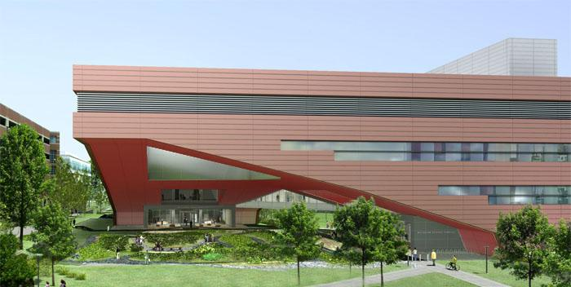

BIMception Proposal
Thomas Villacampa
Alexander Stough
Christopher Russell
Stephen Pfund

Slide 2
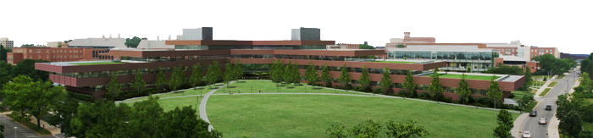

Proposal Overview
Building Enclosure- Façade Redesign
Ceiling Plenum- Investigation of Vertical Space
Cantilever Plaza- A Monumental Space

Slide 3
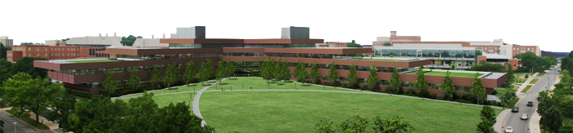
Façade Redesign
Energy Savings
Façade Redesign
  Wall Composition
  Window to Wall Ratio
  Shading Devices
Integration
Window to Wall Ratio
  Mechanical Loads
  Daylight Delivery System

Slide 4
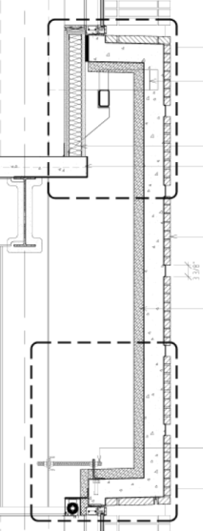
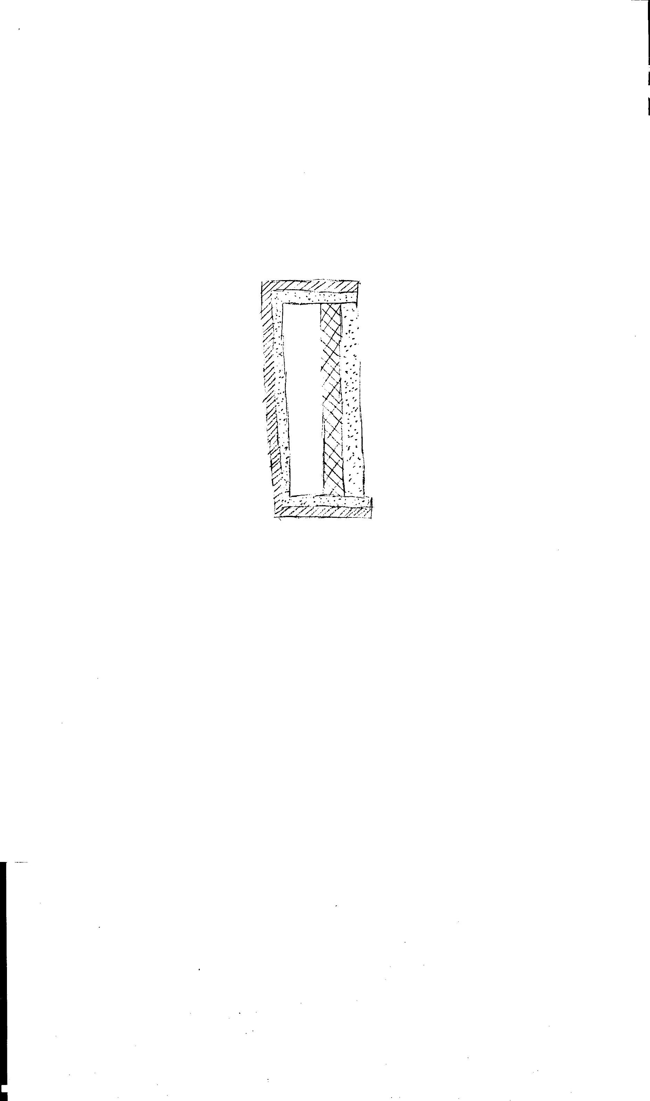
Façade Redesign
Wall Composition Analysis
Improve load flattening
Reduce self weight
Rearrange composition
Reduce volume of concrete with PCM

Slide 5
Façade Redesign
Window to Glass Ratio
Shading Devices
Reduce energy costs
Improve daylighting
Existing Façade Mock Up

Slide 6
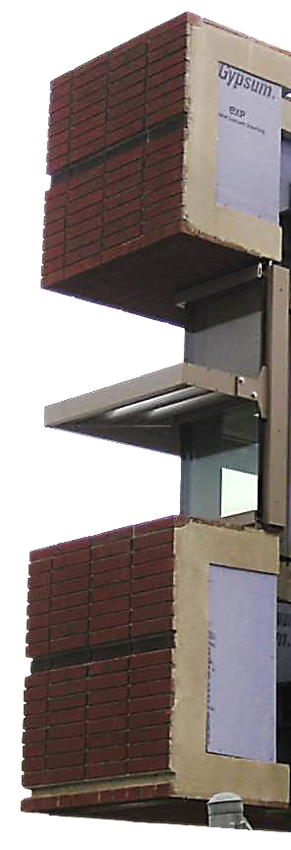
Lighting/Electrical Perspective
Window to Wall Ratio
  Useful Illuminance - 100-2000 lux
  Daylight Autonomy - 300 lux
Shading Devices
  Profile Angle Study
  Light Shelf Height
Control
  Automatic vs. Manual
Existing Façade Mock Up

Slide 7
Structural Investigation
Strength Design of Panel
  Existing and New Designs
  Minimize concrete thickness and reinforcing
Design/ Evaluate Typical Connections
  Façade to Concrete Column- NEW DESIGN
  Façade to Steel Column- EXISTING
Reevaluate Exterior Column Sizes
  Axial loads- Panel weight
  Eccentricity = Column Moment
Existing Façade Mock Up

Slide 8
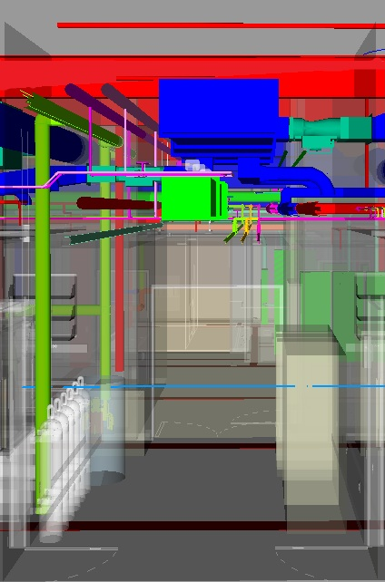
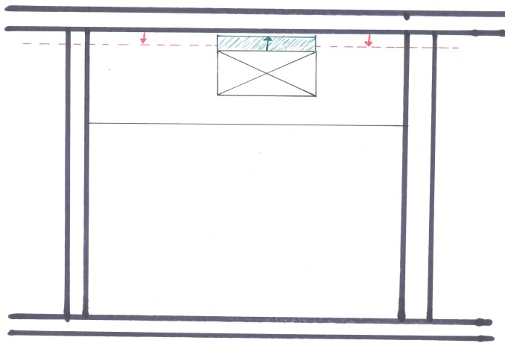
Ceiling Plenum Investigation
Evaluate Verticality
  Opportunities for structural improvements
  Opportunities for energy savings

Slide 9
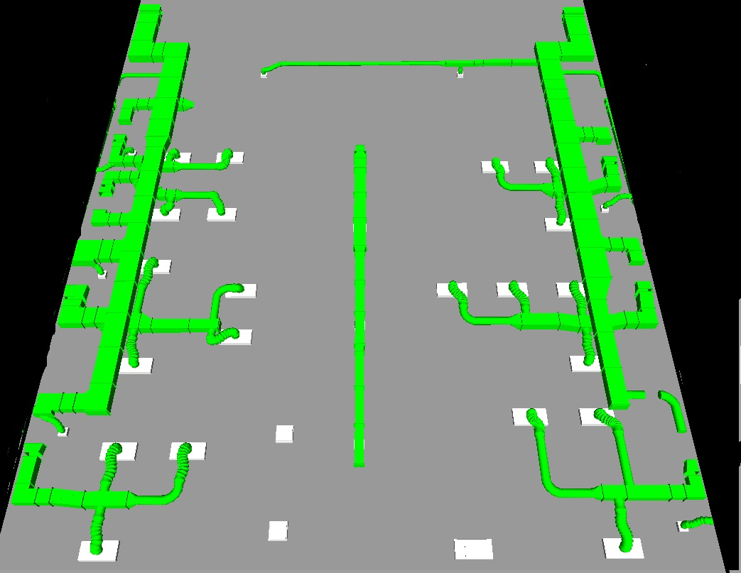
Ceiling Plenum Investigation
Analyze effects of static pressure to save fan energy
  Evaluate incremental benefits
  Compare with structural savings
  Select best life cycle option
  Supply Duct in Material Science Wing

Slide 10
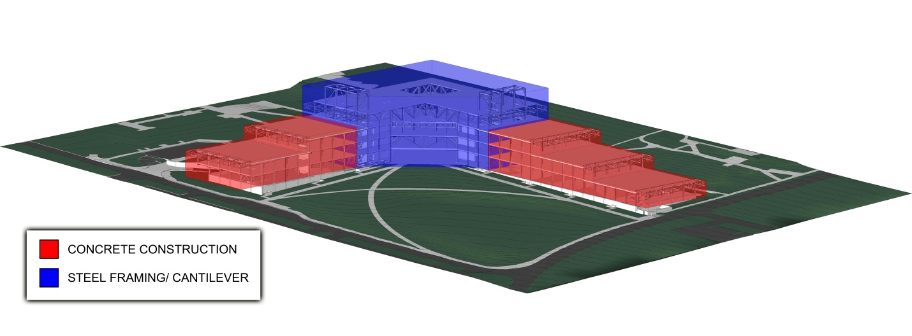
Gravity System Redesign
3-Building Mixed System
  Concrete Wings
  Steel Cantilever
3-Building Solution

Slide 11
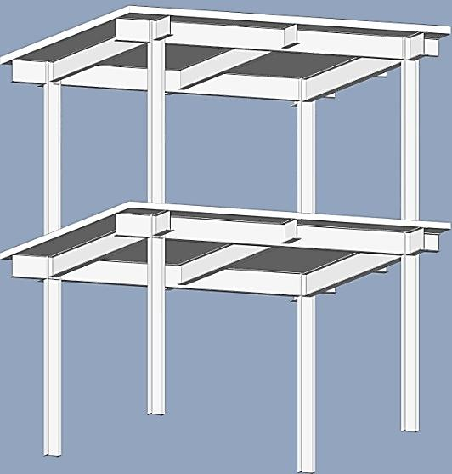
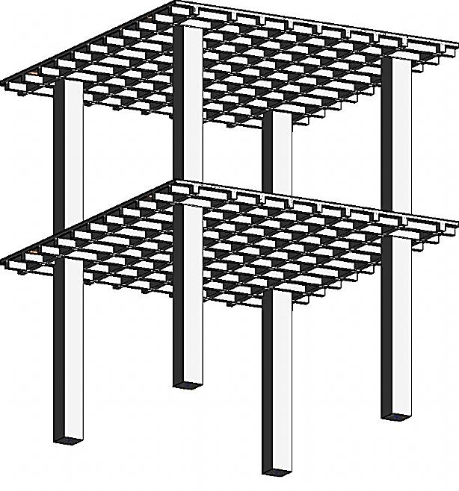
Gravity System Redesign
Existing Conditions Modeling
  Base for comparison
Two Way Concrete System
  Waffle Slab
  Beams at twice spacing
    Wider and/or deeper
Existing Steel Framing
Proposed Waffle Slab

Slide 12
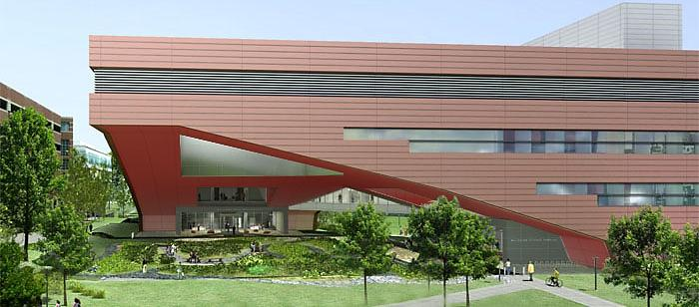
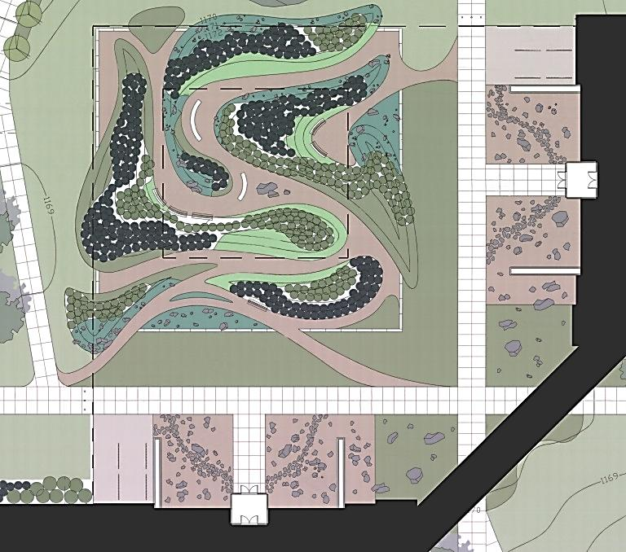
Building Cantilever and Plaza
Cantilever Plaza
-A Gateway to the Sciences

Slide 13
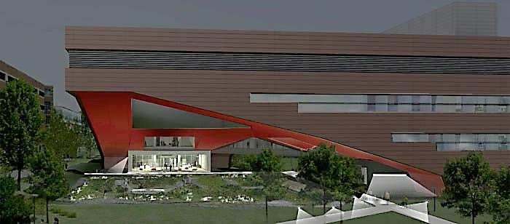
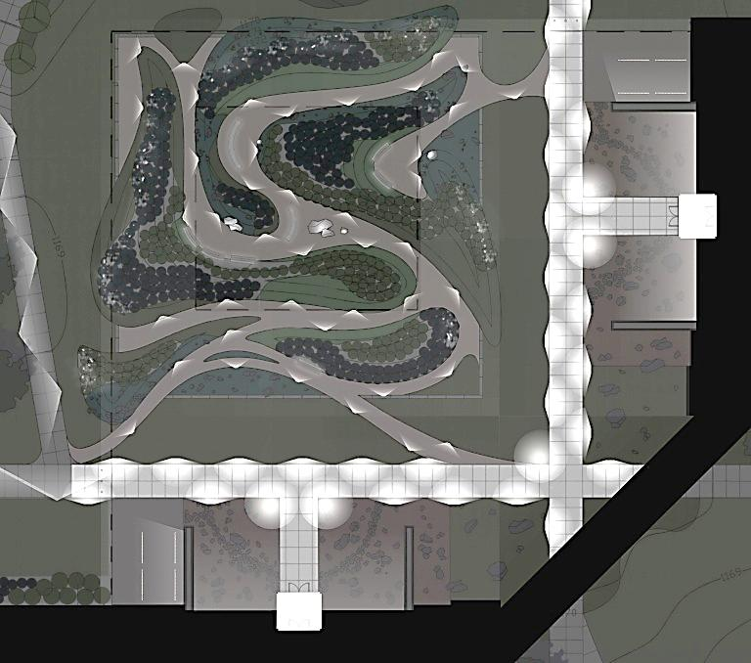
v
Cantilever Plaza

Slide 14
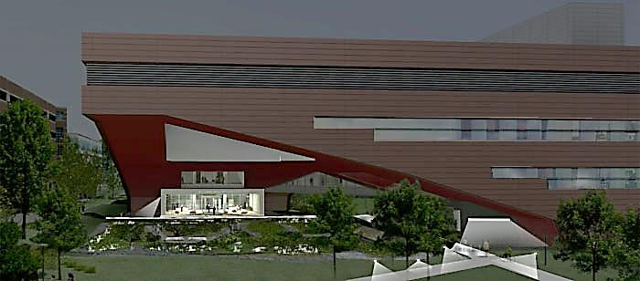
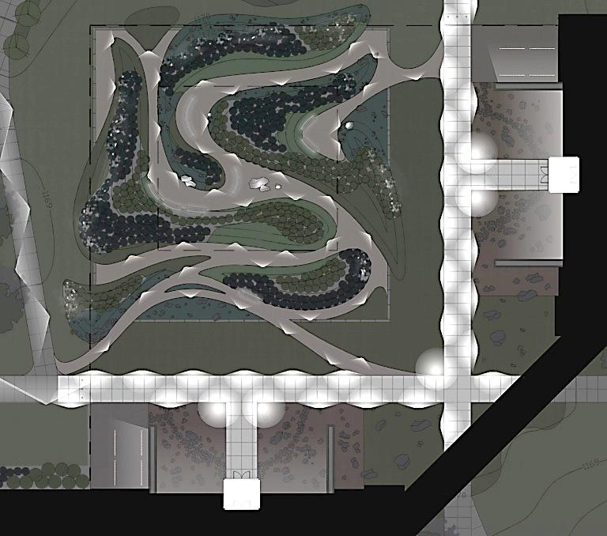
Cantilever Plaza

Slide 15
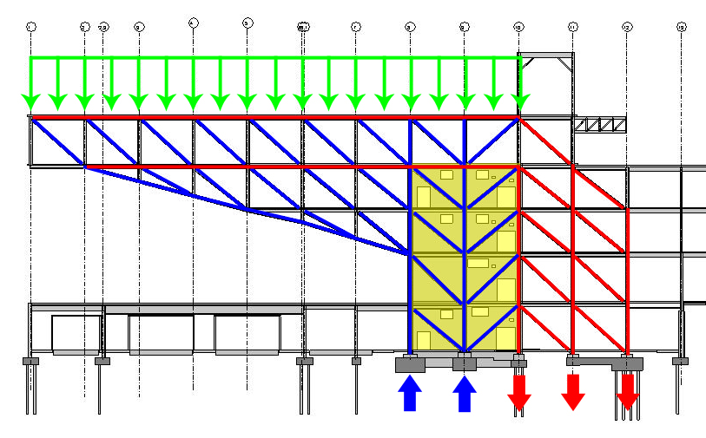
Existing Cantilever Truss
Tension Members
Compression Members
Existing Cantilever Truss

Slide 16
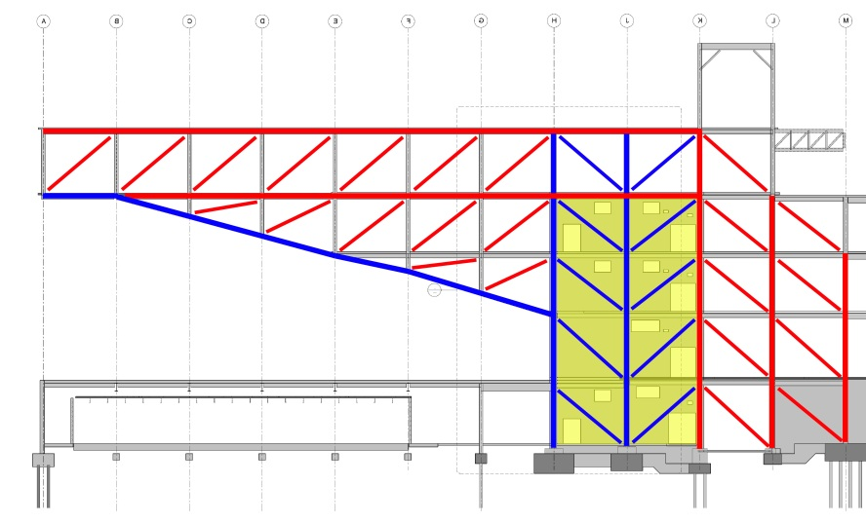
Cantilever Truss Redesign
Tension Members
Compression Members
Cantilever Truss Redesign

Slide 17
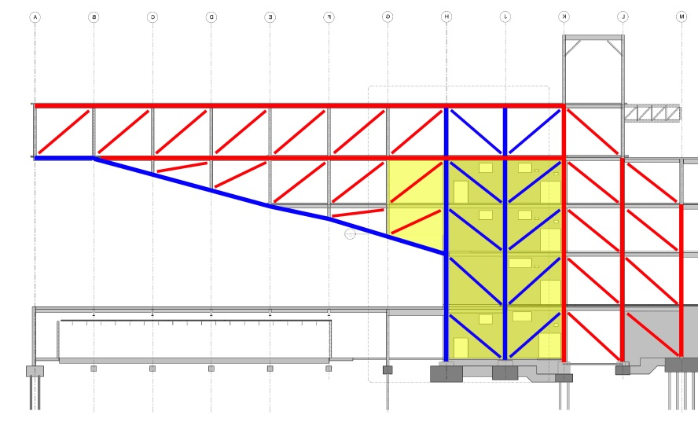
Cantilever Truss Redesign
Tension Members
Compression Members
Cantilever Truss Redesign

Slide 18

Cantilever Truss Redesign
Tension Members
Compression Members
Cantilever Truss Redesign

Slide 19
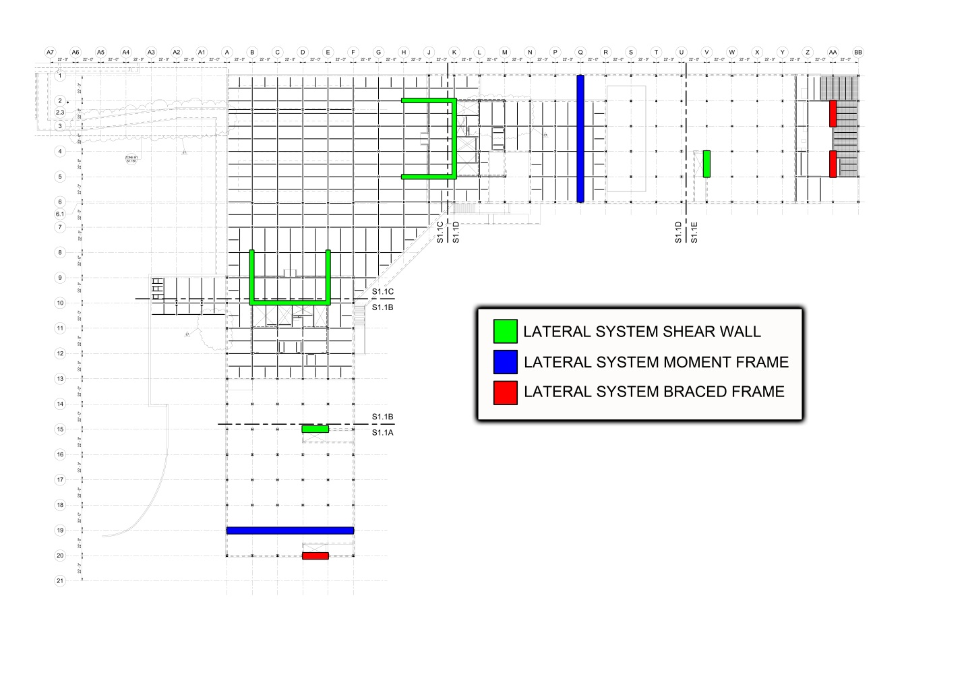
Existing Lateral System
First Floor Plan- Lateral System

Slide 20
Lateral System- Redesign
First Floor Plan- Proposed Lateral System

Slide 21
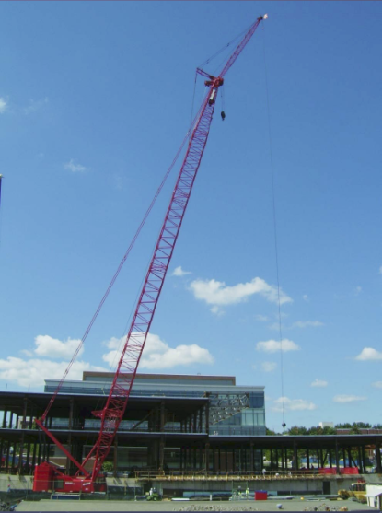
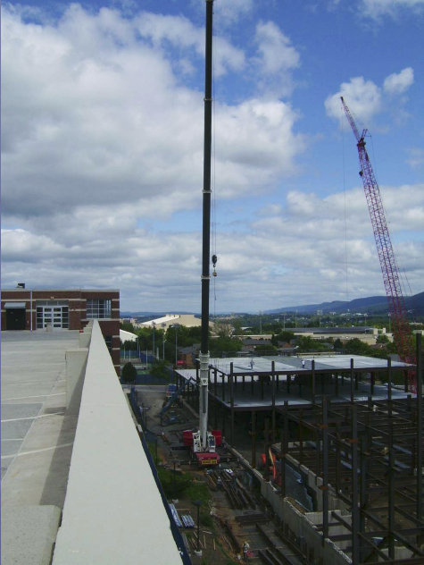
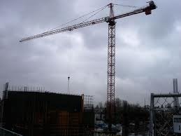
Construction Management Focus
Crane Analysis
  Multiple Crawler Cranes and Pump Trucks versus Single Crawler Crane and Multiple Tower Cranes
  Feasibility of Setups for Construction of Redesigns
    Cost
    Lift Capacity for both Structure and Precast Panels
    Reach of Cranes
    Site Logistics
300 Ton Crawler Crane
275 Ton Crawler Crane
Hammerhead Tower Crane

Slide 22
Construction Management Focus
Cost Analysis
  Material, Labor, Equipment/Vehicles
  Structural System
    Gravity, Lateral, Cantilever Truss, Façade Connections
  Lighting/Electrical System
    Exterior and Interior Lighting Systems
    Electrical Systems
  Mechanical System
    Ductwork and Floor-to-Floor Height Comparison
  Building Enclosure
    Precast panels, Glass, Light Shelf

Slide 23
Construction Management Focus
Schedule Analysis
  Assess Schedule Implications of All Design Changes
    Structural System
      Sequencing of Concrete and Steel
      Lead Times
    Building Enclosure
      Sequence of Construction in Combination with Structure
      Lead Times
    Mechanical/Lighting/Electrical System
      Lead Times
  4D Model of Structure and Enclosure
  Schedule Acceleration

Slide 24
Construction Management Focus
Site Logistics Analysis
  Assess Site Planning Implications of All Design Changes
    Site Planning in Combination with Sequencing and Scheduling
      Structural Redesign
      Erecting of Precast Panels
      Crane/Pump Truck Use

Slide 25
Comments, Questions?

Slide 26
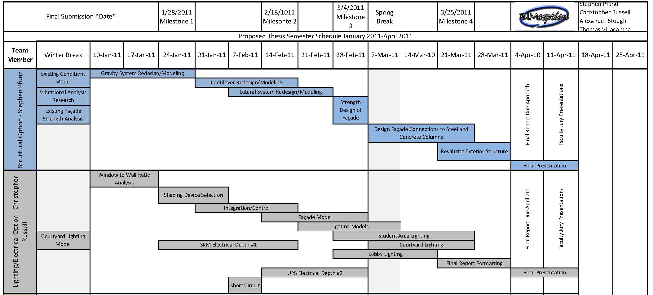

Slide 27
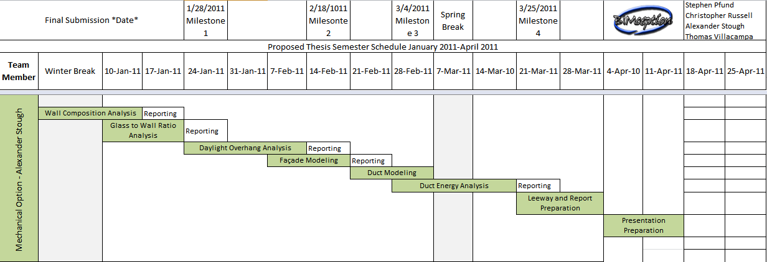
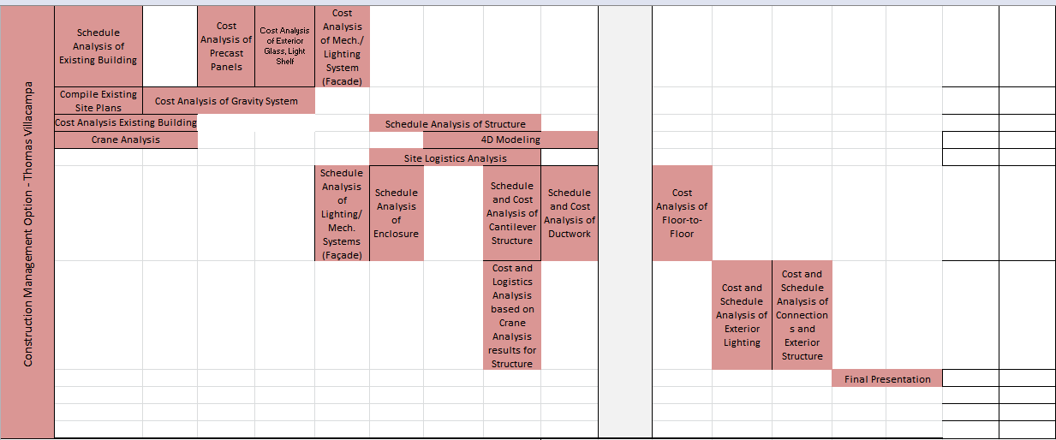

Slide 28
Additional Lighting/Electrical Requirements
Electrical Depths
Short Circuit Analysis (Hand Calculation)
  Panel LB-3D1/2
SKM Analysis
  3rd floor and any changes due to façade and plenum redesign
UPS Investigation
  Price Difference between UPS/Actual Central Power Conditioner

Slide 29
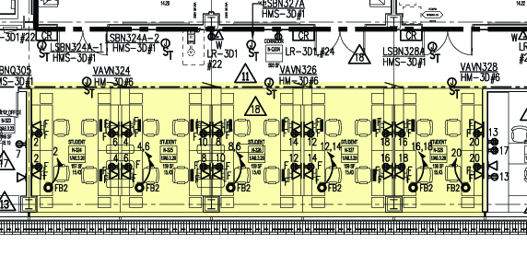
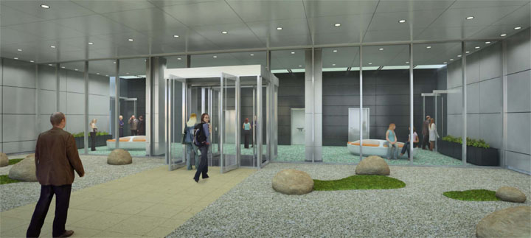
Additional Lighting/Electrical Requirements
Lighting Redesign
  Student Study Area
  Cantilever Plaza
  Entrance Lobby

