Slide 1
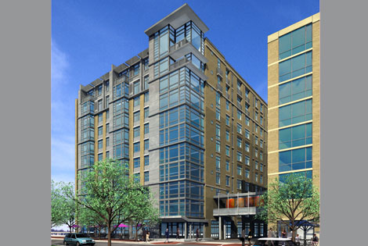
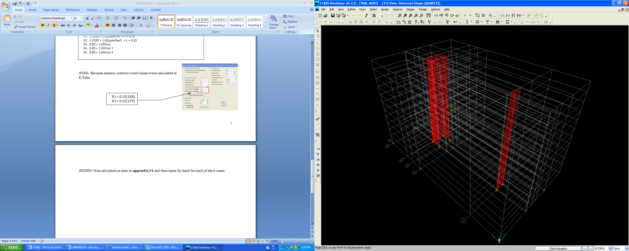
Sr. Thesis Presentation
April 14, 2008
460 L Street Washington D.C.
City Vista | Building 2
Gravity System Optimization
Julie Davis | Structural Option
Penn State University

Slide 2

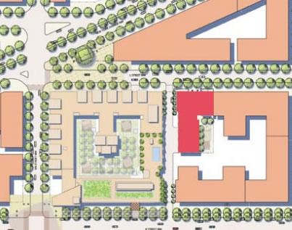
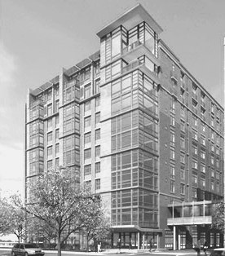
Julie Davis
Structural Option
City Vista |Building 2
Building Stats
| Building Stats | Proposal | Preliminary Design | Gravity System | Lateral System | Constructability | Conclusion |
City Vista| Building 2| 460 L Street Washington D.C 2001
Location: Building 2: 3 building mixed use complex
5th and K, Washington D.C
Size: 11 stories
324,000 sqft
Height: 110’-6”
128’-5” [ including mechanical penthouse]
Use: Residential [ 149 condos]
Constructed Start: December 2005
Finish: December 2007

Slide 3
Building System : Foundation
Julie Davis
Structural Option
City Vista |Building 2
| Building Stats | Proposal | Preliminary Design | Gravity System | Lateral System | Constructability | Conclusion |
Foundation System
Slab On Grade:
Depth: 4”
f’c = 4000 psi
- Reinforcing: Conventional Reinforcing

Slide 4
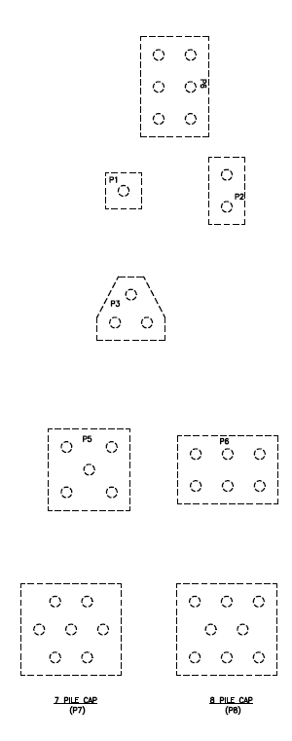
Building System : Foundation
Julie Davis
Structural Option
City Vista |Building 2
| Building Stats | Proposal | Preliminary Design | Gravity System | Lateral System | Constructability | Conclusion |
Foundation System
Slab On Grade:
Depth: 4”
f’c = 4000 psi
- Reinforcing: Conventional Reinforcing
Deep Foundation system:
- Augured cast in place piles
- Quantity: 250 piles
- Size: 16” Diam.
Depth: 60-65 ft

Slide 5
Julie Davis
Structural Option
City Vista |Building 2
Building System : Gravity
| Building Stats | Proposal | Preliminary Design | Gravity System | Lateral System | Constructability | Conclusion |
Gravity System
Slab
- 2-way flat plate
7 ½” Thick
f’c=6000 psi
Reinforcing: Post tension tendons
Banded: North - South
Uniform: East -West
Columns
- (52)- cast in place
- Typical Size : 16” x 28”
- f’c = 5000 psi
Reinforcing: Conventional Reinforcing
Typical : (12)-#9 Base
(8) - #9 Top

Slide 6
Julie Davis
Structural Option
City Vista |Building 2
Building System : Gravity
| Building Stats | Proposal | Preliminary Design | Gravity System | Lateral System | Constructability | Conclusion |
Gravity System
Slab
- 2-way flat plate
7 ½” Thick
f’c=6000 psi
Reinforcing: Post tension tendons
Banded: North - South
Uniform: East -West
Columns
- (52)- cast in place
- Size : 16” x 28”
- f’c = 5000 psi
Reinforcing:
Loading
Pattern : 100 psf corridor
White : 40 psf residential

Slide 7
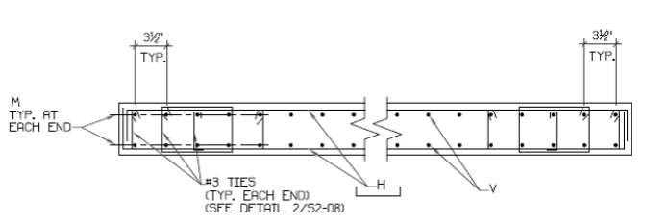
Julie Davis
Structural Option
City Vista |Building 2
Building System : Lateral
| Building Stats | Proposal | Preliminary Design | Gravity System | Lateral System | Constructability | Conclusion |
Lateral System
Shear Walls
(4) Shear Walls
Cast in place
f’c = 5000 psi
Wall 1 : 1ft x 11 ft
Wall 2 : 1 ft x 13 ft
Wall 3 : 1 ft x 18 ft
Wall 4 : 1 ft x 13 ft
Reinforcing:
      Flexural : #5 @ 12” O.C
      Shear : # 4 @ 12” O.C
      Varying Boundary Reinforcing
3
2
4
1

Slide 8
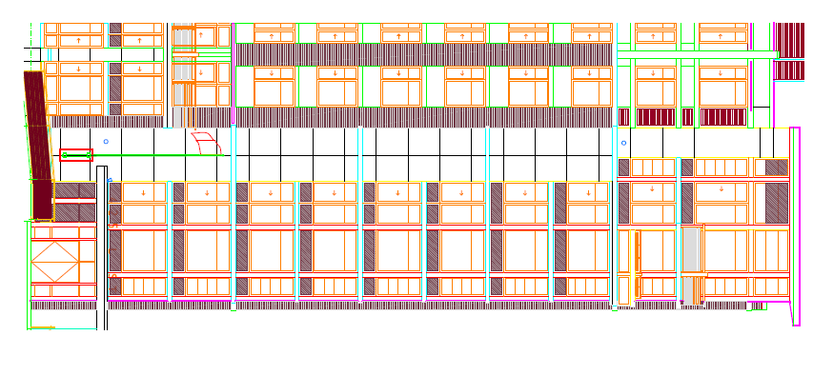
Julie Davis
Structural Option
City Vista |Building 2
Proposal: Objectives
| Building Stats | Proposal | Preliminary Design | Gravity System | Lateral System | Constructability | Conclusion |
OBEJECTIVES
Redesign Gravity System
Developer Options

Slide 9
Proposal: Post Tension System
Julie Davis
Structural Option
City Vista |Building 2
| Building Stats | Proposal | Preliminary Design | Gravity System | Lateral System | Constructability | Conclusion |
Post Tension System
Advantages
Floor to Floor Height = 9’-4”
Slab thickness = 7 ½”
Irregular Column Grid Long Clear Spans
Open Plan Condos
4. Finished Ceiling
5. Lightweight
Disadvantages
Shortening: Tension cracks around perimeter
Remodeling: Very Limited due to tendons
On site erection time

Slide 10
Proposal: Pre-Cast System
Julie Davis
Structural Option
City Vista |Building 2
| Building Stats | Proposal | Preliminary Design | Gravity System | Lateral System | Constructability | Conclusion |
Pre-Cast System
1. Finished Ceiling
2. Similar floor to ceiling height
3. Thin Slab : min thickness 6”
4. Lightweight
Advantages
Structural Integrity: Cast in monitored environment
LEED Possibility
Faster Erection Time : Less field labor

Slide 11
Julie Davis
Structural Option
City Vista |Building 2
Proposal: Objectives
| Building Stats | Proposal | Preliminary Design | Gravity System | Lateral System | Constructability | Conclusion |
OBEJECTIVES
Redesign Gravity System
- Optimize: Pre-Cast Gravity System
Developer Options
Check Existing Lateral System
- New Building Weight
- E-Tabs
- Serviceability / Strength
3. Constructability :
      - Cost
      - Schedule
      - Architecture Impacts

Slide 12
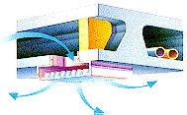
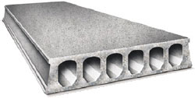
Preliminary Design : Decisions
Julie Davis
Structural Option
City Vista |Building 2
| Building Stats | Proposal | Preliminary Design | Gravity System | Lateral System | Constructability | Conclusion |
System Comparison
Hollow core vs. Solid slab
Composite topping vs. ¾” leveling topping
Ridged diaphragm vs. flexible
- longer spans
- Sound absorption
Fast erection
Finished ceiling
Voids used to run electrical and mechanical equipment

Slide 13
Preliminary Design : Decisions
Julie Davis
Structural Option
City Vista |Building 2
| Building Stats | Proposal | Preliminary Design | Gravity System | Lateral System | Constructability | Conclusion |
System Comparison
Hollow core vs. Solid slab
Composite topping vs. ¾” leveling topping
Ridged diaphragm vs. flexible
Member to member connections
Added Stiffness
Distributes loads
Potentially: Eliminate need to keyhole and grout planks.
Horizontal Shear < 80 psi
Fire Proofing
Transfer forces

Slide 14
Julie Davis
Structural Option
City Vista |Building 2
Preliminary Design : Considerations
| Building Stats | Proposal | Preliminary Design | Gravity System | Lateral System | Constructability | Conclusion |
Optimization of System
Floor Composition
Architecture
6” Plank
2” Topping
Inverted T-Beam

Slide 15
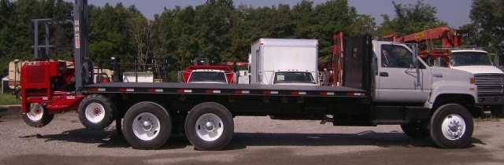
Julie Davis
Structural Option
City Vista |Building 2
Preliminary Design : Considerations
| Building Stats | Proposal | Preliminary Design | Gravity System | Lateral System | Constructability | Conclusion |
Optimization of System
Floor Composition
Architecture
Manufacturing
Erection / Transportation
40 ft max
13’-6” max
8’ wide
20 ton max
6” Plank
2” Topping
Inverted T-Beam

Slide 16
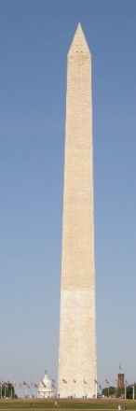
Julie Davis
Structural Option
City Vista |Building 2
Preliminary Design : Considerations
| Building Stats | Proposal | Preliminary Design | Gravity System | Lateral System | Constructability | Conclusion |
Optimization of System
Floor Composition
Architecture
Manufacturing
Erection / Transportation
Height Restriction
40 ft max
13’-6” max
8’ wide
20 ton max
6” Plank
2” Topping
130’-0”
Inverted T-Beam
CONTROLLING FACTOR

Slide 17

Julie Davis
Structural Option
City Vista |Building 2
Preliminary Design : Considerations Cont.
| Building Stats | Proposal | Preliminary Design | Gravity System | Lateral System | Constructability | Conclusion |
Optimization of System
Floor Composition
Architecture
Manufacturing
Erection / Transportation
Height Restriction
Fireproofing
- Type II
- Floors: 2 hr fire rating
- 6” plank 1” Topping

Slide 18
Julie Davis
Structural Option
City Vista |Building 2
Preliminary Design : Considerations Cont.
| Building Stats | Proposal | Preliminary Design | Gravity System | Lateral System | Constructability | Conclusion |
Optimization of System
Floor Composition
Architecture
Manufacturing
Erection / Transportation
Height Restriction
Fireproofing
Span / Depth Ratio
Cost
Type II
Floors: 2 hr fir rating
6” plank 1” Topping
Span / Depth Ratio
Hollow Core Floor Slabs | 30-40
Hollow Core Roof Slabs | 40-50
Beams | 10-20

Slide 19
Julie Davis
Structural Option
City Vista |Building 2
Preliminary Design : Considerations Cont.
| Building Stats | Proposal | Preliminary Design | Gravity System | Lateral System | Constructability | Conclusion |
Optimization of System
Floor Composition
Architecture
Manufacturing
Erection / Transportation
Height Restriction
Fireproofing
Span / Depth Ratio
Cost
Connections
Type II
Floors: 2 hr fir rating
6” plank 1” Topping
Span / Depth Ratio
Hollow Core Floor Slabs | 30-40
Hollow Core Roof Slabs | 40-50
Beams | 10-20
Hanger
Prone to manufacturing error
Reduce floor to ceiling height
Corbel
Easy Erection
Require a lot of Space
12”

Slide 20
Julie Davis
Structural Option
City Vista |Building 2
Preliminary Design : Considerations Cont.
| Building Stats | Proposal | Preliminary Design | Gravity System | Lateral System | Constructability | Conclusion |
Optimization of System
Floor Composition
Architecture
Manufacturing
Erection / Transportation
Height Restriction
Fireproofing
Span / Depth Ratio
Cost
Connections
Eccentric moment
Type II
Floors: 2 hr fir rating
6” plank 1” Topping
Span / Depth Ratio
Hollow Core Floor Slabs | 30-40
Hollow Core Roof Slabs | 40-50
Beams | 10-20

Slide 21
Julie Davis
Structural Option
City Vista |Building 2
Gravity System :Column Grid
| Building Stats | Proposal | Preliminary Design | Gravity System| Lateral System | Constructability | Conclusion |
New Column Locations
Existing Columns

Slide 22
Julie Davis
Structural Option
City Vista |Building 2
Gravity System :Column Grid
| Building Stats | Proposal | Preliminary Design | Gravity System| Lateral System | Constructability | Conclusion |
L1 = l1
L1 = l2
Maximize span / depth ratio
Thin floor to floor height
1. Rectangular
2. Inverted Tee-Beams
Reduce eccentricity
Column location
- Not In corridors

Slide 23
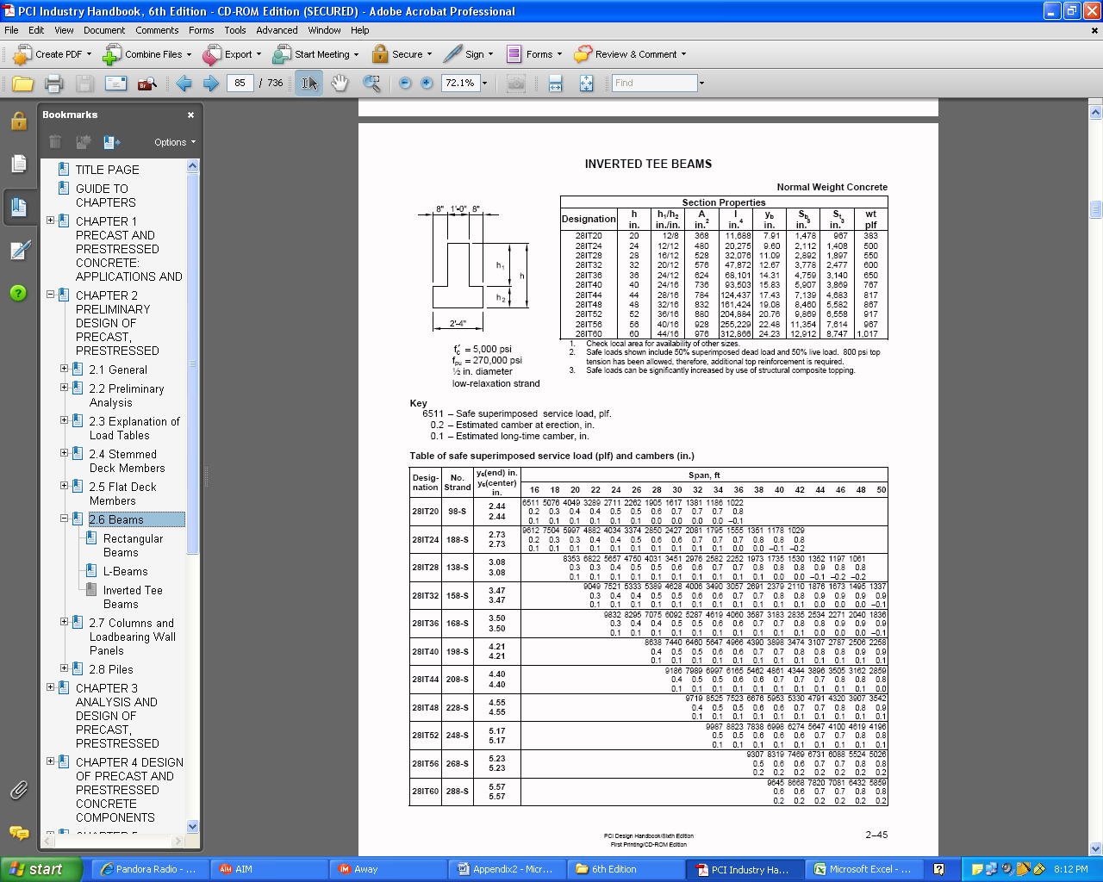
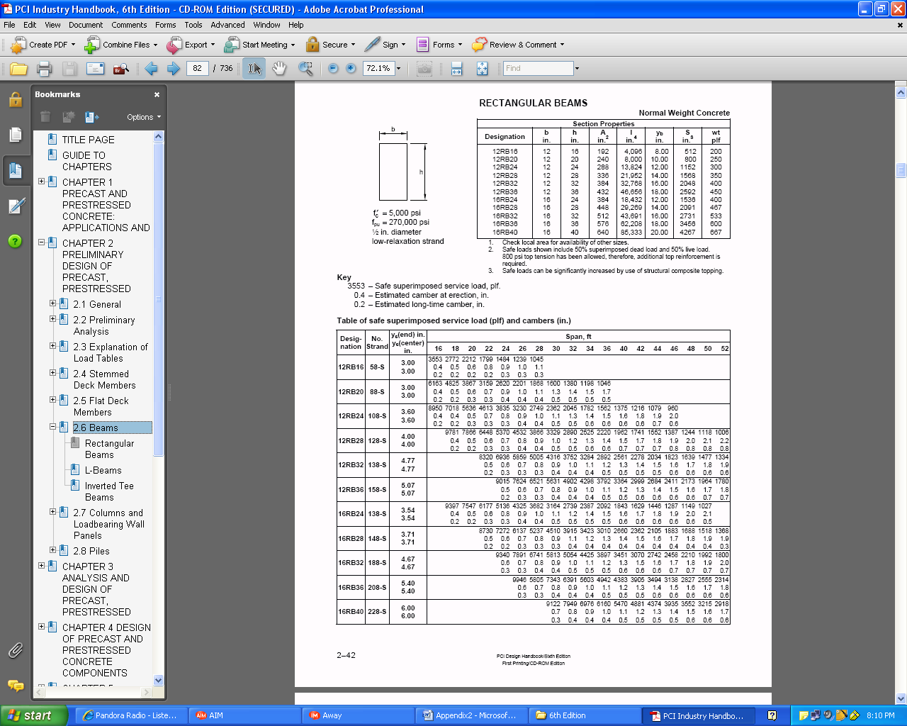
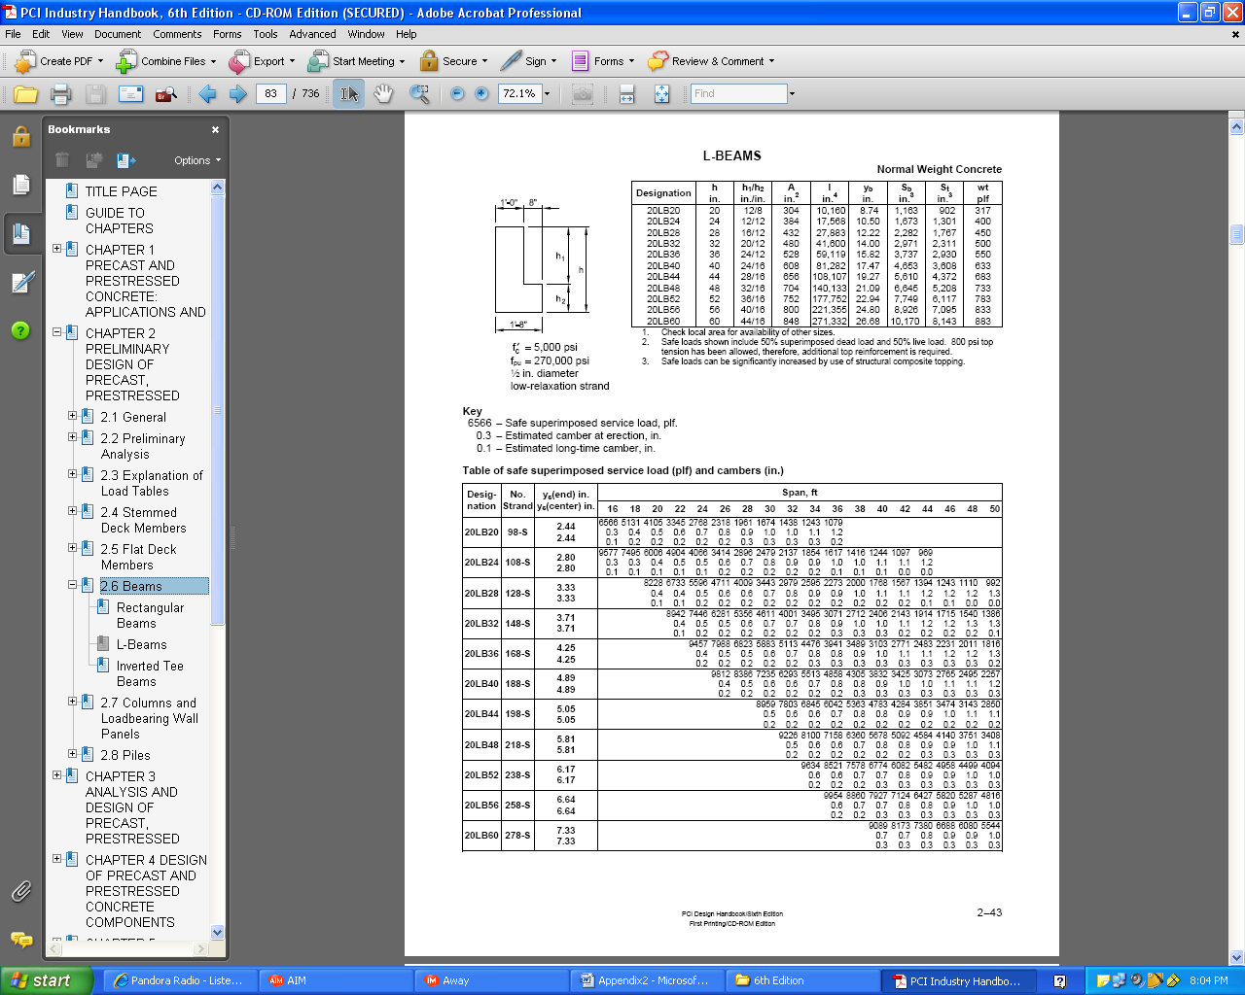
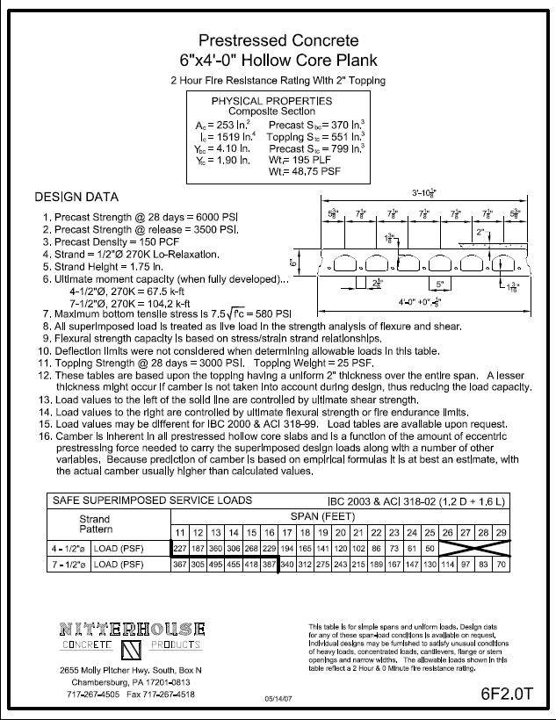
Julie Davis
Structural Option
City Vista |Building 2
Gravity System : Member Selection
| Building Stats | Proposal | Preliminary Design | Gravity System| Lateral System | Constructability | Conclusion |
6”x4’-0” Hollow core Plank
2” Composite Topping
7-1/2” Diam. Strands
Ac= 253 in²
Ic = 1519 in 4
Wt = 196 plf
Topping Wt = 48.75 plf

Slide 24
Julie Davis
Structural Option
City Vista |Building 2
Gravity System : Member Selection
| Building Stats | Proposal | Preliminary Design | Gravity System| Lateral System | Constructability | Conclusion |
20LB20 L-Beam
9-1/2” Diam. Strands
Fpu=270 ksi
H= 20”
Ac= 304 in²
F’c= 5000 psi
Wt = 317 plf
1’-0”
20”
8”
1-8”

Slide 25

Julie Davis
Structural Option
City Vista |Building 2
Gravity System : Member Selection
| Building Stats | Proposal | Preliminary Design | Gravity System| Lateral System | Constructability | Conclusion |
20LB20 L-Beam
9-1/2” Diam. Strands
Fpu=270 ksi
H= 20”
Ac= 304 in²
F’c= 5000 psi
Wt = 317 plf

Slide 26
Julie Davis
Structural Option
City Vista |Building 2
Gravity System : Member Selection
| Building Stats | Proposal | Preliminary Design | Gravity System| Lateral System | Constructability | Conclusion |
12RB16 R-Beam
8-1/2” Diam. Strands
Fpu=270 ksi
H= 16”
Ac= 192 in²
F’c= 5000 psi
Wt = 200 plf
16”
12”

Slide 27
Julie Davis
Structural Option
City Vista |Building 2
Gravity System : Member Selection
| Building Stats | Proposal | Preliminary Design | Gravity System| Lateral System | Constructability | Conclusion |
28IT24 –T-beams
(18) ½” Diam Strands
Fpu = 270 ksi
A=480 in
H = 24”
Wt 500 plf
24”

Slide 28
Julie Davis
Structural Option
City Vista |Building 2
Gravity System : Member Selection
| Building Stats | Proposal | Preliminary Design | Gravity System| Lateral System | Constructability | Conclusion |
28IT20 T-beams
(9) ½” Diam Strands
Fpu = 270 ksi
A=192 in
H = 20”
Wt 200 plf
20”

Slide 29
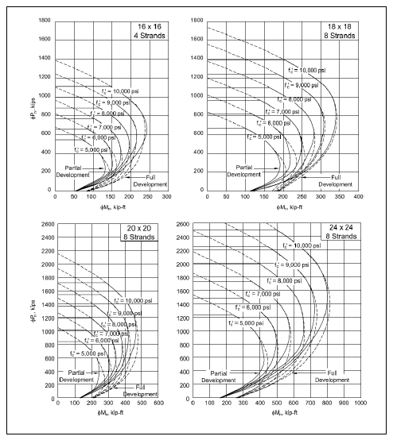
Julie Davis
Structural Option
City Vista |Building 2
Gravity System: Columns
| Building Stats | Proposal | Preliminary Design | Gravity System| Lateral System | Constructability | Conclusion |
Columns
Conventionally Reinforced
Sized Every 4 stories
Cast Double story height
  Story 1-4: 24x24 (4-#11)
  20x20 , 18x18 (4 - #9)
  Story 5-9: 18x18
  16x16 (4- #8)
  Story 10-11: 16x16
f’c = 5000 psi
16x16
18x18
20x20
24x24

Slide 30
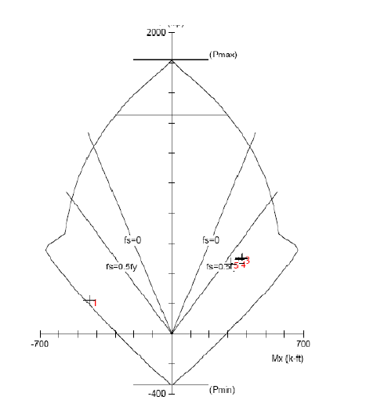
Julie Davis
Structural Option
City Vista |Building 2
Gravity System: Columns
| Building Stats | Proposal | Preliminary Design | Gravity System| Lateral System | Constructability | Conclusion |
Columns
Flexure Check:
24x24 column (base)
P = 474 kips
M = 352 kip-ft
16x16
18x18
20x20
24x24
Well within the limit

Slide 31
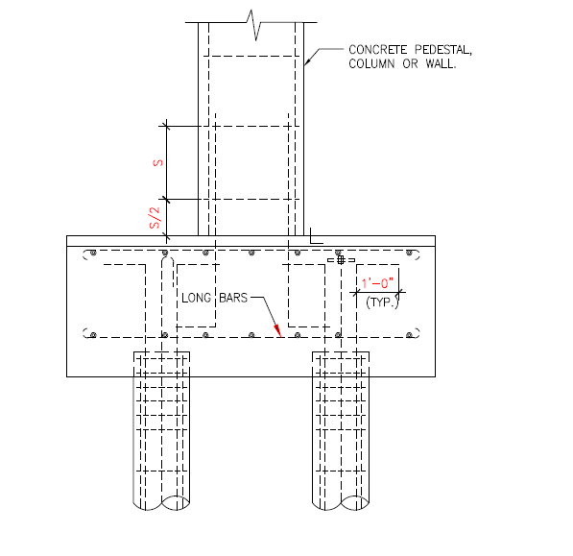
Julie Davis
Structural Option
City Vista |Building 2
Gravity System: Connections
| Building Stats | Proposal | Preliminary Design | Gravity System| Lateral System | Constructability | Conclusion |
Column Connection
Existing System : Pedestal pile caps
    Depth = 48 “
    Length = Varies
Pedestal
48”
Piles

Slide 32
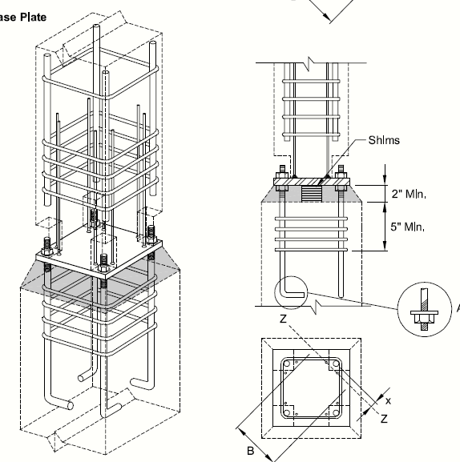
Julie Davis
Structural Option
City Vista |Building 2
Gravity System: Connections
| Building Stats | Proposal | Preliminary Design | Gravity System| Lateral System | Constructability | Conclusion |
Typical connection for 20x20 column
1” Plate
Hooked anchor bolts
Use →(4) 1” ø Bolts
Deformed anchor bars
USE →(8) ½” anchors

Slide 33
Julie Davis
Structural Option
City Vista |Building 2
Gravity System: Connections
| Building Stats | Proposal | Preliminary Design | Gravity System| Lateral System | Constructability | Conclusion |
Ledger Reinforcing
Hollow core bearing on T & L Beams
Torsion
Shear
Un-even loading
Bearing Pad : 3” min bearing
e

Slide 34
Julie Davis
Structural Option
City Vista |Building 2
Gravity System: Connections
| Building Stats | Proposal | Preliminary Design | Gravity System| Lateral System | Constructability | Conclusion |
Ledger Reinforcing
Hollow core bearing on T & L Beams
Torsion
Shear
Un-even loading
- Shear Reinforcing
e
A_{s} #3 @ 12” O.C
A_{sh} #3 @ 12” O.C

Slide 35
Julie Davis
Structural Option
City Vista |Building 2
Gravity System: Connections
| Building Stats | Proposal | Preliminary Design | Gravity System| Lateral System | Constructability | Conclusion |
Ledger Reinforcing
Hollow core bearing on T & L Beams
-Torsion
- Shear
Bearing Pad
Shear Reinforcing
Longitudinal
e
A_{wv} #3 [ Out of plane bending ]
A_{s} #3 @ 12” O.C
A_{sh} #3 @ 12” O.C
Pre-Stress Tendons

Slide 36
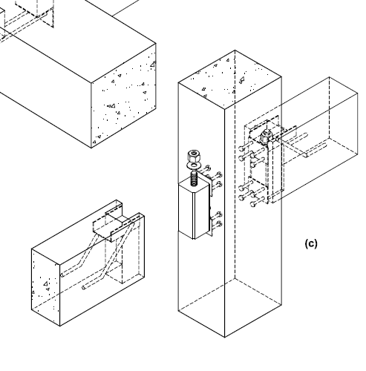
Julie Davis
Structural Option
City Vista |Building 2
Gravity System: Connections
| Building Stats | Proposal | Preliminary Design | Gravity System| Lateral System | Constructability | Conclusion |
Dapped End Reinforcing
For Hanger connection to column

Slide 37
Julie Davis
Structural Option
City Vista |Building 2
Gravity System: Connections
| Building Stats | Proposal | Preliminary Design | Gravity System| Lateral System | Constructability | Conclusion |
Av= 2 #4
Dapped End Reinforcing
For Hanger connection to column
Diagonal Tension
Ash= 4 #5
Ash’= 5 #4
Development Length = 26.6”

Slide 38
Julie Davis
Structural Option
City Vista |Building 2
Gravity System: Connections
| Building Stats | Proposal | Preliminary Design | Gravity System| Lateral System | Constructability | Conclusion |
Ah= 2 #4
Dapped End Reinforcing
For Hanger connection to column
Diagonal Tension
Direct Shear
Flexure
As = 2 #4
Pre-Stress Tendons
Development Length = 26.6”

Slide 39
Julie Davis
Structural Option
City Vista |Building 2
Gravity System: Foundation
| Building Stats | Proposal | Preliminary Design | Gravity System| Lateral System | Constructability | Conclusion |
Foundation Capacity Numbers
1 Pile = 125 Tons
1 Kips = 0.446 Tons
[ 1 ton = 2.24 kips ]
Foundation Alterations
Existing piles : Adequate
Reduction in column Size
Reduction in column loading
(5) additional column
Column load : 0-700 Kips
Column load: 700-999 Kips

Slide 40
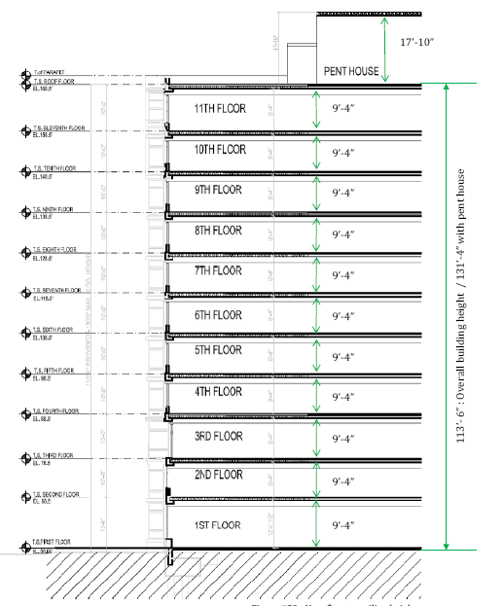
Julie Davis
Structural Option
City Vista |Building 2
Gravity System: Outcome
| Building Stats | Proposal | Preliminary Design | Gravity System| Lateral System | Constructability | Conclusion |
Gravity System Summary
Height Increase : 3’-o”
- 8” added to each floor
- 9’-4” maintained
Reducing : 1st floor : 9’-4”
11th floor : 9’-4”
Building Height : 113’- 6”
At pent house : 128’-6”
6” Over height limit
Solution: Reduction in pent house height 17’-10” : Not Considered

Slide 41

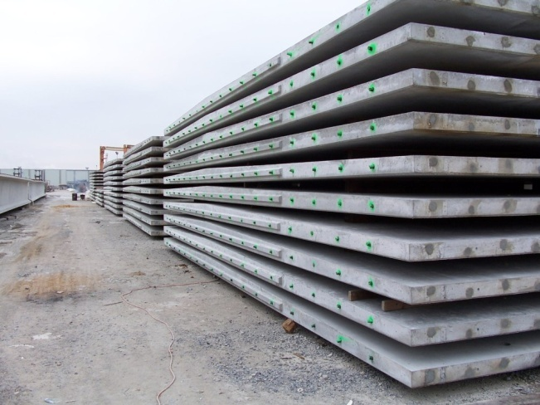
Julie Davis
Structural Option
City Vista |Building 2
Gravity System: Outcome
| Building Stats | Proposal | Preliminary Design | Gravity System| Lateral System | Constructability | Conclusion |
2. Finished Ceiling
- Exposed Beams
- Finished Ceiling ( add additional height)

Slide 42
Julie Davis
Structural Option
City Vista |Building 2
Gravity System: Outcome
| Building Stats | Proposal | Preliminary Design | Gravity System| Lateral System | Constructability | Conclusion |
2. Finished Ceiling
- Exposed Beams
- Finished Ceiling ( add additional height)
3. Weight Increase ~ 3000 Kips [ 1.1 % weight increase ]
Result : Composite Topping (25psf)
Beams ( 275 kips / floor)
Still Lightweight Structure

Slide 43
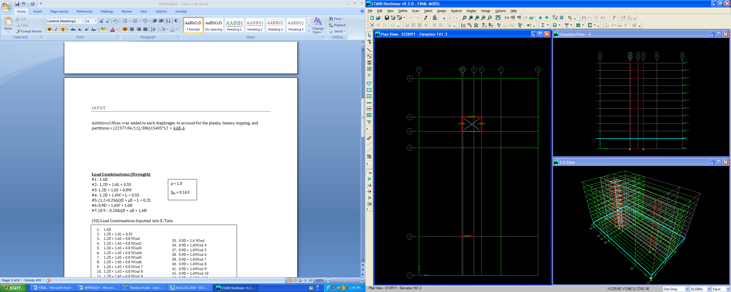
Julie Davis
Structural Option
City Vista |Building 2
Lateral System: Check
| Building Stats | Proposal | Preliminary Design | Gravity System | Lateral System | Constructability | Conclusion |
Seismic Check
Height increase = 3’-0”
Weight increase =3000 Kips
1.1 % increase
Seismic Base Shear = 915.27 Kips
Over-turning Moment = 73,601.43 Kip-Ft
Site Class : D
Design Category: B
Occupancy: I
R = 5.0
Ω = 2.5
Cd = 4.5

Slide 44
Julie Davis
Structural Option
City Vista |Building 2
Lateral System: Check
| Building Stats | Proposal | Preliminary Design | Gravity System | Lateral System | Constructability | Conclusion |
Seismic Check
Height increase = 3’-0”
Weight increase =3000 Kips
1.1 % increase
Seismic Base Shear = 915.27 Kips
Over-turning Moment = 73,601.43 Kip-Ft
E-Tabs Analysis:
Flexural reinforcement
Shear reinforcement
Story Drift

Slide 45
Julie Davis
Structural Option
City Vista |Building 2
Lateral System: Reinforcement
| Building Stats | Proposal | Preliminary Design | Gravity System | Lateral System | Constructability | Conclusion |
Reinforcing:
Wall #1: Adequate [ V: #5 @ 12” O.C]
[ H:#4 @ 12” O.C]
B.E.: None Req’d

Slide 46
Julie Davis
Structural Option
City Vista |Building 2
Lateral System: Reinforcement
| Building Stats | Proposal | Preliminary Design | Gravity System | Lateral System | Constructability | Conclusion |
Reinforcing:
Wall #1: Adequate [ V: #5 @ 12” O.C]
[ H:#4 @ 12” O.C]
B.E.: None Req’d
Wall #3: Adequate [ #5 @ 12” O.C]
[ #4 @ 12” O.C]
B.E. : 4 ft

Slide 47
Julie Davis
Structural Option
City Vista |Building 2
Lateral System: Reinforcement
| Building Stats | Proposal | Preliminary Design | Gravity System | Lateral System | Constructability | Conclusion |
Reinforcing:
Wall #1: Adequate [ V: #5 @ 12” O.C]
[ H:#4 @ 12” O.C]
B.E.: None Req’d
Wall #2: Inadequate
Wall #4: Inadequate

Slide 48
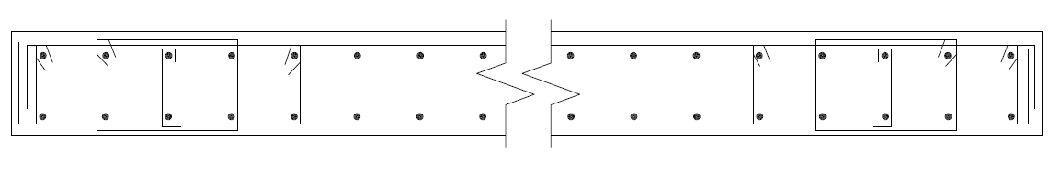
Julie Davis
Structural Option
City Vista |Building 2
Lateral System: Reinforcement
| Building Stats | Proposal | Preliminary Design | Gravity System | Lateral System | Constructability | Conclusion |
Reinforcing Alterations:
Wall #2: Adequate
Wall #4: Adequate
Thick : 16”
V: Story 1-2: #8 @ 12” O.C
H: Story 1 -2 #5 @ 12” O.C
Thick : 16”
V: Story 1-2: #8 @ 12” O.C
H : Story 1-2: #5 @ 12” O.C
Boundary Reinforcing
Shear Reinforcing
Flexural Reinforcing
Typical Detail From existing drawings

Slide 49
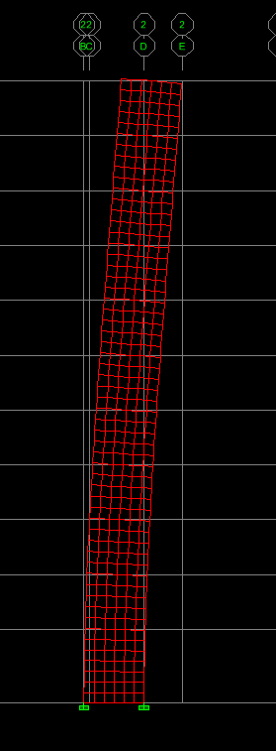
Julie Davis
Structural Option
City Vista |Building 2
Lateral System: Drift
| Building Stats | Proposal | Preliminary Design | Gravity System | Lateral System | Constructability | Conclusion |
Seismic Drift : [ ASCE7-03]
- Amplified : C_{d}δ_{ei}/I_{e}
Drift Requirement = 0.020h_{sk}
North\South (x- dir): ADEQUATE
Wall #1
Wall #3
Shear in East \ West : INADEQUATE
Wall #2
Wall #4
C_{d} = 4.5
h_{sk} = 10ft
I_{e}= 1.0
Total Drift 1.82” < 2.40”
Total Drift 3.78” > 2.40”

Slide 50
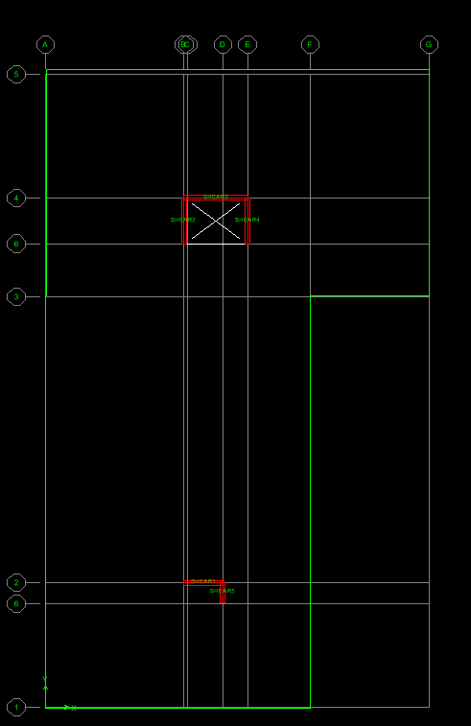
Julie Davis
Structural Option
City Vista |Building 2
Lateral System: Summary
| Building Stats | Proposal | Preliminary Design | Gravity System | Lateral System | Constructability | Conclusion |
Seismic Summary
Model assumption 100% lateral load taken by walls
Original : Columns took a portion of lateral loads
Possible Solution:
Added Shear wall in E-W Direction
Wall #5: 6’x16”
Reinforcing : V: #5 @ 12” O.C
H: #4 @ 12” O.C
B.E: 1ft
Drift : Reducing Drift 2.38” < 2.40”

Slide 51
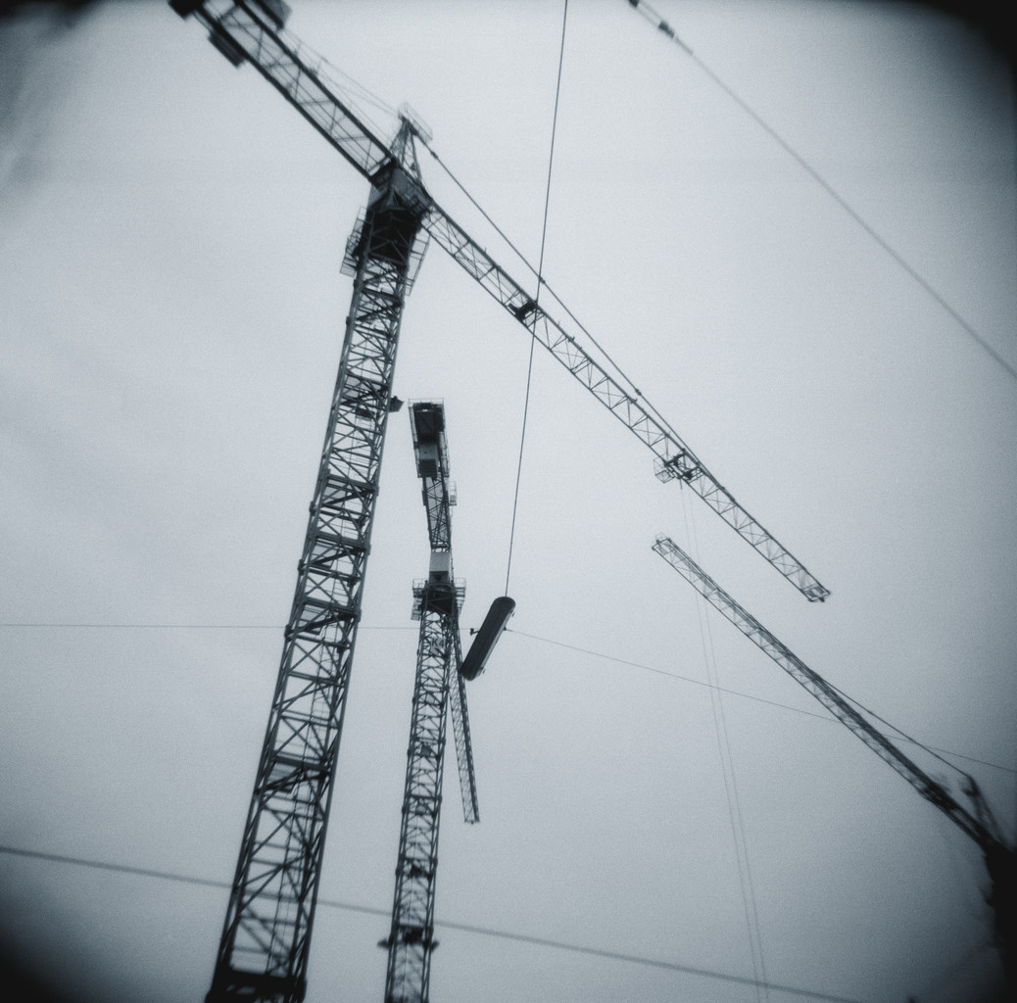
Julie Davis
Structural Option
City Vista |Building 2
Constructability: Erection
| Building Stats | Proposal | Preliminary Design | Gravity System | Lateral System | Constructability | Conclusion |
Erection Concerns
Stripping
Storing
Pick Point
Line Lifts
- eccentric moment

Slide 52
Julie Davis
Structural Option
City Vista |Building 2
Constructability: Erection
| Building Stats | Proposal | Preliminary Design | Gravity System | Lateral System | Constructability | Conclusion |
Erection Concerns
Stripping
Storing
Pick Point : Line Lifts
- eccentric moment
- P∆ affects
θ

Slide 53
Julie Davis
Structural Option
City Vista |Building 2
Constructability: Erection
| Building Stats | Proposal | Preliminary Design | Gravity System | Lateral System | Constructability | Conclusion |
Erection Concerns
Stripping
Storing
Pick Point : Line Lifts
- eccentric moment
- P∆ affects
SAFTEY FACTOR = 1.2
θ

Slide 54
Julie Davis
Structural Option
City Vista |Building 2
Constructability: Erection
| Building Stats | Proposal | Preliminary Design | Gravity System | Lateral System | Constructability | Conclusion |
Crane: Saddle Jib tower crane
Lay down
Building 2
15,500 sqft
Lay down
Existing Building
Building 1A-1B Begin in Aug 2007

Slide 55

Julie Davis
Structural Option
City Vista |Building 2
Constructability: LEEDS
| Building Stats | Proposal | Preliminary Design | Gravity System | Lateral System | Constructability | Conclusion |
Material Recourses:
Reusable
Corrosion control Maintenance
Production:
Material Waste : 2.5%
Water Reuse : 95%
Energy:
Possibility : passive solar system
Production: slag cement & silica fumes
Reuse:
Modular pieces
RE-USE

Slide 56
Julie Davis
Structural Option
City Vista |Building 2
Constructability: LEEDS
| Building Stats | Proposal | Preliminary Design | Gravity System | Lateral System | Constructability | Conclusion |
Material Recourses:
Reusable
Corrosion control Maintenance
Production:
Material Waste : 2.5%
Water Reuse : 95%
Energy:
Possibility : passive solar system
Production: slag cement & silica fumes
Reuse:
Modular pieces
23/27 : LEEDS CERTIFIED BUILDING
RE-USE

Slide 57
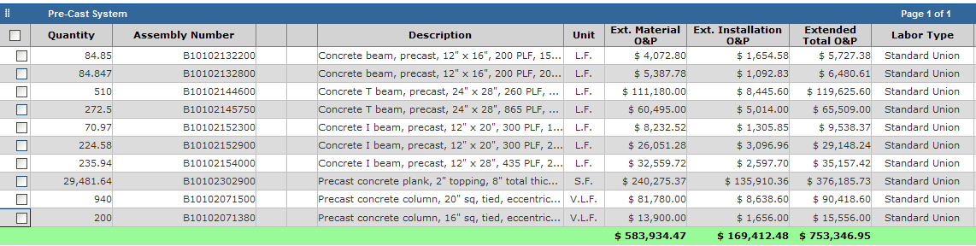
Julie Davis
Structural Option
City Vista |Building 2
Constructability: Cost & Schedule
| Building Stats | Proposal | Preliminary Design | Gravity System | Lateral System | Constructability | Conclusion |
Cost Analysis : materials and labor
Pre-Cast System:
$750,000.00 / Floor
Post Tension System :
$600,000.00 / Floor
Pre-Cast : $ 2,000,000.00
After the Fact:
Considering - Scaffolding
        Shoring
        Formwork
Cost would balance out

Slide 58
Julie Davis
Structural Option
City Vista |Building 2
Constructability: Cost & Schedule
| Building Stats | Proposal | Preliminary Design | Gravity System | Lateral System | Constructability | Conclusion |
Cost Analysis : materials and labor
Pre-Cast System:
$750,000.00 / Floor
Post Tension System :
600,000.00 / Floor
Pre-Cast : $ 2,000,000.00
Schedule Analysis: Gravity System and shear walls
Pre-Cast System:
62,000 in² /week
(2) Floor every 11 days
Post Tension:
(2) Floors every 12 days
Overall : 11 Day Saving
Member | Quantity | Total Area
Column #1 [20x20] | 24 | 66.69 in²
Column #2 [16x16] | 10 | 17.68 in²
Column #3 [24x24] | 23 | 92 in²
L-Beams | 31 | 9424 in²
T-Beams | 34 | 16 320 in²
R-Beams | 9 | 1728 in²
Planks | 200 | 50,600 in²
TOTAL |  | 78,249 in²

Slide 59
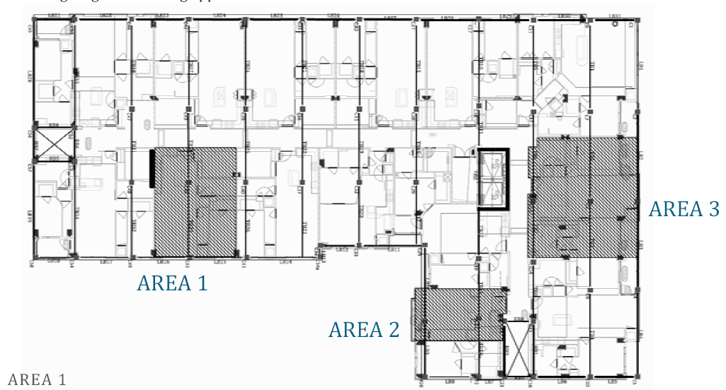
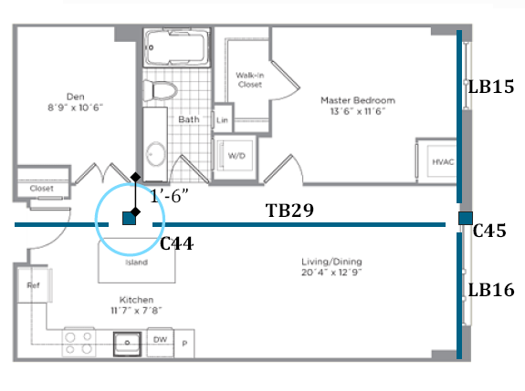
Julie Davis
Structural Option
City Vista |Building 2
Constructability: Architecturally
| Building Stats | Proposal | Preliminary Design | Gravity System | Lateral System | Constructability | Conclusion |
Architectural Concerns
Additional Columns
- Reducing rentable space
- Reducing window

Slide 60
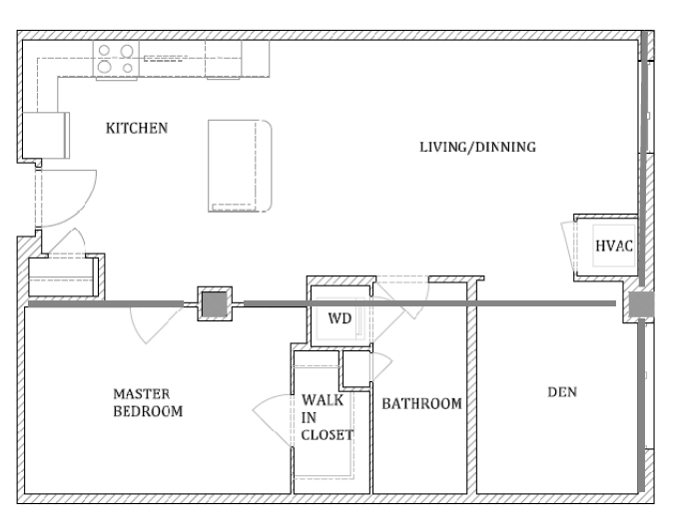
Julie Davis
Structural Option
City Vista |Building 2
Constructability: Architecturally
| Building Stats | Proposal | Preliminary Design | Gravity System | Lateral System | Constructability | Conclusion |
Architectural Concerns
Additional Columns
- Reducing rentable space
- Reducing window
Architectural Solution

Slide 61
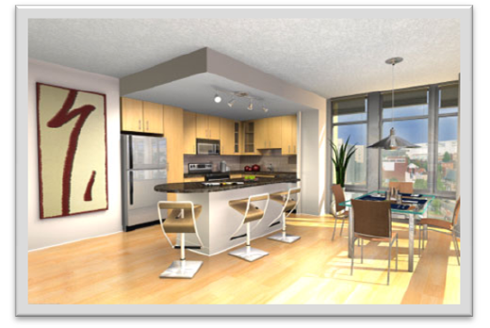
Julie Davis
Structural Option
City Vista |Building 2
Constructability: Architecturally
| Building Stats | Proposal | Preliminary Design | Gravity System | Lateral System | Constructability | Conclusion |
Architectural Concerns
Additional Columns
- Reducing rentable space
- Reducing window
2. Exposed Ceiling Grid

Slide 62
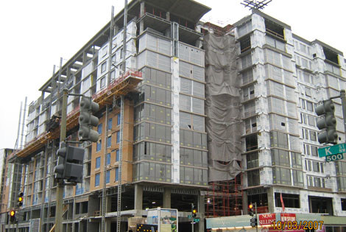
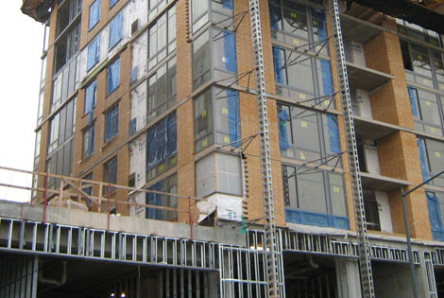
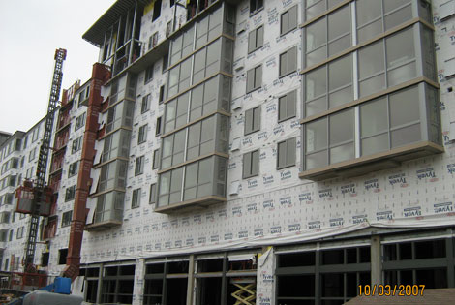
Julie Davis
Structural Option
City Vista |Building 2
Conclusion
| Building Stats | Proposal | Preliminary Design | Gravity System | Lateral System | Constructability | Conclusion |
Pre-cast is NOT a better solution
Post Tension System:
Height: Not as restricting
Architecture: Irregular grid Open plan condos
Economically: Post-tension less concrete Cheaper

Slide 63
Julie Davis
Structural Option
City Vista |Building 2
Conclusion
| Building Stats | Proposal | Preliminary Design | Gravity System | Lateral System | Constructability | Conclusion |
Pre-cast is NOT a better solution
Post Tension System:
Height: Not as restricting
Architecture: Irregular grid Open plan condos
Economically: Post-tension less concrete Cheaper
Although If …….
Incorporation in preliminary design
1. Height Limit
2. Finished Ceiling
3. LEEDS possibility
4. Fast onsite erection

Slide 64
Acknowledgements
SK& A Engineering
Davis Construction
Faculty
Friends and Family

Slide 65
QUESTIONS ?

