Slide 1
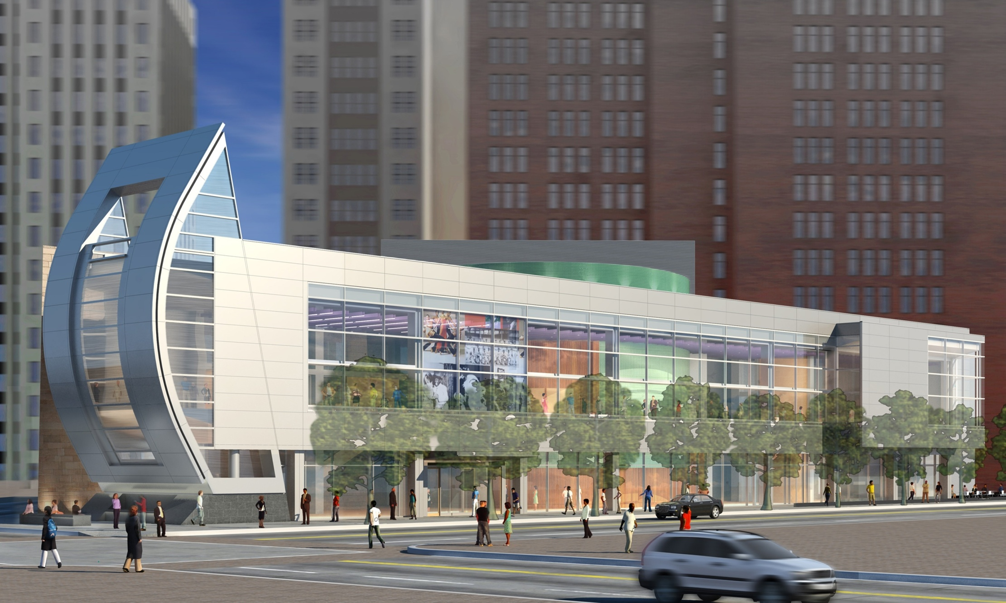
THE AUGUST WILSON CENTER FOR AFRICAN AMERICAN CULTURE
_{PITTSBURGH, PENNSYLVANIA}
_{PERKINS + WILL}
Schematic Design Presentation
MICHAEL P. ROYER

Slide 2
THE AUGUST WILSON CENTER FOR AFRICAN AMERICAN CULTURE
SCHEMATIC DESIGN PRESENTATION: PROJECT OVERVIEW
LOCATION:
Liberty Avenue
Pittsburgh, Pennsylvania
SIZE:
63,000 Square Feet
COST:
Approximately 23 Million Dollars
ESTIMATED OPENING:
SPRING 2009
PRIMARY FUNCTIONS:
500 Seat Theater
Permanent Exhibit Space
Temporary Exhibit Space
Music Café
Gift Shop
Education Spaces
Administrative Offices

Slide 3
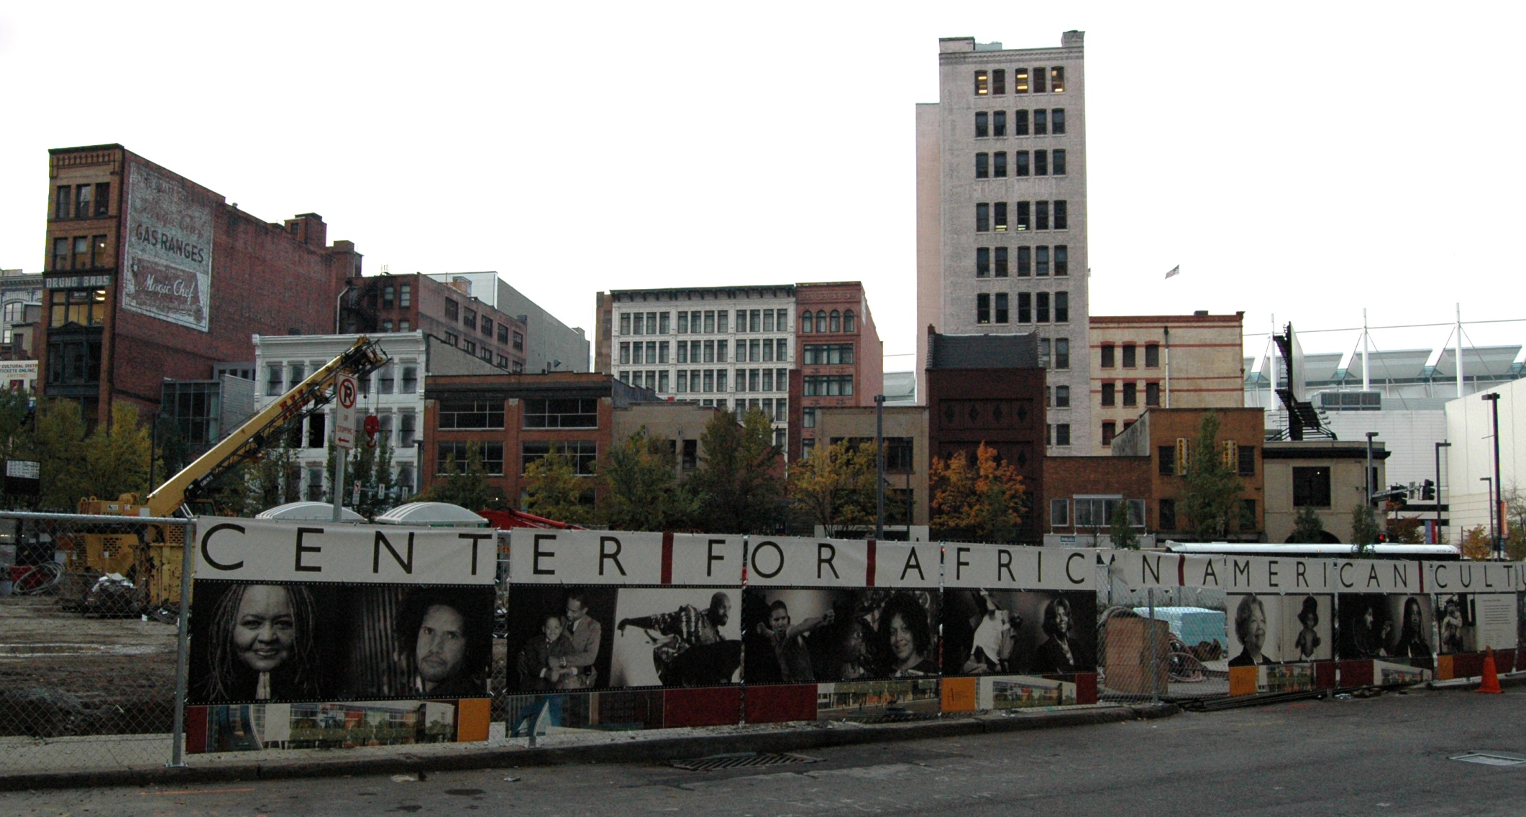
THE AUGUST WILSON CENTER FOR AFRICAN AMERICAN CULTURE
SCHEMATIC DESIGN PRESENTATION: PROJECT OVERVIEW
MAJOR PLAYERS:
owner: The August Wilson Center
architect: Perkins + Will, San Francisco
lighting design: The Studio i Company
electrical consultant: Hornfeck Engineering
construction management: Turner Construction
owner’s representative: Oxford
Development Company

Slide 4
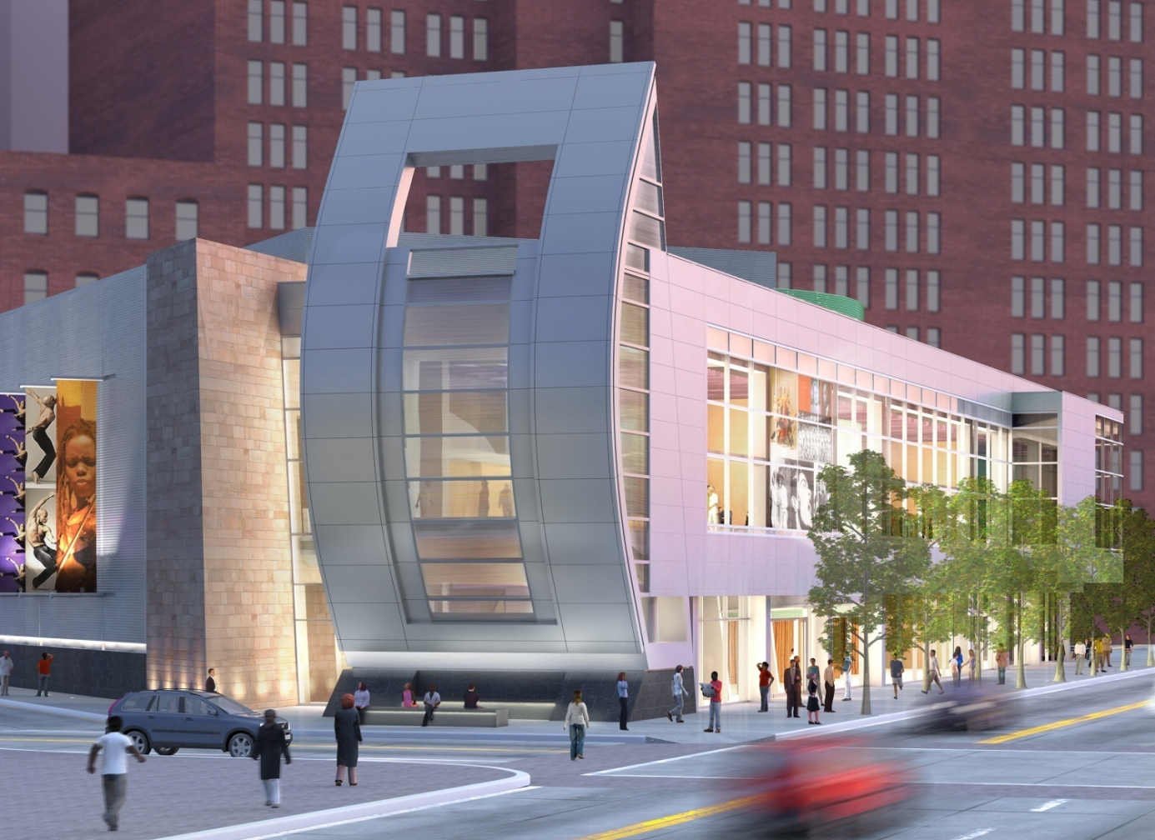
THE AUGUST WILSON CENTER FOR AFRICAN AMERICAN CULTURE
SCHEMATIC DESIGN PRESENTATION: WALKTHROUGH
FAÇADE
_{PERKINS + WILL}

Slide 5
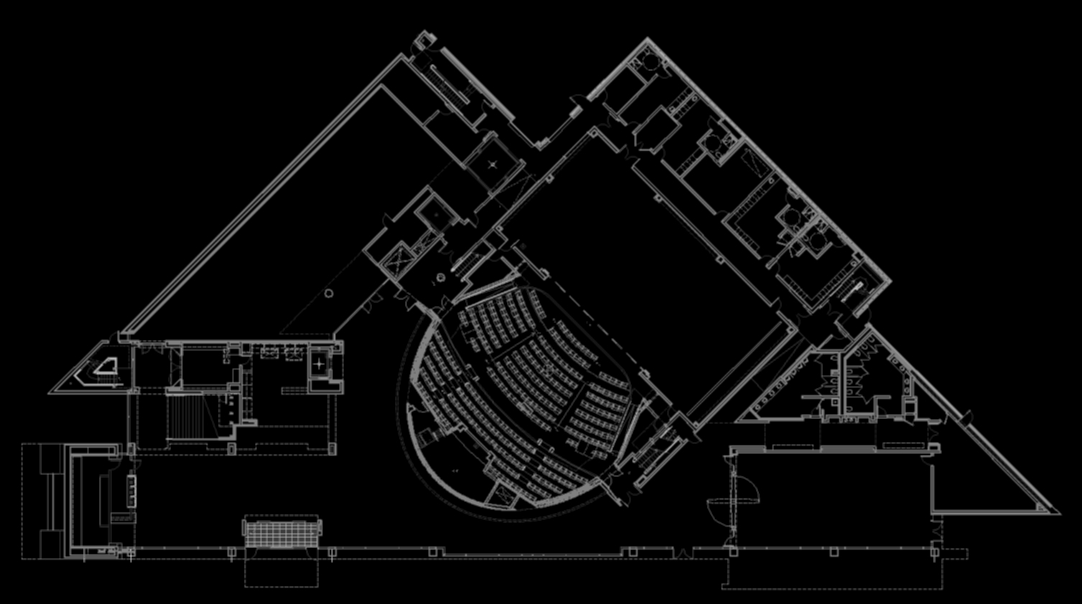
THE AUGUST WILSON CENTER FOR AFRICAN AMERICAN CULTURE
SCHEMATIC DESIGN PRESENTATION: WALKTHROUGH
FIRST LEVEL
[William Penn Place]
MAIN LOBBY
[Liberty Avenue]

Slide 6
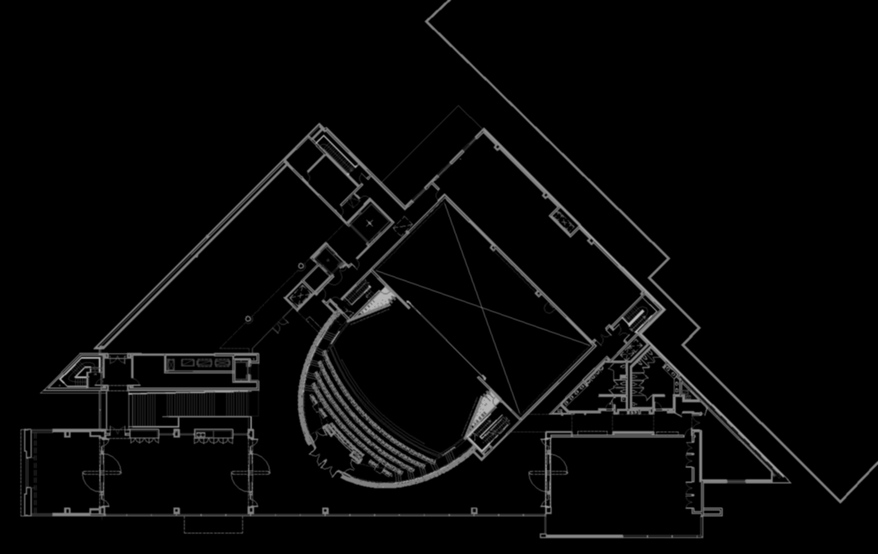
THE AUGUST WILSON CENTER FOR AFRICAN AMERICAN CULTURE
SCHEMATIC DESIGN PRESENTATION: WALKTHROUGH
SECOND LEVEL

Slide 7
THE AUGUST WILSON CENTER FOR AFRICAN AMERICAN CULTURE
SCHEMATIC DESIGN PRESENTATION: OVERALL GOALS
RESPONSIVE. FLEXIBLE. EFFICIENT.
architect’s aesthetic
modern form
materiality
changing appearance
varied uses
user-friendly
environment
simplistic
effective

Slide 8

THE AUGUST WILSON CENTER FOR AFRICAN AMERICAN CULTURE
SCHEMATIC DESIGN PRESENTATION: DETAILS
CRITERIA:
CONCEPTS:
CREATE A WELCOMING APPEARANCE
ESTABLISH A FOCAL POINT
RESPOND TO THE CITY
SIGNATURE BUILDING
ALLOW THE INTERIOR TO BECOME THE FOCUS OF THE EXTERIOR
REINFORCE THE EMPHASIS ESTABLISHED BY THE SAIL
USE LIGHTING TO SHOW WHEN THE BUILDING IS ACTIVE
HIGHLIGHT THE UNIQUE VOLUMES OF SPACE
ATTRACT.
BUILDING FAÇADE LOWER LEVEL LOBBY EDUCATION AND LECTURE ROOM MEETING ROOM

Slide 9

THE AUGUST WILSON CENTER FOR AFRICAN AMERICAN CULTURE
SCHEMATIC DESIGN PRESENTATION: DETAILS
_{PERKINS + WILL}
BUILDING FAÇADE LOWER LEVEL LOBBY EDUCATION AND LECTURE ROOM MEETING ROOM

Slide 10
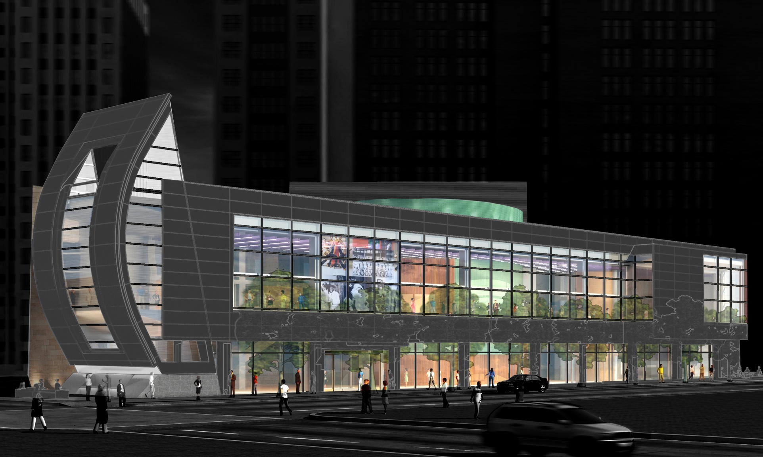
THE AUGUST WILSON CENTER FOR AFRICAN AMERICAN CULTURE
SCHEMATIC DESIGN PRESENTATION: DETAILS
awake
BUILDING FAÇADE LOWER LEVEL LOBBY EDUCATION AND LECTURE ROOM MEETING ROOM

Slide 11
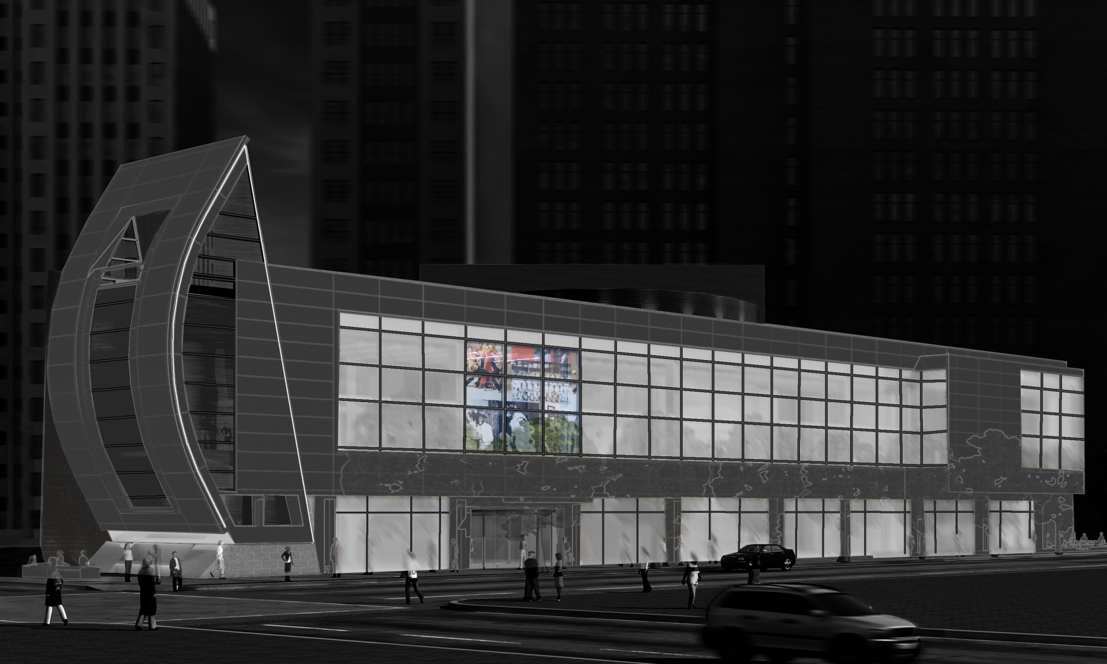
THE AUGUST WILSON CENTER FOR AFRICAN AMERICAN CULTURE
SCHEMATIC DESIGN PRESENTATION: DETAILS
asleep
BUILDING FAÇADE LOWER LEVEL LOBBY EDUCATION AND LECTURE ROOM MEETING ROOM

Slide 12
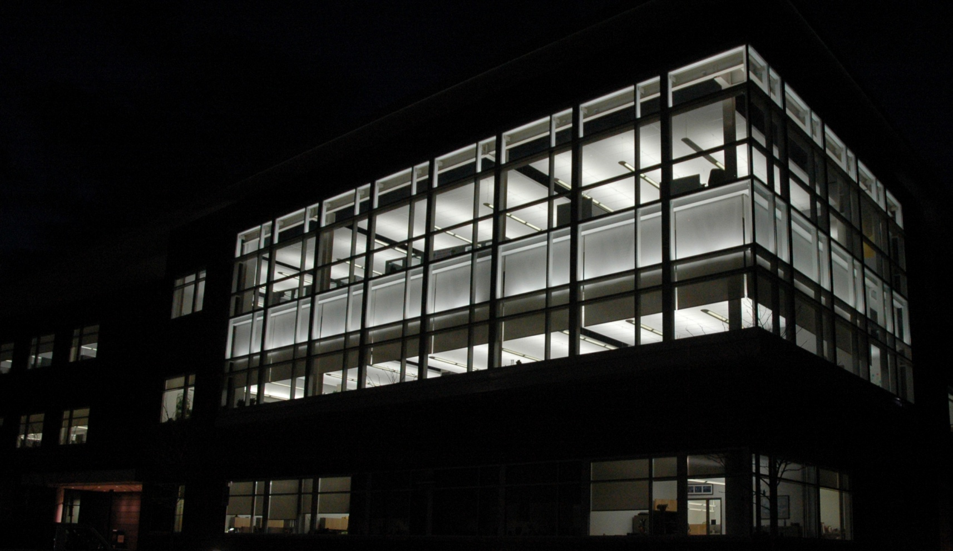
THE AUGUST WILSON CENTER FOR AFRICAN AMERICAN CULTURE
SCHEMATIC DESIGN PRESENTATION: DETAILS
BUILDING FAÇADE LOWER LEVEL LOBBY EDUCATION AND LECTURE ROOM MEETING ROOM

Slide 13
THE AUGUST WILSON CENTER FOR AFRICAN AMERICAN CULTURE
SCHEMATIC DESIGN PRESENTATION: DETAILS
BUILDING FAÇADE LOWER LEVEL LOBBY EDUCATION AND LECTURE ROOM MEETING ROOM

Slide 14
THE AUGUST WILSON CENTER FOR AFRICAN AMERICAN CULTURE
SCHEMATIC DESIGN PRESENTATION: DETAILS
CRITERIA:
CONCEPTS:
CREATE A RELAXING AND WELCOMING ENVIRONMENT
DRAW PATRONS TO POINTS OF INTEREST
FLEXIBLE DESIGN FOR VARIED USES
ENERGY EFFICIENCY
USE NONUNIFORM LIGHT WITH PERIMETER FOCUS
USE HIGHER LUMINANCES TO ATTRACT ATTENTION
DIMMABLE FIXTURES CAN BE USED TO RESPOND TO VARIED SITUATIONS
UTILIZE DIMMING AND DAYLIGHT SENSING TO REDUCE ENERGY
WELCOME.
BUILDING FAÇADE LOWER LEVEL LOBBY EDUCATION AND LECTURE ROOM MEETING ROOM

Slide 15
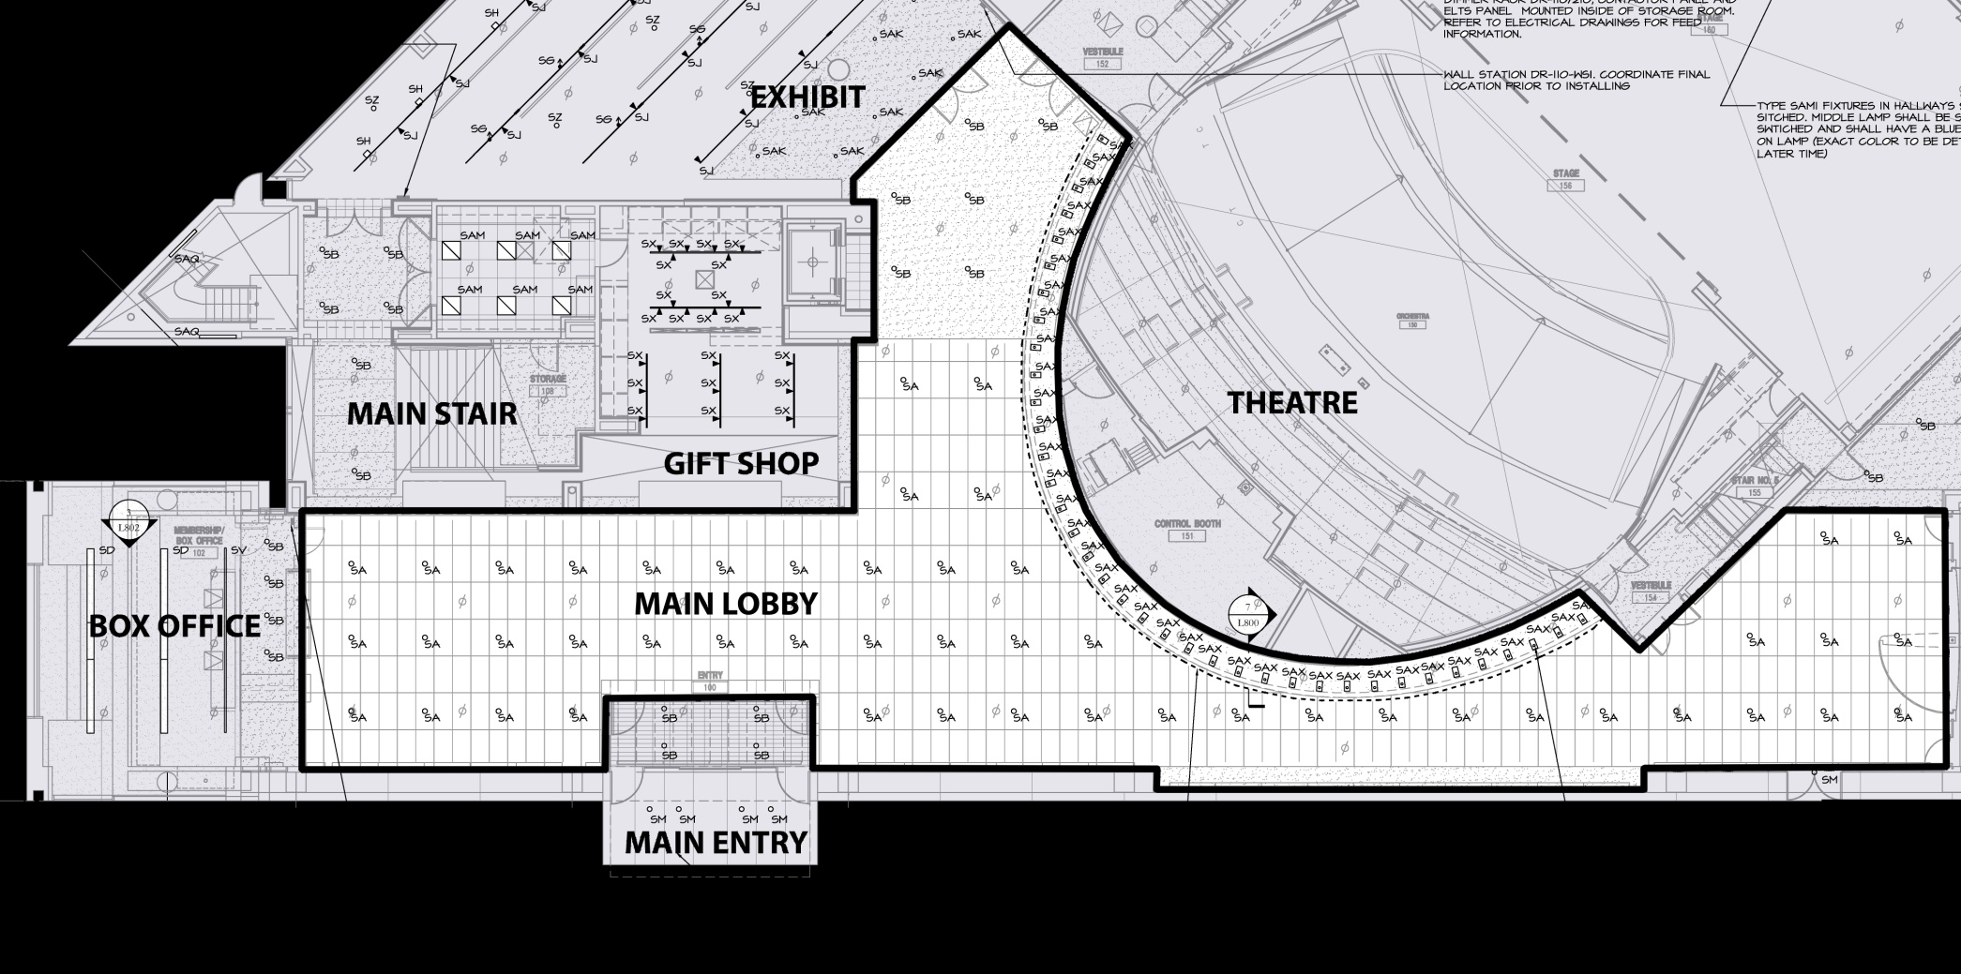
THE AUGUST WILSON CENTER FOR AFRICAN AMERICAN CULTURE
SCHEMATIC DESIGN PRESENTATION: DETAILS
BUILDING FAÇADE LOWER LEVEL LOBBY EDUCATION AND LECTURE ROOM MEETING ROOM

Slide 16
THE AUGUST WILSON CENTER FOR AFRICAN AMERICAN CULTURE
SCHEMATIC DESIGN PRESENTATION: DETAILS
MAIN LOBBY
BUILDING FAÇADE LOWER LEVEL LOBBY EDUCATION AND LECTURE ROOM MEETING ROOM

Slide 17
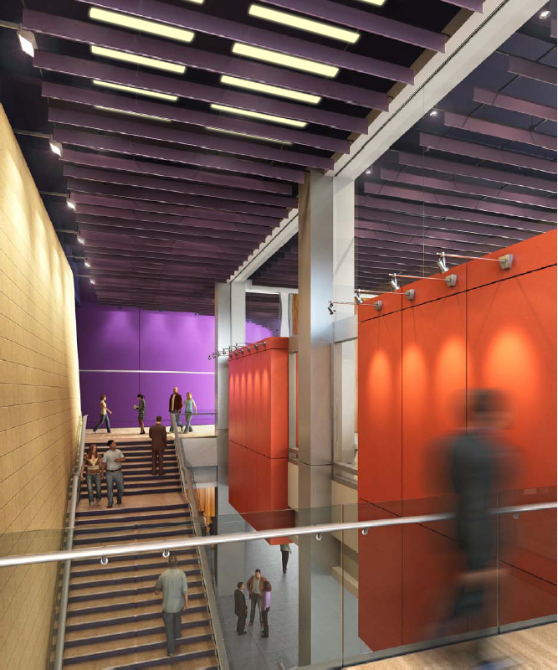
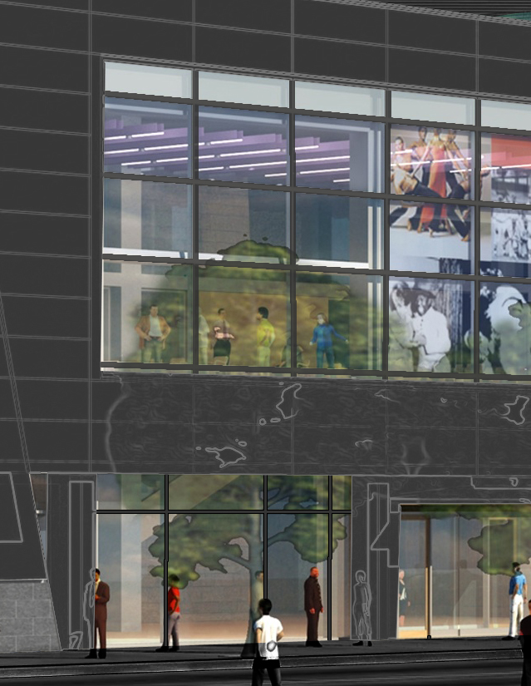
THE AUGUST WILSON CENTER FOR AFRICAN AMERICAN CULTURE
SCHEMATIC DESIGN PRESENTATION: DETAILS
BUILDING FAÇADE LOWER LEVEL LOBBY EDUCATION AND LECTURE ROOM MEETING ROOM

Slide 18
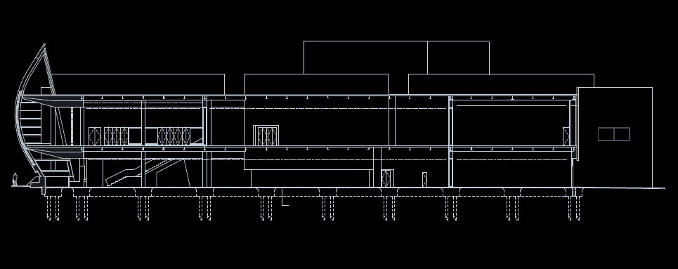
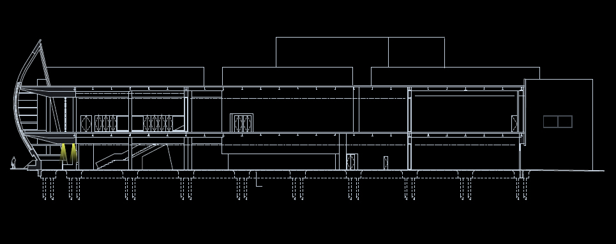
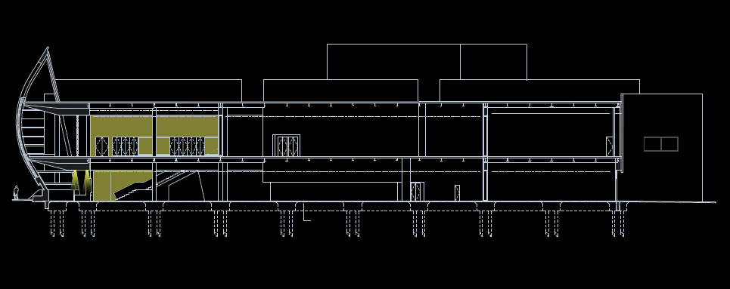
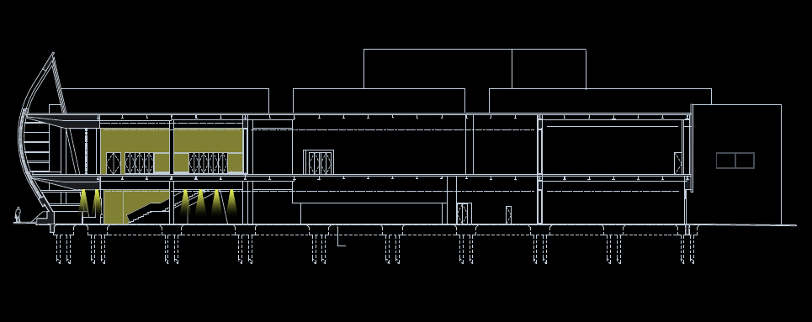
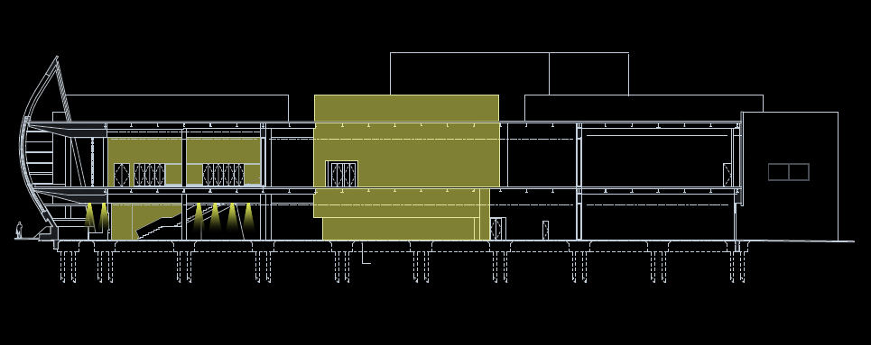
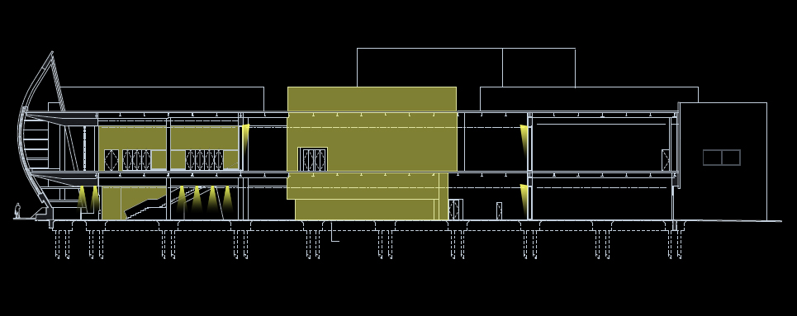
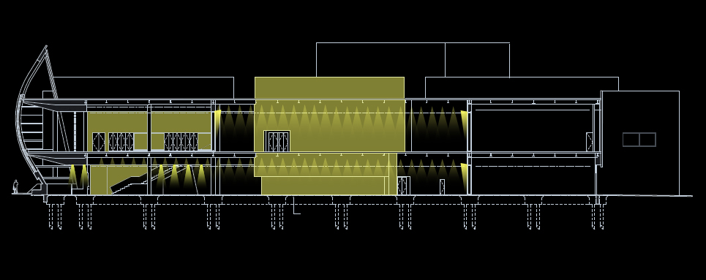
THE AUGUST WILSON CENTER FOR AFRICAN AMERICAN CULTURE
SCHEMATIC DESIGN PRESENTATION: DETAILS
BUILDING SECTION
BOX OFFICE
STAIRS
GIFT SHOP
THEATER
DOORS
AMBIENT
BUILDING FAÇADE LOWER LEVEL LOBBY EDUCATION AND LECTURE ROOM MEETING ROOM

Slide 19
THE AUGUST WILSON CENTER FOR AFRICAN AMERICAN CULTURE
SCHEMATIC DESIGN PRESENTATION: DETAILS
BUILDING FAÇADE LOWER LEVEL LOBBY EDUCATION AND LECTURE ROOM MEETING ROOM

Slide 20
THE AUGUST WILSON CENTER FOR AFRICAN AMERICAN CULTURE
SCHEMATIC DESIGN PRESENTATION: DETAILS
CRITERIA:
CONCEPTS:
CREATE VISUAL CLARITY
PROVIDE EVEN AND ADEQUATE LIGHT TO WORK PLANE
FLEXIBLE LIGHTING FOR VARIED PRESENTATION TYPES
RESPOND TO THE ENVIRONMENT
DESIGN FOR A UNIFORM LAYOUT OF LUMINAIRES WITH PERIPHERAL EMPHASIS
PERFORM ADEQUATE CALCULATION TO ENSURE PROPER LIGHT LEVELS
USE MULTIPLE GROUPS AND CONTROLS TO CREATE A USER-FRIENDLY ENVIRONMENT
UTILIZE DIMMING AND DAYLIGHT SENSORS TO TAKE ADVANTAGE OF DAYLIGHT PRESENSE
PERFORM.
BUILDING FAÇADE LOWER LEVEL LOBBY EDUCATION AND LECTURE ROOM MEETING ROOM

Slide 21
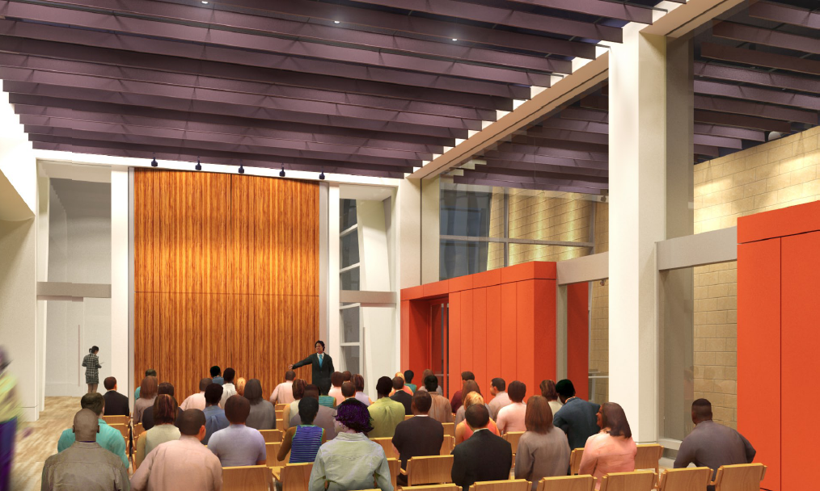
THE AUGUST WILSON CENTER FOR AFRICAN AMERICAN CULTURE
SCHEMATIC DESIGN PRESENTATION: DETAILS
_{PERKINS + WILL}
FOR SPACE VISUALIZATION PURPOSES ONLY
BUILDING FAÇADE LOWER LEVEL LOBBY EDUCATION AND LECTURE ROOM MEETING ROOM

Slide 22
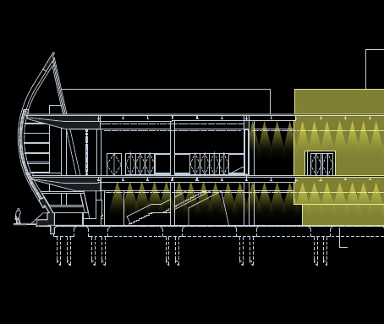
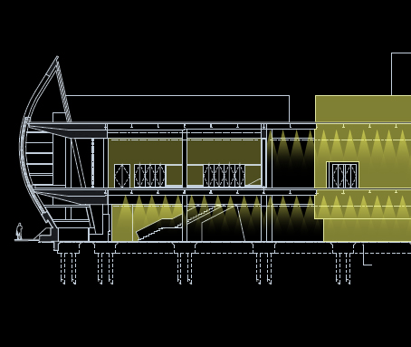
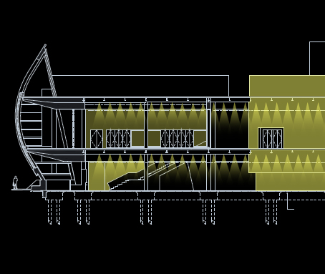
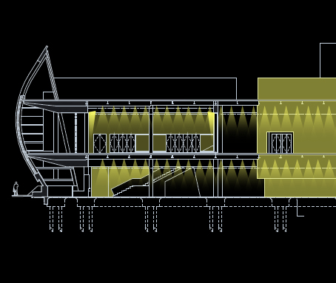
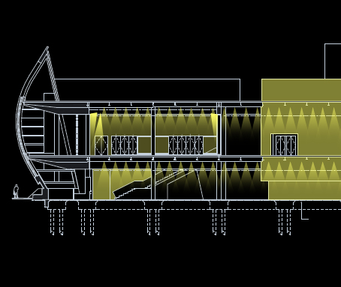
THE AUGUST WILSON CENTER FOR AFRICAN AMERICAN CULTURE
SCHEMATIC DESIGN PRESENTATION: DETAILS
OUTSIDE
EXTERNAL
AMBIENT
PERIMETER
TASK
BUILDING SECTION
BUILDING FAÇADE LOWER LEVEL LOBBY EDUCATION AND LECTURE ROOM MEETING ROOM

Slide 23
THE AUGUST WILSON CENTER FOR AFRICAN AMERICAN CULTURE
SCHEMATIC DESIGN PRESENTATION: DETAILS
CRITERIA:
CONCEPTS:
WARM AND RELAXING AMBIANCE
UPSCALE APPEARANCE
STRONG FACIAL RENDERING
SIGNATURE ROOM
UTILIZE NONUNIFORMITY AND LOW CCT SOURCES
USE DECORATIVE LUMINAIRES TO PRODUCE A DISTINCT STYLE
AVOID OVERHEAD DOWNLIGHT
LEAVE THE PATRON WITH THE IMPRESSION OF A HIGH CLASS SPACE
IMPRESS..
BUILDING FAÇADE LOWER LEVEL LOBBY EDUCATION AND LECTURE ROOM MEETING ROOM

Slide 24
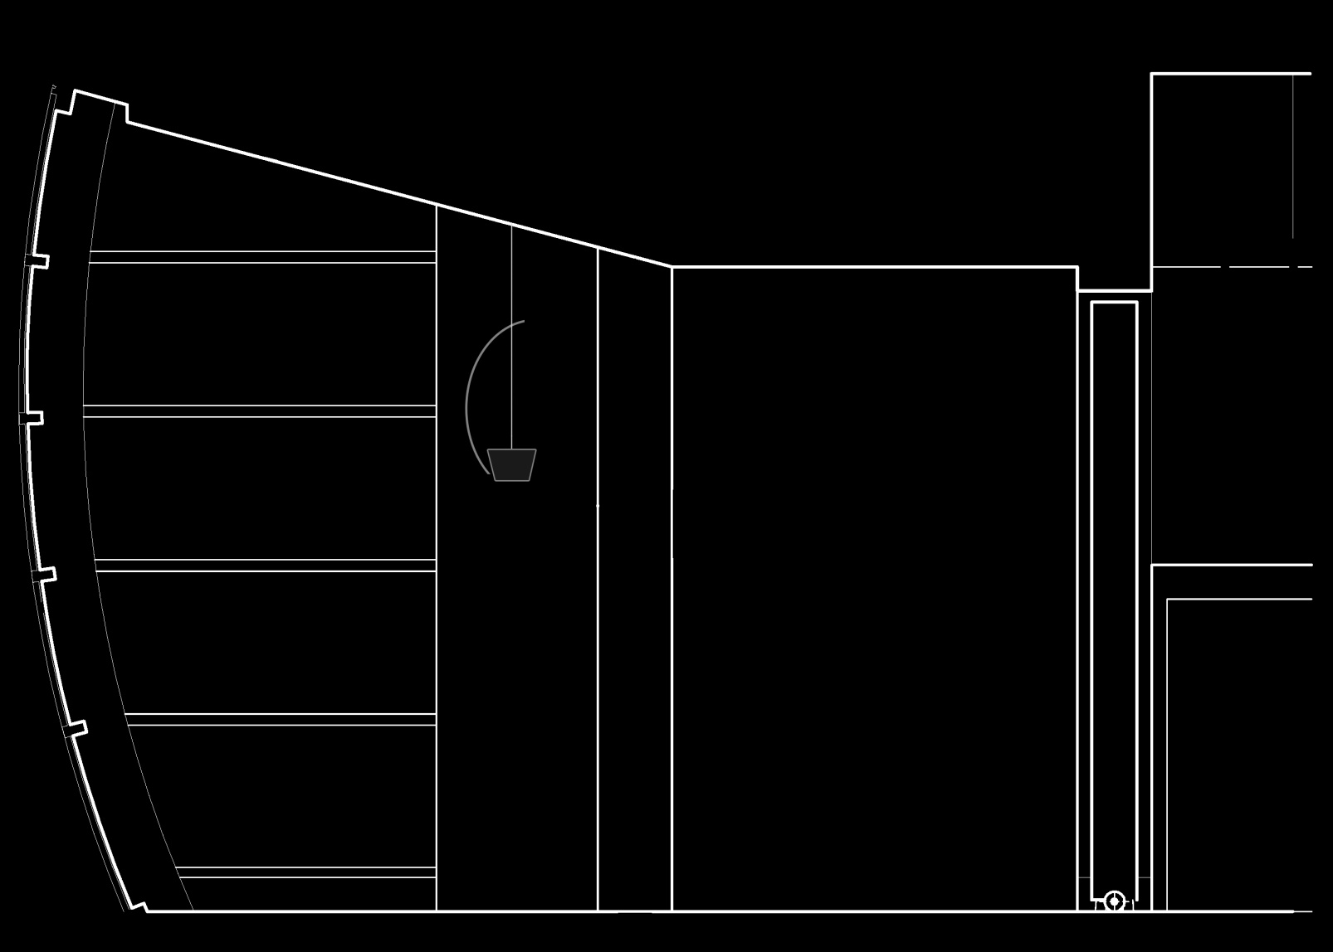
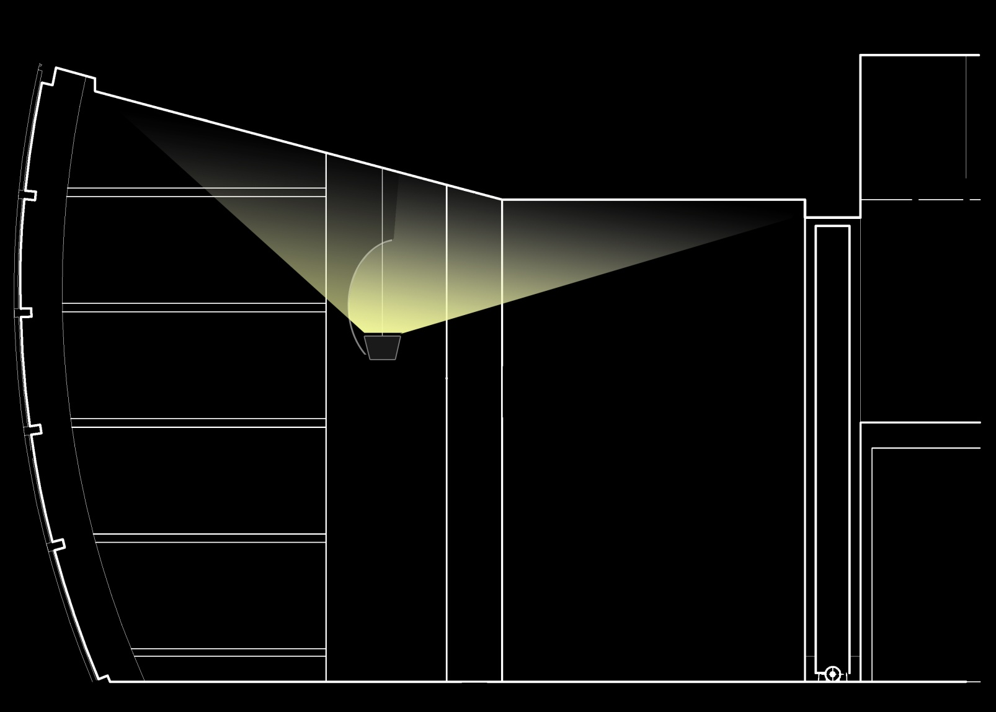
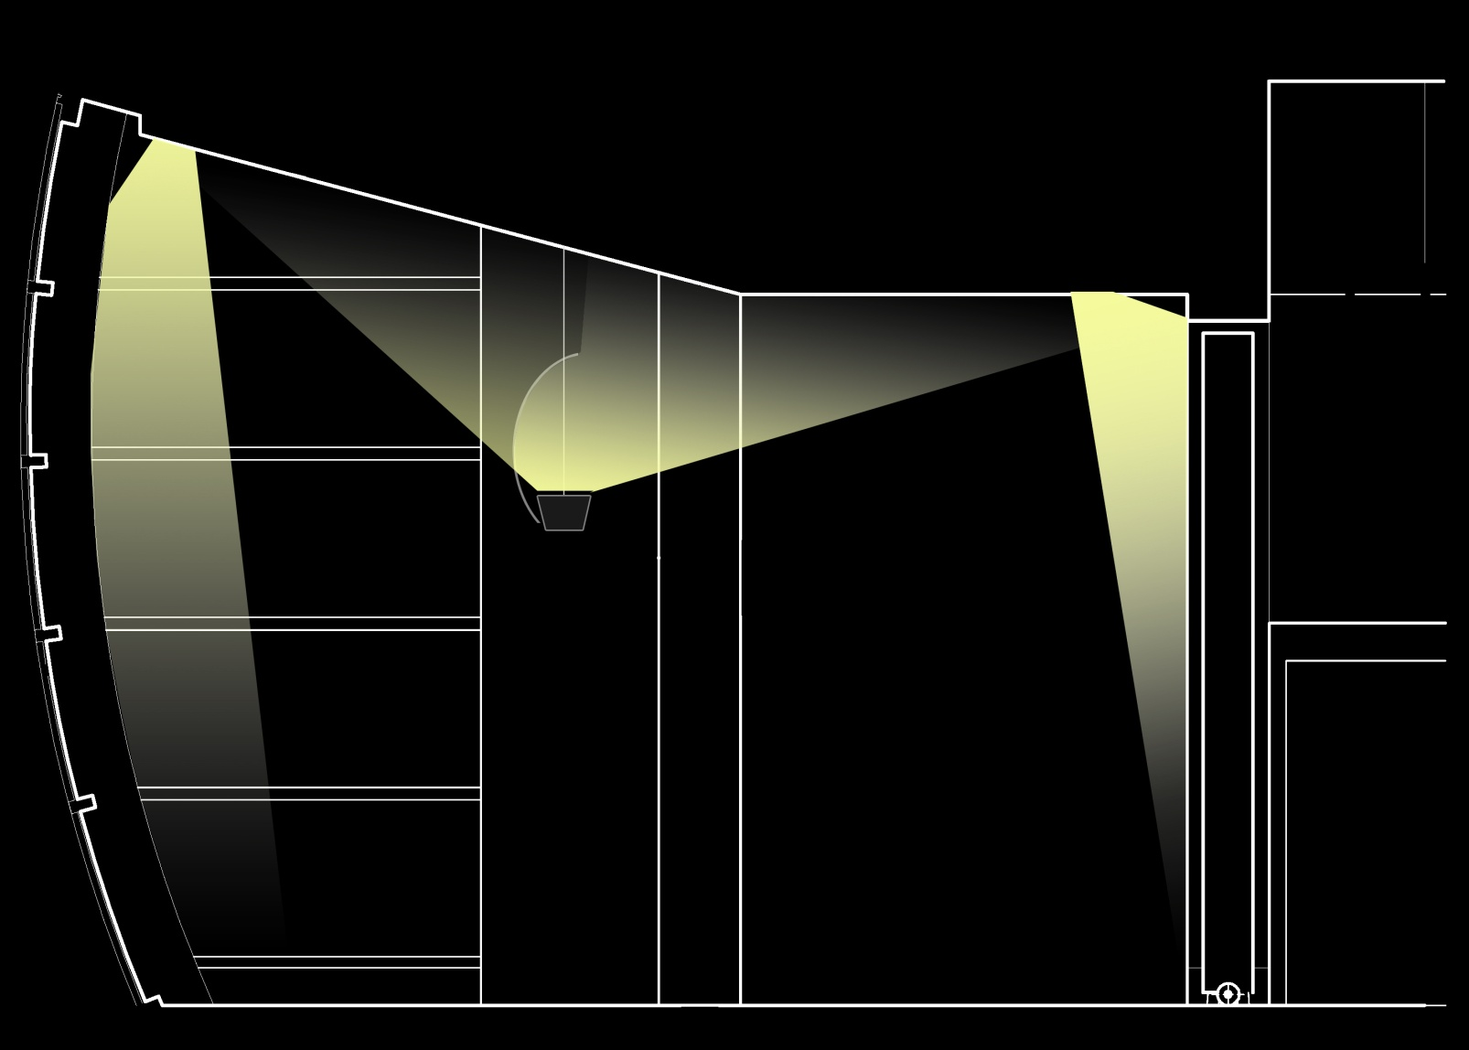
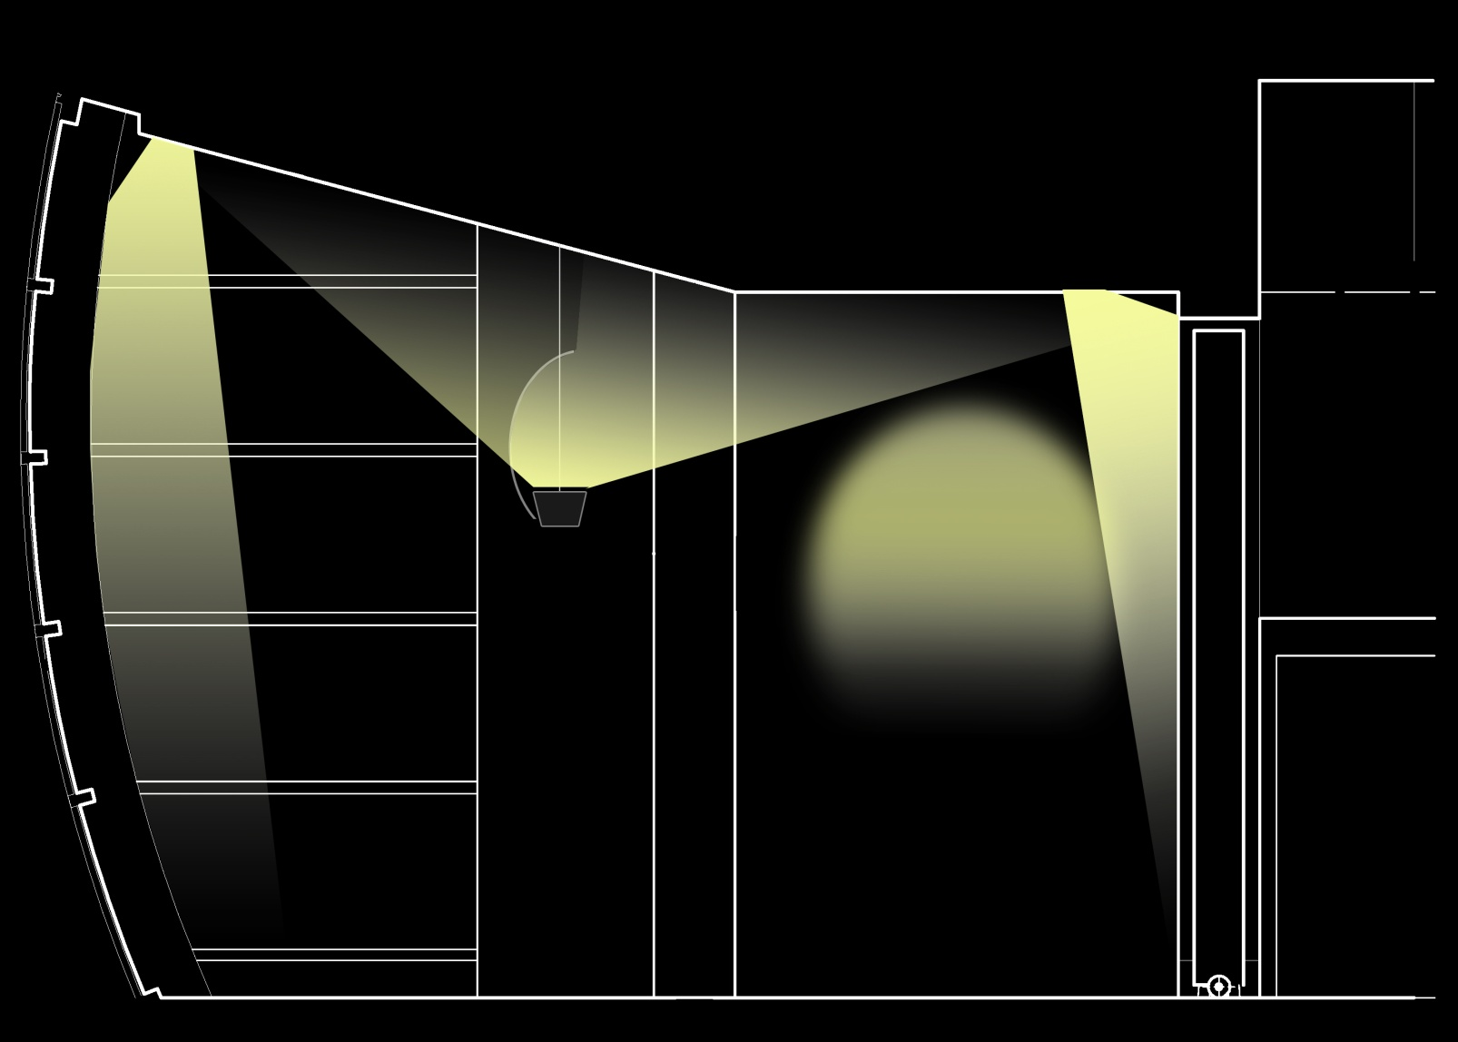
THE AUGUST WILSON CENTER FOR AFRICAN AMERICAN CULTURE
SCHEMATIC DESIGN PRESENTATION: DETAILS
AMBIENT
PERIMETER
ACCENT
SECTION
BUILDING FAÇADE LOWER LEVEL LOBBY EDUCATION AND LECTURE ROOM MEETING ROOM

Slide 25

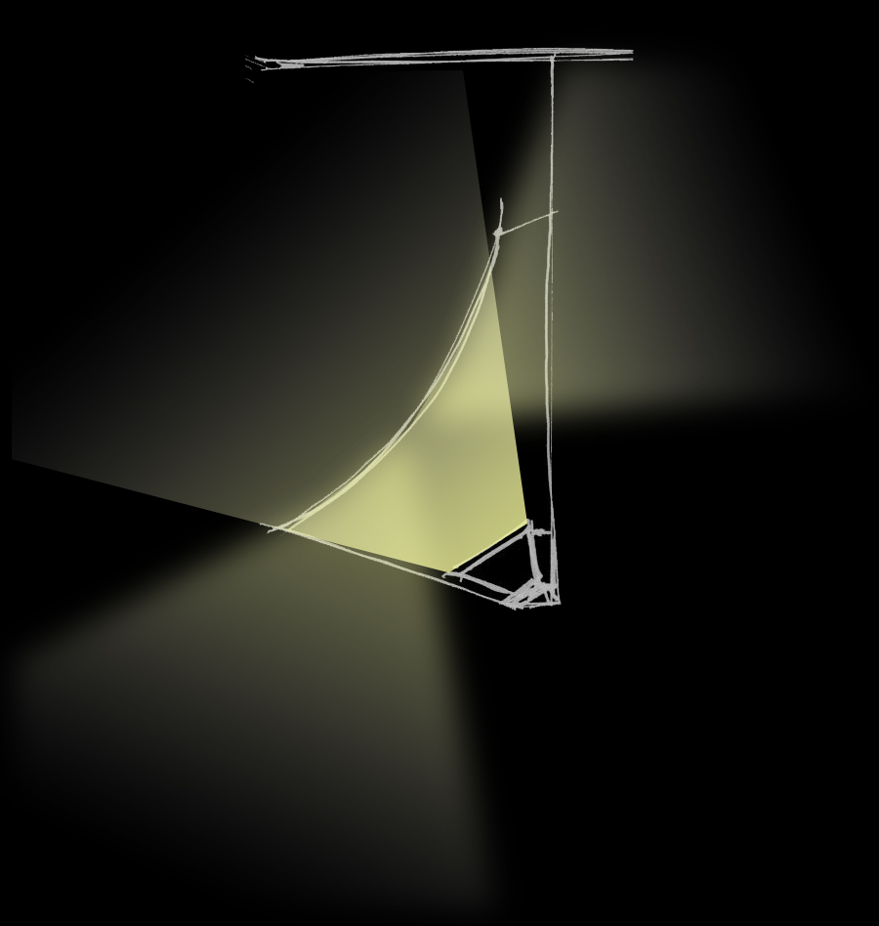

THE AUGUST WILSON CENTER FOR AFRICAN AMERICAN CULTURE
SCHEMATIC DESIGN PRESENTATION: DETAILS
CONCEPT ONE
CONCEPT TWO
EXISTING FIXTURE
BUILDING FAÇADE LOWER LEVEL LOBBY EDUCATION AND LECTURE ROOM MEETING ROOM

Slide 26
THE AUGUST WILSON CENTER FOR AFRICAN AMERICAN CULTURE
SCHEMATIC DESIGN PRESENTATION: DETAILS
BUILDING FAÇADE LOWER LEVEL LOBBY EDUCATION AND LECTURE ROOM MEETING ROOM

Slide 27
THE AUGUST WILSON CENTER FOR AFRICAN AMERICAN CULTURE
_{PITTSBURGH, PENNSYLVANIA}
_{PERKINS + WILL}
RESPONSIVE. FLEXIBLE. EFFICIENT.

Slide 28
THE AUGUST WILSON CENTER FOR AFRICAN AMERICAN CULTURE
SCHEMATIC DESIGN PRESENTATION
PRESENTED:
ADVISOR:
THESIS SITE:
THANK YOU:
December 13, 2007
Dr. Mistrick
http://www.engr.psu.edu/ae/thesis/portfolios/2008/mpr184
Lutron Electronics, Inc.
Guest Panel

