Slide 1
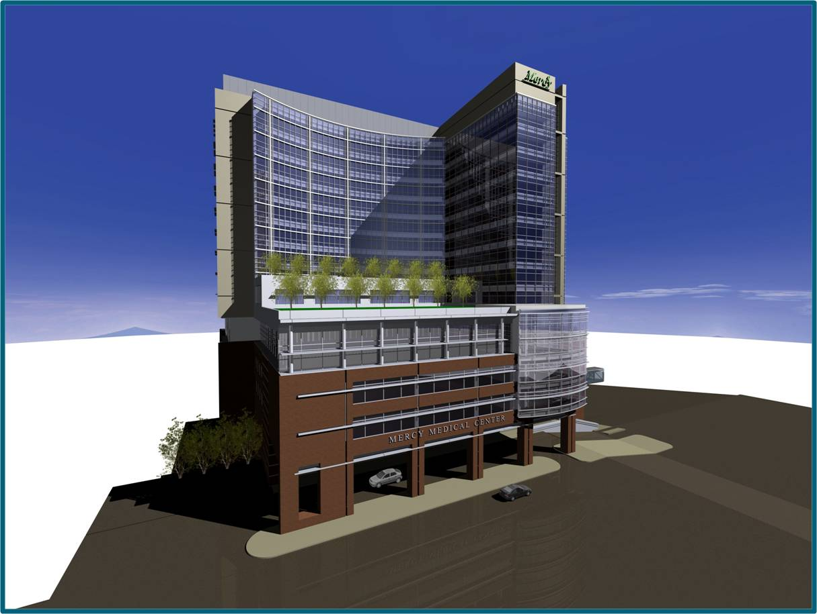
Nicole C. Jenkins
Construction Management
April 15, 2008
Replacement Clinical Tower

Slide 2
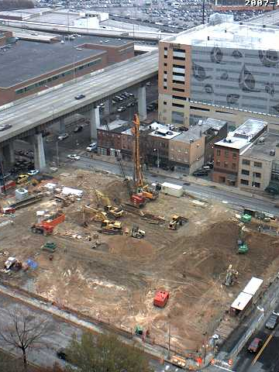
AGENDA
Project Overview
Women in Construction
ICRA Research
Mat Foundation Re-design
Reflection

Slide 3

Project Overview:
Owner: Mercy Medical Center
Location: Downtown, Baltimore, Maryland
Building Use: Acute Care
Building Size: 681,265 SQ.FT
Construction dates: May 2007- December 2010
Contractor: Whiting-Turner
A/E Firm: Ellerbe Becket
Cost: $ 219,812,043

Slide 4

Women in Construction

Slide 5
Women In Construction
What are ways more women can be recruited in the construction Industry?

Slide 6
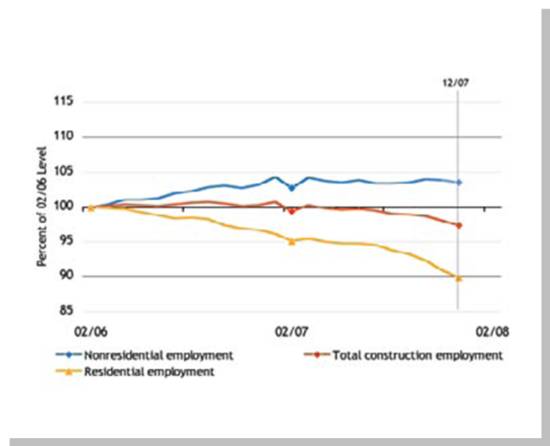
Construction Employment
Women in Construction

Slide 7
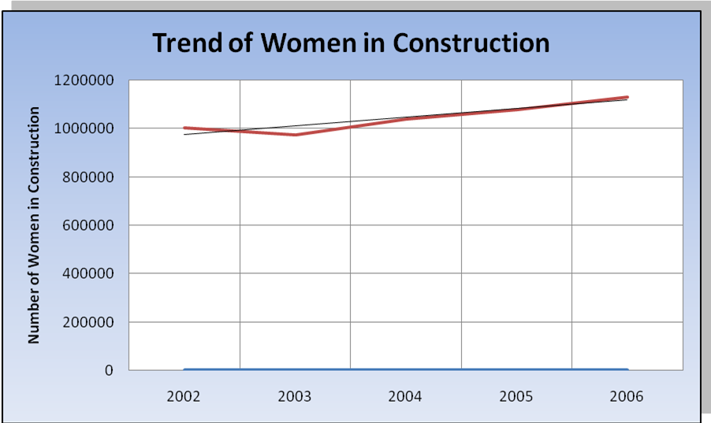
Trend of Employment
Women in Construction

Slide 8
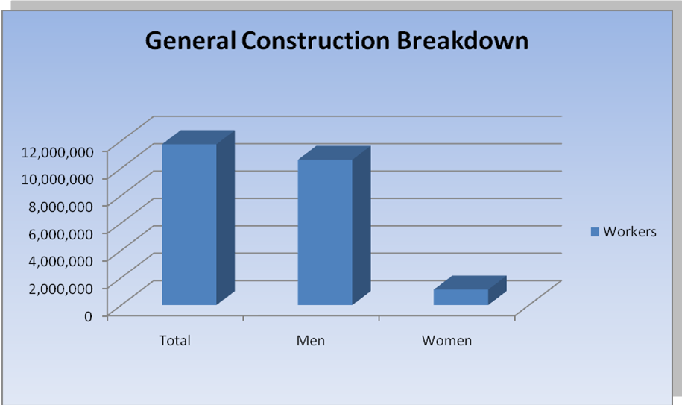
Men and Women Employees
Women in Construction

Slide 9

Methodology
Women in Construction

Slide 10
Response

Slide 11
Solution
Women in Construction Workshop
  ESTABLISHING INTEREST
    Through establishing interest there is a more likely chance that more females will enter into a construction related field.
  CREATING THE OPPORTUNITY
    The workshops main purpose is to create and show the opportunities available within the construction industry.
  FOLLOW-THROUGH FROM BOTH PARTIES

Slide 12

ICRA Research

Slide 13
ICRA Research
How can cross-contamination be reduced or eliminated?

Slide 15
X-rays one-month apart

Slide 16
Identified Risk Category
Referenced ICRA Chart To determine Steps to reduce Risk
Applied Those steps to the Site
Methodoloy
ICRA Research

Slide 17
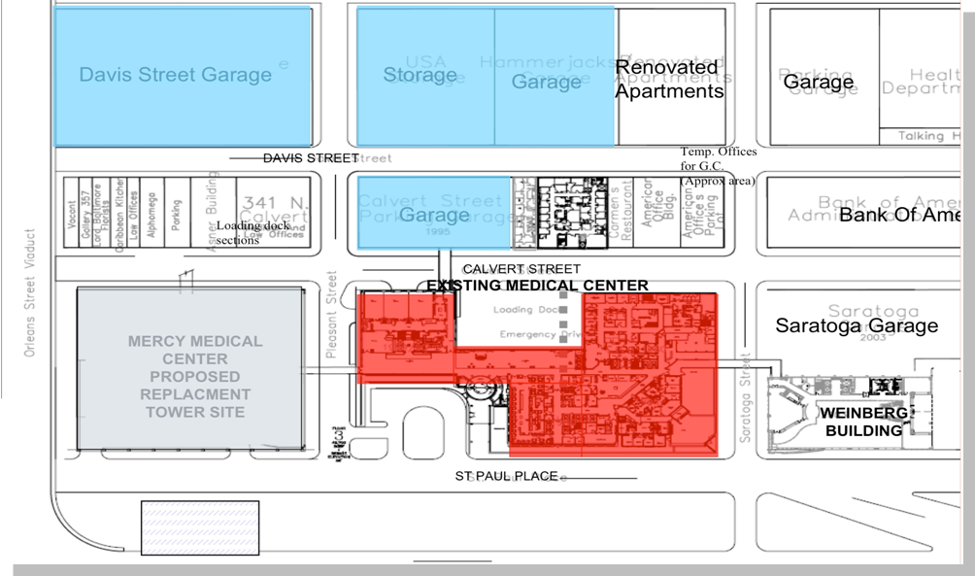
ICRA Research

Slide 18
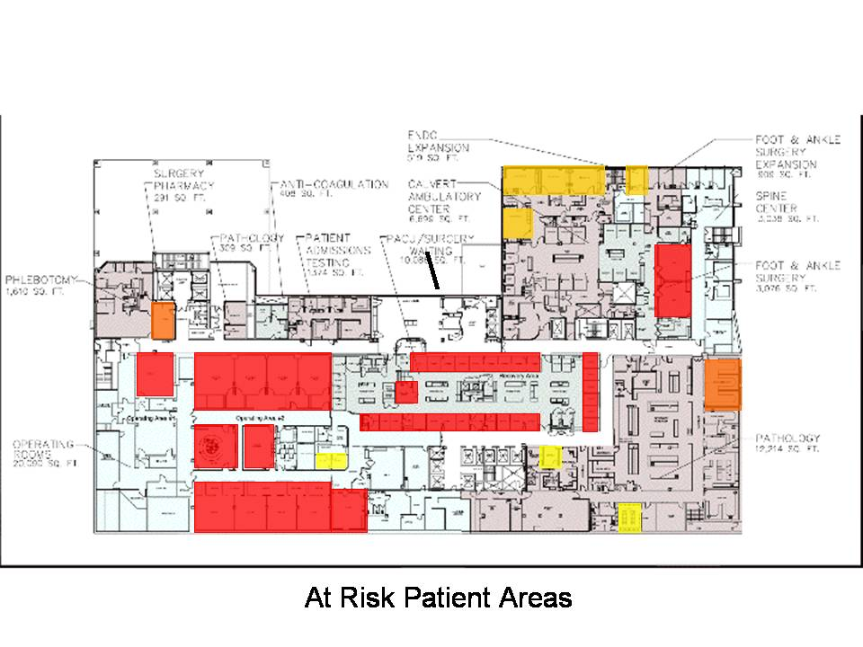
ICRA Research

Slide 19
ICRA Team
ICRA Team needs to be established
The team should include the owner, contractor, and a ICRA specialist
Ventilation
On site temporary ventilation
HEPA filters and vacuums are shown to be the most effective.
Monitoring System
Safety Surveillor
A system which monitors the number of infections in a hospital during a particular time frame.
All responsibilities should be divided
ICRA Research

Slide 20
ICRA Research

Slide 21
ICRA Research

Slide 22
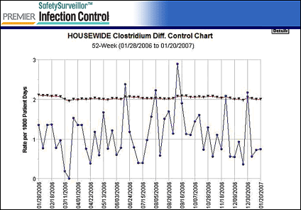
Safety Surveillor
ICRA Research

Slide 23
Foundation Re-design

Slide 24
Identify advantages and disadvantages of both systems
Re-design foundation using knowledge gained in CE 397A and AE 402
Compare the costs and schedules of both systems
Foundation Re-design

Slide 25
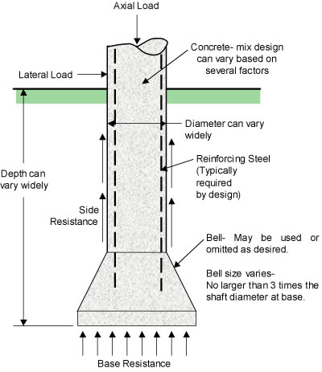
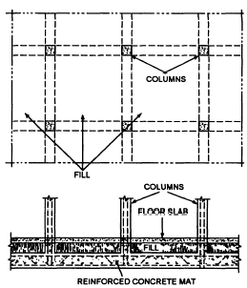
Drilled Shaft Foundation
Vs.
Mat Foundation
Foundation Re-design

Slide 26
Advantages of Mat Foundation
Cost (affordable)
Construction Procedure (simple)
Materials (mostly concrete)
Labor (does not need expertise)
Disadvantages of Mat Foundation
Settlement
Limit Capacity * Soil * Structure
Irregular ground surface (slope, retaining wall)
Foundation subjected to pullout, torsion, moment
Foundation Re-design

Slide 27
RESULTS
Mercy Medical Center Calculations:
AREA CALCULATIONS: 41,520 SQ FT
LIVE LOAD :101,761 kips
DEAD LOAD :104,767 kips
CRITICAL COLUMN LOAD:6,935 kips
MAT SLAB THICKNESS: 74 INCHES
REINFORCEMENT: No. 11 bars @ 6 ½ inches apart
Reinforcement : 883 Tons
Foundation Re-design

Slide 28
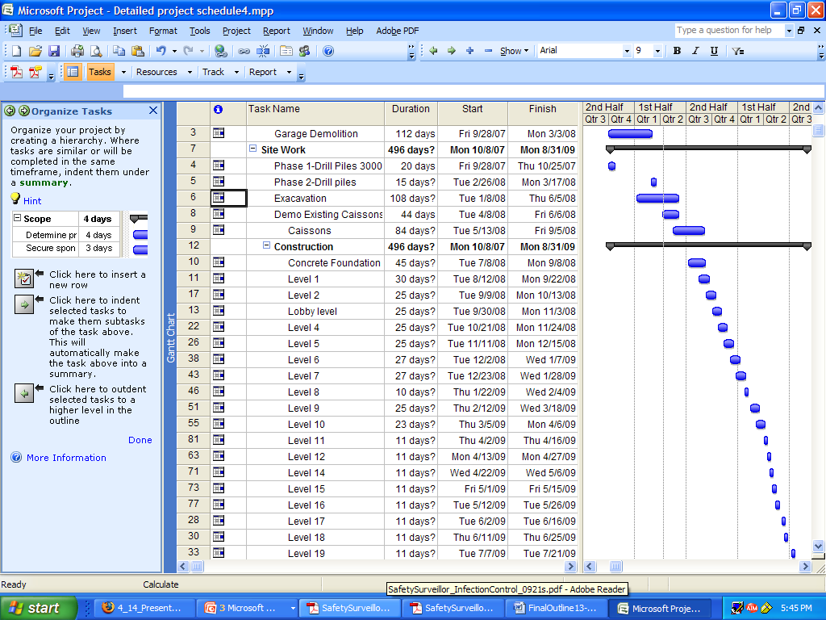
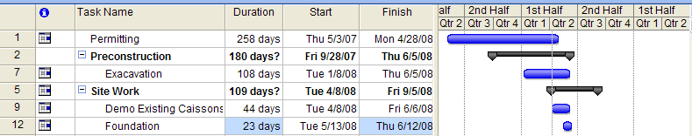
Drilled Shaft Foundation Schedule
Mat Foundation Schedule
Foundation Re-design

Slide 29
Cost Savings
Original Foundation Costs: $ 3,804,477
Mat Foundation Costs: $2,289,163
Total Savings: $ 1,515,314
Foundation Re-design

Slide 30
Schedule Reductions:
22 day difference between the foundation types
Foundation Re-design

Slide 31
Ellerbe Becket
Adrian Hagerty, AIA
Hani Wahbi, PE, Electrical
Paula Gillette, PE, LEED
Survey Participants
Balfour Beatty Construction
Vivian Arnold, Project Engineer
Bibi Ukoli, E.I.T
Rebecca Nordby
Brown Contracting
Michelle Wythe
Whiting-Turner Contracting Company
Kate Edwards, Project Manager
Lisa Decker
Kate Craigmile, Project Engineer
Atlantic Risk Management
Stephanie Freeman
Whiting-Turner Contracting Company
Kate Edwards, Project Manager
Bob Moore, Project Manager
Southland Industries,
Mike McLaughlin, PE
LVI
Brian Kline, PE
RTKL
Robert Berry
Penn State University
David R. Riley
Walter G. M Schnieder
Kevin Parfitt
Robert Holland
Schnabel Engineering
David Carpenter, P.E, Project Engineer
Schnabel Engineering
David Carpenter, P.E, Project Engineer
X-th
Ari Tinkoff, P.E, Project Engineer
Safety Surveillor
Vanessa Hermann
Acknowledgements

