Slide 1
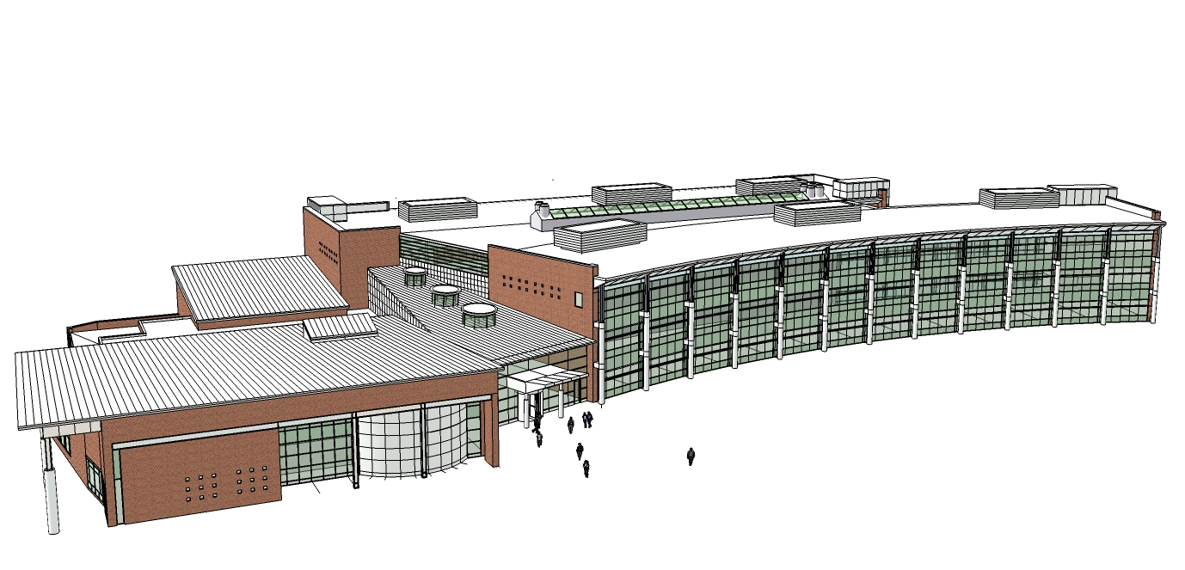
The Edward L Kelly Leadership Center
The Pennsylvania State University
Department of Architectural Engineering
Senior Thesis
Ryan Pletz
Structural
Dr. Hanagan
April 14, 2008

Slide 2
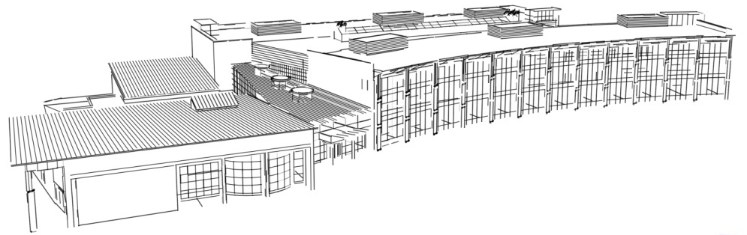
Project Team
Owner: Prince William County Schools
Architect: Jim Pociluyko, Moseley Architects
Structural Engineer: Jeff O’beirne, Moseley Architects
Mechanical Engineer: Jim Miller , Moseley Architects
Electrical Engineer: Russell Roundy , Moseley Architects
Plumbing Engineer: Jeffry Mortensen , Moseley Architects
Civil Engineer: Ross, France, Ratliff, Ltd.
Construction: V.F. Pavone

Slide 3
Where We’re Going…
Existing Conditions
Problem / Proposal
Research Goals
Architectural Study
Structural Study
Conclusions

Slide 4
Where We’re Going…
Existing Conditions
Problem / Proposal
Research Goals
Architectural Study
Structural Study
Conclusions

Slide 5
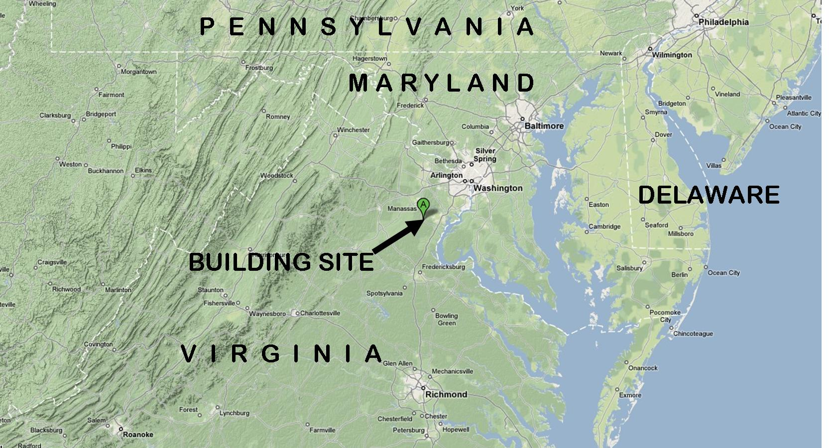
Existing Conditions
Location: Manassas, Virginia

Slide 6
Existing Conditions
Location: Manassas, Virginia
Administration building for Prince William County Schools
150,000 square feet
One 1-story wing, two 3-story wings
Original building height: 46’-0”

Slide 7
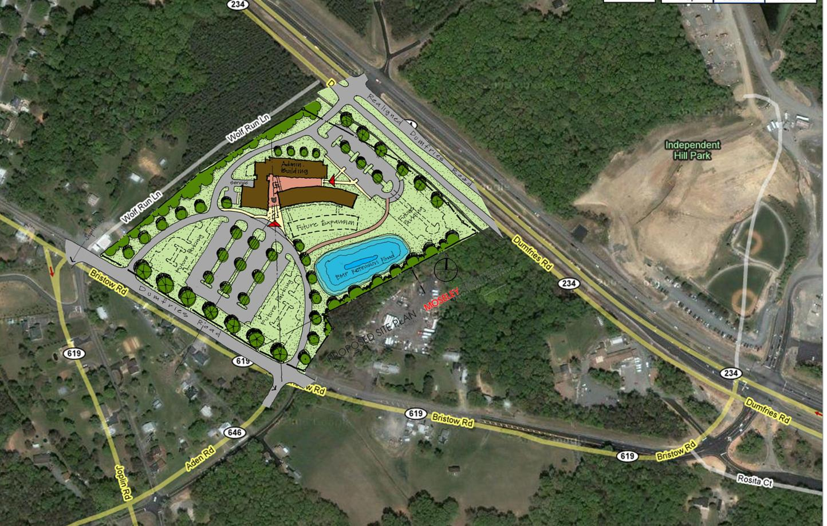
Existing Conditions
Location: Manassas, Virginia

Slide 8
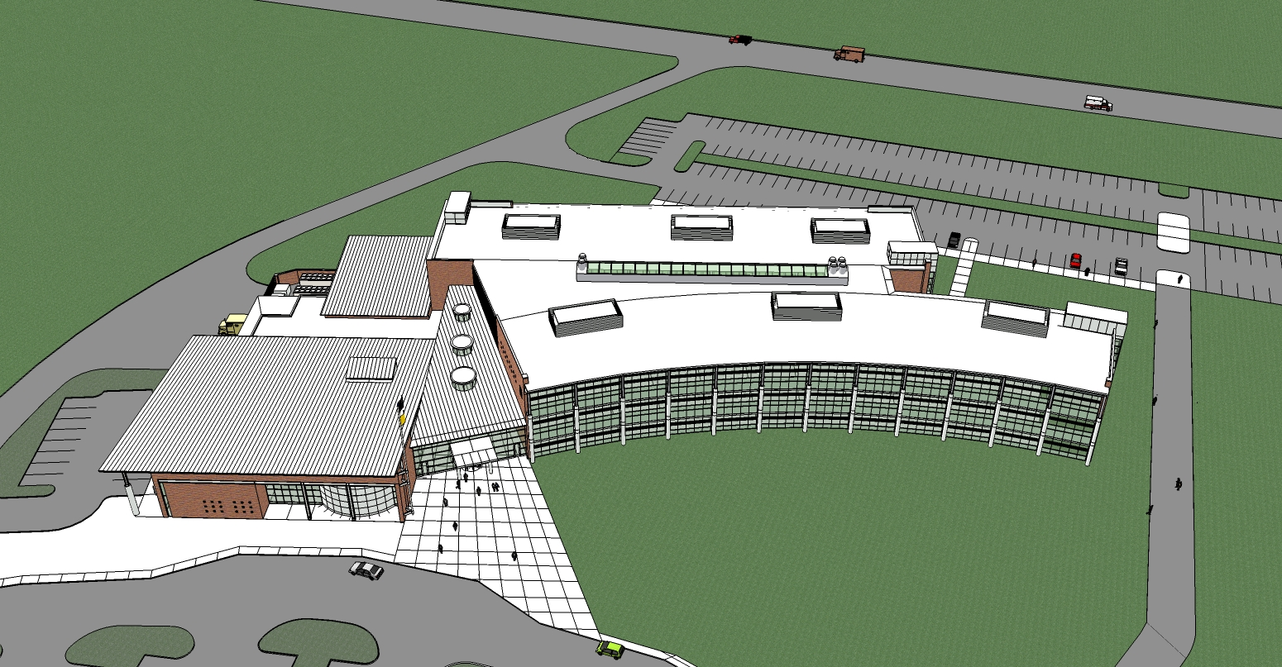
Existing Conditions

Slide 9
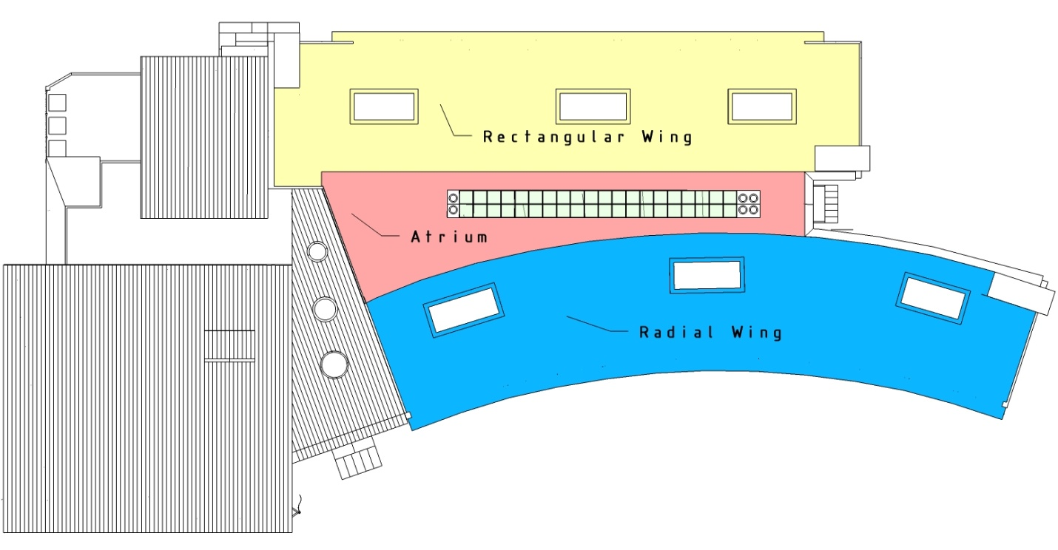
Existing Conditions

Slide 10
Where We’re Going…
Existing Conditions
Problem / Proposal
Research Goals
Architectural Study
Structural Study
Conclusions

Slide 11
Problem / Proposal
Owner wants more building space
  Where to expand?
Impact on the existing structural system
  Foundations
  Gravity Columns
  Lateral System
Alternative and possibly more efficient system
  Gravity
  Lateral

Slide 12
Where We’re Going…
Existing Conditions
Problem / Proposal
Research Goals
Architectural Study
Structural Study
Conclusions

Slide 13
Research Goals
Add additional space and maintain good aesthetics throughout
Create more efficient structural system
Save money and scheduling time

Slide 14
Where We’re Going…
Existing Conditions
Problem / Proposal
Research Goals
Architectural Study
Structural Study
Conclusions

Slide 15
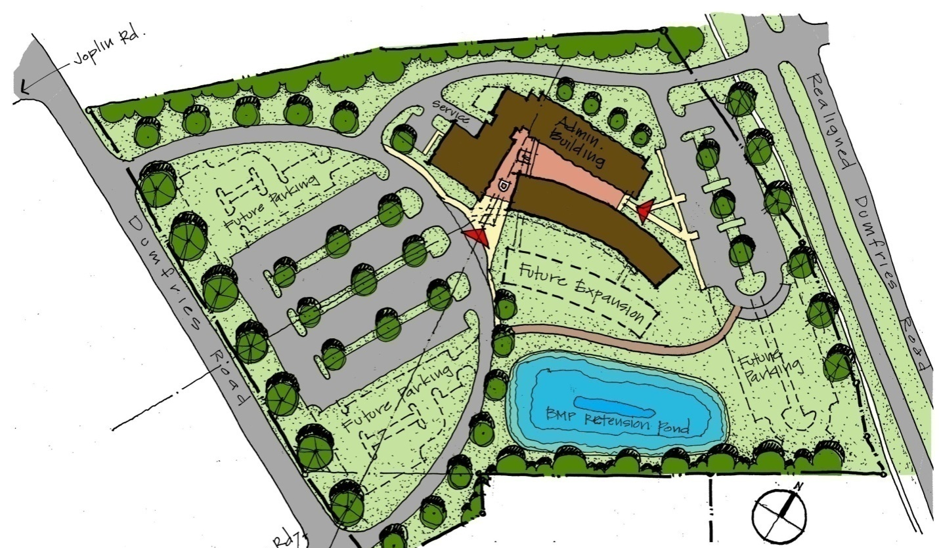
Architectural Study
2 preliminary options
  Expand Outward
  Expand Upward

Slide 16
Architectural Study
2 options
  Expand Outward
  Expand Upward
    Minimize site impact
    Increase site usable space (Parking, …)
    One construction sequence

Slide 17
Architectural Study

Slide 18
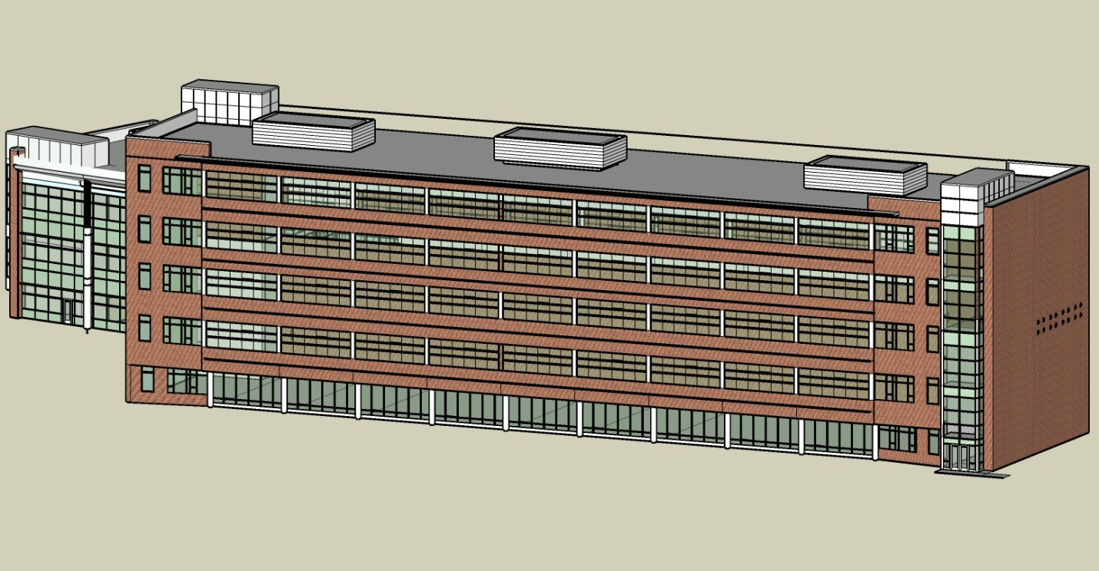
Architectural Study

Slide 19

Architectural Study
  Additional 2 stories (15’-4” story height)
  New Height: 76’-8”
  37,770 additional square feet
  116 additional open workstations
  36 additional private offices

Slide 20
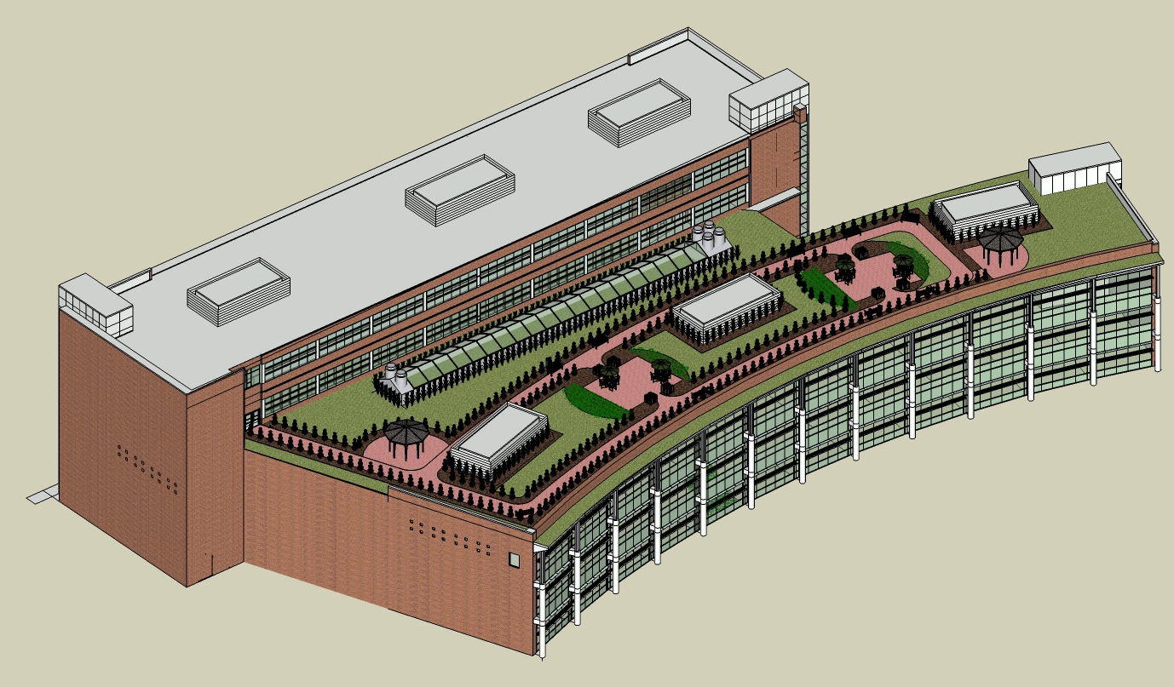
Architectural Study
    Landscaped Roof
Occupant experience
  New Stories 4-5
    Views of rooftop
    Mechanical units
  Greater aesthetics
  Connect the occupant to outside

Slide 21

Architectural Study
    Landscaped Roof
    30,000 square feet
    Intensive-type
    Aesthetic and psychological benefits
    Ecological and economic benefits

Slide 22
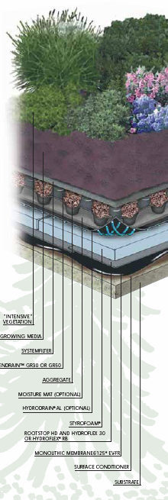
Architectural Study
    Landscaped Roof
Typical Hardscape to Softscape Transition
Typical Intensive Roof Garden Details

Slide 23
Where We’re Going…
Existing Conditions
Problem / Proposal
Research Goals
Architectural Study
Structural Study
Conclusions

Slide 24
Structural Study
Existing System
  Non-Composite
  Steel W-shape main beams and girders
    24’-0” width, 31’-0” length
  OWSJ bay fillers
    6 per bay, 4’-0” on center
  Spread footing foundation

Slide 25
Structural Study
New System
  Composite
    Steel W-shapes at 3 per bay, 8’-0” on center
  No joists
  4” Composite concrete slab

Slide 26
Structural Study
  Roof Framing
  Typical Size: W14x22
  Original Design: 20KCS2
  30% reduction in depth

Slide 27
Structural Study
  Floor Framing
  Typical Sizes: W14x22, W12x19, and W21x44
  Original Design: 28K8
  50-57% reduction in depth

Slide 28
Structural Study
Gravity
Lateral
  Column Redesign for Floors 3, 4, and 5
  Column Redesign for Floors 1 and 2
    Size spliced at second story

Slide 29
Structural Study
Column S-17
(Highest Axial Load)
  Foundation Redesign
Column M-17
(Highest Moment)

Slide 30
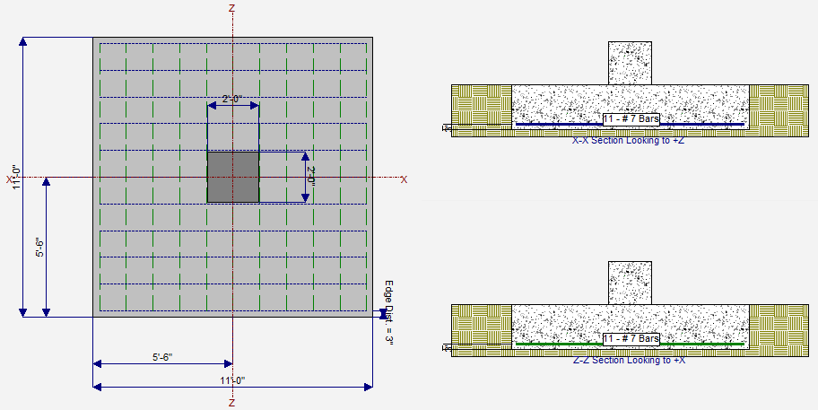
Structural Study
  Foundation Redesign
  Footing M-17
  P = 228.3 kips (106.5 Dead, 121.8 Live)
  M = 291 ft-kips

Slide 31
Structural Study
  Foundation Redesign
  Footing M-17
  11’-0”x11’-0” (49% larger)
  25” thick
  (11)#7 bars each way
  Original Redesign
  Footing M-17
  9’-0”x9’-0”
  25” thick
  (10)#7 bars each way

Slide 32
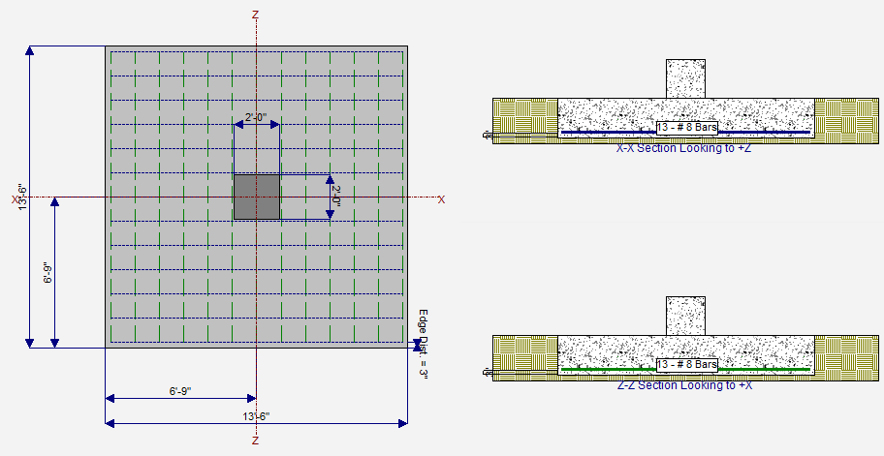
Structural Study
  Foundation Redesign
  Footing S-17
  P = 475.6 kips (212.4 Dead, 258.2 Live)
  M = 255.2ft-kips

Slide 33
Structural Study
  Foundation Redesign
  Footing S-17
  13’-6”x13’-6” (65% increase)
  25” thick
  (13)#8 bars each way
  Original Design
  Footing S-17
  10’-6”x10’-6”
  25” thick
  (10)#7 bars each way

Slide 34
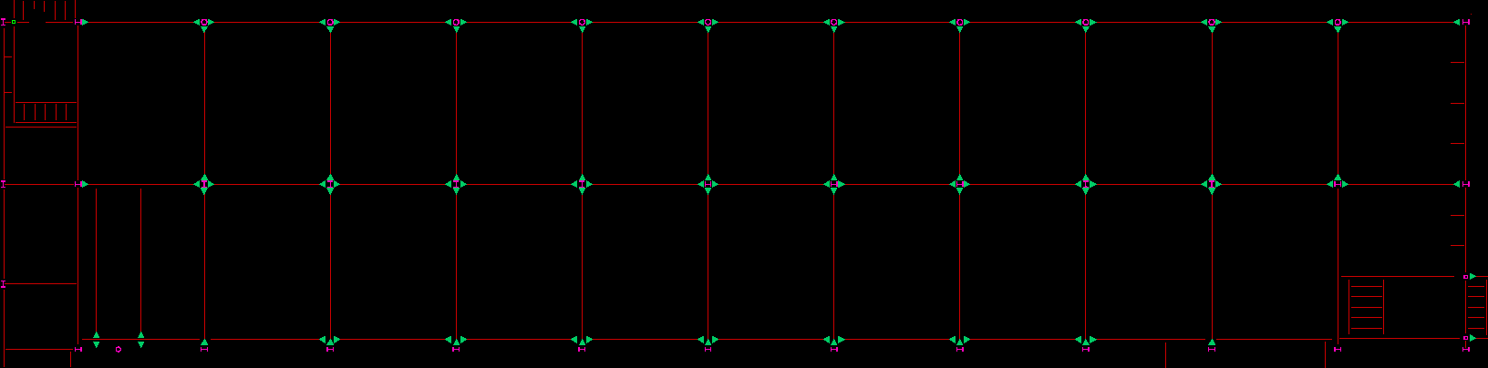
Structural Study
Existing Lateral System
  Moment Frames
    11 in N-S Direction
    3 in E-W Direction
  102 fixed connections framing level

Slide 35
Structural Study
Redesign possibilities
  Braced Framing
  Shear Walls
  Dual System
  Reduction in Moment Frames

Slide 36
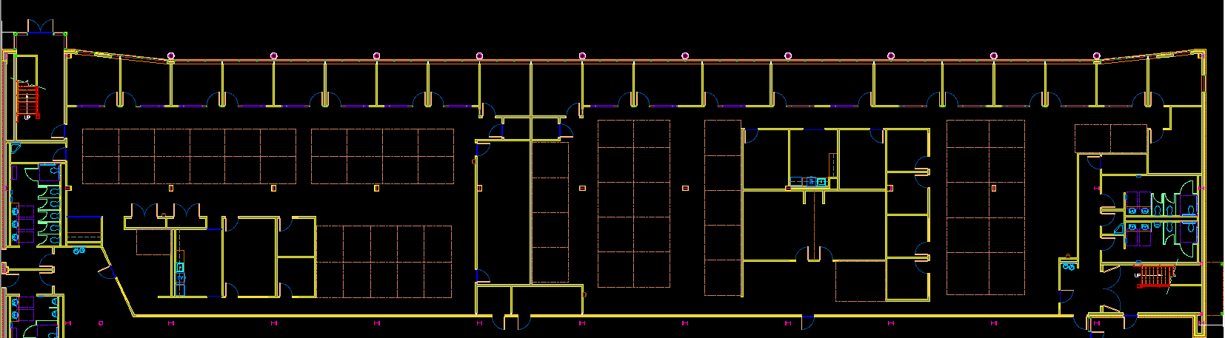
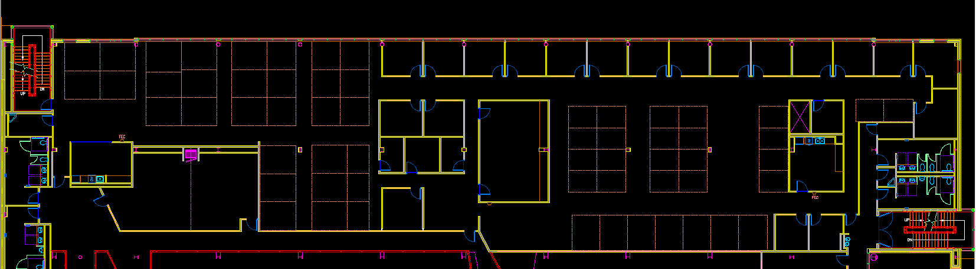
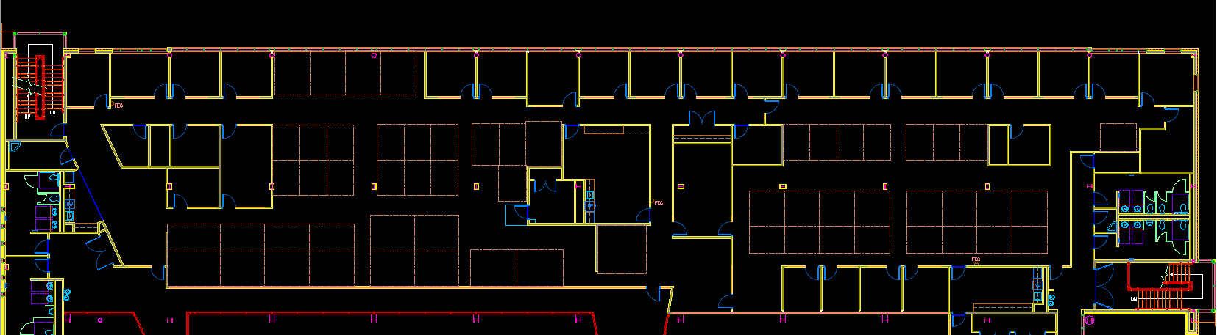

Slide 37
Structural Study

Slide 38
Structural Study
Redesign possibilities
  Braced Framing
  Shear Walls
  Reduction in Moment Frames
    3 north-south frames
      6 north-south frames
    1 east-west frame

Slide 39
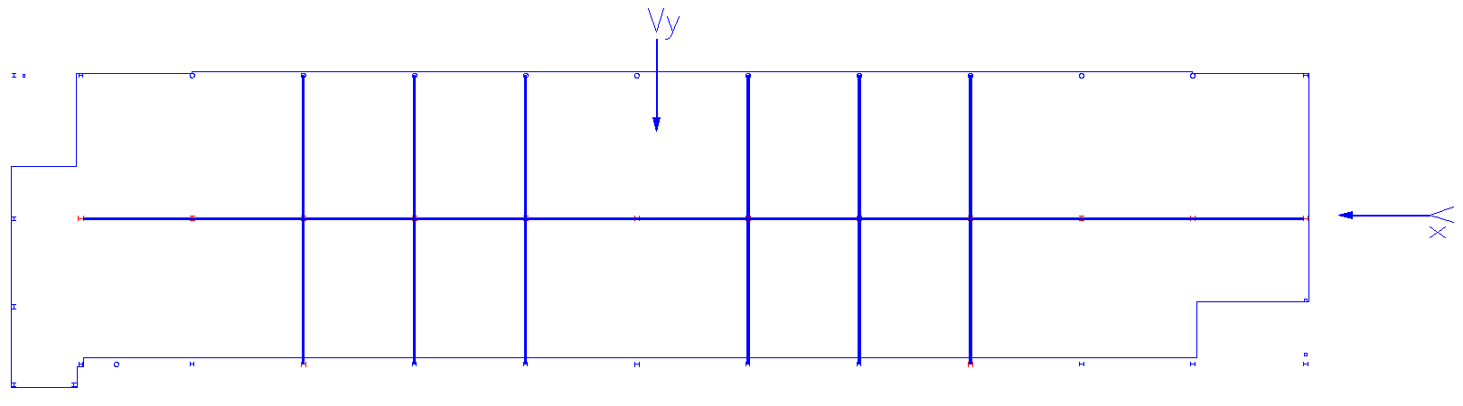
Structural Study
  Redesigned Moment Frame Plan

Slide 40
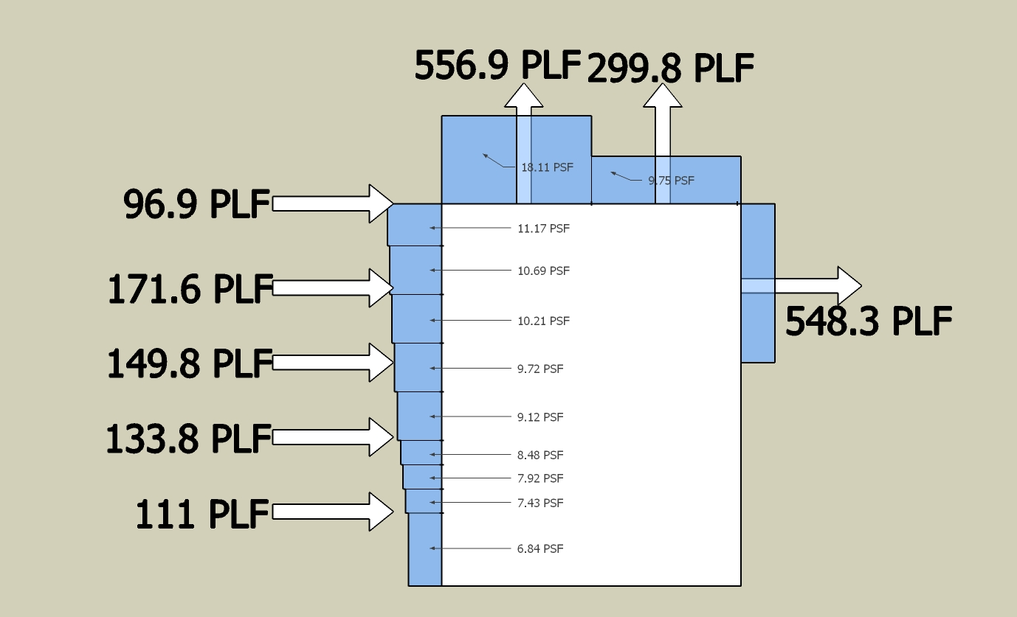
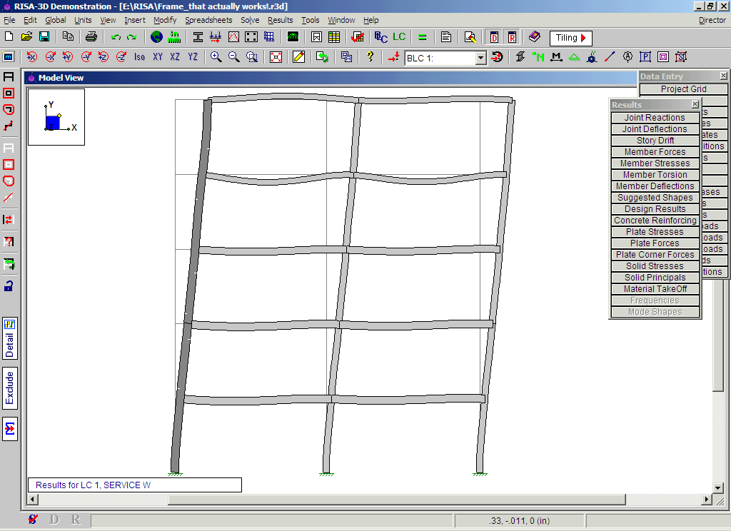
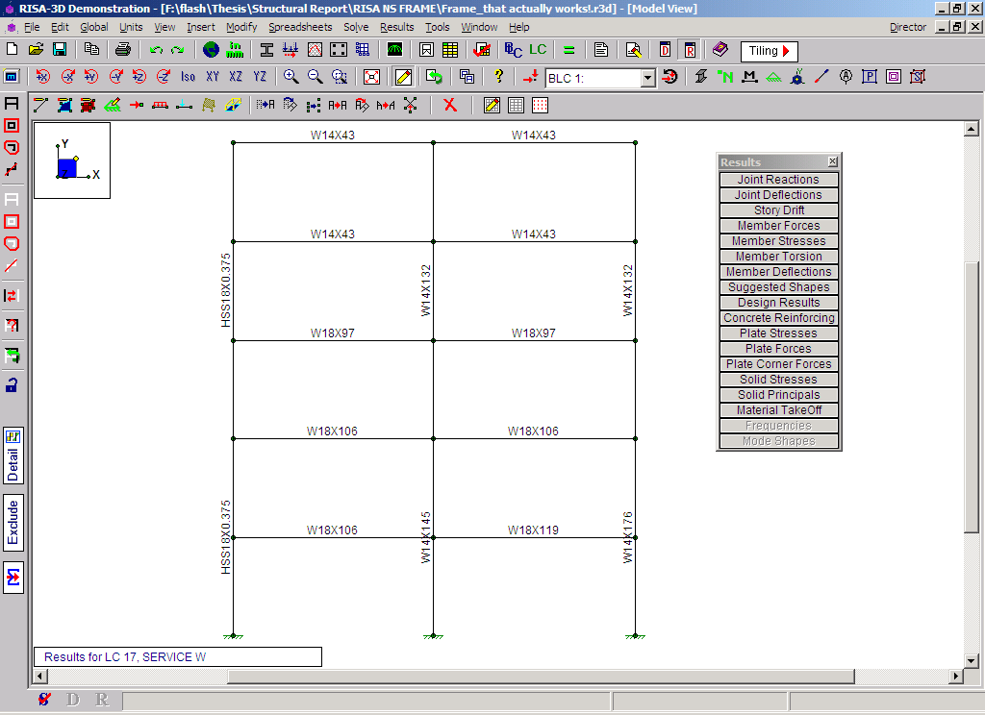
Structural Study
  Wind
    Controlling Lateral Load for North-South Frames

Slide 41
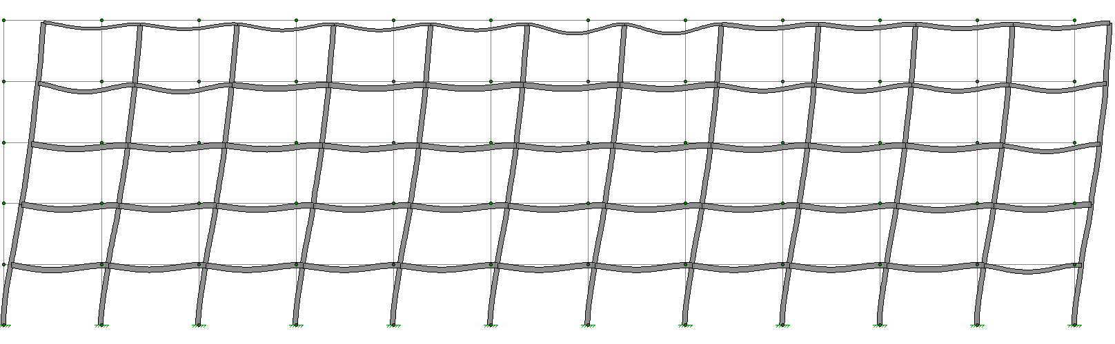
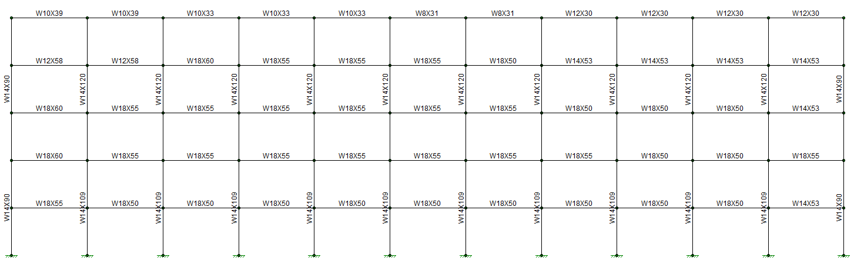
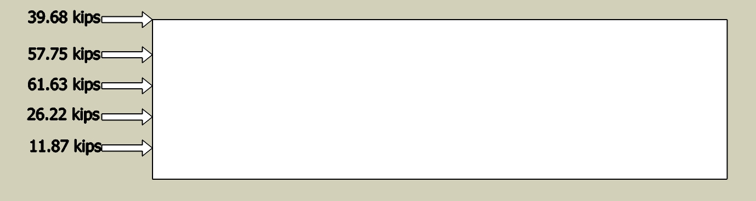
Structural Study
  Seismic
    Controlling Lateral Load for East-West Frame

Slide 42
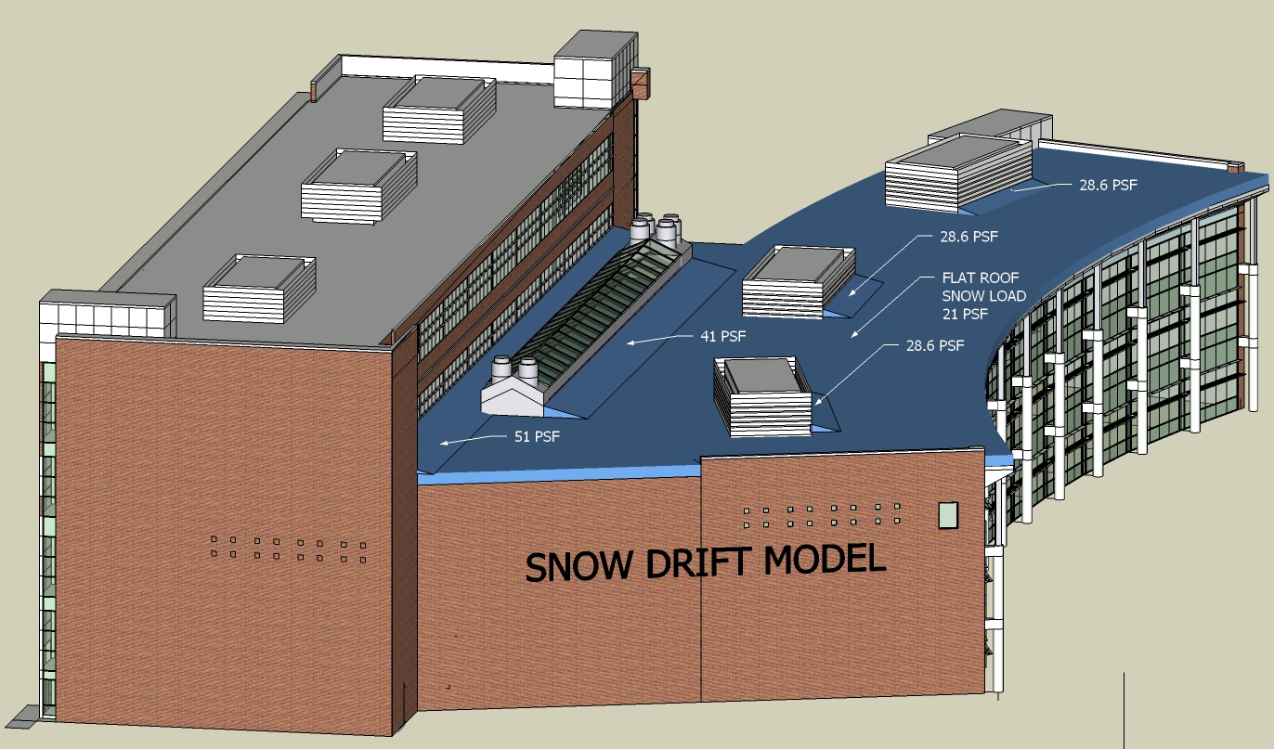
Structural Study
  Green Roof Framing
    Loading

Slide 43
Structural Study
  Green Roof Framing
    Design
      Radial: W18x40
      Atrium:W8x10 to W16x31

Slide 44
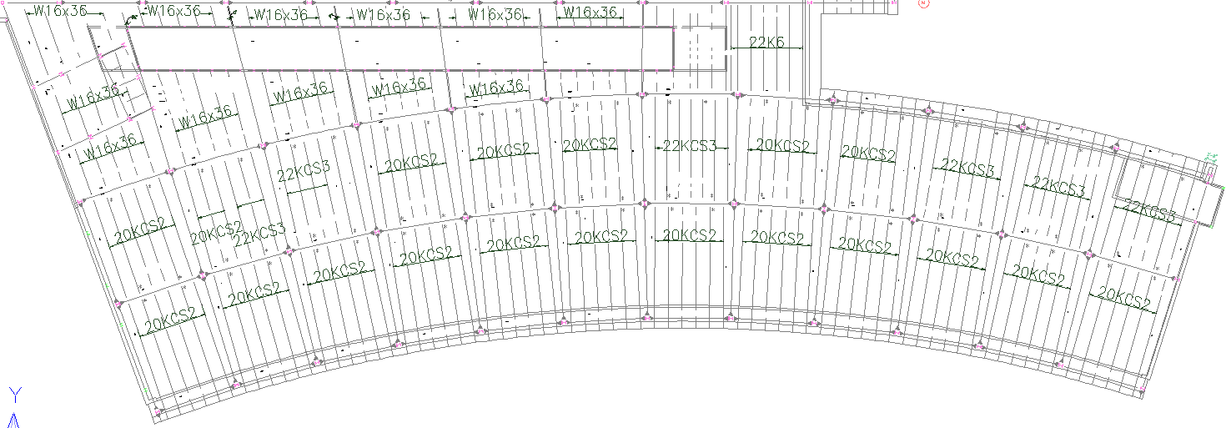
Structural Study
  Green Roof Framing

Slide 45
Where We’re Going…
Existing Conditions
Problem / Proposal
Research Goals
Architectural Study
Structural Study
Conclusions

Slide 46
Conclusions
New Architecture provides needed additional space requirements for future growth
Green Roof aesthetically pleasing and provides potential economic benefits
Structural floor framing more efficient than original
Decreased number of lateral frames
  Frames much bigger than original
  Original design still adequate
Construction costs very close to original

Slide 47
Acknowledgments
Prince William County Schools for permission
Moseley Architects for sponsorship
American Hydrotech for all the green information that I could want
V.F. Pavone Construction for multiple site visits
Dr. Hanagan and the structural faculty for everything you have taught me
Professor Holland and all the consultants and mentors for all the guidance through this research
All 2008 AE students for always being around to help
Friends and family for support, inspiration, and encouragement

Slide 48
Thank you for your attention
Questions?

