Slide 1

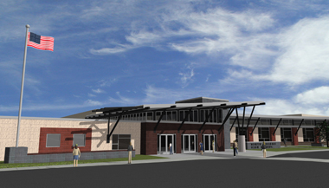
North Pocono High School
Building System Integration
Energy and Cost Analysis
Dan Hanley
Architectural Engineering Senior Thesis Presentation
Pennsylvania State University
Mechanical Option

Slide 2
Dan Hanley
Mechanical
Option
Presentation Outline
Project Outline
Existing Mechanical System
Design Conditions
Air Side System
Hydronic System
ASHRAE Standards
Standard 90.1
Standard 62.1
Mechanical System Redesign
Redesign Objectives
Sizing the Ground Loop
Ground Source Heat Pump
Dedicated Outdoor Air System
System Comparison
Energy Comparison
Cost Comparison
Environmental Comparison
Structural Breadth
Load Comparison
Member Comparison
Cost Comparison
Electrical Breadth
North Pocono High School

Slide 3
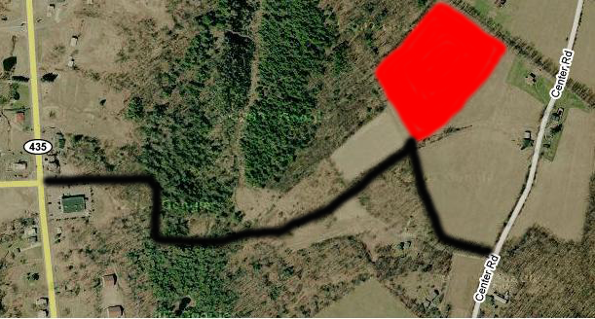
Dan Hanley
Mechanical
Option
Project Outline
Project Location:
Covington Township, PA
Delivery Method:
Design – Bid – Build
Design Base Bid:
$30 Million
Construction Dates:
July 2007 – Sept. 2009
Project Size:
3 Levels
230,000 ft²
North Pocono High School

Slide 4
Dan Hanley
Mechanical
Option
Presentation Outline
Project Outline
Existing Mechanical System
Design Criteria
Air Side System
Hydronic System
North Pocono High School

Slide 5
Dan Hanley
Mechanical
Option
Existing Conditions
Design Criteria:
Restrained by Budget
Follow the 2005 International Mechanical Code
Design Conditions:
Indoor Design Conditions
Outdoor Design Conditions
Cooling DBT | 72 ºF
Heating DBT | 72 ºF
Relative Humidity | 50 %
Latitude | 41.14º
Longitude | 75.52º
Elevation | 550 ft
Cooling Design DBT | 87 ºF
Heating Design DBT | 5 ºF
North Pocono High School

Slide 6
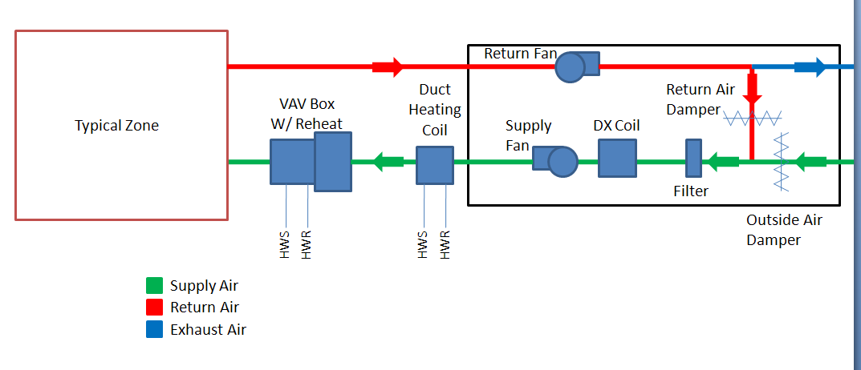
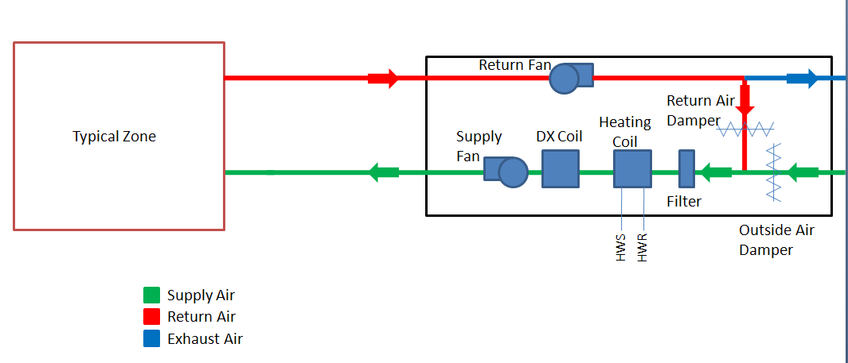
Dan Hanley
Mechanical
Option
Existing Conditions
Air Side System
16 Direct Expansion Rooftop Air Handlers
12 VAV AHU with Duct Mounted Hot Water Coils
100 VAV Box Reheat Coils
North Pocono High School

Slide 7
Dan Hanley
Mechanical
Option
Existing Conditions
Air Side System
16 Direct Expansion Rooftop Air Handlers
4 CV AHU with Hot Water Coils
Condition: Auditorium
2 – Multi-Use Space
Locker Room Area
North Pocono High School

Slide 8
Dan Hanley
Mechanical
Option
Existing Conditions
Hydronic System
2 – 7,000 MBH Oil Fired Boilers
Heating Coils in the AHU
Reheat Coils in the VAV Terminal Units
Boiler 1
Return
Water
Chemical
Treatment
Supply
Water
Boiler 2
Pumps
Air Separator
Expansion Tanks
North Pocono High School

Slide 9
Dan Hanley
Mechanical
Option
Presentation Outline
Project Outline
Existing Mechanical System
Design Conditions
Air Side System
Hydronic System
ASHRAE Standards
Standard 90.1
Standard 62.1
North Pocono High School

Slide 10
Dan Hanley
Mechanical
Option
ASHRAE Standards
ASHRAE Standard 90.1
Building Envelope
Fenestration is <40% of Total Enclosure
Opaque Surfaces
Element | Insulation R-Value | Standard Min. R-Value | Compliant | Assembly U-Value | Assembly Max. U-Value | Compliant
Roof | 10 | 20 | No | 0.681 | 0.48 | No
Wall Type 1 | 10 | 11.4 | No | 0.67 | 0.09 | Yes
Wall Type 2 | 10 | 11.4 | No | 0.093 | 0.09 | No
Slab on Grade | NR | NR | NR | 0.213 | 0.73 | Yes
Fenestration
Fenestration | Assembly U-Value | Assembly Max. U-Value | Assembly SHGC | Max SHGC | Compliant
Metal Framing | 0.5 | 0.45 | 0.55 | 0.4 | No
North Pocono High School

Slide 11
Dan Hanley
Mechanical
Option
ASHRAE Standards
ASHRAE Standard 90.1
Building Equipment
Building Area >25,000 ft²
Air Handler Compliancy
Unit | Air Flow (cfm) | CFM*0.0015 | Fan HP | Complaint
AHU-1 | 15,850 | 23.8 | 25 | No
AHU-2 | 16,415 | 24.6 | 25 | No
AHU-3 | 36,000 | 54.0 | 25 | Yes
AHU-4 | 3,700 | 5.6 | 5 | Yes
AHU-5 | 6,800 | 10.2 | 15 | No
AHU-6 | 19,500 | 29.3 | 20 | Yes
AHU-7 | 13,500 | 20.3 | 20 | Yes
AHU-8 | 12,650 | 19.0 | 20 | No
AHU-9 | 14,195 | 21.3 | 25 | No
AHU-10 | 8,565 | 12.8 | 15 | No
AHU-11 | 3,000 | 4.5 | 5 | No
AHU-12 | 3,800 | 5.7 | NA | NA
AHU-13 | 18,200 | 27.3 | 30 | No
AHU-14 | 10,300 | 15.5 | 10 | Yes
AHU-15 | 15,300 | 23.0 | 25 | No
AHU-16 | 3,000 | 4.5 | 5 | No
North Pocono High School

Slide 12
Dan Hanley
Mechanical
Option
ASHRAE Standards
ASHRAE Standard 62.1
Label | ASHREA Standard | Designer Value
 | (cfm) | (cfm)
AHU-1 | 4,195 | 4,355
AHU-2 | 5,025 | 7,360
AHU-3 | 4,810 | 10,270
AHU-5 | 2,750 | 3,860
AHU-6 | 2,865 | 19,500
AHU-7 | 4,525 | 4,800
AHU-8 | 3,895 | 4,315
AHU-9 | 5,370 | 6,225
AHU-10 | 1,670 | 3,685
AHU-11 | 465 | 3,000
AHU-12 | 2,400 | 2,255
AHU-13 | 5,105 | 10,725
AHU-14 | 1,985 | 2,470
AHU-15 | 3,950 | 5,890
AHU-16 | 470 | 3,000
Total | 49,480 | 91,710
Difference | 42,230
North Pocono High School

Slide 13
Dan Hanley
Mechanical
Option
Presentation Outline
Project Outline
Existing Mechanical System
Design Conditions
Air Side System
Hydronic System
ASHRAE Standards
Standard 90.1
Standard 62.1
Mechanical System Redesign
Redesign Objectives
Sizing the Ground Loop
Ground Source Heat Pump
Dedicated Outdoor Air System
North Pocono High School

Slide 14
Dan Hanley
Mechanical
Option
Mechanical System Redesign
Redesign Objectives
Lower Energy Use
Lower Life Cycle Cost
Lower Emissions
North Pocono High School

Slide 15
Dan Hanley
Mechanical
Option
Mechanical System Redesign
Dedicated Outdoor Air System (DOAS)
15 DOAS Units Replaced 15 DX AHU
Saved Energy
Saved in Operating Cost
Ground Source Heat Pumps (GSHP)
Sized to Handle the Majority of the Sensible Load
3 Different Models were Selected
North Pocono High School

Slide 16
Dan Hanley
Mechanical
Option
Mechanical System Redesign
DOAS
ASHRAE Standard 90.1
DOAS Compliancy
Unit | Air Flow (cfm) | CFM*0.0015 | Fan HP | Compliant
DOAS-1 | 4,195 | 6.3 | 5 | Yes
DOAS-2 | 4,815 | 7.2 | 5 | Yes
DOAS-3 | 4,810 | 7.2 | 5 | Yes
DOAS-5 | 2,750 | 4.1 | 3 | Yes
DOAS-6 | 2,865 | 4.3 | 3 | Yes
DOAS-7 | 4,525 | 6.8 | 5 | Yes
DOAS-8 | 3,895 | 5.8 | 5 | Yes
DOAS-9 | 4,910 | 7.4 | 5 | Yes
DOAS-10 | 1,670 | 2.5 | 1.5 | Yes
DOAS-11 | 935 | 1.4 | 1 | Yes
DOAS-12 | 2,115 | 3.2 | 3 | Yes
DOAS-13 | 5,105 | 7.7 | 5 | Yes
DOAS-14 | 1,985 | 3 | 2 | Yes
DOAS-15 | 3,950 | 5.9 | 5 | Yes
North Pocono High School

Slide 17
Dan Hanley
Mechanical
Option
Mechanical System Redesign
Sizing the Ground Loop
Building Heat Gains and Losses
Hours | Heat Losses (MBh) | Heat Gains (MBh)
8 a.m. – Noon | 15186.2 | 11621.7
Noon – 4 p.m. | 15779.0 | 11133.4
4 p.m. – 8 p.m. | 851.0 | 623.2
8 p.m. – 8 a.m. | 0 | 0
North Pocono High School

Slide 18
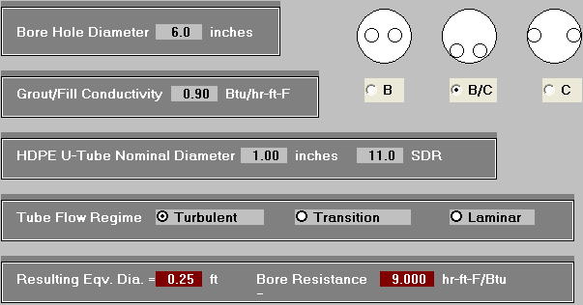
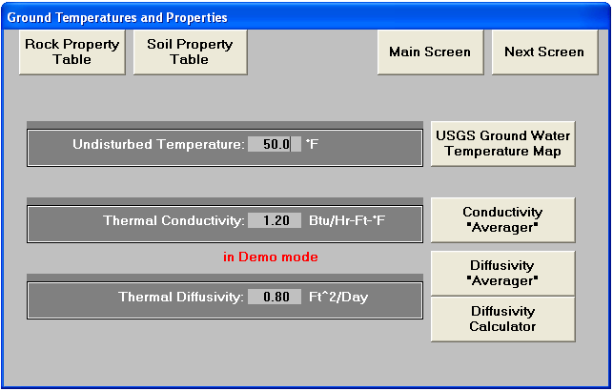
Dan Hanley
Mechanical
Option
Mechanical System Redesign
Sizing the Ground Loop
Piping Properties
Ground Properties
North Pocono High School

Slide 19
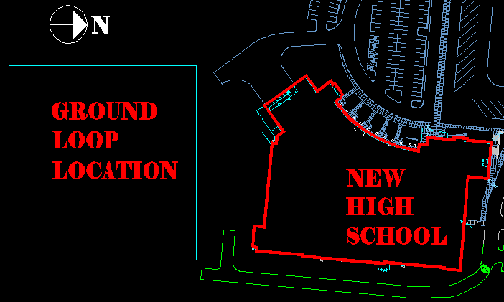
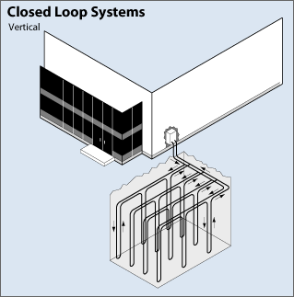
Dan Hanley
Mechanical
Option
Mechanical System Redesign
Sizing the Ground Loop
Ground Loop Layout and Location
Vertical Closed Loop
30 rows x 35 loops with 8 bores per a loop
140,000 ft²
North Pocono High School

Slide 20
Dan Hanley
Mechanical
Option
Mechanical System Redesign
Ground Loop Performance
Heating Capacity - 3,200 MBH
Heating Needed - 5,100 MBH
Conditioned spaces
Ground Loop
Boiler
North Pocono High School

Slide 21
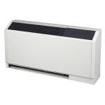
Dan Hanley
Mechanical
Option
Mechanical System Redesign
GSHP Selection
Classroom Spaces
Console Water Source Heat Pumps
Dedicated Outdoor Air Ceiling Diffusers
Carrier’s Console Model
Typical Classroom Space
Console Heat Pump
North Pocono High School

Slide 22


Dan Hanley
Mechanical
Option
Mechanical System Redesign
GSHP Selection
Gymnasium
Auditorium
Administrative Area
Cafeteria
Carrier’s Packaged
Heat Pump
Carrier’s
Rooftop Heat Pump
North Pocono High School

Slide 23
Dan Hanley
Mechanical
Option
Presentation Outline
Project Outline
Existing Mechanical System
Design Conditions
Air Side System
Hydronic System
ASHRAE Standards
Standard 90.1
Standard 62.1
Mechanical System Redesign
Redesign Objectives
Sizing the Ground Loop
Ground Source Heat Pump
Dedicated Outdoor Air System
System Comparison
Energy Comparison
Cost Comparison
Environmental Comparison
North Pocono High School

Slide 24
Dan Hanley
Mechanical
Option
System Comparison
Energy Comparison
Energy Consumption Per Year
75% Reduction In Building Energy
63% Reduction In Source Energy
North Pocono High School

Slide 25
Dan Hanley
Mechanical
Option
System Comparison
Cost Comparison
Total Utility Cost per Year
Initial Cost
Column1 | Cost ($)
New Mechanical Cost | 50,291,756
Original Initial Cost | 4,300,000
Difference | 45,991,756
New System Saves $187.4 Thousand
Current System – $1.30/ft²-yr
New System – $0.43/ft²-yr
North Pocono High School

Slide 26
Dan Hanley
Mechanical
Option
System Comparison
Environmental Comparison
CO₂ Yearly Emissions
SO₂ and NO_{x} Yearly Emissions
Total Emissions Reduced by 75%
North Pocono High School

Slide 27
Dan Hanley
Mechanical
Option
Presentation Outline
Project Outline
Existing Mechanical System
Design Conditions
Air Side System
Hydronic System
ASHRAE Standards
Standard 90.1
Standard 62.1
Mechanical System Redesign
Redesign Objectives
Sizing the Ground Loop
Ground Source Heat Pump
Dedicated Outdoor Air System
System Comparison
Energy Comparison
Cost Comparison
Environmental Comparison
Structural Breadth
Load Comparison
Member Comparison
Cost Comparison
North Pocono High School

Slide 28
Dan Hanley
Mechanical
Option
Structural Breadth
Roof Structure
Non- Composite 1.5” 20 gauge steel deck – 7.0 psf
Supported by Steel Joists
Joists Bear on 8” CMU Walls
North Pocono High School

Slide 29
Dan Hanley
Mechanical
Option
Structural Breadth
Load Comparison
Controlling Snow Load – 39 psf
CURRENT ROOF LOADS |  |  | REDESIGNED ROOF LOADS
Unit | Weight (lbs) | Weight (lbs/ft²) | Unit | Weight (lbs) | Weight (lbs/ft²)
AHU-1 | 8,295 | 61.4 | DOAS-1 | 4,975 | 43.7
AHU-2 | 9,360 | 32.8 | DOAS-2 | 4,975 | 43.7
AHU-3 | 23,752 | 52.8 | DOAS-3 | 5,575 | 49.0
AHU-4 | 2,816 | 33.4 | AHU-4 | 2,816 | 33.4
AHU-5 | 4,903 | 45.5 | DOAS-5 | 3,280 | 38.2
AHU-6 | 12,815 | 46.1 | DOAS-6 | 3,260 | 38.0
AHU-7 | 6,602 | 43.2 | DOAS-7 | 4,975 | 43.7
AHU-8 | 5,553 | 39.6 | DOAS-8 | 3,260 | 38.0
AHU-9 | 8,364 | 41.2 | DOAS-9 | 4,975 | 43.7
AHU-10 | 4,903 | 45.5 | DOAS-10 | 3,160 | 36.8
AHU-11 | 4,891 | 55.7 | DOAS-11 | 2,720 | 31.7
AHU-12 | 1,896 | 26.2 | DOAS-12 | 2,855 | 33.3
AHU-13 | 9,965 | 32 | DOAS-13 | 5,075 | 44.4
AHU-14 | 4,731 | 39.1 | DOAS-14 | 3,160 | 36.8
AHU-15 | 8,364 | 41.2 | DOAS-15 | 3,260 | 38.0
AHU-16 | 4,891 | 55.7 | RTG-1 (3) | 1,960 | 59.6
CU-2a | 4,057 | 43.4 | RTG-2 (2) | 1,770 | 53.9
CU-2b | 4,057 | 43.4 | x | x | x
CU-3 | 3,998 | 29.4 | x | x | x
CU-4 | 484 | 28.9 | x | x | x
CU-5 | 484 | 28.9 | x | x | x
CU-8 | 531 | 20.9 | x | x | x
Total | 135,712 | 886.3 | Totals | 62,051 | 705.9
55% Reduction in Weight
North Pocono High School

Slide 30
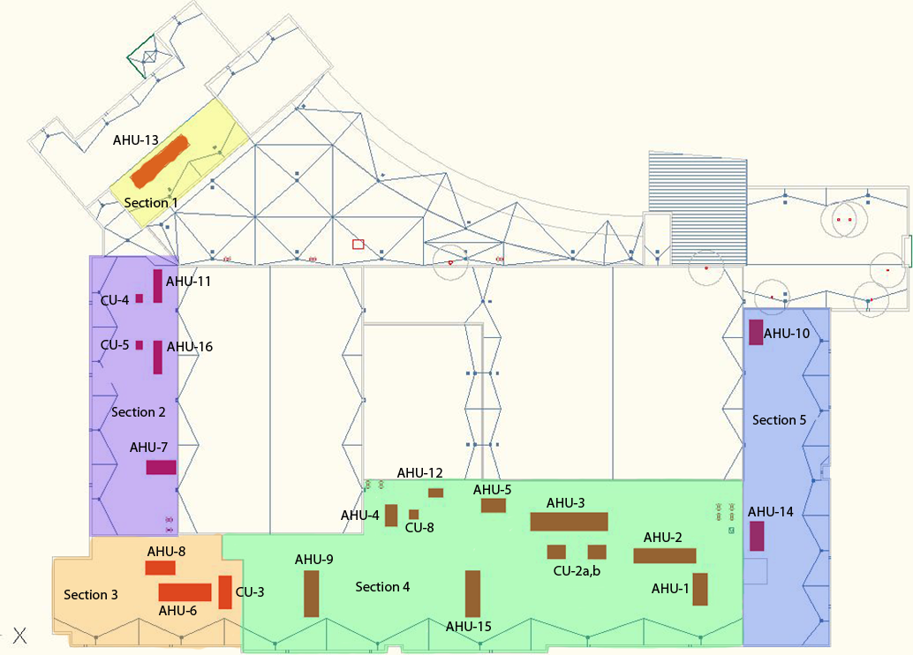
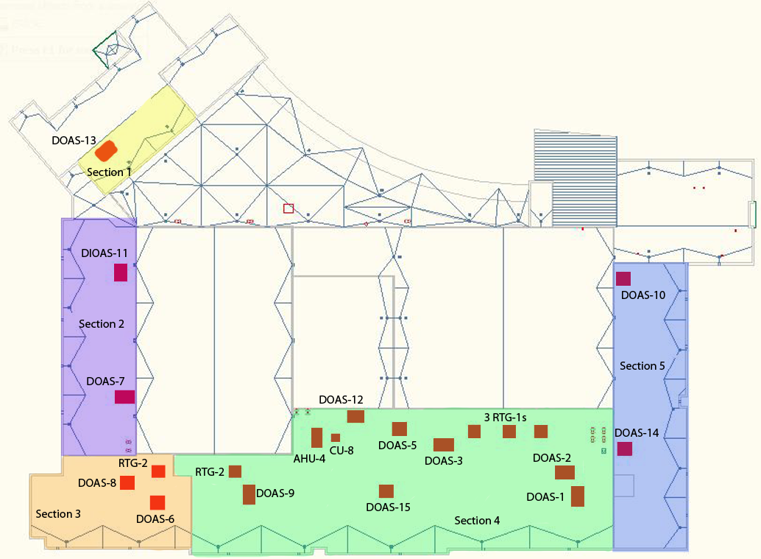
Dan Hanley
Mechanical
Option
Structural Breadth
Equipment Location
Current Locations
Redesigned Locations
North Pocono High School

Slide 31
Dan Hanley
Mechanical
Option
Structural Breadth
Member Comparison
Joist Comparison
Section | Joist Span | Joist Spacing | Current Joist | Redesigned Joist
Section 1 | 29'- 4" | 5'-2" | 22K9 | 16K2
Section 2 | 34'-8" | 5'-8" | 24K9 | 18K3
 | 13'-1" | 5'-6" | 16KCS3 | 10K1
Section3 | 13'-0" | 5'-10 1/8" | 12K3 | 10K1
 | 34'-8" | 5'-7 1/2" | 24k9 | 26k6
 | 13'-4" | 5'-0" | 16KCS3 | 10K1
Section 4 | 38'-0" | 5'-7 1/2" | 24K9 | 28k6
 | 13'-0" | 5'-10 1/8" | 12K3 | 10K1
 | 13'-0" | 5'-4" | 16KCS3 | 10K1
 | 11'-4" | 4'-9" | 16KCS3 | 10K1
 | 10'-0" | 4-9" | 12K5 | 10K1
 | 43'-8" | 5'-6 1/2" | 28K12 | 30K9
 | 10'-8" | 6'-2" | 12K3 | 10K1
 | 25'-8" | 5'-7 1/2" | 20K6 | 24K4
Section 5 | 13'-0" | 5'-10 3/4" | 12K3 | 10K1
 | 34'-4" | 5'-9" | 24K9 | 22K4
North Pocono High School

Slide 32
Dan Hanley
Mechanical
Option
Structural Breadth
Cost Comparison
Material and Construction Cost
New System saves 17% of the Initial Cost
North Pocono High School

Slide 33
Dan Hanley
Mechanical
Option
Presentation Outline
Project Outline
Existing Mechanical System
Design Conditions
Air Side System
Hydronic System
ASHRAE Standards
Standard 90.1
Standard 62.1
Mechanical System Redesign
Redesign Objectives
Sizing the Ground Loop
Ground Source Heat Pump
Dedicated Outdoor Air System
System Comparison
Energy Comparison
Cost Comparison
Environmental Comparison
Structural Breadth
Load Comparison
Member Comparison
Cost Comparison
Electrical Breadth
North Pocono High School

Slide 34
Dan Hanley
Mechanical
Option
Electrical Breadth
Electrical Load Comparison
Current Electrical Data
New Electrical Data
Equipment | Amps | KVA
AHU-1 | 230.56 | 110.67
AHU-2 | 226.25 | 108.60
AHU-3 | 66.51 | 138.56
AHU-5 | 134.40 | 64.53
AHU-6 | 71.00 | 34.08
AHU-7 | 180.10 | 86.46
AHU-8 | 166.25 | 79.80
AHU-9 | 230.00 | 110.40
AHU-10 | 135.94 | 65.25
AHU-11 | 17.19 | 8.25
AHU-12 | 49.6 | 23.82
AHU-13 | 135.69 | 282.69
AHU-14 | 109.12 | 52.38
AHU-15 | 103.02 | 214.63
AHU-16 | 17.19 | 8.25
Pump-1 | 46.75 | 22.44
Pump-2 | 46.75 | 22.44
Pump-3 | 46.75 | 22.44
Boiler -1 | 6.33 | 13.19
Boiler -2 | 6.33 | 13.19
CU-2a | 230 | 110.4
CU-2b | 230 | 110.4
CU-3 | 75.81 | 157.93
CU-4 | 43.38 | 20.82
CU-5 | 43.38 | 20.82
Total | 2648.3 | 1902.44
Equipment | Amps | KVA
DOAS-1 | 95.62 | 45.90
DOAS-2 | 105.63 | 50.70
DOAS-3 | 103.75 | 49.80
DOAS-5 | 67.50 | 32.40
DOAS-6 | 72.50 | 34.80
DOAS-7 | 88.12 | 42.30
DOAS-8 | 80.00 | 38.40
DOAS-9 | 175.00 | 84.00
DOAS-10 | 59.37 | 28.50
DOAS-11 | 49.37 | 23.70
DOAS-12 | 62.50 | 30.00
DOAS-13 | 292.50 | 140.40
DOAS-14 | 59.37 | 28.50
DOAS-15 | 80 | 38.4
Pump-1 | 46.75 | 22.44
Pump-2 | 46.75 | 22.44
RTG-1a | 67.36 | 32.34
RTG-1b | 67.36 | 32.34
RTG-1c | 67.36 | 32.34
RTG-2a | 40.31 | 19.35
RTG-2b | 40.31 | 19.35
Total | 1767.43 | 848.4
33% Reduction in Amps
55% Reduction in KVA
North Pocono High School

Slide 35
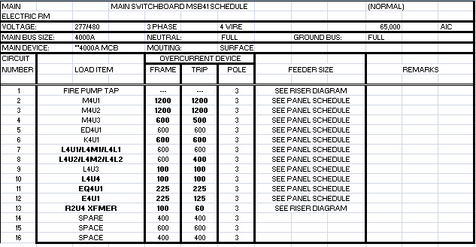
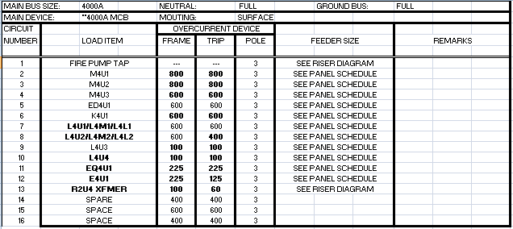
Dan Hanley
Mechanical
Option
Electrical Breadth
Current Main Panel
Redesigned Main Panel
North Pocono High School

Slide 36
Dan Hanley
Mechanical
Option
Conclusions
$46 Million Increase in Mechanical First Cost
$187.4 Thousand in Utility Savings
Yearly Energy Consumption Reduced by 75%
Building Emissions Reduced by 75%
17% Material and Construction Cost for Smaller Roof Structure
Electrical Consumption was Reduced by 55%
North Pocono High School

Slide 37
Dan Hanley
Mechanical
Option
Acknowledgments
North Pocono School District
Crabtree Rohrbaugh Assoc.
Greenman and Pedersen Inc.
Penn State AE Faculty
North Pocono High School

Slide 38
Thank You
Questions?

