Slide 1
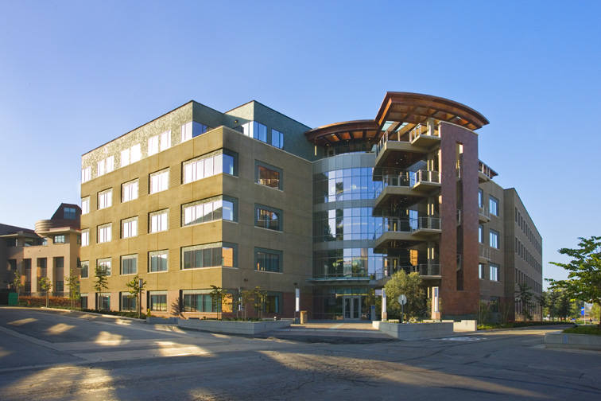
UCI Natural Sciences Unit 2
Irvine, CA
Schematic Lighting Design
11.December.2008
GRANT W KIGHTLINGER

Slide 2
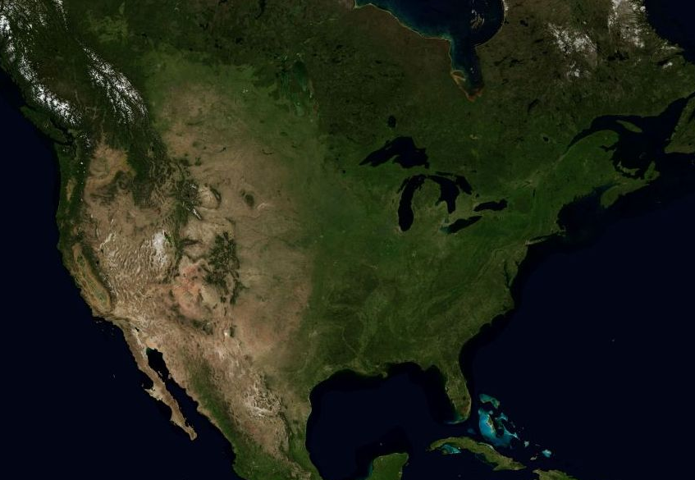
SITE LOCATION
IRVINE,
CA
maps.live.com
2
UCI Natural Sciences Unit 2

Slide 3
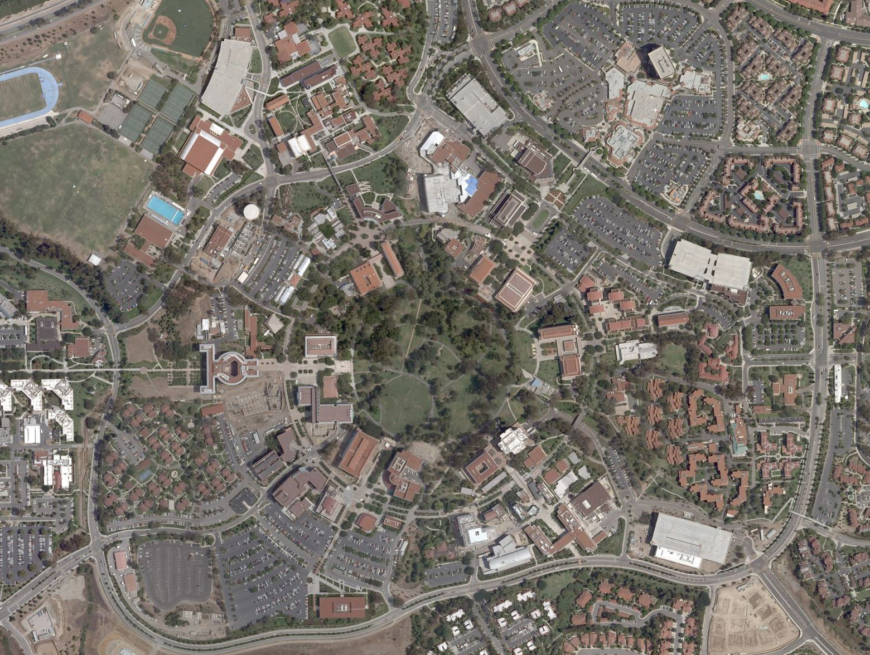
SITE LOCATION
maps.live.com
3
UCI Natural Sciences Unit 2

Slide 4
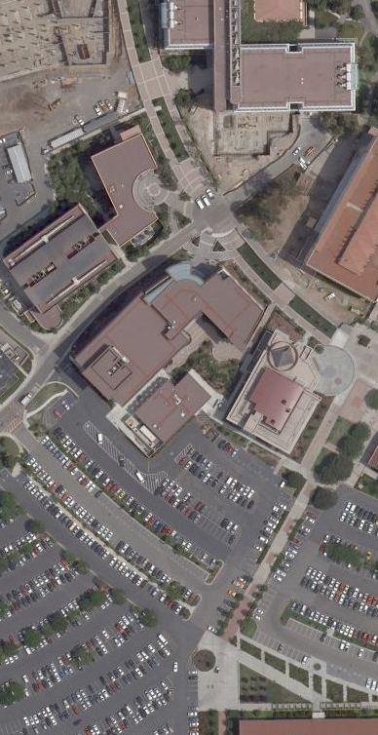
BUILDING SUMMARY
NAME: UCI Natural Sciences Unit 2
LOCATION: Irvine, California
OWNER: The Univ. of California, Irvine
SIZE: 146,075 SF
Five Stories
COST: $45 Million
FUNCTIONS: Science Laboratories
Faculty Offices
Graduate Student Offices
maps.live.com
4
UCI Natural Sciences Unit 2

Slide 5

DESIGN APPROACH
MODERN
DYNAMIC
CLEAN
SHARP
TRANSPARENT
EFFICIENT
gettyimages.com
5
UCI Natural Sciences Unit 2

Slide 6
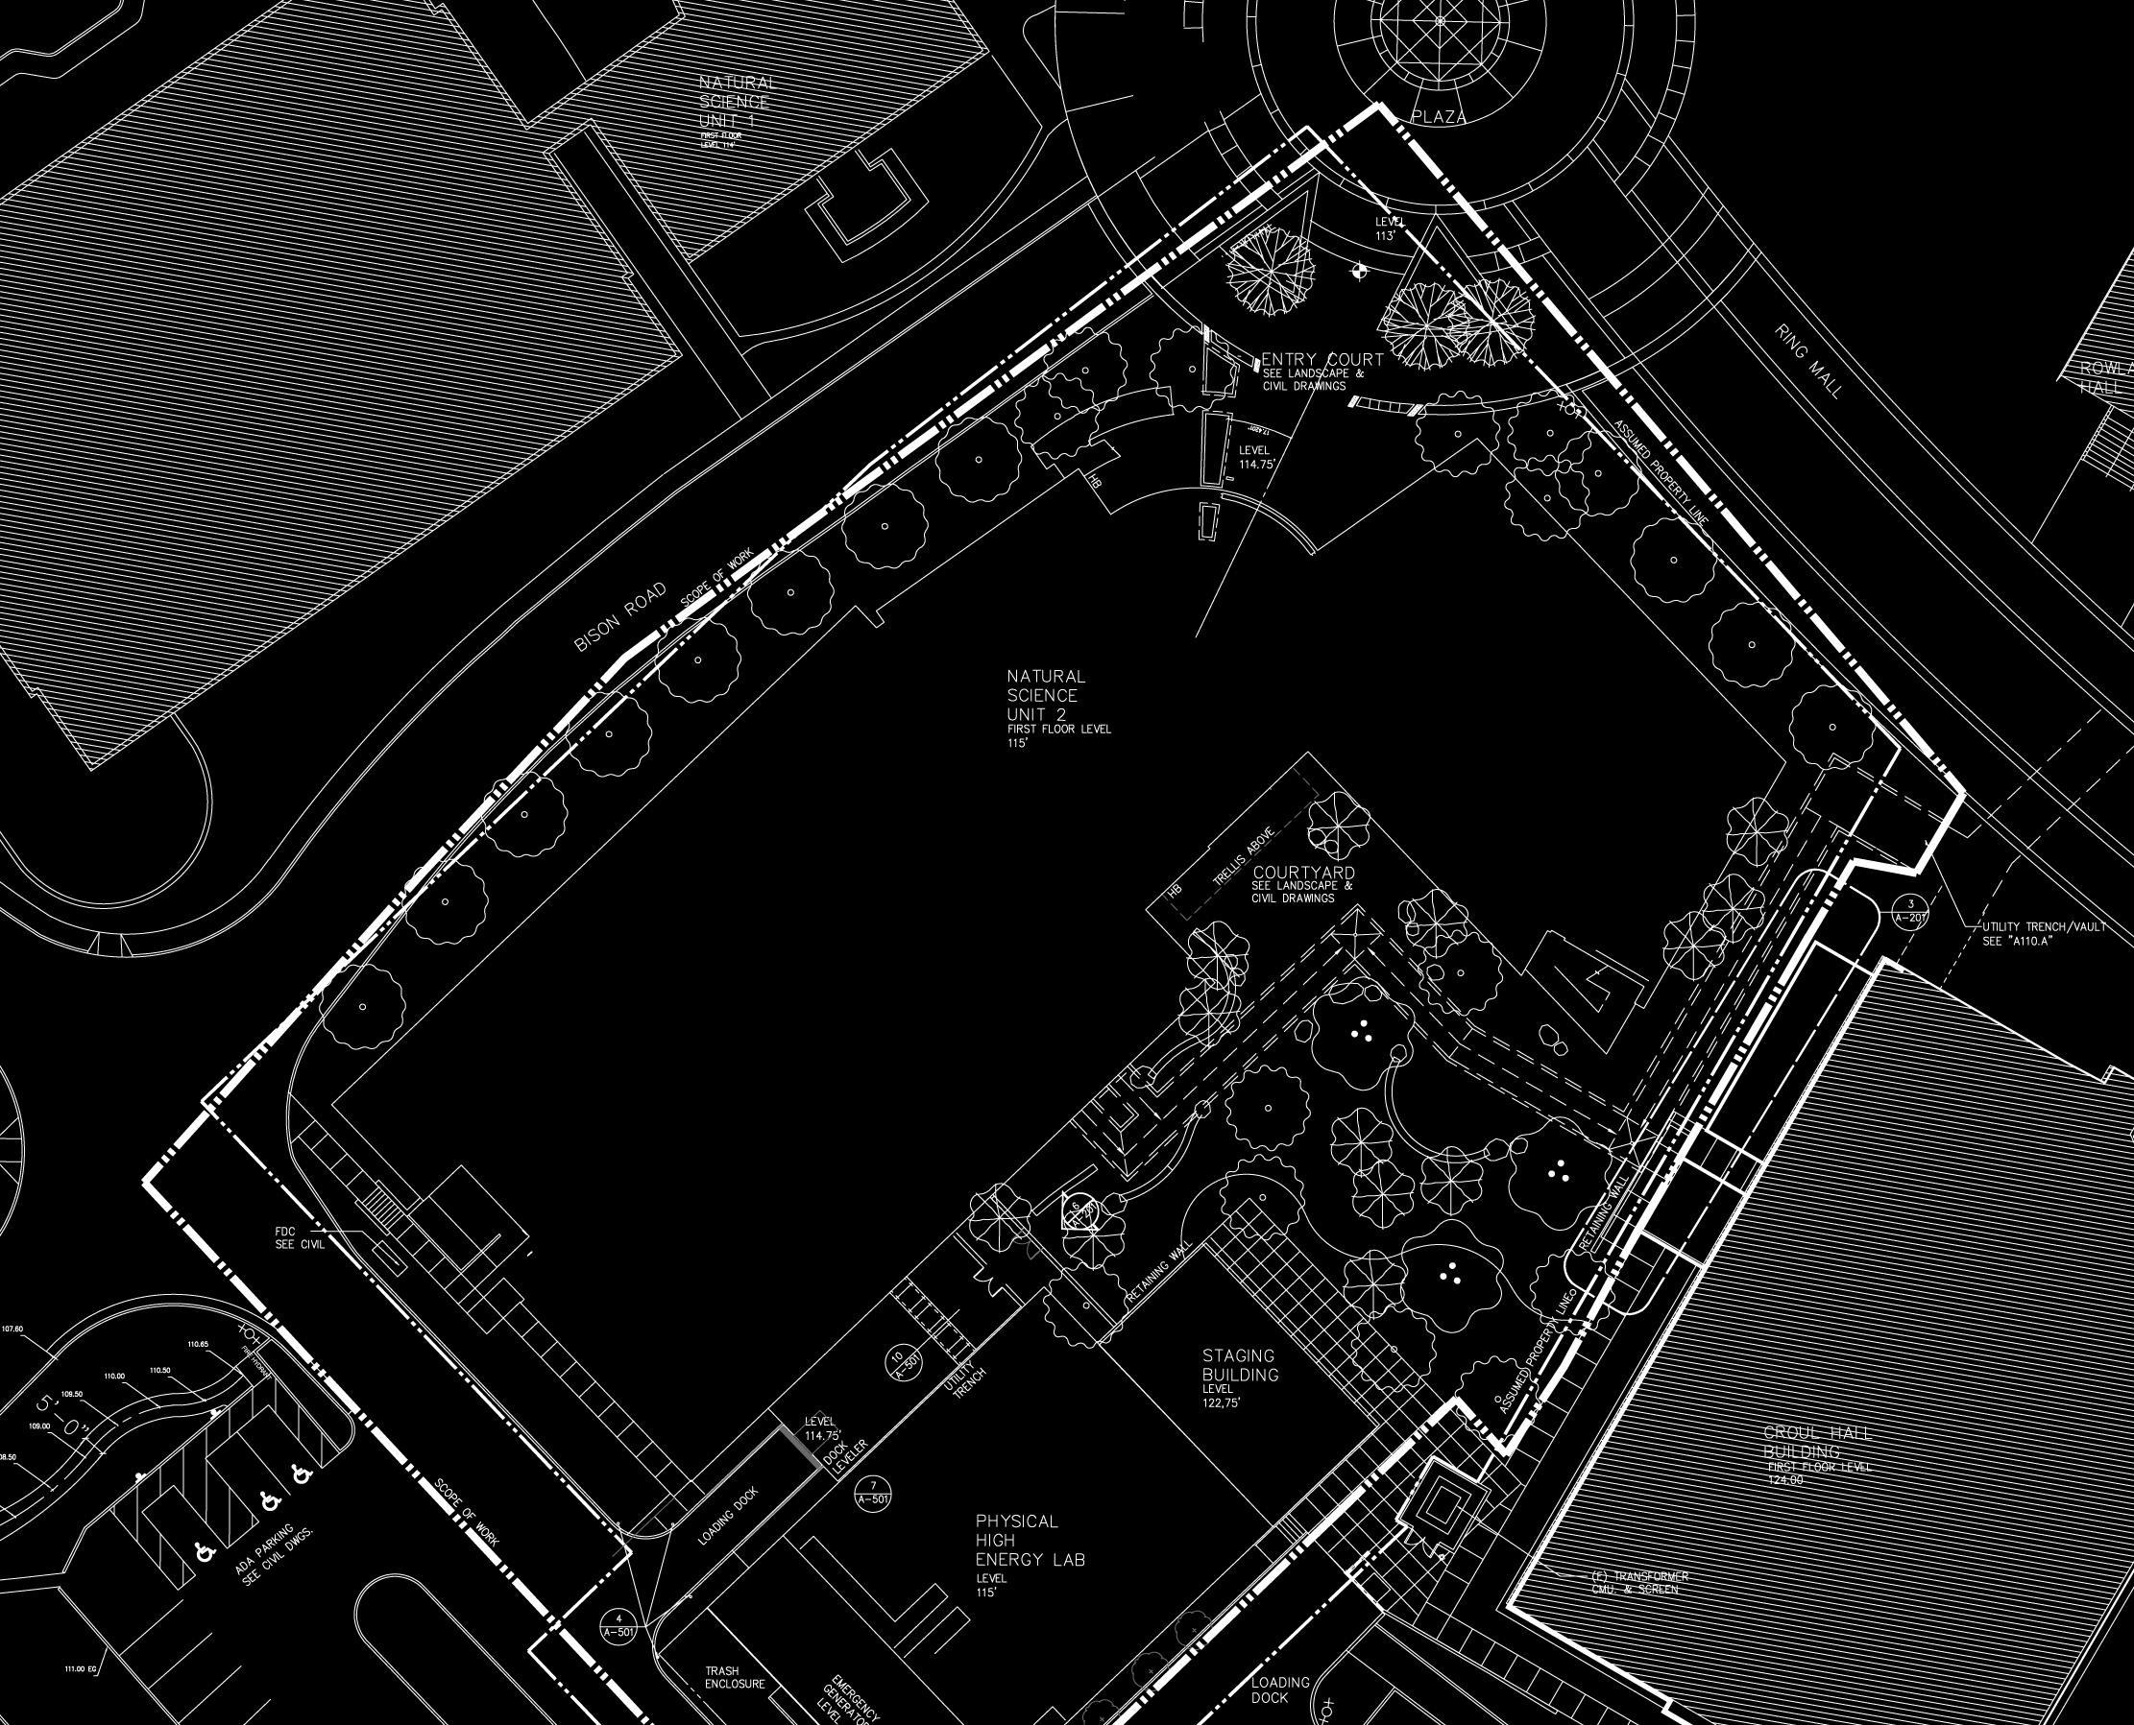
SPACES
▲
1
N
OPEN
OFFICE
3F
4
2
3
1
CONF.
ROOM
1F
2
3
LOBBY
1F + 2F
4
NORTH
FAÇADE
6
UCI Natural Sciences Unit 2

Slide 7
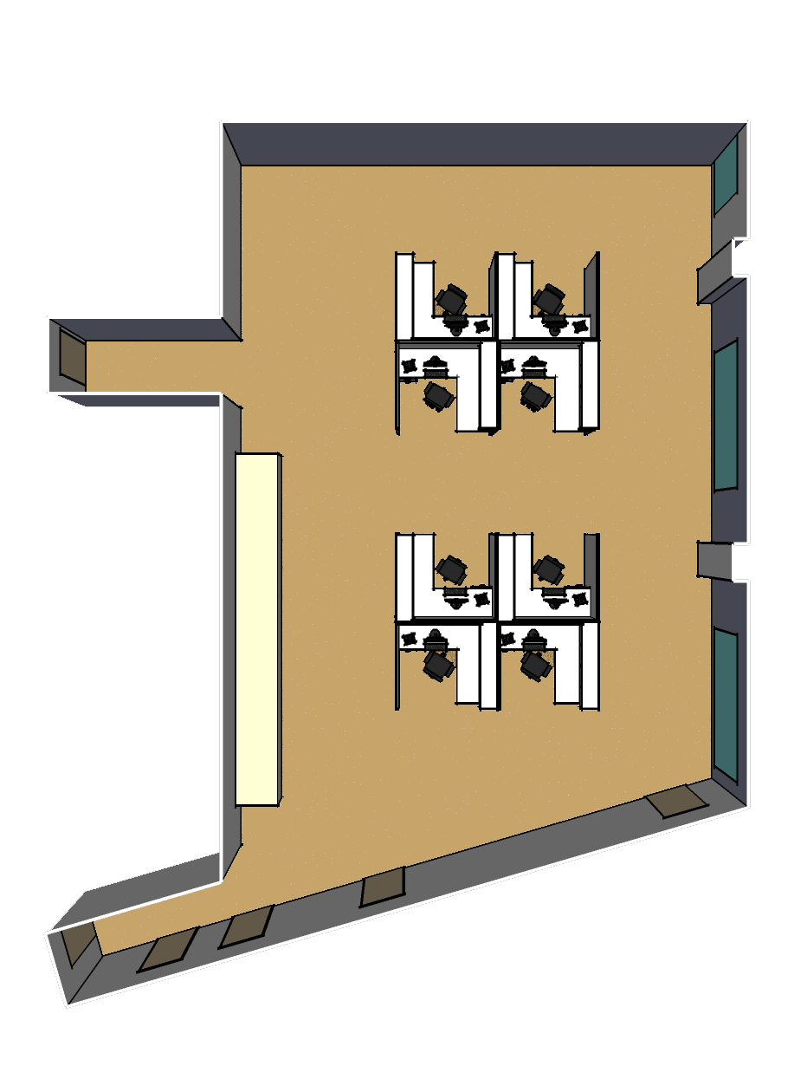
OPEN OFFICE 3F
FUNCTIONS: Grad. Student Workspaces
Faculty Offices (Adjacent)
FOCAL PTS: Windows
Personal Task
Circulation Areas
CONCEPTS: Flexibility
Simplicity
Efficiency
▲
N
7
UCI Natural Sciences Unit 2

Slide 8
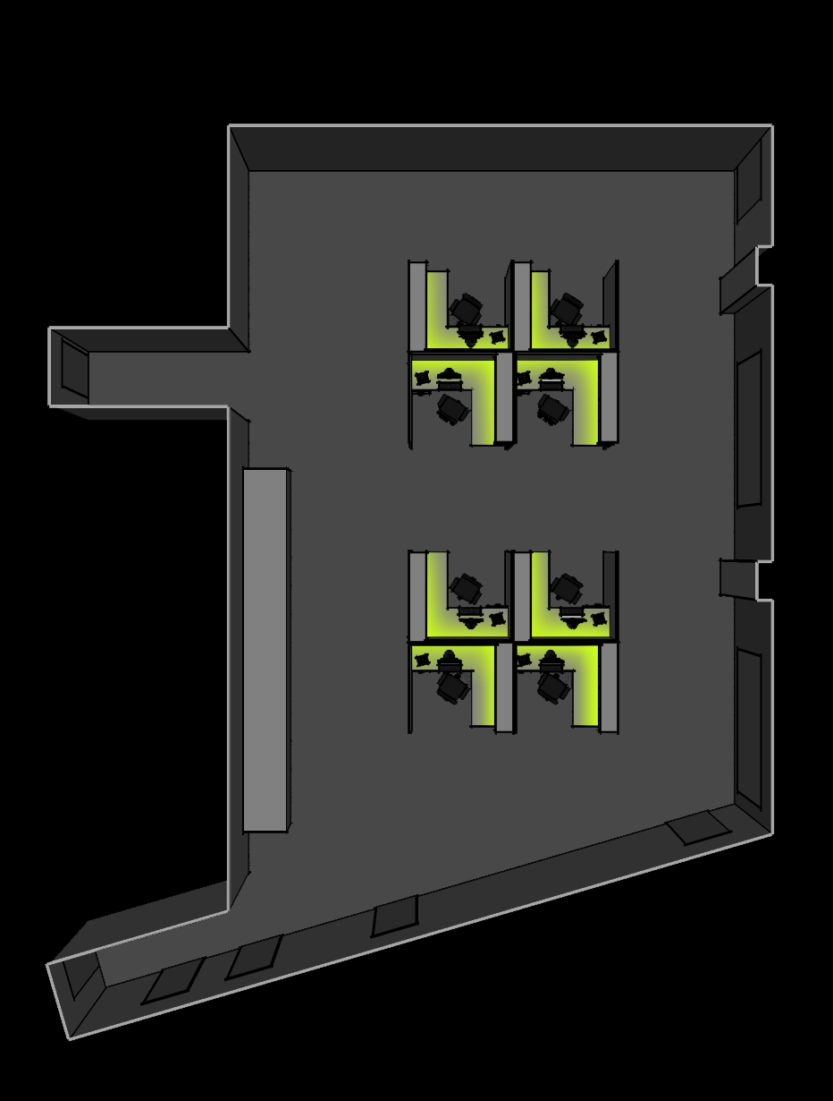
OPEN OFFICE 3F
FUNCTIONS: Grad. Student Workspaces
Faculty Offices (Adjacent)
FOCAL PTS: Windows
Personal Task
Circulation Areas
CONCEPTS: Flexibility
Simplicity
Efficiency
▲
N
8
UCI Natural Sciences Unit 2

Slide 9
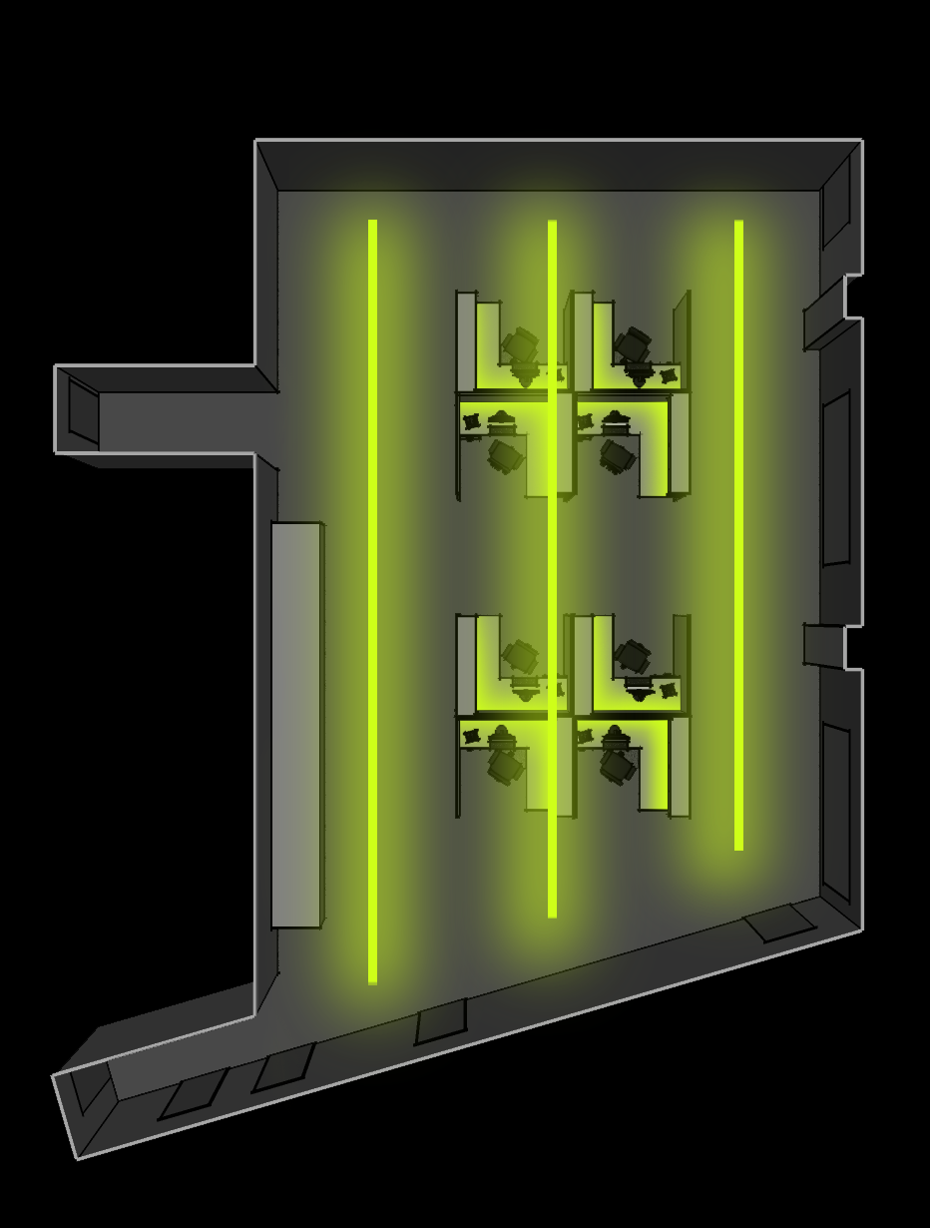
OPEN OFFICE 3F
FUNCTIONS: Grad. Student Workspaces
Faculty Offices (Adjacent)
FOCAL PTS: Windows
Personal Task
Circulation Areas
CONCEPTS: Flexibility
Simplicity
Efficiency
▲
N
9
UCI Natural Sciences Unit 2

Slide 10
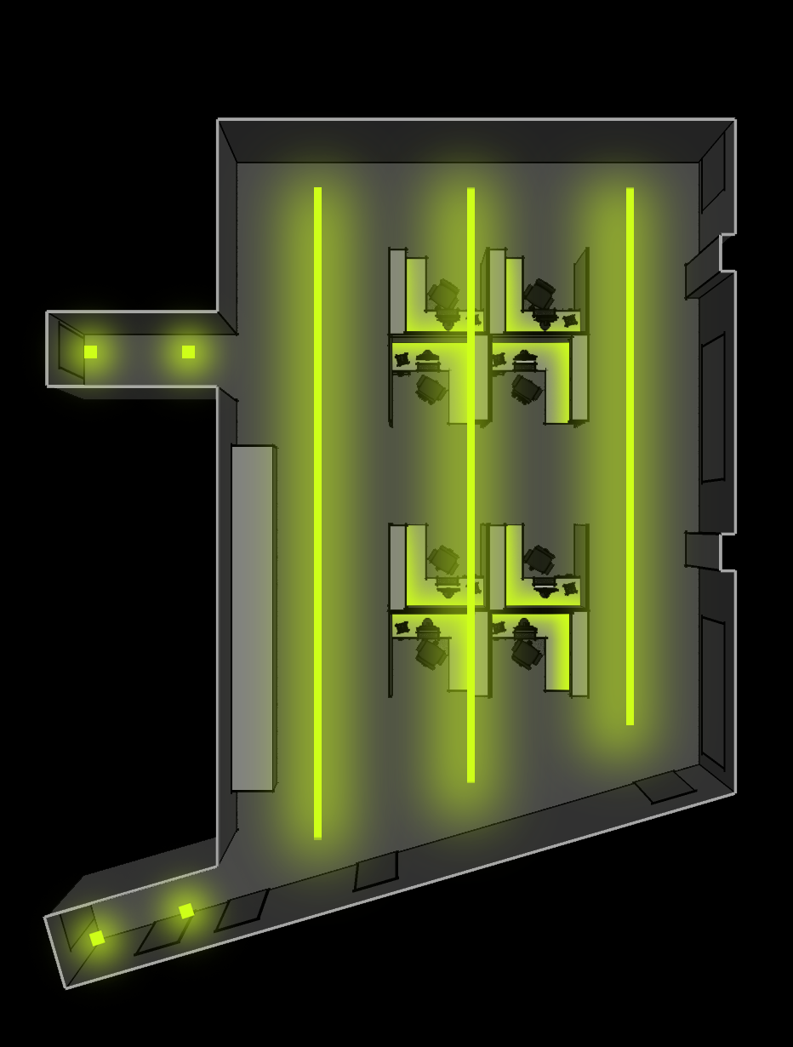
OPEN OFFICE 3F
FUNCTIONS: Grad. Student Workspaces
Faculty Offices (Adjacent)
FOCAL PTS: Windows
Personal Task
Circulation Areas
CONCEPTS: Flexibility
Simplicity
Efficiency
▲
N
10
UCI Natural Sciences Unit 2

Slide 11

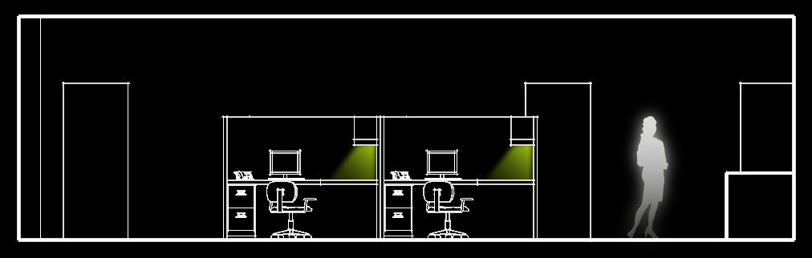
OPEN OFFICE 3F
FUNCTIONS: Grad. Student Workspaces
Faculty Offices (Adjacent)
FOCAL PTS: Windows
Personal Task
Circulation Areas
CONCEPTS: Flexibility
Simplicity
Efficiency
11
UCI Natural Sciences Unit 2

Slide 12
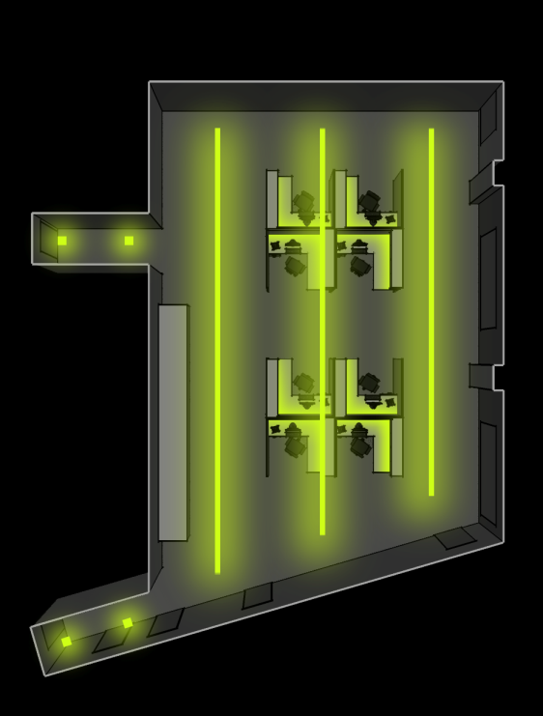
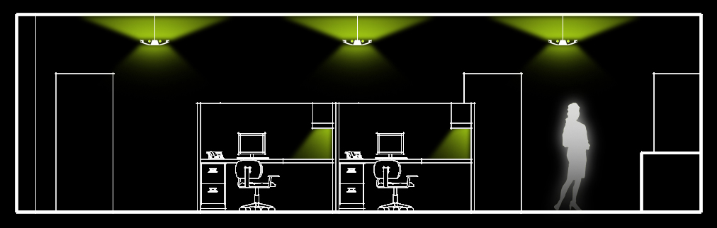
OPEN OFFICE 3F
FUNCTIONS: Grad. Student Workspaces
Faculty Offices (Adjacent)
FOCAL PTS: Windows
Personal Task
Circulation Areas
CONCEPTS: Flexibility
Simplicity
Efficiency
12
UCI Natural Sciences Unit 2

Slide 13
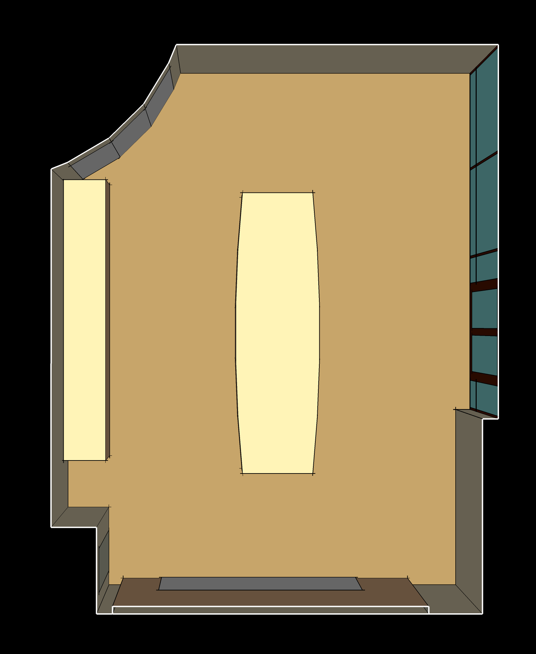
CONFERENCE ROOM 1F
FUNCTIONS: Meetings
Lectures
A / V Presentations
Social Functions
FOCAL PTS: Patio
Whiteboard
Face-to-Face
Note-Taking
Credenza
CONCEPTS: Transparency
Connection to Outdoors
Automation
Customization
▲
N
13
UCI Natural Sciences Unit 2

Slide 14
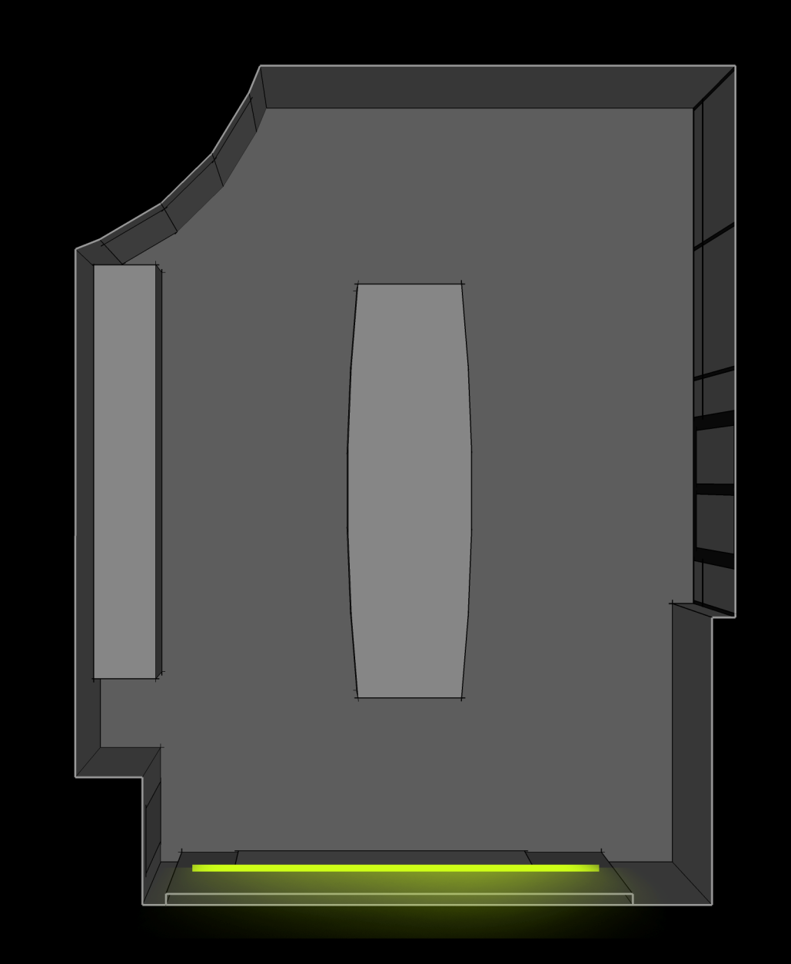
CONFERENCE ROOM 1F
FUNCTIONS: Meetings
Lectures
A / V Presentations
Social Functions
FOCAL PTS: Patio
Whiteboard
Face-to-Face
Note-Taking
Credenza
CONCEPTS: Transparency
Connection to Outdoors
Automation
Customization
▲
N
14
UCI Natural Sciences Unit 2

Slide 15
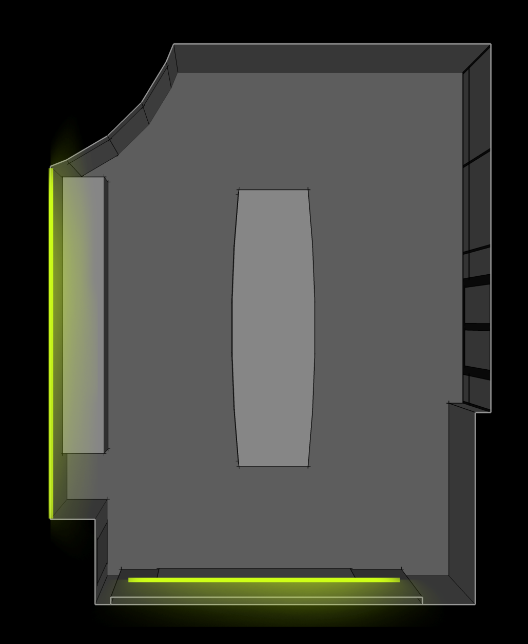
CONFERENCE ROOM 1F
FUNCTIONS: Meetings
Lectures
A / V Presentations
Social Functions
FOCAL PTS: Patio
Whiteboard
Face-to-Face
Note-Taking
Credenza
CONCEPTS: Transparency
Connection to Outdoors
Automation
Customization
▲
N
15
UCI Natural Sciences Unit 2

Slide 16
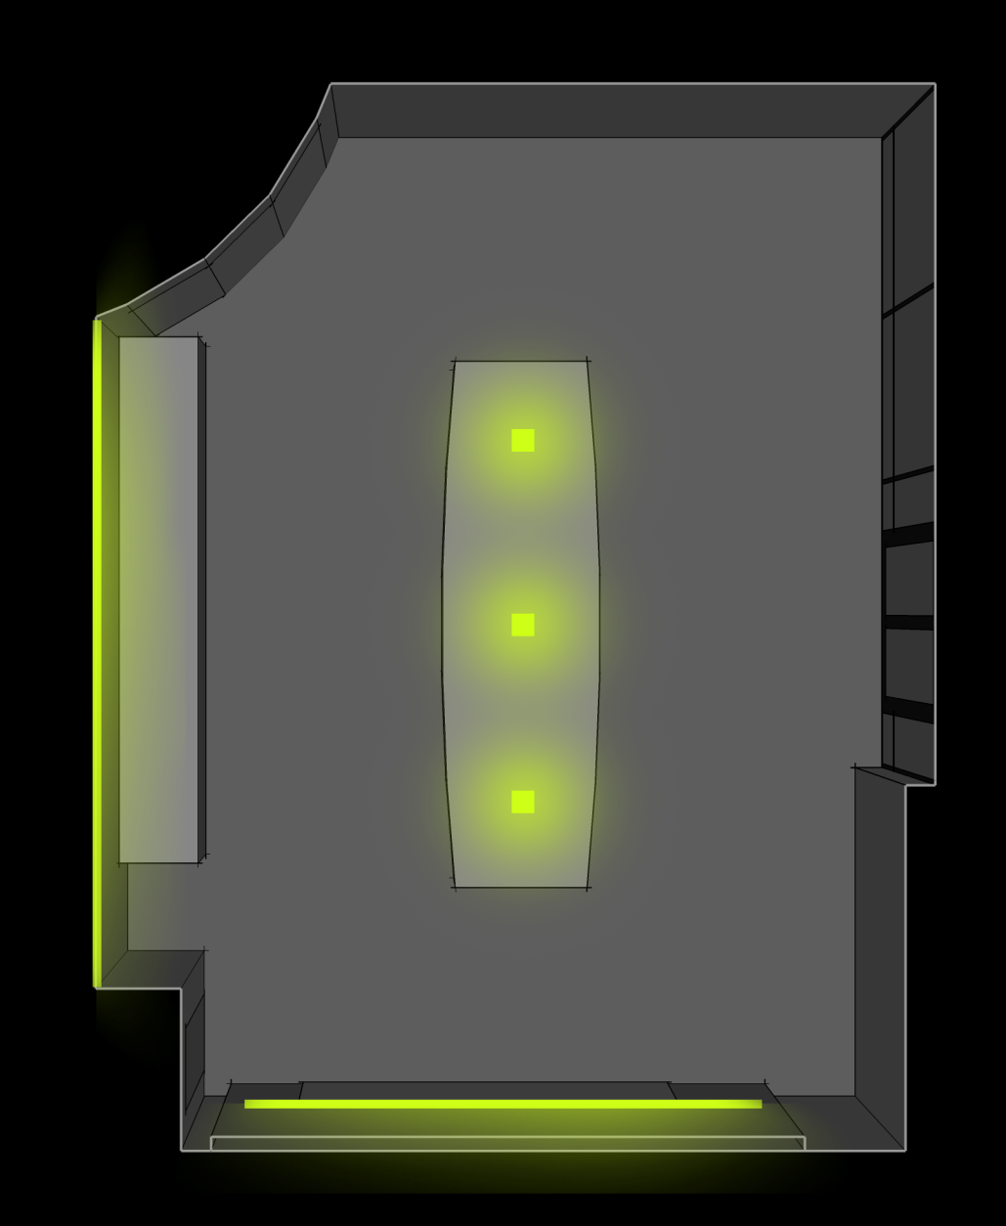
CONFERENCE ROOM 1F
FUNCTIONS: Meetings
Lectures
A / V Presentations
Social Functions
FOCAL PTS: Patio
Whiteboard
Face-to-Face
Note-Taking
Credenza
CONCEPTS: Transparency
Connection to Outdoors
Automation
Customization
▲
N
16
UCI Natural Sciences Unit 2

Slide 17
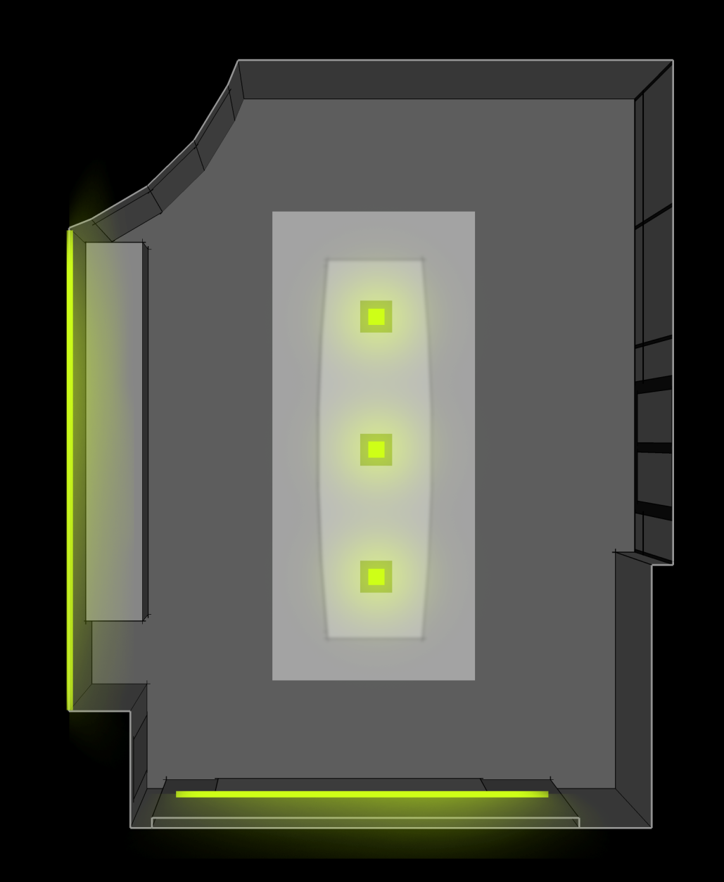
CONFERENCE ROOM 1F
FUNCTIONS: Meetings
Lectures
A / V Presentations
Social Functions
FOCAL PTS: Patio
Whiteboard
Face-to-Face
Note-Taking
Credenza
CONCEPTS: Transparency
Connection to Outdoors
Automation
Customization
▲
N
17
UCI Natural Sciences Unit 2

Slide 18
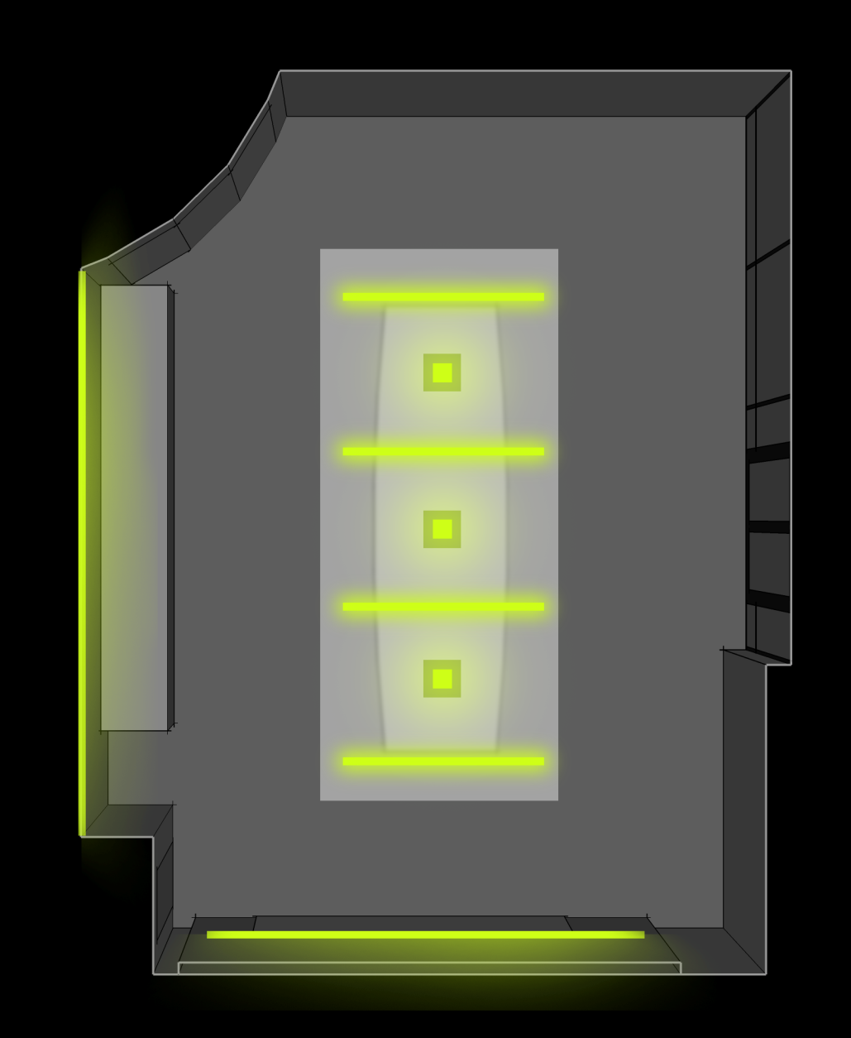
CONFERENCE ROOM 1F
FUNCTIONS: Meetings
Lectures
A / V Presentations
Social Functions
FOCAL PTS: Patio
Whiteboard
Face-to-Face
Note-Taking
Credenza
CONCEPTS: Transparency
Connection to Outdoors
Automation
Customization
▲
N
18
UCI Natural Sciences Unit 2

Slide 19
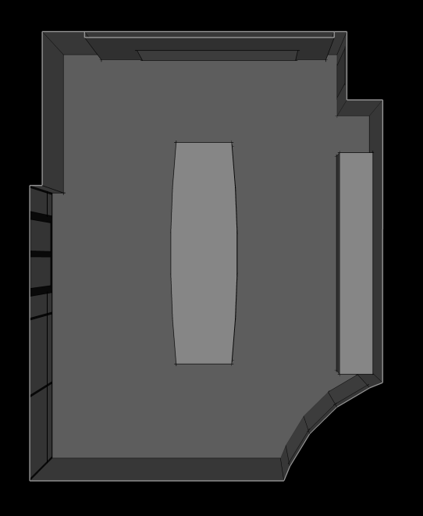
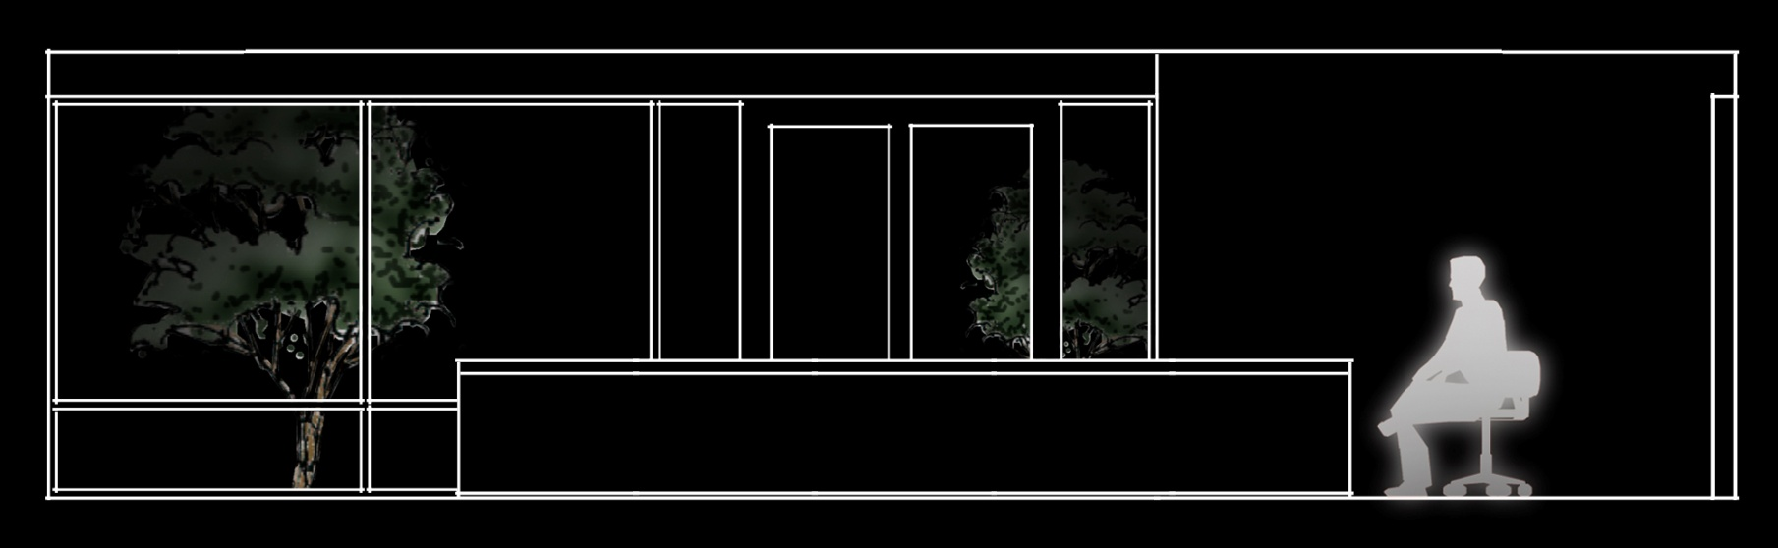
CONFERENCE ROOM 1F
FUNCTIONS: Meetings
Lectures
A / V Presentations
Social Functions
FOCAL PTS: Patio
Whiteboard
Face-to-Face
Note-Taking
Credenza
CONCEPTS: Transparency
Connection to Outdoors
Automation
Customization
19
UCI Natural Sciences Unit 2

Slide 20
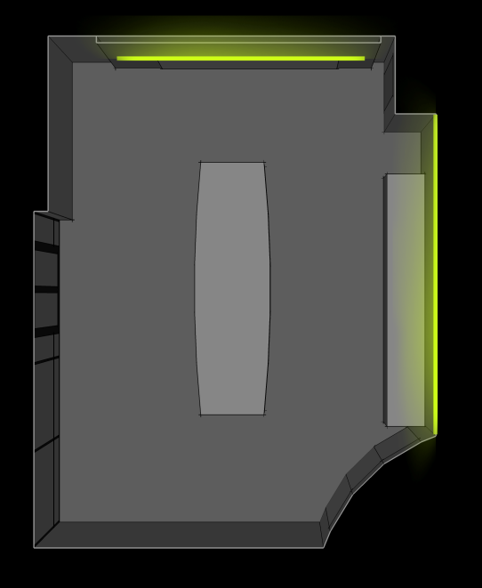
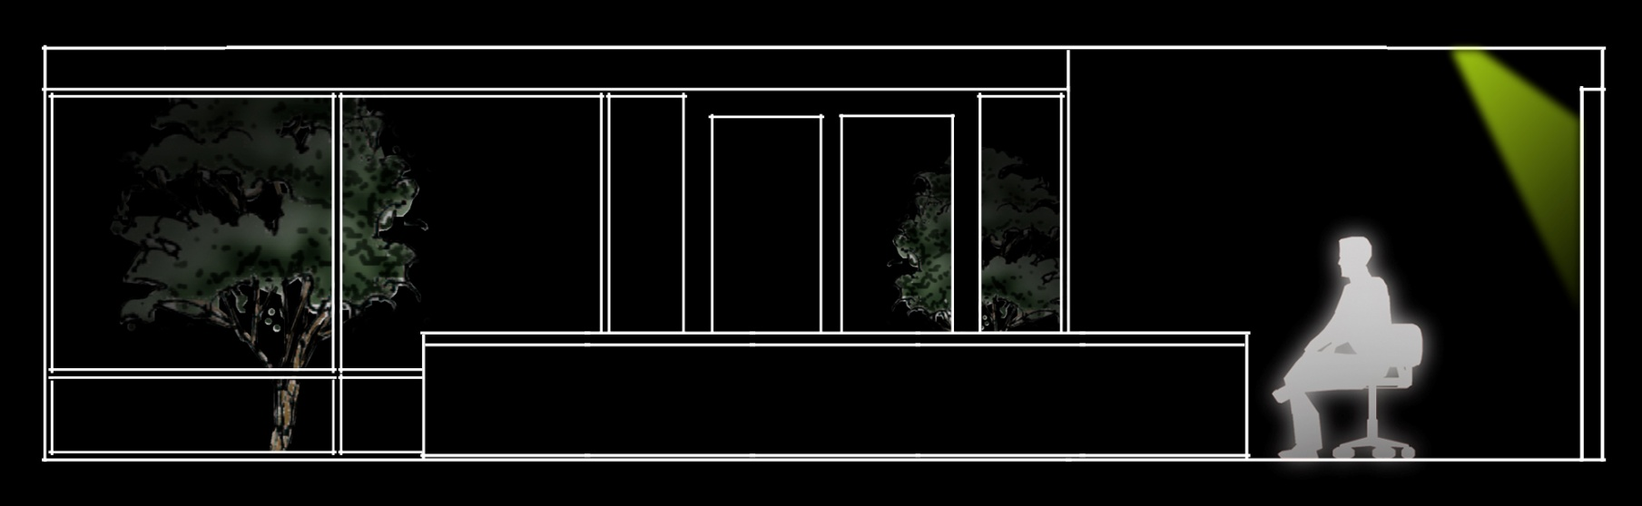
CONFERENCE ROOM 1F
FUNCTIONS: Meetings
Lectures
A / V Presentations
Social Functions
FOCAL PTS: Patio
Whiteboard
Face-to-Face
Note-Taking
Credenza
CONCEPTS: Transparency
Connection to Outdoors
Automation
Customization
20
UCI Natural Sciences Unit 2

Slide 21

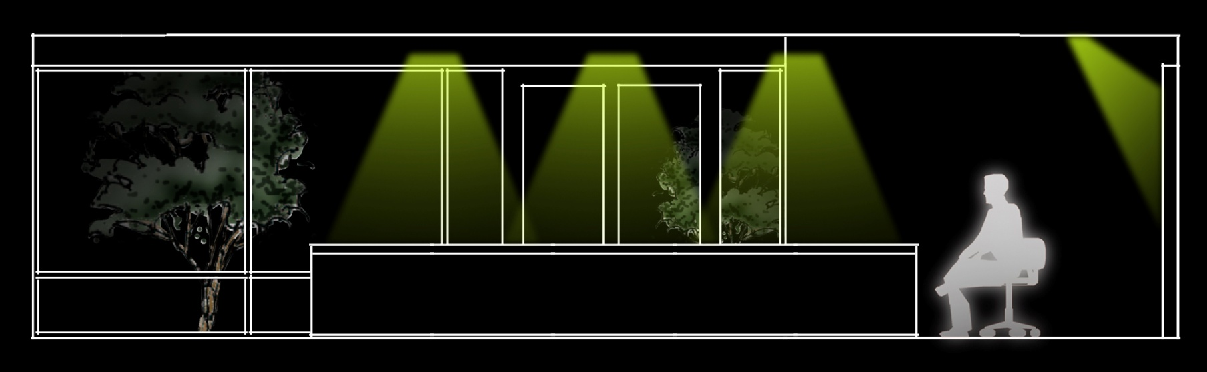
CONFERENCE ROOM 1F
FUNCTIONS: Meetings
Lectures
A / V Presentations
Social Functions
FOCAL PTS: Patio
Whiteboard
Face-to-Face
Note-Taking
Credenza
CONCEPTS: Transparency
Connection to Outdoors
Automation
Customization
21
UCI Natural Sciences Unit 2

Slide 22

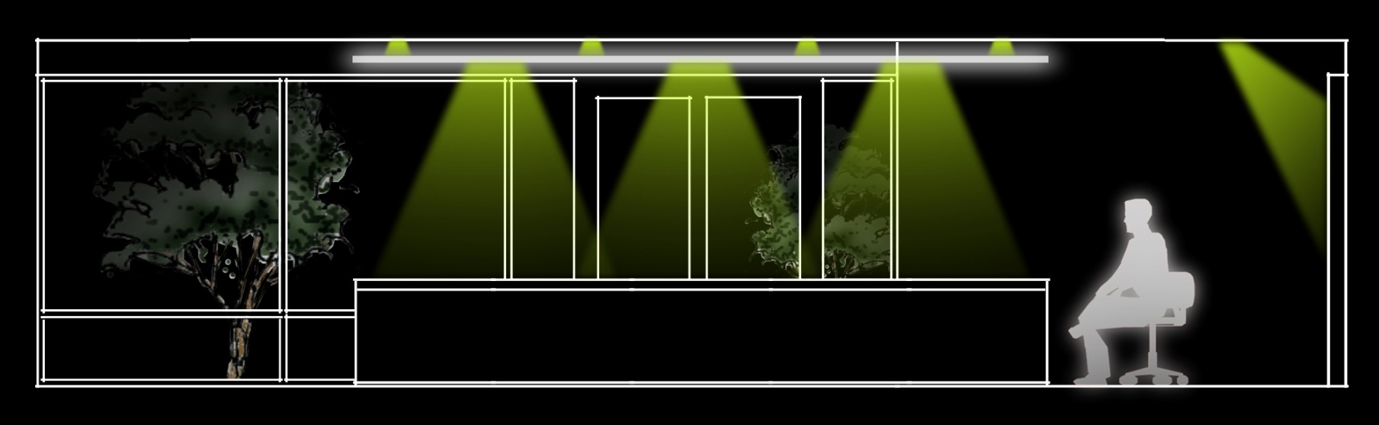
CONFERENCE ROOM 1F
FUNCTIONS: Meetings
Lectures
A / V Presentations
Social Functions
FOCAL PTS: Patio
Whiteboard
Face-to-Face
Note-Taking
Credenza
CONCEPTS: Transparency
Connection to Outdoors
Automation
Customization
22
UCI Natural Sciences Unit 2

Slide 23
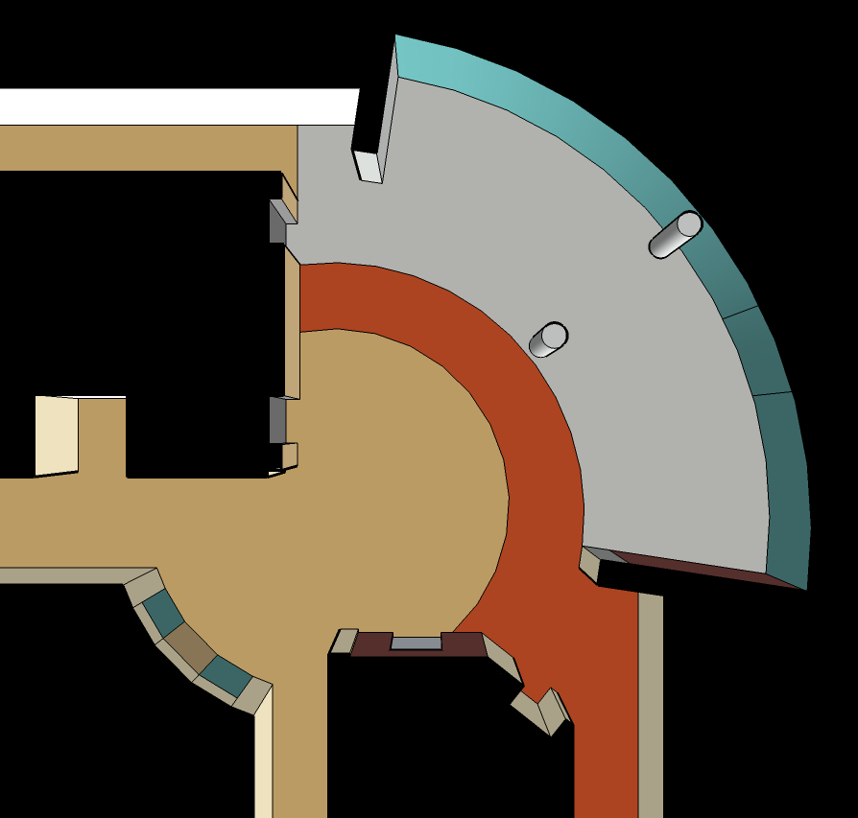
LOBBY 1F
FUNCTIONS: Circulation
Gathering Space
Social Interaction
FOCAL PTS: Center Point
Circulation Access
Feature Wall
Plaza
CONCEPTS: Vertical Motion
Radial Motion
Connection to Outdoors
▲
N
23
UCI Natural Sciences Unit 2

Slide 24
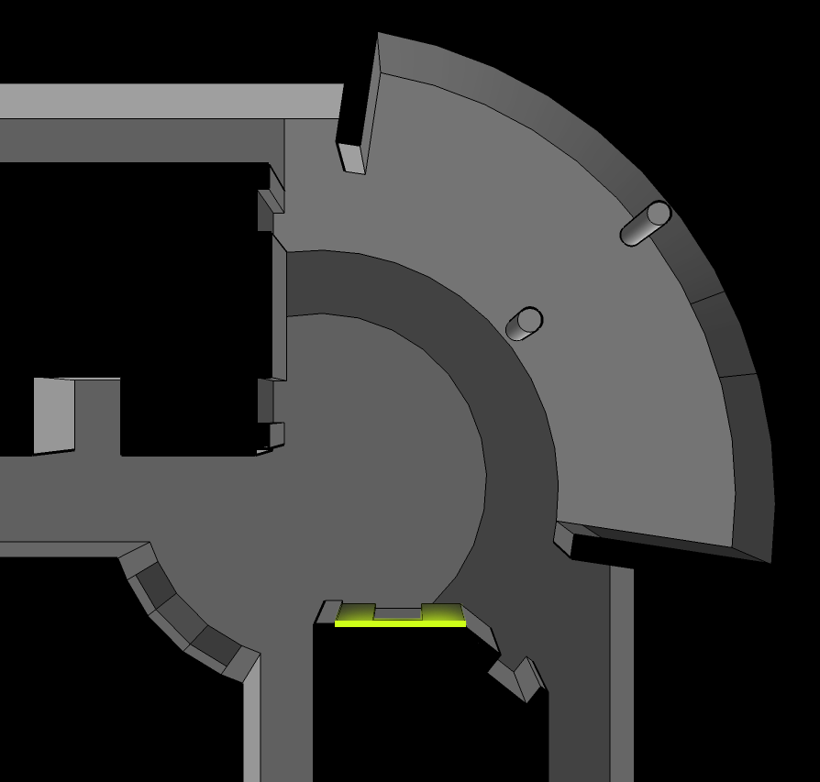
LOBBY 1F
FUNCTIONS: Circulation
Gathering Space
Social Interaction
FOCAL PTS: Center Point
Circulation Access
Feature Wall
Plaza
CONCEPTS: Vertical Motion
Radial Motion
Connection to Outdoors
▲
N
24
UCI Natural Sciences Unit 2

Slide 25
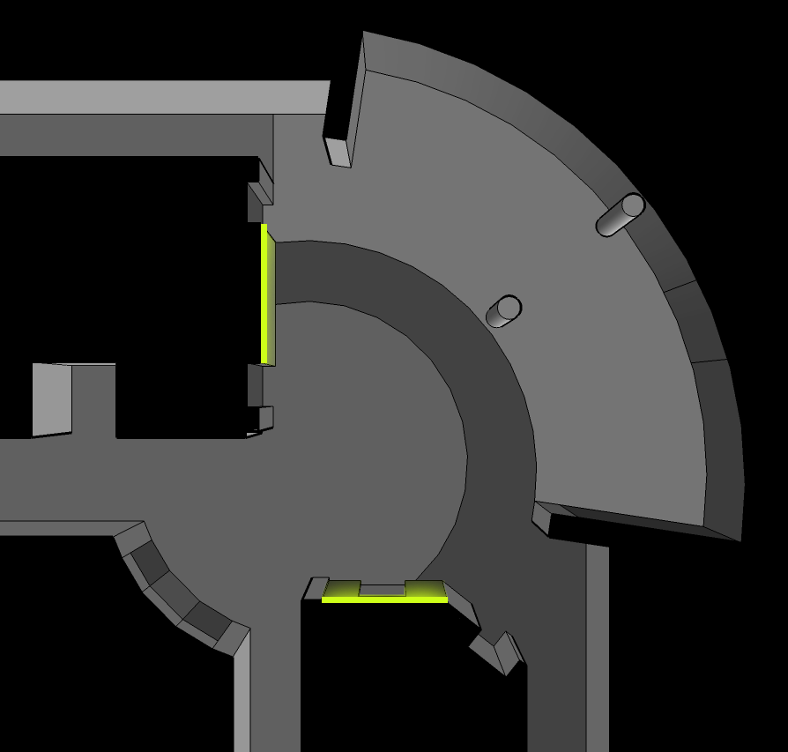
LOBBY 1F
FUNCTIONS: Circulation
Gathering Space
Social Interaction
FOCAL PTS: Center Point
Circulation Access
Feature Wall
Plaza
CONCEPTS: Vertical Motion
Radial Motion
Connection to Outdoors
▲
N
25
UCI Natural Sciences Unit 2

Slide 26
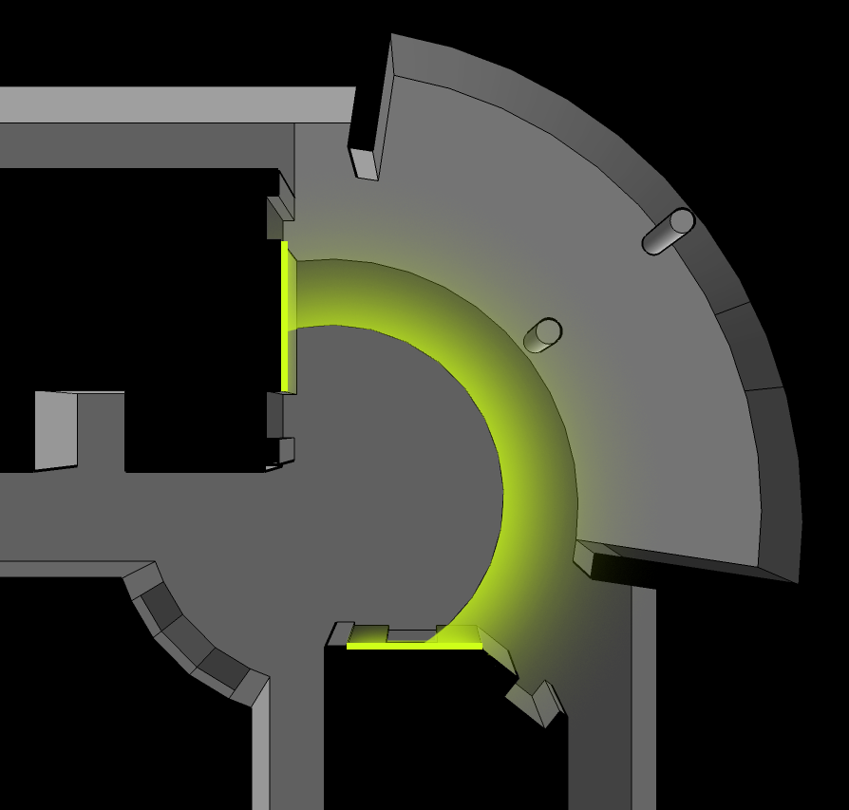
LOBBY 1F
FUNCTIONS: Circulation
Gathering Space
Social Interaction
FOCAL PTS: Center Point
Circulation Access
Feature Wall
Plaza
CONCEPTS: Vertical Motion
Radial Motion
Connection to Outdoors
▲
N
26
UCI Natural Sciences Unit 2

Slide 27
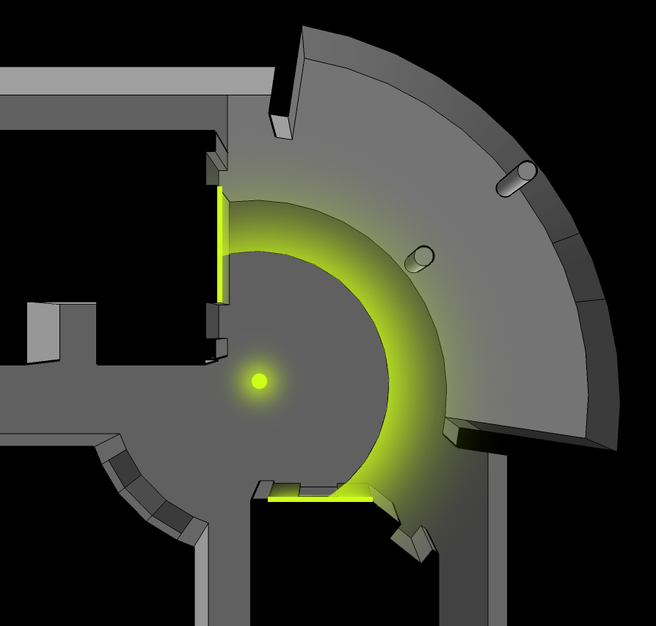
LOBBY 1F
FUNCTIONS: Circulation
Gathering Space
Social Interaction
FOCAL PTS: Center Point
Circulation Access
Feature Wall
Plaza
CONCEPTS: Vertical Motion
Radial Motion
Connection to Outdoors
▲
N
27
UCI Natural Sciences Unit 2

Slide 28
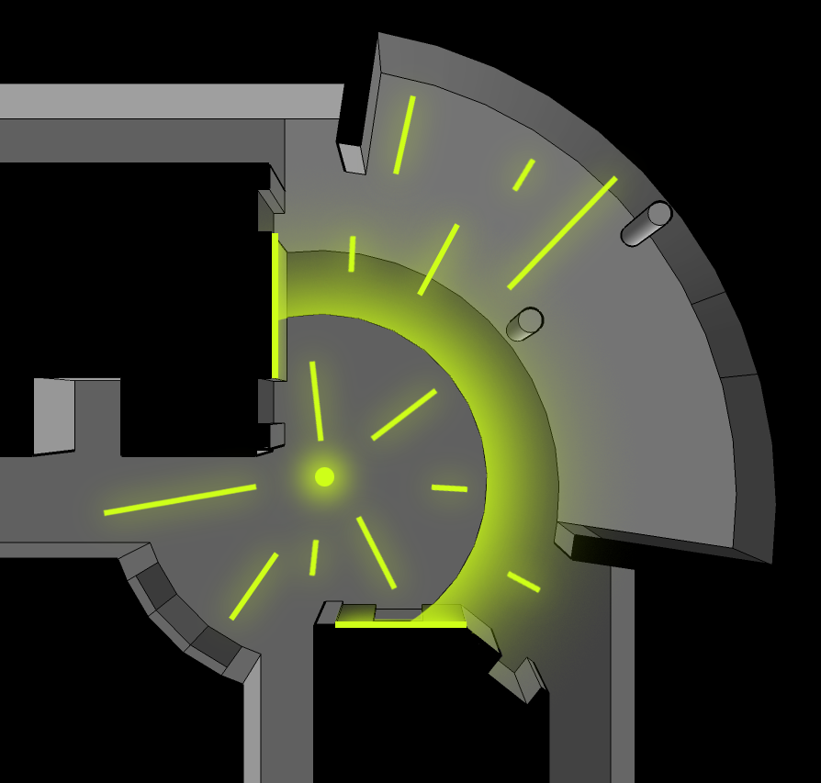
LOBBY 1F
FUNCTIONS: Circulation
Gathering Space
Social Interaction
FOCAL PTS: Center Point
Circulation Access
Feature Wall
Plaza
CONCEPTS: Vertical Motion
Radial Motion
Connection to Outdoors
▲
N
28
UCI Natural Sciences Unit 2

Slide 29

LOBBY 1F
FUNCTIONS: Circulation
Gathering Space
Social Interaction
FOCAL PTS: Center Point
Circulation Access
Feature Wall
Plaza
CONCEPTS: Vertical Motion
Radial Motion
Connection to Outdoors
▲
N
29
UCI Natural Sciences Unit 2

Slide 30
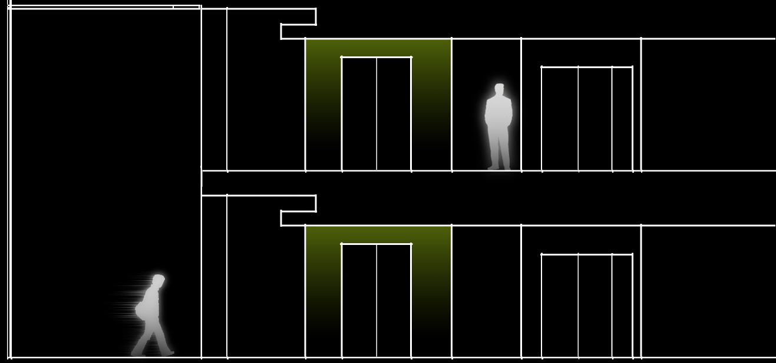
LOBBY 1F + 2F
FUNCTIONS: Circulation
Gathering Space
Social Interaction
FOCAL PTS: Center Point
Circulation Access
Feature Wall
Plaza
CONCEPTS: Vertical Motion
Radial Motion
Connection to Outdoors
30
UCI Natural Sciences Unit 2

Slide 31

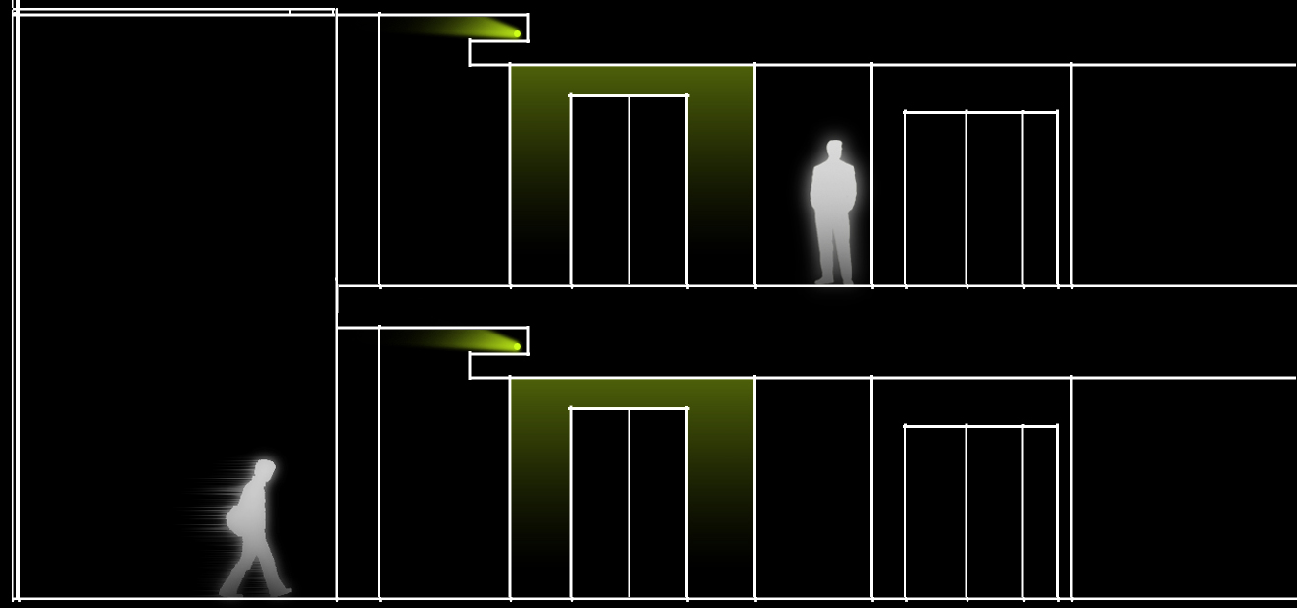
LOBBY 1F + 2F
FUNCTIONS: Circulation
Gathering Space
Social Interaction
FOCAL PTS: Center Point
Circulation Access
Feature Wall
Plaza
CONCEPTS: Vertical Motion
Radial Motion
Connection to Outdoors
31
UCI Natural Sciences Unit 2

Slide 32

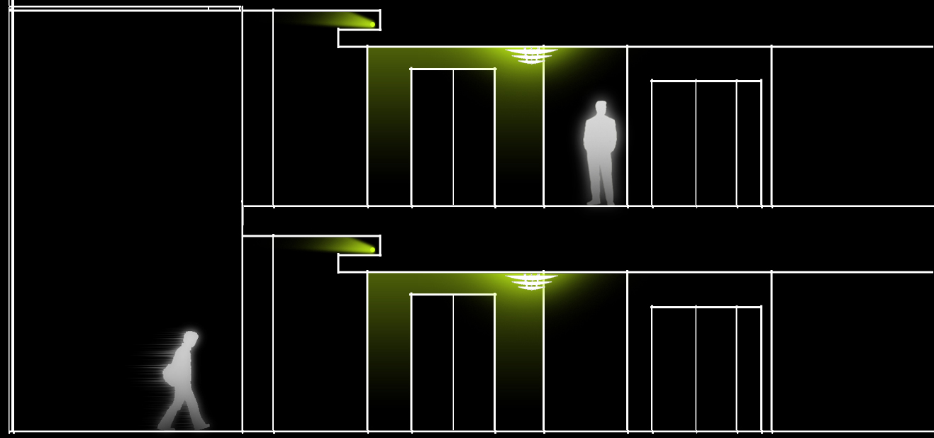
LOBBY 1F + 2F
FUNCTIONS: Circulation
Gathering Space
Social Interaction
FOCAL PTS: Center Point
Circulation Access
Feature Wall
Plaza
CONCEPTS: Vertical Motion
Radial Motion
Connection to Outdoors
32
UCI Natural Sciences Unit 2

Slide 33

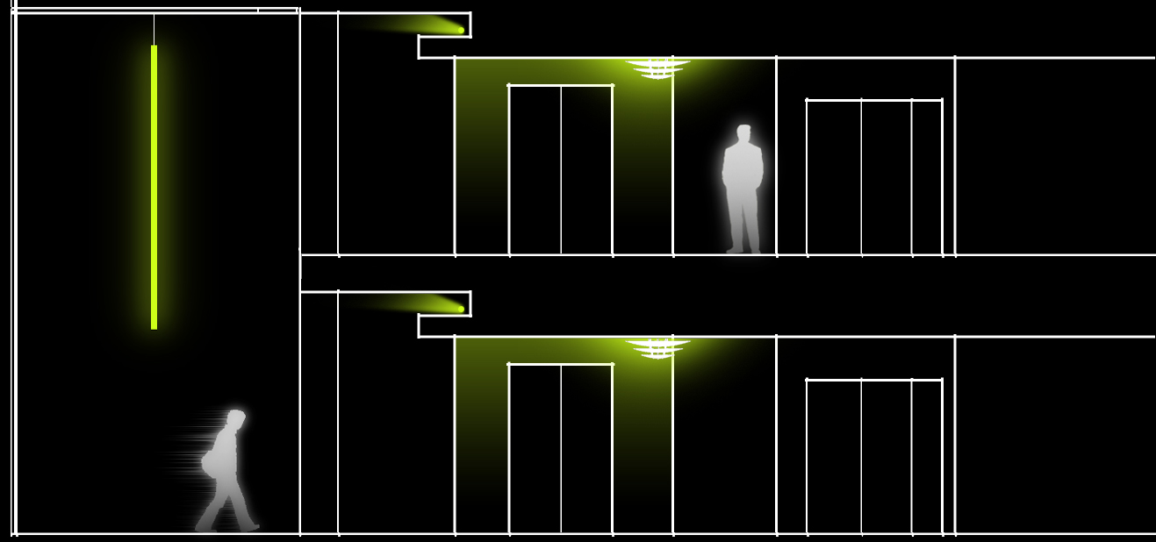
LOBBY 1F + 2F
FUNCTIONS: Circulation
Gathering Space
Social Interaction
FOCAL PTS: Center Point
Circulation Access
Feature Wall
Plaza
CONCEPTS: Vertical Motion
Radial Motion
Connection to Outdoors
33
UCI Natural Sciences Unit 2

Slide 34
NORTH FAÇADE
FUNCTIONS: Circulation
Gathering Space
Social Interaction
FOCAL PTS: Stair
Plaza
Terrace
Circulation
Curtain Wall
Lobby Lighting
34
UCI Natural Sciences Unit 2

Slide 35
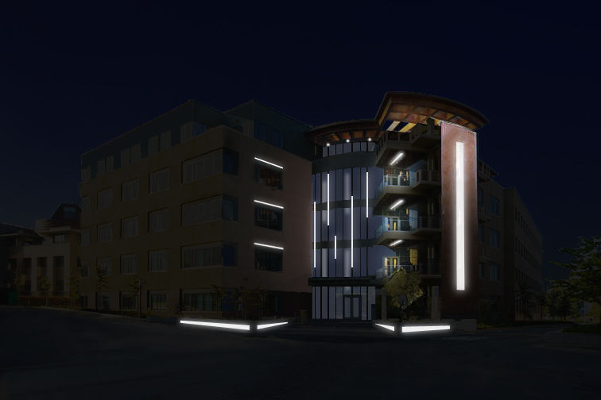
NORTH FAÇADE OPTION ONE
FUNCTIONS: Circulation
Gathering Space
Social Interaction
FOCAL PTS: Stair
Curtain Wall
Atrium Lighting
CONCEPTS: Vertical Motion
Sharpness
Complexity
Warm / Cool
35
UCI Natural Sciences Unit 2

Slide 36
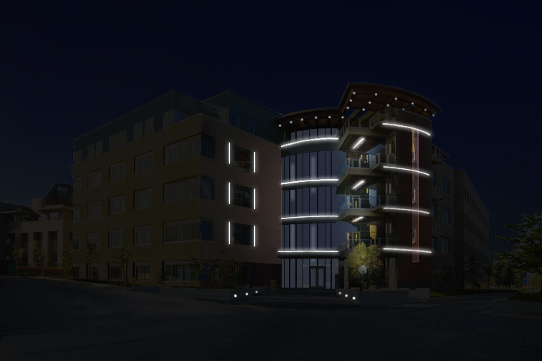
NORTH FAÇADE OPTION TWO
FUNCTIONS: Circulation
Gathering Space
Social Interaction
FOCAL PTS: Levels
Terrace
Curtain Wall
CONCEPTS: “Drawer” Effect
Accentuated Levels
Curves
Radial Motion
Warm / Cool
36
UCI Natural Sciences Unit 2

Slide 37
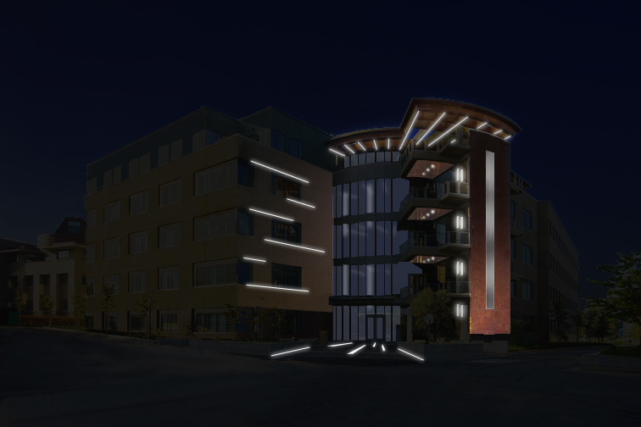
NORTH FAÇADE OPTION THREE
FUNCTIONS: Circulation
Gathering Space
Social Interaction
FOCAL PTS: Terrace
Lobby
Plaza
CONCEPTS: Radial Motion
Central Point
Connection to Indoors
Dynamic
Warm / Cool
37
UCI Natural Sciences Unit 2

Slide 38
THANK YOU

