Slide 1
Geisinger Hospital for Advanced Medicine
Jen Redington
Mechanical Option
AE Senior Thesis
Spring 2009

Slide 2
Presentation Outline
Building Overview
Existing Mechanical Systems
Mechanical Depth
  Dedicated Outdoor Air Systems and Chilled Beams
  Combined Heat and Power
Electrical Breadth
Architectural Breadth
Conclusions

Slide 3
Building Overview
Geisinger Hospital for Advanced Medicine
Location: Danville, PA
Size: 300,600 SF, 9 stories
Total Project Cost: $108 million
Construction Dates : June 2007-Spring 2010

Slide 4
Building Overview
Building Use
  Cardiology
  Surgery
  Patient Rooms
  Clinics
  Diagnostics
  Staff Areas
  Food Service
  Shell Spaces

Slide 5
Existing Mechanical Systems
Chiller Plant
  New chiller plant being constructed housing:
    Two existing 900-ton chillers to a new chiller plant
    One existing free-cooling plate and frame heat exchanger
    One new 900-ton chiller
    One new 8,000 ton-hour, thermal energy storage tank

Slide 6
Existing Mechanical Systems
Boiler Plant
  Boiler plant addition being constructed housing:
    Two new steam boilers, one electric and one gas
    Two new 8,900 MBH shell and tube heat exchangers for heating water

Slide 7
Existing Mechanical Systems
Air handling units
  Five air handling units to be installed now
  Three air handling units for the future

Slide 8
Mechanical Depth
Dedicated Outdoor Air System and Chilled Beams
  Replace VAV boxes with a dedicated outdoor air system and chilled beams
  Goals
    Reduce Energy Use and Cost
    Improve Ventilation and Indoor Air Quality
    Reduce Mechanical Space

Slide 9
Mechanical Depth
Dedicated Outdoor Air System and Chilled Beams
  Advantages
    Separation of sensible and latent loads
    Improved indoor air quality (IAQ)
    Reduced reheating of air
    Increased comfort level due to chilled beams
    Ensures ventilation requirements are meet

Slide 10
Mechanical Depth
System Design
  Outdoor Design Conditions
    Summer Conditions (0.4%)
      90.1°F DB
      72.9°F WB
      Winds: W 9.8 mph
    Winter Conditions (99.6%)
      3°F DB
      Winds: WNW 7 mph

Slide 11
Mechanical Depth
System Design
  Indoor Design Conditions
    Operating Rooms
      Room temperature: 60°F to 70°F (adjustable by room)
      50%-55% RH at 60°F
      35%-40% RH at 70°F
    Patient Rooms
      Room temperature: 70°F to 75°F (adjustable by room)
      30% RH min (winter)
      60% RH max (summer)
    Exam/Treatment
      Room temperature: 75°F
      30% RH min (winter)
      50% RH max (summer)
    Other spaces:
      Summer: 75°F, 50% RH maximum
      Winter: 70°F, 30% RH minimum

Slide 12
Mechanical Depth
System Design
  Replaced AHU-S-1, AHU-S-2, and AHU-N-2 with dedicated outdoor air systems
  Surgical pharmacy air handling unit eliminated, spaces controlled by south air handling units

Slide 13
Mechanical Depth
System Design
  Ventilation rates determined by ASHRAE 62.1-2007 and AIA Guidelines for Design and Construction of Hospitals and Health Care Facilities, 2001

Slide 14
Mechanical Depth
System design
  Determining supply air temperature
  Based on temperature needed for latent loads and to control humidity

Slide 15
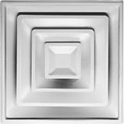
Mechanical Depth
System Design
  High Induction Diffusers
    Improve mixing in room
    Necessary due to low supply air temperatures
    Allow rooms to meet air change rates

Slide 16
Mechanical Depth
System Design
  Air Handling Units
    Trane M-Series Size 21
        Airflow range – 7350 - 12600

Slide 17
Mechanical Depth
System Design
  Enthalpy Wheel
    Increased energy efficiency
    T₃ shows temperatures after passing through the enthalpy wheel

Slide 18
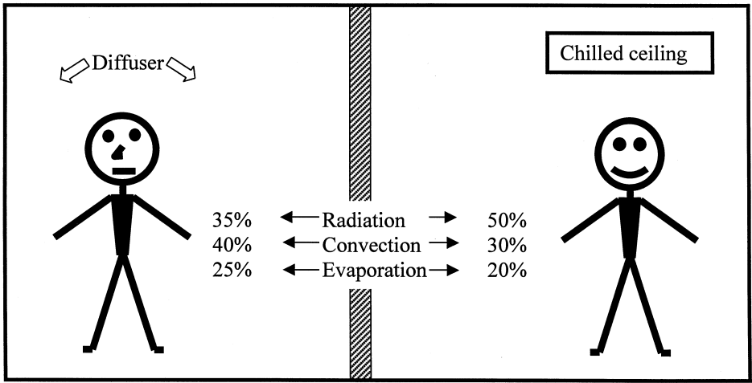
Mechanical Depth
System Design
  Chilled Beams
    Increase thermal comfort
      Radiation effects
      Decreased air motion in the space
    Decreased fan power

Slide 19
Mechanical Depth
Results
  Air Savings

Slide 20
Mechanical Depth
Results
  Decreased Mechanical Space
    Fourth floor mechanical room
      Removal of AHU-4-3
    Mechanical Penthouse
      Original AHU’s – 154” x 224”
      New DOAS AHU’s – 52” x 77”
    Decreased mechanical shaft size
      Original supply ducts from air handling units – 108” x 138”
      New supply ducts from air handling units – 42” x 44”

Slide 21
Mechanical Depth
Results
  Improved Indoor Air Quality
    Decreased recirculation of contaminants
    Increased mixing due to high induction diffusers

Slide 22
Mechanical Depth
Results
  Energy Use Savings

Slide 23
Mechanical Depth
Results
  Energy Cost Savings

Slide 24
Mechanical Depth
Combined Heat and Power (CHP)
  Install combined heat and power plant on site
  Goals
    Lower Energy Use
    Lower Emissions
    Lower Energy Cost

Slide 25
Mechanical Depth
Combined Heat and Power
  Feasibility
    Sparks Gap > $12/MMBTU
  Geisinger Hospital for Advanced Medicine
    Sparks Gap = $5/MMBTU
      Much lower than recommended for energy cost savings

Slide 26
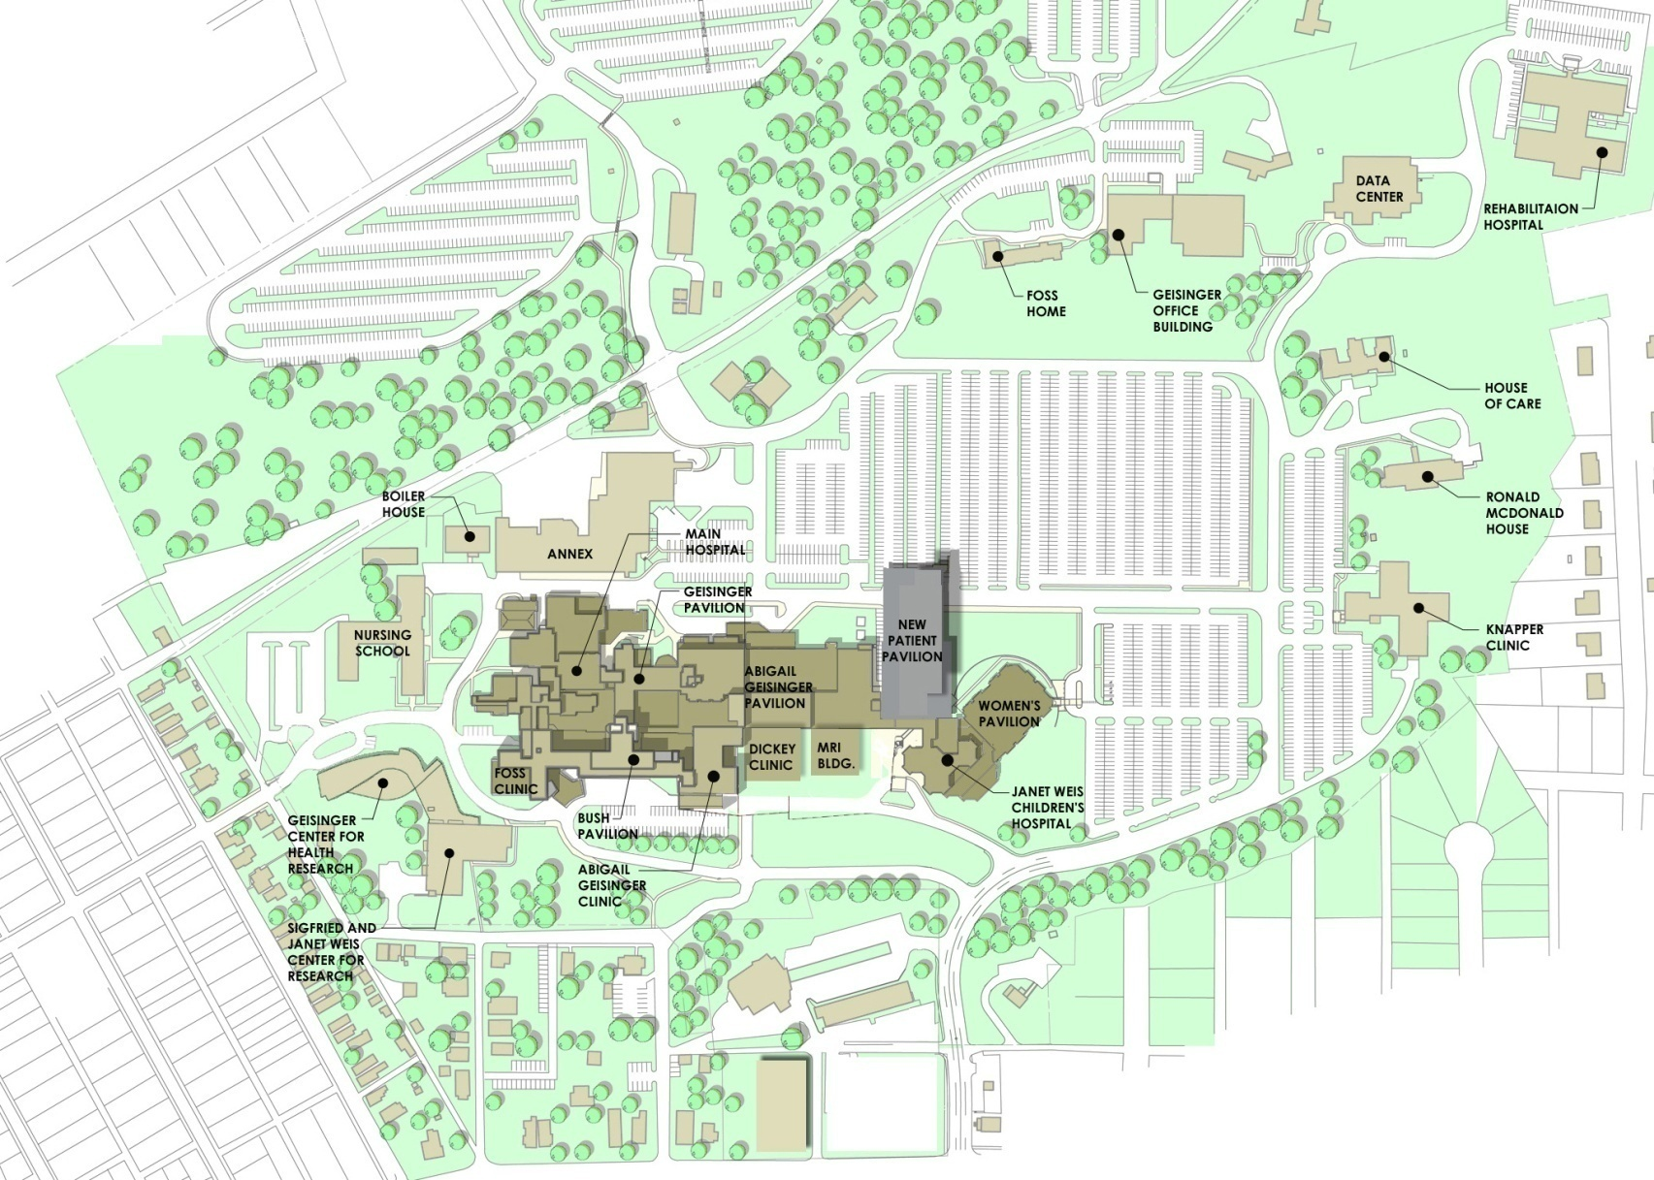
Mechanical Depth
Combined Heat and Power
  Feasibility
    Campus Design
  Geisinger Campus

Slide 27
Mechanical Depth
Combined Heat and Power
  Feasibility
    Existing on site equipment
  Geisinger
    Many of the chillers and boilers are existing
    Necessary hot water significantly decreased by DOAS
    For optimal use chiller plant would have to be converted to absorption chiller plant

Slide 28
Electrical Breadth
Dedicated Outdoor Air
  Decreases amount of power needed
    AHU motor size change
    Decreases breaker sizes

Slide 29
Electrical Breadth
Dedicated Outdoor Air System
  AHU motor size changes

Slide 30
Electrical Breadth
Dedicated Outdoor Air System
  AHU breaker size changes

Slide 31
Electrical Breadth
Combined Heat and Power
  Power lines to hospital would have to be redesigned
  Due to the distance from the boiler house this would add a significant amount of cost
  Back-up power would also have to be available

Slide 32
Architectural Breadth
Dedicated Outdoor Air System
  Slight increase of space on fourth floor
  Decreased size of mechanical penthouses

Slide 33
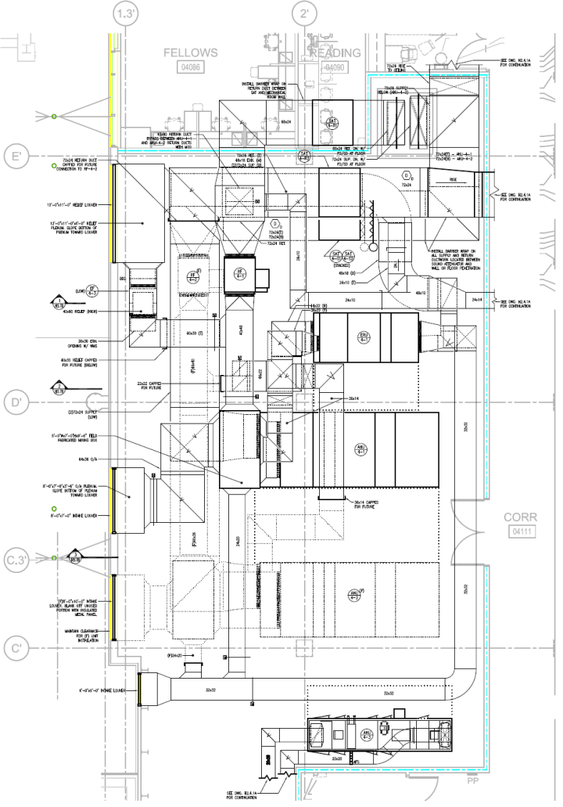
Architectural Breadth
Dedicated Outdoor Air System

Slide 34
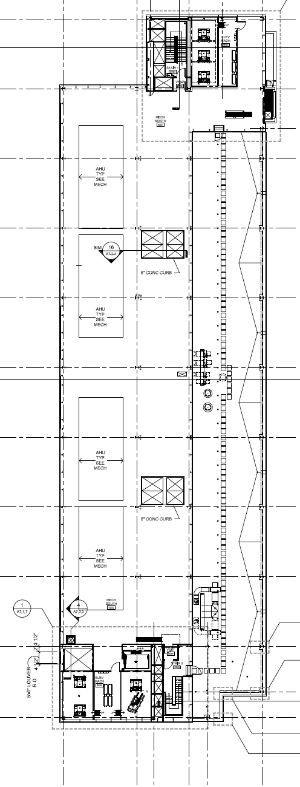
Architectural Breadth
Dedicated Outdoor Air System

Slide 35
Architectural Breadth
Combined Heat and Power
  Boiler house addition would need to be increased to provide space for gas turbines

Slide 36
Conclusions
Dedicated Outdoor Air System
  Should be implemented
  Energy Savings
  Increased Air Quality
  Increased Thermal Comfort
Combined Heat and Power
  Should not be implemented
  Cost savings would not be significant
  Difficult to integrate into existing systems

Slide 37
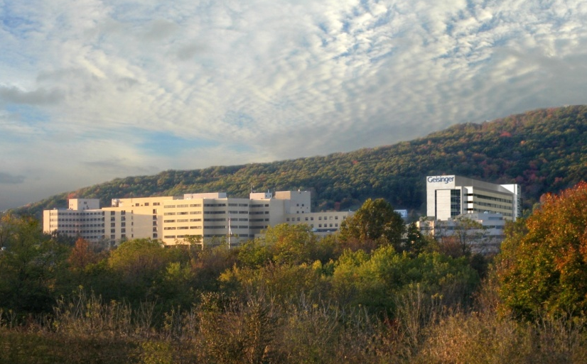
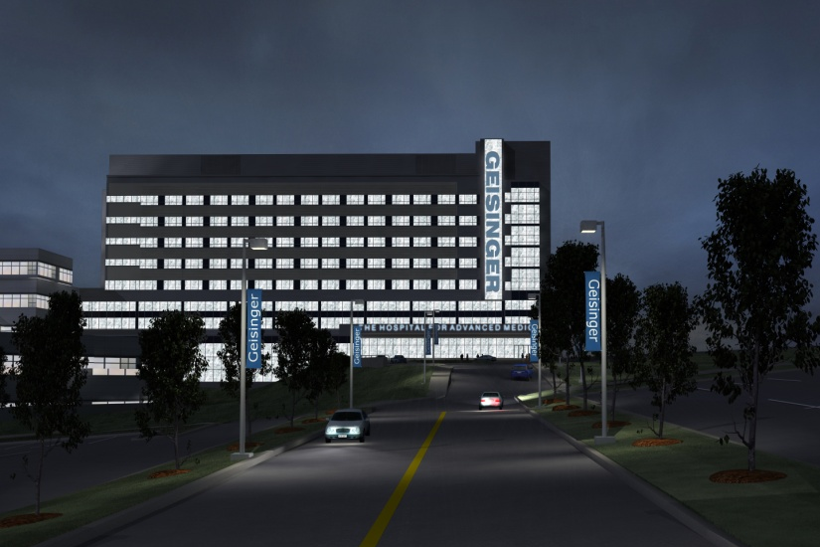
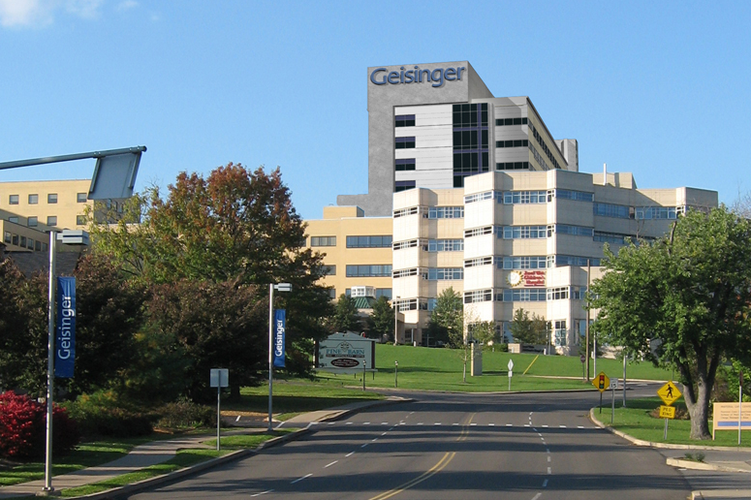
Questions?

