Slide 1
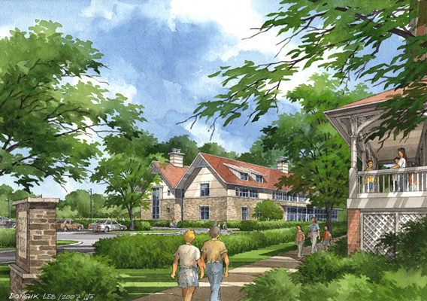
Science & Technology Center
Chestnut Hill Academy
Philadelphia, PA
Michael R. Pothering
Construction Management
Architectural Engineering
Senior Thesis 2009

Slide 2
Science & Technology Center
Chestnut Hill Academy
Presentation Outline
Project Overview
Analysis 1: Exterior Façade Redesign
Analysis 2: Solar Redesign
BIM Implementation
Conclusions
Questions

Slide 3
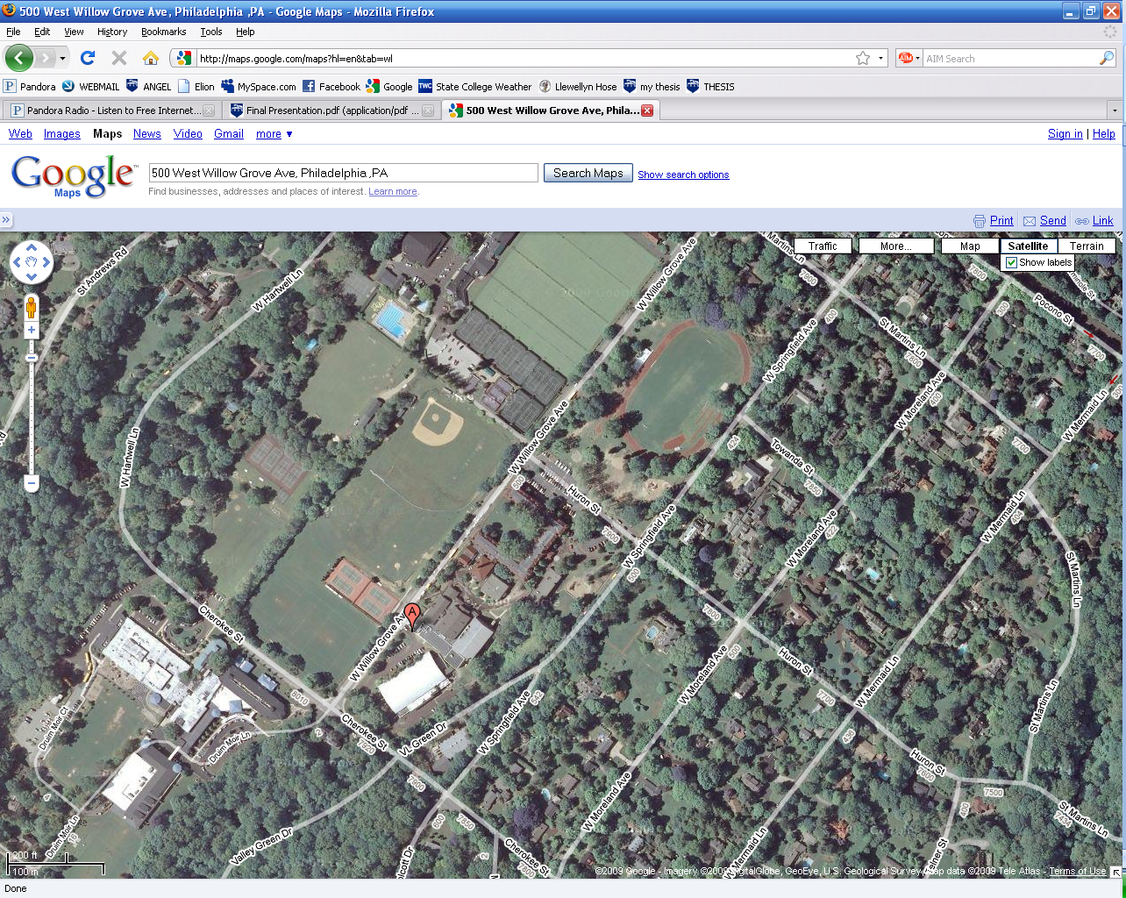
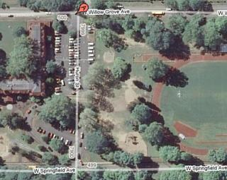

Science & Technology Center
Chestnut Hill Academy
Project Overview
Analysis 1: Exterior Façade Redesign
Analysis 2: Solar Redesign
BIM Implementation
Conclusions
Questions
Client Information
  Chestnut Hill Academy was established in 1861
  Located in Philadelphia, PA
  K-12 Boys College Preparatory School
  Enrolls approximately 600 students
Project Team
  GC - Turner Construction
  Architect – Lilley.Dadagian
  Owners Rep. – Aegis Property Group
  Structural Eng. – Roome & Guarracino
  Civil Eng. – Cairone & Kaupp, Inc.
  MEP Eng. – Bruce E. Brooks & Assoc.

Slide 4
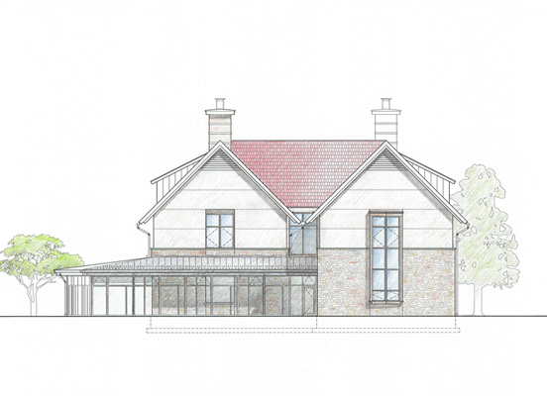
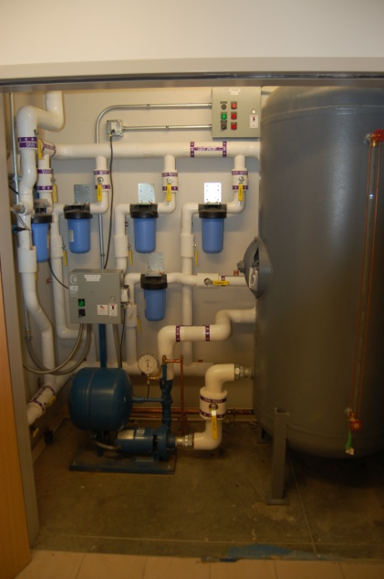
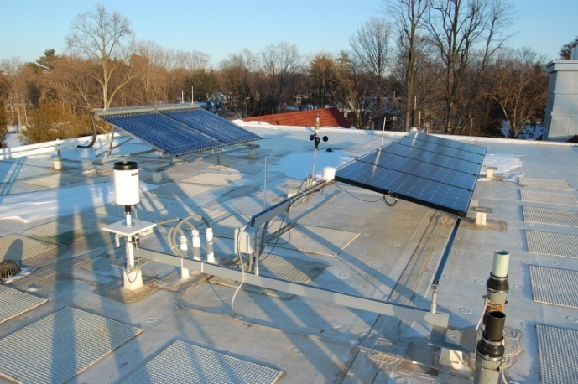
Science & Technology Center
Chestnut Hill Academy
Project Overview
Analysis 1: Exterior Façade Redesign
Analysis 2: Solar Redesign
BIM Implementation
Conclusions
Questions
Science & Technology Center:
  2.5 stories with ½ story mechanical attic
  26,870 SF
  LEED Silver Certified
  Classrooms
  Science Laboratories
  Faculty Offices
Sustainable Design
  PV panels
  Thermal Heat Conductors
  Wind Turbine
  Greywater System
    Raingardens
    Permeable Parking Lot
  Tree Arboretum

Slide 5
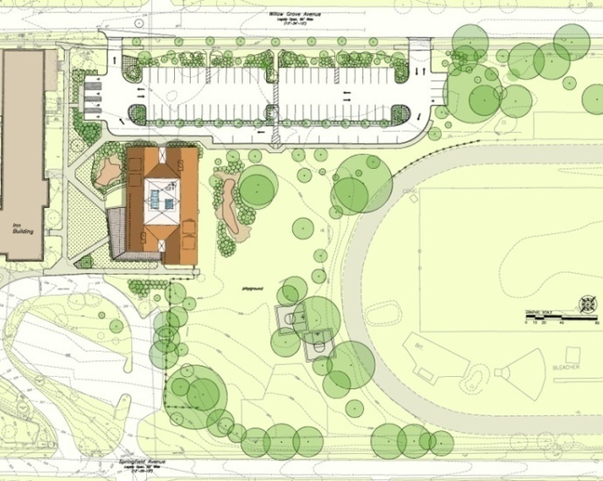
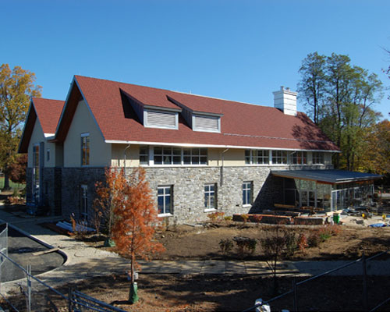
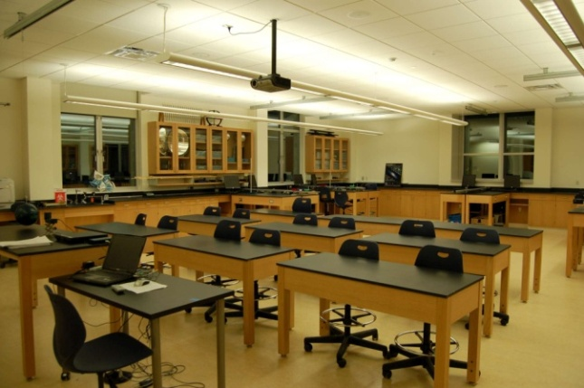
Science & Technology Center
Chestnut Hill Academy
Project Overview
Analysis 1: Exterior Façade Redesign
Analysis 2: Solar Redesign
BIM Implementation
Conclusions
Questions
Project Cost:
  $9,600,000
Building System Cost | Total | SF
Concrete | $ 424,600 | $ 15.80
Steel | $ 744,600 | $ 27.71
Drywall | $ 713,000 | $ 26.54
HVAC and Plumbing | $ 1,543,700 | $ 57.45
Electrical | $ 866,800 | $ 32.26
Fire Protection | $ 109,300 | $ 4.07
Roofing | $ 550,700 | $ 20.49
Masonry | $ 634,900 | $ 23.63
Glass, Glazing, Curtain wall | $ 450,800 | $ 16.78
Construction Information:
  Start Date: November 2007
  12 Month Construction Schedule
  Structural steel frame
  Stucco and Stone veneer

Slide 6
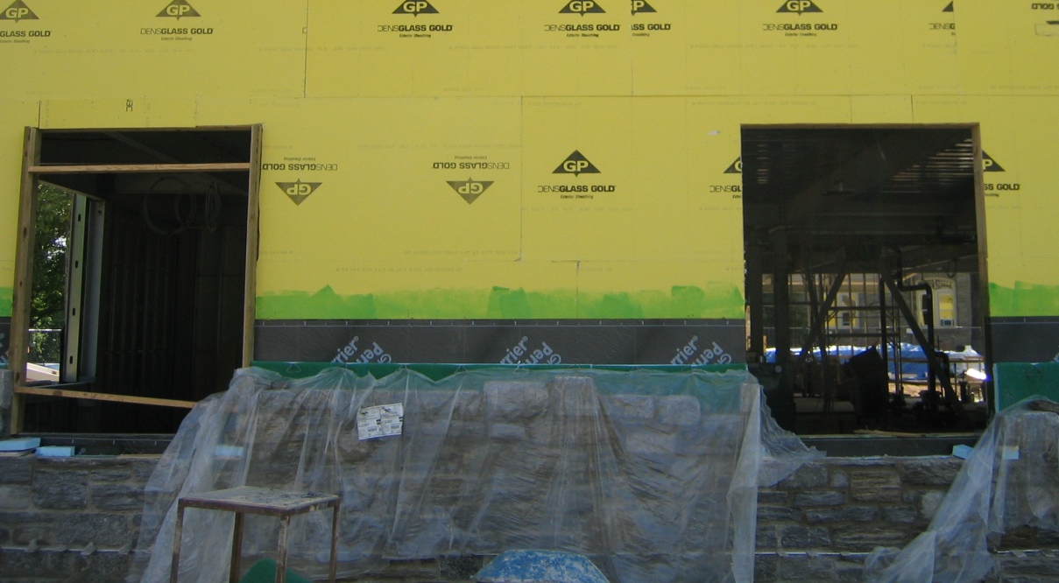
Science & Technology Center
Chestnut Hill Academy
Exterior Façade Veneer Redesign
Problem & Goal
Project Overview
Analysis 1: Exterior Façade Redesign
Analysis 2: Solar Redesign
BIM Implementation
Conclusions
Questions
Natural Fieldstone
Masonry Veneer
Problem:
  Long construction time. Material Costs, delay’s other schedule activities
Goal:
  Speed up construction schedule and decrease material price
  Maintain envelope requirements

Slide 7
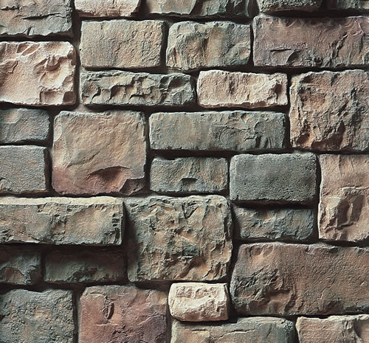
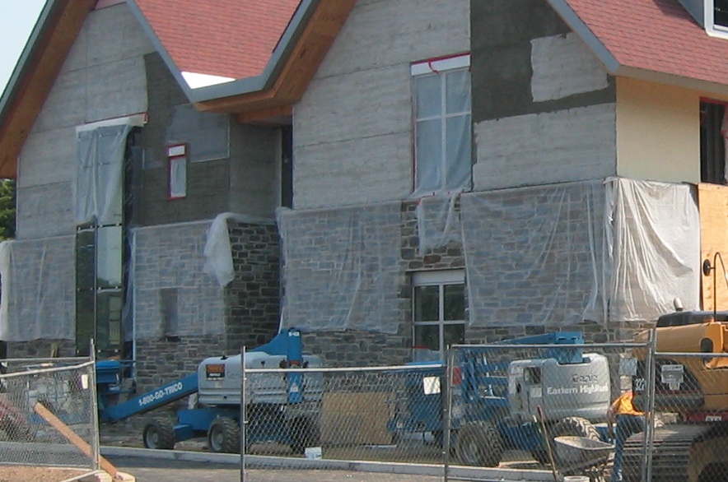

Science & Technology Center
Chestnut Hill Academy
Existing Natural Stone- Material
Precast Stone- Material
Project Overview
Analysis 1: Exterior Façade Redesign
Analysis 2: Solar Redesign
BIM Implementation
Conclusions
Questions
Natural Field Stone Veneer
  Thickness – 4”-6”
  Weight – 60 lb/ft²
Cultured Stone Veneer
Manufactured by Owens Corning
    Thickness – 1” – 2 5/8”
    Weight – 15 lb/ft²

Slide 8
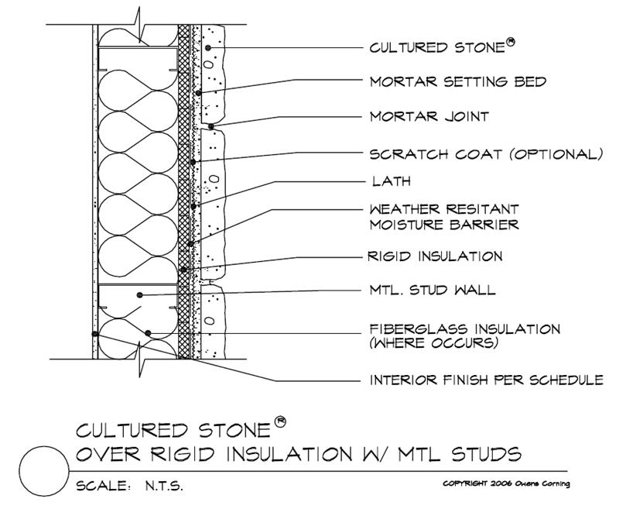
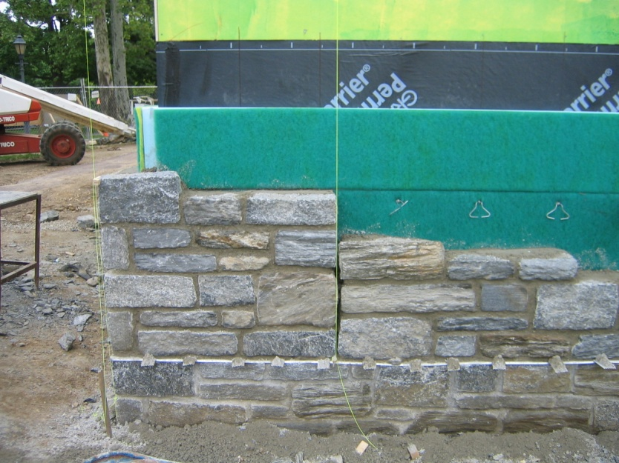
Science & Technology Center
Chestnut Hill Academy
Existing Natural Stone- Material
Precast Stone- Material
Project Overview
Analysis 1: Exterior Façade Redesign
Analysis 2: Solar Redesign
BIM Implementation
Conclusions
Questions

Slide 9
Science & Technology Center
Chestnut Hill Academy
Natural Stone Cost
Precast Stone Cost
Project Overview
Analysis 1: Exterior Façade Redesign
Analysis 2: Solar Redesign
BIM Implementation
Conclusions
Questions
Natural Fieldstone
Masonry Veneer
Precast Thin Stone Veneer Cultured Stone®
Exterior Façade Material | Material | Labor
Natural Stone Veneer
 | $126,564 | $97,557
 | TOTAL | $224,119
Exterior Façade Material | Material | Labor
Cultured Stone®
 | $36,506 | $85,165
 | TOTAL | $121,670
 | Saving’s | -$102,450
 | % Saving | 54.6%

Slide 10

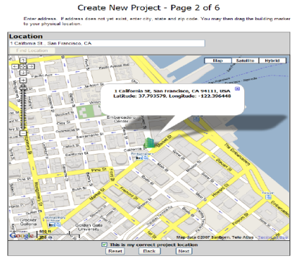
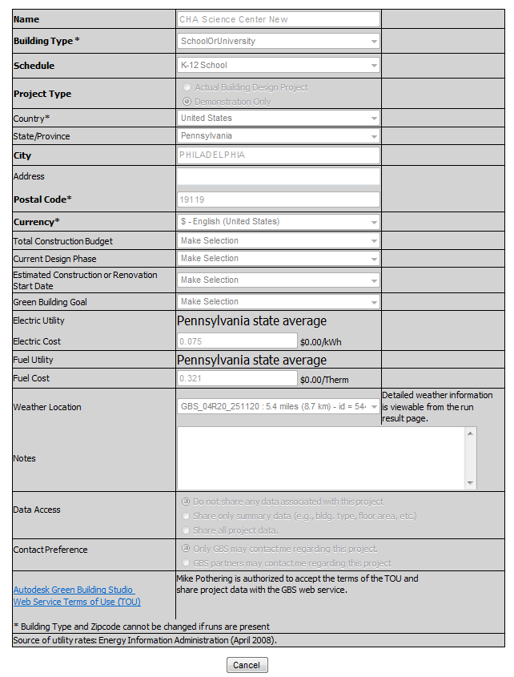
Science & Technology Center
Chestnut Hill Academy
Thermal Load Analysis - Mechanical Breadth
Green Building Design Studio
Project Overview
Analysis 1: Exterior Façade Redesign
Analysis 2: Solar Redesign
BIM Implementation
Conclusions
Questions
Green Building Design Studio
  Incorporates building location, size, function, and design into calculations
  Utilizes actual wall material thicknesses to calculate energy load
  Considers room volumes and window sizes for heating and cooling loads
Process:
  Utilize 3D Revit designed model
  Export to GBDS
  Enter project information ( location, type, energy rates)
  Add special system considerations
  I.E. Occupancy/Daylight sensors
  Adjust specific project equipment (HVAC)
  Run analysis program

Slide 11
Science & Technology Center
Chestnut Hill Academy
Green Building Design Output
General Information
Project Overview
Analysis 1: Exterior Façade Redesign
Analysis 2: Solar Redesign
BIM Implementation
Conclusions
Questions
General Information
Project Title: CHA Science Center New
Template Title: CHA Science Center New
(Last updated on: 3/27/2009 4:12:00 AM)
Run Title: thin wall
Building Type: School or University
Floor Area: 23,272 ft²
                Location Information
                Building: PHILADELPHIA, PA 19119
                Electric Cost: $0.08/kWh
                Fuel Cost: $0.32/Therm
                Weather: GBS_04R20_251120

Slide 12


Science & Technology Center
Chestnut Hill Academy
Green Building Design Output
General Information
Green Building Design Output
Existing Façade System
Proposed Facade System
Project Overview
Analysis 1: Exterior Façade Redesign
Analysis 2: Solar Redesign
BIM Implementation
Conclusions
Questions
General Information
Project Title: CHA Science Center New
Template Title: CHA Science Center New
(Last updated on: 3/27/2009 4:12:00 AM)
Run Title: thin wall
Building Type: School or University
Floor Area: 23,272 ft²
                Location Information
                Building: PHILADELPHIA, PA 19119
                Electric Cost: $0.08/kWh
                Fuel Cost: $0.32/Therm
                Weather: GBS_04R20_251120
Estimated Energy & Cost Summary
Annual Energy Cost | $19,996
Lifecycle* Cost | $272,346
Annual CO₂ Emissions
Electric† | 124.6 | tons
Onsite Fuel | 67.9 | tons
Large SUV Equivalent | 17.5 | Large SUV's
Annual Energy
Electric | 216,543 | kWh
Fuel | 11,699 | Therms
Annual Peak Electric Demand | 133.0 | kW
Lifecycle* Energy
Electric | 6,496,296 | kWh
Fuel | 350,964 | Therms
* 30 -year life and 6.1 % discount rate for costs. † Does not include electric transmission losses or the renewable and natural ventilation potential.
Estimated Energy & Cost Summary
Annual Energy Cost | $19,950
Lifecycle* Cost | $271,719
Annual CO₂ Emissions
Electric† | 124.3 | tons
Onsite Fuel | 67.7 | tons
Large SUV Equivalent | 17.5 | Large SUV's
Annual Energy
Electric | 216,010 | kWh
Fuel | 11,680 | Therms
Annual Peak Electric Demand | 132.8 | kW
Lifecycle* Energy
Electric | 6,480,297 | kWh
Fuel | 350,397 | Therms
* 30 -year life and 6.1 % discount rate for costs. † Does not include electric transmission losses or the renewable and natural ventilation potential.
Natural Stone

Slide 13
Science & Technology Center
Chestnut Hill Academy
Natural Stone R-Value Calculations
Precast Stone R-Value Calculations
Project Overview
Analysis 1: Exterior Façade Redesign
Analysis 2: Solar Redesign
BIM Implementation
Conclusions
Questions
Natural Stone Veneer | Item | Thickness | R-Value | Total R-Value
Wall System
 | Outside Air Film | - | 0.17 | 0.17
 | Stone Masonry | 6” | 0.08 | 0.48
 | Airspace | 0.5” | 1 | 0.5
 | Rigid insulation | 2.5” | 5 | 12.5
 | Vapor barrier | 40mm | - | -
 | Dens-Glass | 0.5” | 0.56 | 0.28
 | Metal Stud Space | 6” | 1 | 6
 | Drywall | 5/8" | - | 0.56
 | Inside Air Film | - | 0.68 | 0.68
 |  |  | Total R-Value | 21.17 | hr-sf-Fº/BTU
 |  |  | U-Value | 0.0472 | BTU/hr-sf-Fº
Cultured Stone Veneer | Item | Thickness | R-Value | Total R-Value
Wall System
 | Outside Air Film | - | 0.17 | 0.17
 | Stone Masonry | 1.75” | - | 0.62
 | Rigid insulation | 2.5” | 5 | 12.5
 | Vapor barrier | 40mm | - | -
 | Dens-Glass | 0.5” | 0.56 | 0.28
 | Metal Stud Space | 6” | 1 | 6
 | Drywall | 5/8" | - | 0.56
 | Inside Air Film | - | 0.68 | 0.68
 |  |  | Total R-Value | 21.31 | hr-sf-Fº/BTU
 |  |  | U-Value | 0.0469 | BTU/hr-sf-Fº
Natural Stone

Slide 14
Science & Technology Center
Chestnut Hill Academy
Exterior Wall
Heat Loss Calculations
Exterior Wall
Heat Gain Calculations
Project Overview
Analysis 1: Exterior Façade Redesign
Analysis 2: Solar Redesign
BIM Implementation
Conclusions
Questions
Winter Temperatures | ºF
To (outside) | 25.5
Ti (inside) | 71
ΔT | 45.5
Summer Temperatures | ºF
To (outside) | 85.5
Ti (inside) | 71
ΔT | 14.5
Estimated Heat Loss (winter) | U-Value (BTU/hr-sf-Fº) | Area (SF) | ΔT ( ºF) | Heat Loss (BTU/hr)
Natural Stone | 0.0472 | 4890 | 45.5 | 10501.76
Cultured Stone | 0.0469 | 4890 | 45.5 | 10435.02
Estimated Heat Gain (summer) | U-Value (BTU/hr-sf-Fº) | Area (SF) | ΔT ( ºF ) | Heat Gain (BTU/hr) | Heat-Gain (tons)
Natural Stone | 0.0472 | 4890 | 14.5 | 3346.72 | 0.279
Cultured Stone | 0.0469 | 4890 | 14.5 | 3325.44 | 0.277

Slide 15

Science & Technology Center
Chestnut Hill Academy
Façade Redesign
Recommendations
Project Overview
Analysis 1: Exterior Façade Redesign
Analysis 2: Solar Redesign
BIM Implementation
Conclusions
Questions
Advantages of Cultured Stone Veneer
Cost savings of 54.6% approx. $102,000
Schedule acceleration of approx. 6 weeks
Less Site Congestion
50 year warranty

Slide 16

Science & Technology Center
Chestnut Hill Academy
Solar Energy System Redesign
Problem & Goal
Project Overview
Analysis 1: Exterior Façade Redesign
Analysis 2: Solar Redesign
BIM Implementation
Conclusions
Questions
Problem Statement:
Small 1kW capacity
Invisible to public eye
Goal:
Redesign the solar system to utilize Building Integrated Photovoltaic’s (BIPV)
Integrate BIPV into Southern exposed roof allowing the shingles to be visible to public, staff, and students
Utilize more solar energy to offset energy consumption

Slide 17
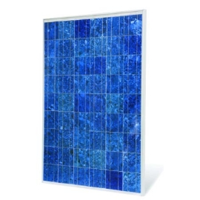
Science & Technology Center
Chestnut Hill Academy
Existing Panel System
Proposed BIPV Roofing System
Project Overview
Analysis 1: Exterior Façade Redesign
Analysis 2: Solar Redesign
BIM Implementation
Conclusions
Questions
GEPV-200-M Panel by General Electric
Product Description
    Peak power of 200 W of energy produced per panel
Bracket Mounted above roof
Grid tied system
SUNSLATES by Atlantis Energy Systems
Product Description
    Peak power of 12.2 W of energy produced
    per slate
Mounted directly to roofing substrate and used as building envelope
Aesthetically pleasing
Grid tied system

Slide 18
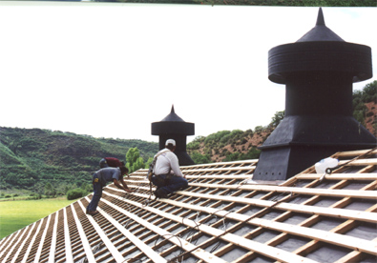
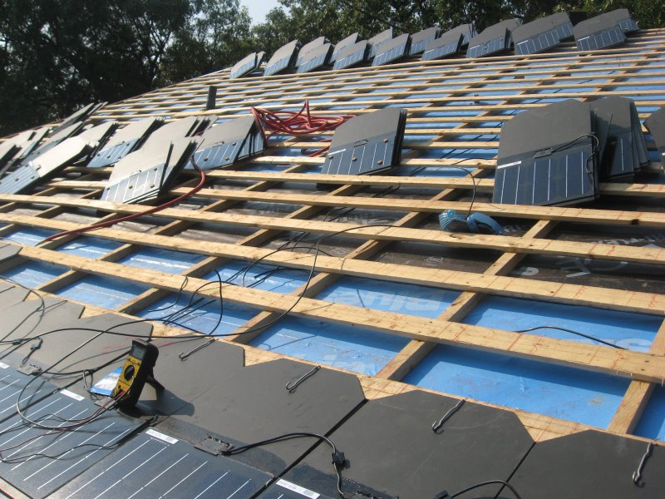
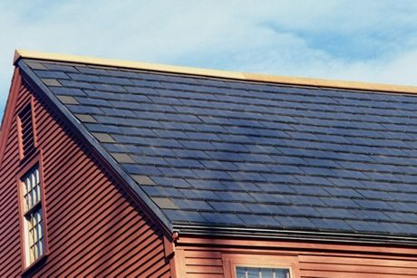
Science & Technology Center
Chestnut Hill Academy
Installation Process
Project Overview
Analysis 1: Exterior Façade Redesign
Analysis 2: Solar Redesign
BIM Implementation
Conclusions
Questions
Installation Process:
  SUNSLATESs are mounted on a 1x4 nailers resting on 2x2 sleepers which form a grid anchored to roof deck
  Slates are then attached to the wood battens with storm anchor hooks
  Each tile is then attached to the adjacent tiles by the connecting wires
  At the end of each course a home run is ran to a splice box under the roof
  deck which is then ran to the inverter.

Slide 19
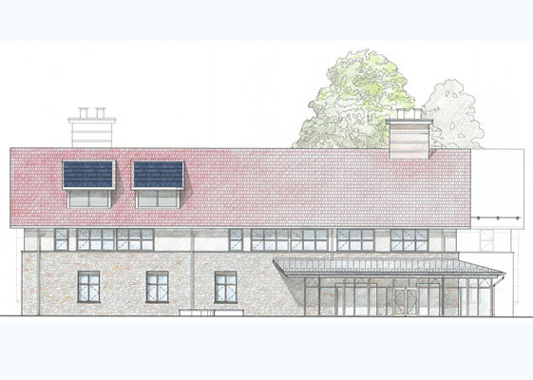
Science & Technology Center
Chestnut Hill Academy
SUNSLATE Energy Calculations
SUNSLATE Cost – Savings – Payback Period
Project Overview
Analysis 1: Exterior Façade Redesign
Analysis 2: Solar Redesign
BIM Implementation
Conclusions
Questions
Small Area System:
# of slates:
231
cost per slate:
12.2W * $15/W
= $183/slate
Total Cost of Shingle’s:
231 shingles * $183/slate
= $42,273
Small Area Savings:
Savings Per Year
12,529kWh/year * $0.0753/ kWh
= $943 / year
Payback Period
$42,273 ÷ $943/year
= 44.8 years
Small Area Design
Calculated Energy Production for Small Areas of SUNSLATES
# of Slates | 231
Watts/slate | 12.2
Month | Jan | Feb | Mar | Apr | May | Jun | Jul | Aug | Sep | Oct | Nov | Dec
Days/month | 31 | 28 | 31 | 30 | 31 | 30 | 31 | 31 | 30 | 31 | 30 | 31
kWh/day | 27.28 | 30.15 | 33.54 | 37.20 | 40.30 | 41.99 | 41.43 | 38.61 | 35.23 | 31.28 | 28.18 | 26.49
kWh/month | 845.69 | 844.33 | 1,039.63 | 1,116.01 | 1,249.31 | 1,259.74 | 1,284.25 | 1,196.89 | 1,056.83 | 969.74 | 845.46 | 821.22
kWh/Year | 12,529.10

Slide 20
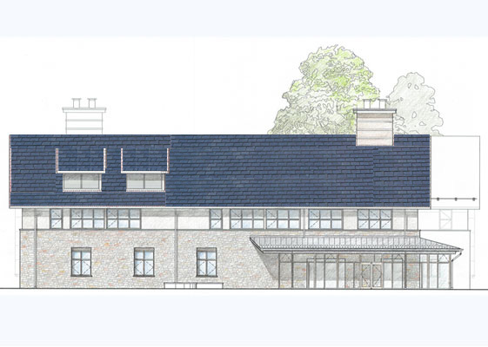
Science & Technology Center
Chestnut Hill Academy
SUNSLATE Energy Calculations
SUNSLATE Cost – Savings – Payback Period
Project Overview
Analysis 1: Exterior Façade Redesign
Analysis 2: Solar Redesign
BIM Implementation
Conclusions
Questions
Entire Roof Area System:
# of shingles:
2365
cost per shingle:
12.2W * $15/W
= $183/shingle
Total Cost of Shingle’s:
2365 shingles * $183/ shingle
= $432,795
Entire Roof Savings:
Savings Per Year
128,274 kWh/year * $0.0753/ kWh
= $9,659 / year
Pay back Period
$432,795 ÷ $9,659/ year
= 44.8 years
Entire Roof Design
Calculated Energy Production for Entire Roof of SUNSLATES
# of Slates | 2365
Watts/slate | 12.20
Month | Jan | Feb | Mar | Apr | May | Jun | Jul | Aug | Sep | Oct | Nov | Dec
Days/month | 31 | 28 | 31 | 30 | 31 | 30 | 31 | 31 | 30 | 31 | 30 | 31
kWh/Day | 279.30 | 308.73 | 343.35 | 380.86 | 412.60 | 429.91 | 424.14 | 395.29 | 360.66 | 320.27 | 288.53 | 271.22
kWh/Month | 8,658.21 | 8,644.36 | 10,643.87 | 11,425.79 | 12,790.53 | 12,897.29 | 13,148.31 | 12,253.87 | 10,819.88 | 9,928.32 | 8,655.90 | 8,407.76
kWh/yr | 128,274.09

Slide 21

Science & Technology Center
Chestnut Hill Academy
Existing Energy Calculations
Existing Cost – Savings – Payback Period
Project Overview
Analysis 1: Exterior Façade Redesign
Analysis 2: Solar Redesign
BIM Implementation
Conclusions
Questions
Existing System:
# of panels:
5
cost per panel:
$1235.29/panel
Total Cost of Panel’s:
5 panels * $1,235.29
= $6,176
Existing Panel’s Savings:
Savings Per Year
4,445.78kWh/year * $0.0753/ kWh
= $335 / year
Payback Period
$6,176÷ $335/year
= 18.4 years
Existing Solar Panel Design
Calculated Energy Production for Existing GE Solar Panels
# of Panels | 5
Watts/panel | 200
Month | Jan | Feb | Mar | Apr | May | Jun | Jul | Aug | Sep | Oct | Nov | Dec
Days/month | 31 | 28 | 31 | 30 | 31 | 30 | 31 | 31 | 30 | 31 | 30 | 31
kWh/Day | 9.68 | 10.70 | 11.90 | 13.20 | 14.30 | 14.90 | 14.70 | 13.70 | 12.50 | 11.10 | 10.00 | 9.40
kWh/Month | 300.08 | 299.60 | 368.90 | 396.00 | 443.30 | 447.00 | 455.70 | 424.70 | 375.00 | 344.10 | 300.00 | 291.40
kWh/yr | 4,445.78

Slide 22
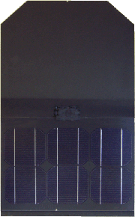

Science & Technology Center
Chestnut Hill Academy
Summary
Recommendations
Project Overview
Analysis 1: Exterior Façade Redesign
Analysis 2: Solar Redesign
BIM Implementation
Conclusions
Questions
 | kWh/yr | Cost Savings / yr | System Cost | Payback Period
Existing | 4,445.78 | $335 | $6,176 | 18.4 years
Small Area | 12,529 | $943 | $42,273 | 44.8 years
Entire Roof | 128,274 | $9,659 | $432,795 | 44.8 years
Proposed system is extremely costly, Inefficient , and has potential delays
Small Area system has high initial cost but can be feasible with energy grants
Entire Roof system is unfeasible due to extreme initial investment
Existing system is cheapest , fastest, and has an easy installation

Slide 23
Science & Technology Center
Chestnut Hill Academy
Building Information Modeling
Problem & Goal
Project Overview
Analysis 1: Exterior Façade Redesign
Analysis 2: Solar Redesign
BIM Implementation
Conclusions
Questions
Problem:
The Science & Technology Center did not fully use BIM, which could have been an extremely valuable asset to the project.
Goal:
  Identify the benefits of BIM on projects
  Develop an understanding of the basic process used to create things such as the 3D and 4D models
  Gain an understand of why it was not used on the project
BIM
3D Visual
4D Planning
Project Team Unity
Problem Mitigation

Slide 24
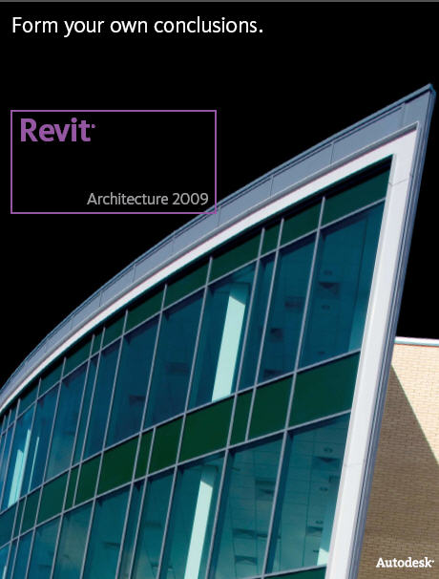


Science & Technology Center
Chestnut Hill Academy
BIM Process
BIM Software
Project Overview
Analysis 1: Exterior Façade Redesign
Analysis 2: Solar Redesign
BIM Implementation
Conclusions
Questions
Typical process for implementing BIM
  Contact a design service which creates BIM models & explain the project
  Send the design firm drawings/designs to allow them to become familiar with the project design and layout
  Design firm will contact architect/engineers for clarifications
  Once clarifications are received the design firm will develop a quote
  Once the agreement is reached the design firm will begin creation of preliminary models/drawings
  Preliminary models/drawings are sent to owner for approval
  Once approved the models/drawings will be finalized and given one last check for Quality and Consistency
The following software titles were used to gain the understanding of the creation of the BIM 3D & 4D models

Slide 25
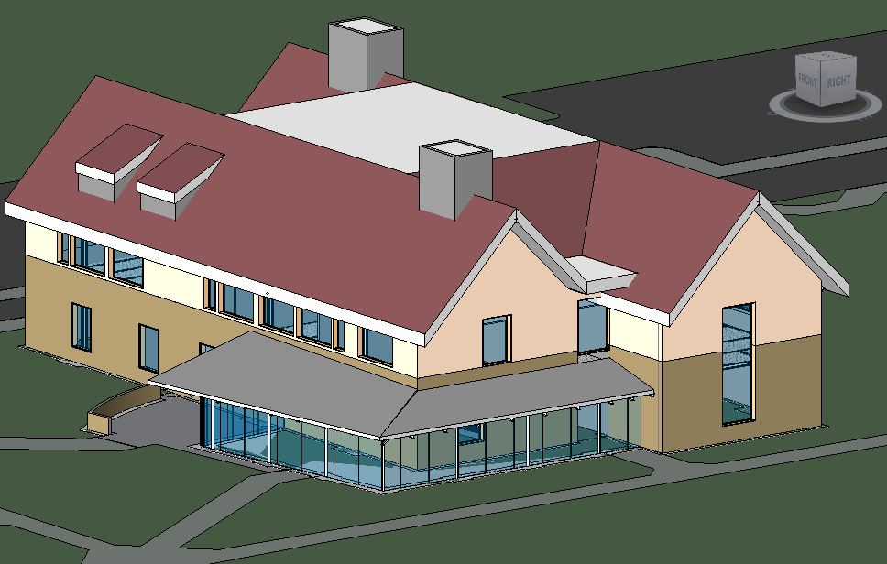
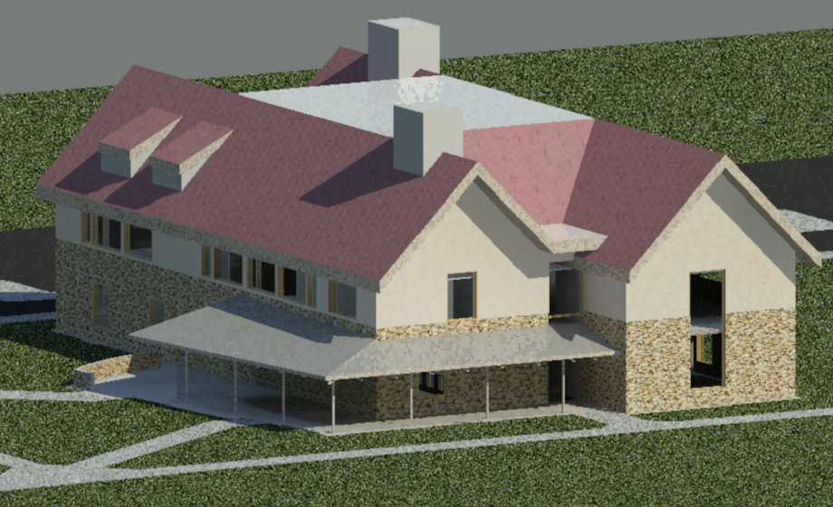
Science & Technology Center
Chestnut Hill Academy
3D Model Design
Revit Output
Project Overview
Analysis 1: Exterior Façade Redesign
Analysis 2: Solar Redesign
BIM Implementation
Conclusions
Questions
3D Model Benefits
  Visualization
  Express Changes
  Work Flow Management
  Construction Clarification
  Phasing
Important Considerations
  In-depth understanding of CD’s
  Attention to detail
  The more accurate your measurements
  results in a better quality model
  3D model will later impact quality
  of the 4Dmodel

Slide 26

Science & Technology Center
Chestnut Hill Academy
4D Model Design
NavisWorks 4D Model
Project Overview
Analysis 1: Exterior Façade Redesign
Analysis 2: Solar Redesign
BIM Implementation
Conclusions
Questions
4D Model Benefits
  Adds time dimension to 3D
  Visualize time constraints
  Sequencing and Phasing
  Contractor Flow
  Improved Schedule Efficiency
Important Considerations
  Time consuming attaching each individual member to a schedule task
  Detailed project schedule allows for a more accurate 4D model
  Ensure 3D Model is 100% finalize before beginning 4D model

Slide 27
Science & Technology Center
Chestnut Hill Academy
Project Team – BIM Survey Results
Project Team – BIM Survey Results
Project Overview
Analysis 1: Exterior Façade Redesign
Analysis 2: Solar Redesign
BIM Implementation
Conclusions
Questions
Architect Interview Results:
Utilized 3D model with Rhino software for massing issues
Small Architecture firm which cannot afford BIM software and training
Would later adopt BIM technology once the technology has
the “bugs” worked out
Believed that use full use of BIM would not have been warranted
for a project of this scale. Would be better used on more complex projects
Project Manager Interview Results:
Limited training with BIM technology
Believes it would aid with trade coordination and minimize confusion
Steel erecters utilized 3D model for steel erection from StruWalker software
Cost savings from BIM on a project of this size would not be worth the cost of training and model production

Slide 28
Science & Technology Center
Chestnut Hill Academy
Recommendation
Project Overview
Analysis 1: Exterior Façade Redesign
Analysis 2: Solar Redesign
BIM Implementation
Conclusions
Questions
BIM Implementation
The use of this technology could benefit the project in numerous ways, but due to the lack of training and budget of the project team. It is better left at the current amount.

Slide 29
Science & Technology Center
Chestnut Hill Academy
Conclusions
Project Overview
Analysis 1: Exterior Façade Redesign
Analysis 2: Solar Redesign
BIM Implementation
Conclusions
Questions
Exterior Façade Redesign
  Cost and Schedule reduced
  Thermal& Mechanical was not impacted
Solar Energy System Redesign
  Proposed system is very expensive with a long payback period
  Installation of proposed system is labor intensive
  Schedule delay due to intensive labor
  Existing system is a better fit for the project
BIM Implementation
  BIM Technology has potential to improve any project but comes at a cost
  Industry members are aware of BIM but lack training or budget to implement

Slide 30
Science & Technology Center
Chestnut Hill Academy
Acknowledgements
Project Overview
Analysis 1: Exterior Façade Redesign
Analysis 2: Solar Redesign
BIM Implementation
Conclusions
Questions
Questions
Turner Construction Company
Chestnut Hill Academy
Penn State AE Faculty and Staff
My family and friends for their continued support

