Slide 1
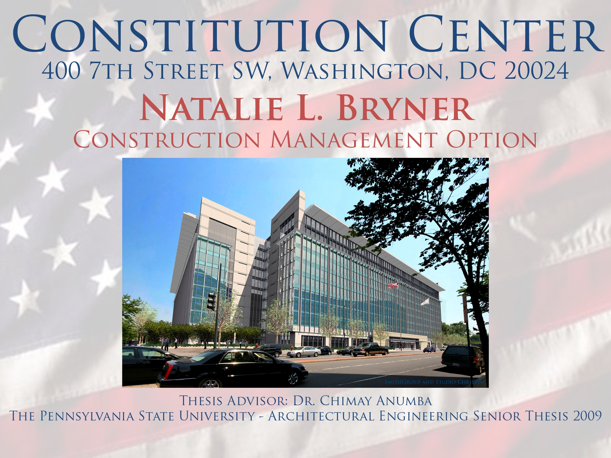

Slide 2

Presentation Outline
Project Overview
Chilled Beams & Commissioning
  Mechanical Breadth
Parking Garage Waffle Slab
  Structural Breadth
Curtain Wall Installation
  MAE Graduate Level Component
Summary
Questions and Acknowledgements
Natalie Bryner Constitution Center
Construction Management Option 400 7th Street SE, Washington, DC 20024

Slide 3
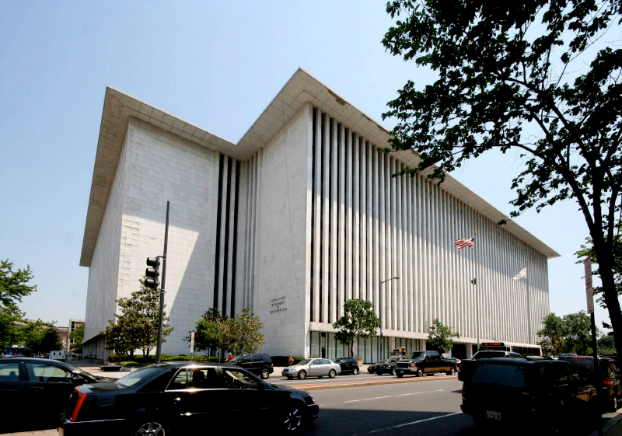
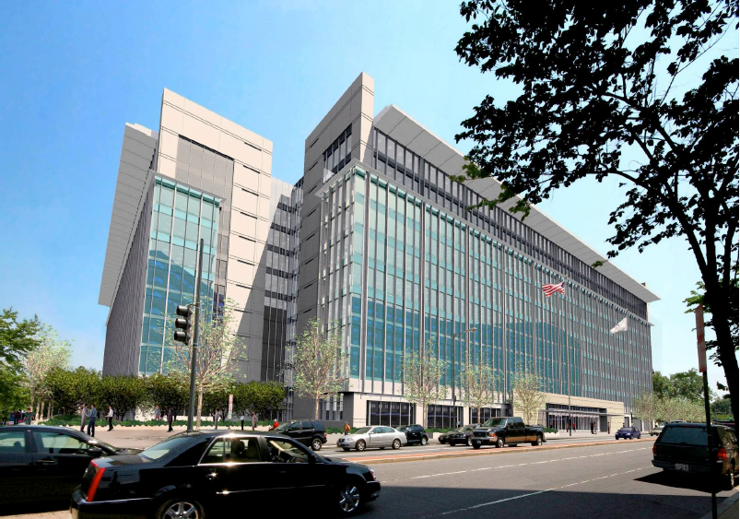
History
Presentation Outline
Project Overview
Chilled Beams & Commissioning
  Mechanical Breadth
Parking Garage Waffle Slab
  Structural Breadth
Curtain Wall Installation
  MAE Graduate Level Component
Summary
Questions and Acknowledgements
Renovation of an existing building
Originally constructed in 1976
Formerly occupied by the Department of Transportation
Operated and leased by David Nassif Associates
Natalie Bryner Constitution Center
Construction Management Option 400 7th Street SE, Washington, DC 20024

Slide 4
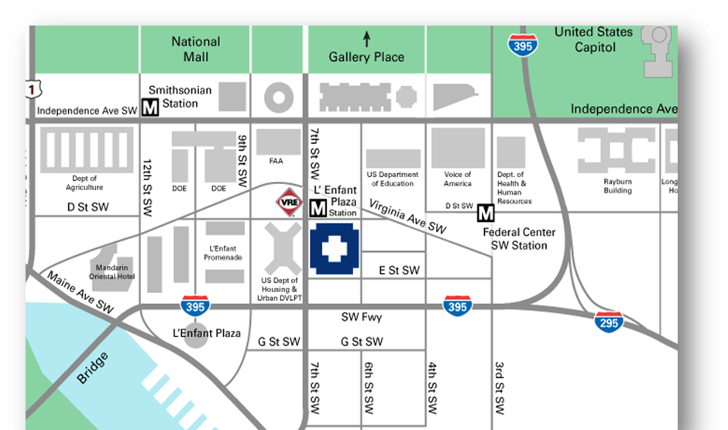
Location
Presentation Outline
Location
Project Overview
Chilled Beams & Commissioning
  Mechanical Breadth
Parking Garage Waffle Slab
  Structural Breadth
Curtain Wall Installation
  MAE Graduate Level Component
Summary
Questions and Acknowledgements
Located a few blocks south of the National Mall and the United State Capital
Between 6th and 7th Street and D and E Street in SW DC
Natalie Bryner Constitution Center
Construction Management Option 400 7th Street SE, Washington, DC 20024

Slide 5
Project Overview
Project Team
Project Overview
Chilled Beams & Commissioning
  Mechanical Breadth
Parking Garage Waffle Slab
  Structural Breadth
Curtain Wall Installation
  MAE Graduate Level Component
Summary
Questions and Acknowledgements
Size: 1,500,000SF base building and 6,000SF parking garage
Number of Stories: Three-level underground parking garage, 10 stories, plus a Pent House
Cost: $246 Million GMP
Construction Dates: July 2007 – November 2009
Security Rating: Level IV
LEED Rating: Gold Project
Owner
David Nassif Associates
Lump Sum
Lump Sum
GMP
Architect/MEP Engineer
SmithGroup, Inc.
Owners Representative
Kramer Consulting
General Contractor
James G. Davis Construction Corp.
Lump Sum
Lump Sum
Lump
Sum
Civil Engineer
Wiles Mensch Corp.
Structural Engineer
SK&A
Unit
Rate
Subcontractors
Not Listed
Abatement Subcontractor
Aceco, Inc.

Slide 6
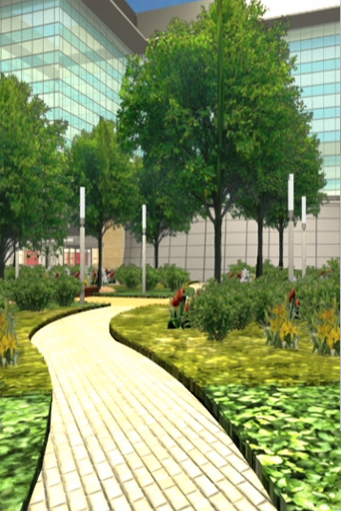
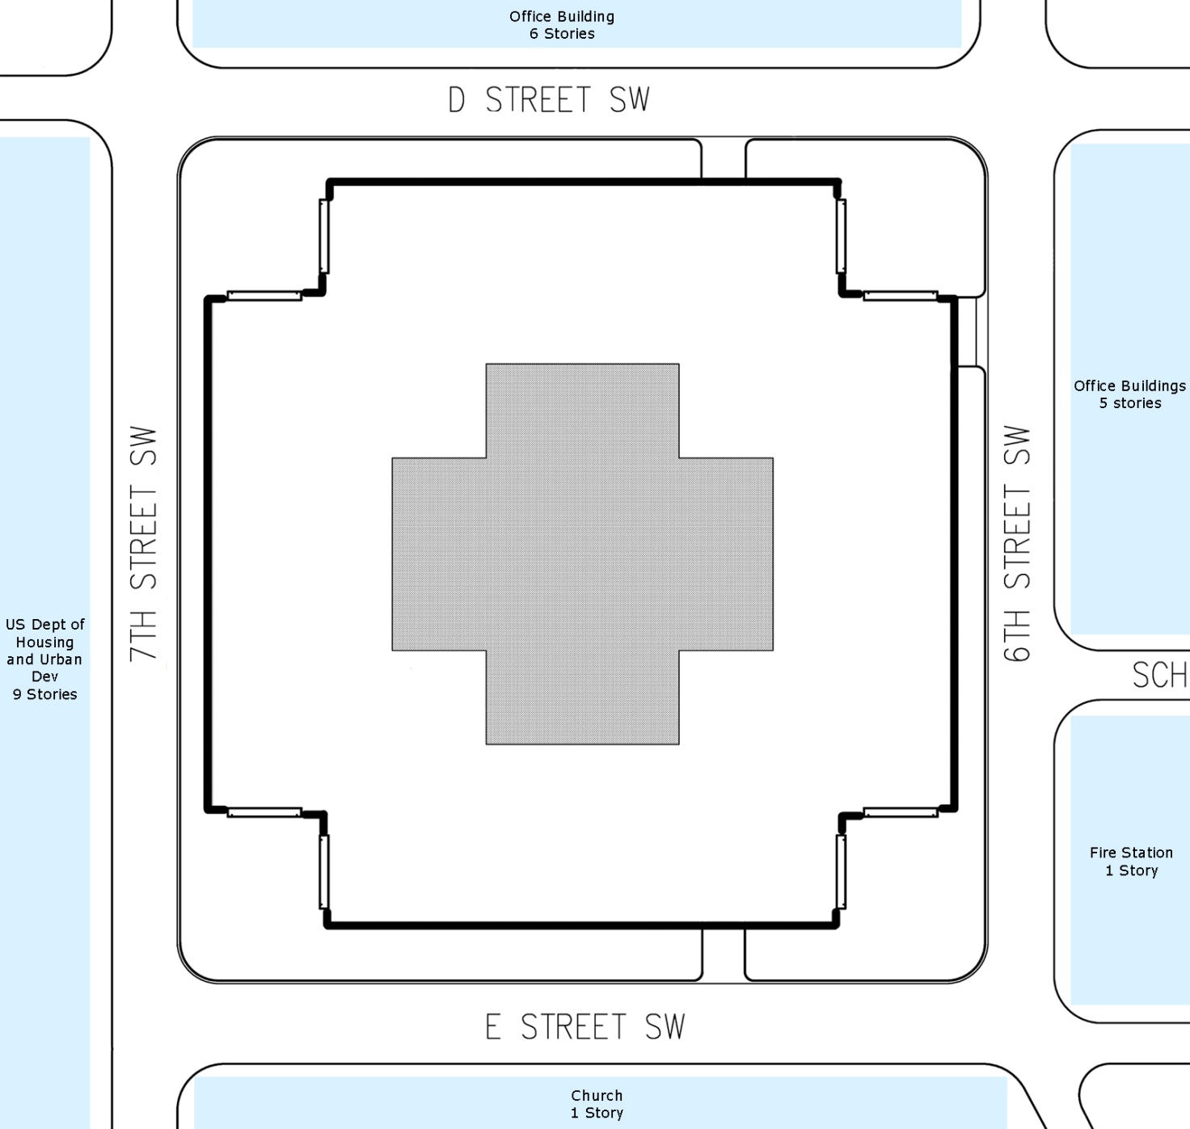
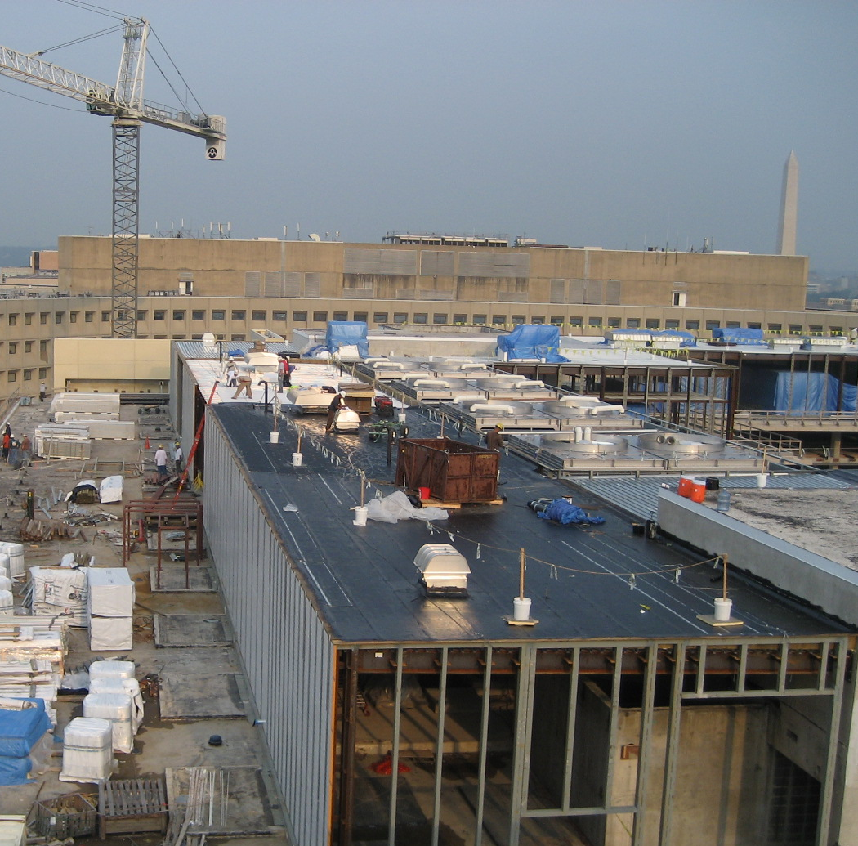
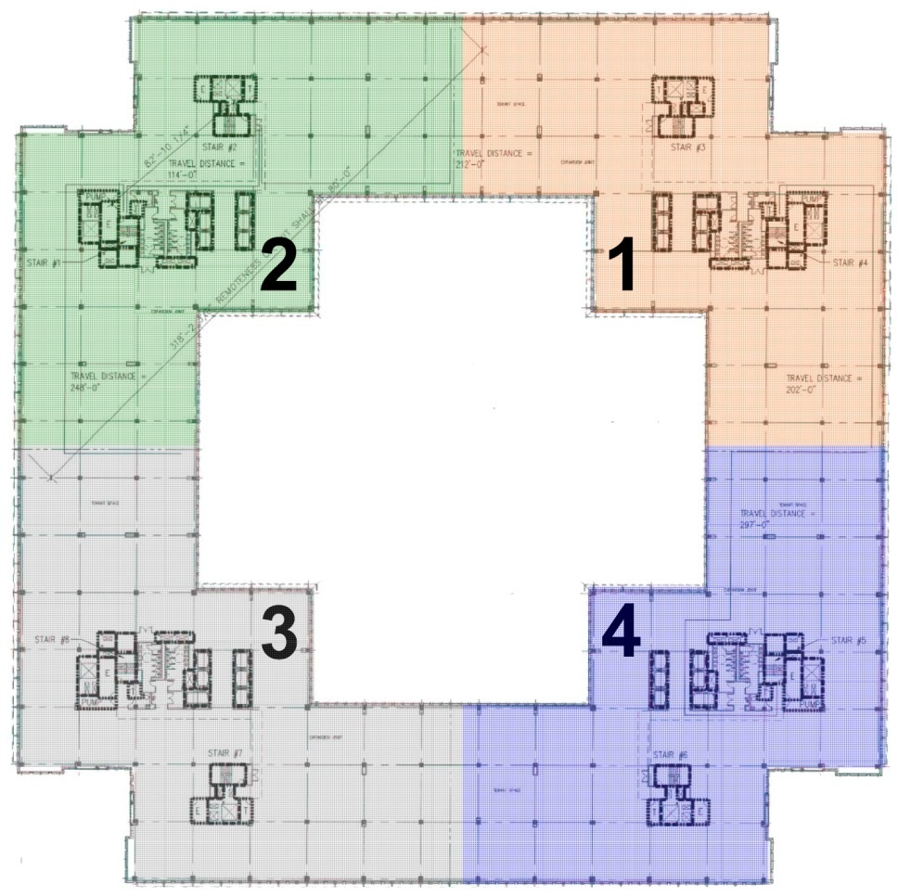
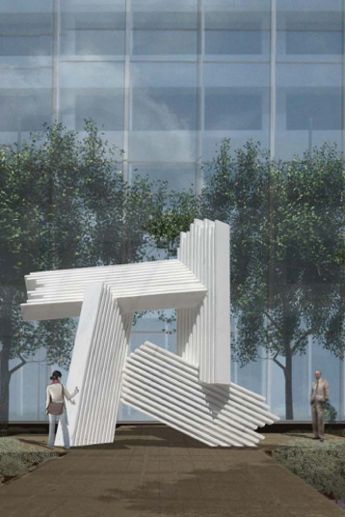
Architecture Overview
Project Overview
Chilled Beams & Commissioning
  Mechanical Breadth
Parking Garage Waffle Slab
  Structural Breadth
Curtain Wall Installation
  MAE Graduate Level Component
Summary
Questions and Acknowledgements
4 separate, but integrated quadrants
  Elevator
  Stairways
  Restrooms
  Electrical and Communication Closets
One acre courtyard that is a private, secure green space
  Fountain, seating areas, sculpture, and 32 Honey Locus Shad Trees that are 11’-5” tall
Built-up roofing system and metal panels used to conceal the MEP equipment on the Pent House level

Slide 7
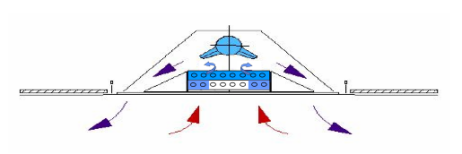
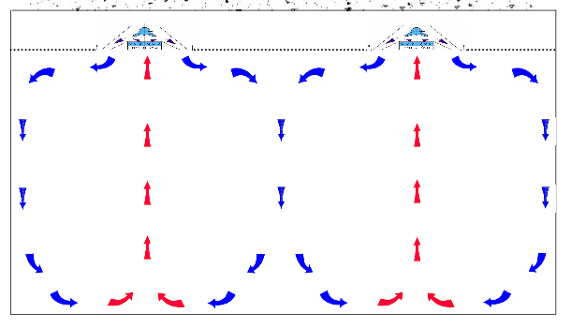
Chilled Beams
Project Overview
Chilled Beams & Commissioning
  Mechanical Breadth
Parking Garage Waffle Slab
  Structural Breadth
Curtain Wall Installation
  MAE Graduate Level Component
Summary
Questions and Acknowledgements
Finned chilled water heat exchanger utilizing cooling coils
Active chilled beams
  About 7,000 units

Slide 8
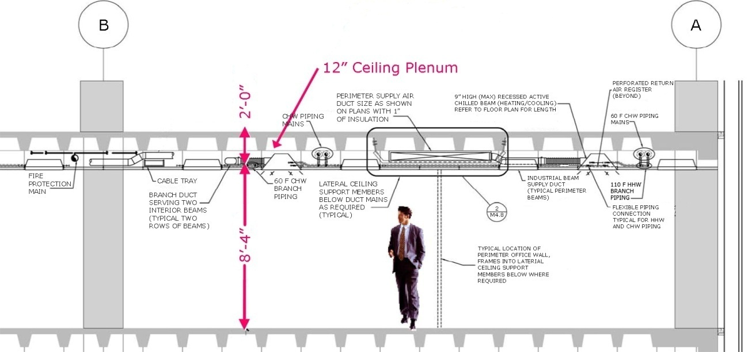
Chilled Beams
Project Overview
Chilled Beams & Commissioning
  Mechanical Breadth
Parking Garage Waffle Slab
  Structural Breadth
Curtain Wall Installation
  MAE Graduate Level Component
Summary
Questions and Acknowledgements
Limited ceiling plenum
Goal:
  8’-4” ceiling height
  Leaves 2’-0” to work with, including 1’-0” waffle slab
TROX customized systems to only be 7.5” high and 2’ wide by 8’ long.

Slide 9
Energy Usage
Energy Cost Comparison
Project Overview
Chilled Beams & Commissioning
  Mechanical Breadth
Parking Garage Waffle Slab
  Structural Breadth
Curtain Wall Installation
  MAE Graduate Level Component
Summary
Questions and Acknowledgements
Savings

Slide 10
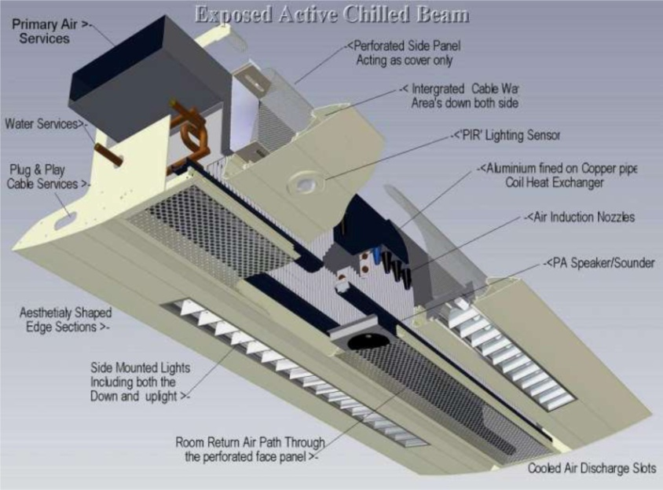
Multi-Service Beams
Project Overview
Chilled Beams & Commissioning
  Mechanical Breadth
Parking Garage Waffle Slab
  Structural Breadth
Curtain Wall Installation
  MAE Graduate Level Component
Summary
Questions and Acknowledgements
Services built into them for “just-in-time” arrival
  Lighting fixtures and control circuits
    Direct and/or indirect
  Public address speakers
  Occupancy sensors
  Fire and smoke sensors and alarms
  Passive infra-red detectors
  Acoustic insulation
  Sprinklers
  Fresh air supply
  Cooling and heating

Slide 11
Advantages
Project Overview
Chilled Beams & Commissioning
  Mechanical Breadth
Parking Garage Waffle Slab
  Structural Breadth
Curtain Wall Installation
  MAE Graduate Level Component
Summary
Questions and Acknowledgements
Shorter construction periods
Clear reduction of interfaces
Less maintenance and operating costs
Energy savings
Maximum flexibility of configuration and technology
Customized exterior frames

Slide 12
Cost Comparison
Schedule Comparison
Project Overview
Chilled Beams & Commissioning
  Mechanical Breadth
Parking Garage Waffle Slab
  Structural Breadth
Curtain Wall Installation
  MAE Graduate Level Component
Summary
Questions and Acknowledgements
Active Chilled Beams
  $150/LF to $200/LF
Multi-Service Chilled Beams
  $350/LF to $500/LF
Active Chilled Beams
  About 20 minutes to install one unit
Multi-Service Chilled Beams
  About 25 minutes to install one unit

Slide 13
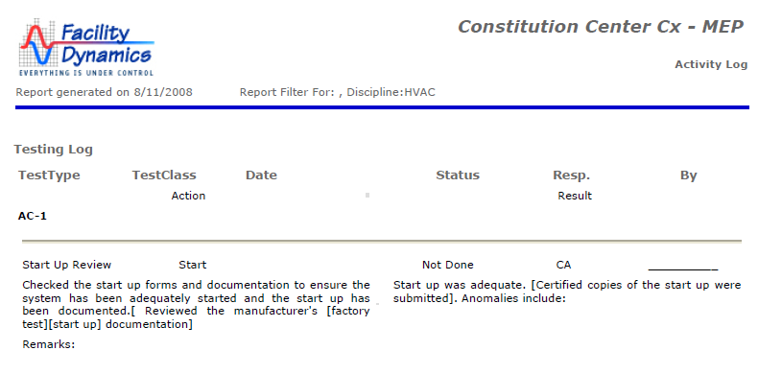
Commissioning
Commissioning
Project Overview
Chilled Beams & Commissioning
  Mechanical Breadth
Parking Garage Waffle Slab
  Structural Breadth
Curtain Wall Installation
  MAE Graduate Level Component
Summary
Questions and Acknowledgements
LEED Gold rating
  Energy & Atmosphere LEED points
Four phases:
  Phase 1 - Hot Water System
  Phase 2 - CHW/CW & North AHU system
  Phase 3 - SW AHU System, Fuel Oil System, Emergency Power System, and Power Monitoring System
  Phase 4 - SE AHU System, FA System, BMS System, and conclude with Endurance Period
ComIT
Program used to track deficiency items, post information such as schedules, submittals, and start-up forms

Slide 14
Commissioning
Project Overview
Chilled Beams & Commissioning
  Mechanical Breadth
Parking Garage Waffle Slab
  Structural Breadth
Curtain Wall Installation
  MAE Graduate Level Component
Summary
Questions and Acknowledgements
Interview of several industry members:
  “Identify the commissioning needs and program requirements early in the design stage so all team members can understand and set their strategies to meet the project goals”
  “Make sure all parties know what is required for commissioning as soon in the project as possible (Communications is key)”

Slide 15
Outcome
Project Overview
Chilled Beams & Commissioning
  Mechanical Breadth
Parking Garage Waffle Slab
  Structural Breadth
Curtain Wall Installation
  MAE Graduate Level Component
Summary
Questions and Acknowledgements
Multi-service chilled beams should be chosen over active chilled beams
To make commissioning easier, it is recommended that a full time staff member ensure that the requirements are met

Slide 16
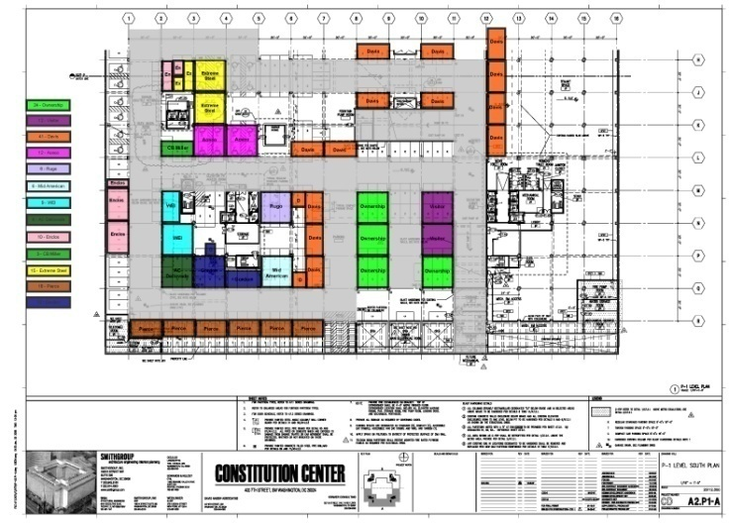
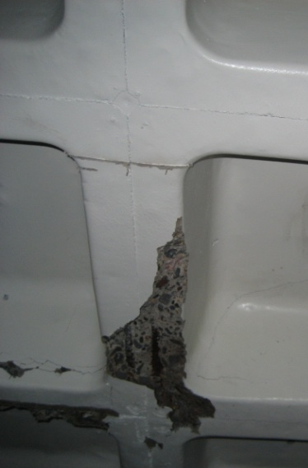
Overview of Parking Garage
Current Renovation Steps
Project Overview
Chilled Beams & Commissioning
  Mechanical Breadth
Parking Garage Waffle Slab
  Structural Breadth
Curtain Wall Installation
  MAE Graduate Level Component
Summary
Questions and Acknowledgements
3 levels totally 6,000 SF
Parking Garage used for construction parking, subcontractor offices, and material storage
Updating sections of the waffle slab
  Area of repair would be completely sectioned off
  Poly-walls were used to contain the dust
  Respirators were required
  Shoring had to remain in place until the concrete was at 100% strength
Recommendations of the engineers
“Sounding” Test
  Listening to the tones of the reverberations caused by dragging heavy chains over the concrete
  Bad concrete made a hollow sound
Overhead Test
  Hammer or pole used
Manual Inspection Test
  Exposed and/or corroded rebar
  Visual spalled sections.

Slide 17
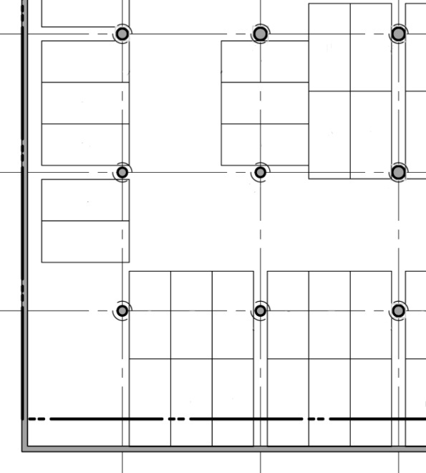
Two-Way Reinforced Concrete Slabs
Given Information
l₁ (ft) | 30 | w_{SDL} (psf) | 15
l₂ (ft) | 30 | w_{DL} (psf) | 150
t_{slab} (in) | 12 | w_{LL} (psf) | 50
γ_{c} (pcf) | 150 | wu (psf) | 278
f'_{c} (psi) | 4000 | φ_{bar} (in) | 1
f_{y} (psi) | 60000 | A_{bar} (in²) | 0.79
Column Size (in) l₂, l₁ | 26 | w_{SDL} (psf) | 15
 | 26 | w_{DL} (psf) | 150
Project Overview
Chilled Beams & Commissioning
  Mechanical Breadth
Parking Garage Waffle Slab
  Structural Breadth
Curtain Wall Installation
  MAE Graduate Level Component
Summary
Questions and Acknowledgements
C
MS
C
CS
B
A
A
A
MS
C
CS
Frame | Total Width (ft) | CS (ft) | MS (ft) | Total - Moment | CS (-M) | MS (-M) | Total + Moment | CS (+M) | MS (+M)
A | 30 | 15 | 15 | -565.33 | -424.00 | -141.33 | 419.96 | 251.98 | 167.98
B | 15 | 7.5 | 7.5 | -104.99 | -104.99 | 0.00 | 209.98 | 125.99 | 83.99
 |  |  |  | -282.67 | -212.00 | -70.67
C | 30 | 15 | 15 | -565.33 | -424.00 | -141.33 | 419.96 | 251.98 | 167.98
D | 15 | 7.5 | 7.5 | -104.99 | -104.99 | 0.00 | 209.98 | 125.99 | 83.99
 |  |  |  | -282.67 | -212.00 | -70.67
MS
MS
D

Slide 18
Two-Way Reinforced Concrete Slab
For Frame B & D Design Reinforcement For CS (Will Use #8 Bars)
Item | Description | Span
 |  | M⁻ | M⁺ | M⁻
1 | M_{u} (ft-Kip) | -104.99 | 125.99 | -212.00
2 | b (in) | 154.00 | 154.00 | 154.00
3 | d( in) | 9.50 | 9.50 | 9.50
4 | M_{n} = M_{u}/0.9 (ft-Kip) | -116.66 | 139.99 | -235.56
5 | R = M_{n}/bd² | 100.72 | 120.87 | 203.38
6 | ρ [Table A.5a] | 0.00 | 0.00 | 0.00
7 | Ast = ρbd (in²) | 2.49 | 3.00 | 5.10
8 | A_{st,min} = 0.002bt | 3.70 | 3.70 | 3.70
9 | N = #7 or #8 (Greater)/A_{bar} | 4.68 | 4.68 | 4.68
10 | Nmin = width_{strip}/2t | 3.75 | 3.75 | 3.75
Project Overview
Chilled Beams & Commissioning
  Mechanical Breadth
Parking Garage Waffle Slab
  Structural Breadth
Curtain Wall Installation
  MAE Graduate Level Component
Summary
Questions and Acknowledgements
Design Reinforcement for CS |  |  | Design Reinforcement for MS
Frame A | 11 |  | Frame A | 8
Frame B | 5 |  | Frame B | 5
Frame C | 14 |  | Frame C | 8
Frame D | 5 |  | Frame D | 5
For Frame A Design Reinforcement For CS (Will Use #8 Bars)
Item | Description | Span
 |  | M⁻ | M⁺ | M⁻
1 | M_{u} (ft-Kip) | -424.00 | 251.98
2 | b (in) | 154.00 | 154.00
3 | d( in) | 11.50 | 11.50
4 | M_{n} = M_{u}/0.9 (ft-Kip) | -471.11 | 279.97
5 | R = M_{n}/bd² | 277.58 | 164.96
6 | ρ [Table A.5a] | 0.00 | 0.00
7 | Ast = ρbd (in²) | 8.43 | 4.96
8 | A_{st,min} = 0.002bt | 3.70 | 3.70
9 | N = #7 or #8 (Greater)/A_{bar} | 10.67 | 6.28
10 | Nmin = width_{strip}/2t | 7.50 | 7.50
For Frame C Design Reinforcement For CS (Will Use #8 Bars)
Item | Description | Span
 |  | M⁻ | M⁺ | M⁻
1 | M_{u} (ft-Kip) | -424.00 | 251.98
2 | b (in) | 154.00 | 154.00
3 | d( in) | 9.50 | 9.50
4 | M_{n} = M_{u}/0.9 (ft-Kip) | -471.11 | 279.97
5 | R = M_{n}/bd² | 406.76 | 241.73
6 | ρ [Table A.5a] | 0.01 | 0.00
7 | Ast = ρbd (in²) | 10.60 | 6.11
8 | A_{st,min} = 0.002bt | 3.70 | 3.70
9 | N = #7 or #8 (Greater)/A_{bar} | 13.42 | 7.73
10 | Nmin = width_{strip}/2t | 7.50 | 7.50

Slide 19
Two-Way Reinforced Concrete Slab
Project Overview
Chilled Beams & Commissioning
  Mechanical Breadth
Parking Garage Waffle Slab
  Structural Breadth
Curtain Wall Installation
  MAE Graduate Level Component
Summary
Questions and Acknowledgements
 | Quantity | Unit | Extended Total | Extended Total O & P
Structural Concrete, Ready Mix, Normal Weight, 4,000psi | 22,500 | CY | $1,040,875 | $3,356,500
Reinforcing steel, in place, elevated slab, #8 | 74 | Ton | $107,418.4 | $136,207.36
Reinforcing steel, in place, Slab on Grade, #8 | 37 | Ton | $54,063.29 | $70,008.44
Total |  |  | $3,202,356.69 | $3,562,765.80

Slide 20
Current Schedule
Two-Way Slab Schedule
Project Overview
Chilled Beams & Commissioning
  Mechanical Breadth
Parking Garage Waffle Slab
  Structural Breadth
Curtain Wall Installation
  MAE Graduate Level Component
Summary
Questions and Acknowledgements
Quadrant | Time Frame
Northeast | November 2007 – February 2008
Southeast | February 2008 – May 2008
Southwest | May 2008 – August 2008
Northwest | August 2008 – November 2008
 | Quantity | Unit | Daily Output | Total (Days)
Structural Concrete, Ready Mix, Normal Weight, 4,000psi, elevated slab, pumped | 15,000 | CY | 180 | 84
Structural Concrete, Ready Mix, Normal Weight, 4,000psi, slab on grade, pumped | 7,500 | CY | 185 | 41
Reinforcing steel, in place, elevated slab, #8 | 74 | Ton | 2.30 | 33
Reinforcing steel, in place, Slab on Grade, #8 | 37 | Ton | 2.90 | 13
Total |  |  |  | 171

Slide 21
Outcome
Project Overview
Chilled Beams & Commissioning
  Mechanical Breadth
Parking Garage Waffle Slab
  Structural Breadth
Curtain Wall Installation
  MAE Graduate Level Component
Summary
Questions and Acknowledgements
Current renovation technique for the parking garage waffle slab is more efficient than replacing it with a two-way reinforced concrete system

Slide 22
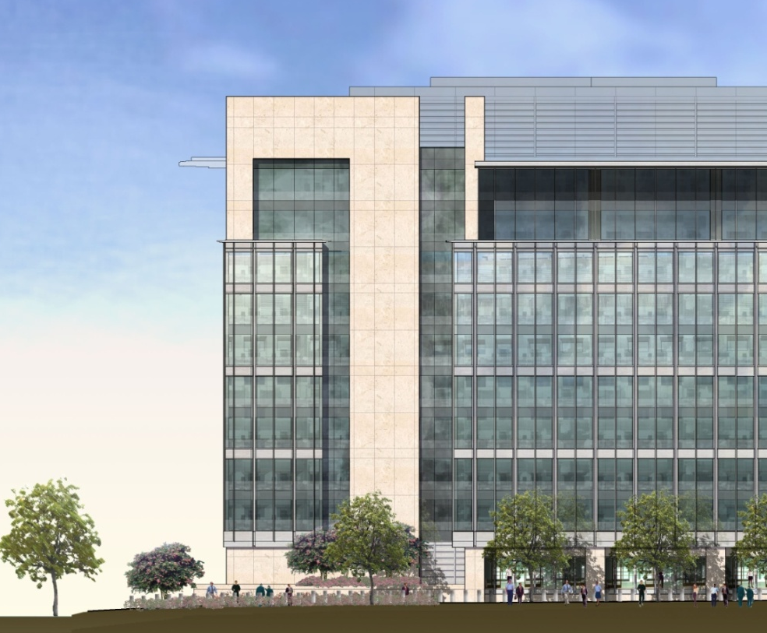

Overview of Curtain Wall
Overview of Curtain Wall
Precast Concrete Panels
Metal Panels & Louvers
Vision Glass
Spandrel Glass
Vertical Aluminum Mullion
6. Vision Glass
7. Spandrel Glass
8. Metal Panel
9. Vision Glass
10.Spandrel Glass
Project Overview
Chilled Beams & Commissioning
  Mechanical Breadth
Parking Garage Waffle Slab
  Structural Breadth
Curtain Wall Installation
  MAE Graduate Level Component
Summary
Questions and Acknowledgements
Nearly 5,000 curtain wall panels
Both Streetside and Courtyard sides
Storefront Panels
  5’ by 12’ by 13’
  1,100 to 1,300 pounds each
Levels 2 to 7 Panels
  5’ by 23’
  2,300 to 2,500 pounds
Levels 8 to 10
  5’ by 10’
  500 to 600 pounds.
1
Courtyard
1
2
4
3
4
3
5
5
6
6
7
7
3
4
Streetside
8
9
10

Slide 23
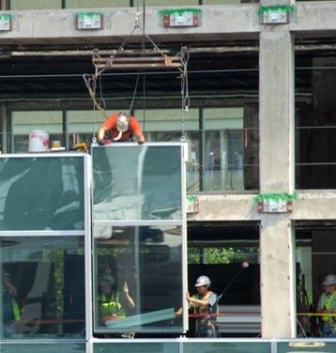
Equipment Used
Estimated Crew Sizes
Project Overview
Chilled Beams & Commissioning
  Mechanical Breadth
Parking Garage Waffle Slab
  Structural Breadth
Curtain Wall Installation
  MAE Graduate Level Component
Summary
Questions and Acknowledgements
Streetside Panels
  Crane for Levels 2 to 8
Courtyard Panels
  Monorail system
Location | Level | Crew Size | Equipment
Streetside | 2 – 8 | 6 | Crane
Streetside | 9 – 10 | 4 | Crane
Courtyard | 2 – 10 | 6* | Monorail
Storefront | 1 | 4 – 6 | Multiple Types
* 4 people used for the monorail installation, and two would follow behind for the sealants and/or boot
Location | Level | Span | Deliveries | Crew Size
Streetside | 2 – 8 | 2 | 12 | 4
Courtyard | 2 – 10 | 1 | 18-24 | 4

Slide 24
Actual Total Crew Size
Project Overview
Chilled Beams & Commissioning
  Mechanical Breadth
Parking Garage Waffle Slab
  Structural Breadth
Curtain Wall Installation
  MAE Graduate Level Component
Summary
Questions and Acknowledgements

Slide 25
Estimated Installation
Actual Installation
Project Overview
Chilled Beams & Commissioning
  Mechanical Breadth
Parking Garage Waffle Slab
  Structural Breadth
Curtain Wall Installation
  MAE Graduate Level Component
Summary
Questions and Acknowledgements
Streetside Panels
  Between 20 to 30
Courtyard Panels
  Between 35 to 40

Slide 26
Productivity
Project Overview
Chilled Beams & Commissioning
  Mechanical Breadth
Parking Garage Waffle Slab
  Structural Breadth
Curtain Wall Installation
  MAE Graduate Level Component
Summary
Questions and Acknowledgements

Slide 27
Estimated Schedule
Actual Schedule
Task | Duration | Start | Finish
Exterior Façade | 366 | 10/1/2007 | 2/23/2009
North | 328 | 10/1/2007 | 12/31/2008
Fabrications for Slab Extensions | 32 | 10/1/2007 | 11/13/2007
Demo & Shoring 2nd Floor at Blast Beams | 10 | 11/6/2007 | 11/19/2007
Slab Extensions | 1 | 12/17/2007 | 12/17/2007
Encase Perimeter Columns at Blast Beams | 1 | 12/5/2007 | 12/5/2007
F,R&P Blast Beams | 1 | 1/18/2008 | 1/18/2008
Fab Anchors & Plates for Curtain wall | 1 | 1/21/2008 | 1/21/2008
Install Anchors & Plates for Curtain wall | 1 | 3/12/2008 | 3/12/2008
Erect Curtain wall | 91 | 2/22/2008 | 6/27/2008
Erect Metal Panels | 20 | 7/28/2008 | 8/22/2008
Erect Exterior Storefront | 17 | 11/12/2008 | 12/4/2008
Erect Exterior Stone | 17 | 12/9/2008 | 12/31/2008
East | 311 | 10/1/2007 | 12/8/2008
West | 266 | 1/22/2008 | 1/27/2009
South | 272 | 2/8/2008 | 2/23/2009
Courtyard Façade | 332 | 1/22/2008 | 4/29/2009
North | 232 | 1/22/2008 | 12/10/2008
Fab Anchors & Plates for Ctyd Curtain wall | 25 | 1/22/2008 | 2/25/2008
Install Anchors & Plates for Curtain wall | 21 | 4/11/2008 | 5/9/2008
Erect Structural Steel & Deck | 16 | 5/12/2008 | 6/2/2008
Erect Curtain wall | 26 | 8/26/2008 | 9/30/2008
Erect Metal Panels | 1 | 10/13/2008 | 10/13/2008
Erect Storefront | 12 | 11/25/2008 | 12/10/2008
East | 207 | 2/8/2008 | 11/24/2008
West | 163 | 5/12/2008 | 12/24/2008
South | 247 | 5/20/2008 | 4/29/2009
Task | Start | Finish
Exterior Façade | 1/29/2008
North | 3/31/2008 | 10/8/2008
East | 4/14/2008 | 12/2/2008
West | 8/12/2008 | 12/3/2008
South | 1/29/2008 | 2/6/2009
Storefront North | 12/9/2008 | 1/3/2009
Storefront East | 1/5/2009 | 1/14/2009
Storefront West | 2/9/2009 | 3/16/2009
Storefront South | 3/6/2009
Courtyard Façade | 5/30/2008
North | 7/14/2008 | 10/3/2008
East | 5/30/2008 | 8/29/2008
West | 9/22/2008 | 11/26/2008
South | 10/13/2008 | 12/12/2008
Courtyard North | 12/4/2008 | 3/12/2009
Courtyard East | 2/18/2009 | 2/23/2009
Courtyard West | 1/3/2009 | 2/16/2009
Courtyard South | 2/16/2009
Project Overview
Chilled Beams & Commissioning
  Mechanical Breadth
Parking Garage Waffle Slab
  Structural Breadth
Curtain Wall Installation
  MAE Graduate Level Component
Summary
Questions and Acknowledgements

Slide 28
Factors for Delays
Project Overview
Chilled Beams & Commissioning
  Mechanical Breadth
Parking Garage Waffle Slab
  Structural Breadth
Curtain Wall Installation
  MAE Graduate Level Component
Summary
Questions and Acknowledgements
Weather
Trade Coordination
Deficient Frames

Slide 29
Outcome
Project Overview
Chilled Beams & Commissioning
  Mechanical Breadth
Parking Garage Waffle Slab
  Structural Breadth
Curtain Wall Installation
  MAE Graduate Level Component
Summary
Questions and Acknowledgements
Curtain wall productivity was slightly under the estimated productivity

Slide 30
Summary
Project Overview
Chilled Beams & Commissioning
  Mechanical Breadth
Parking Garage Waffle Slab
  Structural Breadth
Curtain Wall Installation
  MAE Graduate Level Component
Summary
Questions and Acknowledgements
Chilled Beams & Commissioning
  Multi-service chilled beams
  Communication is key for commissioning
Parking Garage Waffle Slab
  Current renovation technique over a two-way reinforced concrete system
Curtain Wall Installation
  Slightly under productivity

Slide 31

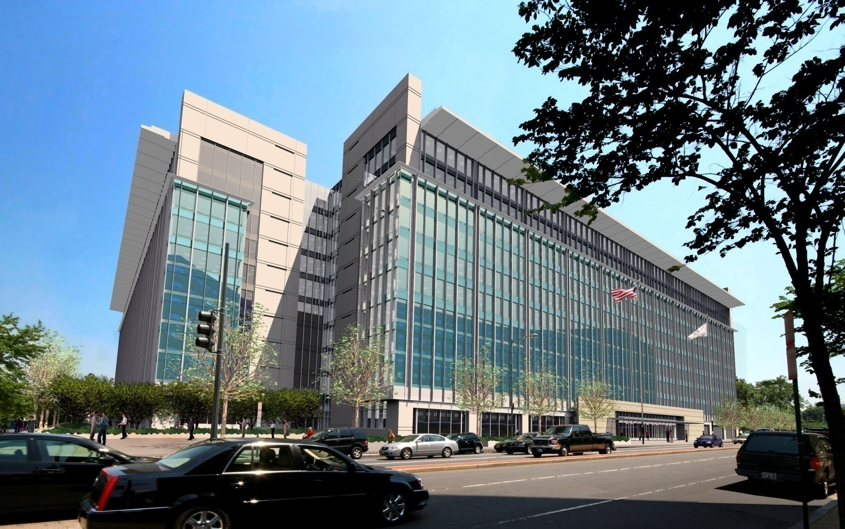





Questions
Acknowledgements
James G. Davis Construction Corporation Bill Bundens Brad Cordek Jonathan Dougherty Ihsan Gin Dan Gowin Ted Holt Frank Lefler Bill Moyer Yolanda Nelson James Pacala Nestor Santos T.J. Sterba Meghan Ulrich |  | Pierce Associates Dan Donaghy Trox USA, Inc. Suzanne Chupp Chris Lawrence Enclos Corp. Paul Sullivan
David Nassif Associates Timothy Jaroch |  | Concrete Restoration Services (CRS) Tod Krauss
SmithGroup, Inc. Melissa Brown David Varner |  | PACE Industry Members Fellow Architectural Engineering Students Joe Wilcher (Structural) The Pennsylvania State University Chimay Anumba Robert Holland Kevin Parfitt
Project Overview
Chilled Beams & Commissioning
  Mechanical Breadth
Parking Garage Waffle Slab
  Structural Breadth
Curtain Wall Installation
  MAE Graduate Level Component
Summary
Questions and Acknowledgements

