Slide 1
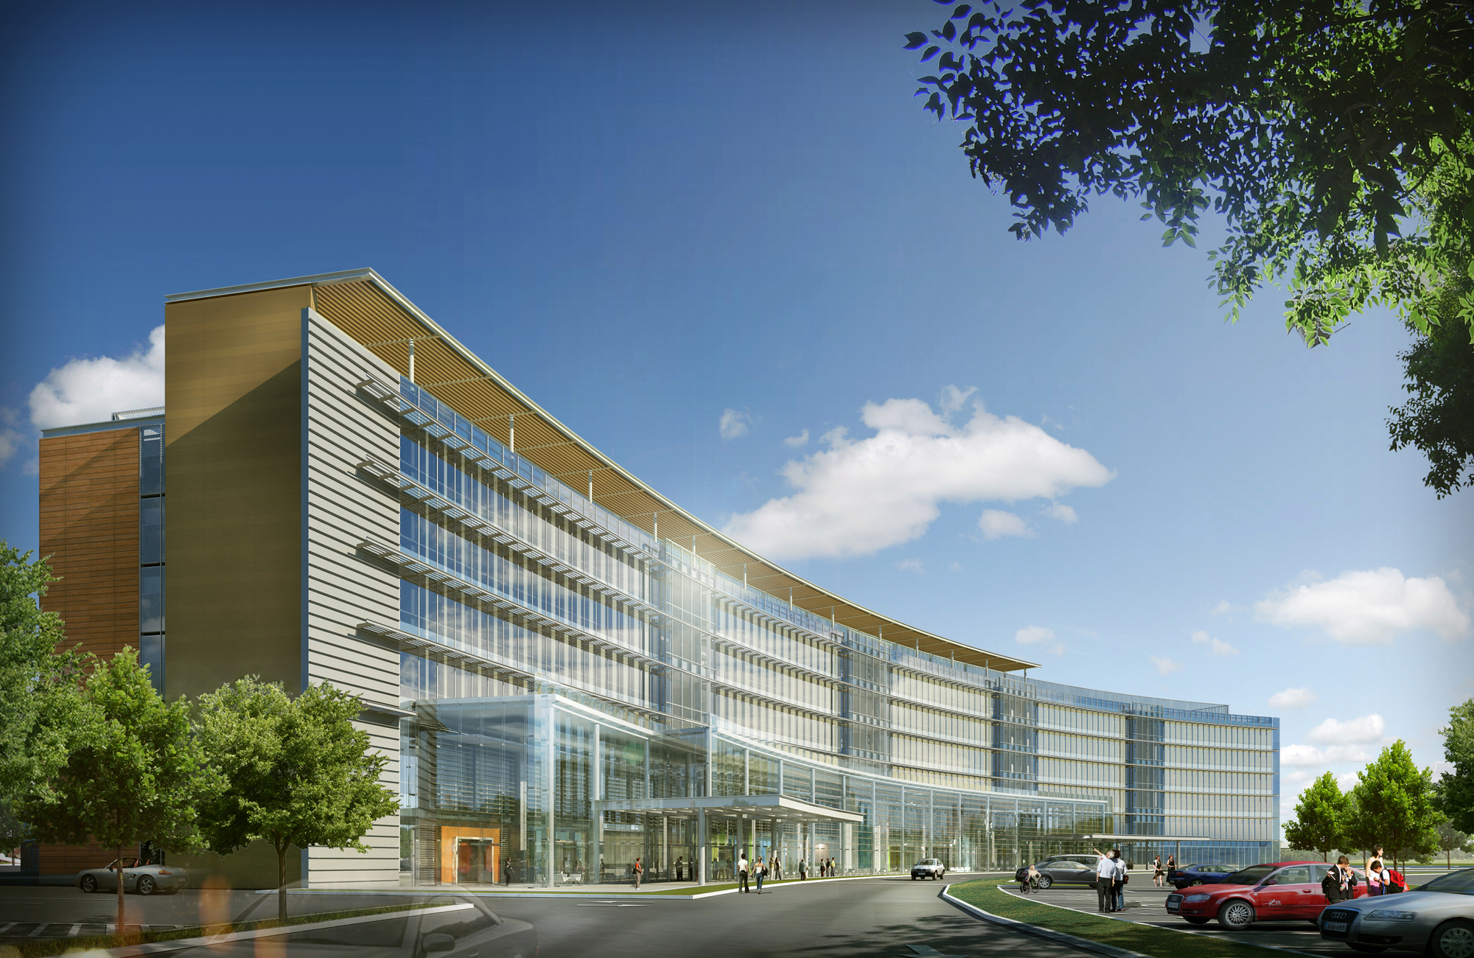
University Medical Center of Princeton
David Bodnar
Construction Management
2010 Senior Thesis

Slide 2
University Medical Center of Princeton
David Bodnar
Construction Management
Outline
Introduction & Outline
Project Background
Efficient Curtain Wall
Greywater System
Pre – Cast Foundation Wall
Green Roof
Remarks & Acknowledgements
Questions
Introduction & Outline
Project Background
Efficient Curtain Wall
Greywater System
Pre – Cast Foundation Wall
Green Roof
Remarks & Acknowledgements
Questions

Slide 3
University Medical Center of Princeton
David Bodnar
Construction Management
Introduction & Outline
Project Background
Efficient Curtain Wall
Greywater System
Pre – Cast Foundation Wall
Green Roof
Remarks & Acknowledgements
Questions
Project Background

Slide 4
University Medical Center of Princeton
David Bodnar
Construction Management
Project Background
Project : University Medical Center of Princeton
Location : Plainsboro NJ
Owner : Princeton HealthCare System
Construction Manager : Turner Construction
Cost : $321 Million
Size : 209,525 square feet / 7 stories
Introduction & Outline
Project Background
Efficient Curtain Wall
Greywater System
Pre – Cast Foundation Wall
Green Roof
Remarks & Acknowledgements
Questions

Slide 5
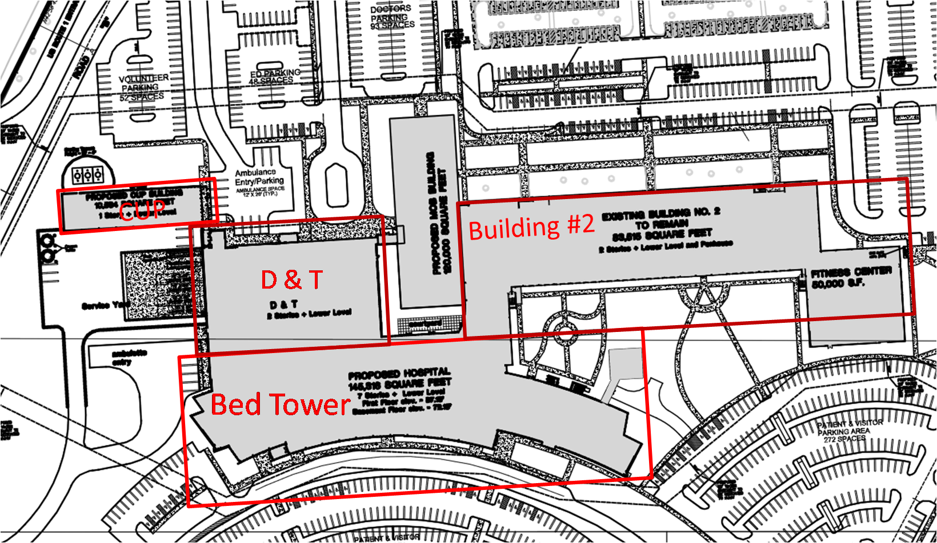
University Medical Center of Princeton
David Bodnar
Construction Management
Project Background
Construction Phases & Buildings
Introduction & Outline
Project Background
Efficient Curtain Wall
Greywater System
Pre – Cast Foundation Wall
Green Roof
Remarks & Acknowledgements
Questions

Slide 6
University Medical Center of Princeton
David Bodnar
Construction Management
Project Background
Thesis Theme
Introduction & Outline
Project Background
Efficient Curtain Wall
Greywater System
Pre – Cast Foundation Wall
Green Roof
Remarks & Acknowledgements
Questions
“To look at sustainable ideas that could possible be incorporated into the design and constructing of the University Medical Center of Princeton”

Slide 7
University Medical Center of Princeton
David Bodnar
Construction Management
Introduction & Outline
Project Background
Efficient Curtain Wall
Greywater System
Pre – Cast Foundation Wall
Green Roof
Remarks & Acknowledgements
Questions
Analysis I
Efficient Curtain Wall

Slide 8
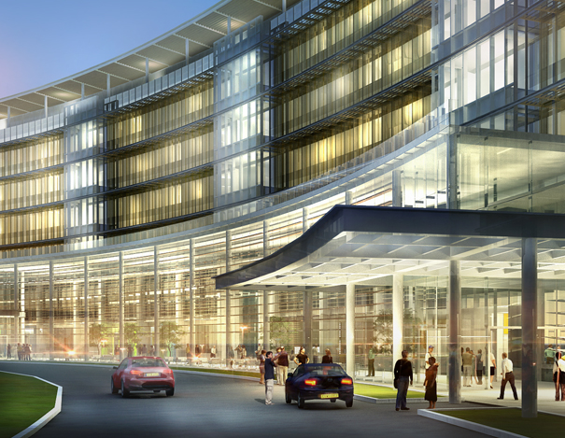

University Medical Center of Princeton
David Bodnar
Construction Management
Efficient Curtain Wall
Original Windows in Place
Introduction & Outline
Project Background
Efficient Curtain Wall
Greywater System
Pre – Cast Foundation Wall
Green Roof
Remarks & Acknowledgements
Questions
Common 1” double pane window
U – Value
Summer – 0.3
Winter – 0.27
SHG – 0.28
UV Transmittance – 16%

Slide 9

University Medical Center of Princeton
David Bodnar
Construction Management
Efficient Curtain Wall
Proposed Windows
Introduction & Outline
Project Background
Efficient Curtain Wall
Greywater System
Pre – Cast Foundation Wall
Green Roof
Remarks & Acknowledgements
Questions
Common 1” double pane window
U – Value
Summer – 0.15
Winter – 0.16
SHG – 0.49
UV Transmittance – 1%

Slide 10
University Medical Center of Princeton
David Bodnar
Construction Management
Efficient Curtain Wall
Benefits of Serious Materials Windows
Introduction & Outline
Project Background
Efficient Curtain Wall
Greywater System
Pre – Cast Foundation Wall
Green Roof
Remarks & Acknowledgements
Questions
Better window insulation with lower U-value
Better for heat gain in the winter
Better protection from harmful UV rays
No change in schedule and constructability
Savings on mechanical equipment and electrical usage to run mechanical system

Slide 11
University Medical Center of Princeton
David Bodnar
Construction Management
Introduction & Outline
Project Background
Efficient Curtain Wall
Greywater System
Pre – Cast Foundation Wall
Green Roof
Remarks & Acknowledgements
Questions
Analysis II
Greywater System

Slide 12
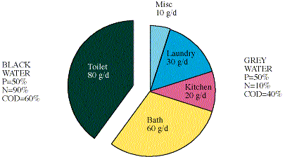
University Medical Center of Princeton
David Bodnar
Construction Management
Greywater System
What is Greywater?
Introduction & Outline
Project Background
Efficient Curtain Wall
Greywater System
Pre – Cast Foundation Wall
Green Roof
Remarks & Acknowledgements
Questions
Greywater comes from laundry, kitchen, bath, etc.
Blackwater comes from toilet
Blackwater harder to purify than greywater due to more nitrogen

Slide 13
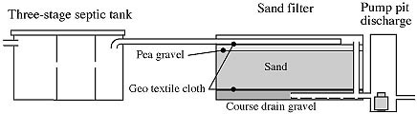
University Medical Center of Princeton
David Bodnar
Construction Management
Greywater System
Anaerobic to Aerobic Pre – Treatment System
Introduction & Outline
Project Background
Efficient Curtain Wall
Greywater System
Pre – Cast Foundation Wall
Green Roof
Remarks & Acknowledgements
Questions
Works best for breaking down cooking grease and food residue
Septic tank breaks down grease and sludge
Sand filter treats water with oxygen
Pumped to planter bed for near potable treatment

Slide 14
University Medical Center of Princeton
David Bodnar
Construction Management
Greywater System
Cost Analysis
Introduction & Outline
Project Background
Efficient Curtain Wall
Greywater System
Pre – Cast Foundation Wall
Green Roof
Remarks & Acknowledgements
Questions
Water and sewage cost for typical hospital kitchen=$10.60 per day
Cost of greywater system = $4,232.00
Total time for system to pay it self off ≈13.5 month

Slide 15
University Medical Center of Princeton
David Bodnar
Construction Management
Greywater System
Benefits and Uses of Greywater
Introduction & Outline
Project Background
Efficient Curtain Wall
Greywater System
Pre – Cast Foundation Wall
Green Roof
Remarks & Acknowledgements
Questions
Usage:
Use recycled greywater for plant irrigation and HVAC cooling
Positive:
Cost savings on water and sewage bill
Negative:
Upfront cost of system

Slide 16
University Medical Center of Princeton
David Bodnar
Construction Management
Introduction & Outline
Project Background
Efficient Curtain Wall
Greywater System
Pre – Cast Foundation Wall
Green Roof
Remarks & Acknowledgements
Questions
Analysis III
Pre – Cast Foundation Wall

Slide 17
University Medical Center of Princeton
David Bodnar
Construction Management
Pre - Cast Foundation Wall
Cost Analysis
Introduction & Outline
Project Background
Efficient Curtain Wall
Greywater System
Pre – Cast Foundation Wall
Green Roof
Remarks & Acknowledgements
Questions
Cost of Cast in Place = $1,894,713.20
Cost of Pre – Cast = $2,540,538.00
General Conditions Savings = $292,100.00 and 57 days / 8 month
Overall added cost = $353,715.80

Slide 18
University Medical Center of Princeton
David Bodnar
Construction Management
Pre - Cast Foundation Wall
Advantages
Introduction & Outline
Project Background
Efficient Curtain Wall
Greywater System
Pre – Cast Foundation Wall
Green Roof
Remarks & Acknowledgements
Questions
Takes less time to installs pre-cast foundation wall systems
Schedule acceleration
Better quality due to being manufactured off site
Less construction waste
More energy efficient

Slide 19
University Medical Center of Princeton
David Bodnar
Construction Management
Pre - Cast Foundation Wall
Disadvantages
Introduction & Outline
Project Background
Efficient Curtain Wall
Greywater System
Pre – Cast Foundation Wall
Green Roof
Remarks & Acknowledgements
Questions
Cost as opposed to cast-in place foundation wall system
Size of panels limitations due to shipping
More coordination on site

Slide 20
University Medical Center of Princeton
David Bodnar
Construction Management
Introduction & Outline
Project Background
Efficient Curtain Wall
Greywater System
Pre – Cast Foundation Wall
Green Roof
Remarks & Acknowledgements
Questions
Analysis IV
Green Roof

Slide 21
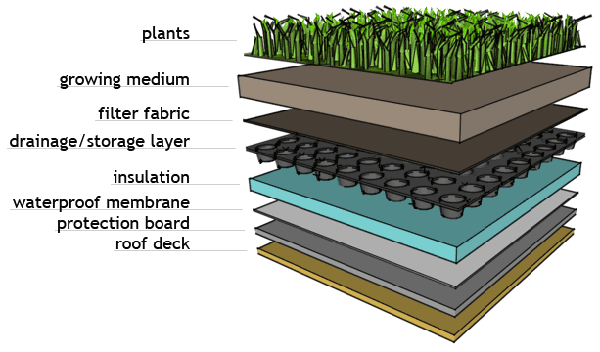
University Medical Center of Princeton
David Bodnar
Construction Management
Green Roof
Components and Cost
Introduction & Outline
Project Background
Efficient Curtain Wall
Greywater System
Pre – Cast Foundation Wall
Green Roof
Remarks & Acknowledgements
Questions
Cost per square foot for green roof = $14.00
Approximately 18,500 square feet of roof area
Overall cost of ≈ $259,000.00

Slide 22
University Medical Center of Princeton
David Bodnar
Construction Management
Green Roof
Structural Analysis
Introduction & Outline
Project Background
Efficient Curtain Wall
Greywater System
Pre – Cast Foundation Wall
Green Roof
Remarks & Acknowledgements
Questions
4” systems weights ≈ 21 pounds per square foot
Passed!!!

Slide 23
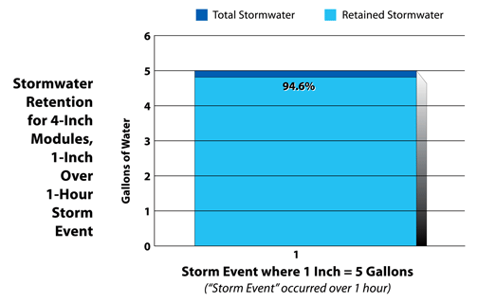
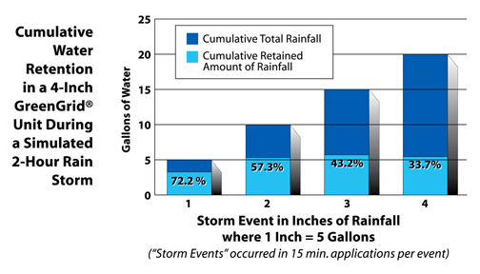
University Medical Center of Princeton
David Bodnar
Construction Management
Green Roof
Stormwater Collection
Introduction & Outline
Project Background
Efficient Curtain Wall
Greywater System
Pre – Cast Foundation Wall
Green Roof
Remarks & Acknowledgements
Questions
Green roofs are very good in collecting Stormwater
Average rain fall in New Jersey is 3.84 inch per month
Average of 44,280 gallons of water run off the roof per month

Slide 24
University Medical Center of Princeton
David Bodnar
Construction Management
Green Roof
Additional Benefits
Introduction & Outline
Project Background
Efficient Curtain Wall
Greywater System
Pre – Cast Foundation Wall
Green Roof
Remarks & Acknowledgements
Questions
Urban Heat-Island Effect
Reduce heating and cooling loads by ≈25%
Use of recycled materials

Slide 25
University Medical Center of Princeton
David Bodnar
Construction Management
Introduction & Outline
Project Background
Efficient Curtain Wall
Greywater System
Pre – Cast Foundation Wall
Green Roof
Remarks & Acknowledgements
Questions
Remarks & Acknowledgements

Slide 26
University Medical Center of Princeton
David Bodnar
Construction Management
Remarks
Introduction & Outline
Project Background
Efficient Curtain Wall
Greywater System
Pre – Cast Foundation Wall
Green Roof
Remarks & Acknowledgements
Questions
Good
  Change in windows
  Greywater system
  Green roof
Bad (Maybe!!!!!!!!!!)
  Pre – Cast Foundation Wall

Slide 27
University Medical Center of Princeton
David Bodnar
Construction Management
Acknowledgements
Penn State Faculty
Dr. Chris Magent
Professor Robert Holland
Turner Construction
Chris Auer, Project Manager
Princeton HealthCare Systems
And most of all my family, friends, and fellow AE students
Introduction & Outline
Project Background
Efficient Curtain Wall
Greywater System
Pre – Cast Foundation Wall
Green Roof
Remarks & Acknowledgements
Questions

Slide 28
University Medical Center of Princeton
David Bodnar
Construction Management
Introduction & Outline
Project Background
Efficient Curtain Wall
Greywater System
Pre – Cast Foundation Wall
Green Roof
Remarks & Acknowledgements
Questions
Questions

