Slide 1
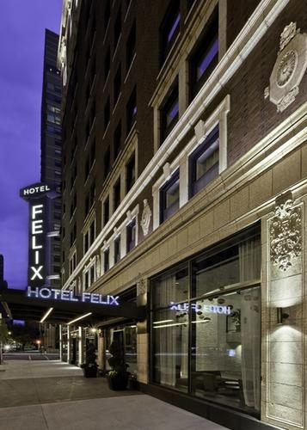
SENIOR THESIS PRESENTATION
Grey-water Reheat with Combined Heat and Power Analysis for a Hotel
Presented by
Geoffrey Kim | Mechanical
Hotel Felix
Chicago, Illinois
The Pennsylvania State University
Department of Architectural Engineering
AE 482 Senior Thesis | Faculty Advisor: Dr. Jelena Srebric

Slide 2
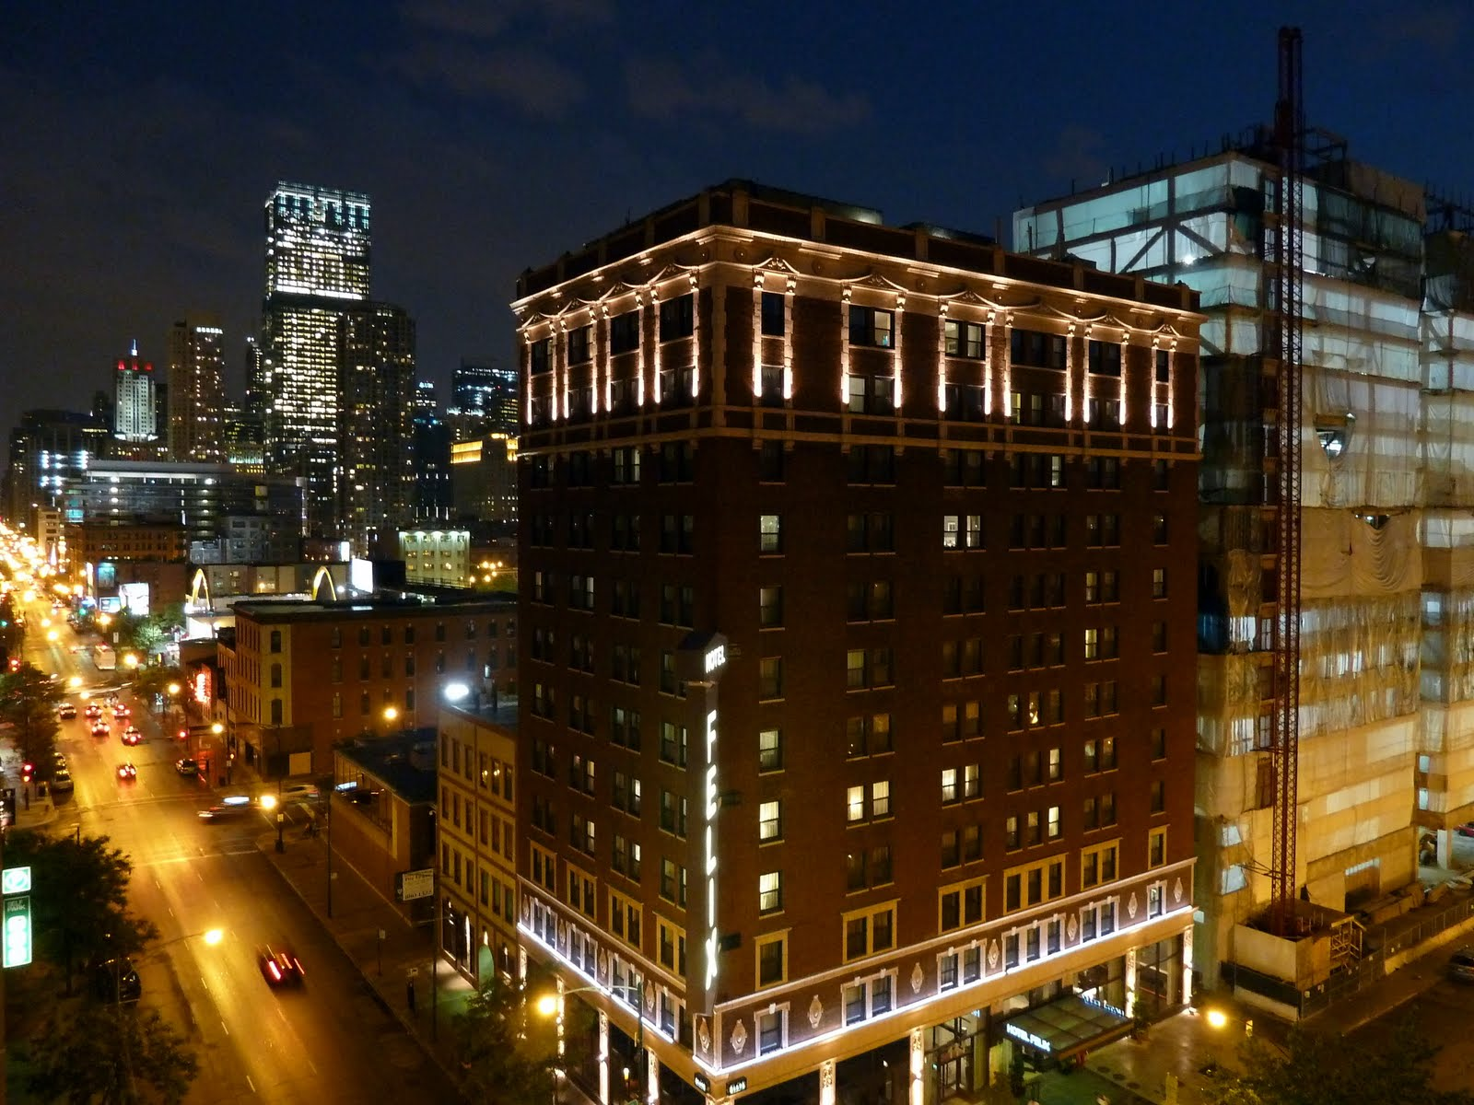
BUILDING OVERVIEW
BUILDING NAME: HOTEL FELIX
LOCATION : CHICAGO, ILLINOIS
SIZE: 85,700 SF
HEIGHT: 12 STORIES
RENOVATION: SEP.2007 – MARCH 2009
LEED SILVER CERTIFIED
INTRODUCTION
HOTEL FELIX
HOTEL FELIX

Slide 3
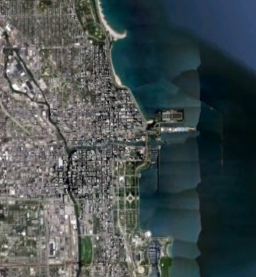
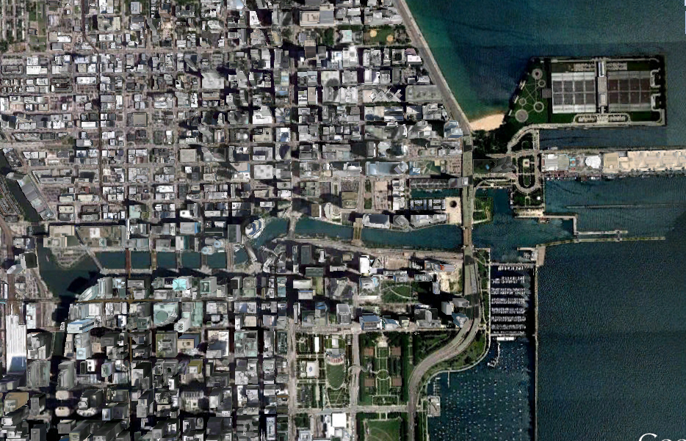
SITE MAP
INTRODUCTION
HOTEL FELIX
HOTEL FELIX

Slide 4
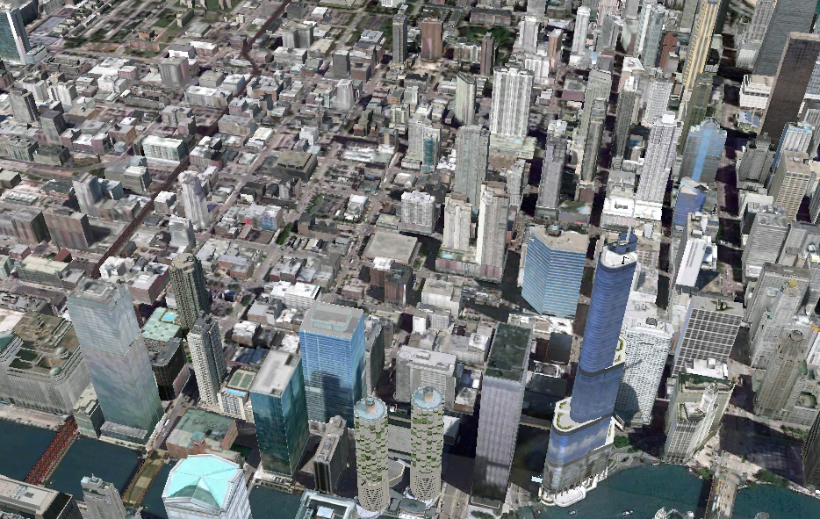
SITE MAP
HOTEL FELIX
W Chicago Ave.
N Michigan Ave
N Lasalle Dr.
INTRODUCTION
HOTEL FELIX
HOTEL FELIX

Slide 5
EXISTING MECHANICAL SYSTEM
(1) Roof Top Air Handling Unit
(1) Self Contained Unit
(225) Water Source Heat Pumps
(1) Split System Air Conditioning Unit
(1) Gas Fired Unit Heater
INTRODUCTION
HOTEL FELIX
HOTEL FELIX

Slide 6
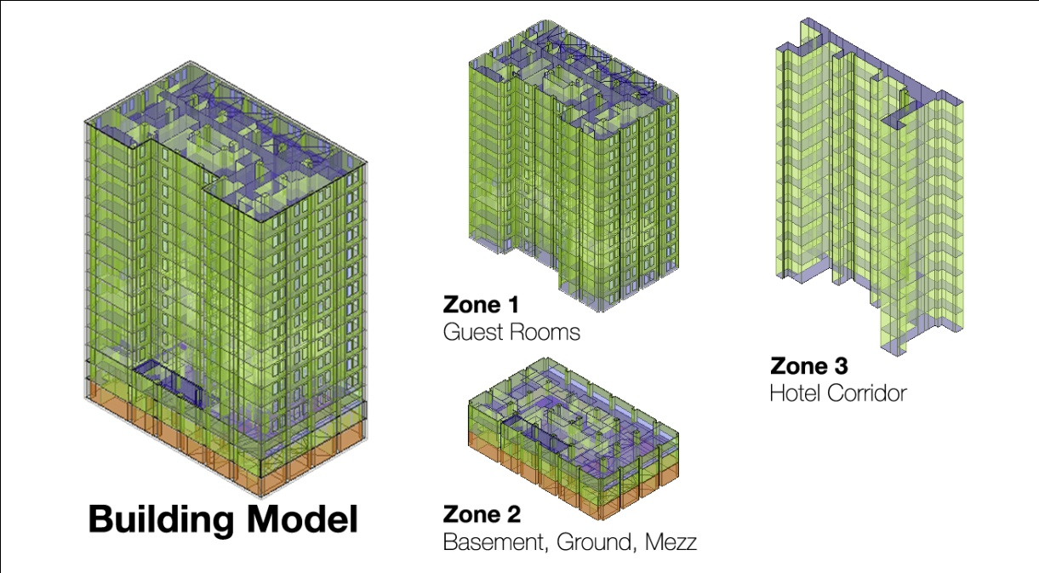
EXISTING MECHANICAL SYSTEM
Zone 1 (Guest Rooms)
Water Source Heat Pumps
Zone 3 (Corridor)
Constant Volume RTU
Zone 2 (Basement, Ground, Mezzanine Floor)
VAV Terminal Boxes w/ Electric Reheat
INTRODUCTION
HOTEL FELIX
HOTEL FELIX

Slide 7
DESIGN OBJECTIVES
Lower Annual Energy Utilization
Lower Impact on the Environment
Investigate Greywater Heat Recovery System and Combined Heating and Power.
MECHANICAL REDESIGN
HOTEL FELIX
HOTEL FELIX

Slide 8
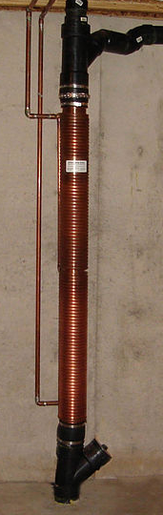
GREYWATER HEAT RECOVERY SYSTEM
HOT WATER FROM BOILER (140°F)
SHOWER
PREHEATED
COLD WATER
DRAIN WATER (110°F)
GREYWATER
HEAT EXCHANGER
BOILER
COLD WATER FOR BOILER (54°F)
MECHANICAL REDESIGN
HOTEL FELIX
HOTEL FELIX

Slide 9
GREYWATER HEAT RECOVERY SYSTEM
 | Hotel Room Showers
Cold Water Supply (⁰F) | 54
Hot Water Leaving Boiler (⁰F) | 140
Temperature of Shower (⁰F) | 110
Efficiency of Boiler + Hot Water Pipes | 80 %
Thermal Capacity of Water (btu/ft³ ⁰F) | 62.4
Energy to heat one gallon of shower water (Btu/gallon) | 585
 | Hotel Room Showers
Typical Shower Flow Rate (GPM) | 2.5
Average Length of Shower (Min) | 5
Number of Showers (225) | 225
Number of Showers per Day per Room | 2
Daily Shower Water Usage (gallons/day) | 6875
Estimated Hotel Occupancy | 70%
Estimated Daily Shower Water Usage (gallons) | 4812
 | Hotel Room Showers
Energy required to heat water per day (btu/day) | 4,024,020
Natural Gas Price ($/therm) | 0.836
Annual cost (per year) | 12,279
MECHANICAL REDESIGN
HOTEL FELIX
HOTEL FELIX

Slide 10
GREYWATER HEAT RECOVERY SYSTEM
Energy Reduction
Annual Energy Consumption 14,673 therms
Annual Energy Savings 4,324 therms
Percentage Reduction 29.5% Savings
Savings
Annual Energy Savings 4,324 therm/year
Annual Cost Savings $5,188 / year
MECHANICAL REDESIGN
HOTEL FELIX
HOTEL FELIX

Slide 11
GREYWATER HEAT RECOVERY SYSTEM
Initial Equipment Cost
Heat Exchanger $27,540
Piping + Labor $6,400
Total =$33,940
Payback Period
$33,940 / $5,188 = 6.54 Years
MECHANICAL REDESIGN
HOTEL FELIX
HOTEL FELIX

Slide 12

COMBINED HEAT AND POWER
WASTE ENERGY
PRIME MOVER
FUEL
GENERATOR
EXHAUST HEAT
ELECTRICITY
THERMAL OUTPUT
MECHANICAL REDESIGN
HOTEL FELIX
HOTEL FELIX

Slide 13
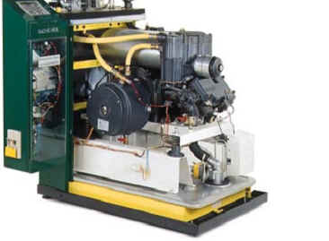
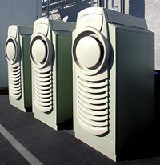
COMBINED HEAT AND POWER
Prime Mover Selection
Internal Combustion Engine
Heat: Power Ratio - 1:1
Capacity – up to 4MW
Micro Turbine
Heat : Power Ratio – 2:1
Capacity – Up to 1MW
MECHANICAL REDESIGN
HOTEL FELIX
HOTEL FELIX

Slide 14
COMBINED HEAT AND POWER
DOLLARS ($)
Monthly Utility Cost
MECHANICAL REDESIGN
HOTEL FELIX
HOTEL FELIX

Slide 15
COMBINED HEAT AND POWER
Initial Equipment Cost
Microturbine ($1500/kW) $45,000
Labor ($400/kW) $12,000
Ductwork and Piping ($100/kW) $3,000
Total =$60,000
MECHANICAL REDESIGN
HOTEL FELIX
HOTEL FELIX

Slide 16
COMBINED HEAT AND POWER
Energy Savings
Annual Cost Saving $6,355
Initial Cost $60,000
Simple Payback Period 9.5 Years
MECHANICAL REDESIGN
HOTEL FELIX
HOTEL FELIX

Slide 17
ACOUSTIC ANALYSIS
Design Criteria
CHP system noise to not exceed 40 NC to Hotel Room Below
CHP System to Meet Chicago Noise Ordinance Code
Acoustic Analysis
HOTEL FELIX
HOTEL FELIX

Slide 18
ACOUSTIC ANALYSIS
Existing Roof – Concrete slab roof w/ steel joists
Acoustic Analysis
HOTEL FELIX
HOTEL FELIX

Slide 19
CONCLUSION
Greywater Reheat Annual Saving $5,188
Payback Period 6.5 Years
CHP System Annual Saving $6,355
Payback Period 9.5 Years
Conclusion
HOTEL FELIX
HOTEL FELIX

Slide 20
ACKNOWLEDGEMENTS
Professor Holland
Professor Srebric
Professor Freihaut
Professor Ling
Leland Curtis
Trien Devon Lam
Shiyun Chen
AE Faculty, and Friends, and Dewberry
Acknowledgements
HOTEL FELIX
HOTEL FELIX

