Slide 1
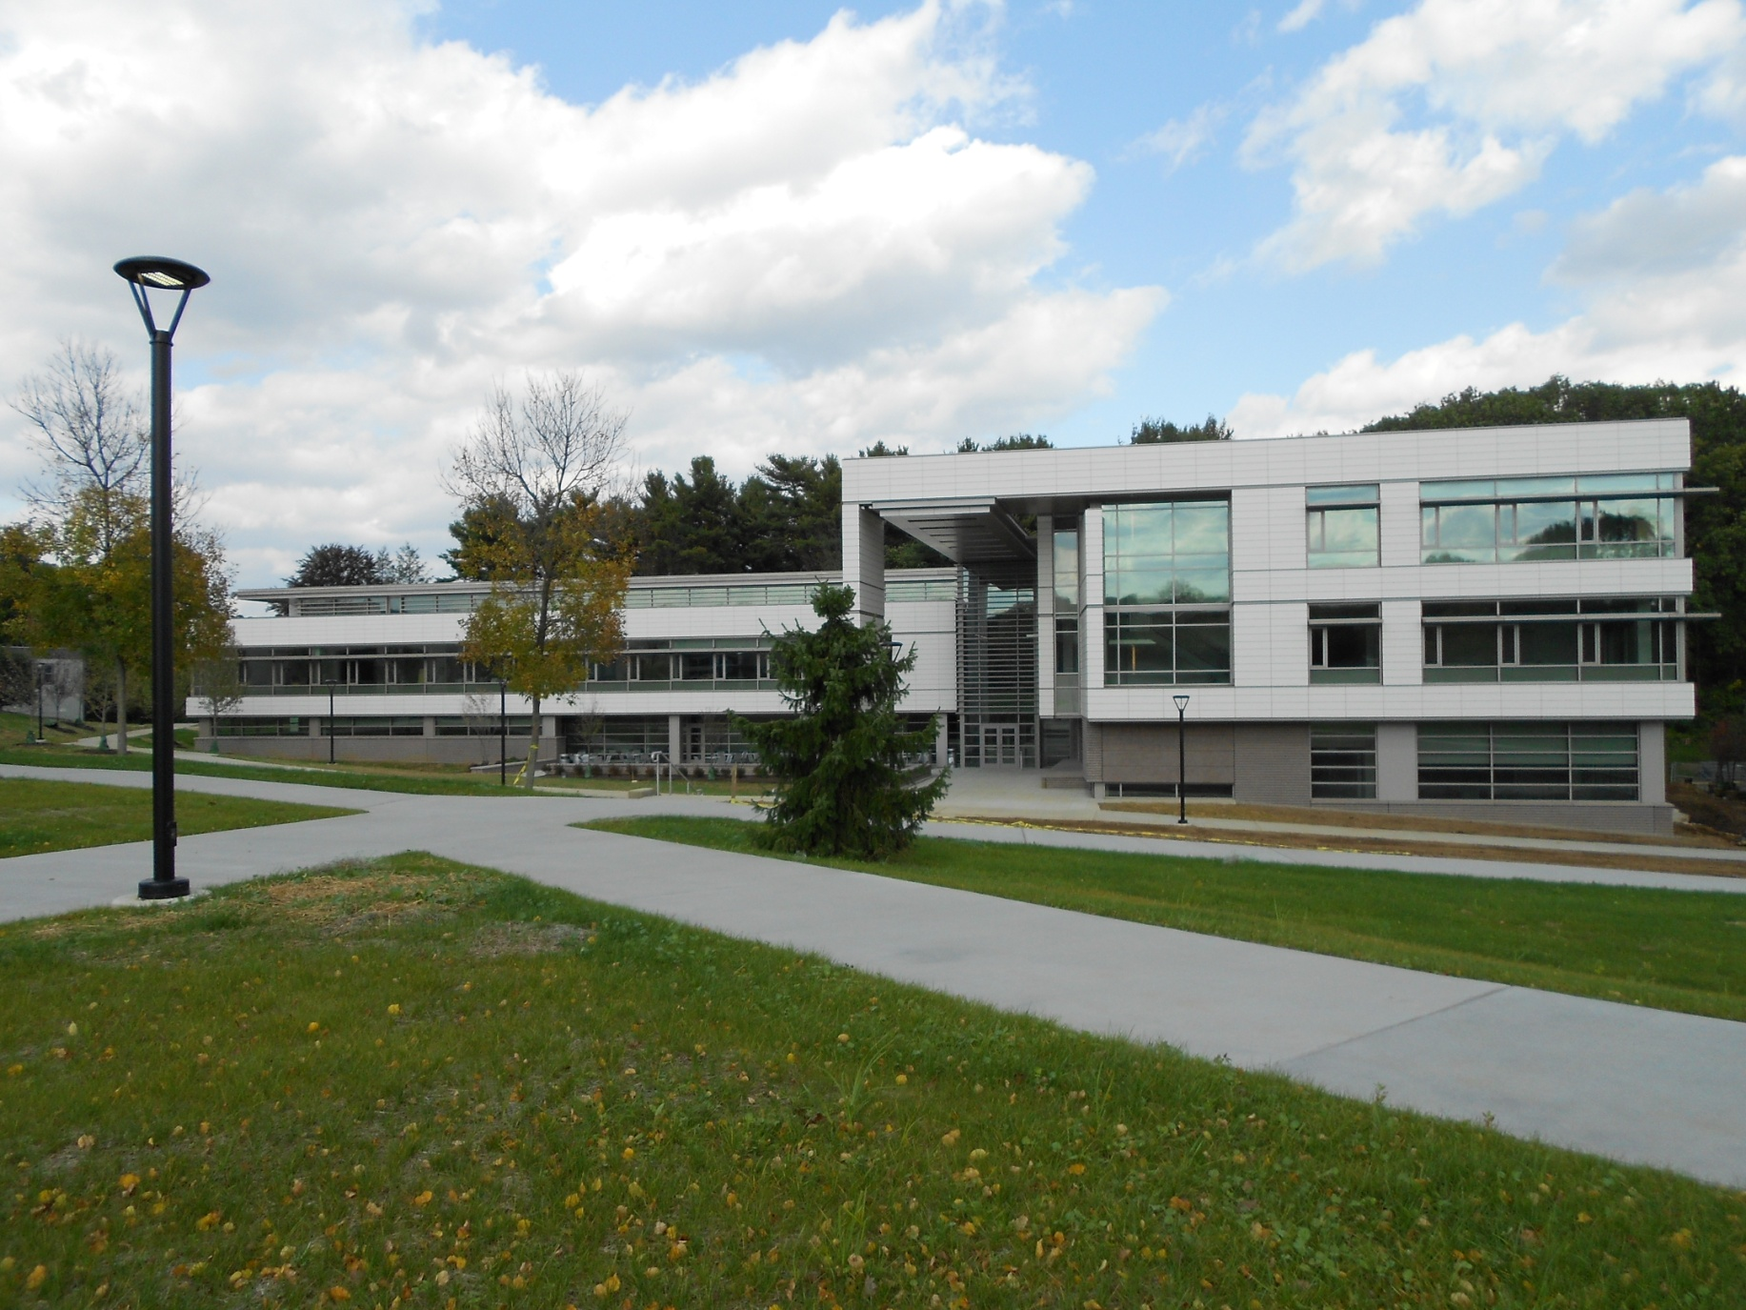
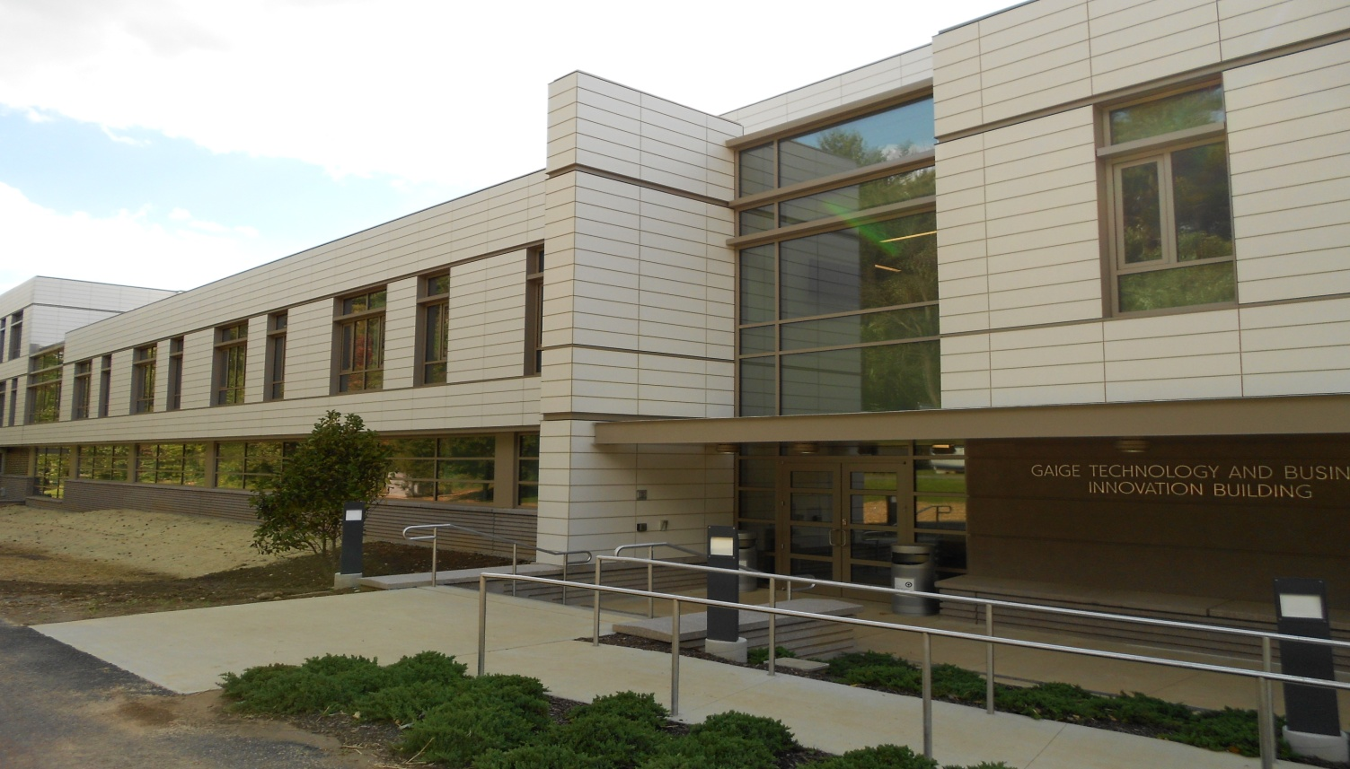
Julia Broskey
Mechanical Option
AE 482 – Senior Thesis
Berks Classroom and Lab Building
Reading, Pennsylvania
Faculty Advisor :Dr. William P. Bahnfleth P.E.

Slide 2
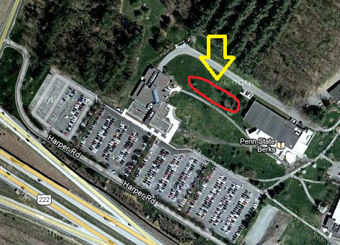
Building Statistics
Introduction
Building Information
Building Stats
Project Team
Architectural
Existing Mechanical
Proposal
Mechanical Redesign
Electrical Breadth
CM Breadth
Conclusion
Location: Penn State Berks Campus Reading, PA
Building Occupant: Penn State Berks Students & Faculty
Occupancy: New Building Group B – Business
Size: 62,188 Sq Ft
Dates of Construction: April 2010 – August/September 2011
Project Delivery Method: Design – Bid - Build
Google Maps

Slide 3
Project Team
Introduction
Building Information
Building Stats
Project Team
Architectural
Existing Mechanical
Proposal
Mechanical Redesign
Electrical Breadth
CM Breadth
Conclusion
Owner: The Pennsylvania State University Berks Campus
General Contractor: Alvin H. Butz, Inc.
Construction Cost Estimator: Becker & Frondorf
Building Architect: RMJM Hiller
Structural Engineer: Greenman-Pedersen, INC
MEP Engineer: H.F. Lenz Company
Civil: Gannett Fleming Engineers
Consultants:
Lighting: Illumination Arts, LLC
Acoustical: Shen Milsom Wilke, Inc.

Slide 4

Architectural
Introduction
Building Information
Building Stats
Project Team
Architectural
Existing Mechanical
Proposal
Mechanical Redesign
Electrical Breadth
CM Breadth
Conclusion
The new facility is constructed using steel framing and is expected to be a LEED Silver certified building. The Berks Classroom and Lab Building is a 3 story building consisting of classroom and laboratory space for the Commonwealth Campus to utilize.
The white portion of the façade is a terracotta rain screen
The lower portion of the façade uses precast concrete panels

Slide 5
Existing Mechanical
Introduction
Building Information
Building Stats
Project Team
Architectural
Existing Mechanical
Proposal
Mechanical Redesign
Electrical Breadth
CM Breadth
Conclusion
Analyzed system
Variable Air Volume System
3 electric roof top units
  RTU-1: 281.1 load in ton
  RTU-2: 98.7 load in ton
  RTU-3: 59.1 load in ton
VAV terminal units
Other Equipment
Computer Room Air Conditioner – Server Room
4 Split System Air-conditioning Units
  1 ton unit – 1
  1.5 ton unit – 3
Boilers 2 – 6.2 gallon boilers
Hot Water Pumps
  3 – 2 duty and 1 stand-by Boiler
  2 – 1 duty and 1 stand-by domestic hot water & VAV Boxes

Slide 6
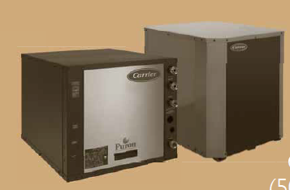
Proposal: Mechanical Depth
Introduction
Proposal
Mechanical Depth
Electrical & CM Breadth Mechanical Redesign
Electrical Breadth
CM Breadth
Conclusion
System: Ground Source Heat Pump
  System Type: Compare Closed Vertical & Horizontal
Total Load: 439.1 Ton
  For the 3 RTU
Pipe: Polyethylene Pipe
Units: Carrier 50YDS064NCP301

Slide 7
Proposal: Electrical Breadth
Proposal: Construction Breadth
Introduction
Proposal
Mechanical Depth
Electrical & CM Breadth
Mechanical Redesign
Electrical Breadth
CM Breadth
Conclusion
Size the major electrical equipment needed to make the proposed mechanical system work
Wire – Lowes 8 AWG
Panels – SquareD
Cost and Schedule analysis
Does not include actual cost for the building
  At owners request
Included
  Ground Source Heat Pump
  Electrical Work
  Construction Equipment

Slide 8
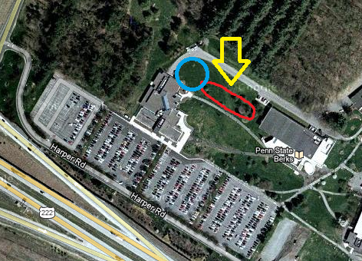
Mechanical Redesign: Site
Introduction
Proposal
Mechanical Redesign
Site
Pumps
Pipe
Energy Comparison
Recommendation
Electrical Breadth
CM Breadth
Conclusion
Location: Penn State Berks Campus outside of Reading, PA
Location for Pipe: Blue Circle

Slide 9
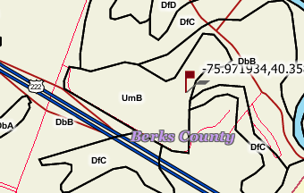
Mechanical Redesign: Site
Introduction
Proposal
Mechanical Redesign
Site
Pumps
Pipe
Energy Comparison
Recommendation
Electrical Breadth
CM Breadth
Conclusion
Flag: Location of Building
Soil Types:
  UmB: Urban Land Duffield Complex
    Urban Land:
      Depth: 10 – 100” lithic bedrock
      Water: Very Low about 0”
    Duffield Land:
      Depth: 48 – 120” lithic bedrock
      Water: High about 10.4”

Slide 10
Mechanical Redesign: Pumps
Introduction
Proposal
Mechanical Redesign
Site
Pumps
Pipe
Energy Comparison
Recommendation
Electrical Breadth
CM Breadth
Conclusion
Manufacturer: Carrier
Unit: 50YDS064NCP301
Size: 5 ton
Compressor: Copeland UltraTech Two Stage Scroll
Refrigerant: 168 ounces Puron
  Connections: 5/8 inch
Weight: 265 pounds
Water Connections: 1 inch Swivel
RTU | Quantity of Pumps | Cost per Pump | Total Cost
RTU-1 | 57 | $6,066 | $345,762
RTU-2 | 20 | $6,066 | $121,320
RTU-3 | 12 | $6,066 | $72,792
Total | 89 |  | $539,874

Slide 11
Mechanical Redesign: Pipe
Introduction
Proposal
Mechanical Redesign
Site
Pumps
Pipe
Energy Comparison
Recommendation
Electrical Breadth
CM Breadth
Conclusion
Vertical Requirements
Minimum Well Depth: 150 ft
  Minimum Pipe:
    1’ Pipe: 14,670 ft @ $14,097.87
    3/4” Pipe: 131,750 ft @ $55,440.40
Maximum Well Depth: 250 ft
  Maximum Pipe:
    1’ Pipe: 14,670 ft @ $14,097.87
    3/4” Pipe: 395,190 ft @ $166,295.95
Horizontal Requirements
Minimum 1” Pipe: 175,640 ft @ $168,790.04
Maximum 1” Pipe: 263,460 ft @ $253,185.06
Area: 2,500 Sq ft per ton
Two Rows of horizontal pipe
  Depth 1st layer: 3’
  Depth 2nd layer: 5’

Slide 12
Mechanical Redesign: Annual Energy Comparison
Introduction
Proposal
Mechanical Redesign
Site
Pumps
Pipe
Energy Comparison
Recommendation
Electrical Breadth
CM Breadth
Conclusion
Design | Energy Type | Consumption | Total Cost
Original Design | Electrical | 8,620,166 kWh | $ 877,249.75
Original Design | Gas | 903,312 kBtu | $ 6.77
Proposed Design | Electrical | 7,812,779 kWh | $ 795,731.31
Proposed Design | Gas | 0 kBtu | $ 0
Total Original Cost: $ 877,256.52
Cost per Square Foot Original: $14.12
Total Proposed Cost: $ 795,731.31
Cost per Square Foot Proposed: $12.80
Savings: $ 82,240.50
Cost per Square foot: $ 1.32
Payback period: 37 years

Slide 13
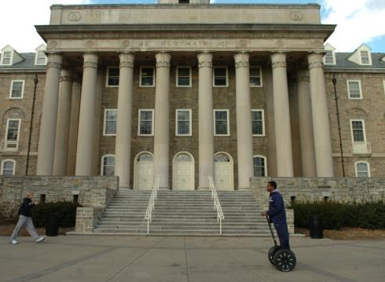
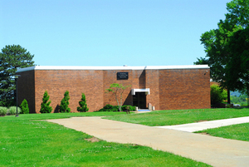
Mechanical Redesign: Recommendation
Introduction
Proposal
Mechanical Redesign
Site
Pumps
Pipe
Energy Comparison
Recommendation
Electrical Breadth
CM Breadth
Conclusion
72 Pumps would need another location besides the mechanical room
  Result: Structural Analysis of the roof to enclose the roof for at least 72 pumps of the 89 pumps
Total cost of system installed: $ 3,039,707.31
  Result: cost is in addition to the total building cost, who pays for it?
  37 years to see any payback on energy savings
Overall Recommendation:
good idea for one or all of the roof top units, if design was utilized prior to construction
37 year payback not bad considering the university park campus still has buildings build in the 1950s or earlier on campus

Slide 14
Electrical Breadth
Introduction
Proposal
Mechanical Redesign
Electrical Breadth
CM Breadth
Conclusion
Model | HWG Pump FLA | External Pump FLA | Total Unit FLA | Min Circuit Amps | Max Fuse/ HACR (2) | Supply Wire (2)
 |  |  |  |  |  | Min AWG | Max Length ft. (3)
064 | 0.4 | 4.0 | 30 | 36.4 | 60 | 8 | 81
Total FLA 30
Min circuit Amps 36.4
30 Amps is the max for 10 AWG wire NEC 2008
Min circuit amps is greater than 30 but less than the max for 8 AWG wire

Slide 15
Electrical Breadth
Introduction
Proposal
Mechanical Redesign
Electrical Breadth
CM Breadth
Conclusion
Material | Total Quantity | Cost per unit | Total cost
8 AWG wire | 3,693.5 LF | $176 /125 LF | $5,200.45
Panels | 5 Panels | $205.07/Panel | $1,025.35
Assumptions:
  Panels are located in the mechanical room
  All units are to be located in the mechanical room
  Panels can take up to 20 circuits

Slide 16
Construction Breadth
Introduction
Proposal
Mechanical Redesign
Electrical Breadth
CM Breadth
Conclusion
Material | Amount | Unit Cost | Total Cost
1” PE Pipe | 263,460 LF | $ 0.961/ LF | $ 253,185.06
Carrier 50YDS, 5 ton Unit | 89 Units | $ 6,066 / Unit | $ 539,874
Excavation work | 127,055 CY | $ 6.74 / CY | $ 856,276
Wire | 3,693.50 LF | $ 176 / 125 LF | $ 5,200.45
Panels | 5 Panels | $ 205.07 / Panel | $ 1,025.35
Total |  |  | $ 1,655,560.86

Slide 17
Construction Breadth
Introduction
Proposal
Mechanical Redesign
Electrical Breadth
CM Breadth
Conclusion
Material | Amount | Labor | Crew | Total Time | Cost | Total Cost
1” PE Pipe | 2,179,800 LF | 79.923 LF / Day / Plumber | 3 Plumbers | 1,099 Days | $33.25 / Hr / Plumber | $1,096,252.50
Carrier 50YDS, 5 ton Unit | 89 Units | 9 Hrs / Unit | 1 HVAC tech | 81 Days | $ 33.25 / hr | $ 26,932.50
Excavation work | 127,055 CY | 1 Excavator 6 Dozers | 1 driver 6 drivers | 80 Days 79 Days | $28.50 / driver / hr (both types) | $ 22,800 $ 135,090
Wire | 3,693.50 LF | 79.923 LF / Day / Electrician | 1 Electrician | 47 Days | $ 33.00 / hr/ electrician | $ 15,510
Panels | 5 Panels | 8 hrs / panel | 1 Electrician | 4 Days | $ 33.00 / hr/ electrician | $ 1,320
Total |  |  |  |  |  | $ 1,297,905

Slide 18
Construction Breadth
Introduction
Proposal
Mechanical Redesign
Electrical Breadth
CM Breadth
Conclusion
Material | Amount | Total Time
1” PE Pipe | 2,179,800 LF | 1,099 Days
Carrier Units | 89 Units | 81 Days
Excavation work | 127,055 CY | 80 Days
Wire | 3,693.50 LF | 47 Days
Panels | 5 Panels | 4 Days
Equipment | Total Used | Total Time
Excavator | 1 | 80 Days
Dozers | 6 | 79 Days
Crane | 1, 25 Ton | 103 Days Rented 89 Days on Site

Slide 19
Conclusions
Introduction
Proposal
Mechanical Redesign
Electrical Breadth
CM Breadth
Conclusion
Proposed system would save on energy costs
Total cost is over $3 million more than building costs
Additional mechanical space would be required
Payback period is 37 years
Critical Item on schedule is the pipe installation
Horizontal GSHP is used due to low depth of bedrock
2 layers were used due to lack of space around the building

Slide 20
Questions?

