Slide 1
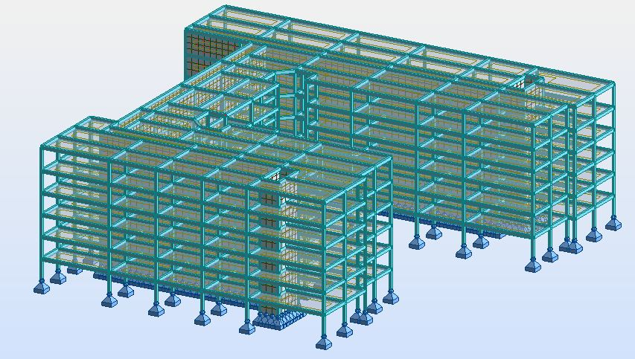
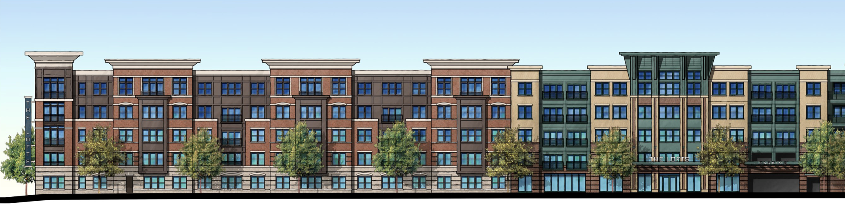
The Residences
Anne Arundel County , Maryland
Ryan English
Structural Option
AE 482 – Senior Thesis
Dr. Richard Behr – Faculty Advisor

Slide 2
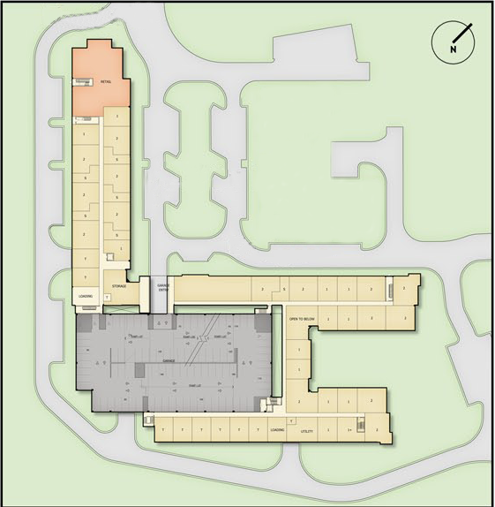
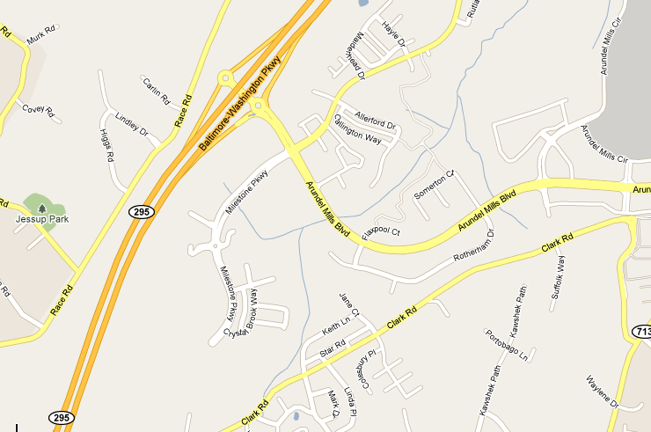
Building Statics
Introduction
Building Statics
Project Team
Architectural
Existing Structural
Proposal
Structural Redesign
Cost And Schedule Impact
Sustainability
Conclusion
Building name: The Residences
Location: Anne Arundel County, Maryland
Occupancy: Mix use, Residential /Retail
Size: 300,000 gross s.f.
Height: 5-6 stories, 60 ft
Dates of construction: September 2009- February 2011
Cost: $39 Million
Project delivery method: Design-bid-build
Ryan English Structural Option
AE 482 – Senior Thesis

Slide 3
Project Team
Introduction
Building Statics
Project Team
Architectural
Existing Structural
Proposal
Structural Redesign
Cost And Schedule Impact
Sustainability
Conclusion
Owner: Summerset Construction
General Contractor/Developer: Encore Developer
Architect: CE*X, Inc
Structural Engineer: Cates Engraining, Ltd.
Civil Engineer: Morris & Ritchie Associates, Inc.
MEP Engineer: Siegel, Rutherford, Bradstock & Ridgway, Inc.
Geotechnical: Geo-Technology Associates, Inc
Landscape Architect: The Faux Group, Inc
Ryan English Structural Option
AE 482 – Senior Thesis

Slide 4
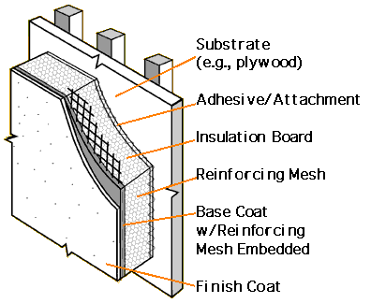
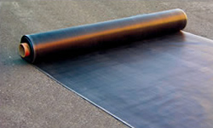
Architectural
Introduction
Building Statics
Project Team
Architectural
Existing Structural
Proposal
Structural Redesign
Cost And Schedule Impact
Sustainability
Conclusion
The building is part of the Arundel Preserve Town Center Phase I project
242 upscale residential units
clubhouse, health center, and an outside pool
Facade: brick veneer and Exterior Insulation Finishing System (EIFS)
Roofing: single-ply EPDM (ethylene propylene diene Monomer) membrane covering 2" rigid insulation
No predominate sustainability feature
Ryan English Structural Option
AE 482 – Senior Thesis

Slide 5
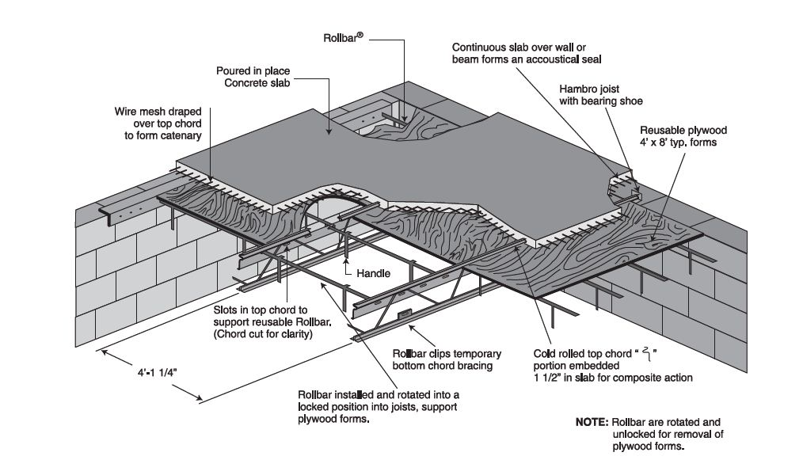
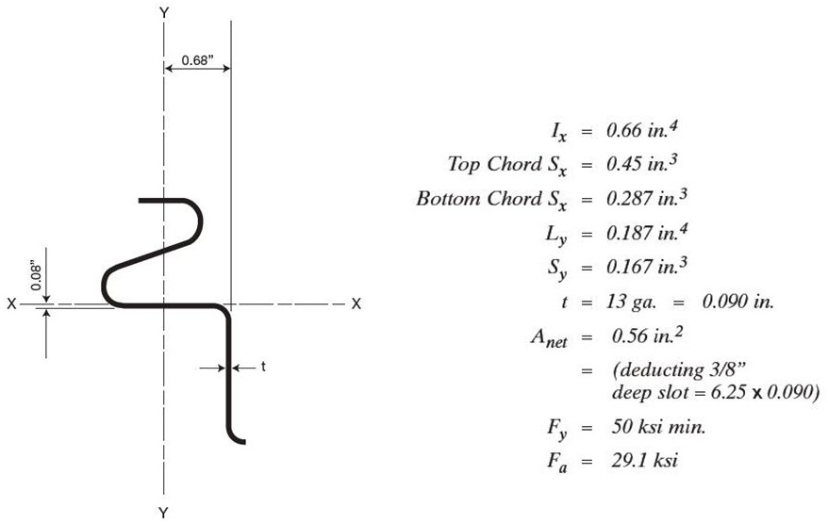
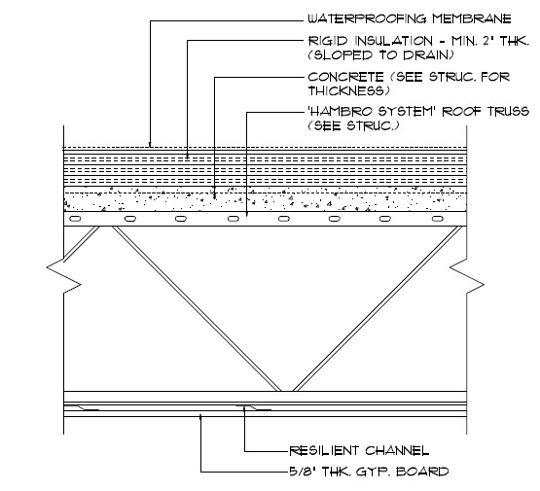
Floor System
Existing Structural
Introduction
Building Statics
Project Team
Architectural
Existing Structural
Proposal
Structural Redesign
Cost And Schedule Impact
Sustainability
Conclusion
the Hambro floor joist flooring system.
“s” shape top compression cord
  compression member
  chair for the welded wire fabric
  continuous shear connection
3” thick 3,000psi slab
20” deep Hambro bar joist
Ryan English Structural Option
AE 482 – Senior Thesis

Slide 6
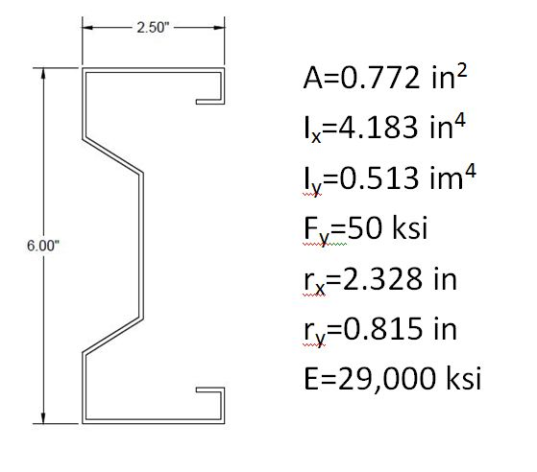
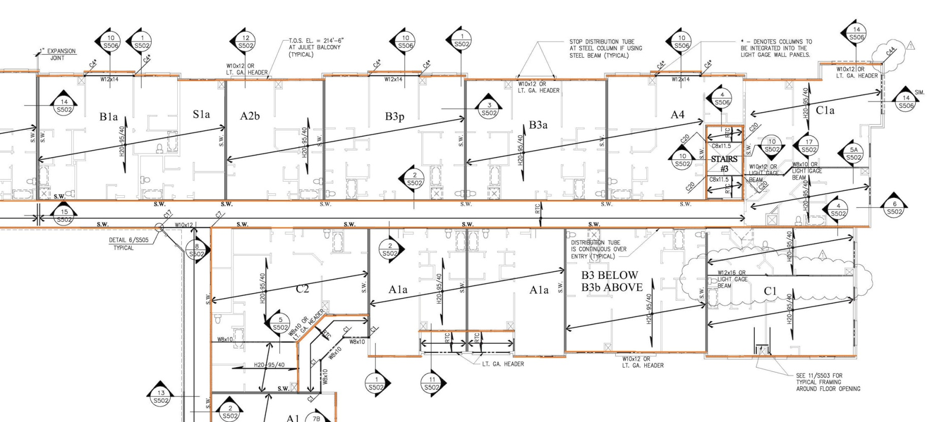
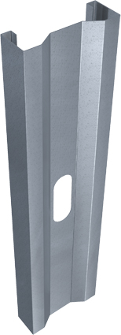
Gravity System
Existing Structural
Introduction
Building Statics
Project Team
Architectural
Existing Structural
Proposal
Structural Redesign
Cost And Schedule Impact
Sustainability
Conclusion
Light gage steel load bearing walls
SigmaStud® - Steel Network Company
Engineered Stud to have a significant increase in load capacity.
6” wide 18 gage stud
Ryan English Structural Option
AE 482 – Senior Thesis

Slide 7
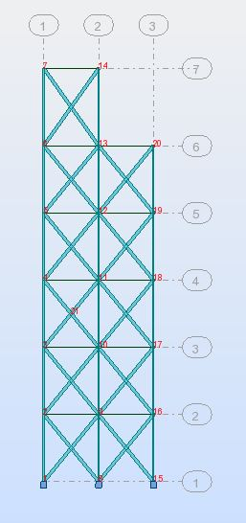
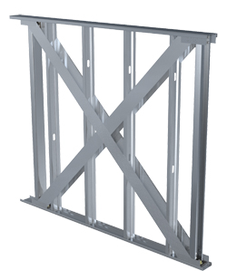
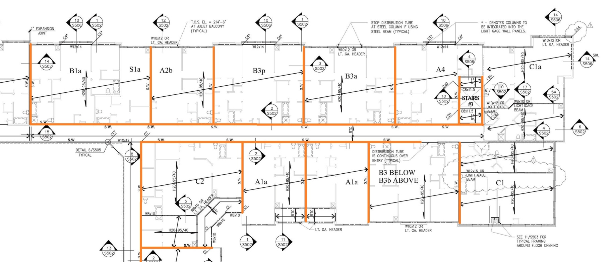
Lateral System
Existing Structural
Introduction
Building Statics
Project Team
Architectural
Existing Structural
Proposal
Structural Redesign
Cost And Schedule Impact
Sustainability
Conclusion
light gage shear wall system
Steel Network Company.
50 ksi 6” steel straps on both sides of the wall
Ryan English Structural Option
AE 482 – Senior Thesis

Slide 8
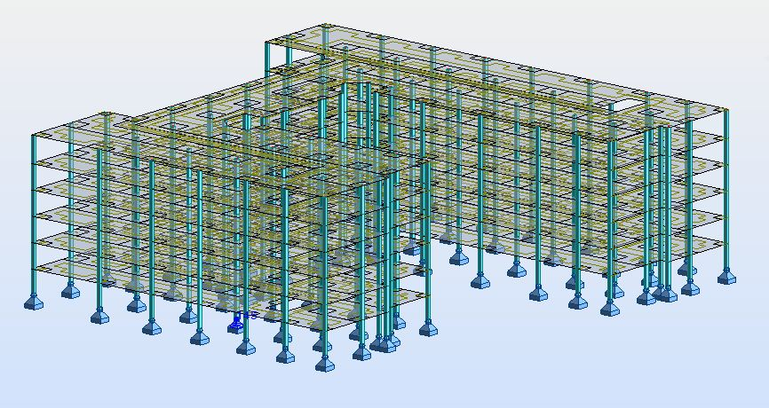
Proposal
Structural Depth
Introduction
Proposal
Structural Redesign
Cost And Schedule Impact
Sustainability
Conclusion
Redesign supper structural
  One Way Concrete Slab system
  Two Way Concrete Slab System
Redesign Lateral system
  Current Location
  High seismic location
  Concrete Shear Walls
  Added mass on roof
3D Modeling
  Autodesk Robot Structural Analysis
Ryan English Structural Option
AE 482 – Senior Thesis

Slide 9
Cost and Schedule Breadth
Sustainability Breadth
Introduction
Proposal
Structural Redesign
Cost And Schedule Impact
Sustainability
Conclusion
Cost comparison between the One Way Concrete Slab and Two Way Concrete Slab, and Original Design
Schedule Comparison between the One Way Concrete Slab, Two Way Concrete Slab, and Original Design
Green Roof layer study and design
Rain water retention
Load impact on gravity and lateral system.
Ryan English Structural Option
AE 482 – Senior Thesis

Slide 10
Design Goals
Structural Redesign
Introduction
Proposal
Structural Redesign
Design Goals
One Way Concrete Slab
Two Way Concrete Slab
Seismic Design
Cost And Schedule Impact
Sustainability
Conclusion
Compare the design of a One Way Concrete Slab and Two Way Concrete Slab
Investigate the effects of having an increase of mass on the roof lever in high seismic region
Not reduce the floor to ceiling height
Minimizes architectural impact
Use computer programs to aid in the design and analysis of the structural
Evaluate the validity and ease of use of Autodesk Robot Structural Analysis program
Ryan English Structural Option
AE 482 – Senior Thesis

Slide 11
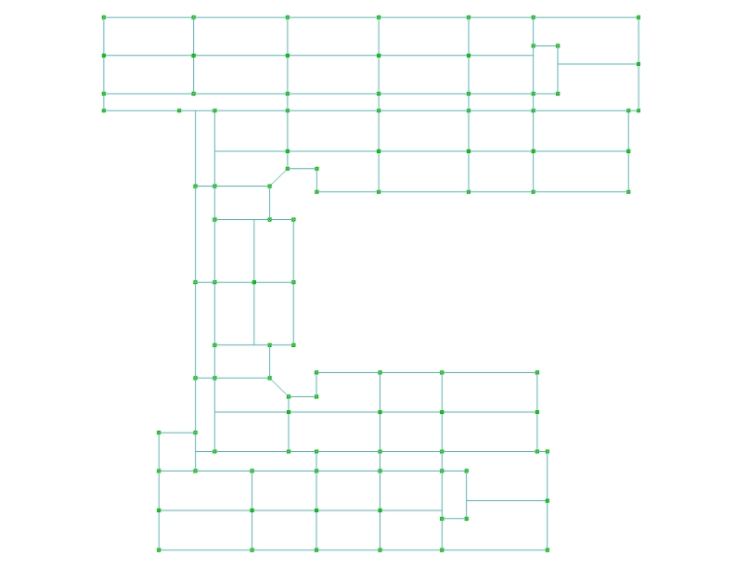
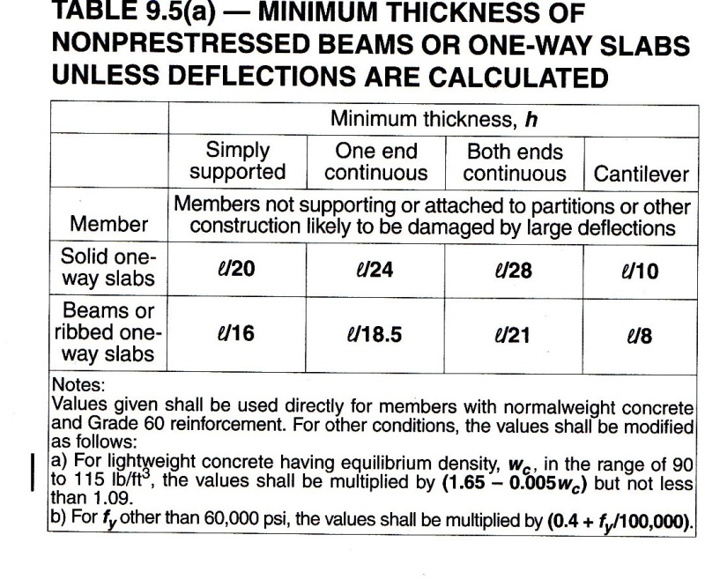
One Way Concrete Slab
Structural Redesign
Introduction
Proposal
Structural Redesign
Design Goals
One Way Concrete Slab
Two Way Concrete Slab
Seismic Design
Cost And Schedule Impact
Sustainability
Conclusion
Design Process
  Preliminary design- f’c= 4000 psi
  Determine slab thickness - L_{n} =15’ , t = 5”
  Determine beam height - L_{n} =30’, t=19”
  Preliminary Column size – 14” x 14”
  3D Model analysis
  Determine slab reinforcing
  Determine beam reinforcing
  Determine Column size and reinforcing
Ryan English Structural Option
AE 482 – Senior Thesis

Slide 12
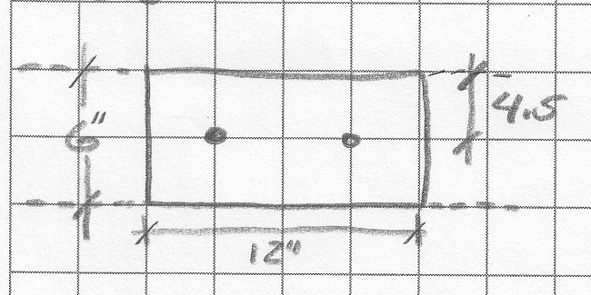
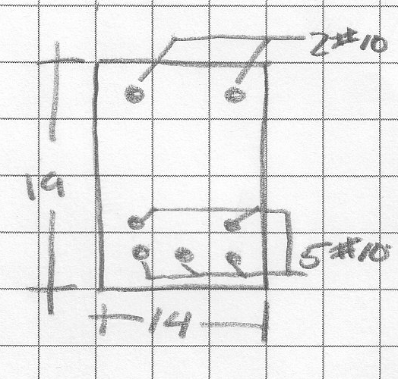
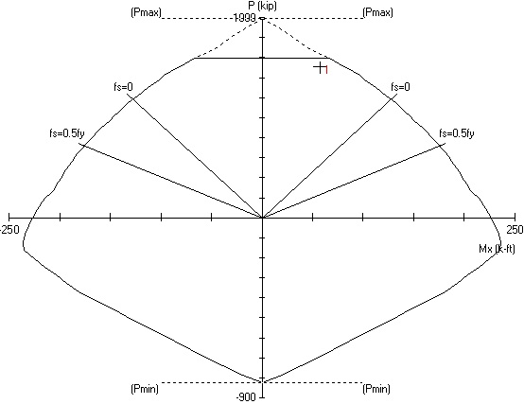
One Way Concrete Slab
Structural Redesign
Introduction
Proposal
Structural Redesign
Design Goals
One Way Concrete Slab
Two Way Concrete Slab
Seismic Design
Cost And Schedule Impact
Sustainability
Conclusion
Slab Reinforcing- A_{s,req} =Mu/4d, 2 #5 per ft.
Beam Reinforcing – Trial and error, As= 5#10, As’= 2#10
Column Reinforcing- Interaction Diagrams
  3 different section - 14”x14”
  1st - 2nd stories: 12#10
  3rd – 4th stories: 8#10
  5th – 6th stories: 4#10
Ryan English Structural Option
AE 482 – Senior Thesis

Slide 13
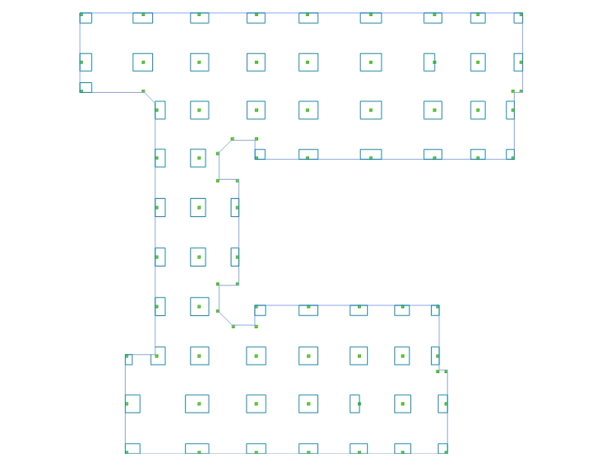
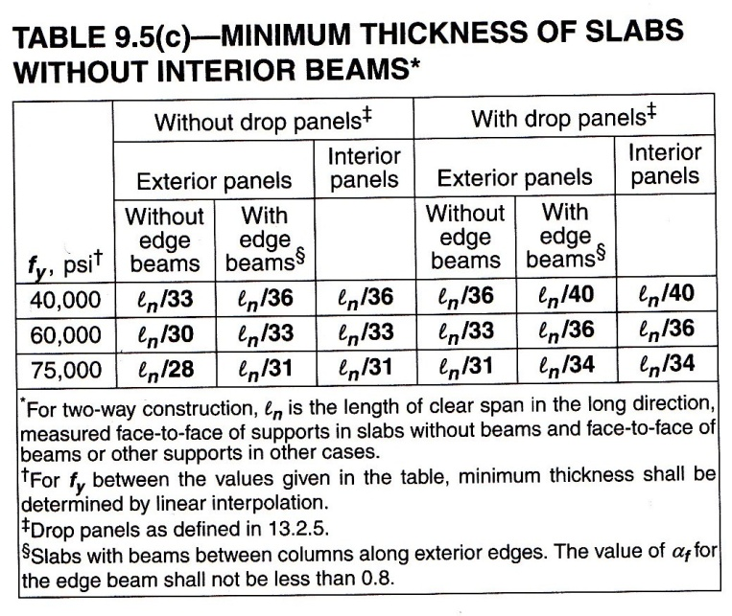
Two Way Concrete Slab
Structural Redesign
Introduction
Proposal
Structural Redesign
Design Goals
One Way Concrete Slab
Two Way Concrete Slab
Seismic Design
Cost And Schedule Impact
Sustainability
Conclusion
Design Process
  Preliminary design - f’c= 4000 psi
  Determine slab thickness - L_{n} =29’ , t = 10”
  Preliminary Column size 16”x16”
  3D Model analysis
  Determine slab reinforcing
  Determine Column size and reinforcing
  Check shear in slab
Ryan English Structural Option
AE 482 – Senior Thesis

Slide 14
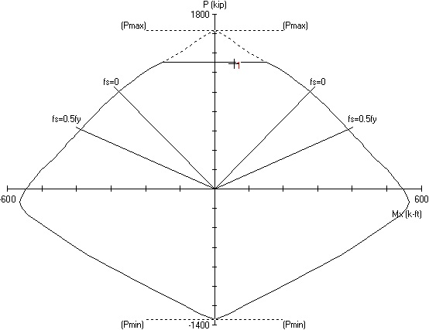
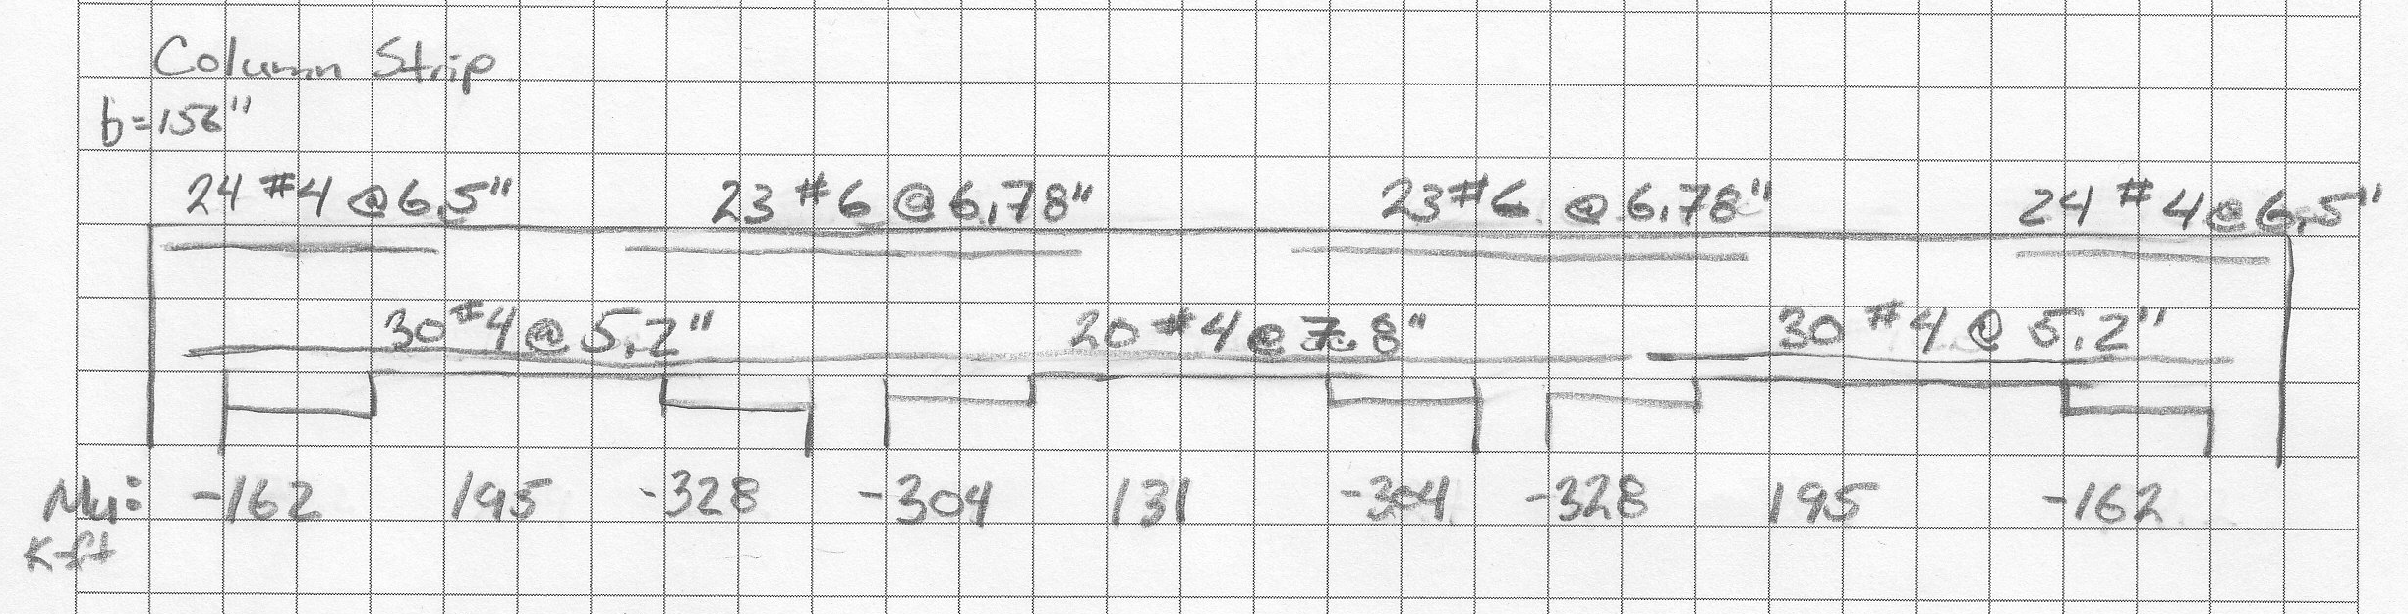
Two Way Concrete Slab
Structural Redesign
Introduction
Proposal
Structural Redesign
Design Goals
One Way Concrete Slab
Two Way Concrete Slab
Seismic Design
Cost And Schedule Impact
Sustainability
Conclusion
Slab Reinforcing- Direct Design Method, A_{s,req} =Mu/4d
Column Reinforcing- Interaction Diagrams
  3 different section
  1st - 2nd stories: 16#11 18”x18”
  3rd – 4th stories: 12#10 16”x16”
  5th – 6th stories: 8#8 16”x16”
Slab Shear
  One Way shear– ok
  Punching shear with out drop panel- Does not work
  Drop Panel- t = 15.25
Ryan English Structural Option
AE 482 – Senior Thesis

Slide 15
Lateral Design
Lateral Forces
Introduction
Proposal
Structural Redesign
Design Goals
One Way Concrete Slab
Two Way Concrete Slab
Seismic Design
Cost And Schedule Impact
Sustainability
Conclusion
Two seismic regions
  Current location (Low Seismic Region)
  Southern California (High Seismic Region )
Seismic Design Category
  Current location SDC: B
  High Seismic Region SDC: D
Lateral System
  Low Seismic Region- Ordinary Reinforced Concrete shear wall: R – 5, C_{d} – 4.5
  High Seismic Region – Special Reinforced Concrete shear wall: R – 6, C_{d} – 5
Equivalent Lateral Force and Modal Response Spectrum Analysis
  Low Seismic Region Base Shear
    One Way Slab: 819 kip
    Two Way Slab: 1,218 kip
  High Seismic Region Base Shear
    One Way Slab: 3,315 kip
    Two Way Slab: 4,931 kip
Ryan English Structural Option
AE 482 – Senior Thesis

Slide 16
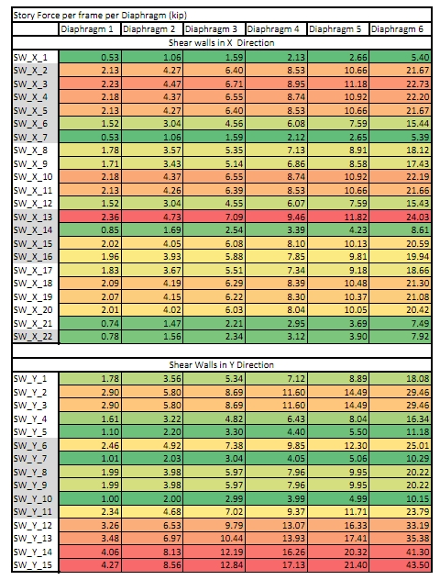
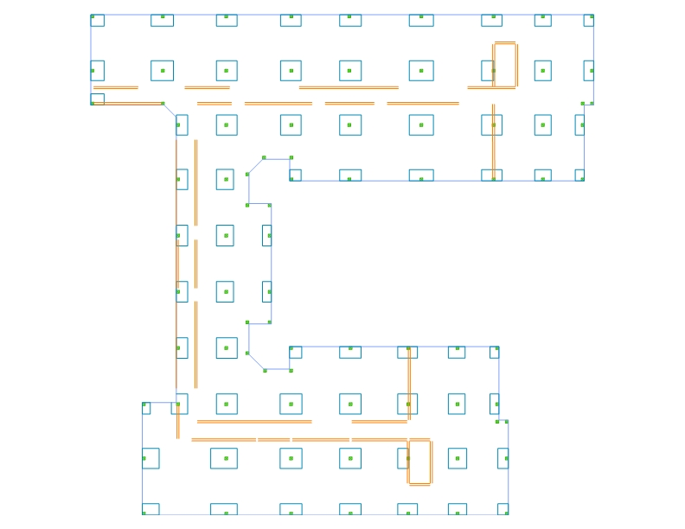
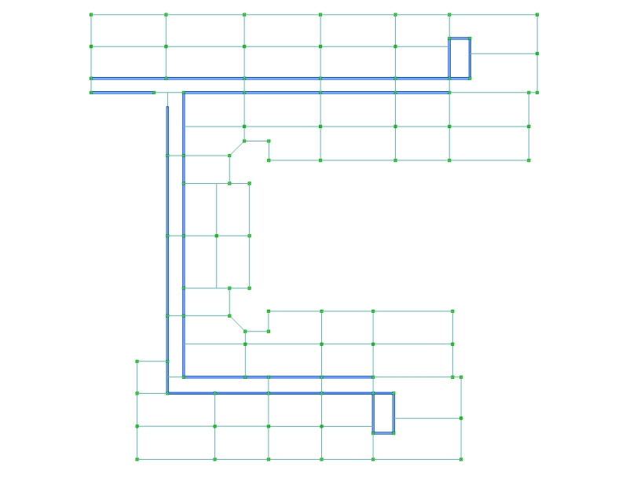
Lateral Design
Shear Wall Design
Introduction
Proposal
Structural Redesign
Design Goals
One Way Concrete Slab
Two Way Concrete Slab
Seismic Design
Cost And Schedule Impact
Sustainability
Conclusion
Preliminary shear wall location
Base Shear Force distribution
Shear Wall Design
Ryan English Structural Option
AE 482 – Senior Thesis

Slide 17
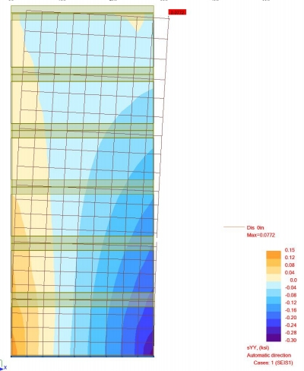
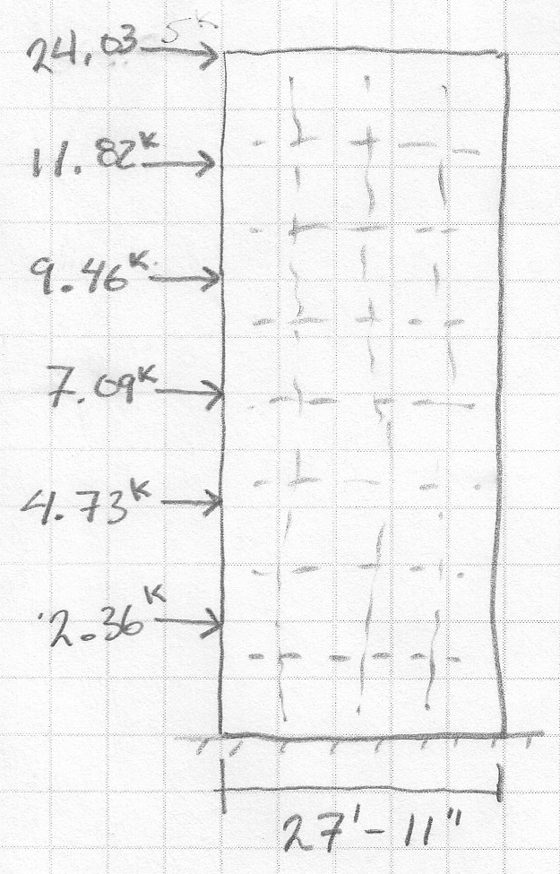
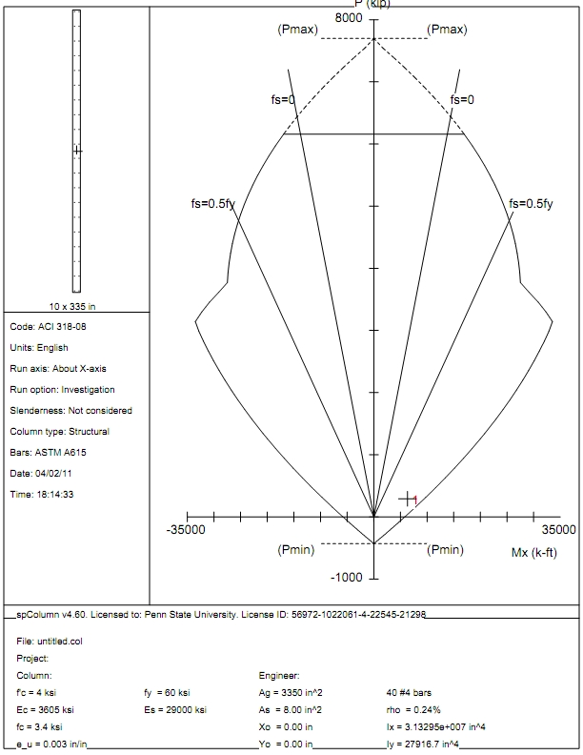
Lateral Design
Shear Wall Design
Introduction
Proposal
Structural Redesign
Design Goals
One Way Concrete Slab
Two Way Concrete Slab
Seismic Design
Cost And Schedule Impact
Sustainability
Conclusion
Ordinary Reinforced Concrete shear wall f’c =4000psi t=10”
  Determine Required Load (V_{u}, M_{u}, P_{u})
    1.2D +1.0E
    0.9D +1.0E
    Determine Shear Wall reinforcing
      ACI 318-08 – Chapter 14 Walls
  Shear Wall - Interaction Diagrams
  Computer Model
V_{u} – 55.49 kip
M_{u} – 6,310 k-ft
P_{u} – 221 kip
P_{u} – 292 kip
< øV_{n} 127.10 kip = 0.5 * 0.75 2 * A_{cv} * √f’_{c}
Ryan English Structural Option
AE 482 – Senior Thesis

Slide 18
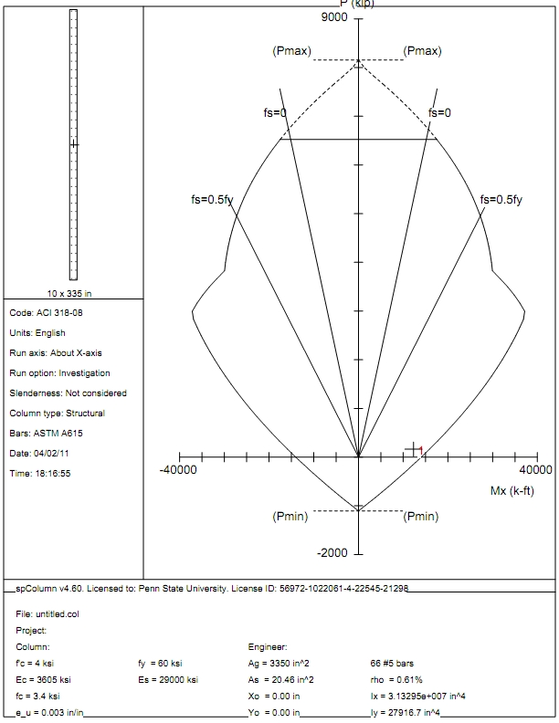
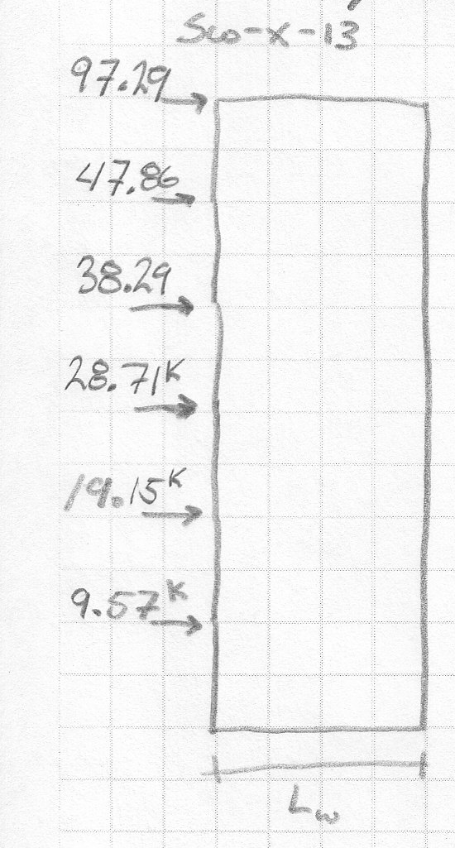
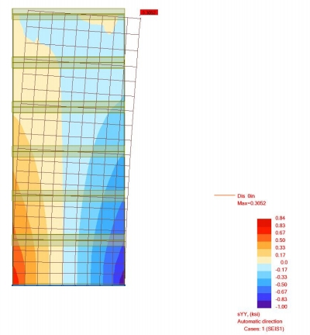
Lateral Design
Shear Wall Design
Introduction
Proposal
Structural Redesign
Design Goals
One Way Concrete Slab
Two Way Concrete Slab
Seismic Design
Cost And Schedule Impact
Sustainability
Conclusion
Special Reinforced Concrete shear wall f’c =4000psi t=10”
  Determine Required Load (V_{u}, M_{u}, P_{u})
    1.2D +1.0E
    0.9D +1.0E
    Determine Shear Wall reinforcing
      ACI 318-08 – Chapter 21.9 Special structural walls
      #4 at 14” -> øV_{n} 591.9 kip
  Shear Wall - Interaction Diagrams
  Check Boundary Element
    C≥ l_{w}/600(δ_{u}/h_{w}), c= 38.65” < 79.8”
  Computer Model
V_{u} – 240.84 kip
M_{u} – 12,310 k-ft
P_{u} – 164.8 kip
P_{u} – 328.6 kip
< øV_{n} 211.9 kip Shear reinforcing needed
Ryan English Structural Option
AE 482 – Senior Thesis

Slide 19
Lateral Design
Story Drifts
Introduction
Proposal
Structural Redesign
Design Goals
One Way Concrete Slab
Two Way Concrete Slab
Seismic Design
Cost And Schedule Impact
Sustainability
Conclusion
One Way | Current location
Story |  | Story Drift (in) | Drift Ratio | Total Drift (in)
1 | 0.033 | 0.150 | 0.11% | 0.150
2 | 0.057 | 0.255 | 0.19% | 0.405
3 | 0.076 | 0.340 | 0.26% | 0.745
4 | 0.092 | 0.414 | 0.31% | 1.160
5 | 0.105 | 0.471 | 0.36% | 1.630
6 | 0.122 | 0.548 | 0.38% | 2.178
Two Way | Current location
Story |  | Story Drift (in) | Drift Ratio | Total Drift (in)
1 | 0.135 | 0.607 | 0.46% | 0.607
2 | 0.191 | 0.861 | 0.65% | 1.468
3 | 0.233 | 1.048 | 0.79% | 2.515
4 | 0.249 | 1.120 | 0.85% | 3.635
5 | 0.271 | 1.219 | 0.92% | 4.854
6 | 0.305 | 1.371 | 0.95% | 6.224
One Way | High Seismic
Story |  | Story Drift (in) | Drift Ratio | Total Drift (in)
1 | 0.141 | 0.705 | 0.53% | 0.705
2 | 0.239 | 1.195 | 0.90% | 1.900
3 | 0.319 | 1.596 | 1.21% | 3.496
4 | 0.389 | 1.945 | 1.47% | 5.441
5 | 0.442 | 2.210 | 1.67% | 7.650
6 | 0.514 | 2.571 | 1.79% | 10.221
Two Way | High Seismic
Story |  | Story Drift (in) | Drift Ratio | Total Drift (in)
1 | 0.300 | 1.349 | 1.02% | 1.349
2 | 0.425 | 1.913 | 1.45% | 3.262
3 | 0.517 | 2.328 | 1.76% | 5.590
4 | 0.553 | 2.489 | 1.89% | 8.079
5 | 0.562 | 2.528 | 1.92% | 10.607
6 | 0.635 | 2.856 | 1.98% | 13.463
Ryan English Structural Option
AE 482 – Senior Thesis

Slide 20
Design Goals
Cost And Schedule
Introduction
Proposal
Structural Redesign
Cost And Schedule Impact
Design Goals
Cost Analysis
Schedule Analysis
Sustainability
Conclusion
Compare the results to the original design
Reduce the cost of the structure
Reduce the schedule of the structure
Ryan English Structural Option
AE 482 – Senior Thesis

Slide 21
Cost
Schedule
Introduction
Proposal
Structural Redesign
Cost And Schedule Impact
Design Goals
Cost Analysis
Schedule Analysis
Sustainability
Conclusion
RS Means 2010 and retail values
Cost based on columns, slab, beam, and walls
Original design is assumed to have foundation cost included
RS Means
Overlapping of tasks
Schedule Summary
 | # Days
One Way Concrete Slab | 375
Two Way Concrete Slab | 262
Original Design | 267
 | One Way Slab | Two Way Slab | Original Design
Cost | $4.6 million | $4.4 million | $10.5 million**
Cost per SF | $170.08 | $162.78 | $183.96
Ryan English Structural Option
AE 482 – Senior Thesis

Slide 22
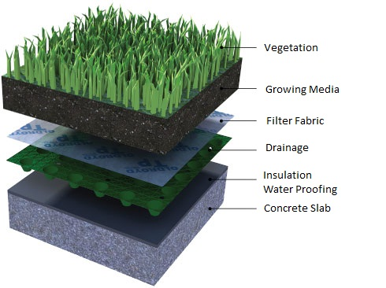
Design Goals
Green Roof Design
Introduction
Proposal
Structural Redesign
Cost And Schedule Impact
Sustainability
Design Goals
Green Roof Design
Conclusion
Retain and collect rain water runoff.
Gray water collection system.
Accessibility to building occupants.
6” extensive green roof
Layers of Green Roofs:
Vegetation
Growing Media
Filter Fabric
Drainage
Insulation
Water Proofing
Ryan English Structural Option
AE 482 – Senior Thesis

Slide 23
Green Roof Design
Green Roof Design
Introduction
Proposal
Structural Redesign
Cost And Schedule Impact
Sustainability
Design Goals
Green Roof Design
Conclusion
Climate data (original location, 5 year study)
    Max Temp. 100 °F
    Min Temp. 8 °F
    Max rain 3.0”
  Three important layers: Vegetation, Growing Media, and Drainage
  Vegetation: Resist the climate.
  Growing Media: Organic matter.
  Drainage: Take excess water.
Lightweight Aggregate | 50%-70%
Organic Material | 10%-20%
Sand | 20%-30%
Ryan English Structural Option
AE 482 – Senior Thesis

Slide 24
Conclusion
Acknowledgements
Introduction
Proposal
Structural Redesign
Cost And Schedule Impact
Sustainability
Conclusion
Structural Redesign
    Adding mass on the roof lever is important in high seismic region
    The Two Way Concrete Slab did not minimizes architectural impact
  Cost and Schedule
    A Two Way Concrete Slab was cheaper and shorter schedule than a One Way Concrete Slab
  Sustainability
    Important to design the right Vegetation, Growing Media, and Drainage
Cates Engineering
Mike Stansbury
Tim Kowalcyk
Architectural Engineering
Dr. Richard A. Behr
Professor M. Kevin Parfitt
A special thanks to family, friends, and classmates because the accomplishments over the past five years could not have been possible without their support and friendship.
Ryan English Structural Option
AE 482 – Senior Thesis

Slide 25
Introduction
Proposal
Structural Redesign
Cost And Schedule Impact
Sustainability
Conclusion
Questions
Ryan English Structural Option
AE 482 – Senior Thesis

