Slide 1
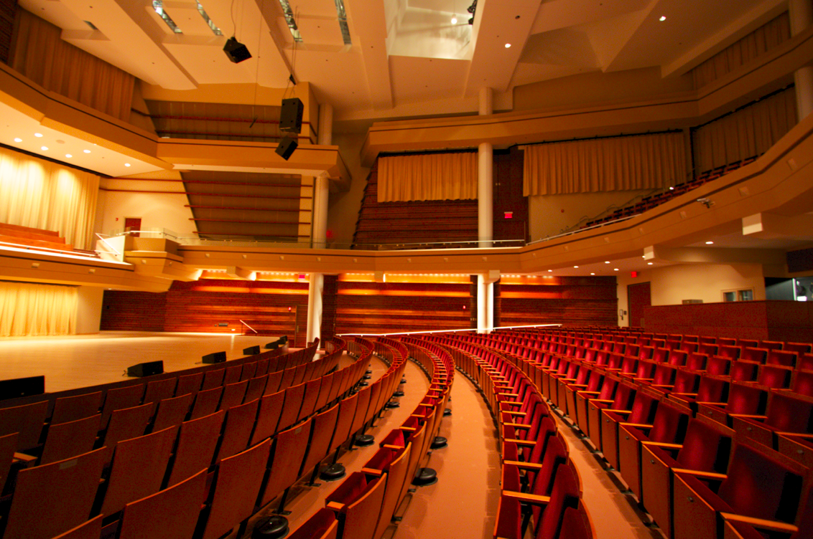
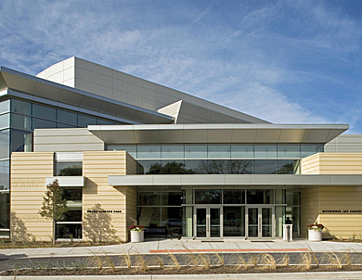
Wentz Concert Hall and Fine Arts Center
Will Lesieutre
Lighting / Electrical Option
Advisors: Dr. Mistrick, Prof. Dannerth
http://www.educationdesignshowcase.com/view.esiml?pid=272

Slide 2
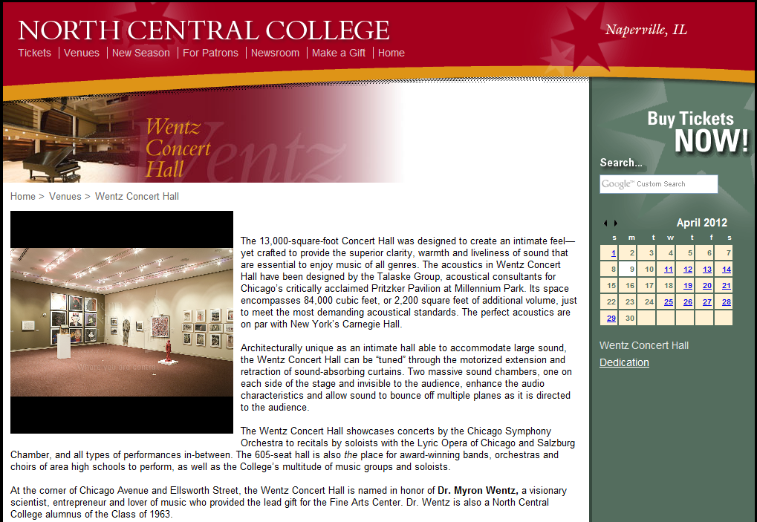
Project Introduction
Introduction
Design Concept
Lighting Designs
  Main Lobby
  Concert Hall
  Facade
  Rehearsal Room
Electrical Depth
Conclusion
North Central College
171 E Chicago Ave
Naperville, Illinois
Size: 57,000 ft²
Completed in 2008
605 seats
Second performing arts facility
Built for outstanding acoustics

Slide 3
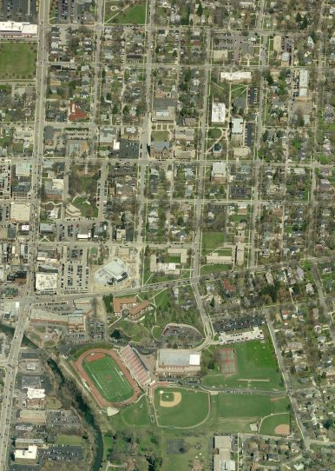
Project Introduction
Introduction
Design Concept
Lighting Designs
  Main Lobby
  Concert Hall
  Facade
  Rehearsal Room
Electrical Depth
Conclusion
"One of the most 'live' rooms in the area, its acoustics proved vivid and vibrant at all volume levels...Better still, the Wentz offered a clarity of orchestral detail lost in many other concert halls
-Howard Reich, Chicago Tribune
Campus/Downtown location
Naperville’s first art gallery
Aerial image via Bing Maps

Slide 4
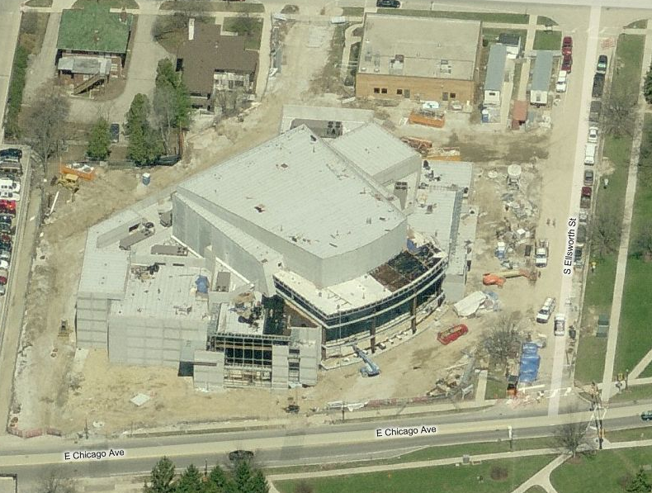
Project Introduction
Introduction
Design Concept
Lighting Designs
  Main Lobby
  Concert Hall
  Facade
  Rehearsal Room
Electrical Depth
Conclusion
Owner: North Central College
Architect: Loebl Schlossman and Hackl
Lighting: Schuler Shook
Acoustics: Talaske
Construction: Gilbane
Aerial image via Bing Maps

Slide 5
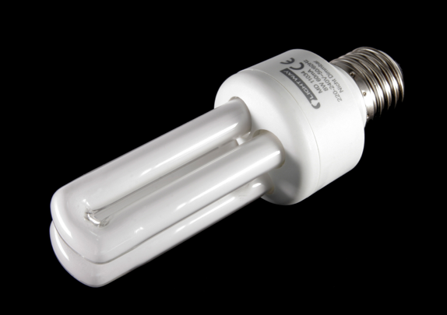
Lighting Redesign Concepts
Introduction
Design Concept
Lighting Designs
  Main Lobby
  Concert Hall
  Facade
  Rehearsal Room
Electrical Depth
Conclusion
Design with linear architecture
Energy efficiency
Community landmark
Welcoming environment
Image Credit:
http://raoulpop.com/2010/02/09/cfl-vs-led-rate-of-adoption/

Slide 6
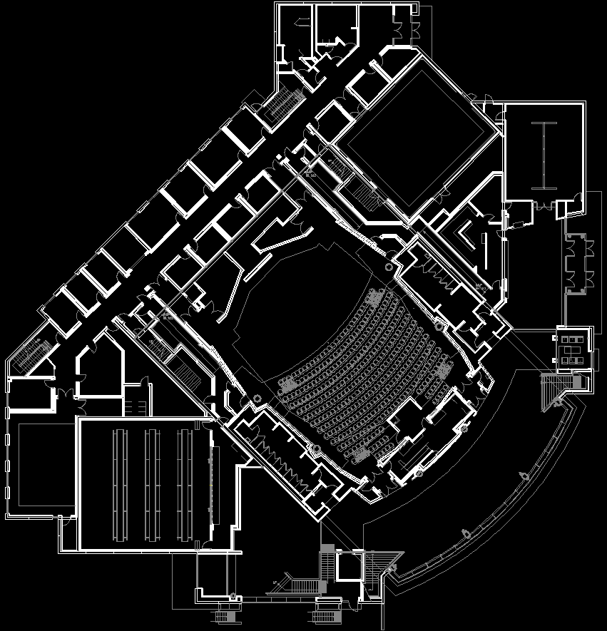
Lighting Redesign Spaces
Introduction
Design Concept
Lighting Designs
  Main Lobby
  Concert Hall
  Facade
  Rehearsal Room
Electrical Depth
Conclusion
Main Lobby (Red)
Concert Hall (Blue)
Façade
Rehearsal Room (Green)

Slide 7
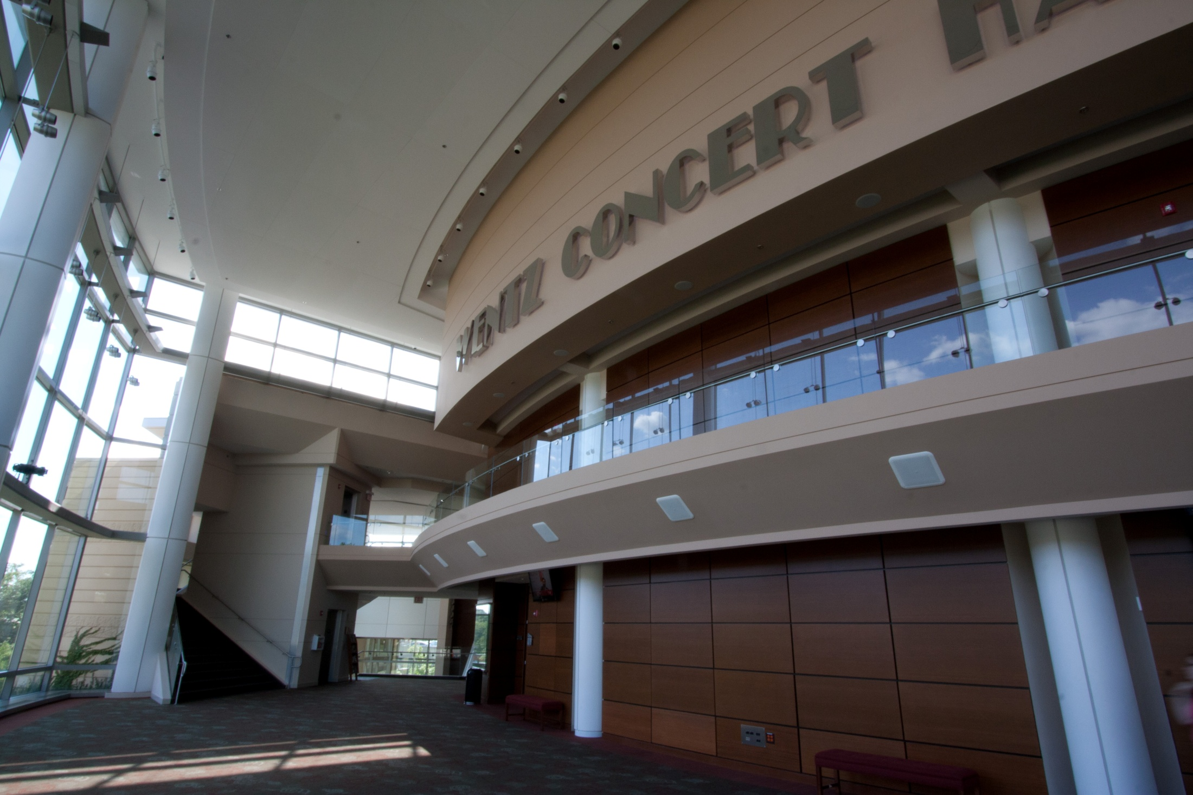
Main Lobby
Introduction
Design Concept
Lighting Designs
  Main Lobby
  Concert Hall
  Facade
  Rehearsal Room
Electrical Depth
Conclusion
Two stories high
Lower ceiling by main entry
  Coat check
  Box office
  Art gallery
Large curtain wall
  Interior visible from outside

Slide 8
Design Considerations
Introduction
Design Concept
Lighting Designs
  Main Lobby
  Concert Hall
  Facade
  Rehearsal Room
Electrical Depth
Conclusion
Illuminance
  15 fc horizontal at floor
    Avg:Min 3:1
  7.5 fc vertical at 5 ft. AFF
    Avg:Min 3:1
Dimmable to < 5 fc
Avoid glare
Reduce energy use

Slide 9
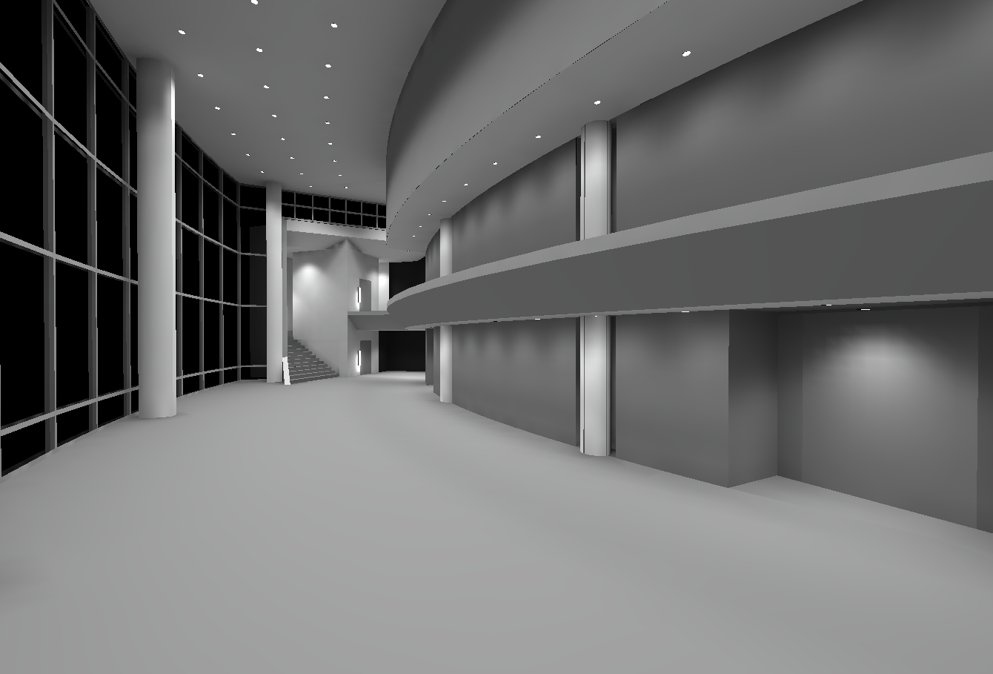
Solution
Introduction
Design Concept
Lighting Designs
  Main Lobby
  Concert Hall
  Facade
  Rehearsal Room
Electrical Depth
Conclusion
Primarily compact fluorescent
General illumination from downlights
Wall washers lighting wood wall
Linear LED arch to mark transition to concert hall

Slide 10
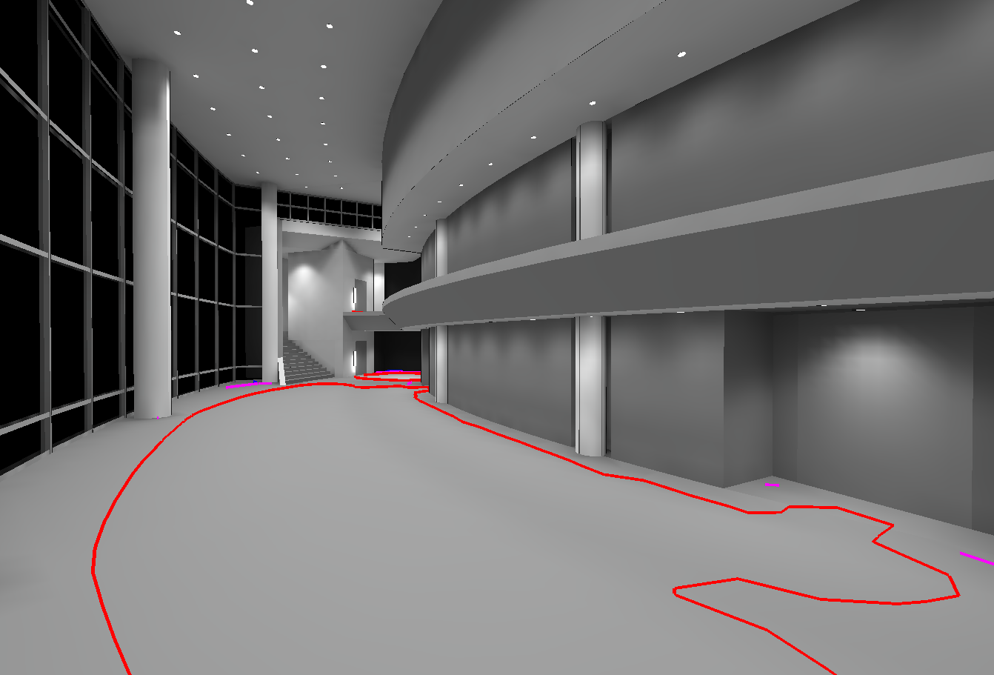
Performance
Introduction
Design Concept
Lighting Designs
  Main Lobby
  Concert Hall
  Facade
  Rehearsal Room
Electrical Depth
Conclusion
Average illuminance
  14.6 fc horizontal
    Target 15 fc
  5.0 fc vertical
    Target 7.5 fc
Magenta: 10 fc Red: 15 fc

Slide 11
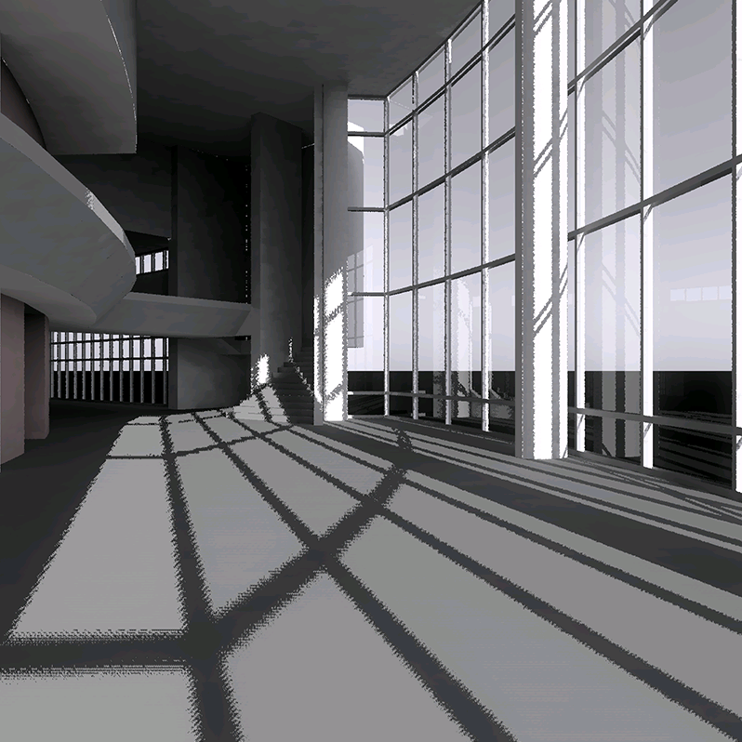
[MAE] Flux Transfer Theory
Introduction
Design Concept
Lighting Designs
  Main Lobby
  Concert Hall
  Facade
  Rehearsal Room
Electrical Depth
Conclusion
Main lobby rendered using Radiance
Daylight is December 21st, 2 PM local time
Shows significant daylight penetration

Slide 12
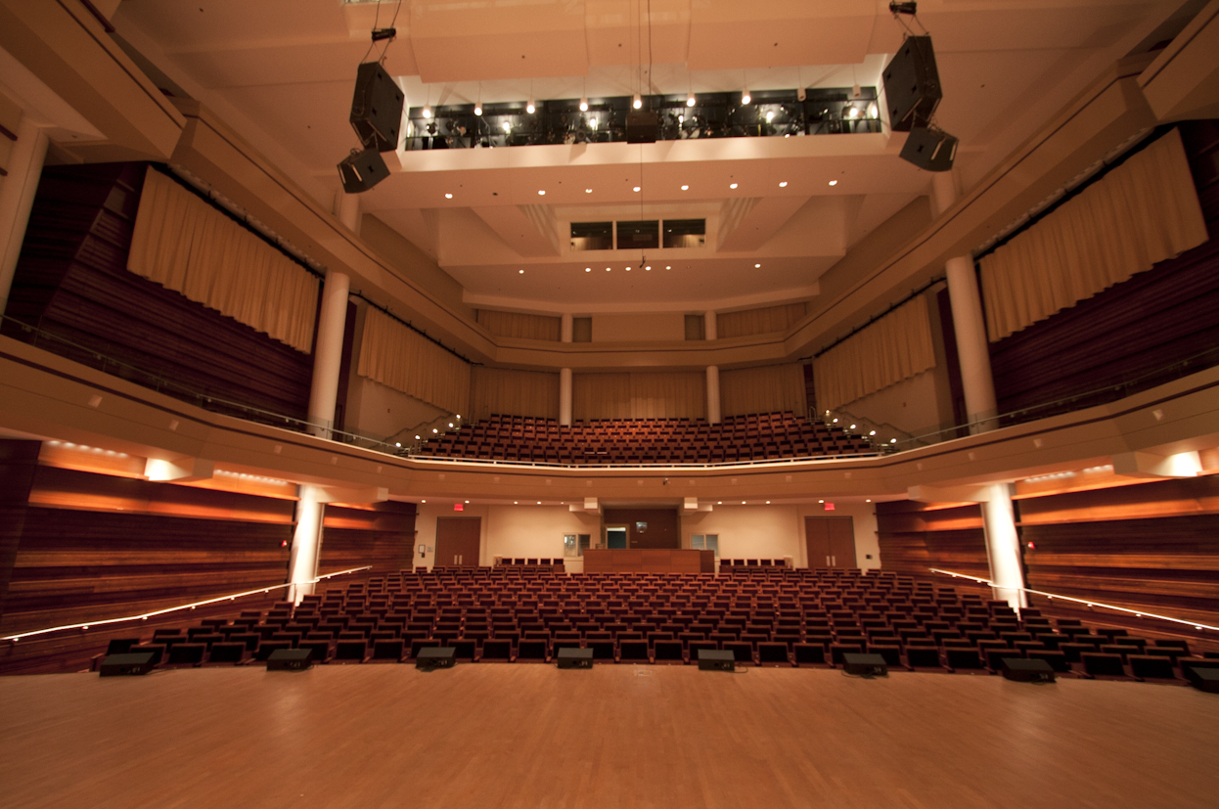
Concert Hall
Introduction
Design Concept
Lighting Designs
  Main Lobby
  Concert Hall
  Facade
  Rehearsal Room
Electrical Depth
Conclusion
First floor and balcony level seating
Entrances at rear of first floor and sides of balcony
Levels separated by angular shelf
Control booth at rear below balcony

Slide 13
Design Considerations
Introduction
Design Concept
Lighting Designs
  Main Lobby
  Concert Hall
  Facade
  Rehearsal Room
Electrical Depth
Conclusion
Illuminance
  10 fc horizontal at floor
    Avg:Min 2:1
  3 fc vertical at 5 ft. AFF
    Avg:Min 2:1
Smooth dimming to 0%
Consistent color rendering
Noise sensitive space
Upper lighting positions restricted by catwalks

Slide 14
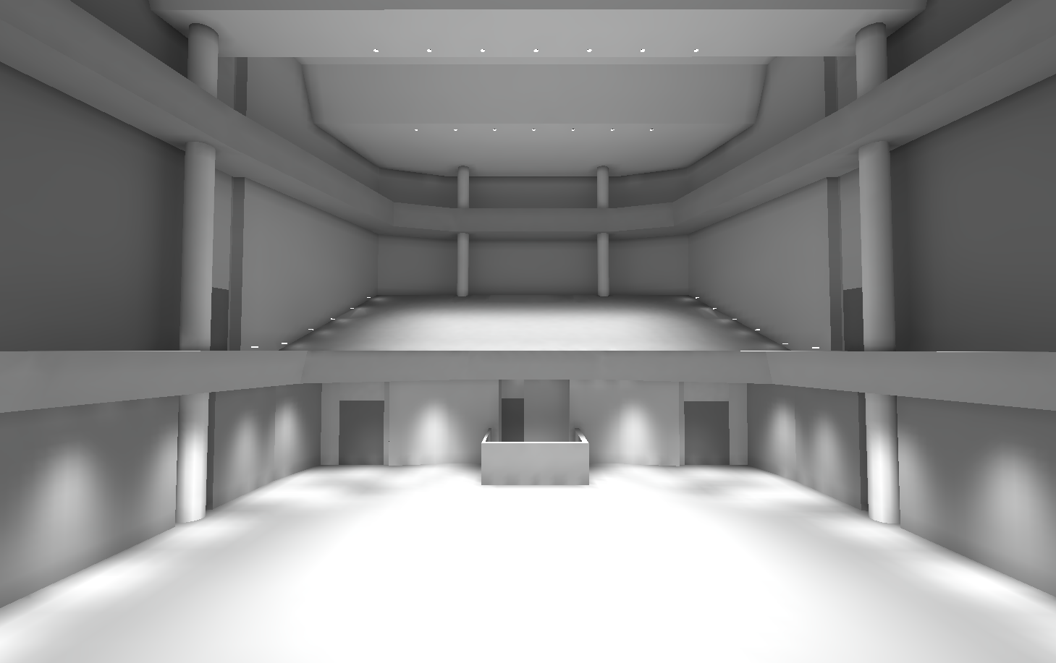
Solution
Introduction
Design Concept
Lighting Designs
  Main Lobby
  Concert Hall
  Facade
  Rehearsal Room
Electrical Depth
Conclusion
General illumination by incandescent downlights
Architectural accents using linear LEDs

Slide 15
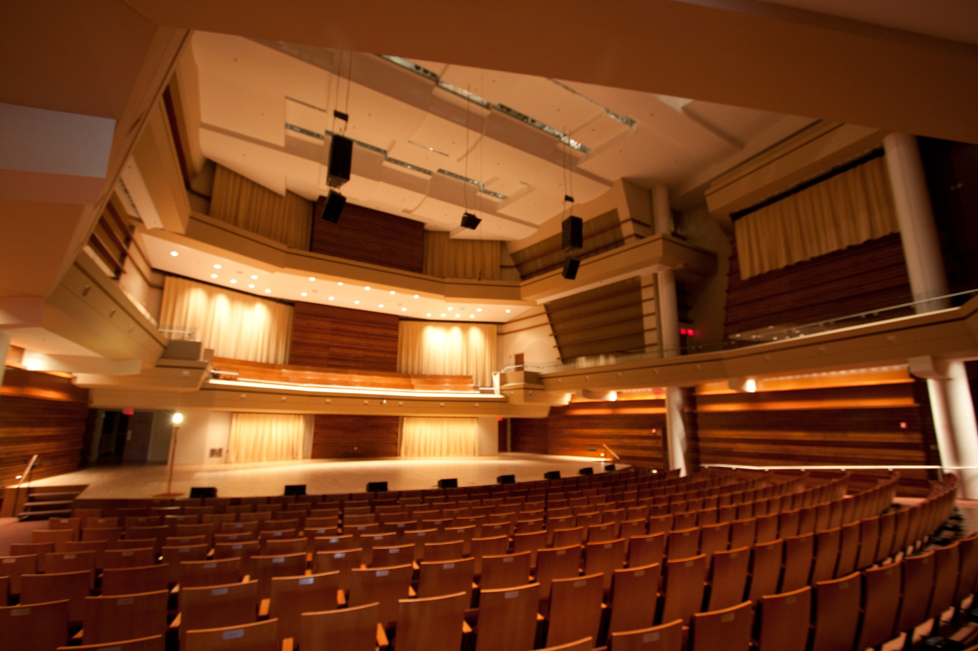
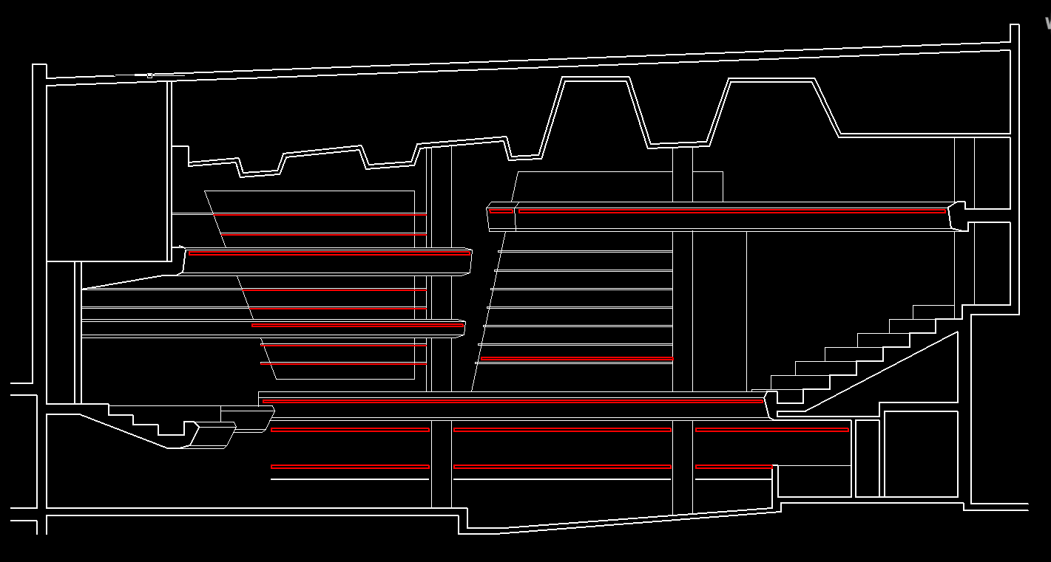
Architectural Breadth
Introduction
Design Concept
Lighting Designs
  Main Lobby
  Concert Hall
  Facade
  Rehearsal Room
Electrical Depth
Conclusion
Create more opportunities for lighting
Enhance transition from seating to stage
Added a middle level shelf
  Produces an arched form on the side walls of the stage
  Integrates with linear lighting in other shelves

Slide 16
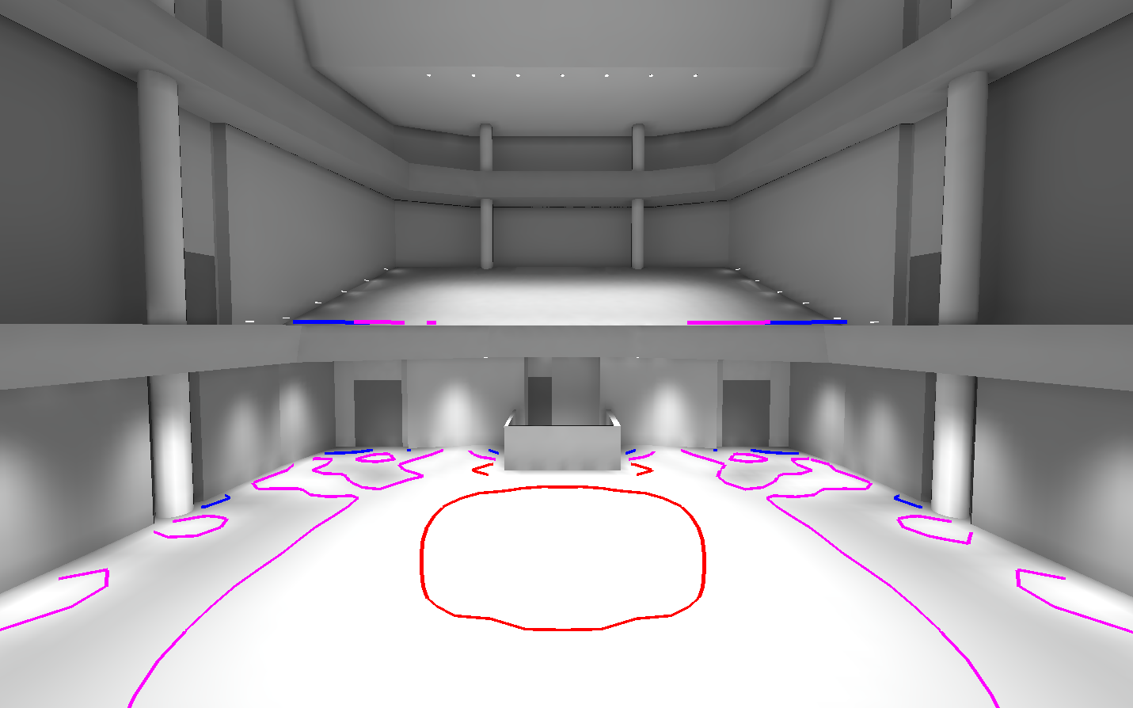
Performance
Introduction
Design Concept
Lighting Designs
  Main Lobby
  Concert Hall
  Facade
  Rehearsal Room
Electrical Depth
Conclusion
Average illuminance
  11.2 fc horizontal
    Target 10 fc
  2 fc vertical
    Target 3 fc
Blue: 5 fc Magenta: 10 fc Red: 15 fc

Slide 17
Facade
Introduction
Design Concept
Lighting Designs
  Main Lobby
  Concert Hall
  Facade
  Rehearsal Room
Electrical Depth
Conclusion
Large curtain walls
  Entries not in solid walls
Architectural precast panels
Metal cornice
High concert hall block
http://www.educationdesignshowcase.com/view.esiml?pid=272

Slide 18
Design Considerations
Introduction
Design Concept
Lighting Designs
  Main Lobby
  Concert Hall
  Facade
  Rehearsal Room
Electrical Depth
Conclusion
Illuminance
  7.5 fc maximum to highlight façade features
  3 fc for large illuminated areas
Create a landmark appearance
  Should be recognizable from a distance at night
http://www.educationdesignshowcase.com/view.esiml?pid=272

Slide 19
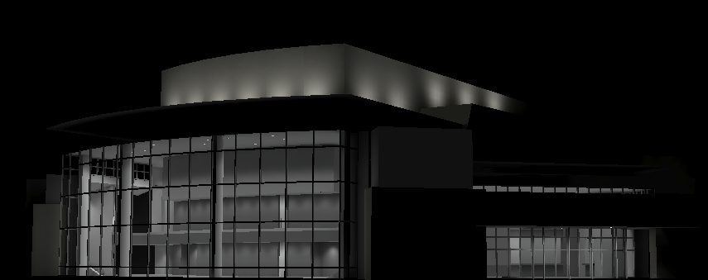
Solution
Introduction
Design Concept
Lighting Designs
  Main Lobby
  Concert Hall
  Facade
  Rehearsal Room
Electrical Depth
Conclusion
Light upper wall with color changing LEDs
Colored lighting uncommon in the area
  Makes the building highly visible
Allows lobby interior lighting to maintain high contrast

Slide 20
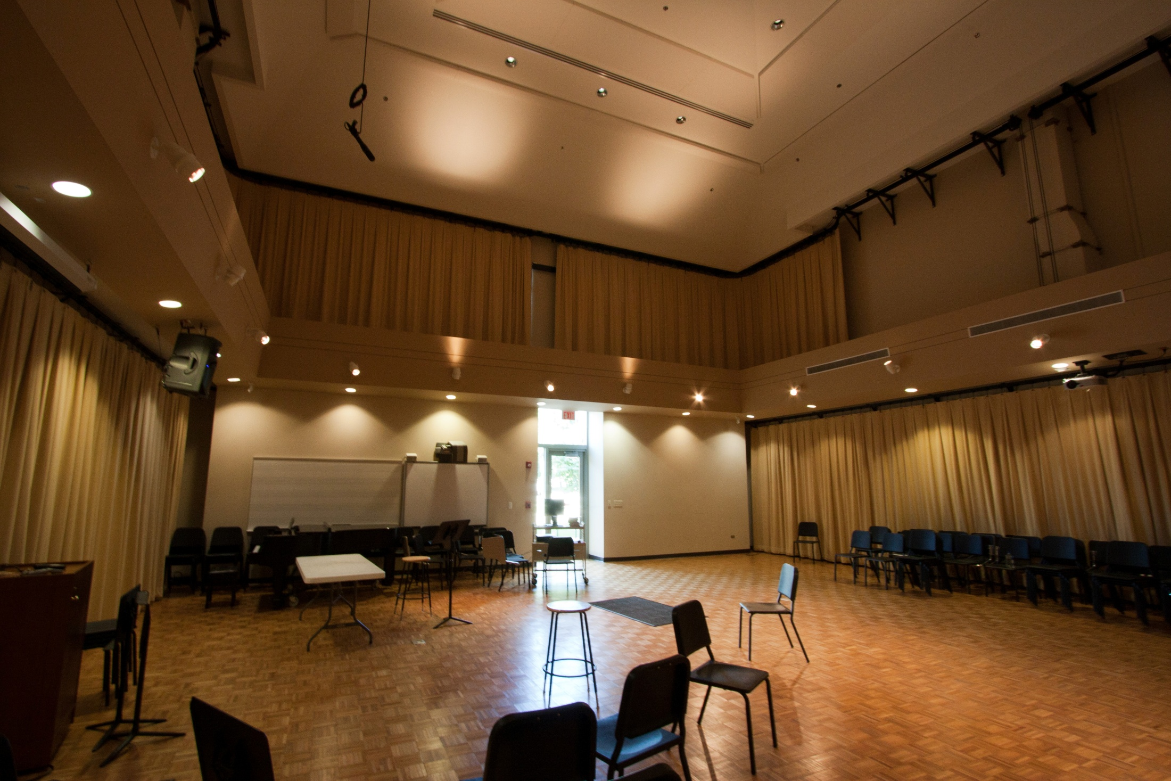
Rehearsal Room
Introduction
Design Concept
Lighting Designs
  Main Lobby
  Concert Hall
  Facade
  Rehearsal Room
Electrical Depth
Conclusion
Multifunction space
  Music classroom
  Rehearsal space
Two floors divided by technical shelf
No fixed furniture
  Seats and music stands are freely positionable

Slide 21
Design Considerations
Introduction
Design Concept
Lighting Designs
  Main Lobby
  Concert Hall
  Facade
  Rehearsal Room
Electrical Depth
Conclusion
Illuminance
  30 fc horizontal at floor
    Avg:Min 2:1
  20 fc vertical at 4 ft. AFF
    Avg:Min 2:1
  High vertical illuminance is required for reading sheet music

Slide 22
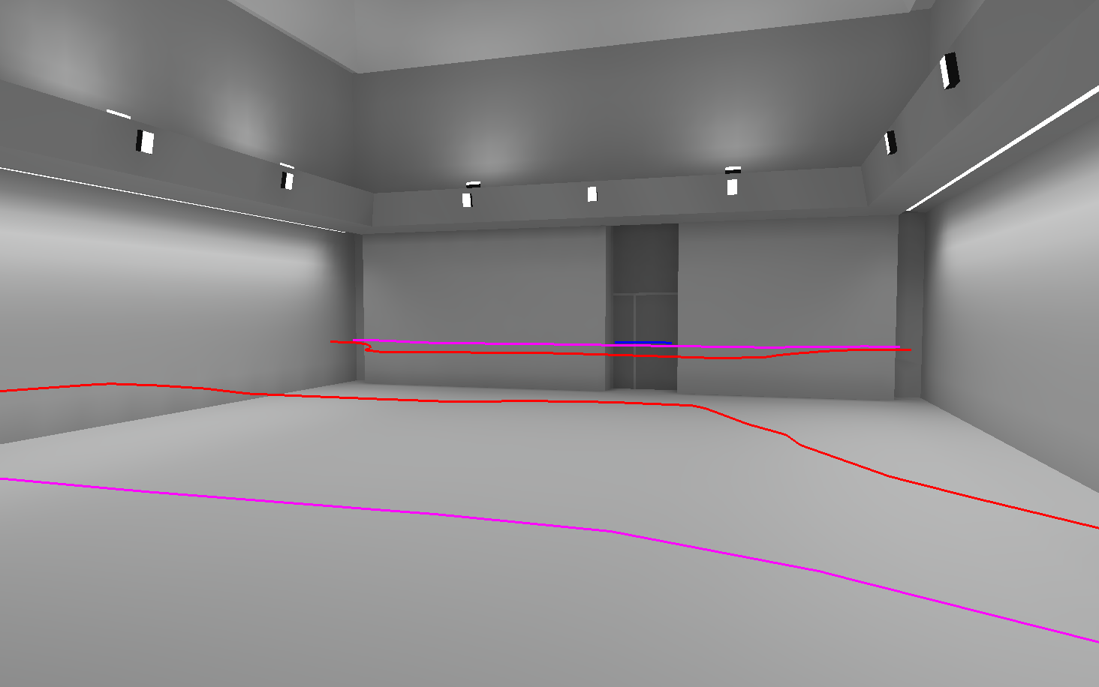
Solution
Introduction
Design Concept
Lighting Designs
  Main Lobby
  Concert Hall
  Facade
  Rehearsal Room
Electrical Depth
Conclusion
CFL downlights from ceiling
CFL uplights and asymmetric side lights from shelf
Linear fluorescent wall washers
Average illuminance
  28.8 fc horizontal
    Target 30fc
  20.1 fc vertical
    Target 20 fc
Blue: 10 fc Magenta: 20 fc Red: 30 fc

Slide 23
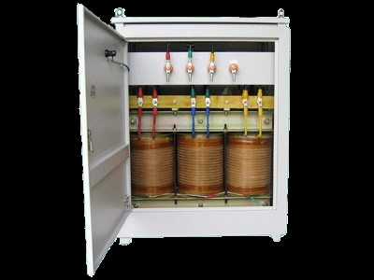
Transformer Consolidation
Introduction
Design Concept
Lighting Designs
  Main Lobby
  Concert Hall
  Facade
  Rehearsal Room
Electrical Depth
Conclusion
As designed, there are five transformers to serve 208/120V loads
Would it be more economical to use a single transformer?
www.everpowerelectric.com

Slide 24
Transformers
Original Design
Tag | Transformer Size | Cost
1-TLDP-1 | 225 kVA | $8,624
1-TLDP-2 | 225 kVA | $8,624
LL-ELP-1 | 30 kVA | $2,800
LL-LDP-1 | 300 kVA | $10,690.00
Total |  | $30,738.00
Introduction
Design Concept
Lighting Designs
  Main Lobby
  Concert Hall
  Facade
  Rehearsal Room
Electrical Depth
Conclusion
One isolation transformer
Four eligible for replacement
Sized based on new central panelboard
  500 kVA
Proposed Centralized Design
Tag | Transformer Size | Cost
TLL-LDP | 500 kVA | $16,325

Slide 25
Panelboards
Original Design
Tag | Panel Size | Cost
1-TLDP-1 | 800 A | $ 4,375.00
1-TLDP-2 | 1400 A | $ 5,625.00
LL-ELP-1 | 400 A | $ 2,860.00
LL-LDP-1 | 1200 A | $ 5,275.00
Total |  | $ 18,135.00
Introduction
Design Concept
Lighting Designs
  Main Lobby
  Concert Hall
  Facade
  Rehearsal Room
Electrical Depth
Conclusion
Original design requires one panel at the 120V side of each transformer
Redesign to feed a single panel
  Would still require some branch panels, this is an upper limit on savings
Proposed Centralized Design
Tag | Panel Size | Cost
LL-LDP | 4000 A | $ 12,200.00

Slide 26
Feeders
Original Design
Load | Type | Phase/N | Ground | Raceway | Length (ft) | Feeder cost / ft | Raceway cost / ft | Total cost
T1-TLDP-1 | THHN | (3) 350 | 3 | 2 1/2" | 135 | 16.705 | 28.5 | $ 6,102.68
T1-TLDP-2 | THHN | (3) 350 | 3 | 2 1/2" | 165 | 15.03 | 28.5 | $ 7,182.45
LL-ELP-2 | THHN | (3) 8 | 10 | 3/4" | 15 | 4.28 | 10.25 | $ 217.95
LL-LDP-1 | THHN | (3) 500 | 3 | 3" | 30 | 20.72 | 36.2 | $ 1,707.60
FPC-ATS | THHN | (4) 1 | n/a | 1 1/4" | 25 | 8.48 | 14.85 | $ 583.25
LL-HDP-1 | THHN | 2x (4) 500 | 1/0 | 3 1/2" | 15 | 50.8 | 44.9 | $ 1,435.50
T1-DCTP-1 | THHN | (3) 1 | 8 | 1 1/4" | 155 | 7.515 | 14.85 | $ 3,466.58
Total: |  |  |  |  |  |  |  | $ 20,696.00
Introduction
Design Concept
Lighting Designs
  Main Lobby
  Concert Hall
  Facade
  Rehearsal Room
Electrical Depth
Conclusion
Original 480/277V system can use smaller feeders
Wire size for 208/120V must be increased
  Higher material cost
  Higher labor cost
Proposed Centralized Design
Load | Design KVA | Design A | Type | Phase/N | Ground | Raceway | Length (ft) | Feeder cost / ft | Raceway cost / ft | Total cost
1-TLDP-1 | 133 | 369 | THHN | (4) 400 | 3 | 3" | 135 | 24.235 | 36.2 | $ 8,158.73
1-TLDP-2 | 146 | 405 | THHN | (4) 500 | 2 | 3" | 165 | 27.075 | 36.2 | $ 10,440.38
LL-ELP-1 | 30 | 83 | THHN | (4) 5 | 8 | 1" | 15 | 9.7 | 12.21 | $ 328.65
LL-LDP-1 | 244 | 677 | THHN | 2x (4) 350 | 2x 3 | 3 1/2" | 30 | 43.43 | 44.9 | $ 2,649.90
FPC-ATS | 80 | 222 | THHN | (4) 3/0 | 4 | 2" | 25 | 14.13 | 20.15 | $ 857.00
LL-LDP | 462 | 1282 | THHN | 3x (4) 500 | 3 | (3) 2 1/2" | 15 | 81.225 | 85.5 | $ 2,500.88
T1-DCTP-1 | 75 | 90 | THHN | (3) 1 | 8 | 1 1/4" | 165 | 7.515 | 14.85 | $ 3,690.23
Total: |  |  |  |  |  |  |  |  |  | $ 28,625.75

Slide 27
Overall Cost
Introduction
Design Concept
Lighting Designs
  Main Lobby
  Concert Hall
  Facade
  Rehearsal Room
Electrical Depth
Conclusion
Centralized system is cheaper, disregarding branch panelboards
  If branch panelboards are unmodified, it will be more expensive
Single point of failure
  Can’t perform maintenance on part of system
Voltage drop
  Long connections at lower voltage may require larger feeders or branch circuits
Category | Original Cost | Centralized Cost
Panels | $ 18,135.00 | $ 12,200.00
Transformers | $ 30,738.00 | $ 16,325.00
Feeders | $ 20,696.00 | $ 28,625.75
Total | $ 69,569.00 | $ 57,150.75

Slide 28
Conclusions
Introduction
Design Concept
Lighting Designs
  Main Lobby
  Concert Hall
  Facade
  Rehearsal Room
Electrical Depth
Conclusion
More efficient lighting system
Accents architectural features
  Modified concert hall to support lighting
Creates a recognizable landmark
Centralized transformer may provide cost savings

Slide 29
Acknowledgements
Introduction
Design Concept
Lighting Designs
  Main Lobby
  Concert Hall
  Facade
  Rehearsal Room
Electrical Depth
Conclusion
Thesis Advisors
  Richard Mistrick
  Ted Dannerth
Other Faculty
  Kevin Houser
  Moses Ling
  Kevin Parfitt
  Bob Holland
Schuler Shook
  Jim Baney
  Emily Klingensmith
  Giulio Pedota
Friends and family
  Including all of you L/E students
Questions?

Slide 30
Introduction
Design Concept
Lighting Designs
  Main Lobby
  Concert Hall
  Facade
  Rehearsal Room
Electrical Depth
Conclusion
Appendix A: Lighting Fixtures

Slide 31
Main Lobby
Introduction
Design Concept
Lighting Designs
  Main Lobby
  Concert Hall
  Facade
  Rehearsal Room
Electrical Depth
Conclusion
Type | Description | Manufacturer | Catalog Number | Lamp(s) | Input Watts
F1 | Unlensed 42W compact fluorescent downlight with 6" nominal aperture, white trim, and wheat reflector | Kurt Versen | P927DM-120-W-WT | (1) F42TBX/827/A/ECO by GE | 43.2
F2 | Unlensed 26W compact fluorescent downlight with 6" nominal aperture, white trim, and wheat reflector | Kurt Versen | P626DM-120-W-WT | (1) F26DBX/827/ECO4P by GE | 26.4
F3 | Unlensed 42W compact fluorescent wall washer with 6" nominal aperture, white trim, and wheat reflector | Kurt Versen | P953DM-120-W-WT | (1) F42TBX/827/A/ECO by GE | 43.2
F4 | Unlensed 18W compact fluorescent wall washer with 4" nominal aperture, white trim, and wheat reflector | Kurt Versen | P919DM-120-W-WT | (1) F18TBX/827/A/ECO by GE | 21.3
F5 | Shielded 3' T5 wall sconce with diffuse white acrylic panel | Lightolier | 48022ALU-21W-120 | (1) F21W/T5/830/ECO by GE | 25
F6 | Continuous diffuse LED strip light with dimmable driver | Birchwood Lighting | JAKE-325-TR-1-HF2N-H-30-CRx-120-CU | 54 3000K LEDs per 10" section | 5 W/ft

Slide 32
Concert Hall
Introduction
Design Concept
Lighting Designs
  Main Lobby
  Concert Hall
  Facade
  Rehearsal Room
Electrical Depth
Conclusion
Type | Description | Manufacturer | Catalog Number | Lamp(s) | Input Watts
F6 | Continuous diffuse LED strip light with dimmable driver | Birchwood Lighting | JAKE-325-TR-1-HF2N-H-30-CRx-120-CU | 54 3000K LEDs per 10" section | 5 W/ft
F7 | Top relampable 250W PAR38 halogen downlight with white trim | Kurt Versen | C7302-W-WT | 250PAR38HALFL30 by Sylvania | 250
F8 | Top relampable 90W PAR38 halogen downlight with white trim | Kurt Versen | C7302-W-WT | 90PAR/FL25XL-EG by GE | 90
F9 | Top relampable 75W PAR30 halogen downlight with white trim | Kurt Versen | C7301-W-WT | 75PAR30/H/FL35 by GE | 75
F10 | Linear LED neon-replacement with diffuse white light guide and dimmable driver | GE | GEWWXNLE1-30K-A | 3000K LEDs | 3.39 W/ft
F11 | LED steplight with black front-plate, fully shielded aperture, and dimmable driver | Cole Lighting | L-2158-BLK | 6W 3000K integrated LED | 8

Slide 33
Facade
Introduction
Design Concept
Lighting Designs
  Main Lobby
  Concert Hall
  Facade
  Rehearsal Room
Electrical Depth
Conclusion
Type | Description | Manufacturer | Catalog Number | Lamp(s) | Input Watts
F12 | Color changing linear LED fixture with 30x60 degree beam distribution in 2' nominal lengths. IP66 rated for outdoor use | Color Kinetics | 123-000030-03 | RGB LEDs | 35
F2 | Unlensed 26W compact fluorescent downlight with 6" nominal aperture, white trim, and wheat reflector | Kurt Versen | P626DM-120-W-WT | (1) F26DBX/827/ECO4P by GE | 26.4
F13 | Wall mounted LED grazer with 10° up and down beams | Beta-Calco | 66-2201 | (2) 3800K white LEDs | 4.5
F14 | Wet rated cylindrical up/downlight, wall mounted with convex lens | Delray Lighting | 242-BM-CUV8242.1E-WL | (2) F42TBX/830/A/ECO by GE | 43.2

Slide 34
Rehearsal Room
Introduction
Design Concept
Lighting Designs
  Main Lobby
  Concert Hall
  Facade
  Rehearsal Room
Electrical Depth
Conclusion
Type | Description | Manufacturer | Catalog Number | Lamp(s) | Input Watts
F15 | Recessed linear T5 fixture in 4' lengths with low iridescent louver | Peerless Lighting | LAR9-28T5-LDL-U4-120-C200 | (1) F28W/T5/830/ECO by GE | 26.8
F16 | Adjustable asymmetric CFL wall washer with lockable angle and semi gloss white finish | Winona Lighting | LS8-CFM142-120-P1-SGW-X-STD | (1) F42TBX/830/A/ECO by GE | 43.2
F17 | Semi-recessed asymmetric CFL with semi gloss white finish | Winona Lighting | LSRU-LR-CFM142-120-P1-SGW-X-STD | (1) F42TBX/830/A/ECO by GE | 43.2
F18 | Unlensed 42W compact fluorescent downlight with 6" nominal aperture, white trim, and wheat reflector | Kurt Versen | P927-120-W-WT | (1) F42TBX/830/A/ECO by GE | 43.2

Slide 35
Introduction
Design Concept
Lighting Designs
  Main Lobby
  Concert Hall
  Facade
  Rehearsal Room
Electrical Depth
Conclusion
Appendix B: Power Density

Slide 36
Main Lobby
Introduction
Design Concept
Lighting Designs
  Main Lobby
  Concert Hall
  Facade
  Rehearsal Room
Electrical Depth
Conclusion
Type | Quantity | Watts/Fixture | Type Total | Notes
F1 | 83 | 43.2 | 3585.6 W
F2 | 40 | 26.4 | 1056 W
F3 | 2 | 43.2 | 86.4 W
F4 | 29 | 21.3 | 617.7 W
F5 | 2 | 25 | 50 W
F6 | 73 ft | 5 W/ft | 365 W | Decorative
Area: 7,167 ft²
Power Allowance: 2.0 W/ft²
Total lighting power (kW) 5.40 kW
Space power allowance (kW) 14.334 kW
Total decorative power 0.365 kW
Space decorative allowance 7.167 kW

Slide 37
Concert Hall
Introduction
Design Concept
Lighting Designs
  Main Lobby
  Concert Hall
  Facade
  Rehearsal Room
Electrical Depth
Conclusion
Type | Quantity | Watts/Fixture | Type Total | Notes
F6 | 14 | 250 | 3500 W
F7 | 7 | 90 | 630 W
F8 | 24 | 75 | 1800 W
F9 | 654 ft | 5 W/ft | 3270 W | Decorative
F10 | 280 ft | 3.39 W/ft | 949.2 W | Decorative
F11 | 22 | 8 | 176 W
Area: 5,921 ft²
Power Allowance: 2.43 W/ft²
Total lighting power (kW) 6.106 kW
Space power allowance (kW) 14.388 kW
Total decorative power 4.219 kW
Space decorative allowance 5.921 kW

Slide 38
Facade
Introduction
Design Concept
Lighting Designs
  Main Lobby
  Concert Hall
  Facade
  Rehearsal Room
Electrical Depth
Conclusion
Type | Quantity | Watts/Fixture | Type Total | Notes
F12 | 37 | 35 | 1.295 W
Illuminated Length 403 ft
Power Allowance 3.75 W/ft
Total lighting power (kW) 1.295 kW
Façade power allowance (kW) 1.511 kW

Slide 39
Rehearsal Room
Introduction
Design Concept
Lighting Designs
  Main Lobby
  Concert Hall
  Facade
  Rehearsal Room
Electrical Depth
Conclusion
Type | Quantity | Watts/Fixture | Type Total | Notes
F15 | 15 | 26.8 | 402 W
F16 | 10 | 43.2 | 432 W | Decorative
F17 | 12 | 43.2 | 518.4 W
F18 | 20 | 43.2 | 864 W
Area: 2,045 ft²
Power Allowance: 1.24 W/ft²
Total lighting power (kW) 1.784 kW
Space power allowance (kW) 2.530 kW
Total decorative power 0.432 kW
Space decorative allowance 2.041 kW

